Slide 1
GOES-19 SUVI PS-PVR
(Provisional Maturity)
SWPC User Perspective
2025-02-25
Steven Hill
NOAA/NWS Space Weather Prediction Center

Slide 2
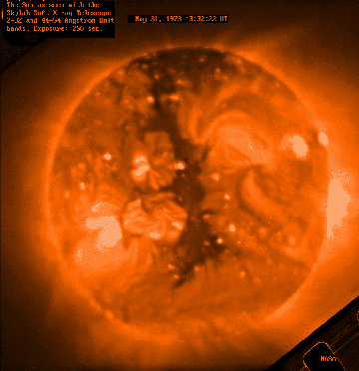
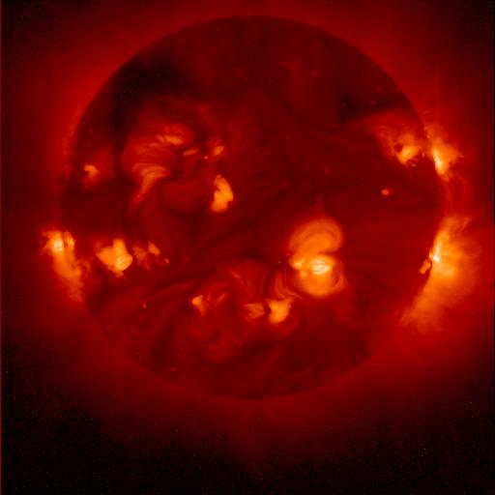
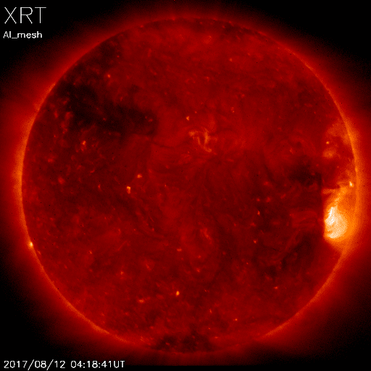
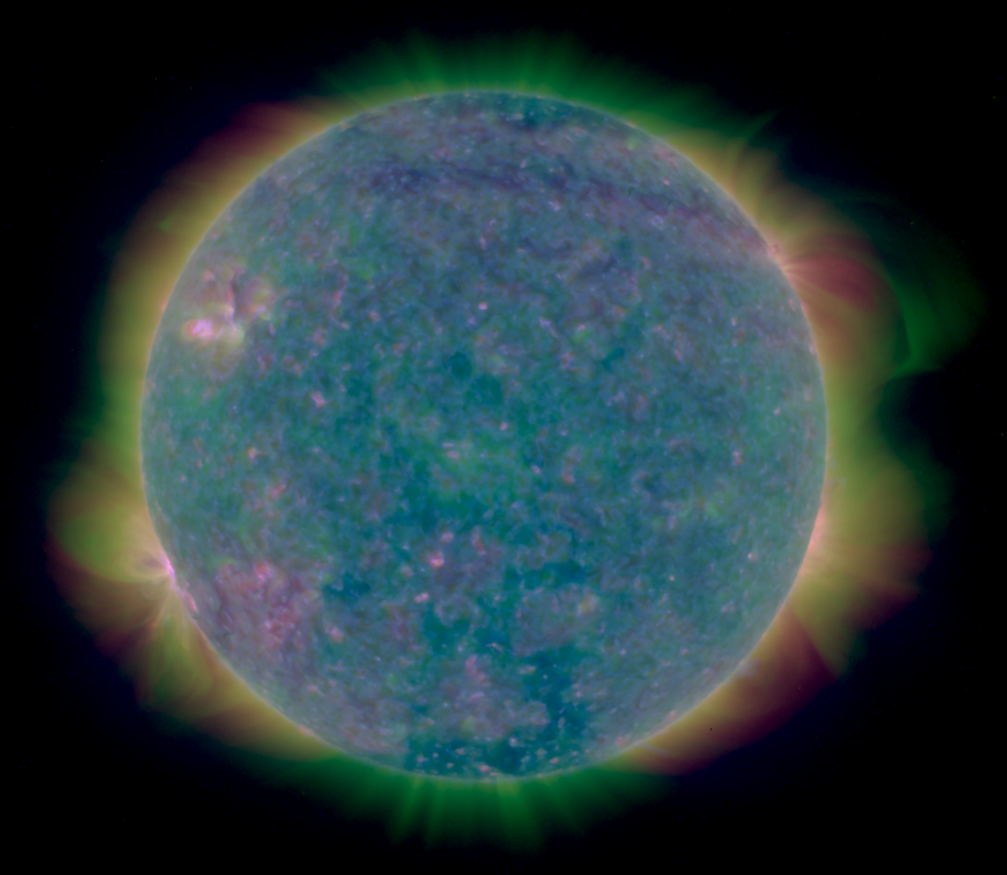
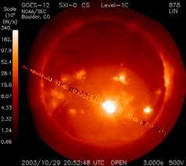
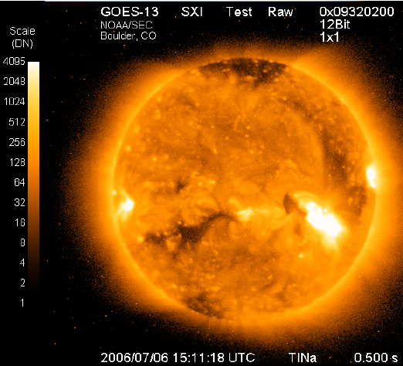
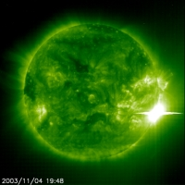
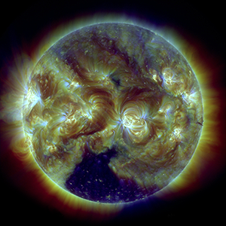
SUVI Heritage
Skylab
1973-74
Yokoh 1991-2001
Hinode
2006-
GOES 12
2001-2007
GOES 13-15
2006-2020
GOES 16-19 SUVI
2017-
SOHO EIT
1996-2010*
SDO AIA
2010-
Notes:
First proposed GOES X-ray imager in 1970s
First formal study for what became GOES-12 SXI started in 1980s

Slide 3
Forecast Applications
Provide advance warning of solar activity.
  “Over the horizon” look at active regions rotating onto the Earth-facing side of the sun.
Provide warning of recurring geomagnetic storms.
  Tracking coronal holes as they rotate across the solar disk.
Provide warning of non-recurring geomagnetic storms.
  Identify, locate, and characterize eruptions (flares, coronal mass ejections).
Provide warning of solar radiation storms.
  Identify, locate, and characterize eruptions (flares, coronal mass ejections).
Assess solar flaring probability.
  Intensity and complexity of solar active regions.

Slide 4
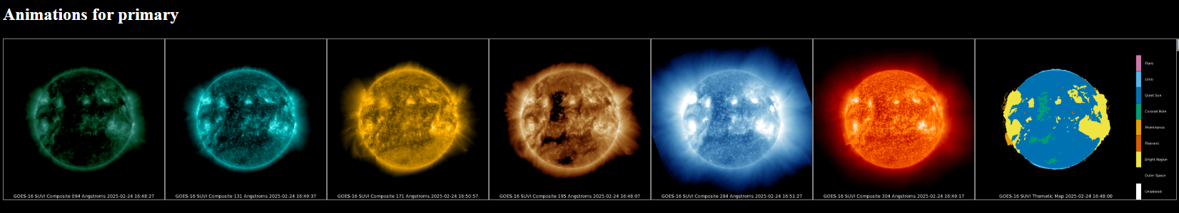
Image Data
Used historically for situational awareness.
Auto updating loops with selectable duration (3 hrs - 8 days), speed (10-60 fps), and cadence (4 min to daily).

Slide 5
Image Data Products
Product | Wavelength (nm) | Uses | Features and Temperature (K)
Composite Images | 9.4 | Flare location (visual) | Flares ~6x10⁶ K
 | 13.1 | Flare location (visual) | Flares ~6x10⁶ K and ‘hot’ flares ~15x10⁶ K
 | 17.1 | Active region characterization | Active regions ~6x10⁵ K
 | 19.5 | Active region characterization and flare location | Active regions ~1x10⁶ K and ‘hot’ flares ~20x10⁶ K
 | 28.4 | Coronal hole location and characterization | Coronal Holes (~2x10⁶ K)
 | 30.4 | Filament location and characterization | Filaments (~6x10⁴ K)
Thematic Map | All | Supervised pixel classifier | All
Notes:
SWPC doesn’t use the L1b products

Slide 6
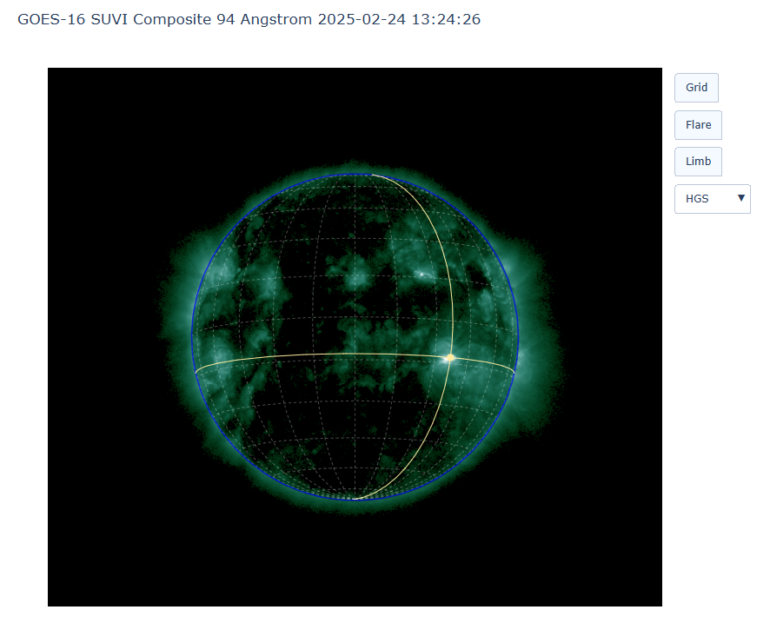
SUVI Flare Location
Used for input to UMASEP model for SEP prediction.
Planned for Artemis II Testbed Exercise in May.
Will become operational this fiscal year.
Can complement XRS flare location.

Slide 7
GOES SUVI Status
GOES 16 and 18 SUVIs are the primary and secondary EUV imagers for operations, respectively.
GOES 17 stored at 104.7° W with SUVI fully functional.
SWPC will be prepared for switch of primary SUVI from GOES-16 to GOES-19 on April 4, 2024.
New products from SPADES to enter operations in FY25 and FY26.

Slide 8
SUVI & SXI Research Impact (selected)
Seaton, D. B., & Darnel, J. M. (2018). Observations of an Eruptive Solar Flare in the Extended EUV Solar Corona. The Astrophysical Journal, 852, L9. doi:10.3847/2041-8213/aaa28e | 78
Veronig, A. M., Podladchikova, T., Dissauer, K., Temmer, M., Seaton, D. B., Long, D., . . . Kliem, B. (2018). Genesis and Impulsive Evolution of the 2017 September 10 Coronal Mass Ejection. The Astrophysical Journal, 868, 107. doi:10.3847/1538-4357/aaeac5 | 95
Darnel, J. M., Seaton, D. B., Bethge, C., Rachmeler, L., Jarvis, A., Hill, S. M., et al. (2022). The GOES-R Solar UltraViolet Imager. Space Weather, 20, e2022SW003044. https://ui.adsabs.harvard.edu/abs/2022SpWea..2003044D | 24
Hill, S. M., Pizzo, V. J., Balch, C. C., Biesecker, D. A., Bornmann, P., Hildner, E., . . . Zimmermann, F. (2005). The NOAA Goes-12 Solar X-Ray Imager (SXI) 1. Instrument, Operations, and Data. Solar Physics, 226, 255-281. doi:10.1007/s11207-005-7416-x | 88
Liu, C., Lee, J., Yurchyshyn, V., Deng, N., Cho, K.-s., Karlický, M., & Wang, H. (2007). The Eruption from a Sigmoidal Solar Active Region on 2005 May 13. The Astrophysical Journal, 669, 1372-1381. doi:10.1086/521644 | 68
Temmer, M., Vršnak, B., & Veronig, A. M. (2007). Periodic Appearance of Coronal Holes and the Related Variation of Solar Wind Parameters. Solar Physics, 241, 371-383. doi:10.1007/s11207-007-0336-1 | 100
Veronig, A. M., Karlický, M., Vršnak, B., Temmer, M., Magdalenić, J., Dennis, B. R., . . . Pötzi, W. (2006). X-ray sources and magnetic reconnection in the X3.9 flare of 2003 November 3. Astronomy and Astrophysics, 446, 675-690. doi:10.1051/0004-6361:20053112 | 121
Warmuth, A., Mann, G., & Aurass, H. (2005). First Soft X-Ray Observations of Global Coronal Waves with the GOES Solar X-Ray Imager. The Astrophysical Journal, 626, L121-L124. doi:10.1086/4317 | 70
Rotter, T., Veronig, A. M., Temmer, M., & Vršnak, B. (2012). Relation Between Coronal Hole Areas on the Sun and the Solar Wind Parameters at 1 AU. Solar Physics, 281, 793-813. doi:10.1007/s11207-012-0101-y | 85
729 citations from top nine papers

Slide 9
Summary
SWPC Recommends Provisional Maturity Status for G19 SUVI.
  SWPC is prepared for April 4th switch to GOES-19.
Product Improvements for Consideration.
  Need to be prepared for light leaks in the future.
  Desired to address 28.4-30.4 ‘mixing’.
  Address roll navigation error.
Thank you to NCEI and the GOES Program!
  For their persistence in overcoming issues and improving products.
  For pursuing improvement by engaging with the research community.

