Slide 1
Peer Stakeholder-Product Validation Review (PS-PVR) For the Provisional Maturity of GOES-19 SEISS SGPS L1b Product
December 6, 2024
GOES-R Calibration Working Group (CWG)
Presenter: Brian Kress
Contributors: Juan Rodriguez, Athanasios Boudouridis, Robert Allsopp, Katherine Pitts and Jon Fulbright
NOAA NCEI / CIRES and GOES-R Program
These GOES-19 data are preliminary, non-operational data and are undergoing testing. Users bear all responsibility for inspecting the data prior to use and for the manner in which the data are utilized.

Slide 2
Outline
SGPS Overview
Review of Beta/PLT Maturity
Product Quality Evaluation
SGPS PLPTs Supporting Provisional Maturity
Provisional Maturity Assessment
Path to Full Validation Maturity
Additional Instrument Health Tests
Summary and Recommendations
These GOES-19 data are preliminary, non-operational data and are undergoing testing. Users bear all responsibility for inspecting the data prior to use and for the manner in which the data are utilized.

Slide 3
SGPS OVERVIEW
GOES-19 SGPS L1b Product Provisional PS-PVR
These GOES-19 data are preliminary, non-operational data and are undergoing testing. Users bear all responsibility for inspecting the data prior to use and for the manner in which the data are utilized.

Slide 4
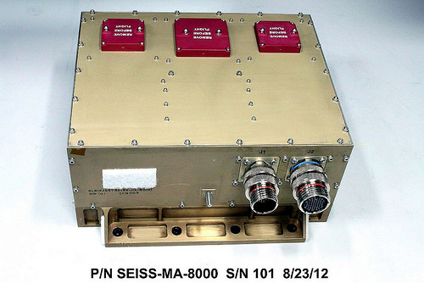
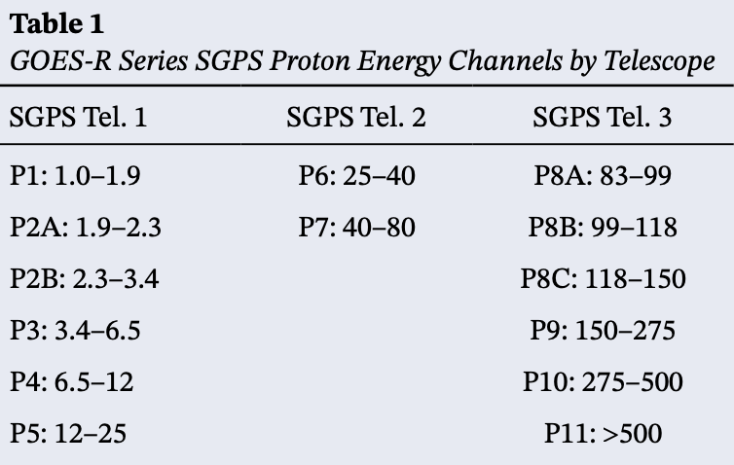
Space Environment In-Situ Suite (SEISS) Solar and Galactic Proton Sensor (SGPS)
2 Units, one looking East (+X) and one West (-X)
3 solid state telescopes on each unit
T1
T3
T2
1-500 MeV protons in 13 differential channels, plus >500 MeV integral channel
4-500 MeV alphas in 12 energy channels
Channel energies in MeV
GOES-19 SEISS sensors turned on 22 August 2024
SEISS SGPS designed, built, tested and calibrated by Assurance Technology Corporation (ATC)
These GOES-19 data are preliminary, non-operational data and are undergoing testing. Users bear all responsibility for inspecting the data prior to use and for the manner in which the data are utilized.

Slide 5
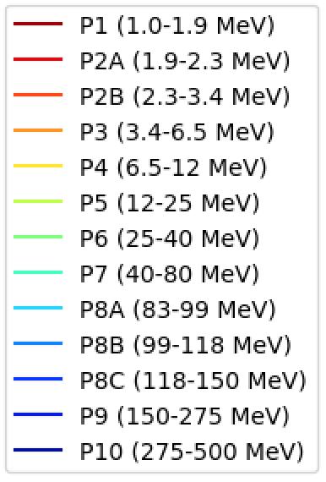
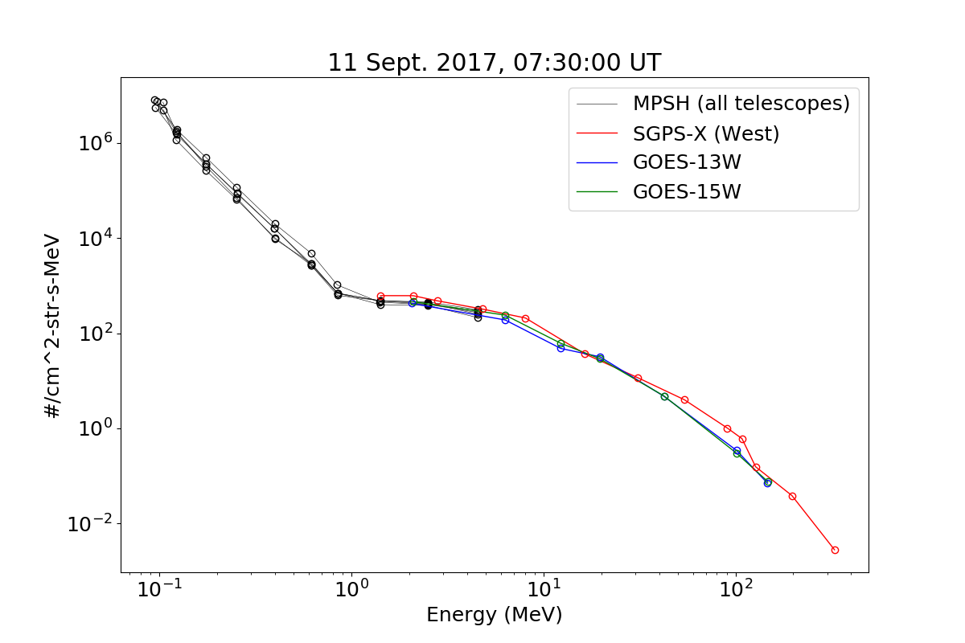
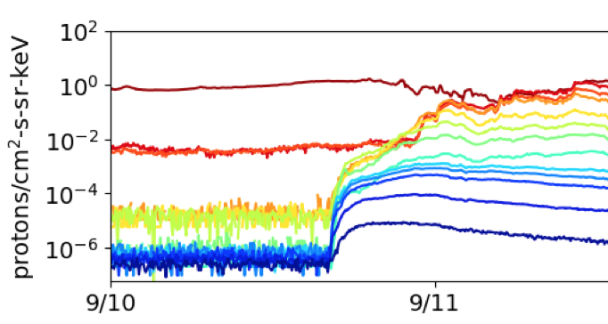
Introductory Material: Space Particle Data Units and Plotting
Two types of units typically used for SEP fluxes
Differential flux: particles / (cm²-s-steradian-MeV)
Integral flux is integrated in energy, above some threshold energy:
j _{>10 MeV}$[particles / (cm2−s−sr)] = \int_{10 MeV}^{∞}{ j_{differential}}dE$
SEP event fluences are also sometimes reported: particles / (cm²-sr-MeV)
Common presentation formats
Energy spectrum (flux vs. energy)
at 7:30 UT time snapshot
Timeseries data
>10 MeV
Integral flux
7:30 UT
5m averaged spectra from GOES-13 and -15 EPS and
GOES-16 SGPS and MPS-HI during Sept. 2017 GLE.
These GOES-19 data are preliminary, non-operational data and are undergoing testing. Users bear all responsibility for inspecting the data prior to use and for the manner in which the data are utilized.

Slide 6
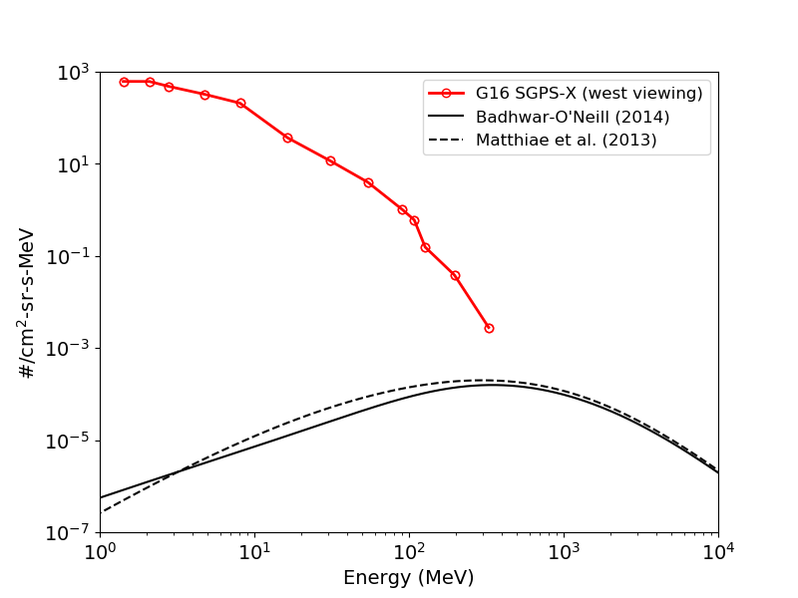
Introductory Material: Energetic Ions In Space
Solar Energetic Particles (SEPs)
Produced during Solar Particle Events (SPEs) lasting one to several days.
Cause heightened levels of harmful radiation in space
Approximately 50 - 100 SPEs per 11 yr. solar cycle
Mostly < 500 MeV protons
P1
P2A,B
P3
P4
P5
P6
10-14 Sept. 2017 Solar Particle Event
(at 7:30 UT on 9/11/17)
P7
P8A,B,C
Galactic Cosmic Rays (GCRs)
Thought to originate from supernovae and galactic nuclei.
Always present in space
Energies up to and > 10¹¹ GeV
Flux peak ~400 MeV
≈ 99.5% H & He
P9
P10
GCR models
These GOES-19 data are preliminary, non-operational data and are undergoing testing. Users bear all responsibility for inspecting the data prior to use and for the manner in which the data are utilized.

Slide 7
SGPS Primary Operational Use
Data stream for NOAA-NWS SWPC Solar Proton Event Detection and Radiation Storm Alerts
Level 1b
Level 2
1 sec.
The NOAA Space Weather Scales communicate to the general public current and future space weather conditions and possible effects on people and systems.
Numbered levels, analogous to hurricanes, tornadoes, and earthquakes that convey severity.
These GOES-19 data are preliminary, non-operational data and are undergoing testing. Users bear all responsibility for inspecting the data prior to use and for the manner in which the data are utilized.

Slide 8
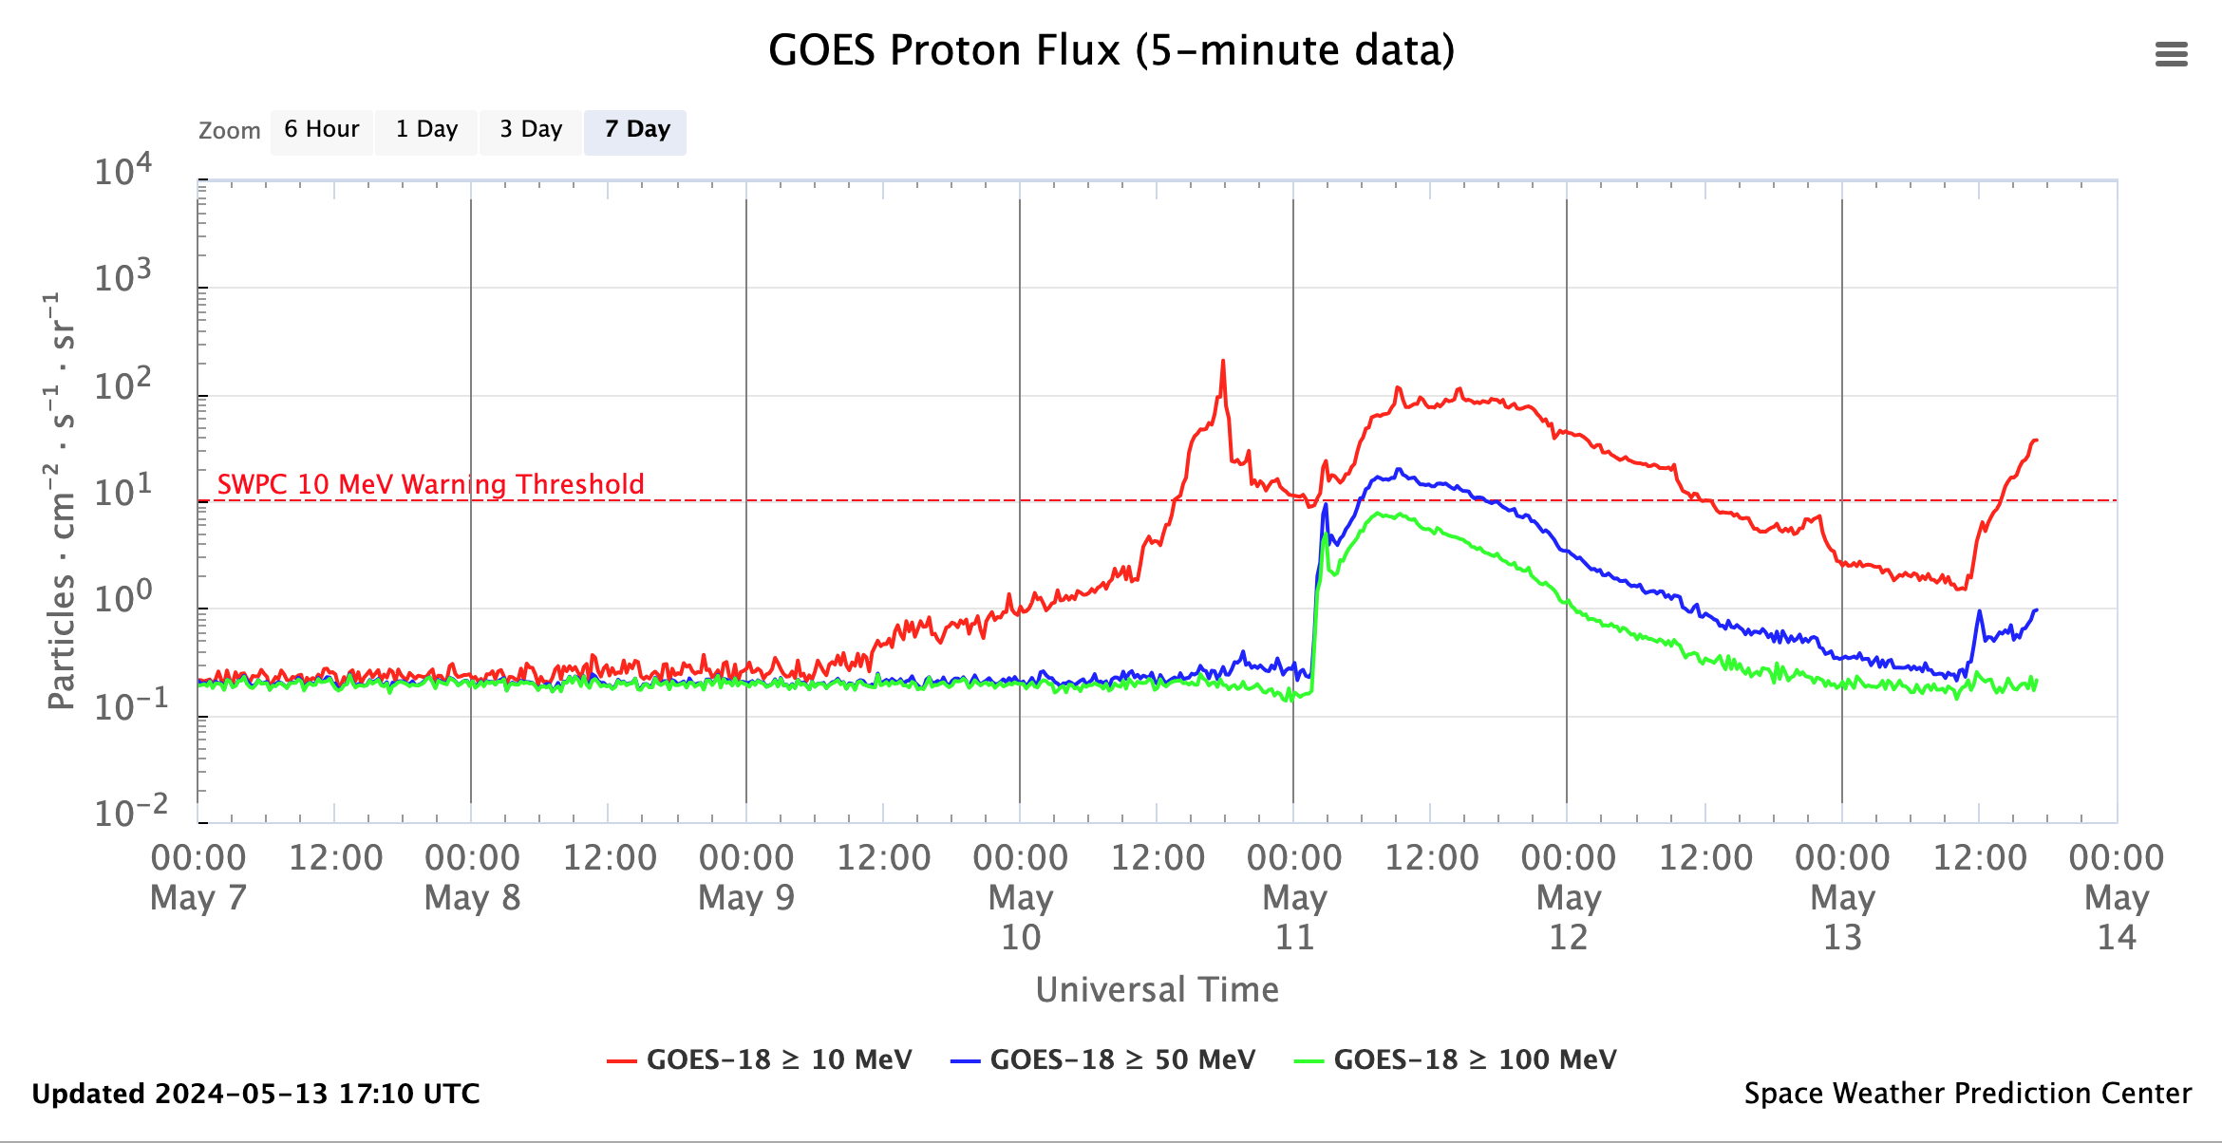
SGPS Primary Operational Use
Real-time Level-2 integral solar proton fluxes from the NWS Space Weather Prediction Center’s (SWPC’s) public web page ( https://www.swpc.noaa.gov/products/goes-proton-flux ).
The original GOES 1-15 Energetic Particle Sensor (EPS) (1975-2020) was primarily intended to monitor the radiation hazard to spacecraft systems and humans in space from 10 to 100s of MeV protons produced during solar proton events (SPEs).
These GOES-19 data are preliminary, non-operational data and are undergoing testing. Users bear all responsibility for inspecting the data prior to use and for the manner in which the data are utilized.

Slide 9
GOES-16, -18 and -19 integral fluxes computed from 5-min. averaged L1b
G18 SGPS integral fluxes (Level-2 data) are currently used for SWPC’s real time monitoring of solar particle events, shown on previous slide.
These GOES-19 data are preliminary, non-operational data and are undergoing testing. Users bear all responsibility for inspecting the data prior to use and for the manner in which the data are utilized.

Slide 10
REVIEW OF BETA MATURITY G19 SEISS Beta, Oct. 22, 2024
GOES-19 SGPS L1b Product Provisional PS-PVR
These GOES-19 data are preliminary, non-operational data and are undergoing testing. Users bear all responsibility for inspecting the data prior to use and for the manner in which the data are utilized.

Slide 11
G19 SGPS Vendor PLTs / Beta Overview
PLT | CDRL | PLT Name | Start Date | End Date | Prelim Report Due (+2 Weeks) | Final Report Due (+2 Months)
 | SEISS-TR-Y121-3-2 | Sensor Activation | 8/22/2024 | 8/22/2024 | 9/5/2024 | 10/22/2024
SEI-006 | SEISS-TR-Y121-4-6 | SGPS Initial In Flight Calibrations | 8/27/2024 | 8/29/2024 | 9/12/2024 | 10/29/2024
SEI-008 | SEISS-TR-Y121-4-8 | SGPS D3-D1 Logic test | 9/6/2024 | 9/9/2024 | 9/23/2024 | 11/8/2024
SEI-007 | SEISS-TR-Y121-4-10 | SGPS Cross Calibration | 8/27/2024 | 9/06/2024 | 9/20/2024 | 11/06/2024
PLT 006
Required for Beta
No SEISS PLPTs supporting Beta maturity.
NCEI performed qualitative review of SGPS data supporting transition to beta validation, shown on following slide.
SEISS-TR-Y121-4-10: Vendor recommends adjustments to calibration factor for G19 SGPS+X P8C (plus additional recommended adjustments to some G16 and G18 SGPS channels)
These GOES-19 data are preliminary, non-operational data and are undergoing testing. Users bear all responsibility for inspecting the data prior to use and for the manner in which the data are utilized.

Slide 12
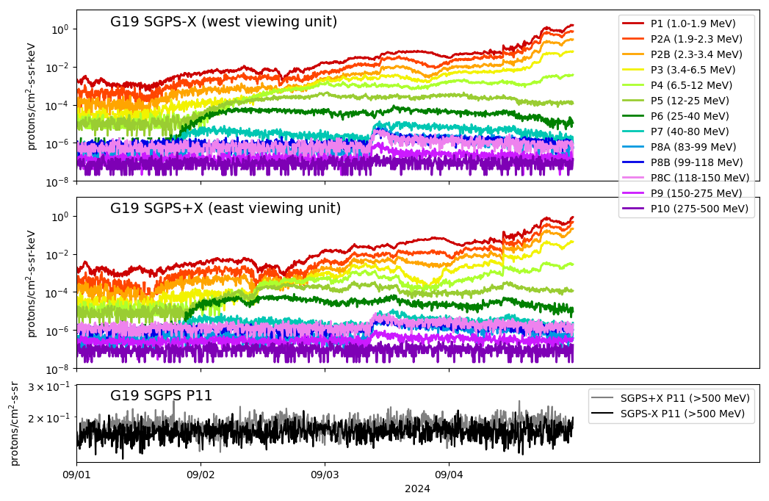
Beta Validation Artifact: GOES-19 SGPS 1-Sept-2024 Solar Particle Event
No obvious temperature dependence (seen in other SGPS units).
G19 SGPS+X P8C appears to be reporting high.
5-min. averaged ground system (GS) L1b
These GOES-19 data are preliminary, non-operational data and are undergoing testing. Users bear all responsibility for inspecting the data prior to use and for the manner in which the data are utilized.

Slide 13
PRODUCT QUALITY EVALUATION
GOES-19 SGPS L1b Product Provisional PS-PVR
These GOES-19 data are preliminary, non-operational data and are undergoing testing. Users bear all responsibility for inspecting the data prior to use and for the manner in which the data are utilized.

Slide 14
G19 SGPS PLPTs Supporting Provisional Maturity
PLPT-SEI-004 SEP Channel Cross-Comparison
PLPT-SEI-006 Backgrounds Trending
These GOES-19 data are preliminary, non-operational data and are undergoing testing. Users bear all responsibility for inspecting the data prior to use and for the manner in which the data are utilized.

Slide 15
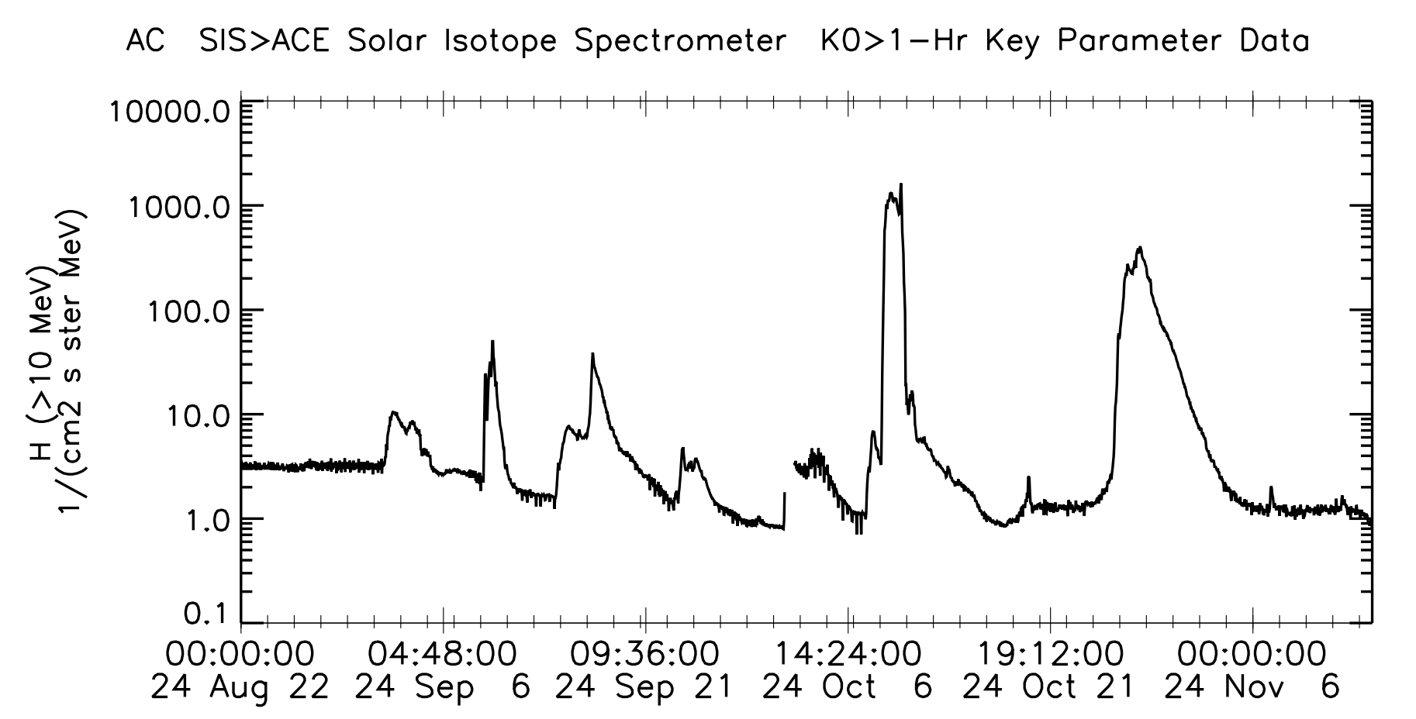
Solar Particle Events Since G19 SGPS Sensor Activation on 8/22/2024
ACE SIS Data provider:
PI, E. C. Stone at CA Inst.
of Tech., via CDAWeb.
These 2 events used for PLPT-SEI-004 SEP Channel Cross-Comparison
7 - 17 Oct.
25 Oct. - 5 Nov.
The 7-17 October 2024 SEP event included enhancements in SGPS channels up to and including P11 (>500 MeV).
The 25 October – 5 November 2024 SEP event included enhancements in SGPS channels up to and including P9 (150-275 MeV).
These GOES-19 data are preliminary, non-operational data and are undergoing testing. Users bear all responsibility for inspecting the data prior to use and for the manner in which the data are utilized.

Slide 16
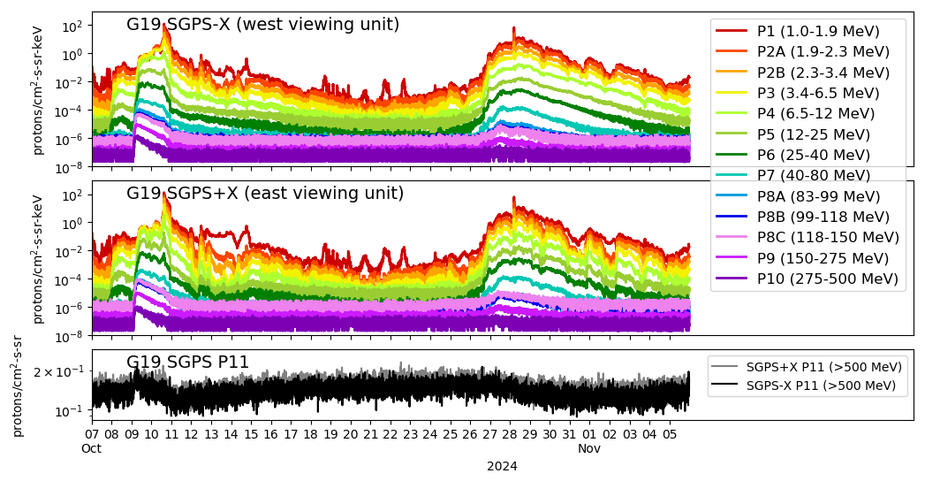
PLPT-SEI-004 SEP Channel Cross Comparison: Oct-Nov 2024 Solar Particle Events
G19 SGPS 5m averaged GS L1b fluxes from 7 Oct – 5 Nov 2024.
Gray shaded regions are periods used for G19-G16 P6-P10 cross comparisons (using 1-hour averages).
Somewhat darker gray shaded region on 10 & 11 Oct. includes high solar wind dynamic pressure and geomagnetic storm, thus used for P1-P5 comparisons (using 5-minute averages).
These GOES-19 data are preliminary, non-operational data and are undergoing testing. Users bear all responsibility for inspecting the data prior to use and for the manner in which the data are utilized.

Slide 17
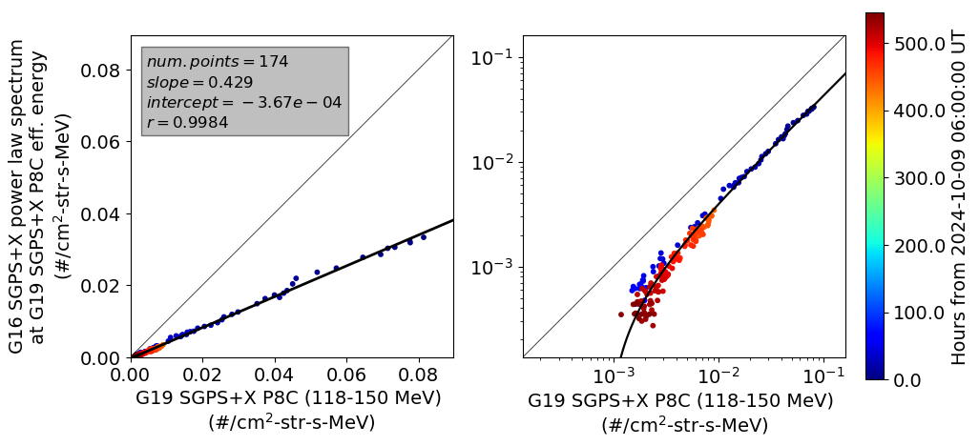
PLPT-SEI-004 SEP Channel Cross Comparison: Cross-comparison Scatter Plot Example
G16 vs. G19 SGPS+X P8C cross comparison (worst case example)
G16-G19 SGPS+X P8C cross comparison of 1-hour averaged GS L1b fluxes during Oct-Nov 2024 SPEs.
The same data and OLS fit are shown in both panels, using linear scales in left panel and log scales in right panel.
A power law is fit to the G16 fluxes, and comparisons with the G16 spectrum are made at G19 channel effective energies.
Taking G16 SGPS+X P8C reported flux as “accepted” value, G19 SGPS+X P8C systematic error is ~130%. Results show there is $≥$40% error in one or both of these channels.
These GOES-19 data are preliminary, non-operational data and are undergoing testing. Users bear all responsibility for inspecting the data prior to use and for the manner in which the data are utilized.

Slide 18
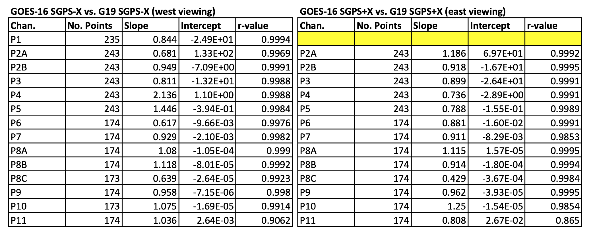
PLPT-SEI-004 SEP Channel Cross Comparison Results
Worst case is ~130% error.
Measurements from like channels and look-directions generally agree to within 10-30%.
Worst case is ~130% error in G19 SGPS+X P8C (taking G16 flux as “accepted” value).
These GOES-19 data are preliminary, non-operational data and are undergoing testing. Users bear all responsibility for inspecting the data prior to use and for the manner in which the data are utilized.

Slide 19
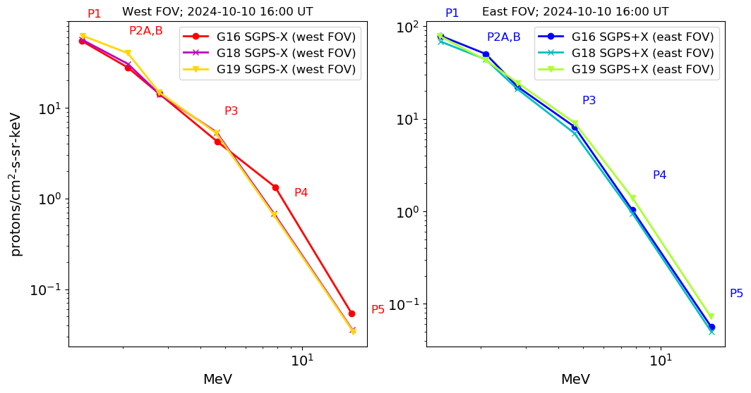
PLPT-SEI-004 SEP Channel Cross Comparison: Cross Sensor Comparison Overview P1-P5
G16 P4 cal. issue
noted in Kress et al. [Space Weather, 2021]
G16 and G19 SGPS 1-hour averaged GS L1b spectra (flux vs. energy) from 16-17 UT on 10 Oct 2024
Agreement is expected between SEP fluxes measured at different longitudes and in different look directions due to high solar wind dynamic pressure and geomagnetic storm during this period.
These GOES-19 data are preliminary, non-operational data and are undergoing testing. Users bear all responsibility for inspecting the data prior to use and for the manner in which the data are utilized.

Slide 20
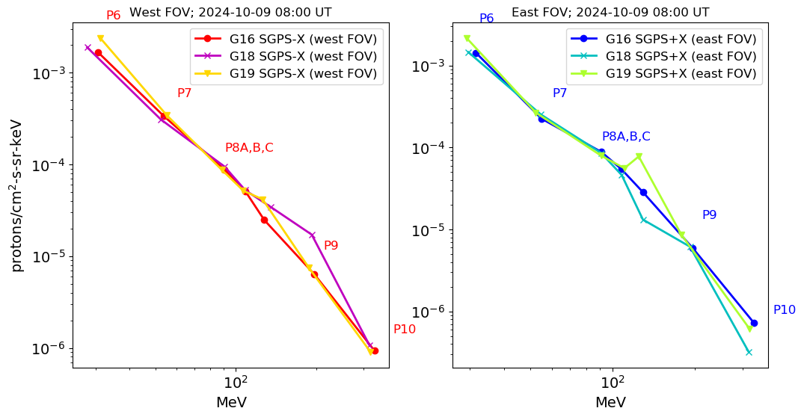
PLPT-SEI-004 SEP Channel Cross Comparison: Cross Sensor Comparison Overview P6-P10
G19 P8C factor of 2-3 high is G19 worst case.
G18 P8C & P9 reporting high, included in G18 Full Val. PS-PVR.
Anonymously low response in G18 SGPS+X P10. Other P10 channels agree well.
G16 and G19 SGPS 1-hour averaged GS L1b spectra (flux vs. energy) from 8-9 UT on 9 Oct 2024
Agreement is expected between SEP fluxes measured at different longitudes and in different look directions since energies >80 MeV are not geomagnetically shielded at geosynchronous, and the interplanetary SEP distribution is isotropic following the event peak during this event.
These GOES-19 data are preliminary, non-operational data and are undergoing testing. Users bear all responsibility for inspecting the data prior to use and for the manner in which the data are utilized.
Pass

Slide 21
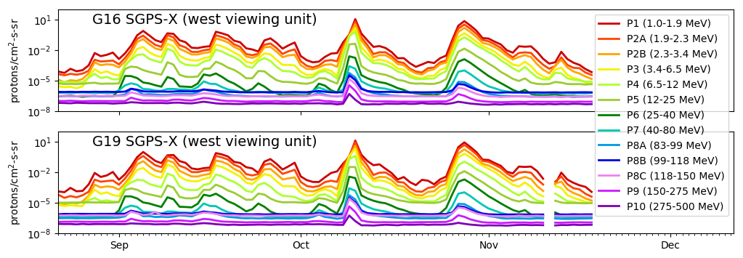
PLPT-SEI-006 Backgrounds Trending: G16 and G19 SGPS Background Fluxes
/keV
1-day averaged GS L1b fluxes
/keV
Stated goal of SGPS Backgrounds Trending [PLPT-SEI-006] is to trend daily/weekly minima and evaluate backgrounds in terms of expected galactic cosmic ray (GCR) fluxes.
Background counts are from GCRs detected in high energy tail portion of channel full response functions. Analysis showing this is in the G16 Full validation PS-PVR, slide 34.
G19 SGPS +/-X backgrounds are in-family with G16-G18 SGPS units.
Pass
These GOES-19 data are preliminary, non-operational data and are undergoing testing. Users bear all responsibility for inspecting the data prior to use and for the manner in which the data are utilized.

Slide 22
PLPT Summary
PLPT-SEI-004 SEP Channel Cross-Comparison
The SEISS PLPTs are not in general pass-fail tests, however a summary statement is that G16 and G19 SGPS like-channels compare well, with 10-30% difference in most cases.
The greatest difference is ≈130% between G16 and G19 SGPS+X P8C
PLPT-SEI-006 Backgrounds Trending
It has been shown previously that SGPS background counts are from GCRs detected in high energy tail portion of response functions.
G19 SGPS +/-X backgrounds are in-family with G16-G18 SGPS units.
Pass
Pass
These GOES-19 data are preliminary, non-operational data and are undergoing testing. Users bear all responsibility for inspecting the data prior to use and for the manner in which the data are utilized.

Slide 23
PROVISIONAL MATURITY ASSESSMENT
GOES-19 SGPS L1b Product Provisional PS-PVR
These GOES-19 data are preliminary, non-operational data and are undergoing testing. Users bear all responsibility for inspecting the data prior to use and for the manner in which the data are utilized.

Slide 24
Provisional Validation -1
Preparation Activities | Assessment
Validation activities are ongoing and the general research community is now encouraged to participate. | Validation activities are ongoing. GOES-19 SGPS data will be made available via NCEI’s website.
Severe algorithm anomalies are identified and under analysis. Solutions to anomalies are in development and testing. | There are currently no severe SGPS L1b algorithm anomalies. ADRs 781 and 863 are in-work.
Incremental product improvements may still be occurring. | Product improvements will result from steps to mitigate known anomalies. Calibration factor adjustments will improve accuracy of reported fluxes.
These GOES-19 data are preliminary, non-operational data and are undergoing testing. Users bear all responsibility for inspecting the data prior to use and for the manner in which the data are utilized.

Slide 25
Provisional Validation -2
End State | Assessment
Product performance has been demonstrated through analysis of independent measurements obtained from select locations, periods, and associated ground truth or field campaign efforts. | G19 SGPS+X and -X units ground/beam calibrated. Validation using data from Oct-Nov 2024 Solar Particle Events
Product analysis is sufficient to communicate product performance to users relative to expectations (Performance Baseline). | PLPT-SEI-004 SEP Channel Cross-Comparison during Oct-Nov 2024 Solar Particle Events provided complete performance analysis of all G19 SGPS channels.
Documentation of product performance exists that includes recommended remediation strategies for all anomalies and weaknesses. Any algorithm changes associated with severe anomalies have been documented, implemented, tested, and shared with the user community. | In this and previous PS-PVR presentations. A complete description of known anomalies will be included in readme file with release of public data.
Testing has been fully documented. | In this presentation and supplemental materials.
Product is ready for operational use and for use in comprehensive cal/val activities and product optimization. | Yes, please see Summary and Recommendations (slide 33).
These GOES-19 data are preliminary, non-operational data and are undergoing testing. Users bear all responsibility for inspecting the data prior to use and for the manner in which the data are utilized.

Slide 26
PATH TO FULL VALIDATION MATURITY
GOES-19 SGPS L1b Product Provisional PS-PVR
These GOES-19 data are preliminary, non-operational data and are undergoing testing. Users bear all responsibility for inspecting the data prior to use and for the manner in which the data are utilized.

Slide 27
Path to Full Validation
Additional Instrument Health Tests (not covered by PLPTs)
Tests for G19 SGPS temperature dependence
SGPS P5 electron contamination
ADRs/WRs to be resolved prior to Full Validation.
PLPTs to be conducted prior to Full Validation.
Performance Baseline status.
These GOES-19 data are preliminary, non-operational data and are undergoing testing. Users bear all responsibility for inspecting the data prior to use and for the manner in which the data are utilized.

Slide 28
ADRs/WRs Impacting Full Validation of G19 SGPS L1b
ADR# | WR# | Short Description | Status | Expected Closure
781 | 8404 | SEISS MPS-HI and SGPS L1b data gaps near IFCs part 2 | Fix-fail in DO.13.00.00 | With ADR 863 (below)
863 | 6736 | Graceful degradation when SGPS data not generated | In testing | Plan to go live before DO.15.00.00.
1401 | NA | Prelaunch LUTs for G19 | installed PR.13.07.00 in 5/30/2024 | Closed
Summary of ADRs 781 and 863 in backup slides.
These GOES-19 data are preliminary, non-operational data and are undergoing testing. Users bear all responsibility for inspecting the data prior to use and for the manner in which the data are utilized.

Slide 29
Path to Full Validation - PLPTs
Title | Activity | Data Needed | Success Criteria
A.3.1 SGPS D3-D1 Contamination Correction [PLPT-SEI-001] | Complete analysis of P7 response functions based on D3-D1 test results. | Full G19 D3-D1 test results (to be completed 5/17/2025) | Magnitude of D3-D1 correction consistent with <10% residual contamination (PORD).
A.3.4 SEP Channel Cross-Comparison [PLPT-SEI-004] | On-orbit cross-calibration of SGPS with EHIS above 10 MeV and MPS-HI and SGPS 1-12 MeV protons, and cross calibrations of SGPS+X and -X units. | Two Solar Energetic Particle (SEP) events. | [Full] Differences quantified on data taken through validation phase.
A.3.6 Backgrounds Trending [PLPT-SEI-006] | Evaluate SGPS backgrounds in terms of expected galactic cosmic ray (GCR) fluxes. | Four months of continuous data. | [Full] Perform analysis during validation phase.
From RIMP v2.0, July 2021
Full PLPTs are ongoing continuations of Provisional PLPTs
These GOES-19 data are preliminary, non-operational data and are undergoing testing. Users bear all responsibility for inspecting the data prior to use and for the manner in which the data are utilized.
29

Slide 30
G19 SGPS Performance Baseline Status
MRD ID | Description | Related PLPTs | Status
MRD2005 | Product Orthogonality/Coverage | -04, -06 | Requirement met
MRD2009 | Product Measurement Range | -04, -06 | Requirement met
MRD2010 | Product Measurement Accuracy | -04, -06 | On-orbit tests indicate some channels not meeting 25% accuracy requirement.
MRD2005: Orthogonality/Coverage
Requirement: 2 directions
Currently being met
MRD2009: Measurement Range:
Requirement: Protons: 1 MeV - 500 MeV, > 500 MeV
Ground calibrations and G16-19 PLPT-SEI-004 SEP Channel Cross-Comparisons demonstrate that energy range is being covered.
MRD2010: Measurement Accuracy
Requirements: 25% when flux level above background is greater than 10x minimum flux; 45% when flux level above background is between minimum flux and 10x minimum flux
Absolute accuracy cannot be verified on-orbit
These GOES-19 data are preliminary, non-operational data and are undergoing testing. Users bear all responsibility for inspecting the data prior to use and for the manner in which the data are utilized.
30

Slide 31
SUMMARY & RECOMMENDATIONS
GOES-19 SGPS L1b Products Provisional PS-PVR
These GOES-19 data are preliminary, non-operational data and are undergoing testing. Users bear all responsibility for inspecting the data prior to use and for the manner in which the data are utilized.

Slide 32
Summary and Recommendations
Solar activity during Sept-Nov 2024 produced sufficient energetic proton events to evaluate the performance of all GOES-19 SGPS channels.
GOES-19 SGPS flux measurements in general compare well with GOES-16. GOES-19 SGPS is performing similarly to the GOES-16 and GOES-18 SGPS units.
GOES-19 SGPS channels do not exhibit temperature dependent fluctuations seen in some SGPS units. Additional tests will be performed to verify absence of significant temperature dependence.
Tests will also be performed to determine SGPS P5 susceptibility to electron contamination, seen in some SGPS units.
NCEI recommends G19 SGPS L1b data for transition to provisional status.
NCEI also recommends inter-calibration among all 8 SGPS units currently on-orbit, enabling comprehensive adjustments of calibration factors to bring reported fluxes into agreement.
These GOES-19 data are preliminary, non-operational data and are undergoing testing. Users bear all responsibility for inspecting the data prior to use and for the manner in which the data are utilized.

Slide 33
BACKUP SLIDES
GOES-19 SGPS L1b Product Provisional PS-PVR
These GOES-19 data are preliminary, non-operational data and are undergoing testing. Users bear all responsibility for inspecting the data prior to use and for the manner in which the data are utilized.

Slide 34
Path forward for correcting SGPS measurement outliers (Slides 34-37)
GOES-19 SGPS L1b Product Provisional PS-PVR

Slide 35
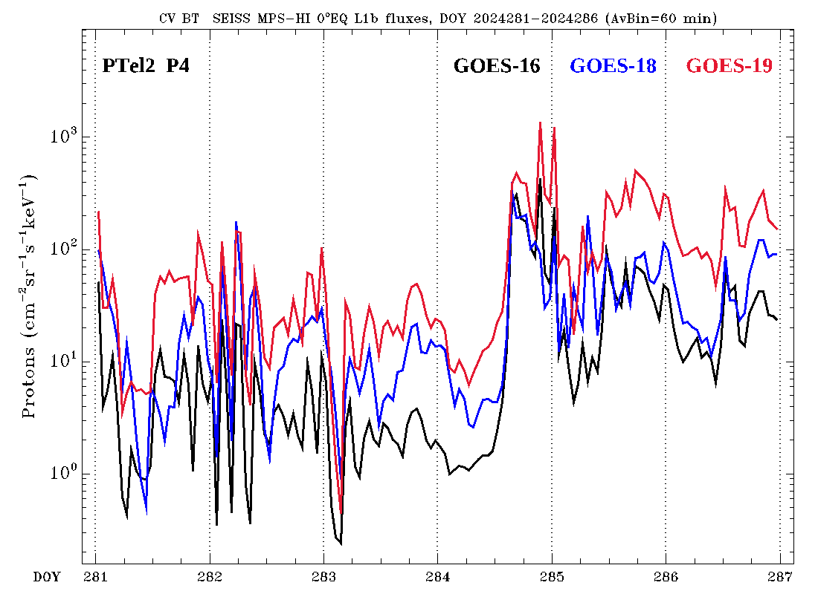
Degradation of MPS-HI P1-P7 proton channels (example case)
7-12 Oct. 2024 (DOY 284 = Oct. 10th)
Magnetopause crossing
Degradation of G16 and G18 MPS-HI P4, with respect to G19 MPS-HI P4, appears to mostly go away with magnetopause crossing into interplanetary medium.
Will consider spectra at two time snapshots
7:00 UT
19:00 UT
These GOES-19 data are preliminary, non-operational data and are undergoing testing. Users bear all responsibility for inspecting the data prior to use and for the manner in which the data are utilized.

Slide 36
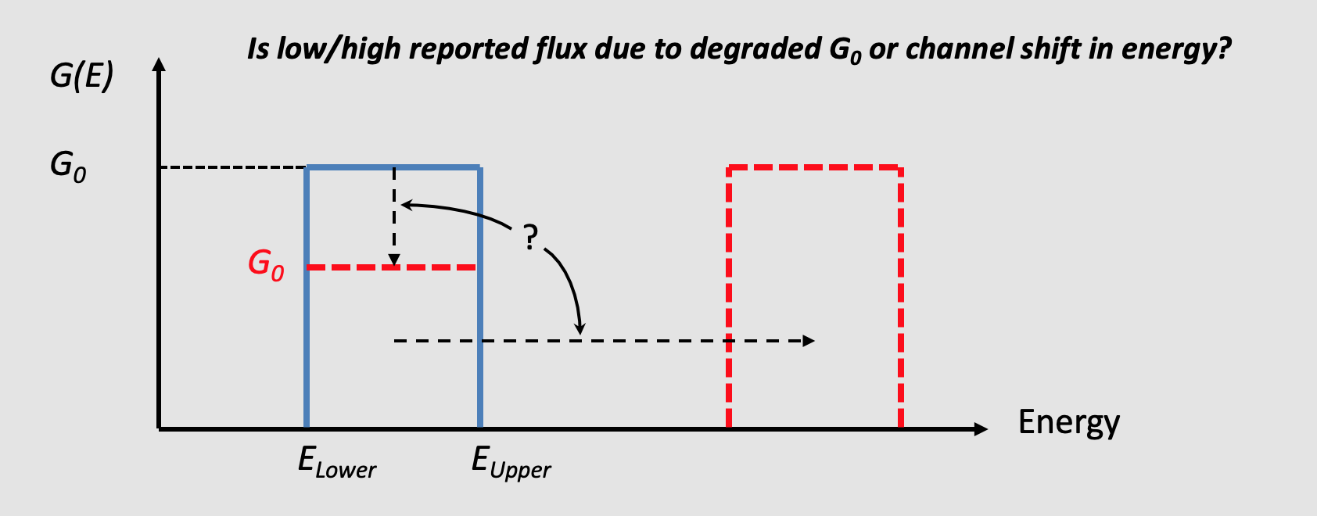
Calibration factors affecting accuracy of reported fluxes
Rectangular model of energy channel response function (used in L1b processing) characterized by three parameters, E_{Lower} , E_{Upper} and G₀.
To get an the energy spectrum from SGPS measurements, we need both the geometric factor GF = G₀ $∆$E and the effective center energy of the channel E_{Eff.} (a function of E_{Upper} , E_{Lower} and the energy spectrum, obtained w/ iterative fit).
These GOES-19 data are preliminary, non-operational data and are undergoing testing. Users bear all responsibility for inspecting the data prior to use and for the manner in which the data are utilized.

Slide 37
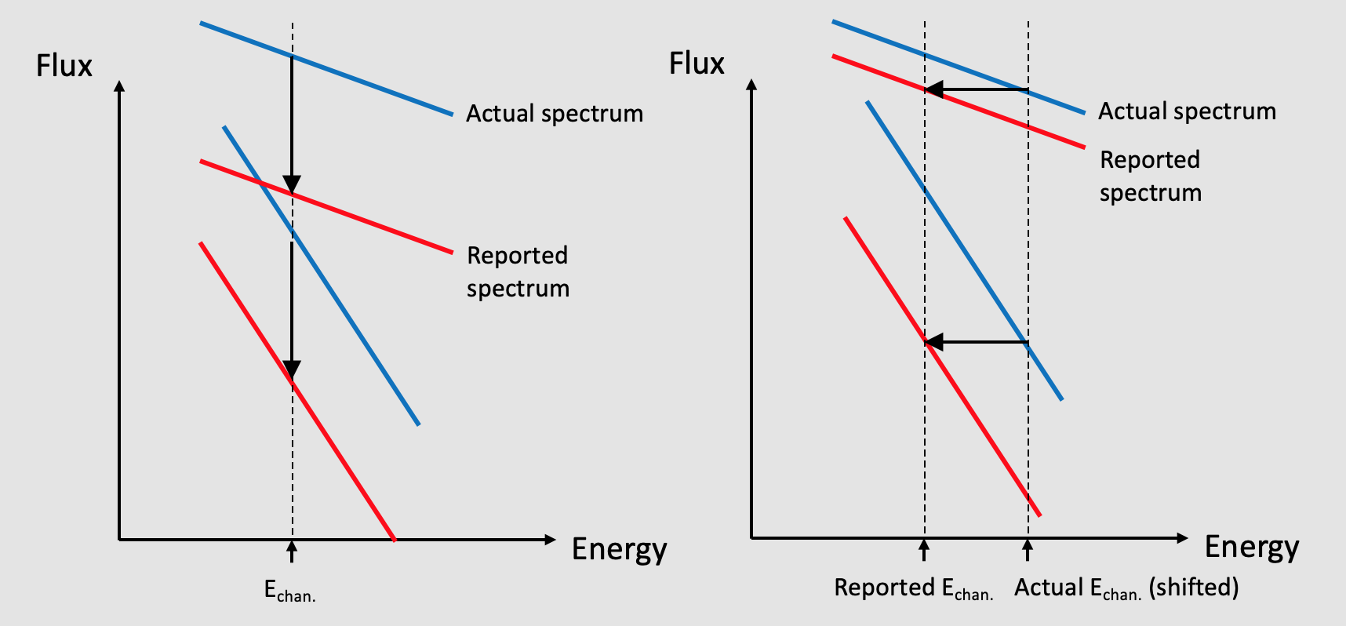
Flux correction, at a given energy, dependence on spectral slope (i.e., flux vs. energy slope in log-log space)
If there is degradation in all channel G₀ s, then we expect the same vertical distance between the actual and degraded spectra regardless of spectral slope.
If channels are shifted upward in energy, then a flatter spectrum reduces the vertical distance between actual and reported spectra.
These GOES-19 data are preliminary, non-operational data and are undergoing testing. Users bear all responsibility for inspecting the data prior to use and for the manner in which the data are utilized.

Slide 38
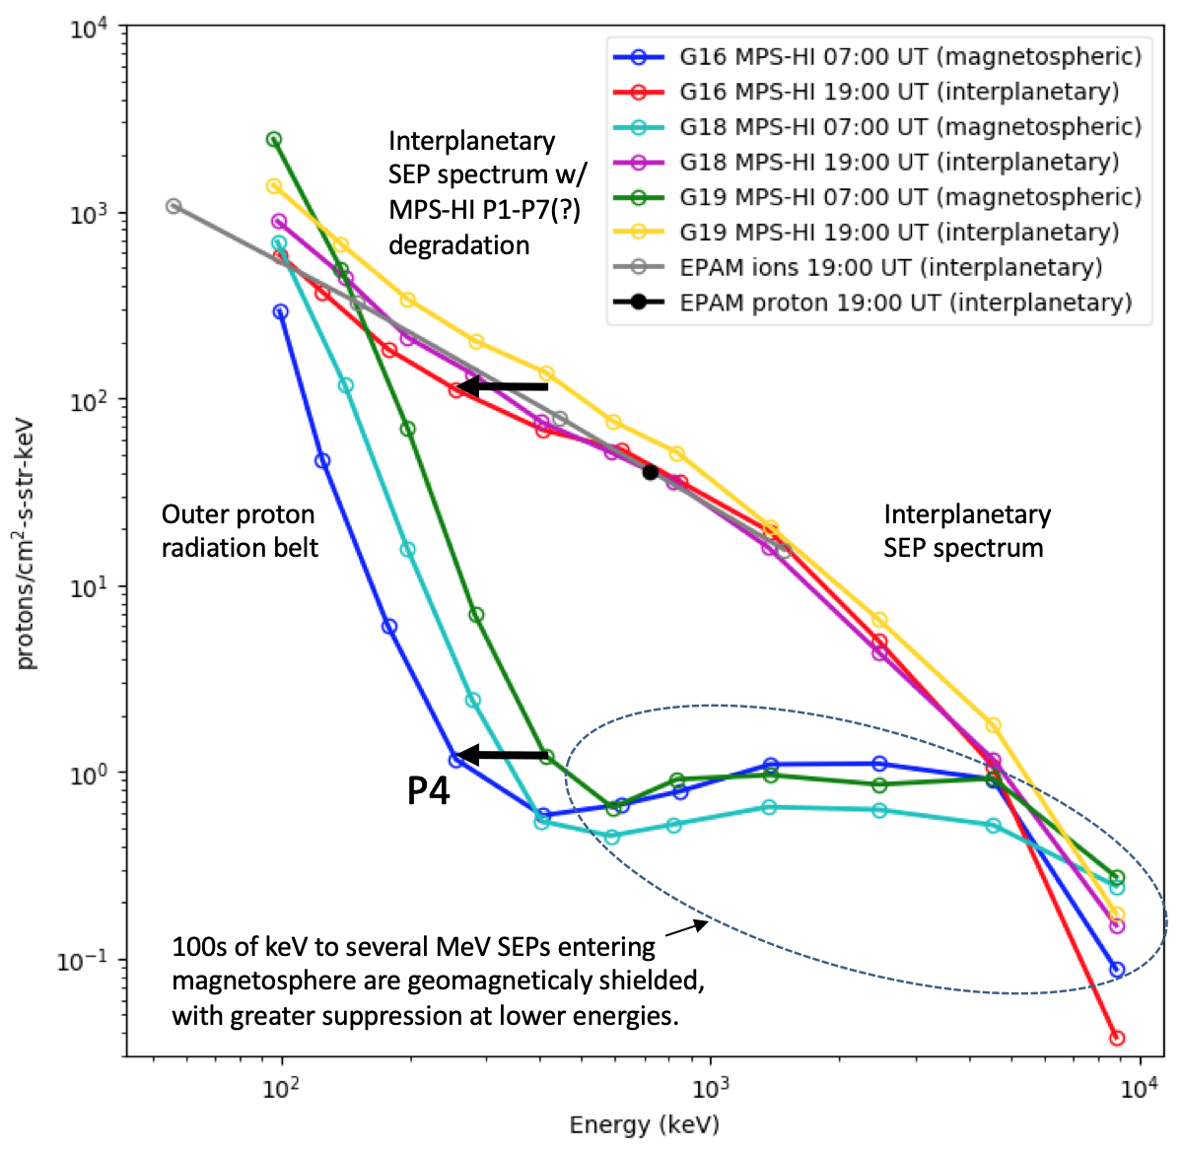
G16,G17,G18 MPS-HI P1-P11 spectra at 2 time snapshots during 10 Oct. 2024 SEP event
Energy spectra from 1-min. averaged GS L1b
Results suggest that MPS-HI proton channel “degradation” is due to upward shift in energy of channels.
Although SGPS channels are not likely to be affected by an SSD dead layer, suspected to be the cause of MPS-HI proton channel degradation, we should consider the possibility that mischaracterized energy bands are a source of outliers among G16-G19 SGPS flux measurements.
Should consider effects of both degraded G₀ and mischaracterized energy bounds.
NCEI recommends inter-calibration among all 8 SGPS units now on-orbit, under many different spectral conditions, enabling comprehensive best-fit adjustments to both channel energy bounds and G₀ calibration factors.
These GOES-19 data are preliminary, non-operational data and are undergoing testing. Users bear all responsibility for inspecting the data prior to use and for the manner in which the data are utilized.

Slide 39
ADRs 781 and 863 – Next 2 slides are from G16 & G17 MPS-HI Full Validation PS-PVR (combined PS-PVR), slides 16 and 17.
GOES-19 SGPS L1b Product Provisional PS-PVR

Slide 40
ADR 781: Update and current status
SGPS-X & SGPS+X IFCs
SGPS-X data gap during SGPS+X IFC
SGPS+X data gap during SGPS-X IFC
MPS-HI IFC
No MPS-HI data gap during SGPS IFCs
ADR 781 (WR 6477) was successful in dealing with the MPS-HI gaps during SGPS IFCs, but unsuccessful for SGPS IFC inter-dependencies
WR 8404 was initiated to revisit the SGPS data gaps
As of 09/16/2021 SGPS algorithm changes have been identified, and work on ADR 781 is ongoing

Slide 41
ADR 863: Graceful degradation when SGPS data not generated
Applies to both GOES-16 and GOES-17
Four electron channels from MPS-HI use SGPS-X data for a contamination correction. The SGPS P5 channel uses data from the opposite SGPS for a contamination correction. If for some reason (like a sensor failure) no data are being generated from one of the SGPS units, then the dependent products should still be produced with only graceful degradation. This is needed for Full validation of MPS-HI and SGPS. This is a generalization of ADR 781.
Case 1: SGPS-X data are not being generated
MPS-HI fluxes should be calculated as if SGPS-X fluxes were zero rather than missing -- graceful degradation of 4 electron channels.
SGPS L1b should still be produced with SGPS-X being all fill and SGPS+X containing valid fluxes (SGPS+X P5 being calculated as if SGPS-X fluxes were zero rather than missing -- graceful degradation of P5).
Case 2: SGPS+X data are not being generated.
MPS-HI fluxes should be produced, no dependence on SGPS+X, no degradation.
SGPS L1b should still be produced with SGPS+X being all fill and SGPS-X containing valid fluxes (SGPS-X P5 being calculated as if SGPS+X fluxes were zero rather than missing -- graceful degradation of P5).
Case 3: neither SGPS+X nor SGPS-X data being generated
MPS-HI fluxes should be calculated as if SGPS-X fluxes were zero rather than missing -- graceful degradation of 4 electron channels.
CAUTION: ADR 863 can become critical in case of catastrophic failure of SGPS. MPS-HI E11 channel will be lost even though it is still functioning.

