Slide 1
Peer Stakeholder-Product Validation Review (PS-PVR)
For the Provisional Maturity of GOES-19 SEISS
MPS-LO L1b Product
February 11, 2025
GOES-R Calibration Working Group (CWG)
Trevor Leonard
CIRES CU Boulder / NOAA NCEI
Contributors: Athanasios Boudouridis, Brian Kress, Juan Rodriguez
CIRES CU Boulder / NOAA NCEI
These GOES-19 data are preliminary, non-operational data and are undergoing testing. Users bear all responsibility for inspecting the data prior to use and for the manner in which the data are utilized.

Slide 2
Outline
MPS-LO Overview
Review of Beta/PLT Maturity
Product Quality Evaluation
  Instrument and GPA Anomalies and Resolution
  Analysis and PLPTs Supporting Assessment for Provisional Status
Provisional Maturity Assessment
Path to Full Validation Maturity
Summary and Recommendations
These GOES-19 data are preliminary, non-operational data and are undergoing testing. Users bear all responsibility for inspecting the data prior to use and for the manner in which the data are utilized.

Slide 3
MPS-LO OVERVIEW
GOES-19 MPS-LO L1b Product Provisional PS-PVR
These GOES-19 data are preliminary, non-operational data and are undergoing testing. Users bear all responsibility for inspecting the data prior to use and for the manner in which the data are utilized.

Slide 4
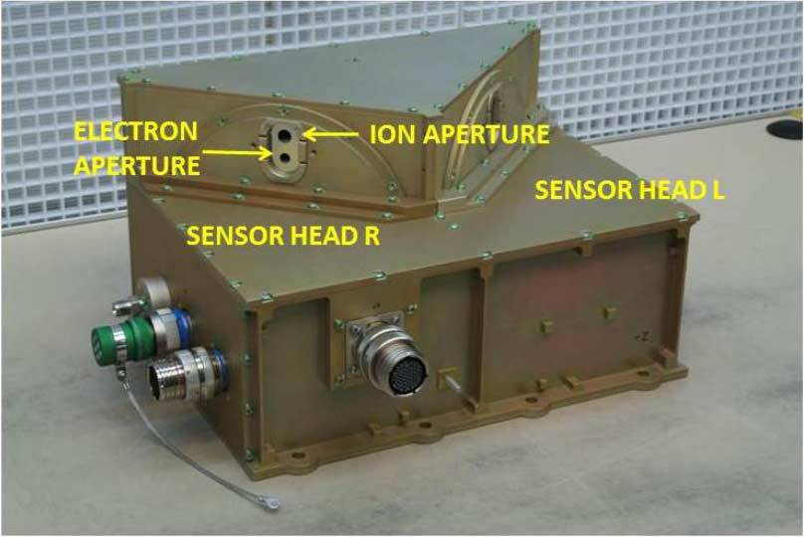
Space Environment In-Situ Suite (SEISS)
Magnetospheric Particle Sensor - Low Energy (MPS-LO)
Primary purpose: measure GOES frame charging and spacecraft charging environment
Electrostatic analyzers (2 ESAs per species) with Microchannel plates (MCPs) as the detection elements
Measures electrons and ions within 30 eV – 30 keV over 15 logarithmically-spaced energy channels
14 angular zones (12 unique) in the north-south plane and 2 background zones
  15 deg FOV angular zones with combined total 180 deg FOV
  30 deg overlap in FOV across 4 angular zones should yield similar fluxes
L1b product: low energy magnetospheric electron and proton fluxes (counts/cm²-s-str-keV)
  2 x 14 x 15 = 420 flux time-series in MPS-LO L1b data
SEISS MPS-LO designed, built, tested and calibrated by Assurance Technology Corporation (ATC)
These GOES-19 data are preliminary, non-operational data and are undergoing testing. Users bear all responsibility for inspecting the data prior to use and for the manner in which the data are utilized.

Slide 5
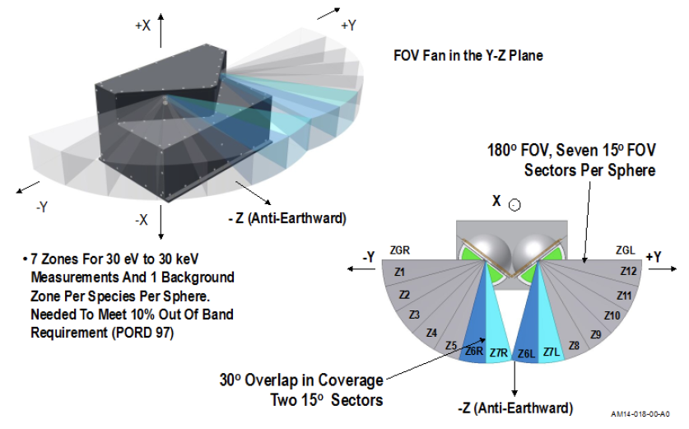
SEISS MPS-LO FOV
These GOES-19 data are preliminary, non-operational data and are undergoing testing. Users bear all responsibility for inspecting the data prior to use and for the manner in which the data are utilized.

Slide 6
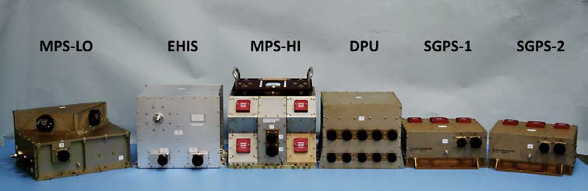
SEISS MPS-LO
An individual energy step observation interval is slightly less than 1/16 of a second and all 15 energy steps are observed during a 1 second cycle
A dead time correction is applied to each observation interval in accordance to the electronics event processing time
Ground processing uses the background zone observations to remove penetrating radiation from the particle observations
Magnetic field vector observations from the GOES magnetometer is essential for calculating pitch angle for each telescope / angular zone
These GOES-19 data are preliminary, non-operational data and are undergoing testing. Users bear all responsibility for inspecting the data prior to use and for the manner in which the data are utilized.

Slide 7
A Few Comments About MPS-LO
NOAA’s first plasma instrument on GOES!
Measures thermal population (~1keV at geosynchronous)
Measuring the low energy component of a plasma is notoriously difficult – Plasma instruments are known to require special care.
Surface charging on spacecraft is associated with <50 keV electrons [NASA, “Mitigating in-space charging effects – a guideline,” NASA Technical Handbook NASA- HDBK-4002A, March 3, 2011].
Electrostatic discharge (ESD) due to spacecraft charging causes most of the environmentally related anomalies on spacecraft, and surface charging has caused the most serious anomalies, i.e., those that have resulted in the loss of the mission [Koons et al., 1999].
In addition to its operational use at SWPC, we are looking forward to making this data available to the science community.
These GOES-19 data are preliminary, non-operational data and are undergoing testing. Users bear all responsibility for inspecting the data prior to use and for the manner in which the data are utilized.

Slide 8
MPS-LO Primary Operational Use
Data stream for NOAA-NWS SWPC
MPS-LO Density and Temperature Moments and Level of Spacecraft Charging
MAG L1b 1m averages
Level 1b
Level 2
SEISS MPS-LO L2 1m averages and the Density and Temperature Moments and Level of Spacecraft Charging algorithm are phase 2 algorithms. MPS-LO 5m averages is phase 3.
L2 densities and temperatures are also used in the L2 Magnetometer Magnetopause Crossing Detection algorithm as an indicator of magnetopause crossings at geosynchronous.
The L2 Moments algorithm identifies ion line signatures of SC charging and uses the ion line to determine the spacecraft potential:
When an ion line is not present, the L2 Moments routine uses an empirical relation between densities, temperatures, and level of charging to monitor SC charging.
1 sec.
Ion line
Backgrounds from heightened radiation belt fluxes
GOES-16 MPS-LO spectrogram of count rates, with ion line signatures of spacecraft charging. The first ion line enhancement appears near 1 keV at ~5:30-6:30 UT during an eclipse period.
UT Hours
On 22 March 2017
These GOES-19 data are preliminary, non-operational data and are undergoing testing. Users bear all responsibility for inspecting the data prior to use and for the manner in which the data are utilized.

Slide 9
Review of Beta/PLT Maturity
GOES-19 MPS-LO L1b Product Provisional PS-PVR
These GOES-19 data are preliminary, non-operational data and are undergoing testing. Users bear all responsibility for inspecting the data prior to use and for the manner in which the data are utilized.

Slide 10
Review of Beta/PLT Maturity
GOES-19 SEISS achieved Beta status on October 22, 2024
ATC MPS-LO PLT
  PLT-SEI-005: MPS-LO Initial Turn-On of Electron and Ion Microchannel Plate High Voltage (MCP HV)
  PLT-SEI-004: MPS-LO Initial In-Flight Calibration (IFC) Execution
PLPT Overview
  PLPT-SEI-003: MPS-LO Zone Cross-Comparison
  PLPT-SEI-005: Cross Satellite Comparison of Trapped Particles
  PLPT-SEI-006: Backgrounds Trending
MPS-LO Specific ADRs/WRs
These GOES-19 data are preliminary, non-operational data and are undergoing testing. Users bear all responsibility for inspecting the data prior to use and for the manner in which the data are utilized.

Slide 11
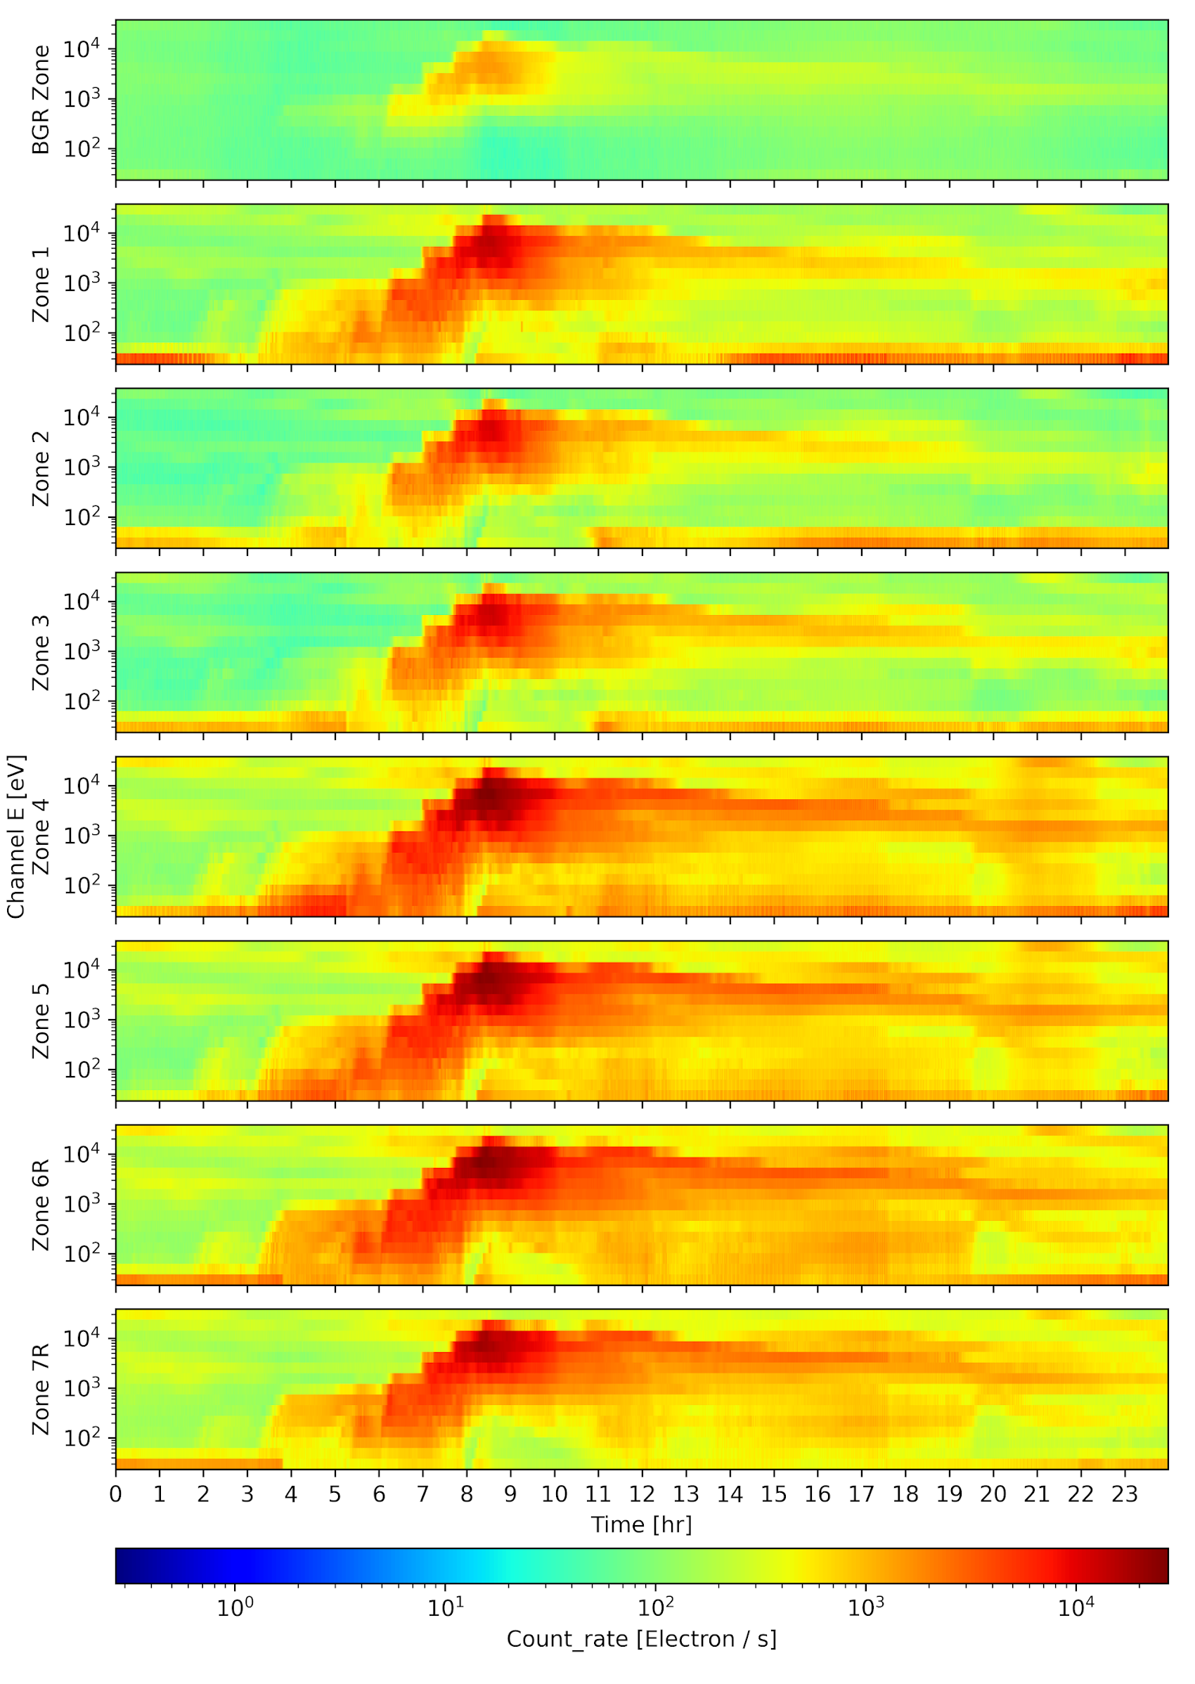
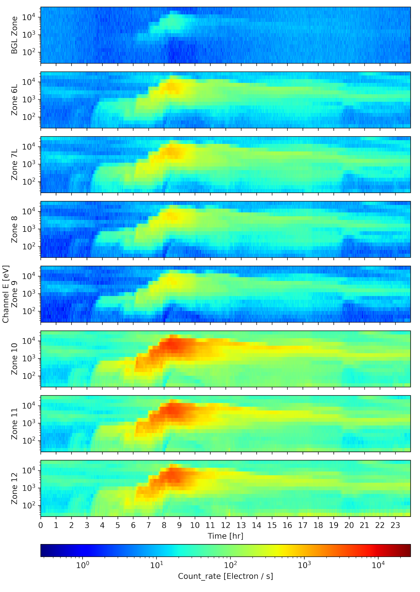
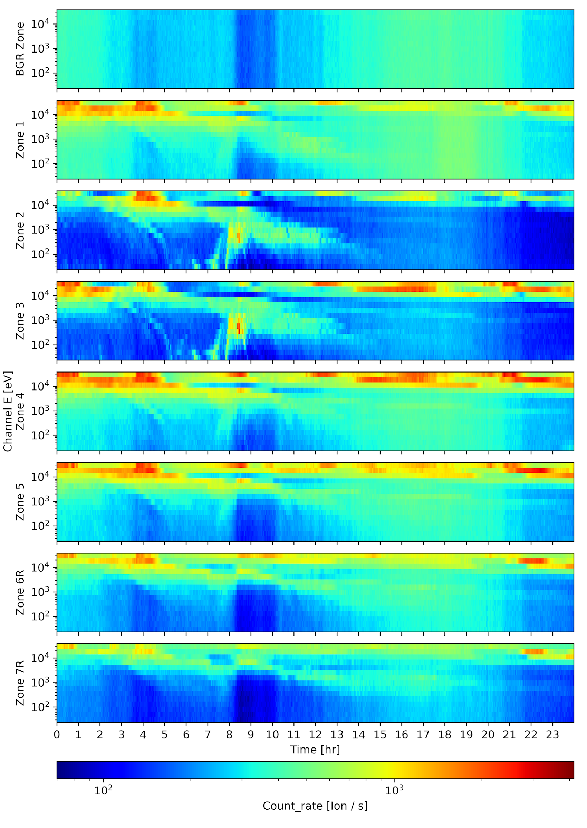
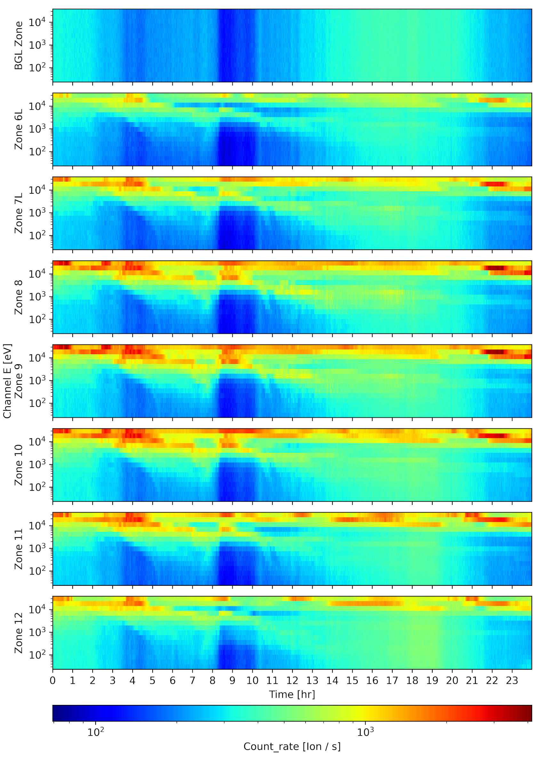
NCEI Beta Assessment
GOES-19 MPS-LO 2024-09-21
Zones 1-7R Electrons Zones 6L-12 Electrons Zones 1-7R Ions Zones 6L-12 Ions
These GOES-19 data are preliminary, non-operational data and are undergoing testing. Users bear all responsibility for inspecting the data prior to use and for the manner in which the data are utilized.

Slide 12
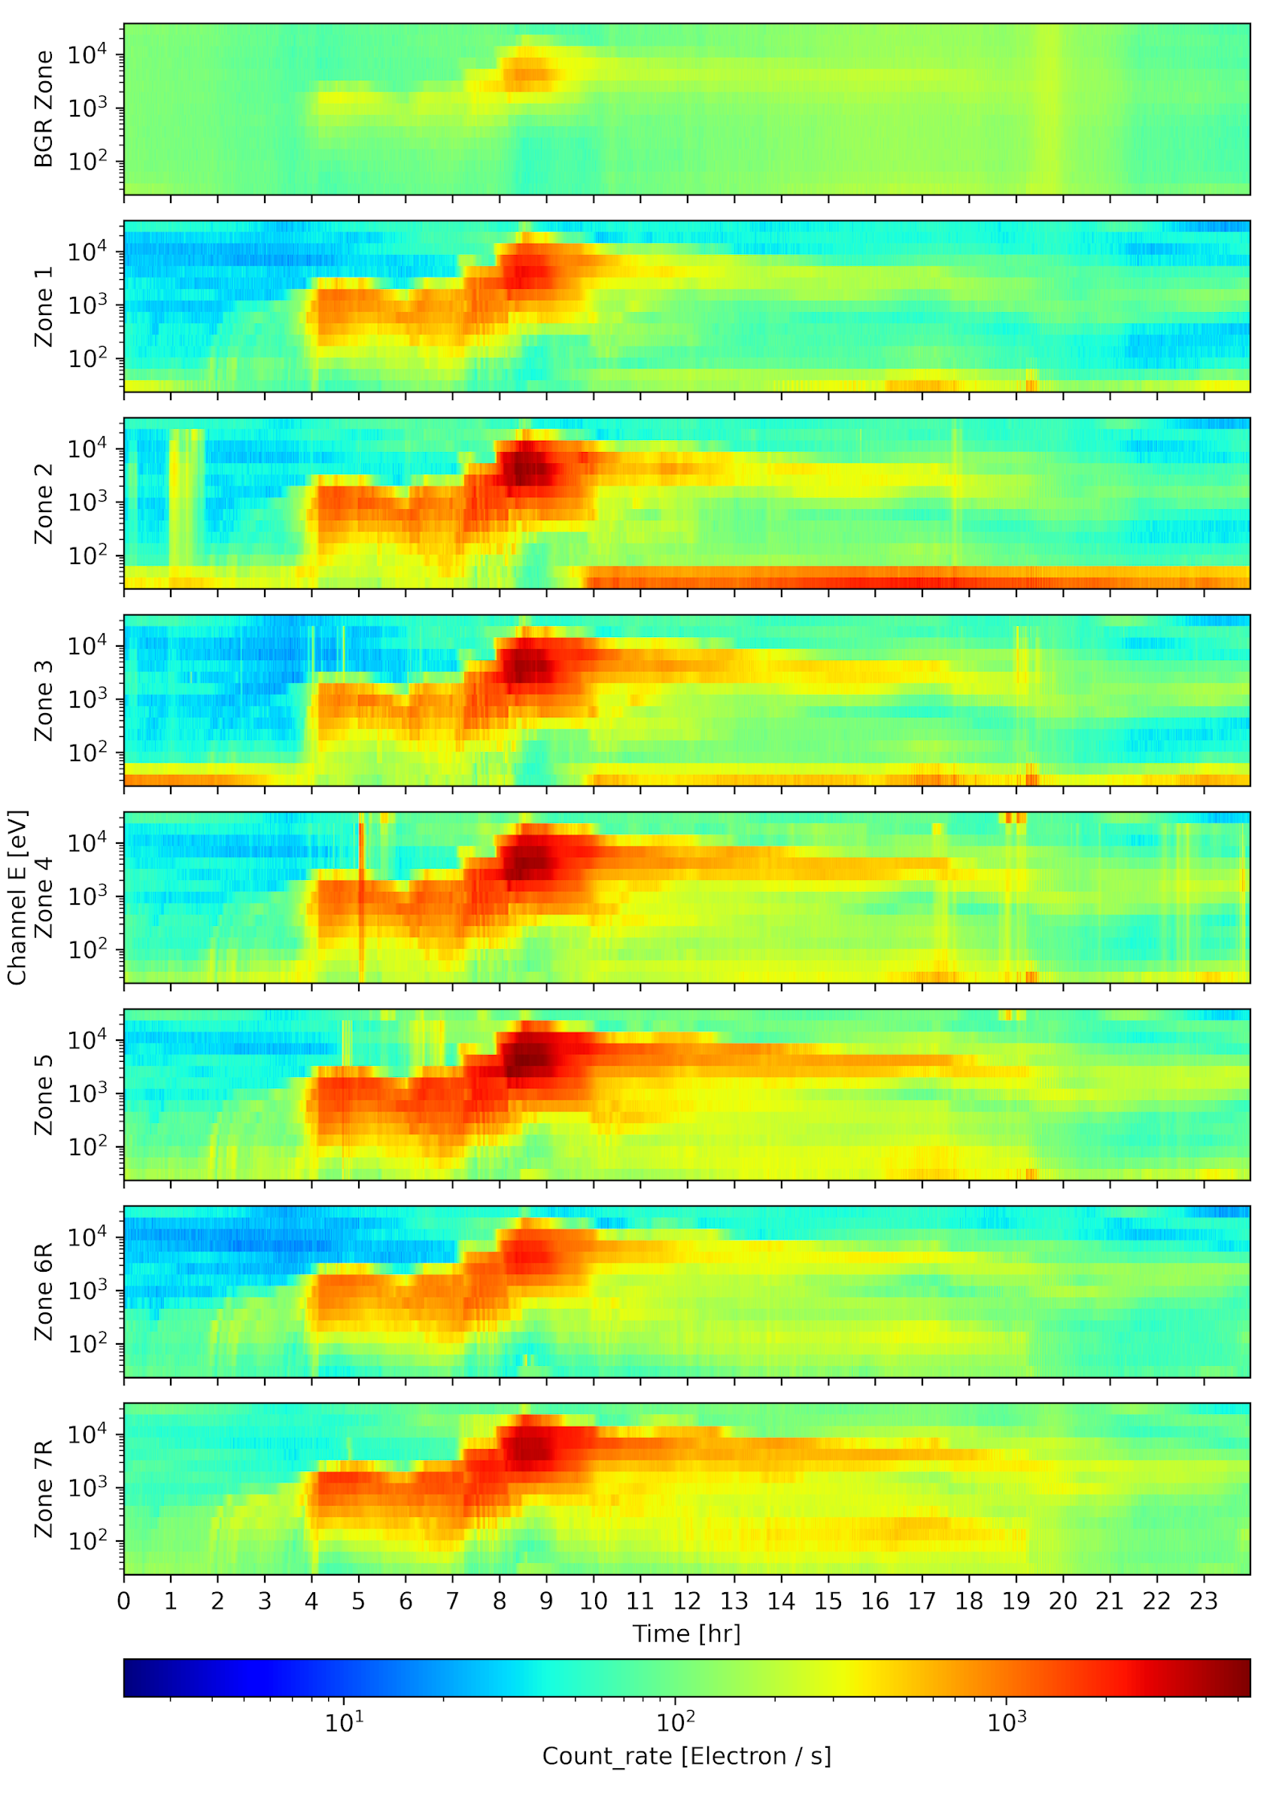
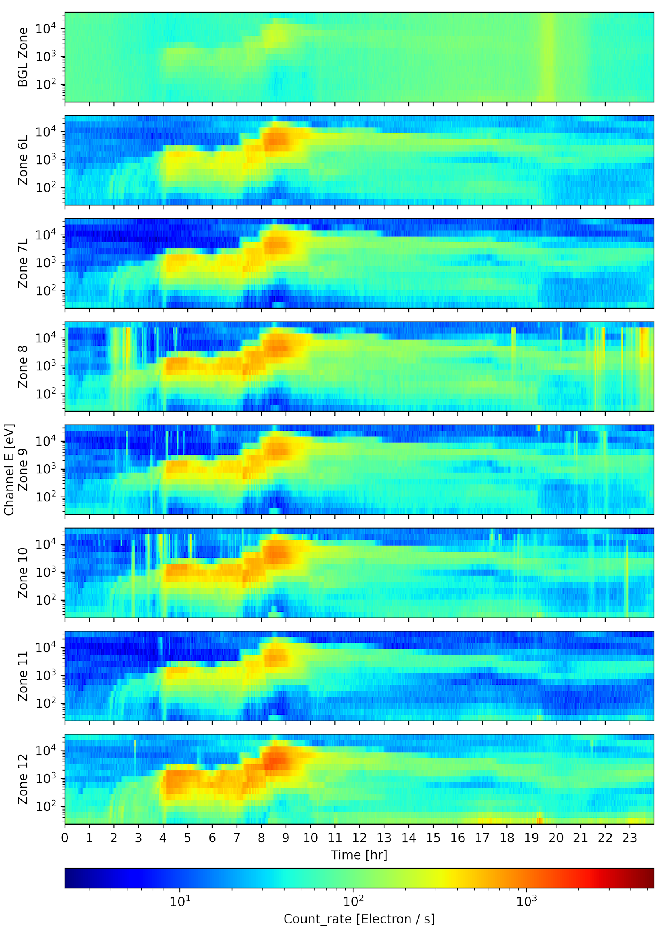
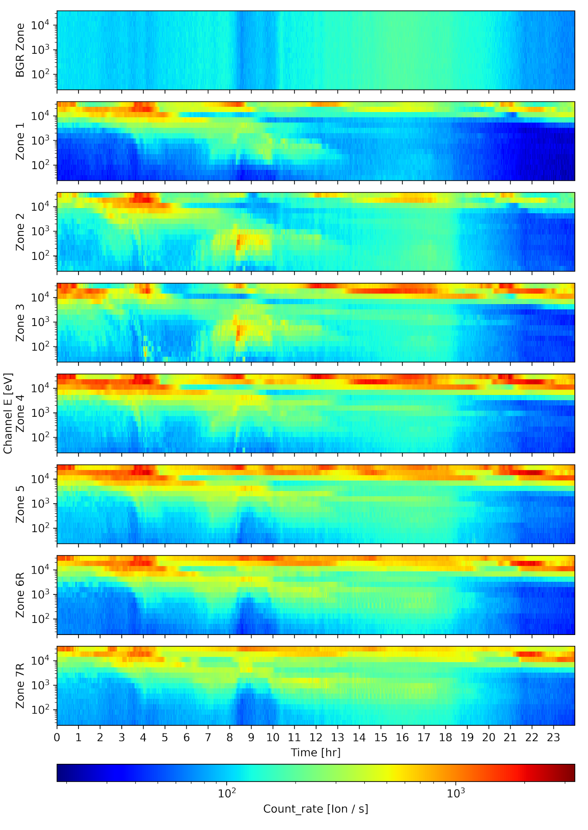
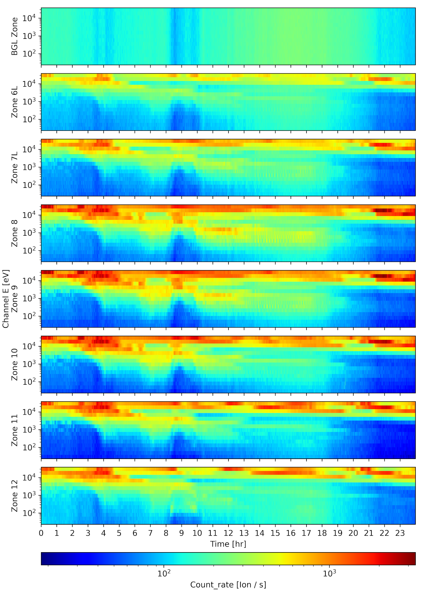
NCEI Beta Assessment
GOES-16 MPS-LO 2024-09-21
Zones 1-7R Electrons Zones 6L-12 Electrons Zones 1-7R Ions Zones 6L-12 Ions
These GOES-19 data are preliminary, non-operational data and are undergoing testing. Users bear all responsibility for inspecting the data prior to use and for the manner in which the data are utilized.

Slide 13
PLT-SEI-005: MPS-LO HV Activation and Bias Optimization
Determine optimal on-orbit HV bias voltage levels for electron (EMCP) and ion (IMCP) microchannel places
  Preflight calibration: EMCP = step 24, IMCP = step 25
  EMCP and IMCP bias set to the sub-operating step 20 and increased incrementally to step 27 with data accumulation at each step
  IMCP bias increased to step 28
  EMCP and IMCP bias decremented to step 20 with data accumulation at each step
  Total test time period: 2024-08-28 – 2024/09/19
Goal is to operate MCP in/near saturation to ensure uniformity of charge exiting MCPs with individual particle hit while keeping HV low enough to avoid excessive noise and crosstalk
Conclusion: ATC recommend the MPS-LO MCP HV baseline settings of EMCP = step 25 and IMCP = step 25; implemented on 2024-10-04
Nominal retest cadence is six months
Pass
These GOES-19 data are preliminary, non-operational data and are undergoing testing. Users bear all responsibility for inspecting the data prior to use and for the manner in which the data are utilized.

Slide 14
PLT-SEI-004: MPS-LO IFC Test
Measure the electron and ion zone thresholds at orbital extremes
  Expect thresholds to vary with temperature
  Ensure no difference in thresholds based on MCP bias state
IFC test completed for MPS-LO ion and electron MCP HV bias optimization
  IFC successfully executed with high voltage disabled and enabled
  IFC results are in-family with pre-launch results and current GOES operational spacecraft
  Temperature dependencies are comparable with ground test
Pass
These GOES-19 data are preliminary, non-operational data and are undergoing testing. Users bear all responsibility for inspecting the data prior to use and for the manner in which the data are utilized.

Slide 15
Path to Provisional - PLPTs
Title | Activity | Data Needed | Success Criteria
A.2.2 MPS-LO Zone Cross-Comparison [PLPT-SEI-003] | Evaluate PADs, determine relative sensitivity/response among MPS-LO zones and calculate inter-calibration factors for Z6L/Z6R and Z7L/Z7R for each of 15 energies and for both electrons and ions. | One month of continuous data. | [Provisional] PADs match science expectations and zones agree within 25%.
A.2.4 Cross Satellite Comparison of Trapped Particles [PLPT-SEI-005] | Inter-calibrate MPS-LO with the same measurements on other operational GOES-R Series satellites. | One month of continuous data. | [Provisional] Differences quantified on data taken through validation phase.
A.2.5 Backgrounds Trending [PLPT-SEI-006] | Trend daily/weekly minima from MPS-LO ion and electron background zones | Two months of continuous data. | [Provisional] If dark noise can be observed above natural backgrounds, decreases with time.
MPS-LO Provisional PLPTs from RIMP v 2.0 (09 July 2021)
These GOES-19 data are preliminary, non-operational data and are undergoing testing. Users bear all responsibility for inspecting the data prior to use and for the manner in which the data are utilized.

Slide 16
MPS-LO Specific ADRs/WRs
ADR | WR | Short Description | Status | Closure
228 | 3961/7067 | SEISS record time mismatches with filenames | Closed | DO.07.01.00/DO.10.01.01 (2021/12/09)
326 | 5424/5860 | MPS-LO GPA Changes | Closed | DO.07.01.00
449/ 596 | 5133/5800 | Make Arc Jet Flag available for SEISS MPS-LO | Closed | DO.07.00.00/DO.10.01.00
780 | 6585/6845 | GPA update for SEISS MPS-HI and MPS-LO L1b IFC leakage | Closed | DO.12.00.00 (2023 May)
1003 | 7506 | Flight delivery of SEISS FM3 LUTs | Closed | PR.09.05.01 (2021/08/20)
1171 | 9326 | EXIS/MAG/SEISS ECEF_Z range | Closed | DO.12.00.00 (2023/05/23)
1198/1199 | N/A | G16/G17 MPS-LO LUT updates | Closed | PR.09.08.08 (2022/10/02)
1209 | N/A | NCEI G18 SEISS LUT Actions (the real prelaunch LUTs) | Closed | PR.09.08.14 (2022/04/14)
1277 | N/A | G18 SEISS MPS-LO LUT Update | Closed | PR.08.08.38 (2022/11/01)
1316 | N/A | G16 and G18 SEISS MPS-LO LUT Update | Closed | PR.11.04.04 (2023/05/04)
These GOES-19 data are preliminary, non-operational data and are undergoing testing. Users bear all responsibility for inspecting the data prior to use and for the manner in which the data are utilized.

Slide 17
MPS-LO Specific ADRs/WRs
ADR | WR | Short Description | Status | Closure
1387 | 9907 | SEISS MPS-LO GPA Output Change to Add Raw Counts | Open | WR In_Work for DO.15 delivery, but may miss the deadline. If so, we will consider a Type 2 approach.
1402 | --- | GOES-U SEISS CDRL79 RevA for PLT | Closed | PR.13.07.00 on 05/29/24
1541 |  | G19 SEISS MPS-LO LUT Update | Open
These GOES-19 data are preliminary, non-operational data and are undergoing testing. Users bear all responsibility for inspecting the data prior to use and for the manner in which the data are utilized.

Slide 18
PRODUCT QUALITY EVALUATION
GOES-19 MPS-LO L1b Product Provisional PS-PVR
These GOES-19 data are preliminary, non-operational data and are undergoing testing. Users bear all responsibility for inspecting the data prior to use and for the manner in which the data are utilized.

Slide 19
Summary of MPS-LO Anomalies
(Common to all MPS-LO flight models to date)
High Backgrounds / Negative Fluxes
  Previous strategy with ADR 326 for G16, G17, and G18 is also applied to G19
  Continued work on the empirical derivation of background removal coefficients
  Source of backgrounds is not fully understood
Interzonal Crosstalk
  G19/FM4 crosstalk observed on-orbit (slide 30), similar to G16/FM1, G17/FM2, and G18/FM3
Evidence for significant error in absolute values of reported fluxes (e.g., PLPT-SEI-003 and PLPT-SEI-005), which was also studied on G16, G17, and G18 with no resolution. Possible sources of error in reported fluxes:
  Gradual decrease in in-band and background zone response with time (seen on slide 39)
  No crosstalk correction scaling of geometric factors
  May be insufficient or too much background removal
  To reduce crosstalk and noise, instrument not operated in full saturation
Degraded performance of lower energy ion channels due to persistent high backgrounds
  Previously studied on G16, G17, and G18 with no resolution
Effect of arc jet firing
  Previously resolved on G16, G17, and G18 with ADR 596 and resolution is true for G19
These GOES-19 data are preliminary, non-operational data and are undergoing testing. Users bear all responsibility for inspecting the data prior to use and for the manner in which the data are utilized.

Slide 20
  High Backgrounds / Negative Fluxes –
  ADR 326 and Empirical Derivation of Background Removal Coefficients at NCEI
GOES-19 MPS-LO L1b Product Provisional PS-PVR
These GOES-19 data are preliminary, non-operational data and are undergoing testing. Users bear all responsibility for inspecting the data prior to use and for the manner in which the data are utilized.

Slide 21
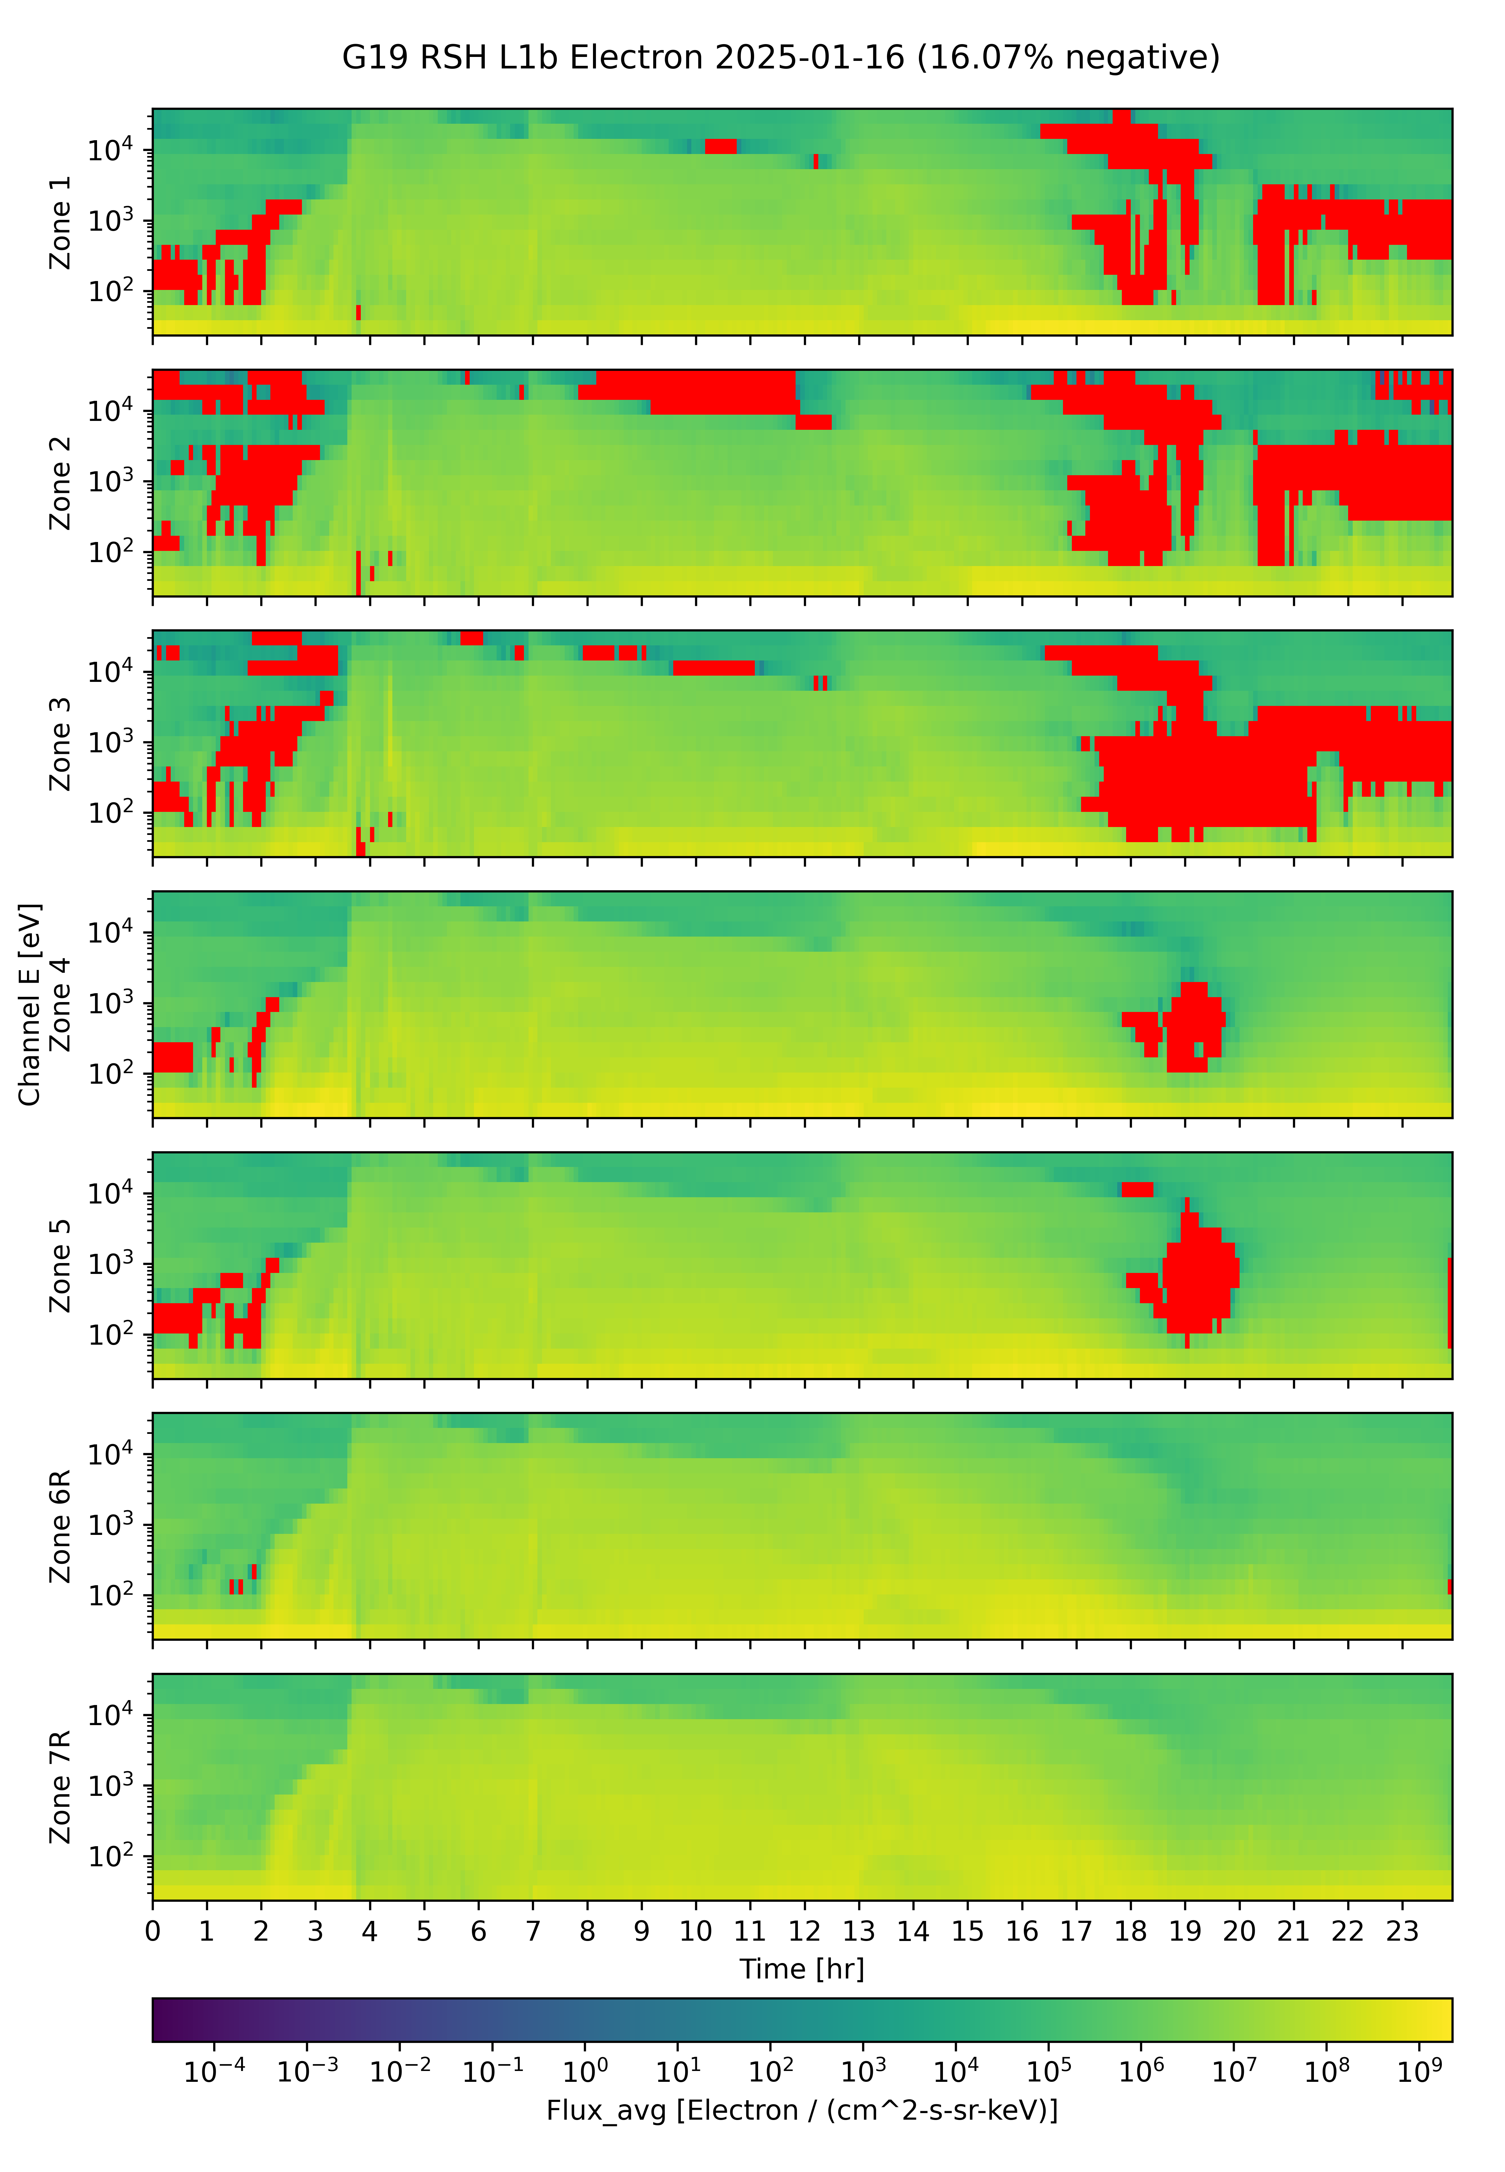
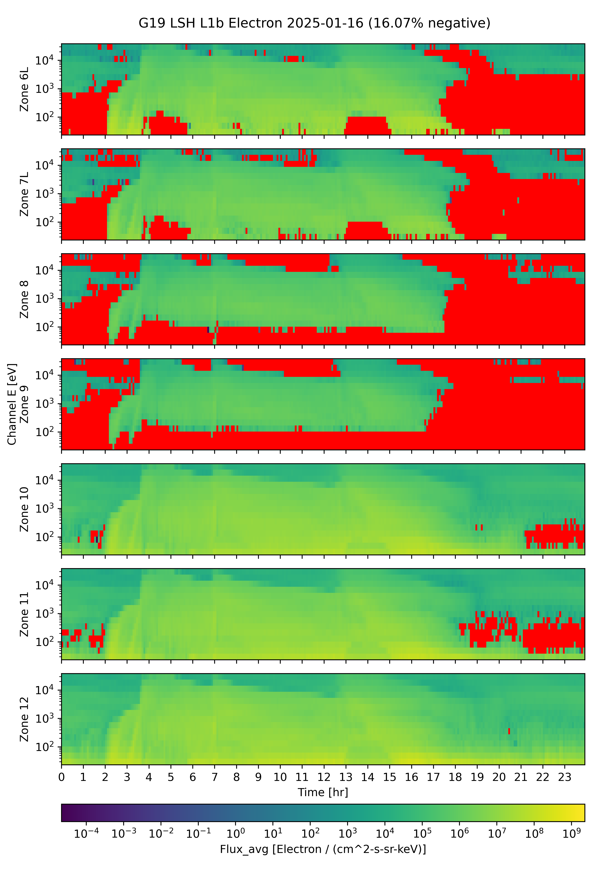
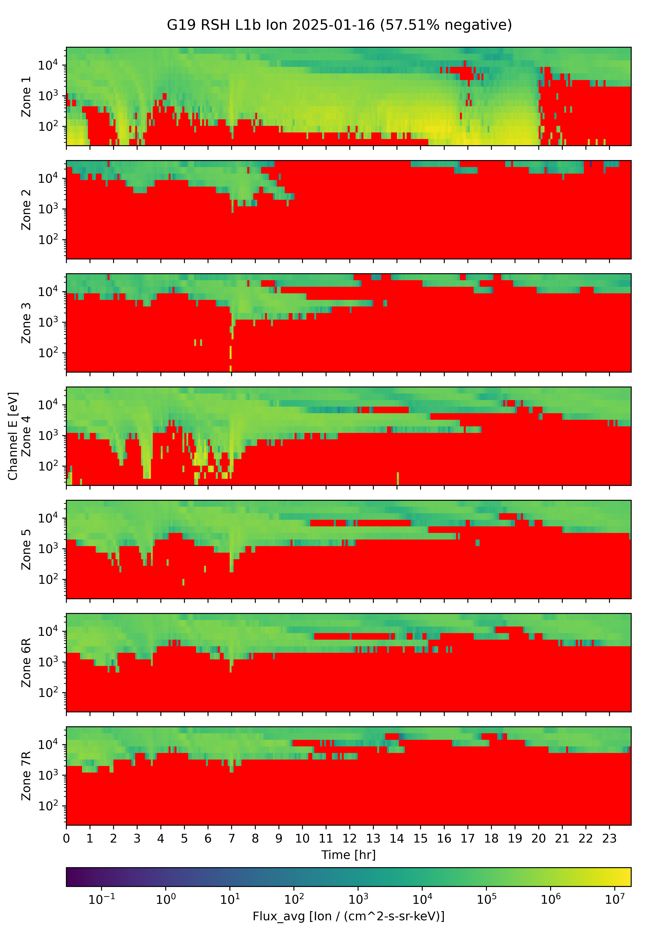
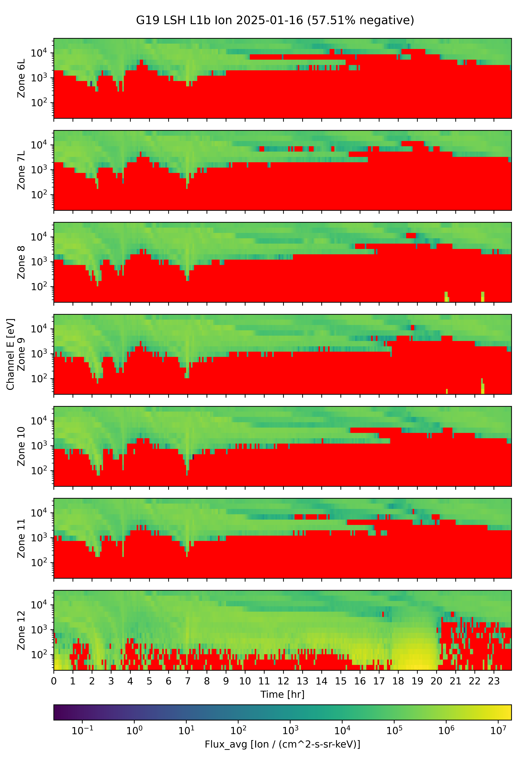
G19 MPS-LO L1b Fluxes 2025/01/16
(Prior to implementation of ADR 1541 MPS-LO LUT Update)
Zones 1-7R Electrons Zones 6L-12 Electrons Zones 1-7R Ions Zones 6L-12 Ions
16.07% Negative Electron Fluxes 57.51% Negative Ion Fluxes
Negative flux (red pixels) are non-physical and due to excessive background subtraction:
Corrected counts = total counts – background counts
Addressed by ADR326/WR5860 MPS-Lo GPA Changes, in build DO.07.01.00, and with an updated LUT in ADR1541.
These GOES-19 data are preliminary, non-operational data and are undergoing testing. Users bear all responsibility for inspecting the data prior to use and for the manner in which the data are utilized.

Slide 22
MPS-LO Background Removal
In-band
(electrons or ions)
Penetrating radiation / Backgrounds
~
Sweep voltage
(selects 15 energies)
BG
In-band
Illuminated zone accumulates
both in-band and BG counts
Unilluminated
Background
Zone
14 zones
(viewing directions)
Simplified background (BG) removal expression :
Corrected Counts = Total counts – BG Removal Coefficient x BG Counts
Pre- ADR326 CDRL80 expression has 4 BG removal coefficients, one for each species and sensor head, all were set to one in the launch version of the MPS-LO LUT. Analysis shows need for energy and zone dependent BG removal coefficients with values <1 for most energy-zone pairs. Need to characterize in-band vs. BG response for 14 zones x 15 energies for electrons and ions.
These GOES-19 data are preliminary, non-operational data and are undergoing testing. Users bear all responsibility for inspecting the data prior to use and for the manner in which the data are utilized.

Slide 23

Three Actions Addressing MPS-LO
High Backgrounds / Negative Fluxes
ADR326: Implement energy dependent background subtraction, previously energy-sweep averaged (Also involves non-trivial modification to error term – Complete description in ADR_326_Addendum_Revised_10-2-18.pdf.)
  $Currently: M_{m,k,i,j}=N_{m,k,i,j}^{tot.}−C_{m,k}{Avg_N}_{m,k}^{BG}$
  $Modify to: M_{m,k,i,j}=N_{m,k,i,j}^{tot.}−C_{m,k}N_{m,k,j}^{BG}$
ADR326: Generalization of background (BG) removal coefficient to include zone and energy dependence
  $C_{m,k}$ (2✕2) → $C_{m,k,i,j}$ (2✕2✕7✕15)
NCEI: Empirical derivation of BG removal coefficients (by demanding positive fluxes, averaged over some interval, using many months of data).
m = 1,2 for electrons and ions respectively.
k = 1,2 for right and left sensor heads.
i = 1-7 is zone index for 7 zones in each SH.
j = 1-15 is energy channel index.
These GOES-19 data are preliminary, non-operational data and are undergoing testing. Users bear all responsibility for inspecting the data prior to use and for the manner in which the data are utilized.

Slide 24
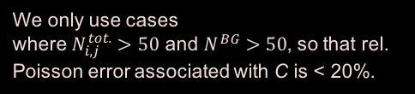

Empirical Determination of Background Removal Coefficients
The corrected counts M in a given zone and energy channel are the total counts N^{tot.} minus the counts from penetrating radiation
$M_{i,j}=N_{i,j}^{tot.}−C_{i,j}N^{BG}$,
where i and j are the zone and energy indices, respectively, and the counts in zone i due to penetrating radiation is assumed to be proportional to the counts in the associated (same species and sensor head) background zone N^{BG}.
If we demand that the flux averaged over some time-interval is non-negative, this places an upper bound on the background removal coefficient.
$${\overline{M}}_{i,j}={\overline{N}}_{i,j}^{tot.}−C_{i,j}{\overline{N}}^{BG}≥0 → C_{i,j}≤\frac{{\overline{N}}_{i,j}^{tot.}}{{\overline{N}}^{BG}}$$
where the overbar denotes an average over some time interval (e.g., 5 min. averages from 1s data). An upper bound for $C_{i,j}$ can be determined empirically by taking the minimum value of ${\overline{N}}_{i,j}^{tot.}/{\overline{N}}^{BG}$ attained over months of data
Set $C_{i,j}=Min\left[{\left(\frac{{\overline{N}}_{i,j}^{tot.}}{{\overline{N}}^{BG}}\right)}_{k}\right]$,
where k is index for the averaging interval, and we take minimum from many such intervals. An upper bound of 1 is also placed on the C coefficients.
We only use cases
where $N_{i,j}^{tot.}>50$ and $N^{BG}>50$, so that rel. Poisson error associated with C is < 20%.
These GOES-19 data are preliminary, non-operational data and are undergoing testing. Users bear all responsibility for inspecting the data prior to use and for the manner in which the data are utilized.

Slide 25
Empirical Background
Removal Coefficients
ADR 1541 G19 SEISS MPS-LO LUT Update will implement the following BRC tables.
Electron Background Removal Coefficients
Ion Background Removal Coefficients
These GOES-19 data are preliminary, non-operational data and are undergoing testing. Users bear all responsibility for inspecting the data prior to use and for the manner in which the data are utilized.

Slide 26
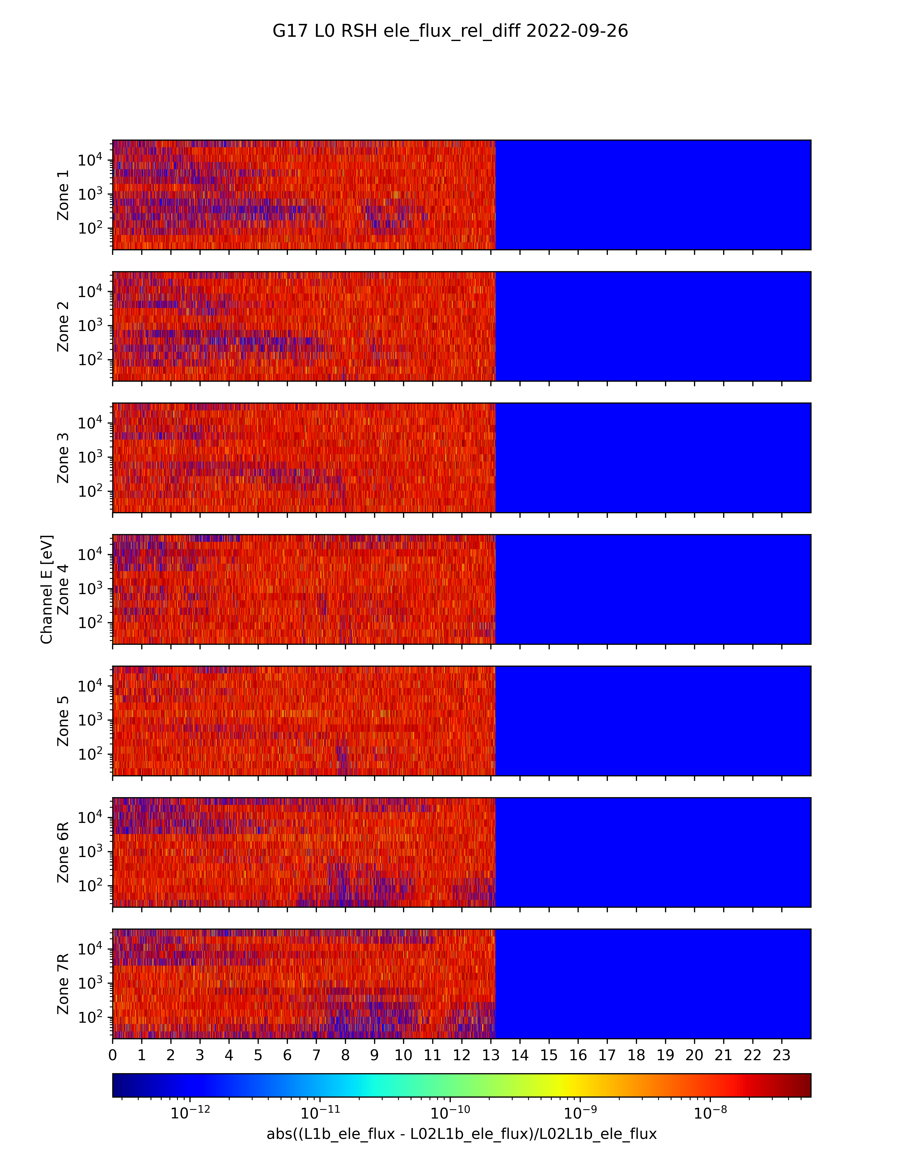
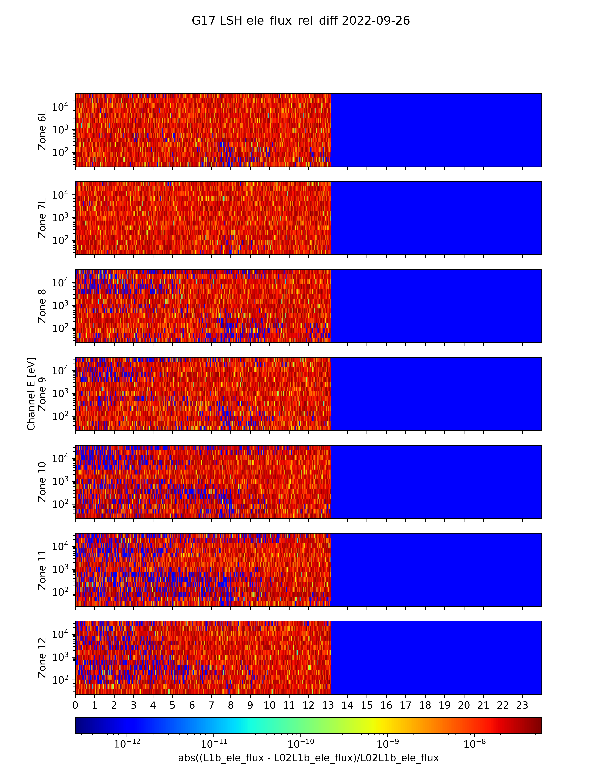
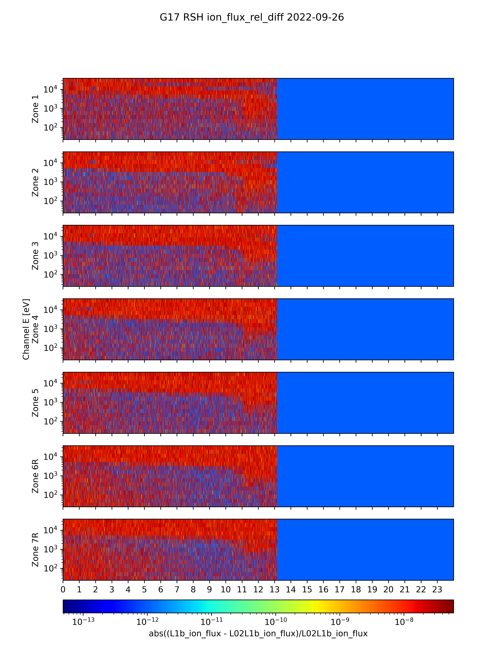
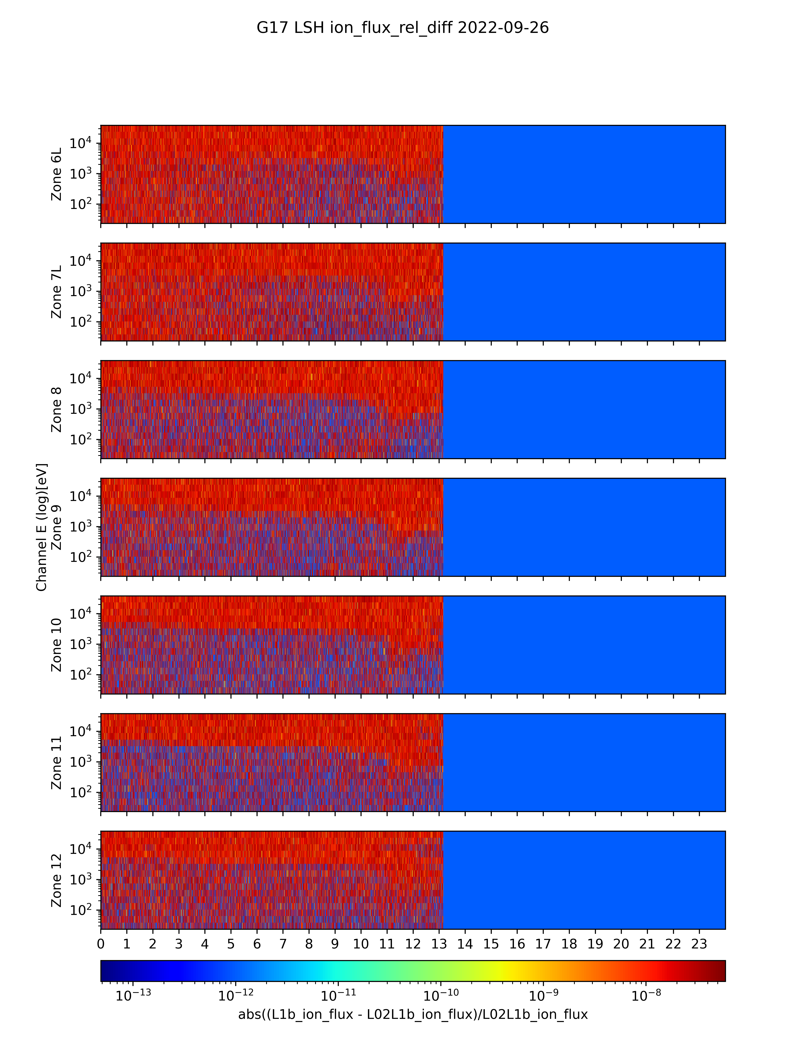
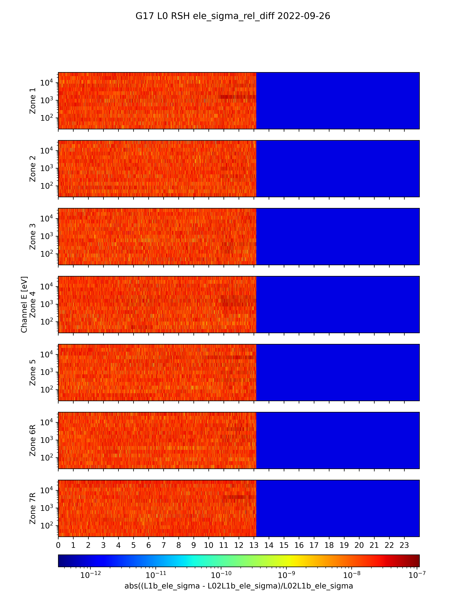
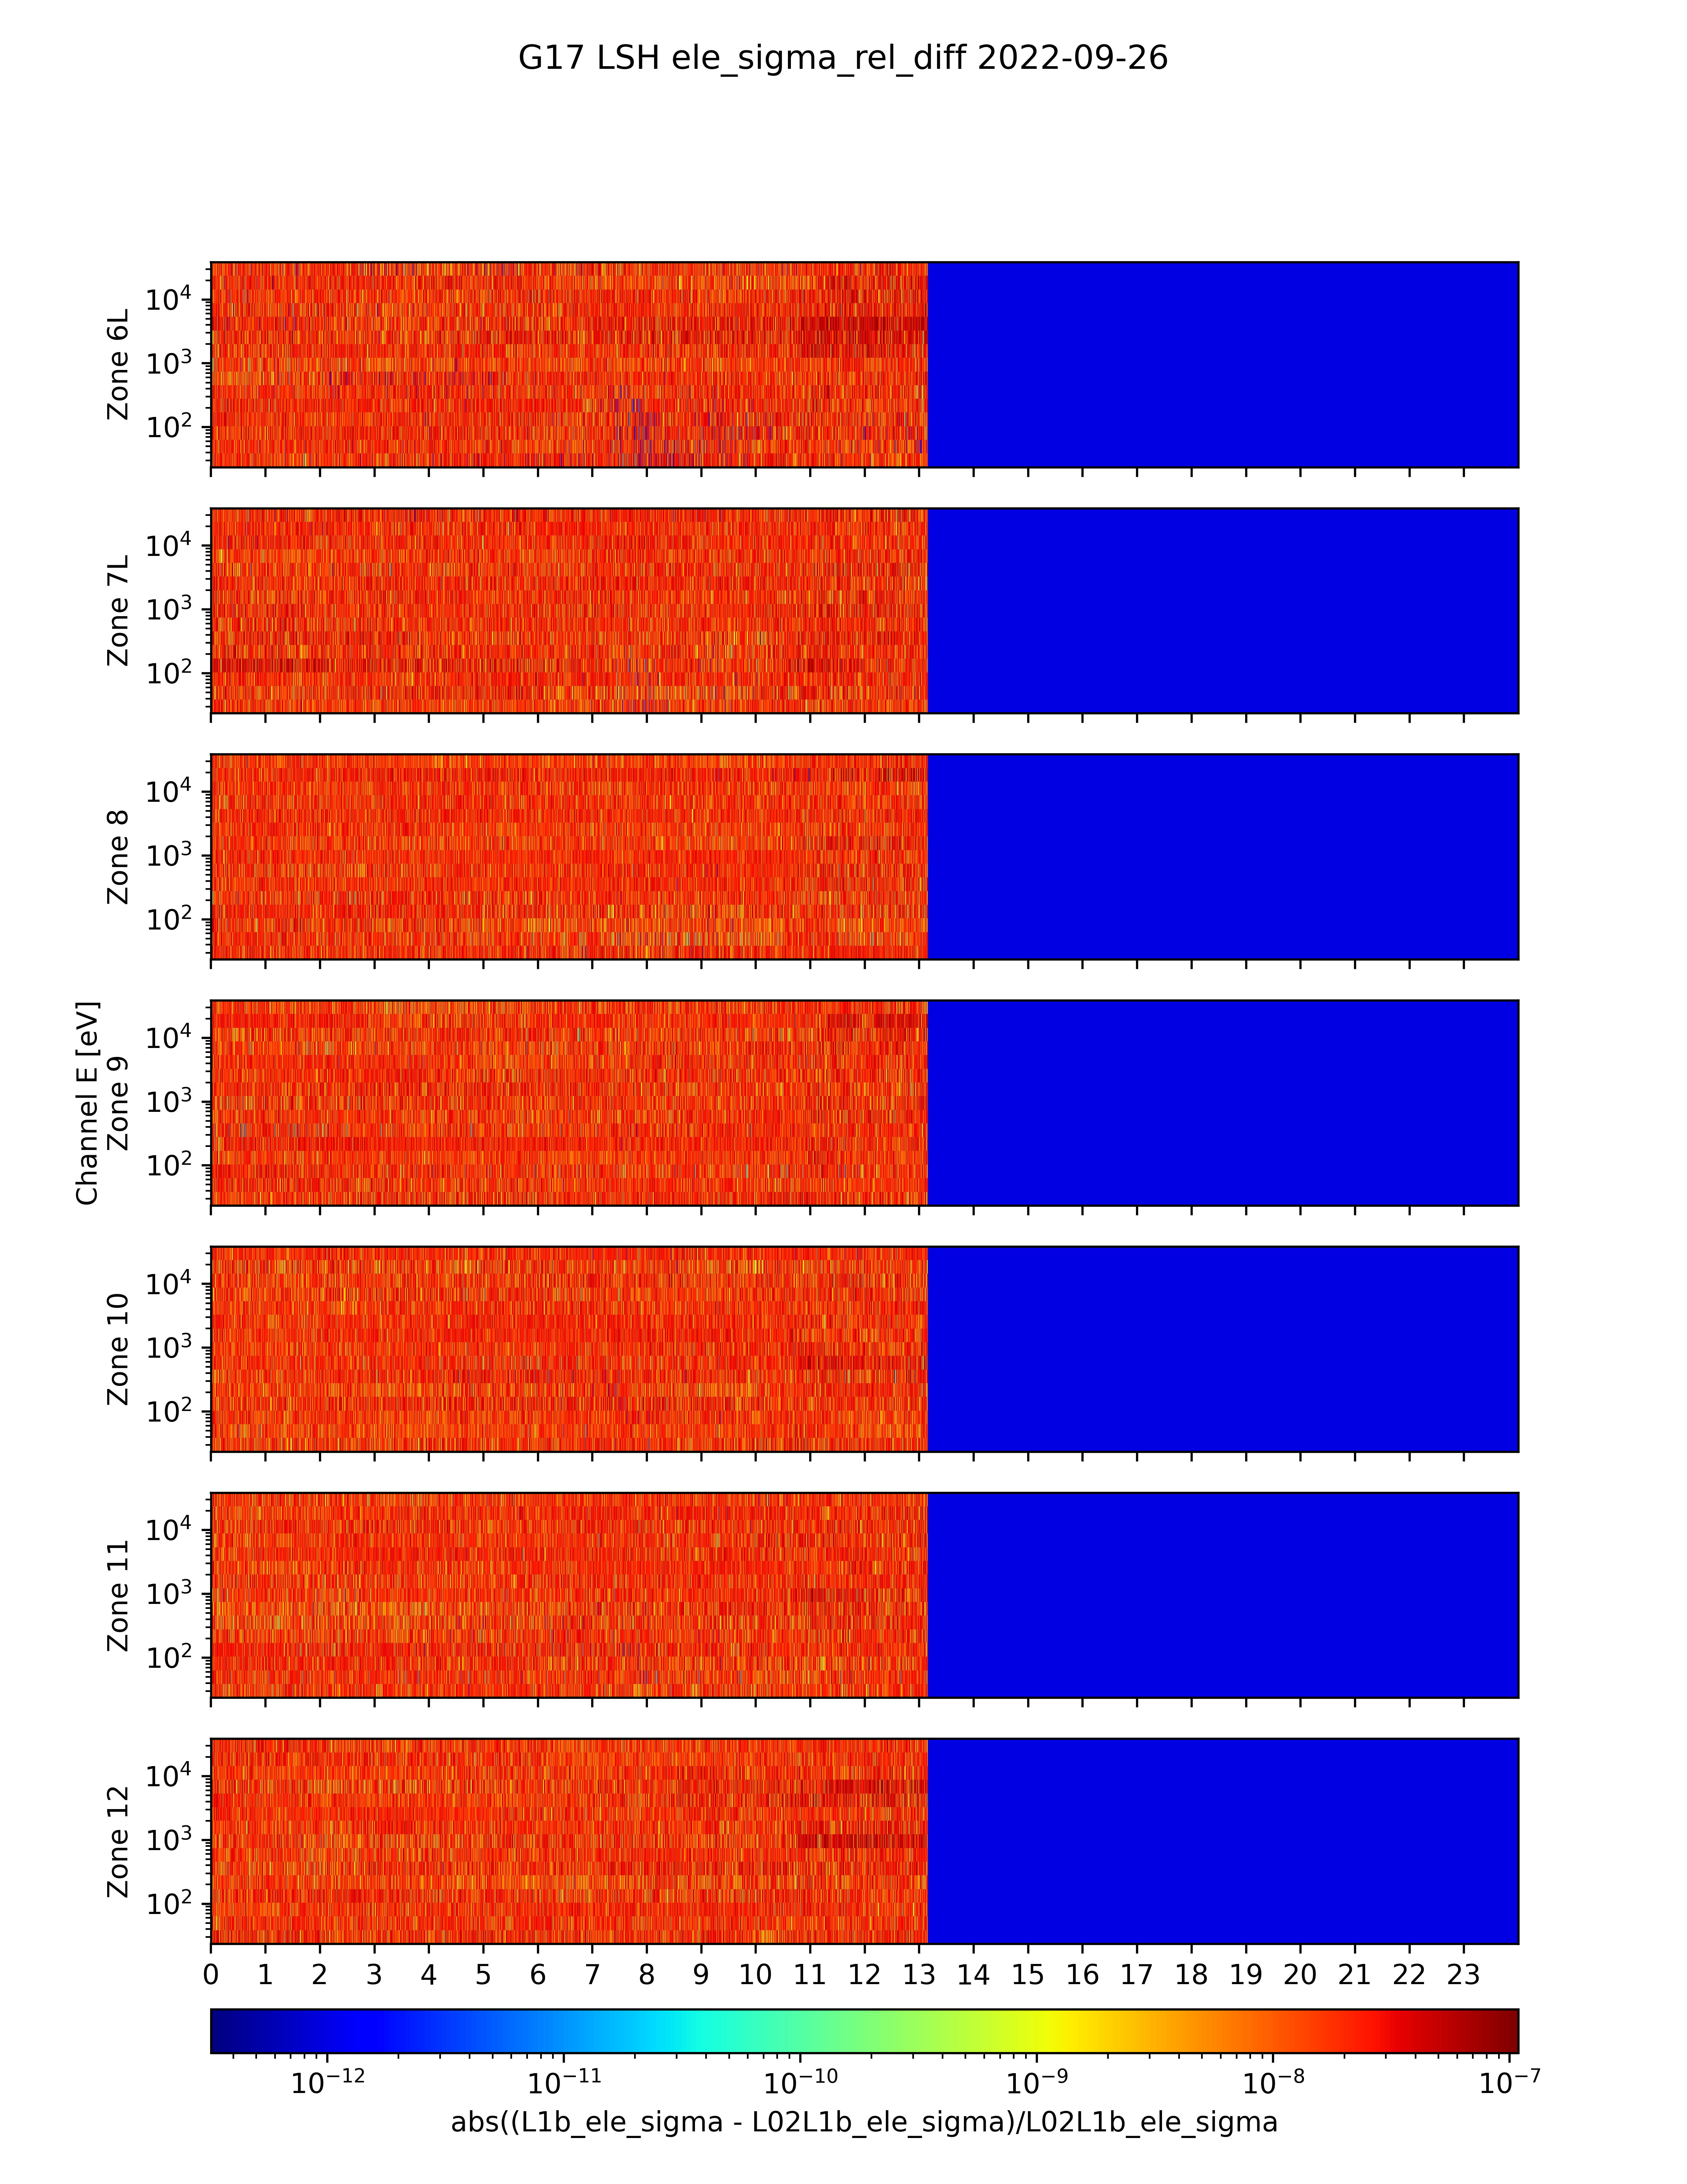
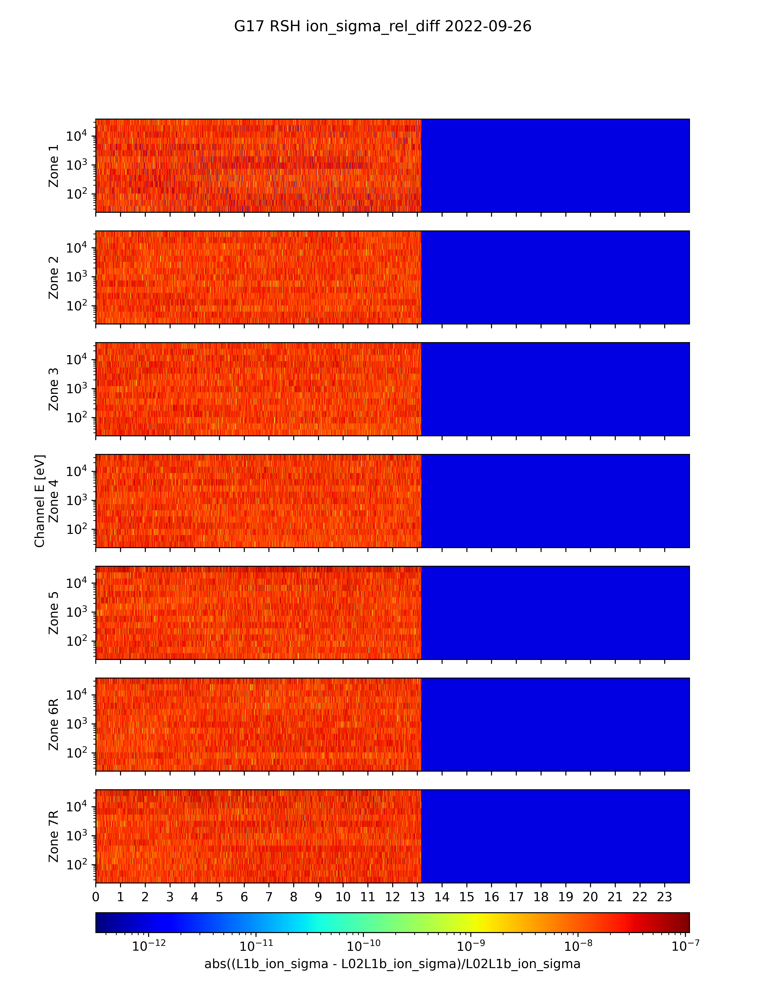
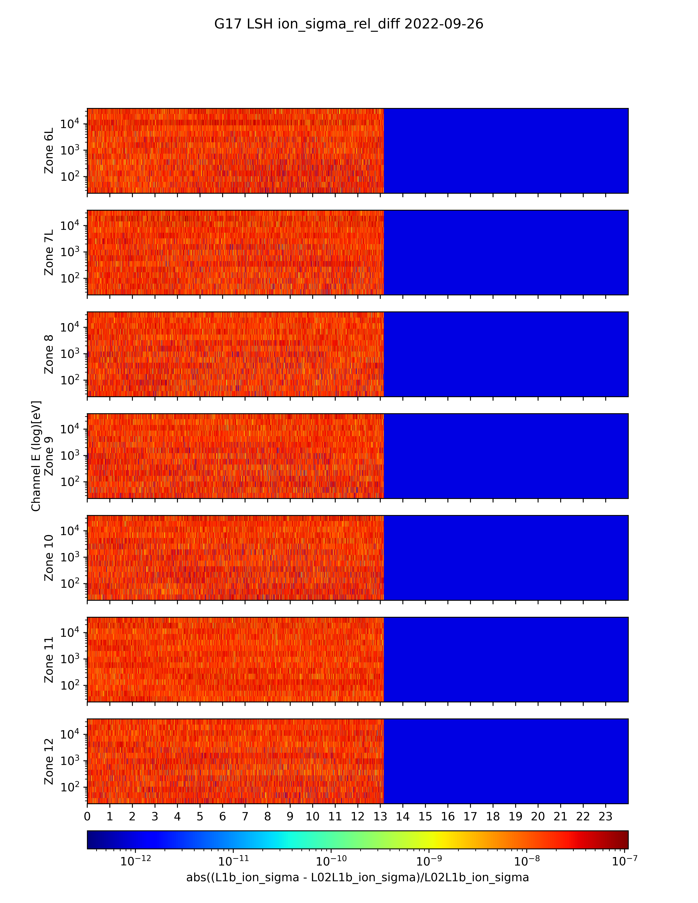
Example Verification of MPS-LO LUT
Update: ADR 1277
(L1b – NCEI_in-house_L0_to_L1b) / NCEI_in-house_L0_to_L1b
Left sensor head electrons
Right sensor head ions
Left sensor head ions
Right sensor head electrons
Verification of fluxes for ~13hrs of test data
Flux error term for R & L SH electrons and ions
Verification of flux error term
Rel. difference < 1.E-7 in all cases.
These GOES-19 data are preliminary, non-operational data and are undergoing testing. Users bear all responsibility for inspecting the data prior to use and for the manner in which the data are utilized.

Slide 27
G19 MPS-LO L1b Fluxes 2025/01/16
(Prior to implementation of ADR 1541 MPS-LO LUT Update)
Zones 1-7R Electrons Zones 6L-12 Electrons Zones 1-7R Ions Zones 6L-12 Ions
16.07% Negative Electron Fluxes 57.51% Negative Ion Fluxes
Negative flux (red pixels) are non-physical and due to excessive background subtraction:
Corrected counts = total counts – background counts
Addressed by ADR326/WR5860 MPS-Lo GPA Changes, in build DO.07.01.00, and with an updated LUT in ADR1541.
These GOES-19 data are preliminary, non-operational data and are undergoing testing. Users bear all responsibility for inspecting the data prior to use and for the manner in which the data are utilized.

Slide 28
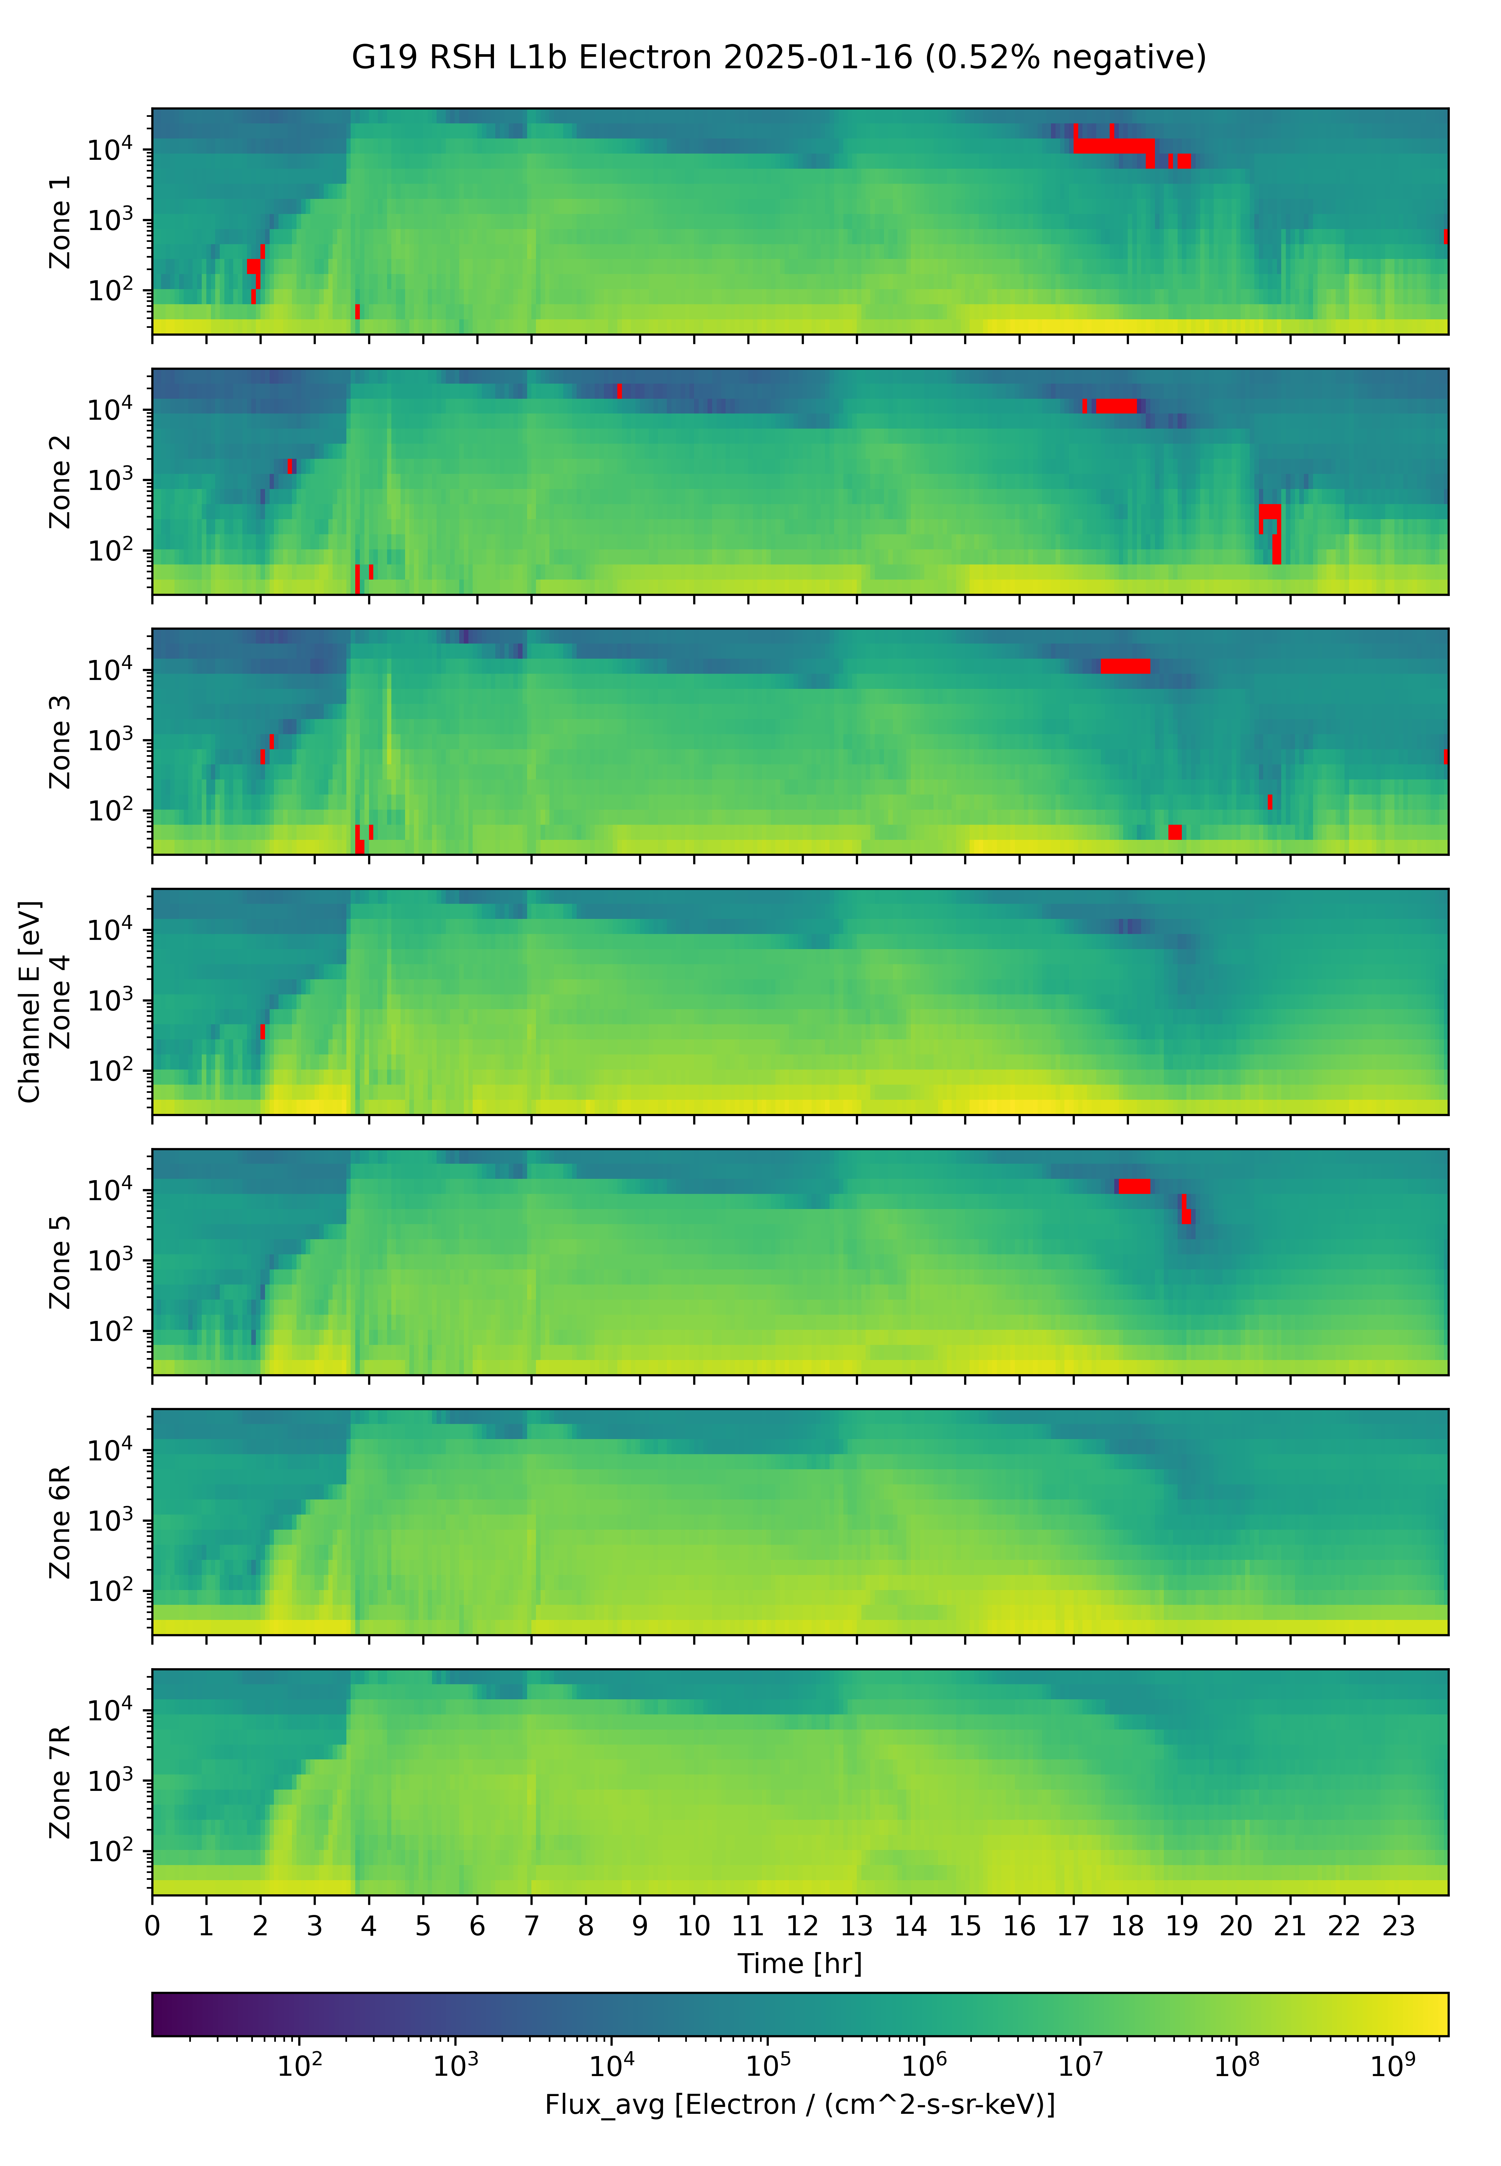
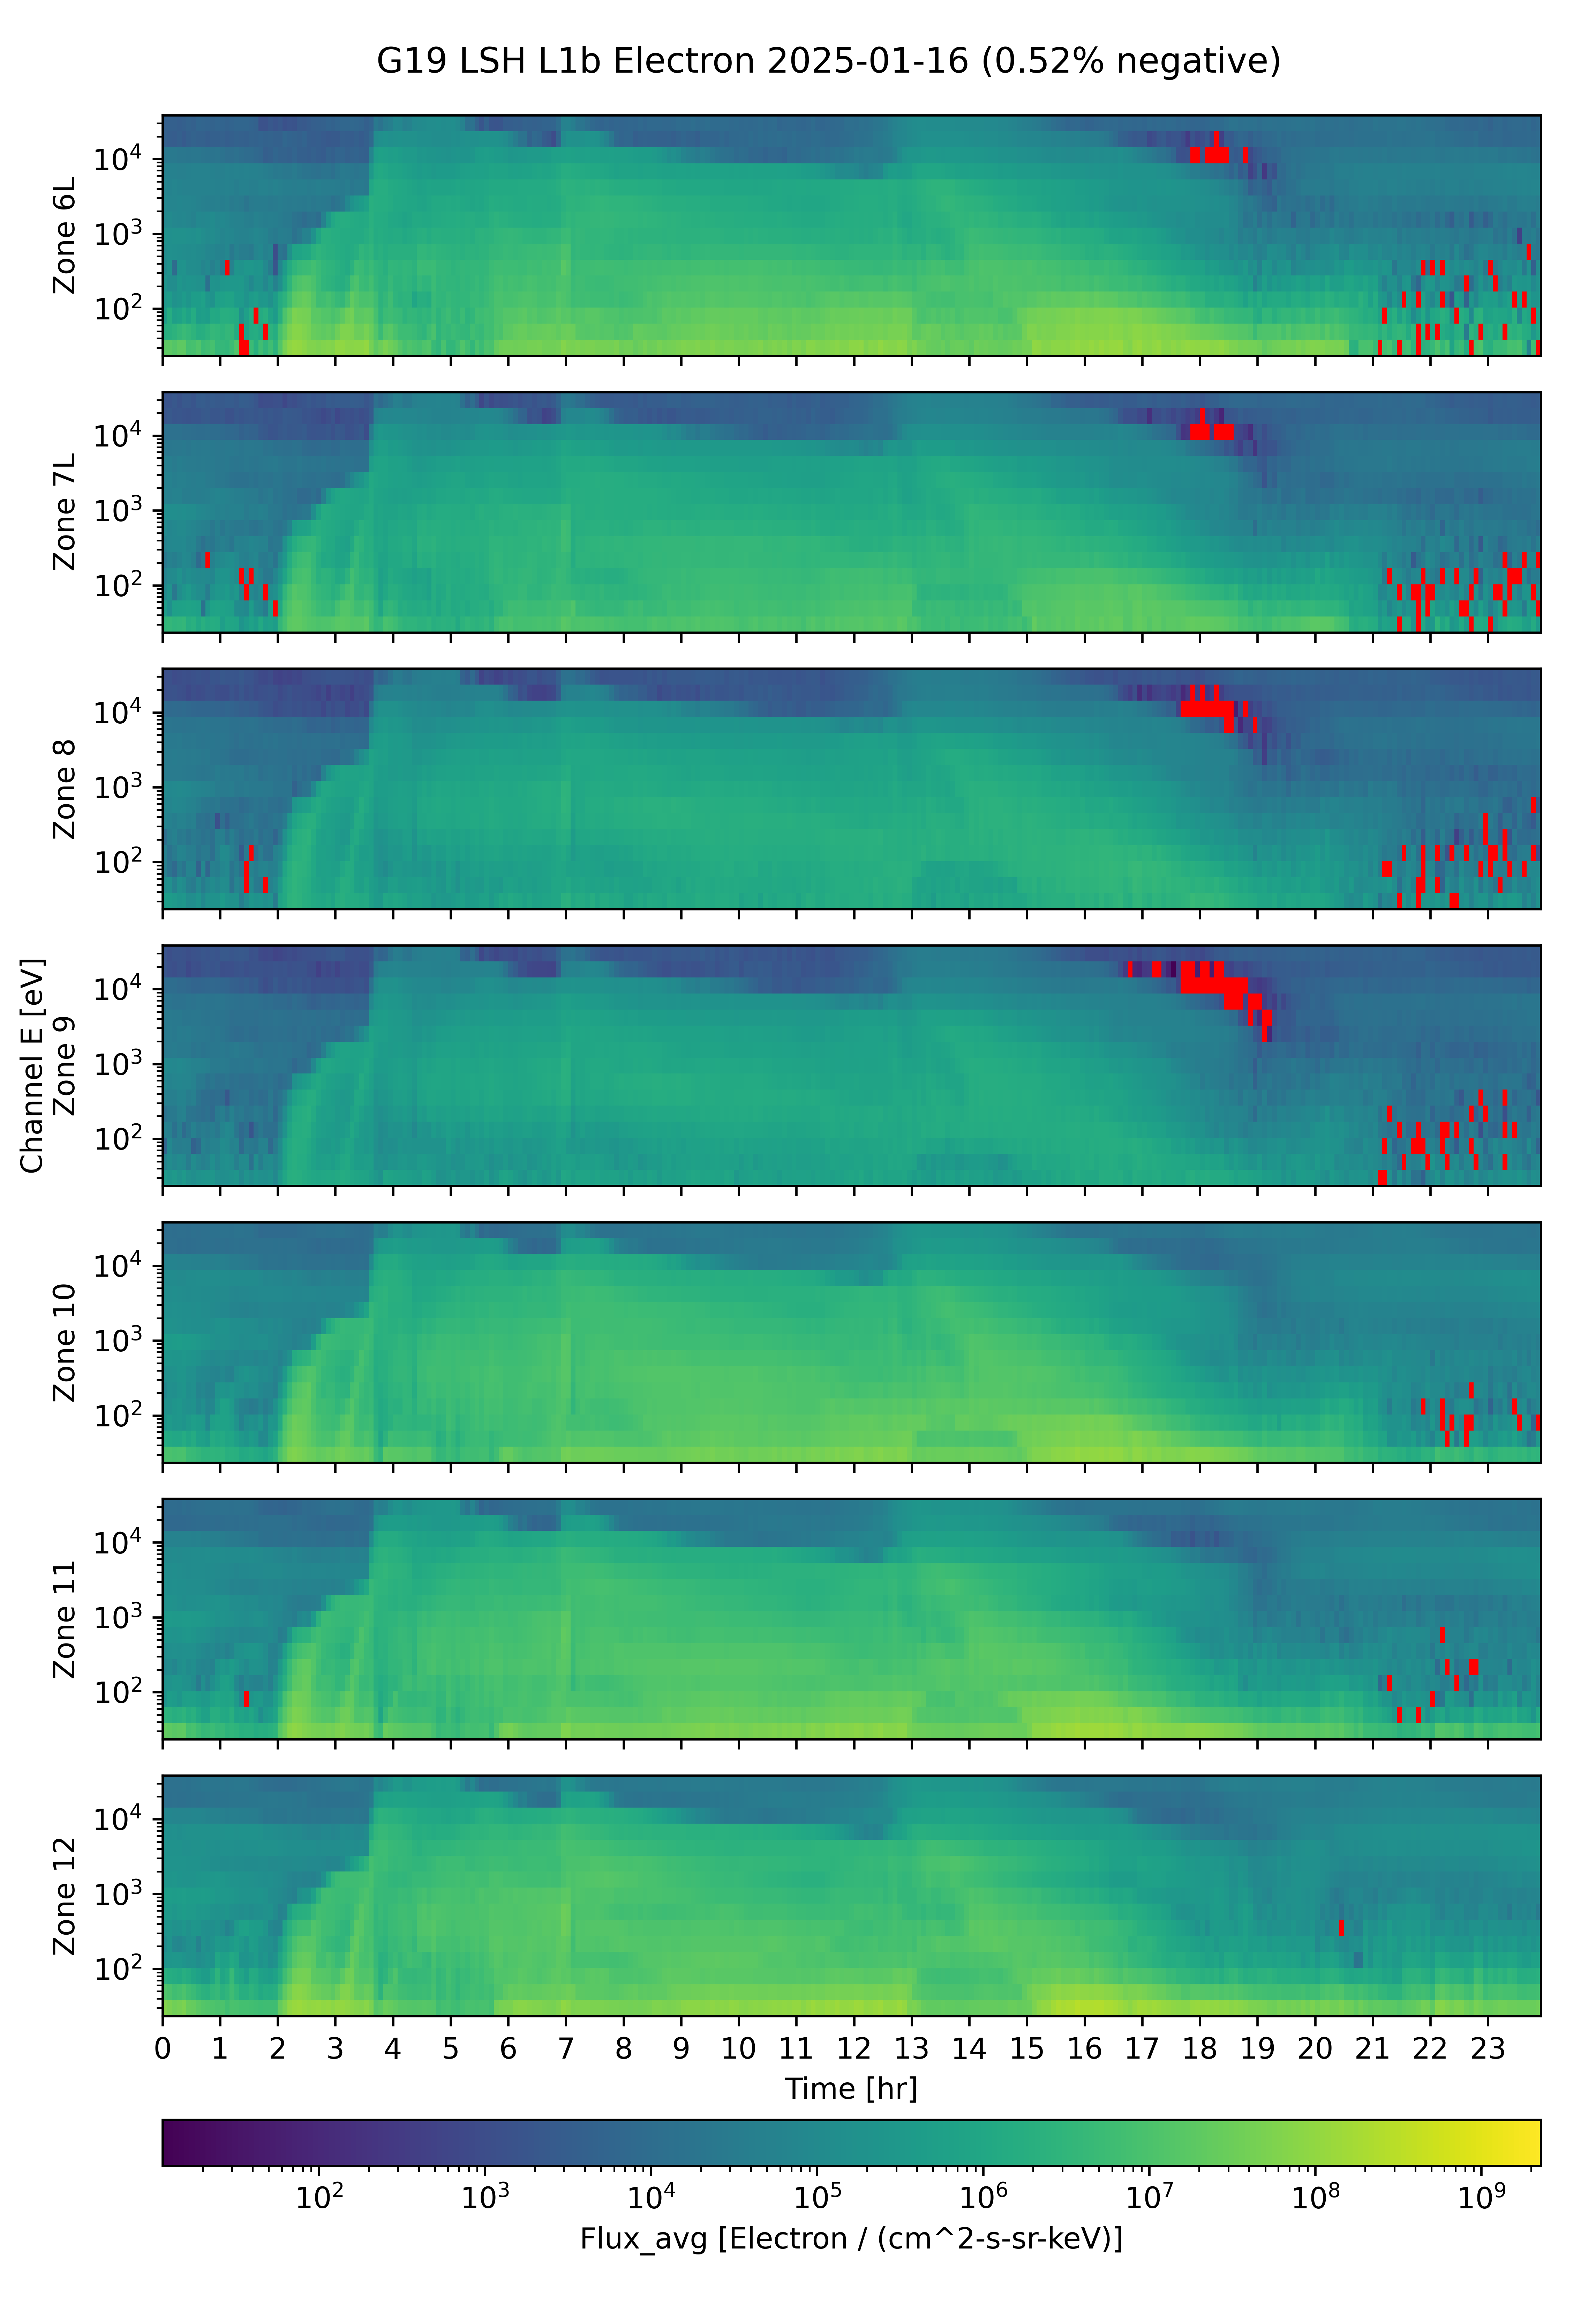
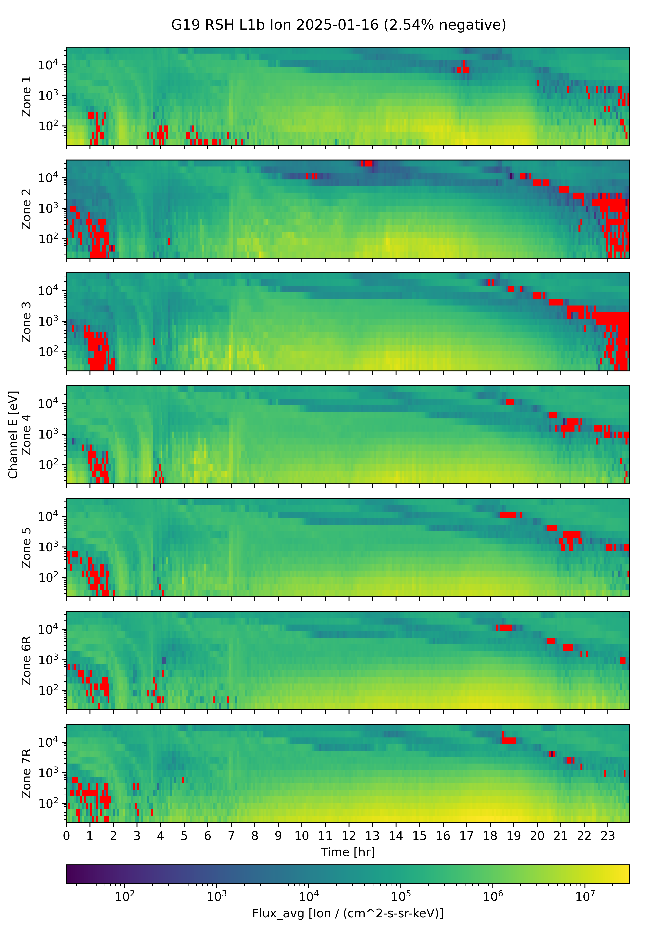
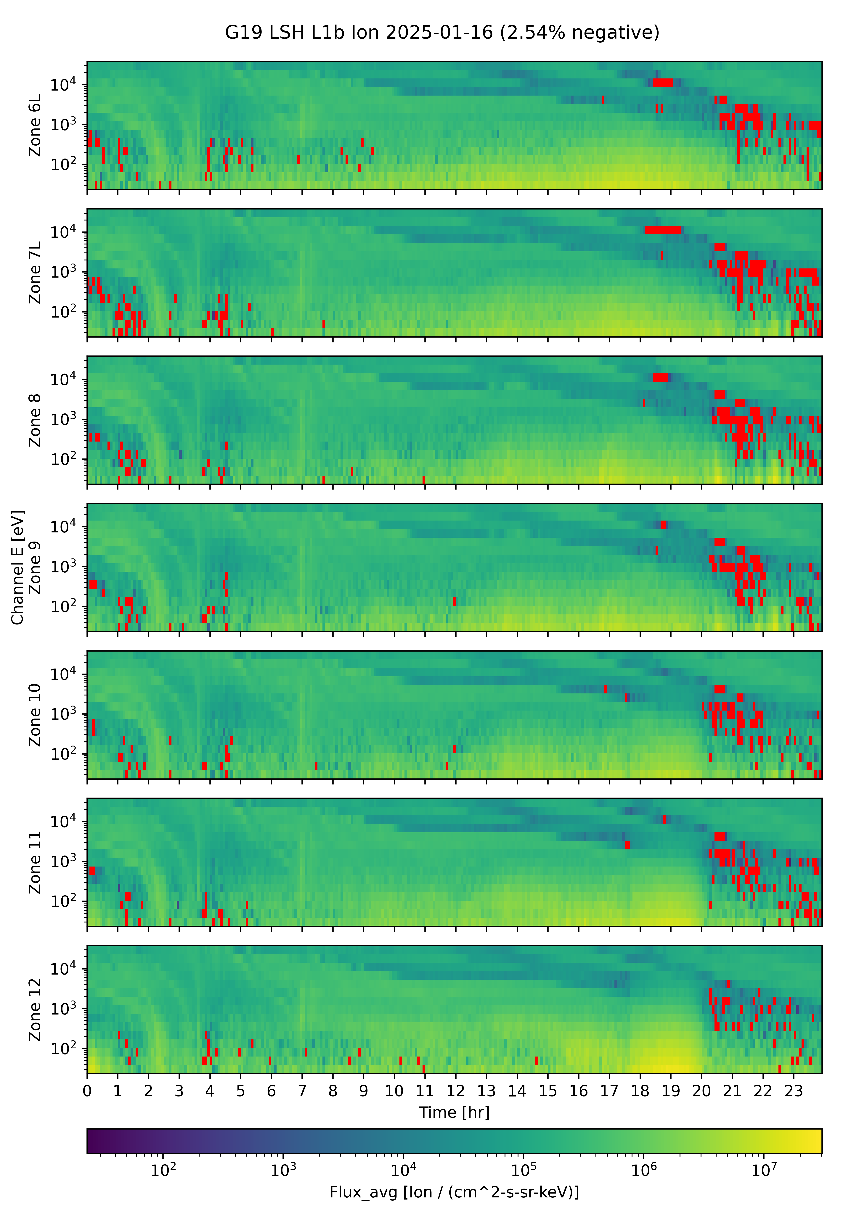
Expected Background Removal Update for 2025/01/16
(Expected after implementation of ADR 1541 MPS-LO LUT Update)
Zones 1-7R Electrons Zones 6L-12 Electrons Zones 1-7R Ions Zones 6L-12 Ions
0.52% Negative Electron Fluxes 2.54% Negative Ion Fluxes
Negative flux (red pixels) are non-physical and due to excessive background subtraction:
Corrected counts = total counts – background counts
Addressed by ADR326/WR5860 MPS-Lo GPA Changes, in build DO.07.01.00, and future LUT updates like ADR1541.
These GOES-19 data are preliminary, non-operational data and are undergoing testing. Users bear all responsibility for inspecting the data prior to use and for the manner in which the data are utilized.

Slide 29
Additional MPS-LO Anomalies
Interzonal Crosstalk
  Partial resolution on slide 27 of G16/G17 Full Validation PS-PVR
Effect of High Backgrounds on Low Energy Ions Measurement
  Low signal to noise instrument/environment issue – No L1b resolution.
Effect of Arc Jet Firing
  Resolved with ADR596
These GOES-19 data are preliminary, non-operational data and are undergoing testing. Users bear all responsibility for inspecting the data prior to use and for the manner in which the data are utilized.

Slide 30
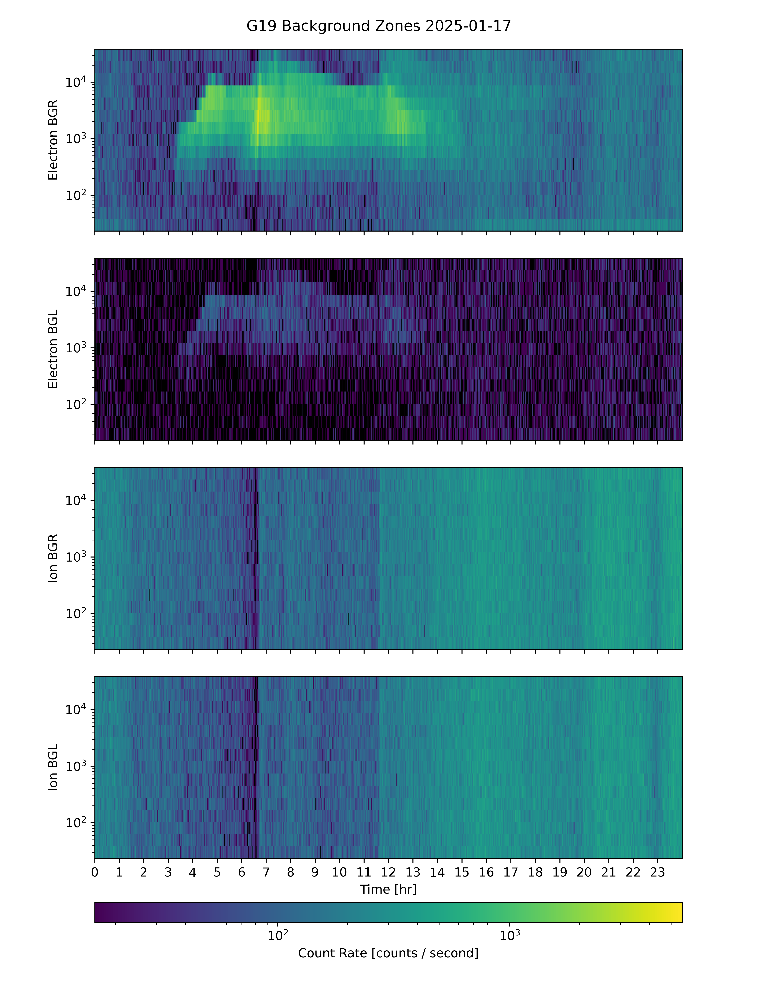
Crosstalk Between Zones Seen in G19 MPS-LO Background Zones
G19 MPS-LO Backgrounds 2025/01/17
Right sensor head
electron background zone
Crosstalk is apparent in energy-sweep dependent count rates in electron background zones in on-orbit data. (Counts from penetrating radiation/particles should be independent of energy-sweep.)
Energy-sweep dependent crosstalk from illuminated zones
Left sensor head
electron background zone
Right sensor head
ion background zone
Energy-sweep independent backgrounds from penetrating radiation
Left sensor head
ion background zone
These GOES-19 data are preliminary, non-operational data and are undergoing testing. Users bear all responsibility for inspecting the data prior to use and for the manner in which the data are utilized.

Slide 31
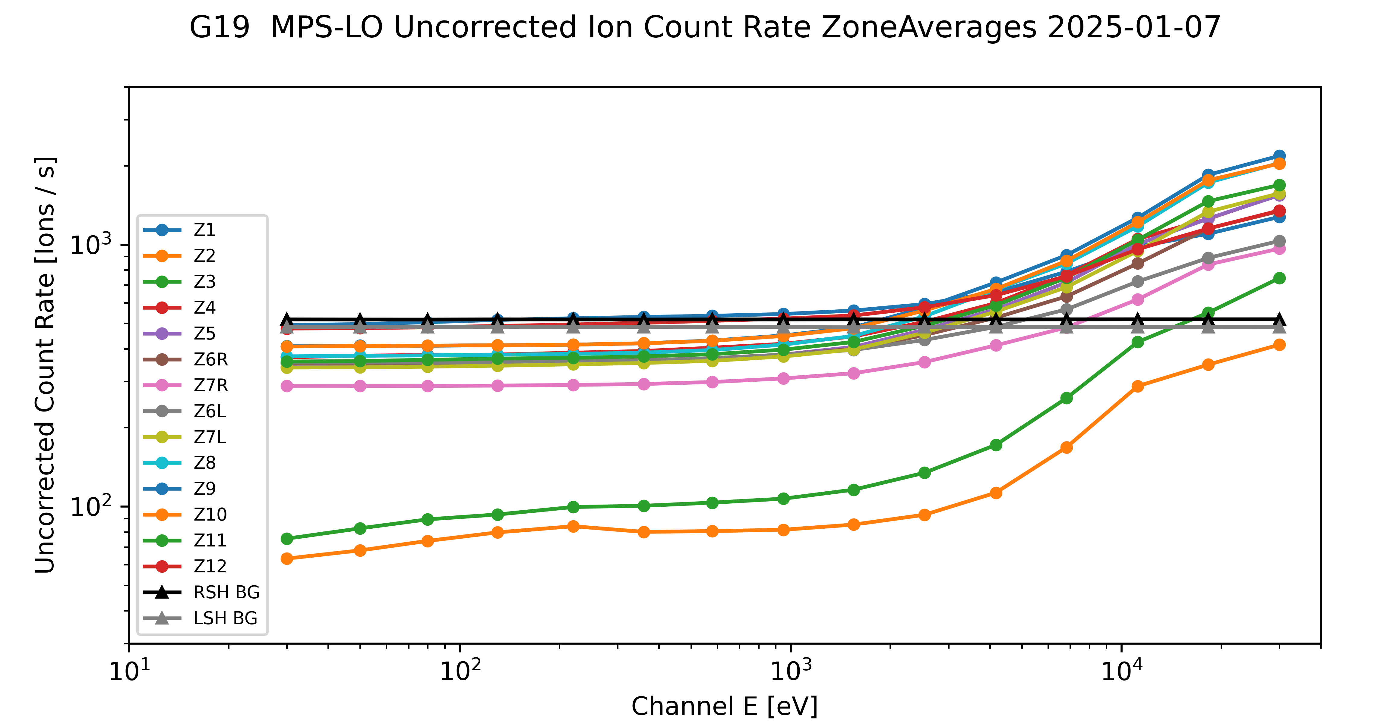
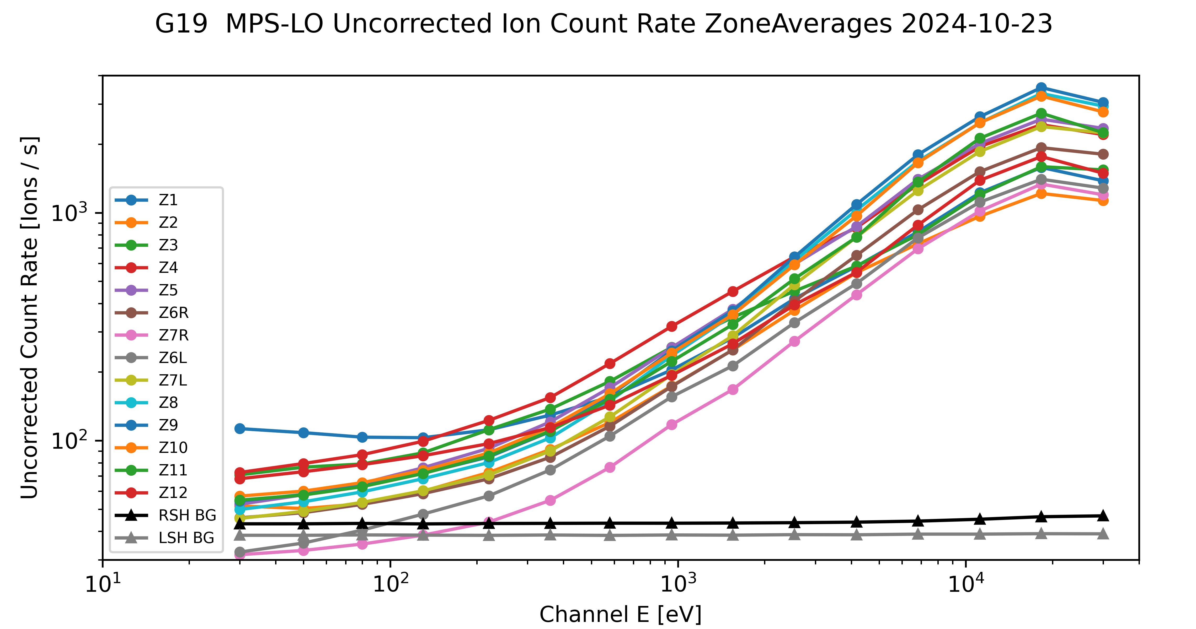
Effect of High Backgrounds on Low Energy Ions Measurement
High radiation belts
(high backgrounds)
Energy independent count rate at lower energies dominated by background counts.
Signal to background ratio low on days when backgrounds are high.
Similar result for all previous MPS-LO
This is an instrument issue due to unexpectedly high background rates. There is no known resolution.
Moderate geomagnetic storm day
(elevated ions)
These GOES-19 data are preliminary, non-operational data and are undergoing testing. Users bear all responsibility for inspecting the data prior to use and for the manner in which the data are utilized.

Slide 32
  MPS-LO Provisional Post Launch Product Tests (PLPTs)
GOES-19 MPS-LO L1b Product Provisional PS-PVR
These GOES-19 data are preliminary, non-operational data and are undergoing testing. Users bear all responsibility for inspecting the data prior to use and for the manner in which the data are utilized.

Slide 33
MPS-LO PLPTs Supporting Provisional Maturity
PLPT-SEI-003 MPS-Lo Zone Cross-Comparison
PLPT-SEI-005 Cross satellite Comparison of Trapped Particles
PLPT-SEI-006 Backgrounds Trending
* PLPTs performed using NCEI in-house L0 → L1b with updated background removal coefficient table submitted in ADR1541, which will soon be in the OE LUT.
These GOES-19 data are preliminary, non-operational data and are undergoing testing. Users bear all responsibility for inspecting the data prior to use and for the manner in which the data are utilized.

Slide 34
PLPT-SEI-003: MPS-LO Zone Cross-Comparison – Method (1/4)
Compares fluxes measured by pairs of MPS-LO angular zones when central pitch angles (α) are the same or supplementary.
Under such conditions, zones should observe the same flux at the same energy
Steps:
  Input 1-min MPS-LO fluxes and pitch angles calculated from MAG BRF
  Identify whenever a pair of zones has pitch angles within 1 degree and pitch angles varying more slowly than 30 deg/minute
  Use supplementary angles of pitch angles > 90 degrees to have sufficient matches (assumes up- and down-going trapped fluxes are the same on a 1-minute timescale)
  Report observed fluxes for each pitch angle match
  Estimate scaling factors optimally based on set of all matches
B (magnetic field dir.)
Zone A look dir.
α
B
α
α
OR
α+90º
Zone A look dir.
Zone B look dir.
Zone B look dir.
Ref: Rowland, W., and R. S. Weigel (2012), Intra-calibration of particle detectors on a three-axis stabilized geostationary platform, Space Weather, 10, S11002, doi:10.1029/2012SW000816.
These GOES-19 data are preliminary, non-operational data and are undergoing testing. Users bear all responsibility for inspecting the data prior to use and for the manner in which the data are utilized.

Slide 35
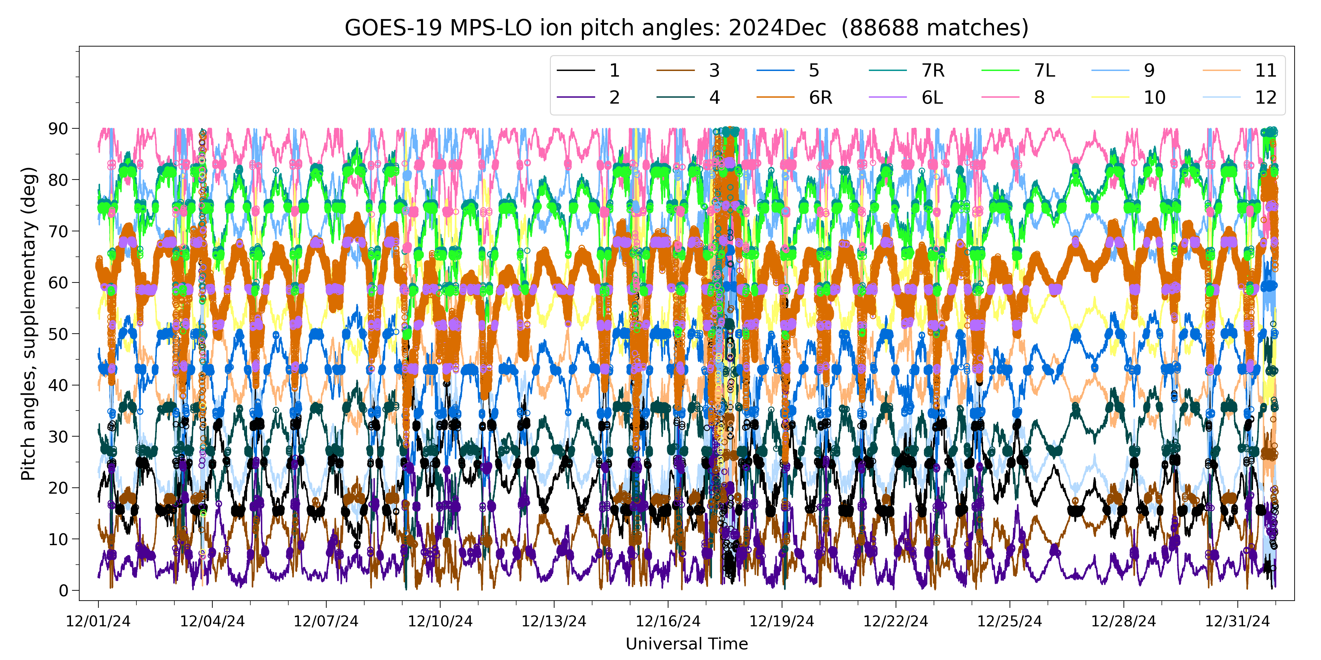
PLPT-SEI-003 – Method (2/4)
Example: Ion Pitch Angles, December 2024 (supplementary angles of p.a. > 90 deg)
90°
Zone
60°
30°
0°
Dots indicate pitch angle matches
1,000-10,000 matches per month per energy-zone pair
These GOES-19 data are preliminary, non-operational data and are undergoing testing. Users bear all responsibility for inspecting the data prior to use and for the manner in which the data are utilized.

Slide 36

PLPT-SEI-003 – Method (3/4)
Use Nelder-Mead method to minimize the following objective function: sum of squares of the following difference term (~30k terms [matches] in the sum per energy)
To reduce effect of statistical noise, use only matches where both fluxes correspond to at least 1000 counts/minute
A non-linear problem: need a good initial guess for the scale factors in order for the solution to converge
  1000-6000 iterations needed, depending on the energy and species
  2.5 (4.3) hours needed for three months, 14 zones, 15 energies of ions (electrons) on macOS 2.4 GHz 8-Core Intel Core i9
Because they are only valid in a relative sense, scale factors must be normalized – here, normalized to those of Zone 8 (arbitrary choice)
$$R\left(m\right)=\frac{{SF}_{i}\left(m\right)J_{i}\left(m\right)−{SF}_{j}\left(m\right)J_{j}\left(m\right)}{{SF}_{i}\left(m\right)J_{i}\left(m\right)+{SF}_{j}\left(m\right)J_{j}\left(m\right)}$$
Ref: Rowland, W., and R. S. Weigel (2012), Intra-calibration of particle detectors on a three-axis stabilized geostationary platform, Space Weather, 10, S11002, doi:10.1029/2012SW000816.
These GOES-19 data are preliminary, non-operational data and are undergoing testing. Users bear all responsibility for inspecting the data prior to use and for the manner in which the data are utilized.

Slide 37
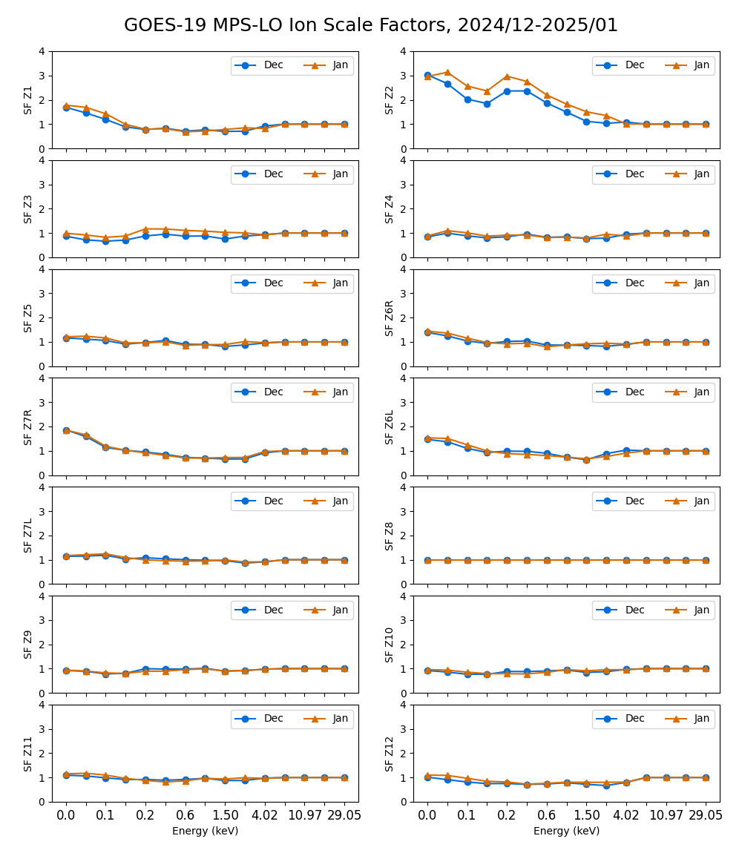
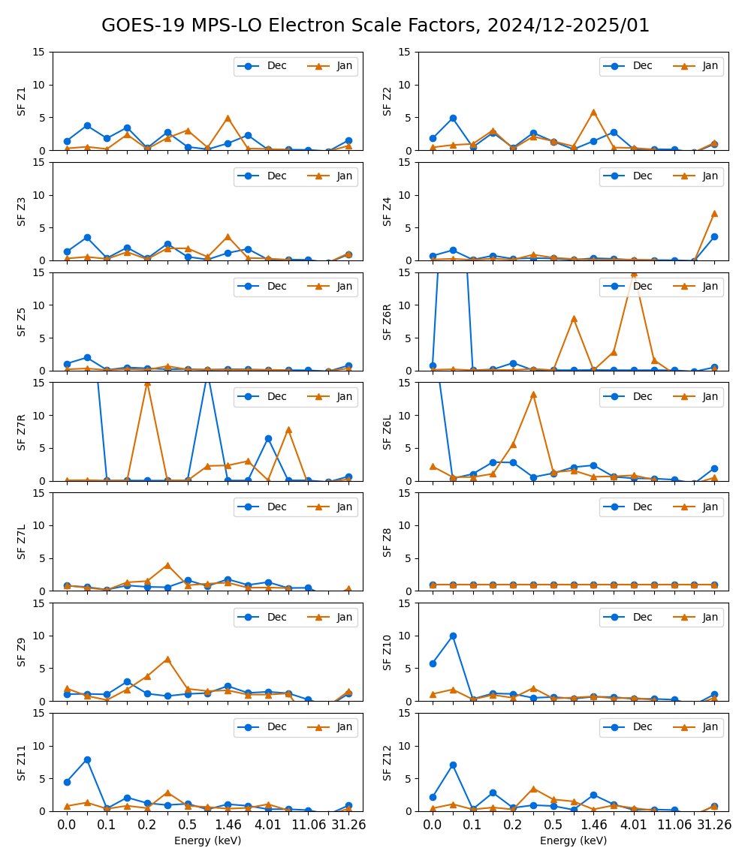
PLPT-SEI-003 – Scale Factor Results (4/4)
Multiplicative scale factors plotted vs. energy channel for each zone
Marginal consistency month-to-month indicates need to do this on a monthly basis
Scaling of up to an order of magnitude needed for some zone-energy channels.
These GOES-19 data are preliminary, non-operational data and are undergoing testing. Users bear all responsibility for inspecting the data prior to use and for the manner in which the data are utilized.

Slide 38
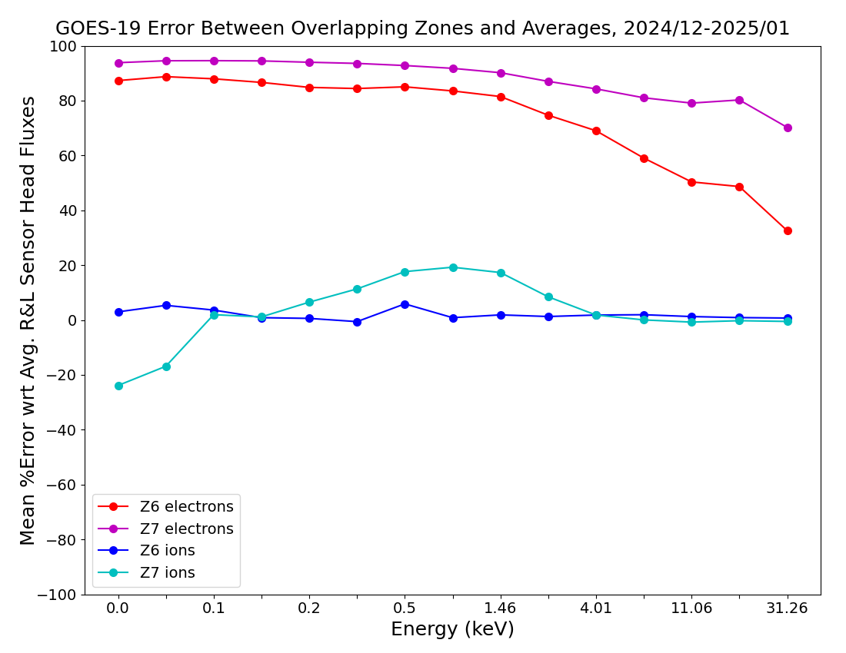
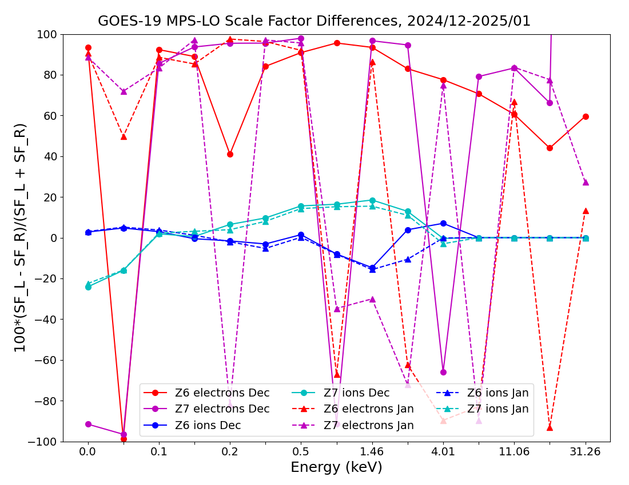
PLPT-SEI-003 – Overlapping Zones Comparison (Z6R/Z6L and Z7R/Z7L)
2-month mean of error of each overlapping zone with respect to average of overlapping pair
Error computed from Z6 and Z7 scale factors
determined with method described on previous slides
Using 2 months of 1 min. averaged fluxes, the percent error with respect to the avg. of the overlapping pair is calculated for each 1m sample (i.e., we split the difference, thus errors associated with the 2 overlapping zones are the same). Then, the mean value of errors from 2 months of 1 min. averages is calculated.
The error computed by comparing fluxes from overlapping zones (left figure) is in close agreement with error computed from the scale factors obtained by minimizing error associated with cross comparisons of all zones described on previous slides (right figure), showing verification of results by an independent method.
Partial pass
These GOES-19 data are preliminary, non-operational data and are undergoing testing. Users bear all responsibility for inspecting the data prior to use and for the manner in which the data are utilized.

Slide 39
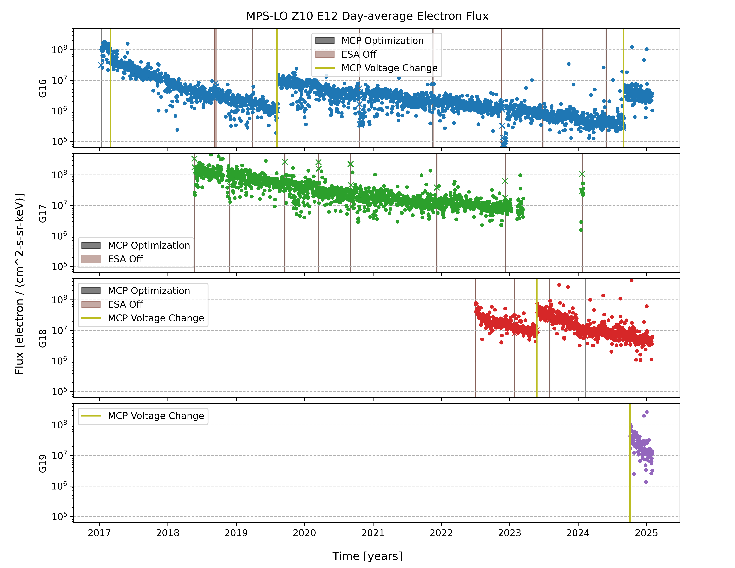
PLPT-SEI-005: Cross Satellite Comparison of Trapped Particles
Comparison of G16, G17, G18, & G19 MPS-LO Z10 E12 Fluxes
Long term trending of day-averaged MPS-LO fluxes show steady non-geophysical decline.
Similar orders-of-magnitude decline is seen in all electron zone-energy channels.
Ion zone-energy channels show significantly less decline (420 analogous ion and electron flux plots created, available on request).
Steady decline in MPS-LO response since launch makes cross-comparison analysis ineffective.
These GOES-19 data are preliminary, non-operational data and are undergoing testing. Users bear all responsibility for inspecting the data prior to use and for the manner in which the data are utilized.

Slide 40
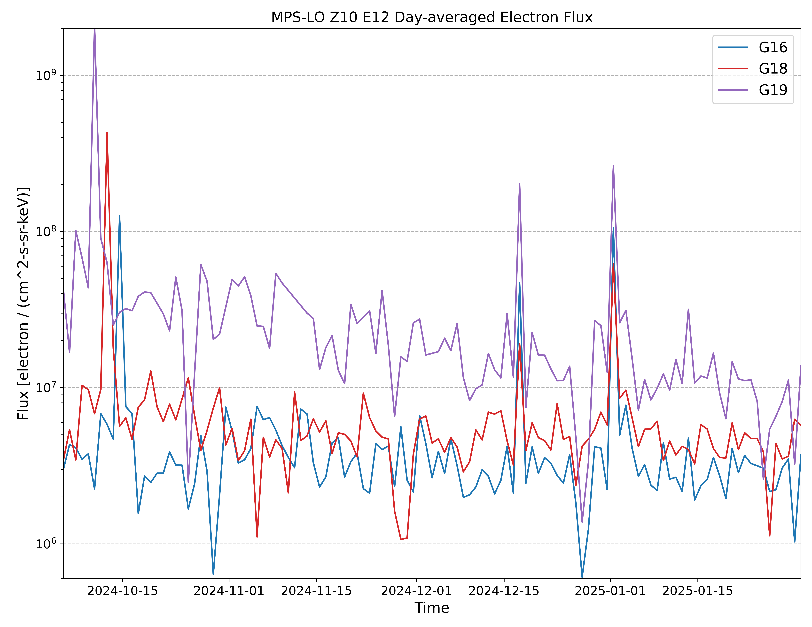
PLPT-SEI-005: Cross Satellite Comparison of Trapped Particles
G16, G17, G18, & G19 MPS-LO Z10 E12 Electron Fluxes
Note similar variations in G16 and G19 MPS-LO Z10 E12 fluxes, but G19 fluxes have decreased by about an order of magnitude and currently greater than G16 fluxes
These GOES-19 data are preliminary, non-operational data and are undergoing testing. Users bear all responsibility for inspecting the data prior to use and for the manner in which the data are utilized.

Slide 41
PLPT-SEI-005: Cross Satellite Comparison of Trapped Particles: Summary
Previously: G16 & G17 MPS-LO Statistical Comparisons with Denton et al. [2015; 2016] model, based on 1990-2007 observations from the MPA instruments on-board seven Los Alamos National Laboratory (LANL) satellites at GEO (e.g., G16/G17 Full Validation PS-PVR, slides 45 & 46).
Geophysically different eV-keV ion and electron flux levels at GOES east and west locations make direct comparisons between MPS-LO units ineffective for determining relative responses.
Proximity of G16 and G19 warrant direct comparisons; however, decline in MCP gain in all MPS-LO units since launch (seen on previous slide) make G16 and G19 MPS-LO cross-comparison analysis ineffective.
Corrections for decline in MCP gain are under development at NCEI.
Success criteria (RIMP): Differences quantified on data taken through validation phase.
Partial pass
These GOES-19 data are preliminary, non-operational data and are undergoing testing. Users bear all responsibility for inspecting the data prior to use and for the manner in which the data are utilized.

Slide 42
PLPT-SEI-006:
Backgrounds Trending
Extensive analysis of G19 MPS-LO backgrounds were performed for empirical determination of G19 MPS-LO background removal coefficients.
Ratio of G19 MPS-LO in-band to background response characterized with determination of background removal coefficients.
As shown in previous MPS-LO PS-PVR, the source of backgrounds is not fully understood (mainly radiation belt electrons, but at lower energies than expected).
  Simulations show that penetration of MPS-LO box by electrons should be limited >=MeV energies.
  There is good correlation between MPS-LO backgrounds and 100s of keV electrons (400-800 keV).
In general, in-band and background zone responses have been gradually decreasing since launch (e.g., slide 39).
Pass
These GOES-19 data are preliminary, non-operational data and are undergoing testing. Users bear all responsibility for inspecting the data prior to use and for the manner in which the data are utilized.

Slide 43
PROVISIONAL MATURITY ASSESSMENT
GOES-19 MPS-LO L1b Product Provisional PS-PVR
These GOES-19 data are preliminary, non-operational data and are undergoing testing. Users bear all responsibility for inspecting the data prior to use and for the manner in which the data are utilized.

Slide 44
Summary of G19 MPS-LO Instrument/GPA Issues Identified and Resolution Status
High Backgrounds / Negative Fluxes
    Resolution: ADR 326 MPS-LO GPA Changes, ADR 1277 G19 MPS-LO LUT update, and empirical derivation of background removal coefficients by NCEI.
    Items above are completed, but background removal coefficients will need additional updates.
Interzonal crosstalk
    Observed on-orbit with G16, G17, and now G19 MPS-LO.
    MPS-LO HV optimized to reduce crosstalk but a complete solution is not currently available.
Mitigating the effect of arc jet firing in operation – ADR 596
Evidence for significant error in absolute values of reported fluxes (e.g., PLPT-SEI-003: MPS-LO Zone Cross-Comparison and PLPT-SEI-005: Cross Satellite Comparison of Trapped Particles) – Geometric factors may need adjustment.
    MCP decline has a significant impact on absolute values of reported fluxes.
These GOES-19 data are preliminary, non-operational data and are undergoing testing. Users bear all responsibility for inspecting the data prior to use and for the manner in which the data are utilized.

Slide 45
GOES-19 MPS-LO
Performance Baseline Status
Assessment at Provisional
MRD ID | Description | MRD Requirement | MIT/LL Predicted Performance Baseline | NCEI Assessment at Provisional | Related PLPTs | Status
1987 | MPS-LO Orthogonality/ Coverage | 5 directions | 14 directions (zones) | 14 directions (zones) | -03 | PASS
1991 | MPS-LO Measurement Range | 30 eV – 30 keV (protons and electrons) | 30 eV – 30 keV | 0.025-30.8 keV (electrons) 0.030-30.0 keV/q (ions) [values from CDRL79] | -05 | PASS
1992 | MPS-LO Measurement Accuracy | 45% @min flux, 25% @10X min flux | 420 separate accuracies (2 species x 14 angles x 15 energies); Worst case for 10x min flux: Electrons: 23%; Ions: 20% Worst case for min flux: Electrons: 40%; Ions: 38% | Absolute accuracy cannot be verified on-orbit. Results of PLPT-03 and factor of ~5 decline in MCP response (in some zones) indicate that 25% relative accuracy not currently achieved on-orbit. | -03, -05, -06 | Results of PLPT-03, 05 and 06 will need to be applied
These GOES-19 data are preliminary, non-operational data and are undergoing testing. Users bear all responsibility for inspecting the data prior to use and for the manner in which the data are utilized.

Slide 46
Provisional Validation
Preparation Activities | Assessment
Validation activities are ongoing and the general research community is now encouraged to participate. | Validation activities are ongoing. Release of data by NCEI will enable research community participation.
Severe algorithm anomalies are identified and under analysis. Solutions to anomalies are in development and testing. | Continued analysis and updates of the NCEI empirical background removal coefficients.
Incremental product improvements may still be occurring. | Product improvements will result from steps to mitigate known (on previous chart) and any yet to be discovered anomalies.
These GOES-19 data are preliminary, non-operational data and are undergoing testing. Users bear all responsibility for inspecting the data prior to use and for the manner in which the data are utilized.

Slide 47
Provisional Validation
End State | Assessment
Product performance has been demonstrated through analysis of independent measurements obtained from select locations, periods, and associated ground truth or field campaign efforts. | G19/FM4/SN103 MPS-LO ground/beam calibrated. Performance tests included in provisional PLPT results
Product analysis is sufficient to communicate product performance to users relative to expectations (Performance Baseline). | Yes, to the limited extent that absolute accuracy can be verified on-orbit.
Documentation of product performance exists that includes recommended remediation strategies for all anomalies and weaknesses. Any algorithm changes associated with severe anomalies have been documented, implemented, tested, and shared with the user community. | A complete description of known anomalies will be included in readme file with release of data to public.
Testing has been fully documented. | In this presentation and supplemental materials.
Product is ready for operational use and for use in comprehensive cal/val activities and product optimization. | Readiness for operational use at provisional PS-PVR review.
These GOES-19 data are preliminary, non-operational data and are undergoing testing. Users bear all responsibility for inspecting the data prior to use and for the manner in which the data are utilized.

Slide 48
PATH TO FULL VALIDATION MATURITY
GOES-19 MPS-LO L1b Product Provisional PS-PVR
These GOES-19 data are preliminary, non-operational data and are undergoing testing. Users bear all responsibility for inspecting the data prior to use and for the manner in which the data are utilized.

Slide 49
Path to Full Validation
PLPTs to be conducted prior to Full Validation.
Risks to getting to Full, both from L1b product definition and user (SWPC) feedback
These GOES-19 data are preliminary, non-operational data and are undergoing testing. Users bear all responsibility for inspecting the data prior to use and for the manner in which the data are utilized.

Slide 50
Path to Full Validation - PLPTs
Title | Activity | Data Needed | Success Criteria
A.3.3 MPS-LO Zone Cross-Comparison [PLPT-SEI-003] | Evaluate PADs, determine relative sensitivity/response among MPS-LO zones, and calculate inter-calibration factors for Z6L/Z6R and Z7L/Z7R for all 15 energies and for both electrons and ions. | Three months of continuous data. | Zones agree to within 25% absent spacecraft charging similar to or greater than channel energy.
A.3.5 Cross Satellite Comparison of Trapped Particles [PLPT-SEI-005] | Inter-calibrate MPS-LO with the same measurements on other operational GOES-R Series satellites. | Three months of continuous data. | Differences quantified on data taken through validation phase.
A.3.6 Backgrounds Trending [PLPT-SEI-006] | Trend daily/weekly minima from MPS-LO ion and electron background zones | Four months of continuous data. | If dark noise can be observed above natural backgrounds, decreases with time.
MPS-LO Provisional PLPTs from RIMP v 2.0 (09 July 2021)
These GOES-19 data are preliminary, non-operational data and are undergoing testing. Users bear all responsibility for inspecting the data prior to use and for the manner in which the data are utilized.

Slide 51
Path to Full Validation – Risks
Risk Name | Description | Impact | Mitigation and Schedule
High Backgrounds / Negative Fluxes | Higher than expected backgrounds results negative (background subtracted) fluxes in L1b. | Degrades accuracy of reported fluxes. | Addressed by ADR 326 MPS-LO GPA Changes, ADR 1277 G19 MPS-LO LUT Update, and empirical derivation of background removal coefficients. Background removal coefficients will need to be periodically updated.
G19/FM4 Crosstalk | Interzonal crosstalk observed in background count rates on-orbit. | May introduce up to 10% error in fluxes (severity dependent on HV setting). | G19 MPS-LO HV optimized to reduce crosstalk but a complete solution is not currently available.
Significant error in absolute values of reported fluxes. | Evidence for significant error in absolute values of reported fluxes from Provisional PLPT results. | Reported fluxes up to an order of magnitude in error - Severely degrades operational and science quality of data. | Full validation PLPTs PLPT-SEI-003 MPS-LO Zone Cross-Comparison and PLPT-SEI-005 Cross satellite Comparison of Trapped Particles, and full assessment of changes in MCP response will provide necessary scaling of geometric factors to be included in future LUT updates.
These GOES-19 data are preliminary, non-operational data and are undergoing testing. Users bear all responsibility for inspecting the data prior to use and for the manner in which the data are utilized.

Slide 52
SUMMARY & RECOMMENDATIONS
GOES-19 MPS-LO L1b Products Provisional PS-PVR
These GOES-19 data are preliminary, non-operational data and are undergoing testing. Users bear all responsibility for inspecting the data prior to use and for the manner in which the data are utilized.

Slide 53
Summary
The G19/FM4 MPS-LO anomalies identified that negatively impact performance are
  High Backgrounds / Negative Fluxes – Addressed by ADR 326 MPS-LO GPA Changes, ADR 1541 G19 MPS-LO LUT Update, and empirical derivation of background removal coefficients by NCEI. Background removal coefficients will need additional updates.
  Interzonal Crosstalk – Observed in energy-dependent background count rates on-orbit.
  Evidence for significant error in absolute values of reported fluxes (e.g., PLPT-SEI-003: MPS-LO Zone Cross-Comparison and PLPT-SEI-005 Cross satellite Comparison of Trapped Particles) – Geometric factors will need periodic adjustment.
MPS-LO uses the ion-line to identify SC charging and quantify the level of charging. If an ion line is not present, MPS-LO L2 processing uses an empirical relation between densities, temperatures, and level of charging to monitor SC charging.
Densities and temperatures from L2 processing will be affected by error in absolute values of reported fluxes, but the empirical relation used to determine level of charging from density and temperature (yet to be determined for MPS-LO) will compensate for errors in absolute value of reported fluxes.
G19/FM4 MPS-LO is currently performing as needed to fulfill an intended operational use, i.e., identifying SC charging and level of charging.
A path to achieving accurate fluxes and moments has been identified (on following slide).
These GOES-19 data are preliminary, non-operational data and are undergoing testing. Users bear all responsibility for inspecting the data prior to use and for the manner in which the data are utilized.

Slide 54
Recommendations
NCEI recommends G19 MPS-LO L1b data for transition to provisional status upon implementation of ADR 1541, background removal LUT update.
    Continue performing MPS-LO HV optimization procedure every 6 months. (Initial ATC recommendation to perform HV optimization every 6 months – May modify to once per year as MCPs stabilize.)
Monitor effect of changes in HV setting on observed count rates.
Background removal coefficients will need to be updated regularly. We recommend performing empirical determination of background removal coefficients and MPS-LO LUT update following each HV optimization.
These GOES-19 data are preliminary, non-operational data and are undergoing testing. Users bear all responsibility for inspecting the data prior to use and for the manner in which the data are utilized.

Slide 55
Recommendations Cont.
Scale geometric factors using results from [Full] PLPT-SEI-003 MPS-LO Zone Cross-Comparison. This will bring MPS-LO into agreement with itself. The Zone Cross-Comparison procedure should be repeated periodically to check for self-consistent agreement among MPS-LO zones and scale geometric factors as needed.
Perform careful comparisons with current data from other missions (e.g., LANL MPA), to insure quality of data for science community and support space weather modeling and prediction at SWPC. This activity is included in [Full] PLPT-SEI-005. This will provide scaling of geometric factors needed to correct error in absolute values of reported fluxes.
Empirically determined parameters used in the SEISS Level 2 Density and Temperature Moments and Level of Spacecraft Charging algorithm need to be tailored to MPS-LO.
MPS-LO is NOAA’s first plasma instrument on GOES –
We need to take special care!
These GOES-19 data are preliminary, non-operational data and are undergoing testing. Users bear all responsibility for inspecting the data prior to use and for the manner in which the data are utilized.

Slide 56
Backup Slides
PLPT-SEI-005: Cross satellite Comparison of Trapped Particles
These GOES-19 data are preliminary, non-operational data and are undergoing testing. Users bear all responsibility for inspecting the data prior to use and for the manner in which the data are utilized.

Slide 57
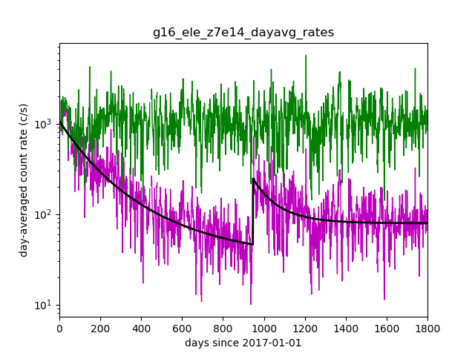

Correction in-work for MPS-LO gain decline for NCEI retrospective/science processing
Analysis to determine corrections for each zone-energy channel:
  Nonlinear fit (black trace) to: $\log_{10}({rate)=Ae^{−DOY/τ}+c}$ (3 parameters)
  Dead-time corrected day-averaged count rate scaled up to fit at first light, i.e., Correction factor = fit(t=0) / fit(t)
    Assumes relatively steady long-term rates over several year period. (Figure on following slide shows this is a reasonable assumption at higher MPS-LO energies.)
    Does not account for different MCP HV settings on-orbit and during ground/beam cal.
  Must recompute background removal coefficients after applying corrections.
  Some possible ways to constrain/modify fits include:
    Demand agreement between G16, G17, G18 and G19 MPS-LO long-term flux variations
    Demand similar G16, G17, G18, and G19 MPS-LO fits in like zone-energy channels
    Choose fits that force G16 and G19 fluxes to agree, while both are operating at GOES west location
    Reproduce long-term MPS-HI flux variations at highest MPS-LO energies
G16 MPS-LO Electron Zone 7R, E15
Corrected
Uncorrected
Two fits performed then forced to agree on 2019-08-06.
These GOES-19 data are preliminary, non-operational data and are undergoing testing. Users bear all responsibility for inspecting the data prior to use and for the manner in which the data are utilized.

Slide 58
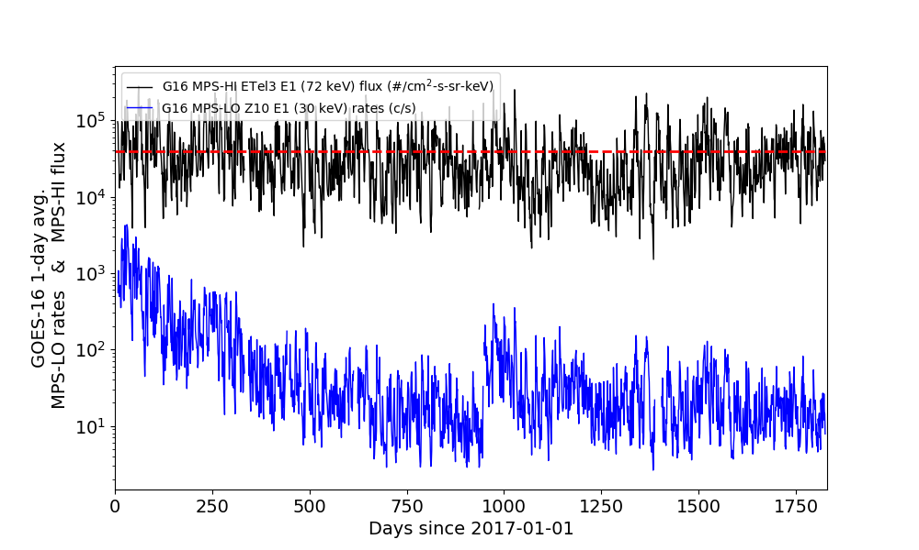
Compare G16 MPS-LO 30 keV and G16 MPS-HI 72 keV
Mean value
(Last day in plot is 2021-12-31)
These GOES-19 data are preliminary, non-operational data and are undergoing testing. Users bear all responsibility for inspecting the data prior to use and for the manner in which the data are utilized.

