Slide 1
Peer Stakeholder-Product Validation Review (PS-PVR) G19 MPS-Hi Provisional Validation SWPC Overview
February 14, 2025
Presenter: Steve Hill
These GOES-19 data are preliminary, non-operational data and are undergoing testing. Users bear all responsibility for inspecting the data prior to use and for the manner in which the data are utilized.

Slide 2
G19 MPS-Hi Provisional Validation SWPC Overview
Instrument
Provides data for critical >2 MeV electron alert at 1000 pfu
Primary Uses
Satellite industry: Deep Charging
Requirements
Derived from 2002 user-requirements workshop
Supported by
2017 Abt Report: Space Weather Economic Impacts
National Space Weather Strategy and Action Plan
2023 Satellite Environment Testbed Exercise

Slide 3
Space Weather Economic Impacts Abt Associates, 2017
MPS-Hi measures a component of the in-situ radiation environment responsible for spacecraft charging that can result in satellite-system anomalies and failure

Slide 4
Space Weather Economic Impacts Abt Associates, 2017
Satellite Impact Matrix
Defensive Investments: “… to protect the integrity of satellites from high cumulative radiation dosages and from anomalous satellite behaviors that can be caused by surface- and deep-dielectric charging.”
Mitigating Actions: “Assessment conducted after any anomalous satellite behavior”

Slide 5
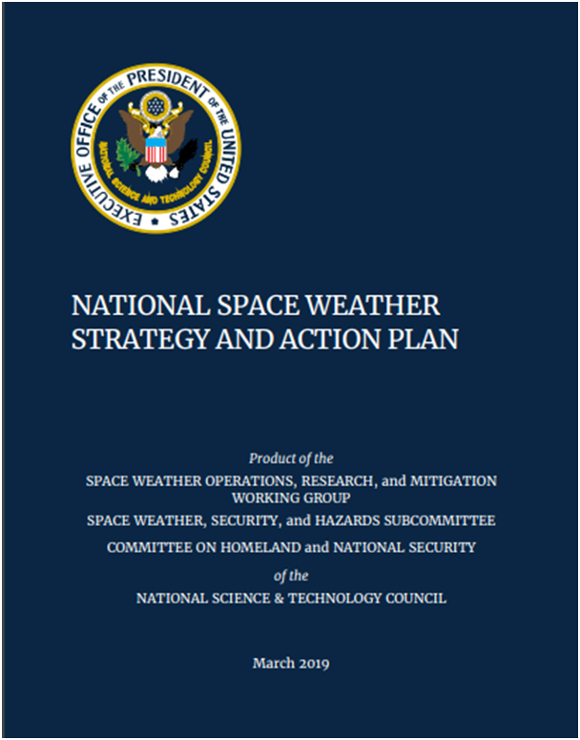
National Space Weather Strategy and Action Plan
Action 2.11.6: DOC, in coordination with NASA and DoD, develop a plan for a robust real-time assimilative environmental specification model such that it supports 1) Nowcasting of the space environment, and 2) Analysis and attribution of spacecraft anomalies due to routine and extreme space weather
MPS-HI will be an important data source for this data assimilative environmental model

Slide 6
G19 MPS-Hi Provisional Validation PS-PVR SWPC Summary
MPS-Hi maintains the critical capability to provide >2 MeV electron alerts warning of the potential for deep charging events
SWPC concurs with NCEI’s recommendation for MPS-Hi to transition to Provisional Validation status.
ADR 863 is important to ensure continuity of MPS-Hi measurements in the event of SGPS failure.
MPS-Hi – SGPS channel disagreement and possible degradation of MPS-Hi proton channels should be further investigated.
SWPC is highly appreciative of the excellent work and diligence provided by NCEI, as well as the support provided by ATC and the entire GOES project

