Slide 1
GOES-19 GLM Provisional Validation
Peer/Stakeholder Product Validation Review (PS-PVR)
March 13, 2025
NWS Perspective: AWIPS verification
Derek Van Pelt/TOWR-S Team
TOWR-S team, NWS Office of Observations

Slide 2
Products Evaluated
(All imagery from 1900Z March 07, 2025)
GLM Total Optical Energy
GLM Minimum Flash Area
GLM Flash Extend Density
GLM products have been on the SBN since March 2023

Slide 3
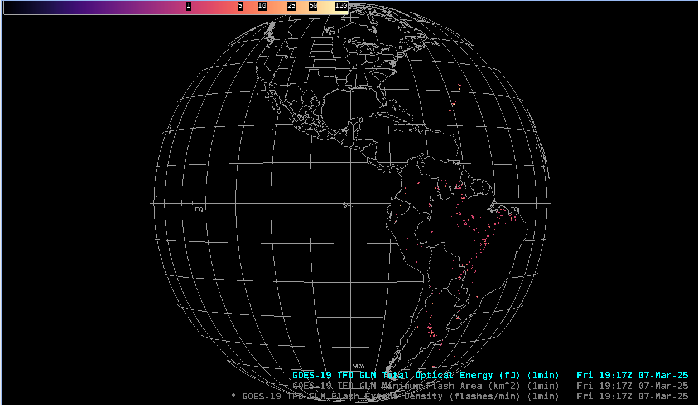
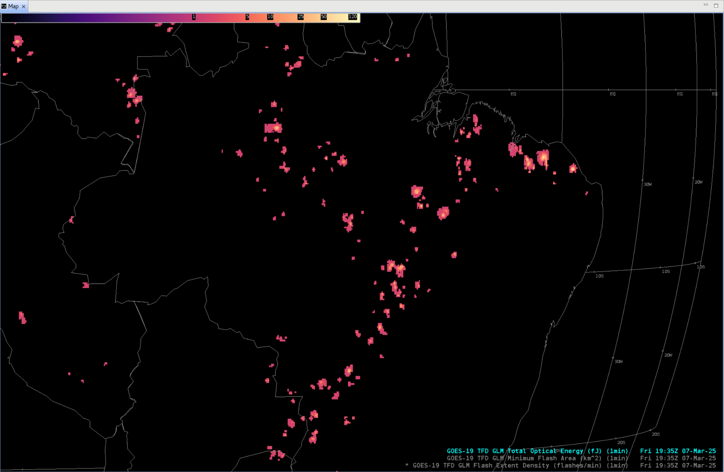
GLM Total Optical Energy
GOES-19 Preliminary, Non-Operational Data
GOES-19 Preliminary, Non-Operational Data

Slide 4
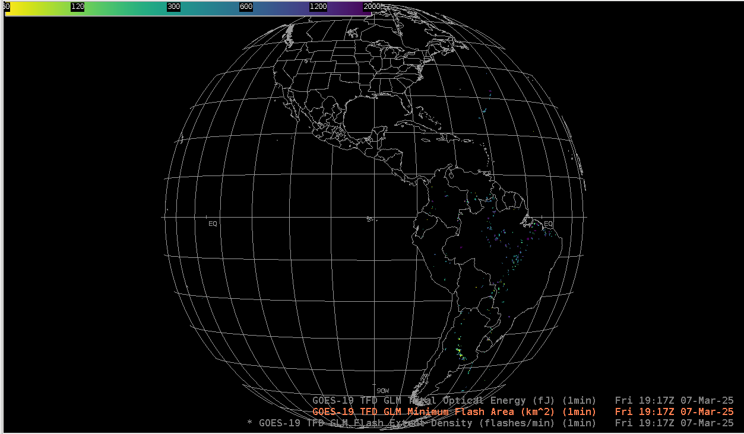
GLM Minimum Flash Area
GOES-19 Preliminary, Non-Operational Data

Slide 5
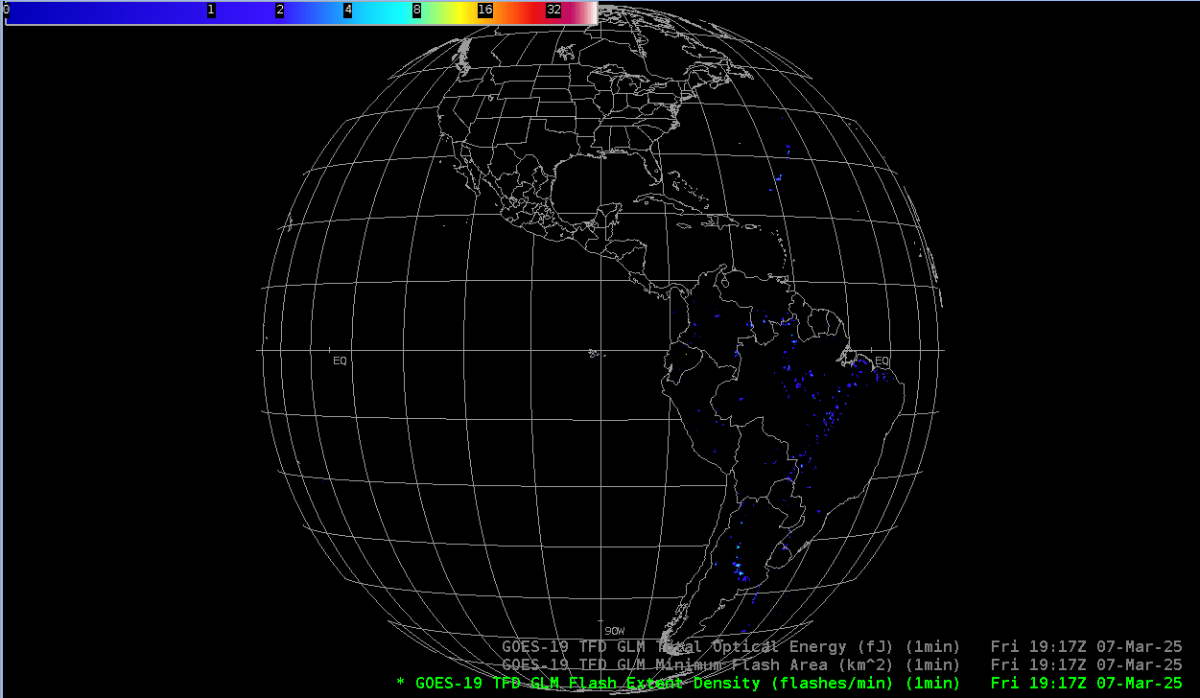
GLM Total Optical Energy
GOES-19 Preliminary, Non-Operational Data

Slide 6
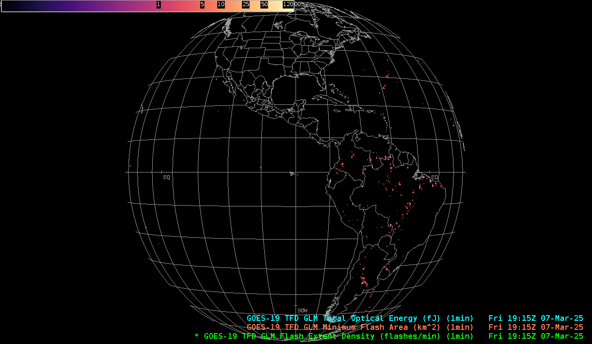
Total Optical Energy
20 minute loop
GOES-19 Preliminary, Non-Operational Data

Slide 7
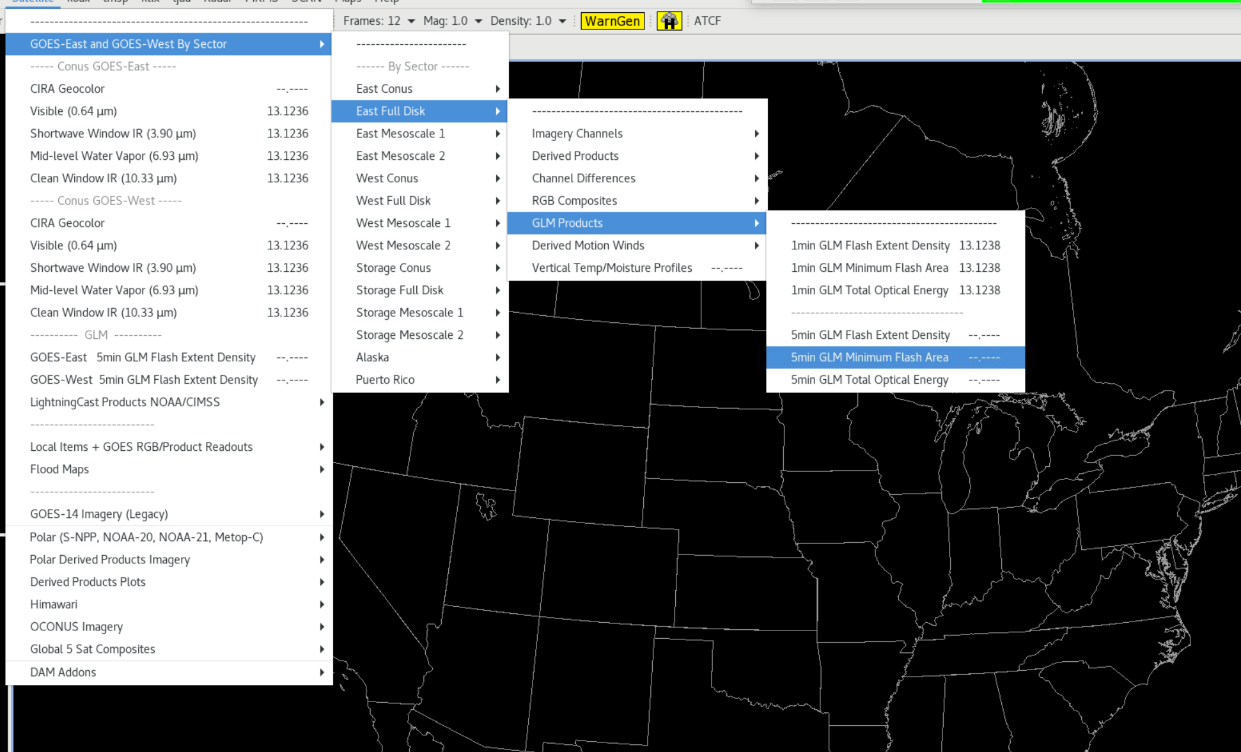
GLM Menu Location

Slide 8
Notes
AWIPS ingests and displays these products.
  No fielding issues are expected
  G-19 products conform closely to G-16, 18 conventions (GOES-R Product User Guide)
  AWIPS’ baseline configurations for G16 and G18 are extensible for G19+

