Slide 1



Peer Stakeholder-Product Validation Review (PS-PVR)
GOES 19 EXIS: User Perspective
11 March, 2025
Rodney Viereck
University of Colorado, CIRES
NOAA/NWS Space Weather Prediction Center
Outline:
Motivation
XRS Data/Products
EUVS Data
Summary
Notes:
based on PLT reports from LASP

Slide 2
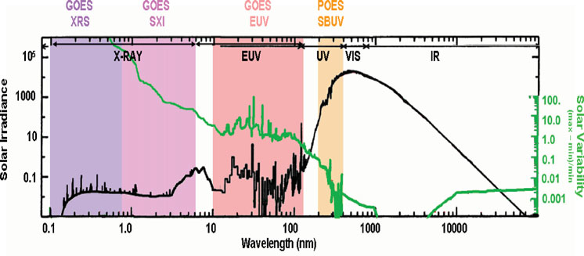
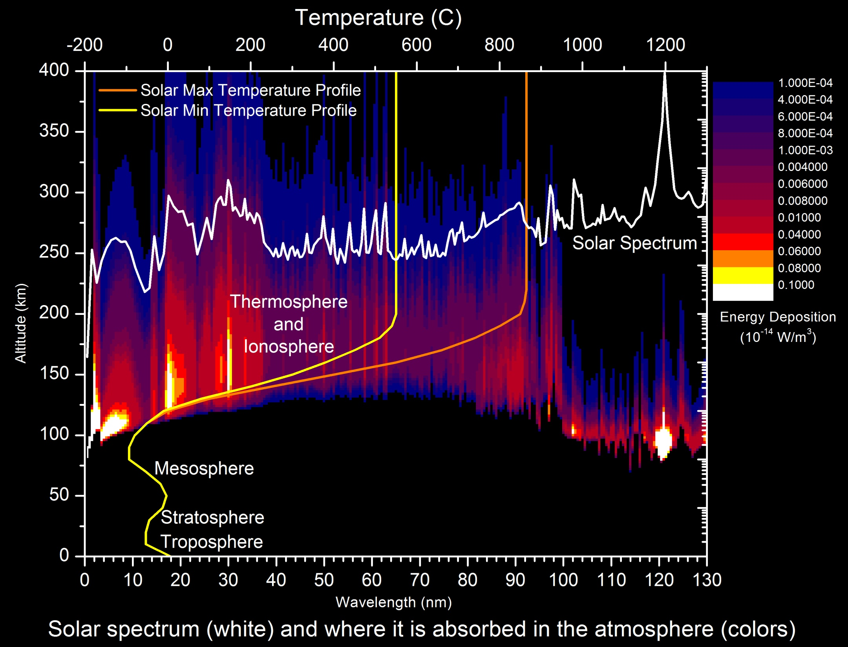
Solar X-Ray and EUV Irradiance
Highly Variable
  X-Ray Variations of order 10⁵
  EUV Variations of order 2 to 50
Absorbed in the Upper Atmosphere
  Between 80 and 1000 km.
Results in very large changes in the thermosphere (neutral density) and ionosphere (electron density)
  Direct Impacts:
    Radio communication
    Satellite orbits and drag
  Indirect Impacts
    Satellite navigation (GPS)
    Other space weather (geomagnetic storms and solar radiation storms)
Plot from Lean (NRL)

Slide 3
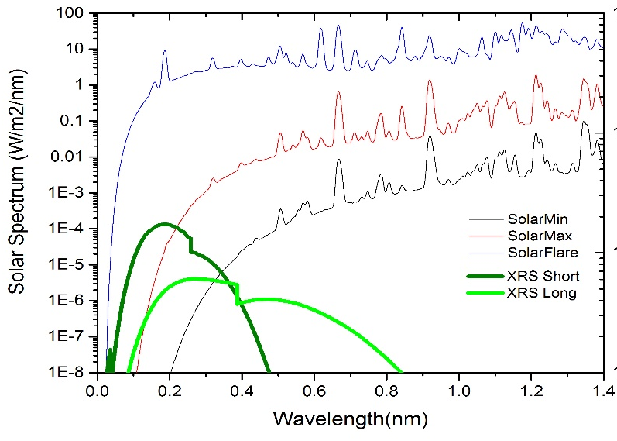
GOES Solar X-Ray Sensor
(XRS)
Provide measurement of the magnitude and location of solar flares.
Requirements: Monitor the disk-integrated solar flux in two x-ray wavelengths.
  XRSA 0.05 nm – 0.4 nm
  XRSB 0.1 nm – 0.8 nm
  Three second cadence
  10 second latency (not being met)
    current latency is 30 sec.
Solar X-Rays:
  Change by several orders of
  magnitude in just a few minutes.
  Are absorbed in the lower ionosphere
  where the flare enhanced electron
  density blocks HF communication.

Slide 4
Applications of the XRS .
Nearly 50-years of continuous measurement of solar x-ray irradiance.
Definitive measurement of the magnitude of solar flares.
  Critical for operations.
  Fundamental for solar research.
Early warning for other types of space weather.
  Most major space weather events start with a large solar flare.
  Flares Coronal Mass Ejections (CMEs) Geomagnetic Storms
  Flares Interplanetary Shocks Energetic Proton Events
Flare location and magnitude provide an estimate of the geo-effectiveness of an event.
  The size of a flare is strongly correlated with the magnitude of the resulting major space weather… e.g. solar proton events and geomagnetic storms.
The XRS data drive one of the three NOAA Space Weather Scales.
  R-Scale or Radio Blackouts - driven GOES solar x-rays
    Primary input to the D-Region Absorption product.
  G-Scale or Geomagnetic Storm – G-Scale driven by USGS ground magnetometers
  S-Scale or Solar Radiation Storm – S-Scale driven by GOES solar protons
Input to Space Weather Models
  D-Region Absorption Model (Specification of HF Radio Blackouts)
  Proton Prediction Model (Prediction of Radiation Storms).
  Ionosphere/Thermosphere models (Satellite Drag, Satellite Navigation)

Slide 5
GOES 19 EXIS Product Validation
Desired Outcome: Evaluation of the IDP data processing and product generation to validate that the data and products going into operations at SWPC and the Space Weather Forecast office meet requirements.
  For previous GOES satellites, this validation involved comparing IDP output with the NCEI processed data.
  Unfortunately, there has not been enough time to get NCEI-processed data.
Actual Outcome: GOES 19 vs GOES 16
  Compare IDP GOES 19 products to IDP and NCEI GOES 16 products.
  Evaluation period: Three days (22-24 Feb 2025) that include a number of flares.

Slide 6
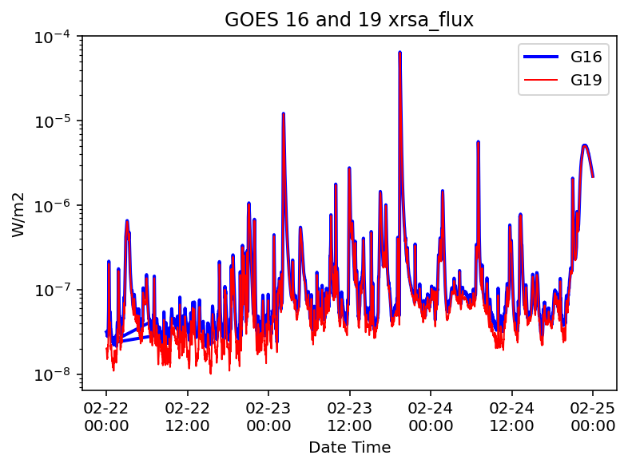
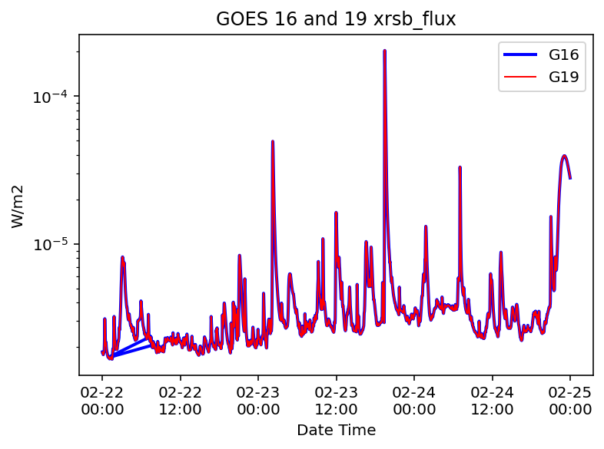
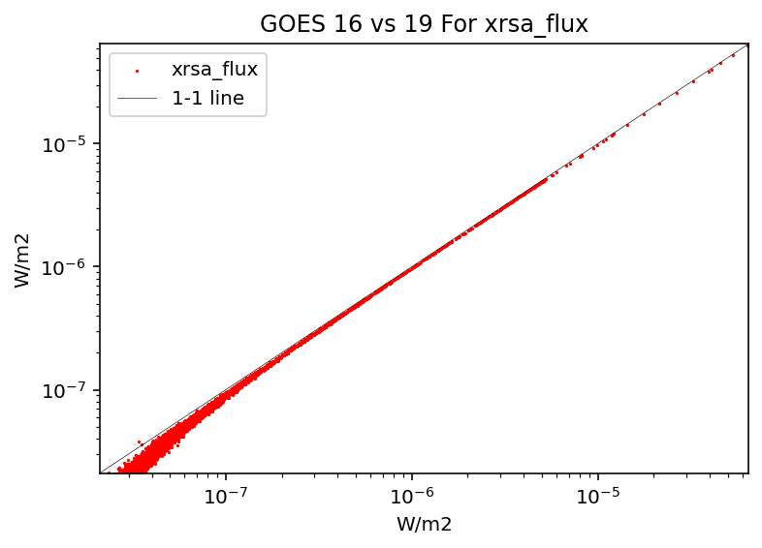
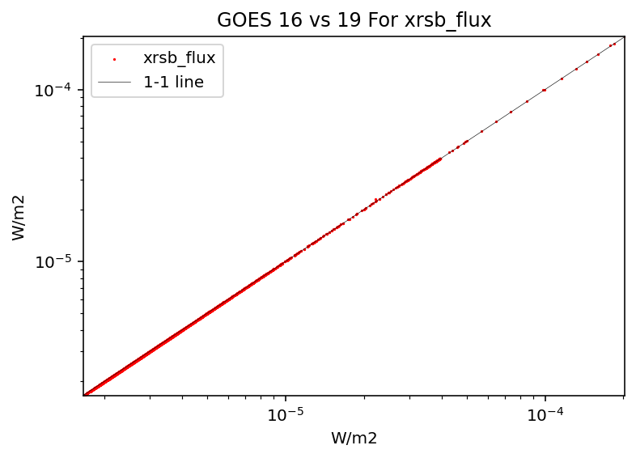
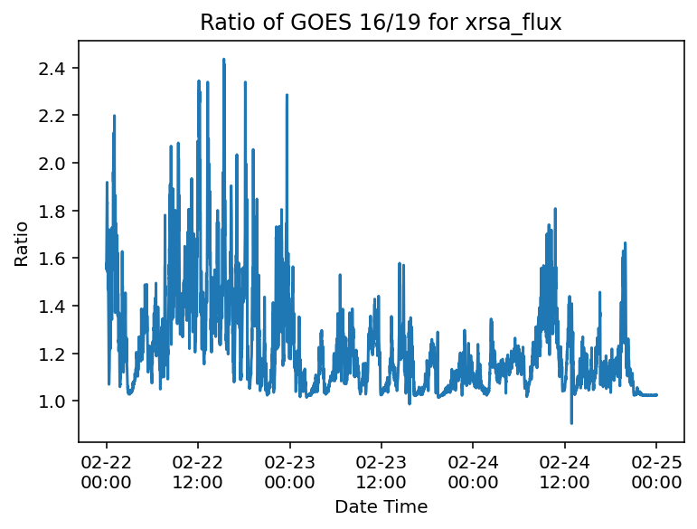
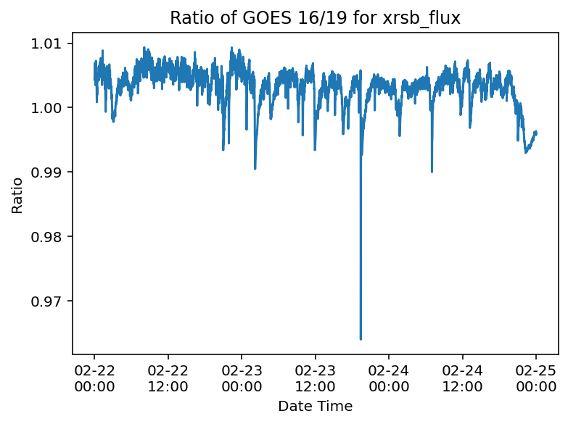
XRS Data Summary
(Comparing IDP GOES 19 to IDP GOES 16)
XRS A and XRS B channels both look extremely good.
Excellent agreement.

Slide 7
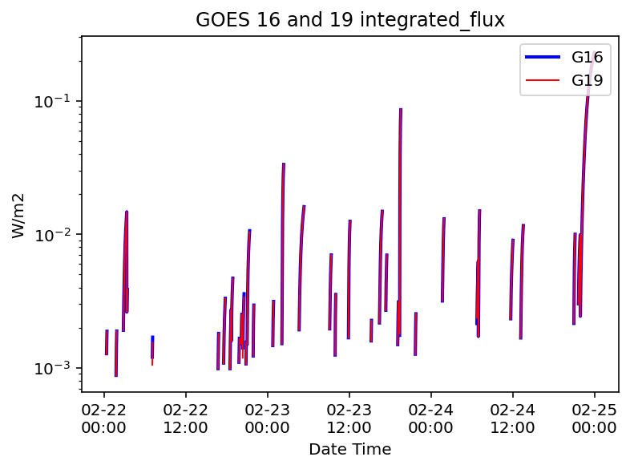
Solar Flare Calculation
The flare detection and flare parameters agree very well.
Note: Every time a solar x-ray flare is detected, a number of flare parameters are calculated in real-time.
  e.g. start-time, peak-time, end-time, peak-magnitude, integrated flux, etc..

Slide 8
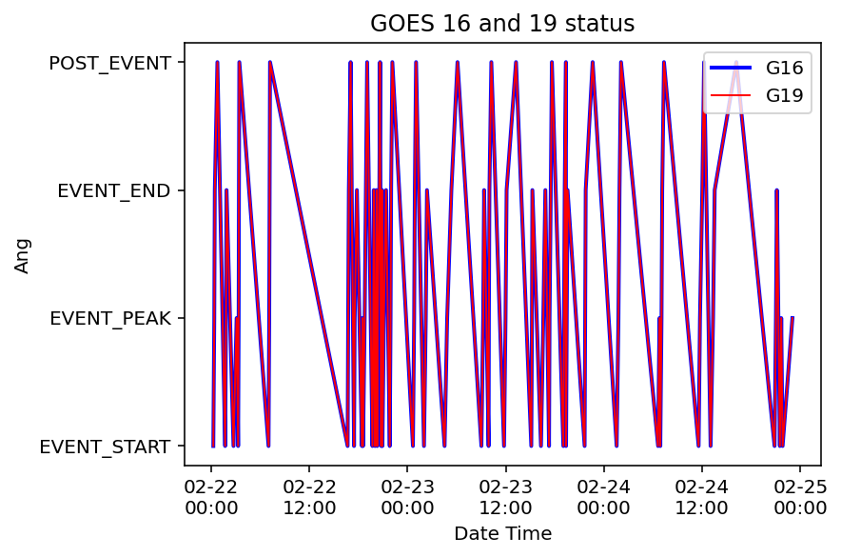
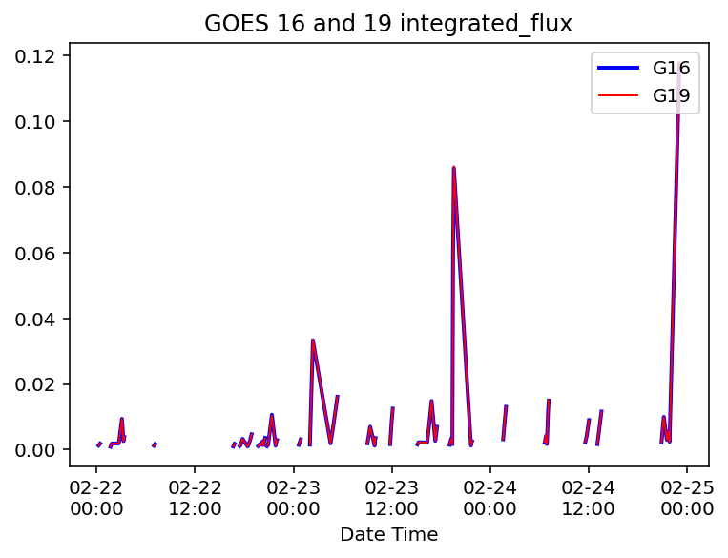
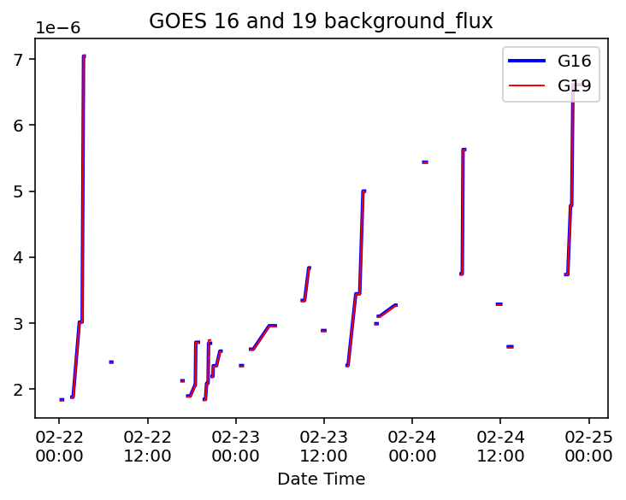
Flare Summary Product
The flare summary products agree very well.

Slide 9
XRS Flare Magnitude
Date Time GOES16 GOES19
2025-02-22 00:22:00 C3.1 C3.1
2025-02-22 01:48:00 C3.2 C3.2
2025-02-22 03:06:00 C8.1 C8.1
2025-02-22 03:21:00 C7.4 C7.4
2025-02-22 07:05:00 C3.3 C3.3
2025-02-22 16:44:00 C3.2 C3.2
2025-02-22 17:32:00 C2.6 C2.6
2025-02-22 18:29:00 C3.3 C3.3
2025-02-22 18:45:00 C3.9 C3.9
2025-02-22 19:48:00 C2.9 C2.9
2025-02-22 20:09:00 C4.0 C4.0
2025-02-22 20:21:00 C3.7 C3.7
2025-02-22 20:49:00 C3.5 C3.6
2025-02-22 21:06:00 C8.3 C8.3
2025-02-22 21:55:00 C5.8 C5.8
2025-02-23 00:48:00 C4.6 C4.6
2025-02-23 02:13:00 M4.9 M4.9
2025-02-23 04:50:00 C6.2 C6.2
2025-02-23 09:14:00 C7.5 C7.6
2025-02-23 09:56:00 M1.0 M1.0
2025-02-23 11:58:00 M1.6 M1.6
2025-02-23 15:12:00 C5.3 C5.3
2025-02-23 16:35:00 M1.0 M1.0
2025-02-23 17:21:00 C9.5 C9.5
2025-02-23 19:07:00 C5.4 C5.4
2025-02-23 19:27:00 X2.0 X2.0
2025-02-23 21:42:00 C5.0 C5.0
2025-02-24 01:46:00 M1.3 M1.3
2025-02-24 06:47:00 C5.8 C5.8
2025-02-24 07:02:00 M3.3 M3.3
2025-02-24 11:44:00 C6.2 C6.2
2025-02-24 13:20:00 C8.7 C8.7
2025-02-24 21:01:00 M1.5 M1.5
2025-02-24 21:40:00 C8.1 C8.1
2025-02-24 23:02:00 M3.9 M3.9
The flare magnitudes agree very well (better than previous satellites).

Slide 10
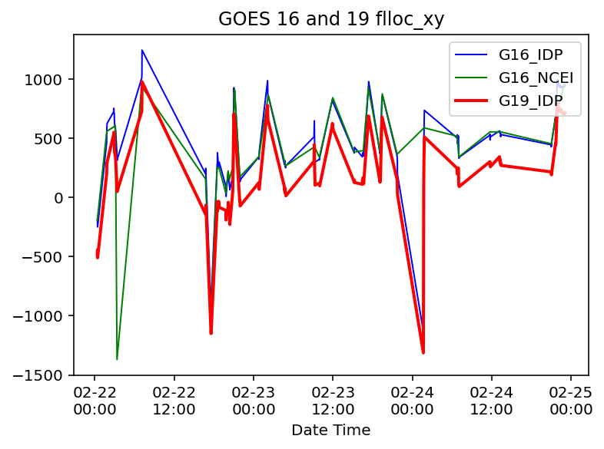
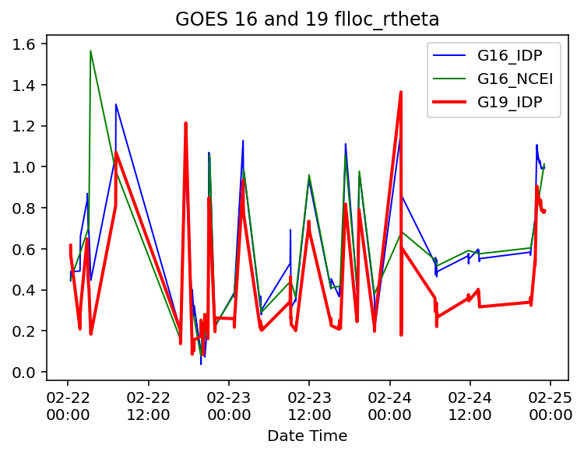
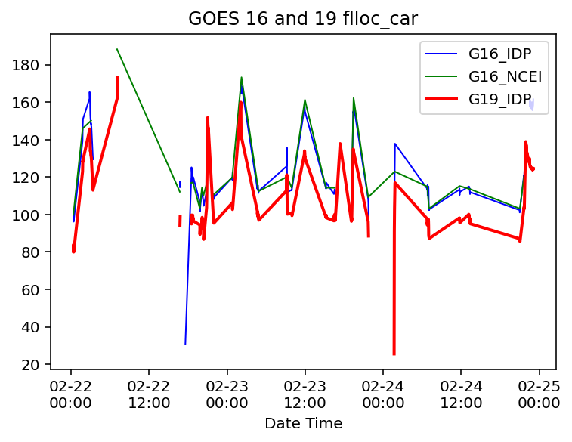
XRS Flare Location
We have been having trouble getting the Flare Location product working.
  GOES 16 from NCEI (green lines) and GOES 16 from IDP (blue lines) code do not agree. This seems to be caused by differences between PDA and GRB data streams.
GOES 19 (red lines) is significantly offset from GOES 16
This will require further investigation.

Slide 11
GOES 19 XRS Issues:
Rapid transition from launch (15 June 2024) to post launch testing (end in mid Feb 2025) to operations (early April?)
  Leaves little time to fully examine data and software performance.
  NCEI is still reprocessing GOES 19 EXIS data making it difficult to validate IDP data products.
  Switching satellites during eclipse season: GOES eclipse season doesn’t end until mid April which may leave operations with only one space craft and resulting data gaps.
IDP GOES 19 Flare Location Products do not agree with GOES 16 (ongoing issue)

Slide 12
Legacy XRS Issues:
Data latency
  GOES XRS 1-second data have latency of more than 30 seconds (due to data aggregation in the GRB).
  Impact: major (modifications to correct this were under consideration ? )
Electron contamination
  GOES XRS data have significant electron contamination.
  Impact: minor with correction algorithm that is currently implemented.
Proton contamination
  GOES XRS data have significant proton contamination.
  Impact: minor (once correction algorithm is implemented)
  Need a few more proton events to further quantify the correction parameters.

Slide 13
Applications of the EUVS
Operational input to the US Air Force High Accuracy Satellite Drag Model (HASDM).
Input to the NOAA Whole Atmosphere Model (WAM) - under development.
  WAM may become the primary satellite orbit prediction and collision avoidance model for civilian spacecraft.
Input to the NOAA Ionosphere Plasmasphere Electrodynamics model (IPE) - under development.
  IPE products support radio communication and satellite navigation.

Slide 14
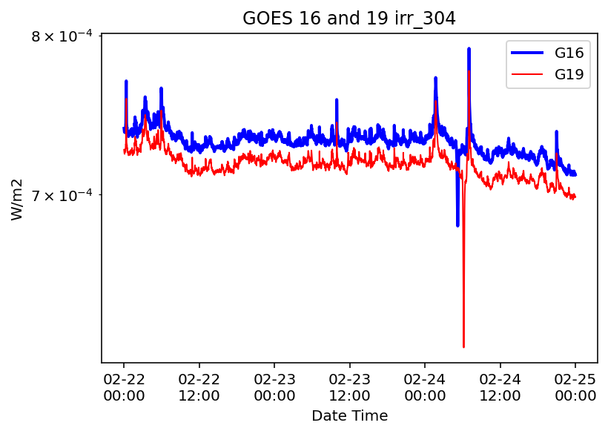
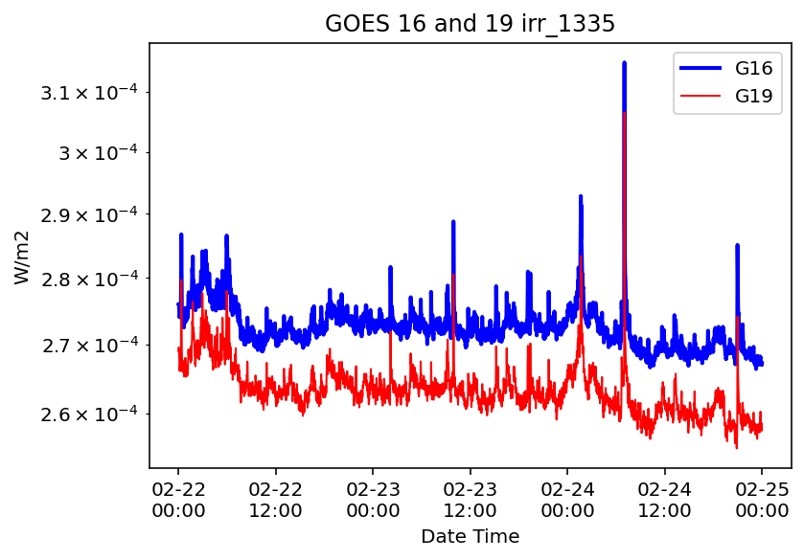
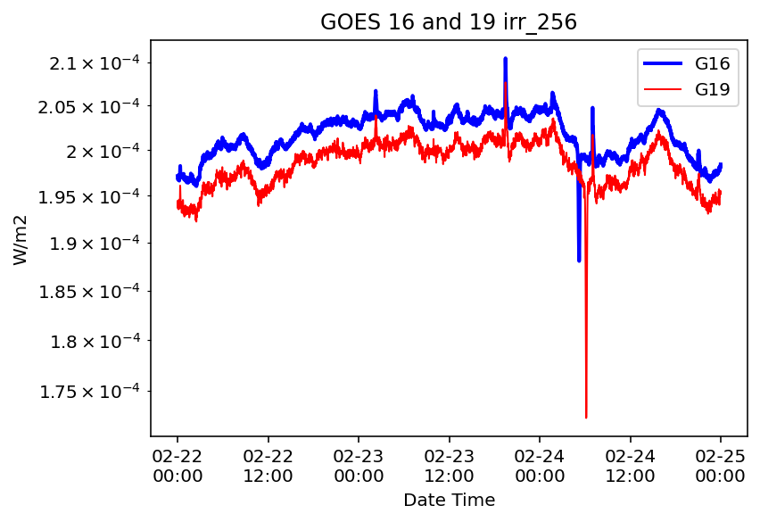
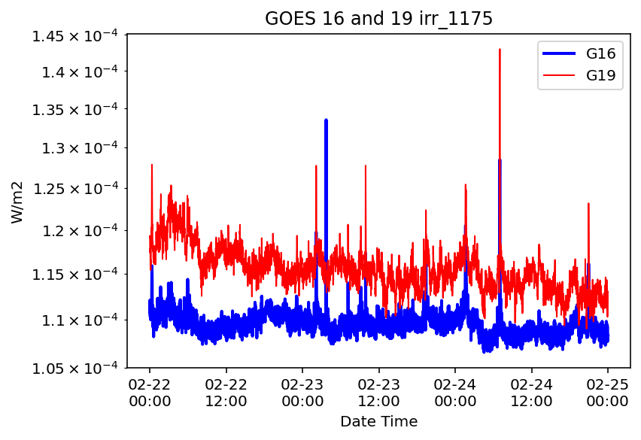
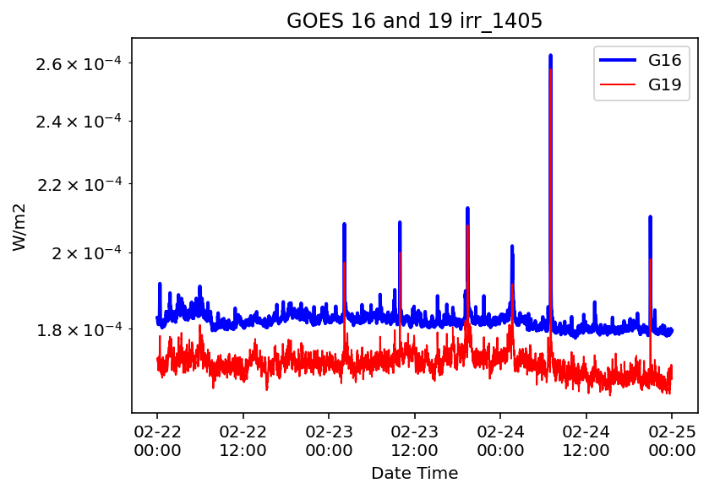
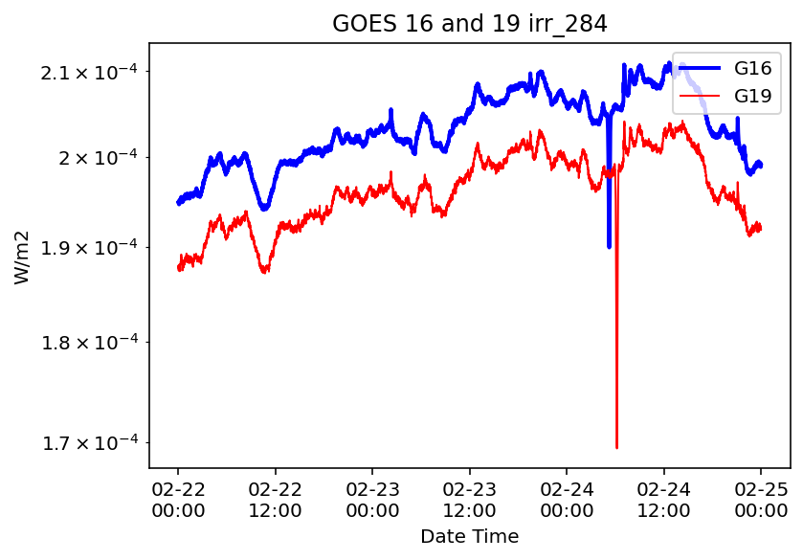
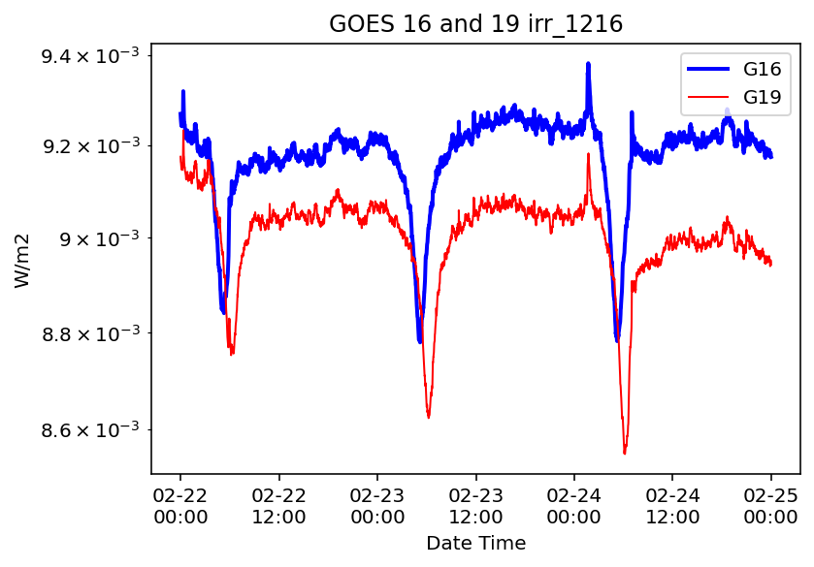
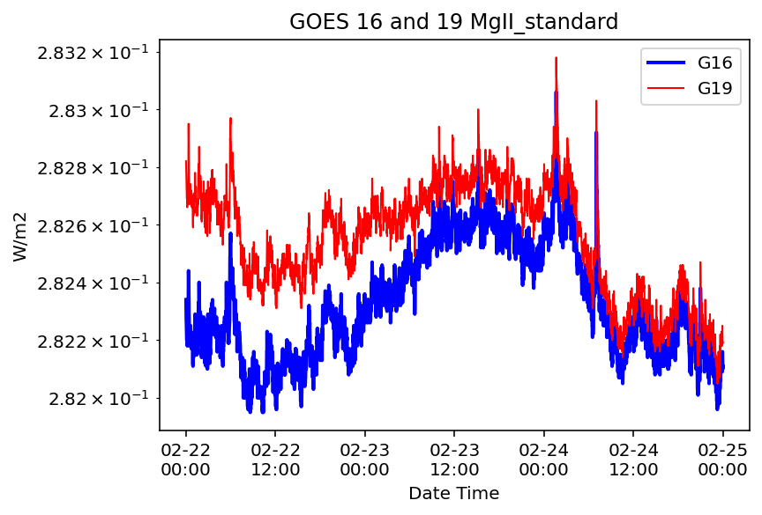
GOES 19 EUVS Data Summary
EUVS Still needs better calibration. NCEI and LASP are working this issues. I think it’s just new LUTS that are needed.

Slide 15
EUVS Issue:
IDP GOES 19 EUVS data products do not agree with GOES 16 EUVS products
  All 8 Channels show significant offsets and trends.

Slide 16
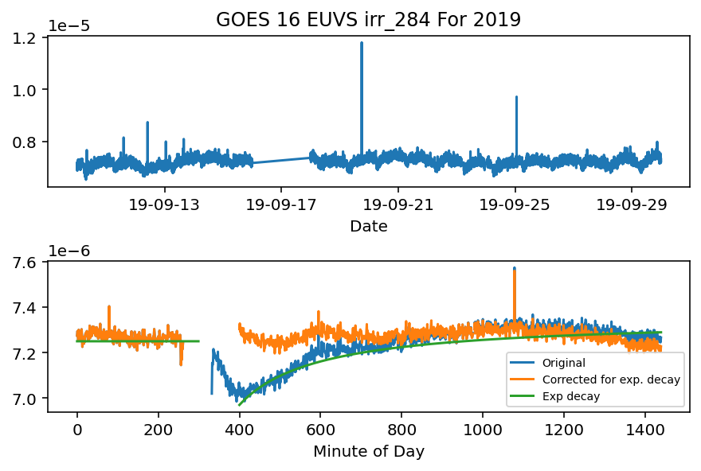
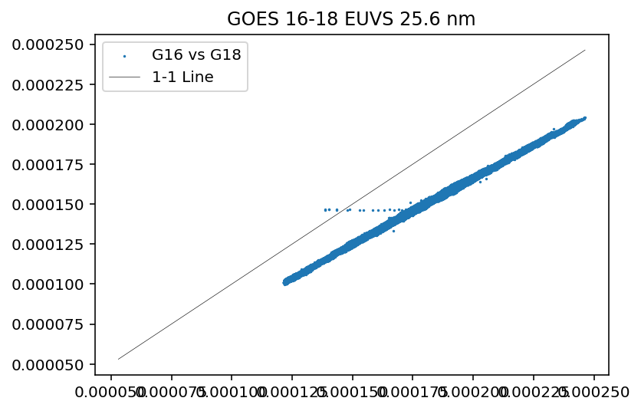
EUVS Legacy Issues
Thermal Correction:
  The EUVS has a significant thermal response that has not been properly accounted for.
Cross Calibration:
  Proper calibration and degradation corrections need to be applied to EUVS data

Slide 17
GOES 19 EXIS Operational Readiness
XRS:
  XRS A and B Data look good and are ready for operations
  The XRS Flare Determination and Flare Summary products are ready for operations
  The GOES 19 XRS Flare Location product do not agree with GOES 16 and is not ready for operations
EUVS:
  The EUVS seven EUV channels and the Mg II core to wing ratio are significantly offset from GOES 16. The GOES 19 EUVS is not ready for operations until new LUTS are implemented.

Slide 18
Questions?

