Slide 1
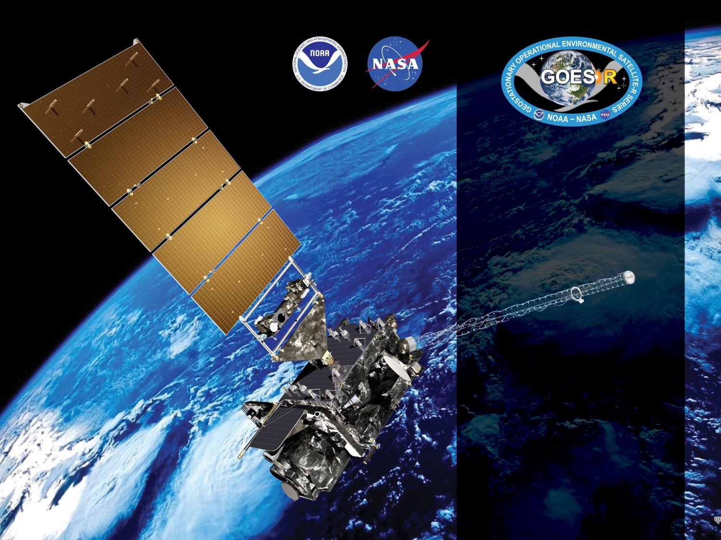


GOES-19 ABI L2+
Fractional Snow Cover (FSC)
Provisional PS-PVR
February 19, 2025
GOES-R AWG
Peter Romanov¹, Yinghui Liu², Jeff Key²
¹CREST/CUNY
²NOAA/NESDIS/STAR
Notes:
PS-PVR - Peer-Stakeholder Product Validation Review

Slide 2
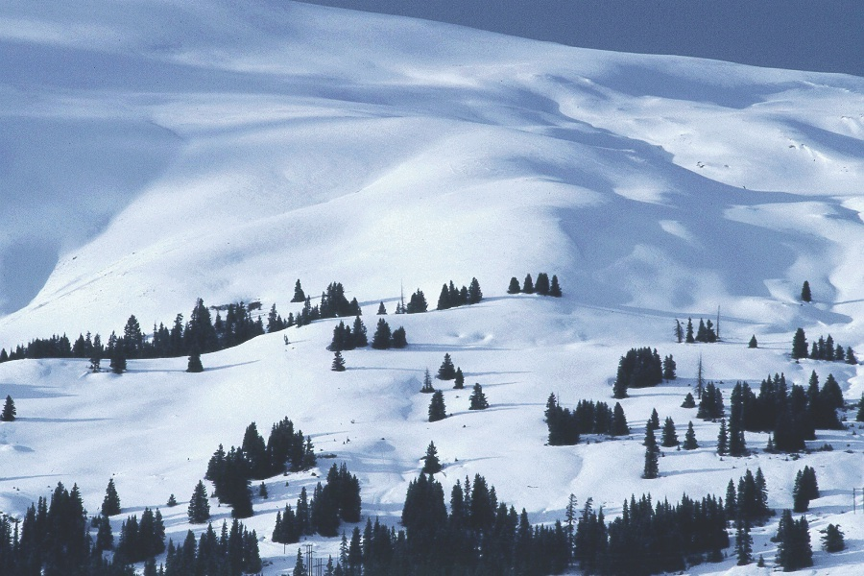
Outline
Product and Algorithm Overview
Snow Product Quality Evaluation
Product Validation / Accuracy Assessment
Identified Issues
Provisional Maturity Assessment
Path to Full Validation
Summary and Recommendations

Slide 3
PRODUCT AND ALGORITHM OVERVIEW

Slide 4
Fractional Snow Cover Definition
Fractional Snow Cover (FSC)* is the fractional area covered by snow in each satellite pixel as seen from space. It is often referred to as the “viewable snow fraction”. The viewable FSC is determined by the actual snow cover fraction on the ground within the pixel and by the snow cover masking by vegetation canopy.
FSC retrievals are expressed as the fraction of the ABI pixel covered by snow, continuously from 0.0 = no snow cover to 1.0 = total snow cover.
*Fractional snow cover and FSC are terms typically used with ABI, whereas snow fraction or snow cover fraction are the more common terms used with VIIRS. Here we use the three interchangeably.

Slide 5
Product Requirements
GOES-R ABI Fractional Snow Cover Requirements
Satellite Source | GOES-R ABI
Measurement Range | 0.0 – 1.0 fractional cover
Accuracy | 0.30
Precision | 0.25
Latency | 60 min
Refresh | 60 min
Coverage | Full Disk, CONUS, Meso
Horizontal Resolution | 2 km
Mapping Accuracy | 1 km
Cloud Cover Conditions Qualifier | Clear conditions associated with threshold accuracy
Temporal Coverage Qualifier | Sun at < 67 deg. daytime solar zenith angle
Product Extent Qualifier | Quantitative out to at least 55° LZA and qualitative at larger LZA
- No requirement for the snow/no-snow discrimination accuracy (VIIRS: 90%)
- TCQ (SolZA < 67 deg) and PEQ( SatZA < 55 deg) appear too low (virtually exclude all latitudes above ~50 deg)
- Accuracy of the cloud mask affects the accuracy of snow identification and of the snow fraction retrieval
Notes:
OSCAR - WMO’s Observing Systems Capability Analysis and Review Tool
There was a presentation given to the GOES-R Algorithm Development Executive Board (ADEB) members in 2010 that clearly notes that incorrect (and current) accuracy and precision specs for the fractional snow cover product and what they should be (accuracy: 15%; precision: 30%). Why they were never corrected is unclear to us.

Slide 6
Product Characterization
Binary Snow Cover (Intermediate Product), OR_I_ABI_L2_FSCx-M6…
Product Field (ubyte)
Quality Flag (ubyte)
Product Value | Meaning
0 | Snow-free land
1 | Snow-covered land
125 | Fill Value (No data)
128 | No Retrieval
QF Value | Meaning
0 | Valid retrieval (clear-sky)
105 | Water
110 | Cloud
111 | Rejected snow (1)
112 | Rejected snow (2)
113 | Rejected snow (3)
114 | Rejected snow (4)
115 | Rejected snow (5)
120 | Unclassified
121 | Insufficient daylight
122 | Undetermined
124 | Bad data
125 | Fill Value (No data)
Important !
Meaningful product image can not be created using the product field only. Both the Product Field and Quality Flags should be used.
Notes:
OSCAR - WMO’s Observing Systems Capability Analysis and Review Tool
There was a presentation given to the GOES-R Algorithm Development Executive Board (ADEB) members in 2010 that clearly notes that incorrect (and current) accuracy and precision specs for the fractional snow cover product and what they should be (accuracy: 15%; precision: 30%). Why they were never corrected is unclear to us.

Slide 7
Product Characterization
Fractional Snow Cover, OR_ABI_L2_FSCx-M6…
Product Field (ubyte)
Quality Flag (ubyte)
Product Value | Meaning
0 | Snow-free land
1-100 | Snow fraction (%)
125 | Fill value (No data)
128 | No FSC retrieval
QF Value | Meaning
0 | Valid retrieval (clear sky)
105 | Water
110 | Cloud
111 | Rejected snow (1)
112 | Rejected snow (2)
113 | Rejected snow (3)
114 | Rejected snow (4)
115 | Rejected snow (5)
120 | Unclassified
121 | Insufficient daylight
122 | Undetermined
124 | Bad data
125 | Fill Value (No data)
Notes:
OSCAR - WMO’s Observing Systems Capability Analysis and Review Tool
There was a presentation given to the GOES-R Algorithm Development Executive Board (ADEB) members in 2010 that clearly notes that incorrect (and current) accuracy and precision specs for the fractional snow cover product and what they should be (accuracy: 15%; precision: 30%). Why they were never corrected is unclear to us.

Slide 8
ABI Enterprise FSC Algorithm
Heritage: VIIRS, MODIS, AVHRR, GOES Imager
Algorithm includes two steps, (1) Snow identification and (2) Snow fraction estimation
Snow fraction is derived only for pixels identified as “snow covered” by the snow identification algorithm
Snow retrievals require daylight and clear-sky conditions.
External cloud mask is used. Performance of the snow algorithm is critically dependent on the performance of the cloud mask product.
Several other auxiliary datasets are used (land mask, elevation, snow cover and LST climatology)

Slide 9

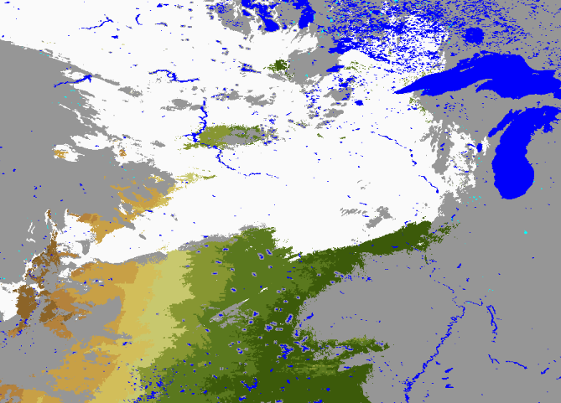
Enterprise Snow Algorithm
Step 1: Snow Identification
ABI G-19 True Color
  Two-step approach: Initial Snow Identification (1) and Consistency Testing (2)
  Initial Snow Identification:
    Spectral threshold-based decision tree algorithm (NDVI/DSI, R2, R3, R5, T13)
  Consistency Testing: Verifies plausibility of identified snow against
    - Snow cover climatology
    - Land surface temperature climatology
ABI G-19 Binary Snow
Auxiliary Datasets
Spectral Threshold Values
Land-water mask
Snow Cover Climatology
LST Climatology
Surface Elevation
Snow
Satellite Data
- Reflectance (ABI bands 2,3,5)
- Brightness Temperature (band 13)
- Observation Angles
- Cloud mask
Snow Identification
Cloud
Initial Snow Identification
“Snow”
pixels
Consistency Testing
Binary Snow Map

Slide 10
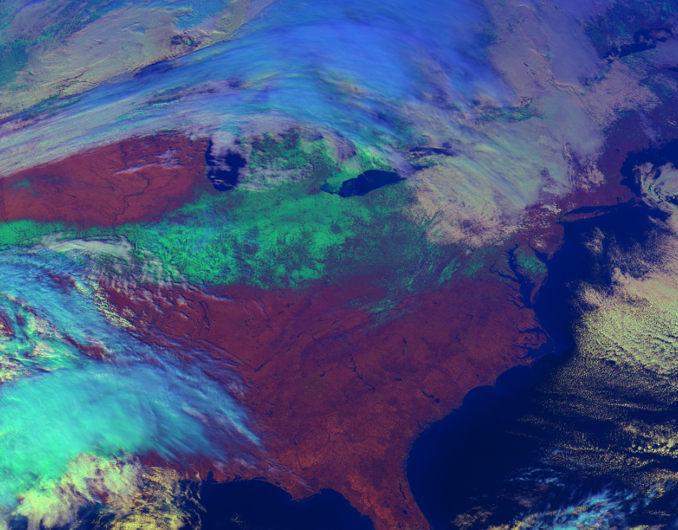
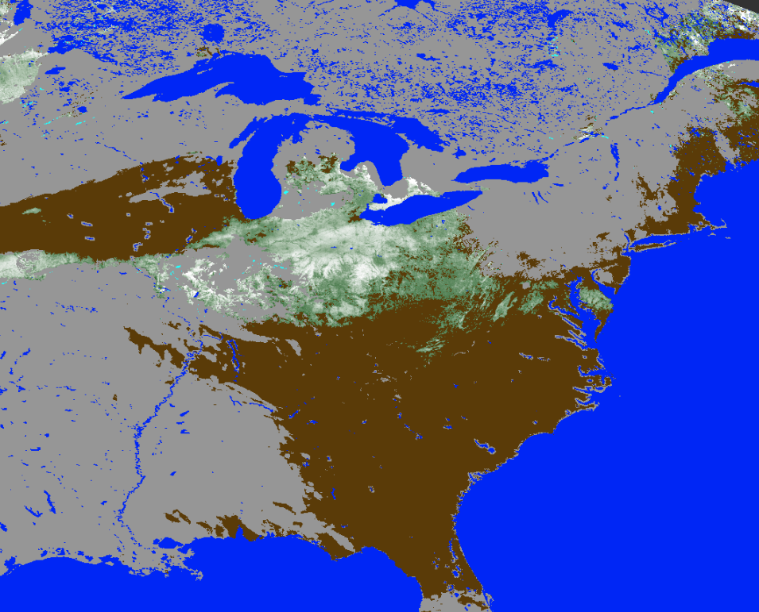

Enterprise Snow Algorithm
Step 2: Snow Fraction Retrieval
Linear unmixture techniques is used:
    SnowFraction = (R - R_{Land})/(R_{Snow} – R_{Land} )
  R - Observed TOA reflectance in the visible band (Band 2)
  R_{Land} - Predicted TOA reflectance of snow-free land surface
  R_{Snow} - Predicted TOA reflectance of snow-covered land
  R_{Land} and R_{Snow}
    Are dependent on the observation geometry (Ɵ_{sol} , Ɵ_{sat} , ɸ_{azm})
    Are simulated using physical radiative transfer model (SBDART-DISORT)
    Are tabulated at 5⁰ interval for Ɵ_{sol} and Ɵ_{sat} and at 10⁰ interval for ɸ_{azm}
ABI G-19 True Color
ABI G-19 Snow Fraction
Clouds are shown in gray

Slide 11
SNOW PRODUCT QUALITY EVALUATION

Slide 12
Top Level Summary of
Product Quality
Our analysis involved GOES-19 ABI snow products covering a substantial, but still limited period of time (09/18/2024-02/15/2025). ABI snow products were generated using Enterprise algorithms within the GOES-R Operational Environment (OE).
Examined FSC snow products from GOES-19 FSC were found to mostly meet the mission accuracy and precision requirements.
Minor issues were identified in the ABI cloud mask and in the climatological filters applied in the algorithm. A detailed description of the issues is provided within this document.
Conclusion: The Enterprise GOES-19 ABI FSC product is ready for operational use. Identified issues will be fixed in the future update of the algorithm. Further monitoring of the product performance is critical to verify that its quality remains acceptable in other seasons of the year.
Notes:
NDSI - Normalized Difference Snow Index

Slide 13
GOES-19 Data Used in this Review
For this review we examined ABI Snow products
- Generated with the Enterprise algorithm within GOES-R OE system
- FSC products (OR_ABI-L2-FSC)
- Time period : from September 18, 2024 to February 15, 2025
- Time range: 1400 to 2300 UTC (day-time coverage of the Western Hemisphere land area)
- Full Disk, CONUS and Mesoscale coverage
Full Disk products: Performance/accuracy was examined
CONUS and Mesoscale products: Verified output structure and content

Slide 14
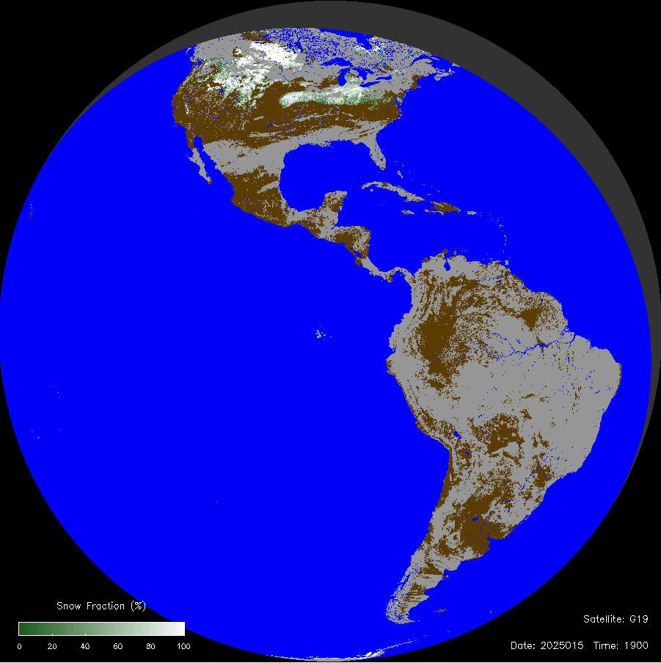
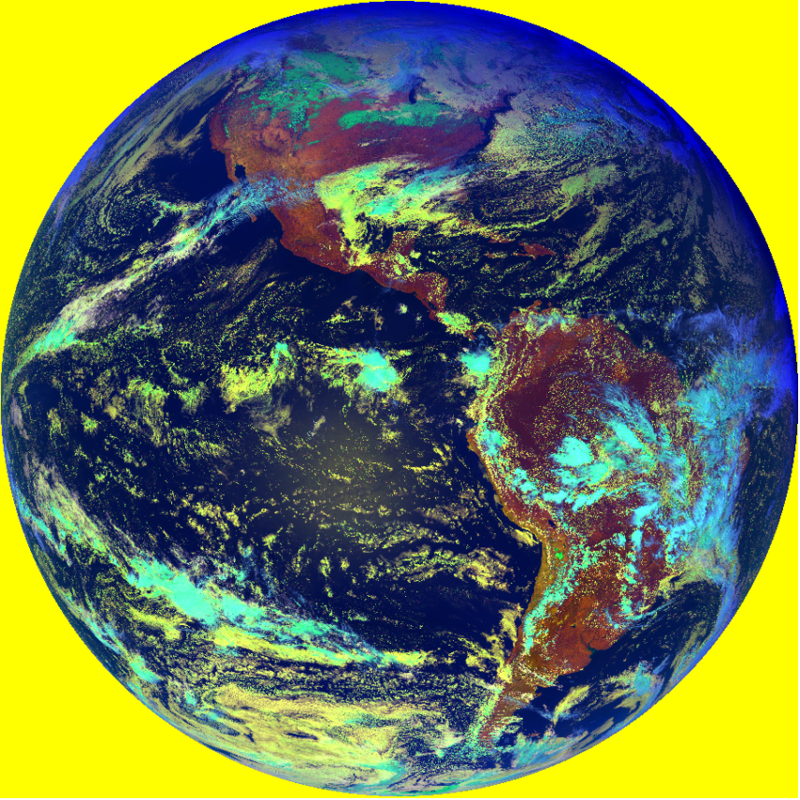
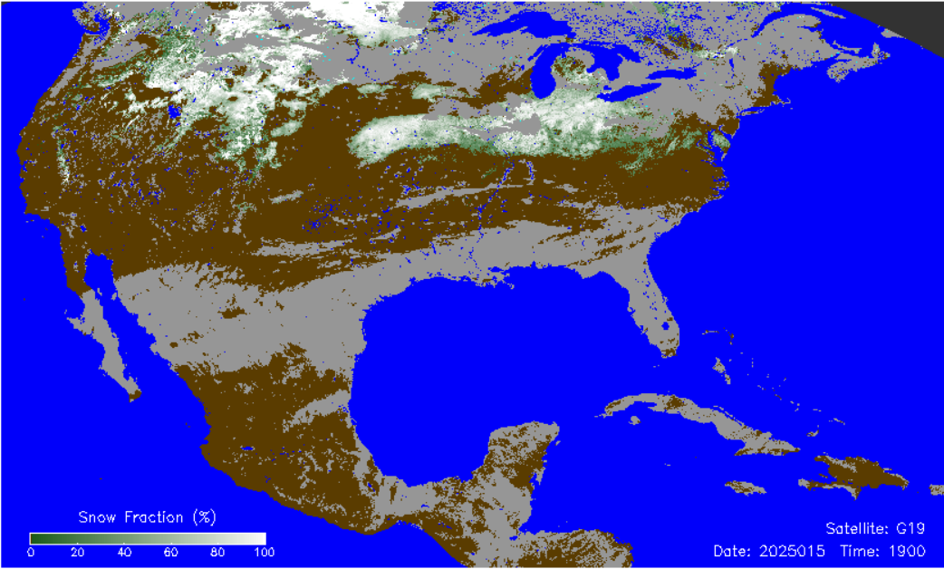
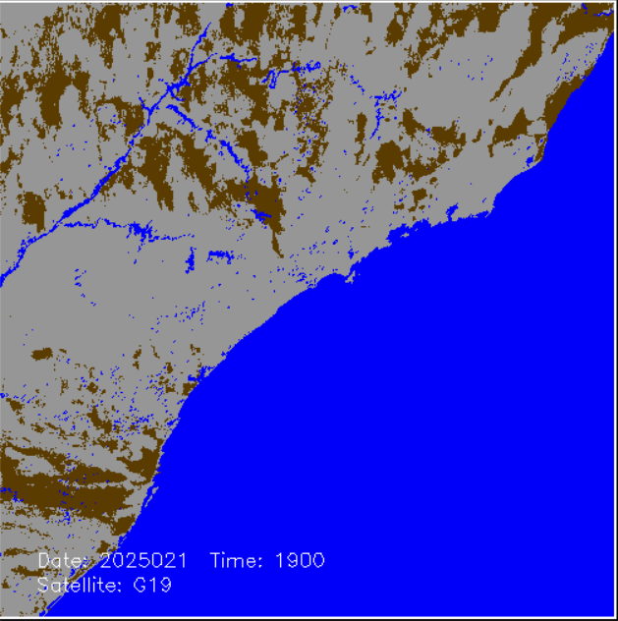
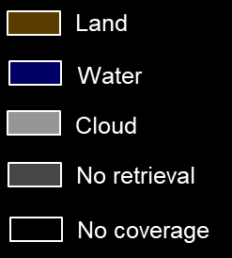
Visual Inspection - GOES-19 Snow
Snow Fraction
GOES-19
Mesoscale Product
Snow Fraction
GOES-19
Full Disk Product
False Color RGB
GOES-19
Snow Fraction, GOES-19
CONUS Product
GOES-19 snow products generated with the Enterprise algorithm provide realistic characterization of the snow extent and of the snow cover fraction over daytime scenes (clouds are shown in light gray)
No differences have been seen in information on the snow cover provided over the same region in the CONUS and in the Full Disk products
Available Mesoscale products covered tropical regions with no snow cover on the ground

Slide 15
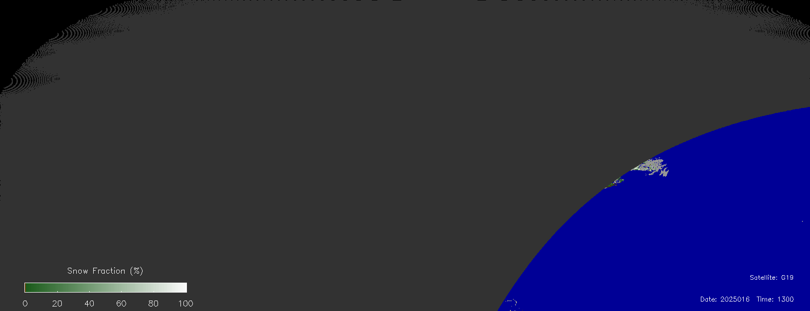
Visual Inspection - GOES-19 Snow (2)
GOES-19 snow products do not demonstrate any spurious diurnal variation in the derived snow cover properties
Snow Fraction
GOES-19
Jan 16, 2025
Land
Water
Cloud
No retrieval
No coverage

Slide 16
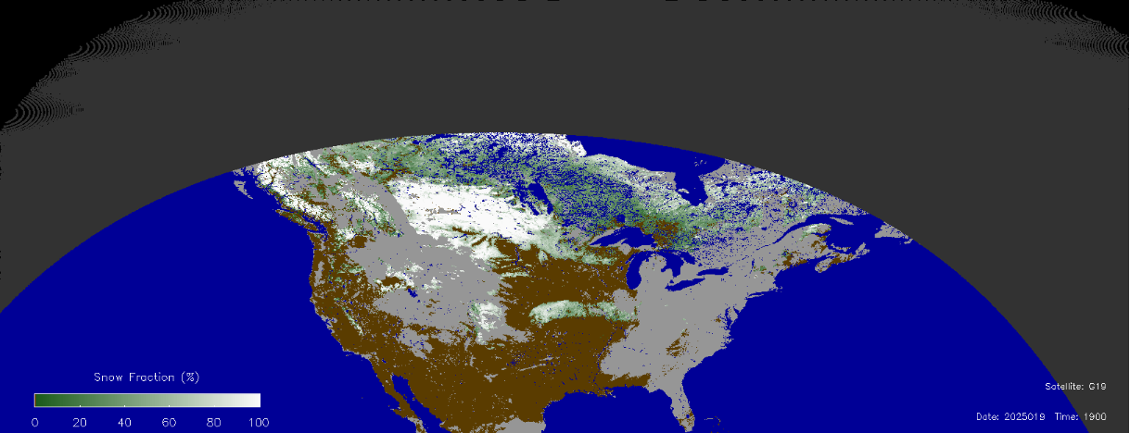
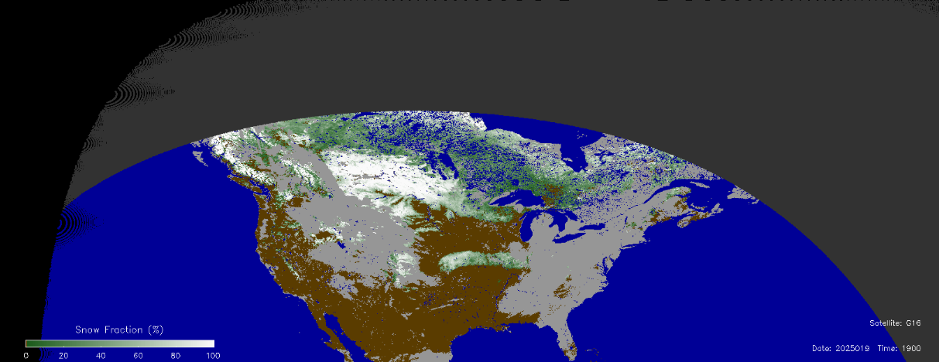
GOES-19 and -16 Matched Snow Images
Snow products from ABI GOES-19 over North America were compared to GOES-16
Products from the two sensors were qualitatively similar with respect to the snow cover properties (snow extent, snow fraction) and to the cloud mask.
Snow Fraction
GOES-19
Jan 19, 2025
1900 UTC
Snow Fraction
GOES-16
Jan 19, 2025
1900 UTC

Slide 17
Product Content Inspection
Product Value | Meaning
0 | Snow-free land
1-100 or 1 | Snow fraction (%) or Snow Flag
125 | Fill value (No data)
128 | No snow retrieval
Product Field
Snow product code values and quality flag values have been checked. All flags are set correctly
- Zero (“0”) QF value corresponds to valid snow retrievals (snow fraction flags of 0-100)
- QF value of 125 (Fill value) corresponds to Fill value of 125 in the snow maps
- Snow map value of 128 (No snow retrieval) correspond to QF values of 105 to 125
QF Value | Meaning
0 | Valid retrieval (clear sky)
105 | Water
110 | Cloud
111 | Rejected snow (1)
112 | Rejected snow (2)
113 | Rejected snow (3)
114 | Rejected snow (4)
115 | Rejected snow (5)
120 | Unclassified
121 | Insufficient daylight
122 | Undetermined
124 | Bad data
125 | Fill Value (No data)
Quality Flag
‹#›

Slide 18
PRODUCT VALIDATION / ACCURACY ASSESSMENT
- Binary Snow Cover
- Fractional Snow Cover

Slide 19
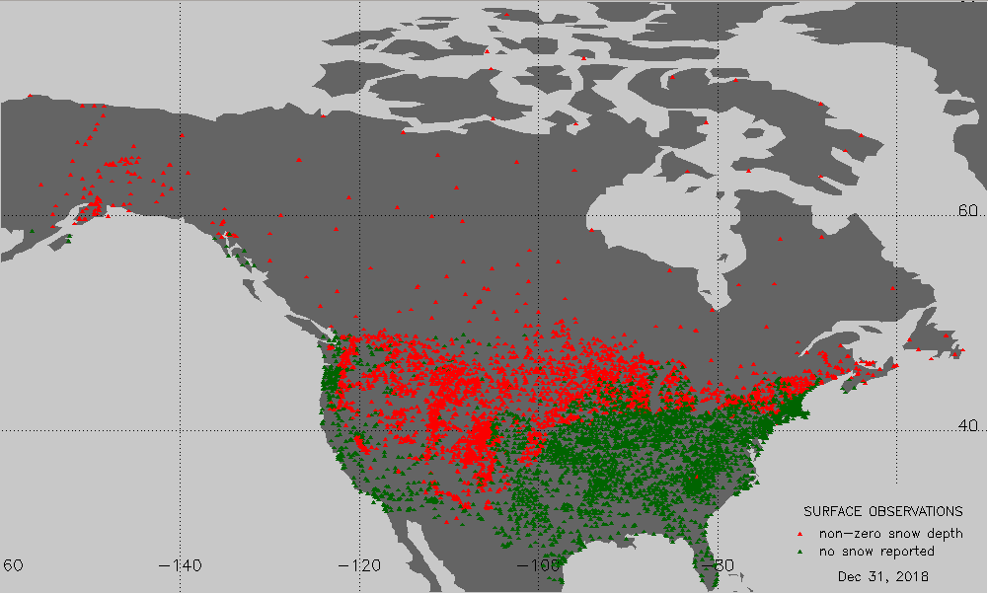
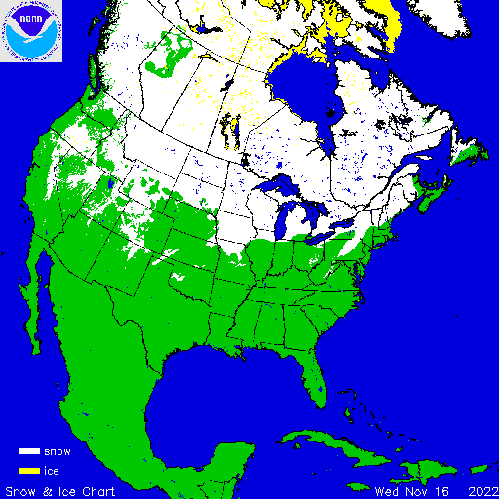
Binary Snow Product: Evaluation Approach
- Direct comparison with in situ snow observations (GHCN-D)
- Comparison with IMS (NOAA Interactive) snow product
- ABI daytime clear-sky snow retrievals used
In the peak of the winter seasons snow depth are available from over 5,000 stations in North America. Most stations are located below 55⁰N latitude.
IMS daily charts at 4 km resolution are routinely produced at NOAA National Ice Center and are available from NSIDC. Charts cover only the Northern Hemisphere.

Slide 20
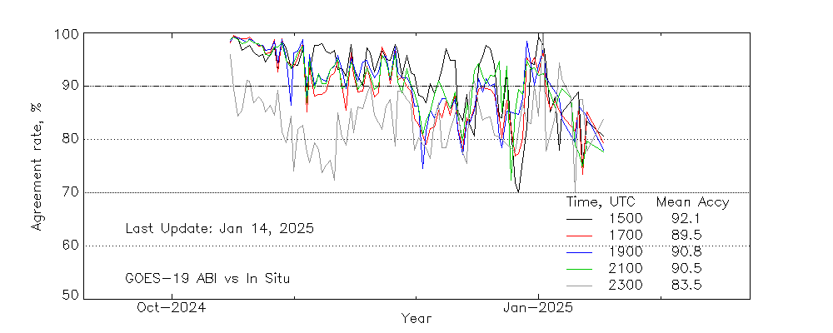
Binary Snow: G19 ABI vs In Situ Data
- About 1000 matched clear-sky observations daily. WMO, COOP, CoCoRAHS, SNOTEL.
- 89.5 to 92.1% mean agreement of ABI snow cover to the station data at 1500 to 2100 UTC
- This generally satisfies the required 0.90 probability of correct snow/no-snow discrimination
- Part of disagreement is due to
- Errors in station reports (~1-2%)
- Lack of ortho-corrected navigation of ABI imagery
- Large solar zenith angles at 2300 UTC
Estimated daily rate of agreement of ABI snow vs in situ data
Notes:
Warm period: peaks in late February, low in early March, peaking again by late March, 16:00-21:00 local time.

Slide 21
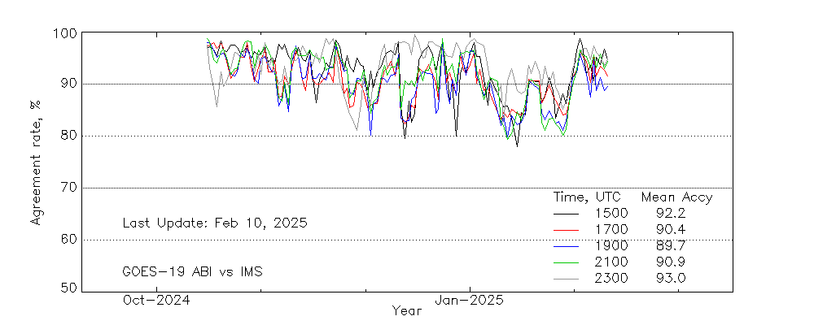
Binary Snow Map: G19 ABI vs IMS
- Comparison performed over all North America land area within GOES-16 coverage
- ABI clear-sky retrievals used
- 89.7-92.8% mean agreement on the snow cover distribution in October 2024-February 2025
- The requirement of 0.90 (or 90%) probability of correct snow/no-snow discrimination is mostly met
Estimated daily rate of agreement of ABI snow vs IMS data
Estimated daily rate of agreement of ABI snow vs IMS
North America
Notes:
Warm period: peaks in late February, low in early March, peaking again by late March, 16:00-21:00 local time.

Slide 22
Binary Snow: Validation Statistics
No specific requirements for ABI Binary Snow accuracy. We use VIIRS requirement instead
The GOES-19 ABI Binary Snow Cover mostly satisfies the product requirements for VIIRS
Product Requirement | Satellite | Requirement (VIIRS) | Test Value (range) | Pass/Fail
Probability of Correct Snow/NoSnow Discrimination | G19 | 90% | 89.5-93.0%* | Pass
*For ABI observations over North America during November – February time period at 1300 to 2300 UTC.

Slide 23
Fractional Snow Cover: Evaluation Approach
“Viewable snow fraction” is a remotely sensed parameter. It is not observed in situ.
Retrieval accuracy of FSC can not be directly evaluated.
Performance of the snow fraction product was assessed using consistency tests.
Consistency of GOES-19 ABI Snow Fraction Product has been established by comparing it with other fully validated operational satellite-based FSC products: GOES-16,-18 ABI, VIIRS, AVHRR
Theoretical estimates of the snow fraction retrieval accuracy have been performed

Slide 24
Fractional Snow Cover:
Theoretical Accuracy Estimate
Error propagation: Method to estimate the function’s uncertainty using known (or assumed) uncertainty of its variables.
Source of uncertainty | Affected Variable | Assumed uncertainty
Visible reflectance measurement noise and calibration error | Observed Reflectance (R) | 0.005
Variable atmospheric properties | Observed Reflectance (R) | 0.1
Variable reflective properties of the snow-free land surface | Snow-free land visible reflectance (R_{land}) | 0.1
Variable reflective properties of snow | Snow visible reflectance (R_{snow}) | 0.1
Residual uncertainty of snow reflectance due to angular anisotropy | Snow visible reflectance (R_{snow}) | 0.03
Residual uncertainty of snow-free land reflectance due to angular anisotropy | Snow-free land visible reflectance (R_{land}) | 0.03
    F = (R - R_{Land})/(R_{Snow} – R_{Land} )
    σ²_{F} = Σ_{i=1,3} (∂F/∂x_{i})² σ_{xi} ²
    x_{i=1,3} : R, R_{land} , R_{Snow}
Estimated Snow Fraction uncertainty with all variables’ uncertainties combined (range): 0.14 … 0.23
This satisfies the product precision requirement of 0.25

Slide 25
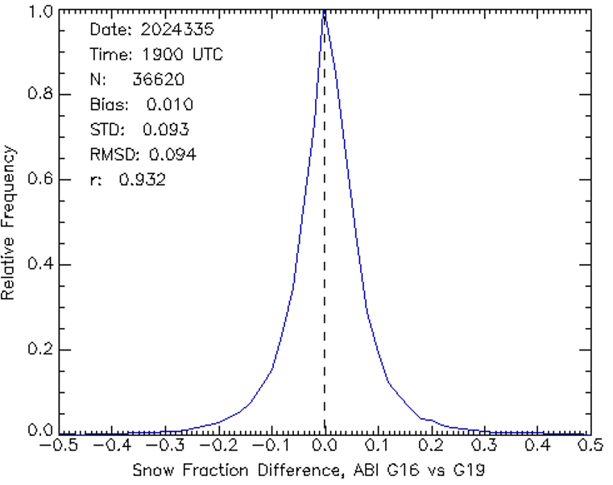
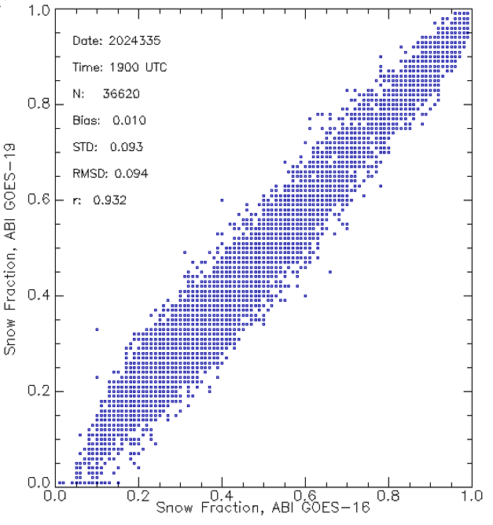
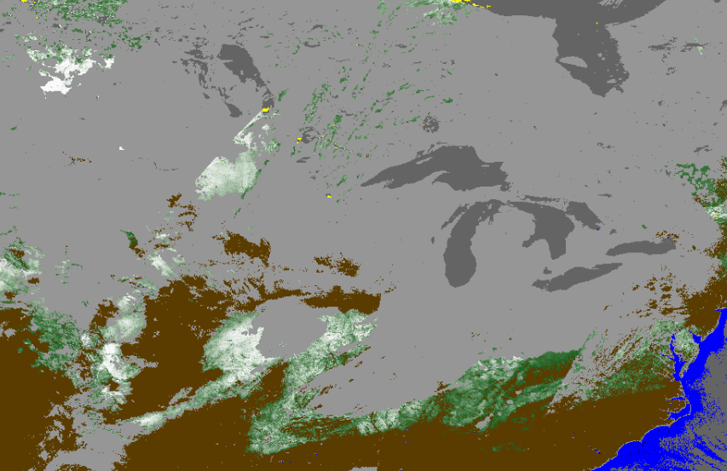
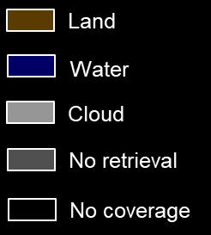
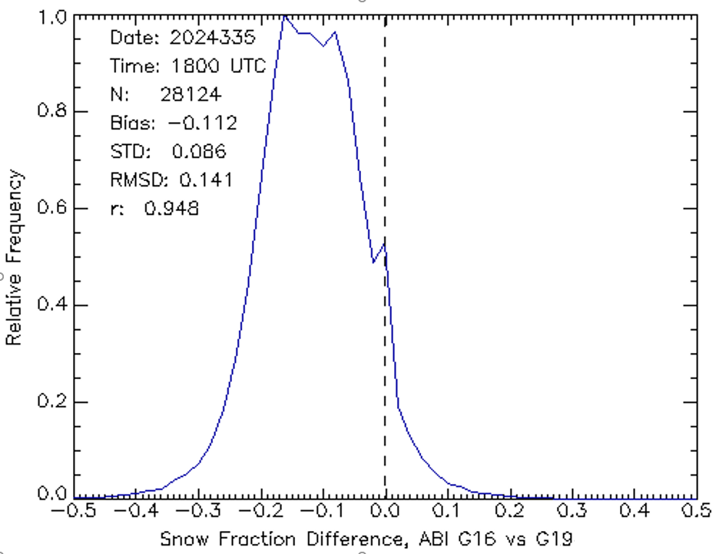
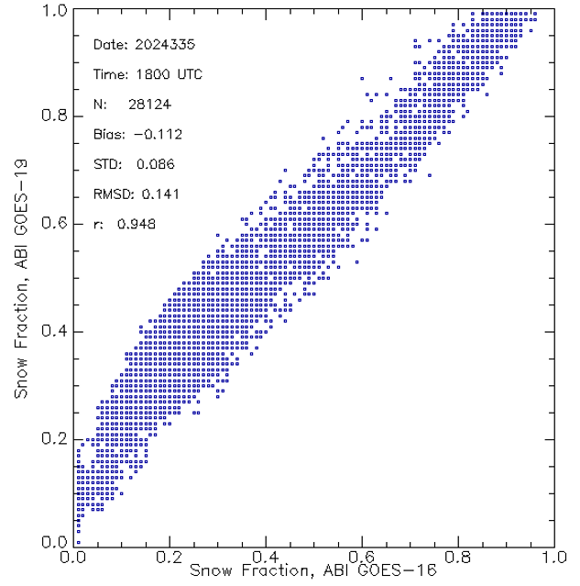
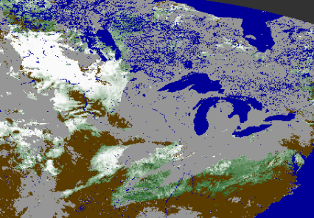

Snow Fraction: ABI G16 vs ABI G19
ABI GOES-19
Dec 1, 2024, 1900 UTC
1900 UTC
ABI GOES-16
Dec 1, 2024, 1900 UTC
1800 UTC
ABI GOES-16 and ABI GOES-19 matched statistics of derived snow fraction for 12/1/2025
Error Statistics (1300 to 2300 UTC) : Accuracy (Bias) : 0.01 … 0.22
Precision (STD): 0.10 … 0.18
This satisfies the requirement of FSC accuracy of 0.30 and FSC precision of 0.25

Slide 26
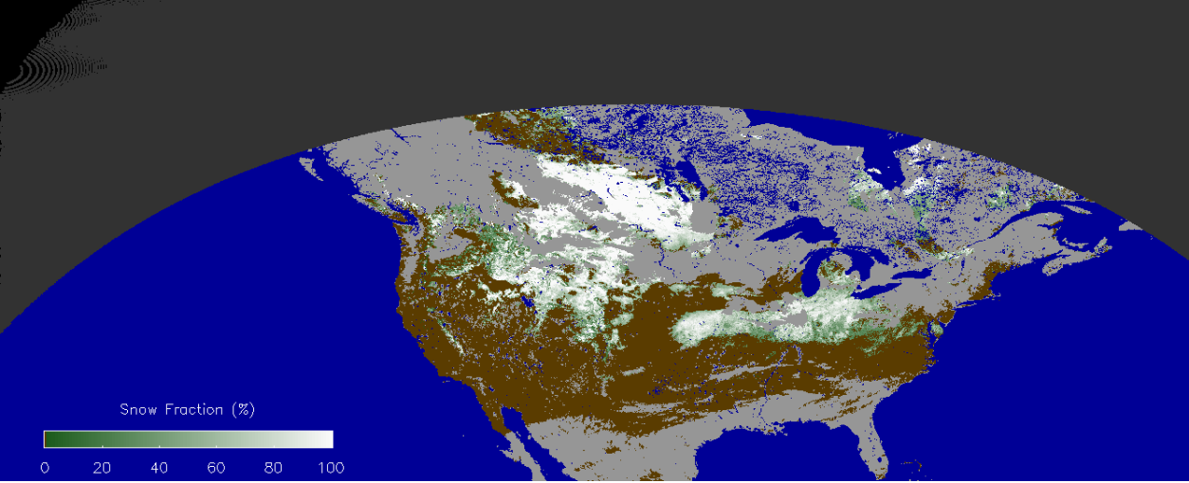
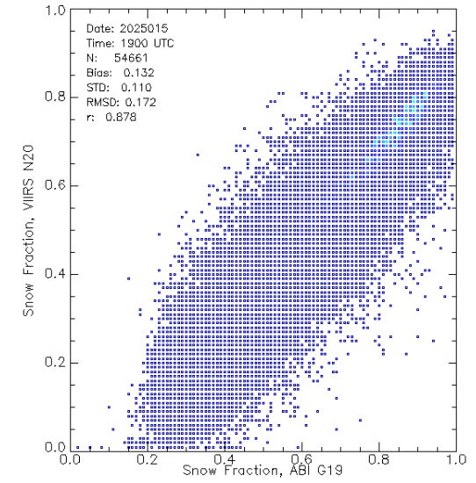
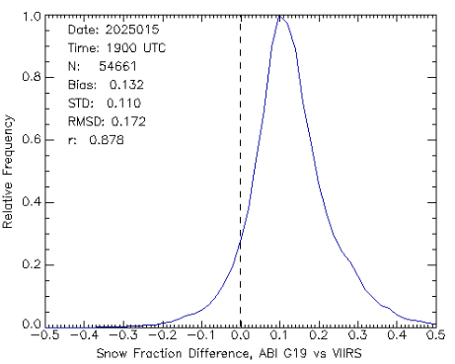
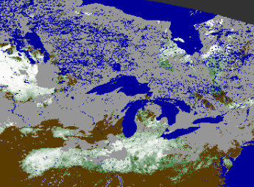
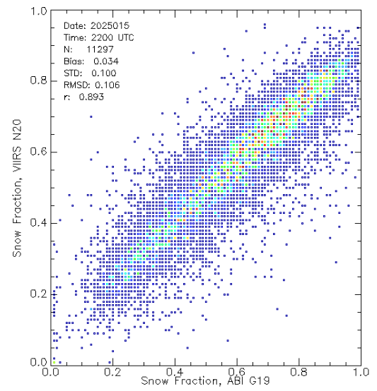
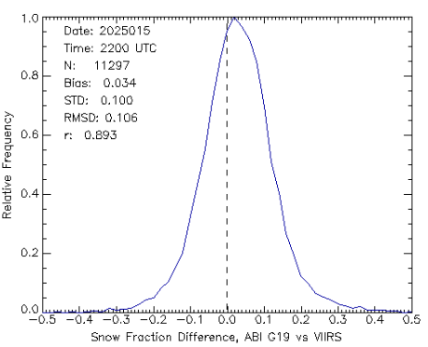
Snow Fraction: ABI G19 vs VIIRS
Scatterplot
Error Frequency
1900 UTC
ABI GOES-19
Jan 15, 2025, 1900 UTC
2200 UTC
ABI G19 vs VIIRS Match-up Statistics, 01/15/2025 (1300 to 2300 UTC)
Accuracy (Bias) : 0.05 … 0.20
Precision (STD): 0.10 … 0.18
This satisfies the requirement of FSC accuracy of 0.30 and FSC precision of 0.25

Slide 27
Snow Fraction: Validation Statistics
Product Requirement | Satellite | Requirement | Test Value (range) | Pass/Fail
Measurement Accuracy | G19 | 0.30 | 0.01 … 0.21 | Pass
Measurement Precision | G19 | 0.25 | 0.12 … 0.18 | Pass
Validation results have been obtained for ABI observations performed mostly at large solar and satellite zenith angles, beyond the geometry exclusion boundaries (Ɵ_{sat} = 55⁰ , Ɵ_{sol} =67⁰) set in the requirements. Better accuracy and precision should be expected for observations at smaller solar zenith and satellite zenith angles.

Slide 28
IDENTIFIED ISSUES
- In the Cloud Mask
- In the Snow Identification Algorithm

Slide 29
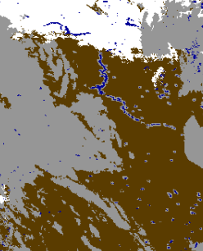
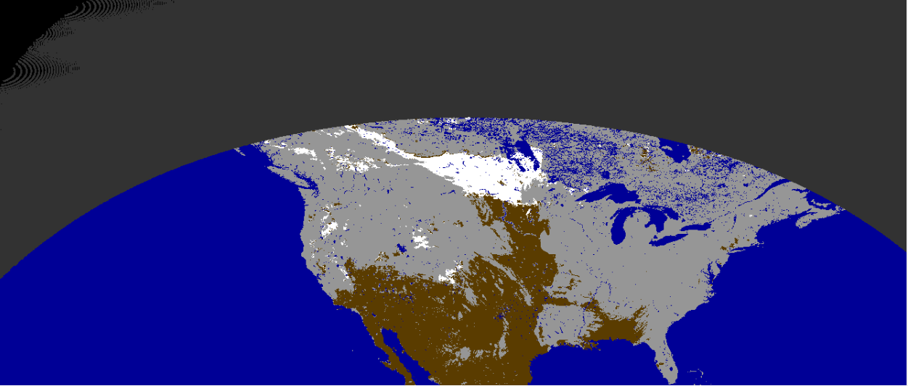
ABI Cloud Mask Issues:
Spurious snow along coastlines
GOES-19 ABI
Dec 29, 2024, 1900 UTC
Spurious clouds are frequently mapped along the land/water boundary by the cloud mask. This hampers proper snow mapping in coastal areas
Land
Water
Cloud
No retrieval
No coverage

Slide 30
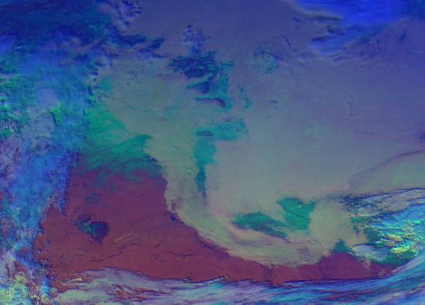
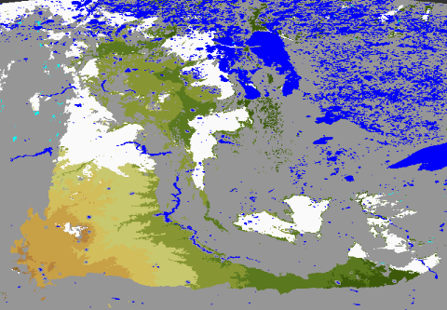
ABI Cloud Mask Issues:
Failure to identify low-level stratus over snow
ABI GOES-19
December 22, 2024 (day 2024358), 1900UTC
Low-level stratus clouds over snow are occasionally missed by the cloud mask. These scenes are not recognized as “snow” by the snow detection algorithm and therefore result in snow misses.

Slide 31
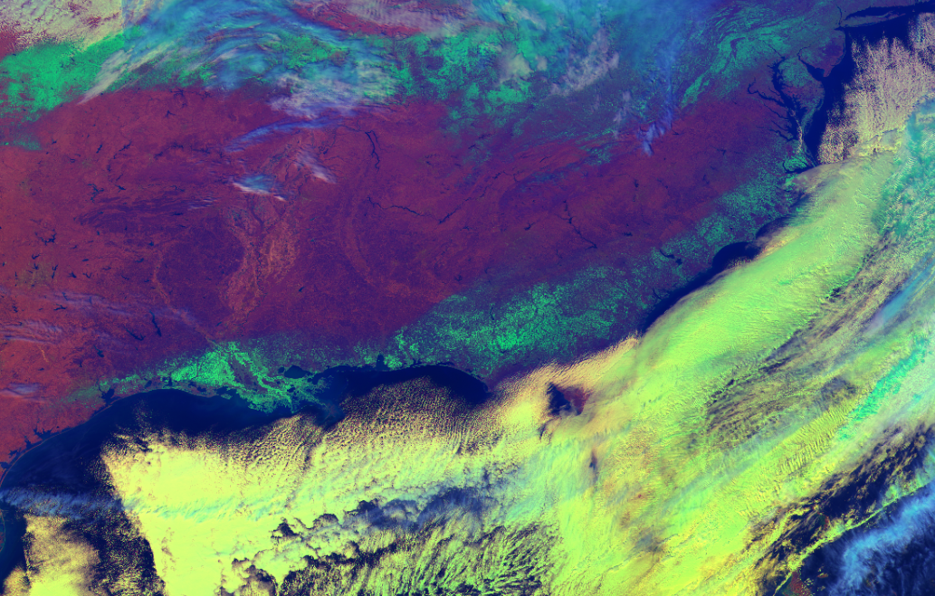
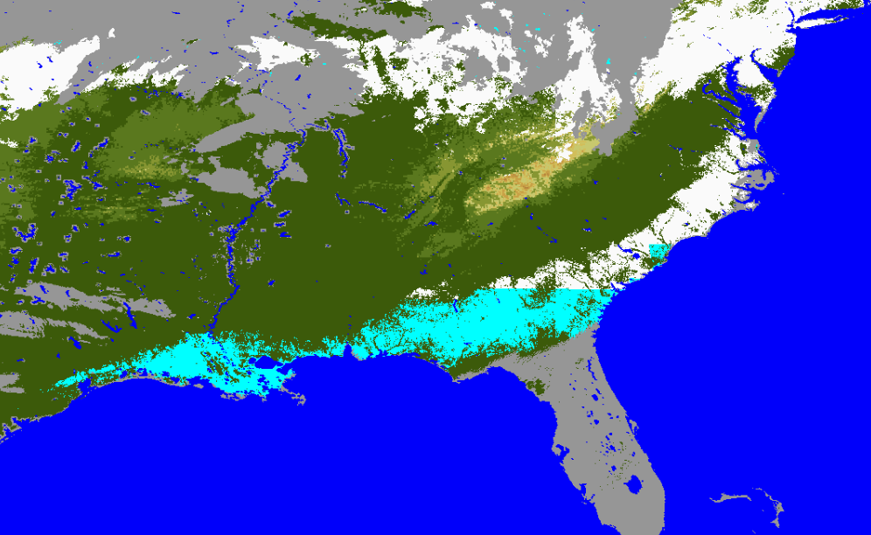
Snow Identification Issue
False Snow Rejection due to Inconsistent Snow Cover Climatology
Gulf Coast Snow, January 22-24, 2025
Rejected snow
Confirmed snow
- Snow storm in New Orleans on Jan 22, 2024 was the first one since 1963
- Snow cover along the Gulf Coast was identified but rejected as inconsistent with the snow cover climatology
- Snow cover climatology has been adjusted to allow snow cover in this region in January
- Updated data files will be implemented into OE with the next algorithm implementation

Slide 32
Validation Summary
GOES-19 ABI binary (IP) fractional snow cover FD products from OE over the period September 18, 2024 – February 15, 2025, 1300 to 2300 UTC have been evaluated.
ABI Binary snow product was evaluated by comparing with in situ data and IMS.
The ABI fractional snow cover products were evaluated by comparing with similar and finer resolution satellite data. Theoretical accuracy estimates have been performed.
Binary snow validation results
- 89.5-93% accuracy of snow/no-snow discrimination at 1300 to 2300 UTC
- Retrieval accuracy generally satisfies the requirement of 0.9 probability of correct snow/no- snow set for VIIRS
Snow Fraction validation results
  - Estimated measurement accuracy range: 0.01 to 0.22, precision range: 0.11 to 0.18
  - Product meets the required accuracy (0.30) and precision (0.25)

Slide 33
PROVISIONAL MATURITY ASSESSMENT

Slide 34
Provisional Validation
Preparation Activities | Assessment
Validation activities are ongoing and the general research community is now encouraged to participate. | True
Severe algorithm anomalies are identified and under analysis. Solutions to anomalies are in development and testing. | Minor anomalies have been identified. Solutions to anomalies have been developed and are being tested
Incremental product improvements may still be occurring. | Yes
L2+ only: Users are engaged in the Product Feedback Forums and user feedback is assessed. | Potential users are aware of the product.The user feedback will be available once the product becomes operational and accessible through AWIPS.
End State | Assessment
Product performance has been demonstrated through analysis of a small number of independent measurements obtained from select locations, periods, and associated ground truth or field campaign efforts. | True
Product analysis is sufficient to communicate product performance to users relative to expectations (Performance Baseline). | True
Documentation of product performance exists that includes recommended remediation strategies for all anomalies and weaknesses. Any algorithm changes associated with severe anomalies have been documented, implemented, tested, and shared with the user community. | True.
Testing has been fully documented. | True
Product is ready for operational use and for use in comprehensive cal/val activities and product optimization. | True

Slide 35
PATH TO FULL VALIDATION

Slide 36
Path to Full Validation
Monitoring of the snow product will continue to assess its performance throughout the whole year
Binary snow cover and snow fraction accuracy estimates will be stratified by
  Surface cover type (grasslands/forest)
  Topography (plains/alpine areas)
  Observation geometry (solar and satellite zenith angle)
Product performance will be evaluated both over North and South America
A larger number of case studies evaluating the agreement of GOES-19 ABI snow products to snow products from other satellite sensors (GOES-16,18 ABI, VIIRS , AVHRR) will be examined
Comparison of GOES-19 ABI snow cover fraction with snow fraction derived with higher resolution satellite sensors (Landsat, Sentinel) will be performed.

Slide 37
Users and Applications
At present NWS is the only known operational user for the ABI fractional snow cover product. Operational GOES-R ABI snow products are accessed through AWIPS. Products are used qualitatively by visual analysis and inspection of product images.
Quantitative application of the product is hampered due to
- Gaps in the coverage due to clouds
- Coarse effective spatial resolution of the product (~4 km at 60 deg latitude)
- Lack of orthorectified navigation. This is particularly important for alpine areas

Slide 38
SUMMARY & RECOMMENDATIONS

Slide 39
Summary
The performance of the GOES-19 ABI Enterprise FSC algorithm and product has been evaluated using a limited set of snow products derived within the GOES-R Operational Environment (OE).
The examined Binary Snow and Snow Fraction products generally satisfy the exiting mission precision and accuracy requirements.
Minor issues have been identified. They do not critically affect the product performance. Corrective measures have been taken.
The product is ready for operational use. Users (NWS) will be able to access and evaluate the product once it is available at AWIPS.

Slide 40
Recommendation
Declare the GOES-19 ABI Enterprise FSC product status as Provisional
Continue monitoring of the product performance. This will yield more reliable/justified/comprehensive accuracy estimates throughout the year.
Continue working to further improve the product properties and usability
- Daily clear sky compositing - to reduce cloud gaps
- Combine ABI snow retrievals with microwave data - to fully eliminate cloud gaps
- Improve the spatial resolution to 0.5-1 km- to satisfy model requirements
- Develop orthorectified product images - to ensure more accurate navigation of the product

Slide 41
