Slide 1
GOES-19 ABI L2+ SST
Provisional Review
February 19, 2025, GOES-R AWG SST Team
Veronica Lance (fed team lead)*,
Victor Pryamitsyn (presenting), Olafur Jonasson, Yury Kihai
*NOAA NESDIS STAR,
GST Inc.

Slide 2
Agenda
Product Overview
Specs/Requirements
NOAA SST Monitoring System
Provisional Maturity Assessment
Conclusion & Path to Full Validation
Summary and Recommendations

Slide 3
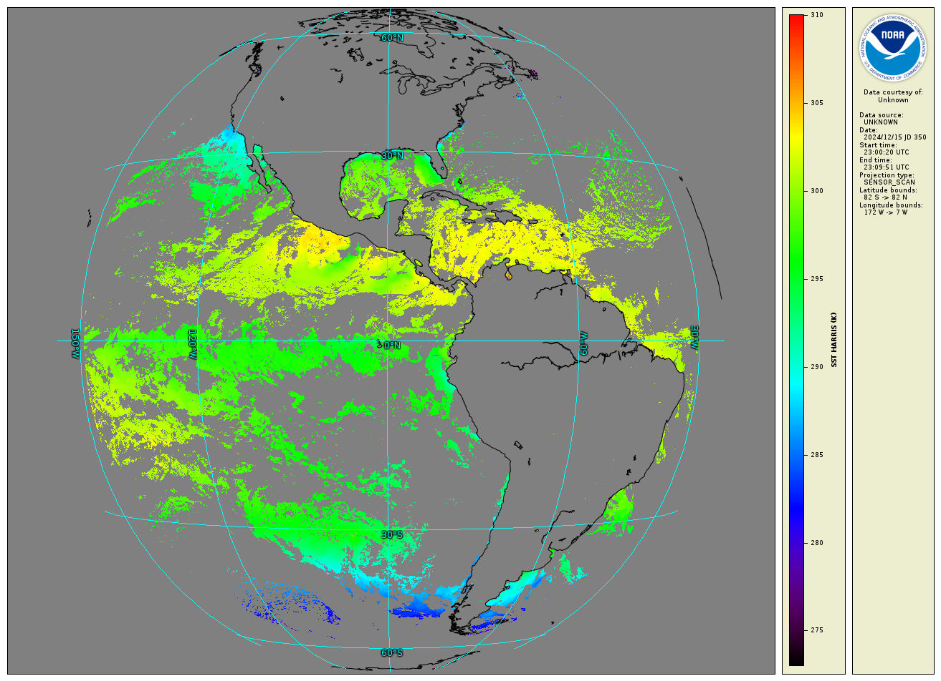
Baseline Product Overview
Baseline SST Product:
  Uses Binary Cloud Mask “Confidently Clear” from Cloud Team as well as individual cloud tests
  Additionally Performs SST QC
  Employs regression trained against quality controlled in situ data
  Uses 11(8.5µm), 13(10.3µm), 14(11.2), &15(12.3µm) bands
Processes all 10min FD data and aggregates them into 1hr composites
Only L2 baseline product is available (no gridded L3 produced)
Open ocean only (no internal water, like Great Lakes)
No downstream products affected by SST
Example 1hr composite SST FD Image
on 15 Dec 2024 @23.00UTC

Slide 4
Summary of GOES-19 ABI L2+ SST status on Jan 2025
The GOES-19 L2 Baseline SST official product name is ‘ABI L2 Sea Surface (Skin) Temperature’ consists of 24 hourly NetCDF files per day, containing two data layers: ‘The ABI L2+ Sea Surface (Skin) Temperature’ and ‘ABI L2+ Sea Surface (Skin) Temperature data quality flags’
The BASELINE L2 SST data for the period from 2024-09-26 to 2025-01-31 (127 days, 127*24=3048 possible L2 files/granules ) was studied for the purposes of SST Quality Analysis:
Total number of the readable SST granules is 2945, remaining granules are missing or unreadable
We have found four unreadable files with a broken names:
OR_ABI-L2-SSTF-M6_G19_s20000011200000_e20243591409513_c20243591410479.nc,
OR_ABI-L2-SSTF-M6_G19_s20000011200000_e20243591409513_c20243591410479.nc,
OR_ABI-L2-SSTF-M6_G19_s20000011200000_e20243590109511_c20243590112399.nc,
OR_ABI-L2-SSTF-M6_G19_s20000011200000_e20243590109511_c20243590112399.nc,
where _s20XXX is the granule start timestamp, _e20XXXX is the granule end timestamp and _s20XXX is the granule creation timestamp.
We have found that 38 granules out of 2945 (~1.3%) have corrupted ‘ABI L2+ Sea Surface (Skin) Temperature data quality flags’ layer, which makes those granules unusable for SST purposes
The problem with corrupted ‘ABI L2+ Sea Surface (Skin) Temperature data quality flags’ layer is not specific for the GOES-19, it has been repeatedly going on for the same product for GOES-16, GOES-17 and GOES-18.

Slide 5
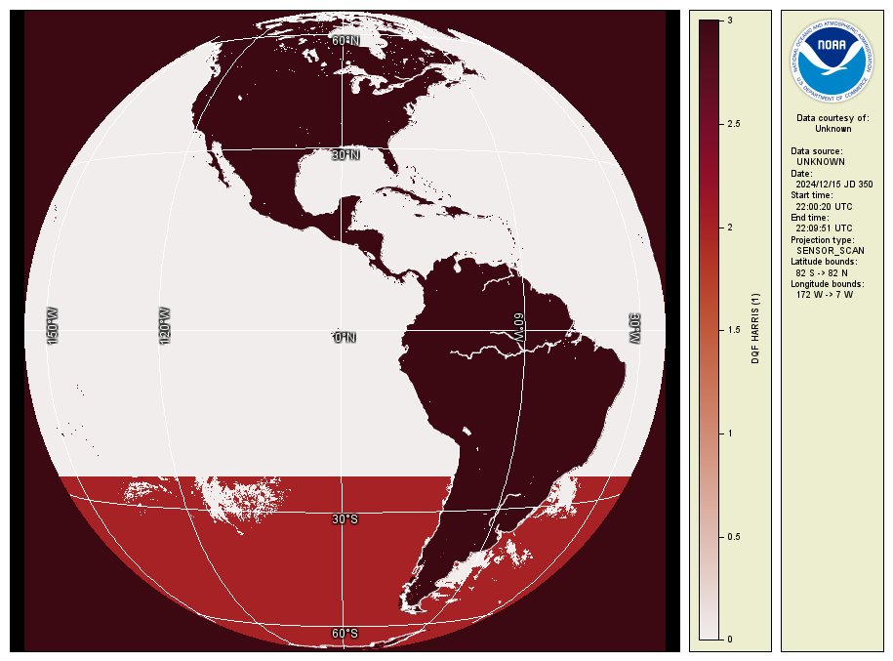
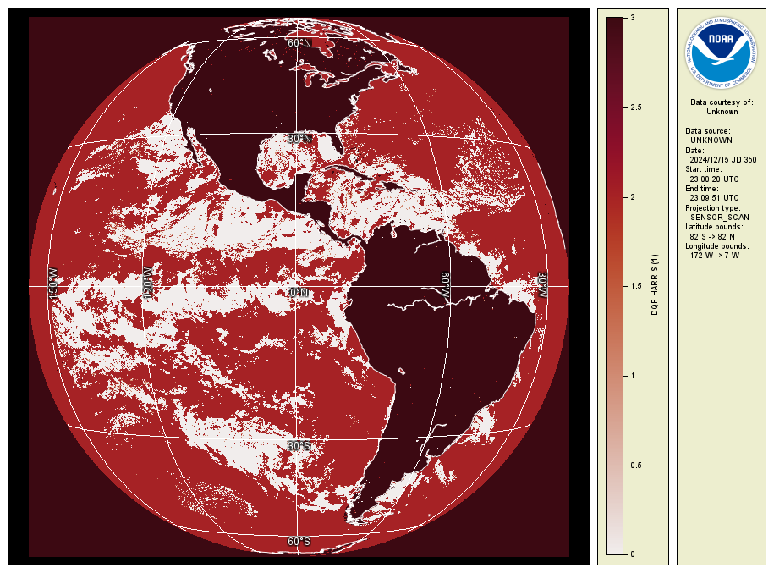
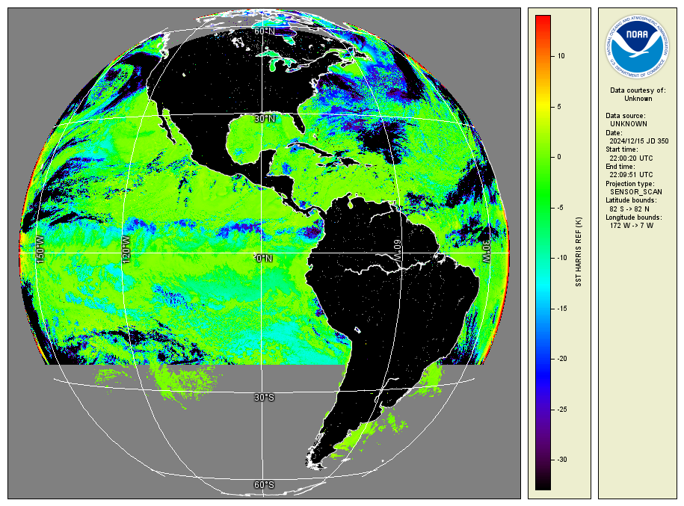
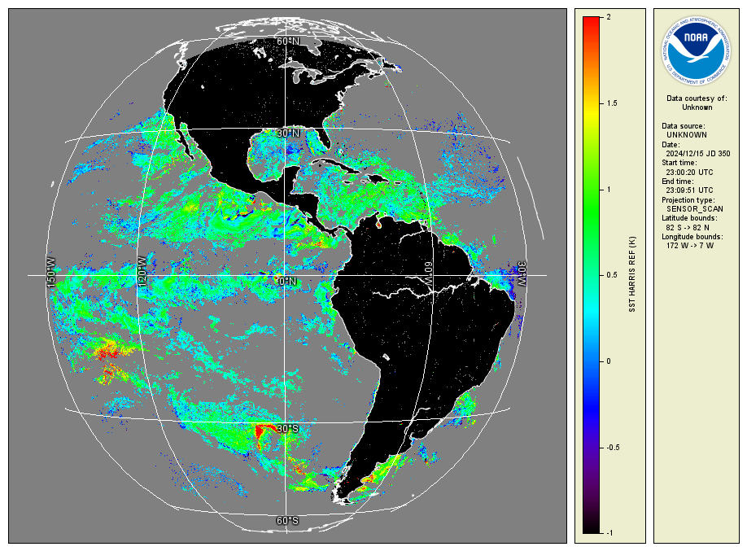
Corrupted vs correct quality flags (DQF)
Quality flags DQF=0 marks the clear sky SST pixels. Granule at the left side for 2024-12-15T22-00 has a large area where DQF is erroneously set to zero (white pixels). The granule at the right for 2024-12-15T23-00 has valid DQF. Tickets submitted to PRO: WR3207 ‘Incorrect DQFs’ and ADR269/ WR4214 ‘Anomalies in SST product’
Maps at the left and right show the difference between L2 SST and a L4 SST product (CMC*) for the same day at the pixels marked as ‘good quality’.
Granule at the left side for 2024-12-15T22-00 and at the right for 2024-12-15T23-00.
Gray pixels are masked pixels (cloud/ice). One can see that the left granule is unusable for SST applications.
*CMC is the Canada Meteorological Center.
See https://doi.org/10.5067/GHCMC-4FM03

Slide 6
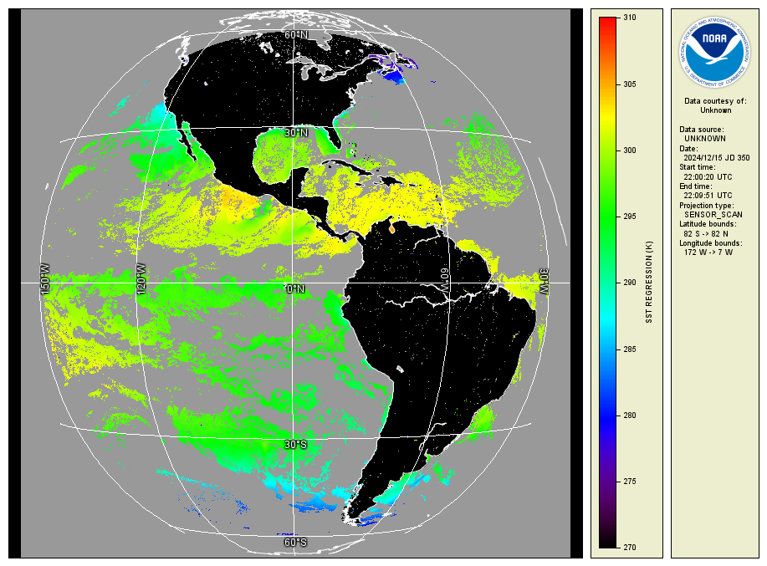
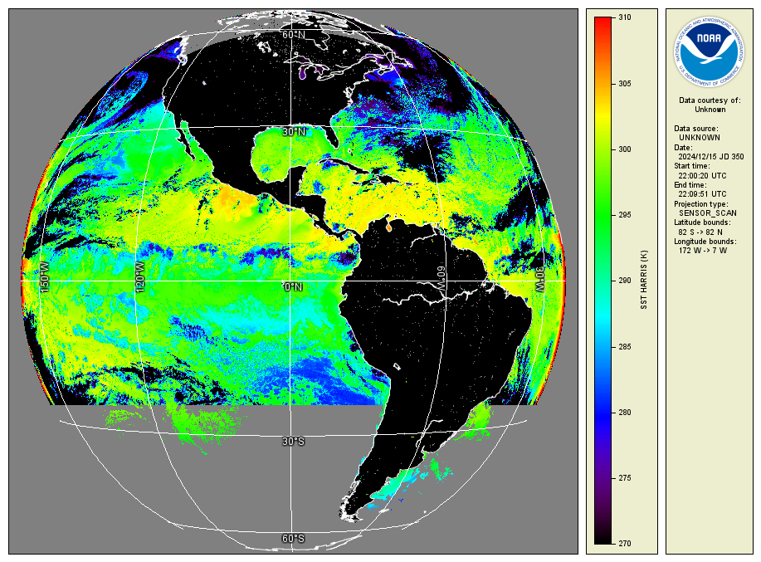
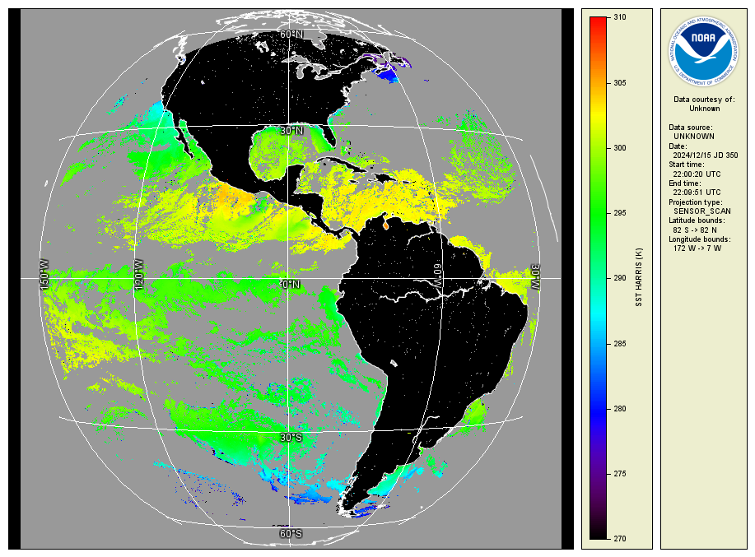
Applying ACSPO Clear Sky Mask to the Baseline L2+SST on a corrupted granule
ACSPO v.3.00 SST for G19 for
2024-12-15T22-00
Baseline L2+SST for G19 for
2024-12-15T22-00
with the DQF Clear Sky Mask
Baseline L2+SST for G19 for
2024-12-15T22-00
with the ACSPO Clear Sky Mask
One can see that ACSPO Clear Sky Mask almost cover the anomalies in the Baseline L2+SST, which that the SST layer is most probably correct, and the only problem is the corrupted DQF Clear Sky Mask

Slide 7
G19 Provisional
Maturity Assessment

Slide 8
Specific Objectives
of SST Provisional Review
Assess Accuracy & Precision of the SST product over a large/wide range of representative conditions, which may still be limited seasonally
SST meets its documented requirements (±3.1K mean bias, and 1K RMS wrt. in situ data) for view zenith angles ≤67º
Remediation strategies are in place for known issues
Product is ready for operational use and for potential use in scientific publications IF KNOWN ISSUES ARE RESOLVED
PLPT ID | Descriptive Title | % Complete | Results | AWG POC
ABI-FD_SST01 | Verify that SST product is generated at the required cadence for FD | 100% | Complete | V. Lance
ABI-FD_SST02 | Assess the accuracy and precision of the SST product | 100% | Complete | V. Lance
SST RIMP Version 2.0

Slide 9
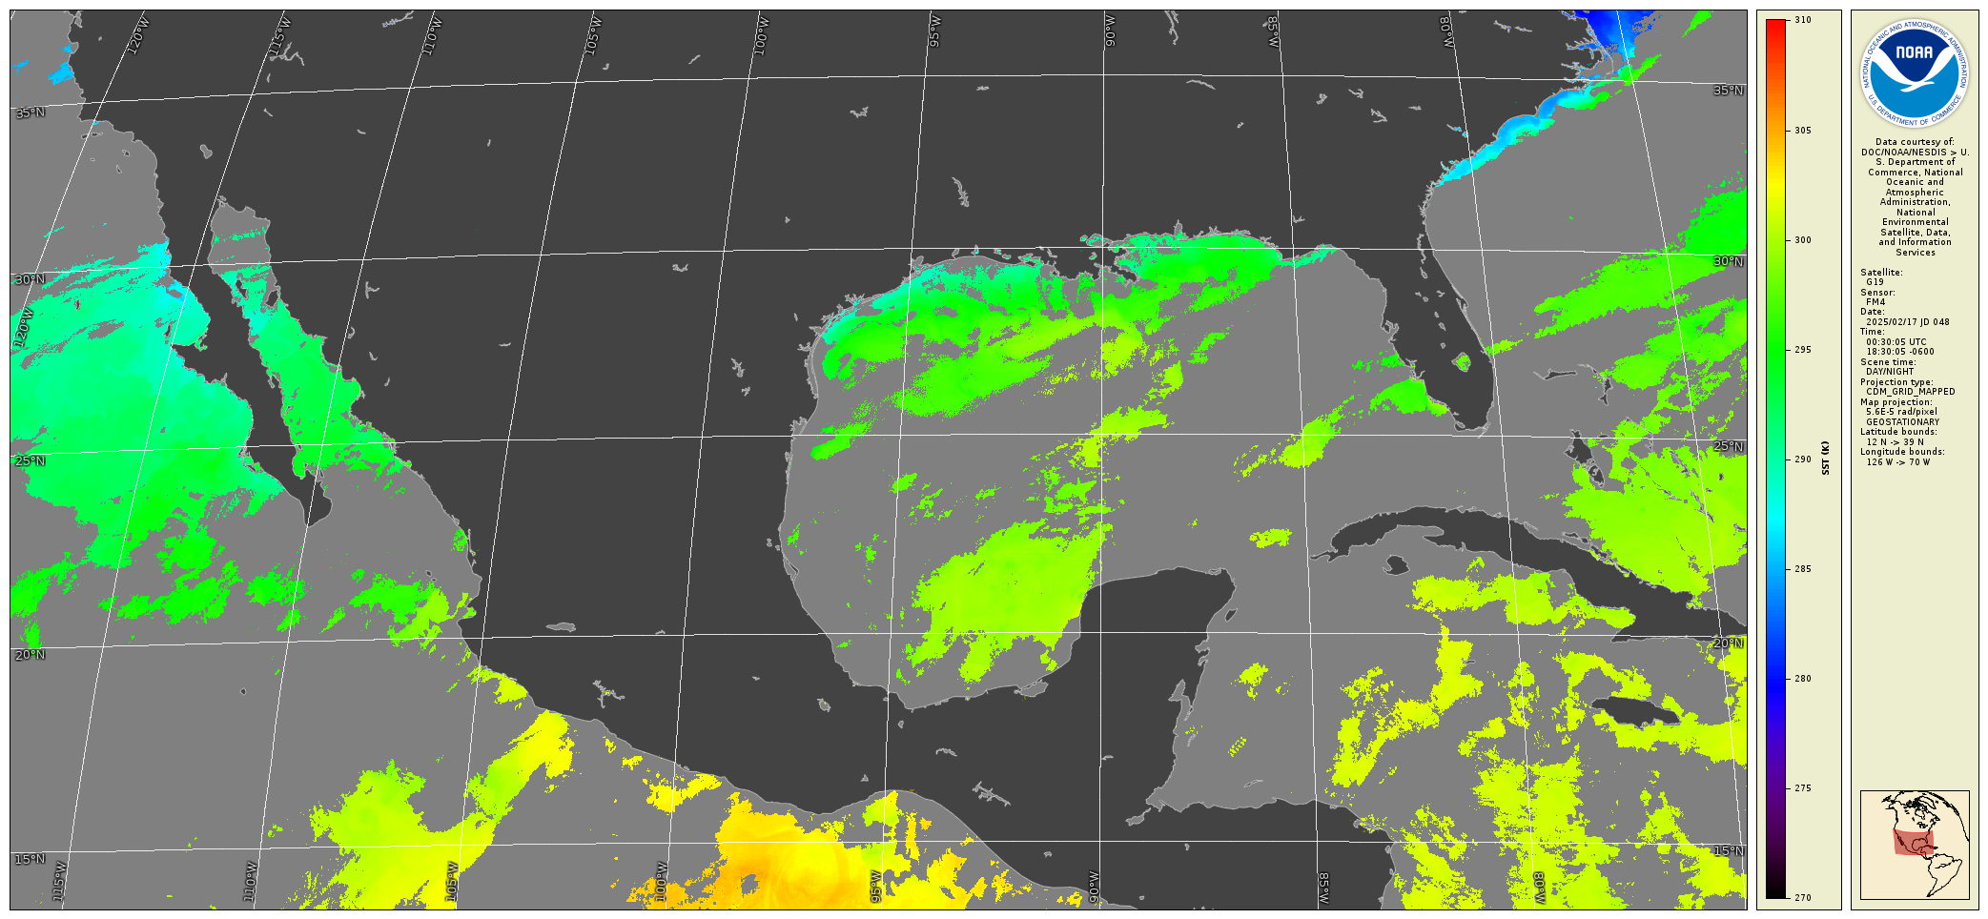
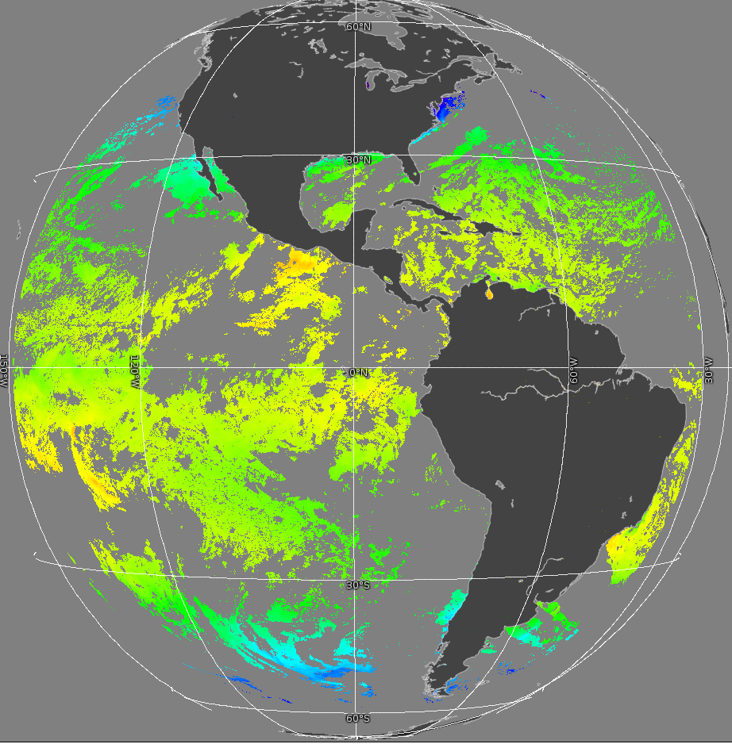
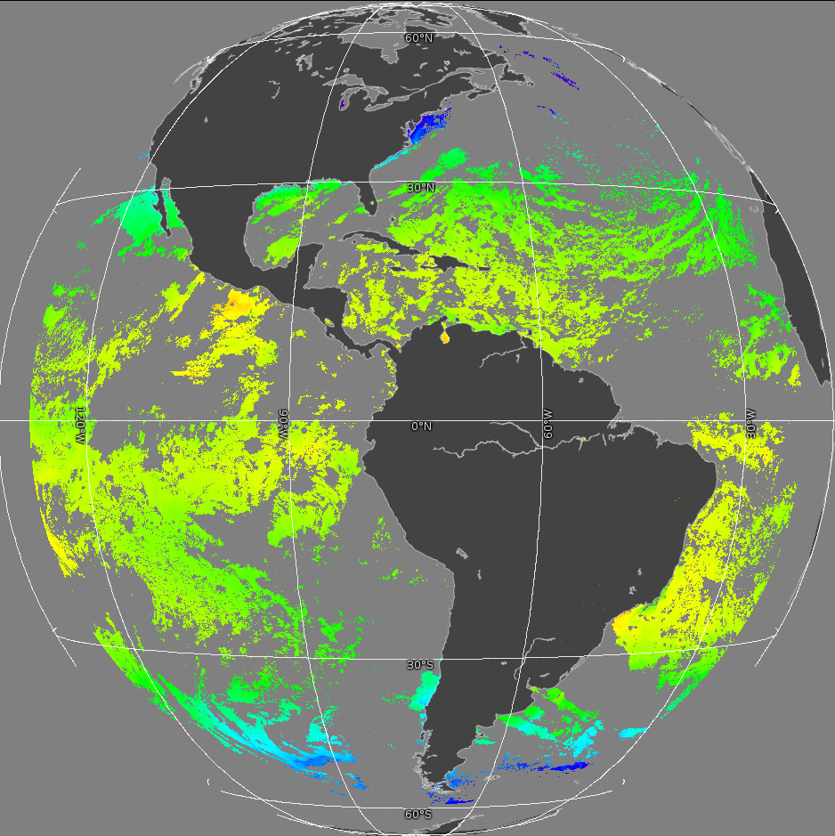
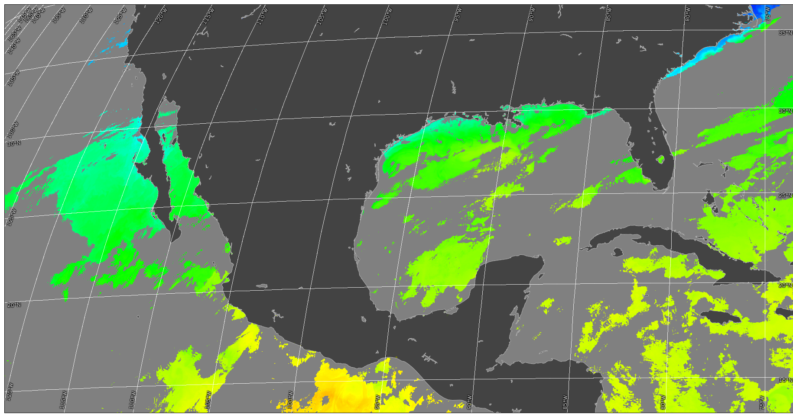
BASELINE SST for G-16 and G-19
Feb 17, 2025 00:00UTC
G19
G16
BASELINE SST products for G16 and G19 are consistent

Slide 10
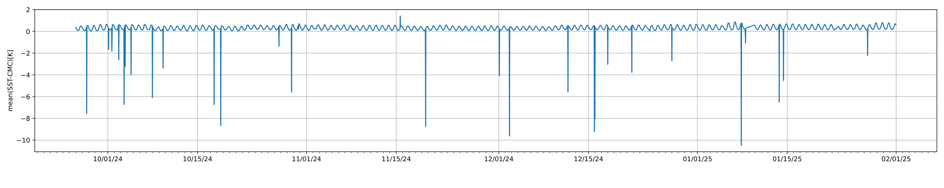
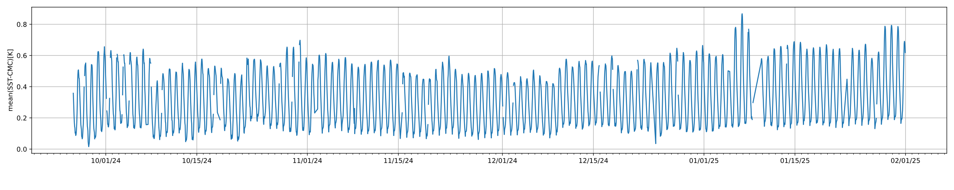
Hourly full disk statistics for the (L2 SST) – (L4 CMC*):
Mean difference (Accuracy)
Outliers corresponds to the granules with the corrupted quality flags (DQF) variable
The removal of the corrupted granules makes mean(SST-CMC) looks meaningful and demonstrates the diurnal SST variations. The overall the skin SST looks warmer than expected: The skin SST should be colder than L4 SST at the nighttime minima.
*CMC is the Canada Meteorological Center. See https://doi.org/10.5067/GHCMC-4FM03

Slide 11
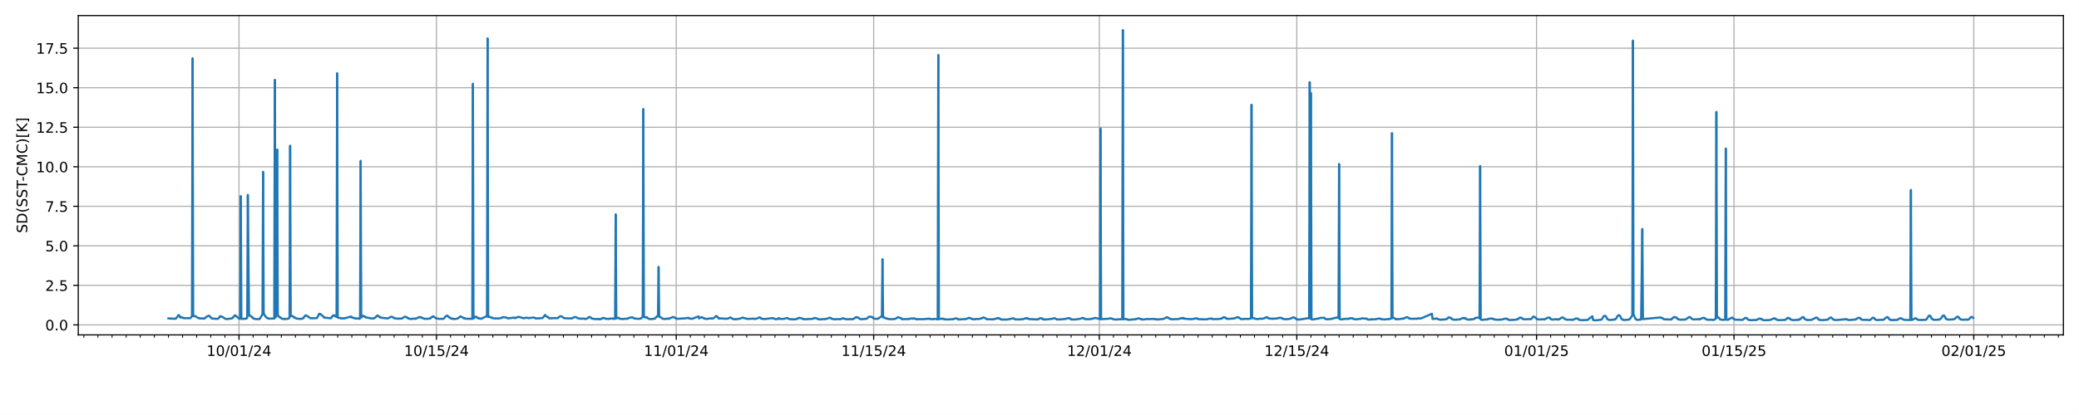
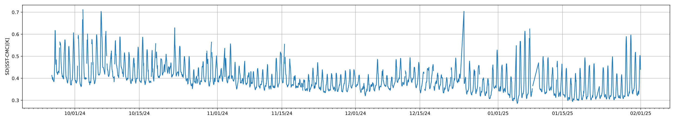
Hourly full disk statistics for the (L2 SST) – (L4 CMC):
Standard Deviation (Precision)
Outliers corresponds to the granules with the corrupted quality flags (DQF) layer
The removal of the corrupted granules makes the standard deviation (SST-CMC) reasonable and the nighttime SD < 1.0 K, which is the requirement

Slide 12
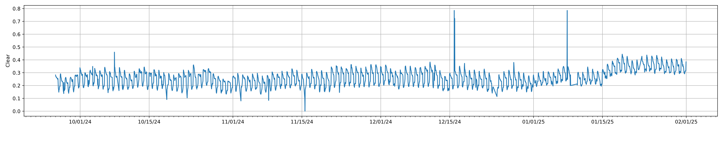
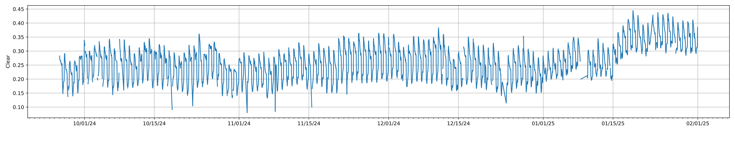
Hourly full disk statistics for the (L2 SST) – (L4 CMC):
Clear Sky pixels Fraction (CSF)
High CSF corresponds to the granules with the corrupted quality flags (DQF) layer
The removal of the corrupted granules makes CSF fluctuate in the range of 0.15<CSF<0.35, which is a reasonable value

Slide 13
Compliance with requirements is assessed using the
NOAA SST Monitoring System

Slide 14
GOES-R SST Specs
Mission / Instrument | Range | Accuracy⁽¹⁾ | Precision⁽²⁾
GOES-R ABI (F&PS/MRD) | 271 to 313 K | ±3.1 K* | 1.0 K*
JPSS VIIRS | 271 to 313 K | ±0.2 K | 0.6 K
POES/Metop-FG AVHRR | 271 to 313 K | ±0.2 K | 0.6 K
Metop-SG METimage | 271 to 313 K | ±0.2 K | 0.6 K
EOS MODIS | 271 to 313 K | ±0.2 K | 0.6 K
Himawari-8/9 AHI | 271 to 313 K | ±0.2 K | 0.6 K
MTG FCI | 271 to 313 K | ±0.2 K | 0.6 K
^{(*)} Ocean. Quantitative for LZA<=67º; Qualitative at LZA>67º
⁽¹⁾ Accuracy = ‘Global’ (Full Disk) Bias of (Sat - in situ SST)
⁽²⁾ Precision = ‘Global’ (FD) Standard Deviation of (Sat - in situ SST)
The F&PS/MRD specs for ABI SST are more liberal & inconsistent with LEO AVHRR/MODIS/VIIRS and GEO AHI/FCI. They may not meet requirements, needs, and expectations of many users
This review evaluates baseline G19 SST vs GOES-R F&PS specs

Slide 15
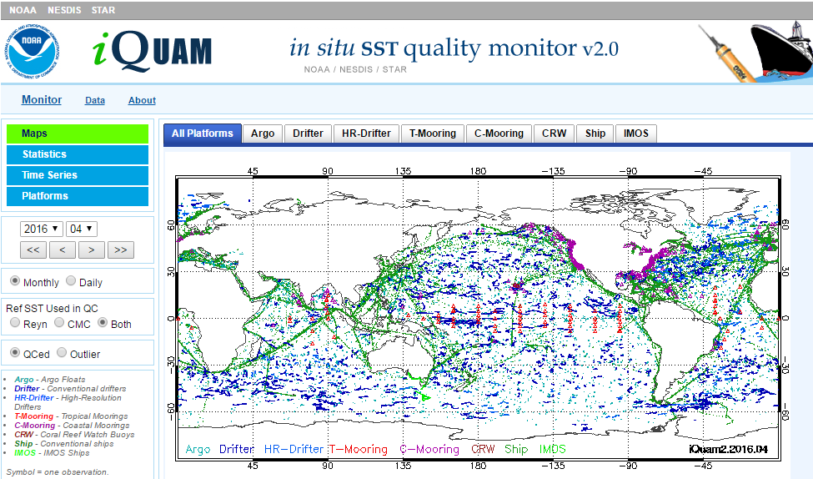
In situ SST Quality Monitor (iQuam)
www.star.nesdis.noaa.gov/sod/sst/iquam/
iQuam applies uniform QC to in situ SSTs (drifters, moorings, Argo, ships) & serves to users

Slide 16
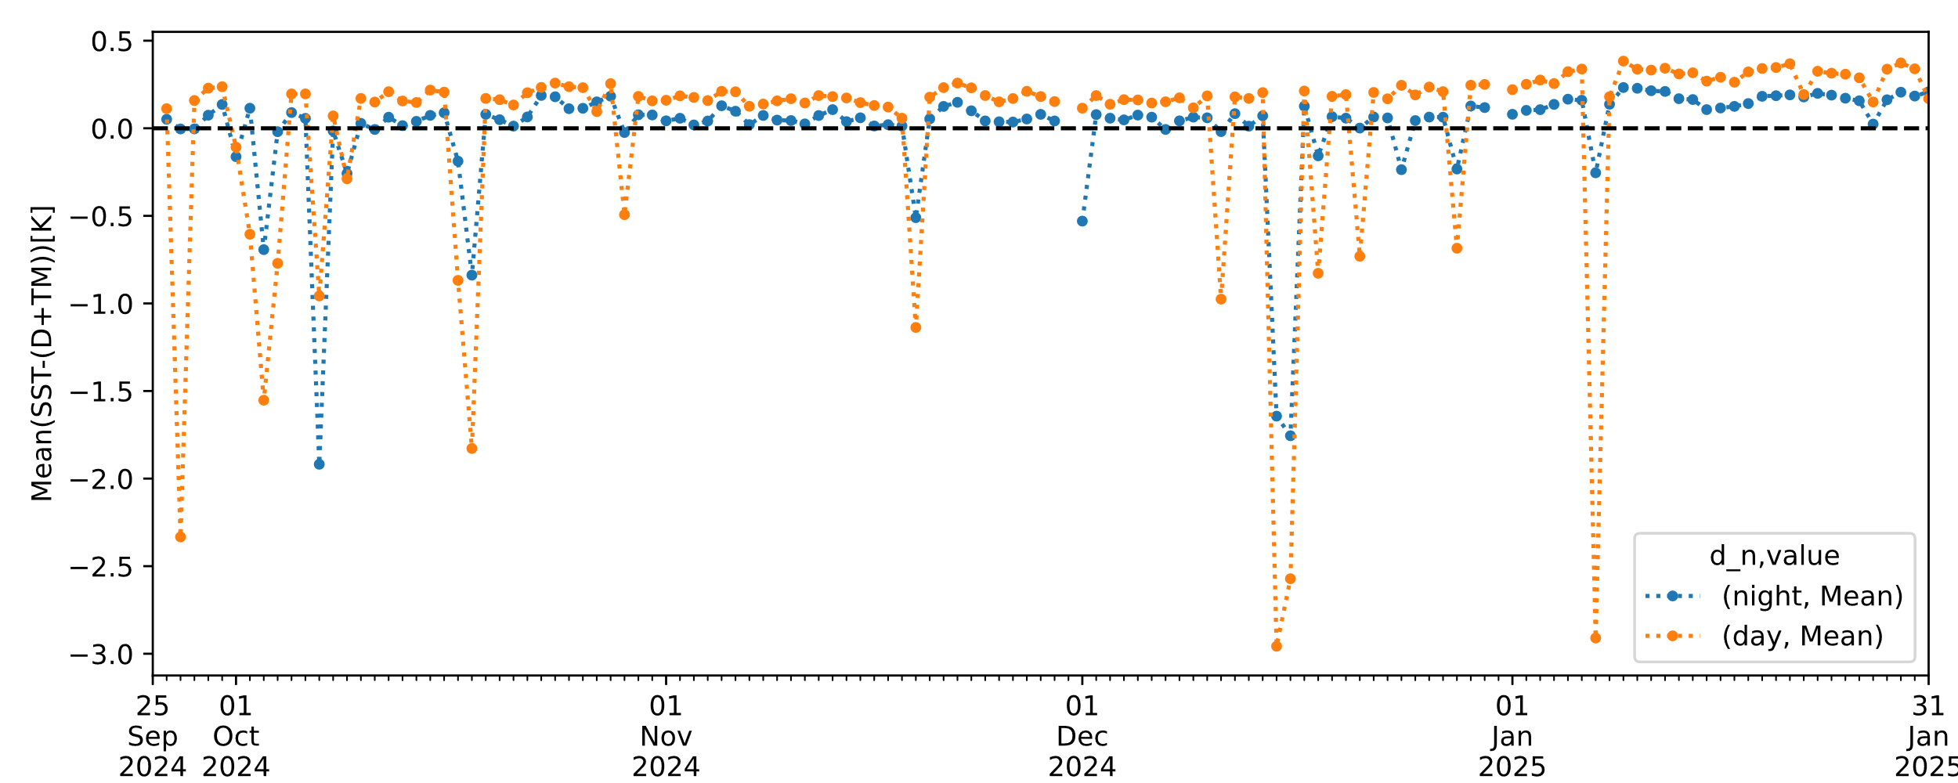
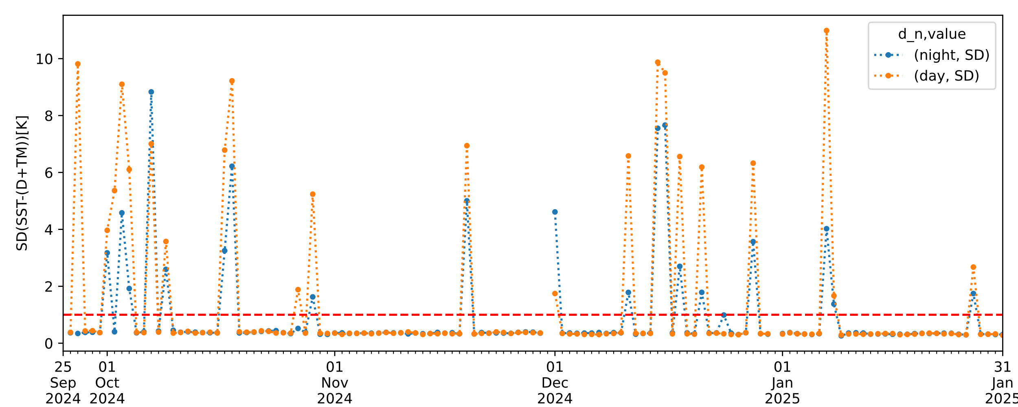
Daily statistics for the
(L2 SST) – (Drifter and Tropical Moorings):
Nighttime and daytime pixels are separated
We can see that even a single corrupted granule causes large outliers in the daily aggregated satellite - in situ SST statistics
The data for the ABI L2+ Sea Surface (Skin) Temperature does not meet precision requirements without the removal of the corrupt files
Mean values
Standard Deviation

Slide 17
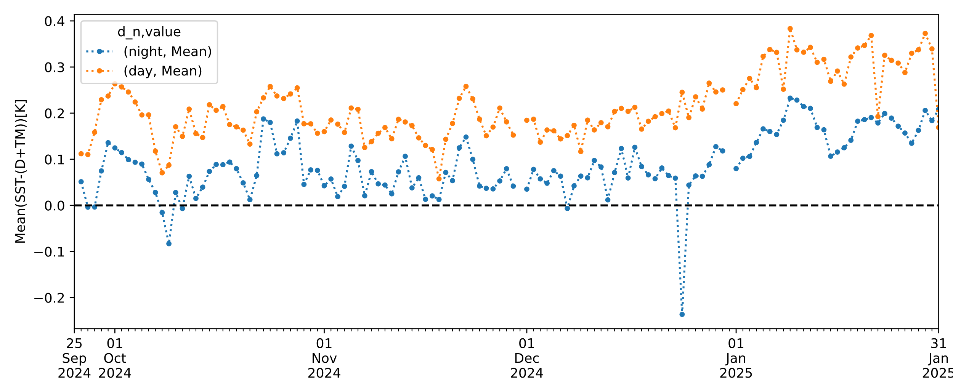
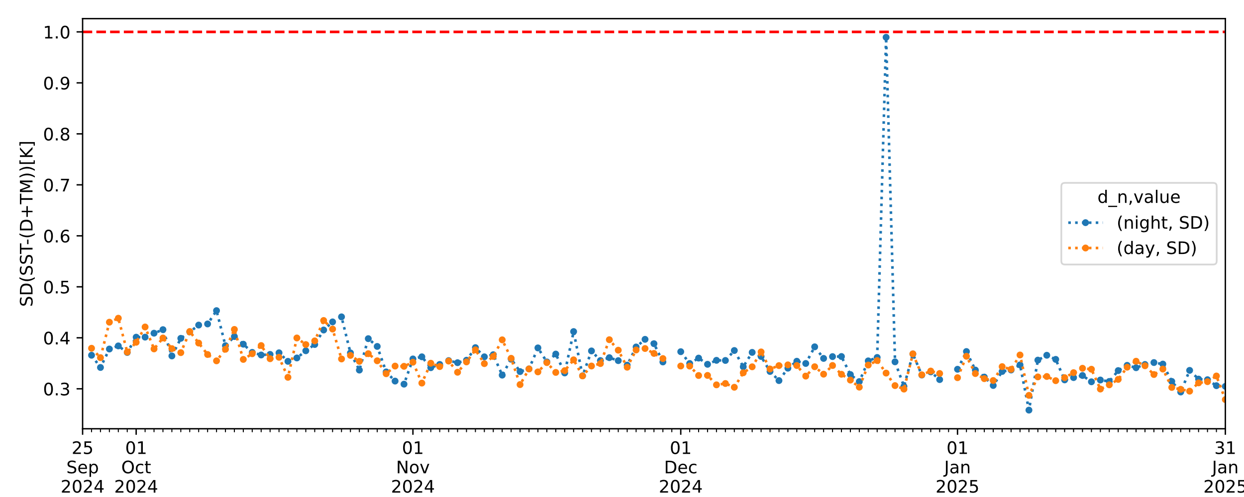
Daily statistics for the
(L2 SST) – (Drifter and Tropical Moorings):
Corrupted granules removed
We can see after the removal of the corrupted files, the global mean SST difference (accuracy) is significantly improved with and satisfies
-3.1 K < ΔSST < 3.1 K specification,
but it has a warm bias ~0.1K
The corresponding standard deviation (precision) is within the specification SD<1K
The apparent outlier at nighttime of 2024-12-24 is due to low number of L2 files (10 of 24) and most of the valid pixels are daytime, which results in a fluctuation of the nighttime statistics vs in situ data
Mean values
Standard Deviation

Slide 18
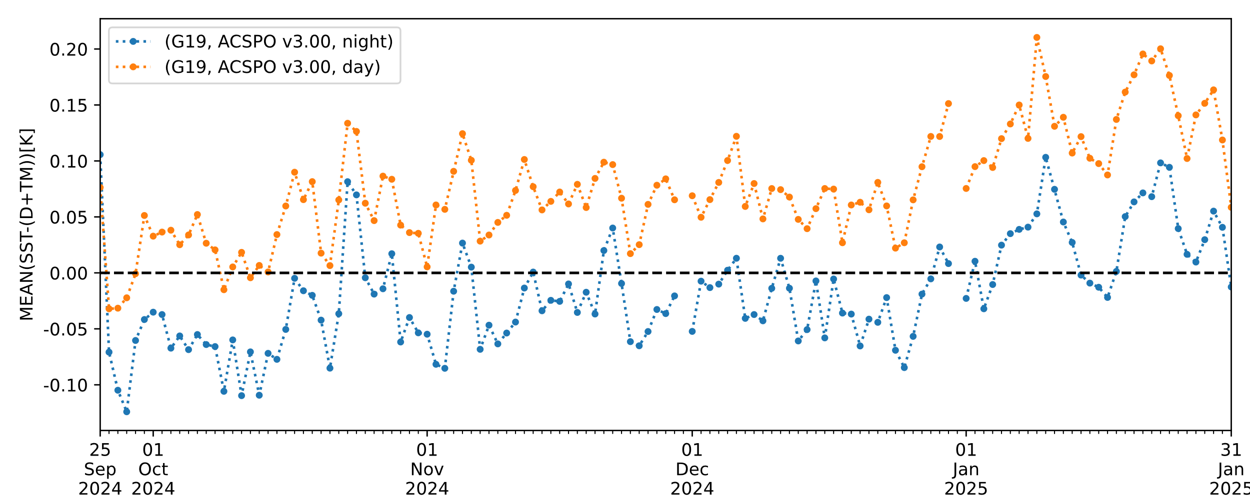
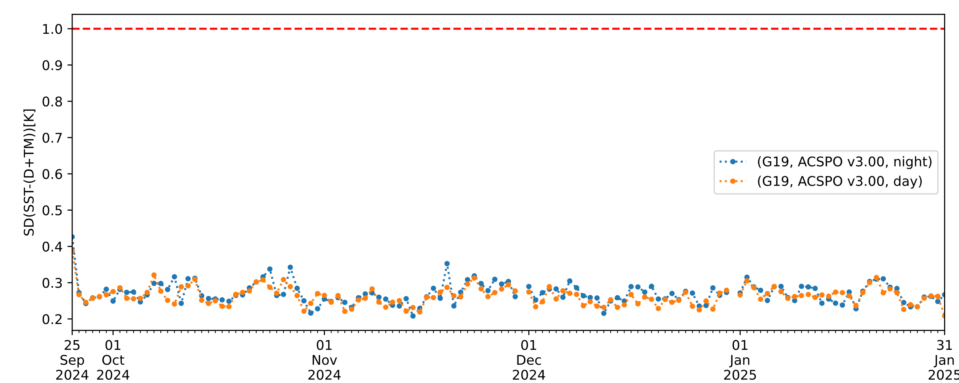
Daily statistics for the G19 ASCPO SST v3.0
(ASCPO SST) – (Drifter and Tropical Moorings):
No granules removed
Mean values
We can see that ACSPO SST satisfies a strict condition
-0.2 K < ΔSST < +0.2 K specification without any adjustment
The corresponding standard deviation (precision) is significantly lower for ASCPO SST if compared with the Baseline SST Product
Standard Deviation

Slide 19
Baseline vs. Enterprise SST
Feature | Baseline | Enterprise
Algorithm | 2010 ACSPO⁽¹⁾ v1.20 (“SEVIRI”) | 2022-2025 ACSPO⁽¹⁾ v2.70/2.80/2.90/3.00 (“AHI/ABI”)
Bands used for SST | Reconciled w/ACSPOv2.41 | Day & Night: 8.6, 10.4, 11.2, 12.3 μm
Switch between day/night | Reconciled w/Enterprise | One algorithm ensures consistent diurnal cycle
Availability to users | PDA, NODD (AWS) | PDA, PO.DAAC, NCEI, CoastWatch
Clear-Sky Mask | Framework “One-size-fits-all” | Optimized for SST, consistent for LEO/GEO
Internal Waters | No | Yes
Gridded L3U Product | No | Yes (consistent w/VIIRS/AVHRR/AHI/MODIS)
Output File Format | Non-GDS2 | GDS2⁽²⁾ – Critical for International SST users
SSES⁽³⁾ | No | Yes. Minimizes local SST biases & global SDs
1hr Compositing/Collation | Composite (propagates cloud) | Collated (minimizes cloud leakages)
Fixes/Improvements | Challenging | Ongoing
Science Maintenance/Val | Unique (Costly/Less Efficient) | Unified (Enterprise Processes)
Reprocessing | No provision | Yes
Consistent w/NOAA SSTs | No | Yes (w/VIIRS/AVHRR/AHI/MODIS)
⁽¹⁾ ACSPO: Advanced Clear-Sky Processor for Oceans – NOAA Enterprise SST System; ⁽²⁾ GDS2 : Group for Hi-Res SST (GHRSST) Data Spec v2.0 – SST community standard; ⁽³⁾ SSES: Single Sensor Error Statistics – in-pixel estimates of SST bias and standard deviation (required by GDS2 format and by modelers, including NCEP)

Slide 20
Provisional Validation
Preparation Activities | Assessment
Validation activities are ongoing and the general research community is now encouraged to participate. | Ongoing validation activities. Data distribution to users starts following Provisional Validation Status Declaration.
Severe algorithm anomalies are identified and under analysis. Solutions to anomalies are in development and testing. | Science algorithm is solid. The implementation has 2 issues: (1) occasional wrong DQFs; and ) unreadable files with invalid timestamps. Both are addressed in the enterprise ACSPO code
Incremental product improvements may still be occurring. | ACSPO: Yes, Baseline SST: No
L2+ only: Users are engaged in the Product Feedback Forums and user feedback is assessed. | Yes, we are working with Geo Polar Blended (GPB) Team
End State | Assessment
Product performance has been demonstrated through analysis of a small number of independent measurements obtained from select locations, periods, and associated ground truth or field campaign efforts. | Yes and more. Analyses have been performed for all FD data for a representative 4-month period and we are confident that these analyses are sufficient to determine the product performance.
Product analysis is sufficient to communicate product performance to users relative to expectations (Performance Baseline). | Yes. Analyses show SST is generally within specifications.
Documentation of product performance exists that includes recommended remediation strategies for all anomalies and weaknesses. Any algorithm changes associated with severe anomalies have been documented, implemented, tested, and shared with the user community. | Yes. See this G19 provisional review, and prior G16/G17/G18 beta and provisional reviews.
Testing has been fully documented. | Yes. See this G19 provisional review, and prior G16/G17/G18 beta and provisional reviews.
Product is ready for operational use and for use in comprehensive cal/val activities and product optimization. | Yes. See this G19 provisional review, and prior G16/G17/G18 beta and provisional reviews.

Slide 21
Conclusion
As of now, approximately 1% of Baseline L2 SST files/granules contain a corrupted Clear Sky Mask and SST product does not meet product specification if those granules are not identified and removed
A removal of corrupted granules brings the quality of the Baseline L2 SST for G-19 within the specification.

Slide 22
ADRs/WRs
WRs/ADRs submitted for G16 (still valid for G19)
Title | Description | Status | Planned Mitigation | Current Status
WR3207 | SST DQF appears to be incorrect | In_Work | DO.06 | Partially resolved
ADR269 (WR4214) | Anomalies in SST Product | In_Work | DO.06 | Partially resolved
These issues do not affect the ACSPO V3.00 G19 SST product.
Notes:
PRO Fills this In

Slide 23
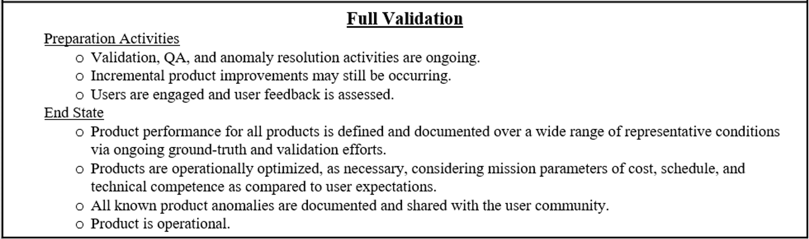
Path to Full Validation
For Full Validation we will perform the same analysis, but for a longer time period, for G19 in the Goes-East position
We also expect feedback from users

Slide 24
Summary and Recommendations
The AWG SST Team believes that the GOES-19 SST Baseline Product has reached Provisional Maturity excluding anomalously processed files
Our recommendation is to retire Baseline L2 SST for ABI and replace it with the Enterprise ACSPO SST v 3.00 for ABI, which was delivered to ASSISTT on January 14, and we expect production at OSPO to start in 2025 for G19 and G18
Remaining issues with G19 Baseline L2 SST will be addressed by transition to ACSPO SST

