Slide 1
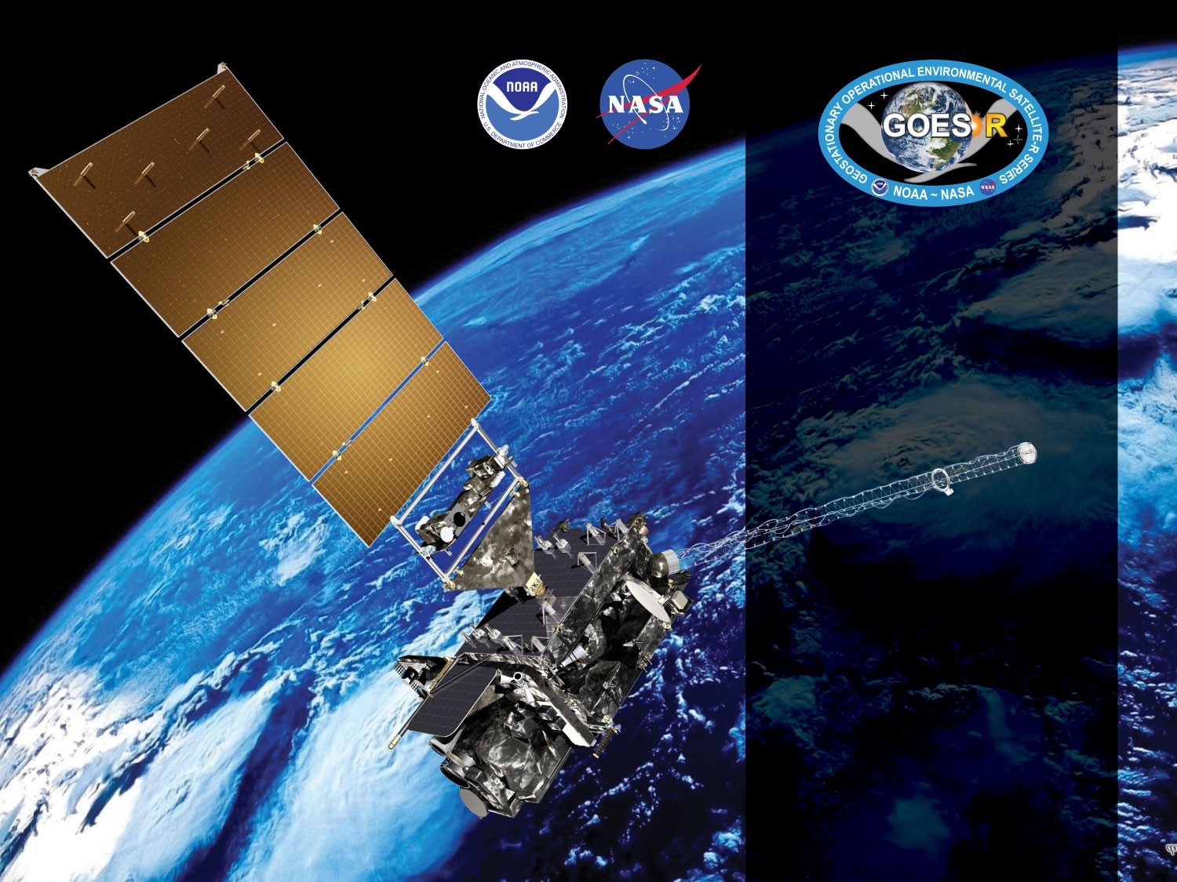


GOES-19 ABI L2+
Land Surface Temperature
Provisional PS-PVR
February 12th, 2025
GOES-R AWG LST Team
PI: Yunyue Yu (NESDIS/STAR),
CI: Peng Yu (CISESS/UMD)
Presenter: Peng Yu
Notes:
PS-PVR = Peer Stakeholder – Product Validation Review

Slide 2
Outline
Product Overview
Provisional Validation Product Maturity Assessment:
  Visual inspection
  Product Validation
  Inter-sensor Comparison
Path to Full Maturity
Summary and Recommendations

Slide 3
PRODUCT OVERVIEW
GOES-19 Land Surface Temperature Provisional PS-PVR

Slide 4
LST Product Overview
Land Surface Temperature (LST) is how hot/cold the “surface” of the Earth would feel to the touch
LST is a critical geophysical parameter essential for climate monitoring and environmental applications
  An Essential Climate Variable (ECV) required by the Global Climate Observing System (GCOS) of the World Meteorological Organization (WMO)
  Extreme weather detection and analysis
  Used as input for the retrieval of other variables, e.g., Evapotranspiration
  Used to evaluate and test data assimilative numerical prediction model
  Urban heat island effect, air surface temperature retrieval, urban heat storage, drought, etc.
GOES-19 LST EDR consists of four hourly products: Full Disk (2kmFD and FD), CONUS, and Meso-scale (MESO1 and MESO2)
Algorithm Transitioned from baseline to “enterprise” in August 2021: 2kmFD has been added during the transition

Slide 5
Mission Requirement
Products | LST (Skin): CONUS | LST (Skin): Full Disk | LST (Skin): Mesoscale
Geographic Coverage | CONUS | Full Disk | Mesoscale
Horizontal Resolution | 2km | 2/10km | 2km
Mapping Accuracy | 1km | 1/5km | 1km
Measurement Range (K) | 213 – 330 | 213 – 330 | 213 – 330
Measurement Accuracy¹ (K) | 2.5 | 2.5 | 2.5
Measurement Precision (K) | 2.3 | 2.3 | 2.3
Refresh Rate | 60 minutes | 60 minutes | 60 minutes
Vendor Allocated Ground latency | 3236 seconds | 806 seconds | 159 seconds
Extent Qualifier | Local Zenith Angle < 70 | Local Zenith Angle < 70 | Local Zenith Angle < 70
¹ The measurement accuracy 2.5 K is conditional with 1) known emissivity, 2) known atmospheric correction, and 3) 80% channel correction; 5K otherwise.

Slide 6
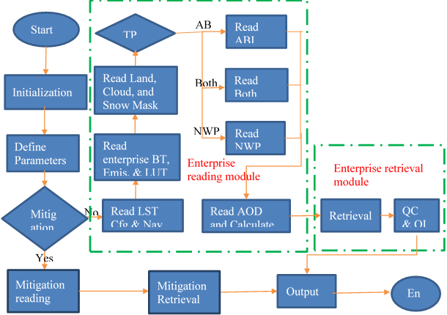
LST Processing Flow
LST is retrieved if
  good pixel availability
        input data not out of space
        input data not bad data
        input data not missing
  not over ocean
  Clear, probably clear, or probably cloudy

Slide 7
ADRs Resolved or still in progress since GOES-18 LST Provisional Maturity
Title | Description | Impact | Mitigation | Status
ADR 1393 (12/3/2019) | The ancillary snow mask requires a special converter "convertSnowMask" when reading in the data for use in the enterprise algorithms. It was discovered that ECOMP and ELST both use "convertEnumType" rather than the "convertSnowMask" function. This should be resolved | Minor impact. | Fixed and implemented. | Closed.
ADR 1447 (5/2/2024) | The DQF and PQI flag_meanings, flag_masks, and flag_values should be space separated in the XSL Metadata templates. LST is the only end product that has commas. It looks like these were mistakenly added with the enterprise algorithm. These should be removed | Minor impact. | Fixed and implemented. | Closed.
Little Impact
Moderate Impact
Big Impact

Slide 8
Provisional Validation product maturity assessment
GOES-19 Land Surface Temperature Provisional PS-PVR

Slide 9
Top Level Evaluation
 | Current Status | Future Outlook
Visual Inspection: (Range, Availability) | Performance has been good and stable without critical issues. | Expect continued good performance.
Quantitative Performance: (Accuracy, Precision) | Overall performance of Land Surface Temperature is good. LST product for Full Disk, CONUS, and MESOs, easily meet accuracy and precision specifications. GOES-19 LST product compares well to the LST from GOES-East and GOES-West. | Expect continued good performance

Slide 10
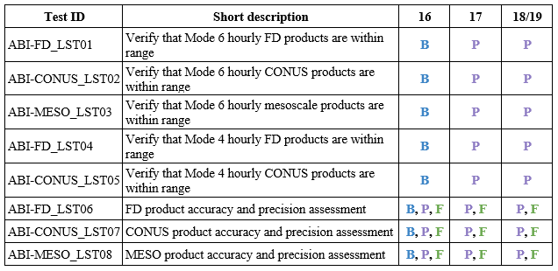
GOES-19 LST Provisional PLPTs
B – Beta maturity
P – Provisional maturity
F – Full maturity
Reference: Geostationary Operational Environmental Satellite (GOES) – R Series ABI L2+ Land Surface Temperature (LST) Beta, Provisional, and Full Validation Readiness, Implementation and Management Plan (RIMP) (v2.0; 410-R-RIMP-0331; September 28, 2021)

Slide 11
Visual inspection
GOES-19 Land Surface Temperature Provisional PS-PVR

Slide 12
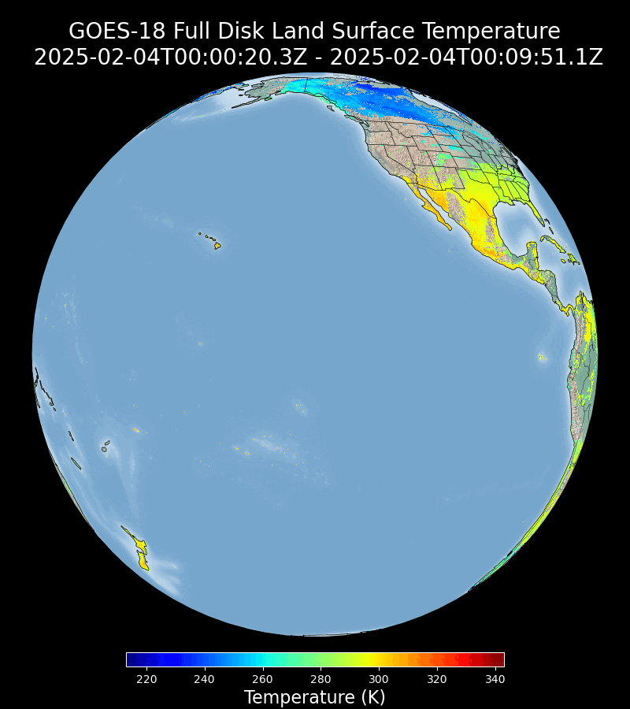
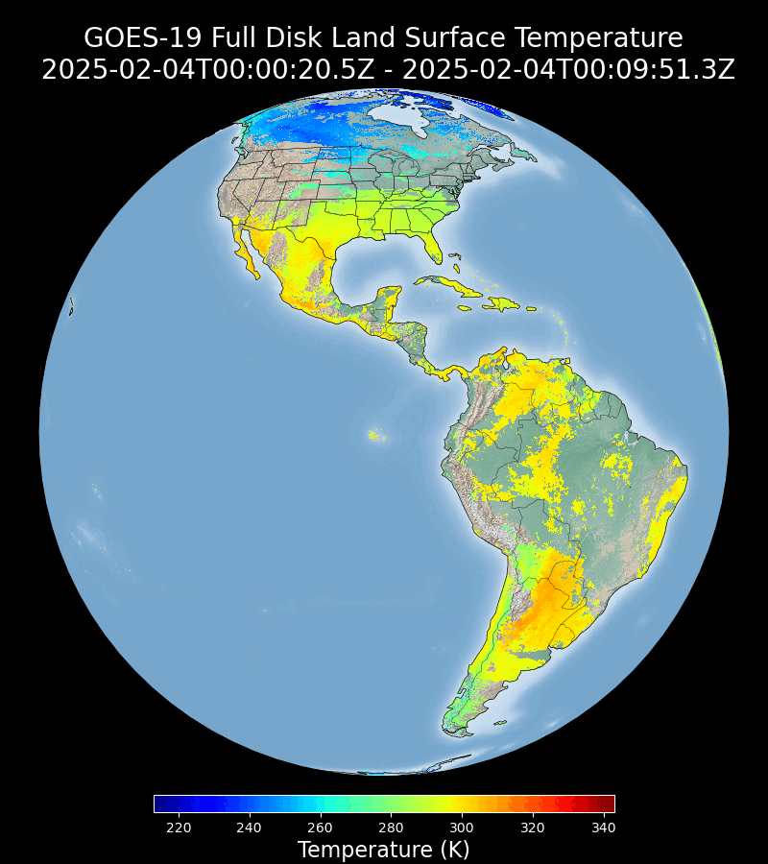
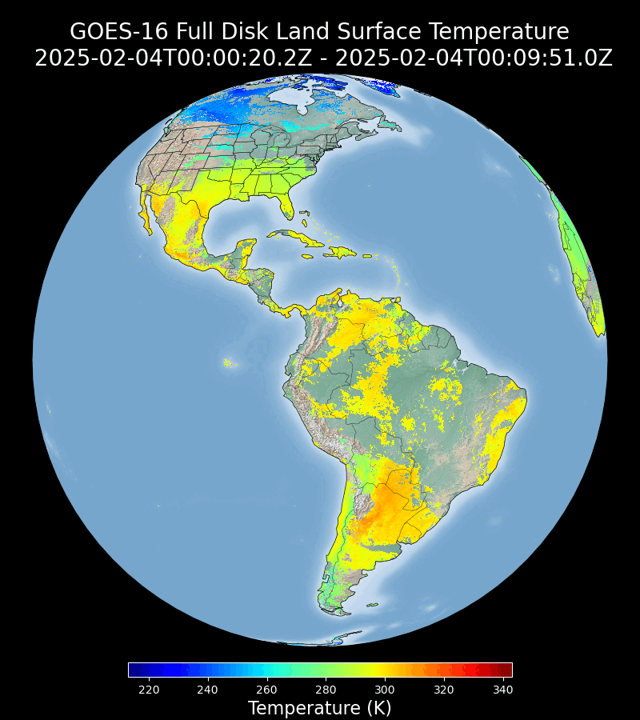
Visual Inspection: Full Disk LST (2KM)
GOES-West
GOES-19
GOES-East
GOES-19 Preliminary, Non-Operational Data
GOES-19 2KMFD LST is being visually inspected and compared to the GOES-East and GOES-West LST on a daily basis. The product behaves normal with very good agreement to its GOES-East counterpart.
Notes:
The comparison presented here is qualitative, quantitative comparison results will presented later.

Slide 13
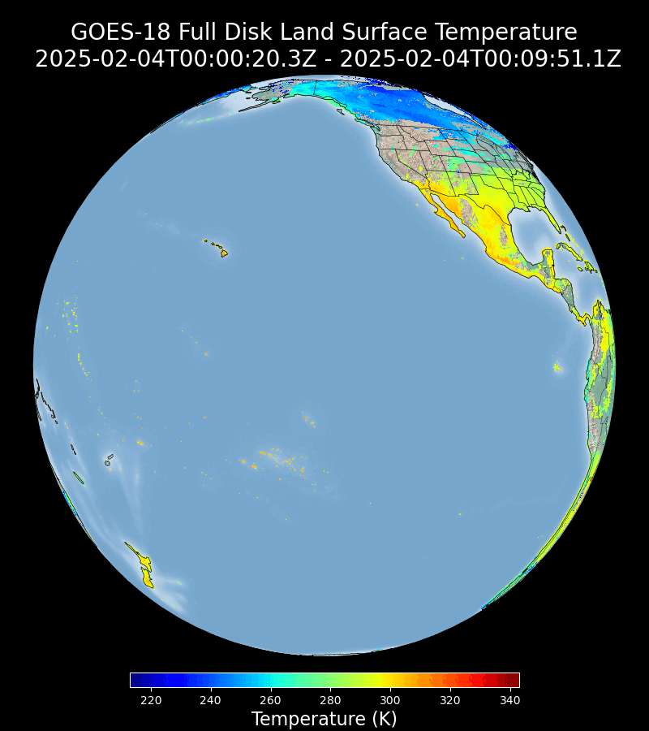
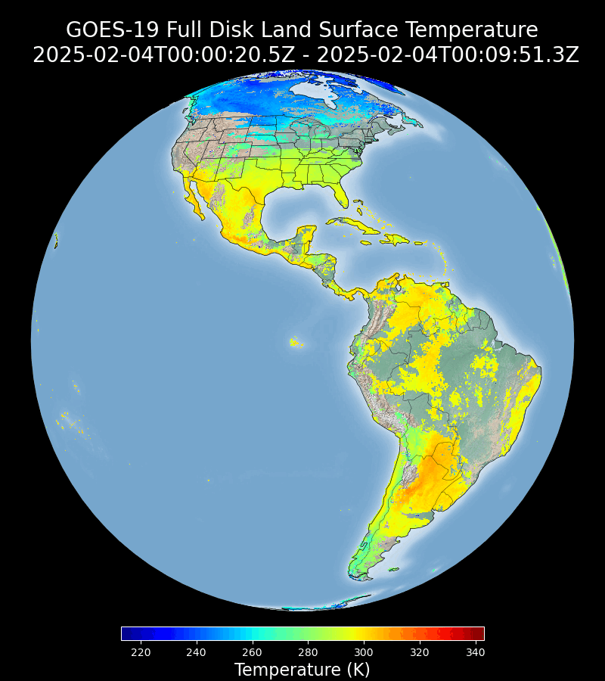
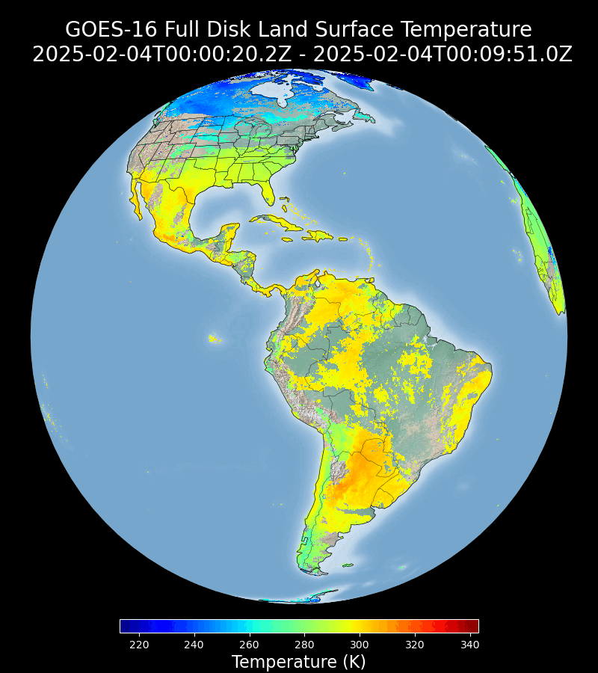
Visual Inspection: Full Disk LST (10KM)
GOES-West
GOES-19
GOES-East
GOES-19 Preliminary, Non-Operational Data
GOES-19 10km Full Disk LST is being visually inspected and compared to the GOES-East and GOES-West LST on a daily basis. The product behaves normal with very good agreement to its GOES-East counterpart.
Notes:
The comparison presented here is qualitative, quantitative comparison results will presented later.

Slide 14
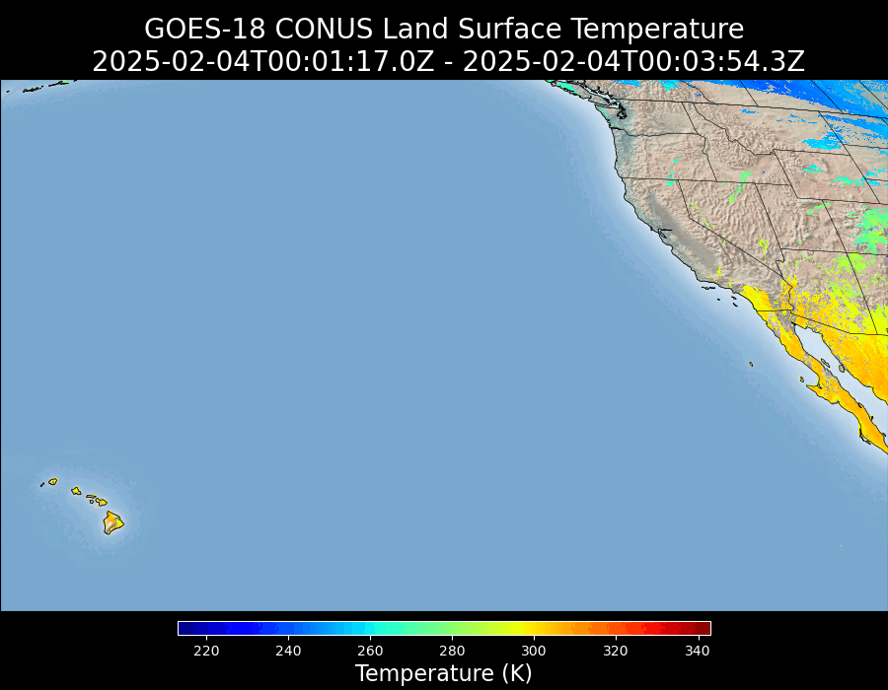
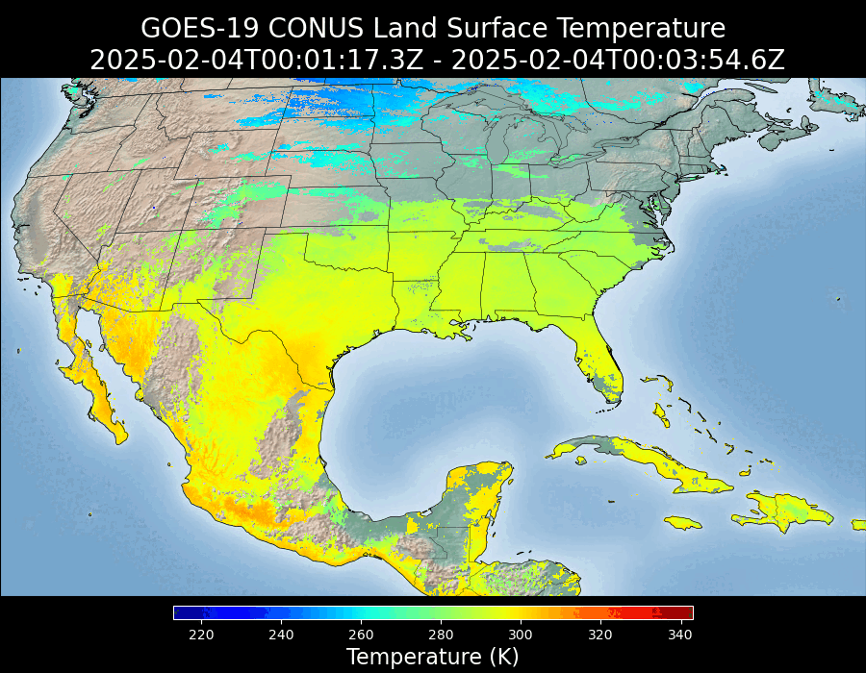
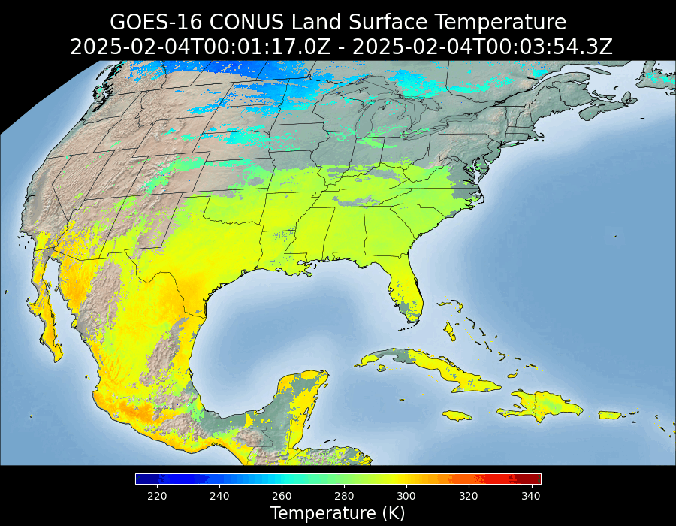
Visual Inspection: CONUS LST
GOES-West
GOES-19
GOES-East
GOES-19 Preliminary, Non-Operational Data
GOES-19 CONUS LST is being visually inspected and compared to the GOES-East and GOES-West LST on a daily basis. The product behaves normal with very good agreement to its GOES-East counterpart.
Notes:
The comparison presented here is qualitative, quantitative comparison results will presented later.

Slide 15
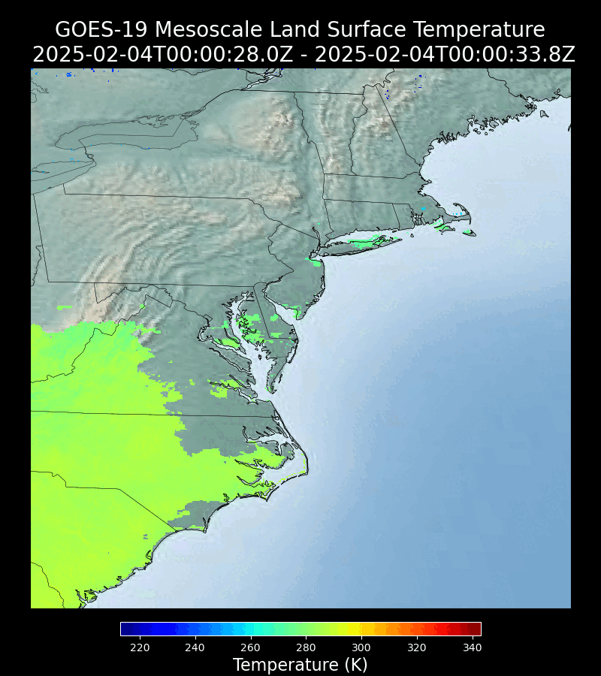
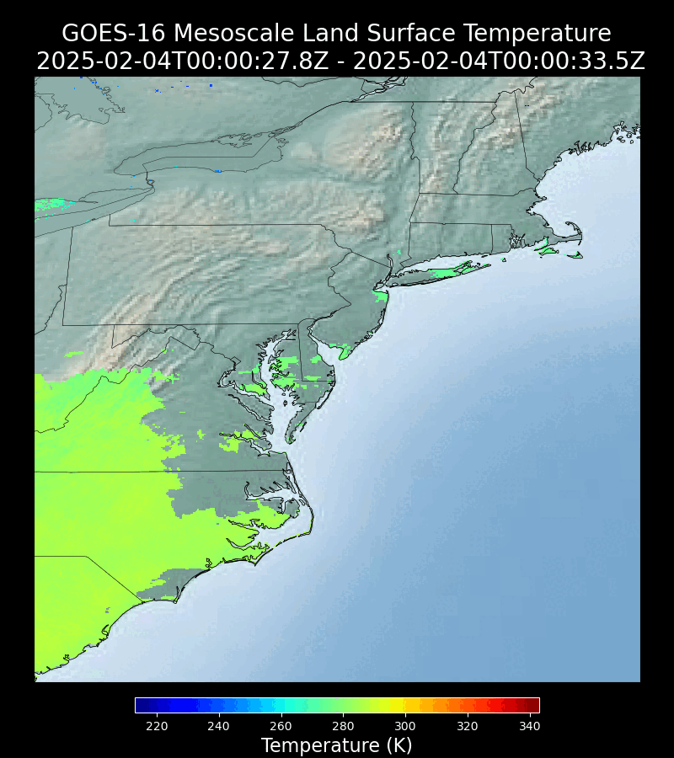
Visual Inspection: MESO1 LST
GOES-19 MESO1
GOES-East MESO1
GOES-19 Preliminary, Non-Operational Data
GOES-19 MESO1 LST is being visually inspected and compared to the GOES-East LST on a daily basis. The product behaves normal with very good agreement to its GOES-East counterpart.

Slide 16
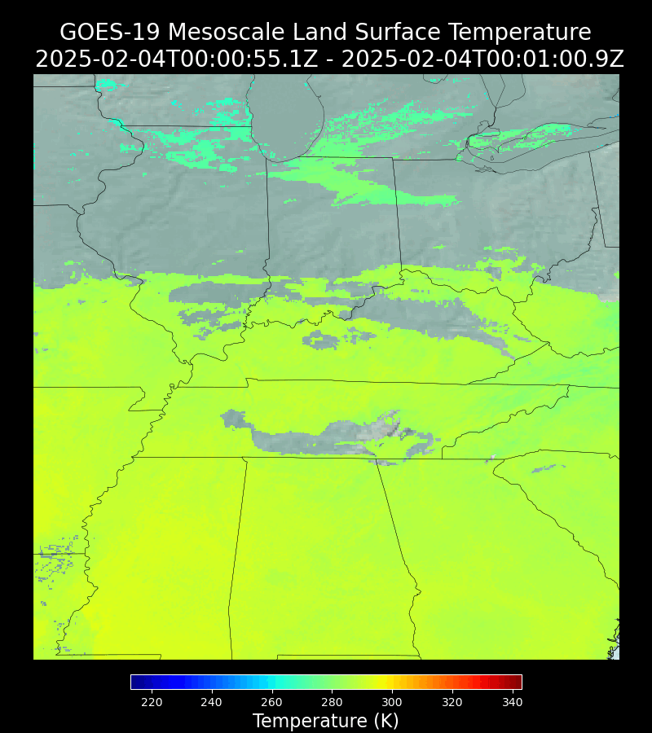
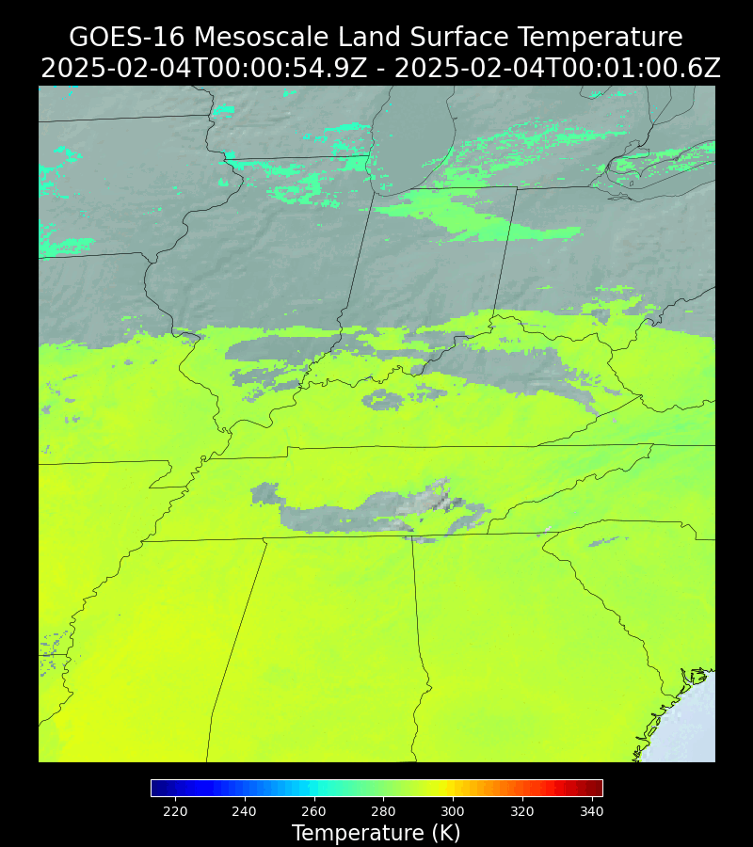
Visual Inspection: MESO2 LST
GOES-19 MESO2
GOES-East MESO2
GOES-19 Preliminary, Non-Operational Data
GOES-19 MESO2 LST is being visually inspected and compared to the GOES-East LST on a daily basis. The product behaves normal with very good agreement to its GOES-East counterpart.

Slide 17
GOES-19 Land Surface Temperature Comparison to Reference LST Data
Validation with In-situ measurements:
  SURFRAD (Primary)
  ARM (Primary)
  NEON (Secondary)
Inter-satellite comparison with GOES-East and GOES-West Land Surface Temperature
Notes:
Mission requirements: 2.5 K bias and 2.3 K precision

Slide 18
Product validation
GOES-19 Land Surface Temperature Provisional PS-PVR

Slide 19
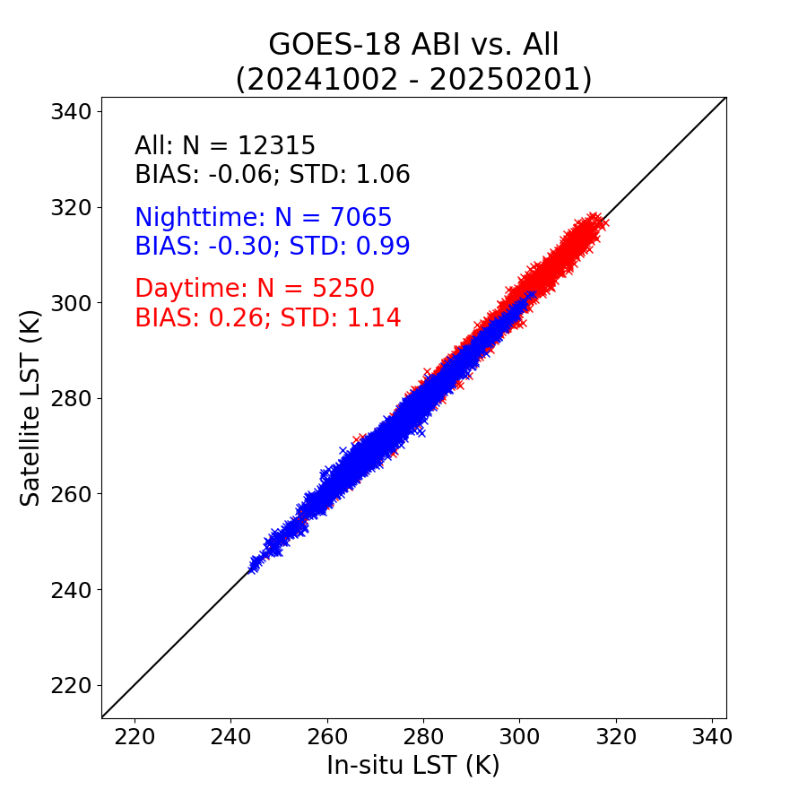
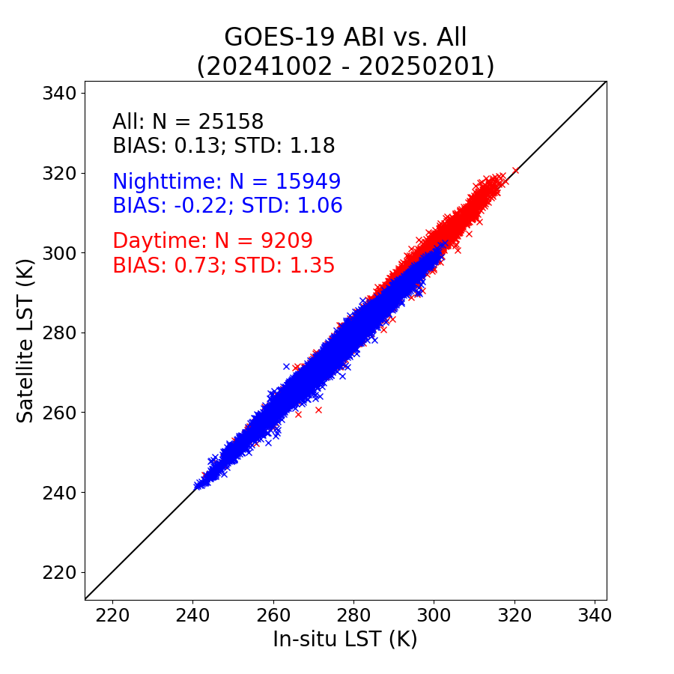
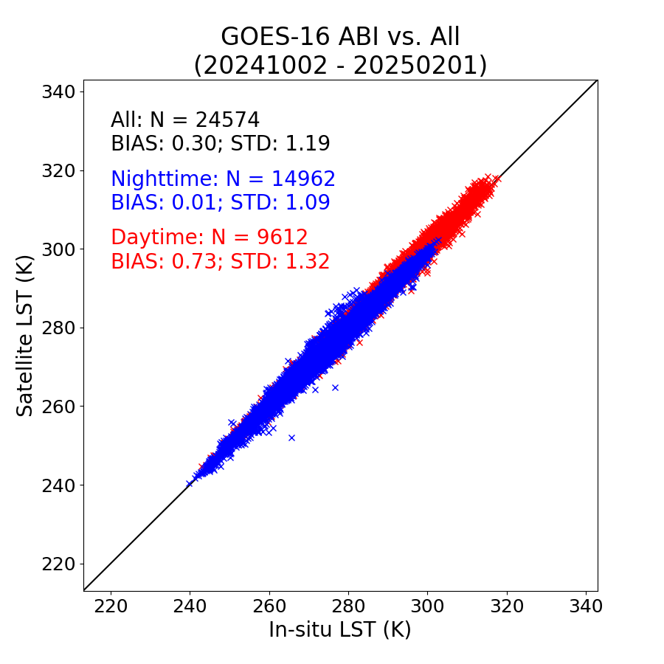
Validation Results: Full Disk （2KM）
GOES-West
GOES-19
GOES-East
GOES-19 Preliminary,
Non-Operational Data
GOES-19 2km Full Disk LSTs meet the required accuracy (2.5 K) and precision (2.3 K).
All: all available in-situ measurements combining SURFRAD, ARM, and NEON

Slide 20
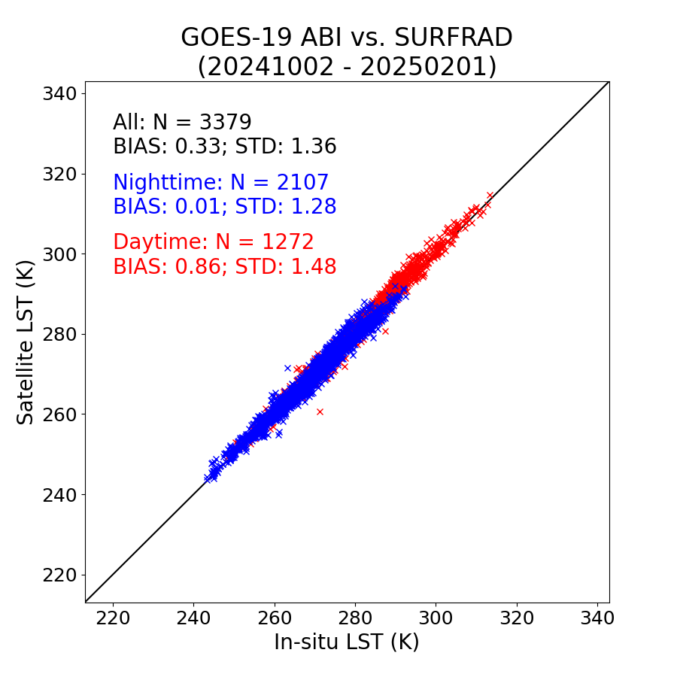
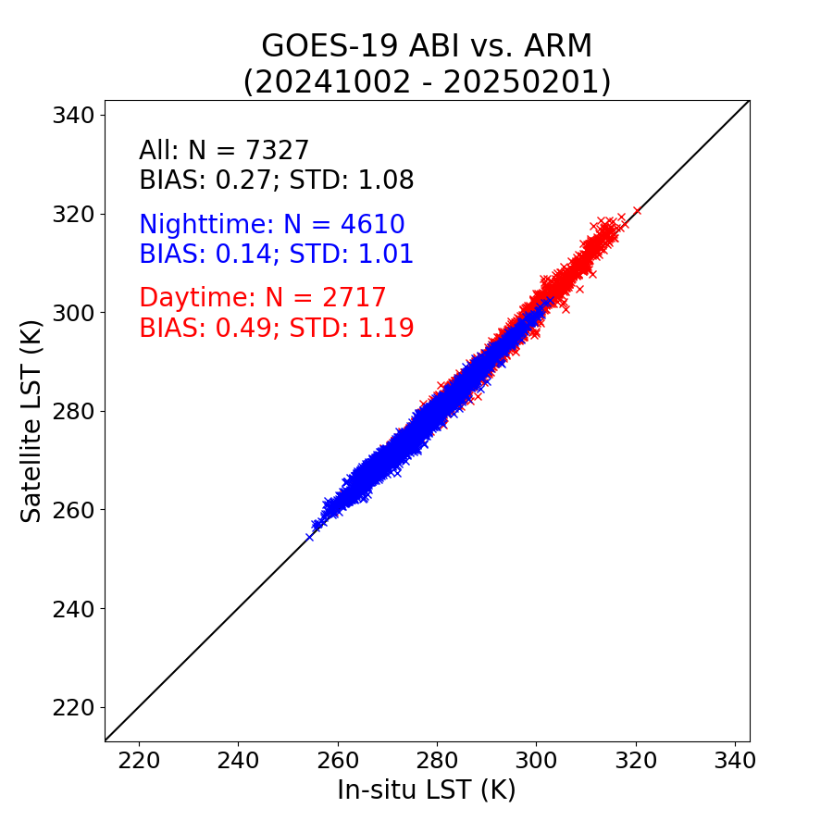
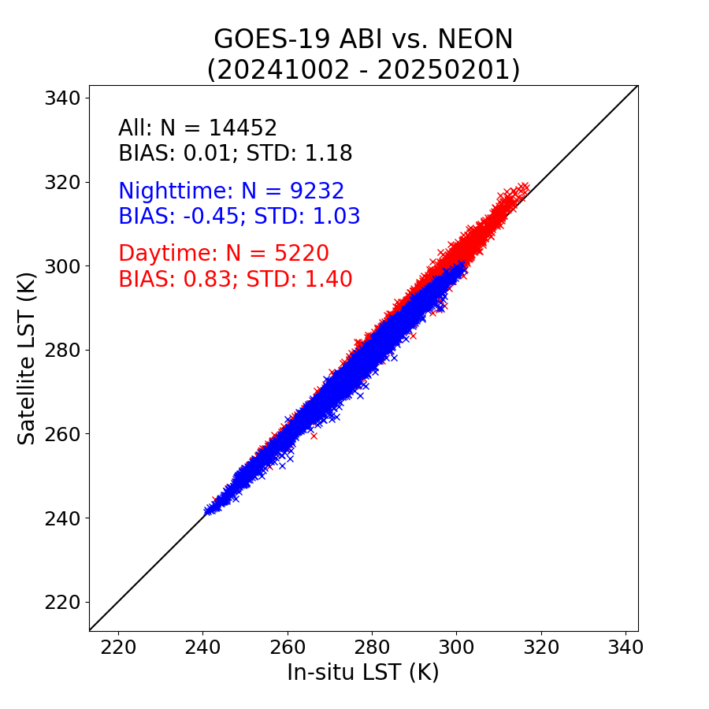
Validation Results: Full Disk （2KM）
SURFRAD
ARM
NEON
GOES-19 Preliminary,
Non-Operational Data
GOES-19 Preliminary,
Non-Operational Data
GOES-19 Preliminary,
Non-Operational Data
GOES-19 2km Full Disk LSTs meet the required accuracy (2.5 K) and precision (2.3 K) at three in-situ networks.

Slide 21
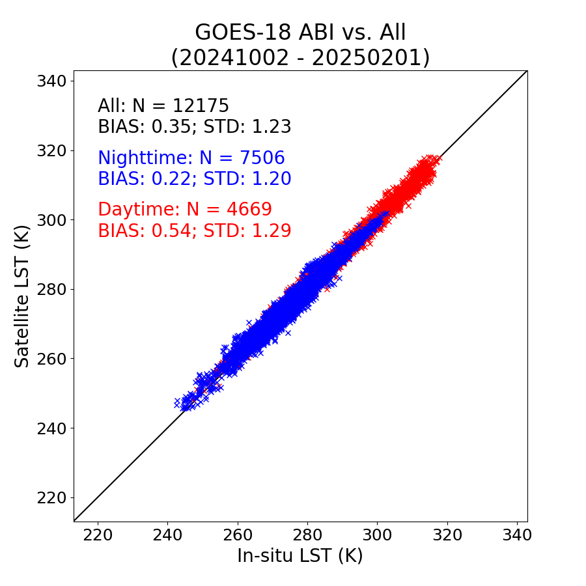
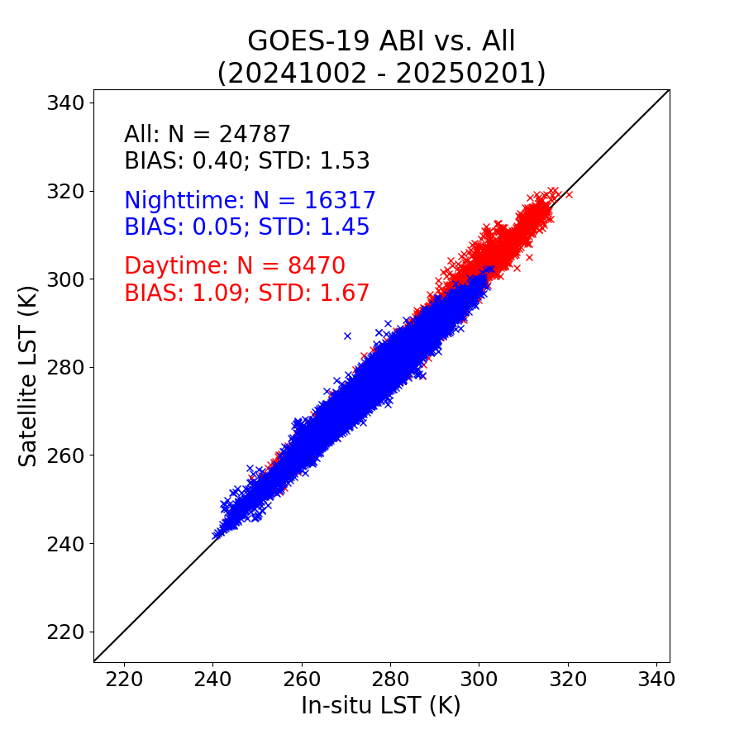

Validation Results: Full Disk （10KM）
GOES-West
GOES-19
GOES-East
GOES-19 Preliminary,
Non-Operational Data
GOES-19 10km Full Disk LSTs meet the required accuracy (2.5 K) and precision (2.3 K).
All: all available in-situ measurements combining SURFRAD, ARM, and NEON
Notes:
In general, the 2km LST outperforms the 10 km LST in both accuracy and precision. Better representativeness of the in-situ measurement when satellite pixel is smaller.

Slide 22
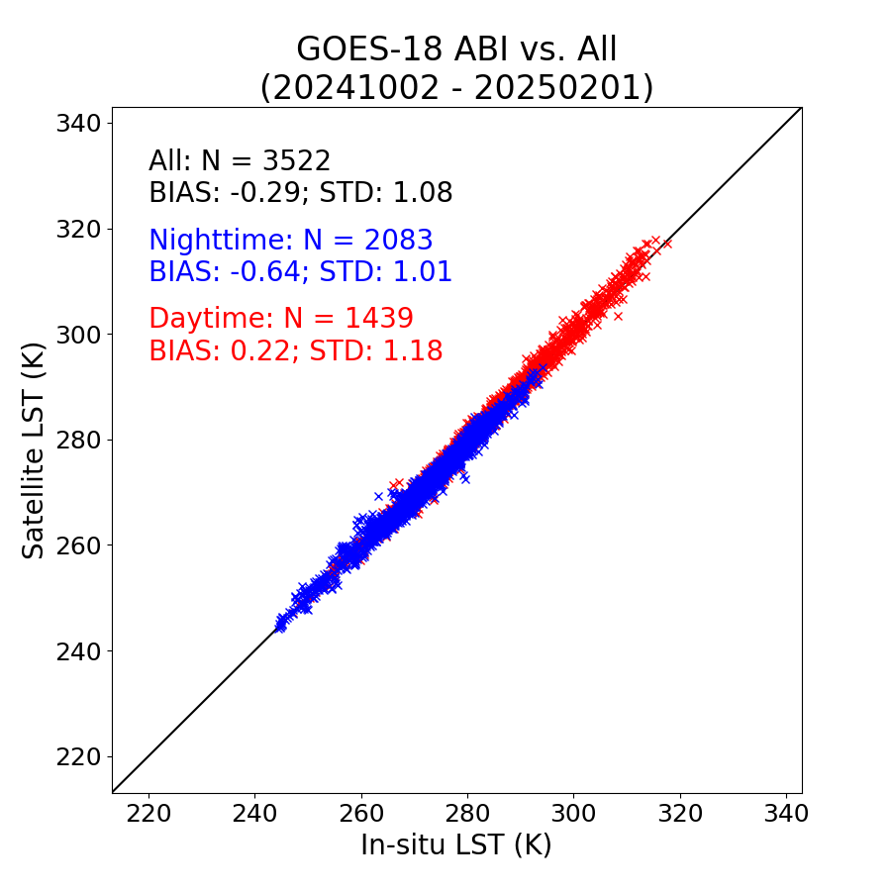

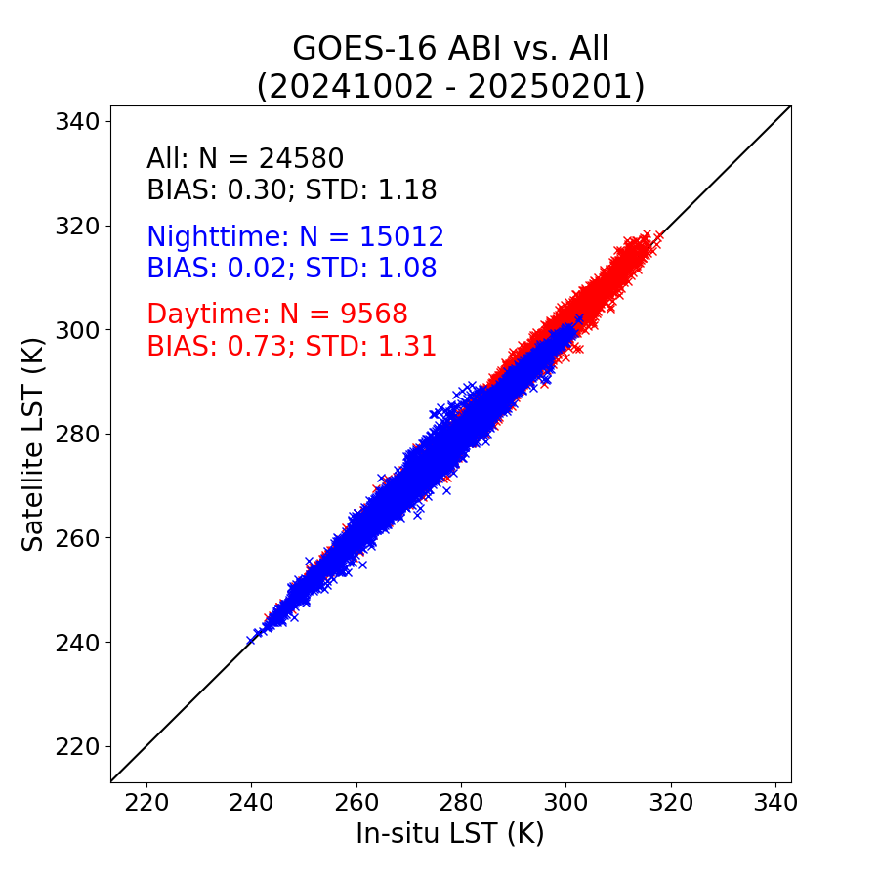
Validation Results: CONUS
GOES-West
GOES-19
GOES-East
GOES-19 Preliminary,
Non-Operational Data
GOES-19 CONUS LSTs meet the required accuracy (2.5 K) and precision (2.3 K).
All: all available in-situ measurements combining SURFRAD, ARM, and NEON
Notes:
In general, the 2km LST outperforms the 10 km LST in both accuracy and precision. Better representativeness of the in-situ measurement when satellite pixel is smaller.

Slide 23
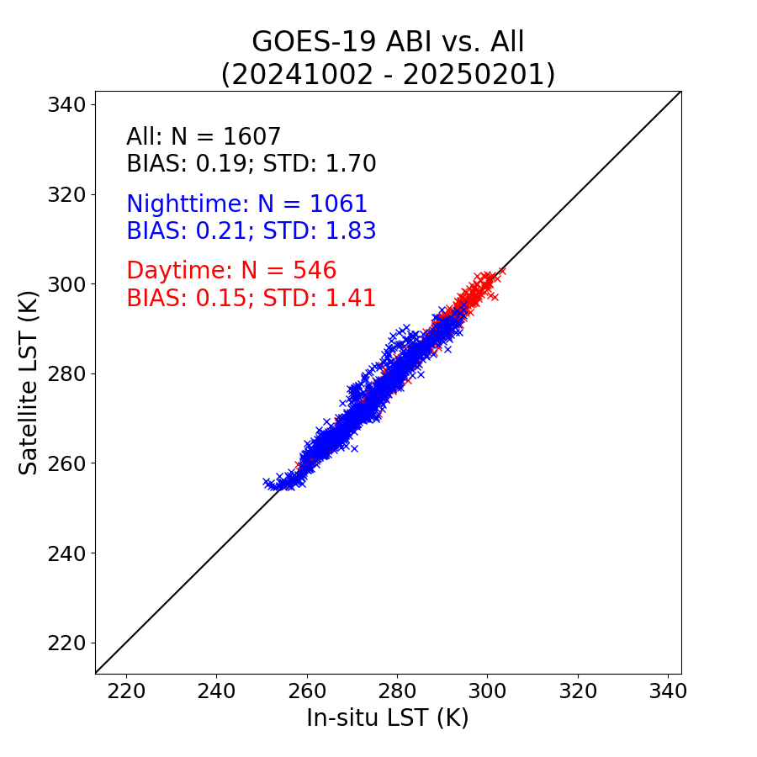
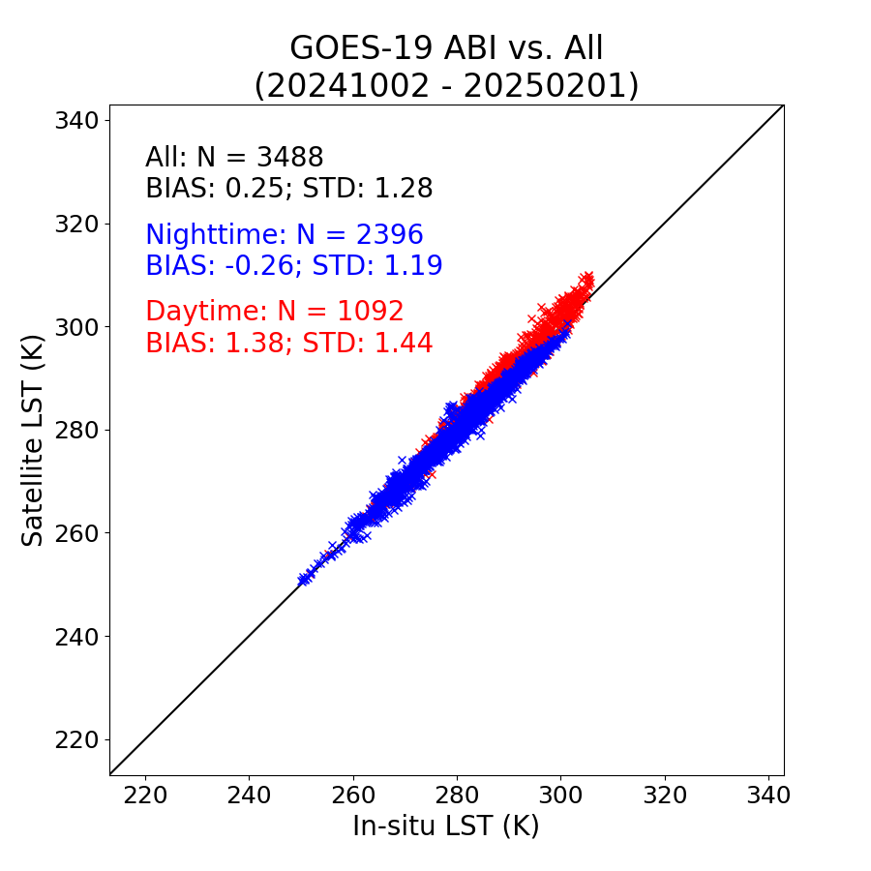
Validation Results: Meso-Scales
GOES-19 MESO1
GOES-19 MESO2
GOES-19 Preliminary,
Non-Operational Data
GOES-19 Preliminary,
Non-Operational Data
Both GOES-19 Meso-Scale LSTs meet the required accuracy (2.5 K) and precision (2.3 K).
All: all available in-situ measurements combining SURFRAD, ARM, and NEON

Slide 24
Inter-sensor comparison
GOES-19 Land Surface Temperature Provisional PS-PVR

Slide 25
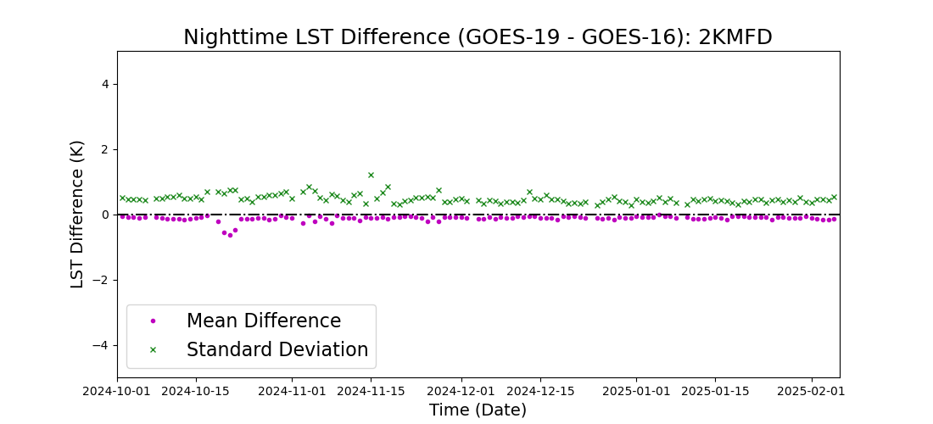
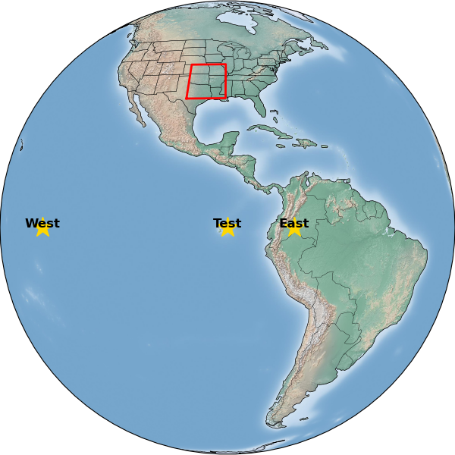
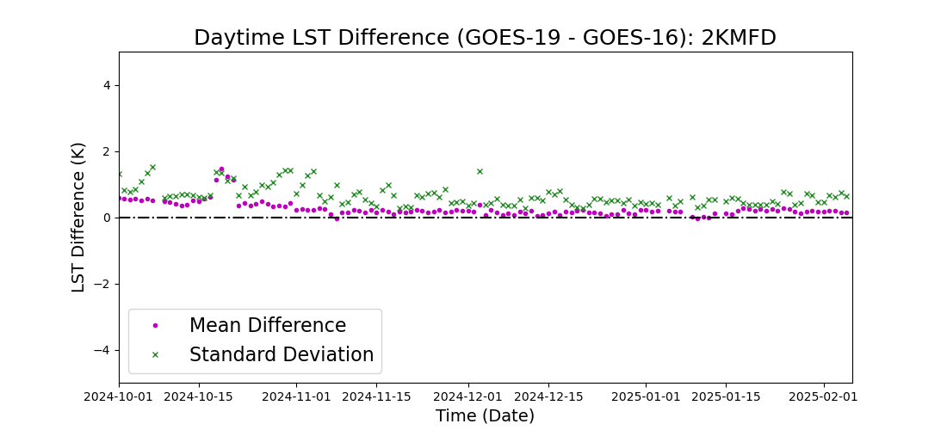
Inter-sensor LST comparison: G19 vs. G16
Area of Comparison
Mean LST difference between the two satellites is very small, especially during nighttime;
Standard deviation of the difference is in general below 1 k;
Better agreement during nighttime
Notes:
Area of comparison was selected to minimize the impact by terrain and viewing angles.
A summary of the inter-sensor LST comparison since G18 moves to ~137 W

Slide 26
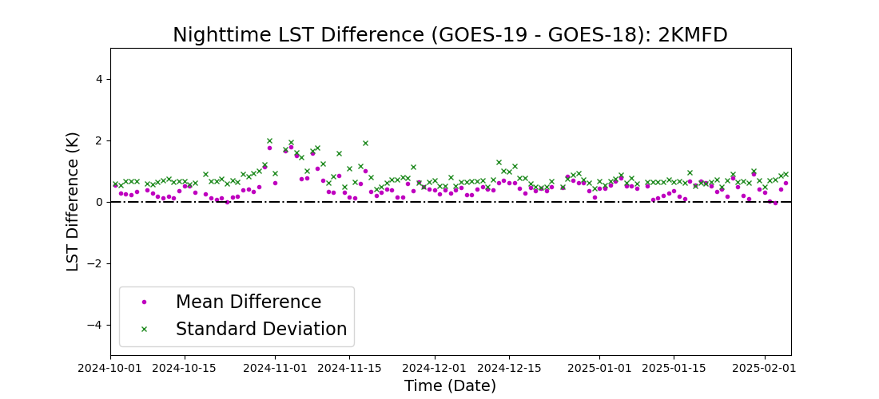
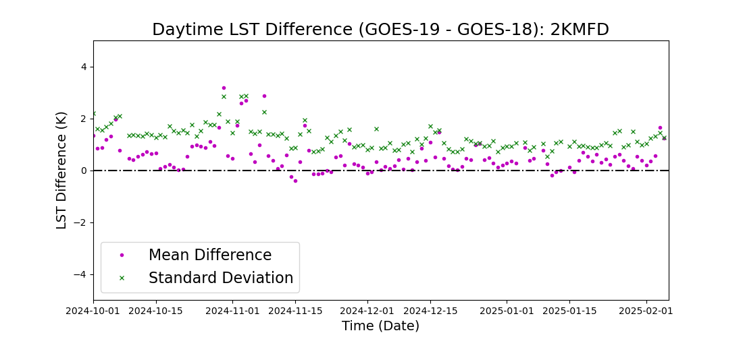
Inter-sensor LST comparison: G19 vs. G18
Area of Comparison
Mean LST difference between the two satellites is larger than between G19 and G16 due to larger discrepancy in view geometry;
Nighttime agreement is better than daytime
Notes:
A summary of the inter-sensor LST comparison since G18 moves to ~137 W

Slide 27
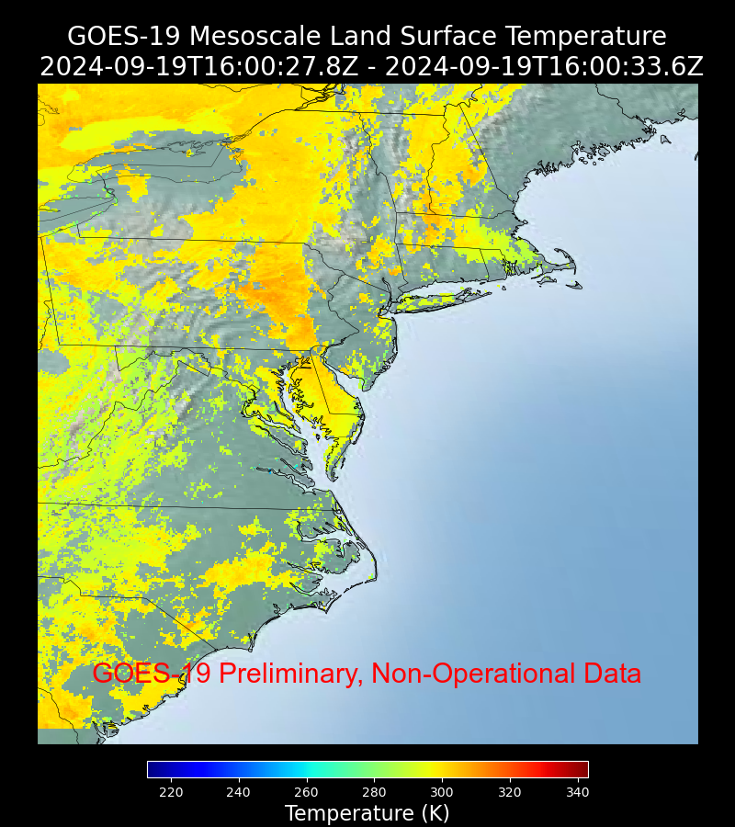
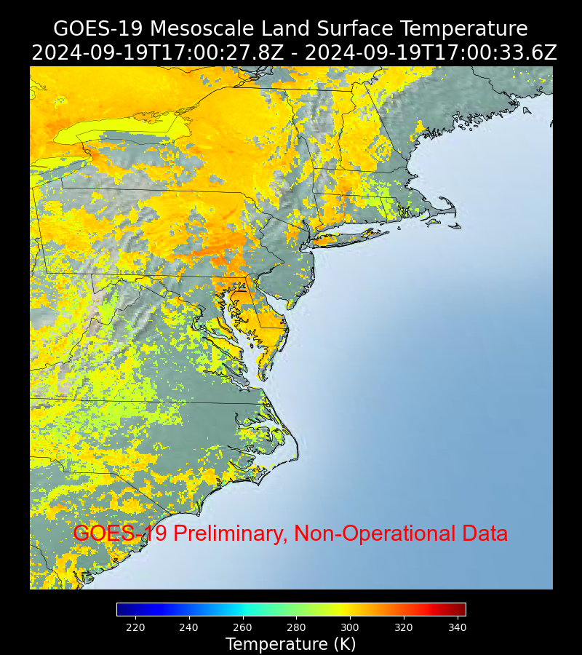
Minor Issues #1 (Fixed)
Large INR Error was fixed between 16 and 17 UTC on 09/19/2024

Slide 28
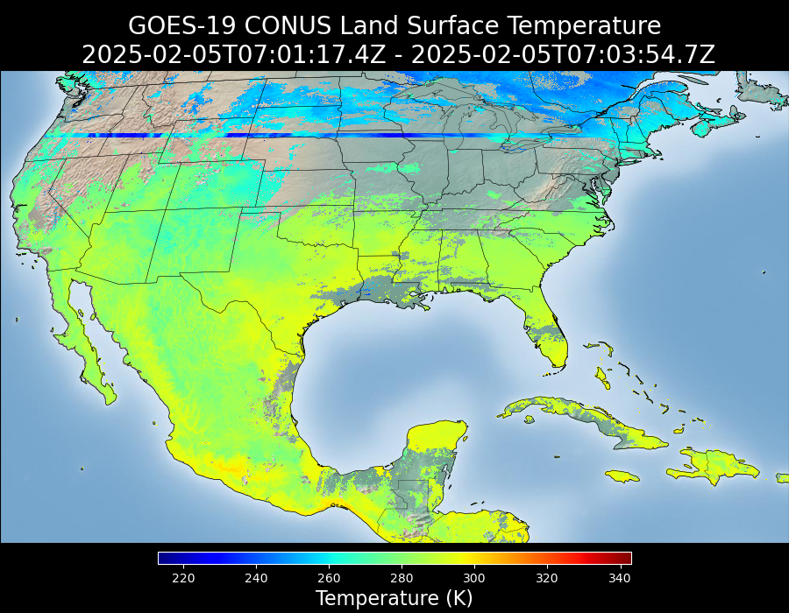
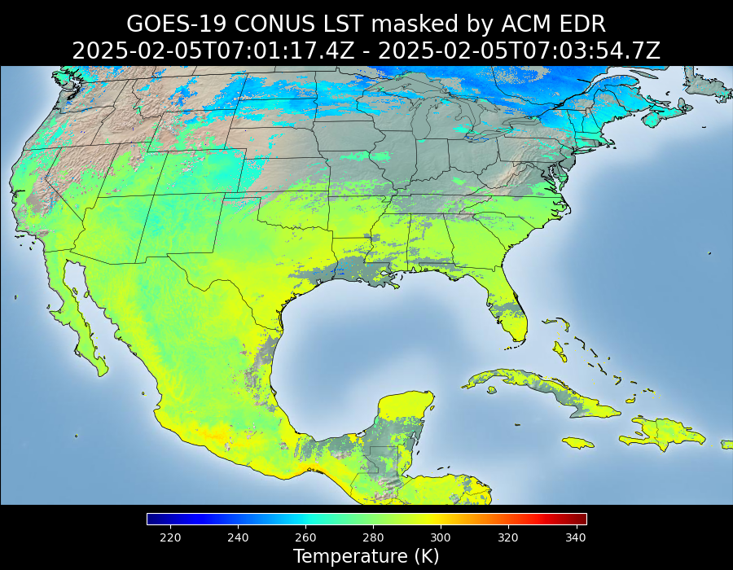
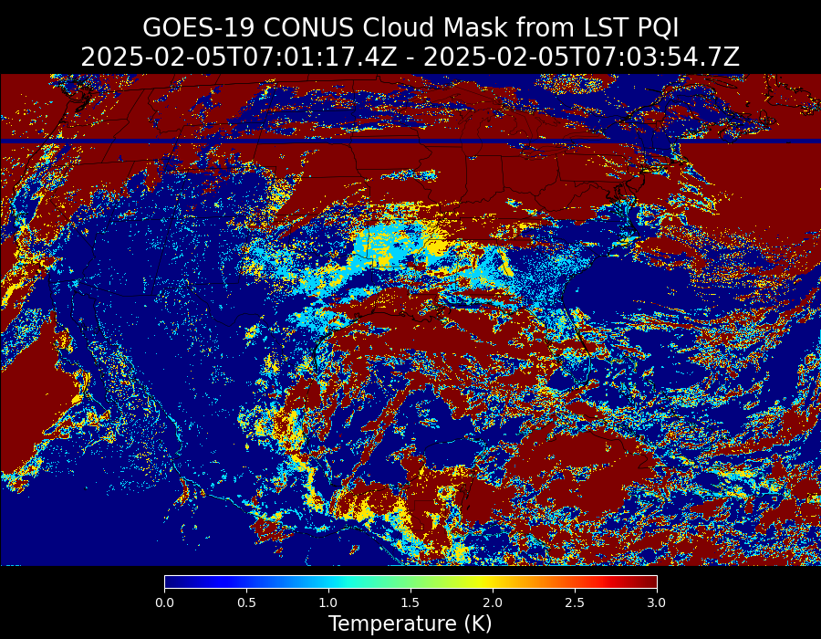
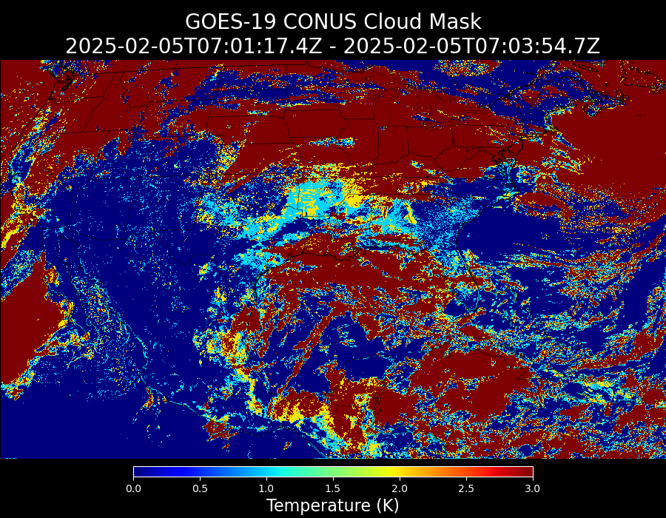
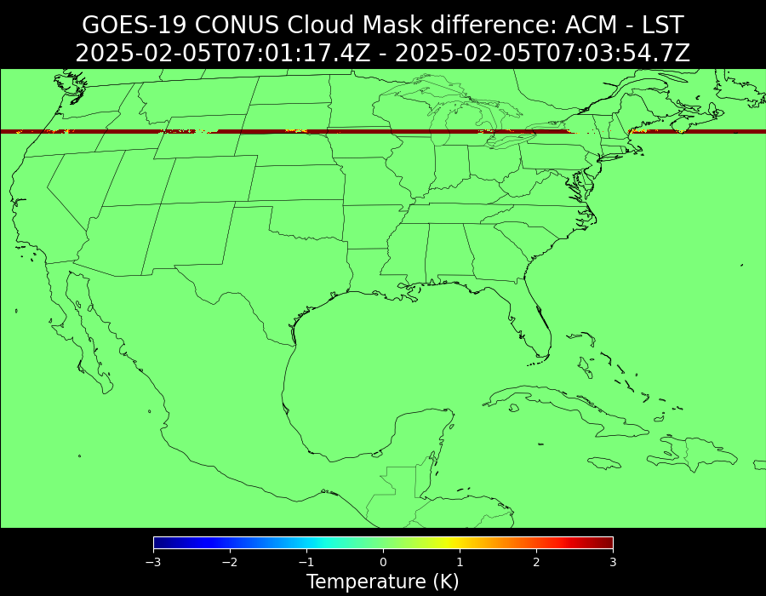
Minor Issues #2 (Once)
Clear Sky Mask information passed to LST retrieval module was incorrect

Slide 29
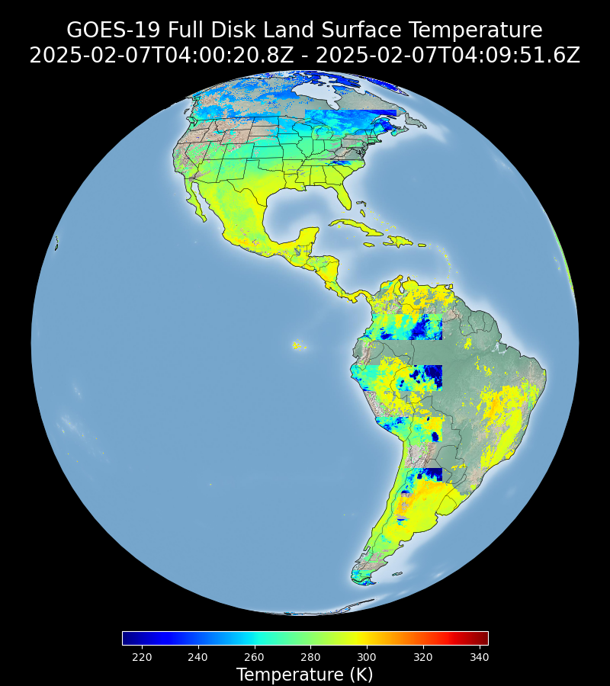
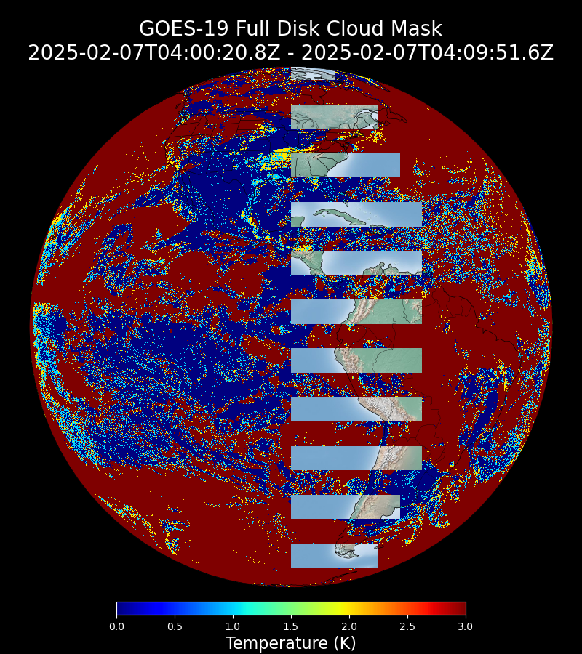
Minor Issues #3 (Once)
Multiple Clear Sky Mask blocks have a value of 128 and were passed to LST.

Slide 30
Provisional Validation
Preparation Activities | Assessment
Validation activities are ongoing and the general research community is now encouraged to participate. | Agree
Severe algorithm anomalies are identified and under analysis. Solutions to anomalies are in development and testing. | No severe algorithm anomalies have been identified.
Incremental product improvements may still be occurring. | Incremental product improvements are expected.

Slide 31
Provisional Validation
End State | Assessment
Product performance has been demonstrated through analysis of a small number of independent measurements obtained from select locations, periods, and associated ground truth or field campaign efforts. | This has been demonstrated.
Product analysis is sufficient to communicate product performance to users relative to expectations (Performance Baseline). | This has been communicated in PS-PVR.
Documentation of product performance exists that includes recommended remediation strategies for all anomalies and weaknesses. Any algorithm changes associated with severe anomalies have been documented, implemented, tested, and shared with the user community. | These are documented in this slide and will be documented in a separate report.
Testing has been fully documented. | Testing will be documented in a PLPT Report.
Product is ready for operational use and for use in comprehensive cal/val activities and product optimization. | Agree

Slide 32
Recommendation
The Land Surface Temperature Science Team believes that the GOES-19 LST L2 product has met the Provisional Maturity criteria defined by the GOES-R Program and should be declared provisional.

Slide 33
Path to full validation maturity
GOES-19 Land Surface Temperature Provisional PS-PVR

Slide 34
Path to Full Validation Maturity
We expected to carry out the same activities for the full validation maturity
All major issues have been addressed
Potential Improvements:
  Higher temporal resolution is preferred over an hourly cadence for various applications due to high temporal variability of the product
  ” We are also hoping to continue using the LST product at 5-min temporal resolution as input to both our urban air temperature and urban heat storage products. We believe the 5-min resolution is essential for training the products that were developed, are being developed, and will be developed in the future. Additionally, the 288 points per day, in contrast to the 24 hourly points that are available in the public cloud servers, are beneficial to the operational status of our products due to the availability of more points per hour. This allows for better real-time prediction and is used to increase the availability of the product at a more steady output rate.”
No risks have been identified

Slide 35
Summary and recommendations
GOES-19 Land Surface Temperature Provisional PS-PVR

Slide 36
Summary and Recommendations
The AWG Land Surface Temperature team recommends that the GOES-19 LST product be transitioned to Provisional status
Qualitative assessment of the GOES-19 LST
  No major issue
  Good agreement with GOES-East and GOES-West LSTs
Quantitative assessment of GOES-19 LST
  Validation results with all in-situ networks easily met the mission requirement
  GOES-19 LST is in good agreement with its GOES-East and GOES-West counterparts

Slide 37
Backup
GOES-19 Land Surface Temperature Provisional PS-PVR

Slide 38
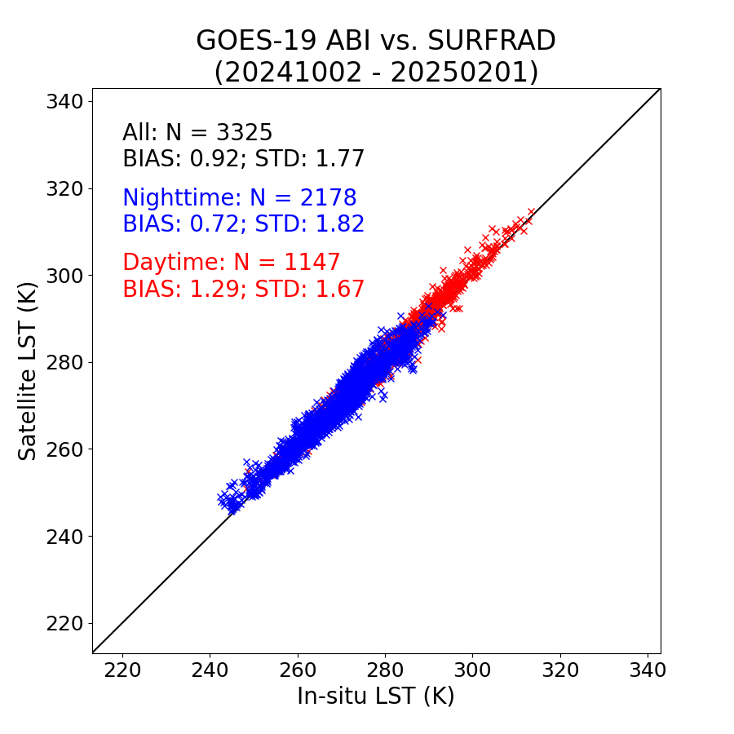
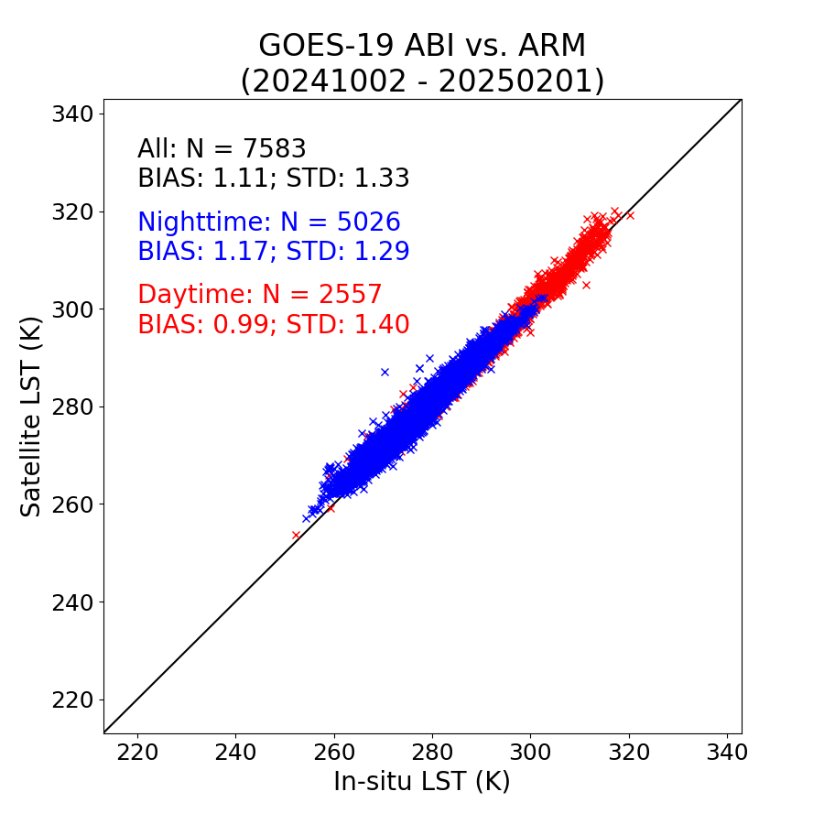
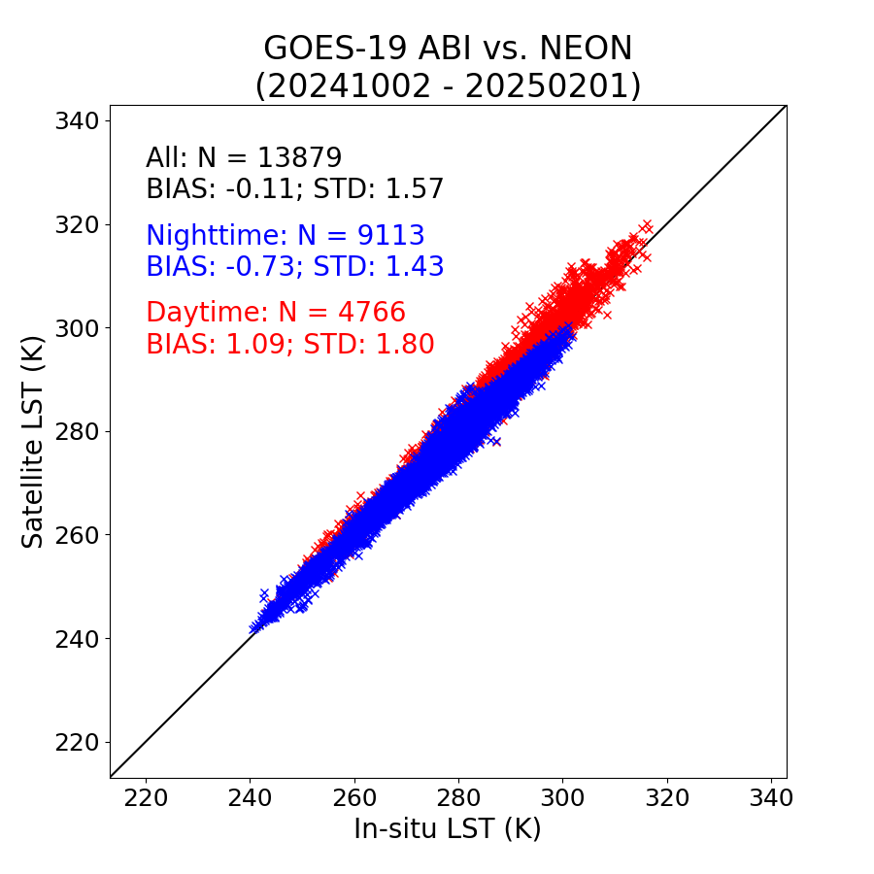
Validation Results: Full Disk （10KM）
SURFRAD
ARM
NEON
GOES-19 Preliminary,
Non-Operational Data
GOES-19 Preliminary,
Non-Operational Data
GOES-19 Preliminary,
Non-Operational Data
GOES-19 10km Full Disk LSTs meet the required accuracy (2.5 K) and precision (2.3 K) at three in-situ networks.

Slide 39


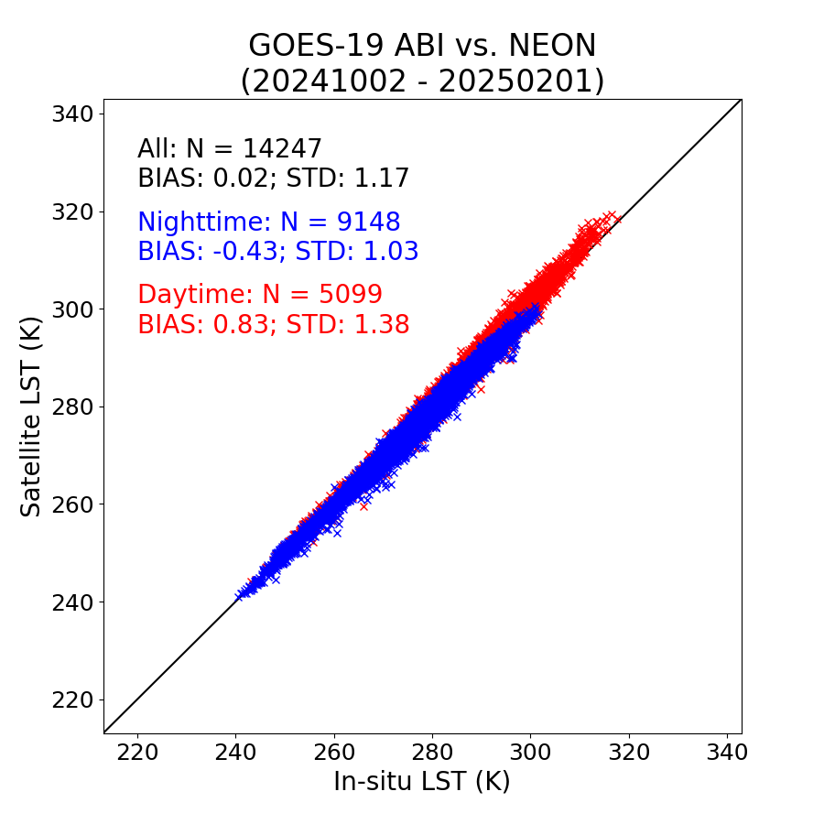
Validation Results: CONUS
SURFRAD
ARM
NEON
GOES-19 Preliminary,
Non-Operational Data
GOES-19 Preliminary,
Non-Operational Data
GOES-19 Preliminary,
Non-Operational Data
GOES-19 CONUS LSTs meet the required accuracy (2.5 K) and precision (2.3 K) at three in-situ networks.

