Slide 1
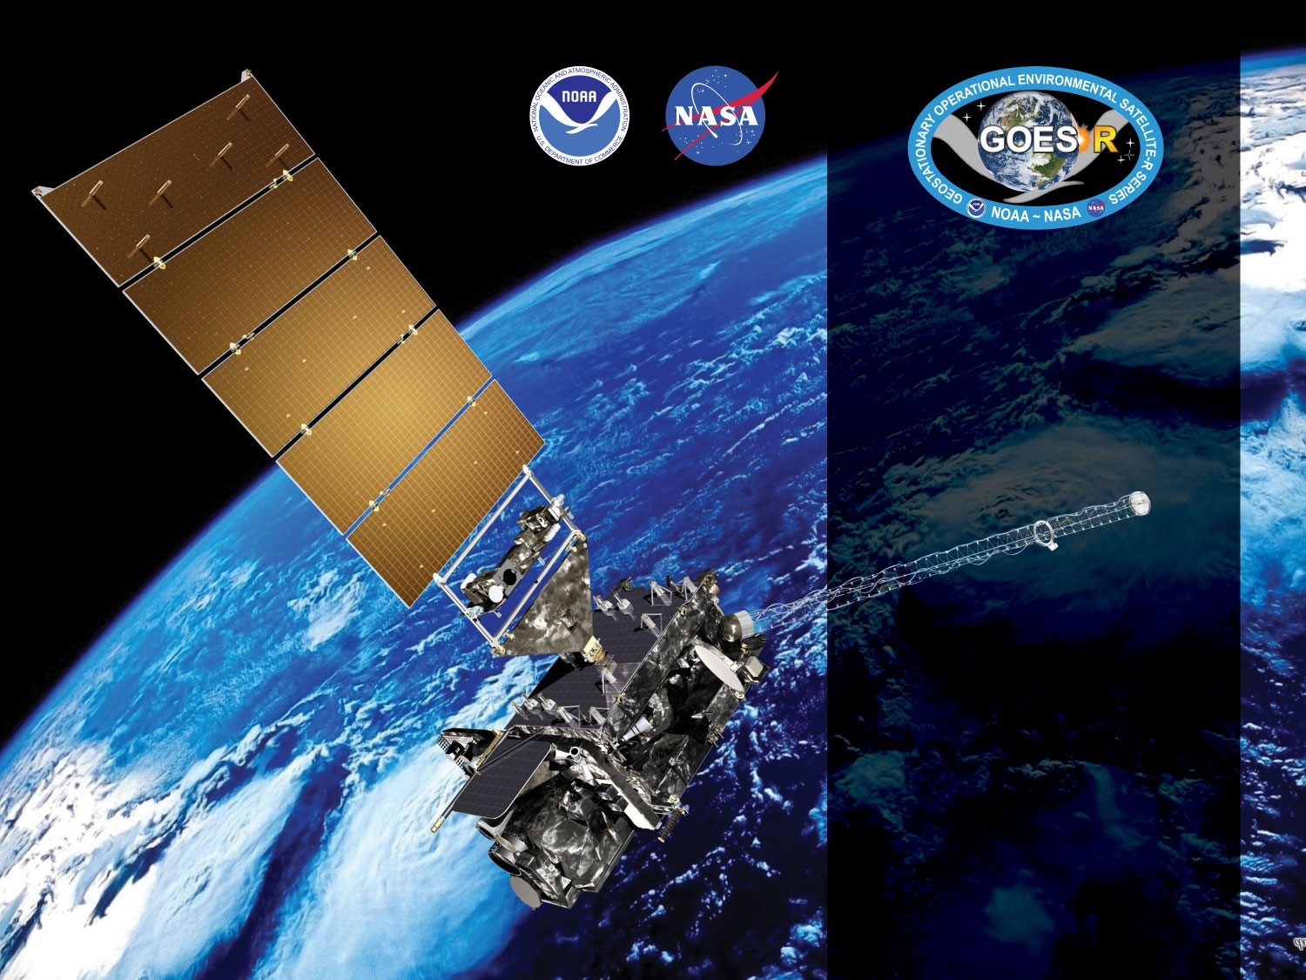


GOES-19 ABI L2+
Land Surface Albedo/Reflectance
Provisional PS-PVR
February 12, 2025
GOES-R AWG Albedo Team
PI: Yunyue Yu (NESDIS/STAR)
CI: Jingjing Peng (CISESS/UMD)
Presenter: Jingjing Peng
Notes:
This presentation is about the GOES-19 LSA and BRF products performance and status for this provisional review.

Slide 2
Outline
Product Overview
  Background, Algorithm, and ADRs
Provisional Product Maturity Assessment
  (Land Surface Albedo and Bidirectional Reflection Factor respectively)
  Visual Inspection
  Product Validation using ground measurements
  Cross Comparison with GOES-16 and GOES-18 counterpart
Summary and recommendations
Path to Full Validation
Notes:
The presentation will include Four main parts.
First I will go through briefly about the product background as it is the same as GOES-16 and -18 product.
The second part is the validation performance of each product respectively.
Then finally will introduce enhancement plan and our recommendation.
The validation of each product will follow the index of: Product quality evaluation through visual inspection, Product validation using ground value, product validation using G17 counterpart, and the provisional Maturity Assessment, the path to full validation and a summary.

Slide 3
PRODUCT OVERVIEW
GOES-19 Land Surface Albedo/Surface Reflectance Provisional PS-PVR

Slide 4
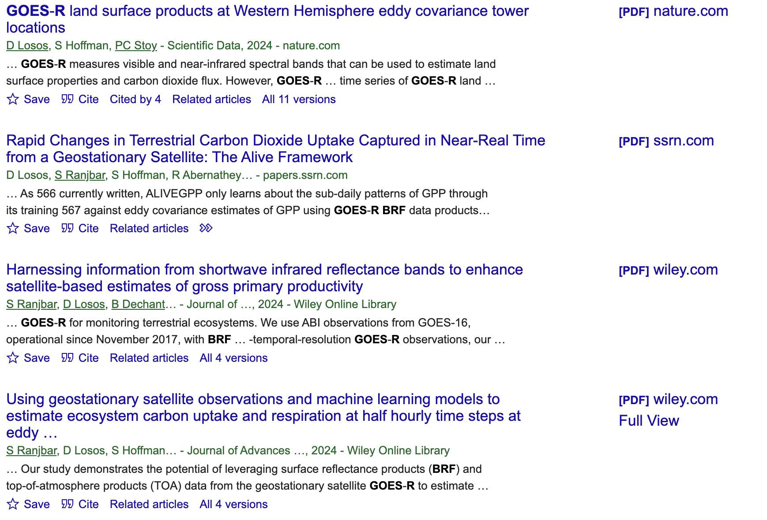
LSA/BRF Product Background
The GOES-R series satellites provide LSA and BRF, which are essential for understanding Earth's energy balance, monitoring vegetation dynamics, and understanding the carbon cycle. Except the EMC users, the products are needed by a broad range of researchers.
Land Surface Albedo (LSA) is one of the Essential Climate Variables (ECVs) identified by the Global Climate Observing System (GCOS), contributing in partitioning reflected solar energy and determining the net radiation budget. Variations in LSA can indicate changes in land cover and land use, influencing climate models and assessments.
Bidirectional Reflectance Factor (BRF), also known as surface reflectance, serves as a fundamental input for vegetation monitoring and studies related to the carbon cycle.

Slide 5
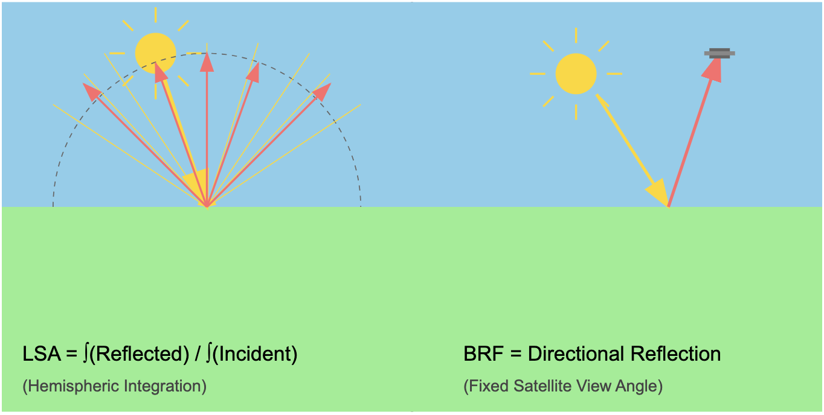
LSA/BRF Product Definition
Land Surface Albedo (LSA) is defined as the ratio between outgoing and incoming irradiance at the earth surface. It is a shortwave broadband blue-sky Albedo over wavelengths between 0.4 and 3.0 µm.
The spectral land surface reflectance (BRF), a ratio between outgoing radiance at view direction and incoming radiance is also generated. The BRF is produced at the following wavelengths: 0.47 µm, 0.64 µm, 0.86 µm, 1.61 µm, and 2.26 µm
The LSA/BRF algorithm generates 2 km product files for Full Disk (FD), Contiguous United States (CONUS), and mesoscale (MESO) regions.

Slide 6
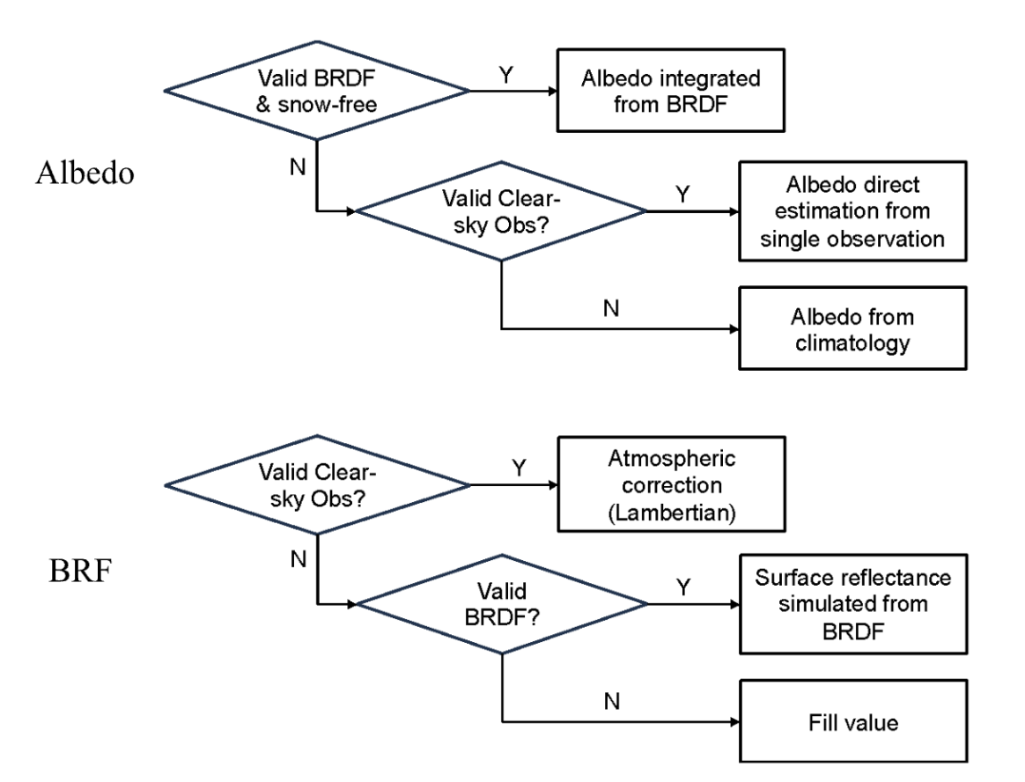
GOESR LSA/BRF Processing Flow
The LSA/BRF algorithm provides spatial and temporal continuous surface albedo/reflectance information by using main/backup retrieval paths for different conditions.
LSA/BRF under clear-sky condition is comparable with the ground measurements.
LSA/BRF under cloudy-sky conditions provides the contemporary surface status under clear-sky condition, not comparable with the ground reference influenced by the cloud.
.
High level flowchart of the online mode of ABI LSA algorithm, illustrating the main processing components
Notes:
The LSA/BRF algorithm provides spatial and temporal continuous surface albedo/reflectance information
Depending on the availability of the BRDF parameters and current clear sky conditions, the algorithm has different retrieval paths to retrieve Surface Albedo and Surface Reflectance.
LSA/BRF under clear-sky condition is comparable and with the ground measurements, which is the only criteria in validation matchup selection process.

Slide 7
LSA/BRF Retrieval Paths
LSA Retrieval Algorithm
Case1: Good BRDF; Snow-free | Case2: BRDF unavailable or snow-covered, but with Good Clear-sky obs | Case3: Bad BRDF; No Clear-sky obs
rp=0: BRDF Algorithm | rp=1: Direct Estimation | rp=2: Graceful Degradation
BRF Retrieval Algorithm
Case1: Good Clear-sky obs | Case2: No Clear-sky obs, but with good BRDF | Case3: Bad BRDF; Bad Clear-sky obs
rp=2: Atmospheric Correction | rp=1: BRDF Model | N/A
LSA retrieval paths:
Routine Algorithm
  Obtain both black-sky and white-sky spectral albedos. Then the blue-sky broadband albedo could be obtained through narrowband-to-broadband conversion and diffuse skylight fraction regulating.
Direct Estimation
  The direct estimation approach directly calculate the surface albedo from TOA signals. Surface albedo is calculated from TOA spectral reflectance at five bands using regression coefficients
Graceful Degradation
  This is used to compute instantaneous albedo from the climatological white-sky albedo
BRF retrieval paths:
Atmospheric Correction
  Surface Reflectance calculated by inverting TOA reflectance formulation and assuming the Lambertian surface
BRDF
  Surface Reflectance calculated from the BRDF model, given BRDF parameters and viewing geometry
Notes:
This table mainly introduce which retrieval path will be used under what kind of situation, and the main idea of each retrieval path.

Slide 8
Mission Requirements: LSA & BRF
Specification: GOES-R ABI Surface Albedo product
Satellite Source | GOES-R ABI
Measurement Range | 0 to 1 Albedo Units
Accuracy | 0.08 Albedo Units
Precision | 10%
Latency | 3236 s
Timeliness | --
Refresh | 10 minutes for FD, and 5 minutes for CONUS
Coverage | Full Disk, CONUS, Meso
Horizontal Resolution | 2 km
Mapping Accuracy | 2 km
Cloud Cover Conditions Qualifier | Clear conditions associated with threshold accuracy
Temporal Coverage Qualifier | Sun at < 67 deg. Daytime solar zenith angle
Product Extent Qualifier | Quantitative out to at least 70° and LZA and qualitative at larger LZA
Other Attributes | netCDF4 format
Specification: GOES-R ABI BRF product
Satellite Source | GOES-R ABI
Measurement Range | 0 to 2 Albedo Units
Accuracy | 0.08 Albedo Units
Precision | 0.08
Latency | 3236 s
Timeliness | --
Refresh | 10 minutes for FD, and 5 minutes for CONUS
Coverage | Full Disk, CONUS, Meso
Horizontal Resolution | 2 km
Mapping Accuracy | 2 km
Cloud Cover Conditions Qualifier | Clear conditions associated with threshold accuracy
Temporal Coverage Qualifier | Sun at < 67 deg. Daytime solar zenith angle
Product Extent Qualifier | Quantitative out to at least 70° LZA; qualitative at larger LZA
Other Attributes | netCDF4 format
Notes:
The mission requirements of LSA product has restricted the measurement range, the accuracy, the precision. Also the refresh rate and coverage has been listed.

Slide 9
PLPTs Under Review: Provisional
Test ID | Short description | G-19
ABI-FD_LSA01 | Verify that Mode 6 FD products are generated with correct cadence and within correct measurement range | P
ABI-CONUS_LSA02 | Verify that Mode 6 CONUS products are generated with correct cadence and within correct measurement range | P
ABI-MESO_LSA03 | Verify that Mode 6 MESO products are generated with correct cadence and within correct measurement range | P
ABI-FD_LSA04 | Verify that Mode 4 FD products are generated with correct cadence and within correct measurement range | P
ABI-CONUS_LSA05 | Verify that Mode 4 CONUS products are generated with correct cadence and within correct measurement range | P
ABI-FD_LSA06 | FD product accuracy and precision assessment | P
ABI-CONUS_LSA07 | CONUS product accuracy and precision assessment | P
Details refer to ‘ABI L2+ Land Surface Albedo/Bi-directional Reflectance Factor (LSA/BRF) Beta, Provisional and Full Validation Readiness, Implementation and Management Plan (RIMP)’, April, 2022 version.

Slide 10
Related ADRs
(Since GOES-18 LSA/BRF Provisional Maturity. 2 closed)
Title | Description | Status | Mitigation
ADR 1185 | Update BRDF climatology and albedo climatology for GOES test location | Closed | GOES-19 is about to be in the test location, and we need to make sure our ancillary data matches this new setup.
ADR 1187 | GOES-19 updates | Open | The LSA team has delivered GOES-19 updates to the ASSISTT team. These updates are anticipated to be delivered to PRO PASS by October 20, 2024 and will need to be implemented by November 20, 2024. These are needed for GOES-19 provisional validation. The DE integration results are currently under verification. During the first round of verification (Jan 21, 2025 version DE data), five issues were reported. Of these, four have clear suggested mitigations, while one requires further investigation. The process has now progressed to the second round of verification (Feb 4, 2025 version DE data). The validation results will be updated in the README files as they become available.
Notes:
All the closed ADRs were closed after the G18 announced provisional and before the G19 operational production, and they contribute to the normal performance of the G19 LSA/BRF. There is one open ADR, which aims to enhance LSA/BRF and expected to be operational soon.

Slide 11
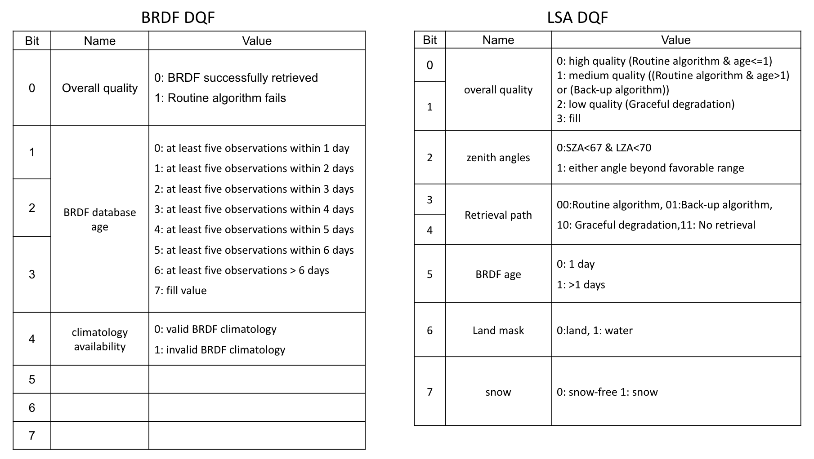
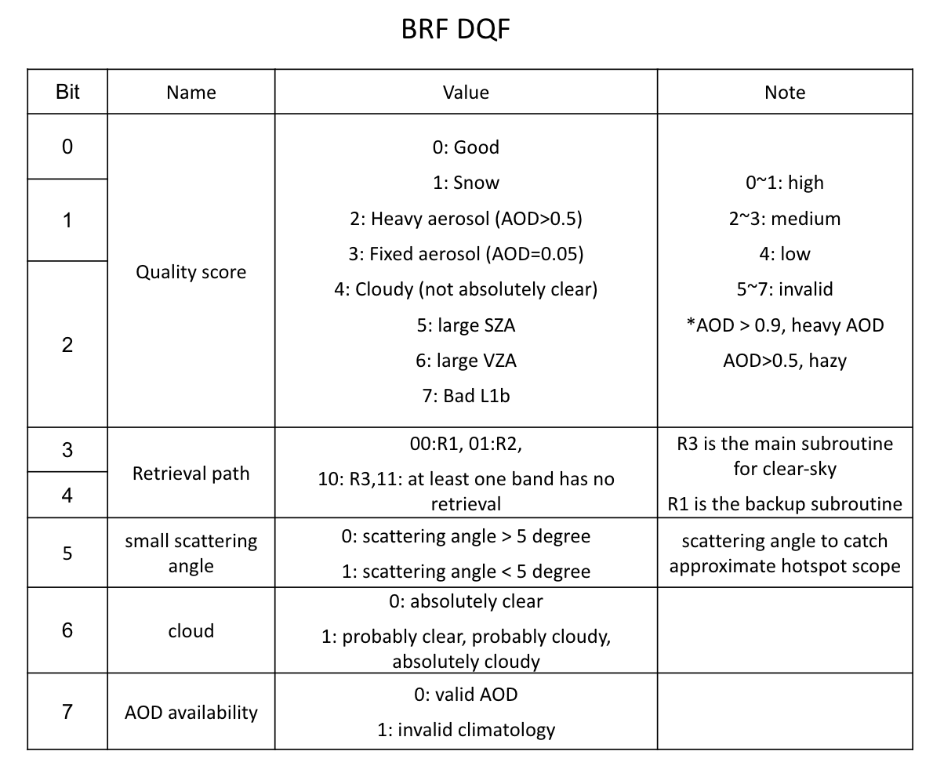
Updates in GOES-19 DAP
We have implemented all the planned updates from the GOES-18 LSA/BRF Provisional Review and exceeded expectations.
Key improvements include:
The LSA/BRF/BRDF DQF has been enhanced with more relevant information, making it easier to identify and address issues in LSA/BRF.
Previously unused bits, now provide important new information (highlighted in orange).
An enhanced LSA/BRF algorithm for snow surfaces.
Switching the BRF for probably clear pixels from atmospheric correction to BRDF simulation.
A cleaner and more organized calculation flow for better clarity and structure.

Slide 12
PROVISIONAL VALIDATION PRODUCT MATURITY ASSESSMENT
GOES-19 Land Surface Albedo/Surface Reflectance Provisional PS-PVR

Slide 13
Top Level Summary of Product Quality
G19 LSA products quality meets the product requirement
  The value range and continuity is as expected from visual inspection
  Validation using ground measurements suggests the accuracy and precision are good
  Inter-comparison with G16- and G18- LSA products show consistency
LSA Product is expected to perform good in a longer period with confidence
Notes:
We will first do the evaluation review of the LSA product.
In summary, the G19 LSA products have met the mission requirement. This conclusion is based on the comparison result with ground measurements and G16 and G18 albedo product.

Slide 14
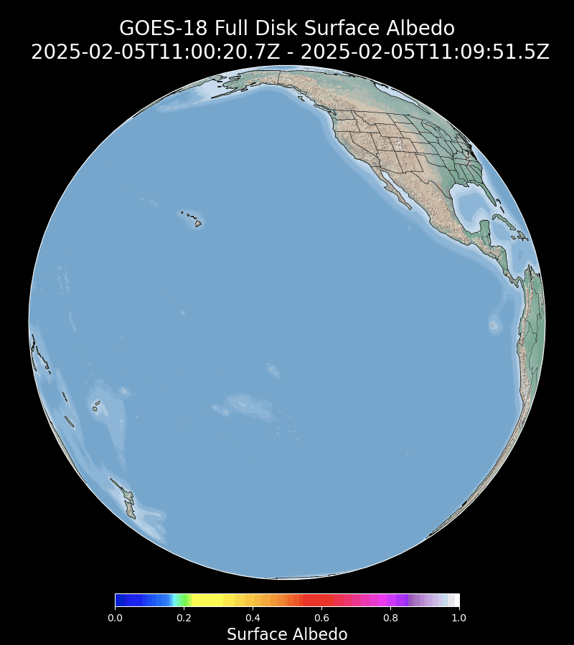
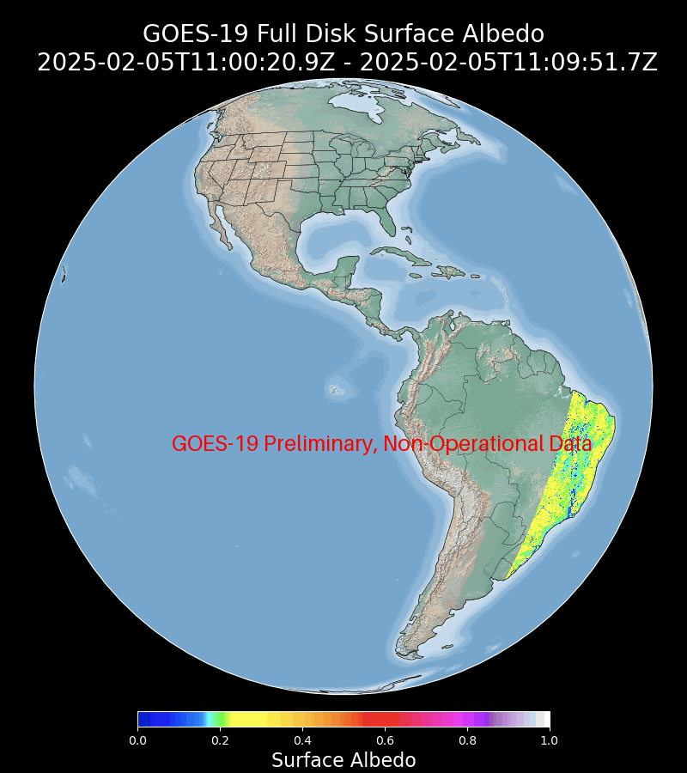
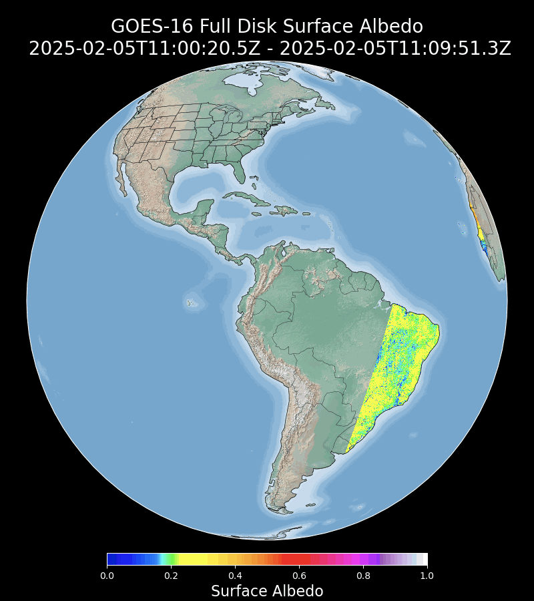
Visual inspection
GOESR G19 vs. G16/G18 FD LSA
Notes:
The GOES-19 FD LSA is being visually inspected. The product behaves normal with very good agreement to its GOES-16 and GOES-18 counterpart

Slide 15
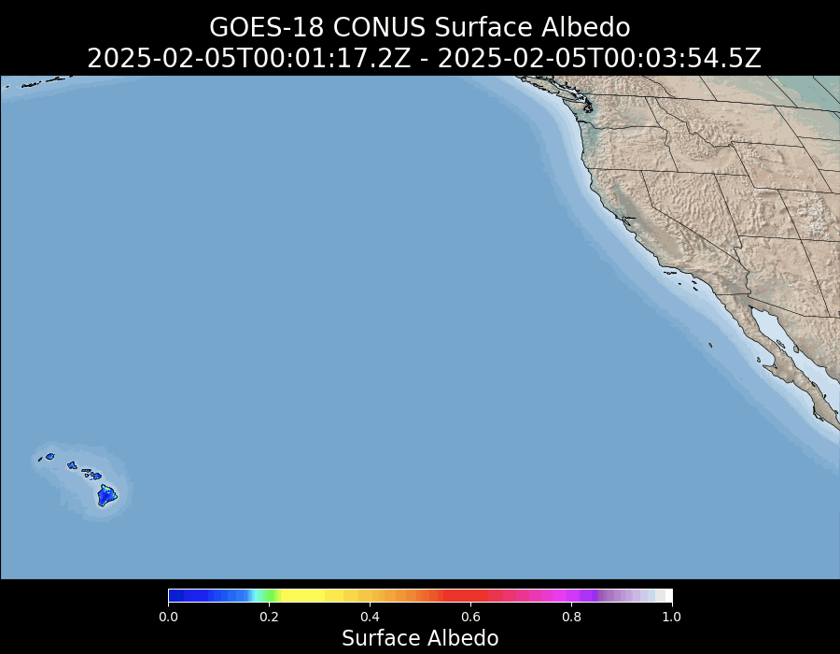
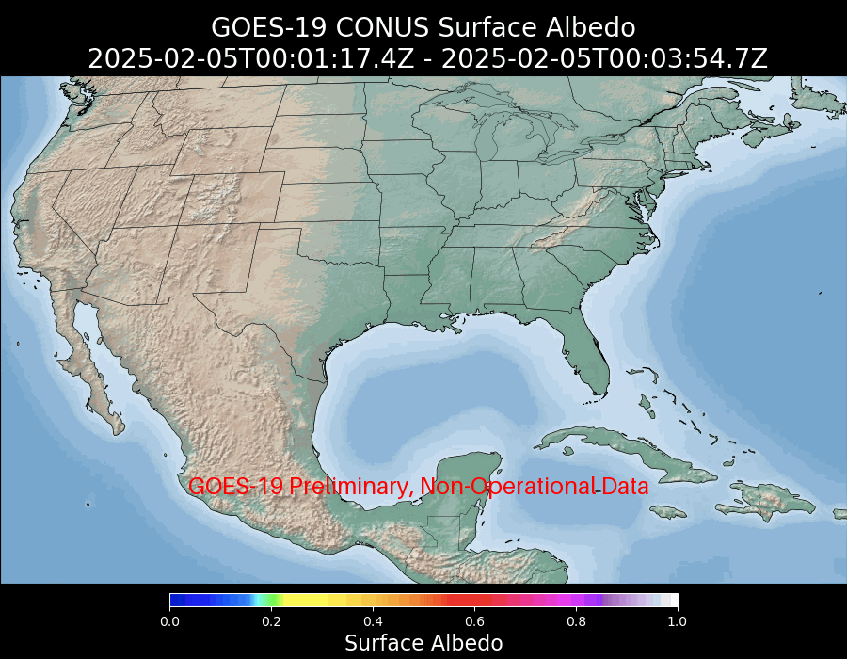
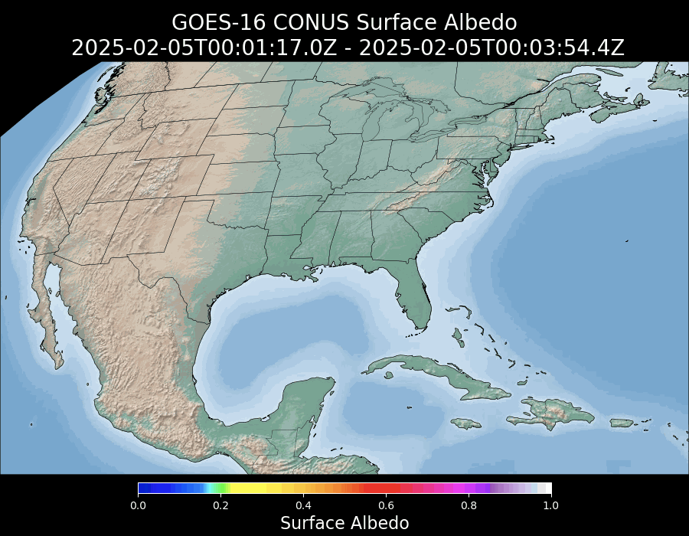
GOESR G19 vs. G16/G18 CONUS LSA
Notes:
The G19 CONUS LSA is visually inspected and monitored in the long-term monitoring system. Its performance is good and consistent with G16 and G18 CONUS LSA.

Slide 16
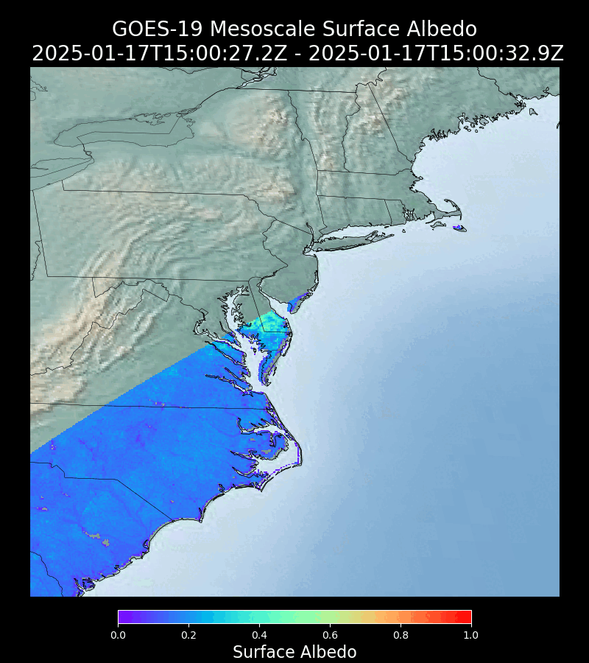
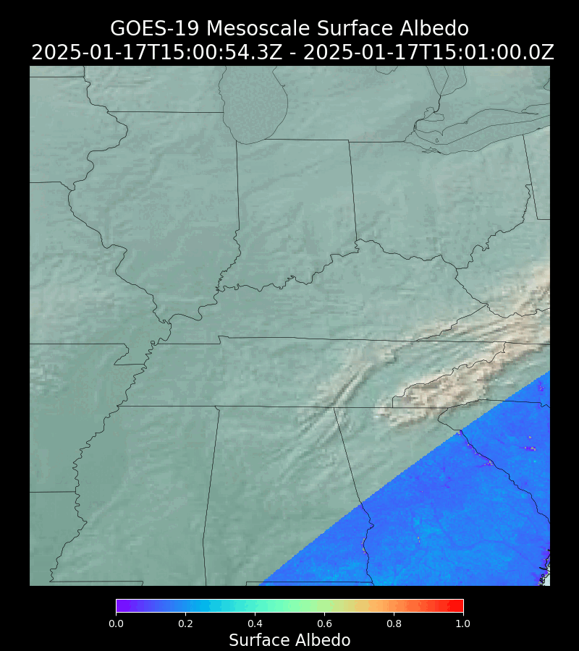
GOESR G19 MESOSCALE LSA
M1
M2

Slide 17
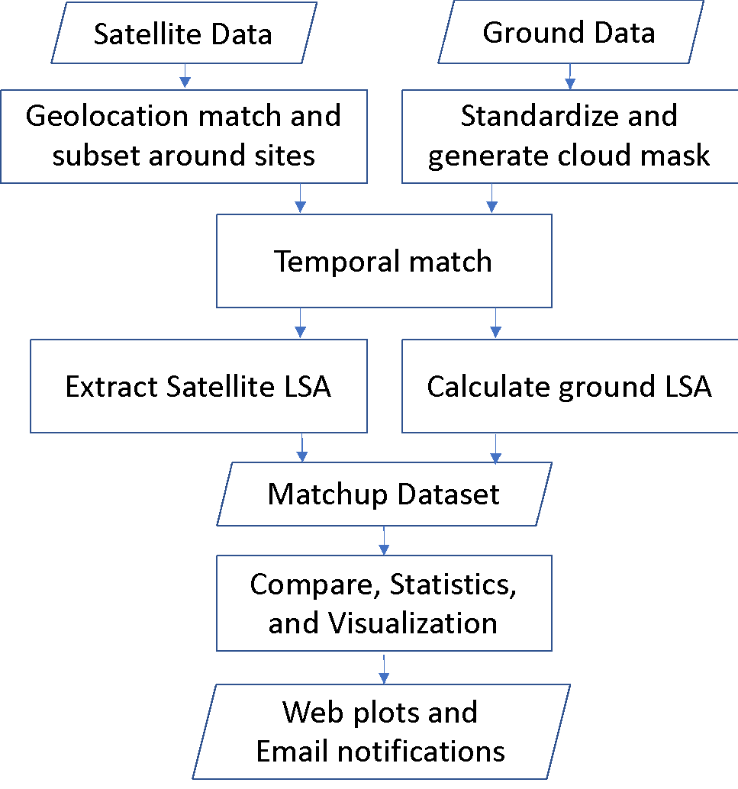
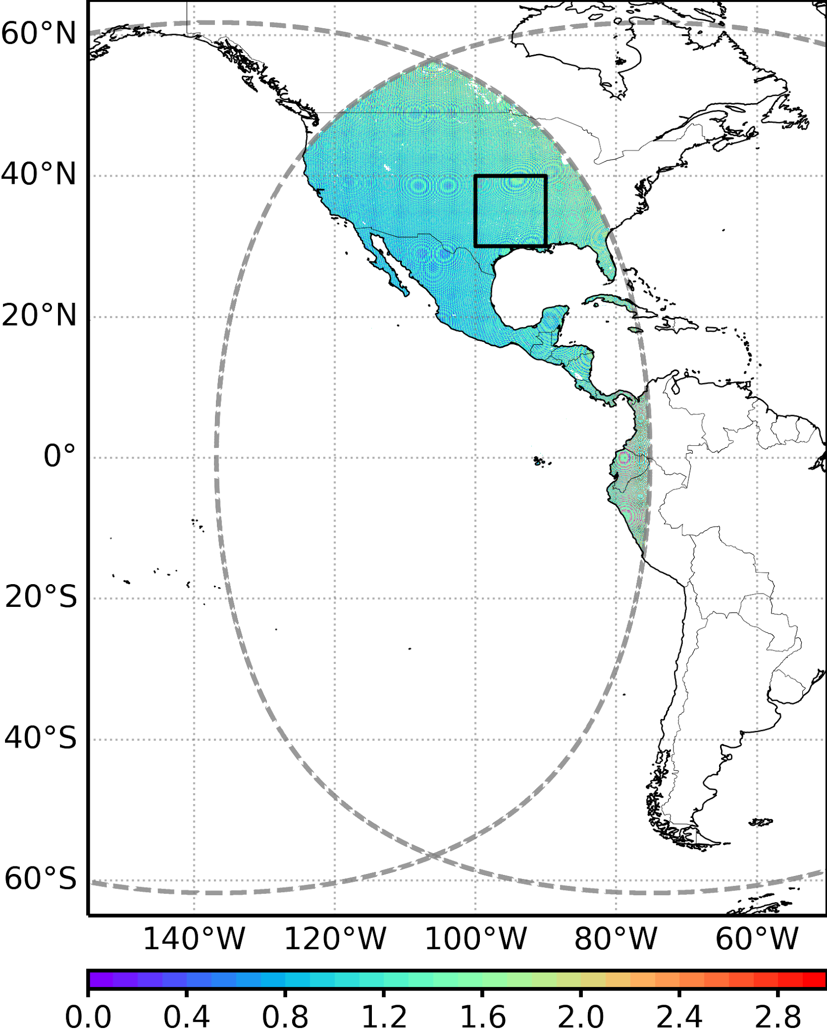
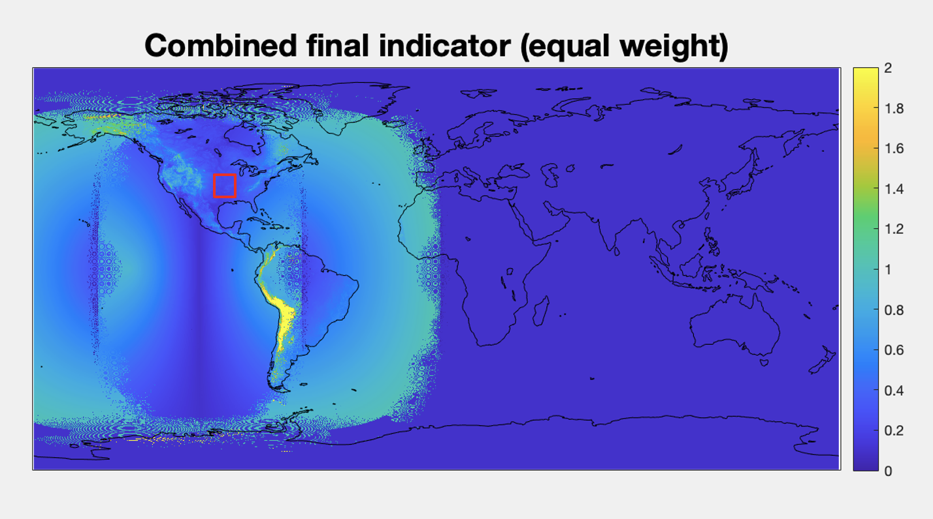
GOES-19 LSA validation Datasets
How did we select the cross-comparison area?
GOES-19 Dataset
Less influence from the terrain effect
Smaller View Zenith Angle (VZA) difference
GOES-19 GS/PDA Data
  GOES-19 FD/CONUS data hourly: Oct 2, 2024 – Feb 05, 2025
(ROI) :
30º N and 40º N
90º W and 100º W
Reference Dataset
The distance of co-located pixel pairs are mostly within 1.5 km.
In-situ LSA from ground measurements
  SURFALB network
  ARM-SGP network
  NEON network
GOES-16 Series ABI LSA
GOES-18 ABI LSA
Flowchart of GOES-R Series LSA ground validation
Notes:
Four months’ worth of GOES-19 LSA was evaluated, from June to October, for both FD and CONUS
The LSA validation has used ground measurements from SURFRAD, ARM-SGP, NEON three networks which are well-maintained. The matchups are collected on an hourly sampling.
We also employed G16, G18 albedo for cross-comparison at each site

Slide 18
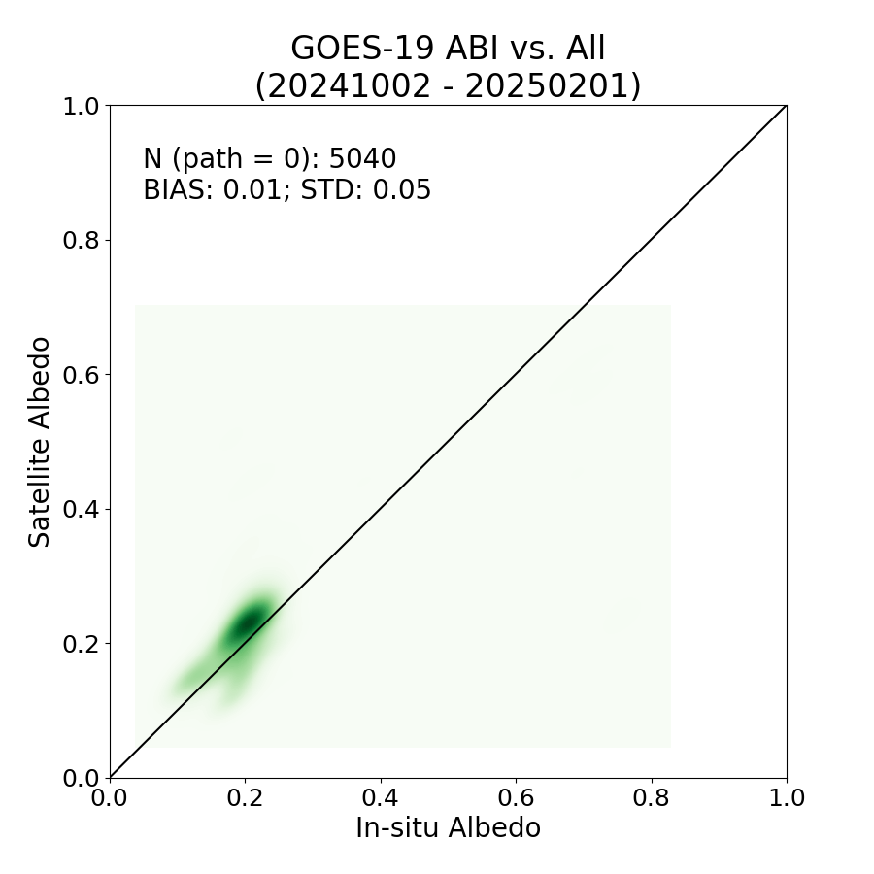
GOES-19 LSA vs. Ground LSA
Evaluated data: GOES-19 LSA
Reference value: All ground measurements from SURFRAD, ARM-SGP, and NEON
Date span: 20241002-20250205
Validation performance: The G19 LSA commits with ground measurements with minor overestimation.
Requirements: BIAS (0.08), STD (10%)

Slide 19

G19 CONUS LSA vs. Ground LSA
Evaluated data: GOES-19 CONUS LSA
Reference value: All ground measurements from SURFRAD ARM-SGP, and NEON
Date span: 20241002-20250205
Validation performance: The G19 LSA commits with ground measurements. The overestimation at specific sites is related to the surface heterogeneity.
Requirements: BIAS (0.08), STD (10%)

Slide 20
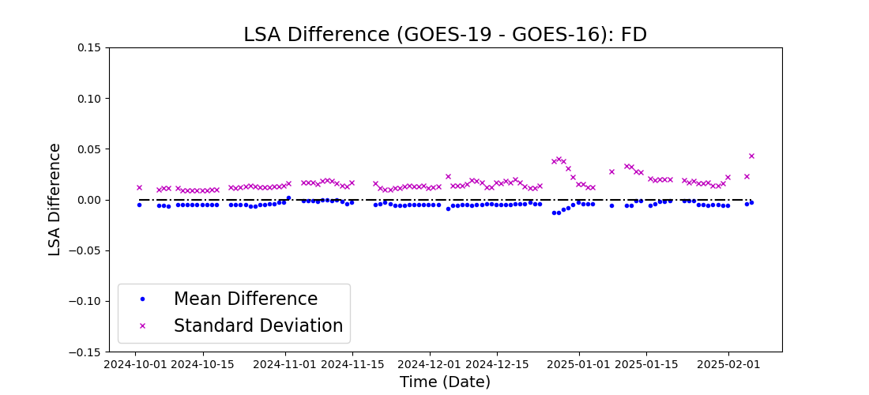
Cross-comparison of G19 vs. G16 LSA
Evaluated data: GOES-19 LSA
Reference value: GOES-16 LSA
Date span: 20241002-20250201
Validation performance: The LSA difference remains a stable level from month to month, with some increase in snow season.

Slide 21
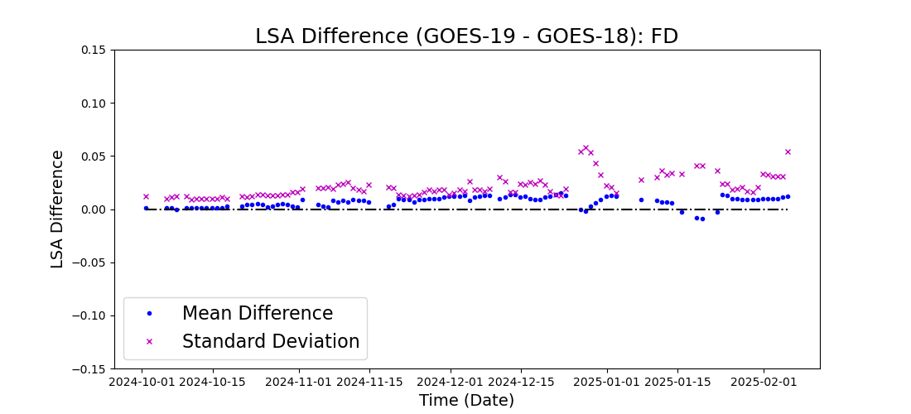
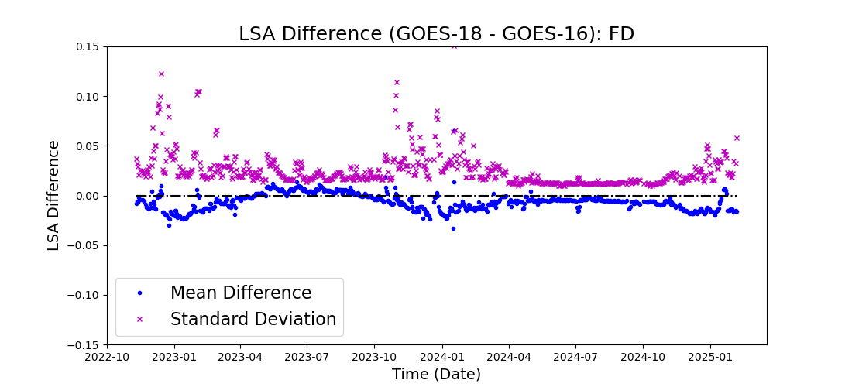
Cross-comparison of G19 vs. G18 LSA
Evaluated data: GOES-19 LSA
Reference value: GOES-18 LSA
Date span: 20241002-20250201
Validation performance: The consistency between GOES-19 and GOES-18 is relatively stable. The bias is slightly larger, combining the due to the larger difference in observation angles and input data calibration result. Looking at the comparison between GOES-18 and GOES-16, the bias is in the opposite direction. As a side note, the differences between GOES-18 and GOES-16 in 2024 are smaller than in the previous two years.

Slide 22

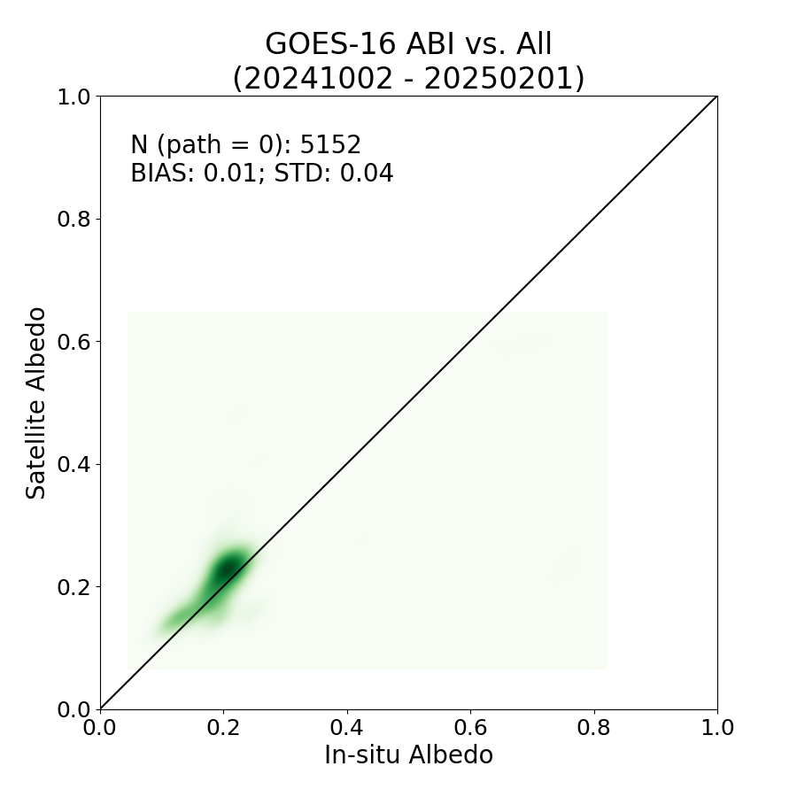
G16 LSA vs. Ground measurements
Evaluated data: GOES-16 LSA FD
Reference value: All ground measured albedo from SURFRAD, ARM-SGP, and NEON
Date span: 20241002-20250201 (G16)
Validation performance: The accuracy metrics of GOES-16 are comparable to GOES-19.
FD
CONUS
Requirements: BIAS (0.08), STD (10%)
Notes:
To see if the G19 LSA performance is very similar to G16 during the same period

Slide 23
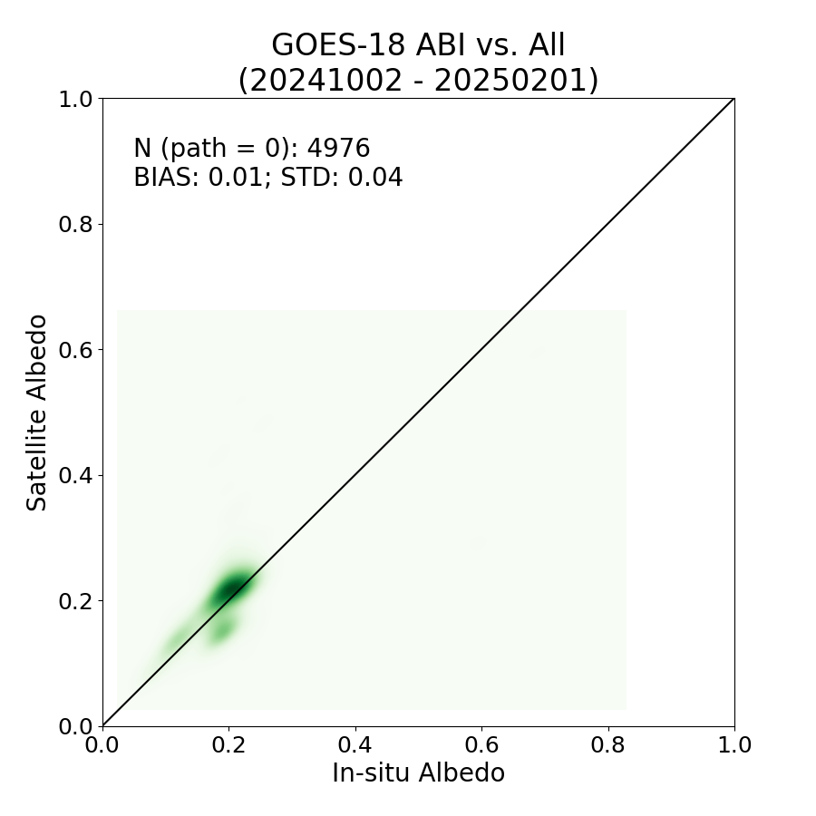
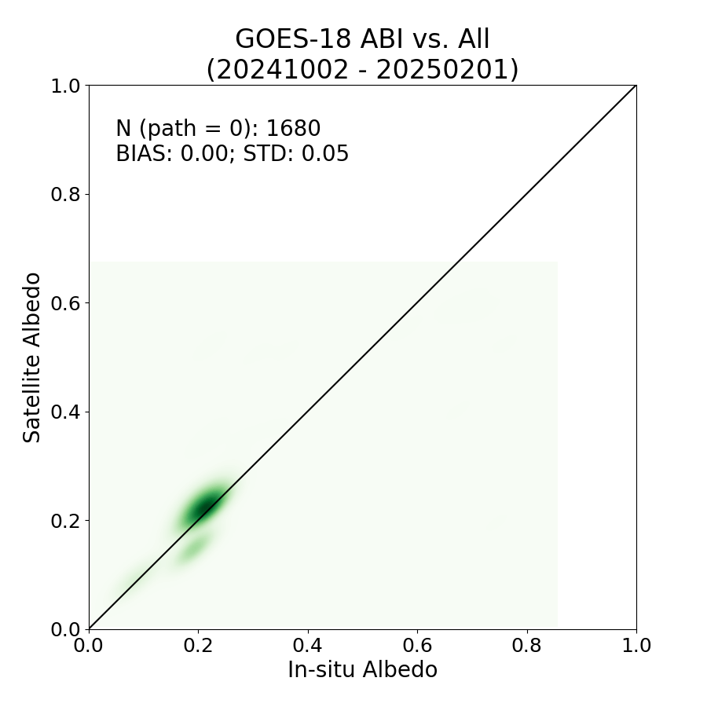
G18 LSA vs. Ground measurements
Evaluated data: GOES-18 LSA FD
Reference value: All ground measured albedo from SURFRAD, ARM-SGP, and NEON
Date span: 20241002-20250201 (G16)
Validation performance: The accuracy metrics of GOES-18 are comparable to GOES-19.
FD
CONUS
Requirements: BIAS (0.08), STD (10%)
Notes:
To see if the G19 LSA performance is very similar to G16 during the same period

Slide 24
Summary of performance
Metrics | Requirement | G19 LSA FD | G18 LSA CONUS
Bias | 0.08 | 0.00 | 0.00
Precision | 10% | 0.04 | 0.04
Notes:
From the validation indicator table, we could see that the used G19 LSA datasets all meet the mission requirement, in FD and CONUS.

Slide 25
Top Level Summary of
Product Quality
The G19 BRF product quality meets the product requirement
  The value range and continuity is as expected from visual inspection
  Validation using ground measurements suggests the accuracy and precision are good
  Inter-comparison with G16- BRF products show consistency
The G19 BRF Product is expected to perform good in a longer period

Slide 26
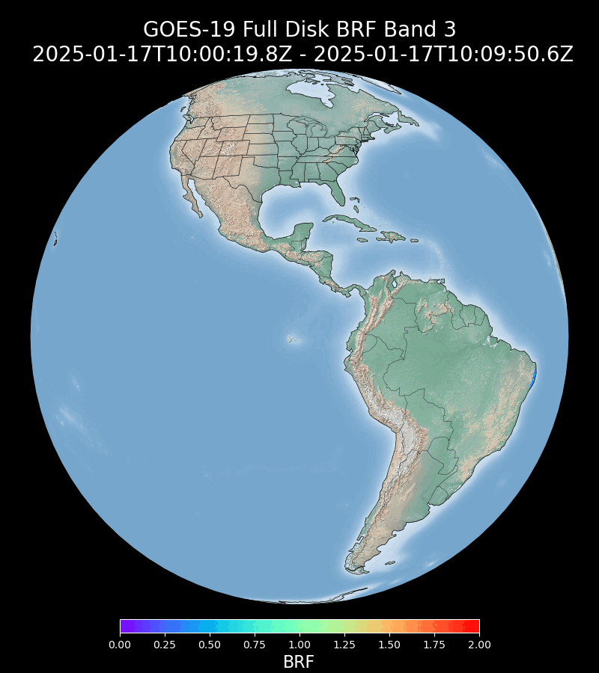
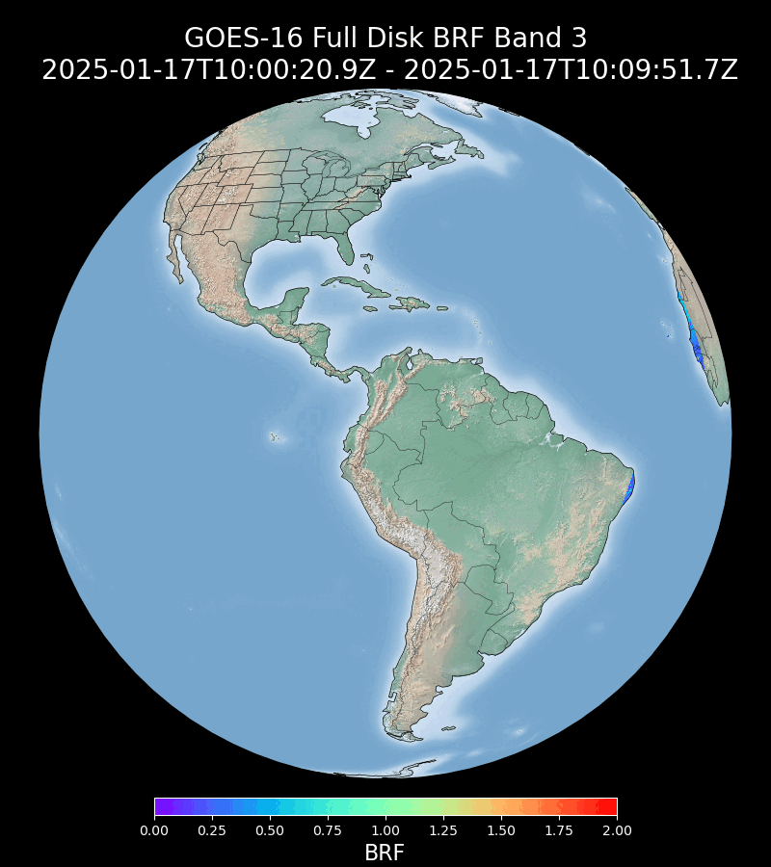
GOESR G19 vs. G16 FD BRF
Visual Inspection

Slide 27
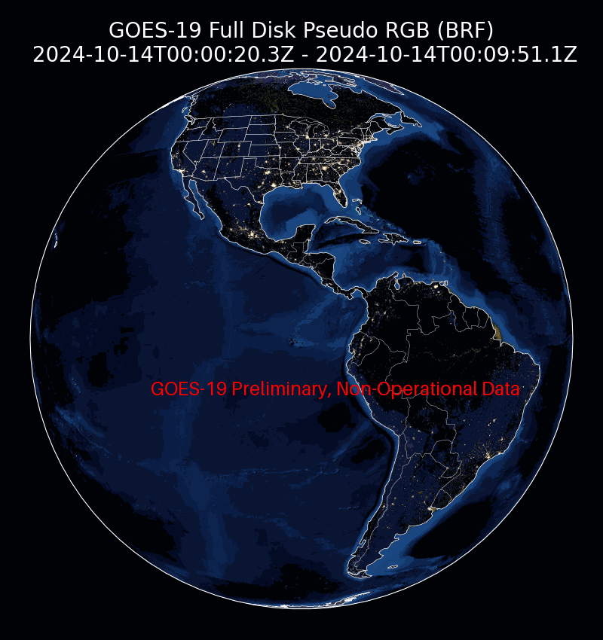
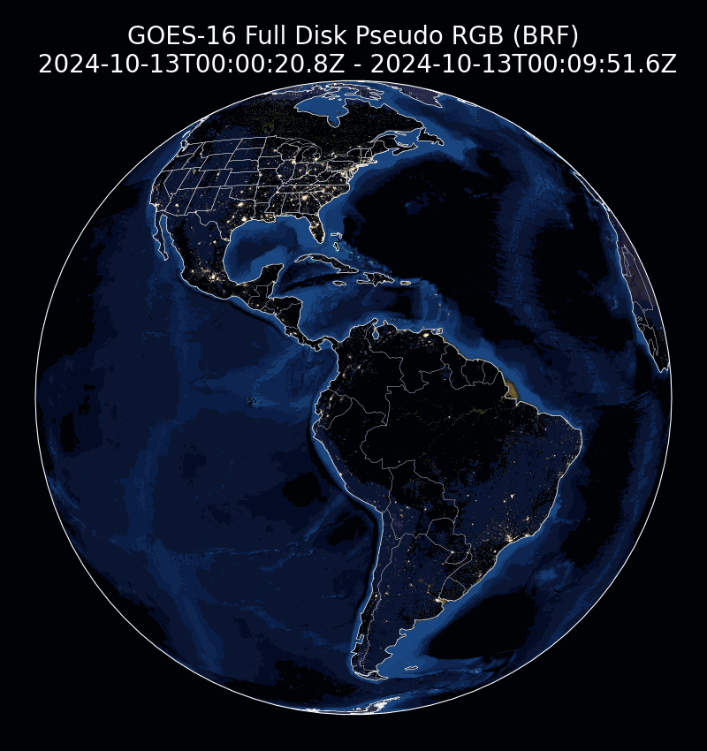
GOESR G19 vs. G16 FD BRF
Visual Inspection
G19
G16

Slide 28
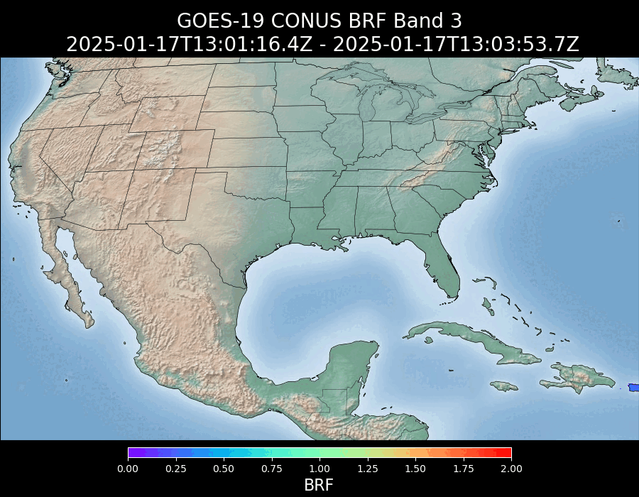
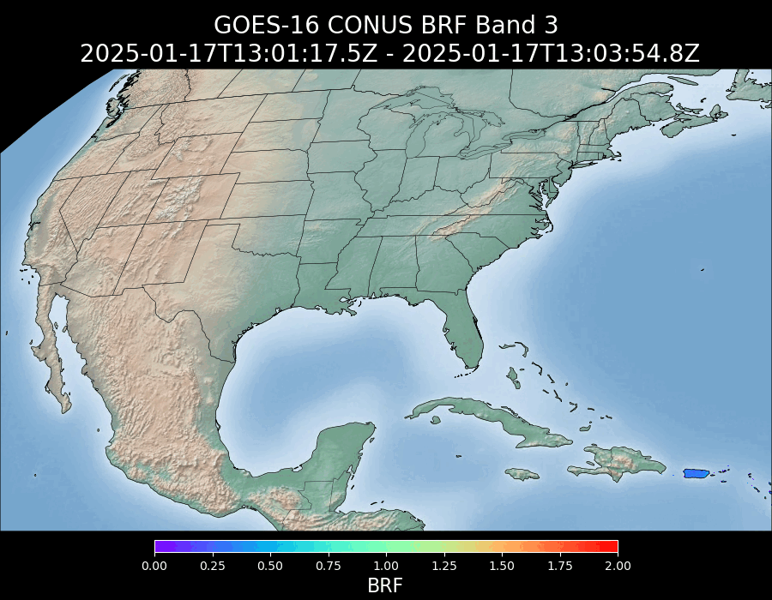
GOESR G19 vs. G16 FD BRF
Visual Inspection

Slide 29
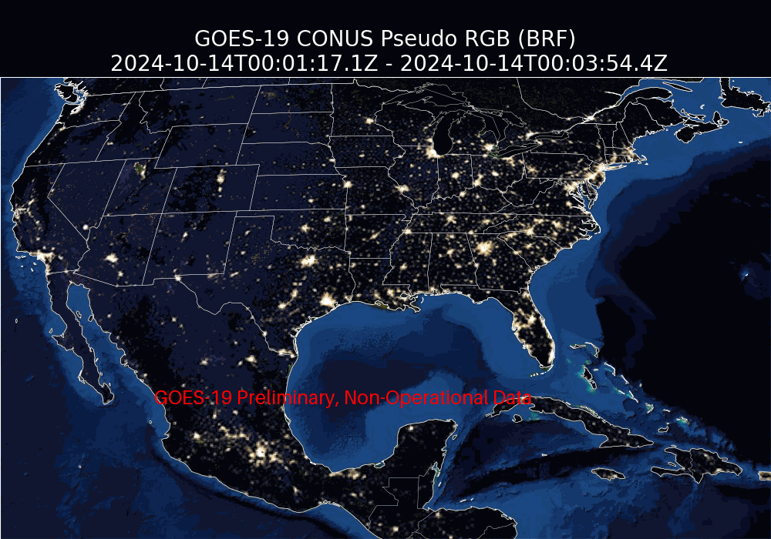
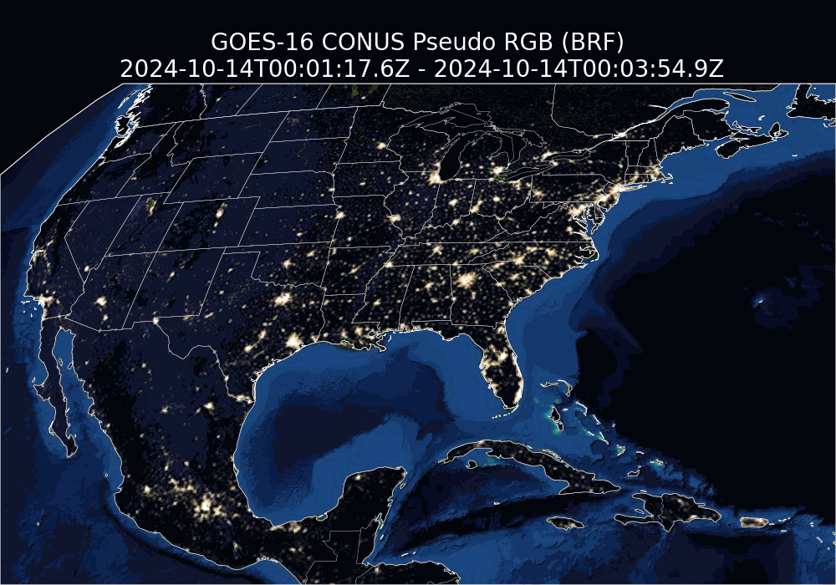
GOESR G19 VS. G16 CONUS BRF
(NATURAL-COLOR COMPOSITE)

Slide 30
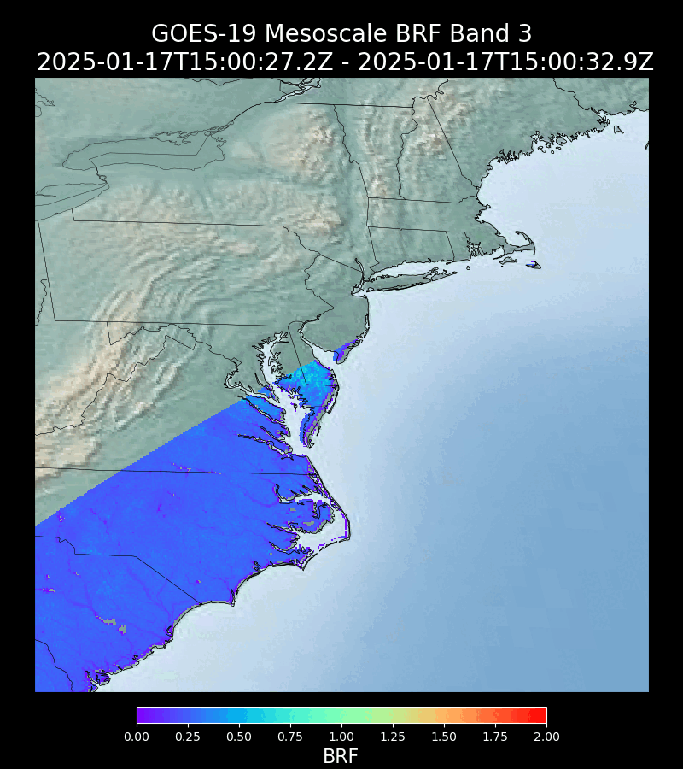
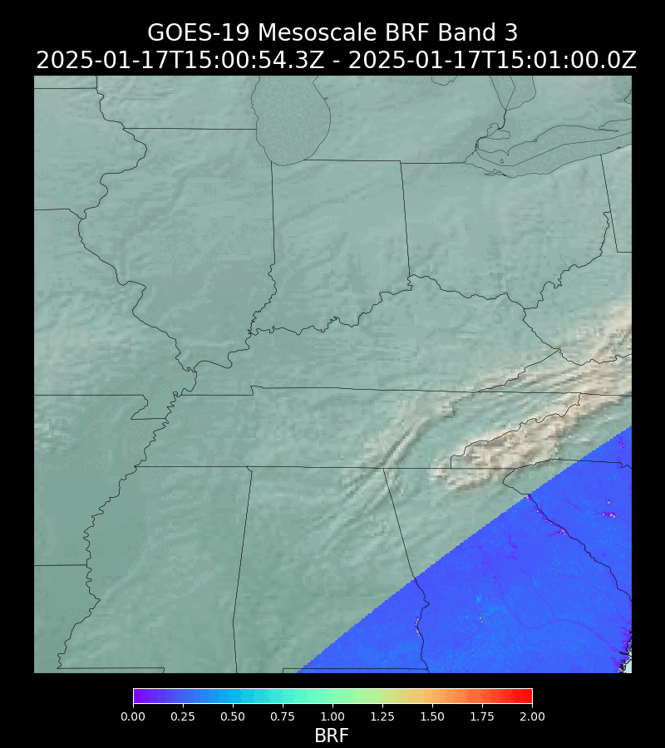
GOES-19 MESOSCALE BRF
M1
M2

Slide 31
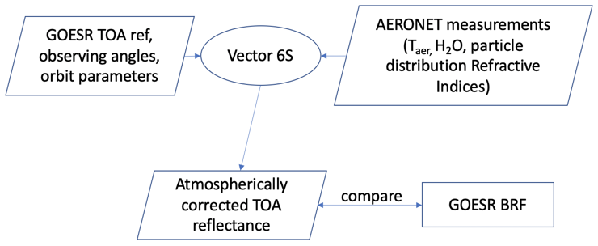
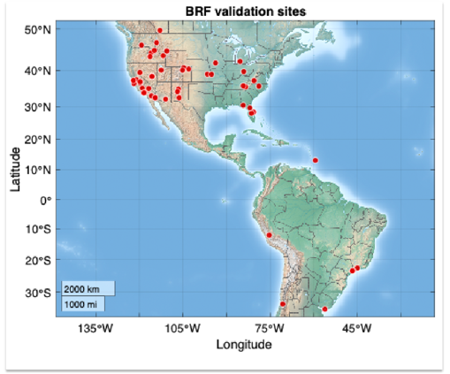
GOES-19 BRF validation Datasets
GOES-19 Dataset
GOES-19 GS/PDA Data
  GOES-19 FD/CONUS data hourly: Oct 02, 2024– Feb 01, 2025
Reference Dataset
Flow of GOES-R Series BRF ground validation
Surface reflectance from 6S model using ground AOD measurements
  AERONET network
Operational GOES-16 Series ABI BRF
  Cross comparison
Aeronet sites
Notes:
The BRF validation has used Surface reflectance from 6S model using ground AOD measurements. We also used G17 BRF for cross-comparison in LTM.
The BRF validation uses the same period of validation data as LSA. The matchups are collected on an hourly sampling
In the validation of BRF, we deploy the Aeronet network ground measurements water vapor, ozone, and refractive indices for aerosols to determine the AOD profile. We used AOD550 from Aeronet and GOESR respectively to generate the reference value.
The radiative transfer approach is also independent, while the reference value is from 6S and our LUT is from Modtran.
The general premise behind this approach is to compare the surface reflectance derived from atmospheric correction using the image parameters against the equivalent using the station derived parameters. This assumes that the surface reflectance derived from the ground parameters is the “truth”

Slide 32
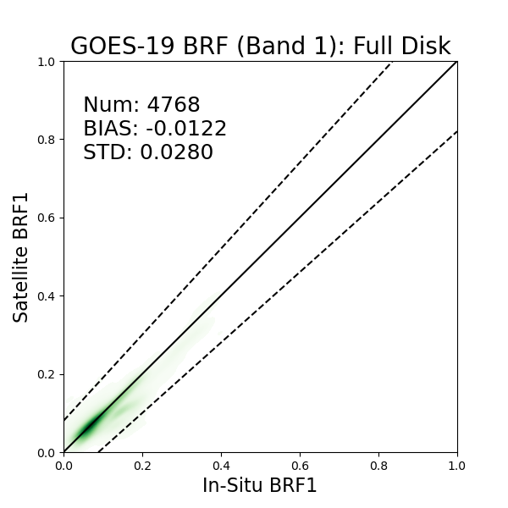
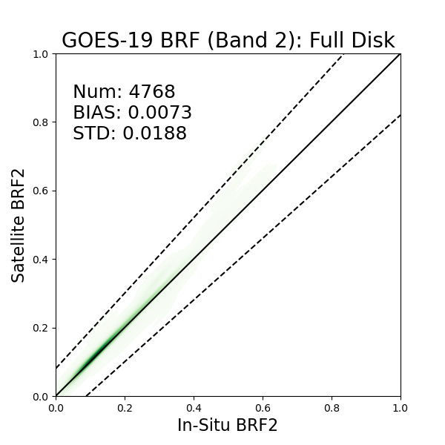
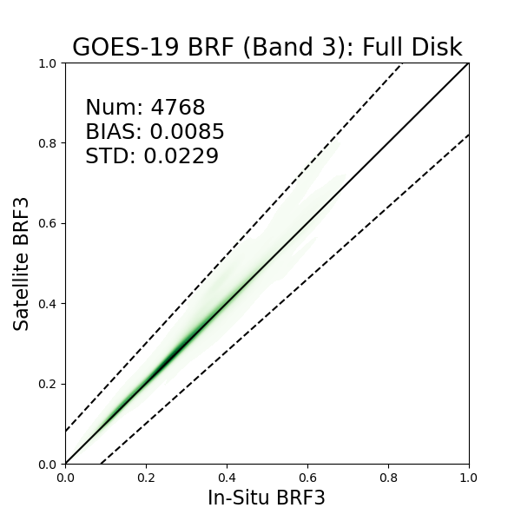
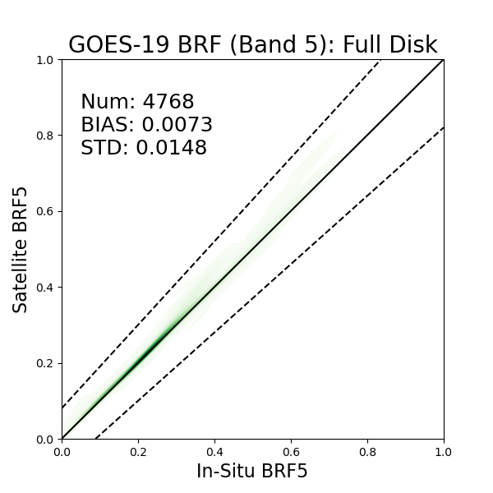
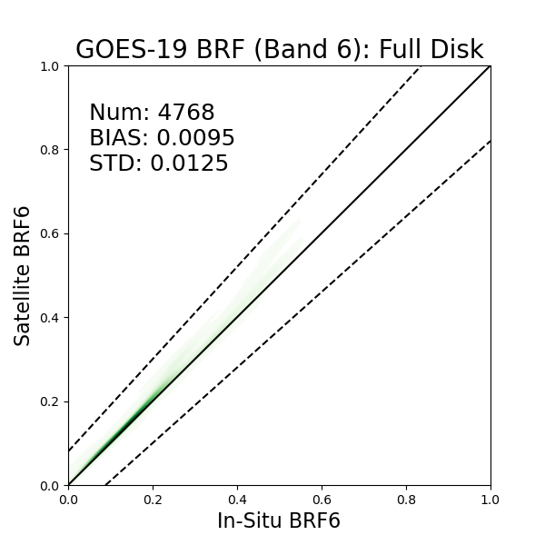

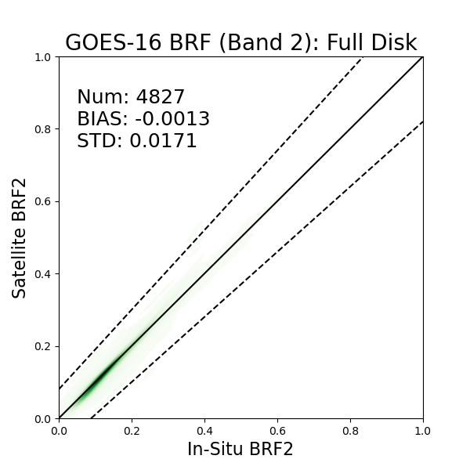
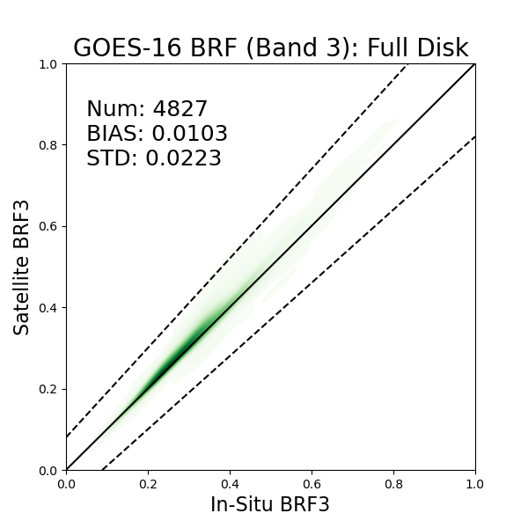
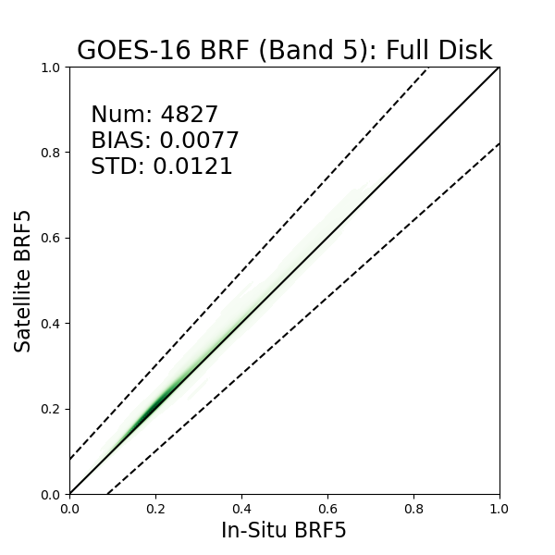

Evaluated data: GOES-19 FD BRF
Reference value: Surface reflectance atmospherically corrected using Aeronet ground measurements, with G16 FD BRF validated together
Date span: 20241002-20250201
Validation performance: The G19 BRF commits well with the independent reference value and consistent performance as G16 counterpart
G19
G16
Requirement:
Requirements: BIAS (0.08), STD (0.08)

Slide 33


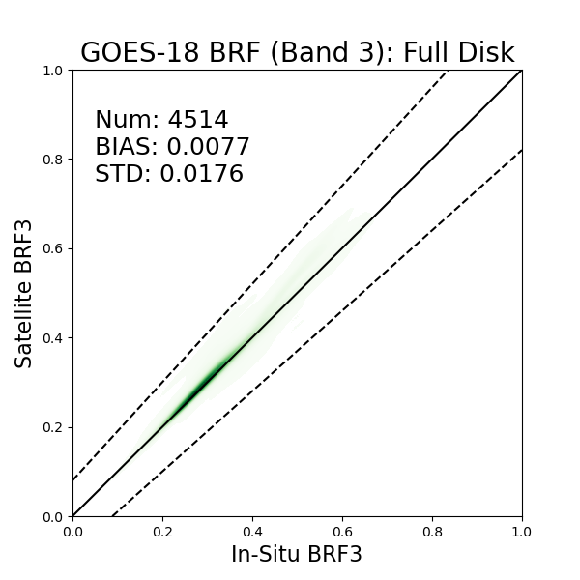
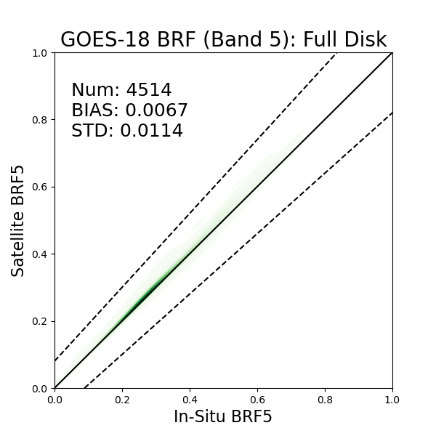

Evaluated data: GOES-19 FD BRF
Reference value: Surface reflectance atmospherically corrected using Aeronet ground measurements, with G18 FD BRF validated together
Date span: 20241002-20250201
Validation performance: The G19 BRF commits well with the independent reference value and consistent performance as G18 counterpart
G19
G18
Requirements: BIAS (0.08), STD (0.08)

Slide 34

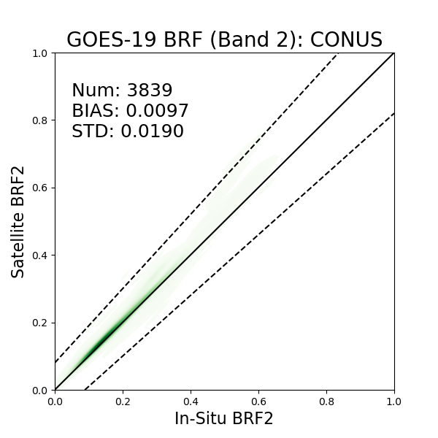



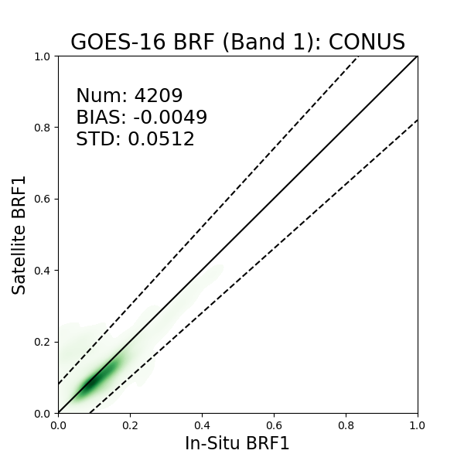

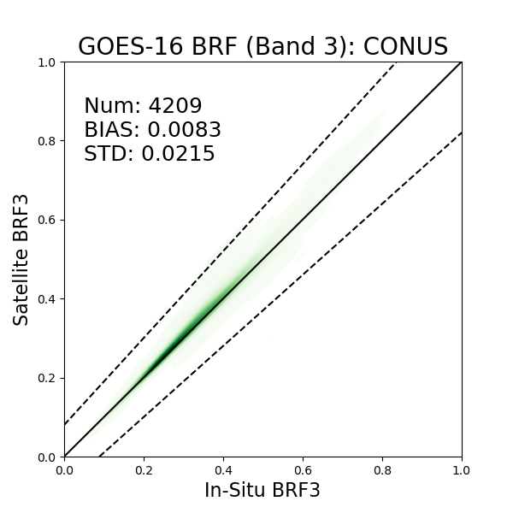
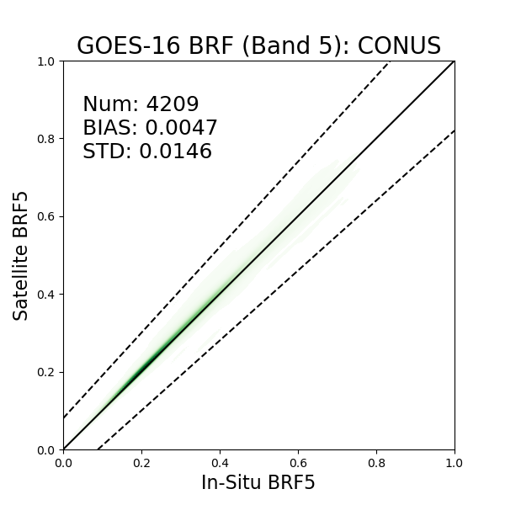

Evaluated data: GOES-19 CONUS BRF
Reference value: Surface reflectance atmospherically corrected using Aeronet ground measurements, with G16 CONUS BRF validated together
Date span: 20241002-20250201
Validation performance: The G19 CONUS BRF commits well with the independent value from Aeronet measurements and 6S model at all channels, similar as G16
G19
G16
Requirements: BIAS (0.08), STD (0.08)
Notes:
The validation result of the G19 BRF product in CONUS product shows consistent result with the reference value at all channels. The first channel is more sensitive to the AOD and worth more attention. Our result has met the mission requirement..

Slide 35





Cross-comparison
GOES-16 BRF vs. GOES-19 BRF: FD
BRF1
Below reference images are from CWG webpage showing the L1b data calibration results
Our cross-comparison results align well with the results from CWG regarding to the L1b data inter-comparison.

Slide 36





Cross-comparison
GOES-16 BRF vs. GOES-19 BRF: FD
BRF2
Below reference images are from CWG webpage showing the L1b data calibration results
Our cross-comparison results align well with the results from CWG regarding to the L1b data inter-comparison.

Slide 37





Cross-comparison
GOES-16 BRF vs. GOES-19 BRF: FD
BRF3
Below reference images are from CWG webpage showing the L1b data calibration results
Our cross-comparison results align well with the results from CWG regarding to the L1b data inter-comparison.

Slide 38





Cross-comparison
GOES-16 BRF vs. GOES-19 BRF: FD
BRF5
Below reference images are from CWG webpage showing the L1b data calibration results
Our cross-comparison results align well with the results from CWG regarding to the L1b data inter-comparison.

Slide 39





Cross-comparison
GOES-16 BRF vs. GOES-19 BRF: FD
BRF6
Below reference images are from CWG webpage showing the L1b data calibration results
Our cross-comparison results align well with the results from CWG regarding to the L1b data inter-comparison.

Slide 40
Summary of performance
Metrics | Band | Requirement | G19 FD | G19 CONUS
Bias | Band 1 | 0.08 | -0.0122 | -0.011
 | Band 2 | 0.08 | 0.0073 | 0.0097
 | Band 3 | 0.08 | 0.0085 | 0.01
 | Band 5 | 0.08 | 0.0073 | 0.008
 | Band 6 | 0.08 | 0.0095 | 0.0102
Precision | Band 1 | 0.08 | 0.028 | 0.0291
 | Band 2 | 0.08 | 0.0188 | 0.019
 | Band 3 | 0.08 | 0.0229 | 0.023
 | Band 5 | 0.08 | 0.0148 | 0.0154
 | Band 6 | 0.08 | 0.0125 | 0.0132
Notes:
From the validation indicator table, we could see that the G19 BRF datasets all meet the mission requirement, for both FD and CONUS.

Slide 41
Provisional Validation
Preparation Activities | Assessment
Validation activities are ongoing and the general research community is now encouraged to participate. | Agree
Severe algorithm anomalies are identified and under analysis. Solutions to anomalies are in development and testing. | There are no algorithm anomalies.
Incremental product improvements may still be occurring. | The results of this review are not dependent upon any planned improvements. Incremental product improvements are expected.
Notes:
We agree that

Slide 42
Provisional Validation
End State | Assessment
Product performance has been demonstrated through analysis of a small number of independent measurements obtained from select locations, periods, and associated ground truth or field campaign efforts. | True, the reference data is independent from the validated data and derived from well- maintained ground instruments.
Product analysis is sufficient to communicate product performance to users relative to expectations (Performance Baseline). | Agree
Documentation of product performance exists that includes recommended remediation strategies for all anomalies and weaknesses. Any algorithm changes associated with severe anomalies have been documented, implemented, tested, and shared with the user community. | This has been communicated in in these slides. No frequent or severe anomalies.
Testing has been fully documented. | This slide set is the documentation for test results.
Product is ready for operational use and for use in comprehensive cal/val activities and product optimization. | Agree

Slide 43
Summary and Recommendations
GOES-19 LSA/BRF products generated by the Ground System have been evaluated for four months data in Fall and Winter of 2024. Recommendations are as follows:
LSA: The GOES-19 LSA product meets accuracy and precision requirements and have reached the Provisional Maturity as defined by the GOES-R Program. We recommend it for Provisional Maturity status.
BRF: The GOES-19 BRF product meets accuracy and precision requirements and have reached the Provisional Maturity as defined by the GOES-R Program. We recommend it for Provisional Maturity status.

Slide 44
Path to Full Validation Maturity
We expect to carry out the same activities on new version OE output for full validation maturity.
No major issues have been addressed
No risks have been identified
Notes:
Path to the full validation maturity

Slide 45
Full Validation PLPTs
The table below lists the types of tests to be performed.
Test ID | Short description | 16 | 17
ABI-FD_LSA06 | FD product accuracy and precision assessment | F | F
ABI-CONUS_LSA07 | CONUS product accuracy and precision assessment | F | F
AWG LSA Team will conduct these tests to further evaluate the L2 LSA product quality.
Full test plans and procedures are given in the LSA Readiness, Implementation, and Management Plan (RIMP v1.0, April, 2022)
Notes:
The mentioned validation work will be for both FD data and CONUS data.

Slide 46
BACKUP SLIDES
GOES-19 Land Surface Albedo/Surface Reflectance Provisional PS-PVR

Slide 47

Product application from user
Figure from user in Smithsonian Astrophysical Observatory (SAO), working in TEMPO group
PI: Dr. Xiong Liu. Dr. Weizhen Hou
A BRF spectral reconstruction result from 400 to 2400 nm based on only five wavelength bands by our newly developed spectral reconstruction model, which may greatly expand the spectral application range of GOES-R ABI’s BRF/BRDF data.

Slide 48
Definitions of Metrics for Quantitative Comparisons
Passed: Accuracy and Precision meet or slightly exceed requirements. Potential contributors for deviations are identified.
Partial-Passed: Accuracy/Precision deviates significantly from requirements, but potential contributors for deviations are identified.
Failed: Accuracy/Precision deviates significantly from requirements and source of poor performance is unknown, or source known and correction requires new algorithm.

