Slide 1
GOES-19 L2 (Group 4) Provisional Validation
Peer/Stakeholder Product Validation Review (PS-PVR)
Feb. 19, 2025
NWS Perspective / AWIPS Verification
Derek Van Pelt / TOWR-S team
NWS Office of Observations

Slide 2
Overview
Sea Surface Temperature
Fractional Snow Cover
Ice Concentration and Extent
Ice Age and Thickness

Slide 3
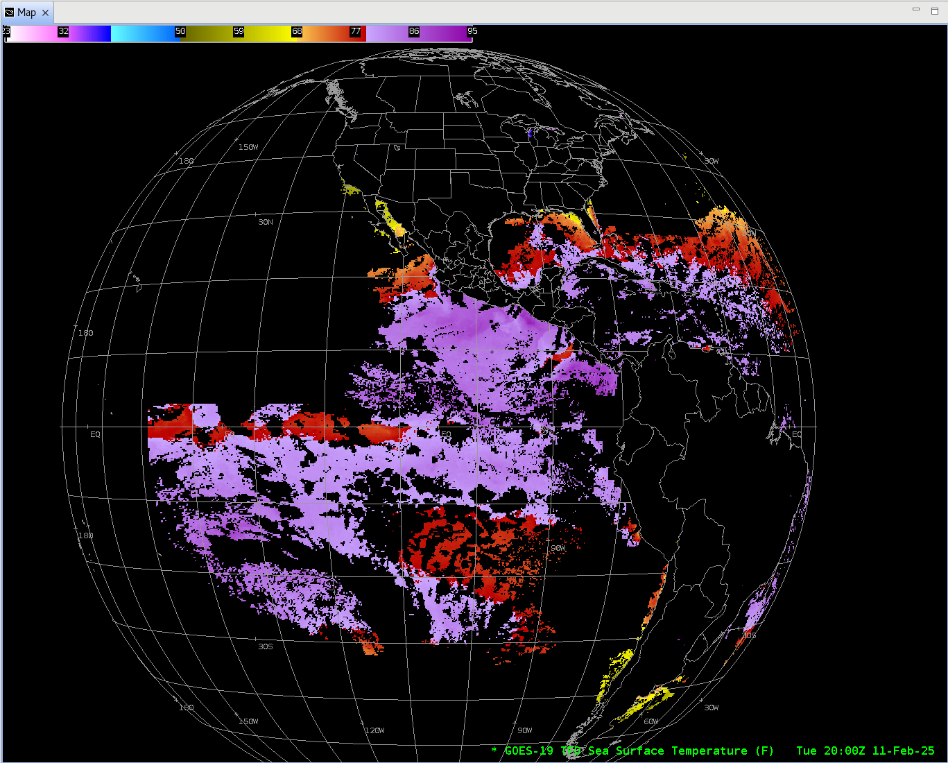
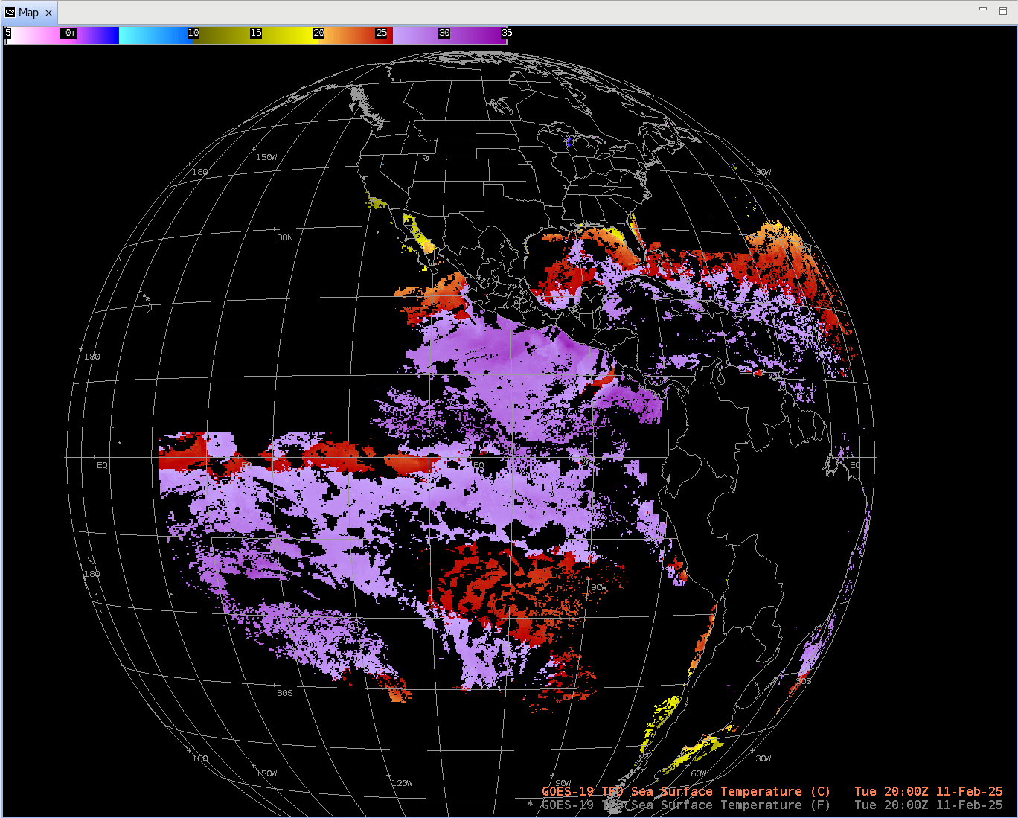
Sea Surface Temperature
GOES-19 Preliminary, Non-Operational Data

Slide 4
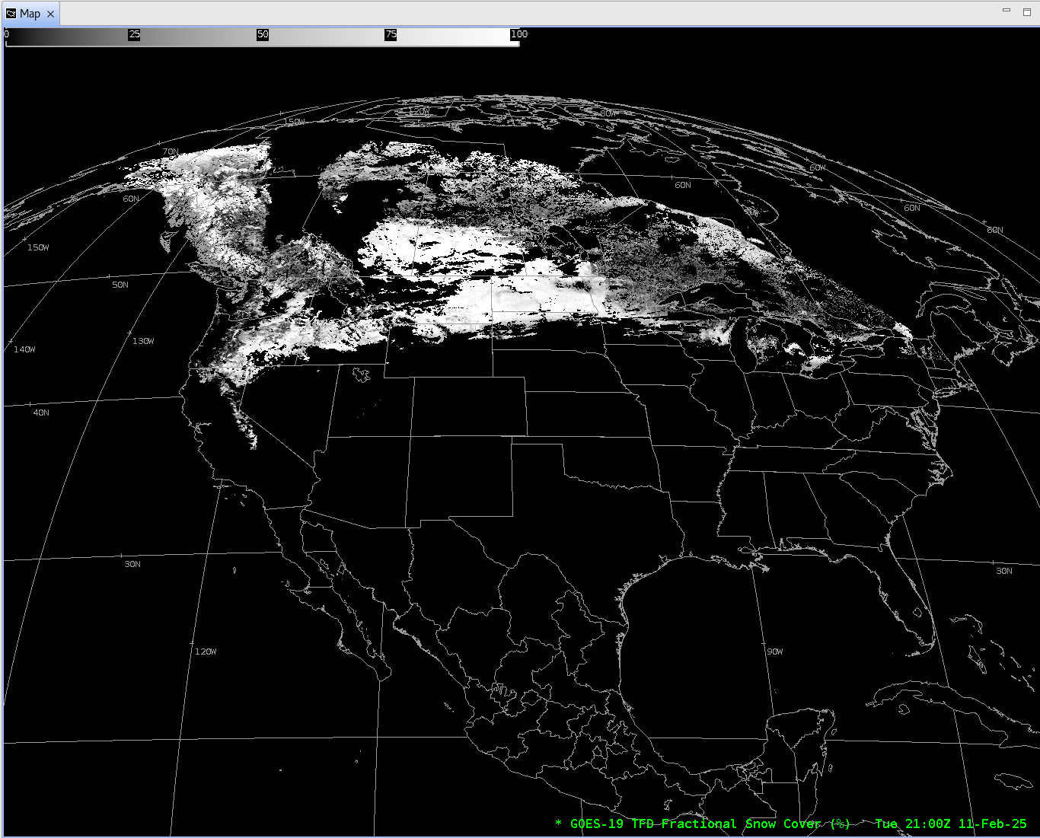
Fractional Snow Cover
GOES-19 Preliminary, Non-Operational Data

Slide 5
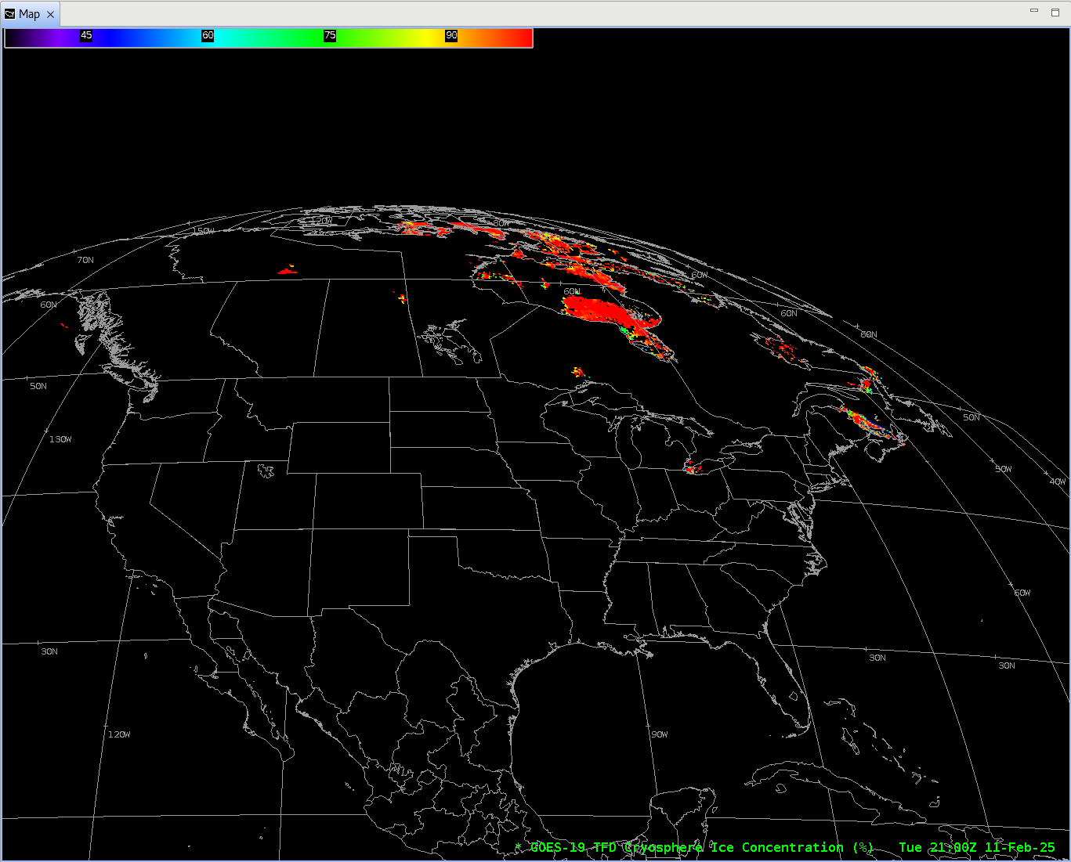
Ice Concentration and Extent
GOES-19 Preliminary, Non-Operational Data

Slide 6
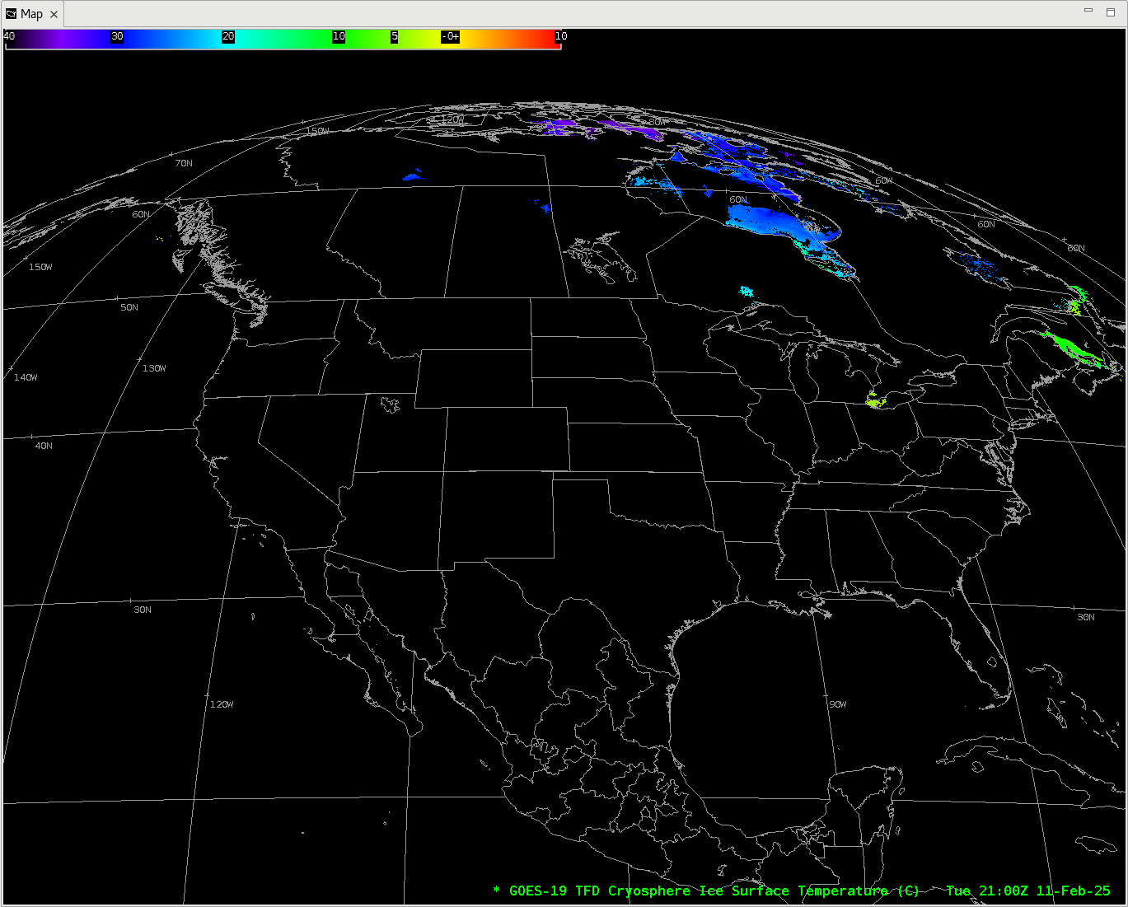
Ice Surface Temperature

Slide 7
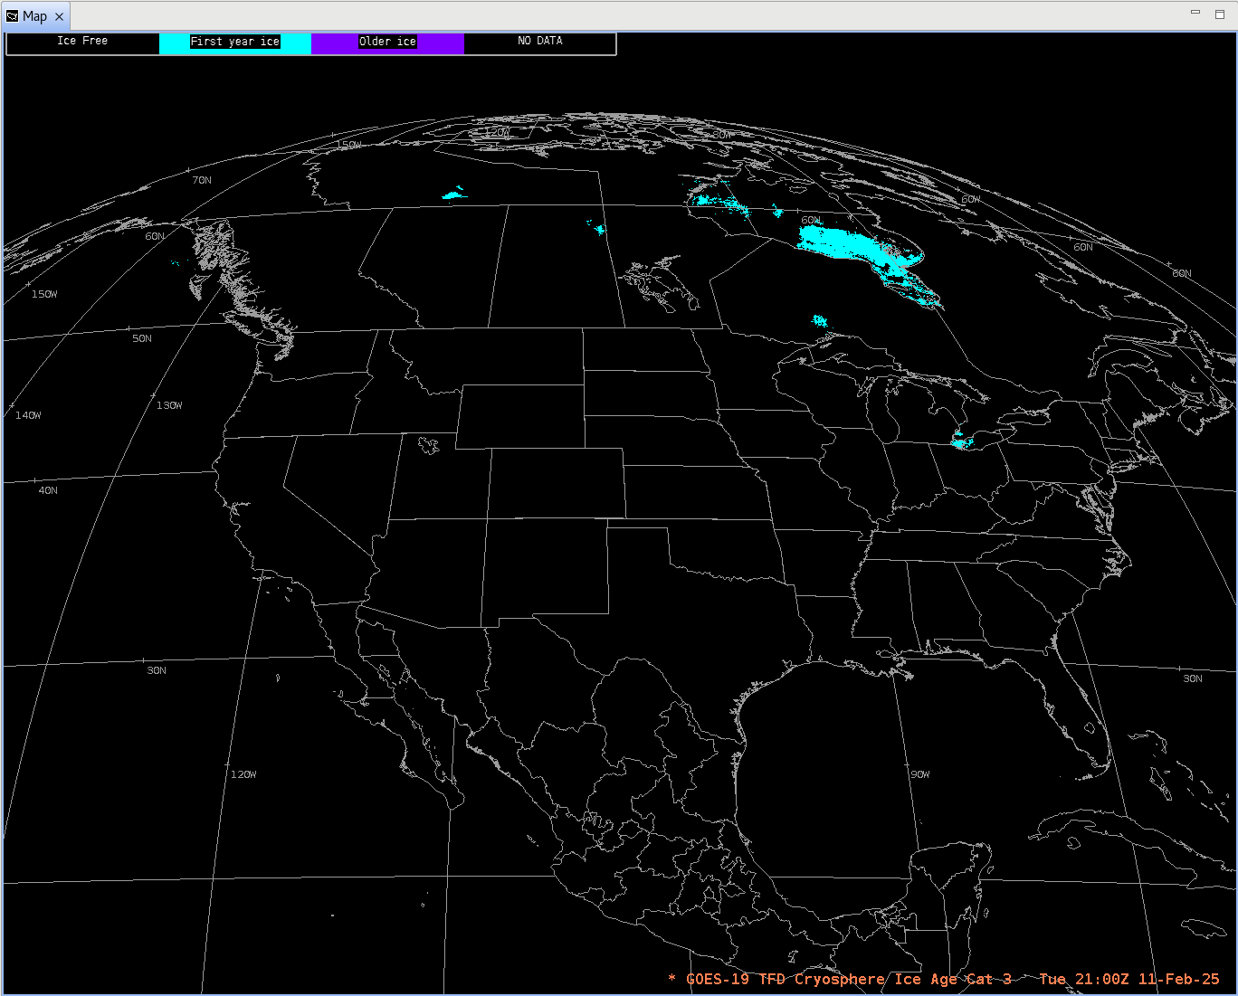
Ice Age (Cat 3)
GOES-19 Preliminary, Non-Operational Data

Slide 8
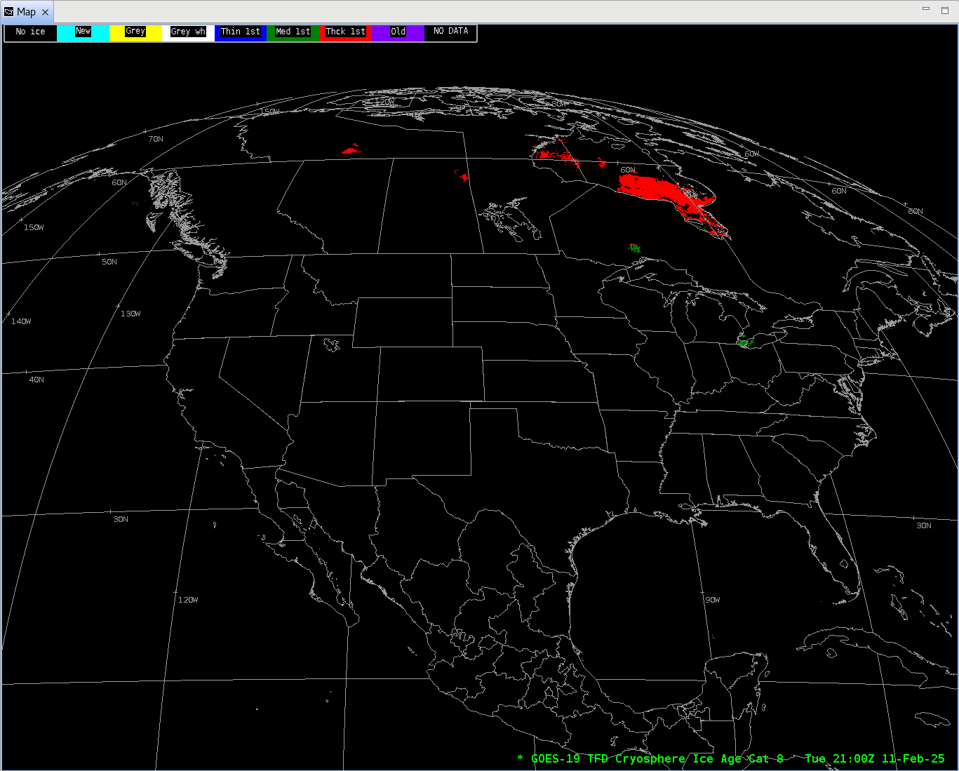
Ice Age (Cat 8)

Slide 9
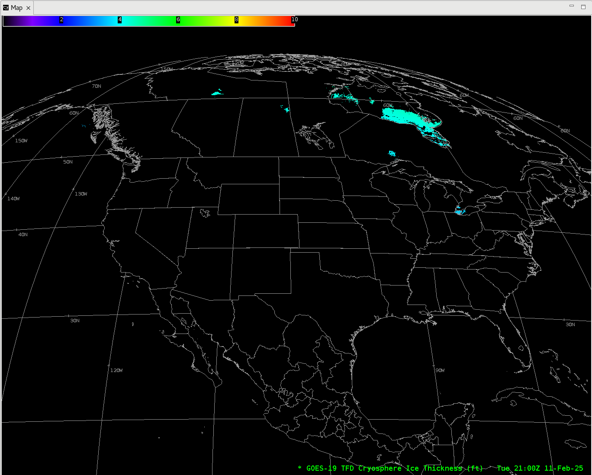
Ice Thickness

Slide 10
Conclusions
AWIPS ingests all G19 variables using baseline GOES-16/17/18 configurations.
  No fielding issues encountered or expected
  G-19 products conform closely to G-16,17,18 conventions (GOES-R Product User Guide)
  AWIPS’ configurations for G16 and G18 are extensible for G19+

