Slide 1
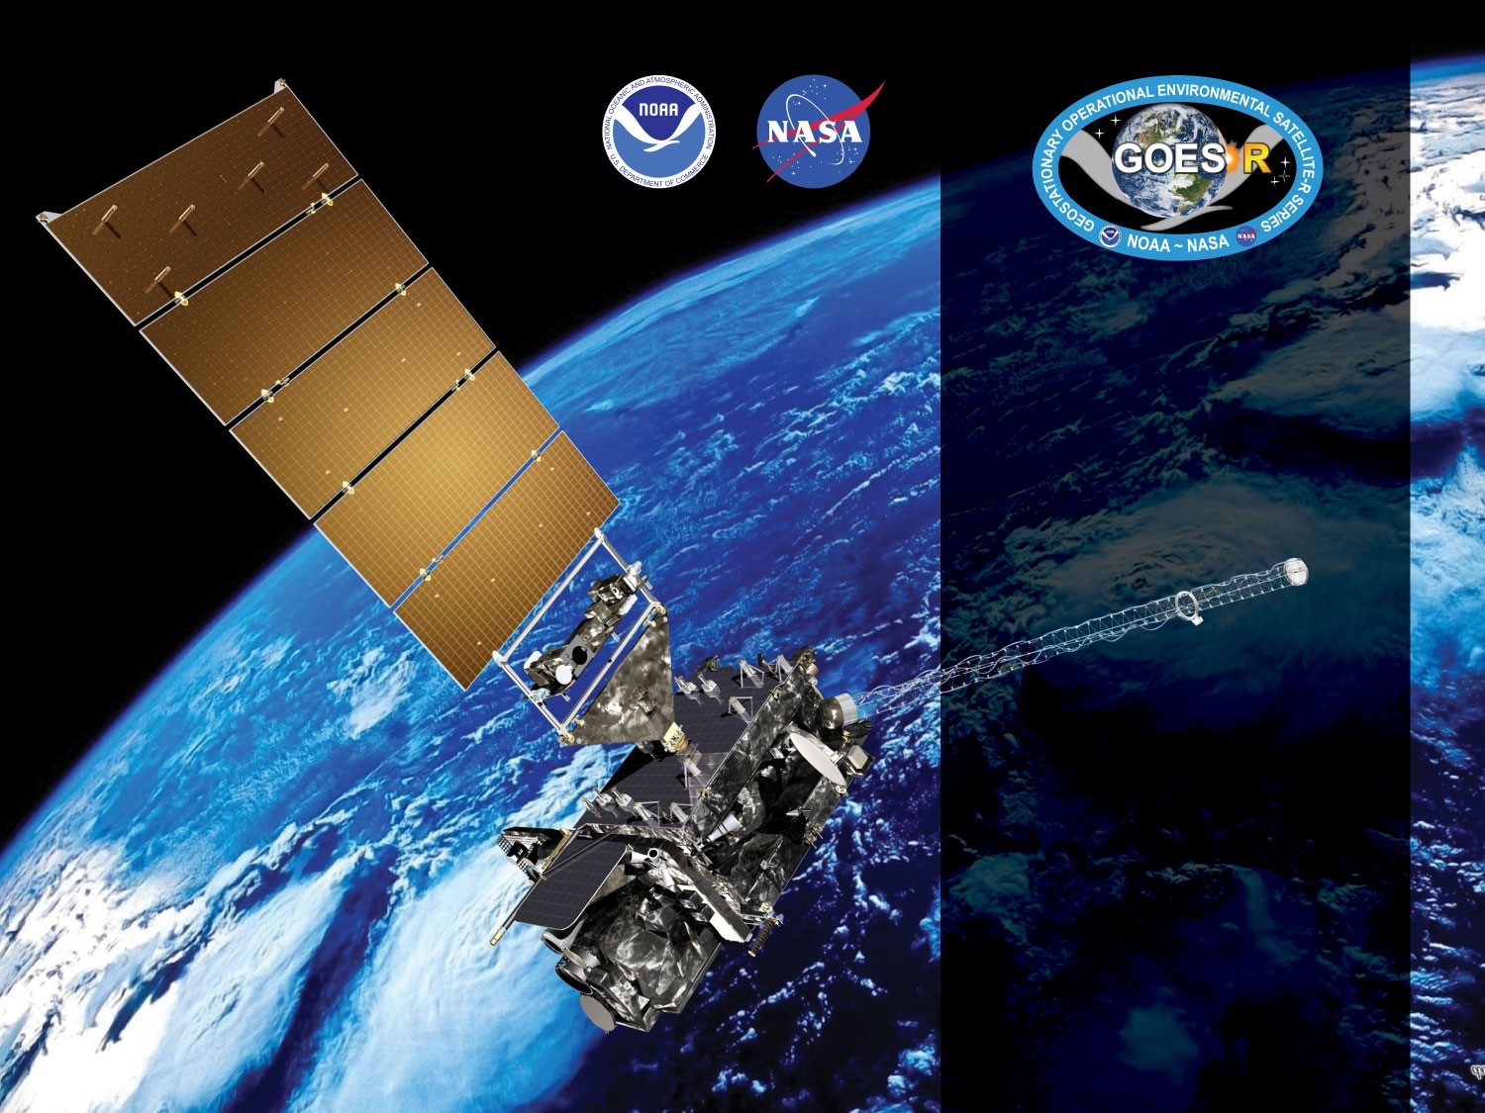
GOES-19 ABI L2+ Fire Detection and Characterization
Provisional
PS-PVR
March 5, 2025
GOES-R AWG
Christopher Schmidt¹,
Ivan Csiszar², Wei Guo³
¹CIMSS/UW-Madison
²NOAA/NESDIS/STAR
³STC at STAR

Slide 2
Outline
Provisional Validation Product Maturity Assessment
  Product Overview
  Status of FDC product related ADRs
  Assessment results
Path to Full Maturity
Summary and Recommendations

Slide 3
Product Overview
The GOES-R ABI Fire Detection and Characterization Algorithm (FDCA) uses five ABI bands to identify and characterize fires using a contextual algorithm. It is the GOES-R series implementation of the Wildfire Automated Biomass Burning Algorithm (WFABBA). Four outputs are produced:
Mask: Contains fire classifications and metadata about non-fire pixels
Fire size*
Fire temperature*
Fire Radiative Power (FRP)
* Fire size and temperature should always be considered together. All of the characteristics represent a single fire that would produce the same radiance signal.
** Required when elevated focal plane temperature mitigation is active
Fire detection is sensitive to radiometric calibration, image navigation, band-to-band co-registration, and the remapping applied to the L0 data.
ABI Band | Central Wavelength (μm) | Required
2 | 0.64
7 | 3.9 | X
13 | 10.3 | X**
14 | 11.2 | X
15 | 12.3

Slide 4
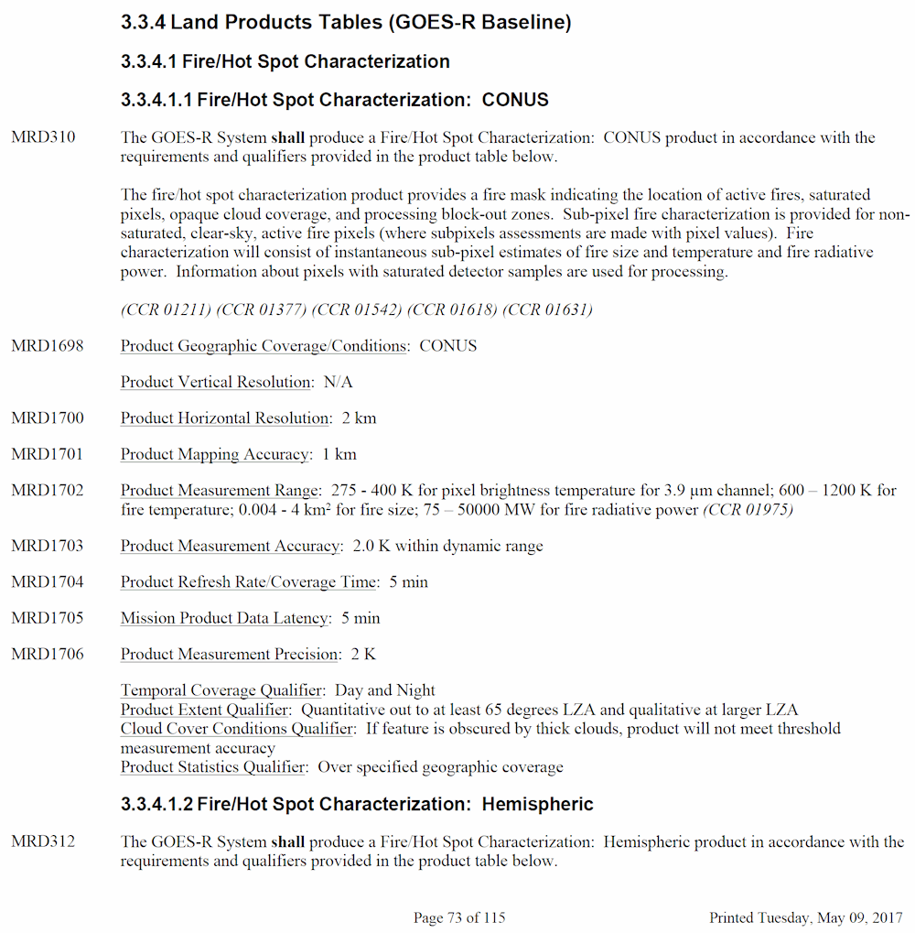
Product Overview: Specifications
Writing requirements for a satellite fire product is challenging given the lack of reliable truth data for fires. The requirement for the FDCA was crafted in terms of brightness temperature in band 7, which was interpreted to mean that fire characteristics combined with the background temperature estimate would recreate the band 7 brightness temperature within 2 K. The algorithm meets this requirement by design, characteristics are calculated by a recursion that recreates the input values to within <0.001 K.
In order to assure adequate product quality, user reviews in the Provisional and Full Validation Review stages are critical. Their acceptance of the product’s quality is the most important threshold. Since these requirements were written there has been advancement in terms of quantitative assessment of satellite fire products, techniques that are applied in the deep-dive analysis tool which will feature in later reviews.
CONUS, MESO, and FD (and Mode 3, 4, and 6) requirements are the same:

Slide 5
Product Overview: Note
The Bipartisan Infrastructure Law (BIL) and the Disaster Relief Supplemental Appropriations Act (DRSA) provided substantial funding to NOAA to improve its products and services related to wildfire. One of the key components of the effort became known as the Next Generation Fire System (NGFS), a fire detection and alerting system based on the Volcano Analysis Toolkit (VOLCAT). In order to avoid duplication of effort, maintenance of the FDC was reduced to what was minimally necessary to maintain baseline performance, such as resolving the Hawaii issue where detections were not being processed due to the lack of ecosystem data there.
Science updates, such as integrating terrain correction and persistent anomalies, have been redirected to the NGFS effort. Terrain correction for GOES was developed under AWG with the FDC in mind, and AWG has continued to support its development. Terrain Correction of fire locations and imagery have proven to be key parts of the NGFS.

Slide 6
ADRs Resolved or still in progress since
GOES-18 FDC Provisional Maturity
ADR | Description | Impact | Mitigation | Status
ADR580 | Diagnostic data for FDCA | Every fire has several dozen associated parameters, many of which are useful for diagnosing why errors and false alarms have occurred and, even moreso, for determining the source of differences between the product produced within different systems. This will be very important for full validation. | Produce diagnostic data | Went operational Oct 2022
ADR1281 | FDCA does not process Hawaii and some other islands. They are missing from two of the static ancillary landcover datasets. | RAVE algorithm is going operational for the Pacific and requires FDCA inputs over Hawaii. | Options include modifying the landcover databases, altering code logic, and replacing the databases | Landcover mask was modified to enable Hawaii coverage
ADR1156 | Ecosystem data isn't being cut out of the full disk correctly. Sometimes it is shifted just down, sometimes down and to the right - but always by one pixel in any direction. | Only affects fires where the background ecosystem type changes, particularly when the ecosystem switches to or from one where fire detection is blocked out. Has not been reported by users. | Identify and rectify source of the incorrect cut (probably rounding errors) | In study
Little Impact
Moderate Impact
Big Impact

Slide 7
ADRs Resolved or still in progress since
GOES-18 FDC Provisional Maturity
ADR | Description | Impact | Mitigation | Status
ADR660 | Many false alarms following the resolution of ADR576 with install of PR 06.10. NESDIS (SAB) team noticed very many class 13 (high probability) and class 14 (medium possibility) false alarms in the FDCC and FDCF products. These false alarms were previously coded as class 15, low possibility fires, and had been left out of SAB analyses. The update did not introduce a new issue, it highlighted existing false alarm issues that were identified as an algorithm risk during the Provisional PS-PVR. | SAB changed procedures with FDCA product. (previously this stated that SAB ceased using the product, which was not the case, SAB limited which categories of fires go into HMS) | Jan 2019 update (installed 25 July 2019) improved situation, however false alarm rate remains high. Additional algorithm updates required to further reduce false positives unless Enterprise Fire Algorithm promoted first | Pending, related to ADRs 1049 and 847
ADR1049 | Episodes of fill data a few times a week. Reported 12 Nov 2019. Missing blocks primarily over South America. Caused by background calculation running to the maximum for many pixels, data expires from data fabric before algorithm completes. This is connected to some types (low possibility fires without FRP, primarily) of frequent false alarms | Some areas of images, usually Full Disk over South America, are not processed. | Algorithm update required unless Enterprise Fire Algorithm promoted first | Pending, related to ADRs 660 and 847
ADR847 | Same issue as ADR1049, but was reported a year earlier and framed differently. | Some areas of images, usually Full Disk over South America, are not processed. | Algorithm update required unless Enterprise Fire Algorithm promoted first | Pending, related to ADRs 660 and 1049
Little Impact
Moderate Impact
Big Impact

Slide 8
ADR notes
Resolution of the ADRs and other updates were frozen when the Next Generation Fire System (NGFS) project began in 2023.
The issues reported in ADRs 660, 1049, and 847 derive from the same set of science issues. The root causes are solar reflections off clouds and airmasses that elevate band 7 temperatures over band 14 temperatures. Both cause pixels to be dropped from background calculations and both can trigger false positives (primarily coded as low possibility fires).

Slide 9
PROVISIONAL VALIDATION MATURITY ASSESSMENT RESULTS
GOES-19 Fire Detection and Characterization Provisional PS-PVR

Slide 10
Top Level Evaluation
 | Current Status | Future Outlook
Visual Inspection: (Cadence, Availability) | Performance is in-line with experience with other ABIs | Replacement by NGFS
Quantitative Performance: (Accuracy, Precision) | Performance of algorithm since the 2022 science update continues. GOES-19 FDCA product compares well to the GOES-16 and GOES-18 FDCA products. Application of terrain correction improves validation statistics.* Water clouds produce a large number of false alarms. Solar farms are producing persistent false alarms. | Replacement by NGFS
* While developed under AWG for the FDC, Terrain Correction hasn’t been integrated into the FDC.

Slide 11
Qualitative Success Definitions
PASSED
Specifications are met for product performance.
PARTIAL-PASSED
Specifications are close to being met for product performance. Example: Not meeting false positive requirement, but being within reason.
FAILED
Specifications are far from being met for product performance.

Slide 12
Review of GOES-19 Provisional PLPTs
PLPT ID | Descriptive Title | Criteria | Pass
ABI-FD_FHS01 | Verify that fire activity detected in FD products generated every 10 min is in accordance with expected measurement range (Mode 6) | Products are generated when fires are present
ABI-CONUS_FHS02 | Verify that fire activity detected in CONUS products generated every 5 min is in accordance with expected measurement range (Mode 6) | Products are generated when fires are present
ABI-MESO_FHS03 | Verify that fire activity detected in MESO products generated every 30 seconds is in accordance with expected measurement range | Products are generated when fires are present
ABI-FD_FHS04 | Verify that fire-free pixels in FD products generated every 10 min are classified accordingly (Mode 6) * | No more than 25% of the detected fires cannot be seen in the Band 7 and/or reference data
ABI-CONUS_FHS05 | Verify that fire-free pixels in CONUS products generated every 5 min are classified accordingly (Mode 6) | No more than 25% of the detected fires cannot be seen in the Band 7 and/or reference data
ABI-MESO_FHS06 | Verify that fire-free pixels in MESO products generated every 30 seconds are classified accordingly (Mode 6) | No more than 25% of the detected fires cannot be seen in the Band 7 and/or reference data
ABI-FD_FHS07 | Verify that fire-free pixels in FD products generated every 15 min are classified accordingly (Mode 4) | No more than 25% of the detected fires cannot be seen in the Band 7 and/or reference data
ABI-CONUS_FHS08 | Verify that fire activity is detected in CONUS products generated every 5 min in accordance with expected measurement range (Mode 4) | No more than 25% of the detected fires cannot be seen in the Band 7 and/or reference data
ABI-FD_FHS09 | Verify that fire-free pixels in FD products generated every 5 min are classified accordingly (Mode 4) | Products are generated when fires are present
ABI-CONUS_FHS10 | Verify that fire-free pixels in CONUS products generated every 5 min are classified accordingly (Mode 4) | Products are generated when fires are present

Slide 13
Review of GOES-19 Provisional PLPTs
PLPT ID | Descriptive Title | Criteria | Pass
ABI-FD_FHS11 | Assess performance of FD product for an extended period that includes some but not all seasonal variability, to demonstrate operational readiness. | • Performance assessment documented in terms of the probability of fire detection, as a function of sub-pixel characteristics and omission and commission error rates for a large and wide range of representative conditions. Representative conditions include the full range of biomes and surface types and seasons present within the Full Disk, including but not limited to wildfires in boreal forest, rainforest, wooded mountains, grassy plains, and agricultural burning during the seasons present during the Provisional period. • Product deficiencies documented and remediation strategies in place for known issues. • Impacts from challenges with upstream dependencies documented. • Feedback from the primary users (NWS, NESDIS, NRL, etc.) is summarized and documented. • Product is ready for operational use and for use in scientific publications to document product performance.
ABI-CONUS_FHS12 | Assess performance of FD product for an extended period that includes some but not all seasonal variability, to demonstrate operational readiness. | Same as ABI-FD_FHS11 but for CONUS products
ABI-MESO_FHS13 | Assess performance of FD product for an extended period that includes some but not all seasonal variability, to demonstrate operational readiness. | Same as ABI-FD_FHS11 but for MESO products
Full test plans and procedures are given in the ABI L2+ Fire Hot Spot (FHS) Readiness, Implementation, and Management Plan (RIMP v2.0; 410-R-RIMP-0328)

Slide 14
Issues requiring resolution
Algorithm delays at night due apparently to warm, moist air: the brightness temperature difference between bands 7 and 14 remains elevated after the solar correction is no longer applied due to atmospheric conditions, causing large areas where all non-cloud pixels require more than 20 loops to find a background temperature. This leads to large delays and data drop-outs in the ground system. A similar issue during the day due to reflected solar radiation was resolved with threshold corrections. This requires a reworking of the background temperature calculation. (a more inclusive fix in any case) This also causes large areas of low possibility false alarms at times.
Reflections due to solar farms and water clouds
Isolated urban heat islands and bare soil that can look like hotspots (can cause code 10 “processed” false alarms, particularly vexing for HMS operators)

Slide 15
User Feedback
(all ABIs)
Feedback has slowed with the introduction of the NGFS to NWS offices and other users
There is no GOES-19 specific feedback
Some NWS WFOs do use the L2 FHS product, there are shortcomings with AWIPS displays
  Production of the mesoscale FDCA was received very positively
  Introduction of the metadata mask into AWIPS was received very well, some forecasters stated they preferred having access to it despite the visibility of false alarms
Smoke/aerosol work is underway
  Very good results for known fires
  FDCA is key to the Regional ABI and VIIRS Emissions (RAVE) product, validation paper “Hourly Biomass Burning Emission Product from Blended Geostationary and Polar-orbiting Satellites for Air Quality Forecasting Applications” has been published (https://doi.org/10.1016/j.rse.2022.113237)
  Additional validation underway, initial results are very positive showing good correlation between emissions generated using the FDCA and ground sensors
Low detection rate at night: FIREX-AQ researchers noted that the detection rate at night seemed low; this was a side-effect of the sensitivity reductions made during previous updates

Slide 16
Provisional Validation
Assessment
Performance PLPT Success Criteria | Assessment
Performance assessment documented in terms of the probability of fire detection, as a function of sub-pixel characteristics and omission and commission error rates for a large and wide range of representative conditions. Representative conditions include the full range of biomes and surface types and seasons present within the Full Disk, including but not limited to wildfires in boreal forest, rainforest, wooded mountains, grassy plains, and agricultural burning during the seasons present during the Provisional period. | Commission rates are low to moderate depending on basis for comparison for highest confidence fire class. Omission rates appear to be as expected based on intensity of omitted fires. Commission rates are high for lowest possibility classes, most are caused by reflective clouds, solar farms, and surface features that mimic hotspots (urban areas, bare ground).
Product deficiencies documented and remediation strategies in place for known issues. | Pathway for algorithm updates are known but algorithm will be retired
Impacts from challenges with upstream dependencies documented. | No L2 upstream dependencies.
Feedback from the primary users (NWS, NESDIS, NRL, etc.) is summarized and documented. | Positive feedback from NWS for mesoscale product and fire metadata mask. NESDIS users reported improved false alarms. Air quality modelers report that for known fires performance is very good, dealing with the false alarms.
Product is ready for potential operational use (user decision based on the user's established criteria) and for use in scientific publications to document product performance. | NWS WFOs are using L2 product, smoke/aerosol modelers are using L2 product

Slide 17
Visual Inspection
FDC Detection Mask

Slide 18
Purpose of Mask
The mask provides the disposition, per the algorithm, of every pixel in the image
Includes the 6 fire classes and their temporally filtered equivalents, codes for cloud tests and ecosystem and glint screens
DQFs are derived from the mask, so discussion here is about the mask
Codes 20-25 do not apply to ABI-class instruments at this time

Slide 19
Definition of Mask Codes
WF_ABBA final output fire mask codes v6.5.011g
Mask Codes | Definition
-99 | Non-processed region of input/output image (algorithm did not start)
0 | Non-processed region of input/output image (algorithm initialized pixel)
10 | Processed fire pixel
11 | Saturated fire pixel
12 | Cloud contaminated fire pixel
13 | High probability fire pixel
14 | Medium probability fire pixel
15 | Low probability fire pixel
20 | Processed fire pixel removed by sampling screen
21 | Saturated fire pixel removed by sampling screen
22 | Cloud contaminated fire pixel removed by sampling screen
23 | High probability fire pixel removed by sampling screen
24 | Medium probability fire pixel removed by sampling screen
25 | Low probability fire pixel removed by sampling screen
30 | Temporally Filtered Processed fire pixel
31 | Temporally Filtered Saturated fire pixel
32 | Temporally Filtered Cloud contaminated fire pixel
33 | Temporally Filtered High probability fire pixel
34 | Temporally Filtered Medium probability fire pixel
35 | Temporally Filtered Low probability fire pixel
40 | Space pixel
50 | Satellite zenith angle block-out zone, greater than threshold of 80°
60 | Reflectance (glint) angle or solar zenith angle block-out zone, within respective thresholds, 10° and 10° respectively
100 | Processed region of image
120 | Bad input data: missing data, 4 µm
121 | Bad input data: missing data, 11 µm
123 | Bad input data: saturation, 4 µm
124 | Bad input data: saturation, 11 µm
125 | Invalid reflectivity product input (value <0). Can be indicative of localized spikes in the reflectivity product/bad data

Slide 20
Definition of Mask Codes
126 | Unusable input data: 4 µm less than minimum threshold (200 K)
127 | Unusable input data: 11 µm less than minimum threshold (200 K)
130 | Reserved
150 | Invalid ecosystem type
151 | Sea water
152 | Coastline Fringe
153 | Inland Water and other Land/water mix
155 | Reserved
160 | Invalid emissivity value
170 | No background value could be computed
180 | Error in converting between temperature and radiance
182 | Error in converting adjusted temperatures to radiance
185 | Values used for bisection technique to hone in on solutions for Dozier technique are invalid.
186 | Invalid radiances computed for Newton’s method for solving Dozier equations
187 | Errors in Newton’s method processing
188 | Error in computing pixel area for Dozier technique
200 | 11 µm threshold cloud test
201 | Band 7 minus 14 difference below threshold and below freezing test
205 | 4 µm minus 11 µm negative difference threshold cloud test
210 | 4 µm minus 11 µm positive difference threshold cloud test
215 | Albedo threshold cloud test (daytime only)
220 | 12 µm threshold cloud test (only used when data available)
225 | 11 µm minus 12 µm negative difference threshold cloud test
230 | 11 µm minus 12 µm positive difference threshold cloud test
240 | Along scan reflectivity product test to identify and screen for cloud edge used in conjunction with 4 µm threshold
245 | Along scan reflectivity product test to identify and screen for cloud edge used in conjunction with albedo threshold

Slide 21
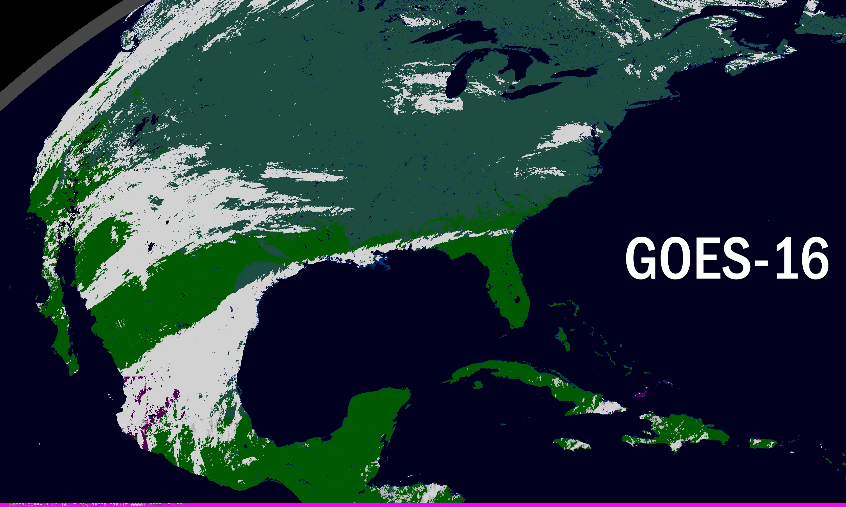
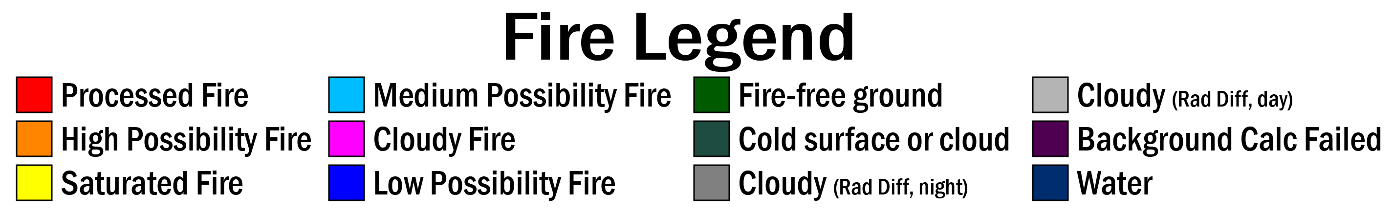
Visual Inspection
Visual inspection of the FDCA mask showed that GOES-19 is in family with GOES-16 and GOES-18.
GOES-19 data is preliminary
and non-operational.

Slide 22
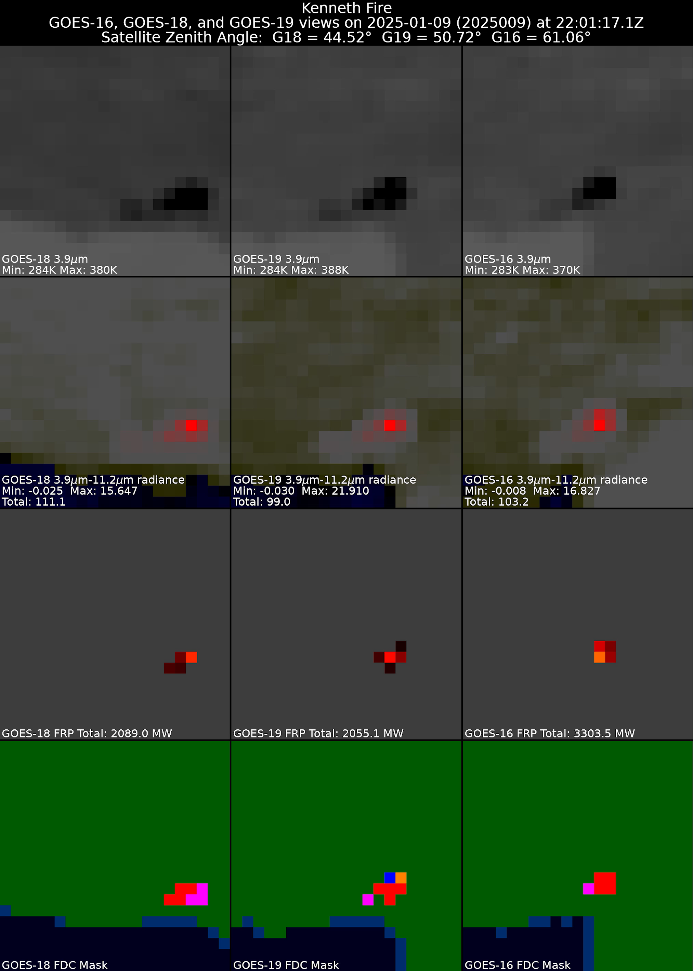
Visual Inspection
GOES-19 data is preliminary
and non-operational.
On 9 January 2025 the Kenneth Fire started northwest of the already extensive Palisades Fire in Pacific Palisades, CA. Due to lower winds at the start of the fire, it was brought under control within hours. These panels compare the three GOES views of the Kenneth Fire and show that GOES-19 is in family with GOES-16 and GOES-18. Differences are to be expected due to the viewing angle, terrain, and where the fires occurs relative to the original samples and resampled pixels.
The top row is band 7 (3.9 µm) brightness temperature (darker is hotter). The second row is the radiance difference between bands 7 and 14 (3.9 µm and 11.2 µm) in 3.9 µm radiance space. This highlights fires, solar reflectance, and fog. The third row is FDC FRP, with the total for the panel. The bottom row is the FDC metadata mask described earlier.

Slide 23
Using Landsat-8 and -9 OLI reference data
Deep-Dive Validation

Slide 24
Methodology
Using near-coincident Landsat-8 and -9 OLI (L8/L9 OLI) data to assess sub-pixel GOES-19 ABI fire activity
  Validation was performed for GOES-16, GOES-18, and GOES-19 from 27 September 2024 to 30 January 2025 (DOY: 2024271-2025030)
  One “reference fire pixel” is one 30x30m L8/L9 OLI active fire pixel
  Limited to fires within GOES 65° SZA
  Temporal separation between L8/L9 OLI and GOES limited to < 5 minutes
  Matches occur when Landsat pixels fall within estimated ABI pixel polygon
  L8/L9 OLI 30-m fire masks provide quantitative measure of fire activity within ABI’s effective pixel footprint
  Sub-pixel fire characterization (Fire Radiative Power) assessment was not performed for GOES-19 data
  All validation is for northern hemisphere cold season
  Landsat fire pixels in ABI pixels adjacent to ABI detected fires are considered misses – heat signature may have been attributed to remapper smearing

Slide 25
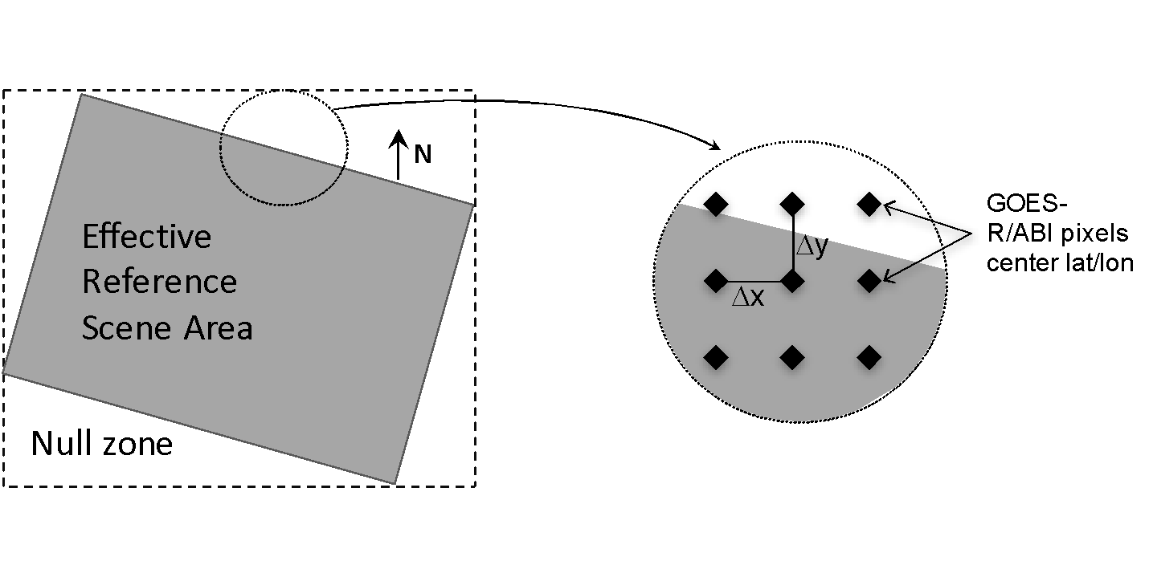
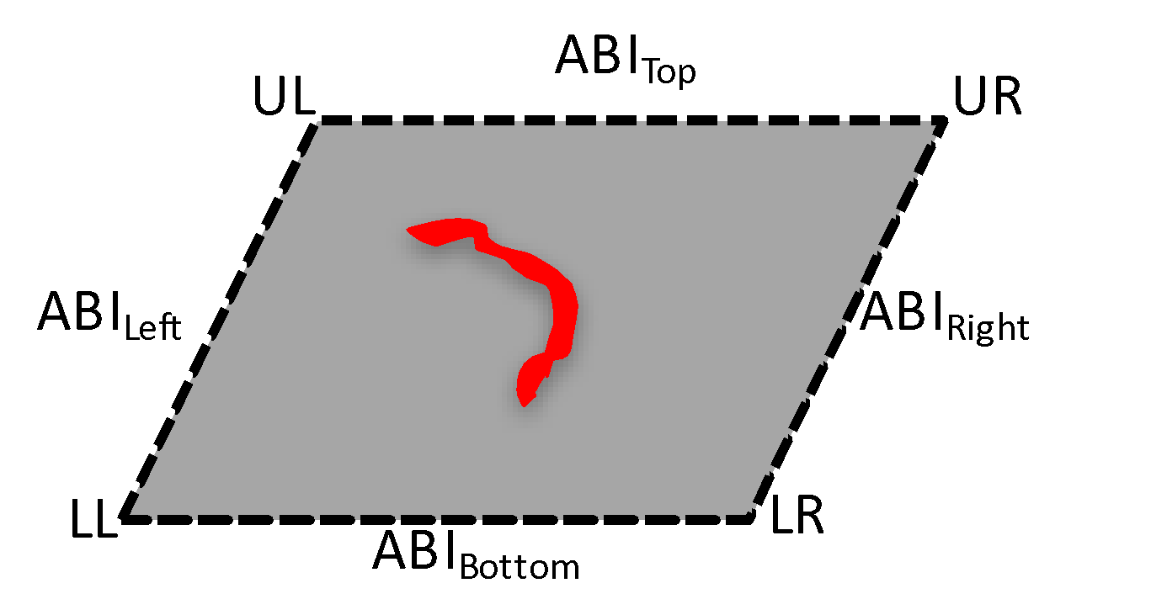
Methodology - Landsat-8/OLI
Fire Detection Data Matching
C
o
-
l
o
c
a
t
e
I
n
d
i
v
i
d
u
a
l
D
e
r
i
v
e
A
B
I
P
e
r
-
P
i
x
e
I
l
n
p
u
t
G
O
E
S
A
B
I
M
a
t
c
h
A
c
q
u
i
s
i
t
i
o
n
V
e
r
i
f
y
D
a
t
a
O
v
e
r
l
a
p
A
B
I
P
i
x
e
l
s
W
i
t
h
S
u
m
m
a
r
y
F
i
r
A
e
c
t
i
v
e
F
i
r
e
D
a
t
a
(
S
p
a
t
i
a
l
M
a
t
c
h
i
n
g
T
≤
)
i
m
e
s
(
5
m
i
n
)
S
t
a
t
i
s
t
i
c
R
e
s
f
e
r
e
n
c
e
D
a
t
a
I
n
p
u
t
L
a
n
d
s
a
t
-
8
/
O
L
I
V
i
s
u
a
l
(
P
N
G
)
A
c
t
i
v
e
F
i
r
e
D
a
t
a
O
u
t
p
u
t
F
i
l
e
A
S
C
I
I
S
u
m
m
a
r
y
F
i
l
e
G
r
a
p
h
i
c
a
l
O
u
t
p
u
t
(
o
m
i
s
s
i
o
n
a
n
d
c
o
m
m
i
s
s
i
o
n
e
r
r
o
r
s
)
∑ (Fire Count_{Landsat8})
Data co-location
Sub-pixel active fire quantification

Slide 26
Validation Scores
Confirm rate indicates the percent of ABI fire pixels that can be verified by Landsat fire (at least 1 Landsat fire pixel falls into a given ABI fire pixel).
False alarm rate is percent of ABI fire pixels that cannot be verified by Landsat fire (at least 1 Landsat cloud free pixel fall into a given ABI fire pixel, but none of them was identified as Landsat fire).
Detection rate evaluates the capability of ABI fire product to catch big fire. Fire size was defined as the number of Landsat pixels in an ABI pixel.

Slide 27
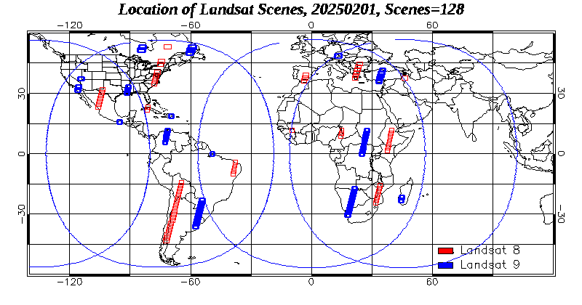
Landsat scenes collected
Above: shows the location of Landsat scenes collected for Feb 1~9, 2025, see Animation)
Only Landsat scenes with were processed.
Land >50%
Cloud <20%
covered by GOES and MSG(SEVIRI) domain (with above circles)
not over desert in Africa
There are about 80-110 Landsat scenes were collected (from USGS) each day.

Slide 28
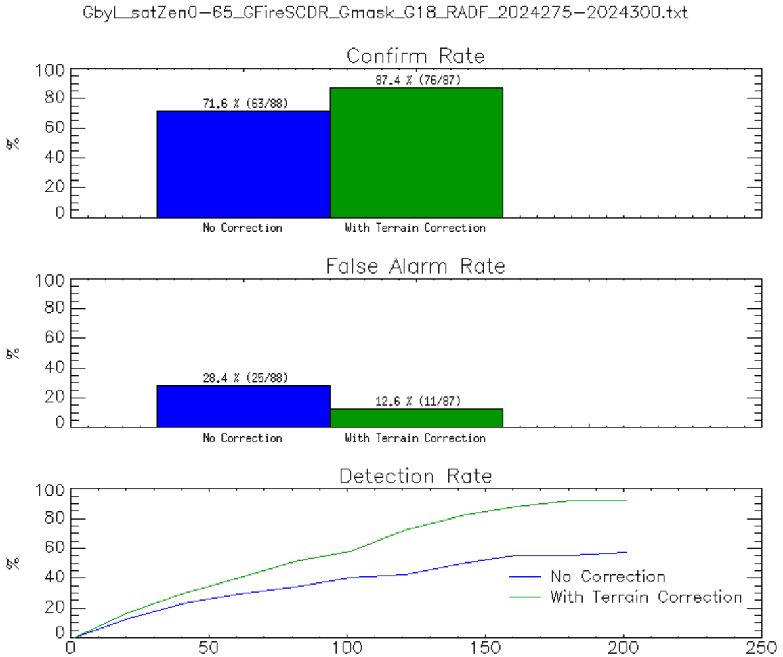
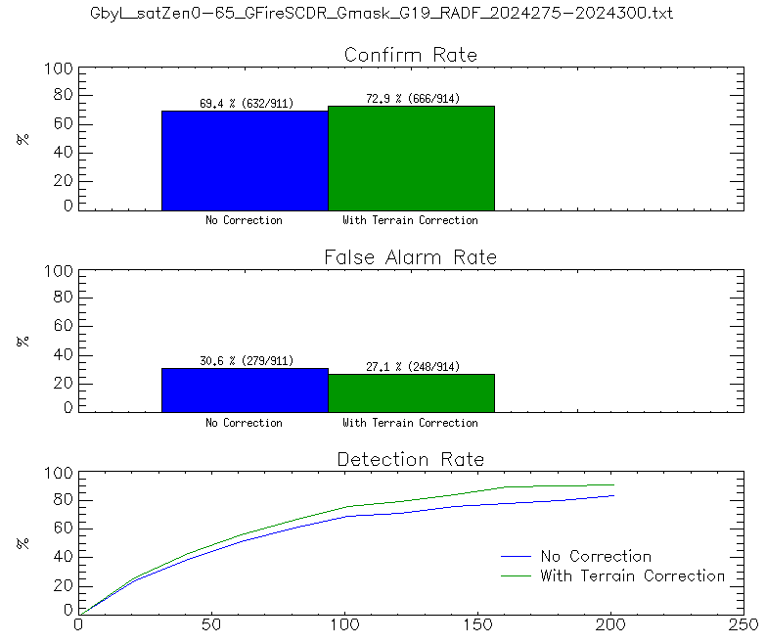
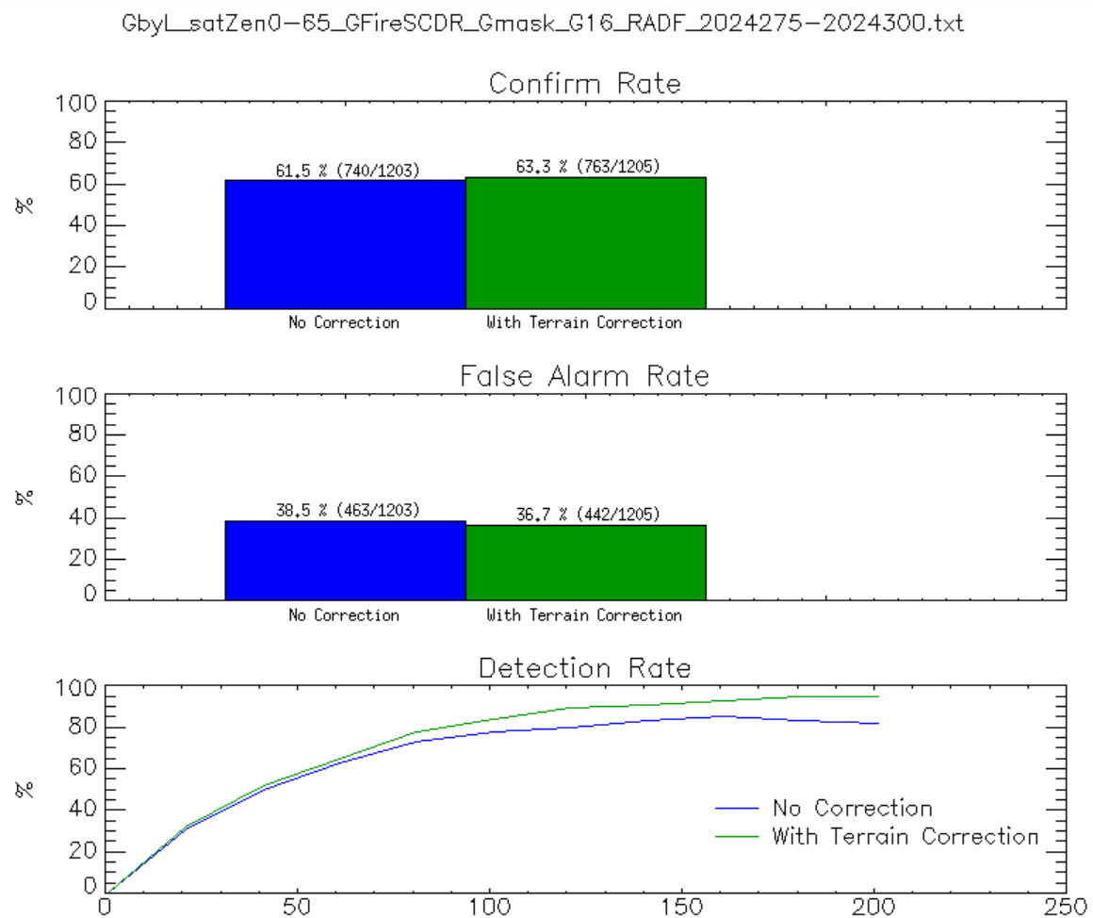
Validation and Terrain Correction
Terrain corrected geolocation has been applied to the FDCA data to more accurately represent algorithm performance. The impact is greatest in places with complex terrain and at high satellite zenith angles. GOES-19 outperforms GOES-16 due to better viewing geometry over CONUS.
GOES-18
GOES-19
GOES-16
71.6%
(63/88)
87.4%
(76/87)
69.4%
(632/911)
72.9%
(666/914)
61.5%
(740/1023)
63.3%
(763/1205)
28.4%
(25/88)
12.6%
(11/87)
30.6%
(279/911)
27.1%
(248/914)
38.5%
(463/1203)
36.7%
(442/1205)

Slide 29
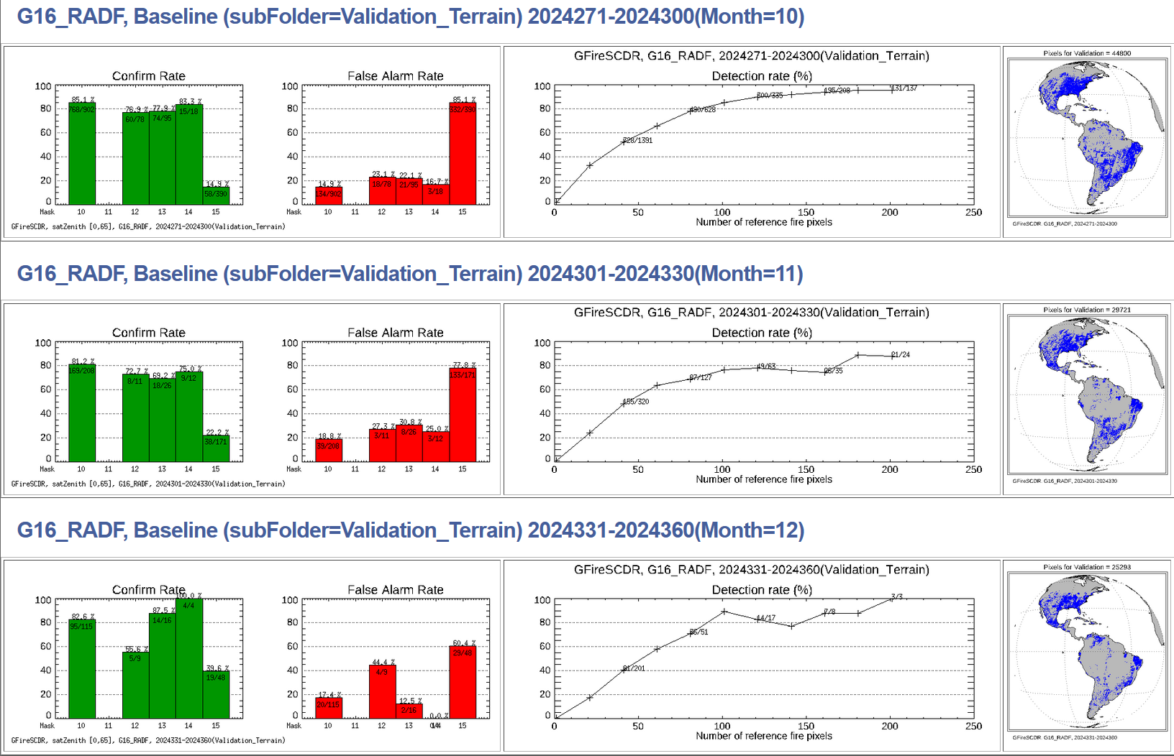
Validation by Landsat: GOES-16
October-December 2024
Notes:
Confirm rate indicates the percent of ABI/SEVIRI fire pixels that can be verified by Landsat fire (at least 1 Landsat fire pixel falls into a given ABI/SEVIRI fire pixel).
False alarm rate is percent of ABI/SEVIRI fire pixels that cannot be verified by Landsat fire (at least 1 Landsat cloud free pixel fall into a given ABI/SEVIRI fire pixel, but none of them was identified as Landsat fire).
Detection rate evaluates the capability of ABI/SEVIRI fire product to catch big fire. Fire size was defined as the number of Landsat pixels in an ABI/SEVIRI pixel.

Slide 30
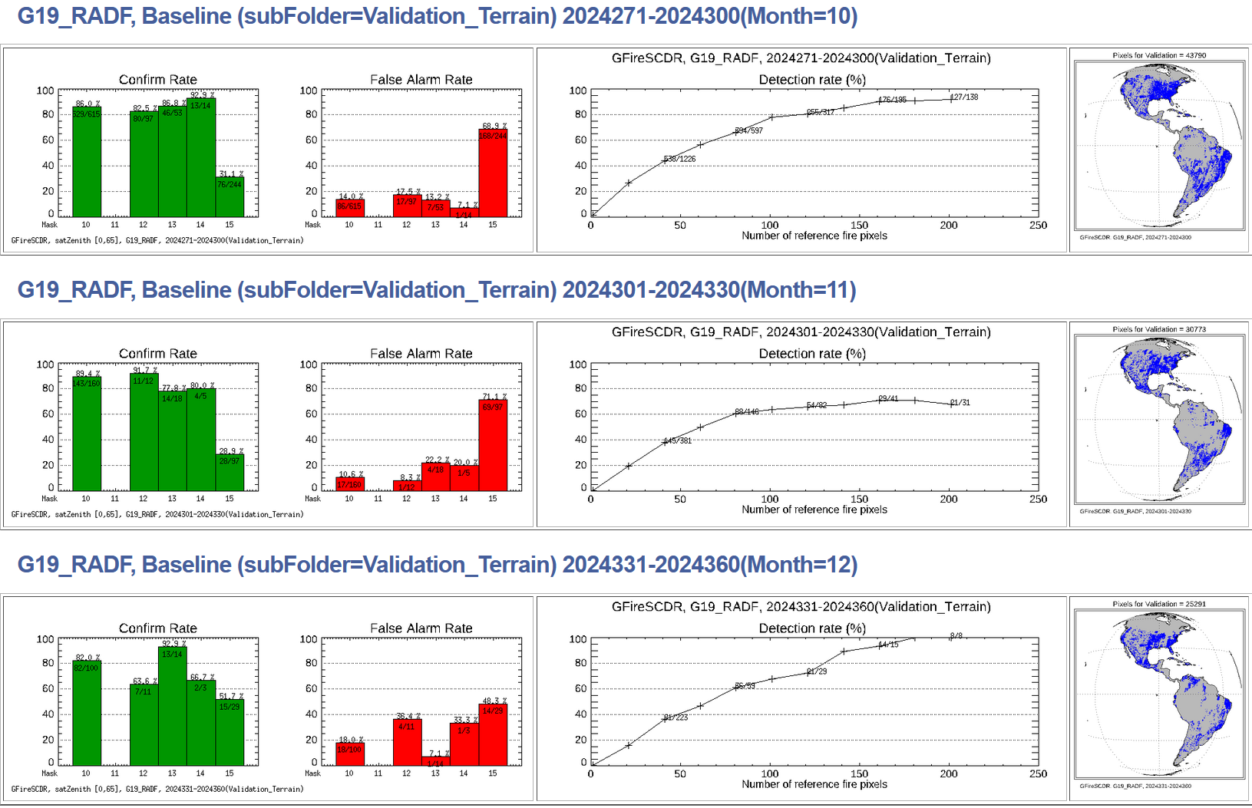
Validation by Landsat: GOES-19
October-December 2024
Notes:
Confirm rate indicates the percent of ABI/SEVIRI fire pixels that can be verified by Landsat fire (at least 1 Landsat fire pixel falls into a given ABI/SEVIRI fire pixel).
False alarm rate is percent of ABI/SEVIRI fire pixels that cannot be verified by Landsat fire (at least 1 Landsat cloud free pixel fall into a given ABI/SEVIRI fire pixel, but none of them was identified as Landsat fire).
Detection rate evaluates the capability of ABI/SEVIRI fire product to catch big fire. Fire size was defined as the number of Landsat pixels in an ABI/SEVIRI pixel.

Slide 31
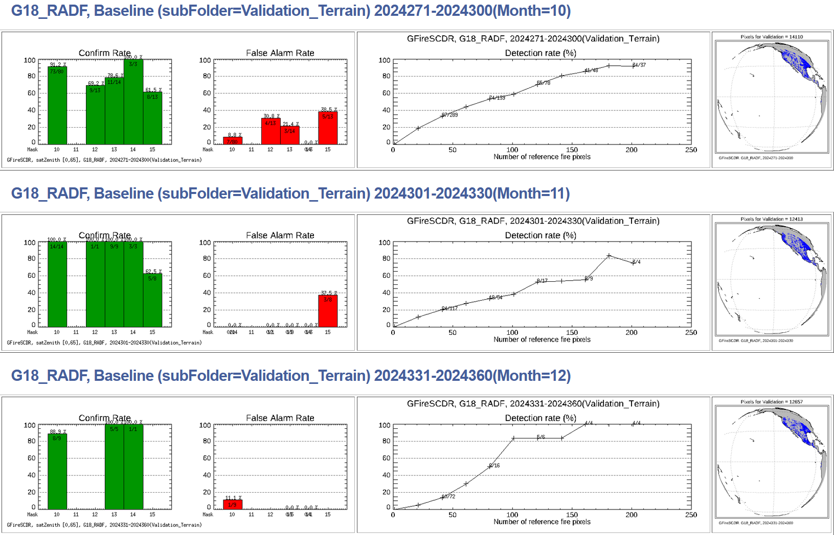
Validation by Landsat: GOES-18
October-December 2024
Notes:
Confirm rate indicates the percent of ABI/SEVIRI fire pixels that can be verified by Landsat fire (at least 1 Landsat fire pixel falls into a given ABI/SEVIRI fire pixel).
False alarm rate is percent of ABI/SEVIRI fire pixels that cannot be verified by Landsat fire (at least 1 Landsat cloud free pixel fall into a given ABI/SEVIRI fire pixel, but none of them was identified as Landsat fire).
Detection rate evaluates the capability of ABI/SEVIRI fire product to catch big fire. Fire size was defined as the number of Landsat pixels in an ABI/SEVIRI pixel.

Slide 32
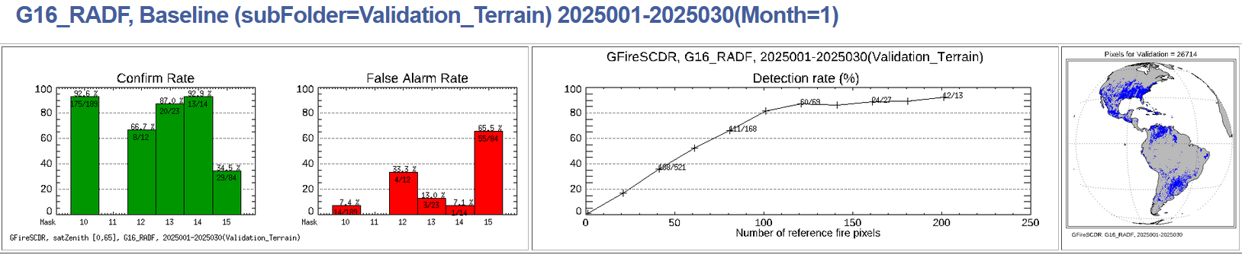
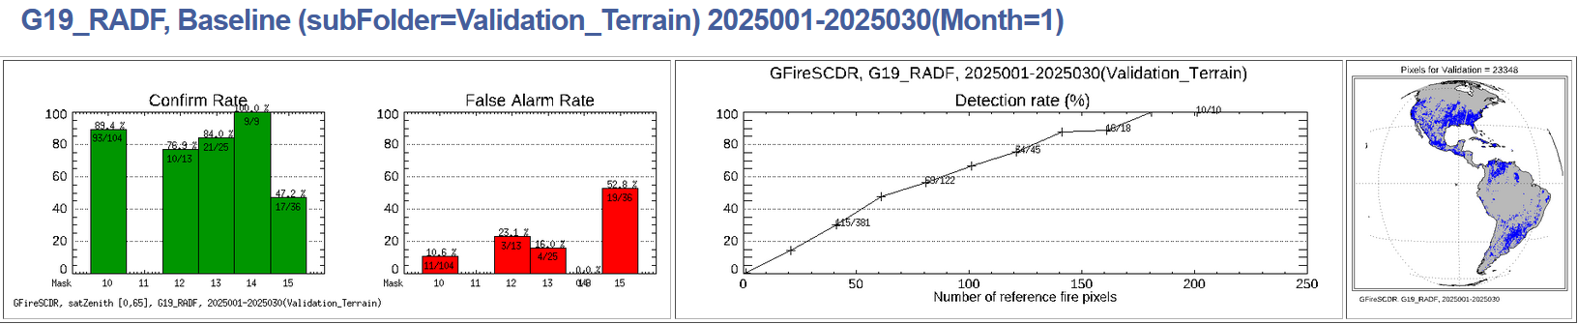
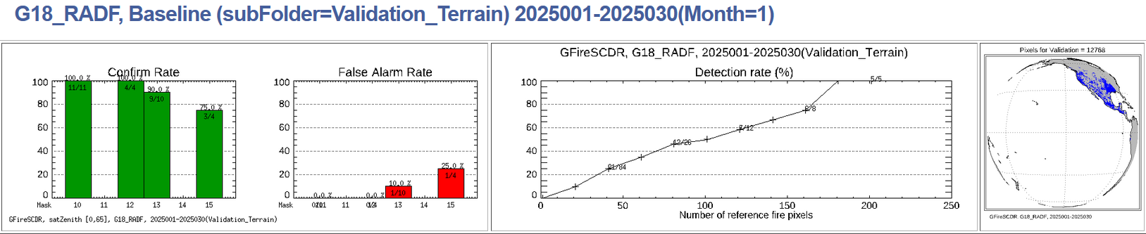
Validation by Landsat: All GOES
January 2025
Notes:
Confirm rate indicates the percent of ABI/SEVIRI fire pixels that can be verified by Landsat fire (at least 1 Landsat fire pixel falls into a given ABI/SEVIRI fire pixel).
False alarm rate is percent of ABI/SEVIRI fire pixels that cannot be verified by Landsat fire (at least 1 Landsat cloud free pixel fall into a given ABI/SEVIRI fire pixel, but none of them was identified as Landsat fire).
Detection rate evaluates the capability of ABI/SEVIRI fire product to catch big fire. Fire size was defined as the number of Landsat pixels in an ABI/SEVIRI pixel.

Slide 33
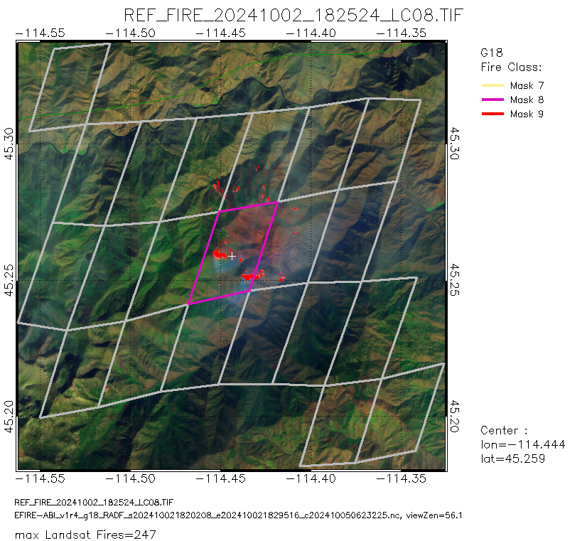
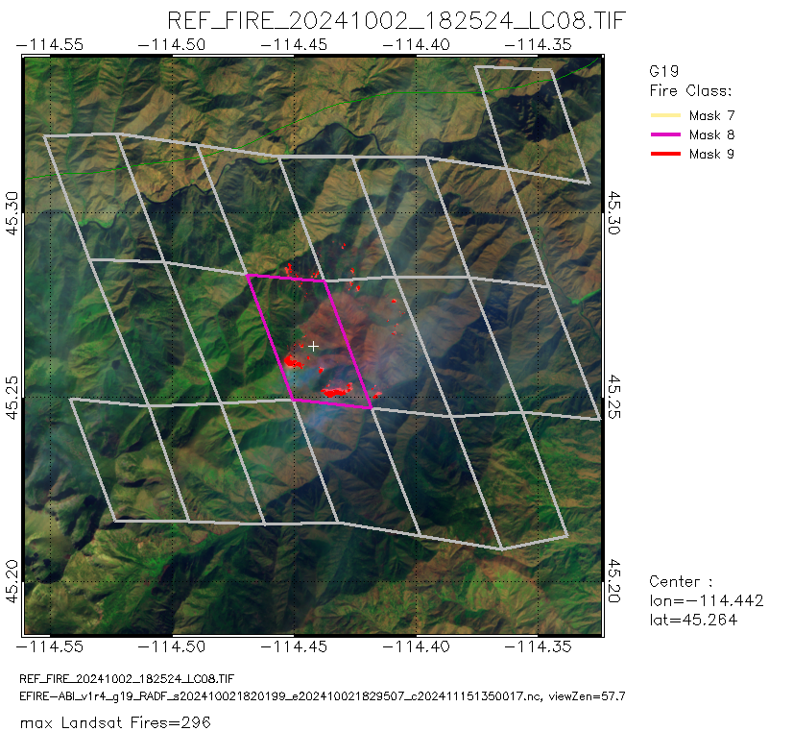
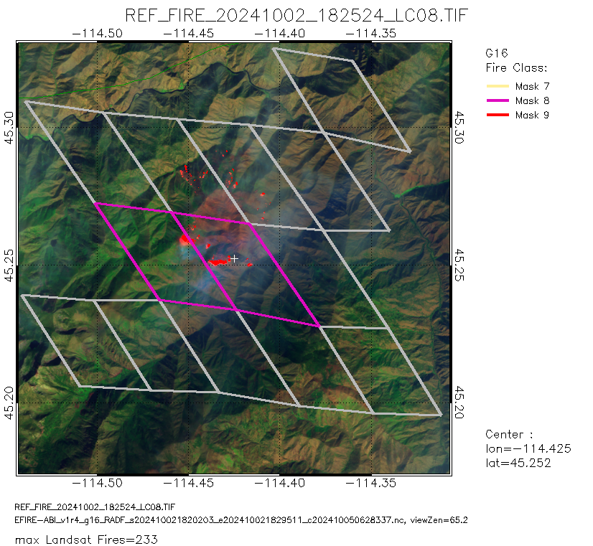
True Positives
Salmon-Challis National Forest, Idaho
2 October 2024
Note: Enterprise Fire algorithm output was used for these examples. EFIRE is a different implementation of the FDCA, and produces VIIRS fire classes instead of FDC classes. Those classes are: red (class 9) - highest confidence, magenta (class 8) - medium confidence, and yellow (mask 7) - lowest confidence.
GOES-18
GOES-19
GOES-16
Center: 45.259N, 114.444W
Center: 45.264N, 114.442W
Center: 45.252N, 114.425W
Each image includes both Landsat “hits” and “misses” even though the FDC correctly identified the presence of a fire.

Slide 34
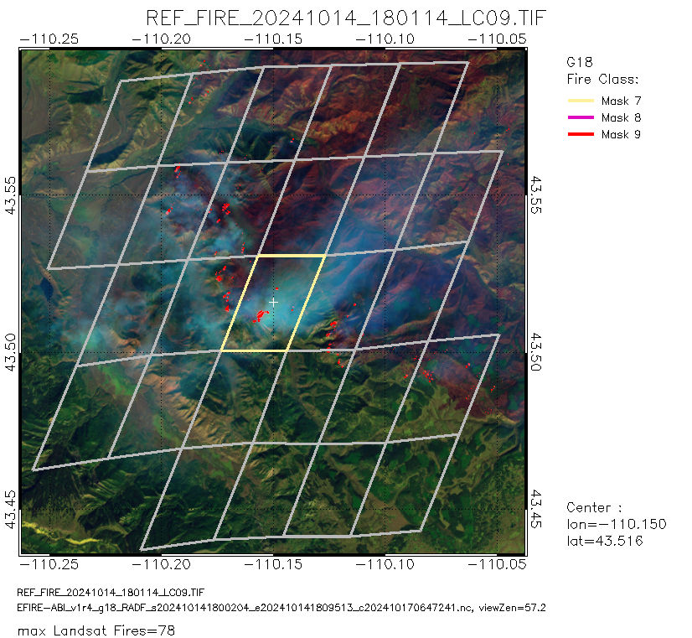
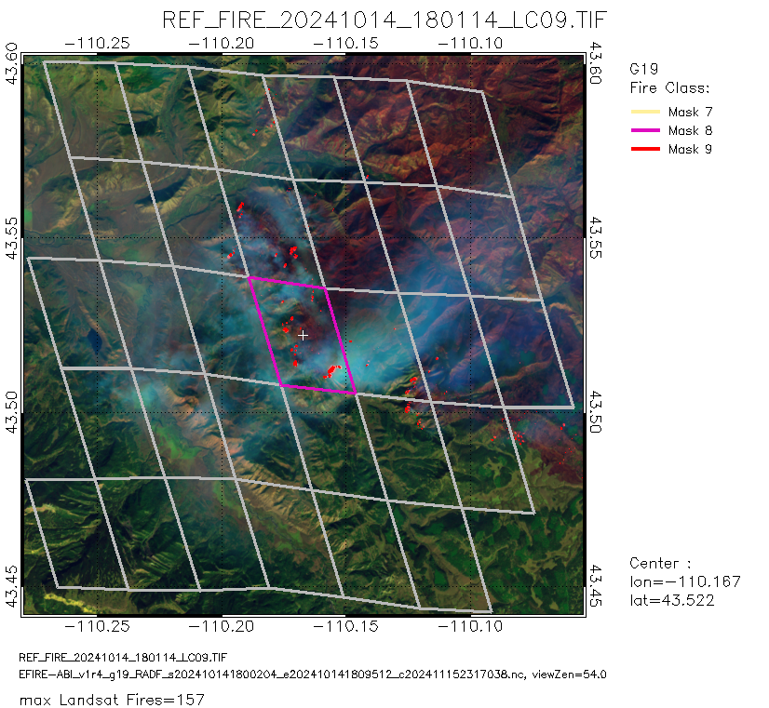
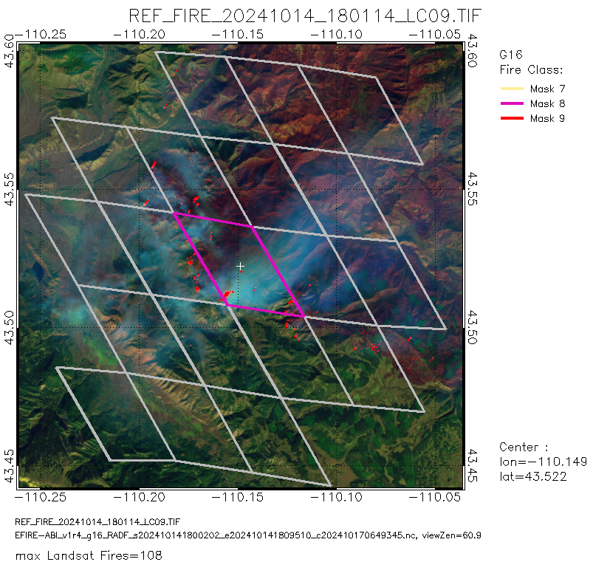
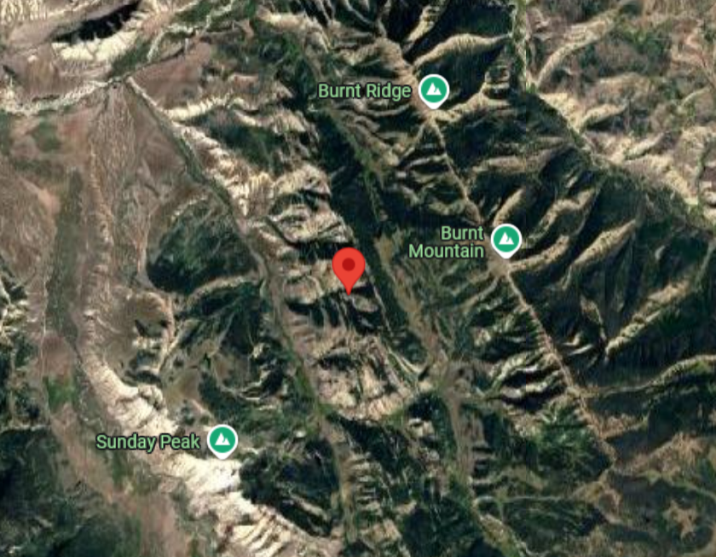
True Positives
Large Fires in Wyoming
14 October 2024
GOES-18
GOES-19
GOES-16
Center: 43.516N, 110.150W
Center: 43.522N, 110.167W
Center: 43.522N, 110.149W
EFIRE fire classes: red (class 9) - highest confidence, magenta (class 8) - medium confidence, and yellow (mask 7) - lowest confidence
The fires were near the peaks called “Burnt Ridge” and “Burnt Mountain”

Slide 35
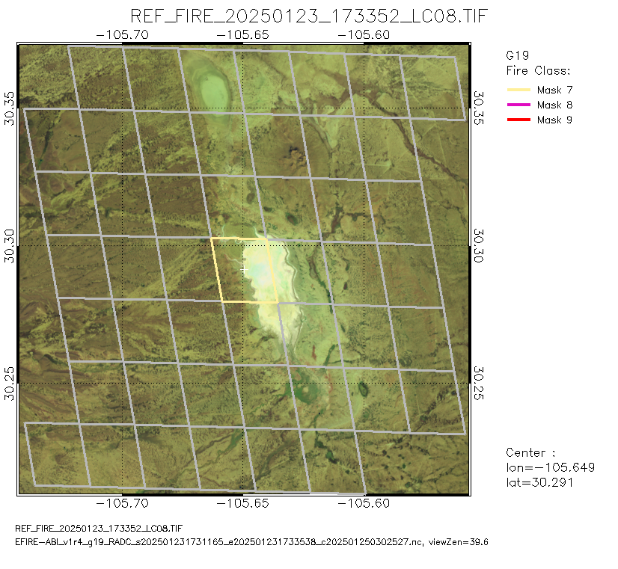
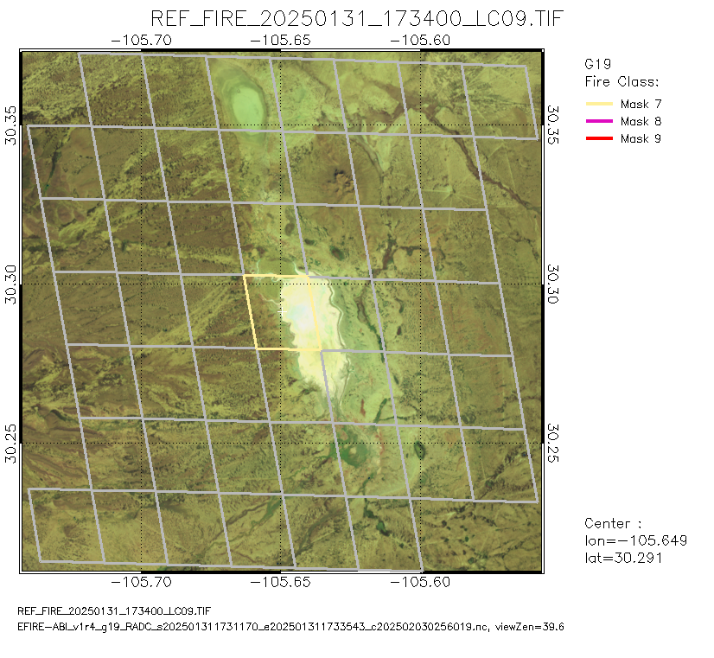
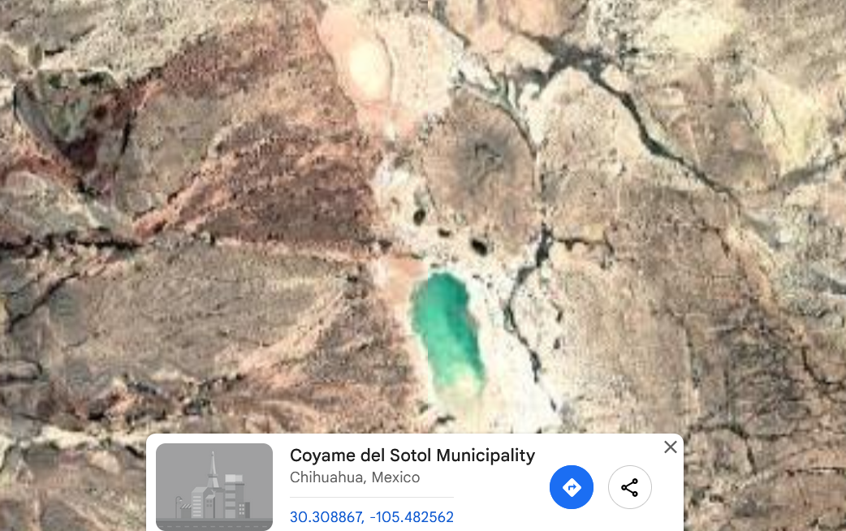
Known Issues:
False Alarms due to sun glint
Center: 30.291N, 105.649W
Center: 30.291N, 105.649W
GOES-19 vs L8
23 January 2025
GOES-19 vs L9
31 January 2025
Sunglint can be off of glassy surfaces (like solar panels) and certain surface types.
This scene located at a lake in Chihuahua, Mexico; Landsat images show obvious sun glint signals.
It was determined as low level fire (Class=7) by GOES-19.

Slide 36
PATH TO FULL MATURITY
GOES-19 Fire Hot Spot Characterization Provisional PS-PVR

Slide 37
Path to Full Maturity
Full maturity follows the same PLPTs as Provisional
  Test periods will be extended and include Northern Hemisphere warm season
Deep dive validation will be refined; New study by Hall et al (2023) showed better performance for GOES-17 than the deep dive analyses did, and there is a known issue with matching Landsat to GOES
The most important test is user acceptance of the fire detection rates (true positive, false positive, etc); the most common complaints are excess false positives and low sensitivity at night
Test with RAVE performance: does it continue to work well as an input and produce the right amount of smoke

Slide 38
Future Plans
The FDC will be retired due to the creation of the Next Generation Fire System (NGFS).
The items highlighted below are repeated from the GOES-18 PS-PVR and have been major focuses of development for the NGFS. To avoid duplication of effort, the AWG team will avoid addressing issues being handled by the NGFS project.
The NGFS will become operational in the NESDIS Common Cloud Framework (NCCF) no sooner than the end of quarter 2 of FY2026. The NGFS and FDC will run side-by-side according to NESDIS product decommissioning best practices. The length of the overlap will depend on the use cases that need to transition to the NGFS. There are no plans to run FDC in the NCCF.
Medium-term improvements – Integration of persistent anomaly database, generate improved metadata for ecosystem/surface types (existing databases are at least 15 years old and remapping to ABI doesn’t account for terrain or the mix of types within the pixel), provide terrain-corrected fire locations and pixel outlines, improved handling of cloudy pixels, common file format for geostationary and polar fire products from NOAA, and creation of “fire events” that provide information about the fire pixel clusters like intensity and perimeter.
Ongoing semi-automated solar farm identification from satellite data – Affects all platforms, but there is not a unified strategy for identifying the farms in order to screen them out.
38

Slide 39
Provisional Validation
Preparation Activities | Assessment
Validation activities are ongoing and the general research community is now encouraged to participate. | Fires Team works with and receives feedback from users who apply data, such as NWS forecasters and smoke/aerosol modelers. Validation papers have been published.
Severe algorithm anomalies are identified and under analysis. Solutions to anomalies are in development and testing. | ADRs cover algorithm issues, but algorithm will be retired.
Incremental product improvements may still be occurring. | Updates to the FDC have been frozen.
L2+ only: Users are engaged in the Product Feedback Forums and user feedback is assessed. | User feedback has been received and assessed.
End State | Assessment
Product performance has been demonstrated through analysis of a small number of independent measurements obtained from select locations, periods, and associated ground truth or field campaign efforts. | Deep-dive validation is ongoing.
Product analysis is sufficient to communicate product performance to users relative to expectations (Performance Baseline). | Readme files and ATBD have been updated and numerous presentations given about the product, including at AMS meetings and the TOWR-S Satellite Book Club (where NWS forecasters are the primary audience).
Documentation of product performance exists that includes recommended remediation strategies for all anomalies and weaknesses. Any algorithm changes associated with severe anomalies have been documented, implemented, tested, and shared with the user community. | Studies have been published or soon will be which document algorithm performance and update history. ATBD and Readme discuss how to address anomalies and weaknesses.
Testing has been fully documented. | Testing methodology is documented in the ABI L2+ Fire Hot Spot (FHS) Readiness, Implementation, and Management Plan (RIMP v2.0; 410-R-RIMP-0328). The results are contained within this presentation.
Product is ready for operational use and for use in comprehensive cal/val activities and product optimization. | GOES-16 and GOES-18 FDC is used in operational settings (such as NWS offices) and has been used in several studies validating smoke/aerosol models and algorithm performance. GOES-19 FDC is in family and ready for operational use.

Slide 40
SUMMARY & RECOMMENDATIONS
GOES-19 Fire Hot Spot Characterization Provisional PS-PVR

Slide 41
Summary & Recommendations
The AWG Fires Team asserts that the GOES-19 baseline Fire Detection and Characterization (FDC) product meets the success criteria and requirements for Provisional status
Sources of false alarms have been identified and include:
  Reflections off water cloud and water
  Surface features, including bare ground and solar farms
There is no user feedback for GOES-19 FDC
Prioritize terrain correction development
  AWG-developed terrain correction (TC) is integrated into the NGFS and has been extremely well received. TC was developed under AWG as the need arose and without AWG further development does not have support. TC is a necessity for fire detection products and should be a requirement for GXI’s fire products.

Slide 42
BACKUP
GOES-19 Fire Hot Spot Characterization Provisional PS-PVR

Slide 43
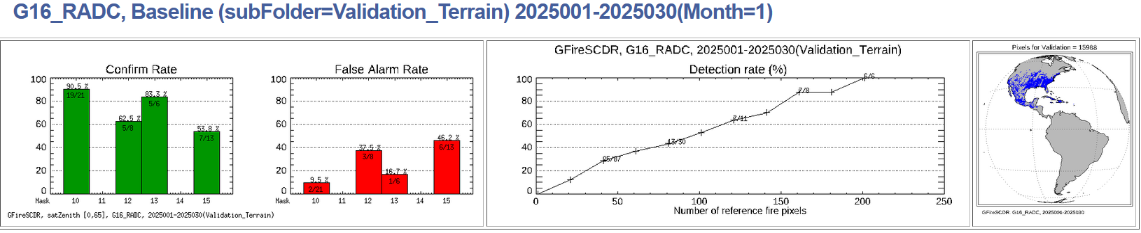
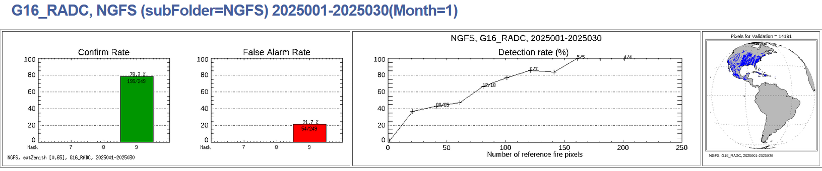
Future Plans
Comparison of NGFS and FDC: For the period of 1-30 January 2025, FDC over GOES-16 CONUS scans had 48 fires in Landsat scenes, of which 36 matched with Landsat (75%). For the same period and scans, NGFS found 249 fires, 195 of which matched with Landsat fires (78.3%). The match percentage doesn’t tell the full story: NGFS finds lower intensity fires than the FDC and performs more rigorous atmospheric corrections. Additionally, a lack of a Landsat match does not mean the detection was definitely a false alarm.
43

Slide 44
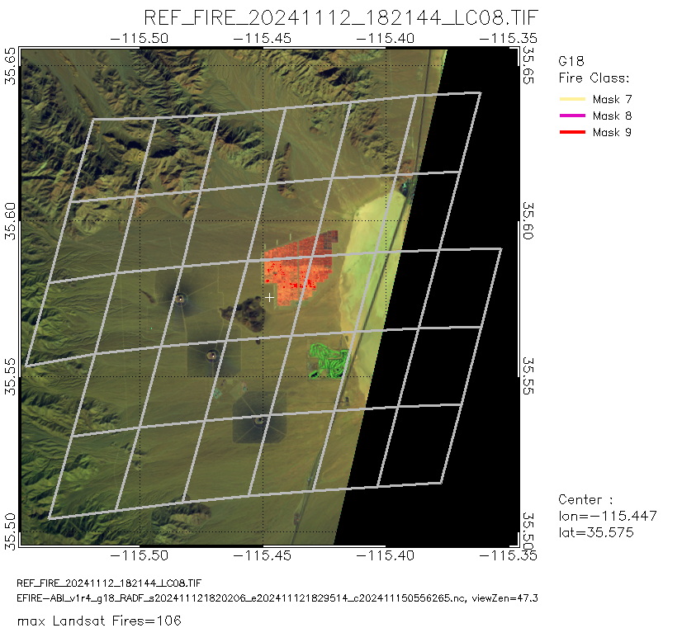
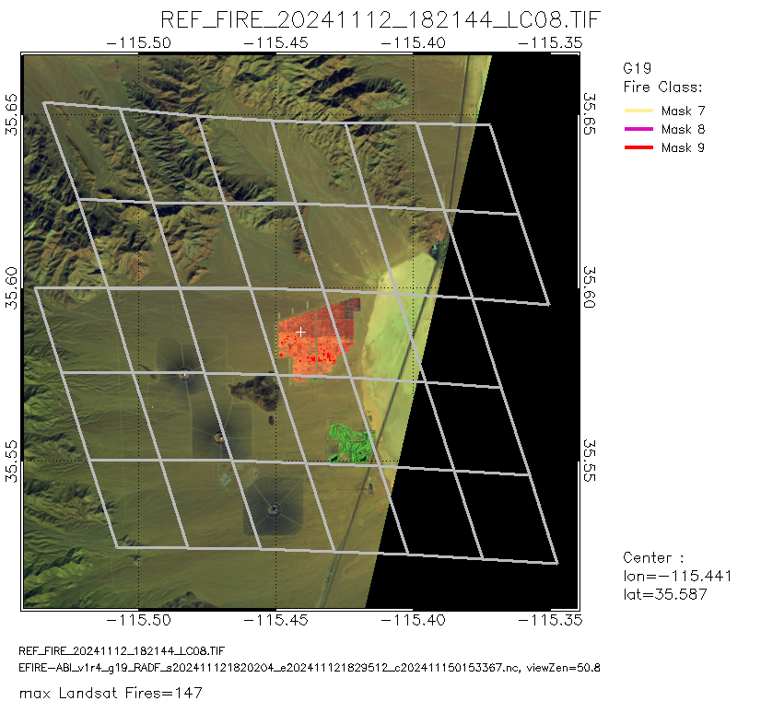
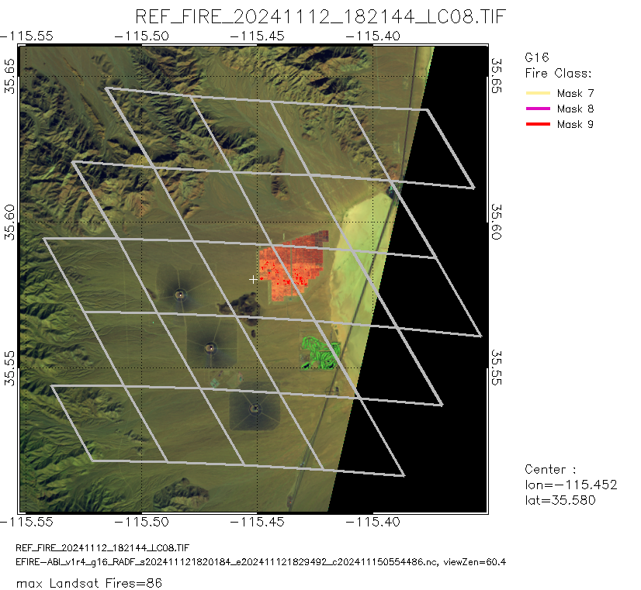
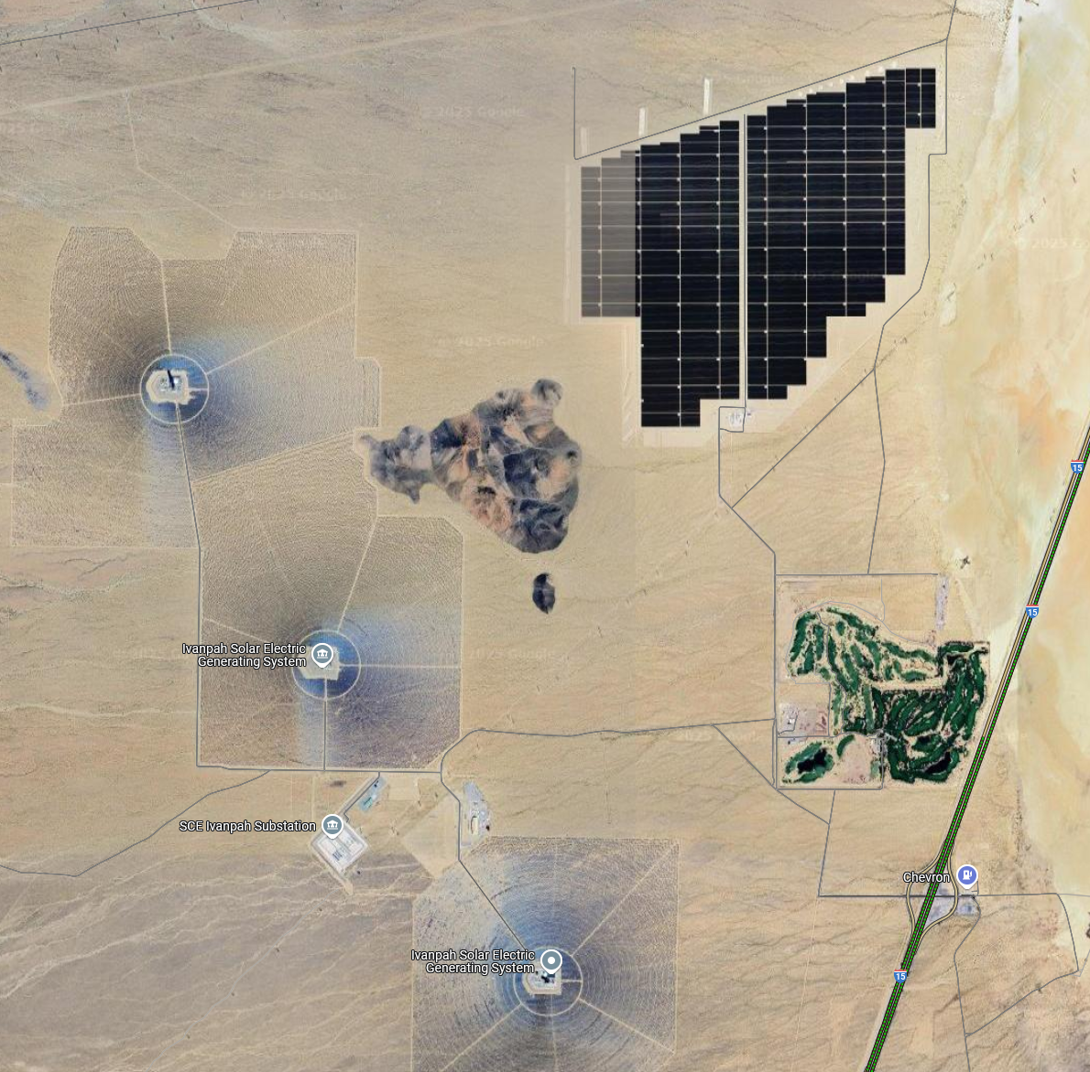
Known Issues:
Landsat False Positives
Solar panels near Las Vegas 12 November 2024
Landsat data indicates there were fires detected (false alarms), and they were not detected by GOES satellites (no false alarm by GOES).
These actually are reflectance from the arrays of solar panels.
There are 3 solar generation towers nearby.
Located at south of Las Vegas (30 miles away).

Slide 45
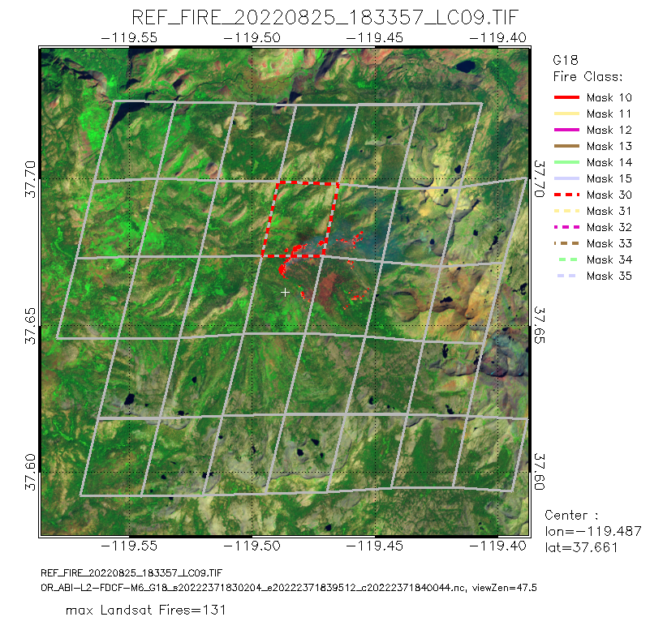
Known Issues:
Match distance
“Missed detection”
Even after terrain correction the lower part of this fire complex is labeled as a miss and counts against the FDCA. However, the reason for the “miss” may be connected to: remapping, small navigational offsets, terrain screening, errors in terrain correction, or some combination of those. Clustering the Landsat detections as an “event” and matching those to GOES “events” would be a more comprehensive way of assessing performance.

Slide 46
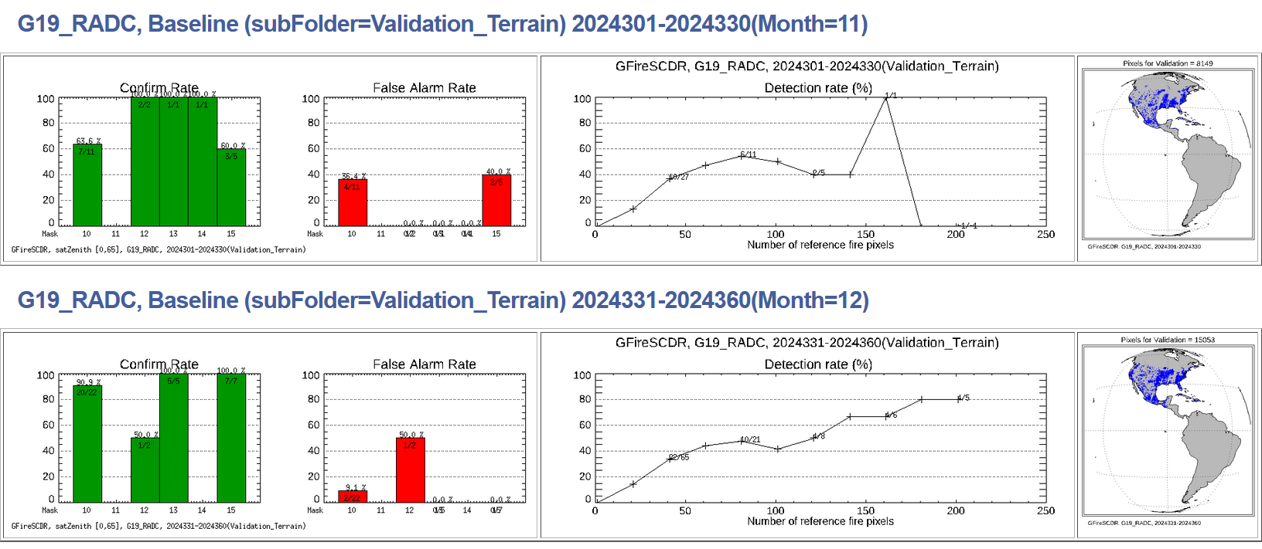
Validation by Landsat: G19
November-December 2024
Notes:
Confirm rate indicates the percent of ABI/SEVIRI fire pixels that can be verified by Landsat fire (at least 1 Landsat fire pixel falls into a given ABI/SEVIRI fire pixel).
False alarm rate is percent of ABI/SEVIRI fire pixels that cannot be verified by Landsat fire (at least 1 Landsat cloud free pixel fall into a given ABI/SEVIRI fire pixel, but none of them was identified as Landsat fire).
Detection rate evaluates the capability of ABI/SEVIRI fire product to catch big fire. Fire size was defined as the number of Landsat pixels in an ABI/SEVIRI pixel.

Slide 47
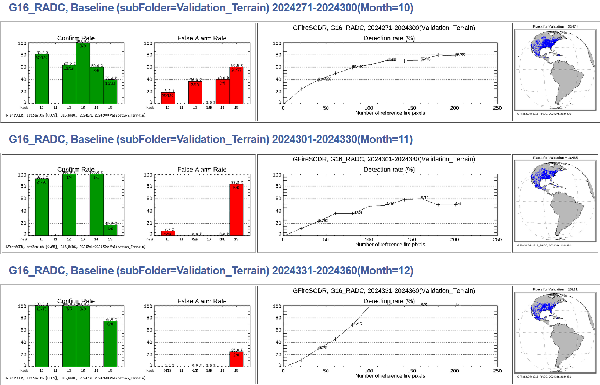
Validation by Landsat: G16
October-December 2024
Notes:
Confirm rate indicates the percent of ABI/SEVIRI fire pixels that can be verified by Landsat fire (at least 1 Landsat fire pixel falls into a given ABI/SEVIRI fire pixel).
False alarm rate is percent of ABI/SEVIRI fire pixels that cannot be verified by Landsat fire (at least 1 Landsat cloud free pixel fall into a given ABI/SEVIRI fire pixel, but none of them was identified as Landsat fire).
Detection rate evaluates the capability of ABI/SEVIRI fire product to catch big fire. Fire size was defined as the number of Landsat pixels in an ABI/SEVIRI pixel.

Slide 48
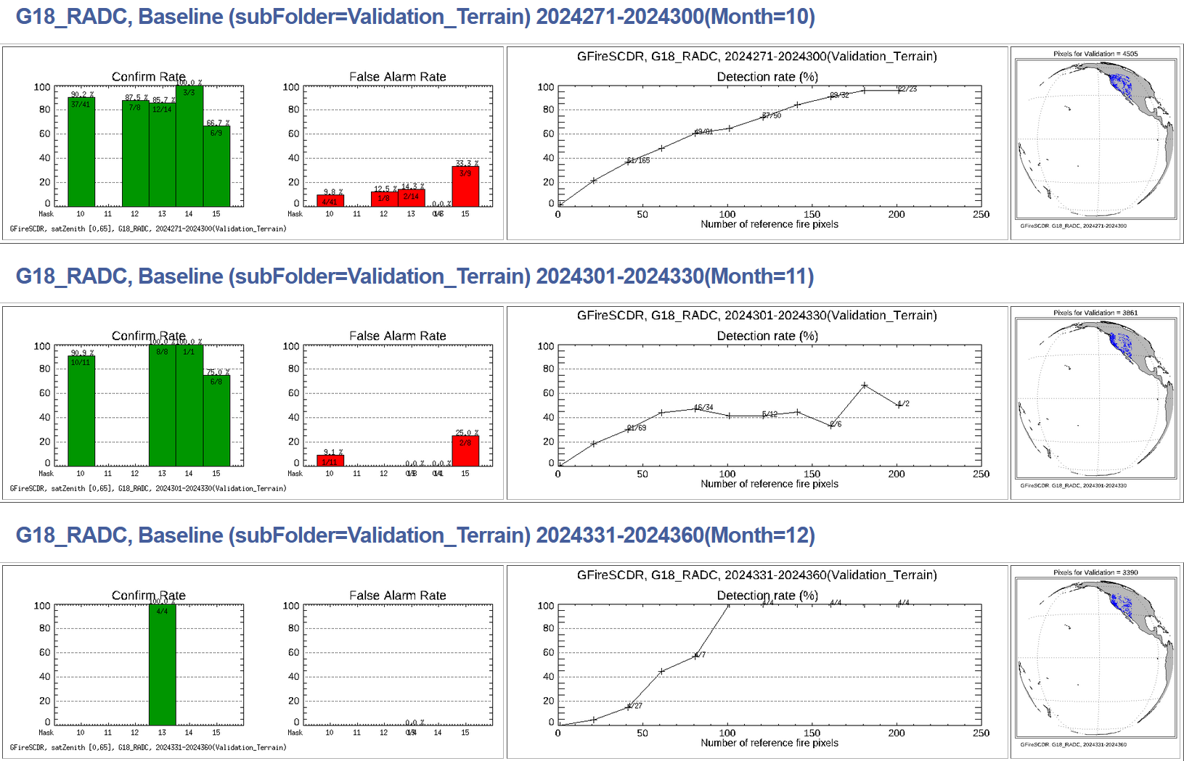
Validation by Landsat: G18
October-December 2024
Notes:
Confirm rate indicates the percent of ABI/SEVIRI fire pixels that can be verified by Landsat fire (at least 1 Landsat fire pixel falls into a given ABI/SEVIRI fire pixel).
False alarm rate is percent of ABI/SEVIRI fire pixels that cannot be verified by Landsat fire (at least 1 Landsat cloud free pixel fall into a given ABI/SEVIRI fire pixel, but none of them was identified as Landsat fire).
Detection rate evaluates the capability of ABI/SEVIRI fire product to catch big fire. Fire size was defined as the number of Landsat pixels in an ABI/SEVIRI pixel.

Slide 49
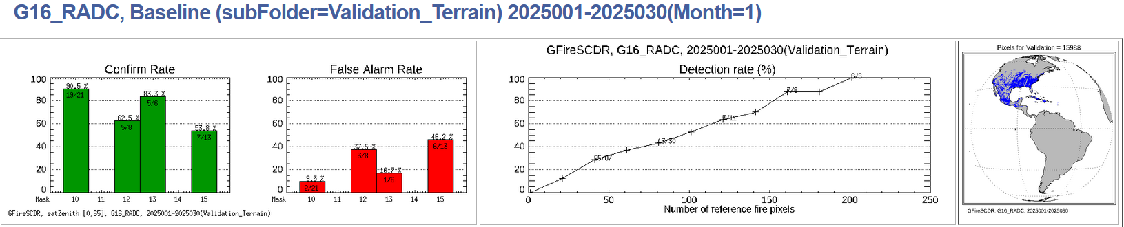
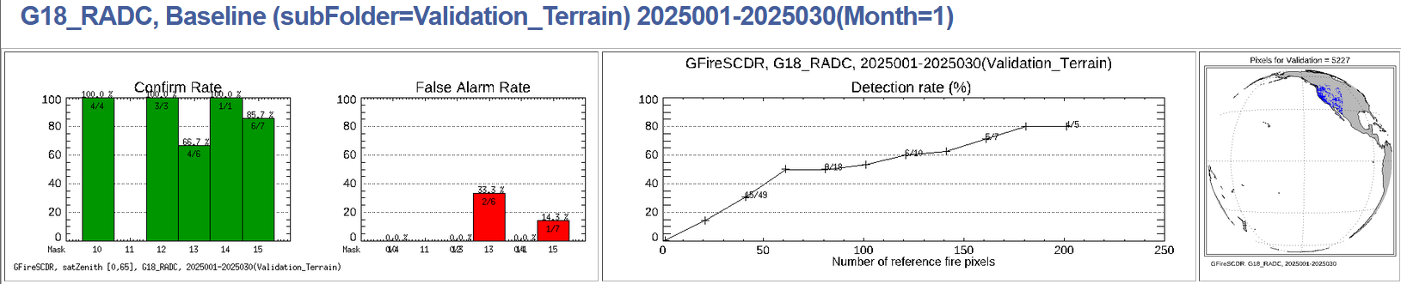
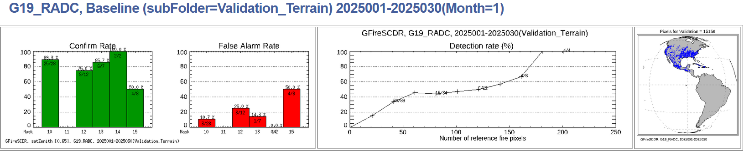
Validation by Landsat: All GOES
January 2025
Notes:
Confirm rate indicates the percent of ABI/SEVIRI fire pixels that can be verified by Landsat fire (at least 1 Landsat fire pixel falls into a given ABI/SEVIRI fire pixel).
False alarm rate is percent of ABI/SEVIRI fire pixels that cannot be verified by Landsat fire (at least 1 Landsat cloud free pixel fall into a given ABI/SEVIRI fire pixel, but none of them was identified as Landsat fire).
Detection rate evaluates the capability of ABI/SEVIRI fire product to catch big fire. Fire size was defined as the number of Landsat pixels in an ABI/SEVIRI pixel.

Slide 50
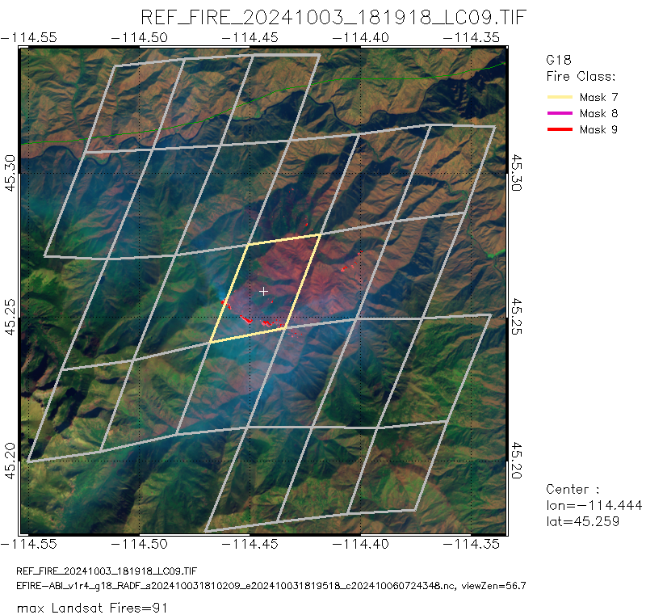
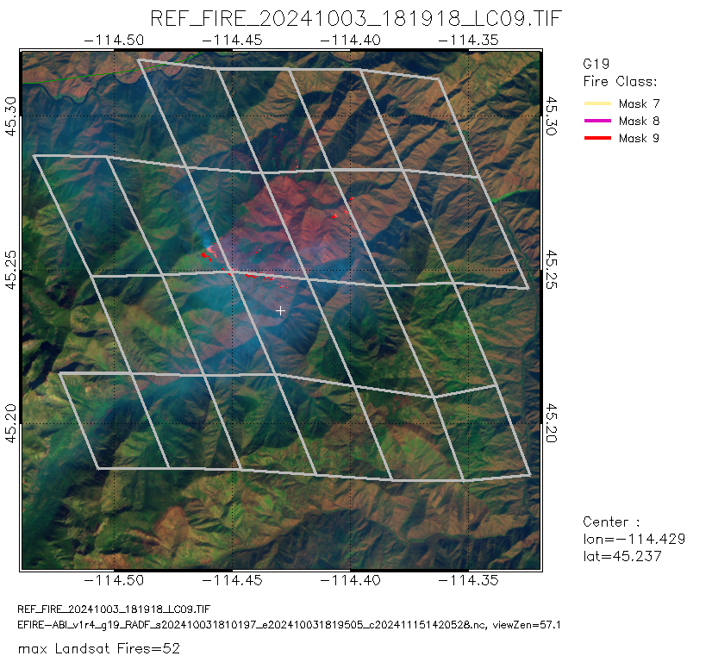
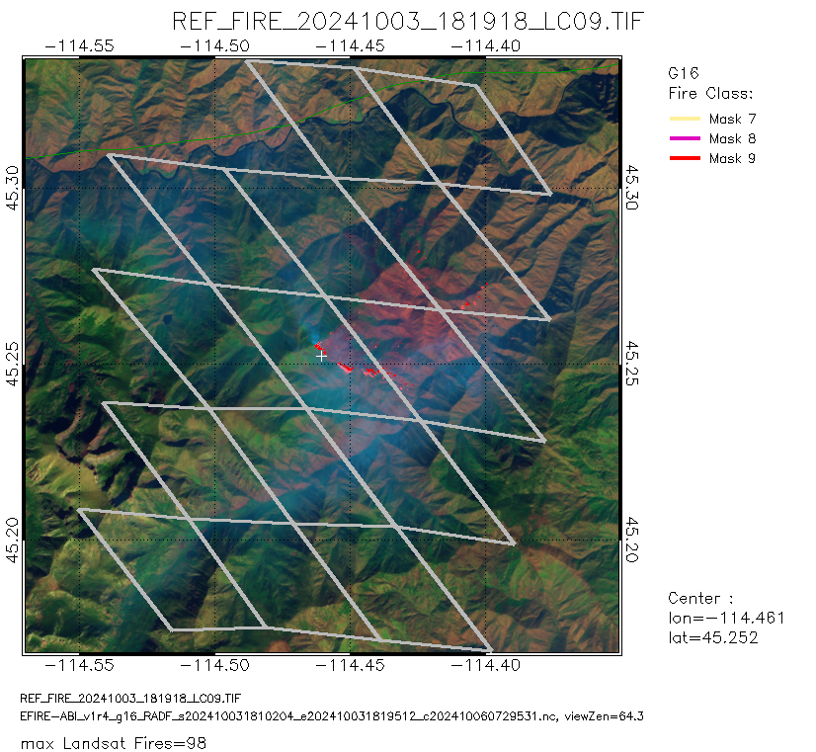
No Good Reason Why It Was Missed
Salmon-Challis National Forest, Idaho
10/3/2025 10/3/2025 10/3/2025
Get Band 7 imagery for these cases
Or just cut this
Fire is visually evident on 2024277 18:10 UTC RadF scan

