Slide 1
Initial Checkout of
GOES-19 AMVs
Brett Hoover¹, Andrew Collard²
Lynker¹, NCEP/EMC²
1/29/2025

Slide 2
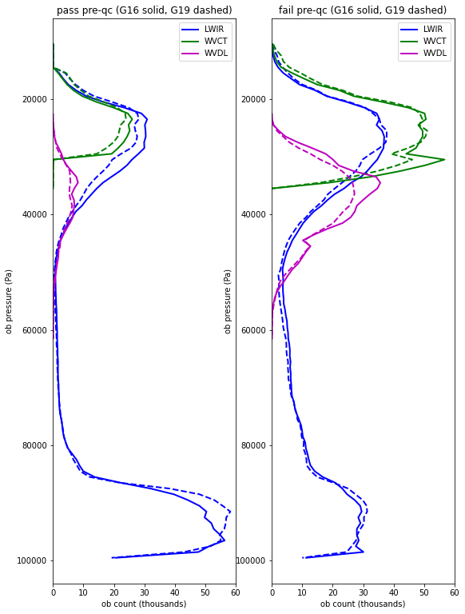
~12M AMVs across 11 6-hourly BUFR dump files
Pre-QC pass/fail by observation type and vertical pressure level is very consistent between GOES-16 (solid lines) and GOES-19 (dashed lines)

Slide 3
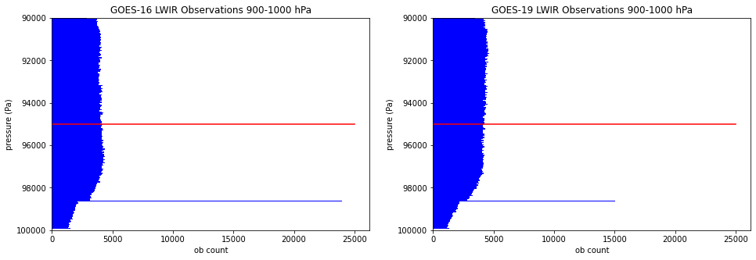
Ob counts in the lowest portion of the troposphere show an anomaly at 986.1 hPa, with a very large departure in counts at this level. NESDIS is still searching for the source of this anomaly, which also affects GOES-16 (and GOES-18) AMVs
Moot for EMC data assimilation, since QC filters remove all AMVs at pressures greater than 950 hPa (red line)

