Slide 1


GOES-19 ABI L1b/CMI Provisional PS-PVR
NWS User Feedback
12/20/2024
Presented by: Lee Byerle

Slide 2
NWS Integration of GOES-19 L1b and CMI
GOES-19 ABI imagery will be provided to AWIPS users as:
  Sectorized Cloud & Moisture Imagery (SCMI) tiles from GOES-R GS via the Satellite Broadcast Network (SBN) (e.g. WFOs/RFCs)
  SCMI tiles generated from L1b radiances (FD, CONUS, Meso) received from GRB (e.g., National Centers)
GOES-19 ABI imagery is compatible with AWIPS baseline configurations
Ongoing GOES-19 Readiness activity (ABI and GLM):
  ISatSS updates with National Centers (GLM and Geocolor RGB) [3/15/25]
  AWIPS Configuration updates through TOWRpro v25 (RPM) (GLM, L2s and Geocolor RGB) [3/1/25]
  Mesoscale Mission Manager Team coordination / MMM suite readiness [2/1/25 testing. 4/4/25 switch]
EMC is planning to examine the All-Sky and Clear-sky radiances for assimilation via PDA I&T access (BUFR). Results expected NET ~Jan 20, 2025

Slide 3
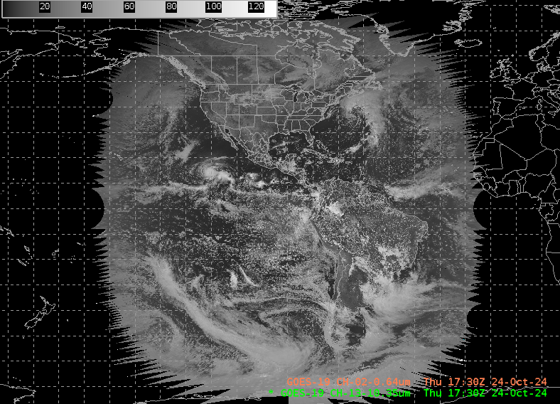
GOES-19 SCMI Full Disk Sector - L1b Sourced from AWC GRB Antenna
source: AWC ISatSS generated from L1b through AWC GRB Antenna
GOES-19 ABI Band 2 (0.64 μm)
17:30Z 24-Oct-2024
TFD - Full Disk SCMI
Provided by:
Amanda Terborg / AWC
Preliminary, non-operational

Slide 4
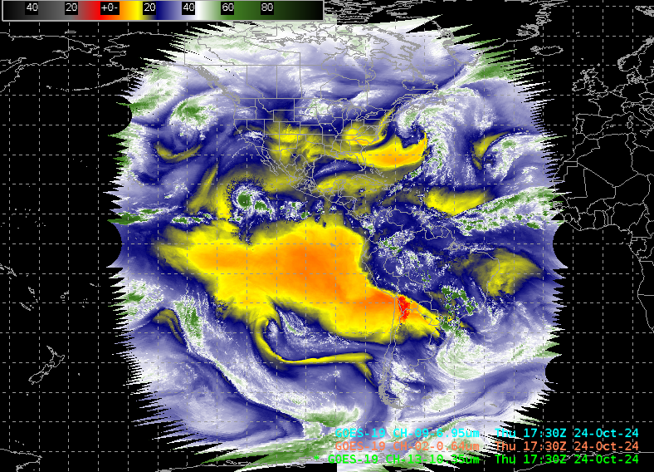
GOES-19 SCMI Full Disk Sector - L1b Sourced from AWC GRB Antenna
source: AWC ISatSS generated from L1b through AWC GRB Antenna
GOES-19 ABI Band 9 (6.95 μm)
17:30Z 24-Oct-2024
TFD - Full Disk SCMI
Provided by:
Amanda Terborg / AWC
Preliminary, non-operational

Slide 5
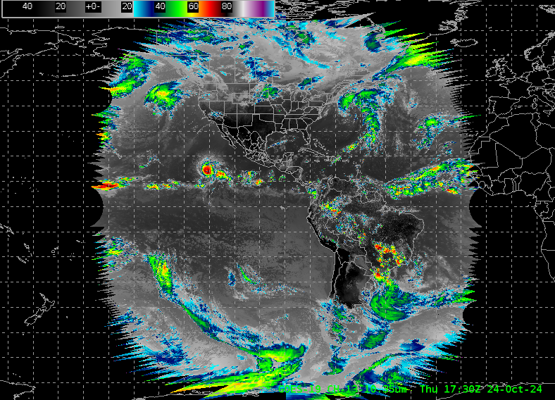
GOES-19 SCMI Full Disk Sector - L1b Sourced from AWC GRB Antenna
source: AWC ISatSS generated from L1b through AWC GRB Antenna
GOES-19 ABI Band 13 (10.35 μm)
17:30Z 24-Oct-2024
TFD - Full Disk SCMI
Provided by:
Amanda Terborg / AWC
Preliminary, non-operational

Slide 6
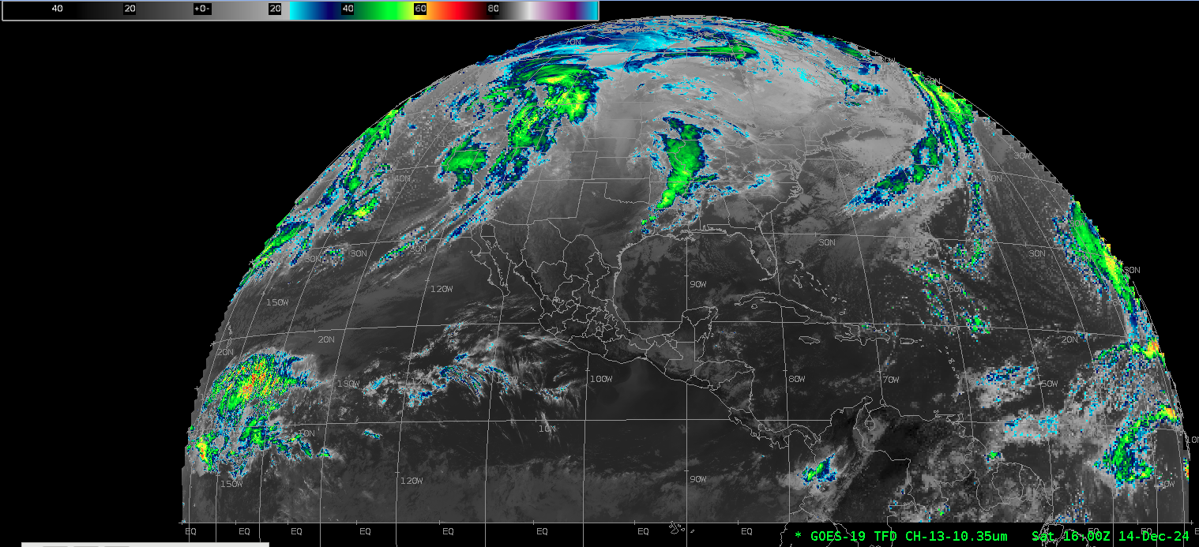
GOES-19 Full Disk Sector SCMI Sourced from Geocloud
source: NESDIS geocloud (GPAS) SCMI
GOES-19 ABI Band 13 (10.3μm)
16:00 Z 14-Dec-2024
TFD - Full Disk SCMI
Preliminary, non-operational
Notes:
bucket download --account=gcops --norecurse geoproducts-plt/plt/GOES-19/scmi/ABI/2024/dec/20241214/OR_TFD-020-B12-M6C13-T006_G19_s2024349160020_c2024349160218.nc

Slide 7
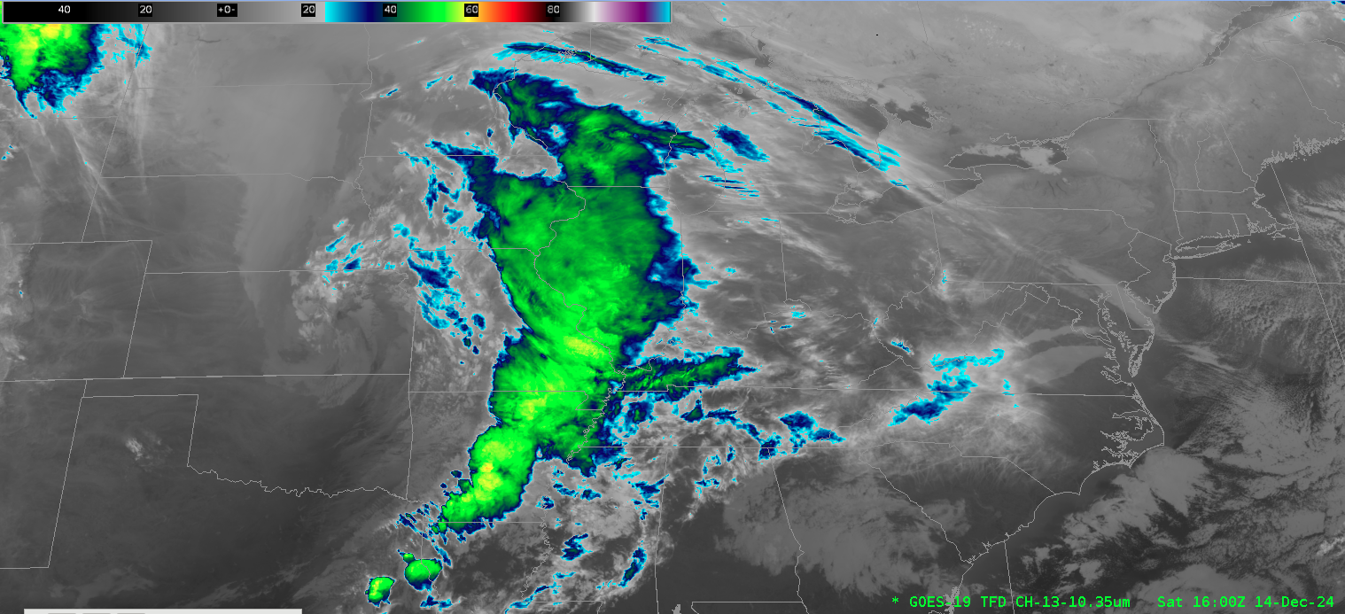
GOES-19 Full Disk Sector SCMI Sourced from Geocloud (zoomed)
GOES-19 ABI Band 13 (10.3μm)
16:00Z 14-Dec-2024
TFD - Full Disk SCMI
source: NESDIS geocloud (GPAS) SCMI
Preliminary, non-operational
Notes:
bucket download --account=gcops --norecurse geoproducts-plt/plt/GOES-19/scmi/ABI/2024/dec/20241214/OR_TFD-020-B12-M6C13-T006_G19_s2024349160020_c2024349160218.nc

Slide 8
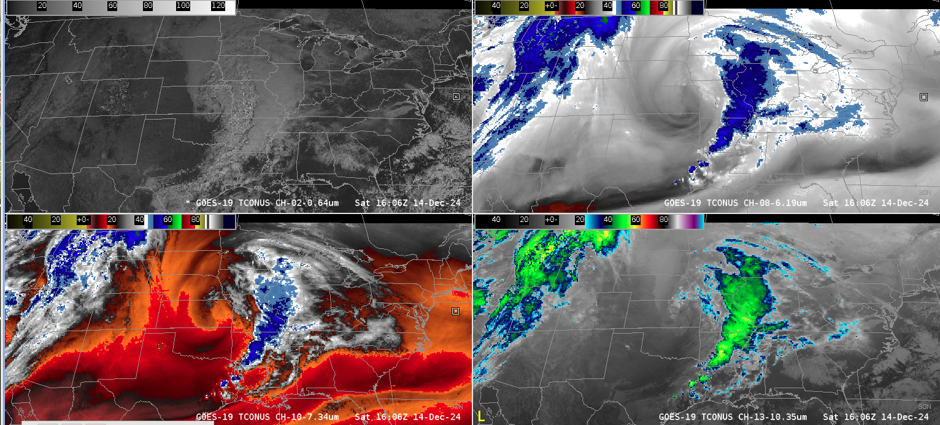
GOES-19 SCMI TCONUS Sector [Compare to next slide]
source: ISatSS tiler in NWS Cloud using NESDIS geocloud (GPAS) L1b
GOES-19
Preliminary, non-operational

Slide 9
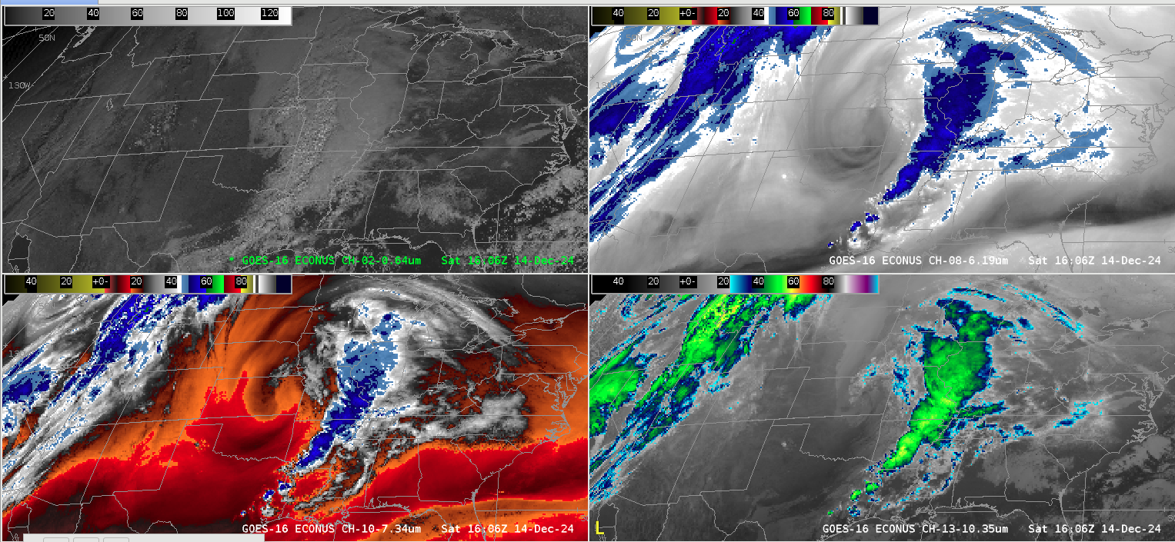
GOES-16 SCMI ECONUS Sector [Compare to previous slide]
source: ISatSS tiler in NWS Cloud using NESDIS geocloud (GPAS) L1b
GOES-18 ABI Band 10 (7.3μm / water vapor) imagery: 30-Aug-2023, 16-20z
Preliminary, non-operational
GOES-16

Slide 10
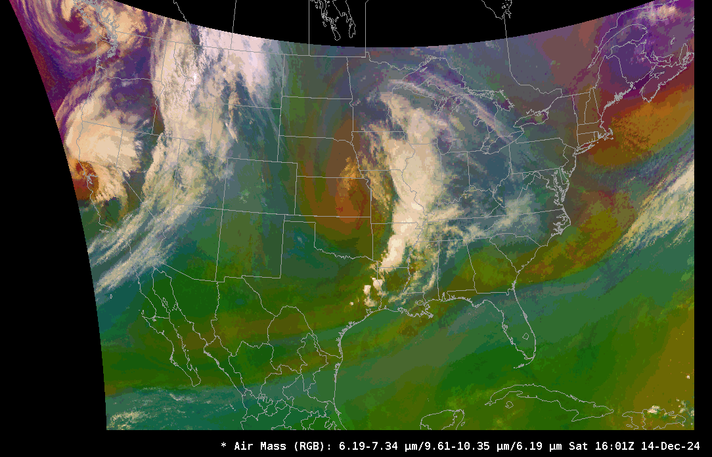
GOES-19 SCMI Air Mass RGB TCONUS Sector [Compare to next slide]
source: ISatSS tiler in NWS Cloud using NESDIS geocloud (GPAS) L1b
GOES-19
Note: AWIPS generates this RGB “on the fly” from the available ABI bands
Preliminary, non-operational

Slide 11
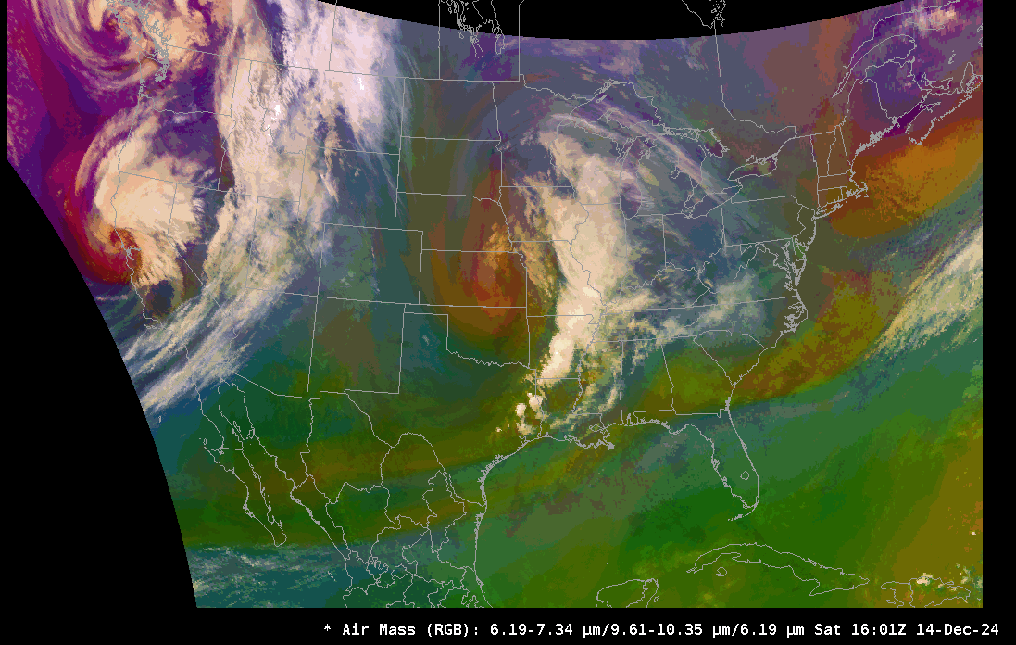
GOES-16 SCMI Air Mass RGB ECONUS Sector [Compare to previous slide]
source: ISatSS tiler in NWS Cloud using NESDIS geocloud (GPAS) L1b
GOES-16
Note: AWIPS generates this RGB “on the fly” from the available ABI bands
Preliminary, non-operational

Slide 12
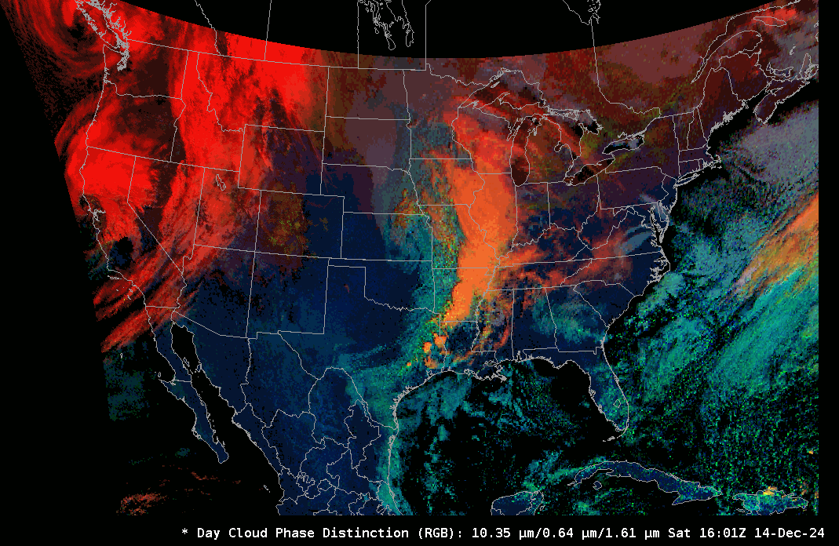
GOES-19 SCMI Day Cloud Phase RGB [Compare to next slide]
source: ISatSS tiler in NWS Cloud using NESDIS geocloud (GPAS) L1b
GOES-19
Note: AWIPS generates this RGB “on the fly” from the available ABI bands
Preliminary, non-operational

Slide 13
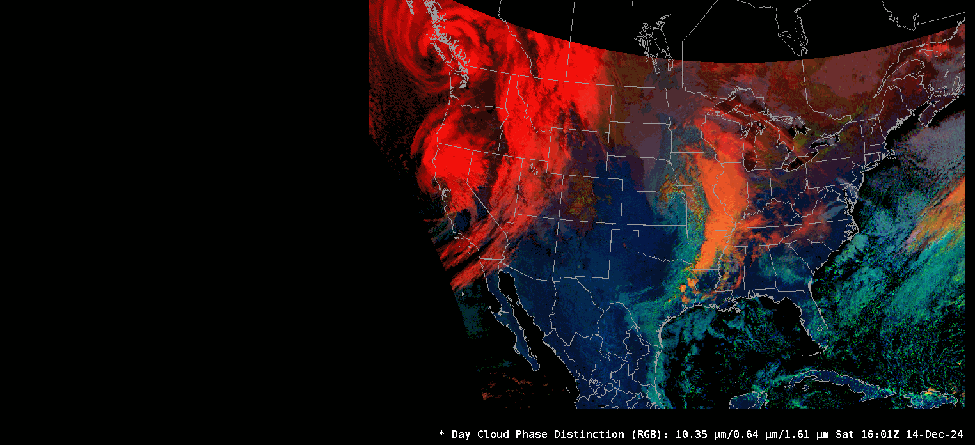
GOES-16 SCMI Day Cloud Phase RGB [Compare to previous slide]
source: ISatSS tiler in NWS Cloud using NESDIS geocloud (GPAS) L1b
GOES-16
Note: AWIPS generates this RGB “on the fly” from the available ABI bands
Preliminary, non-operational

Slide 14
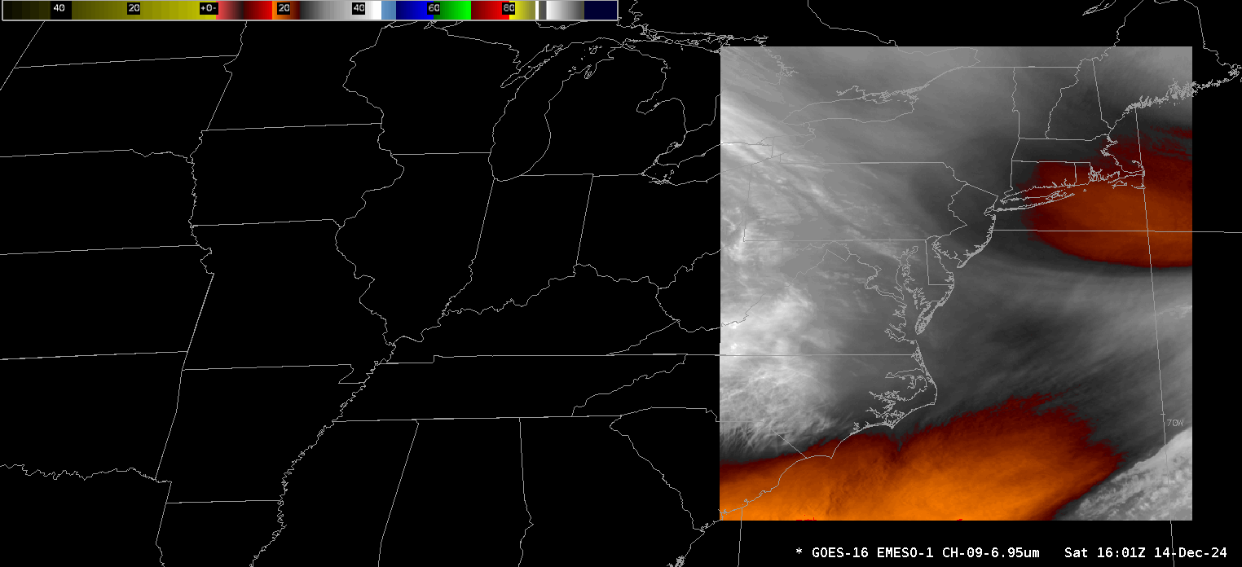
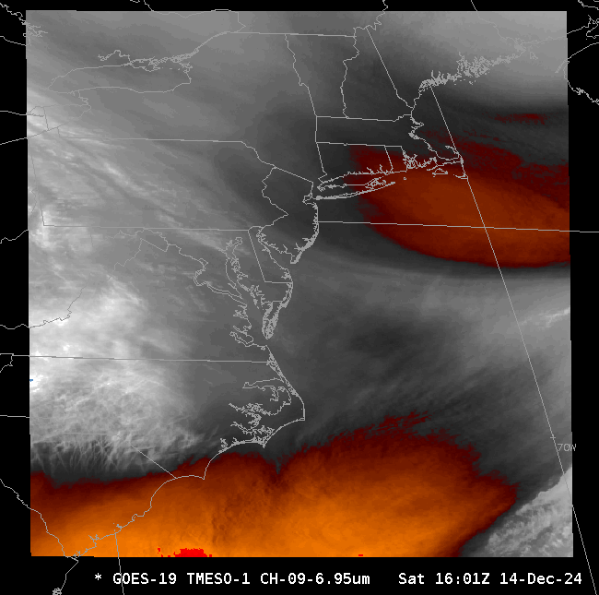
GOES-19 TMESO-1 [left] and GOES-16 EMESO-1 [right]
source: ISatSS tiler in NWS Cloud using NESDIS geocloud (GPAS) L1b
GOES-19 ABI Band (6.95 μm) TMESO-1
GOES-16 ABI Band 9 (6.95 μm) EMESO-1
Preliminary, non-operational
Notes:
Inputs:
OR_ABI-L1b-RadM1-M6C09_G16_s20243491601251_e20243491601314_c20243491601339.nc OR_ABI-L1b-RadM1-M6C09_G16_s20243491604251_e20243491604314_c20243491604344.nc
OR_ABI-L1b-RadM1-M6C09_G16_s20243491602251_e20243491602315_c20243491602347.nc OR_ABI-L1b-RadM1-M6C09_G16_s20243491605251_e20243491605314_c20243491605348.nc
OR_ABI-L1b-RadM1-M6C09_G16_s20243491603251_e20243491603314_c20243491603350.nc OR_ABI-L1b-RadM1-M6C09_G16_s20243491606251_e20243491606314_c20243491606339.nc

Slide 15
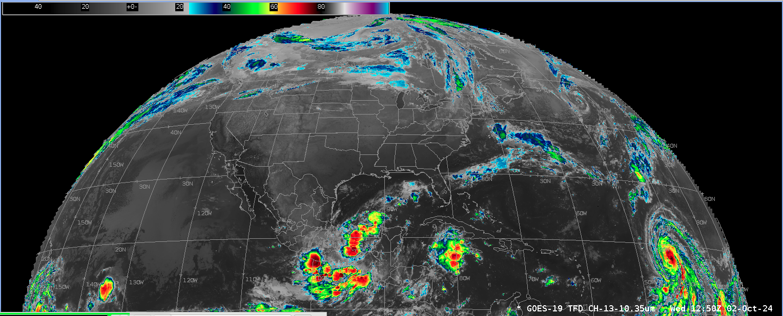
GOES-19 Full Disk Sector SCMI Sourced from Geocloud L1b
source: ISatSS tiler in NWS Cloud using NESDIS geocloud (GPAS) L1b
GOES-19 ABI Band 13 (10.3μm)
12:50 Z 2-Oct-2024
TFD - Full Disk SCMI
Preliminary, non-operational
Notes:
bucket download --account=gcops --norecurse geoproducts-plt/plt/GOES-19/scmi/ABI/2024/dec/20241214/OR_TFD-020-B12-M6C13-T006_G19_s2024349160020_c2024349160218.nc

Slide 16
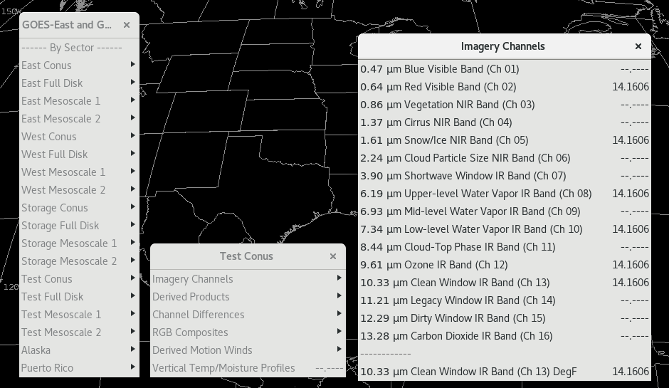
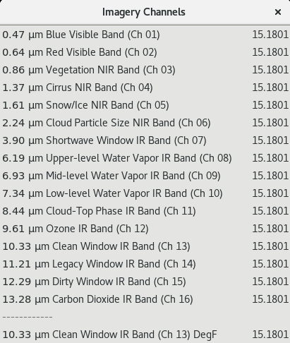
GOES AWIPS Menu - ABI Imagery Bands
source: NWS Cloud AWIPS

Slide 17
Thank You
Questions?
Notes:
bucket download --account=gcops --norecurse geoproducts-plt/plt/GOES-19/scmi/ABI/2024/dec/20241214/OR_TFD-020-B12-M6C13-T006_G19_s2024349160020_c2024349160218.nc

