Slide 1
GOES-19 L2 (Group 1) Provisional Validation
Peer/Stakeholder Product Validation Review (PS-PVR)
Jan. 29, 2025
NWS Perspective: AWIPS verification
Derek Van Pelt / TOWR-S team, NWS Office of Observations
Clear Sky Mask | Cloud Top Temperature
Cloud Top Phase | Cloud Top Pressure
Cloud Top Height | Derived Motion Winds

Slide 2
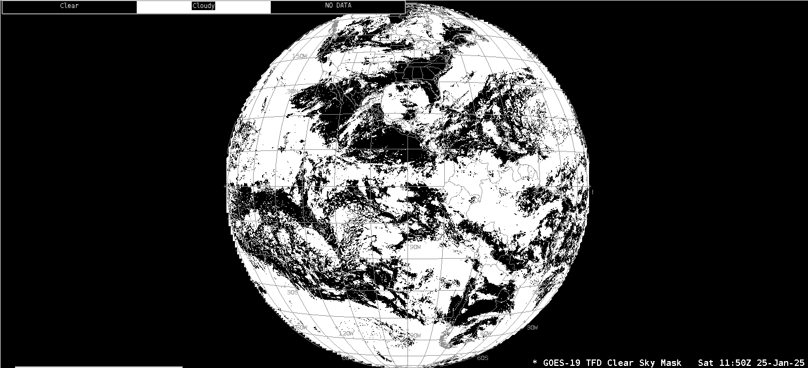
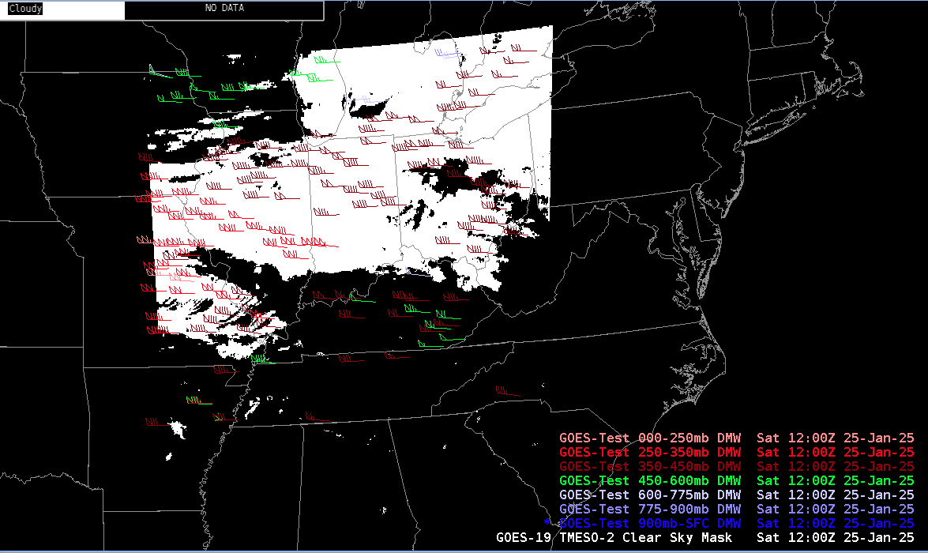
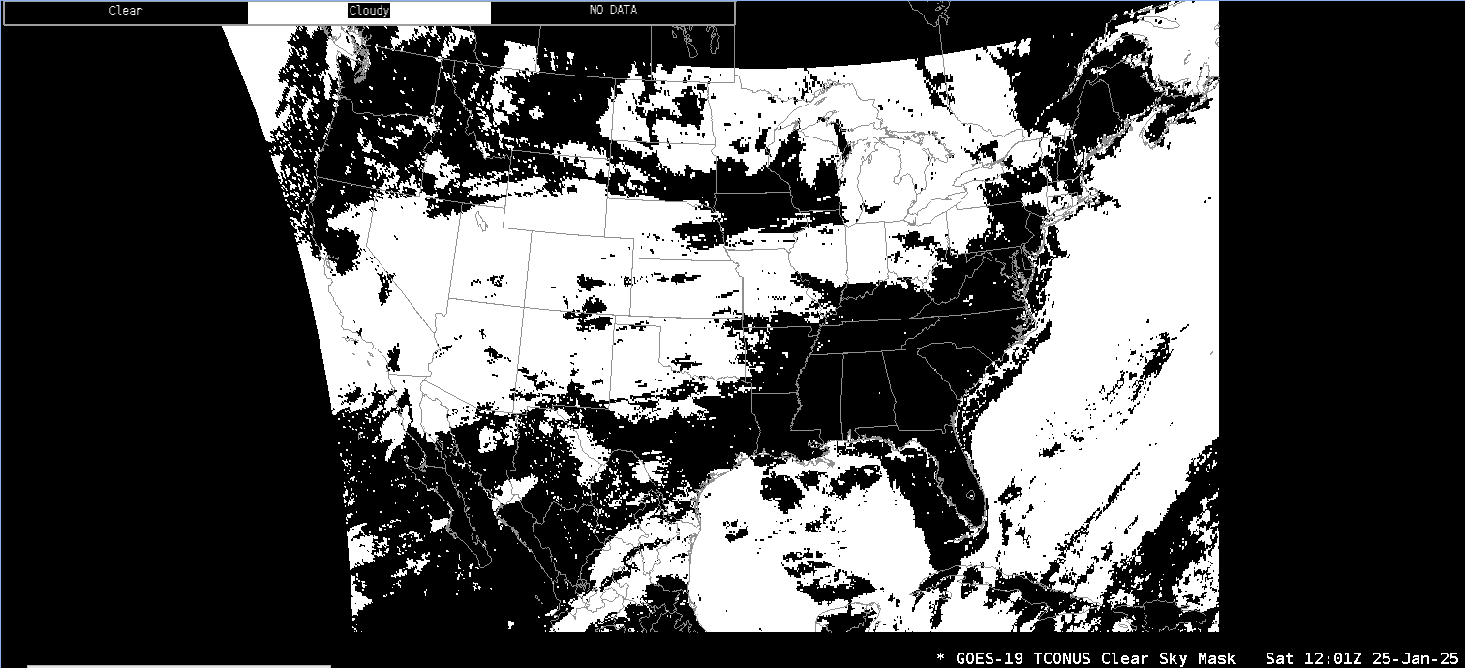
Clear Sky Mask
GOES-19 Preliminary, Non-Operational Data

Slide 3
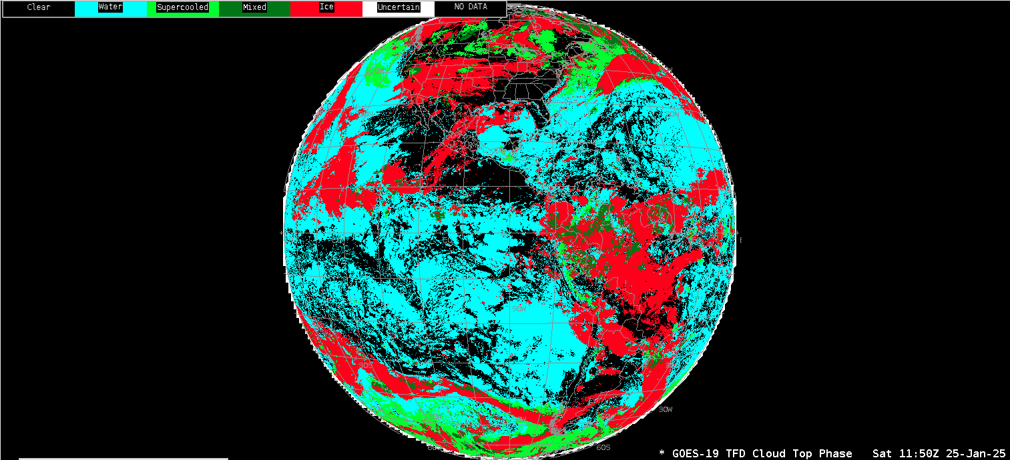
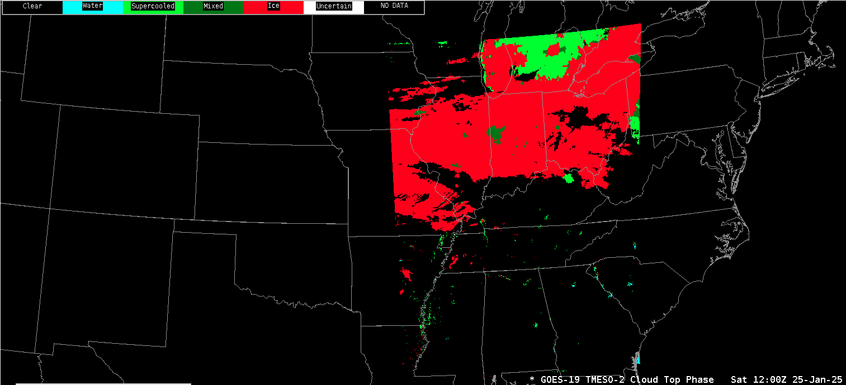
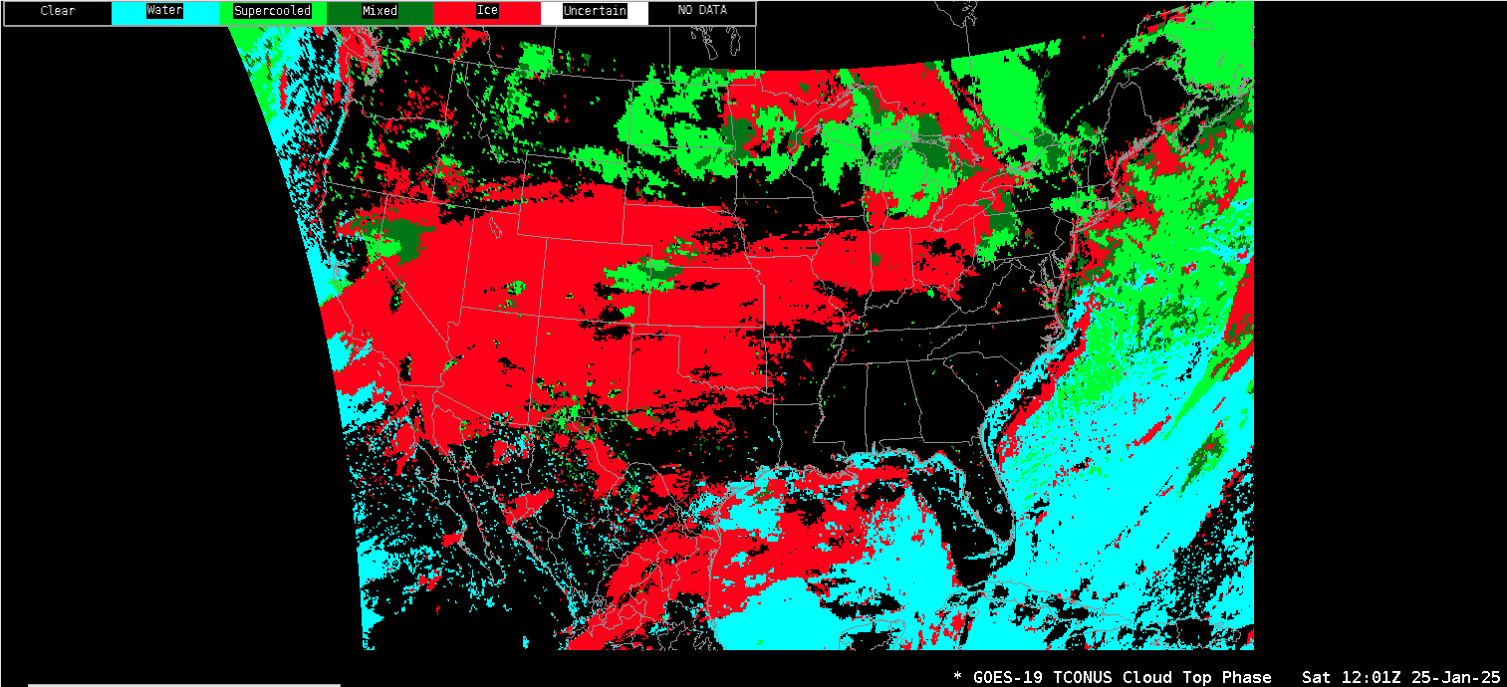
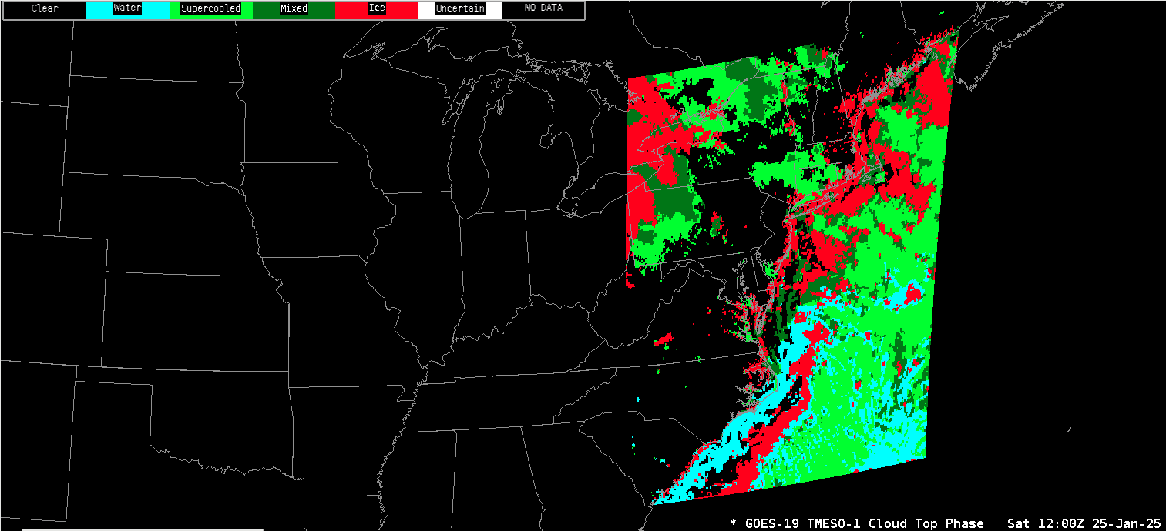
Cloud Top Phase
GOES-19 Preliminary, Non-Operational Data

Slide 4
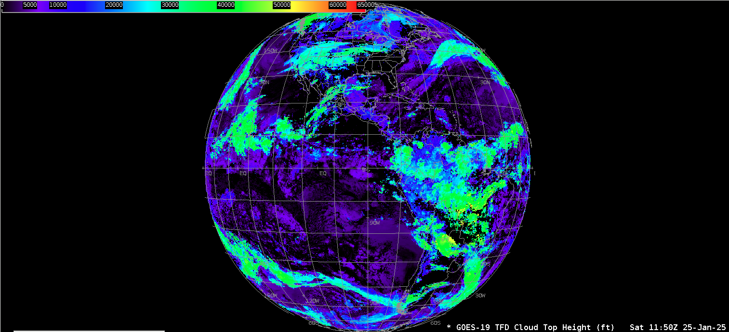
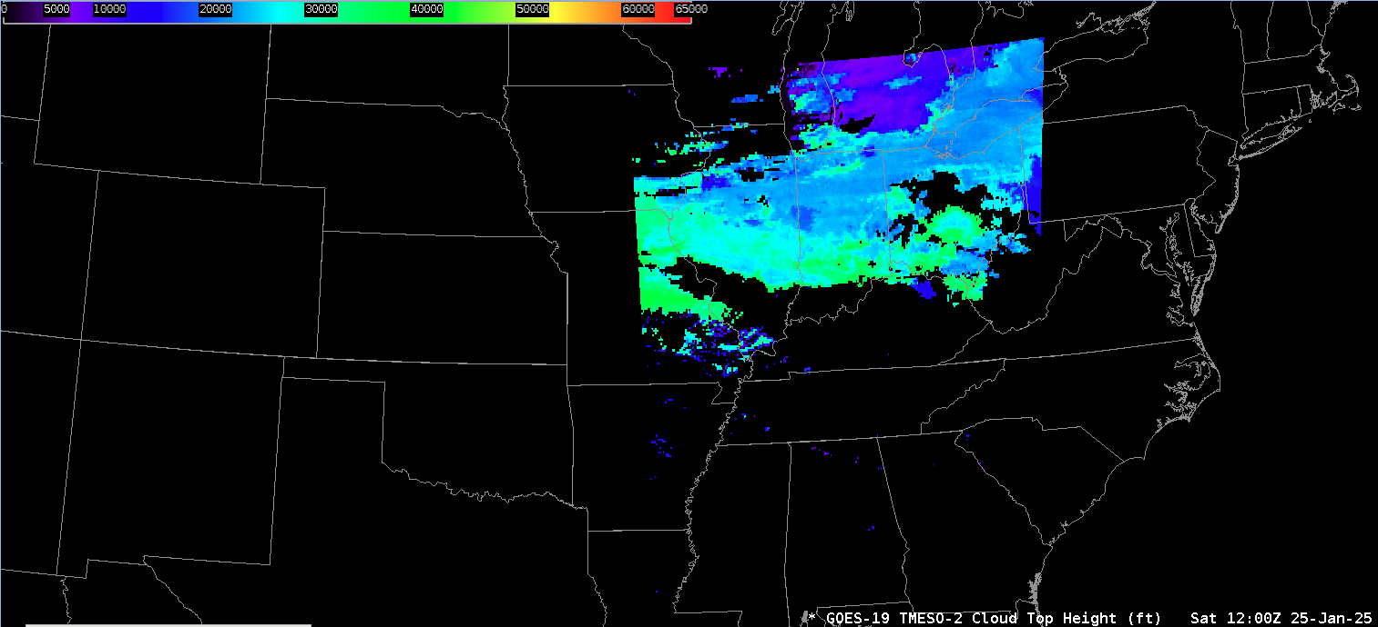
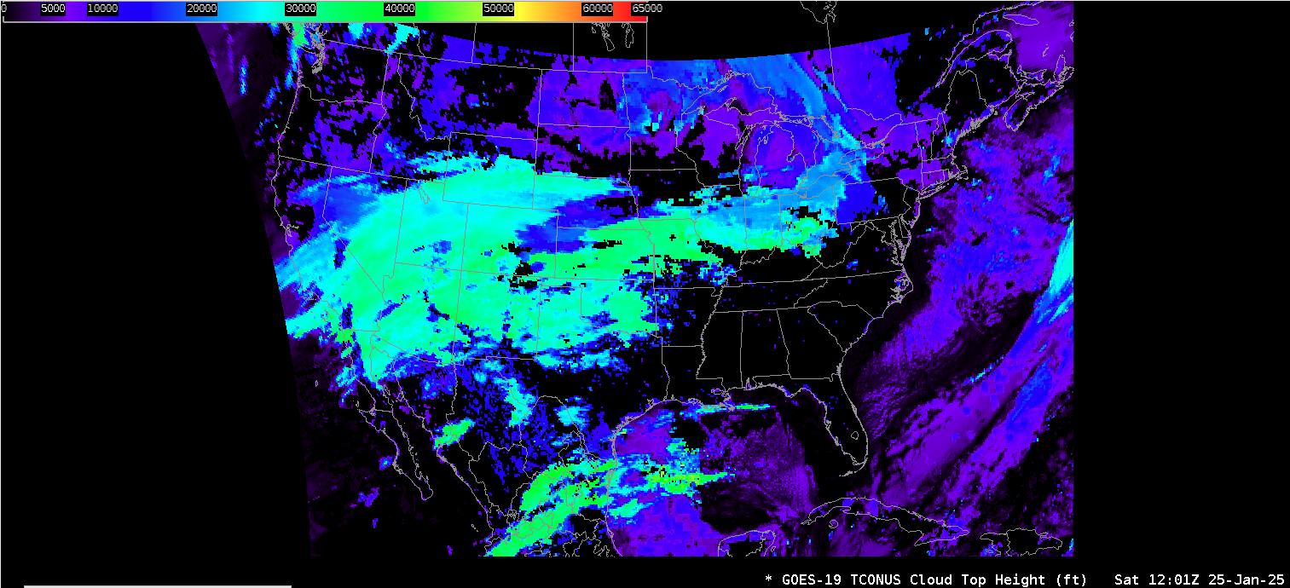
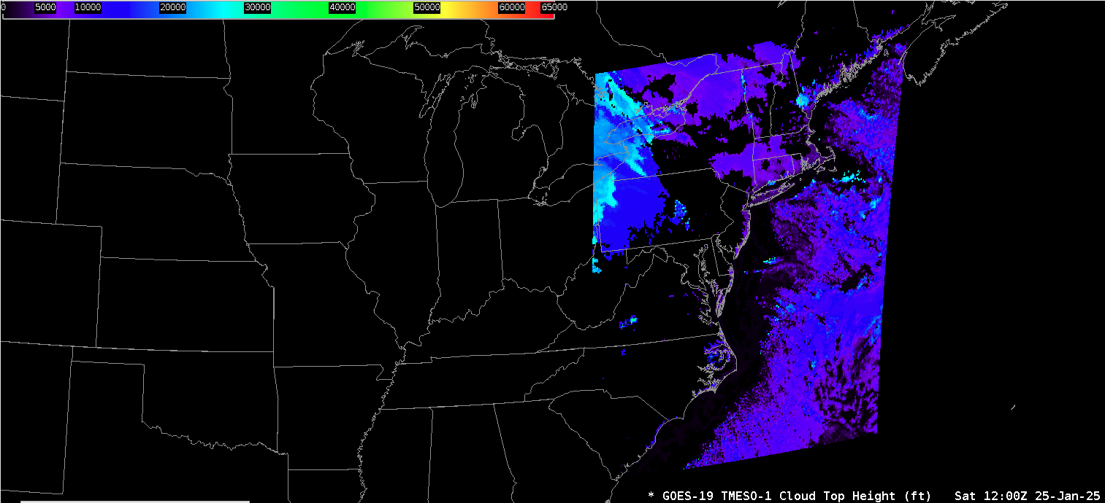
Cloud Top Height
GOES-19 Preliminary, Non-Operational Data

Slide 5
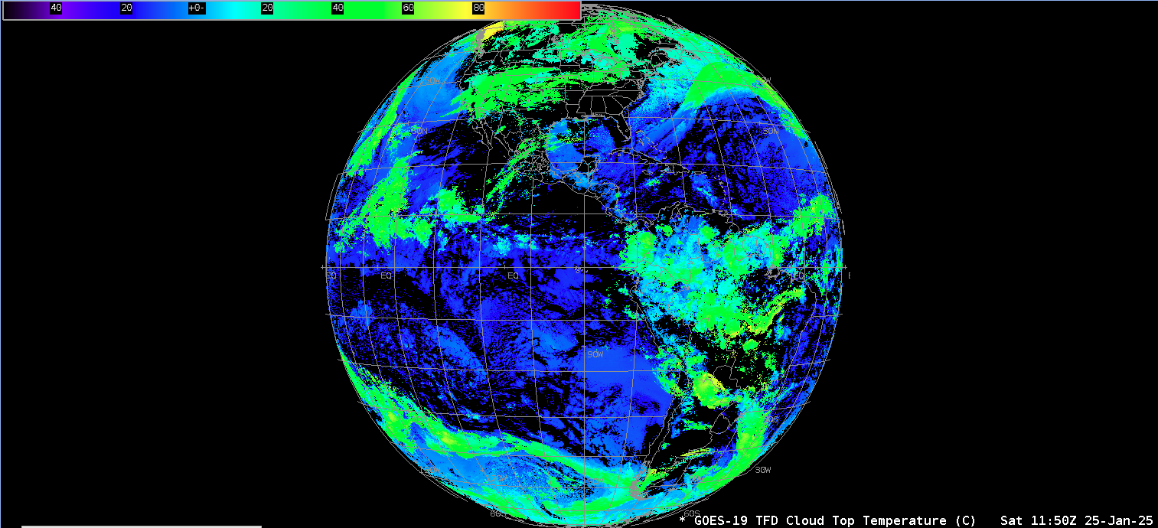
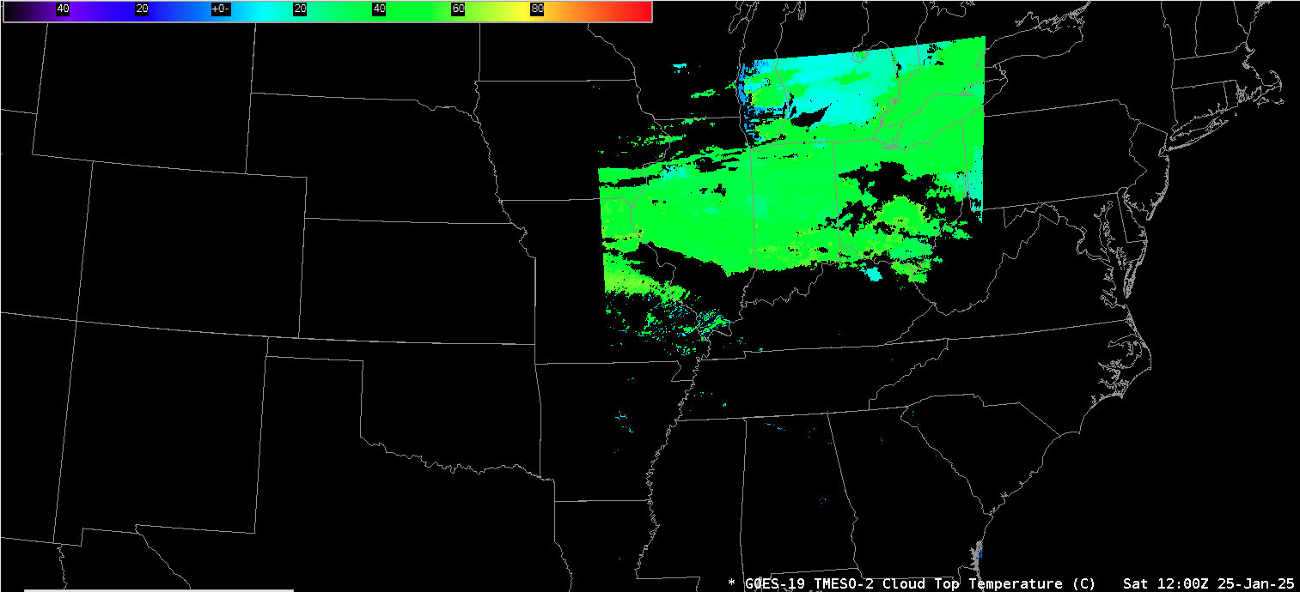
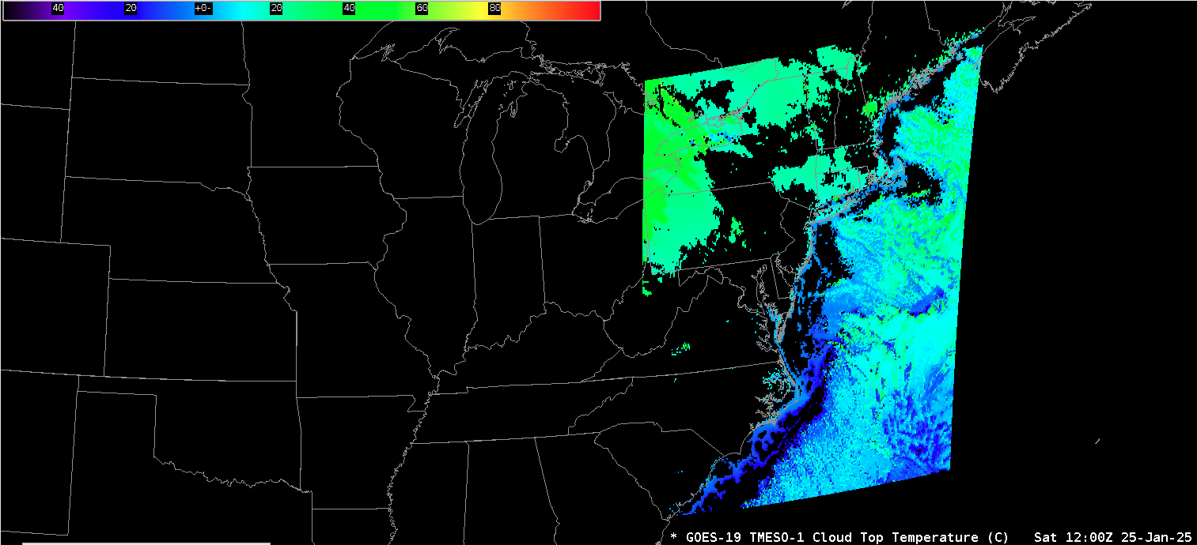
Cloud Top Temperature
GOES-19 Preliminary, Non-Operational Data

Slide 6
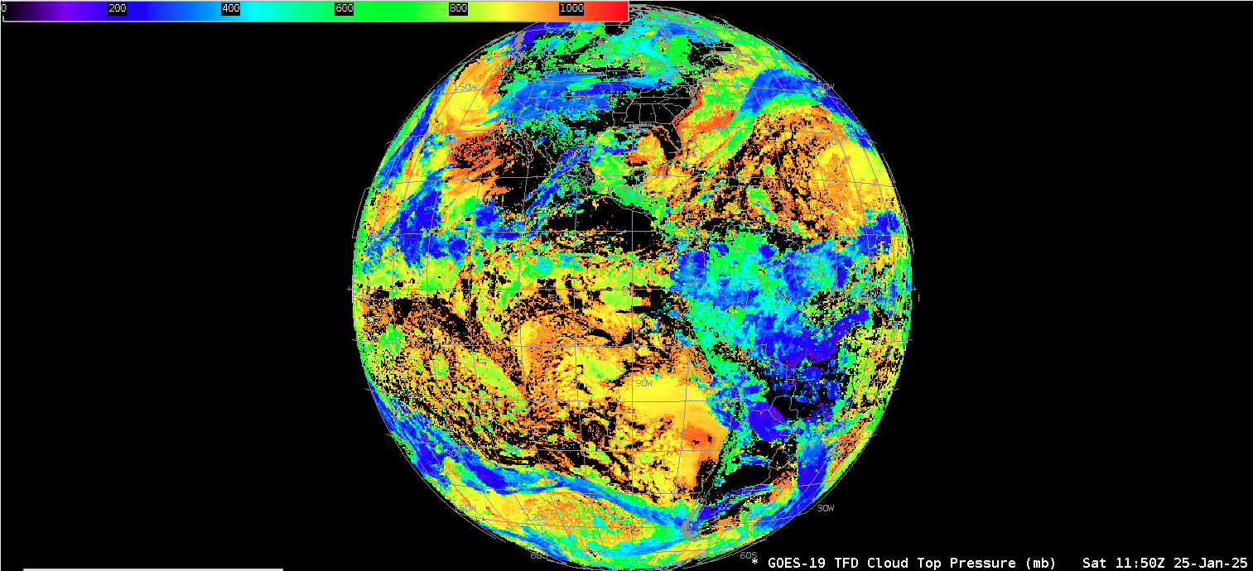
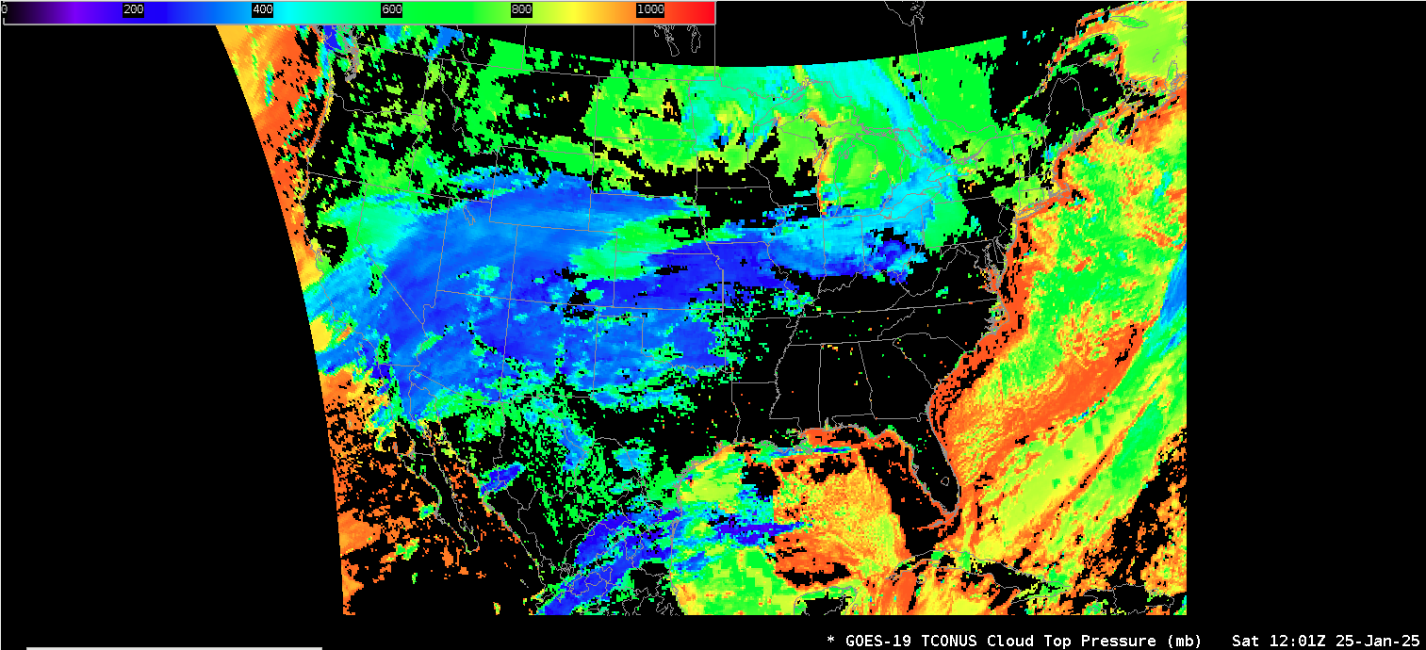
Cloud Top Pressure
GOES-19 Preliminary, Non-Operational Data

Slide 7
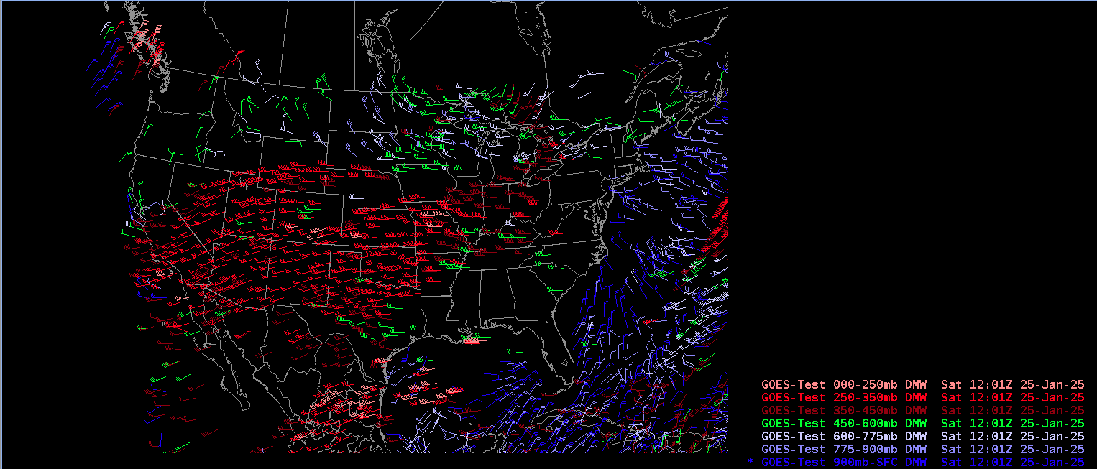
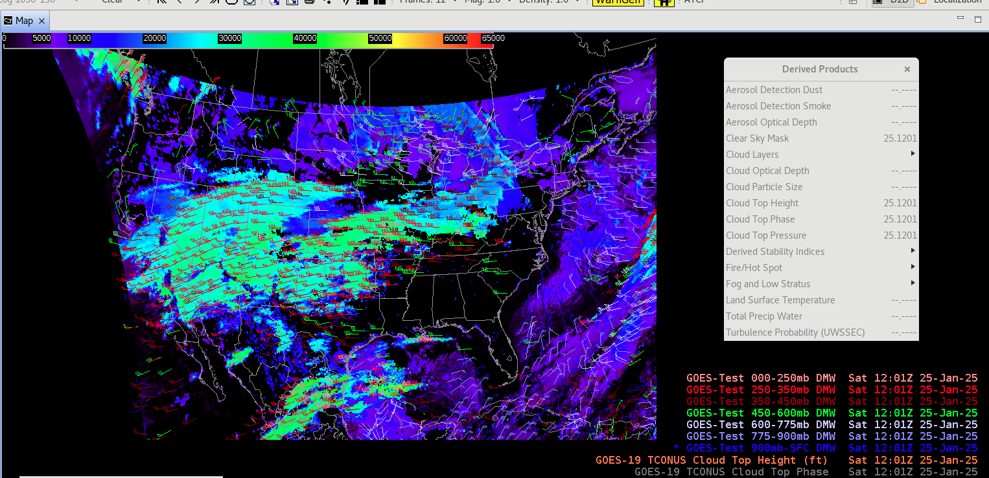
Derived Motion Winds
GOES-19 Preliminary, Non-Operational Data

Slide 8
Notes
AWIPS ingests and displays all these products using its baseline configurations.
  No fielding issues are expected
  G-19 products conform to G-16/18 conventions (GOES-R Product User Guide)
  AWIPS’ baseline configurations allow for new GOES-R satellites

