Slide 1
CIRA input for GOES-19 ABI CCL Provisional Review
60% validation metrics from JPSS and other GOES documentation
Provisional - (JPSS/GOES-R Data Product Validation Maturity Stages – COMMON DEFINITIONS)
Product performance has been demonstrated through analysis of a large, but still limited (i.e., not necessarily globally or seasonally representative) number of independent measurements obtained from selected locations, time periods, or field campaign efforts.
Product analyses are sufficient for qualitative, and limited quantitative, determination of product fitness-for-purpose.
Documentation of product performance, testing involving product fixes, identified product performance anomalies, including recommended remediation strategies, exists.
Product is recommended for potential operational use (user decision) and in scientific publications after consulting product status documents.

Slide 2
Post-Launch Product Tests (PLPT)# Under Review
PLPT ID | Descriptive Title | % Complete | Results | AWG POC
ABI-FD_CTP06 | Assess the accuracy and precision of CCL product generated for FD in ABI Mode 6 | 100 | Complete | AWG
ABI-CONUS_CTP07 | Assess the accuracy and precision of CCL product generated for CONUS in ABI Mode 6 | 100 | Complete | AWG
ABI-MESO_CTP08 | Assess the accuracy and precision of CCL product generated for mesoscale in ABI Mode 6 | Visual Only | Complete | AWG
#Official PLPT tables can be found in the Cloud Top Parameters ABI L2+ RIMP

Slide 3
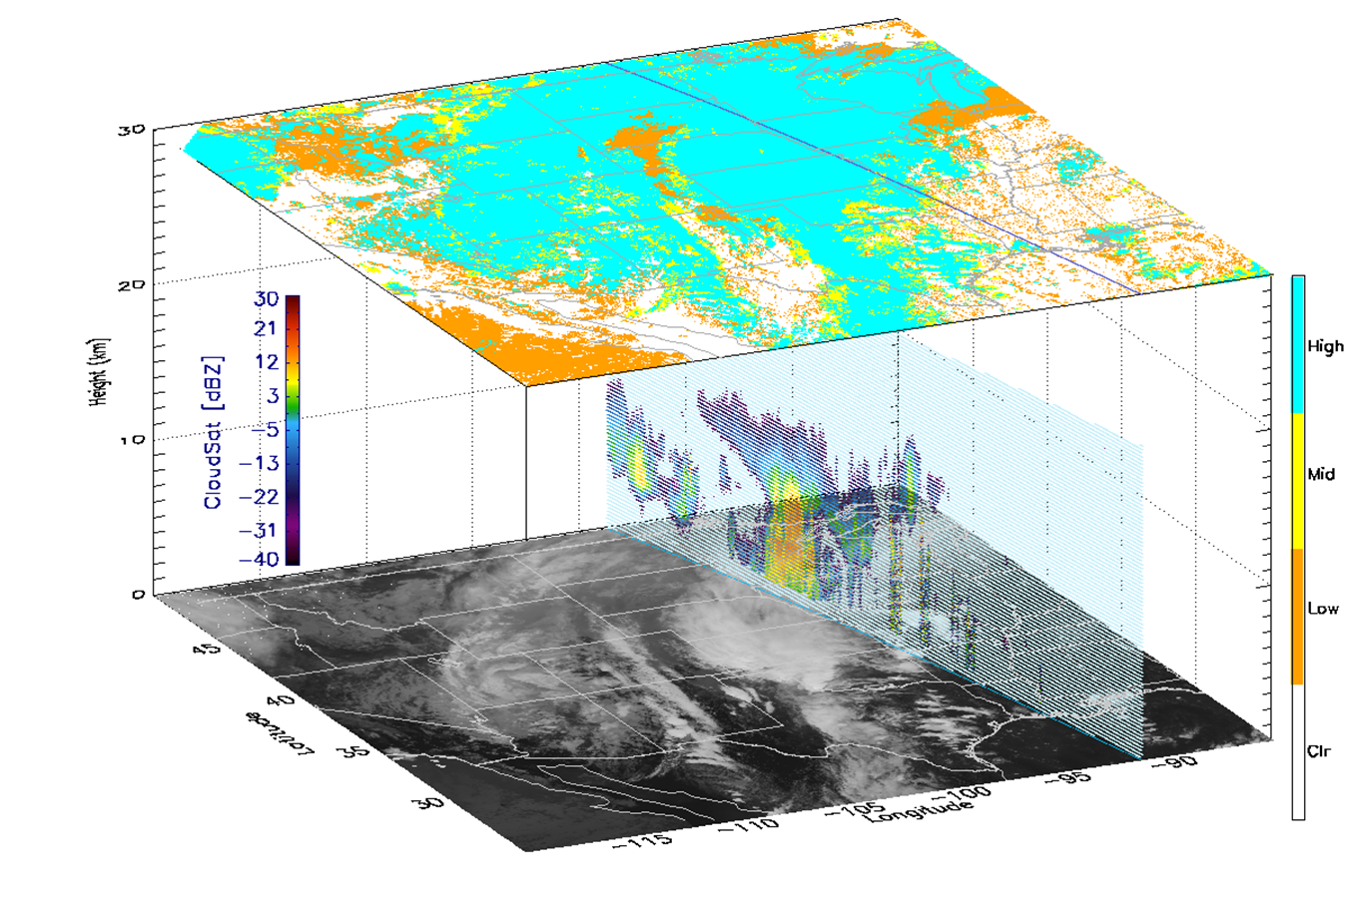
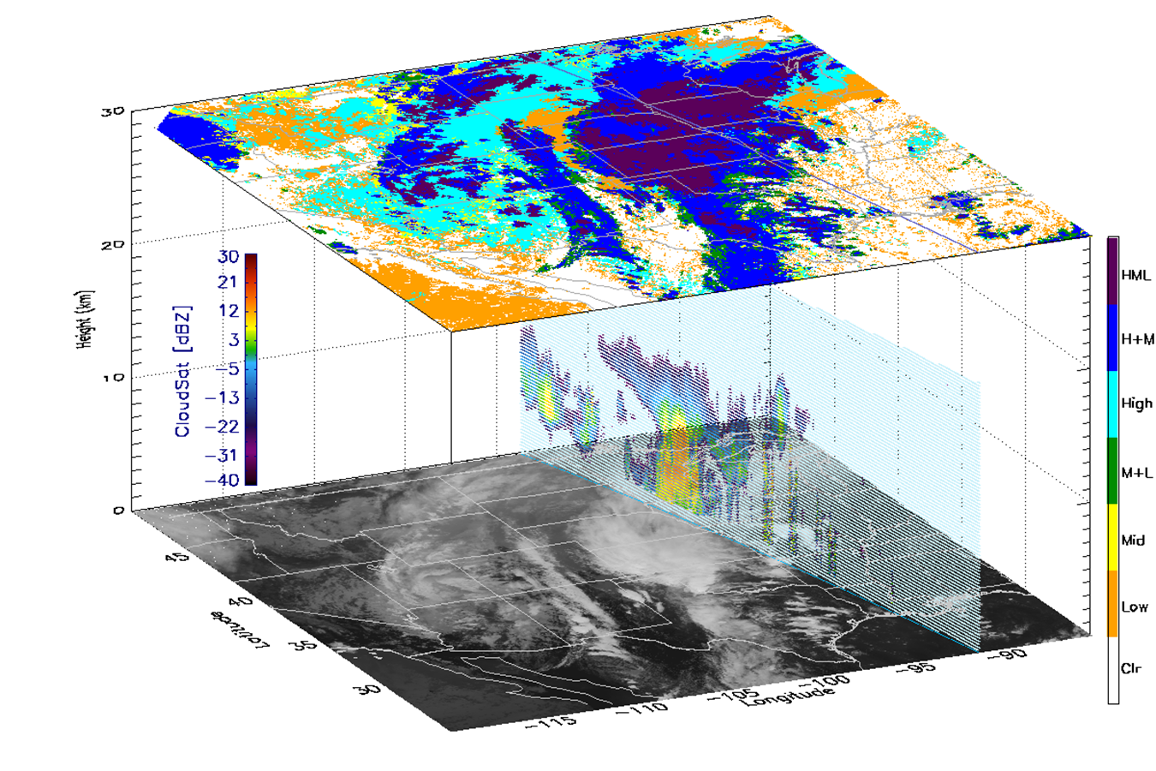
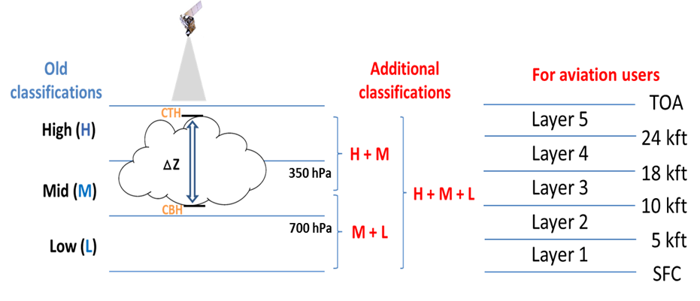
ABI Cloud Cover Layers (CCL) Products Using Cloud Base Height (CBH)
Sample CCL (G16 ABI)
Adding CBH
Cloud Top Only

Slide 4
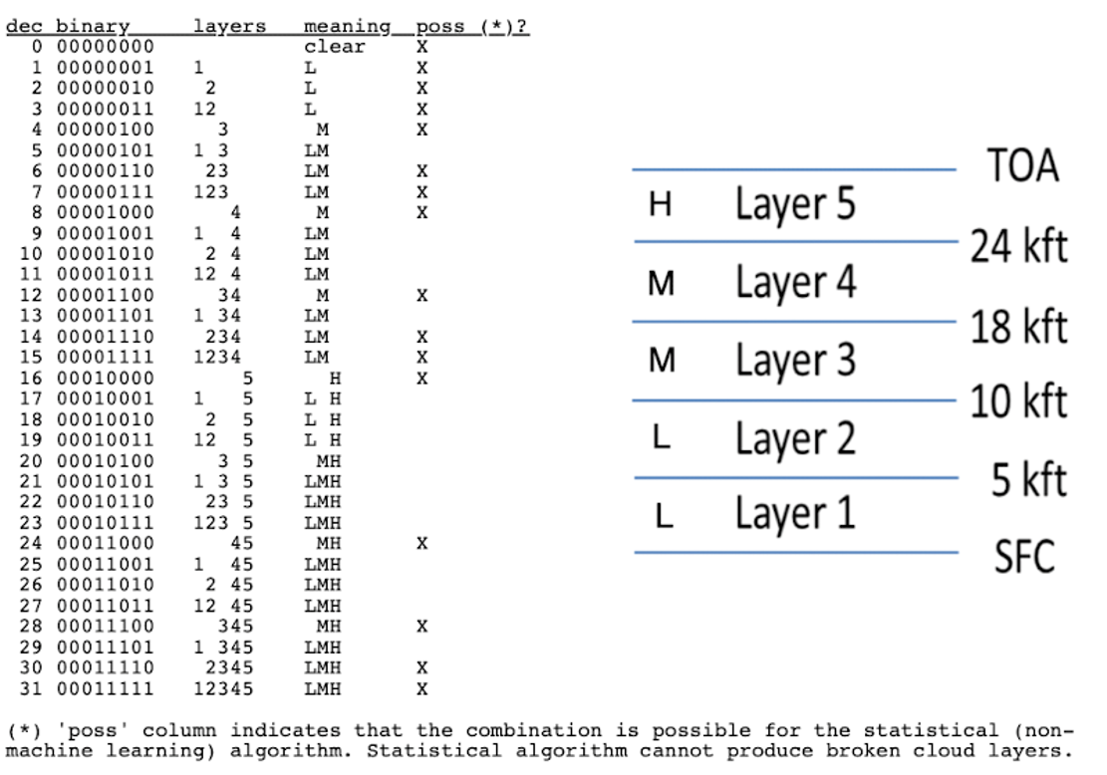
ABI Cloud Cover Layers (CCL) Products
Ground System L2 CCL nc output
10-km resolution for FD / CONUS
4 km resolution for mesos sectors
Hourly for full disk, every 5-min for CONUS and mesos
Consistency check with G19 2-km IP samples
Cloud Layer Flags - Five flight-level based cloud layers will be assessed for (H+M+L)
Layered cloud fractions (each layer)
Cloud base height (CBH) - Intermediate product
No issue on data format/variable structures
Cloud Layers

Slide 5
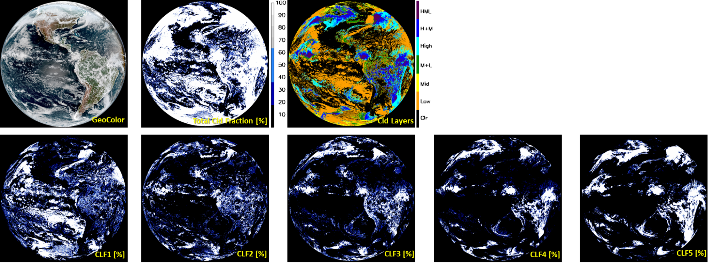
Global View of GOES-19 Cloud Cover Layers Products
20250201 1900 UTC (GS 10-km full disk)
Three variables are available in 10-km output:
TCF (Total CLd Fraction)
CL (Cloud Layers)
CFP (Cloud Fraction Packed for 5 layers)
Cloud Layer Fractions (Lowest CLF1 ~ Highest CLF5)
Notes:
ASSISTT NRT

Slide 6
Data and methods used for validation
Visual inspection and histogram analysis for G19 all sectors
Intercomparison with GOES-16/18 ABIs and JPSS VIIRS CCL
Ground radar data (ARM SGP/Oklahoma site, KAZR)
Ground lidar and ceilometer data (ARM SGP; MPL and Ceilometer)
No CloudSat/CALIPSO available for GOES-19 period
No EarthCARE quality-controlled L2 data, but should be available for future reviews
Cloud Base Height (CBH) is an important intermediate product which we evaluate. It is, potentially, a future operational product (currently used heavily by VIIRS aviation users, and requested by Aviation Weather Center for the ABIs).

Slide 7
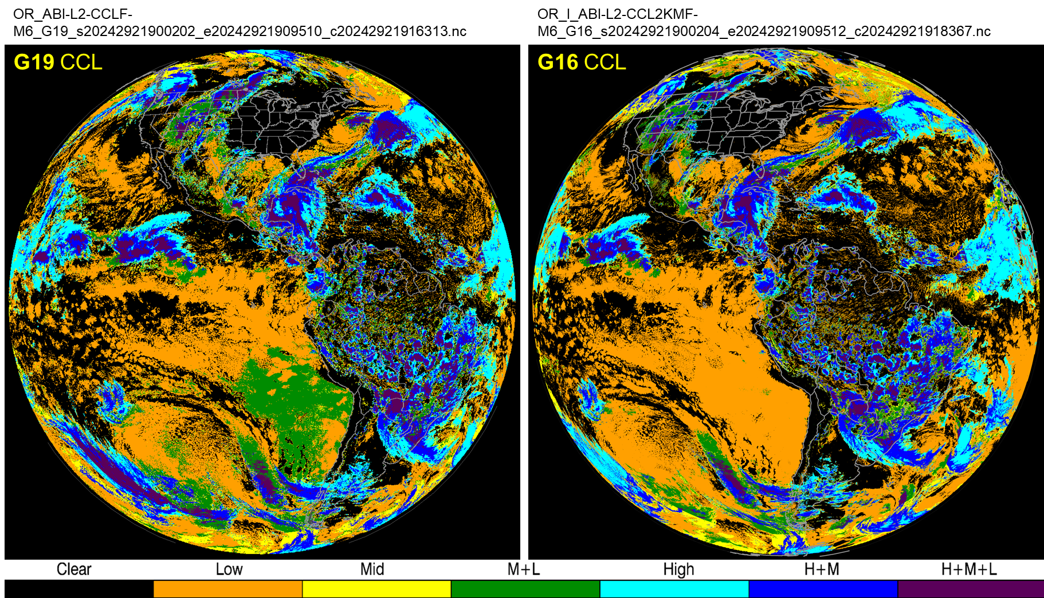
Upstream Issues - Fixed ✅ (Cloud Phase/Top Height - ADR 1502)
Over-icing in the cloud phase product: Fix was implemented and on 10/28/2024 moved to complete
Previous

Slide 8
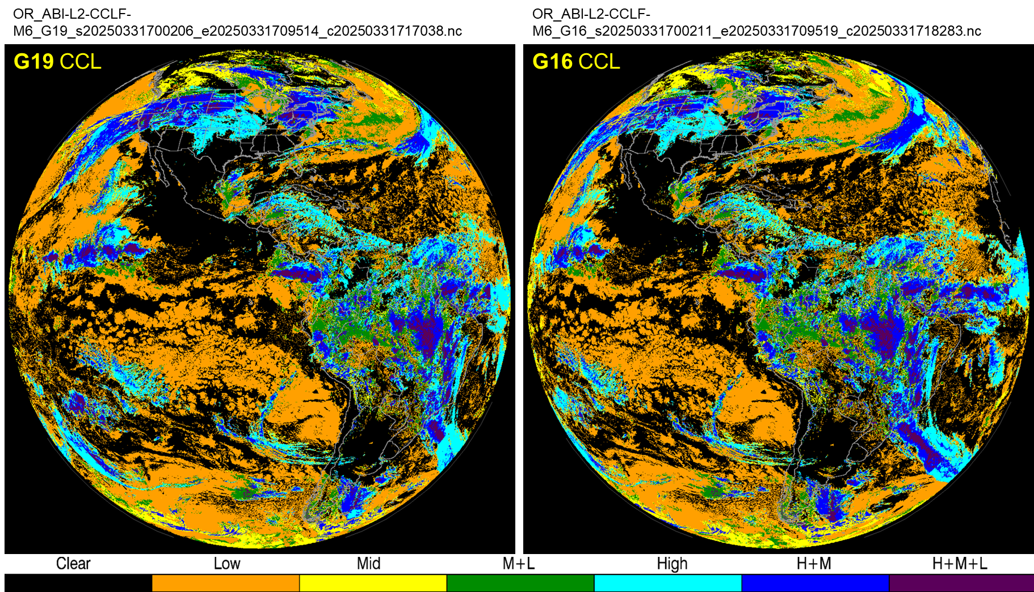
Upstream Issues - Fixed ✅ (Cloud Phase/Top Height - ADR 1502)
Over-icing in the cloud phase product: Fix was implemented and on 10/28/2024 moved to complete
Fixed

Slide 9
Self-consistency checks

Slide 10
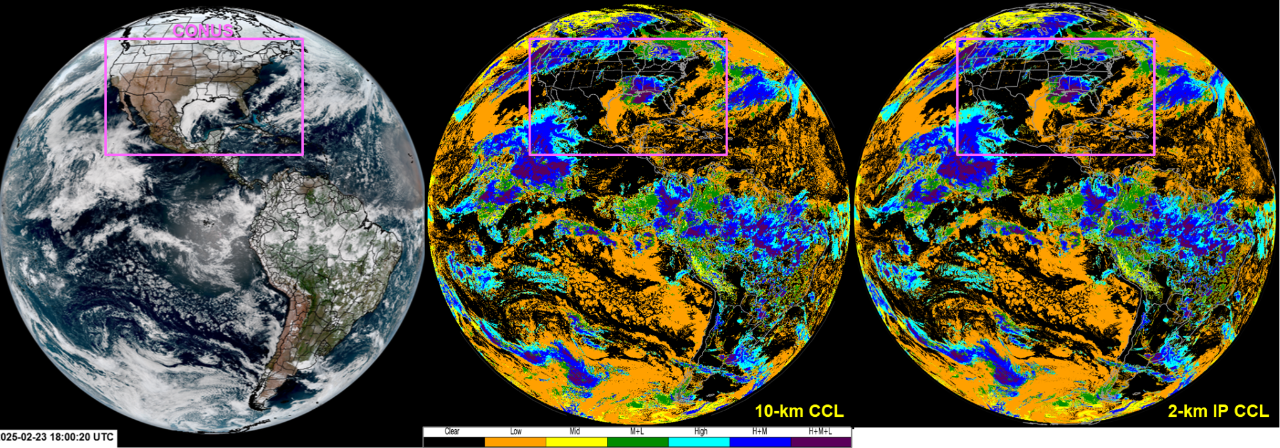
GOES-19 CCL 10-km vs. 2-km resol. comparison - Consistent!

Slide 11
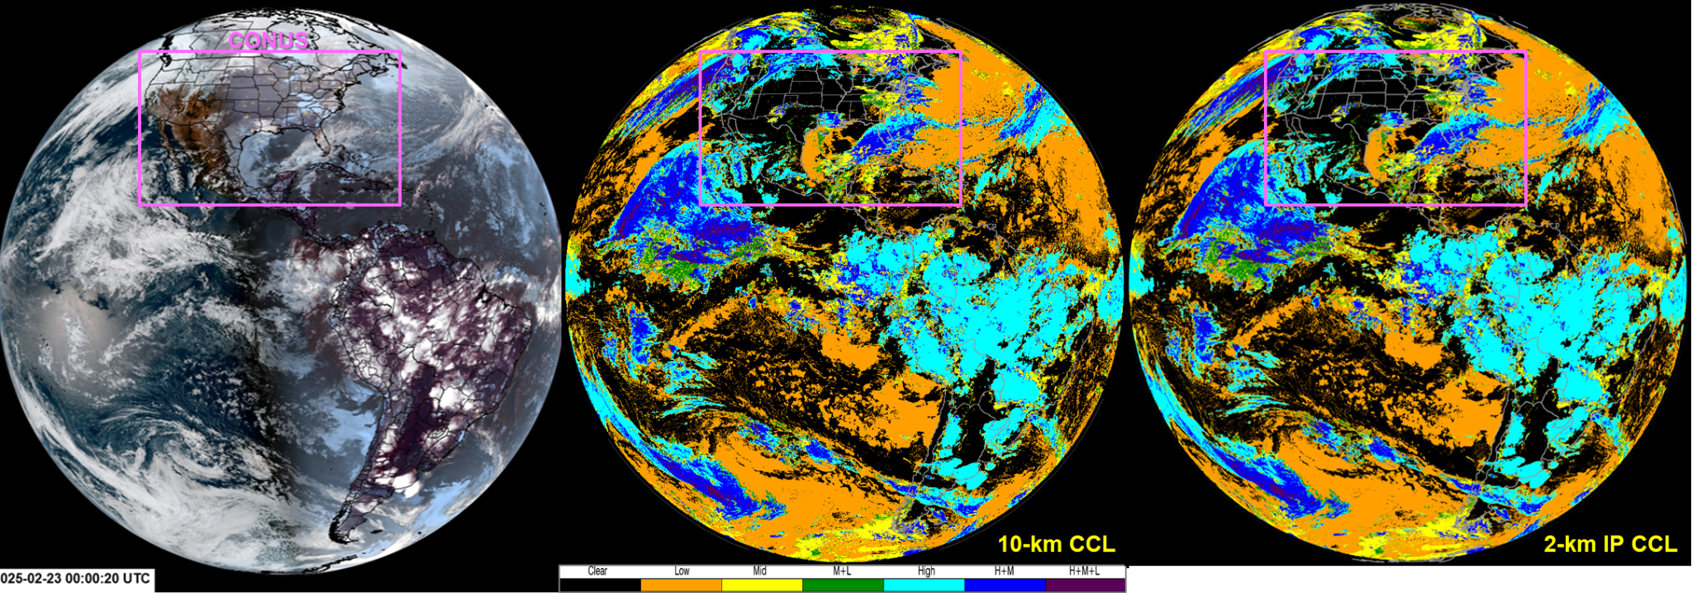
GOES-19 CCL 10-km vs. 2-km resol. comparison - Consistent!

Slide 12
Occasional missing segments in GS output

Slide 13
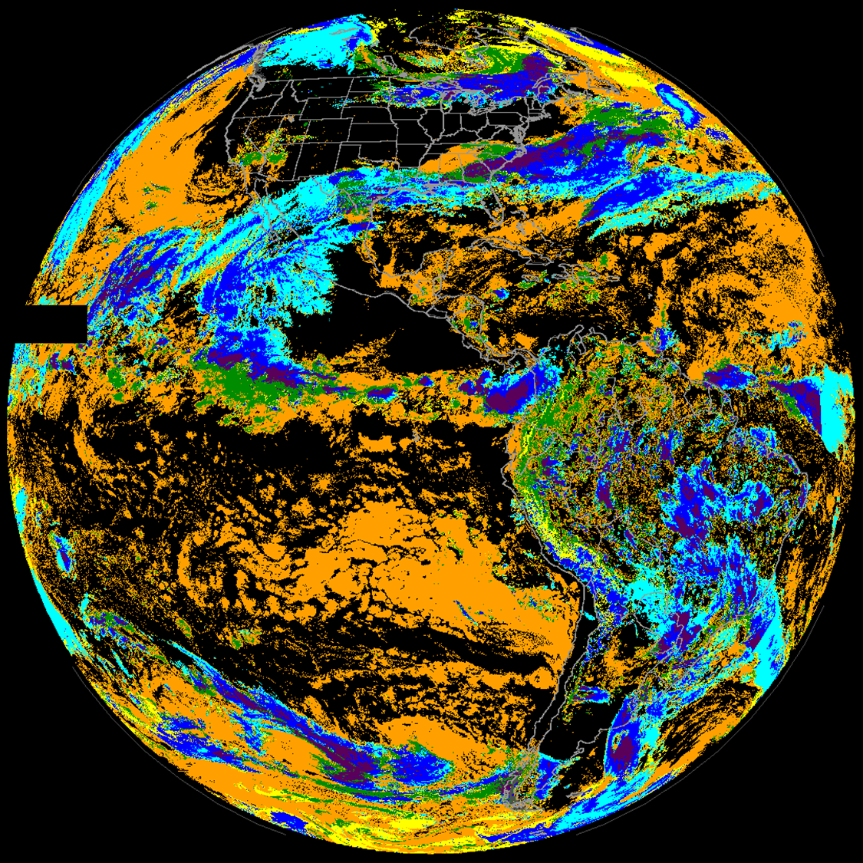
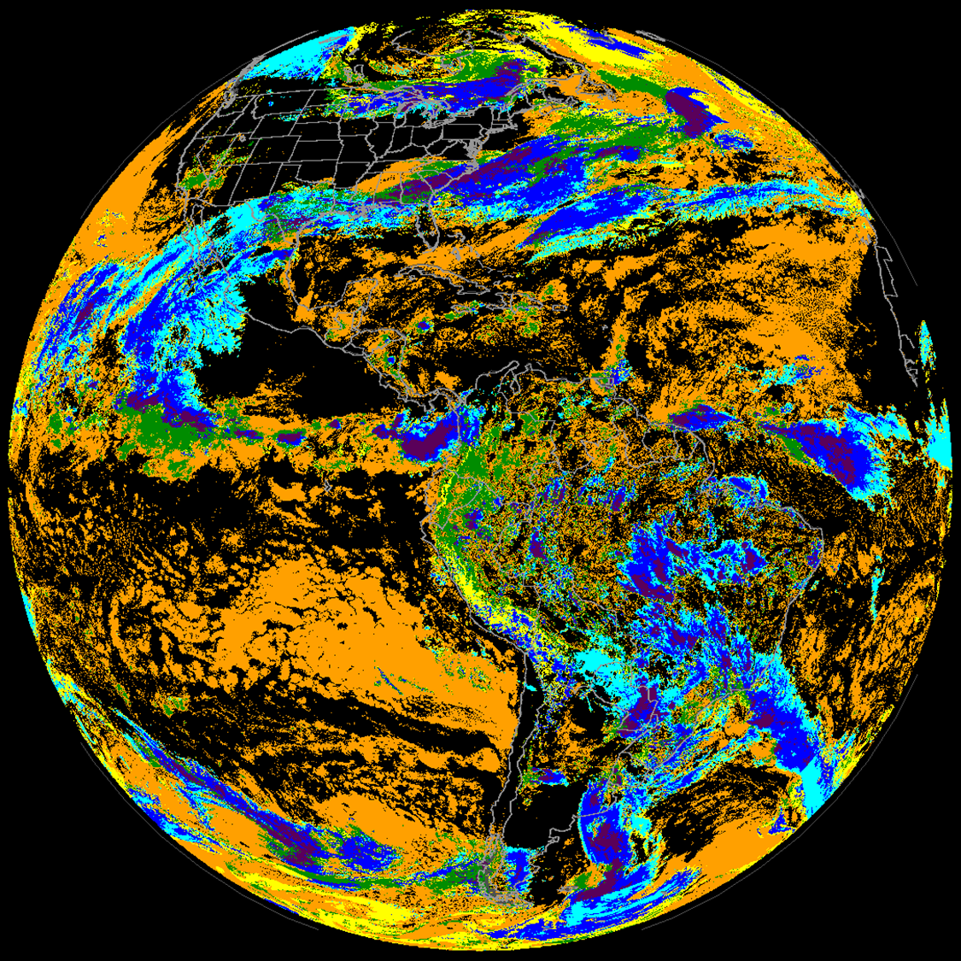
Missing segments in G19 CCL
G19 vs. G16 CCL (18:00 UTC 27 Jan 2025)
OR_ABI-L2-CCLF-M6_G19_s20250271800200_e20250271809508_c20250271816599.nc
OR_ABI-L2-CCLF-M6_G16_s20250271700208_e20250271709516_c20250271718053.nc
G19 CCL
G16 CCL
Sometimes missing segments

Slide 14
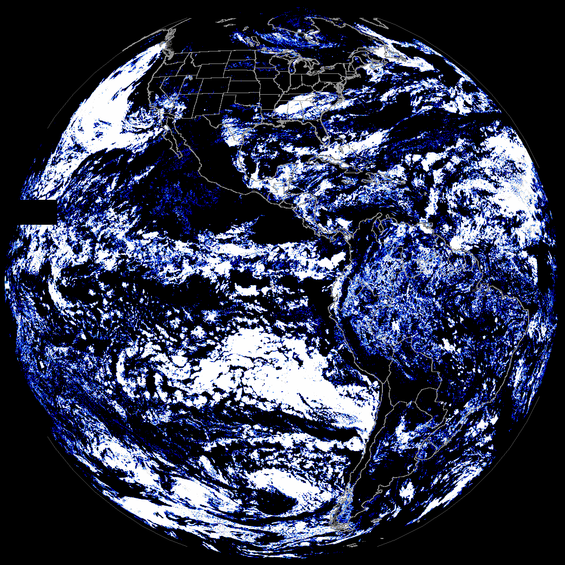
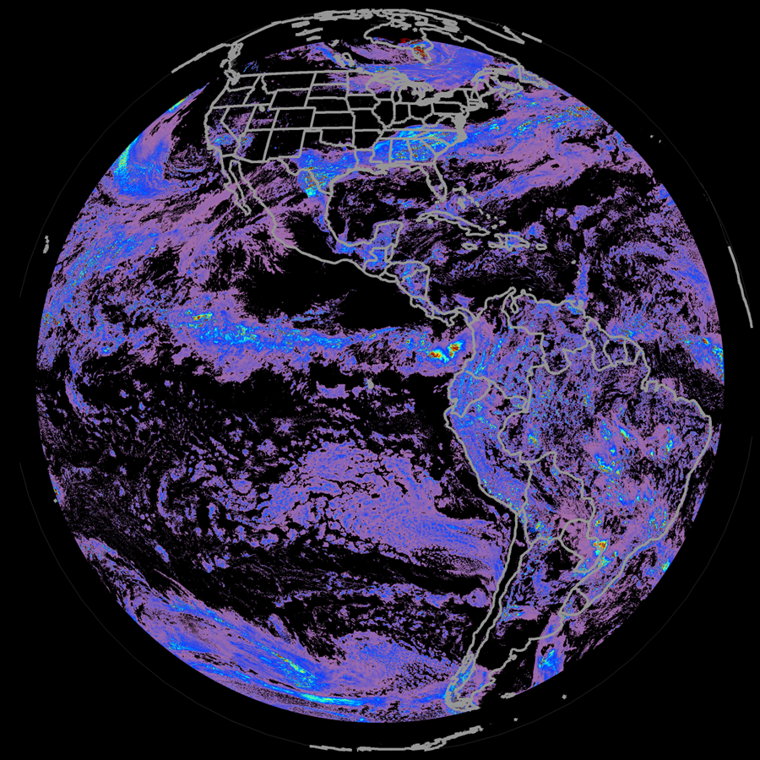
Missing segments in G19 CCL
G19 Cloud Fractions and COD (18:00 UTC 27 Jan 2025)
OR_ABI-L2-CCLF-M6_G19_s20250271800200_e20250271809508_c20250271816599.nc (CF1)
OR_ABI-L2-CODF-M6_G19_s20250271800200_e20250271809508_c20250271813371.nc
G19 CF1
(Cloud Fraction: lowest level, similar to other CFs)
G19 COD
Sometimes missing segments
No main upstream missing

Slide 15
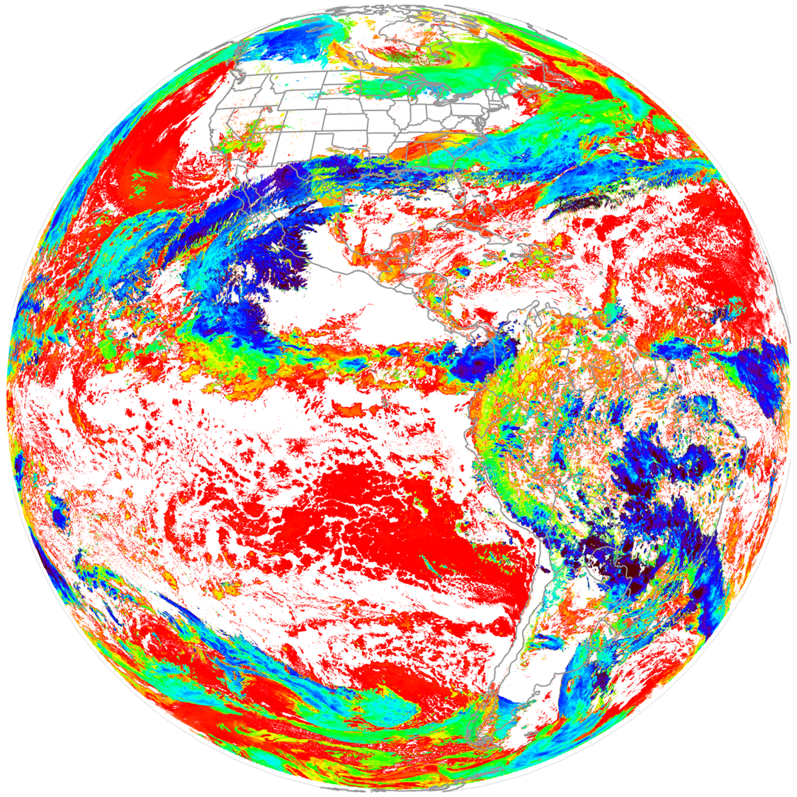
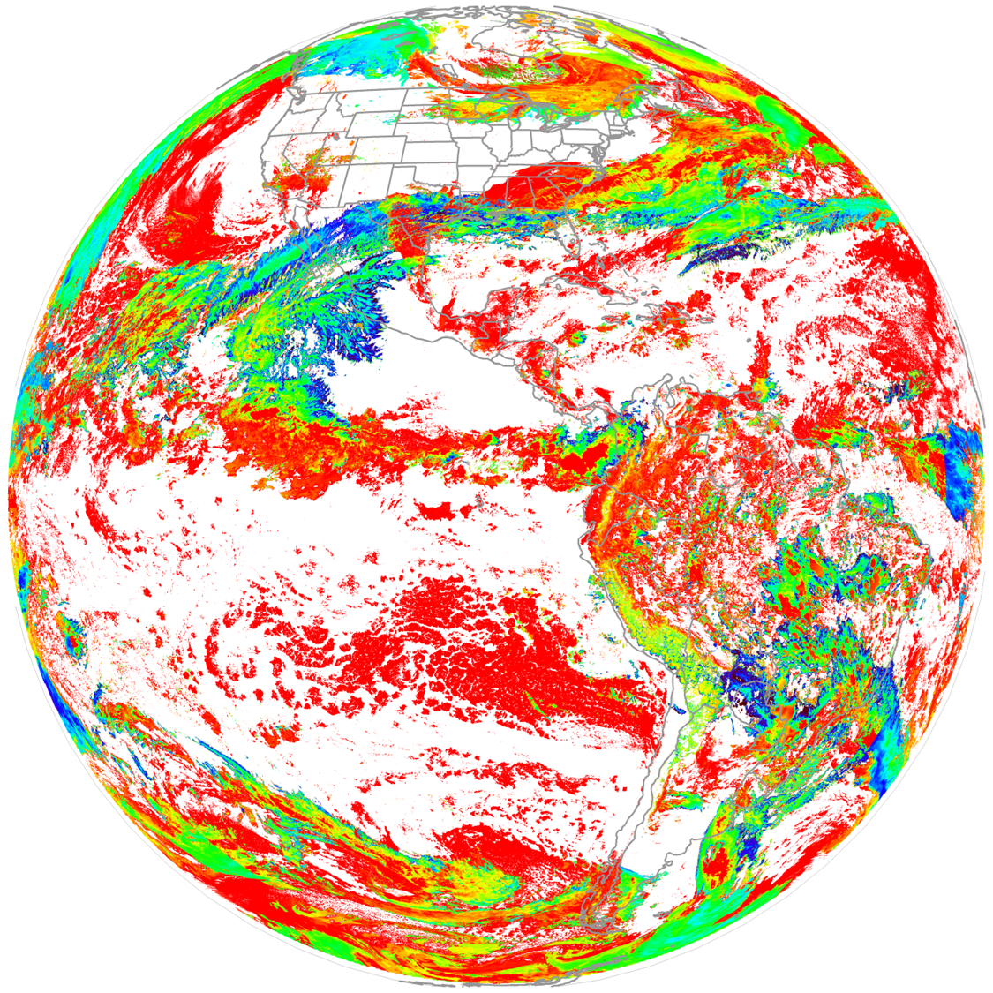
Missing segments in G19 CCL
G19 CTH and CBH (18:00 UTC 27 Jan 2025)
OR_I_ABI-L2-ECBHF-M6_G19_s20250271800200_e20250271809508_c20250271816478.nc
OR_I_ABI-L2-ECBHF-M6_G19_s20250271800200_e20250271809508_c20250271816478.nc
G19 CTH
(2km)
G19 CBH
(2km IP output)
No main upstream missing

Slide 16
Comparisons between GS and SAPF (ASSITT) retrievals

Slide 17
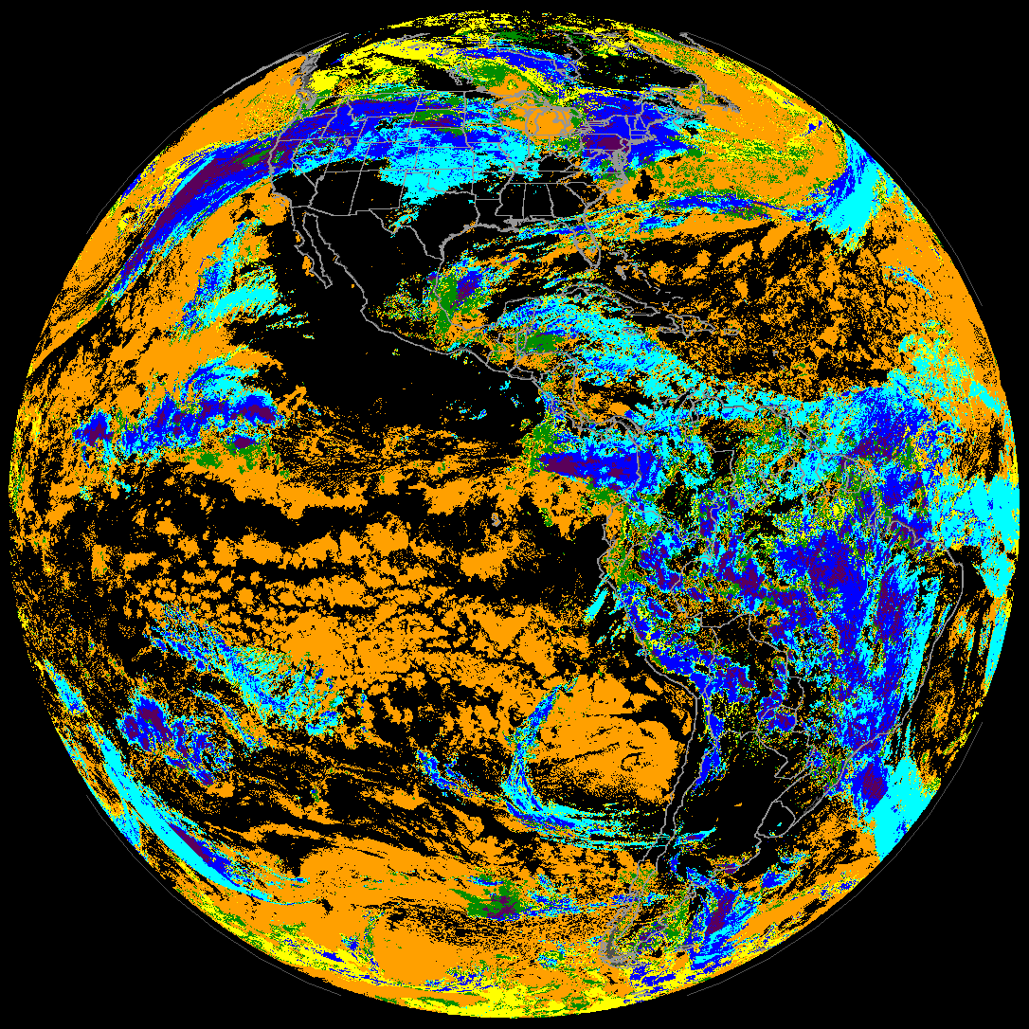
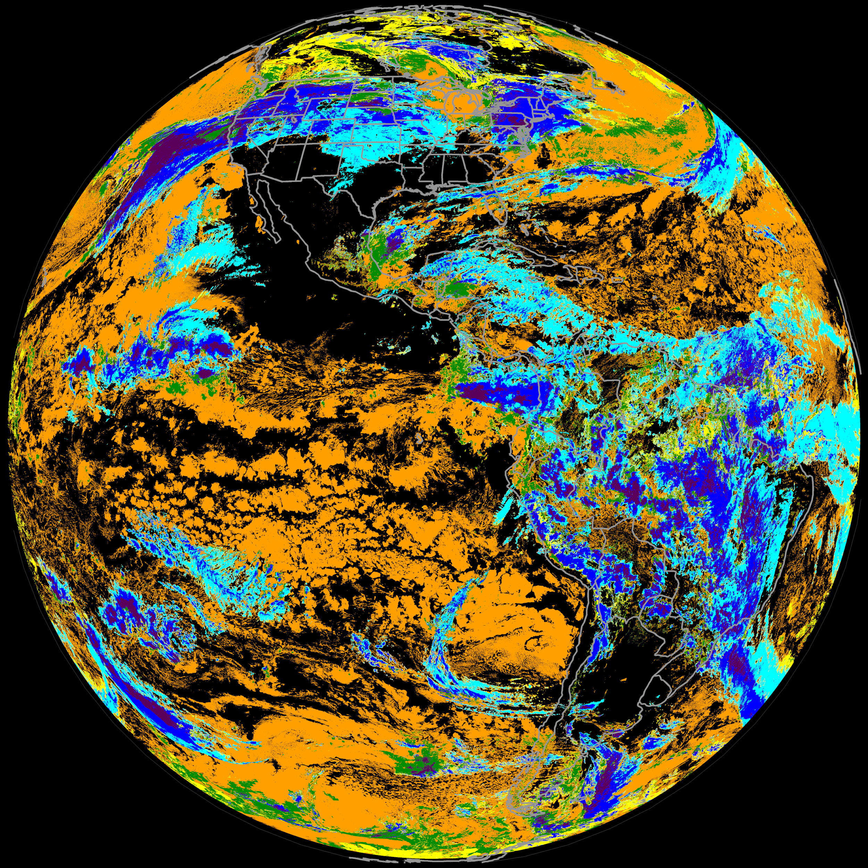
Comparisons between GS and SAPF CCL: Daytime CCLs looks good overall; occasional issues at far edges
DE G19 CCL (10-km resol) from GS
SAPF_ASSISTT CCL (2-km resol. run by CIMSS)
2000 UTC 2025 Feb 02 (SAPF run by S. Wanzong)
Differences around the scan edge areas due to no DCOMP input from GS (cutoff for high-angle areas)

Slide 18
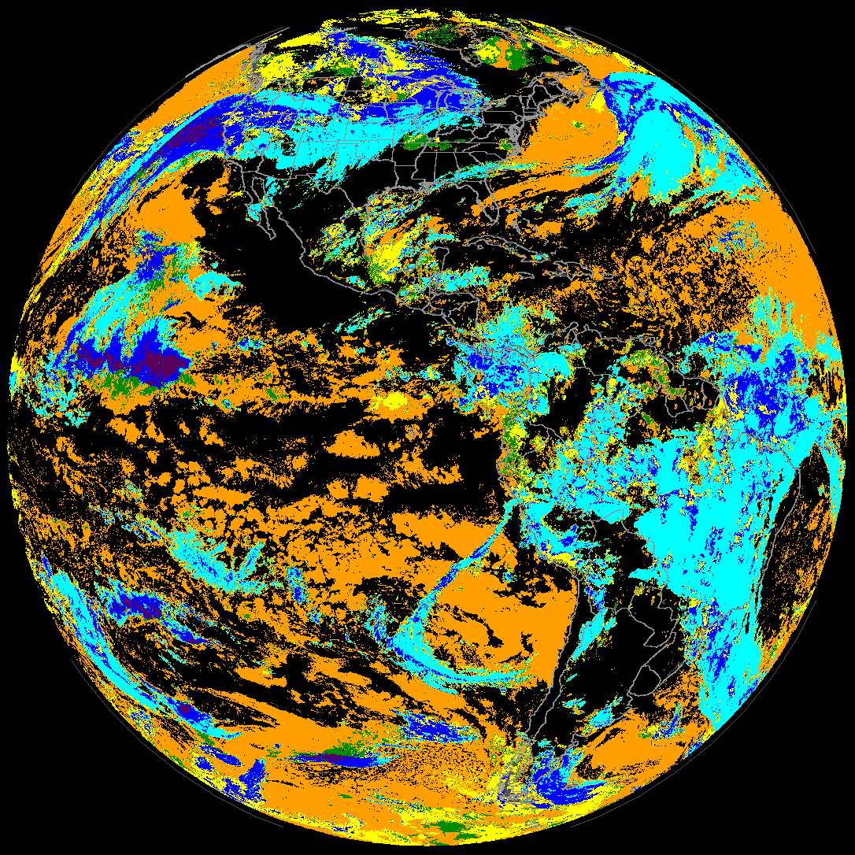
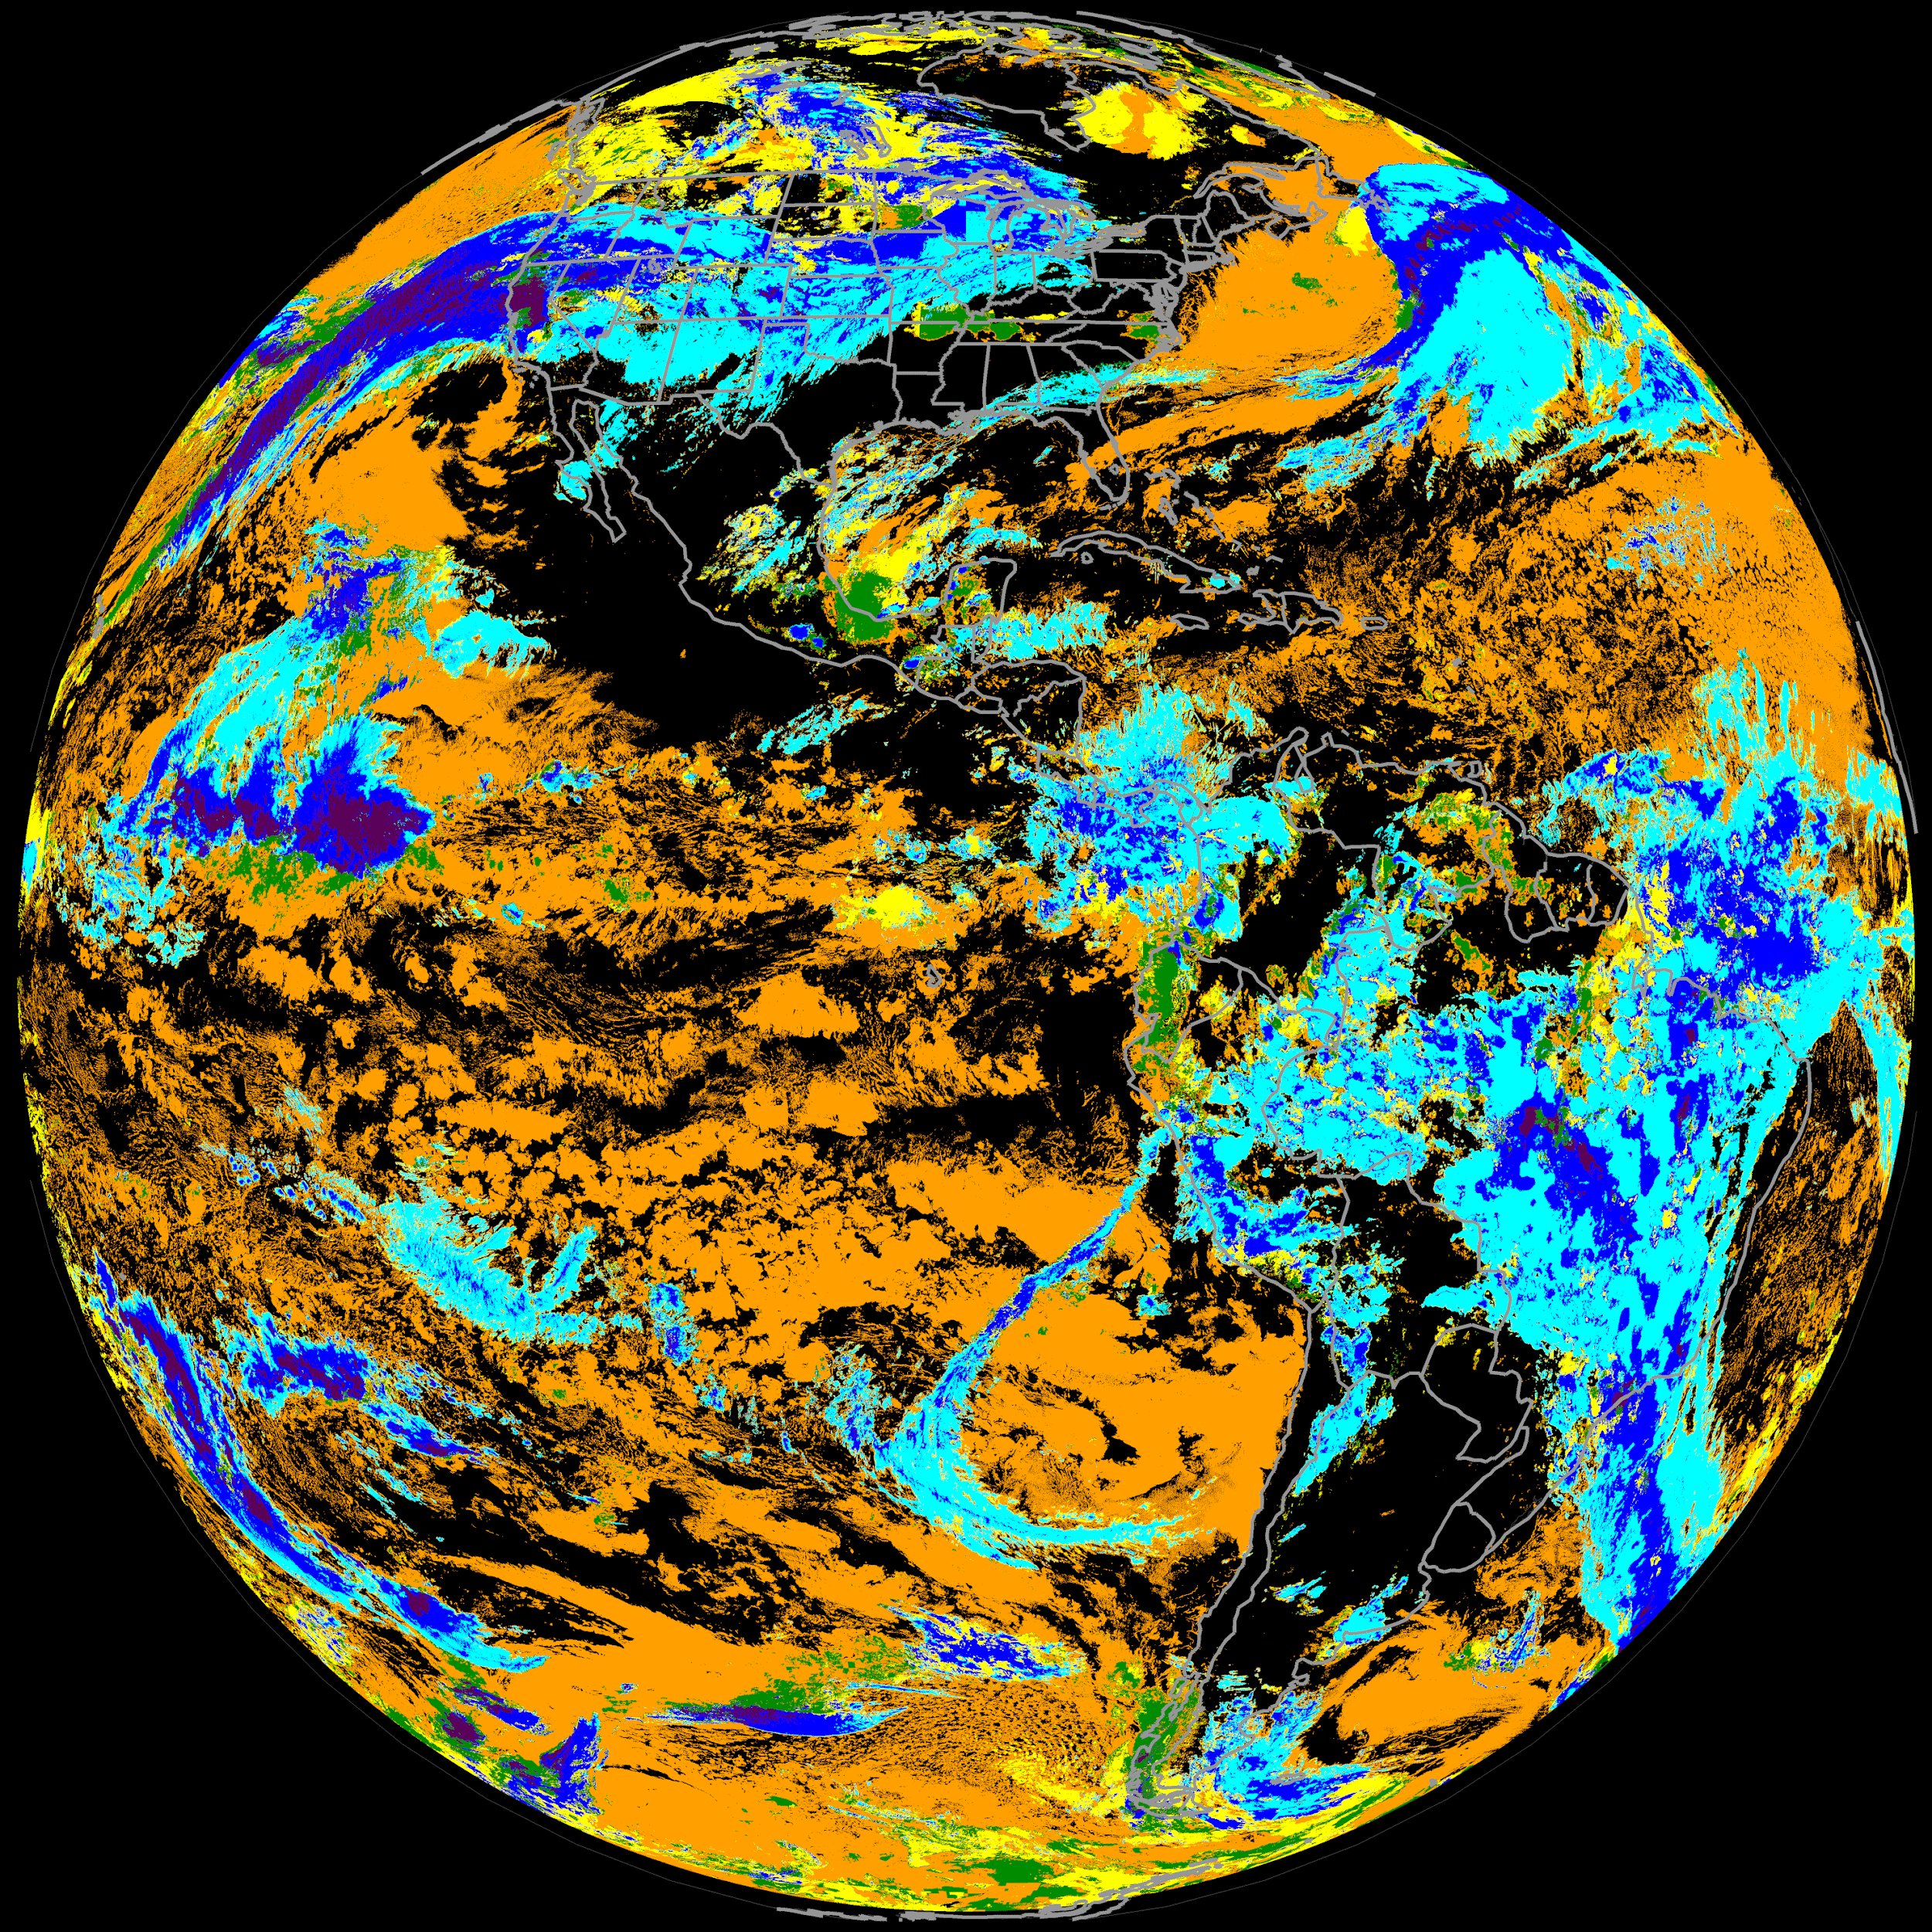
Comparisons between GS and SAPF CCL: Nighttime sometimes shows less low/mid cloud in GS, compared with SAPF
(and local CLAVR-x)
DE G19 CCL (10-km resol) from GS
SAPF_ASSISTT CCL (2-km resol. run by CIMSS)
0000 UTC 2025 Feb 02
Discrepancies possibly due to differences in upstream input: CWP from COMP (day) and NWP data (night) is used for CBH and CCL as well as cutoff for high-angle edge areas)

Slide 19
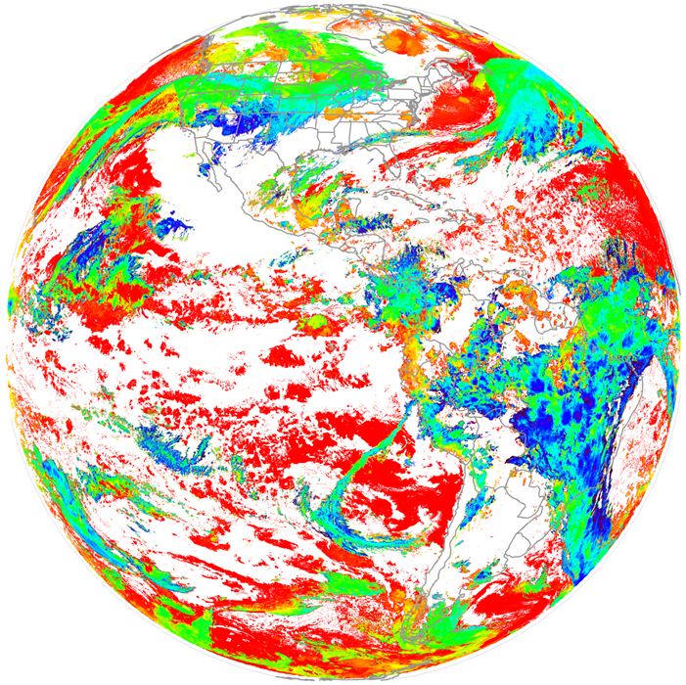
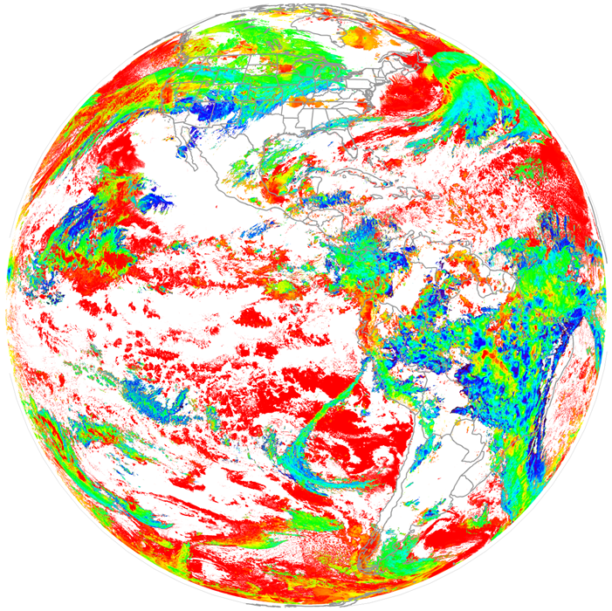
Comparisons between GS and SAPF CBH: Nighttime sometimes shows less low/mid cloud in GS, compared with SAPF
(and local CLAVR-x)
DE G19 CBH (2-km resol IP) from GS
SAPF_ASSISTT CBH (2-km resol. run by CIMSS)
0000 UTC 2025 Feb 02
Discrepancies possibly due to differences in upstream input: CWP from COMP (day) and NWP data (night) is used for CBH and CCL as well as cutoff for high-angle edge areas)

Slide 20
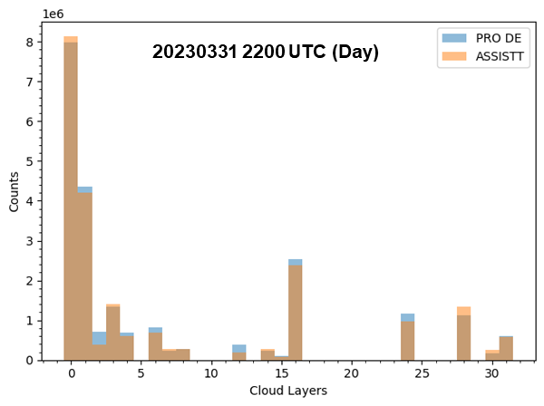
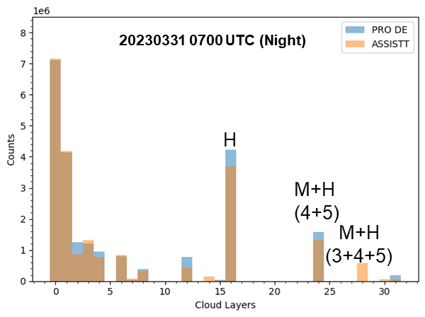
We have seen similar discrepancies before (from G16/18 PS-PVR Review)
Agree in general but some relatively larger differences near the scan edges
A few discrepancies possibly due to differences in upstream input
CWP from COMP (day) and NWP data (night) is used for CBH
Comparisons of full-disk Cloud Layer Flags
(0-31 for five flight-level based layers)
20230412 0700 UTC GOES18 ABI (GS DE)
20230412 0700 UTC GOES18 ABI (ASSISTT SAPF)
Night

Slide 21
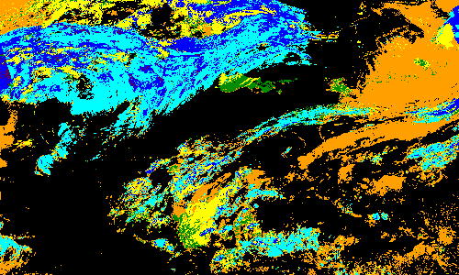
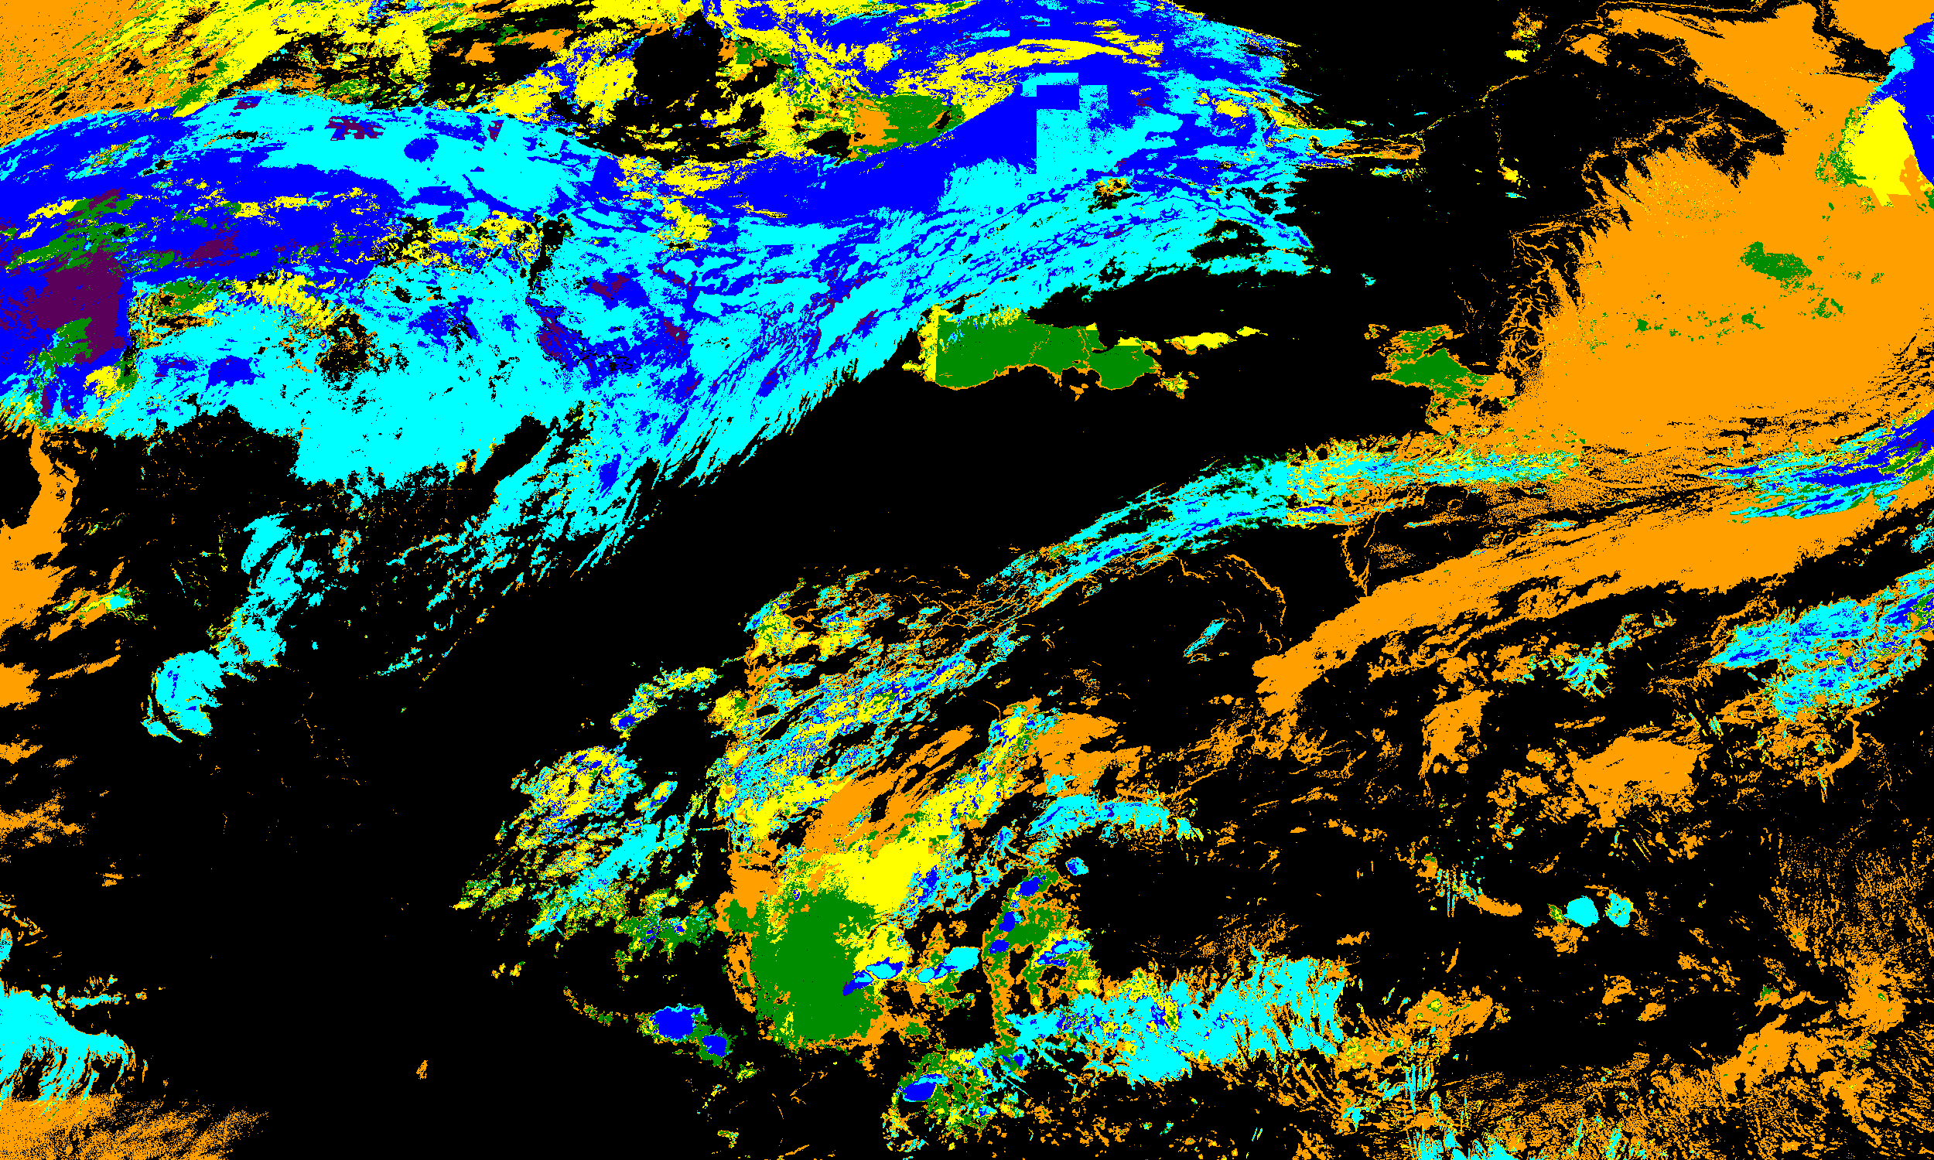
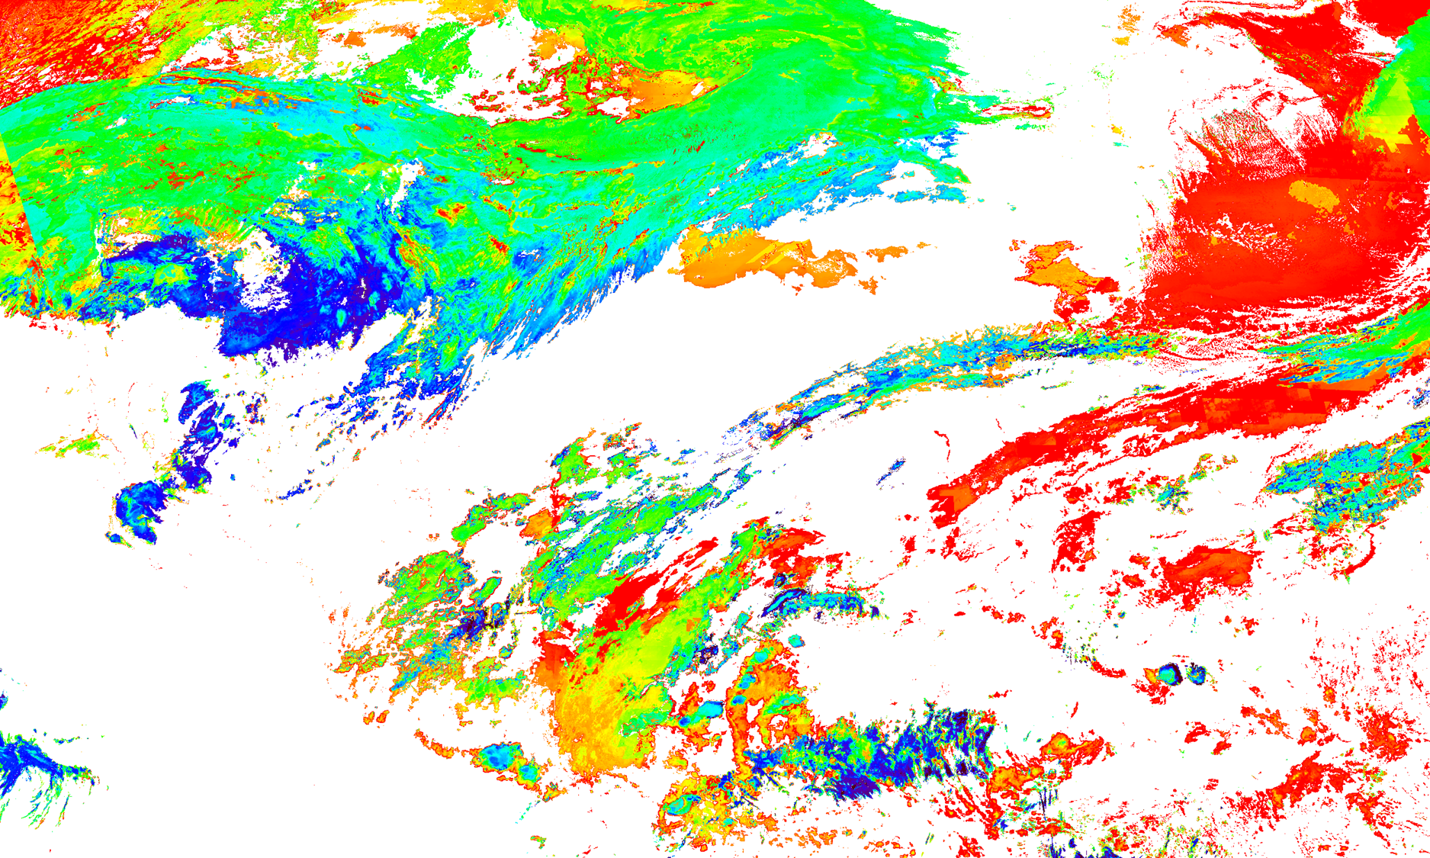
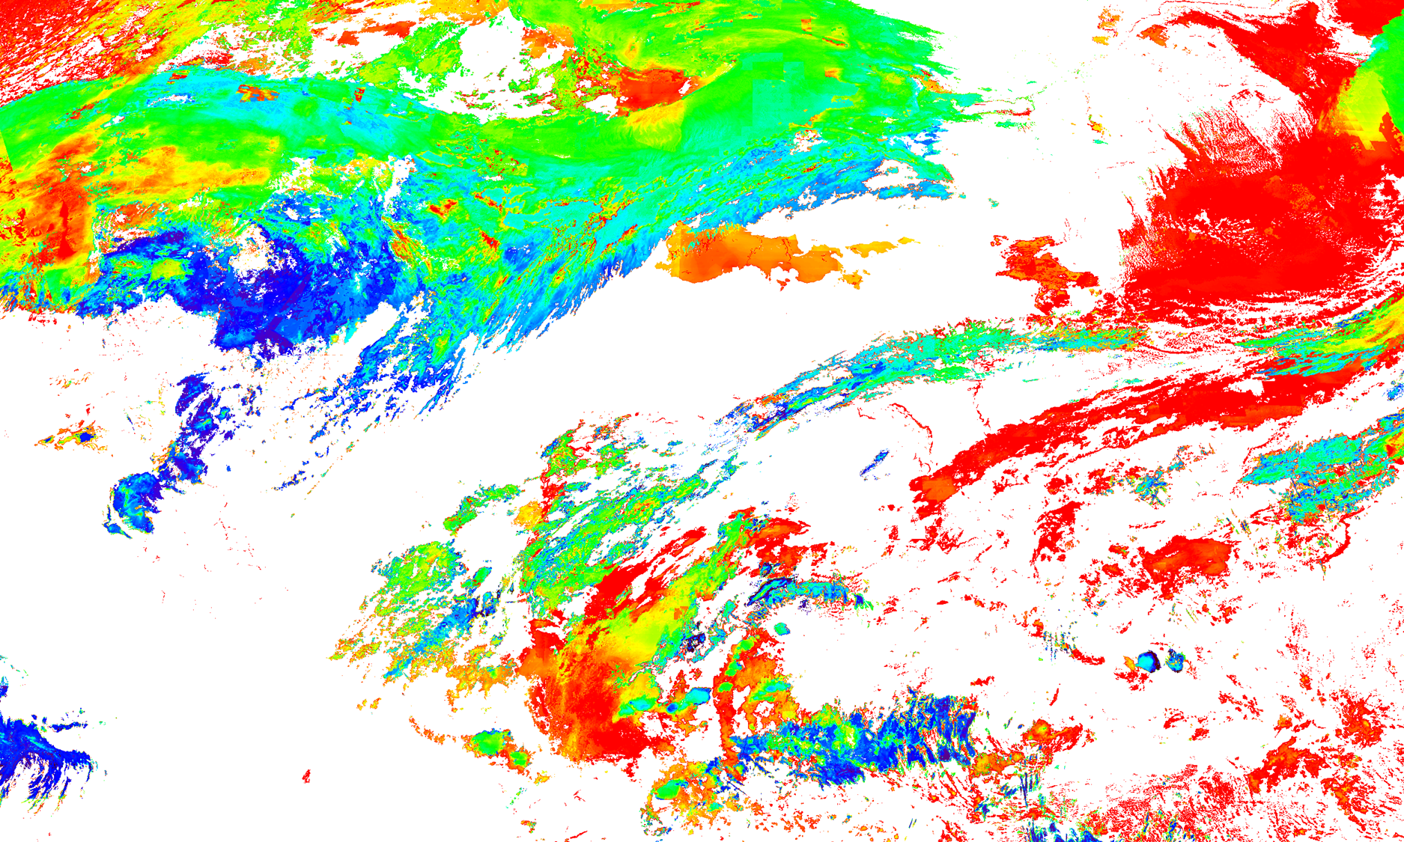
Nighttime discrepancies example 1
DE G19 (10-km, from GS)
SAPF_ASSISTT CCL (2-km, from CIMSS)
We suspect cause is differing CWP input for CBH and CCL. These should come from NWP data (GFS), but it is possible the same data is not accessible to GS NWP.
Further research desirable for nighttime CCL/CBH differences, including potential scientific refinements (e.g., CIRA’s AI/ML research for improved nighttime CWP and CBH)
CCL
CBH
0001 UTC 2025 Feb 02

Slide 22
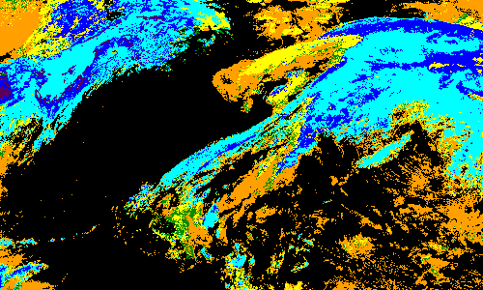
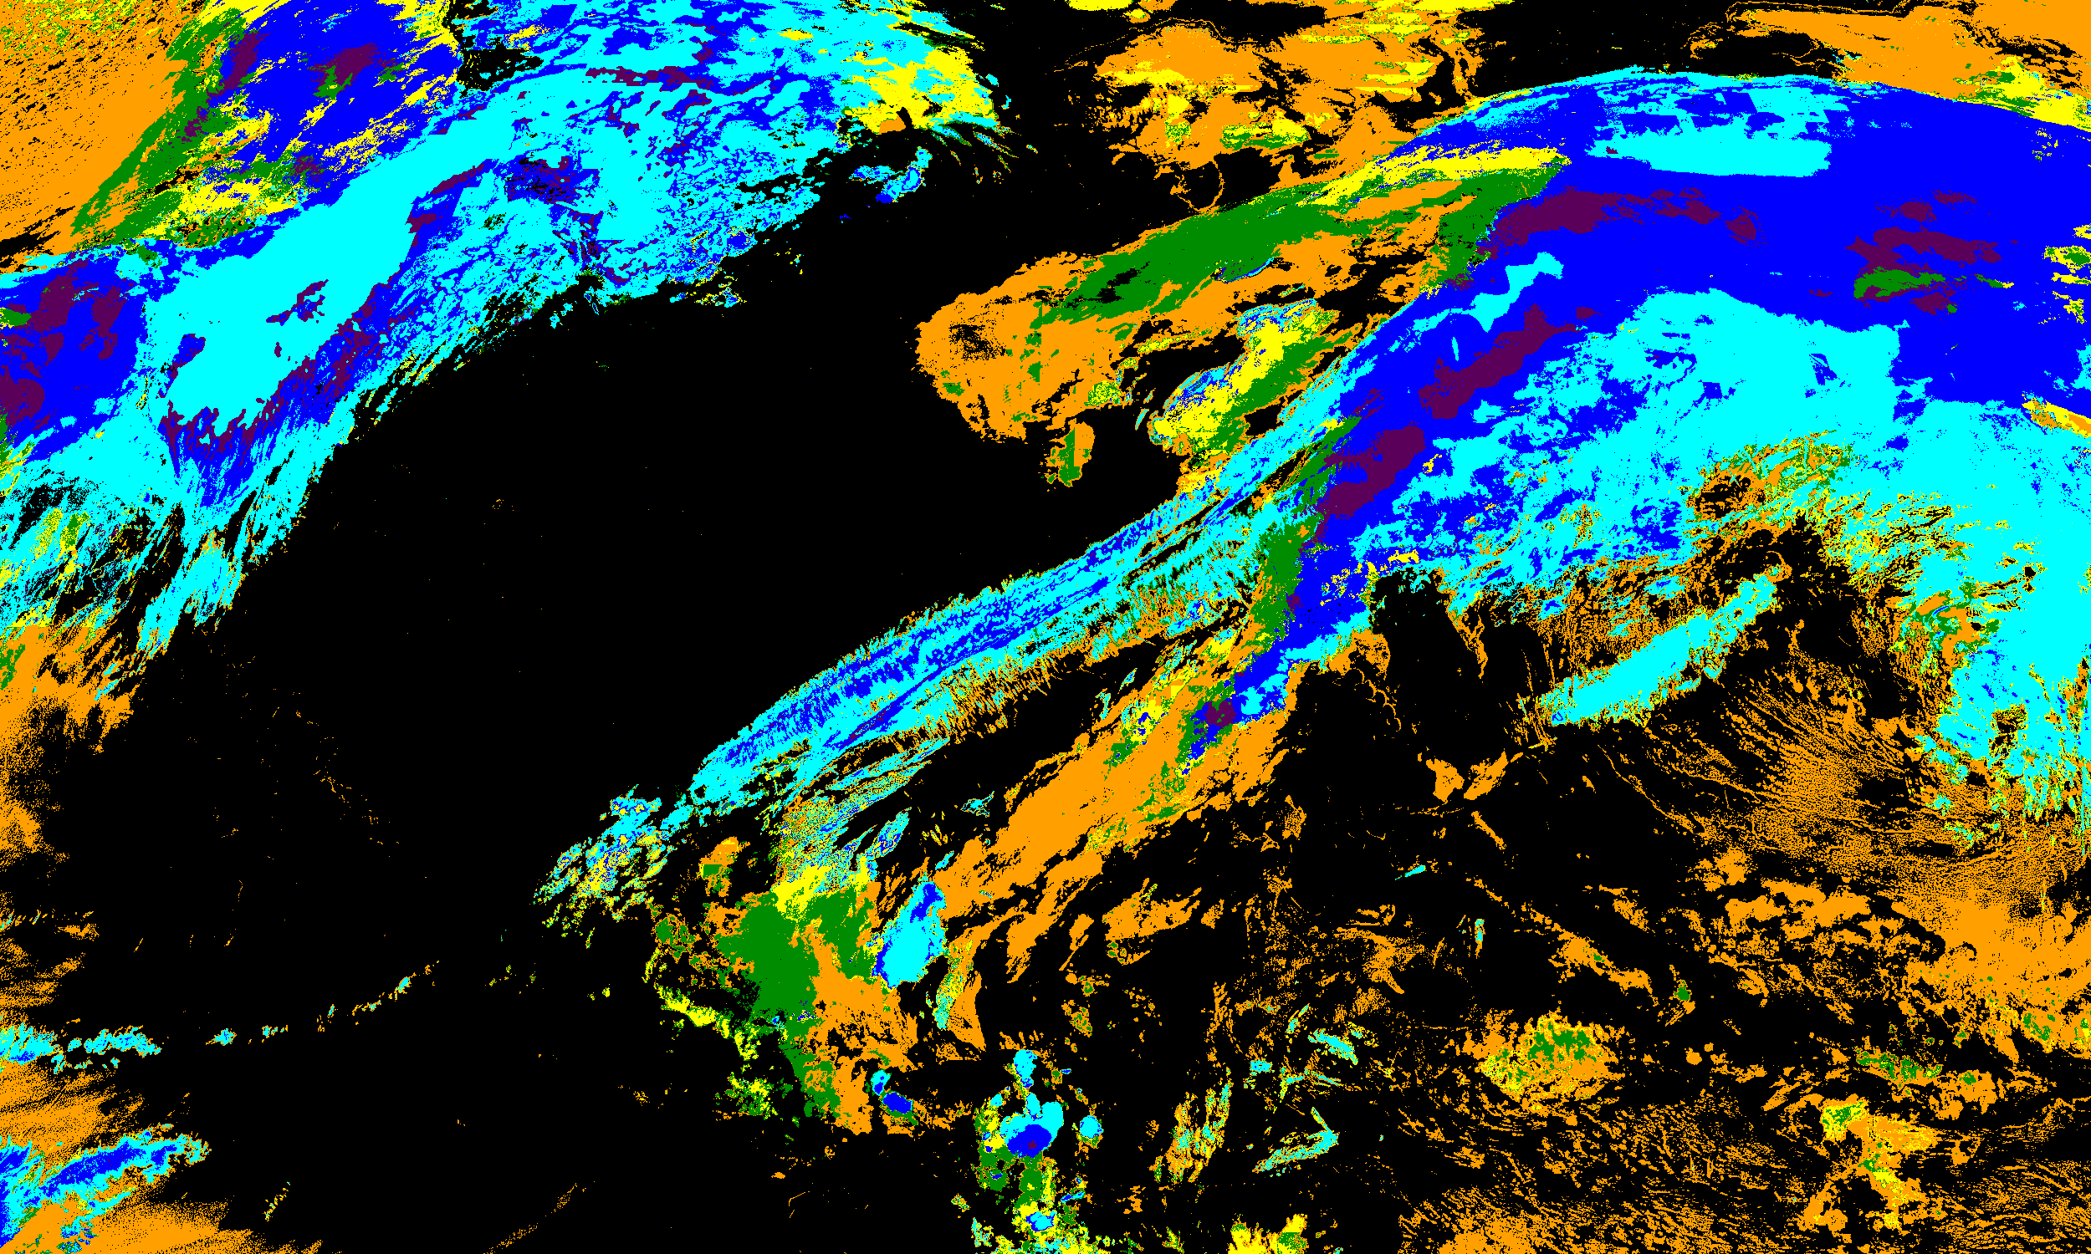
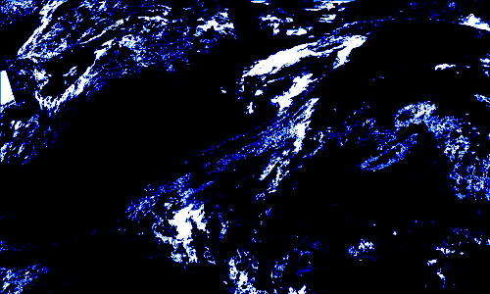
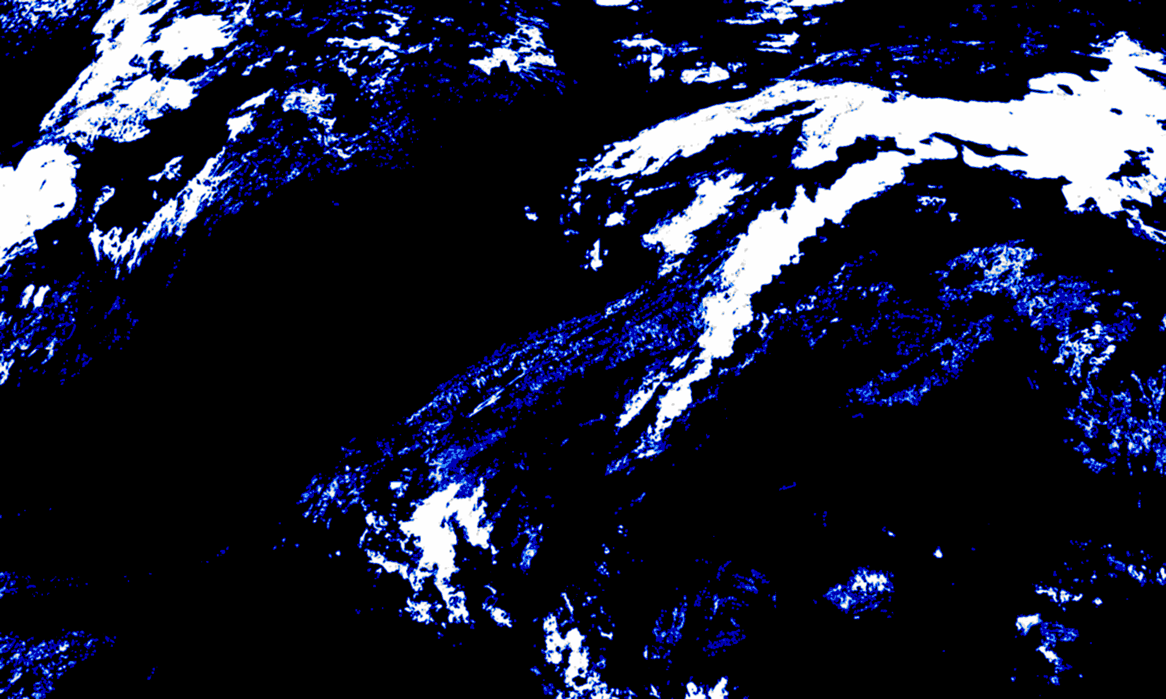
Nighttime discrepancies example 2
DE G19 (10-km, from GS)
SAPF_ASSISTT CCL (2-km, from CIMSS)
We suspect cause is differing CWP input for CBH and CCL. These should come from NWP data (GFS), but it is possible the same data is not accessible to GS NWP.
Further research desirable for nighttime CCL/CBH differences, including potential scientific refinements (e.g., CIRA’s AI/ML research for improved nighttime CWP and CBH)
CCL
CF3
(10-18 kft)
0001 UTC 2025 Feb 01

Slide 23
Sector intercomparison

Slide 24
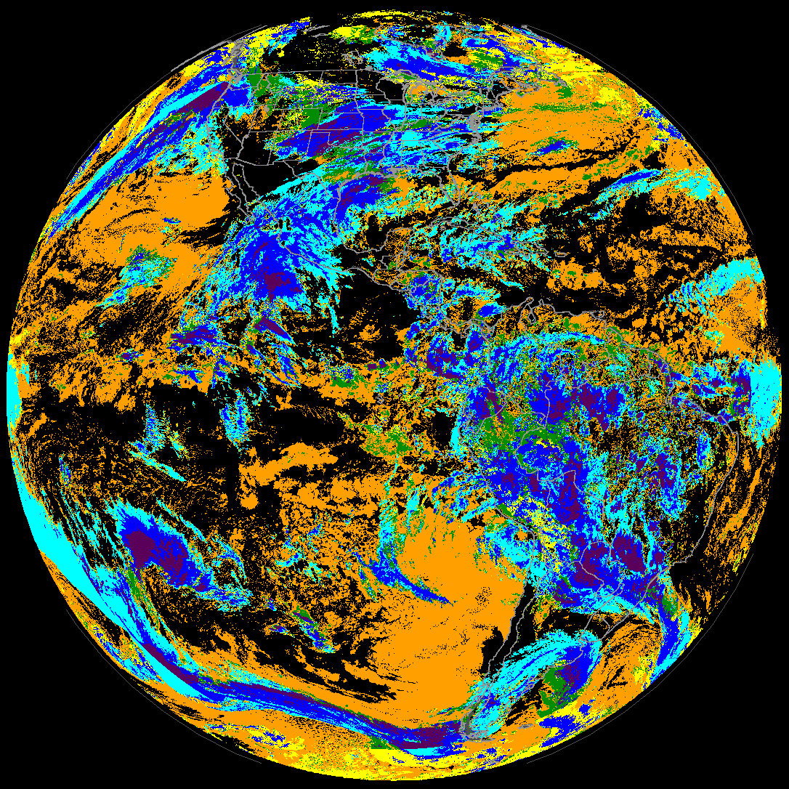
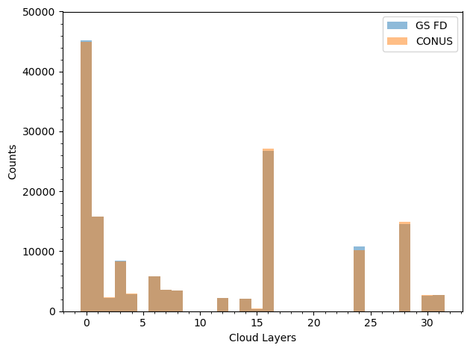
GOES-19 ABI 4 sectors
CONUS
The current CCL resolution
10 km at nadir for FD & CONUS
4 km for Meso 1 & 2
10-km resolution CCL for FD and CONUS
Cloud Layer Flags (0-31 for five flight-level based layers)
Direct histogram analysis between FD and CONUS (10 km): Good matchup!

Slide 25
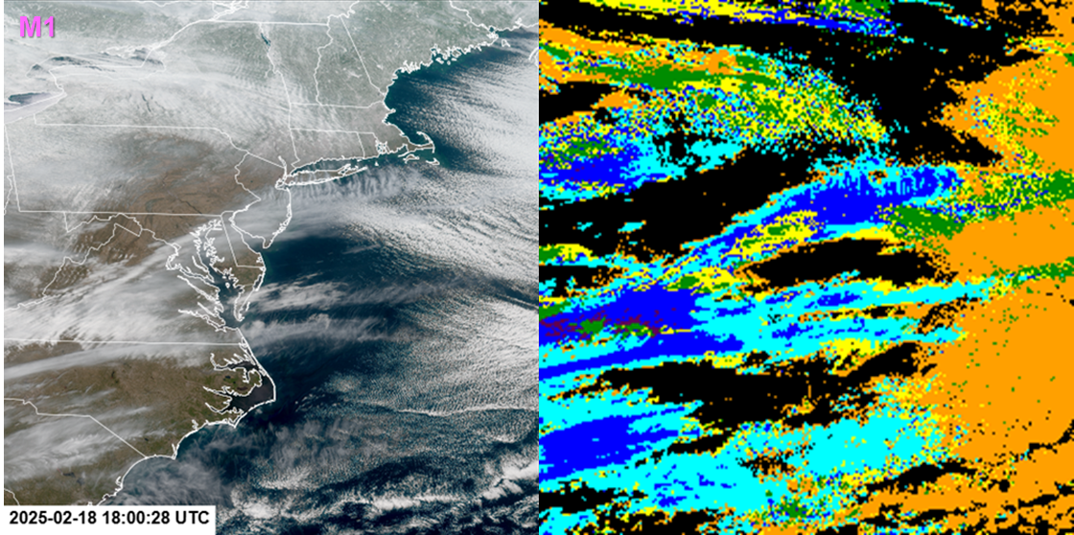
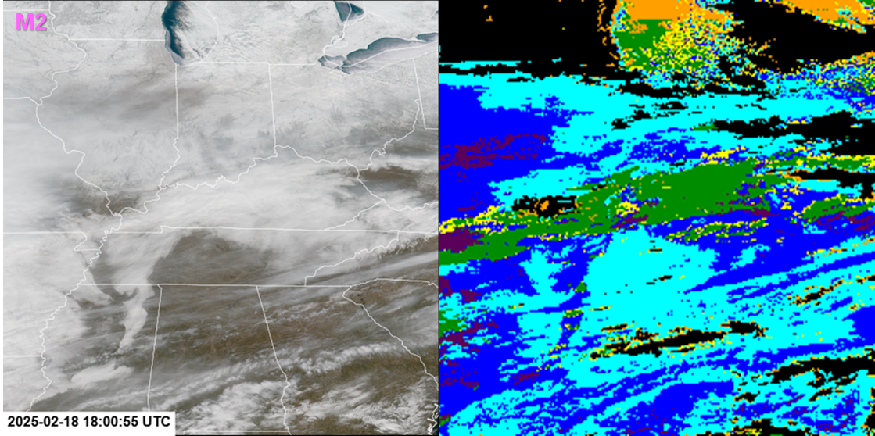
GOES-19 ABI 4 sectors
CONUS
The current CCL resolution
10 km at nadir for FD & CONUS
4 km for Meso 1 & 2
No direct histogram analysis between FD/CONUS (10 km) and Mesos (4 km), but visual matchup is very good.

Slide 26
Visual inspection / comparisons against similar products on other platforms

Slide 27
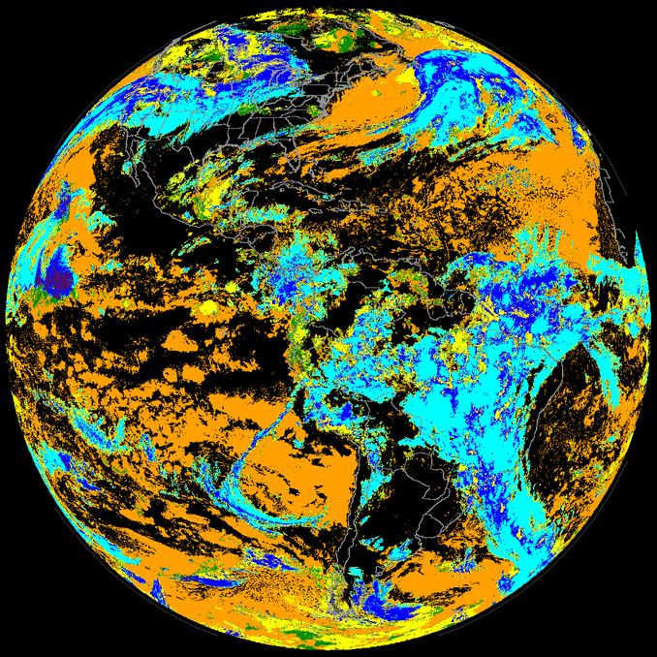
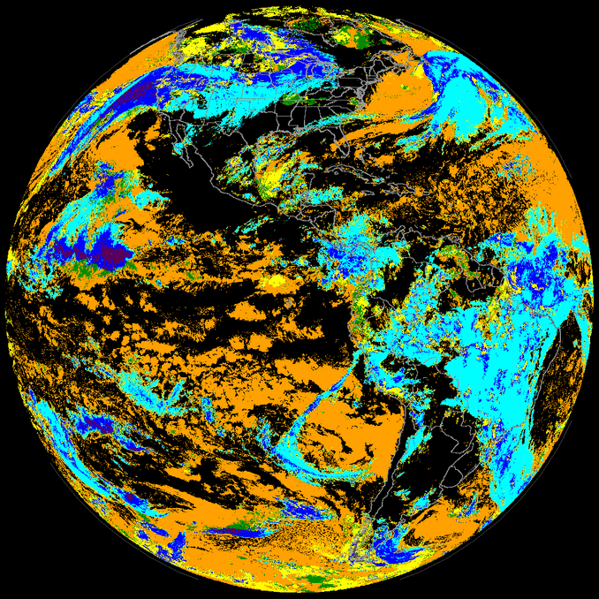
GOES-16 vs. GOES-19 (FD)
Visual inspection
Both 10-km GS outputs
G16 2 Feb 2025 (OR_ABI-L2-CCLF-M6_G16)
G19 ABI (OR_ABI-L2-CCLF-M6_G19)

Slide 28
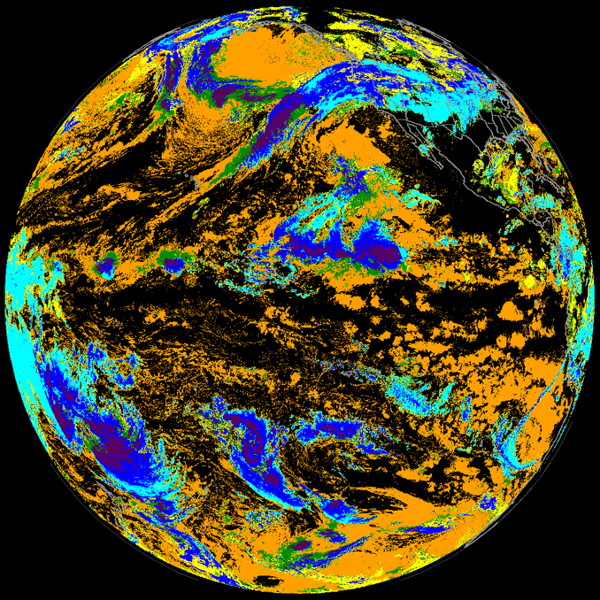
GOES-18 vs. GOES-19 (FD)
Visual inspection
Both 10-km GS outputs
G18 2 Feb 2025 (OR_ABI-L2-CCLF-M6_G18)
G19 ABI (OR_ABI-L2-CCLF-M6_G19)

Slide 29
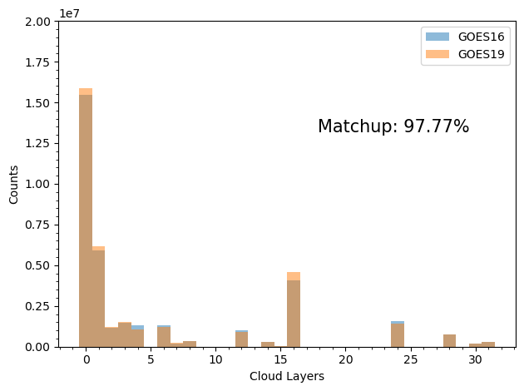
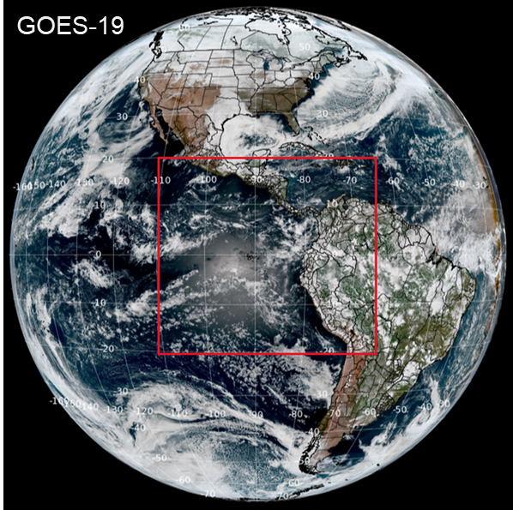
GOES-19 vs. GOES-16 (FD)
Both 10-km GS CCL outputs
Histogram analysis for both sensor consistency check
1-wk hourly full disk (2-8 Feb 2025)
(Lat: -20S to 20N, Lon: -110W to -60W)
No parallax correction
Notes:
The figure shows two histogram counts in total. Because of the total pixel number differences covered by the given area for two ABIs, matchup percentages represent between two histogram counts normalized by each total number.

Slide 30
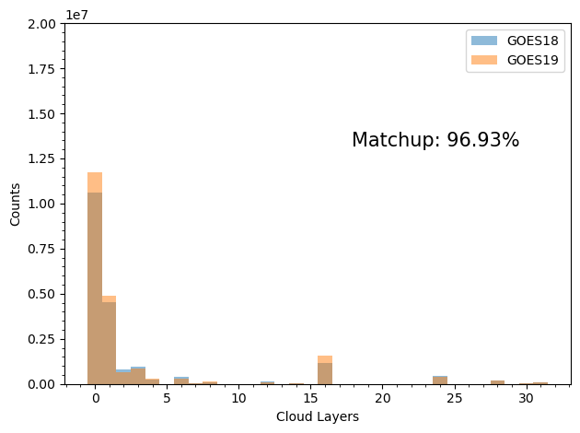
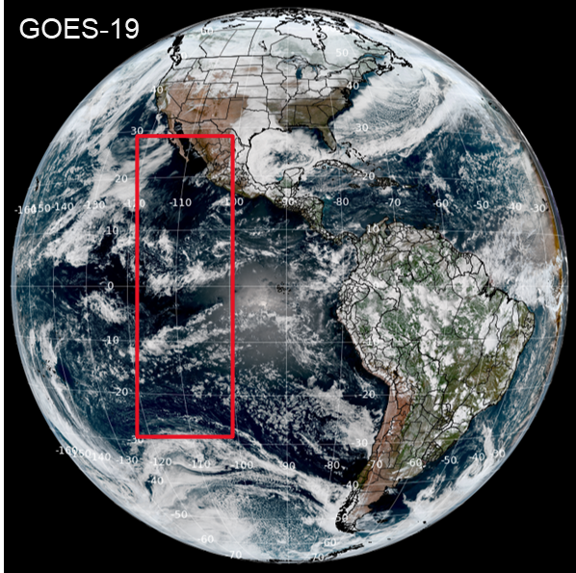
GOES-19 vs. GOES-18 (FD)
Both 10-km GS CCL outputs
Histogram analysis for both sensor consistency check
1-wk hourly full disk (2-8 Feb 2025)
(Lat: -30S to 30N, Lon: -120W to -100 W)
No parallax correction
Note GOES-18’s center location (far west)
Notes:
The figure shows two histogram counts in total. Because of the total pixel number differences covered by the given area for two ABIs, matchup percentages represent between two histogram counts normalized by each total number.

Slide 31
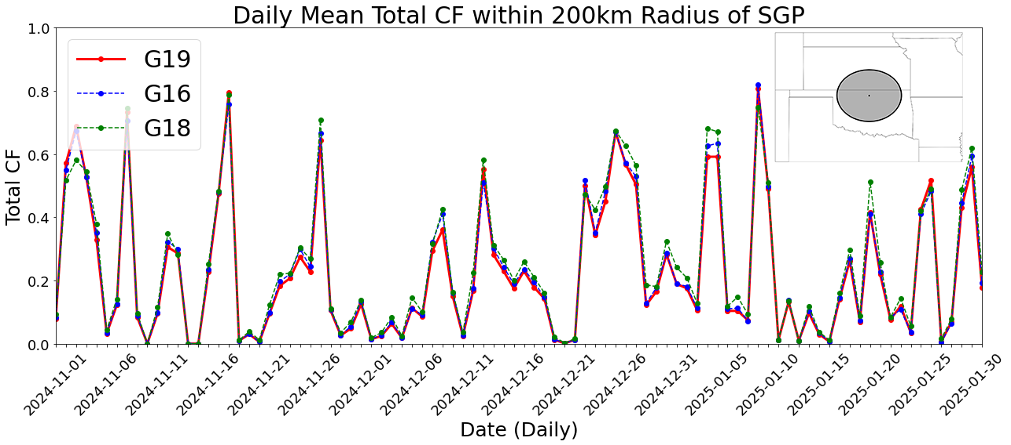
CCLF data. Mean of TCF within 200km radius for hourly data, then averaged per day
TCF: Total Cloud Fraction
Notes:
Total cloud fraction: TCF

Slide 32
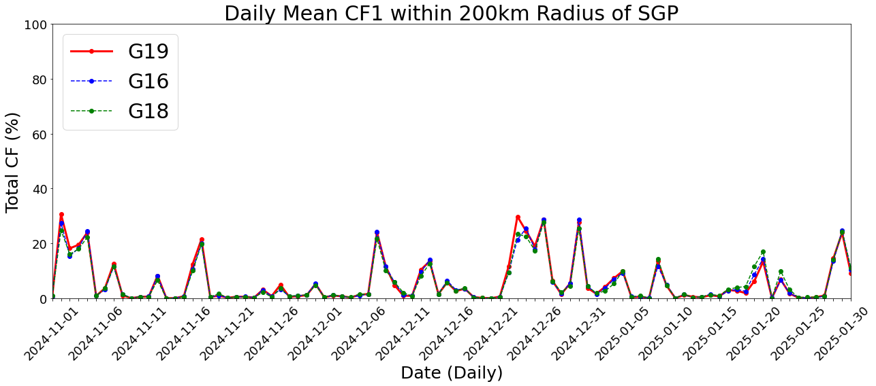
Same as previous but Cloud Fractions for each layer (low CF1-CF5 high)
CF: Cloud Fraction (low CF1-CF5 high)

Slide 33
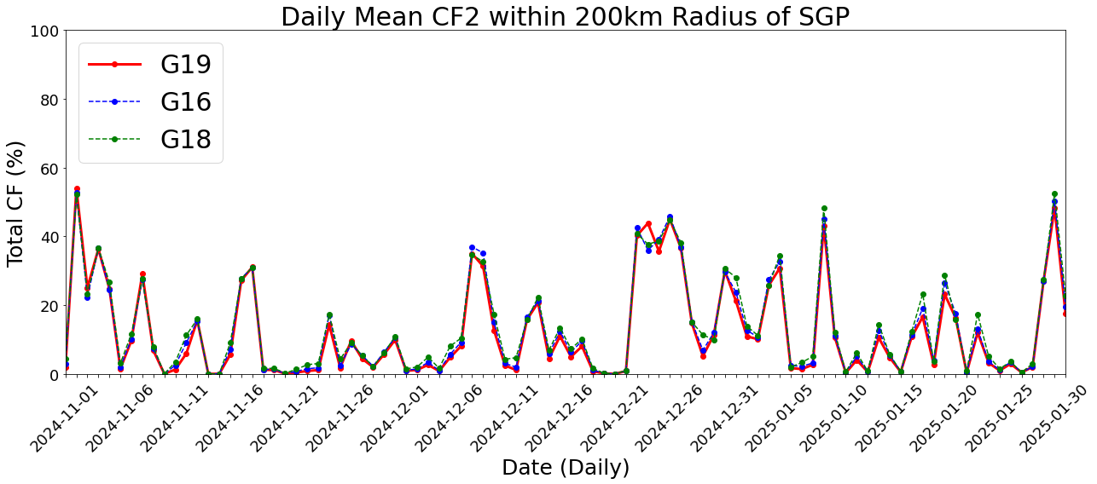
CF: Cloud Fraction (low CF1-CF5 high)

Slide 34
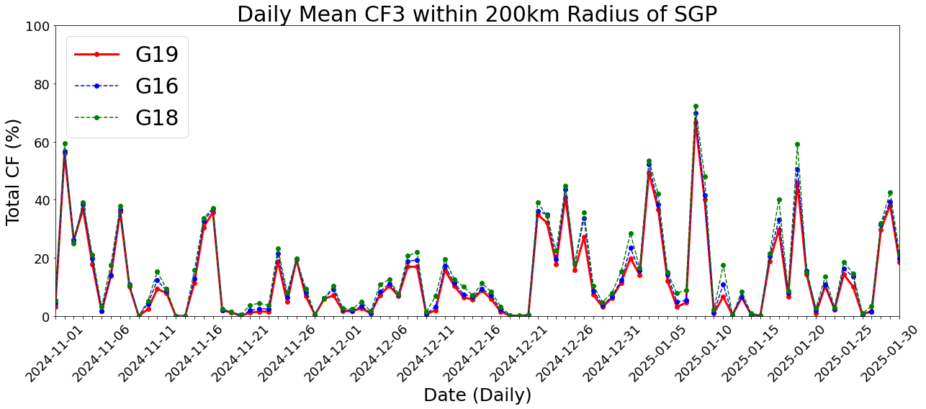
CF: Cloud Fraction (low CF1-CF5 high)

Slide 35
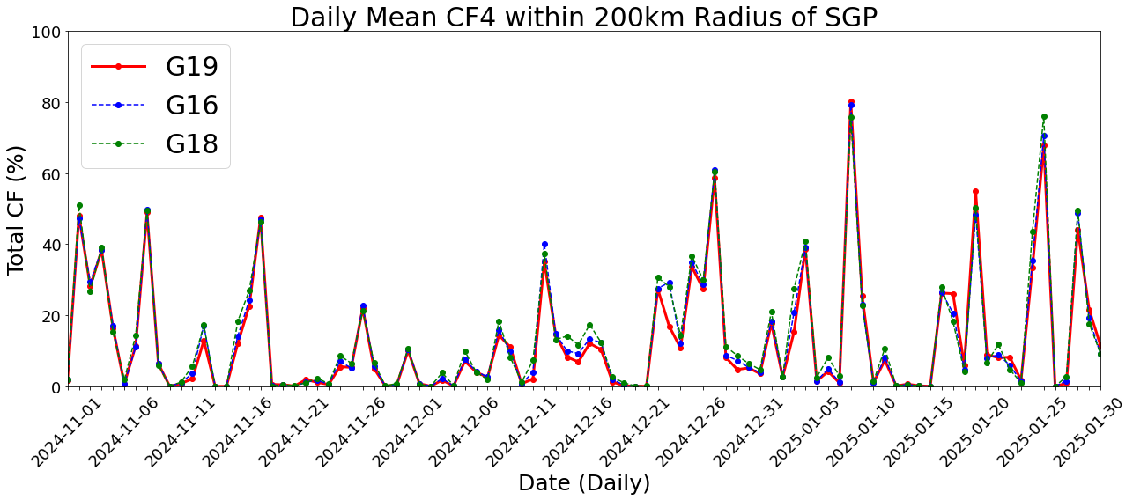
CF: Cloud Fraction (low CF1-CF5 high)

Slide 36
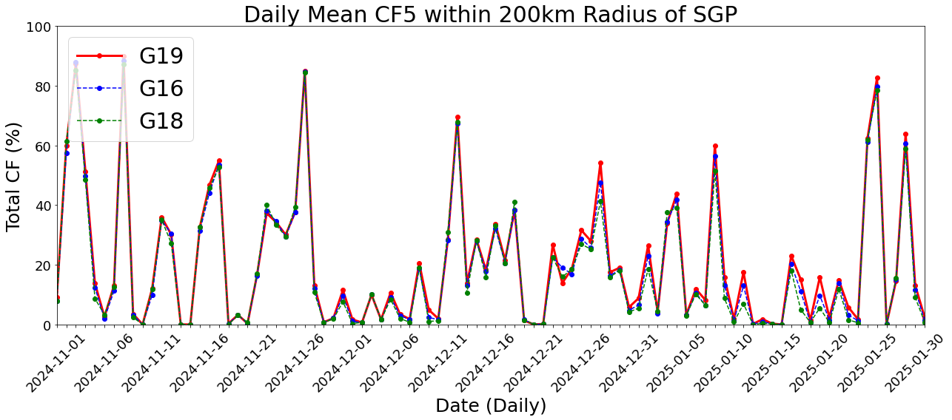
CF: Cloud Fraction (low CF1-CF5 high)

Slide 37
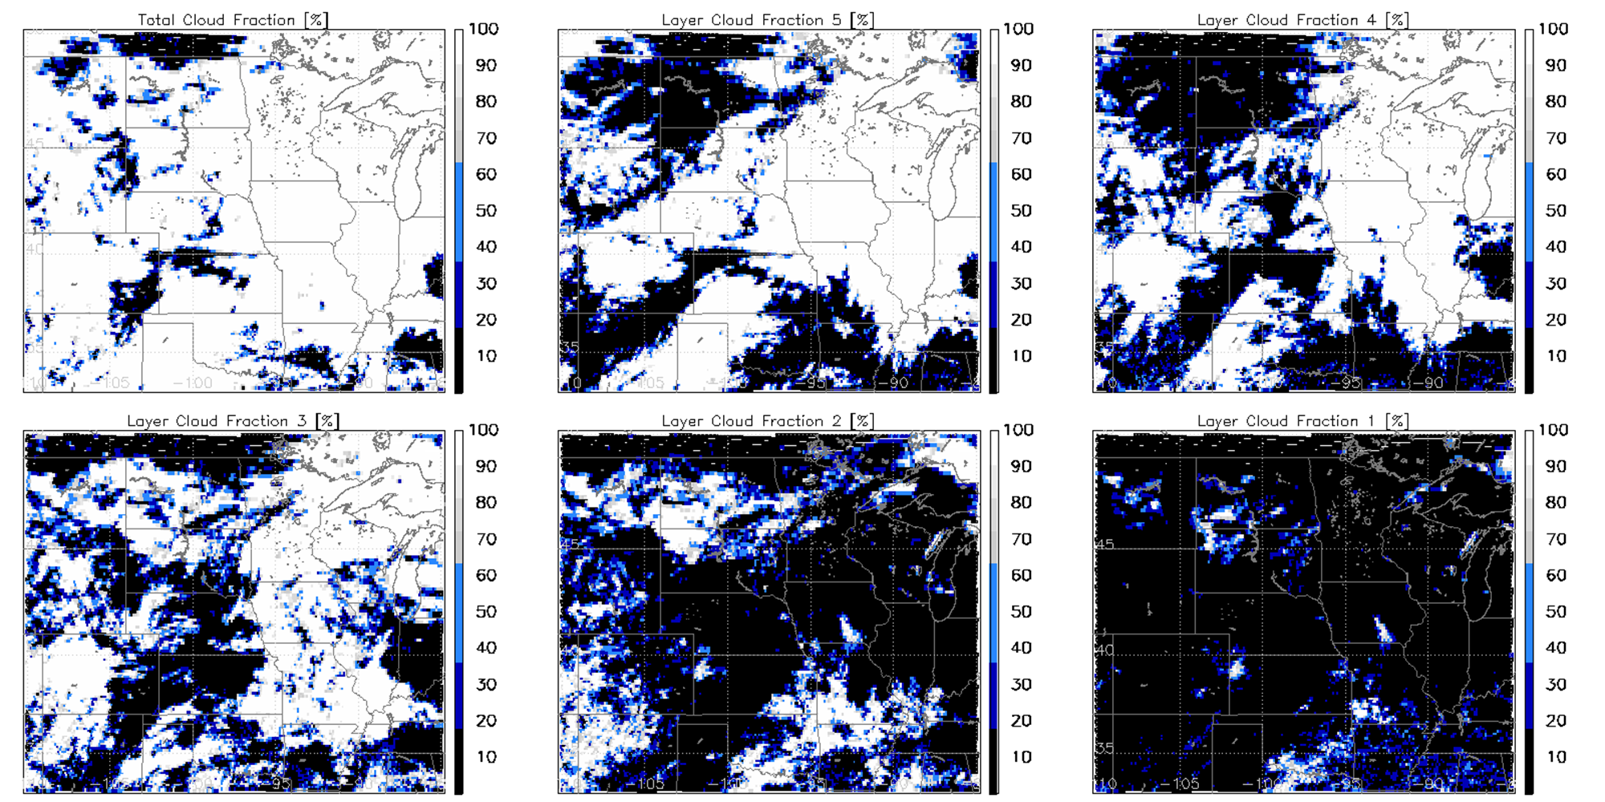
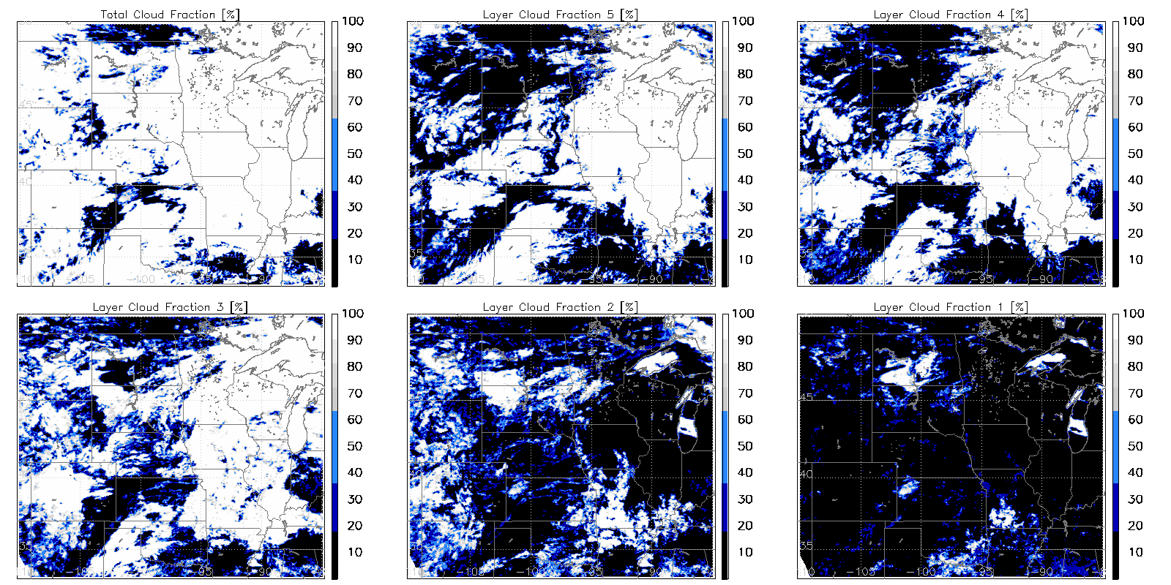
GOES-19 vs. JPSS VIIRS (Day)
Different resolutions but similar patterns
G19 ABI 1900 UTC 14 Feb 2025 (full disk 10 km resolution)
S-NPP VIIRS 1905-1915 UTC (v2r0; 750 m resolution)

Slide 38
GOES-19 vs. JPSS VIIRS (Night)
Different resolutions but similar patterns
G19 ABI 0600 UTC 19 Feb 2025 (full disk 10 km resolution)
NOAA21 VIIRS 0547-0549 UTC (v2r0; 750 m resolution)
Moon phase close to last quarter
More differences at night in mid layer fractions (e.g., CF3) compared to the other layers in this case

Slide 39
Validation
Datasets used for validation
Ground radar data (ARM SGP/Oklahoma site, KAZR)
Ground lidar and ceilometer data (ARM SGP; MPL and Ceilometer)
No CloudSat/CALIPSO available for GOES-19 period
No EarthCARE quality-controlled L2 data, but should be available for future reviews
We made use of several available comparison points. Thank you to ARM/DOE/BNL (Lihong Ma, Die Wang, Scott Giangrande) for making the SGP data available to us on short notice!

Slide 40
GOES-19 10km ABI CCL vs. ARM radar data (SGP, KAZR)
November 1 - December 31, 2024
Figure shows fraction of retrievals in each ABI CCL category, given a matched observation that falls in the given SGP KAZR category.
Detection of multiple CBHs possible with KAZR
Empty layers less than 480m between two cloud layers are merged to a singular cloud
Clouds less than 240m in depth are ignored
H+L valid for SGP KAZR category (unlike ABI)

Slide 41
GOES-19 10km ABI CCL vs. ARM radar data (SGP, KAZR)
Daytime - Solar Zenith angle ≤ 82°
November 1 - December 31, 2024
Figure shows fraction of retrievals in each ABI CCL category, given a matched observation that falls in the given SGP KAZR category.
Detection of multiple CBHs possible with KAZR
Empty layers less than 480m between two cloud layers are merged to a singular cloud
Clouds less than 240m in depth are ignored
H+L valid for SGP KAZR category (unlike ABI)

Slide 42
GOES-19 10km ABI CCL vs. ARM radar data (SGP, KAZR)
Nighttime - Solar Zenith angle > 82°
November 1 - December 31, 2024
Figure shows fraction of retrievals in each ABI CCL category, given a matched observation that falls in the given SGP KAZR category.
Detection of multiple CBHs possible with KAZR
Empty layers less than 480m between two cloud layers are merged to a singular cloud
Clouds less than 240m in depth are ignored
H+L valid for SGP KAZR category (unlike ABI)

Slide 43
GOES-19 10km ABI CCL vs. ARM radar data (SGP, KAZR)
Day + Night
November 1 - December 31, 2024
Figure shows the following for each of the five levels evaluated:
Probability of detection (PoD)
target=1
False alarm ratio (FAR)
target=0
Accuracy (Acc)
target=1
Overall accuracy (correct identification) is > 60% for all layers. Detection in lowest layers is decreased, in part, due to footprint differences (small Cu, for example).
Notes:
Acc > 60% for all layers
Lowest layer PoD small due to radar catching small cumulus ABI cannot see
Avg of 5 layers:
PoD = 0.4443
FAR = 0.4548
Acc = 0.8707

Slide 44
GOES-19 10km ABI CCL vs. ARM radar data (SGP, KAZR)
Daytime
November 1 - December 31, 2024
Figure shows the following for each of the five levels evaluated:
Probability of detection (PoD)
target=1
False alarm ratio (FAR)
target=0
Accuracy (Acc)
target=1
As expected, daytime performance exceeds nighttime performance. Here both accuracy and mean PoD across layers exceeds 60%.
Notes:
Acc > 60% for all layers
Lowest layer PoD small due to radar catching small cumulus ABI cannot see
Avg of 5 layers:
PoD = 0.6089
FAR = 0.3991
Acc = 0.8709

Slide 45
GOES-19 10km ABI CCL vs. ARM radar data (SGP, KAZR)
Nighttime
November 1 - December 31, 2024
Figure shows the following for each of the five levels evaluated:
Probability of detection (PoD)
target=1
False alarm ratio (FAR)
target=0
Accuracy (Acc)
target=1
Performance is degraded at night. Accuracy remains > 60% in all levels, however, which partially reflects the inclusion of successfully- identified clear-sky scenes.
Notes:
Acc > 60% for all layers
Lowest layer PoD small due to radar catching small cumulus ABI cannot see
Avg of 5 layers:
PoD = 0.3435
FAR = 0.5439
Acc = 0.8705

Slide 46
GOES-19 ABI CBH vs. ARM SGP KAZR data
Parallax-corrected, within spec comparisons
Single layer clouds
All clouds (including multilayers)
Notes:
Validate CBHs when CTHs from ABI are within 2km of CTHs from SGP radar
ABI CTH and CBH pixels are averaged around 10km radius of SGP (no radar averaging)
Detection of multiple CBHs possible with KAZR
Single layer clouds: Only 1 CBH layer from KAZR.
Multilayers: Uses highest CBH layer available from KAZR

Slide 47
GOES-19 ABI CBH vs. ARM SGP KAZR data
Parallax-corrected, within spec comparisons
Single layer clouds (Daytime)
Single layer clouds (Nighttime)
Notes:
Validate CBHs when CTHs from ABI are within 2km of CTHs from SGP radar
ABI CTH and CBH pixels are averaged around 10km radius of SGP (no radar averaging)
Detection of multiple CBHs possible with KAZR
Single layer clouds: Only 1 CBH layer from KAZR.
Multilayers: Uses highest CBH layer available from KAZR

Slide 48
GOES-19 ABI CBH vs. ARM SGP MPL data
Parallax-corrected, within spec comparisons
Single layer clouds
All clouds (including multilayers)
Notes:
Validate CBHs when CTHs from ABI are within 2km of CTHs from SGP radar
ABI CTH and CBH pixels are averaged around 10km radius of SGP (no radar averaging)
Detection of multiple CBHs possible with KAZR
Single layer clouds: Only 1 CBH layer from KAZR.
Multilayers: Uses highest CBH layer available from KAZR

Slide 49
GOES-19 ABI CBH vs. ARM SGP MPL data
Parallax-corrected, within spec comparisons
Single layer clouds (Daytime)
Single layer clouds (Nighttime)
Notes:
Validate CBHs when CTHs from ABI are within 2km of CTHs from SGP radar
ABI CTH and CBH pixels are averaged around 10km radius of SGP (no radar averaging)
Detection of multiple CBHs possible with KAZR
Single layer clouds: Only 1 CBH layer from KAZR.
Multilayers: Uses highest CBH layer available from KAZR

Slide 50
SUMMARY
✅ CCL passes visual inspection
Good comparison between GOES-16/GOES-18 and GOES-19 ABIs products
Good comparison between GOES-19 and JPSS VIIRS products
Good comparison between 2 km and 10 km versions of DE products
Problems unrelated to algorithm or upstream cloud inputs are noted in some DE products
We will work with the GS team to identify the source of these discrepancies
✅ CCL passes quantitative analysis
60% accuracy requirement met at all five flight levels for both day and night
Passes for ARM KAZR
CBH “in spec” RMSE is 1.86 km for GOES-19 compared to ARM KAZR, 1.65 for MPL, and 2.15 for the ceilometer (not shown in main slides)
(There is no formal CBH requirement for ABI; is 2 km for VIIRS)

Slide 51
Provisional Validation
Preparation Activities | Assessment
Validation activities are ongoing and the general research community is now encouraged to participate. | Ongoing validation activities. Feedback provided by both general research and user communities.
Severe algorithm anomalies are identified and under analysis. Solutions to anomalies are in development and testing. | Occasional product sectors missing in GS files. Other occasional discrepancies documented between GS and DE environments. Will continue to monitor if these issues and work with ASSISTT to resolve them, if warranted.
Incremental product improvements may still be occurring. | Yes, based on continual algorithm development (e.g. improved training datasets, etc.).
L2+ only: Users are engaged in the Product Feedback Forums and user feedback is assessed. | Yes.
End State | Assessment
Product performance has been demonstrated through analysis of a small number of independent measurements obtained from select locations, periods, and associated ground truth or field campaign efforts. | Yes.
Product analysis is sufficient to communicate product performance to users relative to expectations (Performance Baseline). | Yes.
Documentation of product performance exists that includes recommended remediation strategies for all anomalies and weaknesses. Any algorithm changes associated with severe anomalies have been documented, implemented, tested, and shared with the user community. | Yes.
Testing has been fully documented. | Yes.
Product is ready for operational use and for use in comprehensive cal/val activities and product optimization. | Yes.

Slide 52
Path to Full Maturity
Archive L1, L2, and Intermediate Products for more comprehensive analysis
Seasonal analysis
EarthCARE validation
Opportunistic application-driven analyses from user interaction
Entrain other datasets of opportunity

Slide 53
Backup

Slide 54
Missing segments in G19 CCL
G19 vs. G16 CCL (16:00 UTC 1 Feb 2025)
OR_ABI-L2-CCLF-M6_G19_s20250321600205_e20250321609513_c20250321618235.nc
OR_ABI-L2-CCLF-M6_G16_s20250321600210_e20250321609518_c20250321618360.nc
G19 CCL
G16 CCL
Sometimes missing segments

Slide 55
Comparisons between GS and SAPF CCL: No issue with daytime CCLs over CONUS
DE G19 CCL (10-km resol) from GS
SAPF_ASSISTT CCL (2-km resol. run by CIMSS)
2001 UTC 2025 Feb 02 (SAPF run by S. Wanzong)
Zoom in to CONUS

Slide 56
Contingency Table Evaluation
Correct retrieval?
Observed
ABI
TOA
For each of 5 CCL layers (j=1 to 5), create a contingency table with 4 counts (A_{j}, B_{j}, C_{j}, D_{j}):
✅
Layer 5
D
Observed by CloudSat/CALIPSO?
24 kft
Y N
❌
A_{j} B_{j}
Layer 4
Retrieved by ABI?
Y
C
18 kft
N
C_{j} D_{j}
Layer 3
✅
For each matched set of obs/retrieval, if the observations show cloud in any radar/lidar bin within the bounds of that layer, then observed=Yes; else observed=No.
Prob. of detection for layer j = A_{j}/ (A_{j}+C_{j})
False alarm ratio for layer j = B_{j}/ (A_{j}+B_{j})
Accuracy for layer j = (A_{j}+D_{j})/ (A_{j}+B_{j}+C_{j}+D_{j})
A
10 kft
Layer 2
✅
A
5 kft
Layer 1
❌
B
0 kft

Slide 57
GOES-16 (ASSISTT retrospect) vs. CloudSat
An example from GOES-16, when CloudSat data was available, as a baseline
(May 1-14, 2019)
Topmost Layer CBH
Lowest CBH (all clouds)
Measurement accuracy requirements for VIIIRS CBH: 2 km for COT ≥ 1 & 3 km for COT < 1
Notes:
Comparison of ABI "CldBaseHght" against the lowest cloud occurrence seen by C/C for the matched scene. The lowest C/C cloud base is defined as the lowest occurrence of either a 2B-GEOPROF cloud mask of 20, 30, or 40, OR a 2B-GEOPROF-LIDAR CloudFraction value of 0.5 or greater.

Slide 58
GOES-19 ABI CBH vs. ARM SGP Ceilometer data
Parallax-corrected, within spec comparisons
Parallax-corrected, within spec comparisons (using MPL CTH)
Ceilometer measurements are limited to low levels only (up to ~ 8 km)
Single layer clouds
All clouds (including multilayers)
Notes:
Validate CBHs when CTHs from ABI are within 2km of CTHs from SGP radar
ABI CTH and CBH pixels are averaged around 10km radius of SGP (no radar averaging)
Detection of multiple CBHs possible with KAZR
Single layer clouds: Only 1 CBH layer from KAZR.
Multilayers: Uses highest CBH layer available from KAZR

Slide 59
GOES-19 ABI CBH vs. ARM SGP Ceilometer data
Parallax-corrected, within spec comparisons (using MPL CTH)
Ceilometer measurements are limited to low levels only (up to ~ 8 km)
Single layer clouds (Daytime)
Single layer clouds (Nighttime)
Notes:
Validate CBHs when CTHs from ABI are within 2km of CTHs from SGP radar
ABI CTH and CBH pixels are averaged around 10km radius of SGP (no radar averaging)
Detection of multiple CBHs possible with KAZR
Single layer clouds: Only 1 CBH layer from KAZR.
Multilayers: Uses highest CBH layer available from KAZR

Slide 60
SUMMARY
✅ ATBD
Product ATBD for CCL (with information on cloud base) has been thoroughly revised and updated
It now covers all NOAA sensors (GOES-16..19, JPSS VIIRS) that the algorithm is applied to

