Slide 1
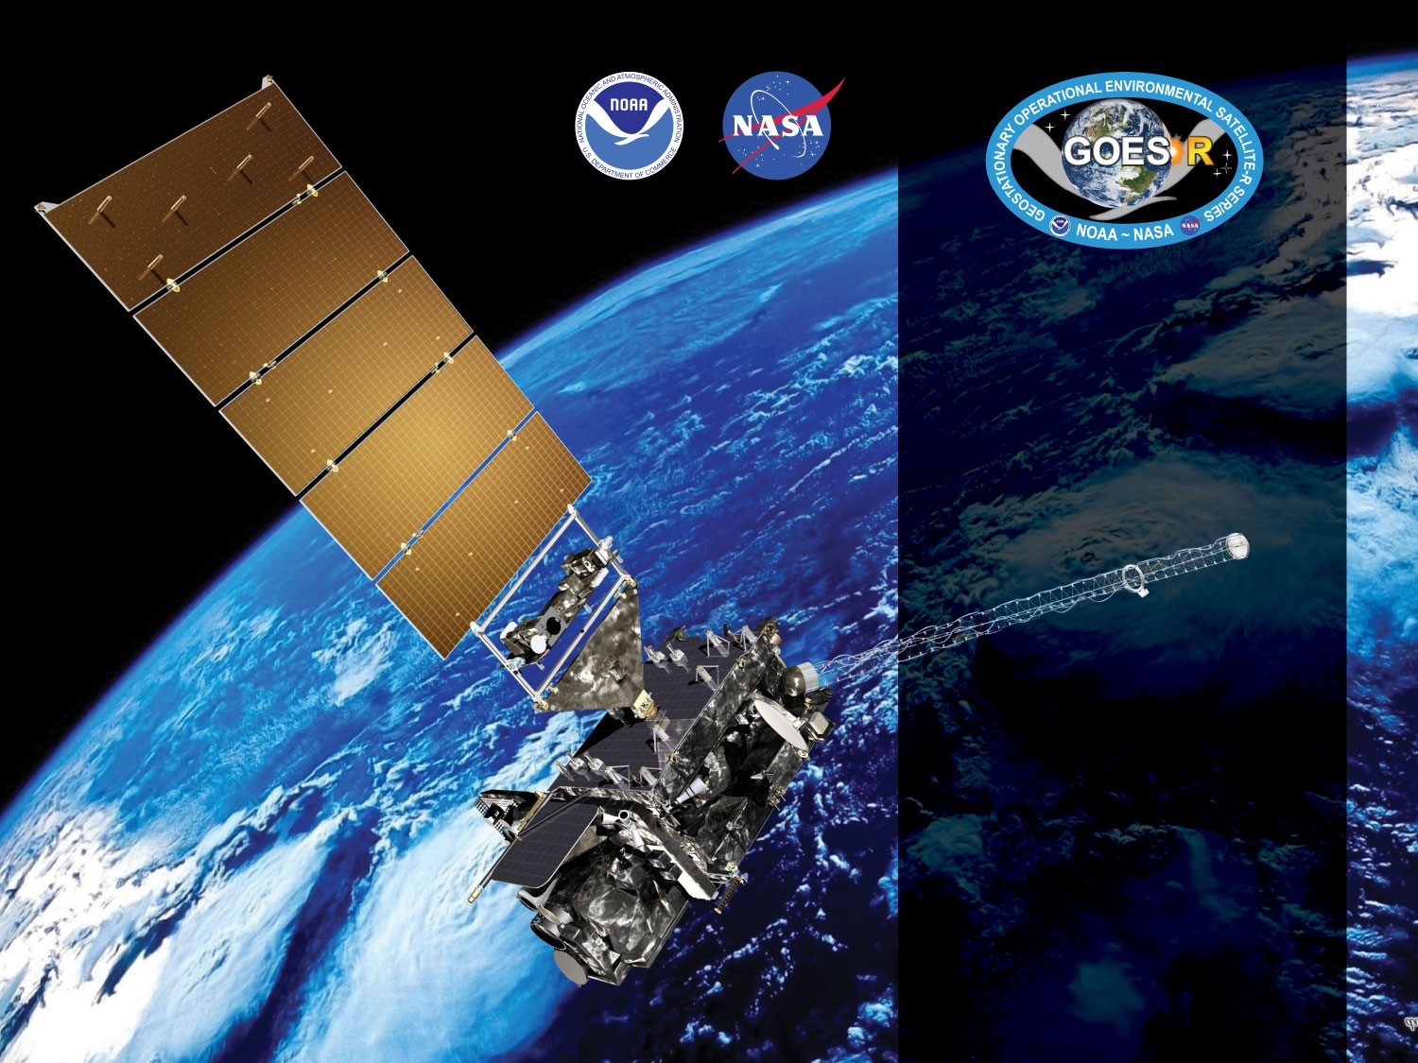
GOES-19 ABI L2+ Aerosol Optical Depth Provisional PS-PVR
March 12, 2025
GOES-R AWG
Istvan Laszlo¹, Mi Zhou², Hongqing Liu² and the
PRO Team
¹NOAA/NESDIS/STAR
²STC

Slide 2
Outline
Product Overview
Review of ADRs
Provisional Maturity Assessment
  Comparisons with AERONET, GOES-16, GOES-18, VIIRS, and MODIS
Path to Full Validation Maturity
Summary and Recommendations
Supplement
  Various supporting material

Slide 3
Product Overview
  Aerosol optical depth (AOD):
    A measure of the columnar extinction (scattering + absorption) of radiation by aerosols. Proportional to the amount (number or mass concentration) of aerosol in an atmospheric column.
  Aerosol Particle Size (APS):
    A measure of the average size of aerosol particles in a unit volume of air. It is reported here (and traditionally) as the Ångström Exponent (AE) calculated from the AOD at two pairs of wavelengths. Small AE (<1) indicates large particle (diameter > 1 µm) and large AE (>2) indicates small particle (diameter < 1 µm).
  Products in file:
    550-nm AOD for Full Disk and CONUS in range -0.05 to +5
    AOD Quality flag (0=high; 1=medium, 2=low, 3=not produced)
    AE1 (0.47, 0.86 µm)and AE2 (0.86, 1.61 µm) over water for Full Disk and CONUS in range -1 to +3.
    AE Quality flag (0=high; 1=medium, 2=low, 3=not produced)
    Mean, max, min and standard deviation of 550-nm AOD (and in 10-degree latitude zones)

Slide 4
Product Overview - AOD
PRODUCT DEFINITION AND USER’S GUIDE (PUG) VOLUME 5: LEVEL 2+ PRODUCTS, VERSION 2.5, 20 JUNE 2024 - Table 5.11.1-1
 |  | Measurement |  |  |  | Mapping
Region | Surface Type | Range | Accuracy | Precision | Performance Conditions ^{[1]} | Accuracy
Full Disk & CONUS | Over Land | -1 to 5 | (1) AOD < 0.04: 0.06 (2) 0.04 ≤ AOD ≤ 0.80: 0.04 (3) AOD > 0.80: 0.12 | (1) AOD < 0.04: 0.13 (2) 0.04 ≤ AOD ≤ 0.80: 0.25 (3) AOD > 0.80: 0.35 | LZA ≤ 60 degrees daytime ^{[2]} clear sky | 1 km
Full Disk & CONUS | Over Ocean | -1 to 5 | (1) AOD < 0.40: 0.02 (2) AOD > 0.40: 0.10 | (1) AOD < 0.40: 0.15 (2) AOD > 0.40: 0.23 | LZA ≤ 60 degrees daytime ^{[2]} clear sky | 1 km
[1] Conditions for data production prescribed by the algorithm also include snow/ice-free and, when over ocean, sunglint angle > 40 degrees.
[2] Conditions for high quality prescribed by the algorithm are for SZA ≤ 80 degrees.
Note to [1]: In the Enterprise Algorithm/Product, sunglint angle is > 36° instead of 40 degrees.
Note to [2]: : In the Enterprise Algorithm/Product, performance condition for high-quality is airmass ≤ 6 instead of LZA ≤ 60 degrees.
Note: In the Enterprise Algorithm/Product, consistent with JPSS AOD, the minimum range value is -0.05 instead of -1.
Horizontal resolution: 2 km
Temporal resolution: 5 min (CONUS), 15/10/5 min (M3/M6/M4 Full Disk) – mode dependent.

Slide 5
Product Overview - APS
PRODUCT DEFINITION AND USER’S GUIDE (PUG) VOLUME 5: LEVEL 2+ PRODUCTS, VERSION 2.5, 20 JUNE 2024 - Table 5.11.1-2
 |  | Measurement |  |  |  | Mapping
Region | Surface Type | Range | Accuracy | Precision | Performance Conditions ^{[1]} | Accuracy
Full Disk & CONUS | Over Ocean | -1 to 3 | 0.3 | 0.15 | LZA ≤ 60 degrees daytime ^{[2]} clear sky | 1 km
[1] Conditions for data production prescribed by the algorithm also include snow/ice-free and, when over ocean, sunglint angle > 40 degrees.
[2] Conditions for high quality prescribed by the algorithm are for SZA ≤ 80 degrees.
Note to [1]: In the Enterprise Algorithm/Product, sunglint angle is > 36° instead of 40 degrees.
Note to [2]: : In the Enterprise Algorithm/Product, performance condition for high-quality is airmass ≤ 6 instead of LZA ≤ 60 degrees.
Note: In the Enterprise Algorithm/Product, consistent with JPSS APS, the Precision value is 0.6 instead of 0.15. The evaluation presented uses the 0.6 value for precision.
Horizontal resolution: 2 km
Temporal resolution: 5 min (CONUS), 15/10/5 min (M3/M6/M4 Full Disk) – mode dependent

Slide 6
GOES-R AOD Product
Precedence Chain
4-level Cloud Mask
Cloud & Moisture Imagery
Snow Mask
ABI FSC product
IMS/SSMI snow ice mask
AOD
TPW
GFS product
Climatology

Slide 7
Pre-Provisional Time-Line
25 Jun 2024 GOES-U Launch
7 Jul 2024 Renamed GOES-19
18 Jul 2024 Reached test position at 89.5° W
1 Oct 2024 GOES-19 AOD Beta Maturity
20 Dec 2024 L1b data reached Provisional
29 Jan 2025 Clear-sky mask reached Provisional
12 Mar 2025 GOES-19 AOD PS-PVR Provisional

Slide 8
ADRs IN PROGRESS PRIOR TO GOES-19 AOD PROVISIONAL REVIEW
GOES-19 Aerosol Optical Depth L2 Product Provisional PS-PVR

Slide 9
ADRs Installed or in Progress
Title | Description | Impact | Mitigation | Status
ADR 498 | Inconsistency in spatial coverage between M6 (M3) and M4 | Smaller spatial coverage from M4 than from M6. | TBD | In analysis
Little Impact
Moderate Impact
Big Impact
No “Big Impact” item. Relatively few occurrence.
Also applies to G16.

Slide 10
PRODUCT QUALITY EVALUATION
GOES-19 Aerosol Optical Depth L2 Product Provisional PS-PVR

Slide 11
Provisional PLPTs
Test ID | Short description | 16 | 17 | 18 | 19
ABI-FD_AOD01 | Verify that the Mode 6 FD product generated every 10 minutes is within required measurement range | B | P | P | P
ABI-CONUS_AOD02 | Verify that the Mode 6 CONUS product generated every 5 minutes is within required measurement range | B | P | P | P
ABI-FD_AOD03 | Verify that the Mode 4 FD product generated every 5 minutes is within required measurement range | B | P | P | P
ABI-CONUS_AOD04 | Verify that the Mode 4 CONUS product generated every 5 minutes is within required measurement range | B | P | P | P
ABI-FD_AOD05 | Assess precision and accuracy of Mode 6 FD product | B, P, F | P, F | P, F | P, F
ABI-CONUS_AOD06 | Assess precision and accuracy of Mode 6 CONUS product | B, P, F | P, F | P, F | P, F
B, P, F indicate test is required for Beta, Provisional, Full maturity.
Geostationary Operational Environmental Satellite (GOES) – R Series ABI L2+ Aerosol Optical Depth (AOD) Beta, Provisional and Full Validation Readiness, Implementation and Management Plan (RIMP) (v2.0; 410-R-RIMP-0326, Sep 29,2021).

Slide 12
Application of PLPT Qualitative & Quantitative Analysis Tests to each Domain
The analysis has 6 elements.
Each element is applied on the FD and CONUS domains.
Analysis Method |  | FD | CONUS
Visual | Visual Inspection of GOES 19 AOD
 | Visual Comparison with GOES 16 AOD
Quantitative | Comparison with ground measurements
 | Comparison with GOES 16 AOD product
 | Comparison with GOES 18 AOD product
 | Comparison with AOD from polar satellites

Slide 13
GOES-19 Data Used in this Review
Time period: 10/01/2024 – 12/31/2024
10/01/2024 – 01/10/2025 (APS)
11/05/2024 – 01/31/2025 (CONUS)
  All daytime retrievals are used.
Matchups:
  GOES-19 FD and CONUS AOD and AERONET AOD;
  GOES-19 FD and CONUS AOD and GOES-16 AOD
  GOES-19 FD and CONUS AOD and GOES-18 AOD
  GOES-19 FD and CONUS AOD and S-NPP, NOAA-21 VIIRS and MODIS AOD.

Slide 14
VISUAL AND QUANTITATIVE COMPARISONS:
COMPARISON WITH GOES-16
GOES-19 Aerosol Optical Depth L2 Product Provisional PS-PVR

Slide 15
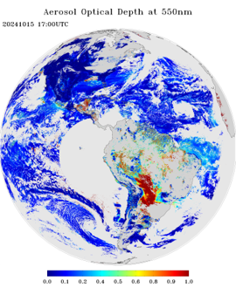
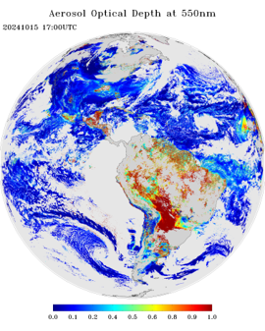
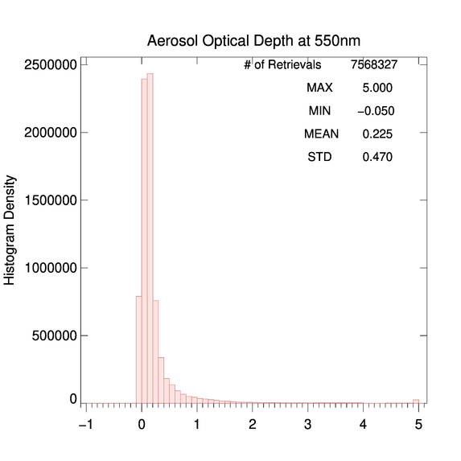
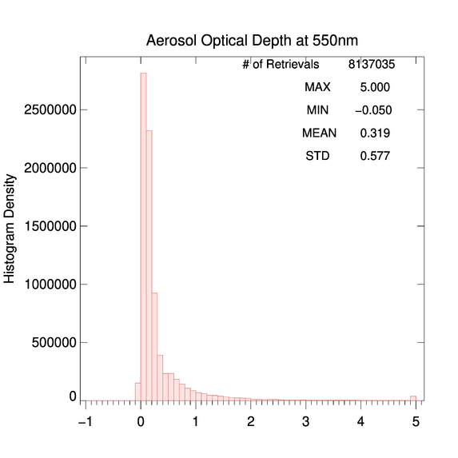
GOES-19 vs. GOES-16
Low+Medium+High QC AOD
10/15/2024 17:00 UTC
PLPT test ABI-FD_AOD01
G19 AOD field is as expected.
Over water, G19 and G16 AOD pattern and magnitude are similar. Lower AOD over land.
Land-water discontinuity of AOD in G19 is larger than that in G16.
G19 has a smaller mean AOD compared to G16.
G19 AOD is within valid range. (Passed)
G19
G16

Slide 16
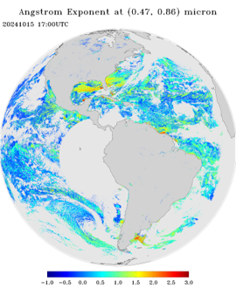
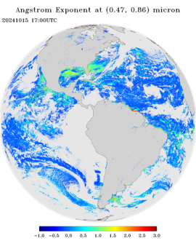
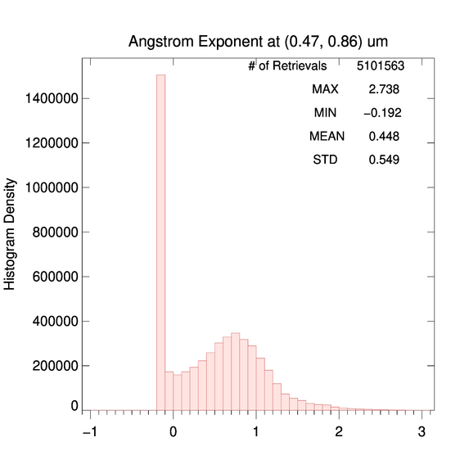
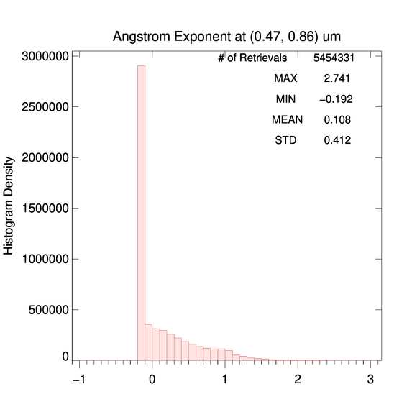
GOES-19 vs. GOES-16
Low+Medium+High QC AE1
09/14/2022 19:10 UTC
PLPT test ABI-FD_AOD01
Low+medium+high QC Angstrom Exponent (AE) is used due to limited spatial coverage for medium and high QC retrievals. (550nm AOD must be >0.2)
The range of G19 AE1 in wavelength pair (0.47, 0.86) µm is as expected.
Relative to G16, G19 AE1 has larger AE1 values, suggesting smaller aerosol particles.
G19
G16

Slide 17
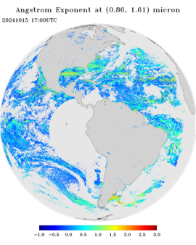
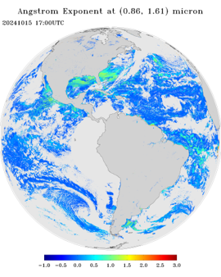
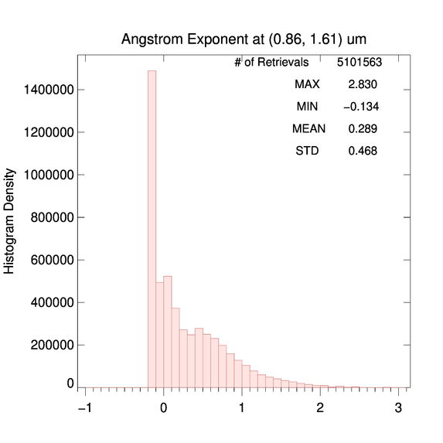
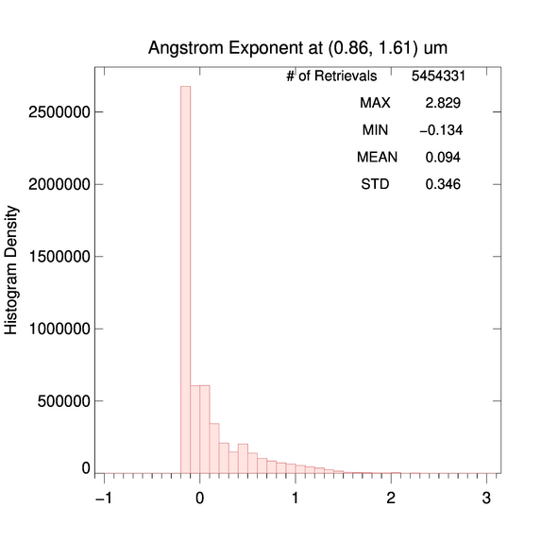
GOES-19 vs. GOES-16
Low+Medium+High QC AE2
09/14/2022 19:10 UTC
PLPT test ABI-FD_AOD01
The range of G19 AE2 in wavelength pair (0.86, 1.61) µm is as expected.
Relative to G16, the G19 mean AE2 is larger, suggesting smaller aerosol particles.
The difference between G19 and G16 AE2 is relatively smaller than that for AE1.
G19
G16

Slide 18
GOES-19 vs. GOES-16
CONUS
Test ABI-CONUS_AOD02 (Supplement A):
  Results are similar to those for FD.
  CONUS G19 AOD (and APS) field is as expected.
  G19 AOD (and APS) is within valid range. (Passed)
  The spatial distribution of G19 AOD/APS is visually similar to that of G16.
  G19 and G16 histograms are similar with a smaller G19 mean AOD compared to G16.

Slide 19
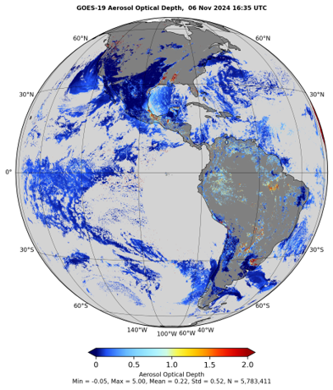
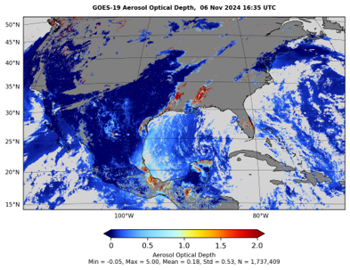
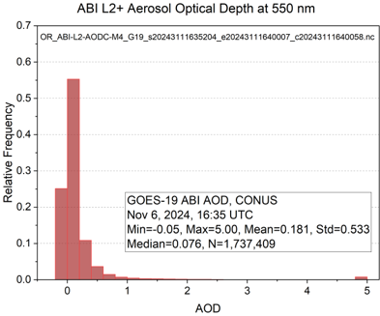
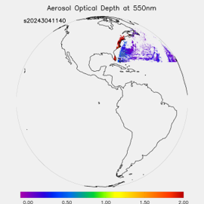
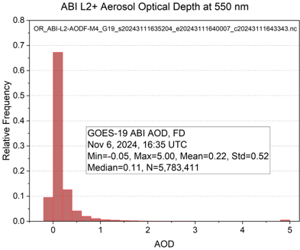
GOES-19 ABI M4 AOD
PLPT test ABI-FD_AOD03
PLPT test ABI-CONUS_AOD04
M4 AOD is within valid range. (Passed)
M4 sometimes has missing data blocks of AOD.
Nov 6, 2024, 16:35 UTC
M4 FD AOD
11:40 UTC
October 30, 2024

Slide 20
Summary of PLPT tasks 01 - 04
Tasks ABI-FD_AOD01, ABI-CONUS_AOD02:
  G19 M6 FD and CONUS AODs are within required measurement range.
  G19 M6 and G16 FD and CONUS AODs are visually similar, except G19 AOD over land is noticeably smaller than G16 AOD.
Tasks ABI-FD_AOD03, ABI-CONUS_AOD04:
  G19 M4 FD and CONUS AODs are within required measurement range.

Slide 21
QUANTITATIVE COMPARISONS
PLPT TASKS ABI-FD_AOD05 AND ABI-CONUS_AOD06
GOES-19 Aerosol Optical Depth L2 Product Provisional PS-PVR

Slide 22
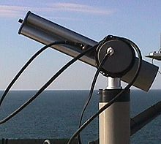
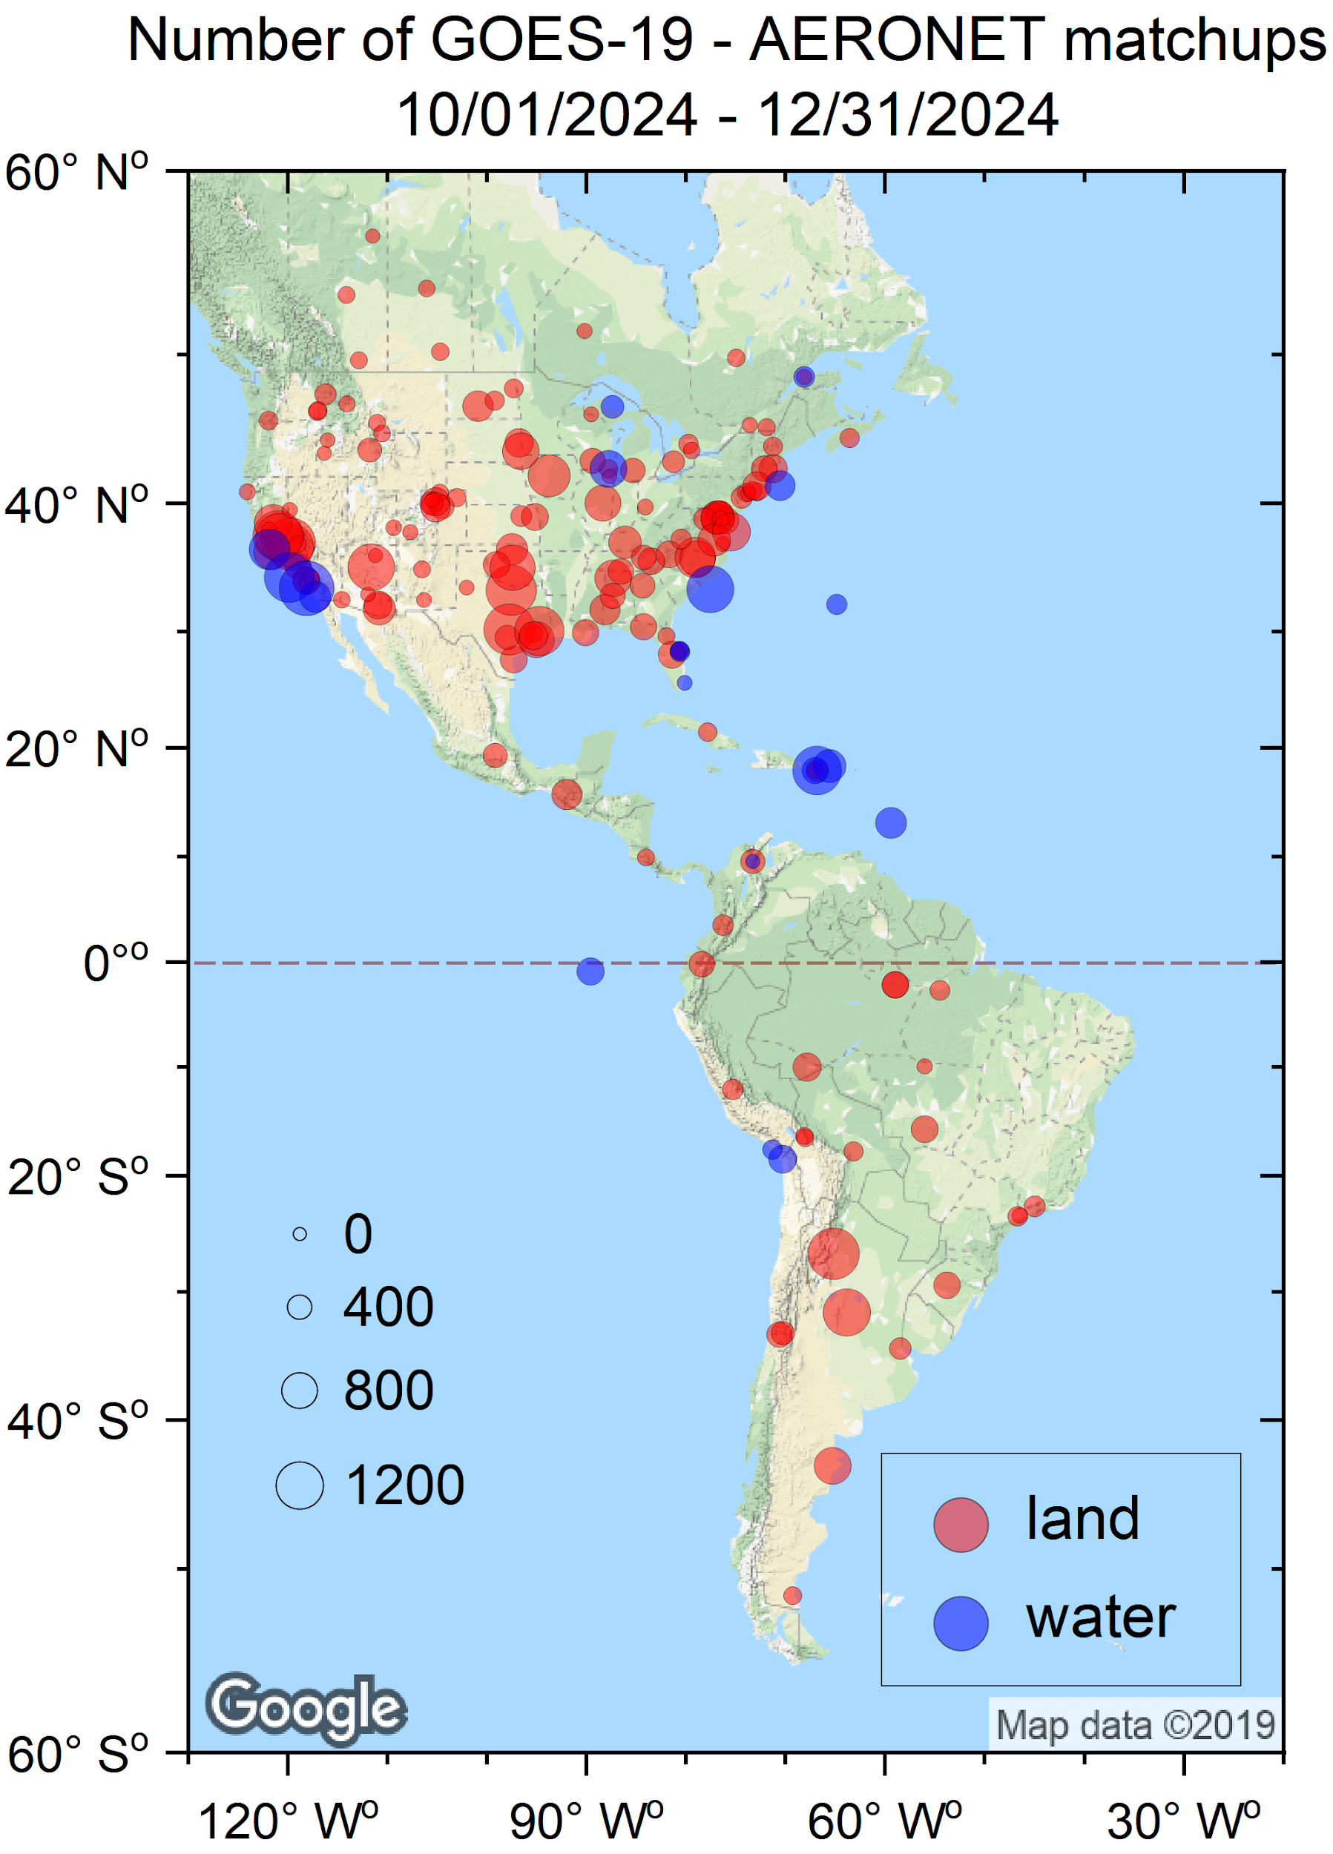
Reference Data
Reference data:
Version 3 L1.5 high-quality aerosol data from the ground-based Aerosol Robotic Network (AERONET) (Holben et al. 1998).
GOES-16 and -18 AOD.
VIIRS and MODIS AOD.
Time period:
10/01/2024 – 12/31/2024
AERONET

Slide 23
Definitions of Metrics for Quantitative Comparisons
Passed: Accuracy and Precision meet or slightly exceed requirements. Potential contributors for deviations are identified.
Partial-Passed: Accuracy/Precision deviates significantly from requirements, but potential contributors for deviations are identified.
Failed: Accuracy/Precision deviates significantly from requirements and source of poor performance is unknown, or source known and correction requires new algorithm.

Slide 24
COMPARISON WITH AERONET GROUND MEASUREMENTS
GS AOD PRODUCT OVER FULL DISK
GOES-19 Aerosol Optical Depth L2 Product Provisional PS-PVR

Slide 25
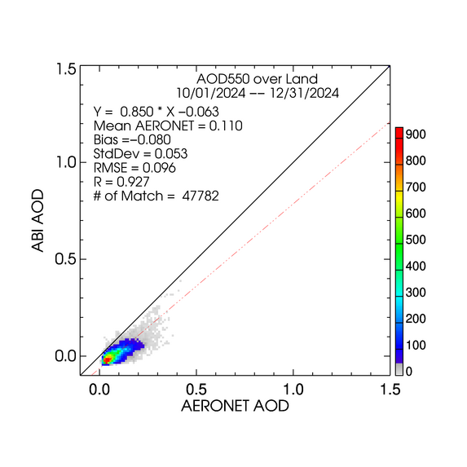
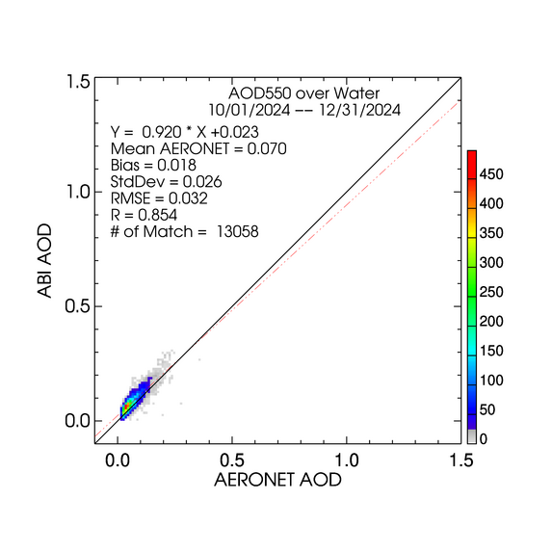
High QC GOES-19 AOD - FD
LAND
WATER
High quality AODs are plotted regardless of magnitude (range).
-0.1 bias over land and 0.02 bias over water.
STD over land is about twice as large as that over water.

Slide 26
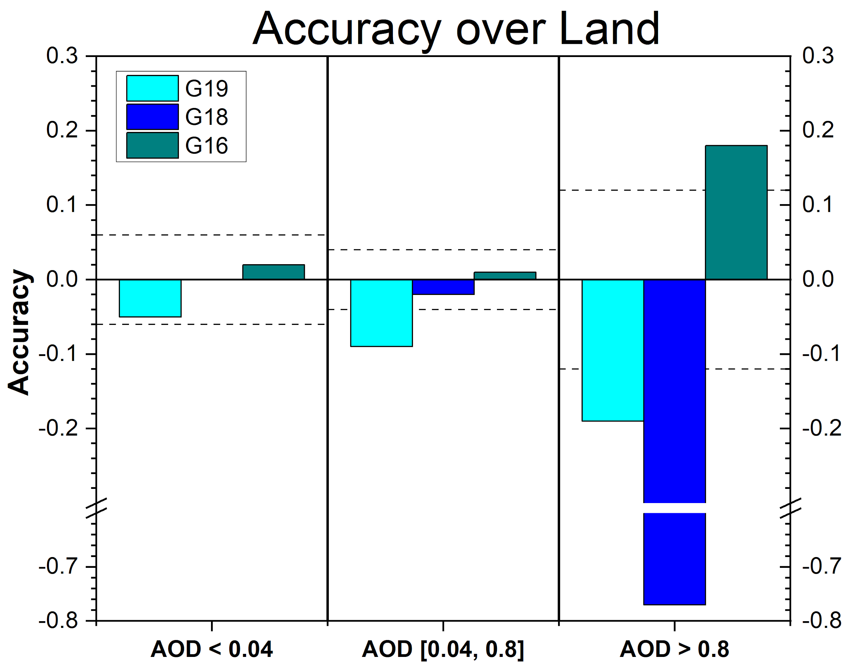
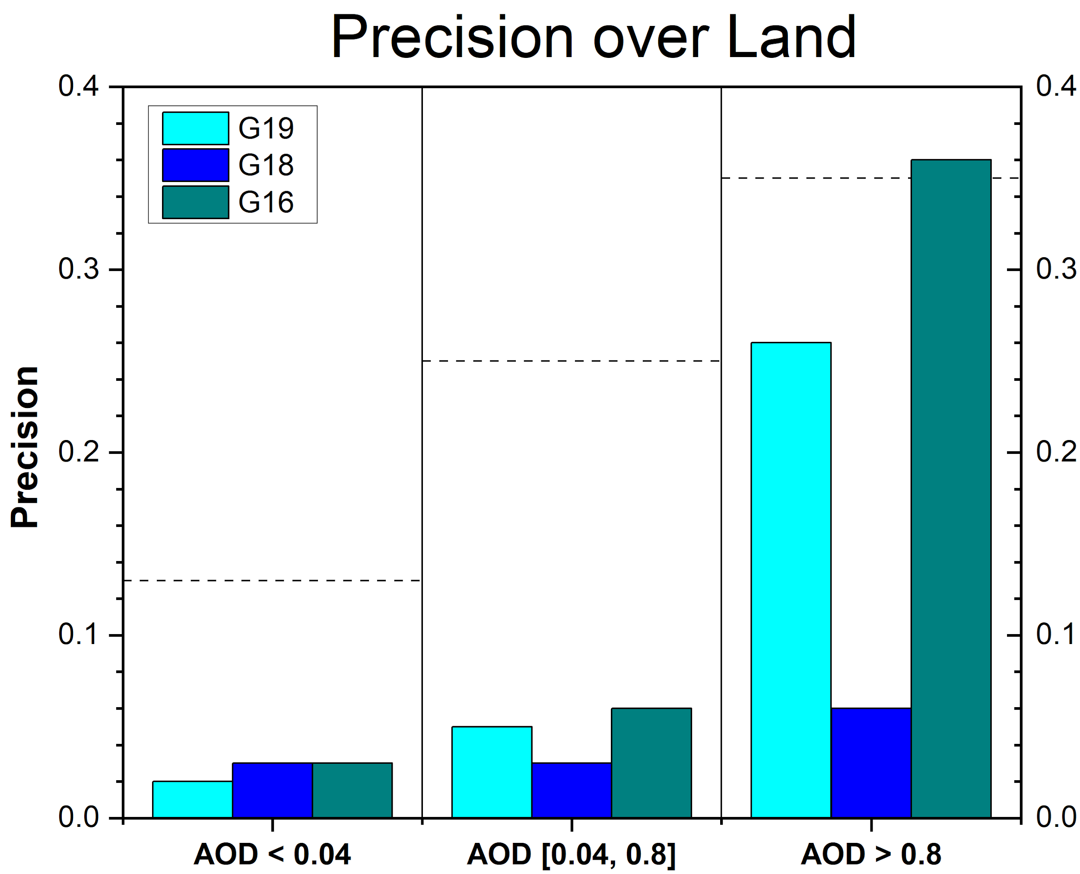
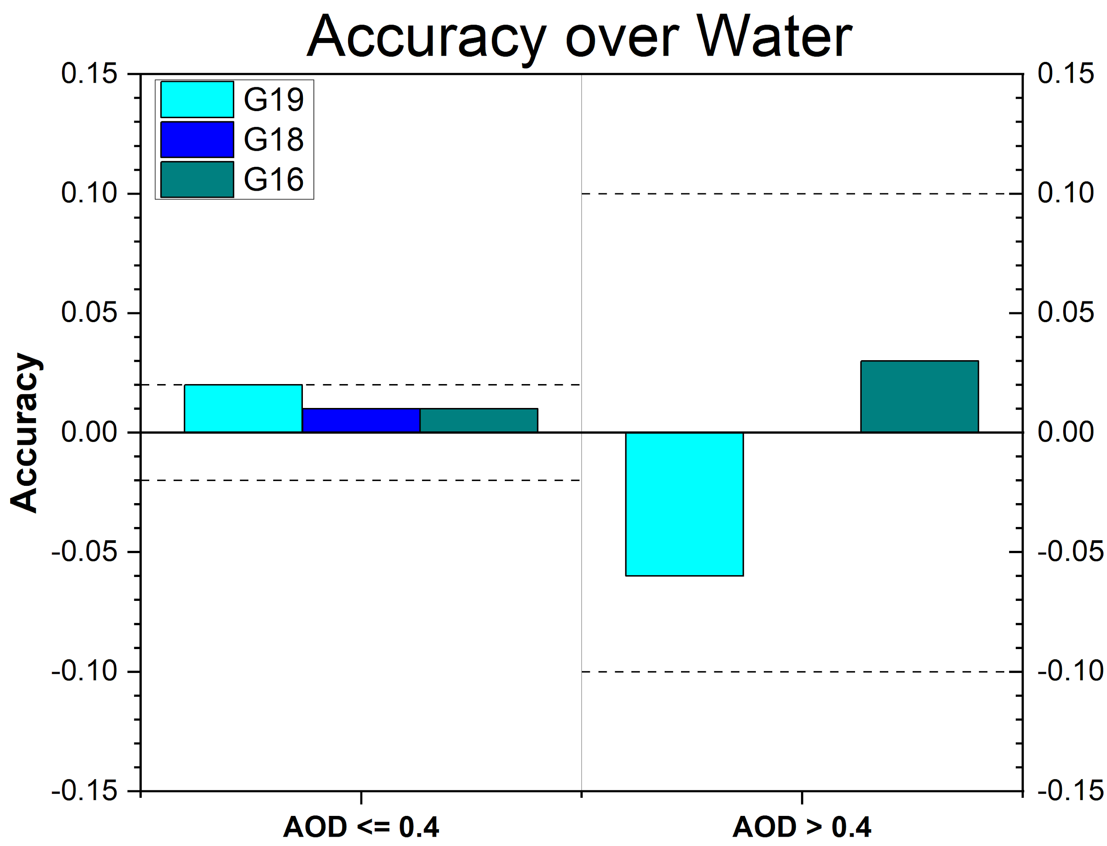
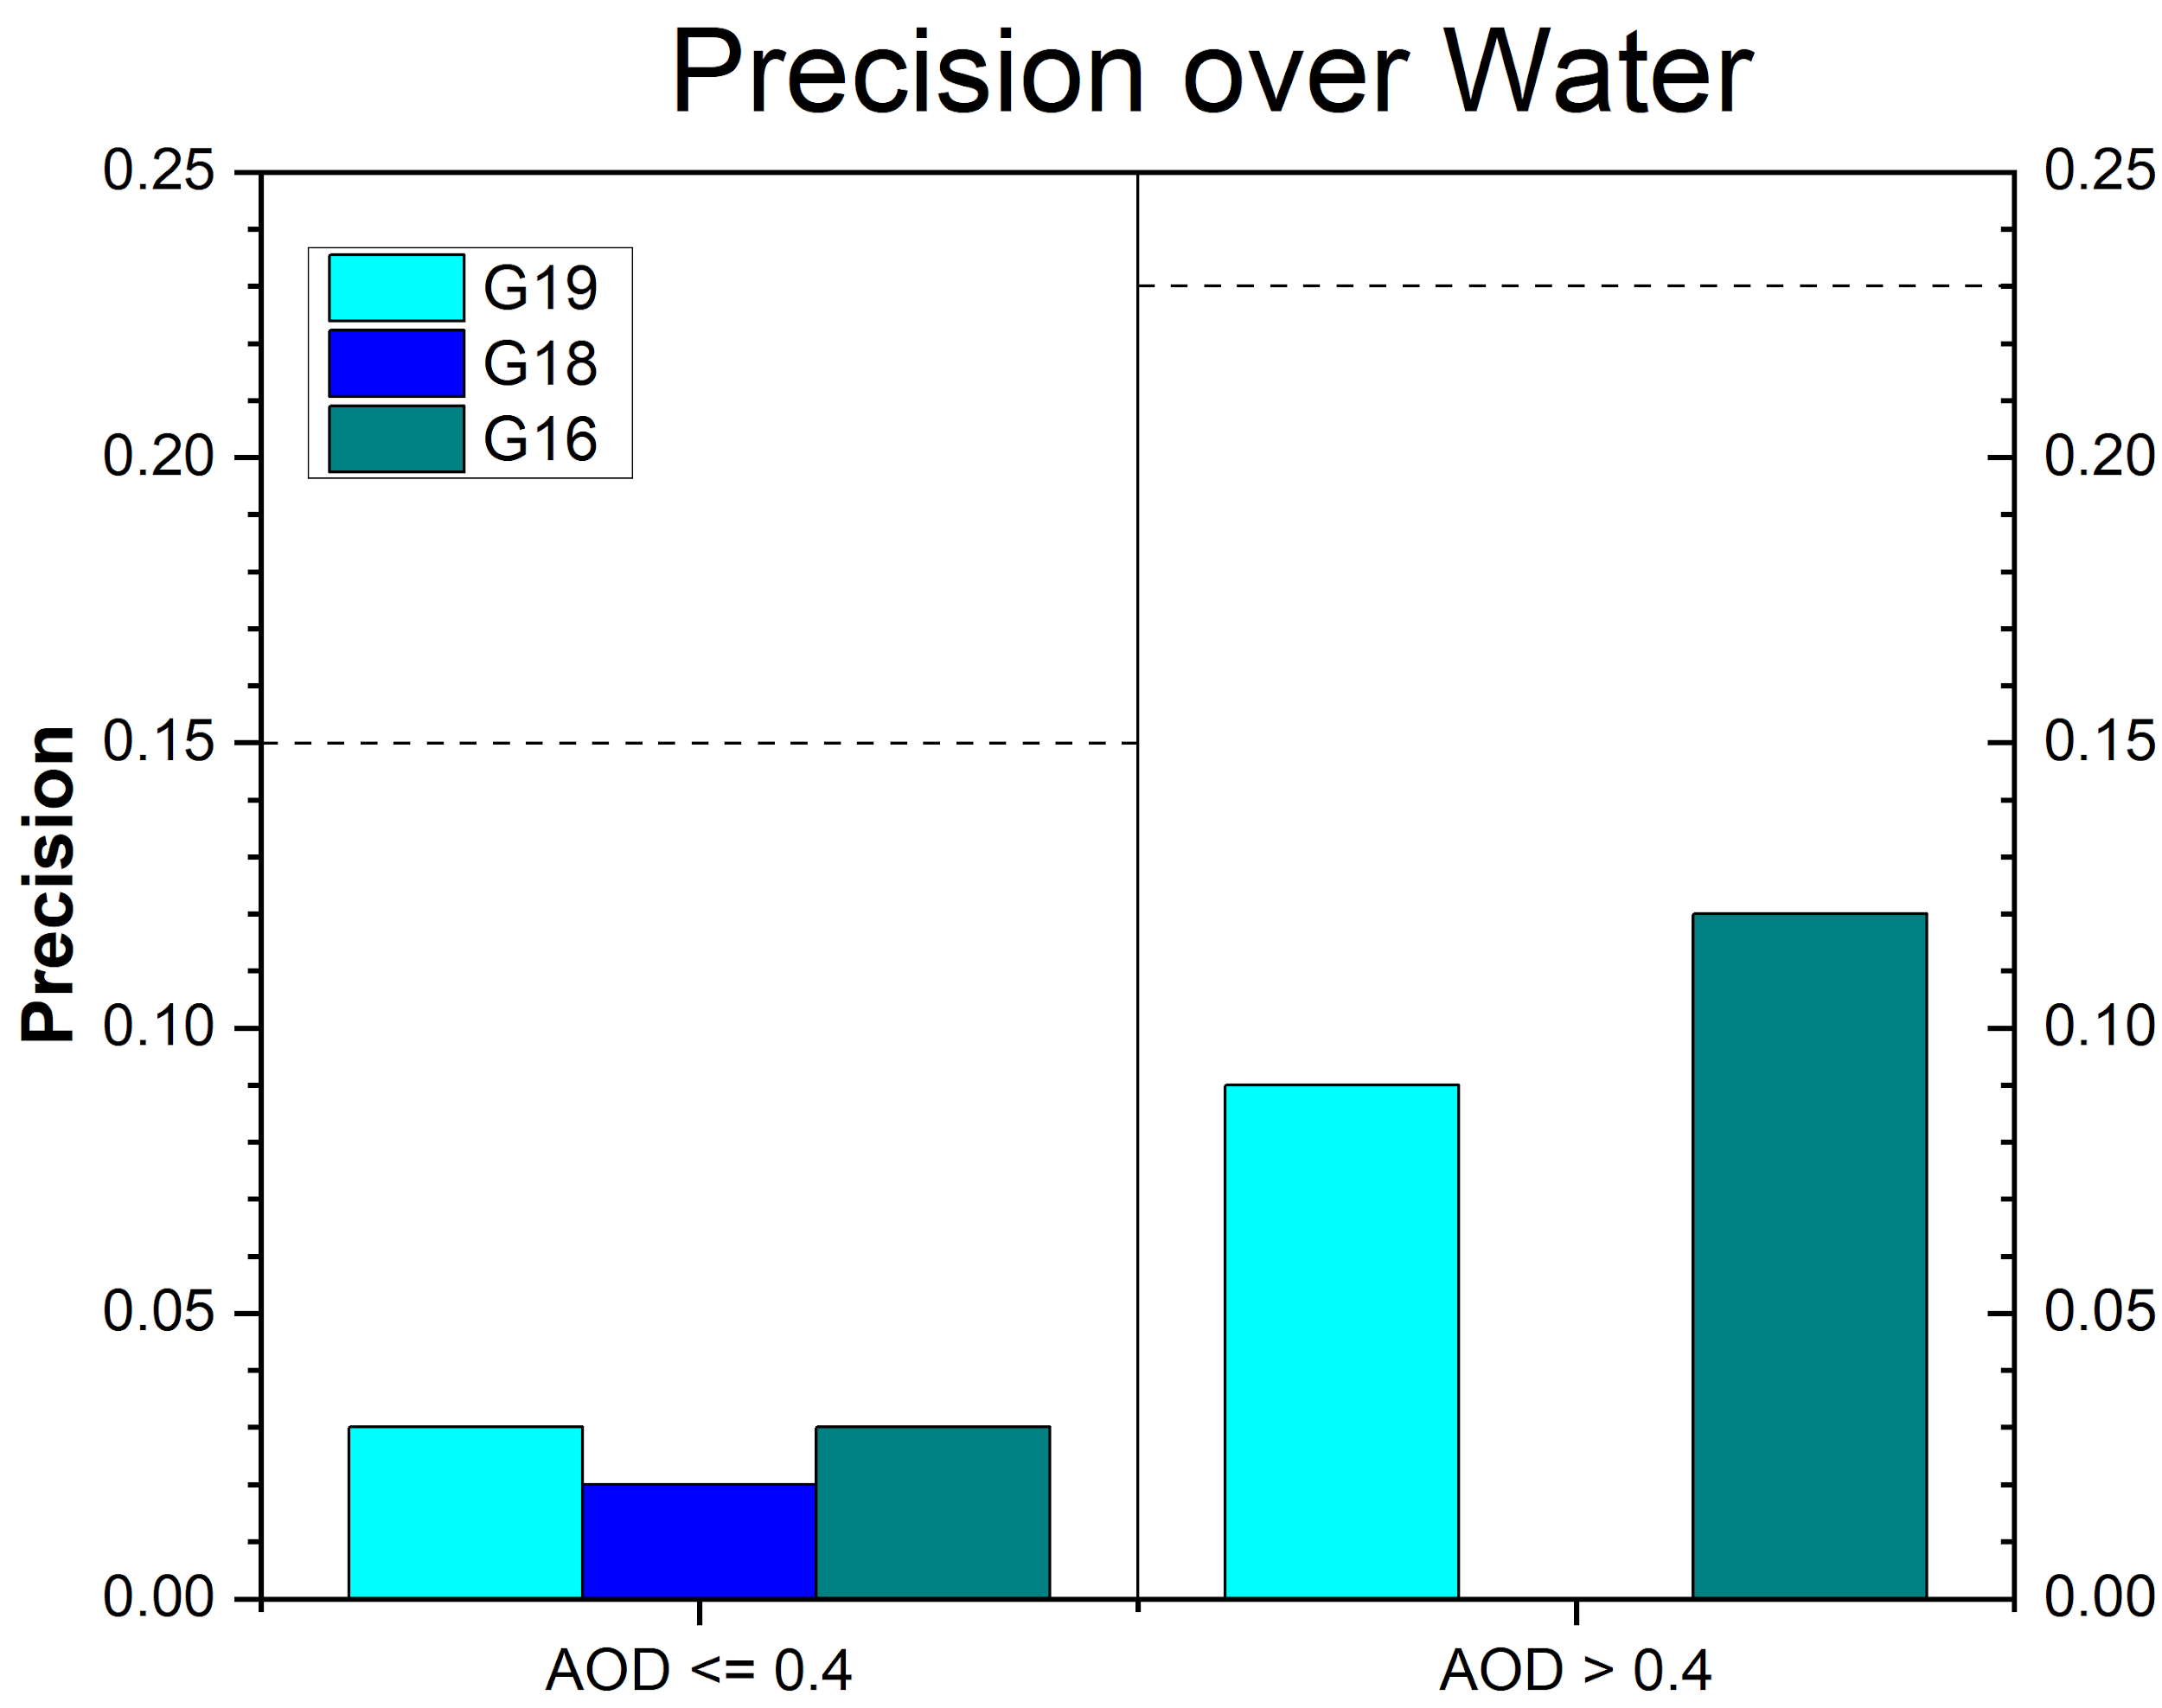
Graphical Summary of A and P
Accuracy (A) and precision (P) of G19, G18 and G16 AOD in defined AOD ranges.
Horizontal dashed lines are the requirement values.
Over land, G19 AOD does NOT meet accuracy (A) requirement in medium and high AOD ranges, but meets precision (P) requirements. In high AOD range, AOD from none of the satellites meets the accuracy requirement (limited sample size).
Over water, AOD from all three satellites meets accuracy and precision requirements.

Slide 27
G19 AOD Statistics - FD
High Quality 550-nm ABI AOD (10/01/2024 – 12/31/2024)
Range | Land |  |  |  | Water
 | AOD | Accuracy | Precision | # of points | AOD | Accuracy | Precision | # of points
Low | <0.04 | -0.05 (0.06) | 0.02 (0.13) | 8,405 | <0.4 | 0.02 (0.02) | 0.03 (0.15) | 13,039
Medium | 0.04 - 0.8 | -0.09 (0.04) | 0.05 (0.25) | 39,019
High | > 0.8 | -0.19 (0.12) | 0.26 (0.35) | 358 | >0.4 | -0.06 (0.10) | 0.09 (0.23) | 19
Accuracy and precision of G19 ABI 550-nm AOD in comparison with AERONET AOD over land and water using collocated ABI-AERONET dataset. F&PS requirements are in parenthesis.
Accuracy and precision are evaluated using only high QC AOD in the required AOD ranges. Here “low”, “medium” and “high” refer to the magnitude of AOD not to its quality.
Accuracy requirements are NOT met in medium and high AOD ranges over land. (Source of overall negative bias.)

Slide 28
G16 AOD Statistics – FD
High Quality 550-nm ABI AOD (10/01/2024 – 12/31/2024)
Range | Land |  |  |  | Water
 | AOD | Accuracy | Precision | # of points | AOD | Accuracy | Precision | # of points
Low | <0.04 | 0.02 (0.06) | 0.03 (0.13) | 24,536 | <0.4 | 0.01 (0.02) | 0.03 (0.15) | 13,595
Medium | 0.04 - 0.8 | 0.01 (0.04) | 0.06 (0.25) | 57,417
High | > 0.8 | 0.18 (0.12) | 0.36 (0.35) | 496 | >0.4 | 0.03 (0.10) | 0.12 (0.23) | 77
Accuracy and precision of G16 ABI 550-nm AOD in comparison with AERONET AOD over land and water using collocated ABI-AERONET dataset. F&PS requirements are in parenthesis.
Requirements are met except for those in high AOD range over land with limited sample size.

Slide 29
G18 AOD Statistics – FD
High Quality 550-nm ABI AOD (10/01/2024 – 12/31/2024)
Range | Land |  |  |  | Water
 | AOD | Accuracy | Precision | # of points | AOD | Accuracy | Precision | # of points
Low | <0.04 | -0.00 (0.06) | 0.03 (0.13) | 21,904 | <0.4 | 0.01 (0.02) | 0.02 (0.15) | 6,795
Medium | 0.04 - 0.8 | -0.02 (0.04) | 0.03 (0.25) | 33,682
High | > 0.8 | -0.77 (0.12) | 0.06 (0.35) | 7 | >0.4 | -- | -- | 0
Accuracy and precision of G16 ABI 550-nm AOD in comparison with AERONET AOD over land and water using collocated ABI-AERONET dataset. F&PS requirements are in parenthesis.
(--) means data are not available and/or statistic is not calculated.
Requirements are met except for accuracy in high AOD range over land. Data are not available in high AOD value range over water.

Slide 30
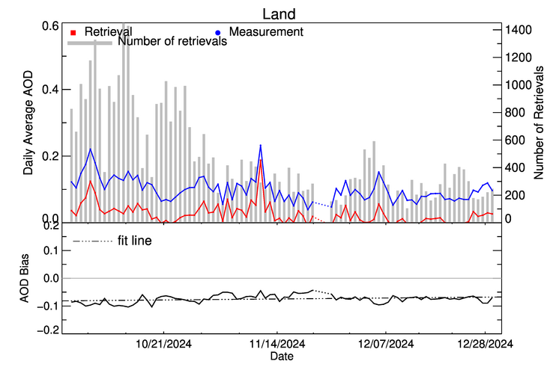
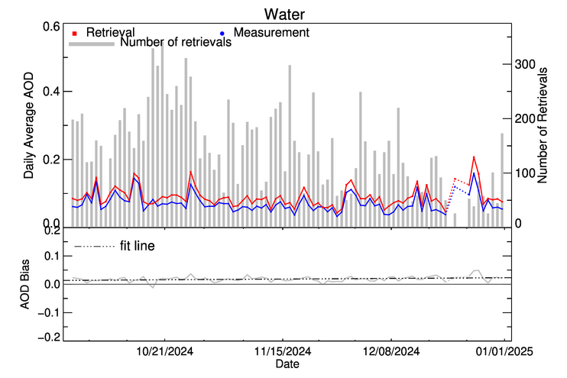
Time Series of G19 AOD - FD
10/01/2024 – 12/31/2024 High QC
Time series of daily average high-quality GOES-19 and AERONET AOD and of GOES-19 – AERONET bias for dark land (upper panel) and water (lower panel).
GOES-19 AOD tracks AERONET AOD, but …
Over land, there is a consistent, large negative (-0.1) bias.
Over water, there is a small positive bias.

Slide 31
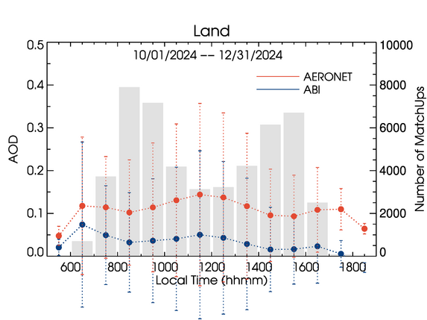
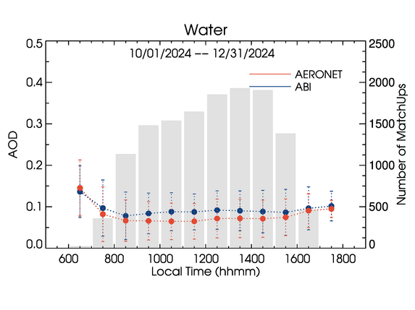
Diurnal Cycle – G19 FD
10/01/2024 – 12/31/2024 High QC
AODs from all sites are averaged.
Diurnal variation of G19 AOD over dark land exhibits a consistent negative bias.
Diurnal variation of G19 AOD over water mostly follows that in AERONET AOD.

Slide 32
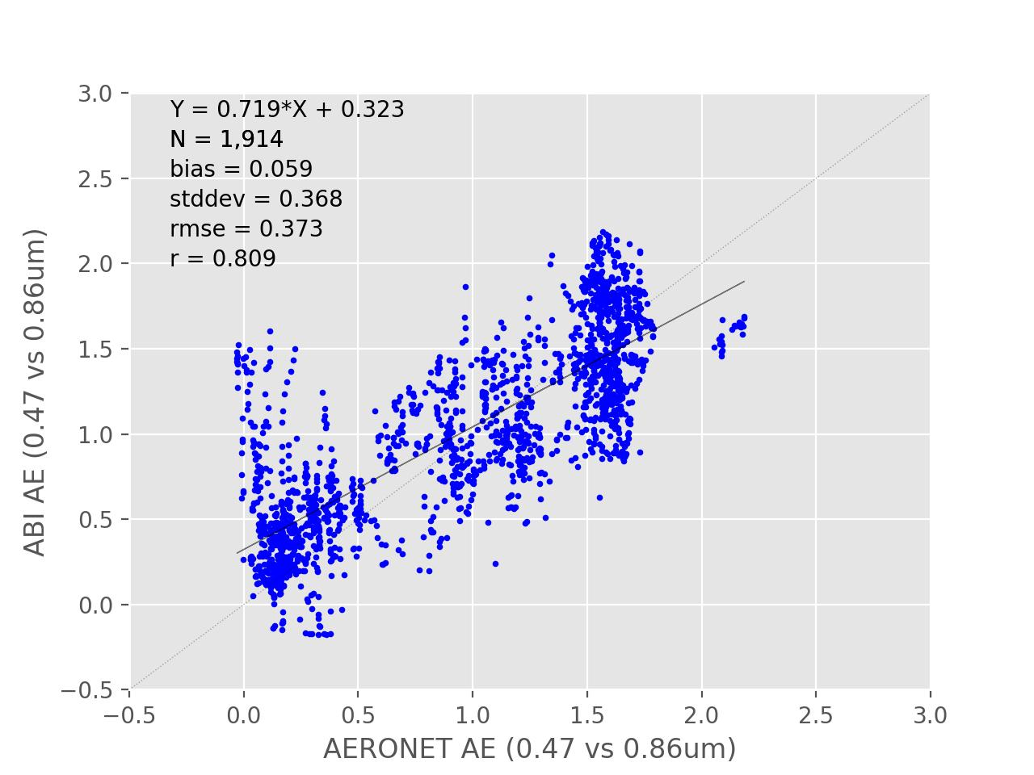
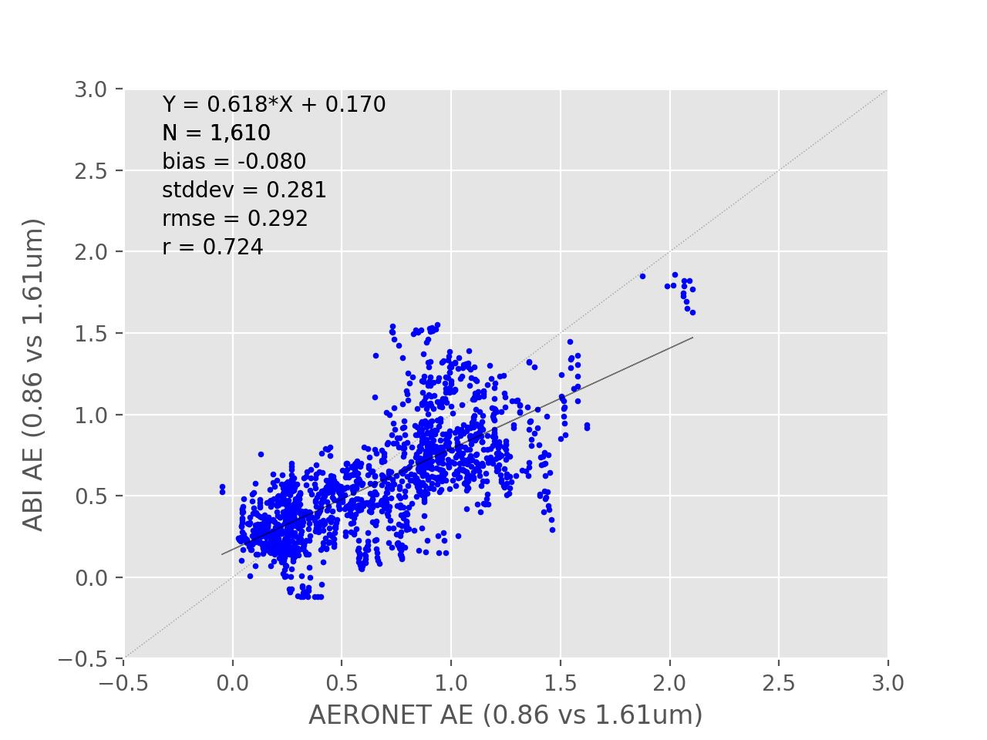
Top2 QC GOES-19 AE - FD
AE1
AE2
From Medium + High quality ABI AOD retrievals and AERONET AOD >= 0.15.
Time period: 10/01/2024 – 01/10/2025
Bias and STD is 0.06/-0.08 and 0.37/0.28 for AE1/AE2.
GOES-19 AEs meet requirements for Accuracy (0.3) and Precision (0.6).

Slide 33
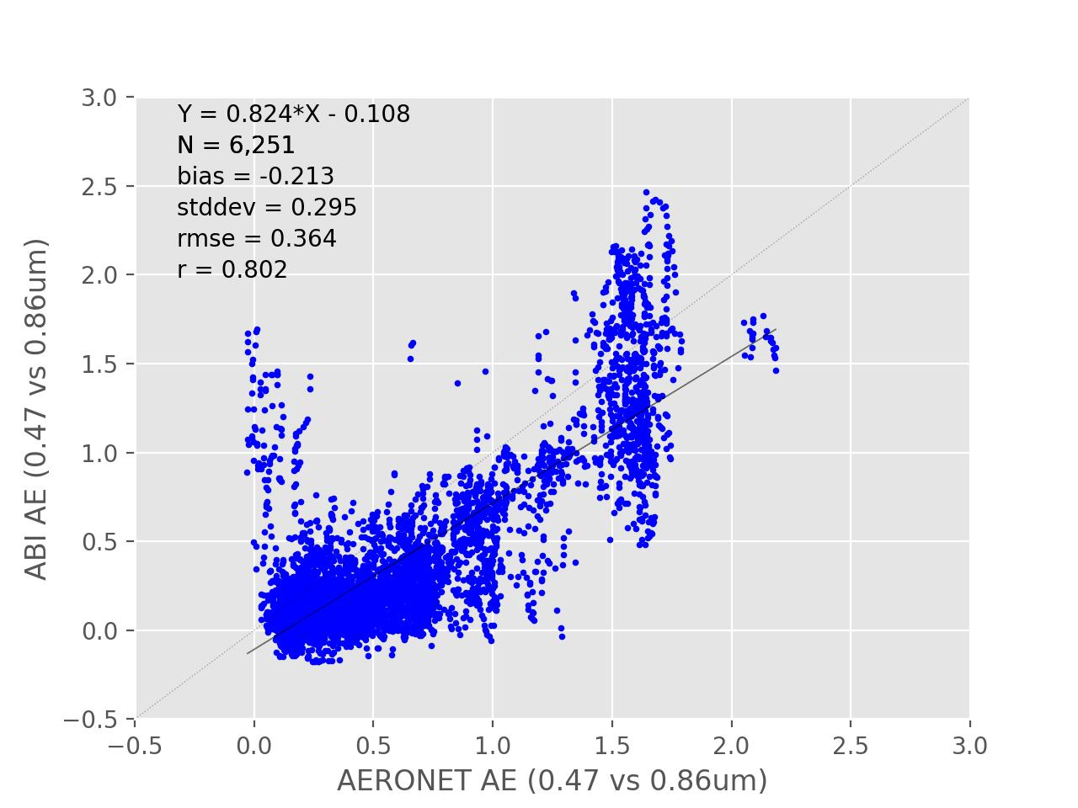
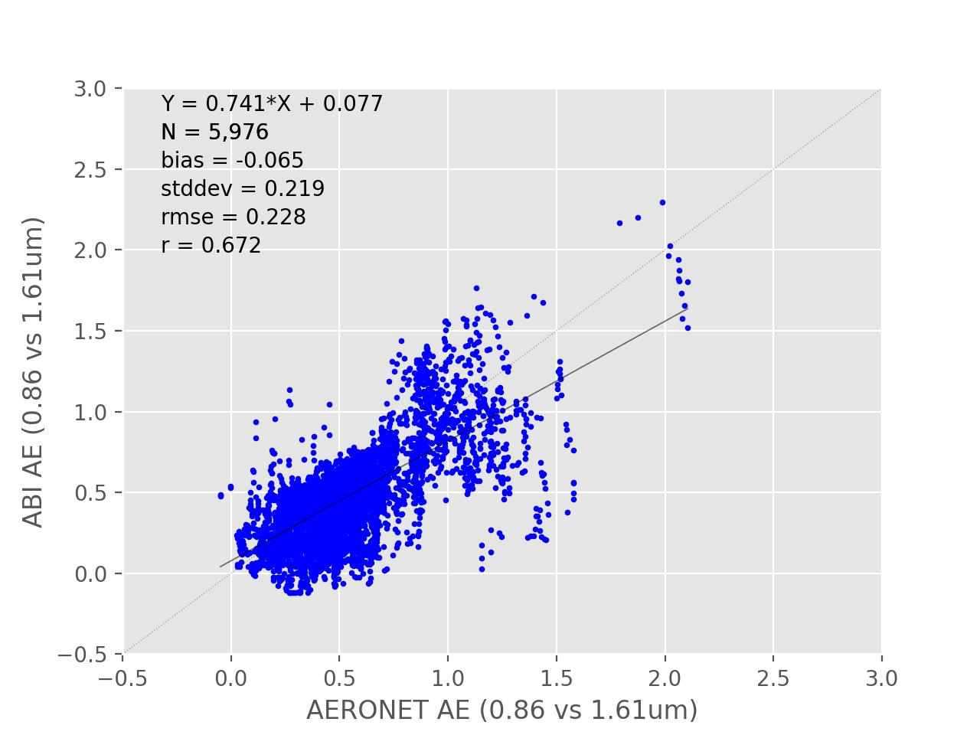
Top2 QC GOES-16 AE - FD
AE1
AE2
From Medium + High quality ABI AOD retrievals and AERONET AOD >= 0.15.
Time period: 10/01/2024 – 01/10/2025
Bias and STD is -0.21/-0.07 and 0.30/0.22 for AE1/AE2.
G16 AEs meet requirements for Accuracy (0.3) and Precision (0.6)

Slide 34
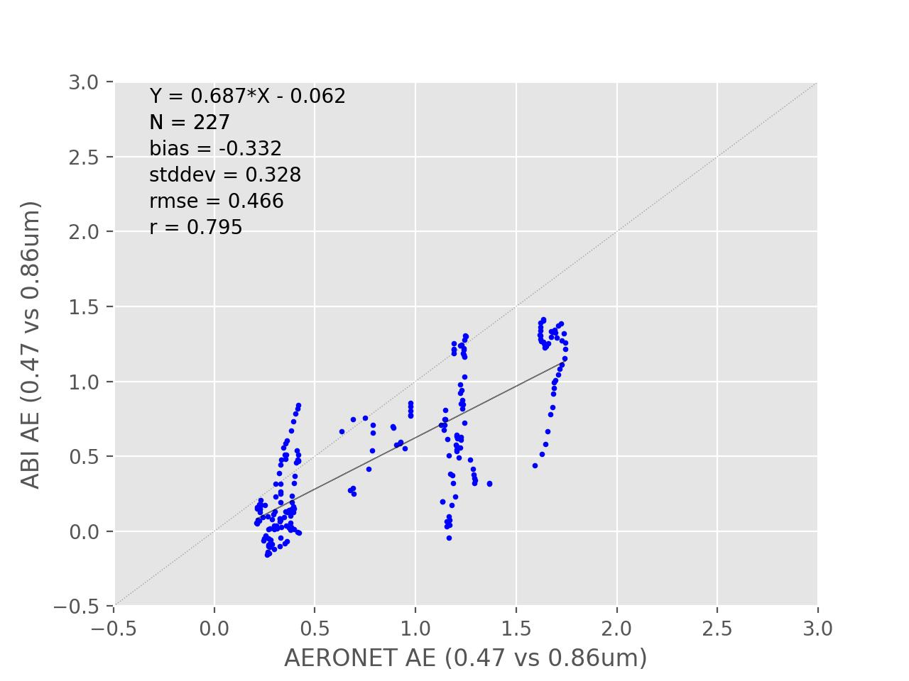
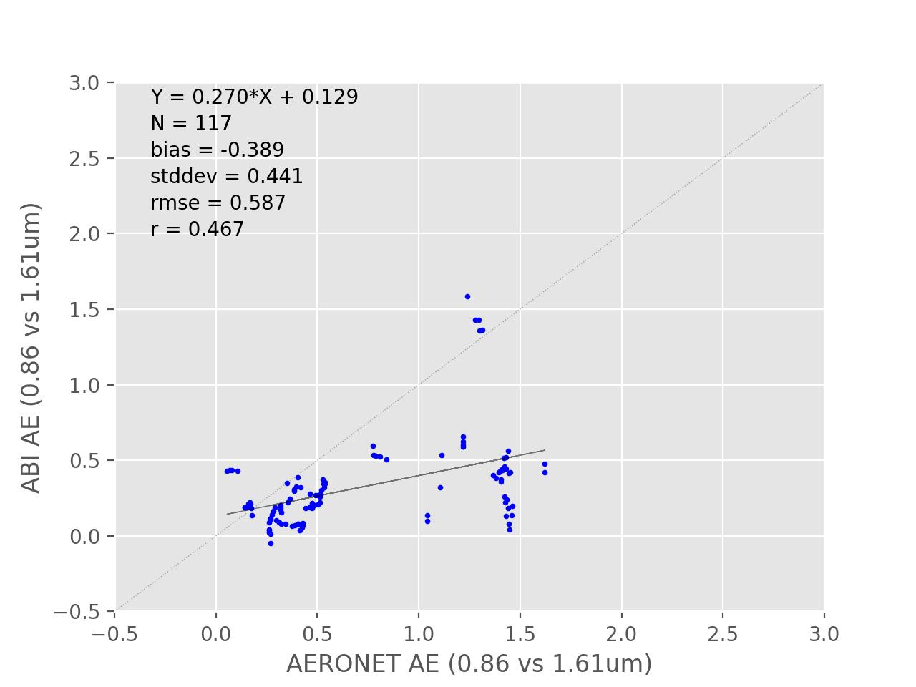
Top2 QC GOES-18 AE - FD
AE1
AE2
From Medium + High quality ABI AOD retrievals and AERONET AOD >= 0.15.
Time period: 10/01/2024 – 01/10/2025
Bias and STD is -0.33/-0.39 and 0.33/0.44 for AE1/AE2.
G18 AEs meet requirement for Precision (0.6), but do NOT meet for Accuracy (0.3) – Small sample size.

Slide 35
Potential Sources of G19 AOD Bias Over Land
GOES-19 Aerosol Optical Depth L2 Product Provisional PS-PVR

Slide 36
Potential Sources of G19 AOD Bias Over Land
Sources of bias:
Difference between GOES-19 and GOES-16 L1B reflectances.
GOES-19 AOD retrieval uses spectral surface reflectance relationships developed from observations made from the GOES-East operational position. Impact on AOD is small. (Supplement D)
GOES-19 AOD retrieval uses spectral surface reflectance relationships developed for GOES-16.

Slide 37
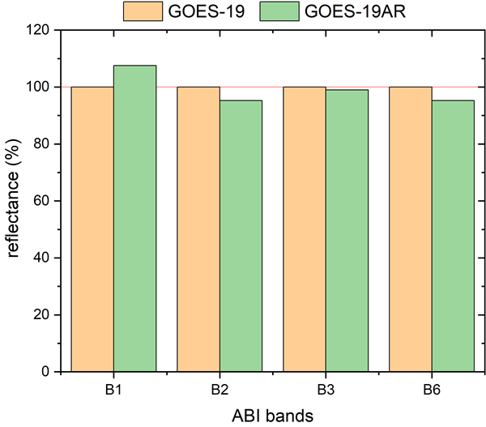
Test of Source 1:
Difference between GOES-19 and GOES-16 L1B reflectances
CWG (Oct 11, 2024): "Compared to GOES-16, GOES-19 B1 is ~7% darker, GOES-19 B2 is ~5% brighter, and B3 & B6 are ~1% and ~5% brighter".
Offline run every 5 days with adjusted G19 reflectance (AR):
  AR_G19(B1) = 1/0.93 * G19(B1)
  AR_G19(B2) = 1/1.05 * G19(B2)
  AR_G19(B3) = 1/1.01 * G19(B3)
  AR_G19(B6) = 1/1.05 * G19(B6)
  Offline = retrieval with adjusted G19 reflectance

Slide 38
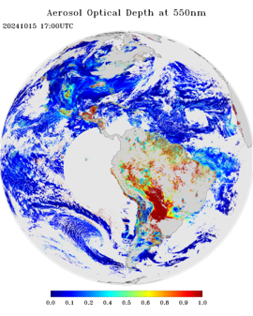
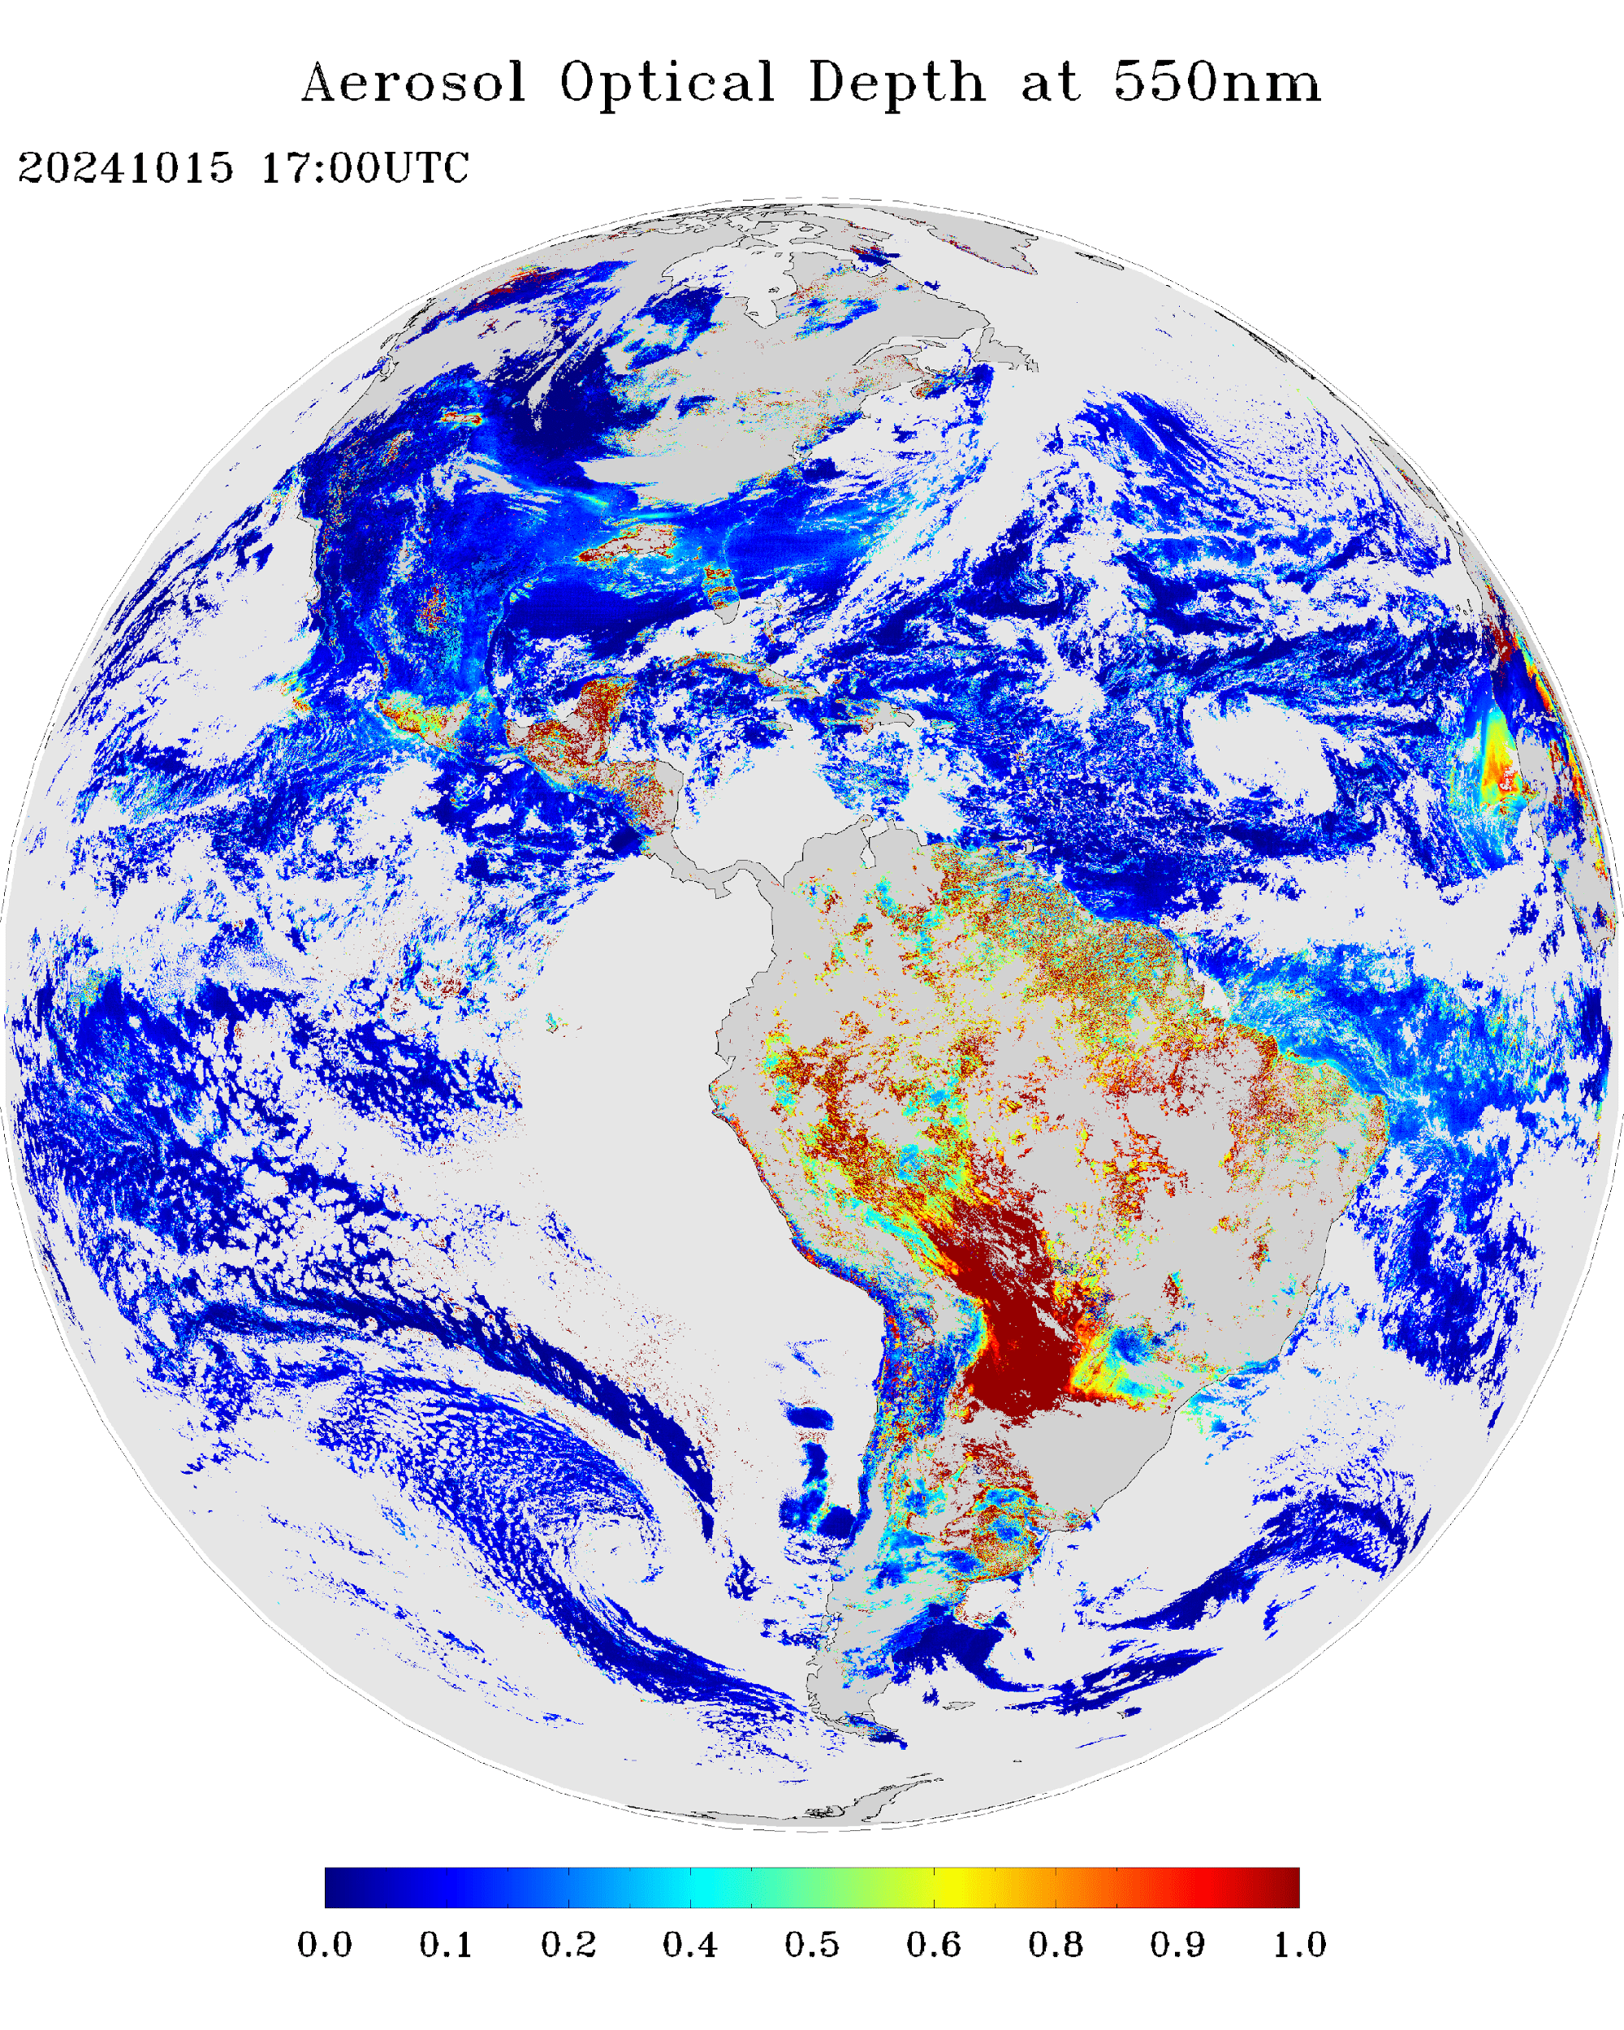
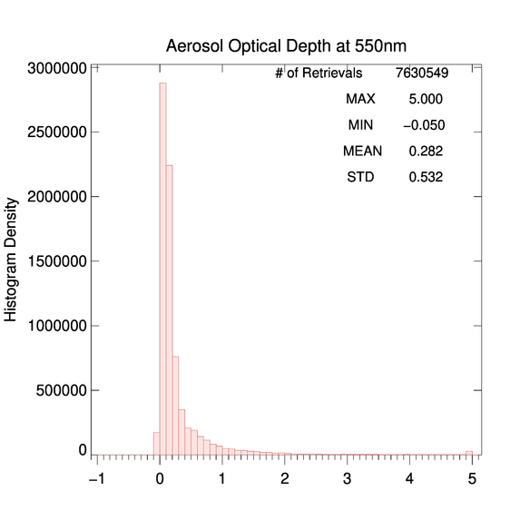
Test of Source 1:
GOES-19 Offline vs. GOES-16
Low+Medium+High QC AOD
10/15/2024 17:00 UTC
PLPT test ABI-FD_AOD01
Land-water discontinuity in G19 offline AOD is decreased.
Similar pattern and magnitude over both land and water.
Histograms of G19 offline and G16 operational AOD are similar. The offline G19 AOD value is larger than the operational G19 AOD but still smaller than G16 AOD.
G19
G16

Slide 39
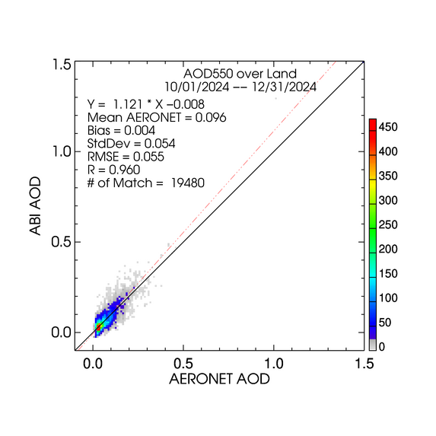
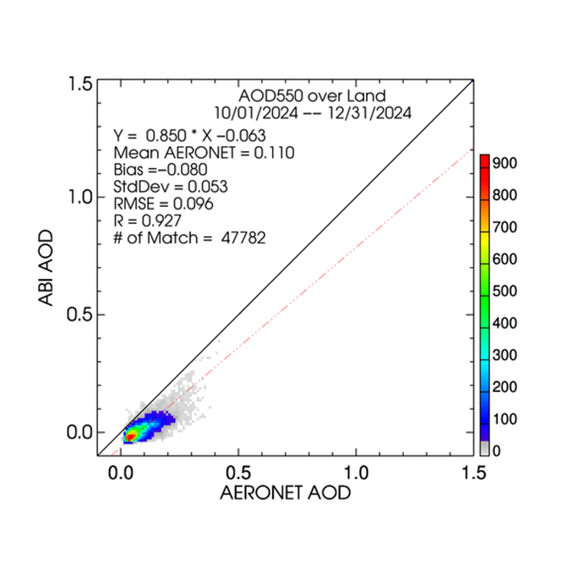
Test of Source 1:
High QC GOES-19 over-land AOD - FD
LAND
From un-adjusted reflectances
From adjusted reflectances
High quality AODs are plotted regardless of magnitude (range).
GOES-19 over-land accuracy is improved from -0.080 to 0.004.

Slide 40
Test of Source 1:
GOES-19 Offline AOD Statistics - FD
High Quality 550-nm ABI AOD (10/01/2024 – 12/31/2024, every 5 days)
Range | Land |  |  |  | Water
 | AOD | Accuracy | Precision | # of points | AOD | Accuracy | Precision | # of points
Low | <0.04 | 0.01(0.06) | 0.03 (0.13) | 6,806 | <0.4 | 0.01 (0.02) | 0.02 (0.15) | 4,101
Medium | 0.04 - 0.8 | 0.00 (0.04) | 0.05 (0.25) | 13,238
High | > 0.8 | 0.19 (0.12) | 0.31 (0.35) | 156 | >0.4 | -0.30 (0.10) | 0.01 (0.23) | 2
Accuracy and precision of G19 ABI 550-nm AOD in comparison with AERONET AOD over land and water using collocated ABI-AERONET dataset. F&PS requirements are in parenthesis.
Accuracy and precision are evaluated using only high QC AOD in the required AOD ranges. Here “low”, “medium” and “high” refer to the magnitude of AOD not to its quality.
Requirements are met except for accuracy in high AOD range over land and water with limited sample size.

Slide 41
Test of Source 3:
GOES-19 AOD retrieval uses spectral surface reflectance relationships developed for GOES-16
Method:
Derived spectral surface reflectance relationship based on unadjusted G19 ABI measurements
  Atmospheric correction of collocated G19 ABI reflectances and AERONET AOD to retrieve spectral surface reflectances
    10/01/2024 – 01/10/2025
    AERONET AOD550 < 0.1
  Derived spectral surface reflectance relationship from the spectral surface reflectance data
Offline G19 ABI AOD retrieval with updated spectral surface reflectance relationship
  10/01/2014 – 01/10/2025
  Evaluation against AERONET measurements

Slide 42
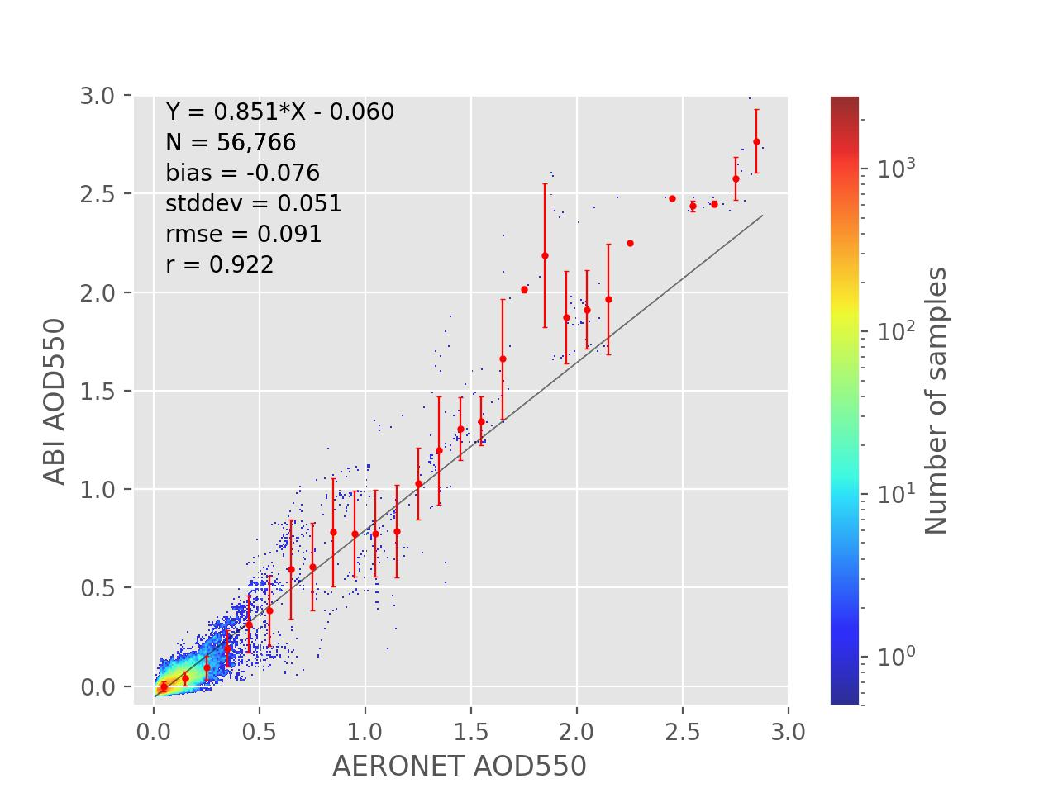
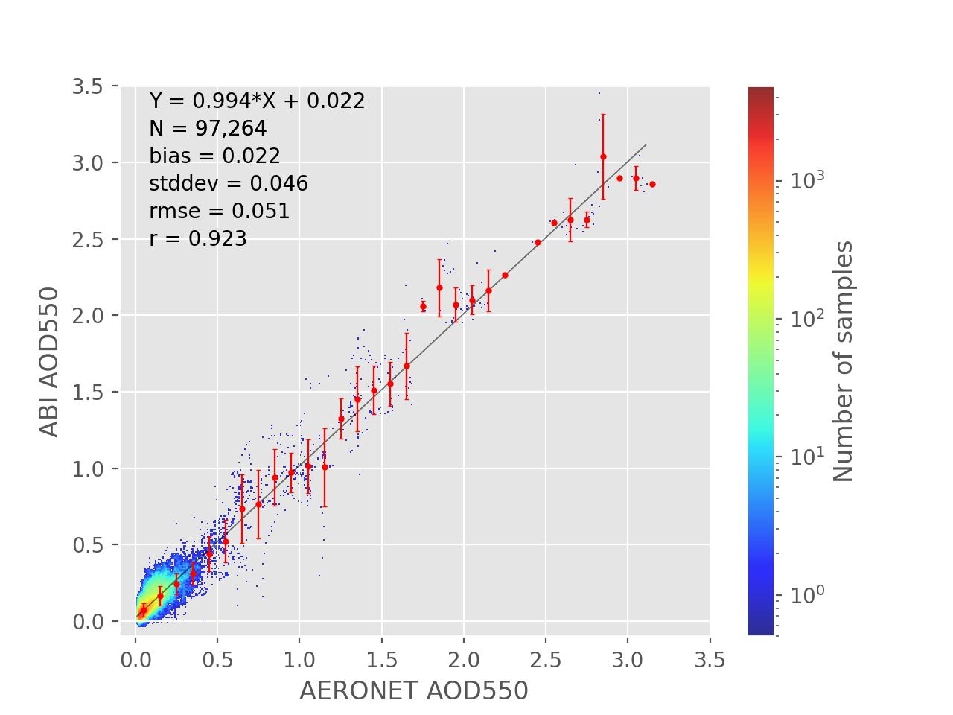
Test of Source 3: Validation over Dark Land
G19 ABI AOD
Retrieved with updated relationship
G19 ABI AOD
Updated spectral surface reflectance relationship improves GOES-19 AOD retrieval
High Quality 550-nm ABI AOD (10/01/2024 – 01/10/2025) Over Dark Land
AOD Range | G19 operational |  |  | G19 with Updated Relationship
 | Accuracy | Precision | # of points | Accuracy | Precision | # of points
Low (<0.04) | -0.04 (0.06) | 0.02 (0.13) | 10,850 | 0.02 (0.06) | 0.03 (0.13) | 30,673
Medium (0.04 - 0.8) | -0.08 (0.04) | 0.05 (0.25) | 45,571 | 0.02 (0.04) | 0.05 (0.25) | 66,203
High (> 0.8) | -0.16 (0.12) | 0.26 (0.35) | 345 | 0.03 (0.12) | 0.20 (0.35) | 388

Slide 43
Summary of GOES-19 vs. AERONET AOD Comparison
GOES-19 AOD retrievals were compared with AERONET version 3 level 1.5 data.
GOES-19 AOD has a consistent negative bias over land.
  Bias is due to two things: 1) G19 and G16 ABI L1B spectral reflectances are different, 2) the current G19 AOD retrieval uses the surface reflectance relationship developed for G16.
  GOES-19 AOD retrieved with updated surface reflectance relationships meets the accuracy and precision requirements over land.
The quality of GOES-19 AOD in high AOD range over land is more or less similar to those of GOES-16 and GOES-18 AOD.
GOES-19 AOD over water meets requirements.
Same is true for CONUS (Supplements A and B).
Overall metrics: Partial-Passed

Slide 44
Summary of Comparison of Offline G19 AOD with
Other Satellite Products
Offline GOES-19 AOD retrievals have been compared with GOES-16, GOES-18, VIIRS and MODIS AOD retrievals at AERONET sites. (Results for S-NPP and NOAA-21 VIIRS, GOES-18 and MODIS are in Supplement C.)
  Offline results were used since they approximate impact of updated surface reflectance relationships.
Over water, GOES-19 bias and standard deviation are similar to VIIRS, MODIS, GOES-16 and GOES-18. (Passed)
Over land, GOES-19 bias and standard deviation are comparable or smaller than VIIRS, MODIS, GOES-16 and GOES-18. (Passed)

Slide 45
PROVISIONAL MATURITY ASSESSMENT
GOES-19 Aerosol Optical Depth L2 Product Provisional PS-PVR

Slide 46
Provisional Validation
Preparation Activities | Assessment
Validation activities are ongoing and the general research community is now encouraged to participate. | Validation activities are ongoing. Standing by to receive feedback from the general research community.
Severe algorithm anomalies are identified and under analysis. Solutions to anomalies are in development and testing. | Two operational risks have been identified. One AOD ADR remains open (occasional missing block), but it does not impact accuracy/precision. The other risk (impacting accuracy over land) is being addressed.
Incremental product improvements may still be occurring. | Incremental product improvements are expected.
Users are engaged in the Product Feedback Forums and user feedback is assessed. | In progress.

Slide 47
Provisional Validation
End State | Assessment
Product performance has been demonstrated through analysis of a small number of independent measurements obtained from select locations, periods, and associated ground truth or field campaign efforts. | This has been demonstrated using AERONET as ground truth and independent satellite retrievals from VIIRS/MODIS and GOES16/18.
Product analysis is sufficient to communicate product performance to users relative to expectations (Performance Baseline). | Concur.
Documentation of product performance exists that includes recommended remediation strategies for all risks and weaknesses. Any algorithm changes associated with risks have been documented, implemented, tested, and shared with the user community. | These are documented in this PS-PVR presentation and will be documented in a separate ReadMe file.
Testing has been fully documented. | Concur.
Product is ready for operational use and for use in comprehensive cal/val activities and product optimization. | Partially concur.

Slide 48
PATH TO FULL VALIDATION MATURITY
GOES-19 Aerosol Optical Depth L2 Product Provisional PS-PVR

Slide 49
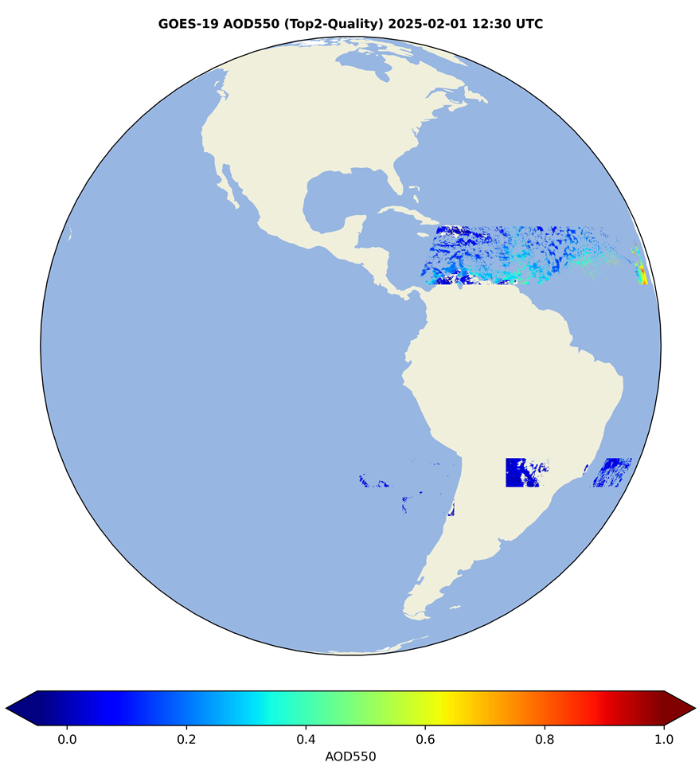
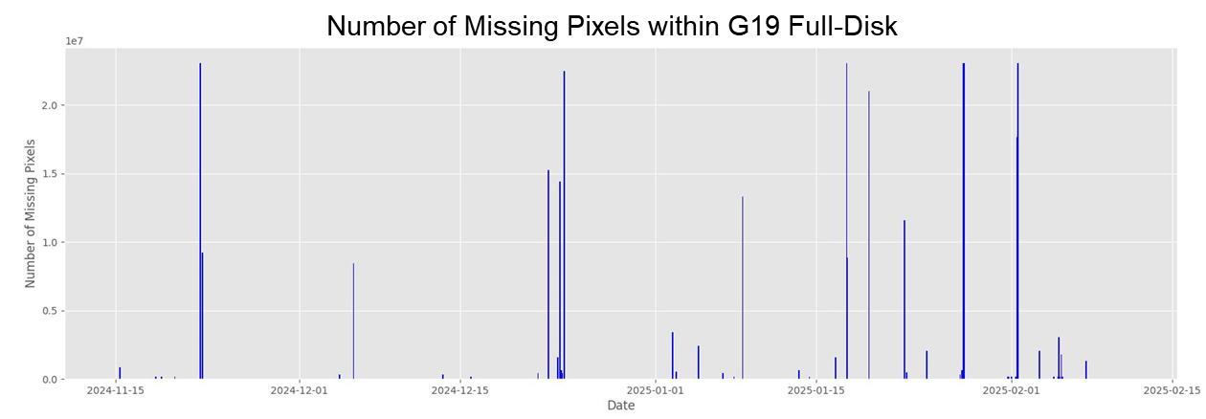
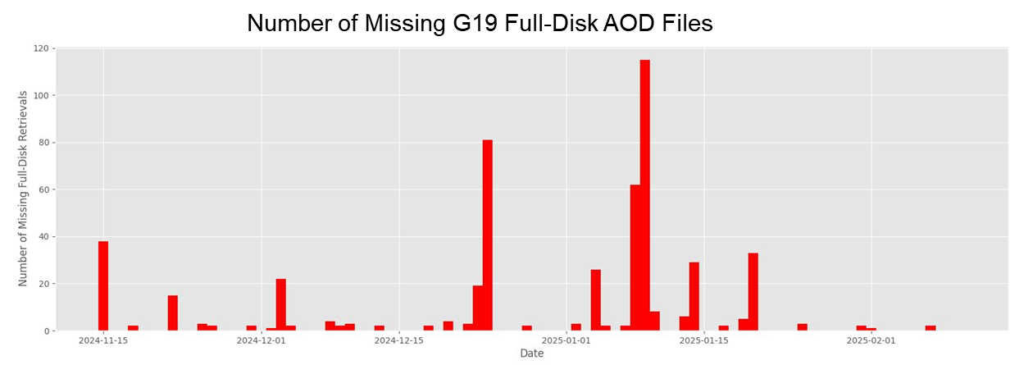
Issues and Status
ADRs Potentially Needing Resolution for Full VAL
ADR | Title | Status | Build
818, 947 | Occasional missing blocks over full disk AOD product | In analysis | --
Not very frequent, and does not affect accuracy and precision, and so for achieving Full Validated Maturity it may not be critical. However, fixing it is desired because events can be missed.
Applies to G16 as well.
Example of missing data blocks
11/15/2024 – 02/10/2025
79 out of 12,284 FD AOD files have missing retrievals (pixels with filled values counted as missing)
12 out of 88 days have >5 FD AOD files missing (time interval > 10min counted as missing)

Slide 50
Issues and Status
Other Actions Needed for Full VAL
Action | Title | Desired Implementation Date into OE
New ADR ^{[1]} | L2 AOD algorithm - update the land-surface reflectance relationship derived from GOES-19 data at the operational position. | ≧6 month prior to PS-PVR FULL
New ADR ^{[2]} | L2 AOD algorithm – Update internal tests | ≧6 month prior to PS-PVR FULL
[1] Current GOES-19 AOD retrieval uses the GOES-16 land-surface reflectance relationship. Due to differences between GOES-19 and GOES-16 L1B reflectances this leads to GOES-19 AOD accuracies that exceed requirement values in medium and high AOD ranges over land. Compliance can be achieved by developing GOES-19 specific surface reflectance relationships.
  Such preliminary GOES-19 spectral surface reflectance relationships have been derived using limited data observed from the test position, and have been delivered to ASSISTT. These data must be extended using data from the operational position and representing more seasons. ADR will be submitted following the Provisional PS-PVR.
[2] ADR will be created when at least 6 months of GOES-19 enterprise AOD is available for analysis and it suggests updates are needed.

Slide 51
Path to Full Validation - PLPTs
PLPT ID | Descriptive Title
ABI-FD_AOD05 | Assess precision and accuracy of Mode 6 FD product
ABI-CONUS_AOD06 | Assess precision and accuracy of Mode 6 CONUS product
AWG AOD Team will conduct these tests to further evaluate the L2 AOD product quality.
Full test plans and procedures are given in the AOD Readiness, Implementation, and Management Plan (RIMP v2.0; 410-R-RIMP-0326)

Slide 52
Path to Full Validation – Risks
Risk Name | Description | Impact | Mitigation and Schedule
Update land surface relationships | as discussed; Priority 1 | Big | New WR/ADR needed
Update AOD algorithm QC thresholds | as discussed; Priority 2 | Moderate | New WR/ADR needed
Little Impact
Moderate Impact
Big Impact

Slide 53
SUMMARY & RECOMMENDATIONS
GOES-19 Aerosol Optical Depth L2 Product Provisional PS-PVR

Slide 54
Summary
Measured AOD performance against reference data
  Accuracy requirements are met except for medium and high AOD ranges over land.
  Precision requirements are met.
  Updates will be needed for land surface relationship for reducing the current bias over land and for internal test thresholds to further improve performance.
Overall, the G19 AOD product is ready for operational and scientific use with the caveat that over land the bias in the medium range (AOD: 0.04-0.8) is relatively large
  Updated surface reflectance relationship reduces the over-land bias and ensures compliance with requirements.
  In general, high quality retrievals are recommended for quantitative applications due to their better overall performance.

Slide 55
Recommendation
AWG Aerosol Team believes that the GOES-19 L2 AOD product has reached Provisional Maturity as defined by the GOES-R Program.
  Source of AOD bias in the medium range that leads to not meeting the requirement is known.
  Surface reflectance relationship developed specifically for GOES-19 ABI, that is shown to significantly reduce the bias over land, has been delivered to ASSISTT.

Slide 56
SUPPLEMENTS
SUPPLEMENT A: VISUAL AND QUANTITATIVE COMPARISONS WITH GOES-16 - CONUS
SUPPLEMENT B: COMPARISON WITH AERONET GROUND MEASUREMENTS – CONUS
SUPPLEMENT C: COMPARISON WITH VIIRS/MODIS/GOES-18 AT AERONET STATIONS
SUPPLEMENT D: TEST OF SOURCE 2 OF OVER-LAND GOES-19 AOD BIAS
GOES-19 Aerosol Optical Depth L2 Product Provisional PS-PVR

Slide 57
Supplement A
VISUAL AND QUANTITATIVE COMPARISONS WITH GOES-16 - CONUS
GOES-19 Aerosol Optical Depth L2 Product Provisional PS-PVR

Slide 58
Data Used
G16, G18, and G19 ABI CONUS AOD matched up with AERONET measurements
Time period: 11/05/2024 - 01/31/2025

Slide 59
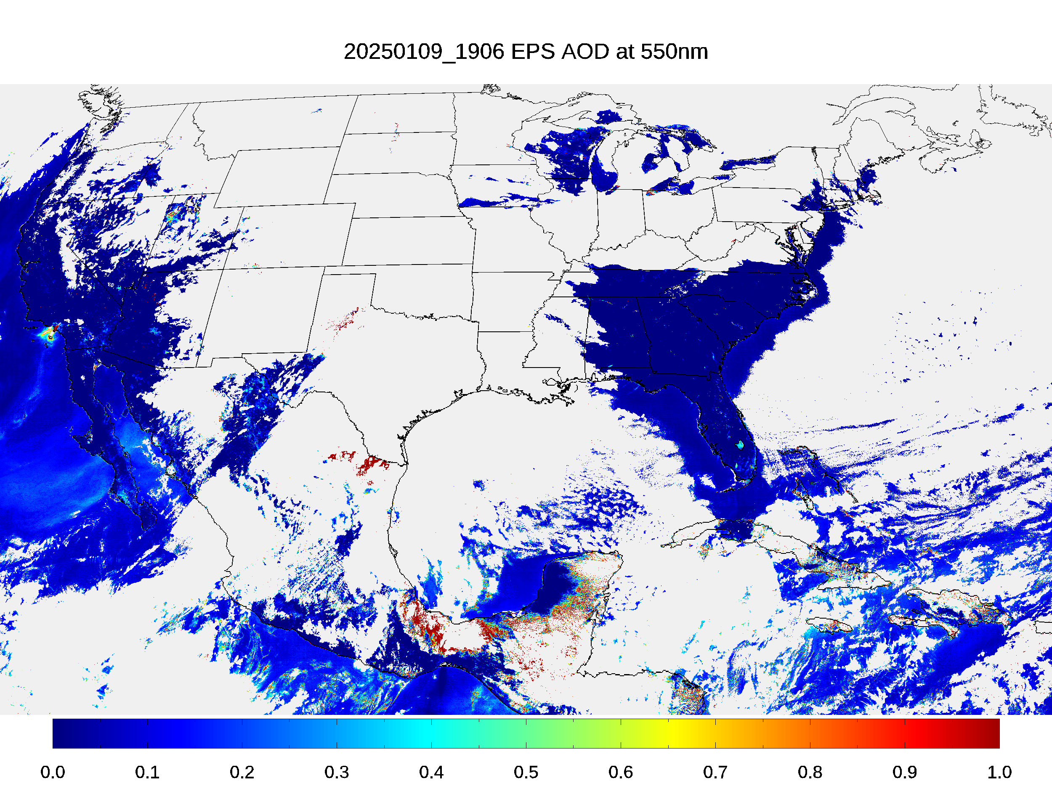
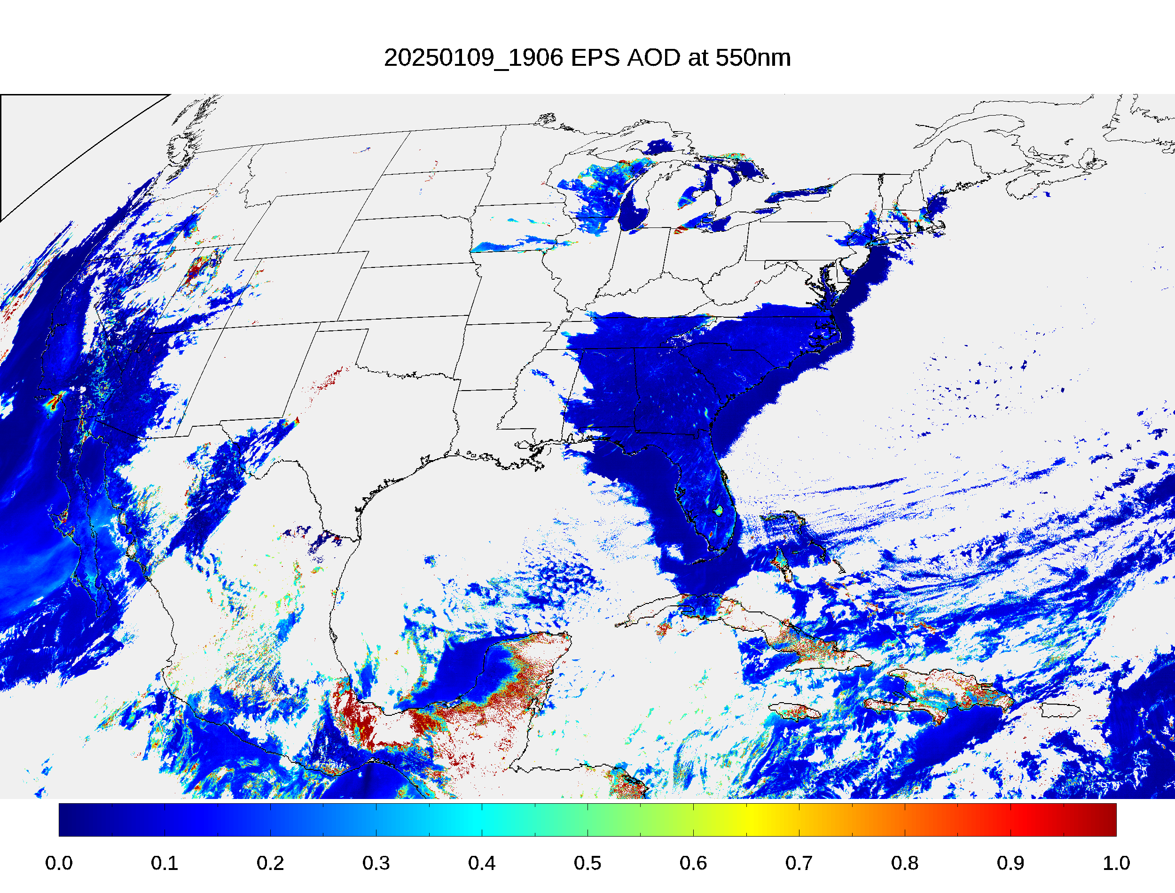
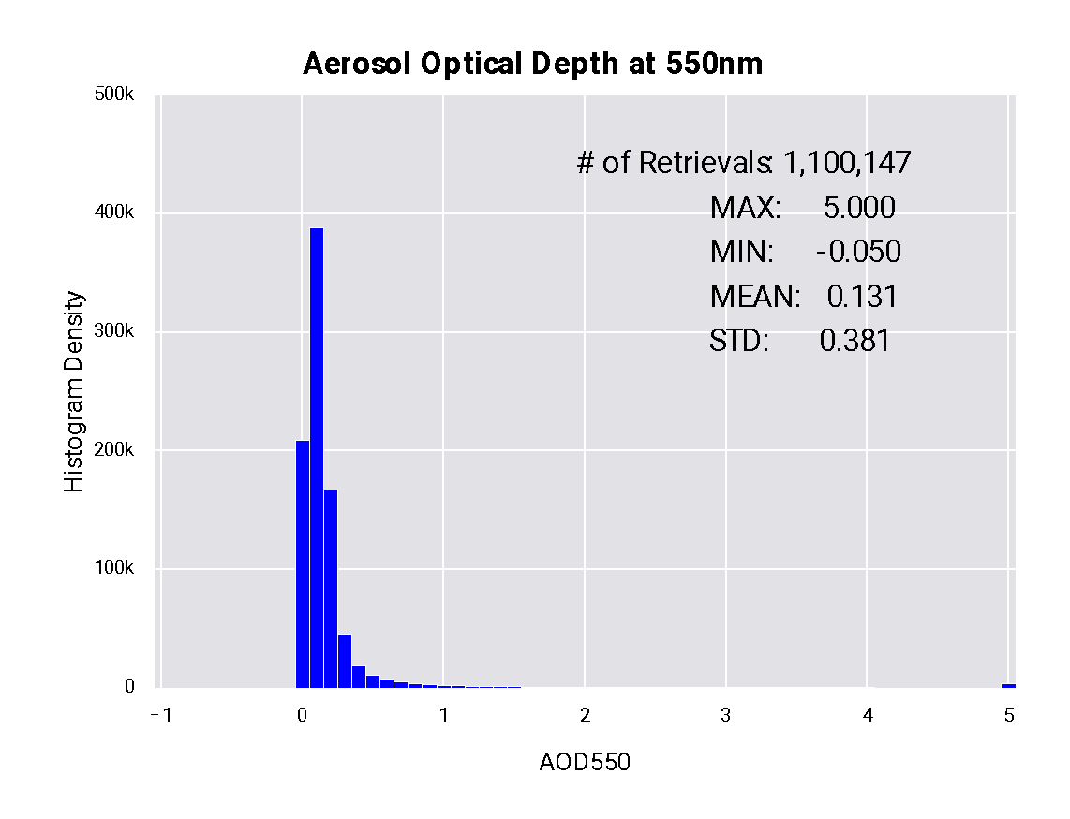

GOES-19 vs. GOES-16
Low+Medium+High QC AOD
01/09/2025 19:06 UTC
PLPT test ABI-FD_AOD02
G19 AOD field is as expected.
Over water, G19 and G16 AOD pattern and magnitude are similar. Lower AOD over land.
Land-water discontinuity of AOD in G19 is larger than that in G16.
G19 has a smaller mean AOD compared to G16.
G19 AOD is within valid range. (Passed)
G19
G16

Slide 60




GOES-19 vs. GOES-16
Low+Medium+High QC AE1
01/09/2025 19:06 UTC
PLPT test ABI-FD_AOD02
Low+medium+high QC Angstrom Exponent (AE) is used due to limited spatial coverage for medium and high QC retrievals.
The range of G19 AE1 in wavelength pair (0.47, 0.86) µm is as expected.
Relative to G16, G19 AE1 has larger AE1 values, suggesting smaller aerosol particles.
G19
G16

Slide 61




GOES-19 vs. GOES-16
Low+Medium+High QC AE2
01/09/2025 19:06 UTC
PLPT test ABI-FD_AOD02
The range of G19 AE2 in wavelength pair (0.86, 1.61) µm is as expected.
Relative to G16, the G19 mean AE2 is larger, suggesting smaller aerosol particles.
The difference between G19 and G16 AE2 is relatively smaller than that for AE1.
G19
G16

Slide 62
Supplement B
COMPARISON WITH AERONET GROUND MEASUREMENTS - CONUS
GOES-19 Aerosol Optical Depth L2 Product Provisional PS-PVR

Slide 63



High QC GOES-19 AOD – CONUS over Land
G16
G18
G19
Time period: 11/05/2024 – 01/31/2025
Compared to GOES-16 (G16) and GOES-18 (G18), GOES-19 (G19) AOD shows underestimation.

Slide 64



High QC GOES-19 AOD – CONUS over Water
G16
G18
G19
Time period: 11/05/2024 – 01/31/2025
Statistics of G19, G16 and G18 AODs compared to reference (AERONET) AOD are similar over water.

Slide 65
G19 AOD Statistics - CONUS
High Quality 550-nm ABI AOD (11/05/2024 – 01/31/2025)
Range | Land |  |  |  | Water
 | AOD | Accuracy | Precision | # of points | AOD | Accuracy | Precision | # of points
Low | <0.04 | -0.05 (0.06) | 0.02 (0.13) | 17,360 | <0.4 | 0.02 (0.02) | 0.02 (0.15) | 17,861
Medium | 0.04 - 0.8 | -0.08 (0.04) | 0.04 (0.25) | 34,425
High | > 0.8 | N/A (0.12) | N/A (0.35) | 0 | >0.4 | N/A (0.10) | N/A (0.23) | 0
Accuracy and precision of G19 ABI 550-nm AOD in comparison with AERONET AOD over land and water using collocated ABI-AERONET dataset. F&PS requirements are in parenthesis.
Accuracy and precision are evaluated using only high QC AOD in the required AOD ranges. Here “low”, “medium” and “high” refer to the magnitude of AOD not to its quality.
Requirements are met except for accuracy in medium AOD range over land. No data in high AOD range.

Slide 66
G16 AOD Statistics – CONUS
High Quality 550-nm ABI AOD (11/05/2024 – 01/31/2025)
Range | Land |  |  |  | Water
 | AOD | Accuracy | Precision | # of points | AOD | Accuracy | Precision | # of points
Low | <0.04 | 0.03 (0.06) | 0.03 (0.13) | 46,252 | <0.4 | 0.01 (0.02) | 0.02 (0.15) | 19,047
Medium | 0.04 - 0.8 | 0.04 (0.04) | 0.03 (0.25) | 47,546
High | > 0.8 | N/A (0.12) | N/A (0.35) | 0 | >0.4 | N/A (0.10) | N/A (0.23) | 0
Accuracy and precision of G16 ABI 550-nm AOD in comparison with AERONET AOD over land and water using collocated ABI-AERONET dataset. F&PS requirements are in parenthesis.
Requirements are met in low and medium AOD ranges. No data in high AOD range.

Slide 67
G18 AOD Statistics – CONUS
High Quality 550-nm ABI AOD (11/05/2024 – 01/31/2025)
Range | Land |  |  |  | Water
 | AOD | Accuracy | Precision | # of points | AOD | Accuracy | Precision | # of points
Low | <0.04 | 0.02 (0.06) | 0.03 (0.13) | 23,585 | <0.4 | 0.01 (0.02) | 0.02 (0.15) | 8,000
Medium | 0.04 - 0.8 | 0.00 (0.04) | 0.04 (0.25) | 17,885
High | > 0.8 | N/A (0.12) | N/A (0.35) | 0 | >0.4 | N/A (0.10) | N/A (0.23) | 0
Accuracy and precision of G18 ABI 550-nm AOD in comparison with AERONET AOD over land and water using collocated ABI-AERONET dataset. F&PS requirements are in parenthesis.
Requirements are met in Low and Medium AOD rangers. Data are not available in high AOD value range.

Slide 68


GOES-19 AE - CONUS
AE1
AE2
Top2 Quality results are based on medium/high-quality ABI AOD retrievals and AERONET AOD >= 0.15.
Bias and STD is 0.01/-0.16 and 0.48/0.25 for AE1/AE2.
Meeting requirements for Accuracy (0.3) and Precision (0.6).

Slide 69




GOES-16/18 AE - CONUS
GOES-16
AE1
AE2
GOES-18
AE1
AE2
Pattern of G16 and G18 AEs vs. AERONET AEs are similar to that from G19.

Slide 70
Supplement C
COMPARISON WITH VIIRS, MODIS and GOES-18 AT AERONET STATIONS
GOES-19 Aerosol Optical Depth L2 Product Provisional PS-PVR

Slide 71


Offline G19 ABI bias vs.
S-NPP VIIRS bias - FD
Over Land
Over Water
Distributions of G19/ABI and S-NPP/VIIRS biases (wrt AERONET) around the (0,0) point are not very different.
S-NPP/VIIRS has a relatively larger bias and STD over land and water.

Slide 72


Offline G19 ABI bias vs.
NOAA-21 VIIRS bias - FD
Over Land
Over Water
Distributions of G19/ABI and NOAA-21/VIIRS biases (wrt AERONET) around the (0,0) point are not very different.
G19/ABI over water (NOAA-21/VIIRS over land) has a relatively larger.

Slide 73


Time Series of Daily Offline G19 ABI and S-NPP VIIRS Biases Relative to AERONET - FD
Upper panel: Time series of (G19/ABI – AERONET) and (S-NPP/VIIRS – AERONET) biases for land (left) and water (right).
Lower panel: Time series of (G19/ABI - S-NPP/VIIRS) for land (left) and water (right).
A slightly increasing relative bias over land and water.

Slide 74


Time Series of Daily G19 Offline ABI and NOAA-21 VIIRS Biases Relative to AERONET - FD
Same as previous slide but for NOAA-21 VIIRS.
Day-to-day variability of differences is larger over land than over water.
A slight increase of relative bias over land, close to no trend in bias over water.

Slide 75


Offline G19 ABI bias vs.
MODIS bias - FD
Over Land
Over Water
Distributions of G19/ABI and MODIS (wrt AERONET) around the (0,0) point are not very different.
G19/ABI over water (NOAA-21/VIIRS over land) has a relatively larger.

Slide 76


Time Series of Daily Offline ABI and MODIS Biases Relative to AERONET - FD
Upper panel: Time series of (G19/ABI – AERONET) and (MODIS – AERONET) biases for land (left) and water (right).
Lower panel: Time series of (G18/ABI - MODIS) for land (left) and water (right).
A slight increase of relative bias over land; no trend in bias over water.

Slide 77


Offline GOES-19 vs. GOES-18 bias - FD
Over Land
Over Water
GOES-19 has smaller bias but larger standard deviation than GOES-18 over land; they are statistically comparable over water.

Slide 78


Time Series of Daily Offline GOES-19 and GOES-18 Biases Relative to AERONET - FD
GOES-19 daily AOD bias tracks changes of GOES-18 daily bias but with a smaller magnitude over land.

Slide 79


Diurnal Variation of Hourly GOES-19 and GOES-18 Biases Relative to AERONET - FD
Diurnal cycle of (G19/ABI – AERONET) and (G18/ABI – AERONET) biases for land (left) and water (right).
Over land, GOES-19 shows a smaller bias in the local late afternoon and a larger negative in the early morning.
Over water, GOES-19 mostly show a similar diurnal bias.

Slide 80
Supplement D
TEST OF SOURCE 2 OF OVER-LAND GOES-19 AOD BIAS
GOES-19 Aerosol Optical Depth L2 Product Provisional PS-PVR

Slide 81
Test of Source 2: GOES-19 AOD retrieval uses spectral surface reflectance relationships developed from observations made from the GOES-East operational position
Test impact of using surface reflectance relationship derived from ABI reflectances observed from GOES-East operational position applied to ABI reflectances observed from GOES-Test position.
  Built collocated ABI/AERONET measurements from G16 and G19 for October, 2024.
  Adjusted GOES-19 B1, B2 and B6 reflectances at test position to make them similar to GOES-16 reflectances. (Reduces impact of instrument difference.)
  Applied atmospheric correction to adjusted GOES-19 ABI reflectances to retrieve surface reflectances.
  Established surface reflectance relationship from reflectances in step c.

Slide 82


Test of Source 2:
Comparison of Retrieved AOD
AOD retrieval over land with 10/20/2024 18:00UTC G16 FD data using two sets of surface reflectance spectral relationships (derived from G16 and G19). The difference in AOD is small (0.009±0.034)
Impact of test vs. operational positions is small on AOD.

