Slide 1
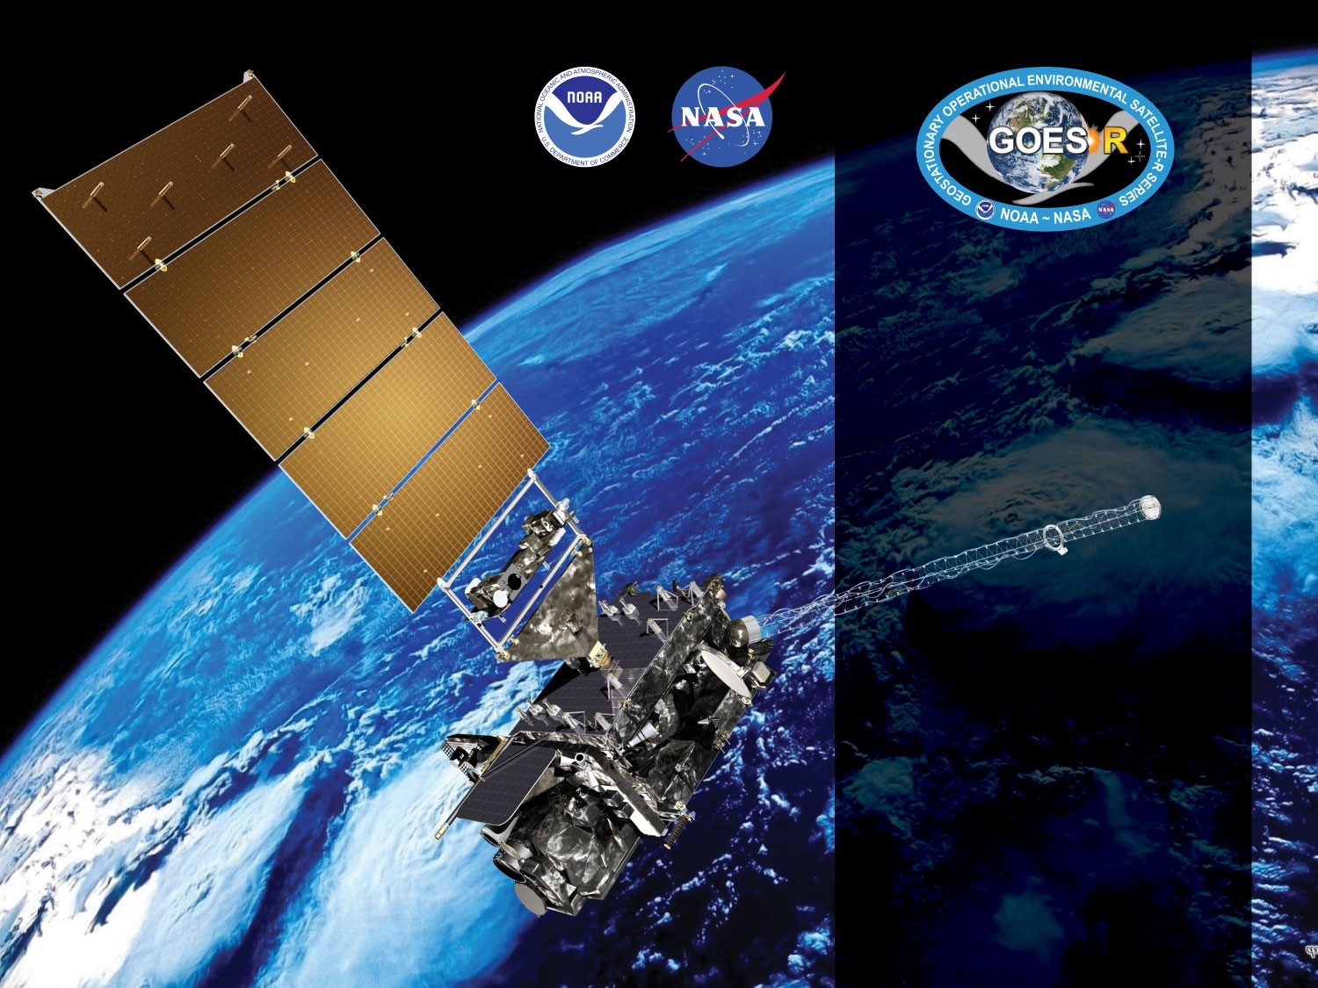



GOES-19 ABI L2+ Aerosol Detection Product (ADP)
Provisional PS-PVR
March 12, 2025
GOES-R AWG
Pubu Ciren¹, Amy Huff¹, and
Shobha Kondragunta²
STC¹
NOAA/NESDIS/STAR²

Slide 2
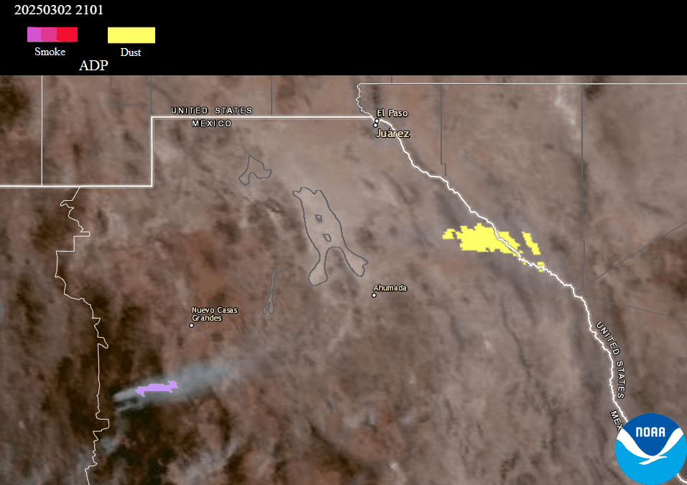

ABI L2+ ADP Overview
ABI Aerosol Detection Product (ADP) indicates the presence of smoke or dust aerosols in the atmosphere
  Binary (“yes/no”) detection
Daytime product only
ADP not retrieved over areas with clouds or snow/ice
GOES-16 ABI ADP
dust
Scan Sector | Observation Frequency (min) |  | Spatial Resolution at Nadir (km)
 | Mode 6 | Mode 4
FULL DISK | 10 | 5 | 2
CONUS | 10 | 5
MESO | 5 | -----
smoke
Animation from AerosolWatch website

Slide 3
ABI L2+ ADP Algorithm
No changes to the physics of the ABI ADP algorithm for GOES-19
ABI ADP is produced using the Enterprise Algorithm
  Threshold tests separate smoke & dust aerosols
  from clouds and clear sky regions
  Key upstream inputs: Cloud Mask and Snow/Ice Mask
Sunglint Flag
  Smoke ADP retrieved inside & outside glint regions
  Dust ADP not recommended inside glint due to high
  number of false detections
Valid Zenith Angle Flags
  End users: use ADP retrieved within valid solar zenith
  angle (SZA ≤ 70°) & satellite view zenith angle (VZA ≤ 60°)
  ADP cal/val: evaluation of ADP retrieved within & outside
  of valid range (0° ≤ SZA ≤ 90°, 0° ≤ VZA ≤ 90°)*
ABI bands used in the ADP algorithm
ABI Band | Central Wavelength (µm) | Dust Detection | Smoke Detection
1 | 0.47 | X | X
2 | 0.64 | X | X
3 | 0.865 | X | X
4 | 1.378 | X
5 | 1.61 | X | X
6 | 2.25 |  | X
7 | 3.9 | X | X
13 | 10.35 | X
14 | 11.2 | X | X
15 | 12.3 | X
“Public” Settings
“Evaluation” Settings
*Settings for all ABI ADP imagery shown in this presentation, unless otherwise specified

Slide 4
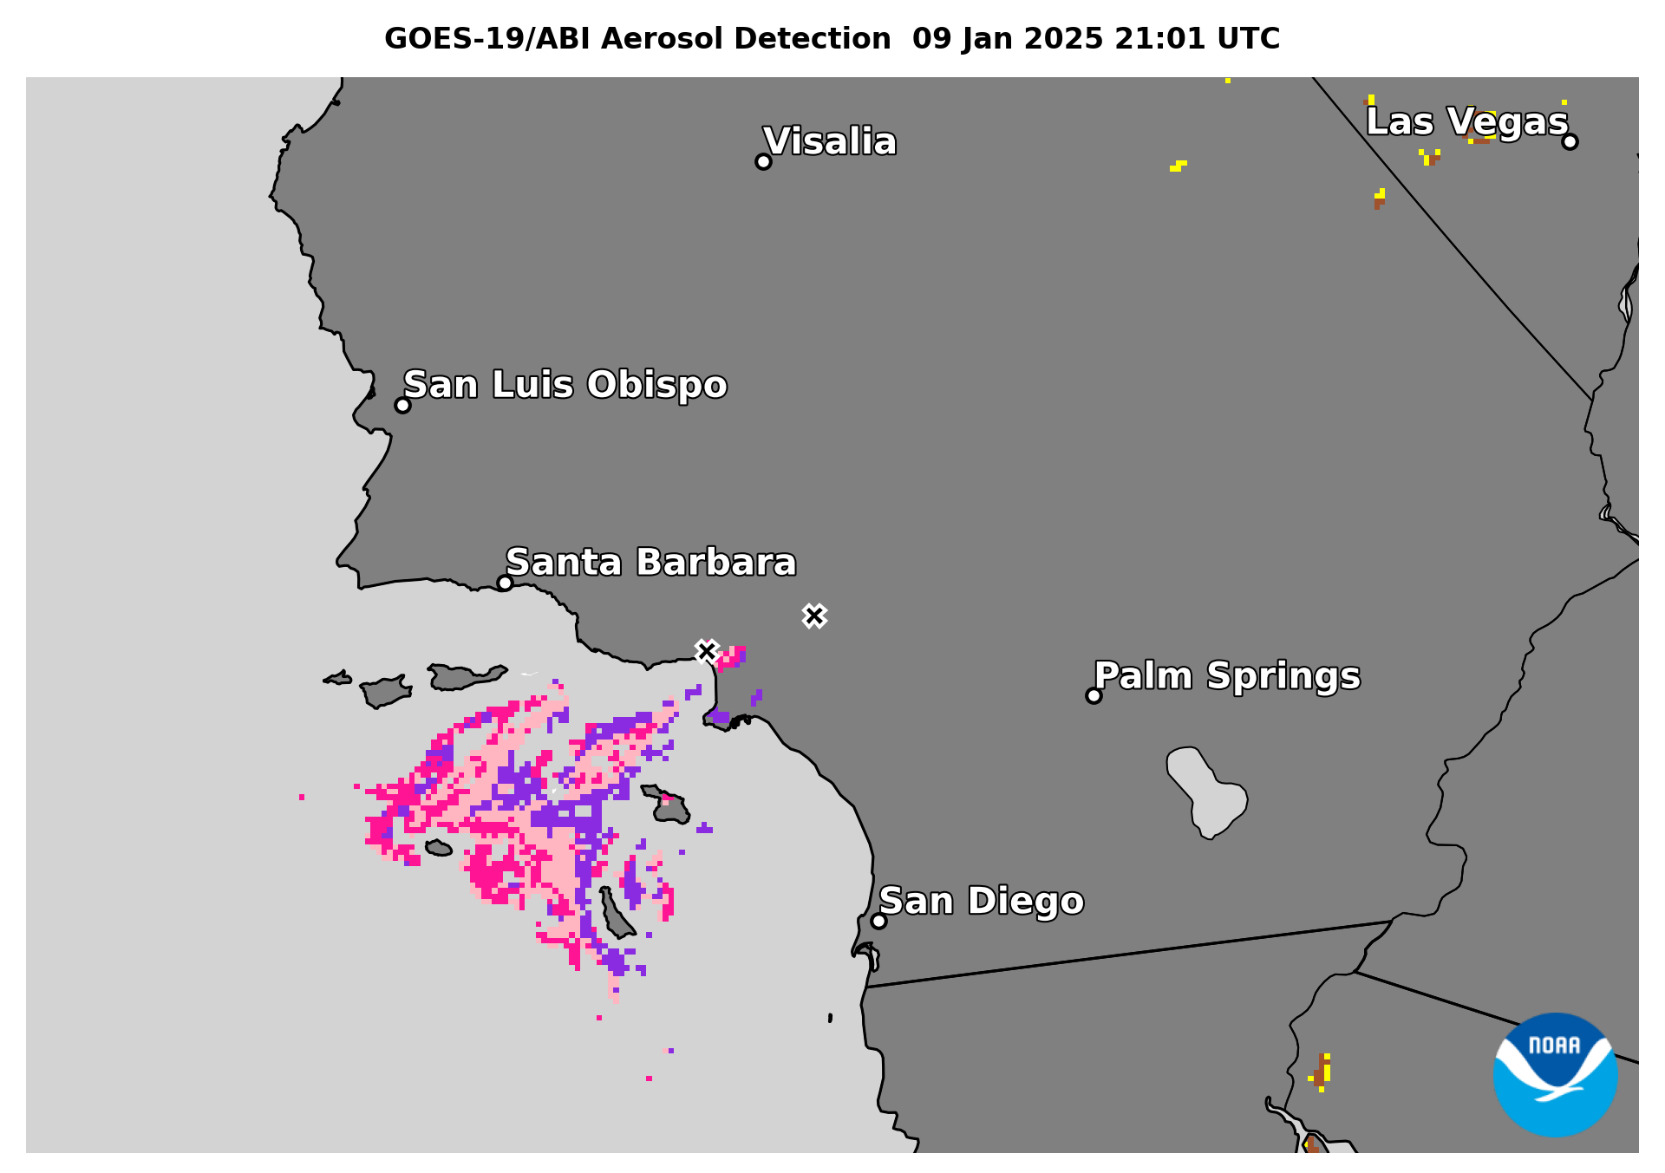
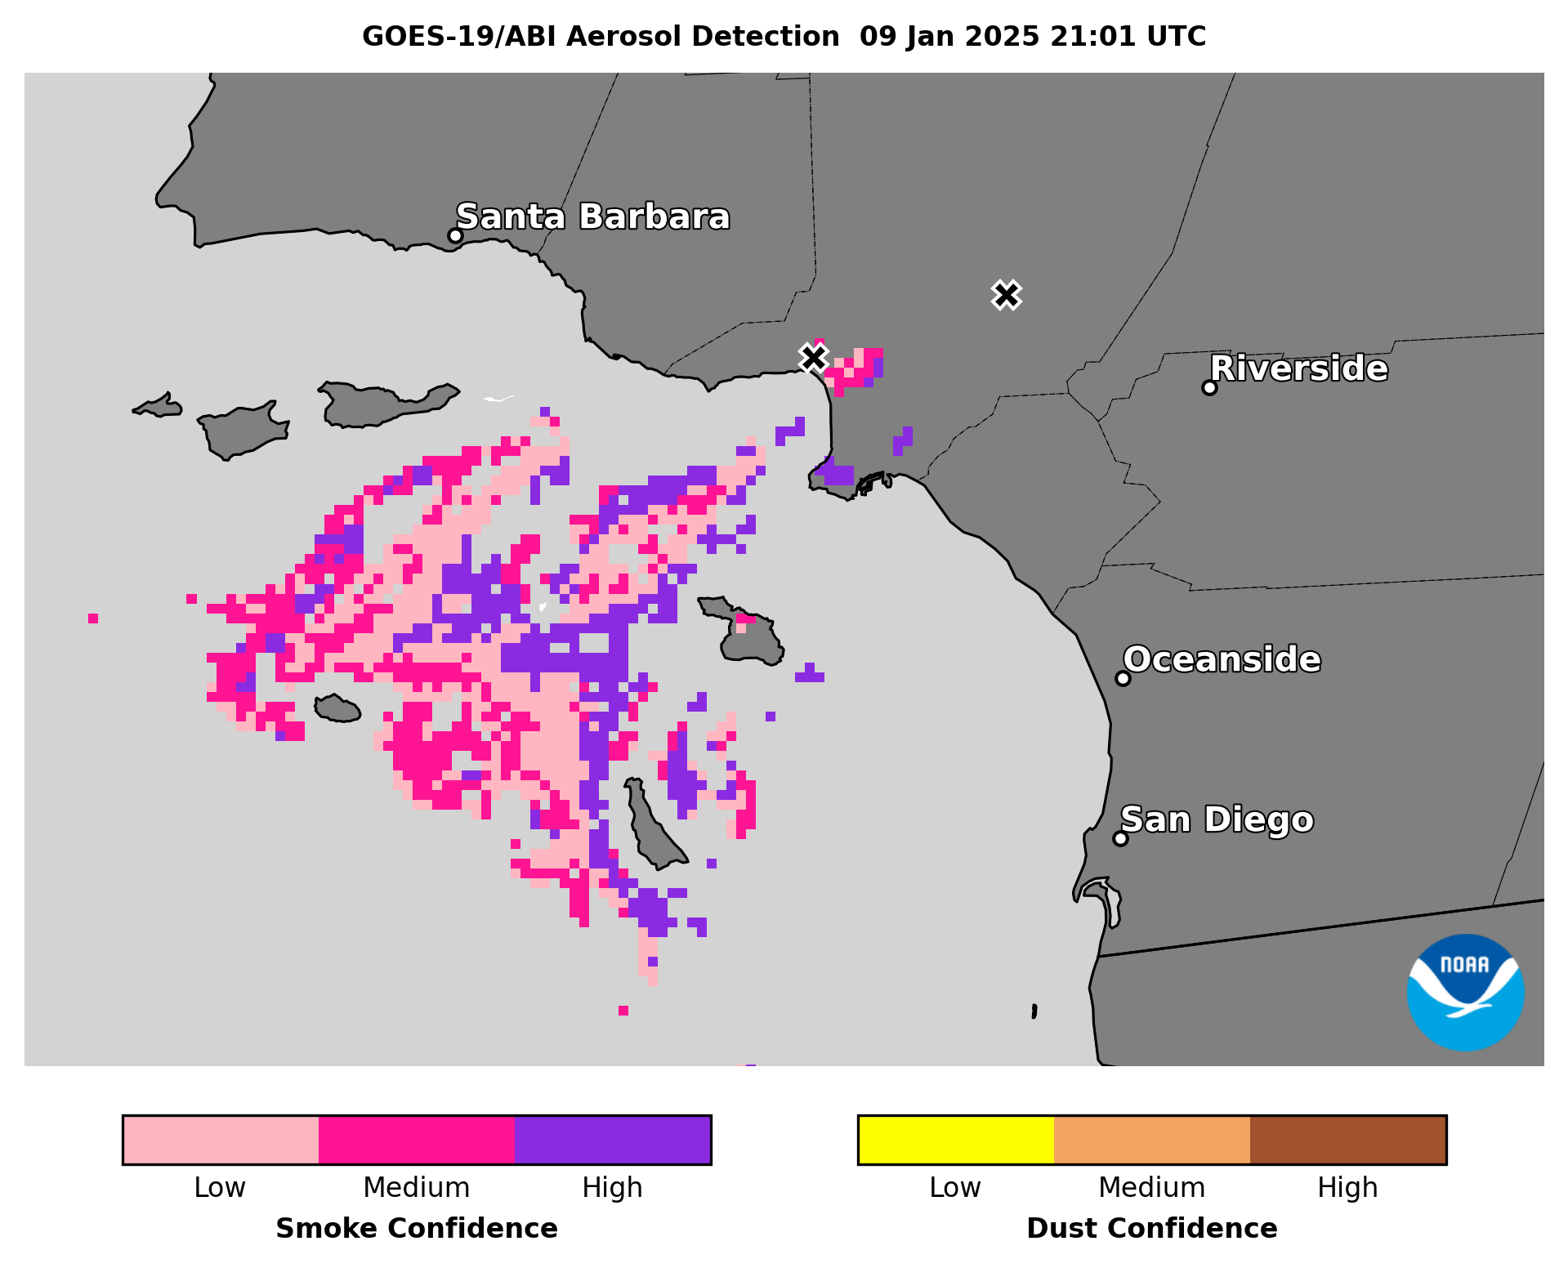
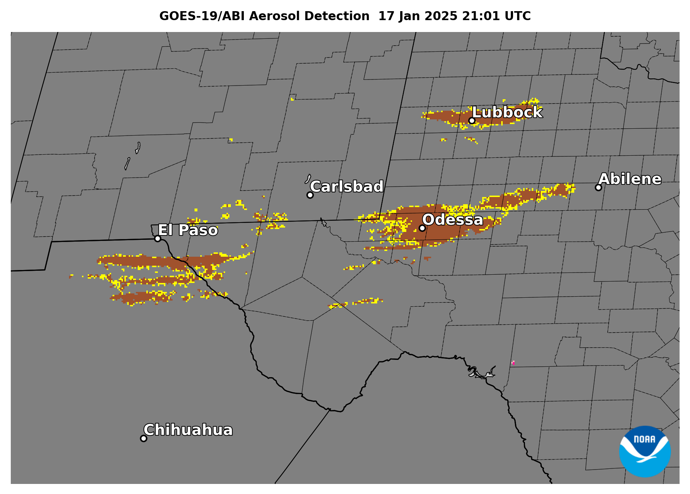
ADP Confidence Flags
ABI L2+ ADP files include a confidence flag
  Expresses confidence level – high, medium, or low – in the ADP retrieval
Confidence levels determined by calculation of Confidence Value (CV) using 1 or more crucial threshold tests based on:
  How close test is to specified threshold
  Solar zenith angle (SZA)
  Satellite view zenith angle (VZA)
Different CV calculations for:
  Smoke vs dust
  Thick vs thin aerosol
  Aerosol over land vs over water
Confidence Level | Confidence Value (CV) from one (1) Crucial Threshold Test |  | SZA |  | VZA
Low | CV ≤ 0.25 | OR | > 70° | OR | > 60°
Medium | 0.25 < CV < 0.75 | AND | ≤ 70° | AND | ≤ 60°
High | CV ≥ 0.75 | AND | ≤ 70° | AND | ≤ 60°
Crucial Threshold Test for
thick smoke detection over water:
TOA reflectance(0.47μm/1.61μm) > 6.0
Crucial Threshold Test for
dust detection over land:
(BT_{11.2μm} – BT_{12.3μm} ) < 0.4

Slide 5
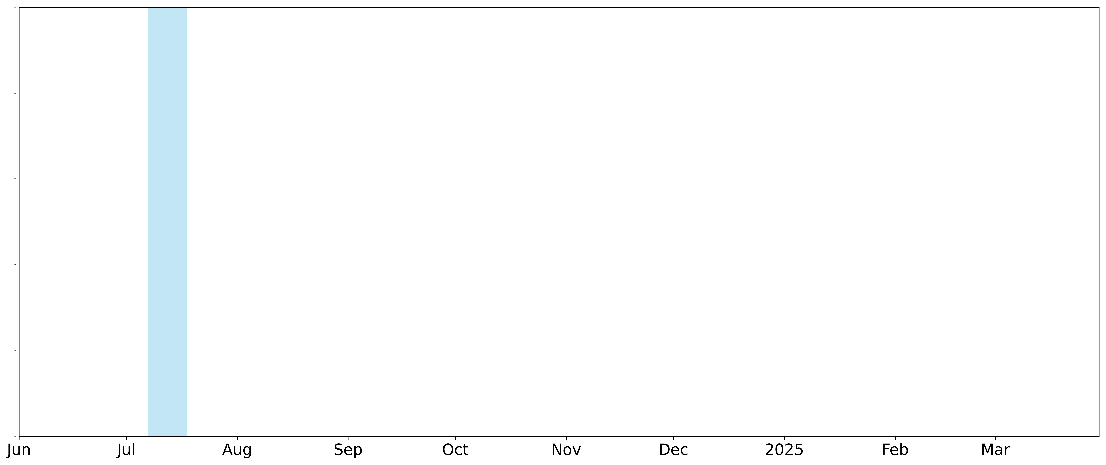
GOES-19 ADP Validation Timeline
Aug 28 to mid-Dec
INR & CCR issues impacted IR bands;
degraded dust ADP & shortened its validation period
Drift to 89.5 °W
Aug 28
M6 scanning starts ~12:50 UTC
L2 data availability starts ~13:00 UTC
Begin ADP validation
Mar 12
ADP Provisional PS-PVR
Short overall validation period for G19 ADP:
Aug 28 to Feb 28 (~6 months)
Aug 20
ABI Door Opens
Oct 9-10
Navigation (INR) stable
(large errors due to missing stars corrected)
Dec 10
Co-channel registration (CCR) of MWIR & LWIR bands substantially improved (RDP update J)
Jul 7
Renamed GOES-19
Jun 25
GOES-U launch
Oct 1
L1b & L2 declared β-Maturity
Dec 20
L1b/CMI declared Provisional Maturity

Slide 6
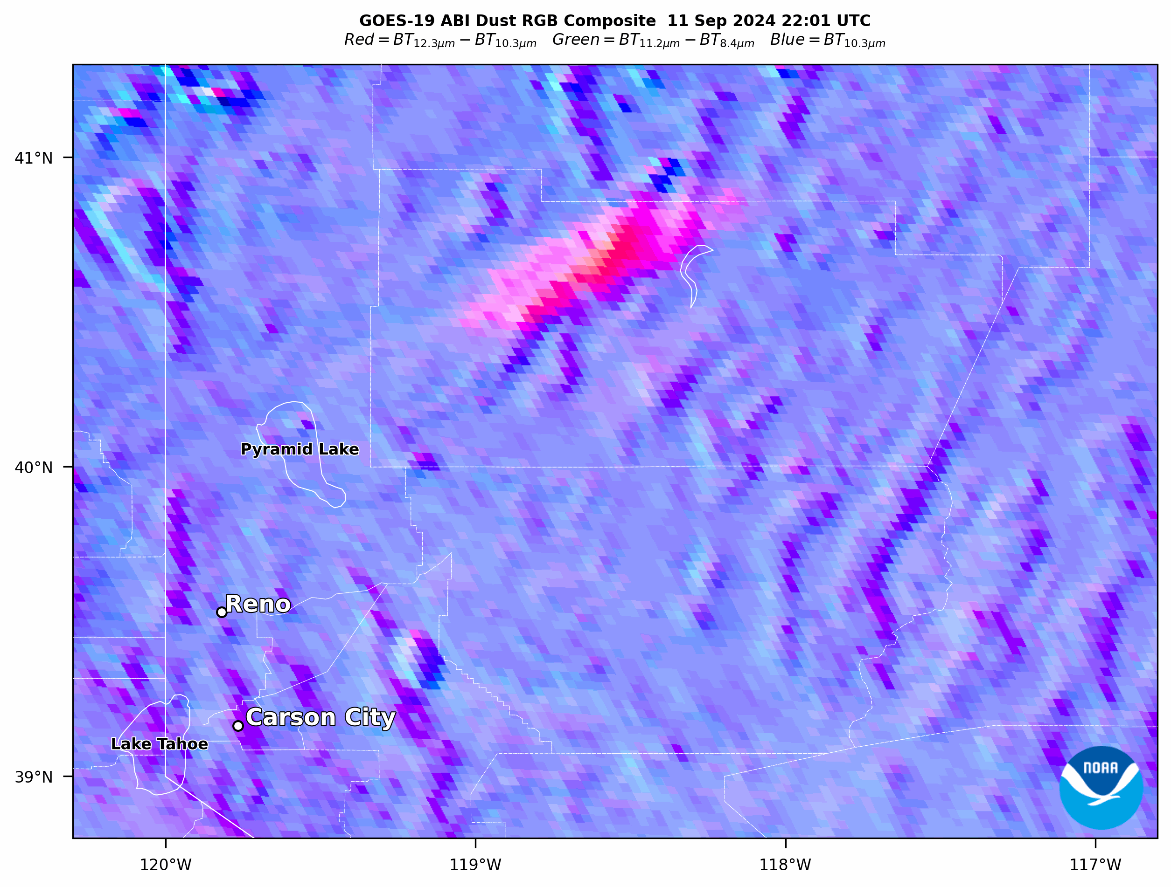
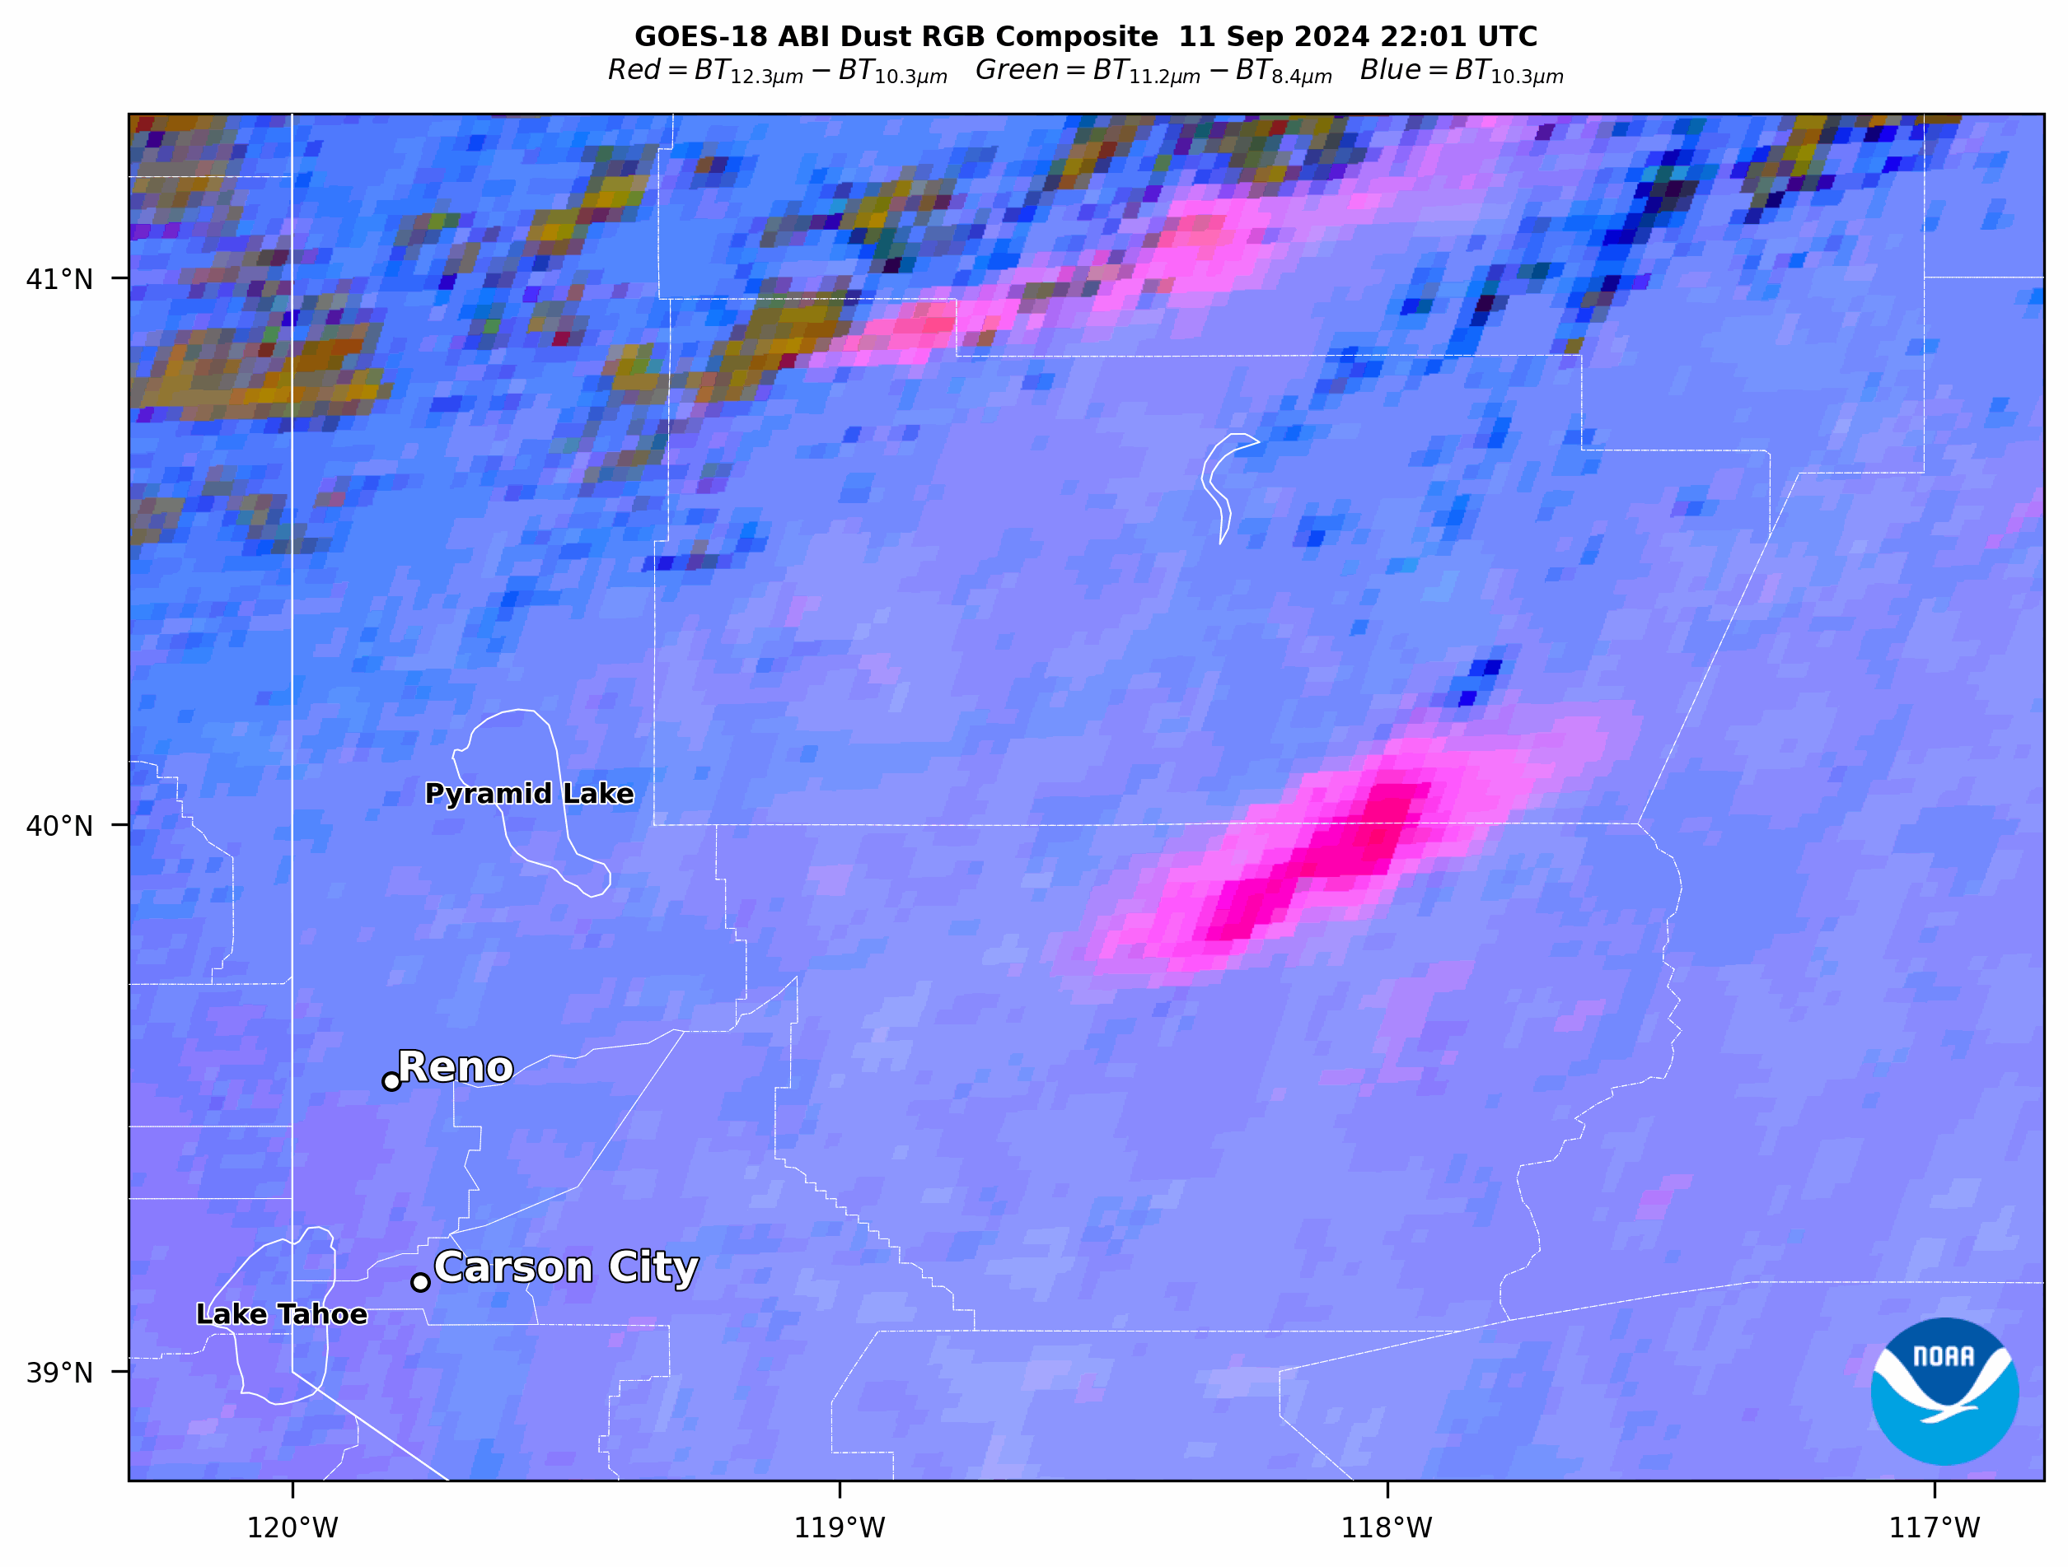
Example of GOES-19 ABI CCR & INR Errors
Blowing Dust in Central Nevada
Sep 11, 2024 22:01-23:01 UTC CONUS Sector
GOES-19 Dust RGB
Large navigation (INR) errors
INR stable by Oct 9-10, 2024 when large errors due to missing stars were corrected
GOES-18 Dust RGB
Blurriness caused by
co-channel registration (CCR) errors in IR bands
CCR of MWIR & LWIR bands substantially improved by mid-Dec 2024 (RDP update J)
Impact of INR & CCR errors on dust ADP:
  Direct impact (IR bands used in dust ADP algorithm)
  Indirect impact from upstream Cloud Mask

Slide 7
PRODUCT QUALITY EVALUATION
GOES-19 Aerosol Detection Product (ADP) Provisional PS-PVR

Slide 8
Inter-Comparison of GOES-19 ABI ADP with Reference Satellite Data for Smoke and Dust Events
Test ID | Description | Evaluation Method
ABI-FD_ADP01 ABI-CONUS_ADP02 ABI-MESO_ADP03 | Verify Mode 6 FULL DISK, CONUS, MESO products generated during aerosol event(s) are within the required measurement range | Visual inspection Inter-comparison to GOES-16 & -18 ABI ADP and NOAA-21, NOAA-20 & SNPP VIIRS ADP imagery Also used when available: TROPOMI UV AI & CO imagery TEMPO-ABI ADP imagery TEMPO UV AI imagery

Slide 9
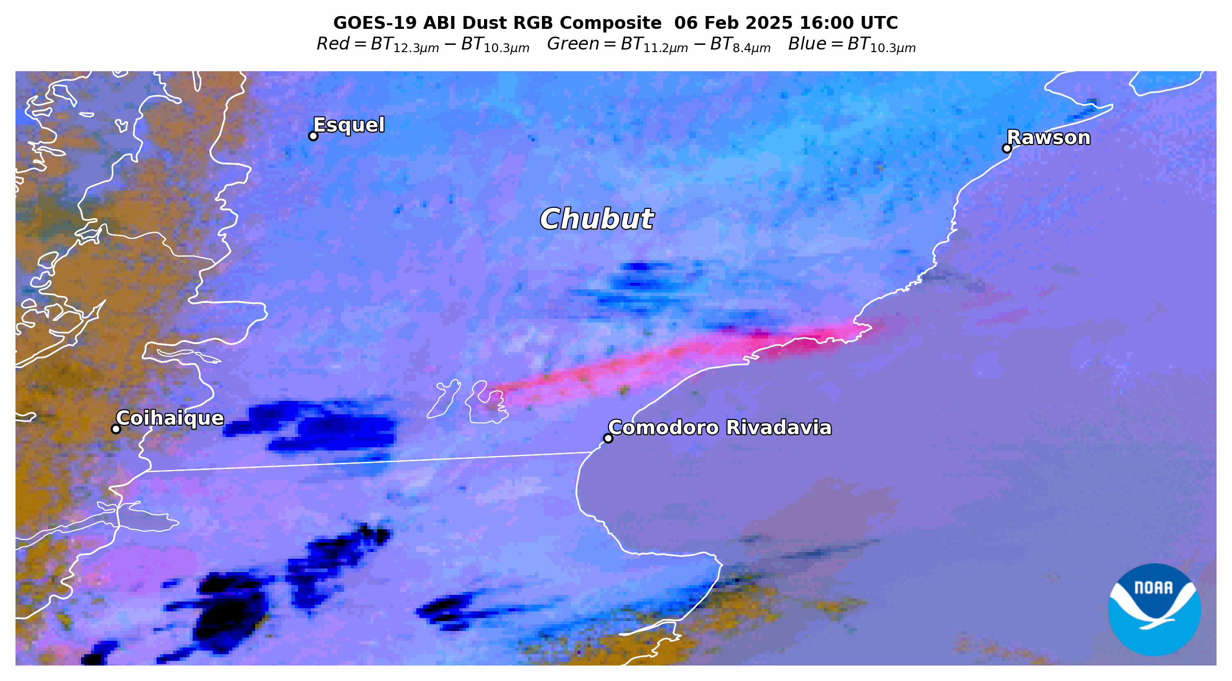
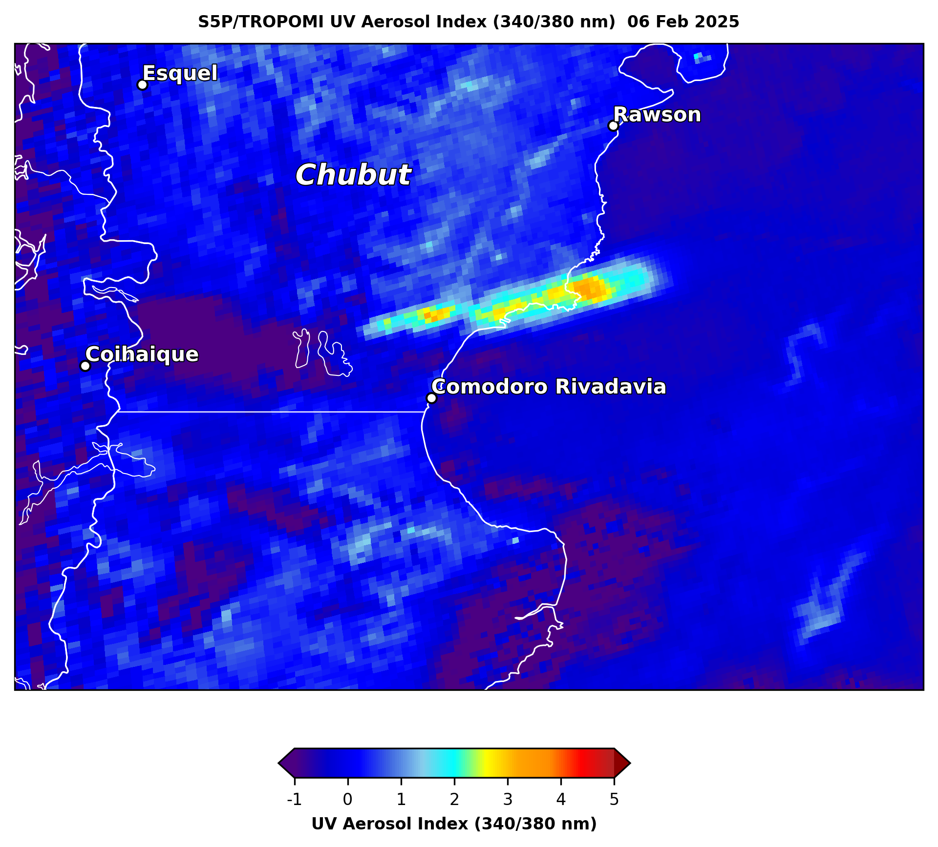
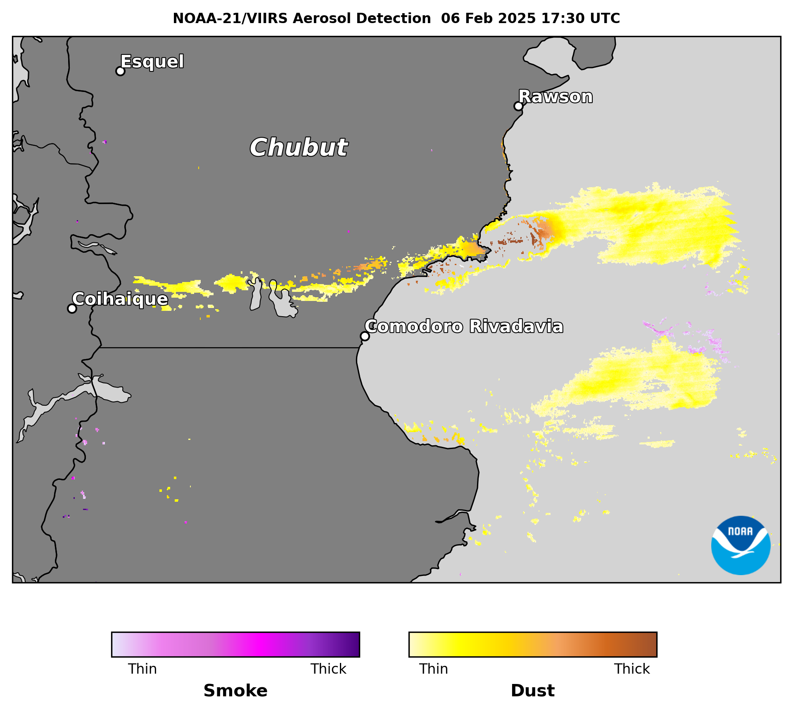
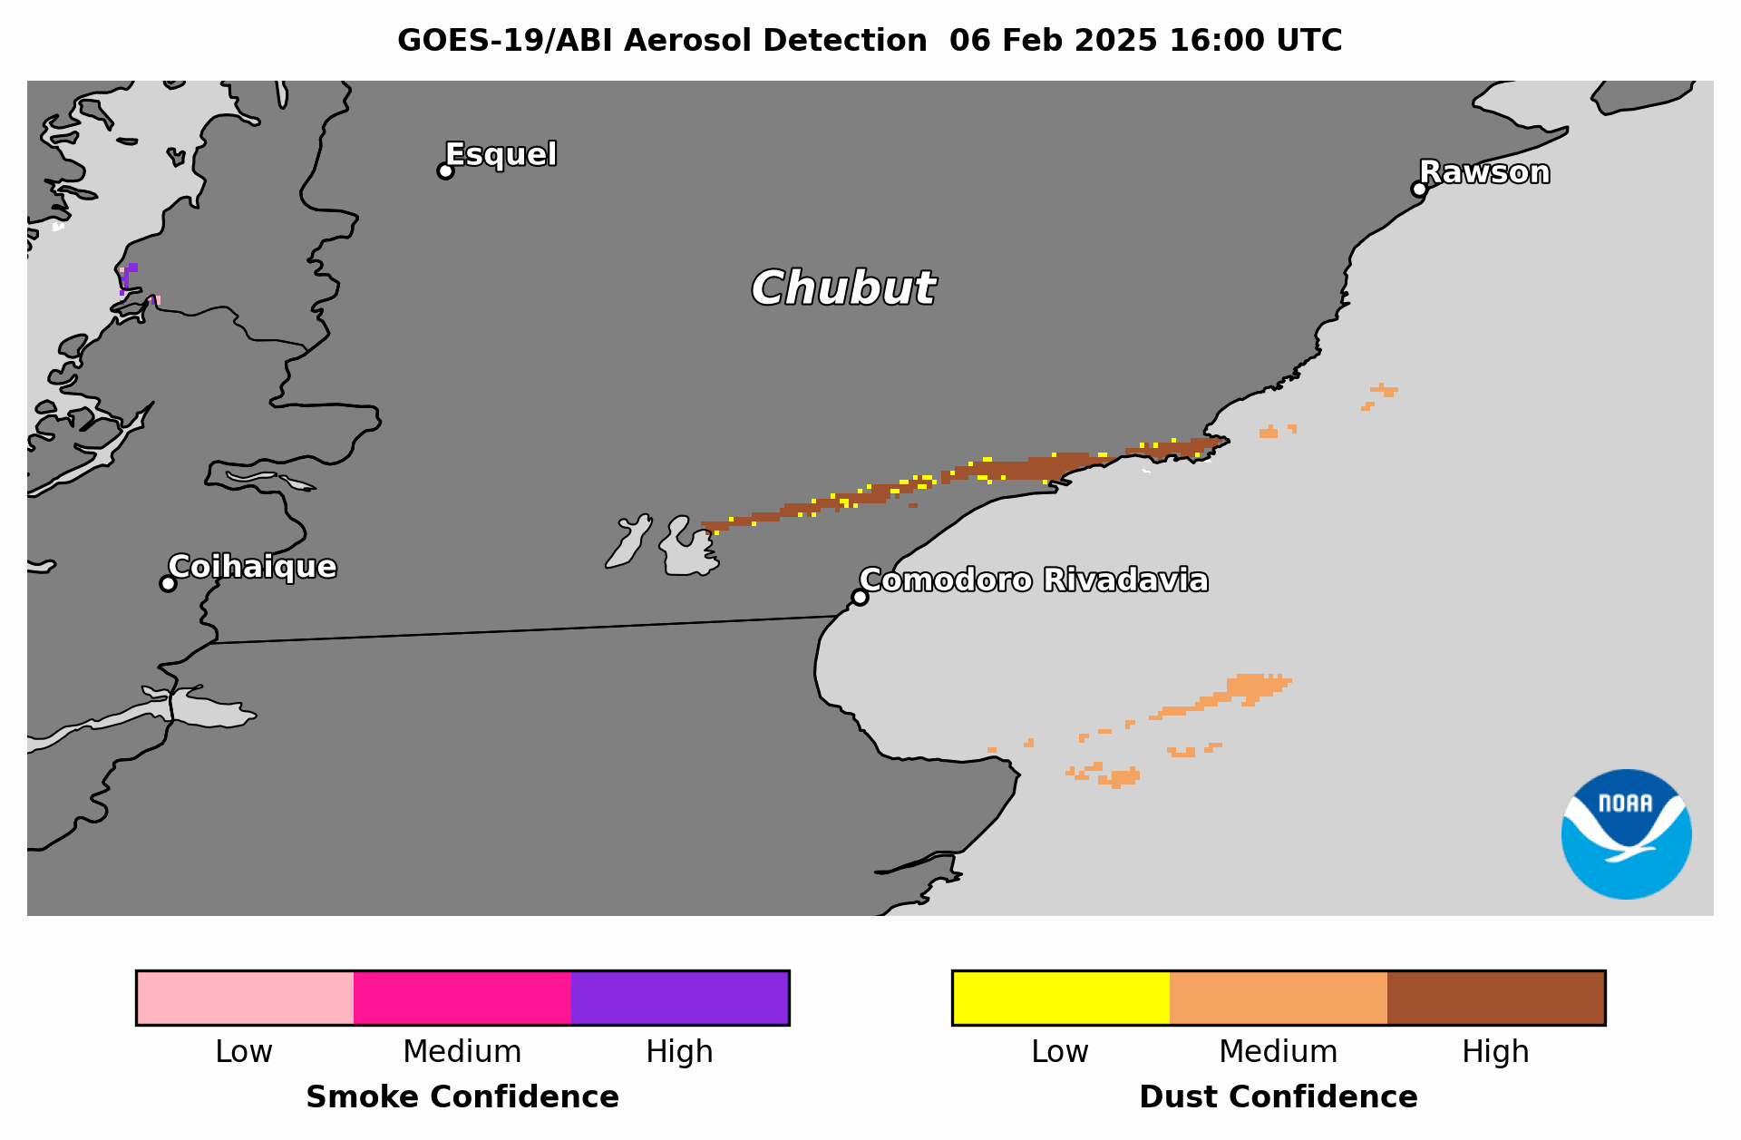
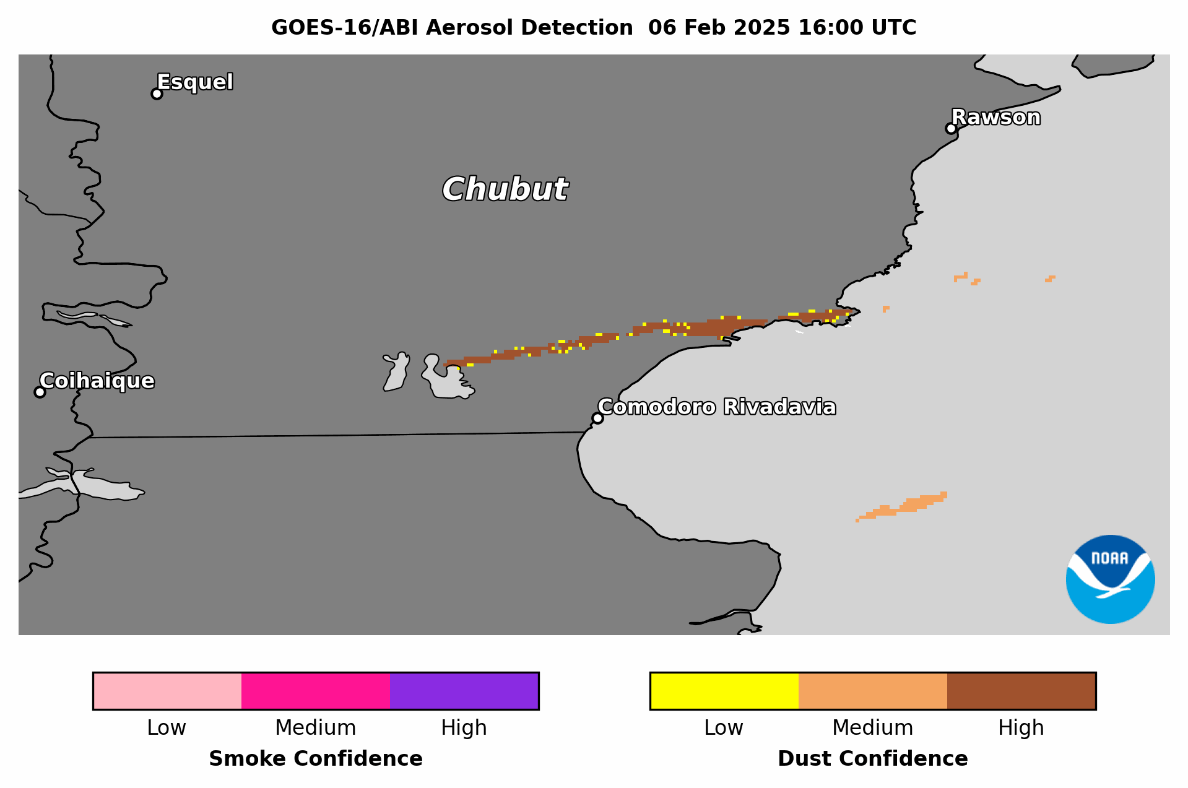
Blowing Dust in Southern Argentina
Feb 6, 2025 16:00-17:00 UTC Full Disk Sector
GOES-19 ABI ADP has:
  Coverage & confidence comparable to GOES-16
  Coverage comparable to NOAA-21 VIIRS ADP & S5P TROPOMI UV AI
Blowing dust from dry lakebeds in Chubut Province, southern Argentina (common summertime phenomenon)

Slide 10
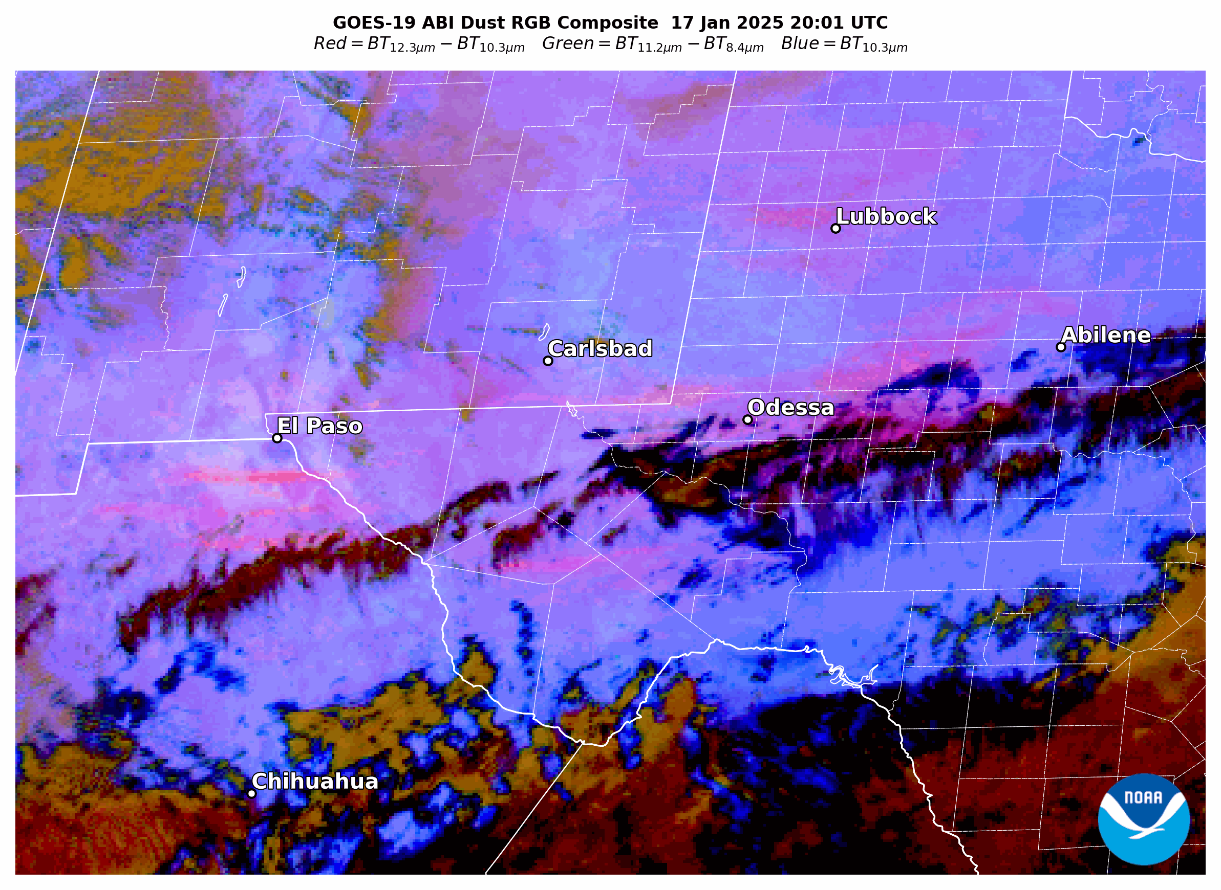
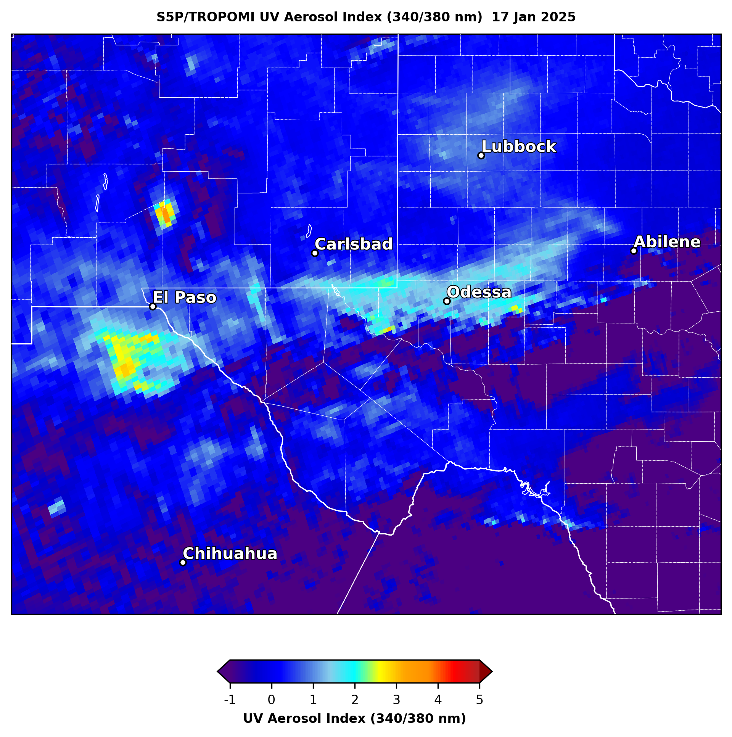
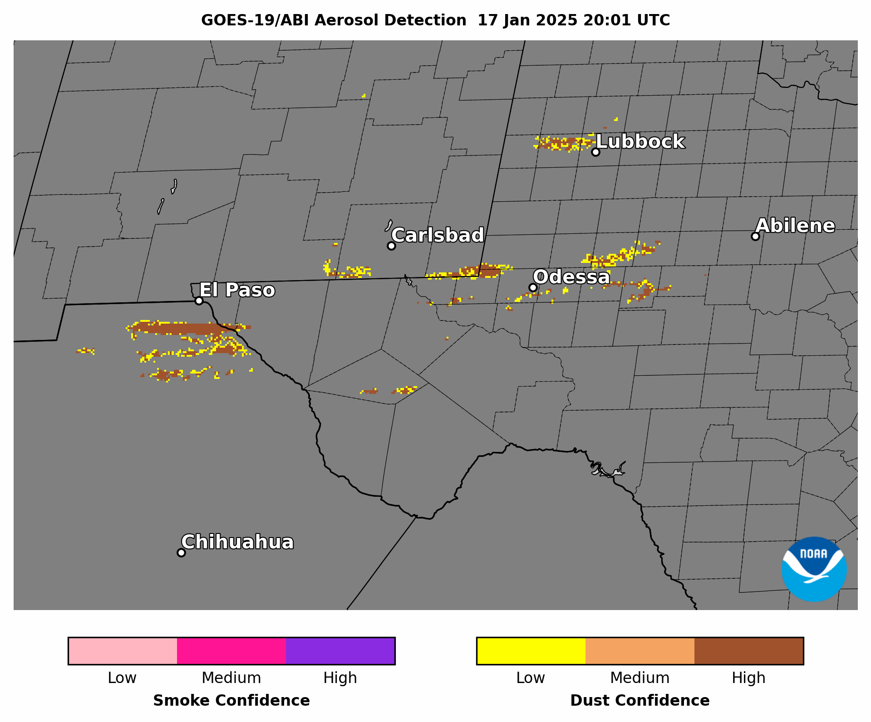
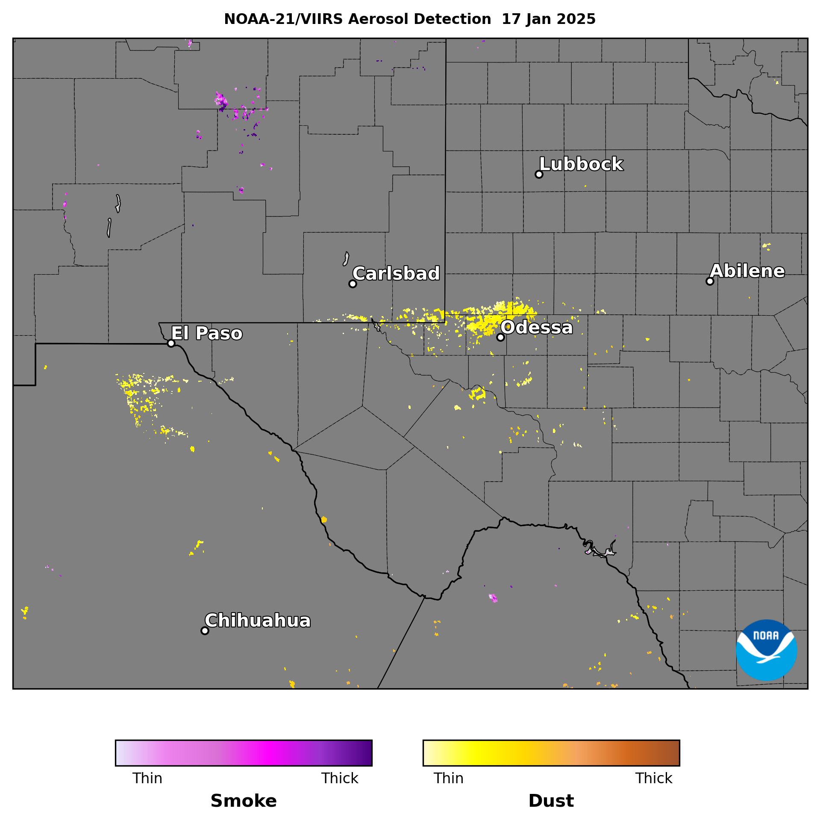
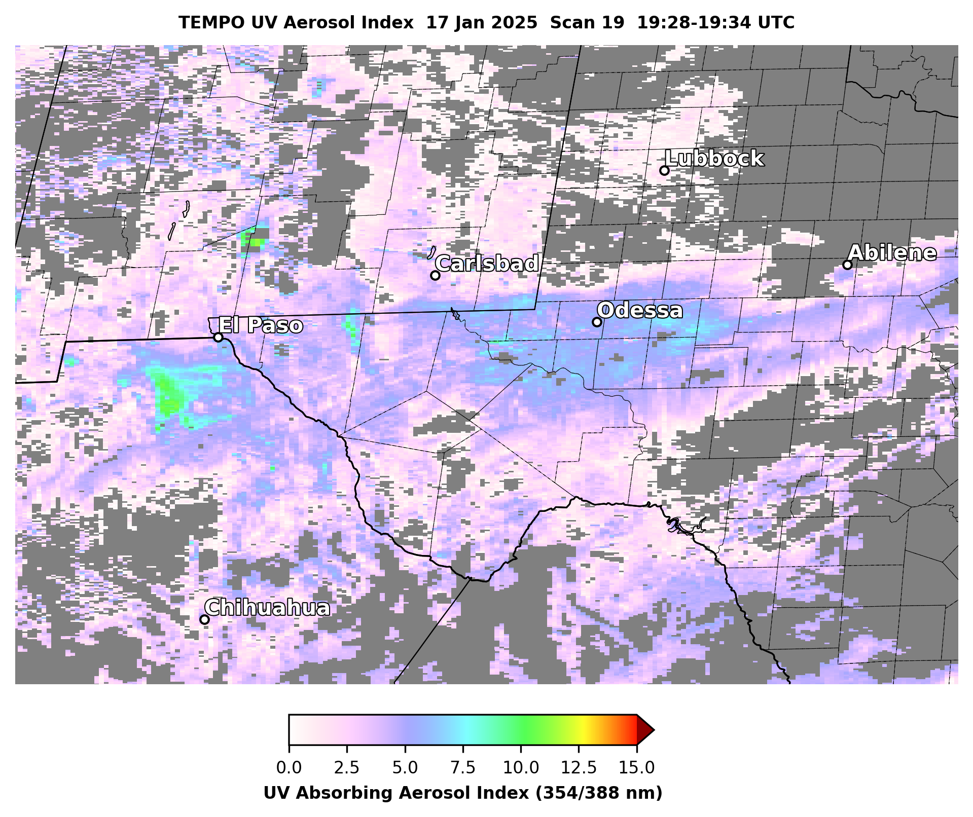
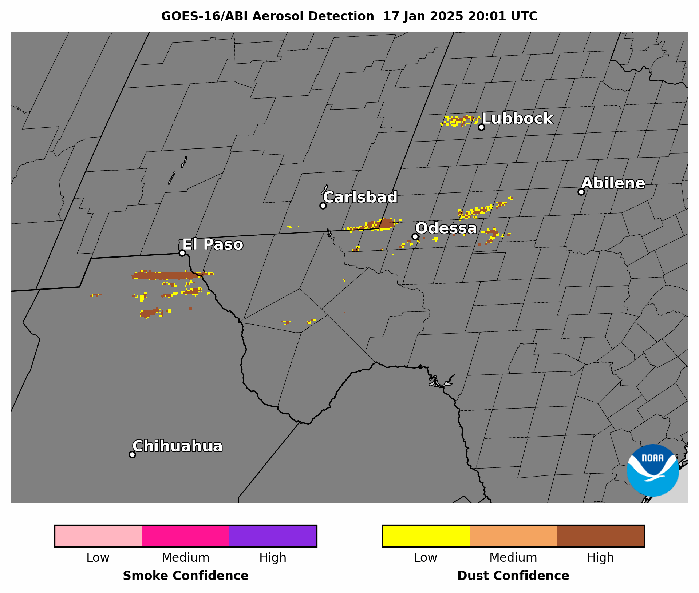
Blowing Dust in New Mexico, Texas & N. Mexico
Jan 17, 2025 20:01-21:01 UTC CONUS Sector
Blowing dust from Chihuahua Desert, northern Mexico & arid regions of west Texas and southern New Mexico (very common in winter & early spring)
GOES-19 ABI ADP has:
  Coverage & confidence comparable to GOES-16
  Coverage comparable to NOAA-21 VIIRS ADP, S5P TROPOMI UV AI, & TEMPO UV AI

Slide 11
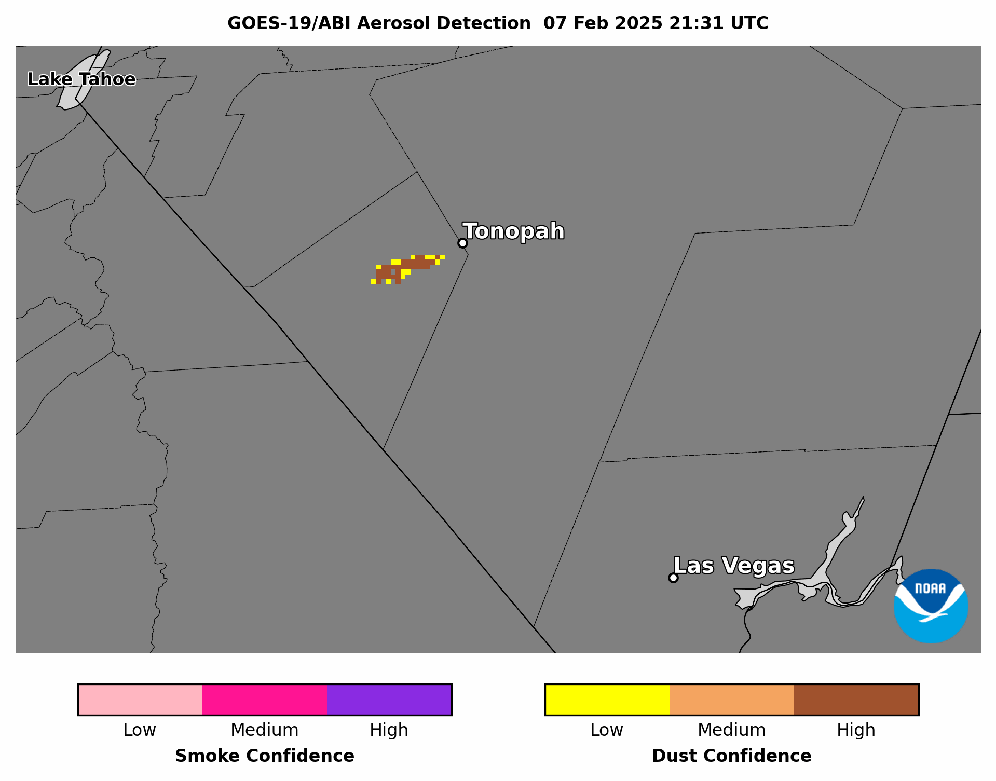
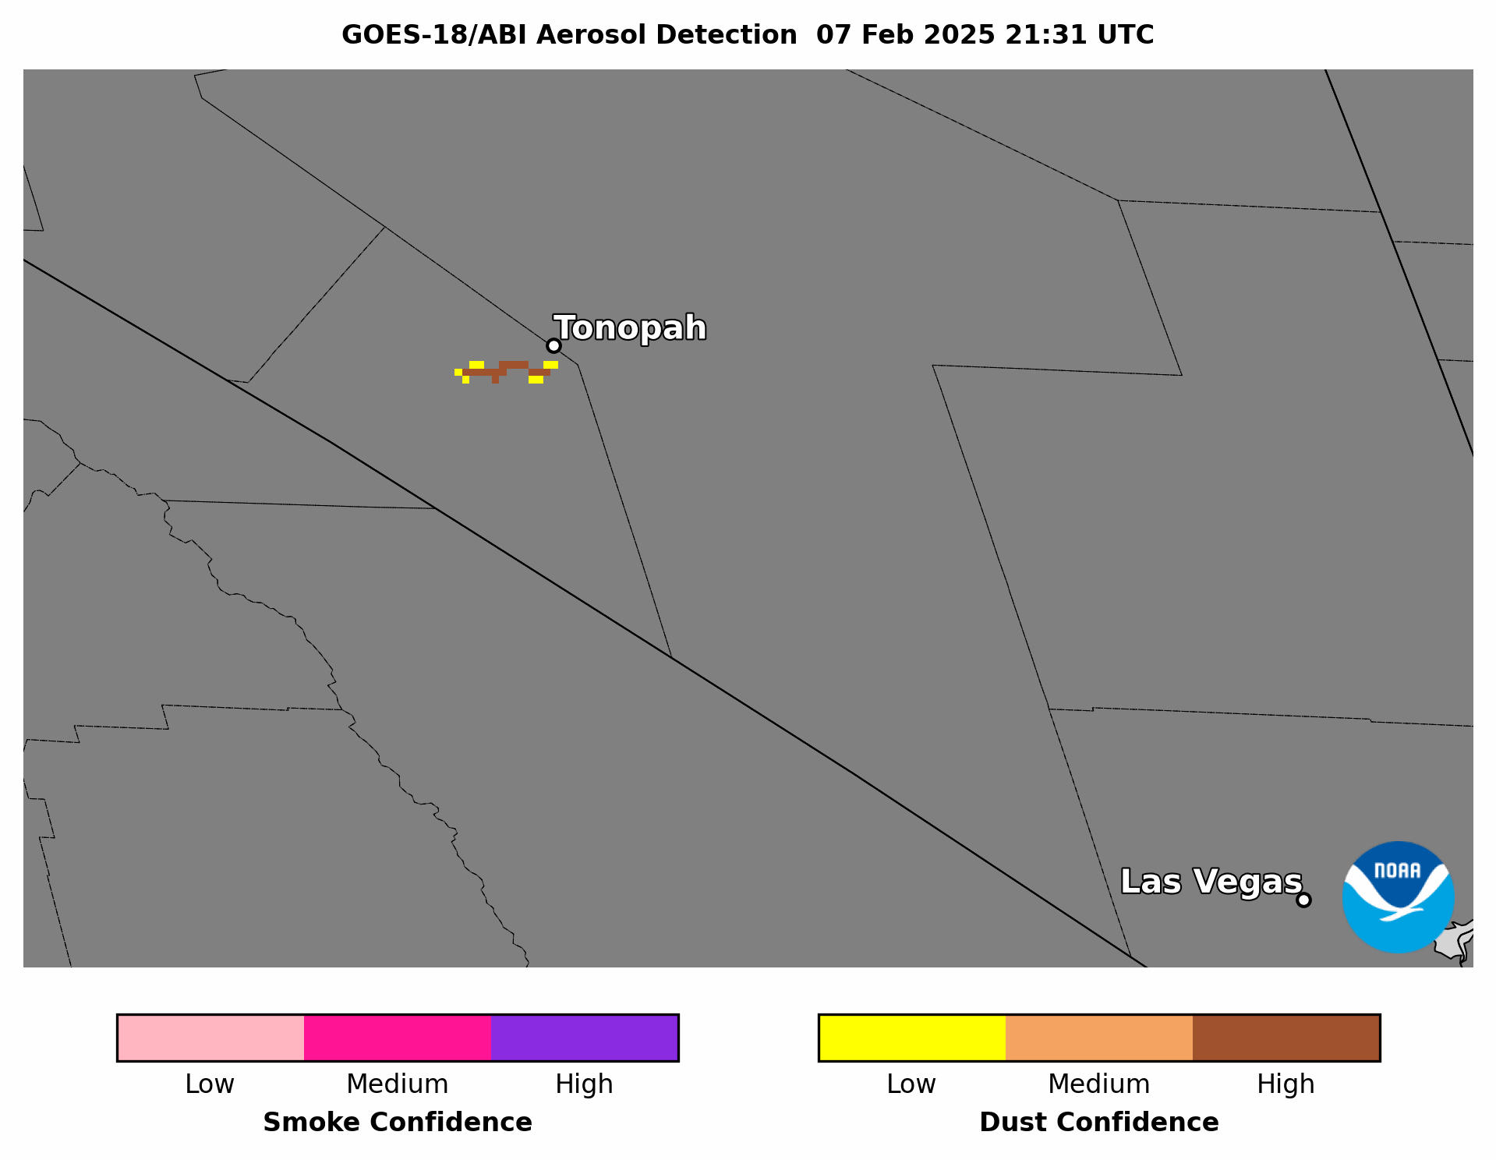
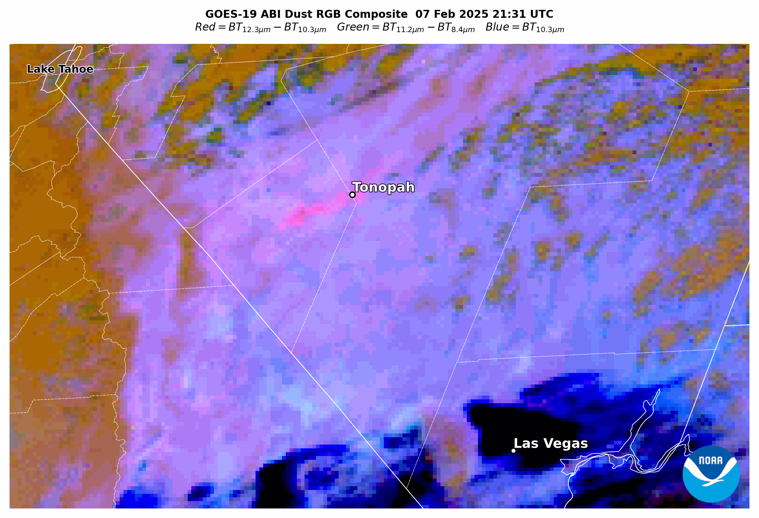
Blowing Dust in South-Central Nevada
Feb 7, 2025 21:31-22:31 UTC CONUS Sector
Very small, short-duration, isolated blowing dust event
GOES-19 ABI ADP has:
  Coverage & confidence comparable to GOES-18
Very small event (temporally & spatially); not observed by any other satellite products

Slide 12
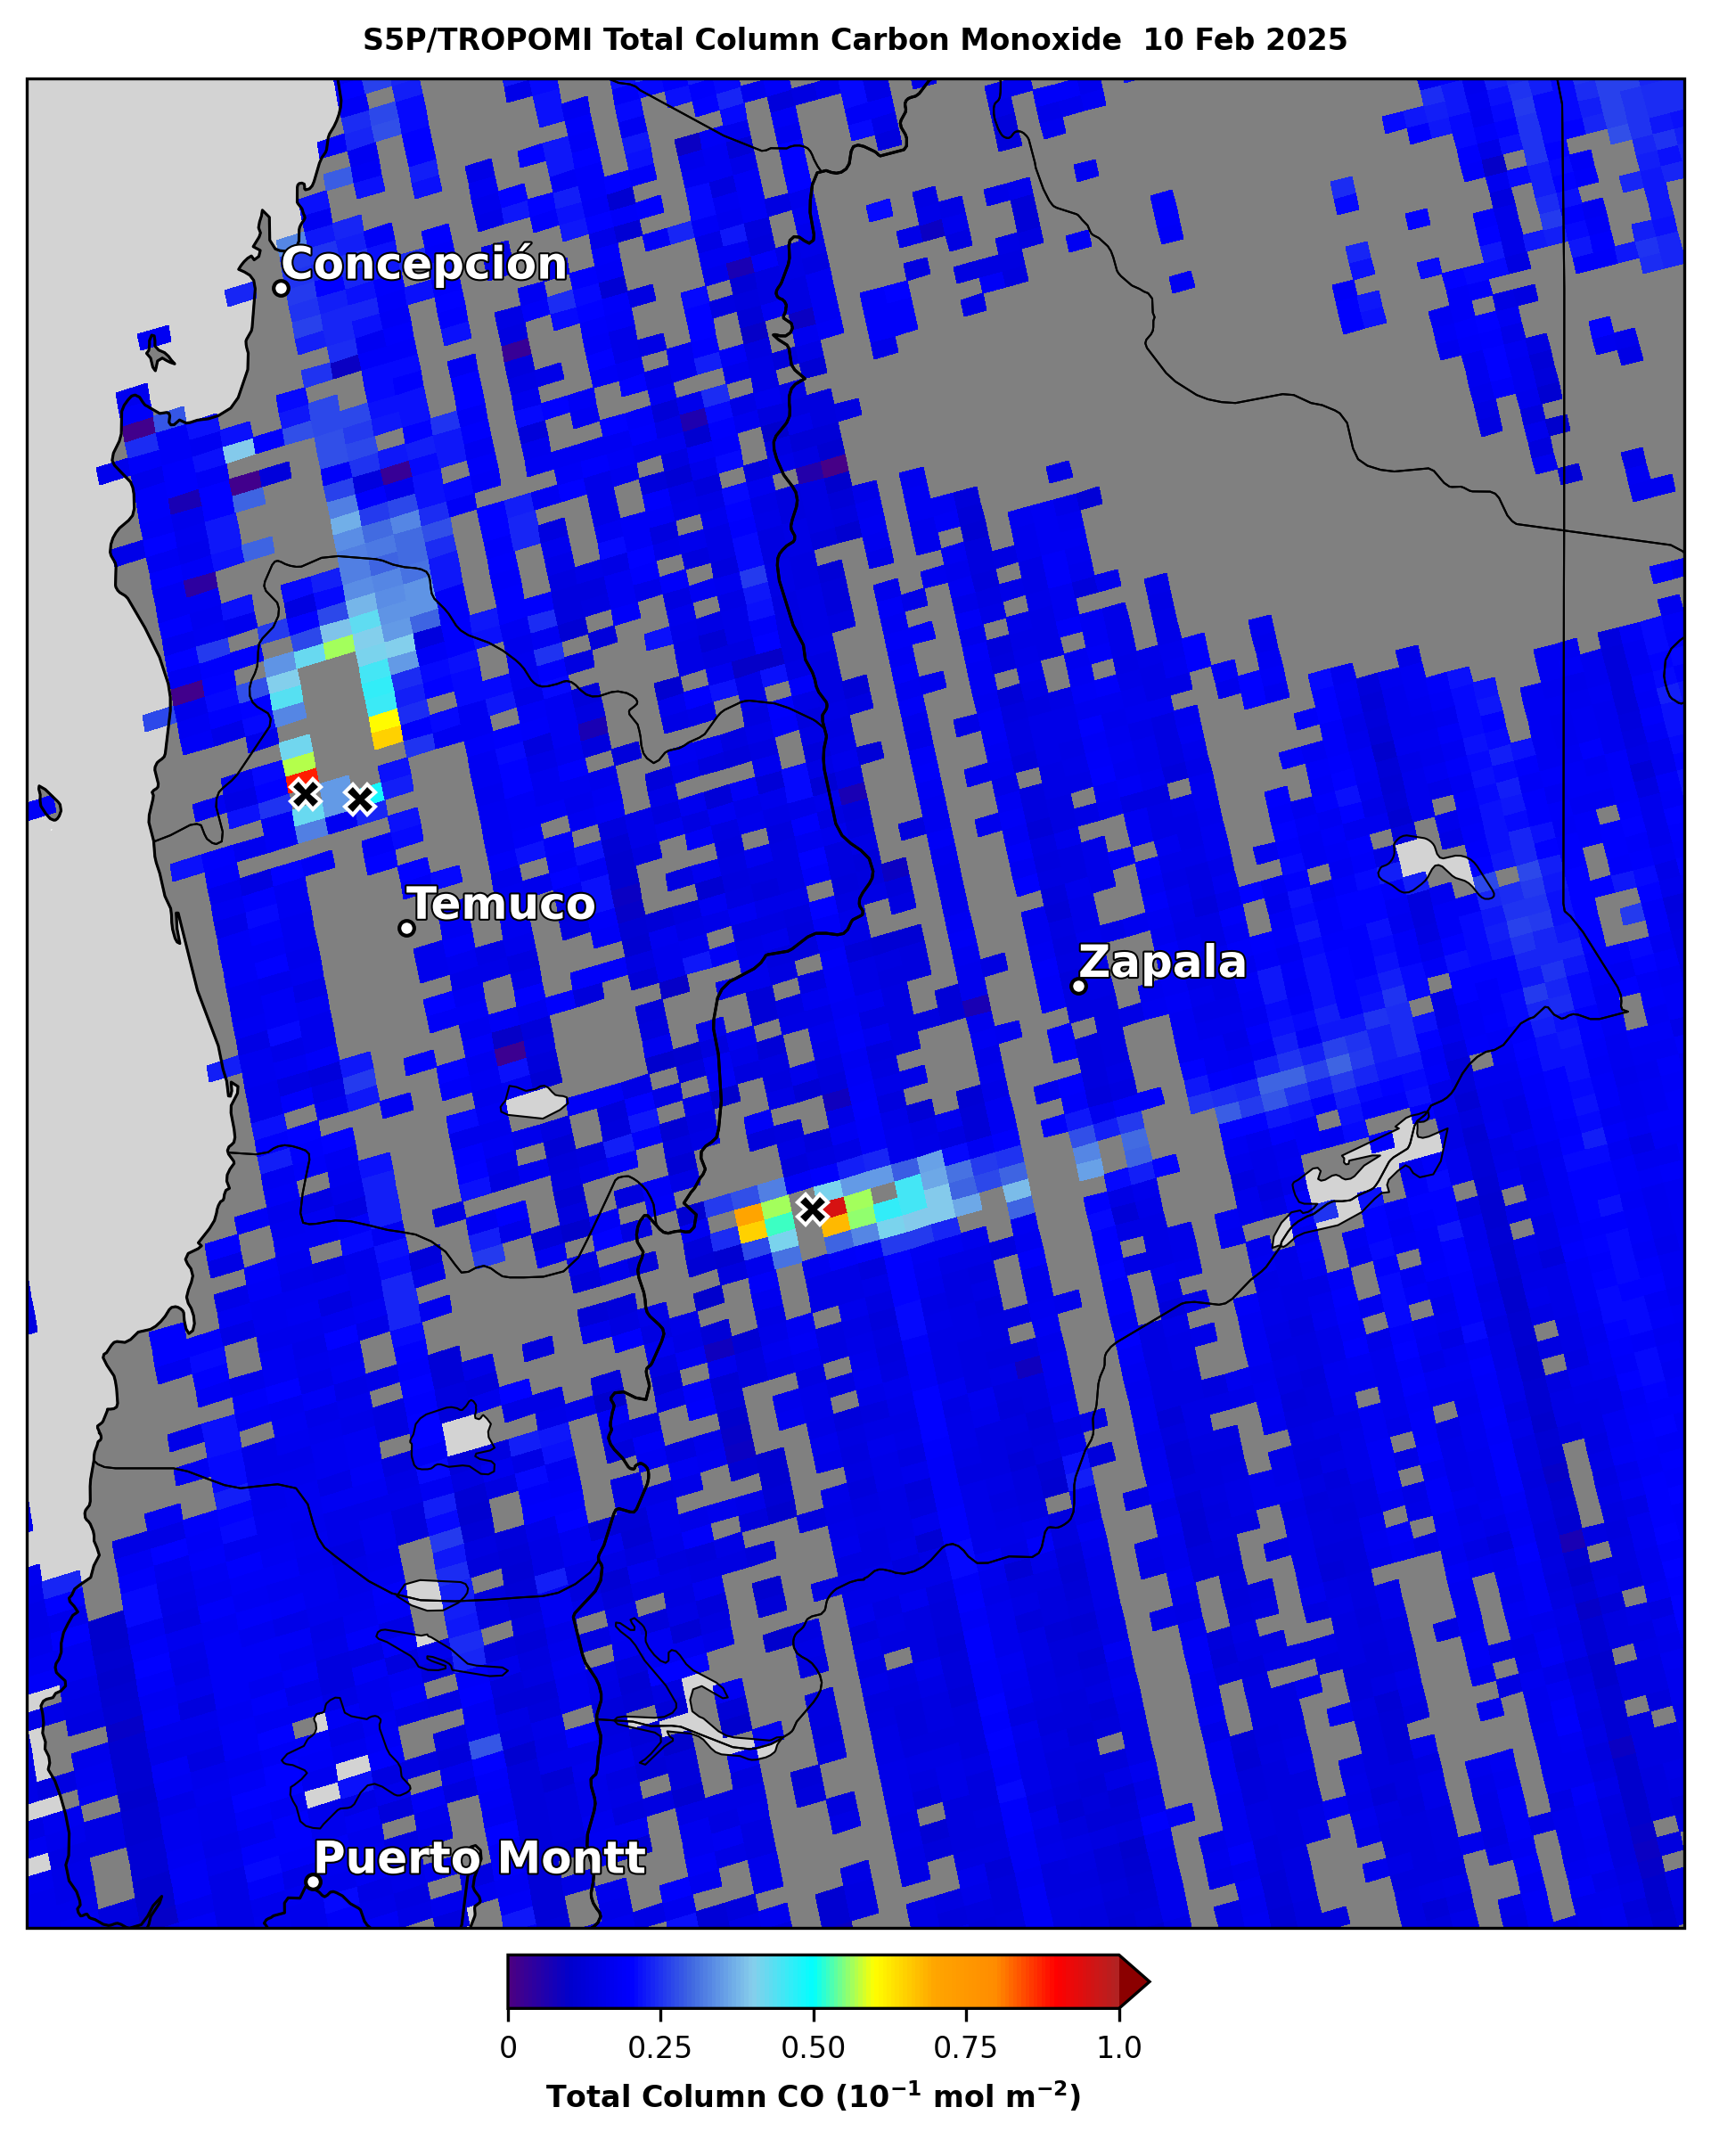
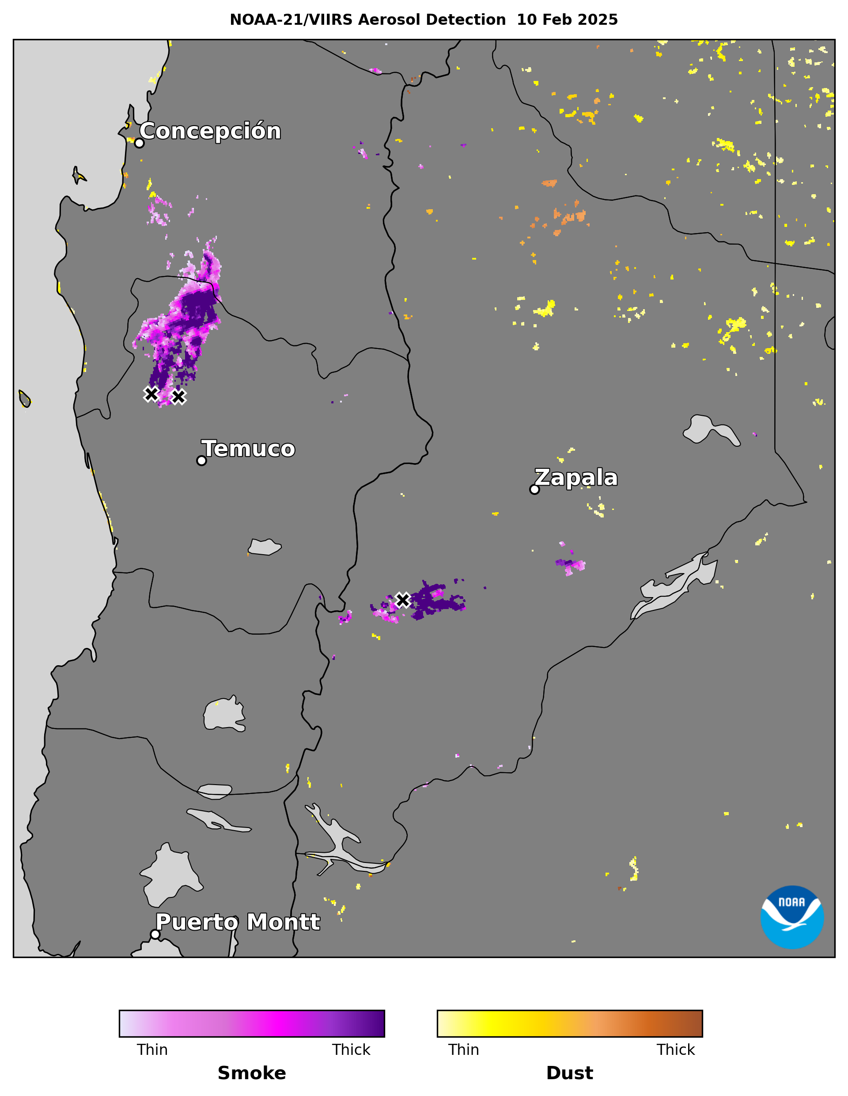
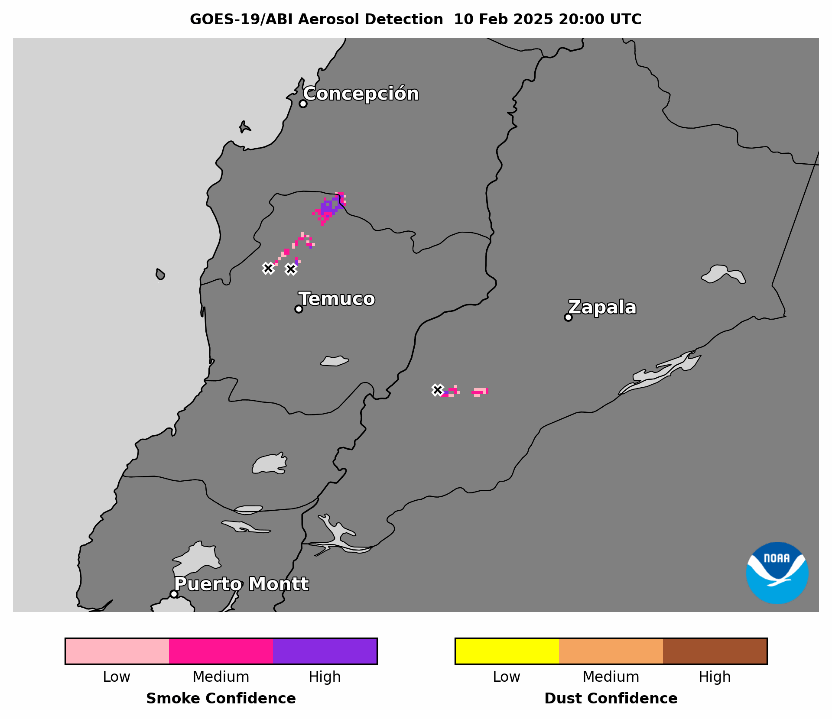
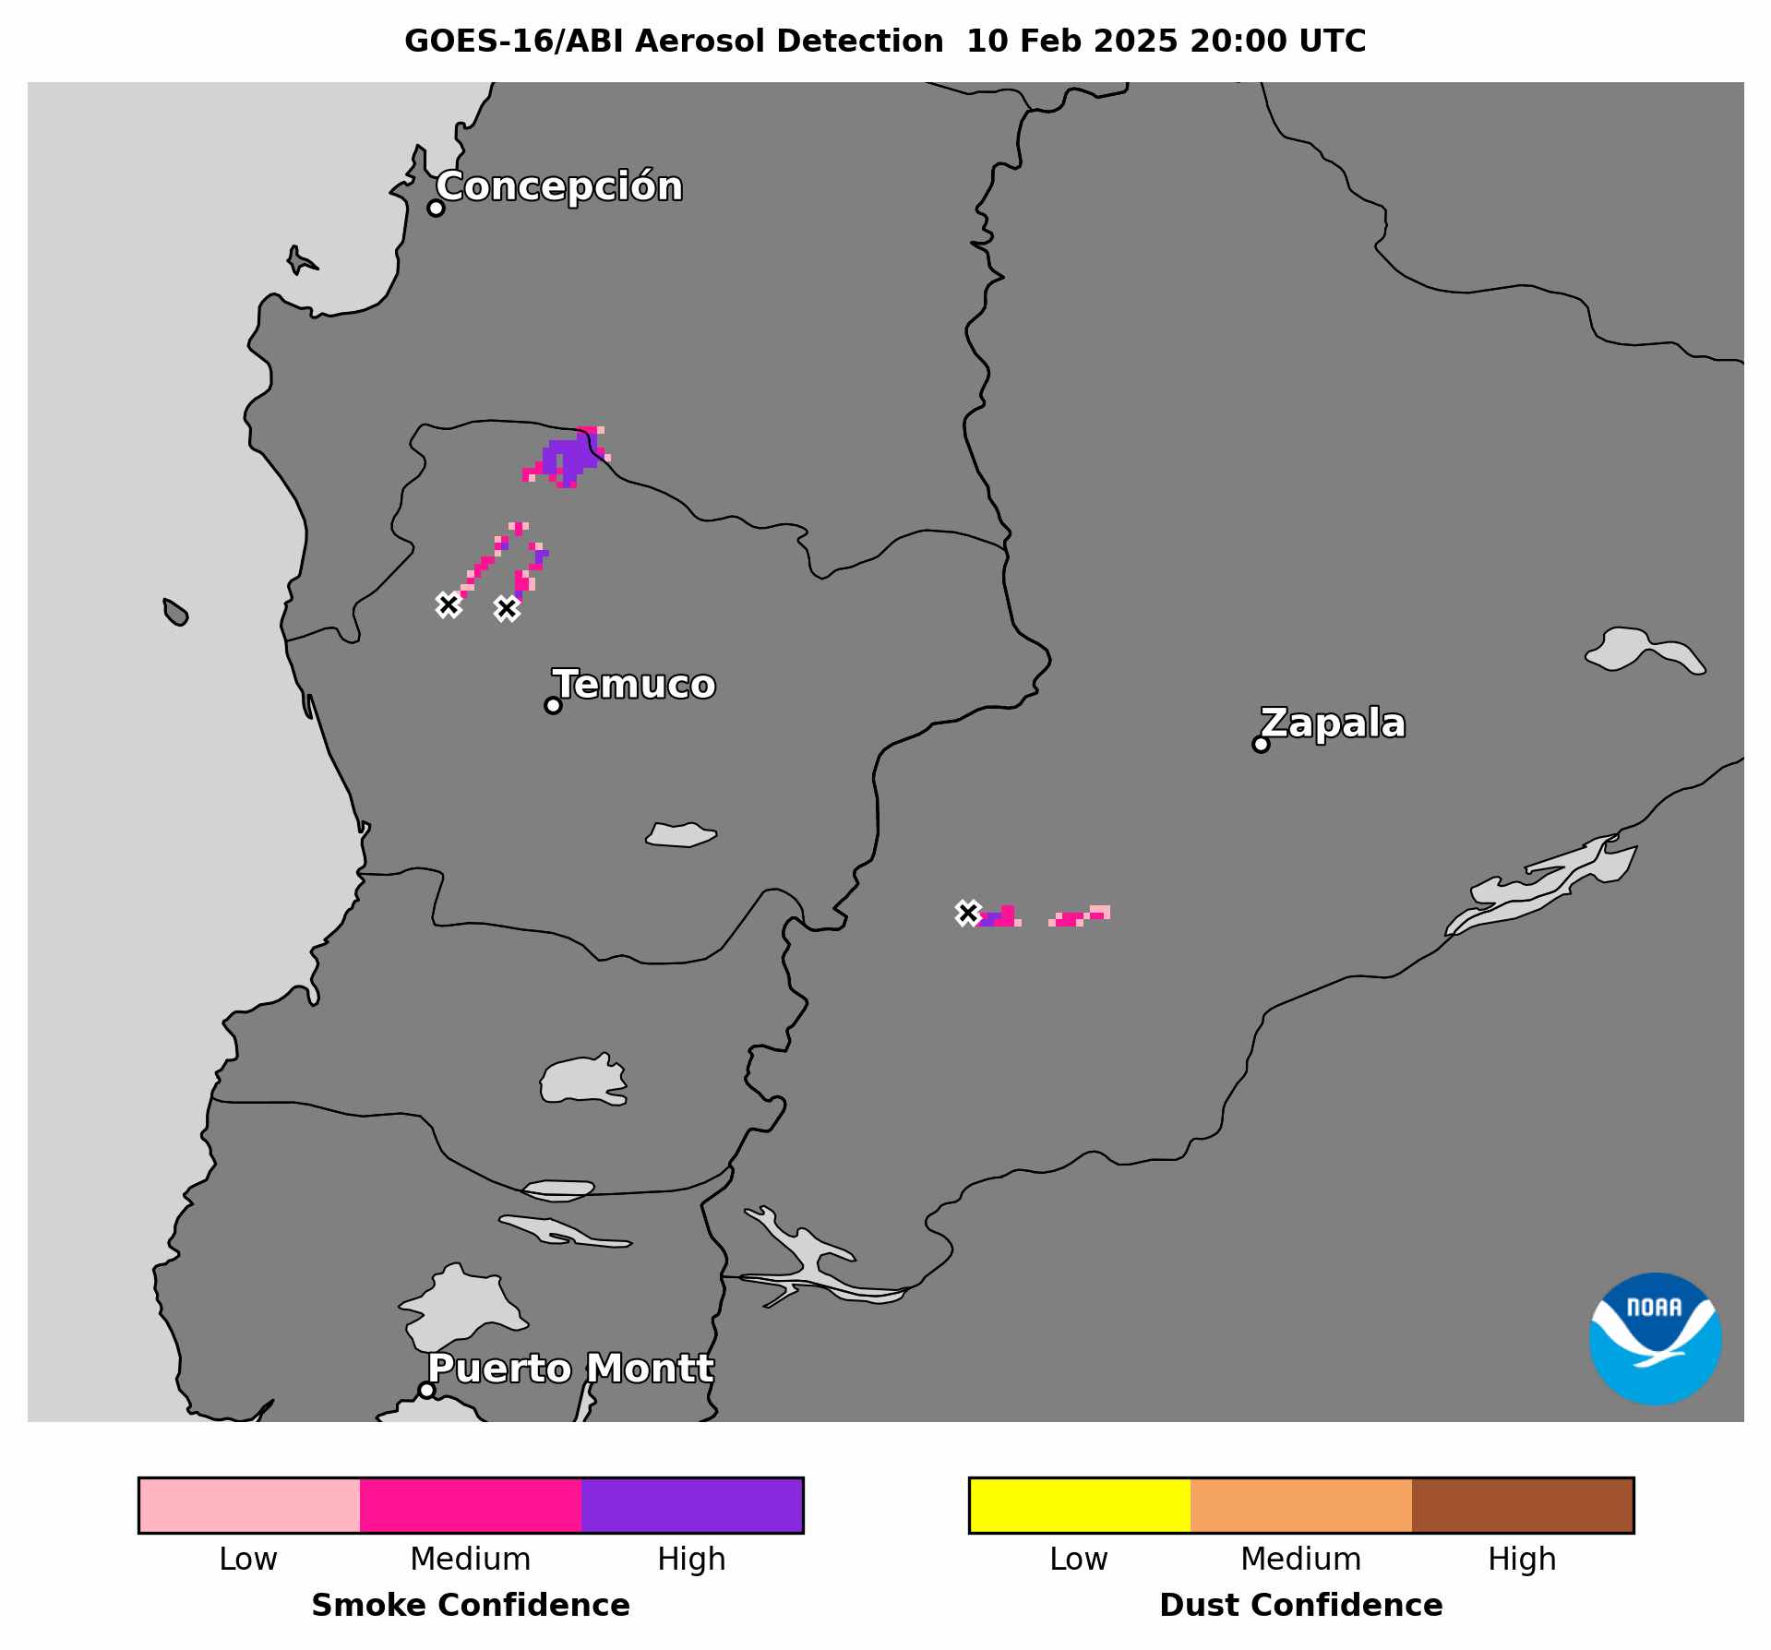
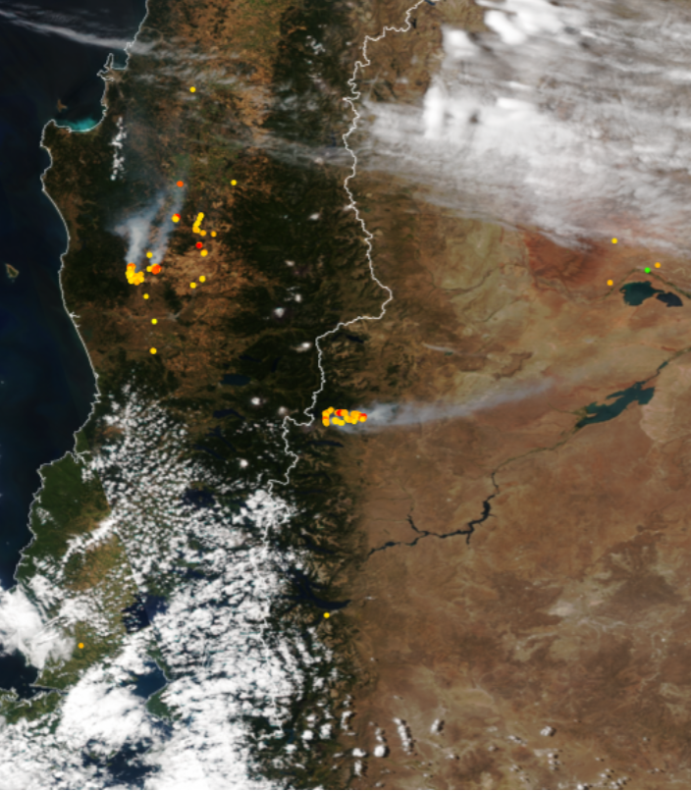

Wildfires in Chile & Argentina
Feb 10, 2025 20:00-21:00 UTC Full Disk Sector
NOAA-21 VIIRS True Color RGB Composite & FRP 10 Feb 2025
NOAA-21 VIIRS True Color RGB Composite & FRP 10 Feb 2025
Summertime wildfires in southern Chile & southwestern Argentina
Prevailing winds on opposite sides
of the Andes Mountains blew smoke plumes in different directions
GOES-19 ABI ADP has:
  Coverage & confidence comparable to GOES-16
  Coverage comparable to NOAA-21 VIIRS ADP & S5P TROPOMI CO
Image from JSTAR Mapper website
Image from JSTAR Mapper website

Slide 13
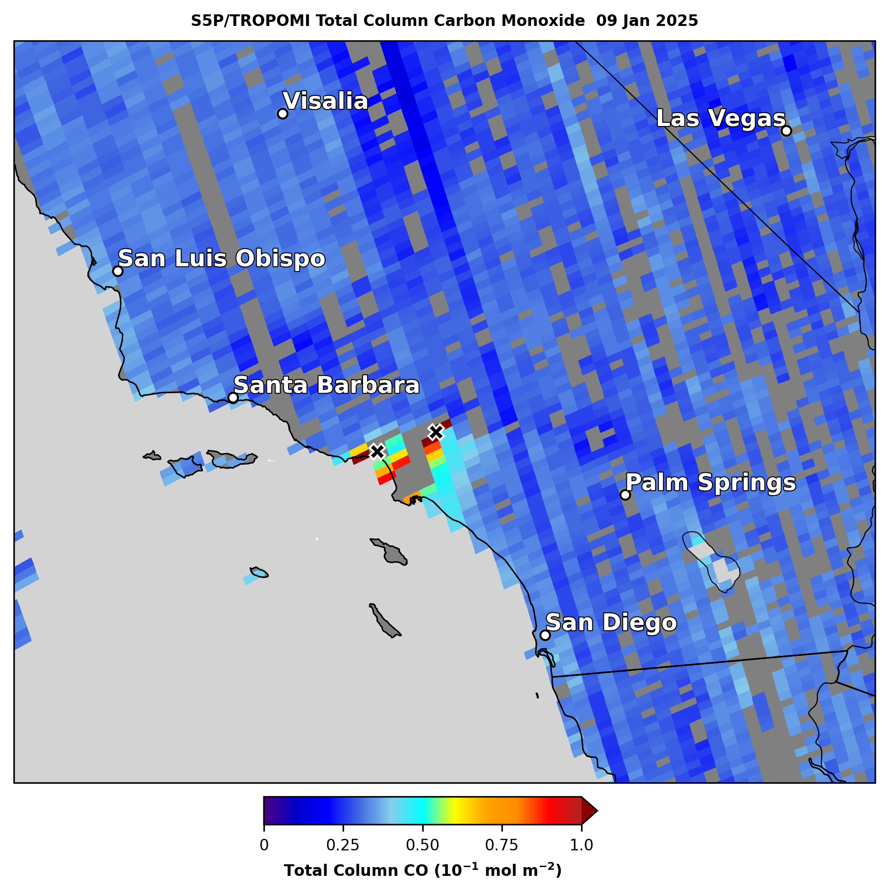
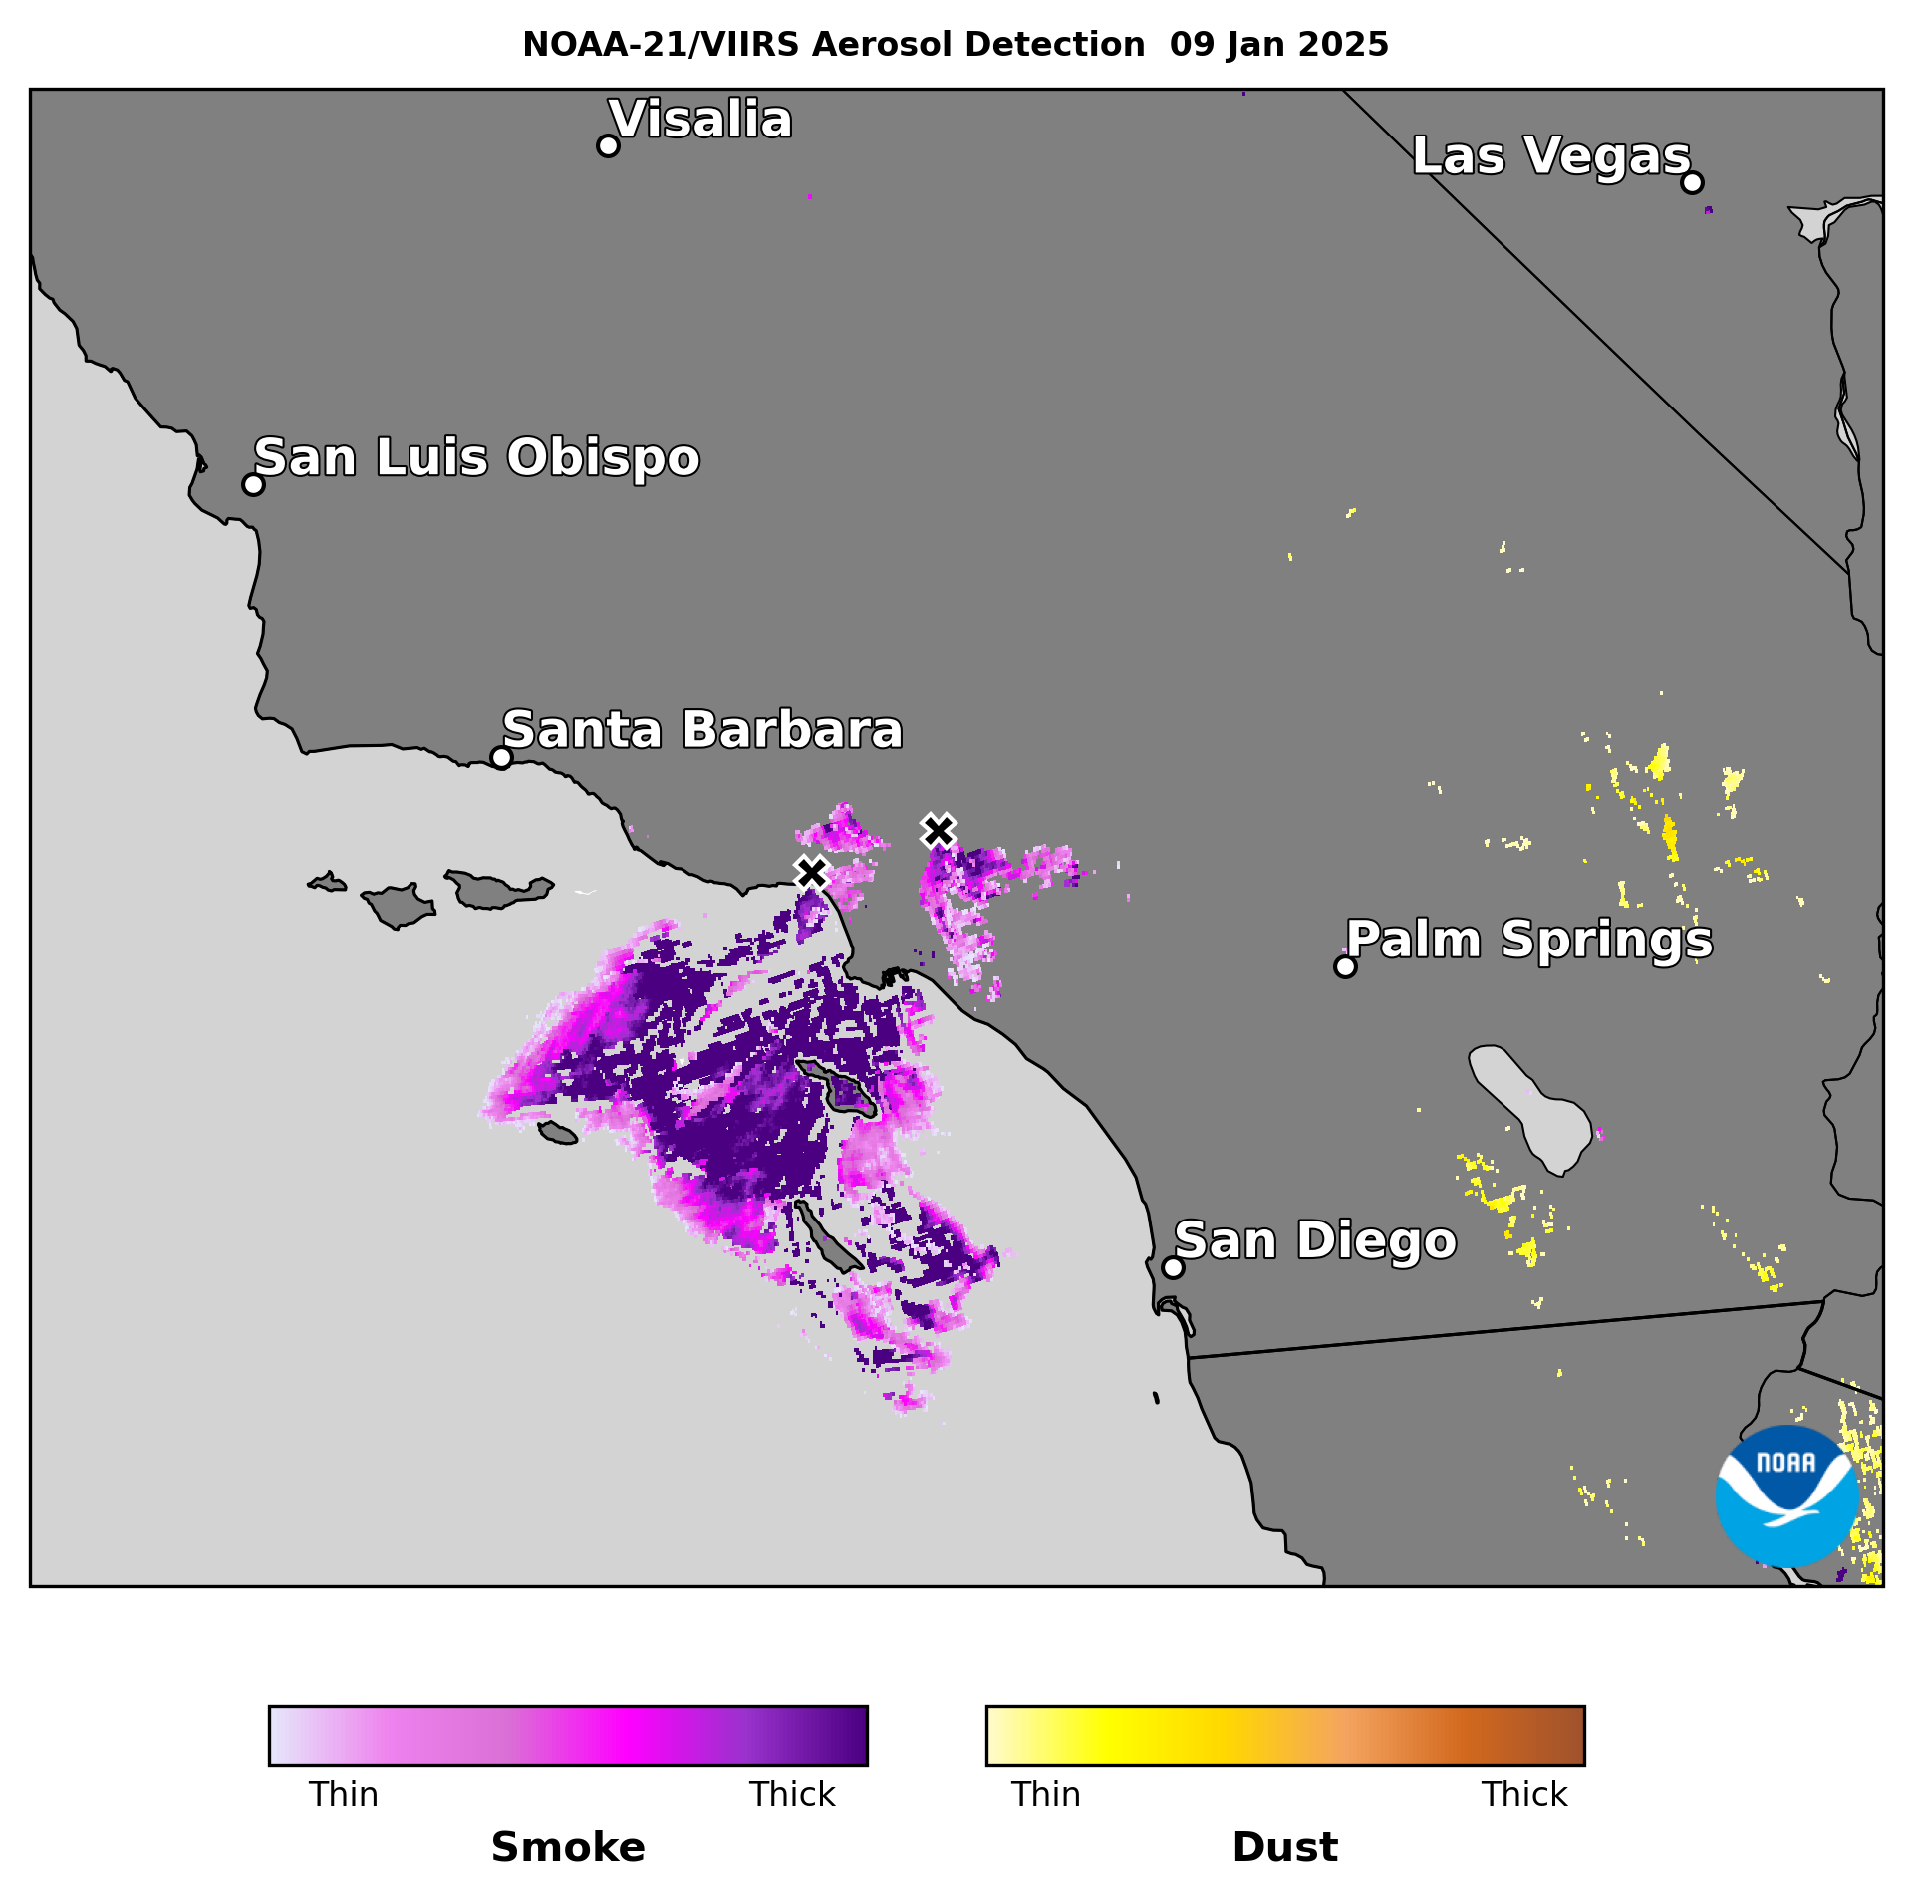
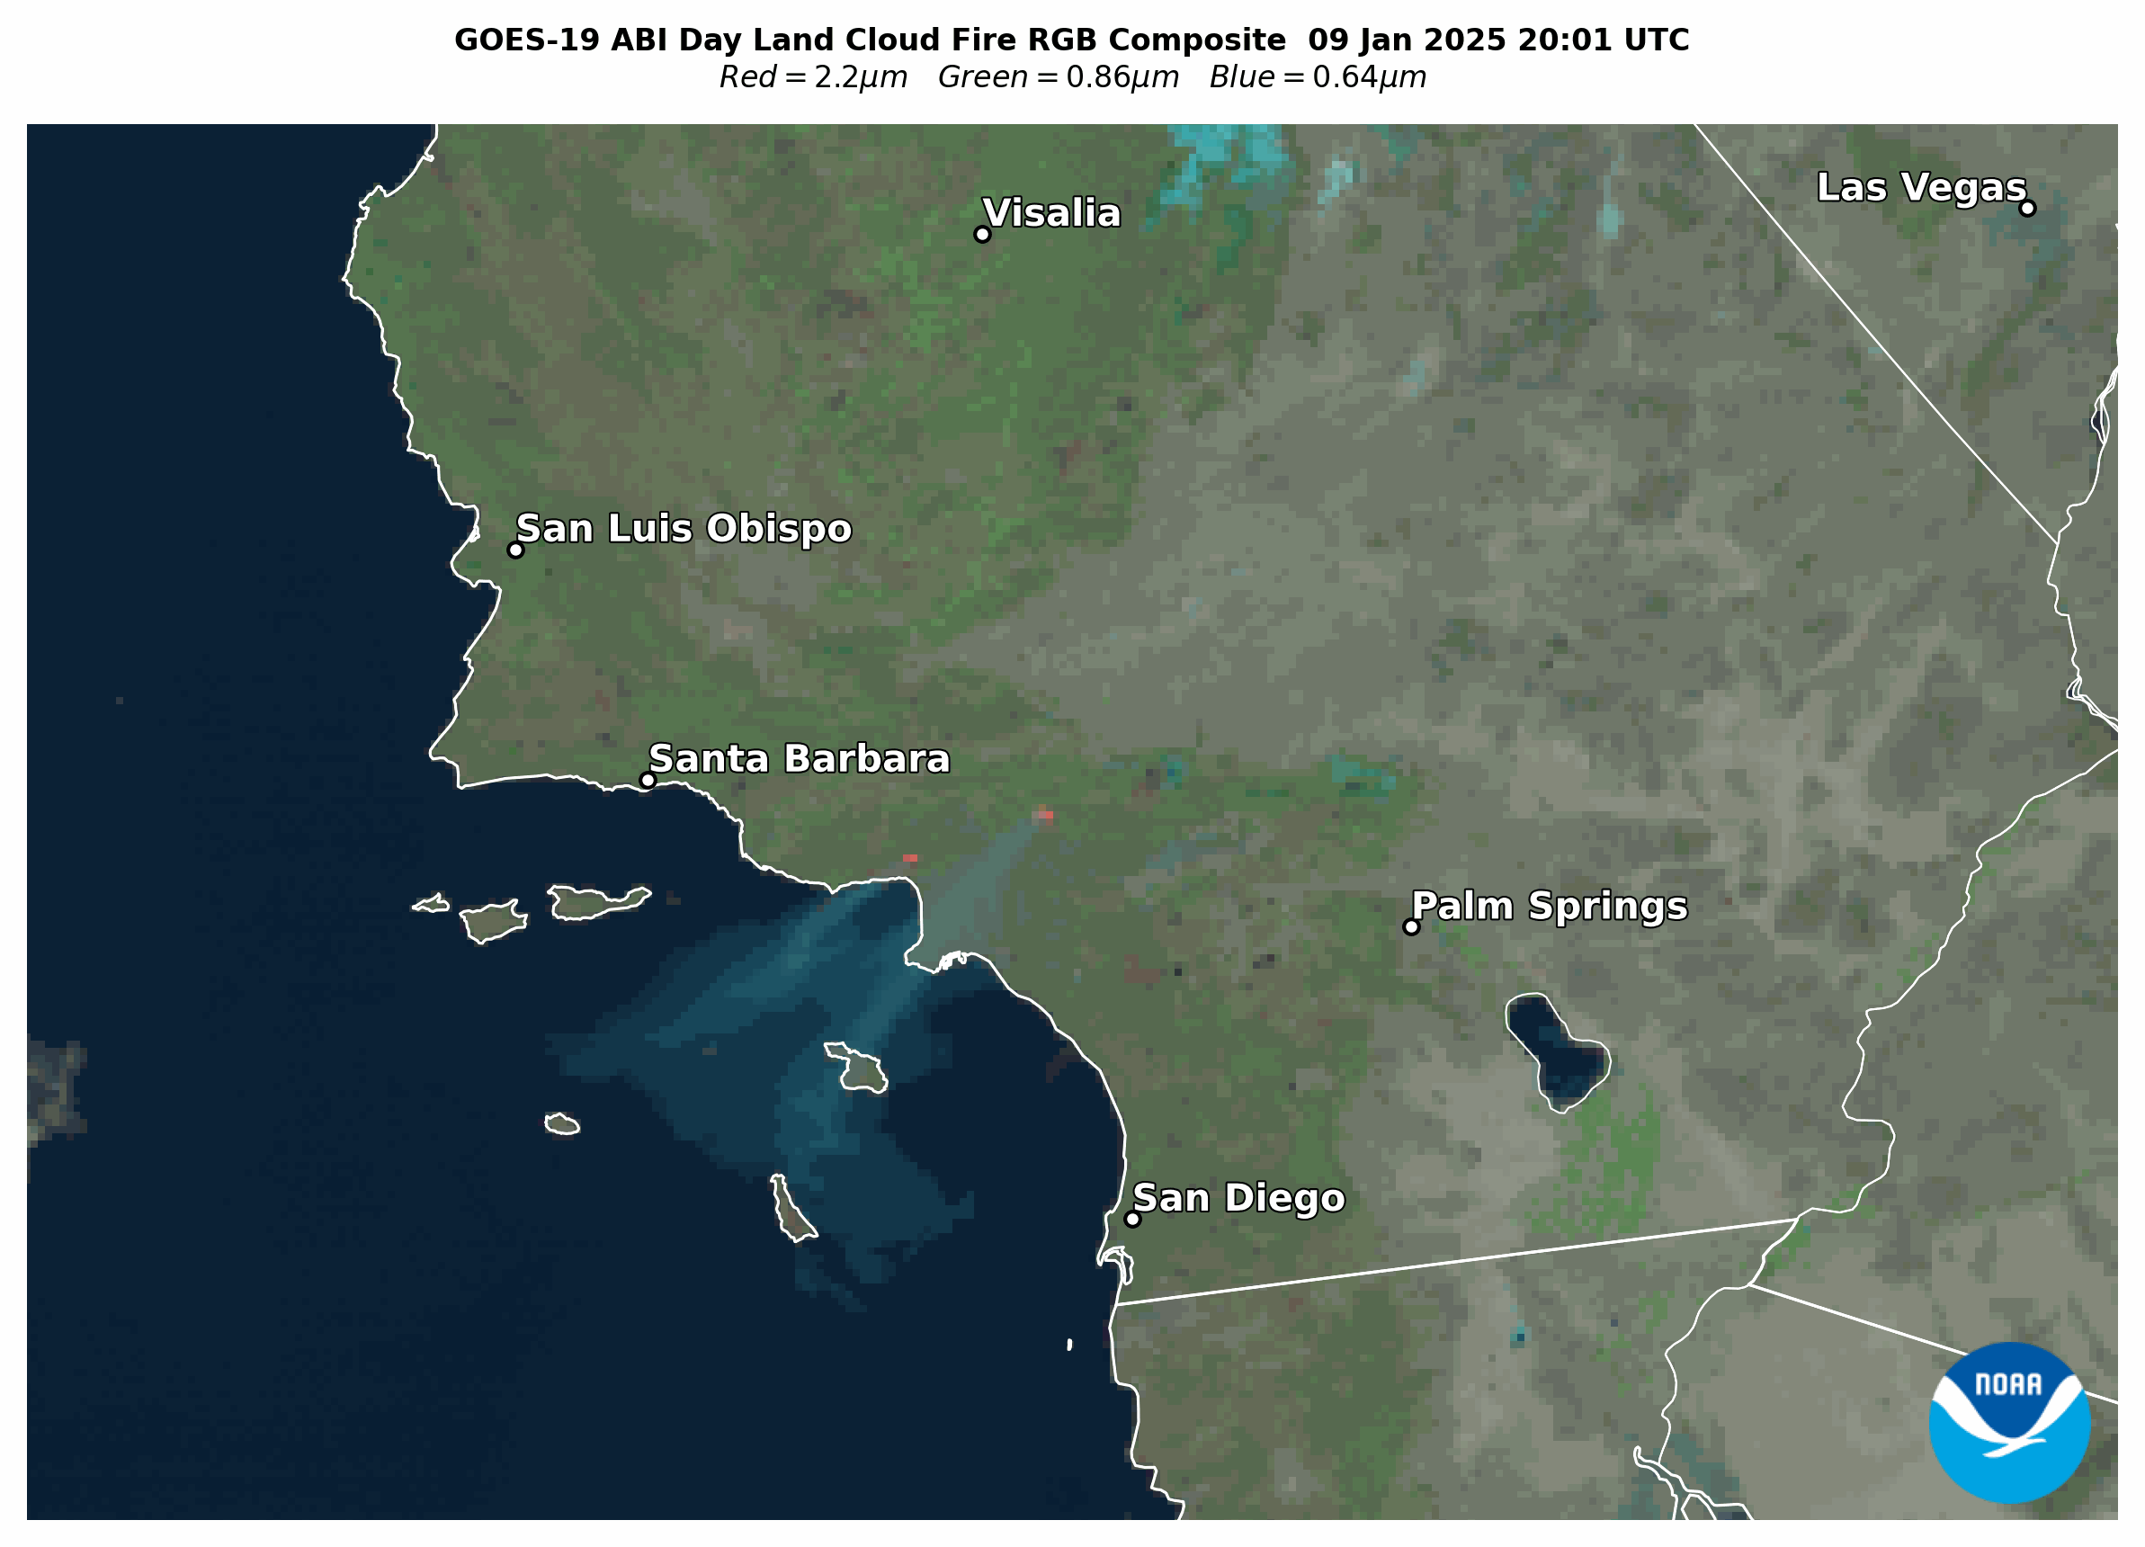
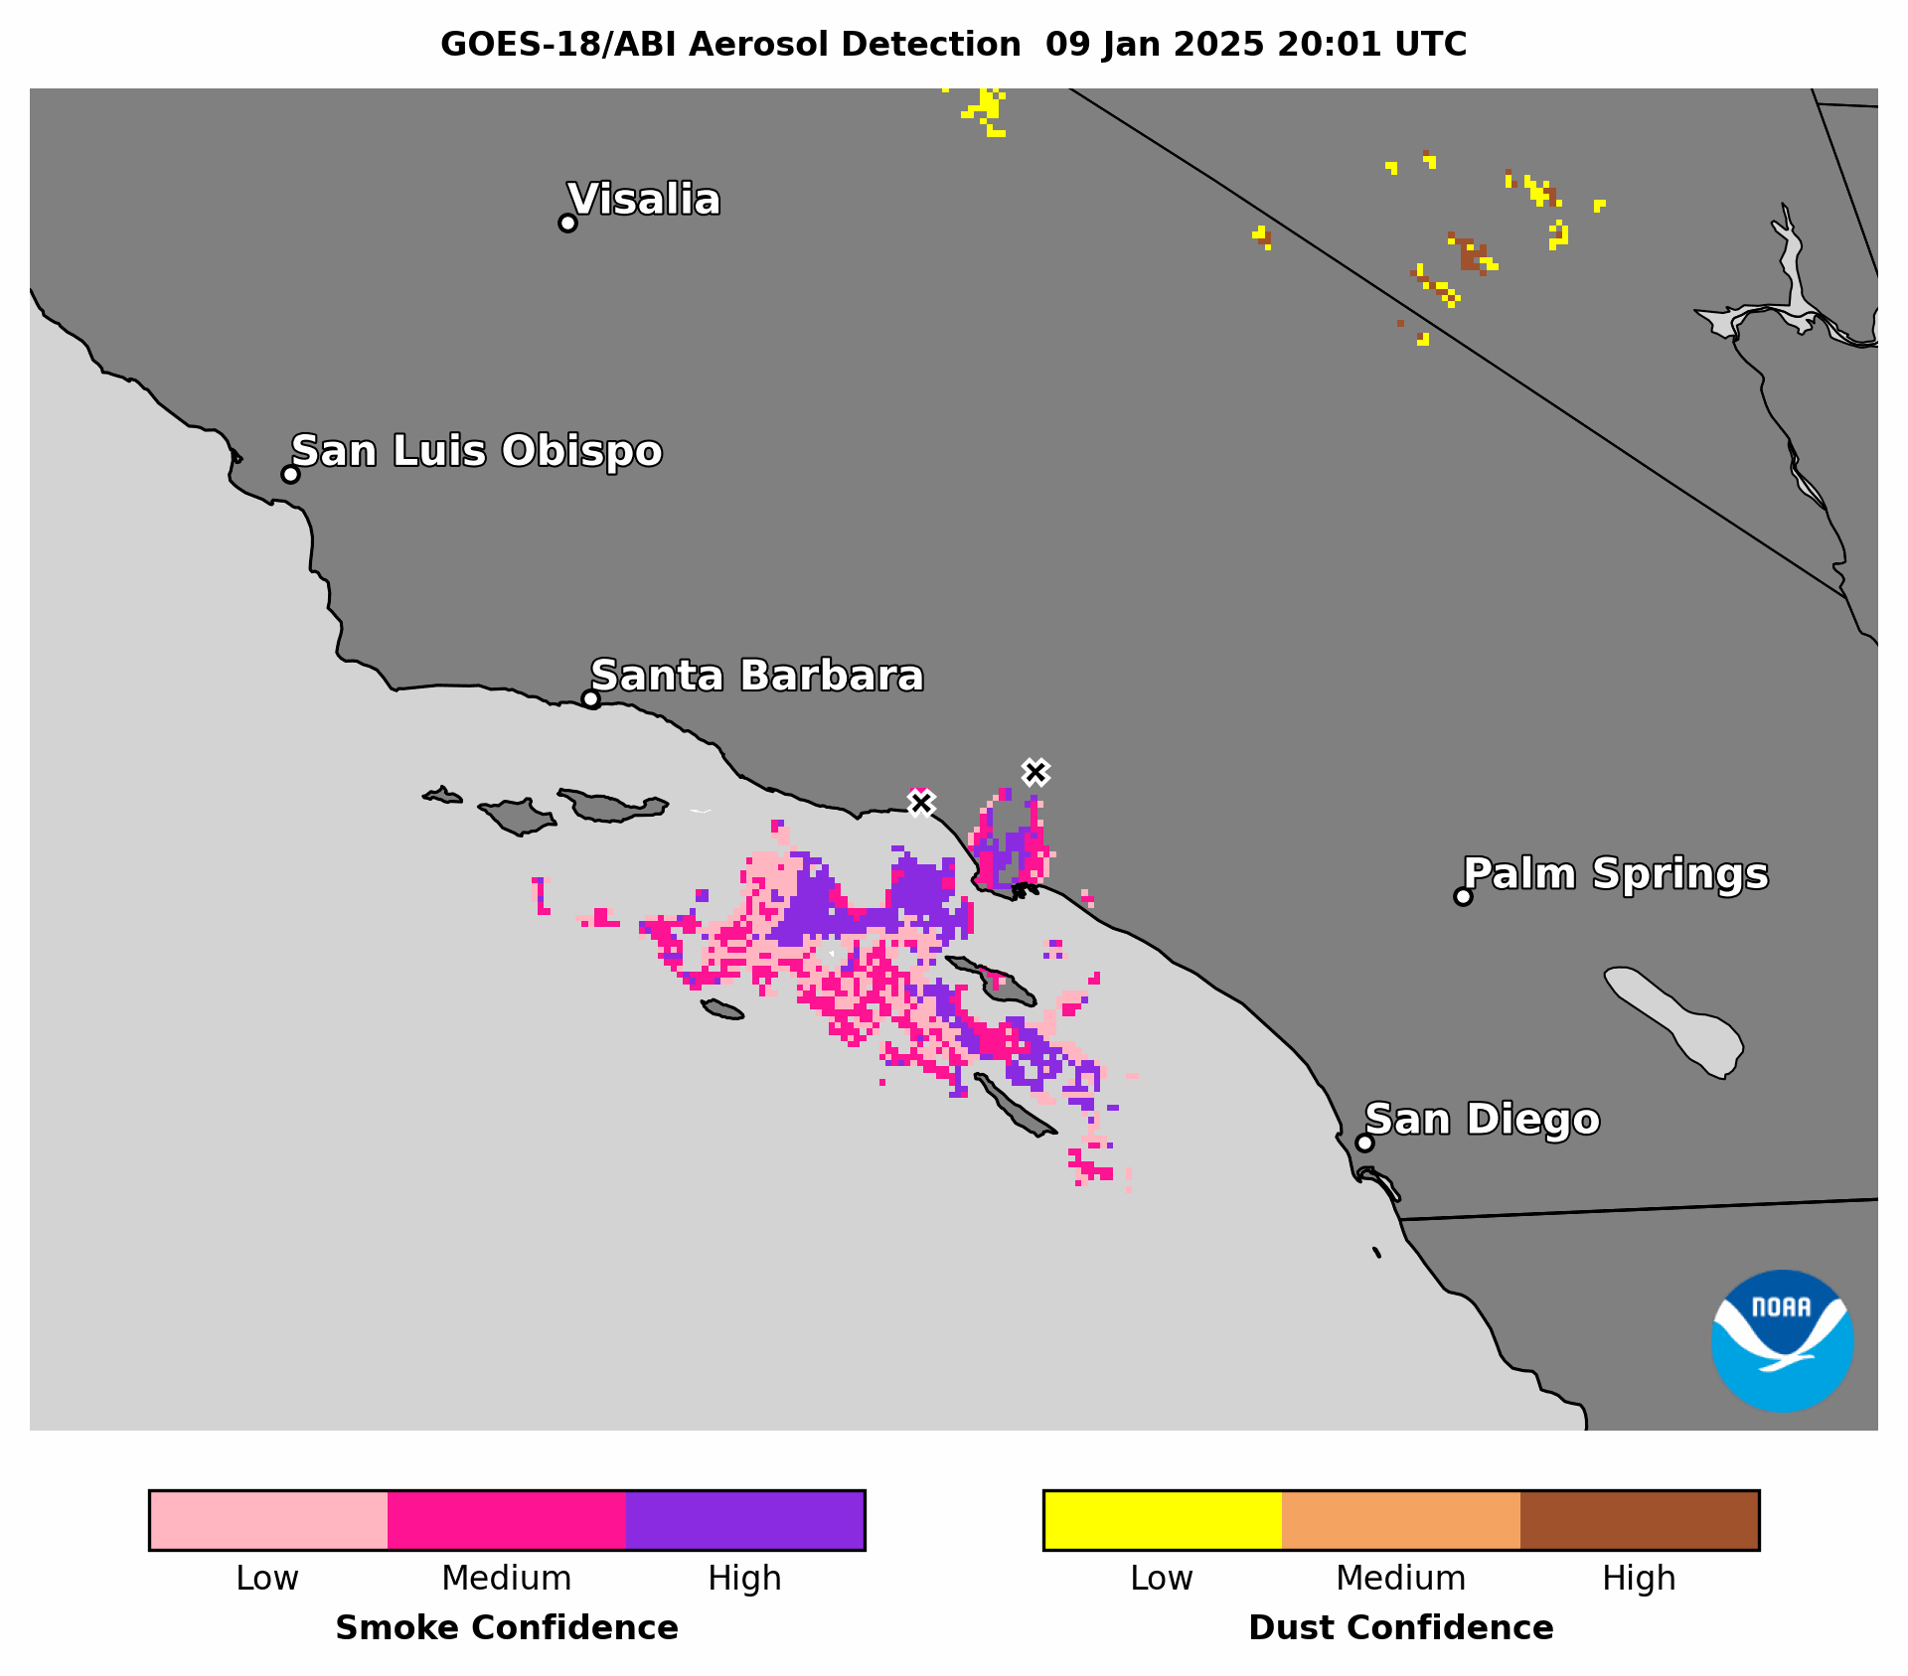
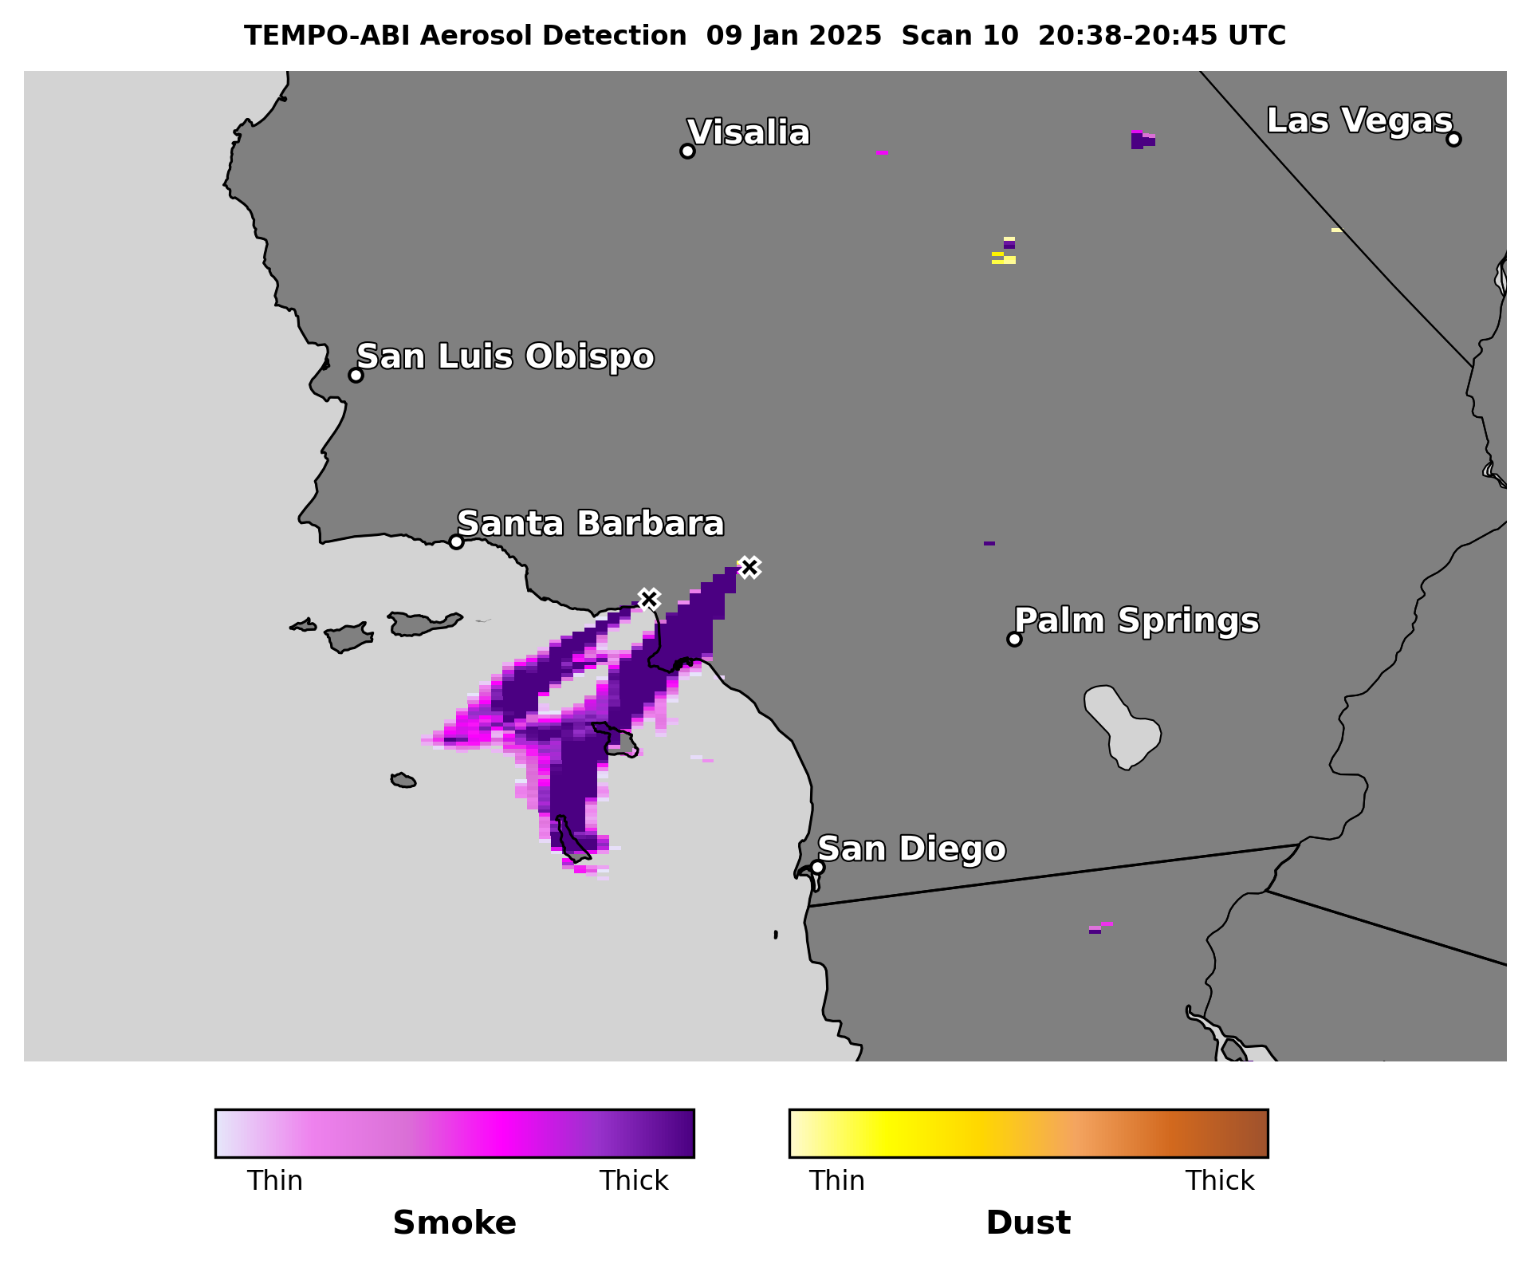
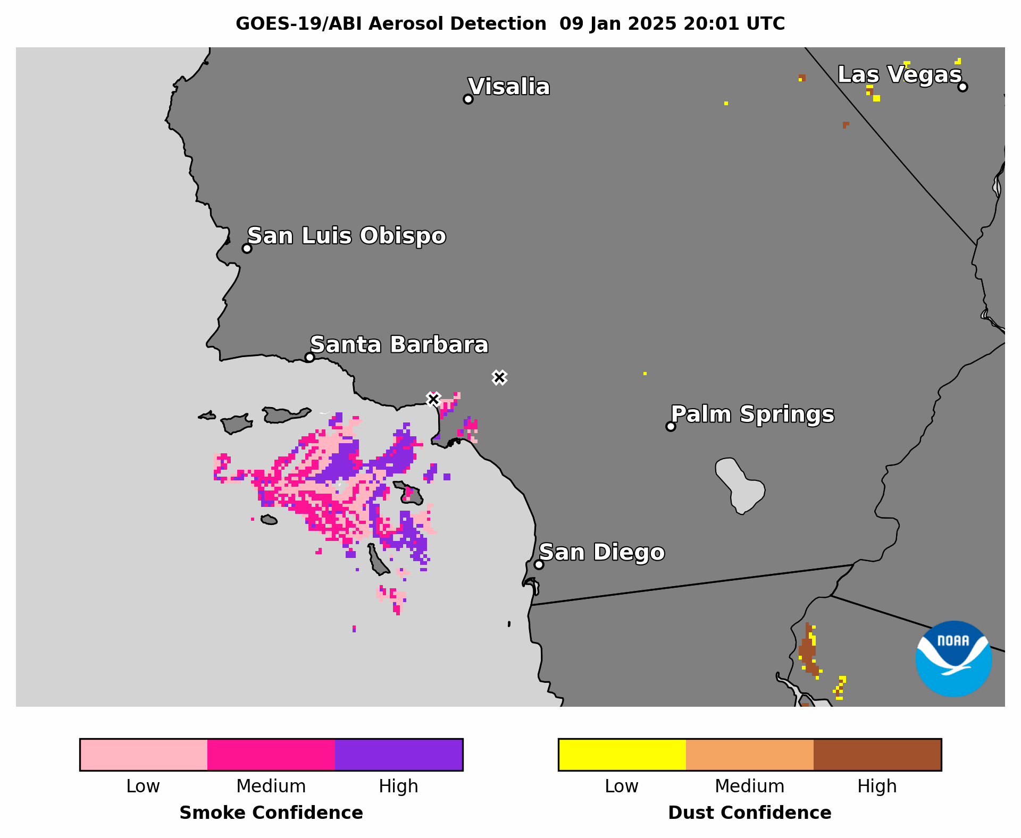
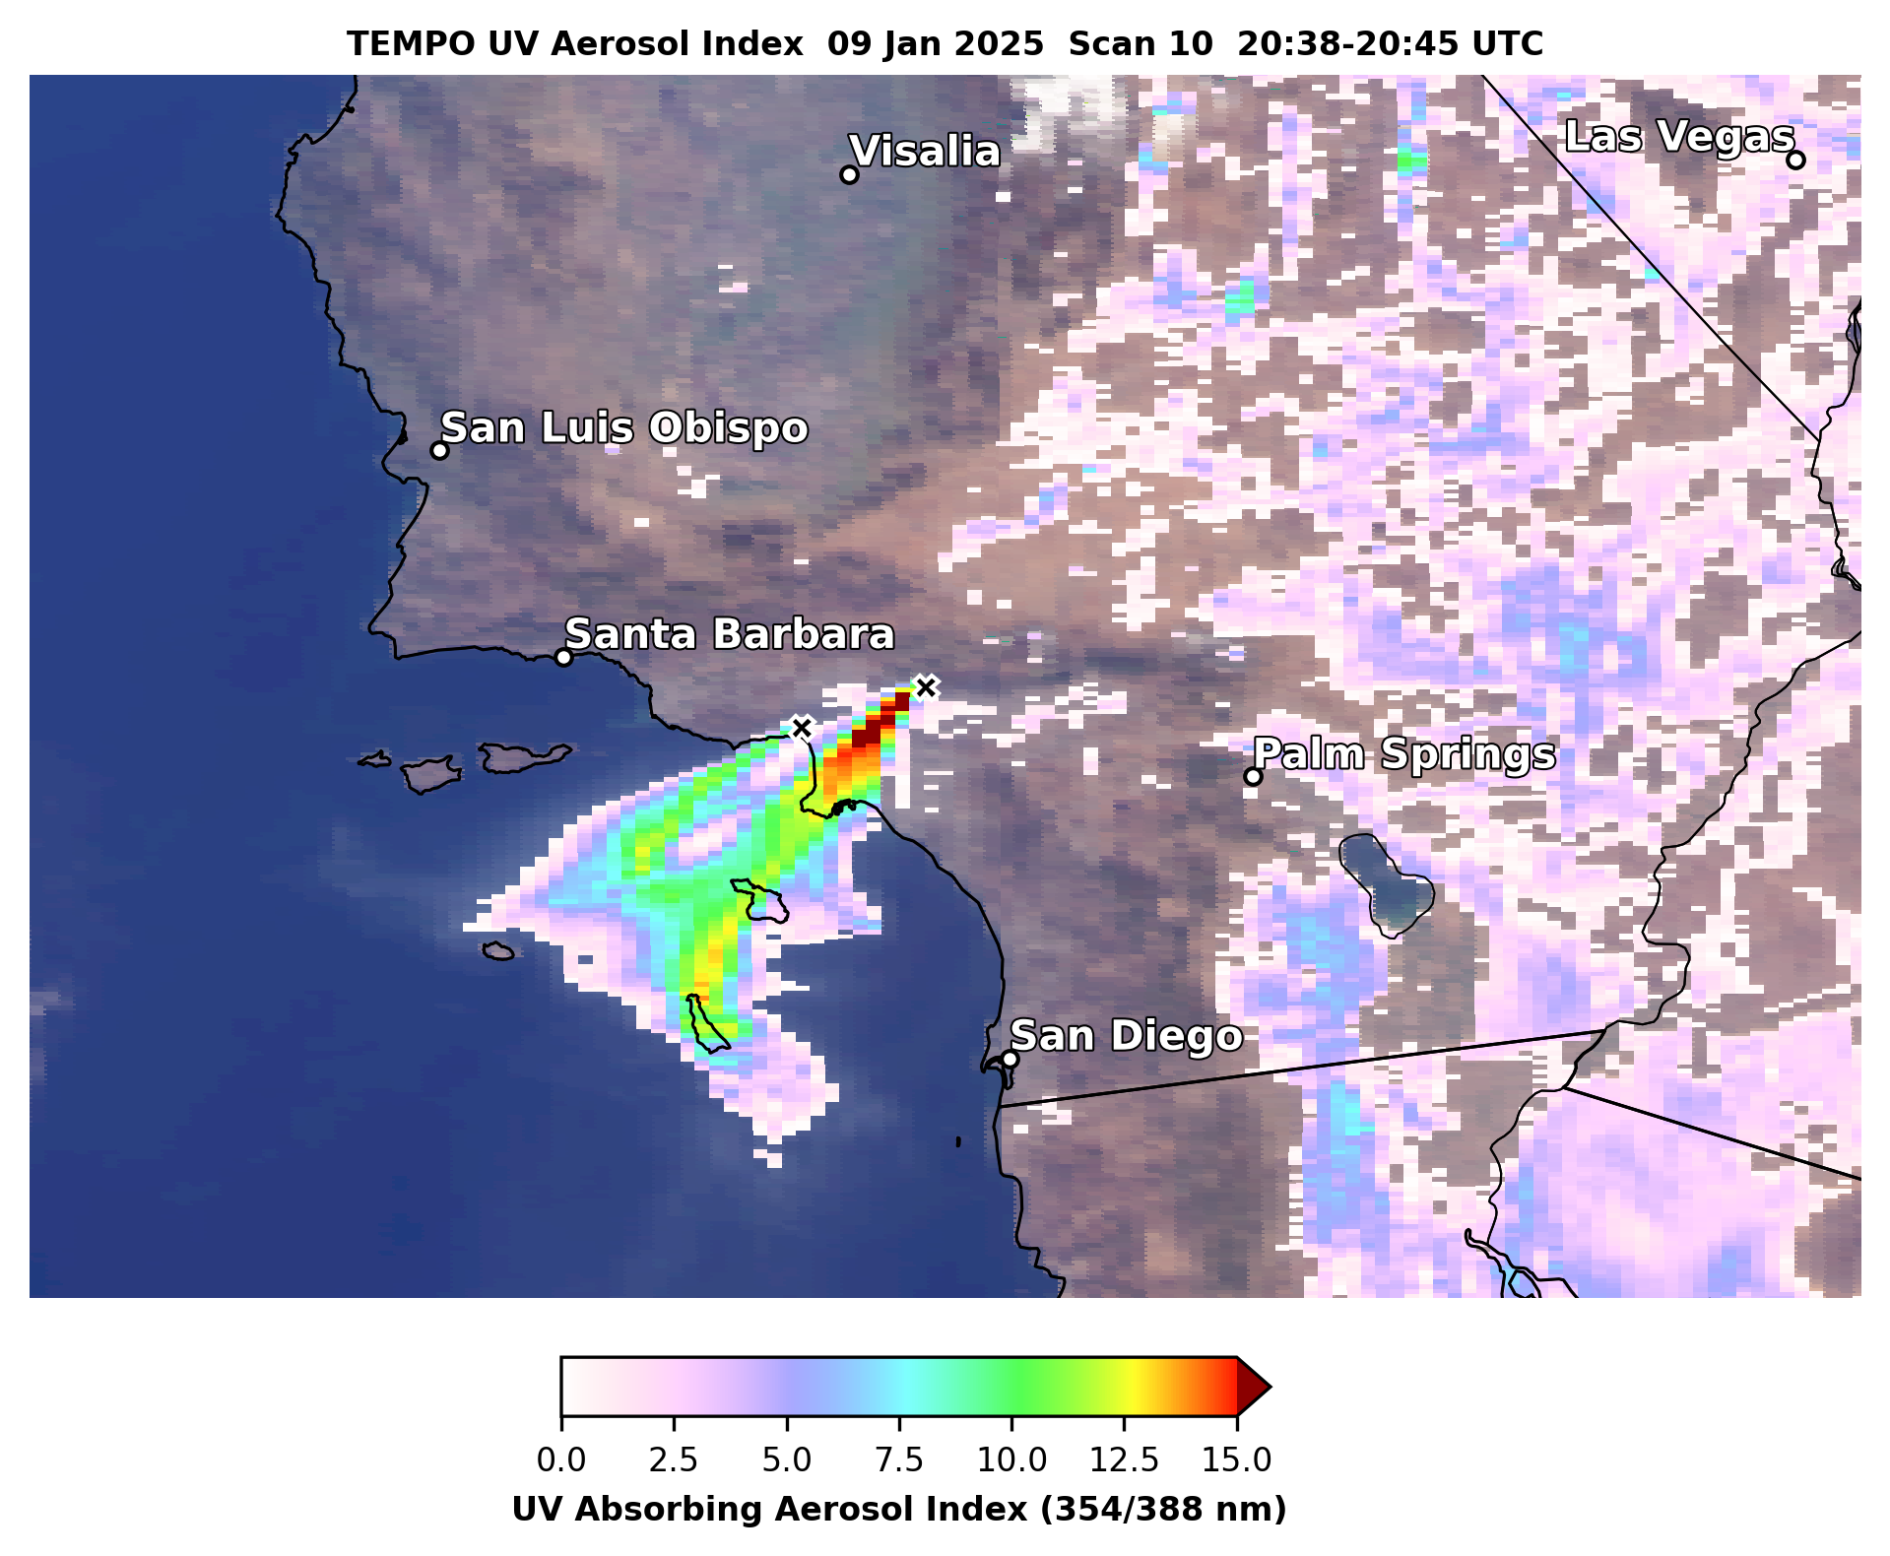
Palisades & Eaton Wildfires in Los Angeles County
Jan 9, 2025 20:01-21:01 UTC CONUS Sector
GOES-19 ABI ADP has:
  Coverage & confidence comparable to GOES-18
  Coverage comparable to NOAA-21 VIIRS ADP, S5P TROPOMI CO, TEMPO ADP & UV AI
Day Land Cloud Fire RGB composite highlights smoke plumes & fire hotspots (orange pixels)

Slide 14
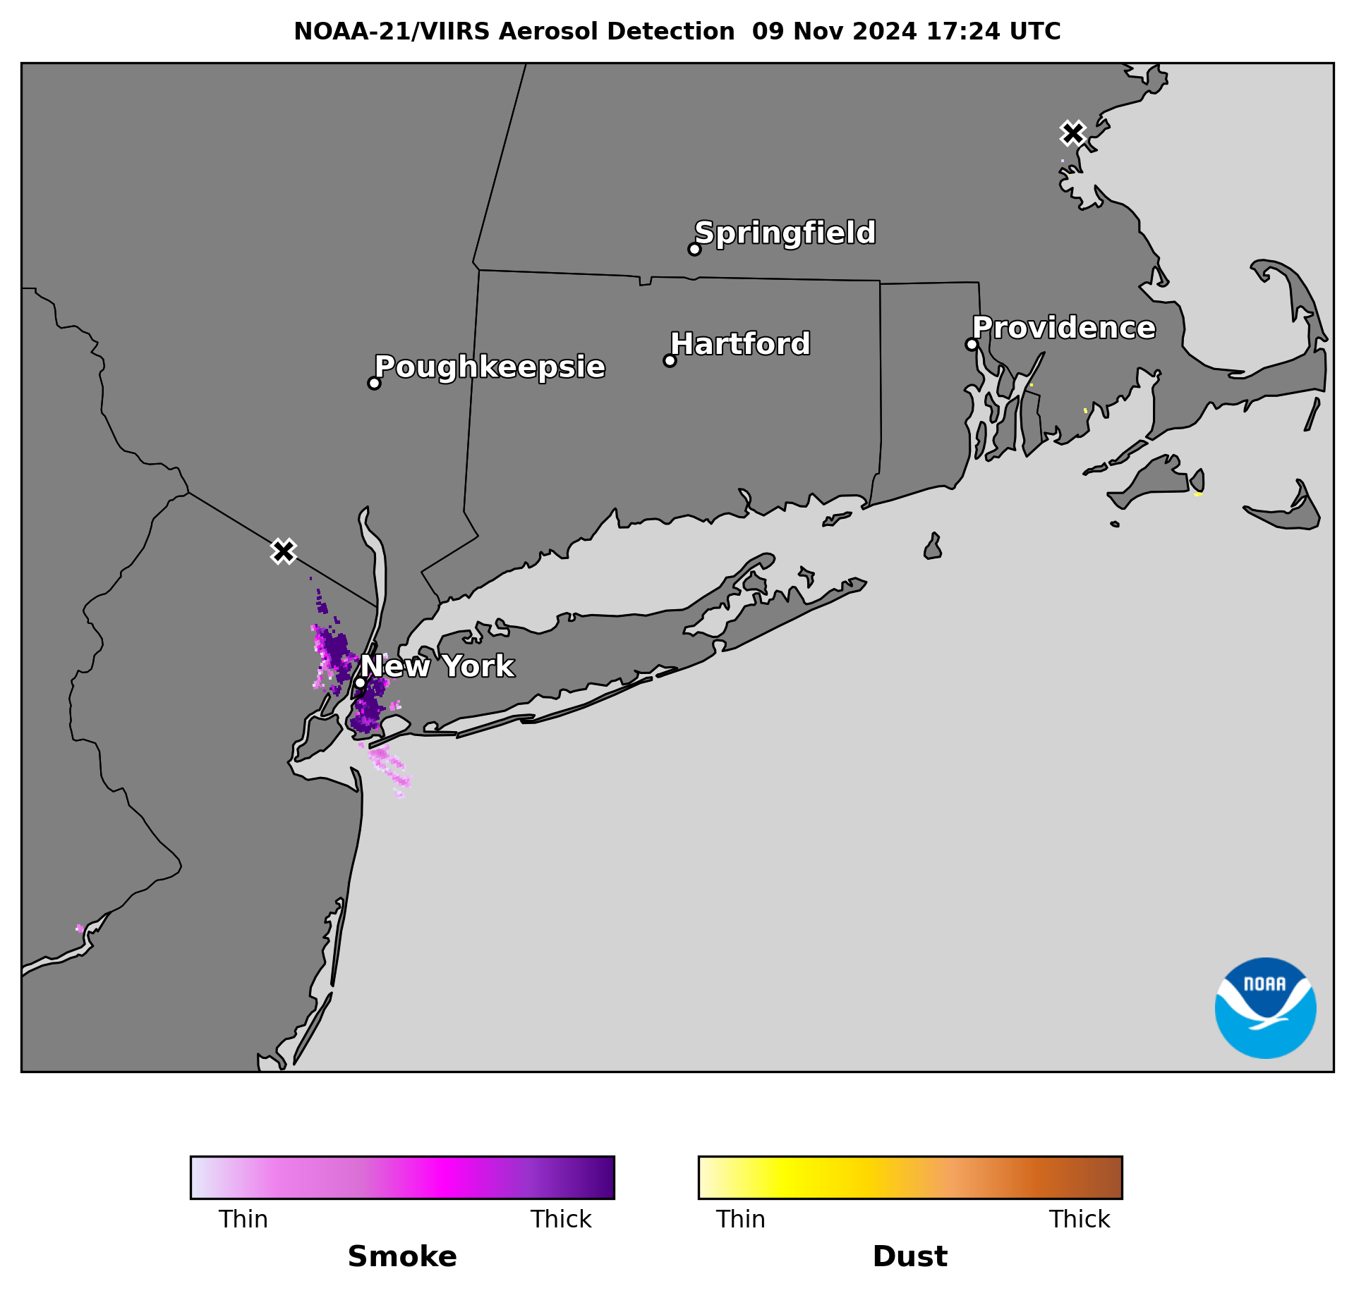
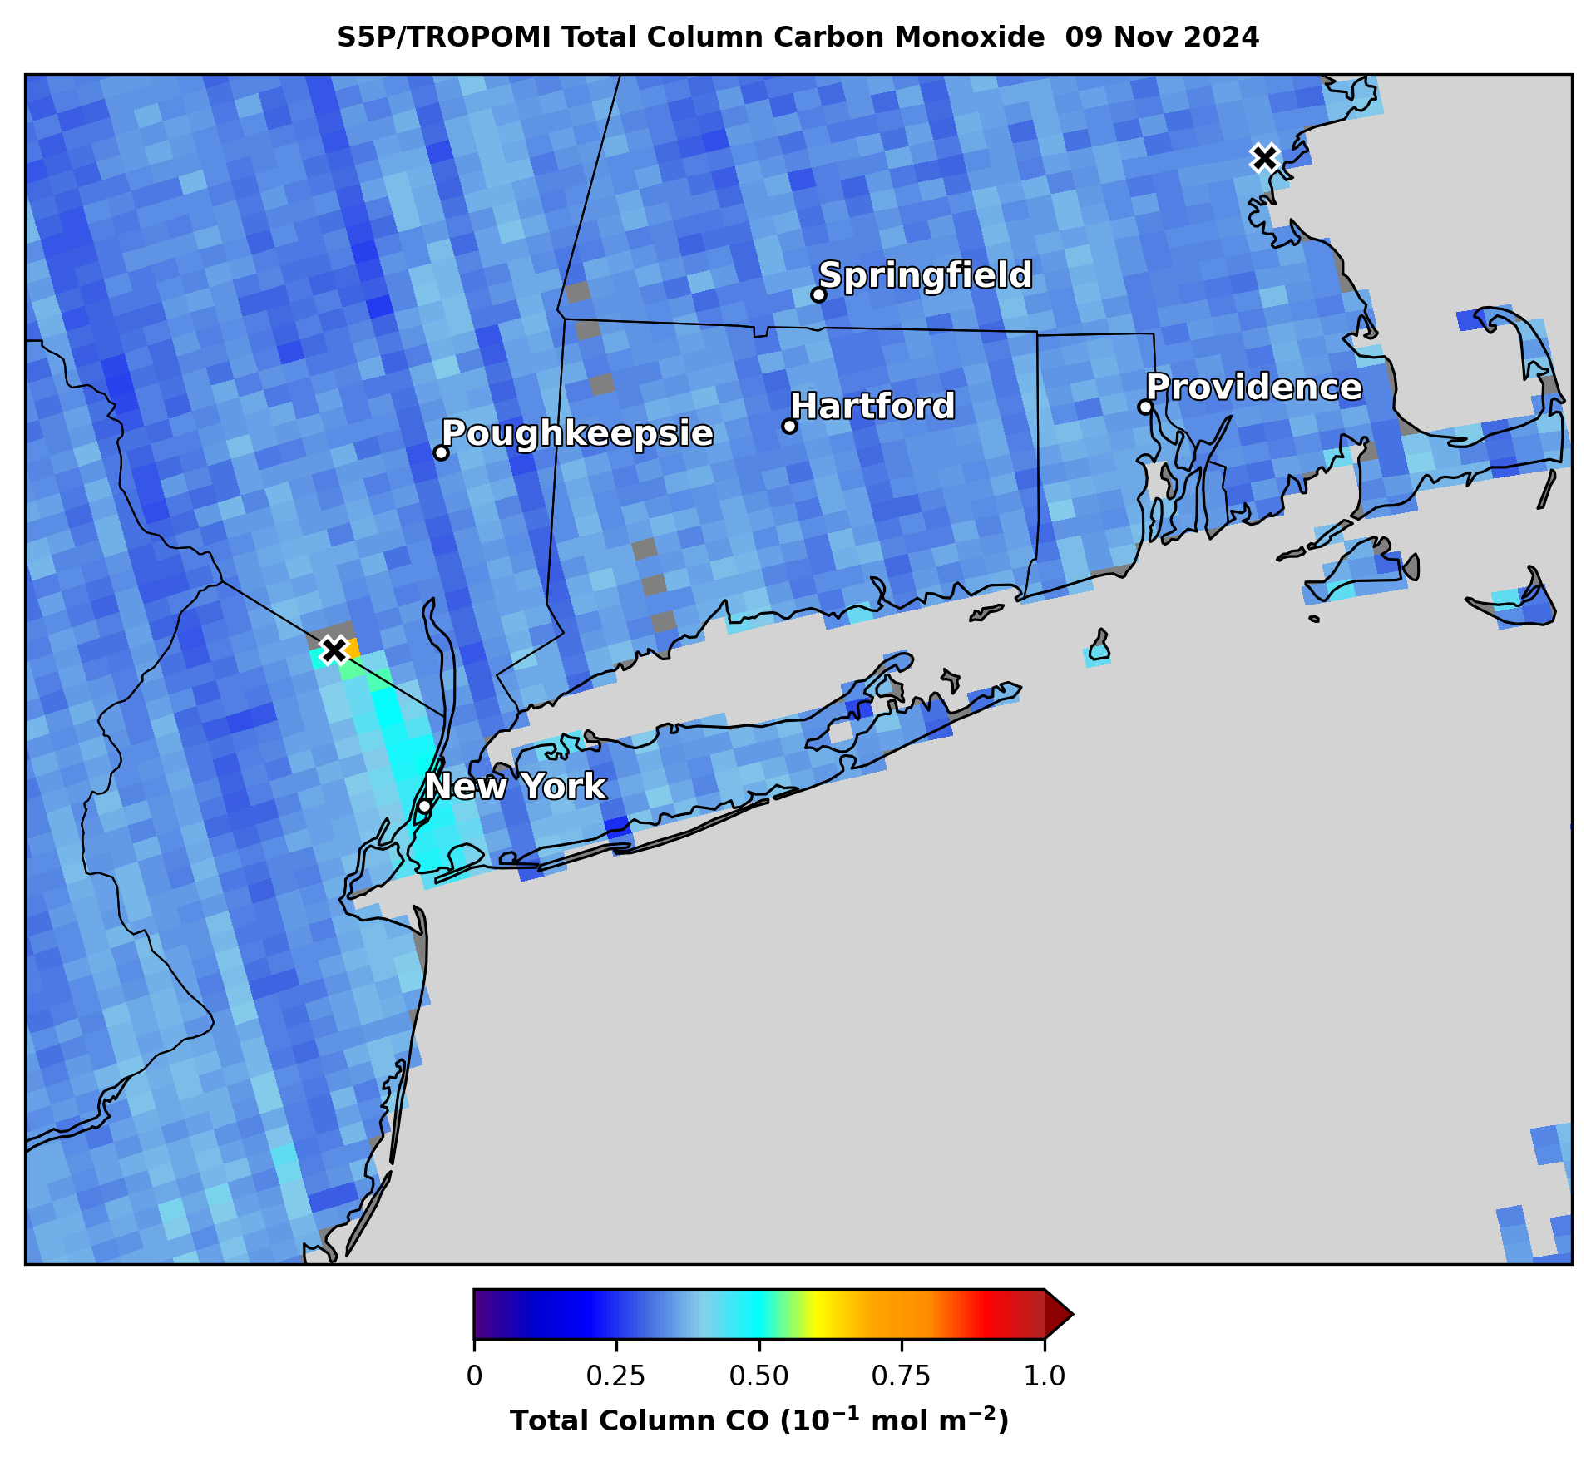
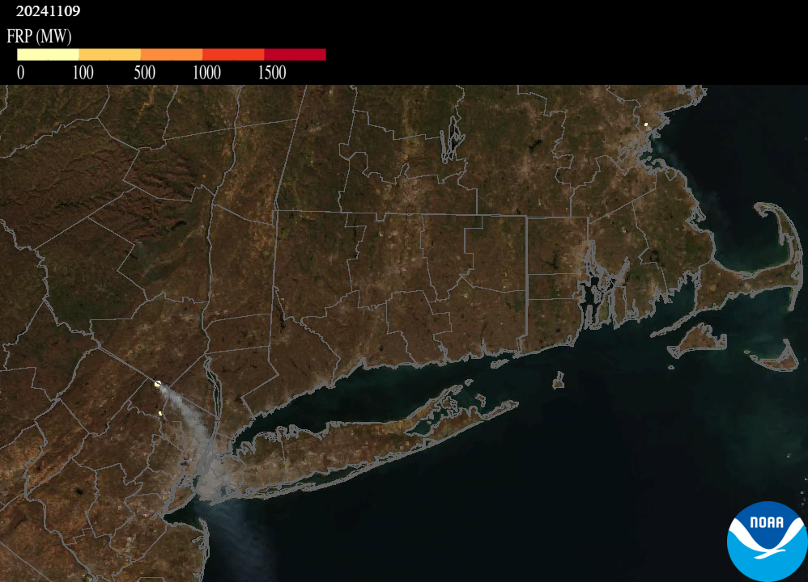
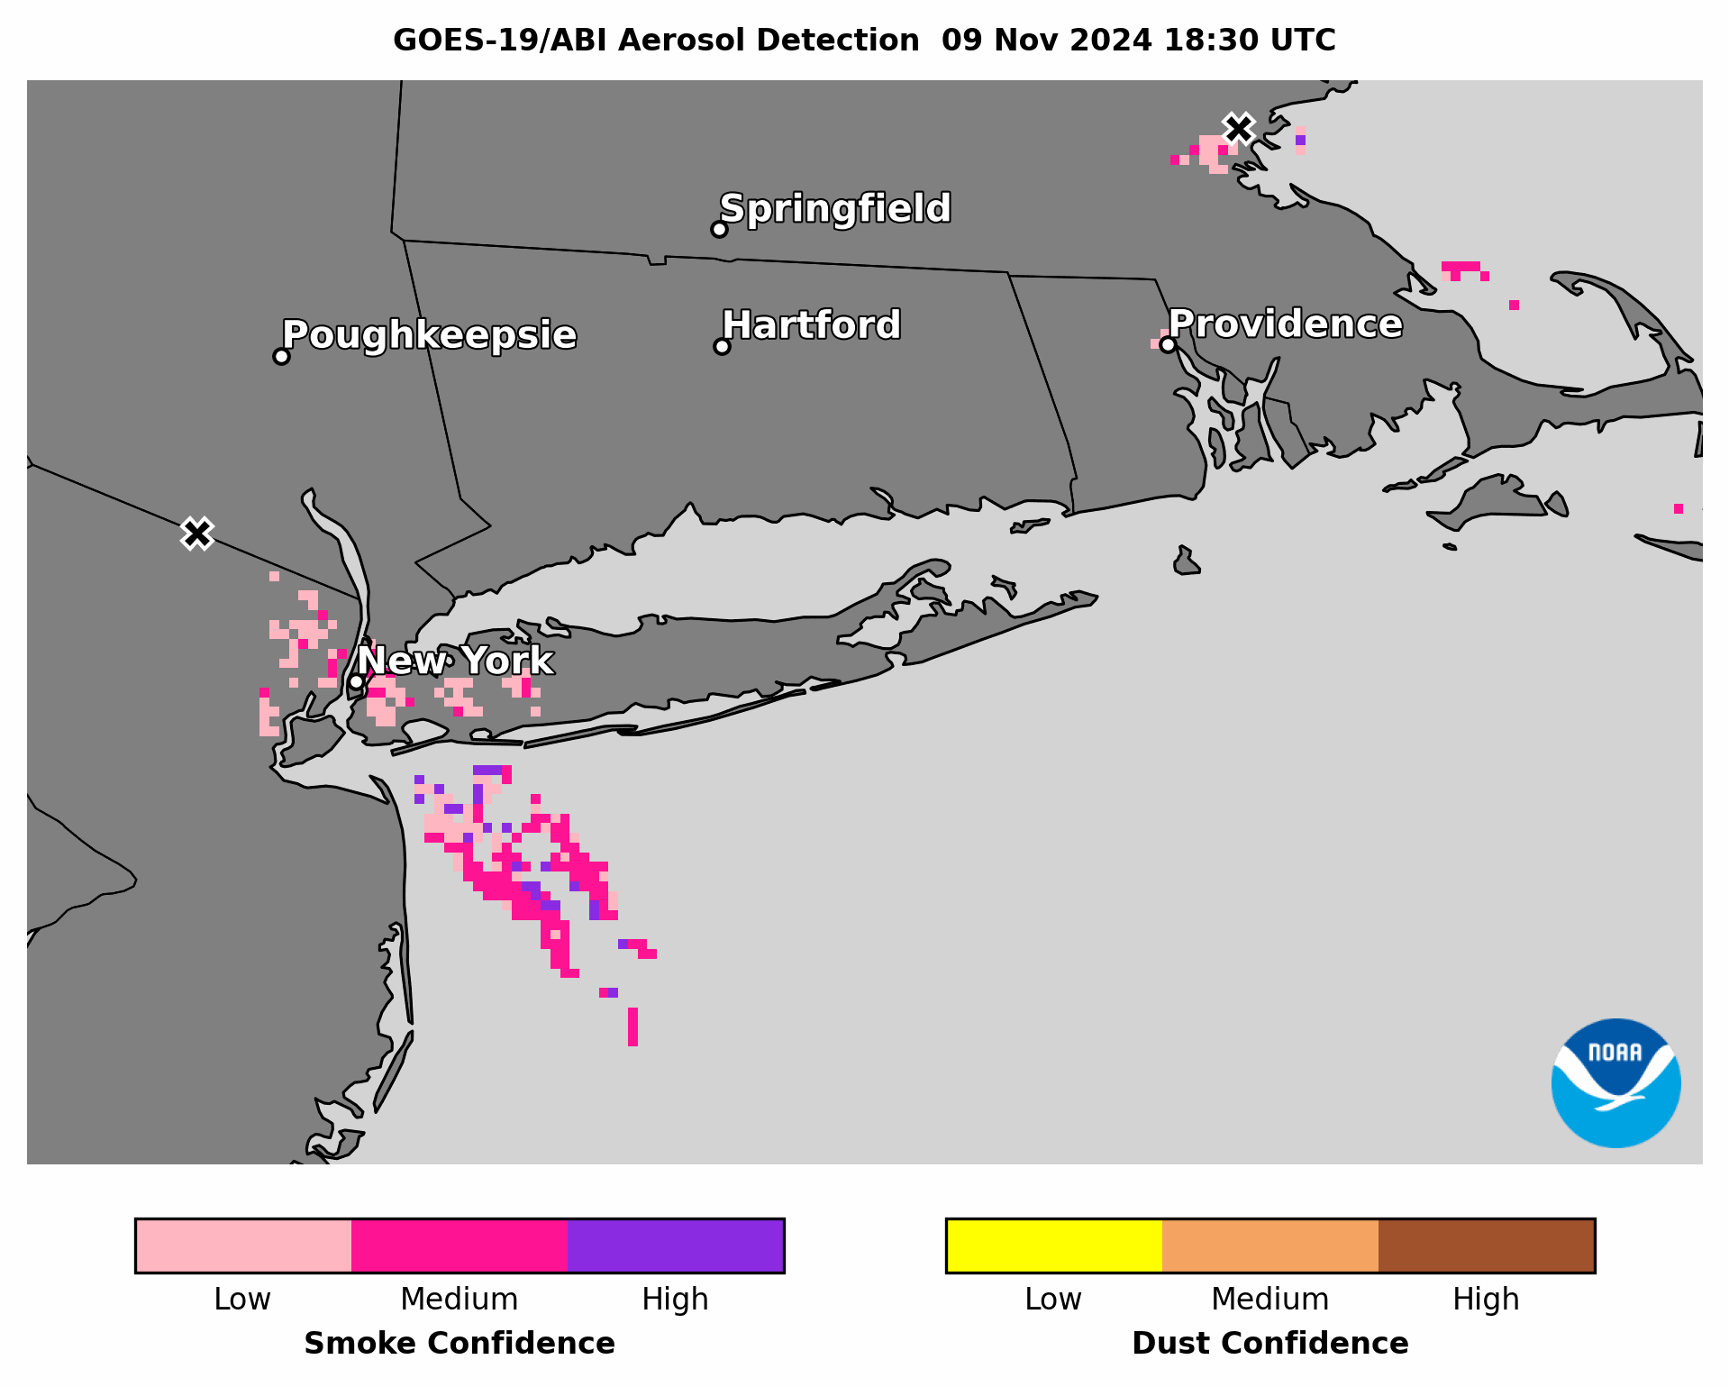
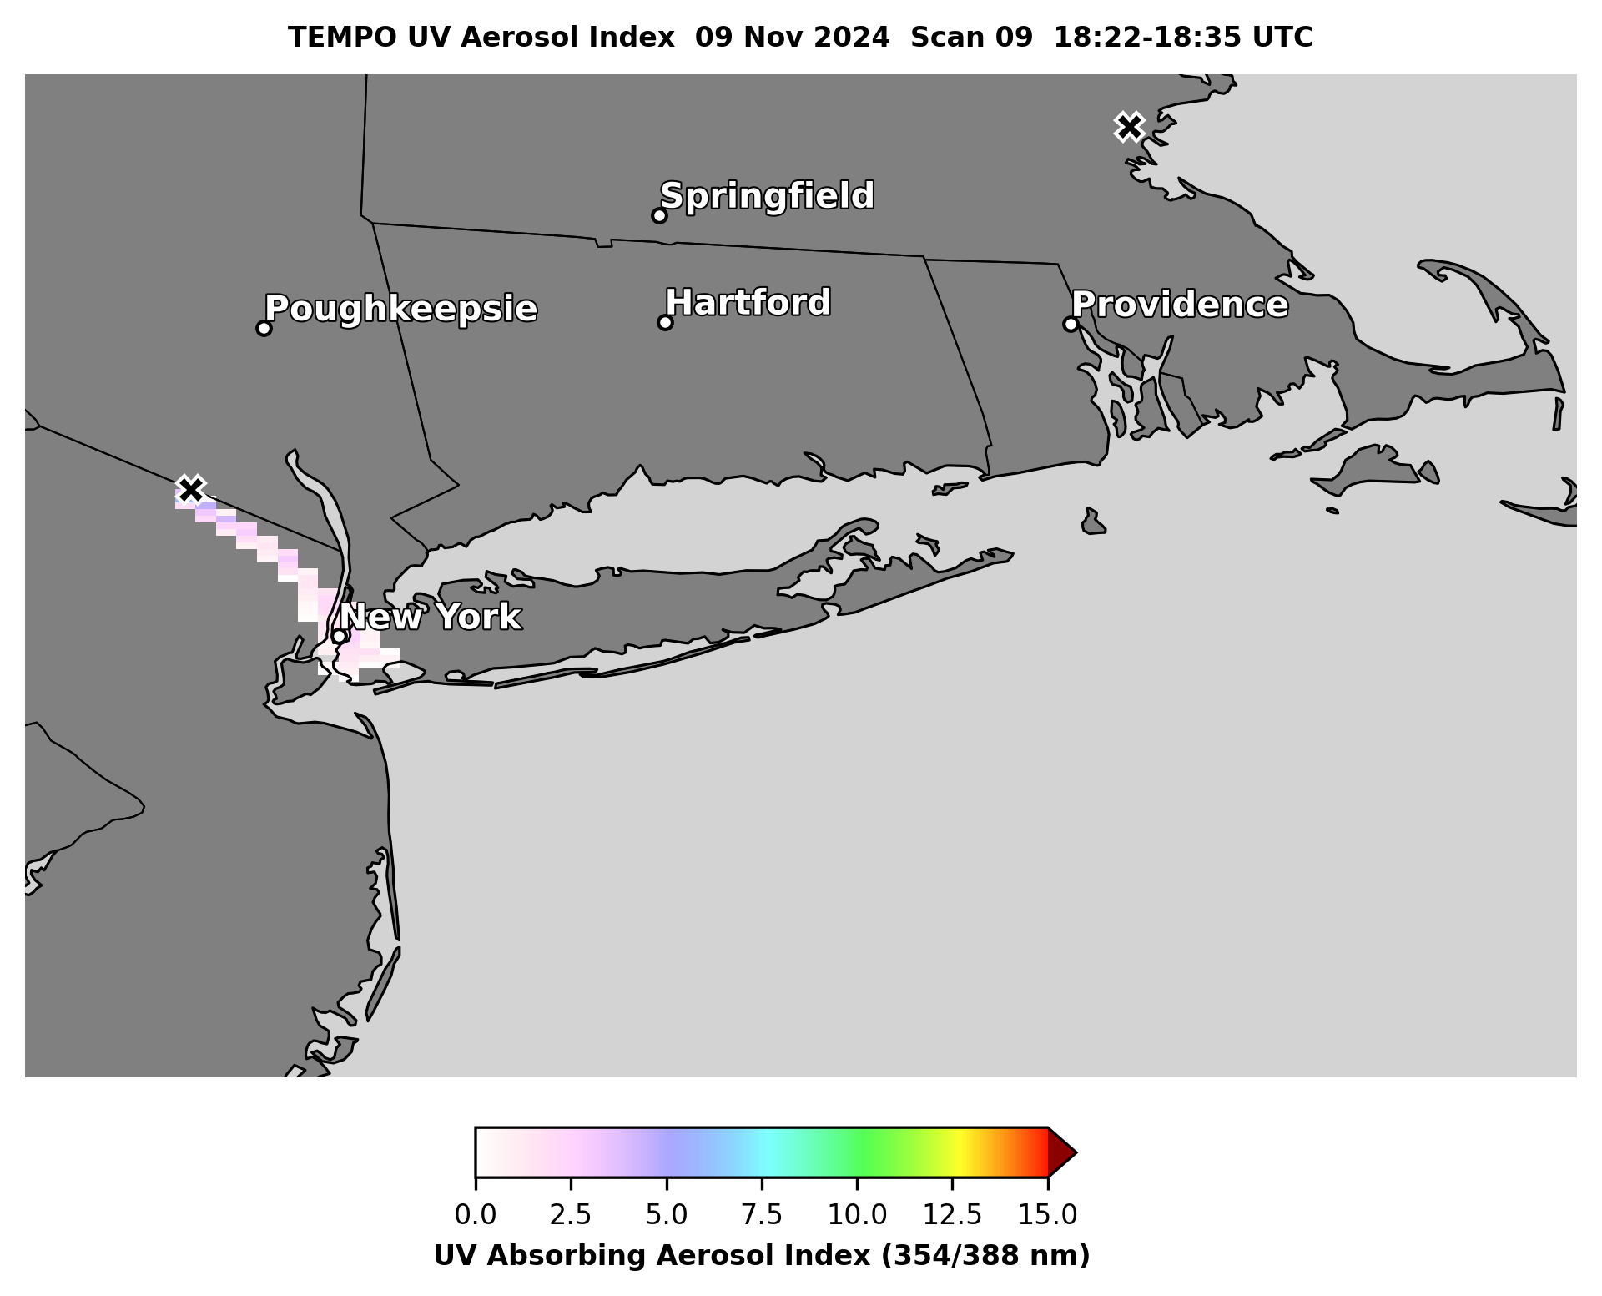
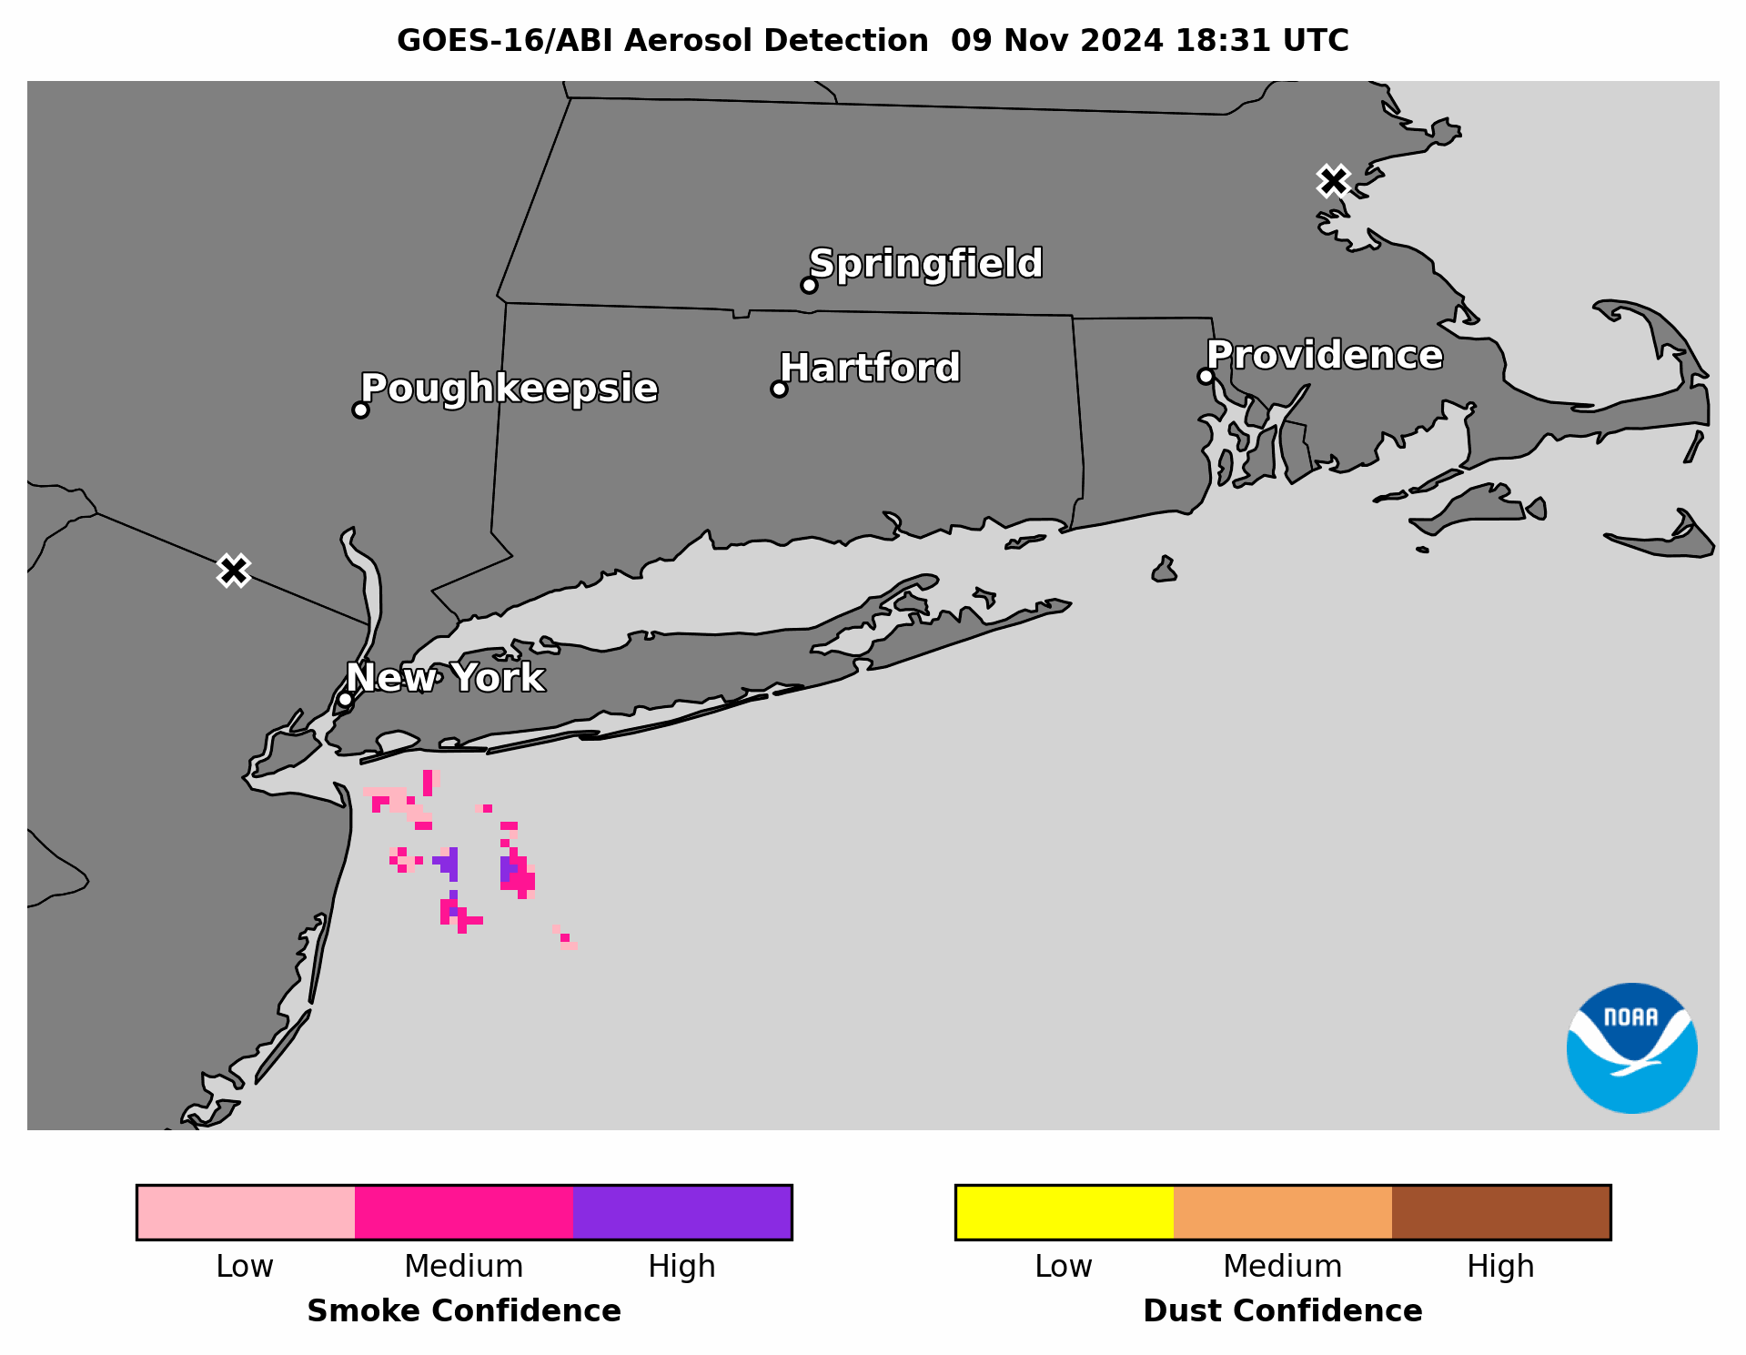
Wildfires in Northeast US
Nov 9, 2024 18:30-19:05 UTC Mesoscale 1 Sector
NOAA-20 VIIRS True Color RGB Composite & FRP
NOAA-20 VIIRS True Color RGB Composite & FRP
Small wildfires in northern NJ & near Boston, MA emitted thin smoke plumes that blew southeast over the ocean
Image from AerosolWatch website
GOES-19 ABI ADP has:
  Coverage & confidence comparable to or better than GOES-16
  Coverage comparable to or better than NOAA-21 VIIRS ADP, S5P TROPOMI CO & TEMPO UV AI
Image from AerosolWatch website

Slide 15
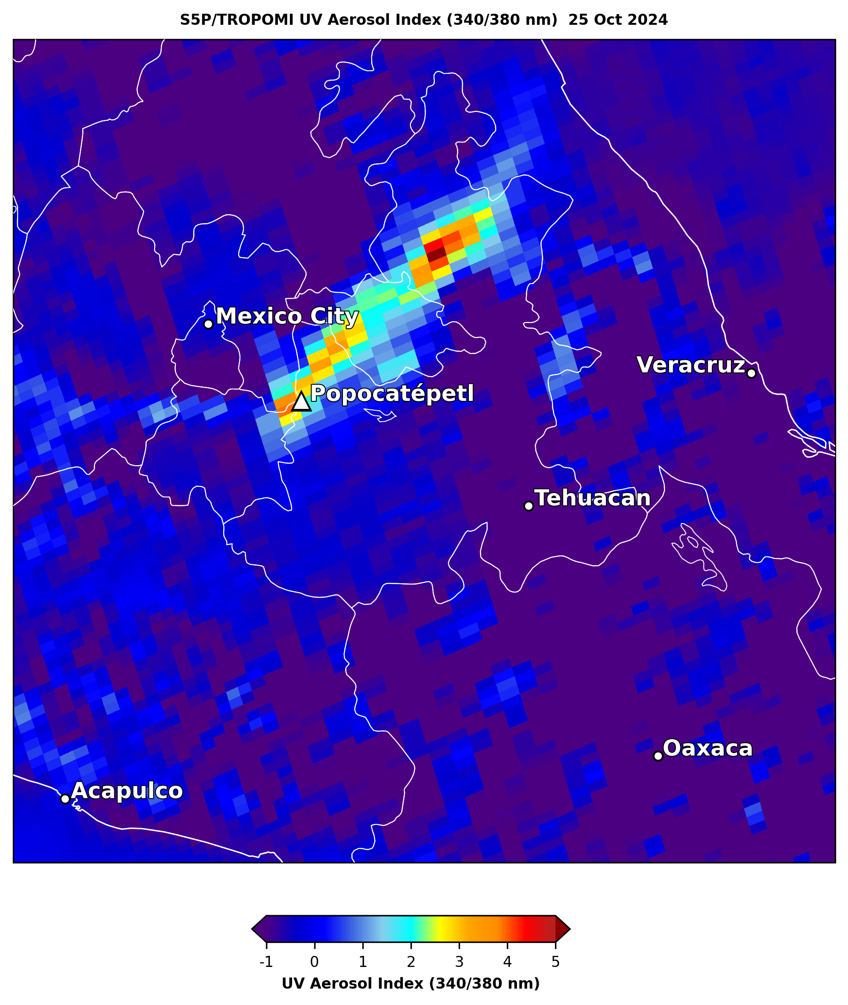
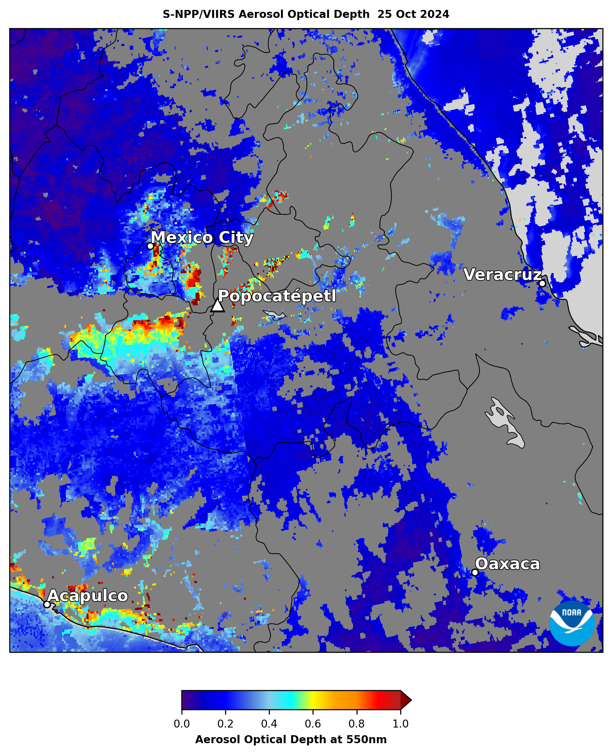
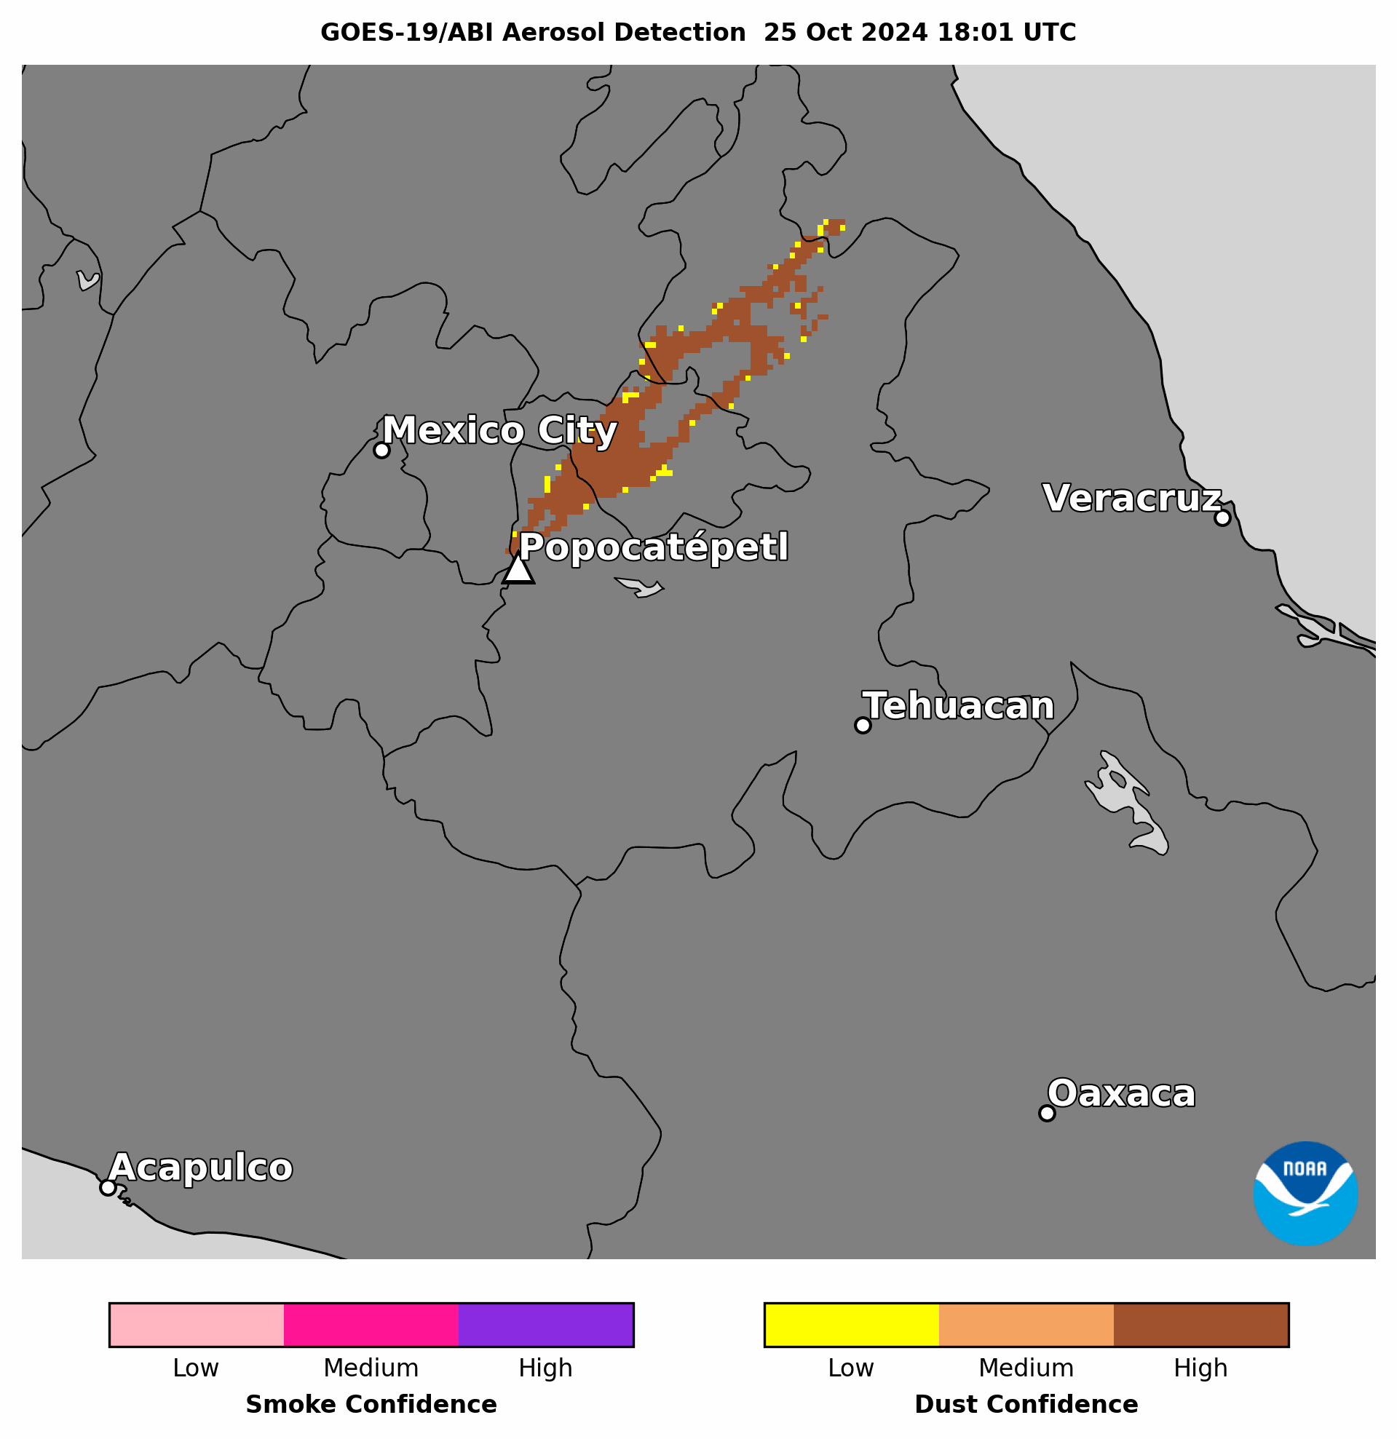
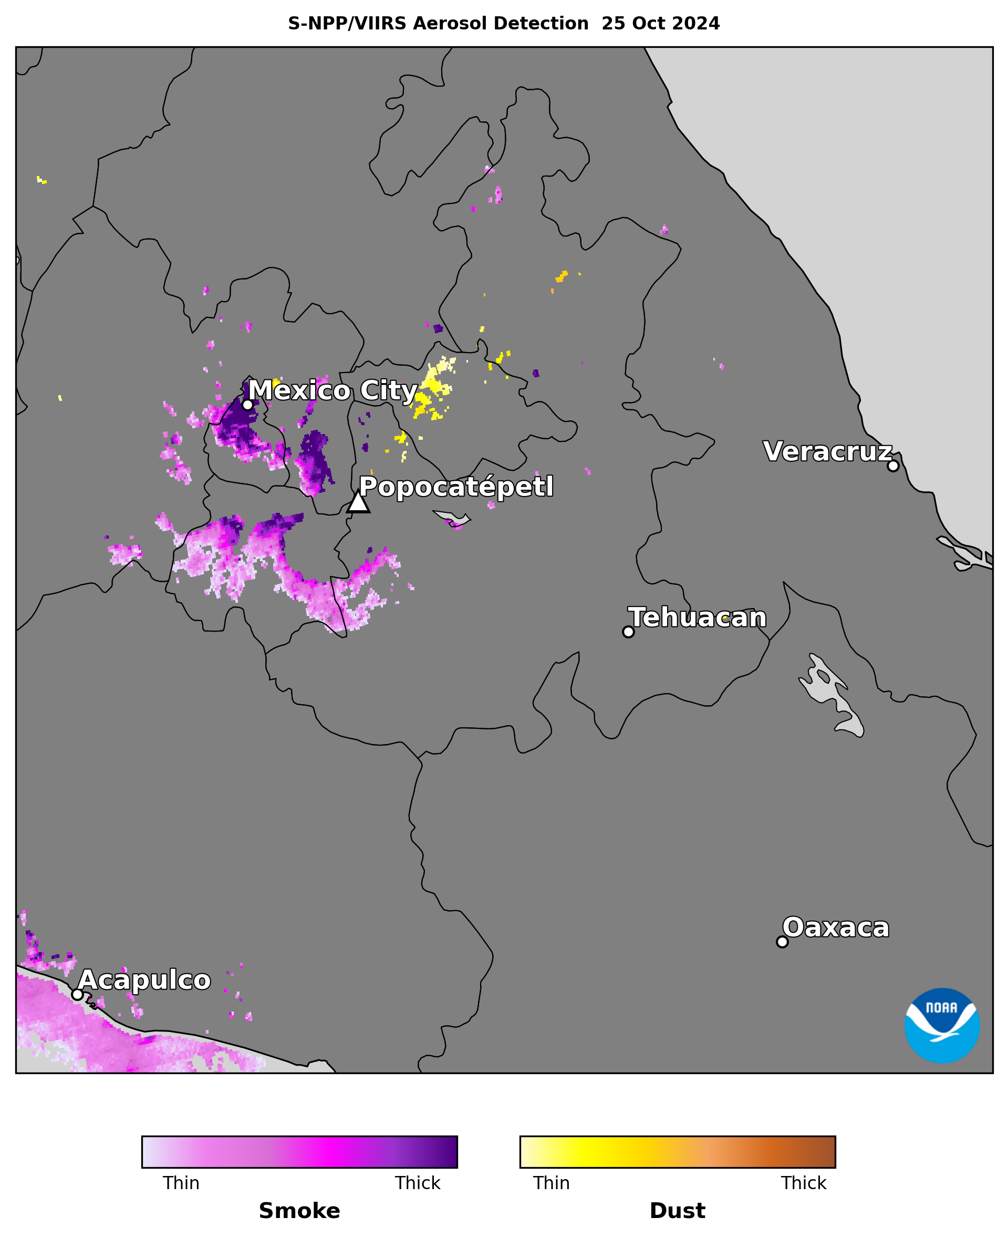
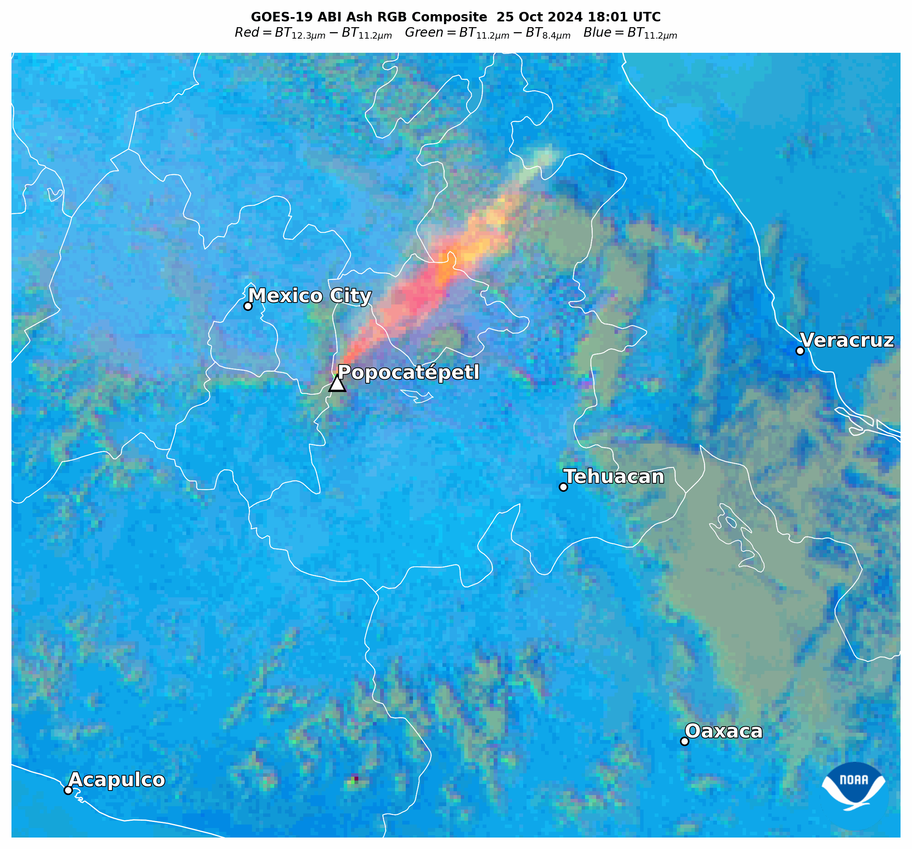
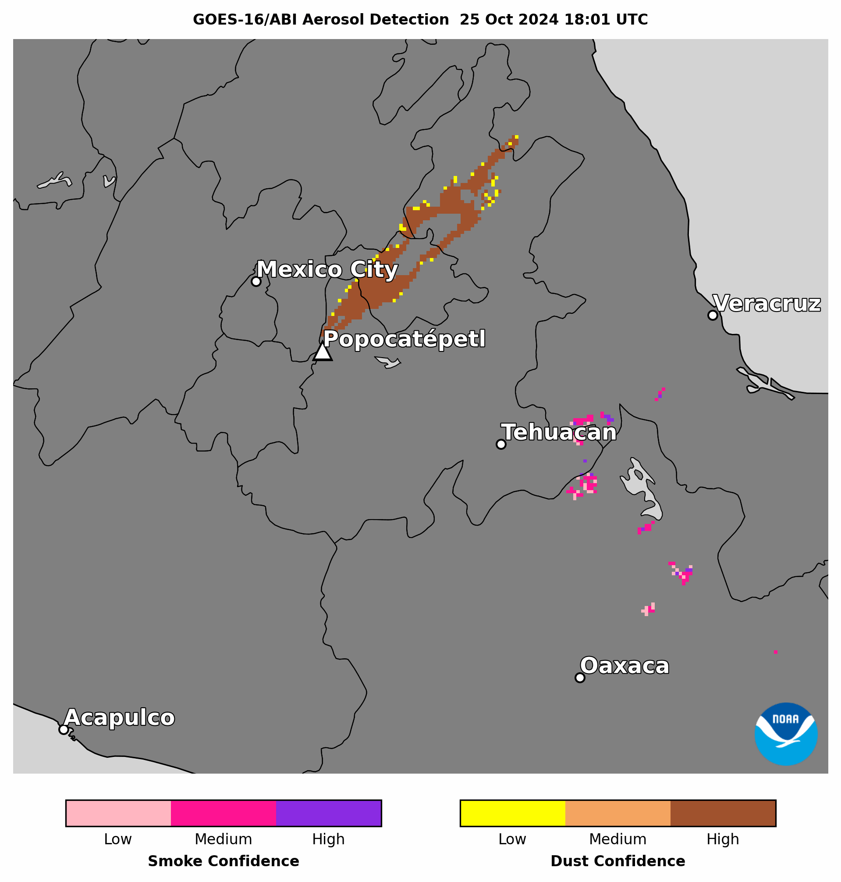
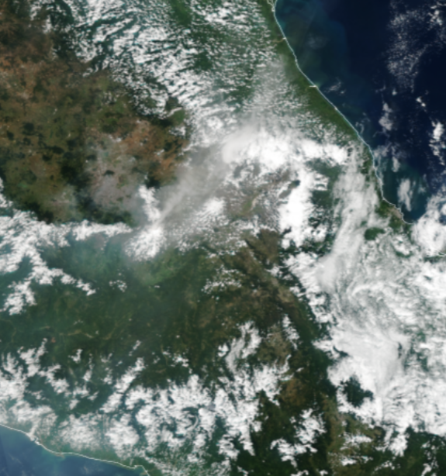
Popocatépetl Volcanic Ash (Detected as Dust)
Oct 25, 2024 18:01-19:01 UTC CONUS Sector
SNPP VIIRS True Color RGB Composite 25 Oct 2024
Popocatépetl volcano near Mexico City, Mexico erupted for several days in late Oct 2024
The volcano emitted an ash plume, shown as orange/yellow in the Volcanic Ash RGB composite, which was detected as dust by ABI & VIIRS ADP
Sulfate aerosol, derived from volcanic SO₂, was detected as smoke by VIIRS ADP
volcanic ash
Popocatépetl
volcanic sulfate
Image from JSTARMapper website
GOES-19 ABI ADP has:
  Coverage & confidence (of volcanic ash) comparable to GOES-16
  Coverage (of volcanic ash) comparable to SNPP VIIRS ADP & S5P TROPOMI UV AI

Slide 16
Comparison of GOES-19 ABI ADP to
GeoColor Imagery for Null Test
Test ID | Description | Evaluation Method
ABI-FD_ADP04 ABI-CONUS_ADP05 ABI-MESO_ADP06 | Null test to verify that Mode 6 FULL DISK, CONUS, MESO products are not generated when no aerosol events are occurring | Comparison to GOES-19 ABI GeoColor imagery

Slide 17
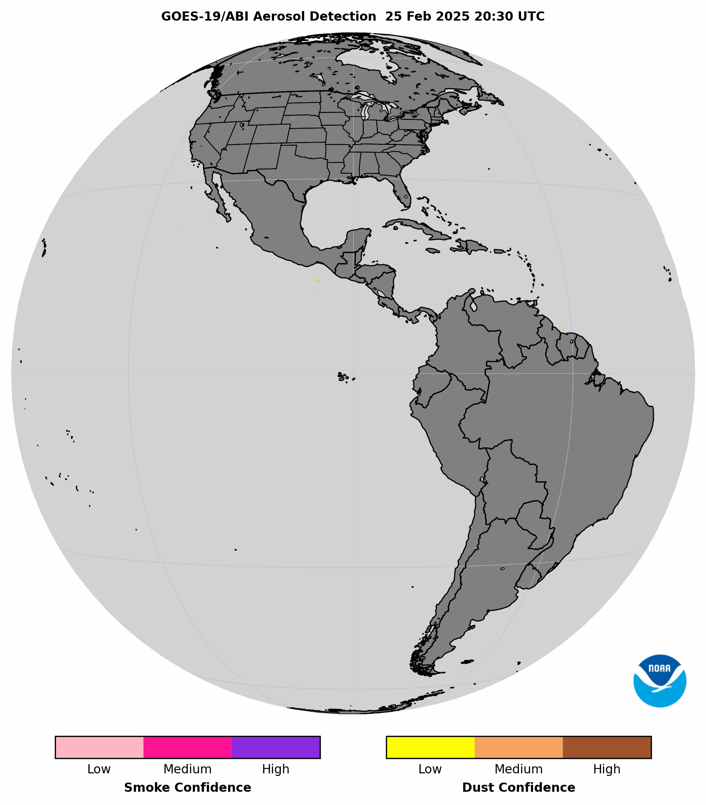
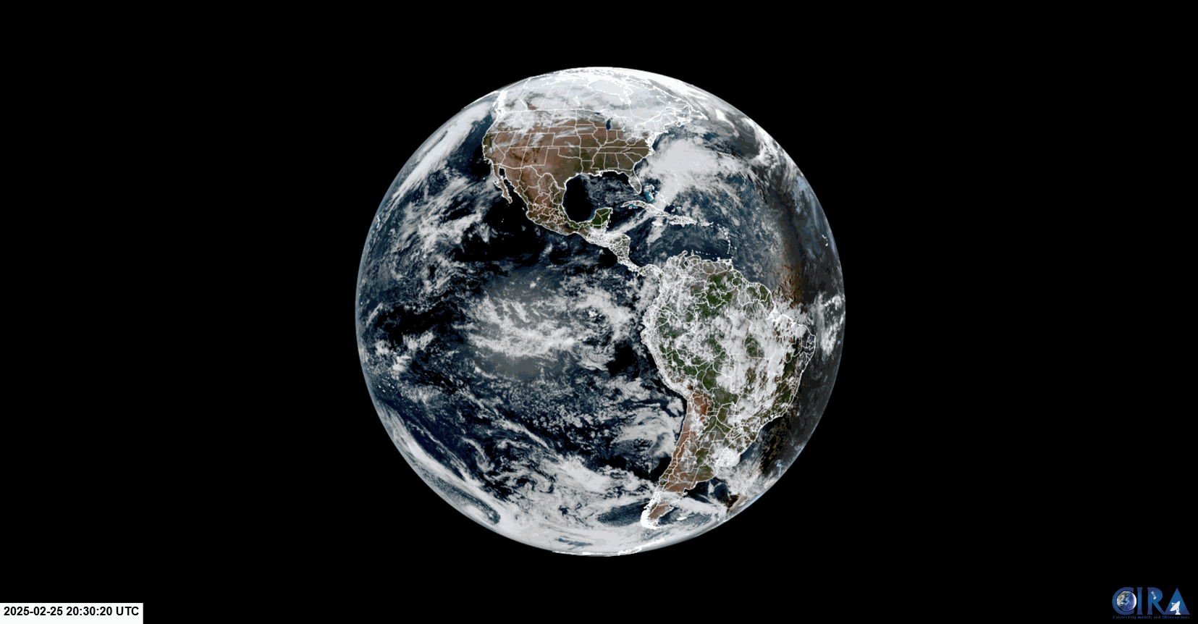

GOES-19 ABI ADP Null Test (“Public” Settings)
Feb 25, 20:30-21:30 UTC
No aerosol events occurring, no ADP retrievals

Slide 18
Validation of GOES-19 ABI ADP with
AERONET data
Test ID | Description | Evaluation Method
ABI-FD_ADP09 ABI-CONUS_ADP10 ABI-MESO_ADP11 | Assess accuracy, POCD, and POFD of the FULL DISK, CONUS, MESO products | Validation with AERONET Level 1.5 data

Slide 19



Validation with AERONET Data
Daily matchups with ~150 AERONET stations
Level 1.5 AERONET data
  AERONET AOD interpolated to 550nm
  AERONET Ångström exponent at 440nm/870nm
Results for two periods:
  8/28/24 to 12/20/24 (dust detection degraded due to INR & CCR)
  12/21/24 to 2/28/25 (after L1b declared Provisional Maturity)
Statistics not calculated separately for matchups over land and over water
  Short validation period (limited number of matchups)
AERONET Detections |  | AOD @550nm | Ångström Exponent (440nm/870nm)
Smoke | Yes | > 0.2 | > 1.0
 | No |  | < 0.5
Dust | Yes | > 0.2 | < 0.5
 | No |  | > 1.0
 | AERONET
 |  | Yes | No
 | Yes | A | B
 | No | C | D
G19 ABI ADP
Probability of Correct Detection (POCD) =
$$\frac{A}{A+C}$$
Probability of False Detection (POFD) =
$$\frac{B}{A+B}$$
Accuracy =
$$\frac{A+D}{A+B+C+D}$$

Slide 20
Dust ADP-AERONET Validation Statistics
GOES-19 dust detection
POCD is low and POFD is
very high prior to mid-Dec
After fixes to INR & updates
to improve CCR, GOES-19
dust detection improved!
  GOES-19 POCD of 77% is
  slightly better than that of
  GOES-16 (73%) & GOES-18
  (76%)
GOES-19 is not meeting requirement of 80% POCD due to the short validation period, but performance is comparable to other GOES-R satellites, which are Full Maturity for ADP
  GOES-19 is expected to meet requirements over a longer validation period
Dust Detection
Time Period | Satellite | A correct detection | B false detection | C missed detection | D null detection | POCD (%) | POFD (%) | Accuracy (%)
8/28/24 to 12/20/24 | GOES-16 | 1264 | 534 | 673 | 17892 | 65.2 | 29.0 | 94.1
 | GOES-18 | 1521 | 447 | 706 | 21645 | 68.3 | 22.7 | 95.2
 | GOES-19 | 1380 | 2554 | 983 | 20528 | 58.4 | 64.8 | 86.1
12/21/24 to 2/28/25 | GOES-16 | 994 | 182 | 365 | 3267 | 73.1 | 16.1 | 88.5
 | GOES-18 | 793 | 171 | 254 | 4740 | 75.7 | 17.7 | 92.8
 | GOES-19 | 899 | 162 | 281 | 2672 | 76.1 | 15.2 | 88.9
GOES-R/ABI ADP Requirements
Dust | POCD (%)
Over Land | 80
Over Water

Slide 21
Smoke ADP-AERONET Validation Statistics
GOES-19 smoke detection is very similar for both periods
GOES-19 is close to meeting 70% POCD requirement over water
GOES-19 performance is comparable to other GOES-R satellites, which are Full Maturity for ADP
  GOES-19 is expected to meet requirements over a longer validation period
Smoke Detection
Time Period | Satellite | A correct detection | B false detection | C missed detection | D null detection | POCD (%) | POFD (%) | Accuracy (%)
8/28/24 to 12/20/24 | GOES-16 | 2360 | 345 | 976 | 7961 | 70.7 | 12.7 | 88.6
 | GOES-18 | 2591 | 504 | 851 | 8071 | 75.2 | 24.7 | 88.7
 | GOES-19 | 2771 | 671 | 1186 | 8214 | 70.0 | 19.4 | 85.5
12/21/24 to 2/28/25 | GOES-16 | 482 | 71 | 271 | 936 | 64.0 | 11.8 | 80.5
 | GOES-18 | 886 | 112 | 291 | 1001 | 75.2 | 11.2 | 82.4
 | GOES-19 | 645 | 81 | 289 | 993 | 69.1 | 11.1 | 81.5
GOES-R/ABI ADP Requirements
Smoke | POCD (%)
Over Land | 80
Over Water | 70

Slide 22
Missing ADP in Scan Mode 4 due to Cloud Mask
Impact of Cloud Mask on ADP
ABI ADP relies on the upstream Cloud Mask
During routine ~weekly 2-consecutive
Scan Mode 4 (M4) runs in the mornings, the cloud mask fell behind, causing ADP
to be completely or partially missing
  If upstream Cloud Mask is not available, ADP is not generated
Impacted M4 scan varies – 1st or 2nd , as does the severity of the missing ADP – full or partial scan
No impacts on ADP during 12-hour M4 scans on 1/22/25
  ADP in all M4 scans for 12:00-23:55 UTC appeared normal
Date of M4 Scans | Last M6 | 1st M4 | 2nd M4 | Resume M6
12/23/24 | 11:40 | 11:50 | 11:55 | 12:00
1/2/25 | 11:50 | 12:00 | 12:05 | 12:10
1/13/25 | 11:50 | 12:00 | 12:05 | 12:10
1/19/25 | 11:50 | 12:00 | 12:05 | 12:10
1/21/25 | 12:00 | 12:10 | 12:15 | 12:20
2/7/25 | 12:00 | 12:10 | 12:15 | 12:20
2/14/25 | 12:00 | 12:10 | 12:15 | 12:20
2/21/25 | 12:00 | 12:10 | 12:15 | 12:20
ADP missing for entire scan
ADP missing in lower half of scan (Southern Hemisphere)
ADP normal

Slide 23
PROVISIONAL MATURITY ASSESSMENT
GOES-19 Aerosol Detection Product (ADP) Provisional PS-PVR

Slide 24
Recommendation for Provisional Maturity
The AWG ADP Team recommends GOES-19 ABI ADP for provisional maturity
  POCD requirements for validation with AERONET data technically were not met, but GOES-19 performance was comparable to that of GOES-16 & -18, which are Full Maturity for ADP
    GOES-19 ADP is expected to meet quantitative validation requirements over a longer validation period
Test ID | Description | Evaluation Method | Results
ABI-FD_ADP01 ABI-CONUS_ADP02 ABI-MESO_ADP03 | Verify Mode 6 FULL DISK, CONUS, MESO products generated during aerosol event(s) are within the required measurement range | Visual inspection Inter-comparison to GOES-16 & -18 ABI ADP and NOAA-21, NOAA-20 & SNPP VIIRS ADP imagery | PASSED
ABI-FD_ADP04 ABI-CONUS_ADP05 ABI-MESO_ADP06 | Null test to verify that Mode 6 FULL DISK, CONUS, MESO products are not generated when no aerosol events are occurring | Comparison to GOES-19 ABI GeoColor imagery | PASSED
ABI-FD_ADP07 | Verify Mode 4 FULL DISK products generated during aerosol event(s) are within the required measurement range | Visual inspection Inter-comparison to GOES-16 & -18 ABI ADP and NOAA-21, NOAA-20 & SNPP VIIRS ADP imagery | PASSED
ABI-FD_ADP08 | Null test to verify that Mode 4 FULL DISK products are not generated when no aerosol events are occurring | Comparison to GOES-19 ABI GeoColor imagery | PASSED
ABI-FD_ADP09 ABI-CONUS_ADP10 ABI-MESO_ADP11 | Assess accuracy, POCD, and POFD of the FULL DISK, CONUS, MESO products | Validation with AERONET Level 1.5 data | Partial-Passed

Slide 25
GOES-19 ABI ADP Assessments
Preparation Activities | Assessment
Validation activities are ongoing and the general research community is now encouraged to participate. | Completed and presented in the Provisional Review.
Severe algorithm anomalies are identified and under analysis. Solutions to anomalies are in development and testing. | No major algorithm anomalies have been identified.
Incremental product improvements may still be occurring. | No incremental product improvements are anticipated.
L2+ only: Users are engaged in the Product Feedback Forums and user feedback is assessed. | We will begin working with end users to obtain feedback once GOES-19 ABI ADP is declared Provisional.
End State | Assessment
Product performance has been demonstrated through analysis of a small number of independent measurements obtained from select locations, periods, and associated ground truth or field campaign efforts. | Yes
Product analysis is sufficient to communicate product performance to users relative to expectations (Performance Baseline). | Yes
Documentation of product performance exists that includes recommended remediation strategies for all anomalies and weaknesses. Any algorithm changes associated with severe anomalies have been documented, implemented, tested, and shared with the user community. | Known product issues are described in the GOES-19 ABI ADP Provisional Maturity Readme file.
Testing has been fully documented. | Yes
Product is ready for operational use and for use in comprehensive cal/val activities and product optimization. | Yes

Slide 26
PATH TO FULL VALIDATION MATURITY
GOES-19 Aerosol Detection Product (ADP) Provisional PS-PVR

Slide 27
Path to GOES-19 ABI ADP Full Validation
GOES-19 ABI ADP PLPTs for full validation focus on validation with AERONET data
Potential to use a new “truth” dataset for quantitative validation: ESA/JAXA EarthCARE satellite’s atmospheric lidar (ATLID) Vertical Feature Mask (VFM)
  ATLID L2 data expected to become available in March 2025
The full maturity validation period will last 52 weeks
  Extends conditions under which accuracy, POCD, and POFD are calculated
  Allows for a seasonally representative number of independent measurements, particularly for dust ADP
  Separate validation statistics for ADP over land and over water will be calculated
Test ID | Description | Evaluation Method
ABI-FD_ADP09 ABI-CONUS_ADP10 ABI-MESO_ADP11 | Assess accuracy, POCD, and POFD of the FULL DISK, CONUS, MESO products | Validation with AERONET Level 1.5 data Potential validation with Earthcare ATLID VFM

Slide 28
SUMMARY AND RECOMMENDATIONS
GOES-19 Aerosol Detection Product (ADP) Provisional PS-PVR

Slide 29
Evaluation Summary
GOES-19 ABI ADP is ready to be declared provisional maturity
  Coverage & confidence are comparable to or better than Full Maturity GOES-16 & -18 ABI ADP and NOAA-21, NOAA-20 & SNPP VIIRS ADP for a range of dust and smoke events
  GOES-19 ADP correctly detects smoke and dust in the atmosphere:
    In the Full Disk, CONUS, and MESO sectors
    Over land and water
    At low, middle, and high latitudes
GOES-19 ABI ADP did not technically meet POCD requirements for smoke & dust detection, but the validation period was short and the performance was comparable to Full Maturity GOES-16 & -18 ADP
  GOES-19 ADP is expected to demonstrate required POCD over a full year of validation
  Earthcare ATLID VFM dataset is a potential replacement for previous CALIPSO CALIOP VFM (decommissioned in Sep 2023)
Full/partial missing GOES-19 ABI ADP in one of two consecutive Mode 4 scans, due to missing upstream Cloud Mask, does not impact ADP performance metrics

