Slide 1
G18 EHIS Full Validation SWPC Overview
Primary Uses of EHIS Data
Satellite industry: Satellite anomaly resolution and design guidelines
Aviation industry: Radiation advisories
Human Spaceflight: Anticipated for avionics
Requirements
Derived from 2002 user-requirements workshop
Alphas and EHIS were reinforced at the 2023 Space Weather Prediction (SWPT) Testbed Satellite Environment Exercise

Slide 2
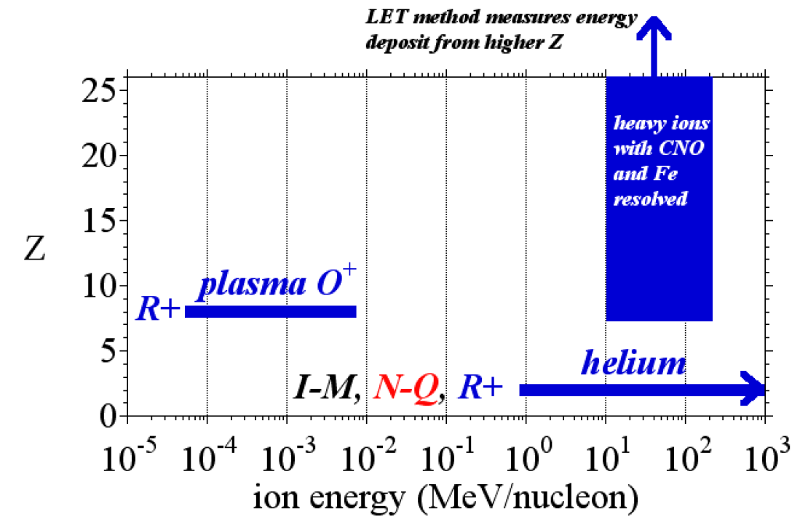
Helium and Higher Z Ions
Helium
Measurements have been made since the early GOES.
Input to the aviation-radiation model run by the FAA
Heavier Ions (up to Iron)
The measurement of ions heavier than Helium is a new capability.
Necessary to support satellite anomalies, launch decisions, and satellite design.
Workshop recommendations for heavy ion measurements on GOES-R+

Slide 3
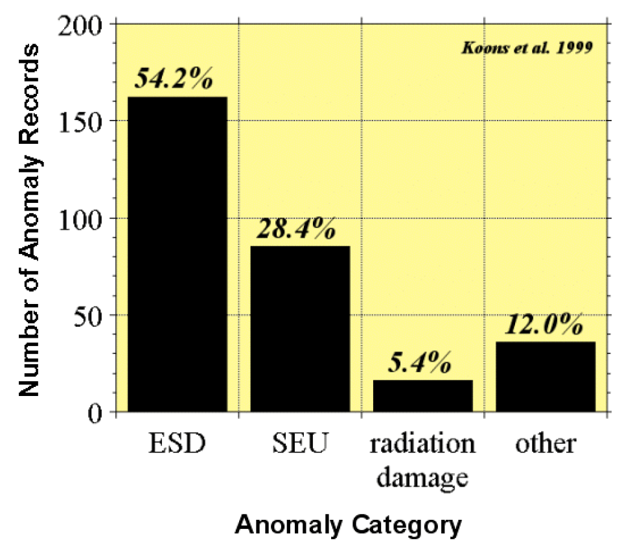
Satellite Industry
Single event upset (SEU)
Primary impact of alphas and heavies
Customer Concerns
Satellite anomaly resolution
Launch decisions
Environmental design guidelines
Workshop recommended heavy ion measurements to support “…spacecraft anomaly investigations, decisions for launches of vehicles with single-event effect (SEE) susceptibilities, and archival data for the generation of environmental models.”
Compilation of databases of spacecraft anomalies attributed to the space environment
Study sponsored by the National Security Space Architect

Slide 4
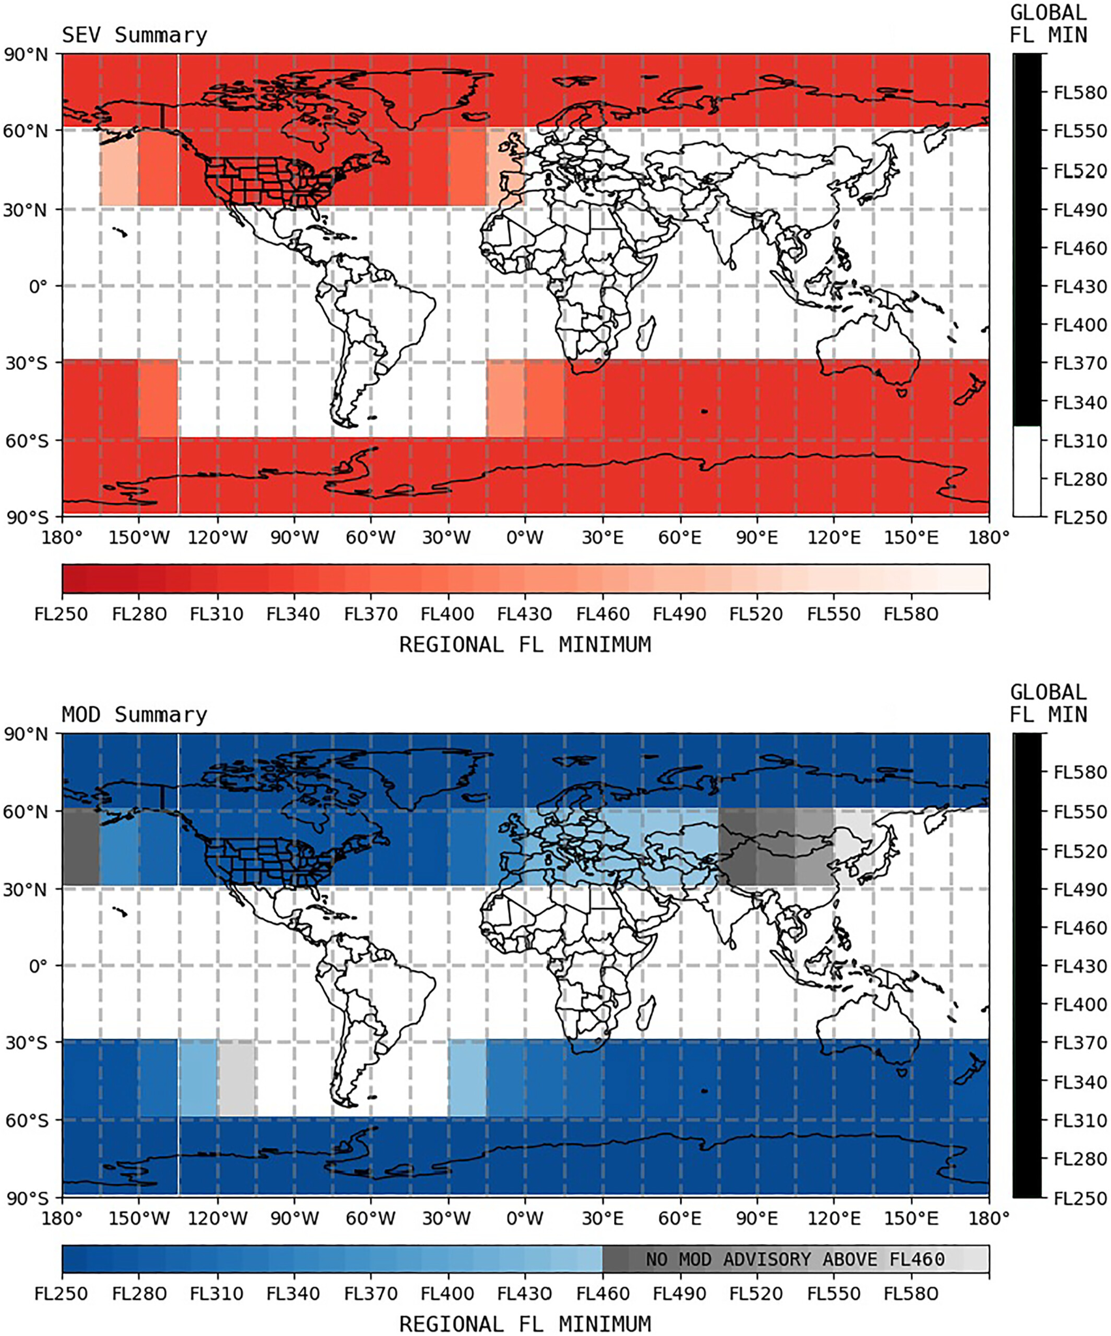
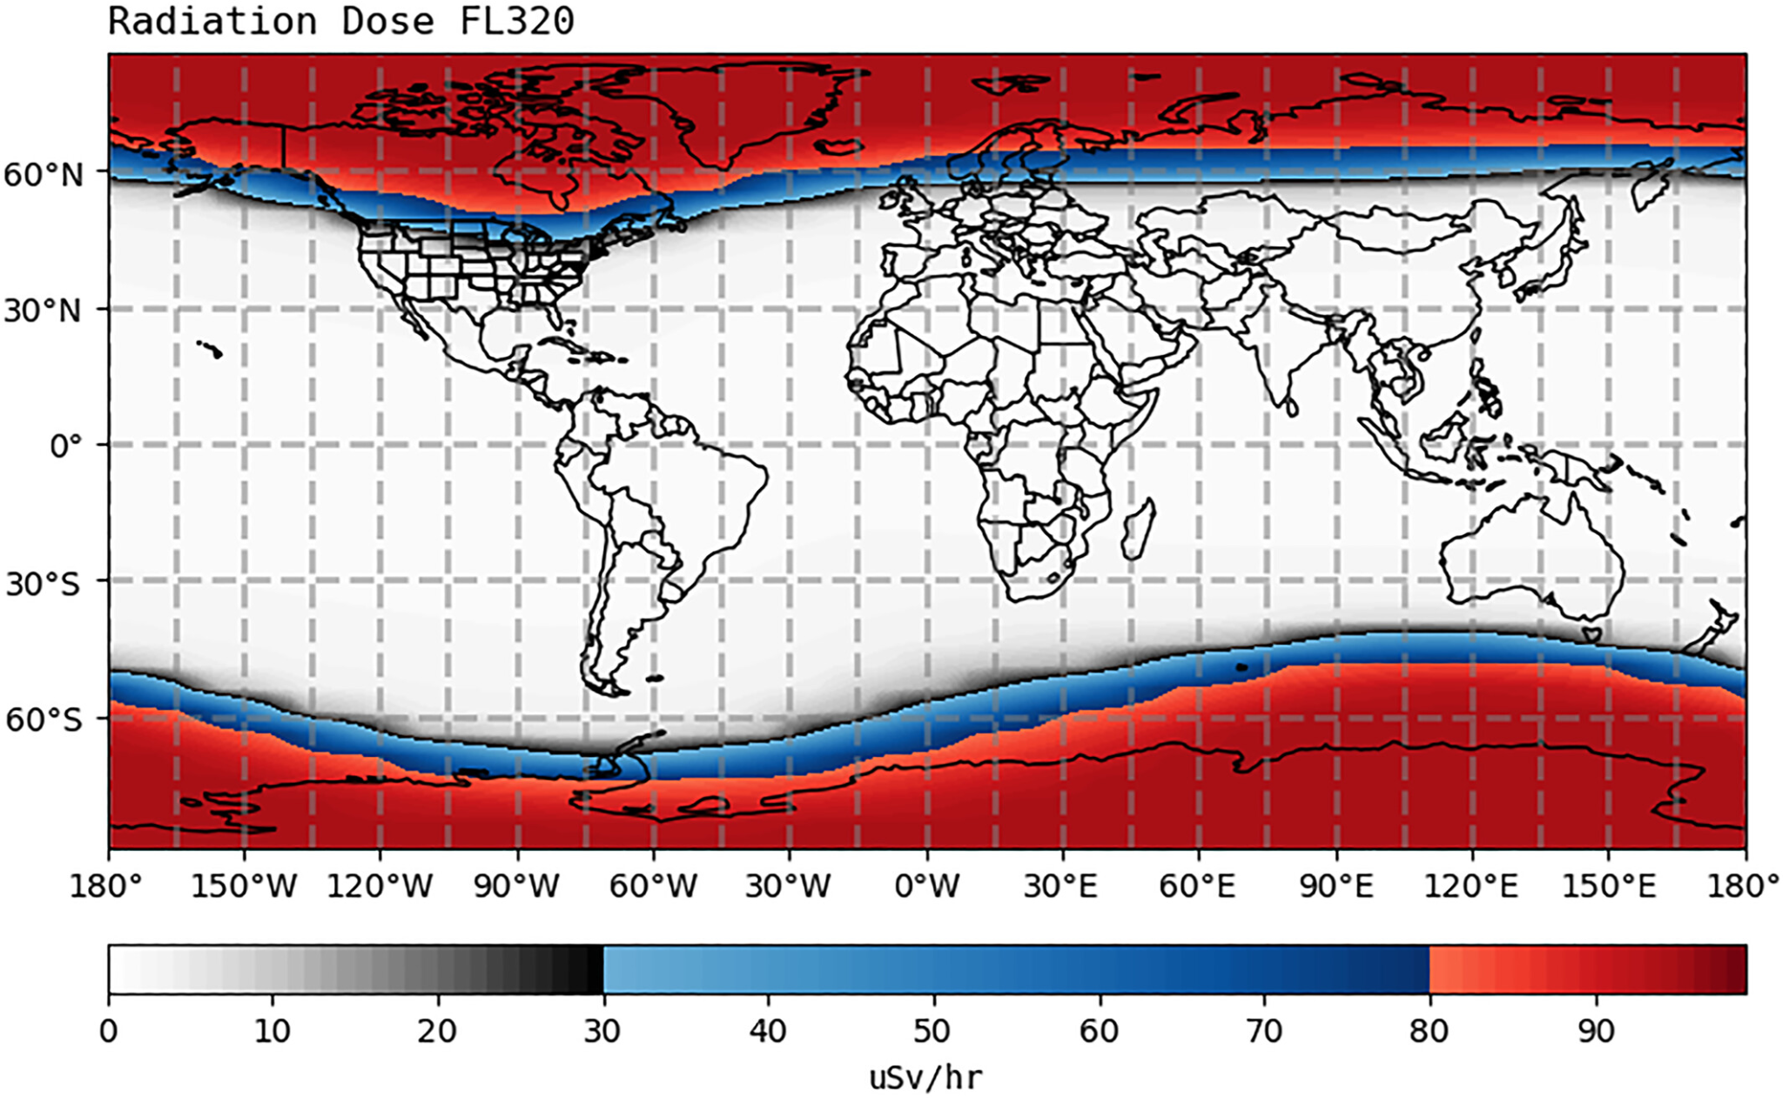
Aviation Industry
International Civil Aviation Organization (ICAO) Radiation Advisories
Ground Level Enhancement 69 (GLE69) solar radiation storm which occurred on the 20th of January 2005. Above: CARI-7 Model, Top Right: Areas exceeding ICAO severe threshold, Bottom Right: Areas exceeding ICAO moderate threshold.
Bain, H. M., Copeland, K., Onsager, T. G., & Steenburgh, R. A. (2023). NOAA Space Weather Prediction Center radiation advisories for the International Civil Aviation Organization. Space Weather, 21, e2022SW003346. https://doi.org/10.1029/2022SW003346

Slide 5
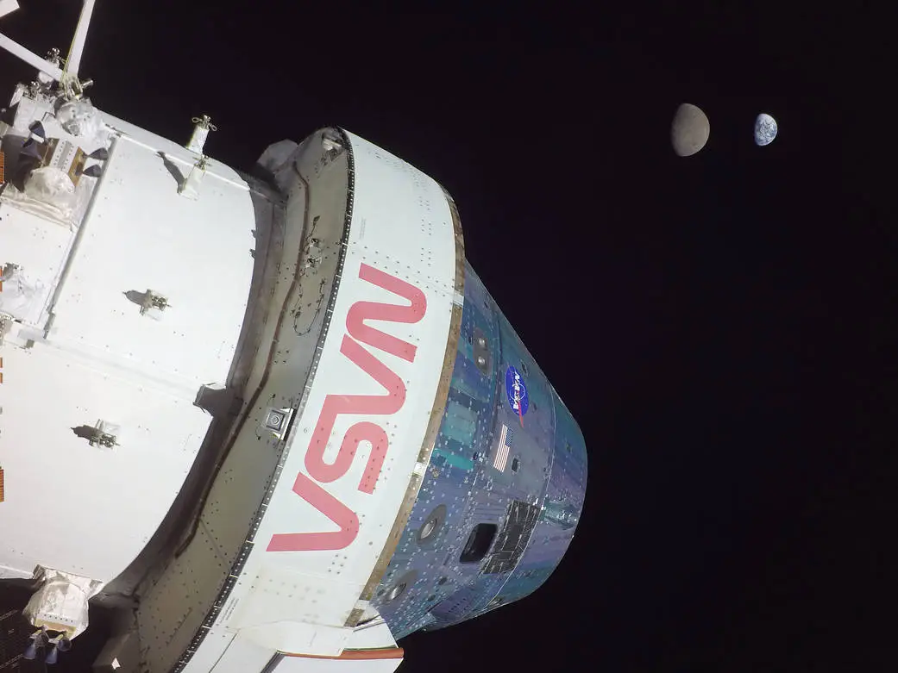
Human Spaceflight
Concerns for SEU and radiation damage as missions extend beyond the magnetosphere
Linear Energy Transfer (LET) aggregates impacts across species
Workshop attendees “…pointed out the need for improved specification of the high-energy and high-Z SEP environment, but expressed in units of LET (MeV/mg-cm2) most useful to the spacecraft design and testing communities.”

Slide 6
G18 EHIS Full Validation SWPC Summary
The EHIS data will support aviation operations, satellite operations, and future human and robotic exploration.
Helium data are a legacy GOES product, and the heavier ions are a new capability.
SWPC concurs with NCEI’s recommendations for the EHIS L1b data:
GOES-18 EHIS L1b data be transitioned to Full Validation status
Continuing on-orbit calibrations of GOES-18 EHIS to improve histogram quality at all energies.
Work should continue on open EHIS L1b ADRs
Setting a higher scintillator high-flux criterion on one of the EHIS’s (GOES-18 or 19) in order to get higher-quality NonPrime data in real time
SWPC is highly appreciative of the dedication and diligence of UNH, ATC, NCEI, and the GOES program for assessing EHIS. We look forward to the work that will continue to improve the instrument characterization.

