Slide 1
Peer Stakeholder-Product Validation Review (PS-PVR) For the Full Maturity of GOES-18 GMAG L1b Product
September 27, 2023
GOES-R Calibration Working Group (CWG)
Presenter: Aspen Davis¹
Contributors: Paul Loto’aniu¹, Aspen Davis¹, Alison Jarvis¹, Michael Grotenhuis², Alessandra Pacini¹, Fadil Incleoglu¹, Sarah Auriemma¹, Fred Rich³
¹NOAA-NCEI / CU-CIRES, ²NASA-GSFC, ³MIT Lincoln-Labs
This review incorporates results from NASA, PLTs, and MIT.

Slide 2
Outline
GMAG Overview
Instrument Status Review
Product Quality Evaluation
Summary of GMAG Anomalies and Resolution Status
PLPTs Supporting Assessment for Full Status
Full Maturity Assessment
Summary and Recommendations

Slide 3
MAG OVERVIEW
GOES-18 GMAG L1b Product Full PS-PVR

Slide 4
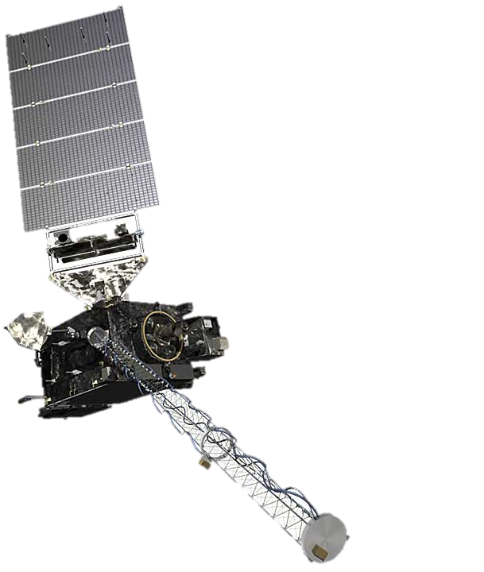
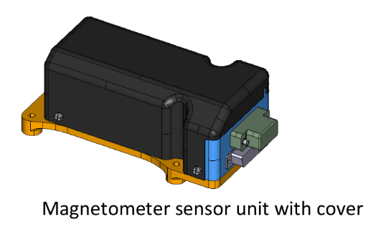
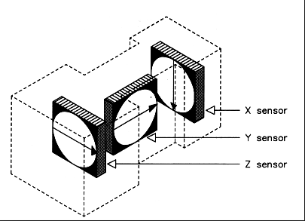
GMAG Overview
Characteristics | GOES 8-12 | GOES 13-15 | GOES 16-U
3-axis fluxgates | 2 | 2 | 2
Sampling Rate | 2 Hz | 2 Hz | 10 Hz
Low-Pass Filter Cutoff | 0.5 Hz | 0.5 Hz | ~2.5 Hz
Boom Length | 3 m | 8.5 m | 8.5 m
Inboard (IB) GMAG
0.3 nT noise requirement (excluding arcjet firings).
1 nT accuracy requirement (but performance requirements for GOES-16/GOES-17 were loosened).
Two boom-mounted fluxgate magnetometers - Inboard GMAG (IB) 6.3 m from boom base and Outboard GMAG (OB) 8.5 m from the base.
GOES-18 has new sensor units, called GMAG, built by NASA-GSFC Planetary Magnetospheres Lab in Maryland, under a contract separate from the spacecraft.
Outboard (OB) GMAG

Slide 5
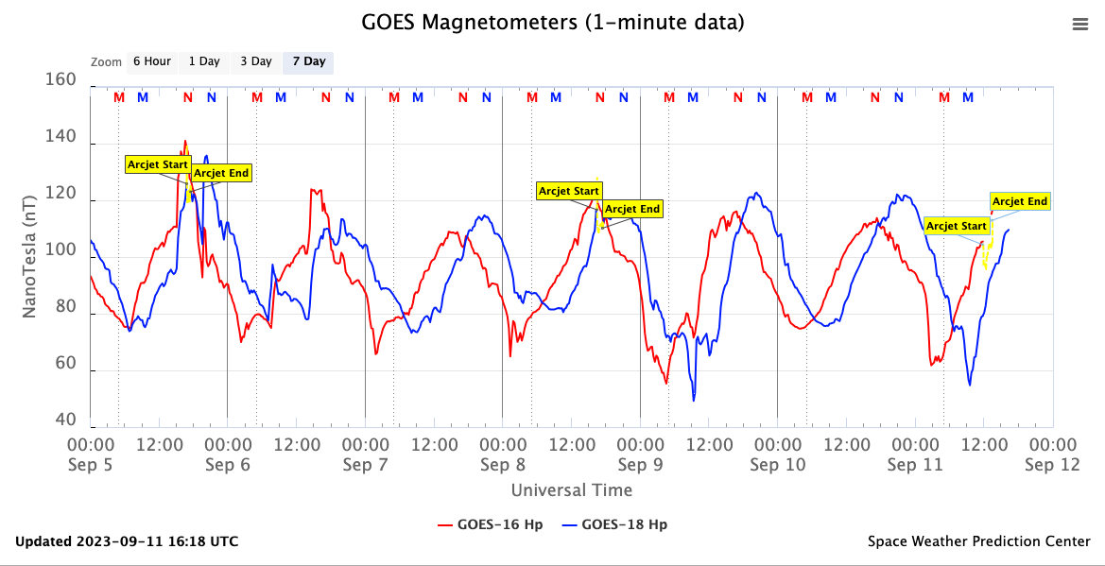
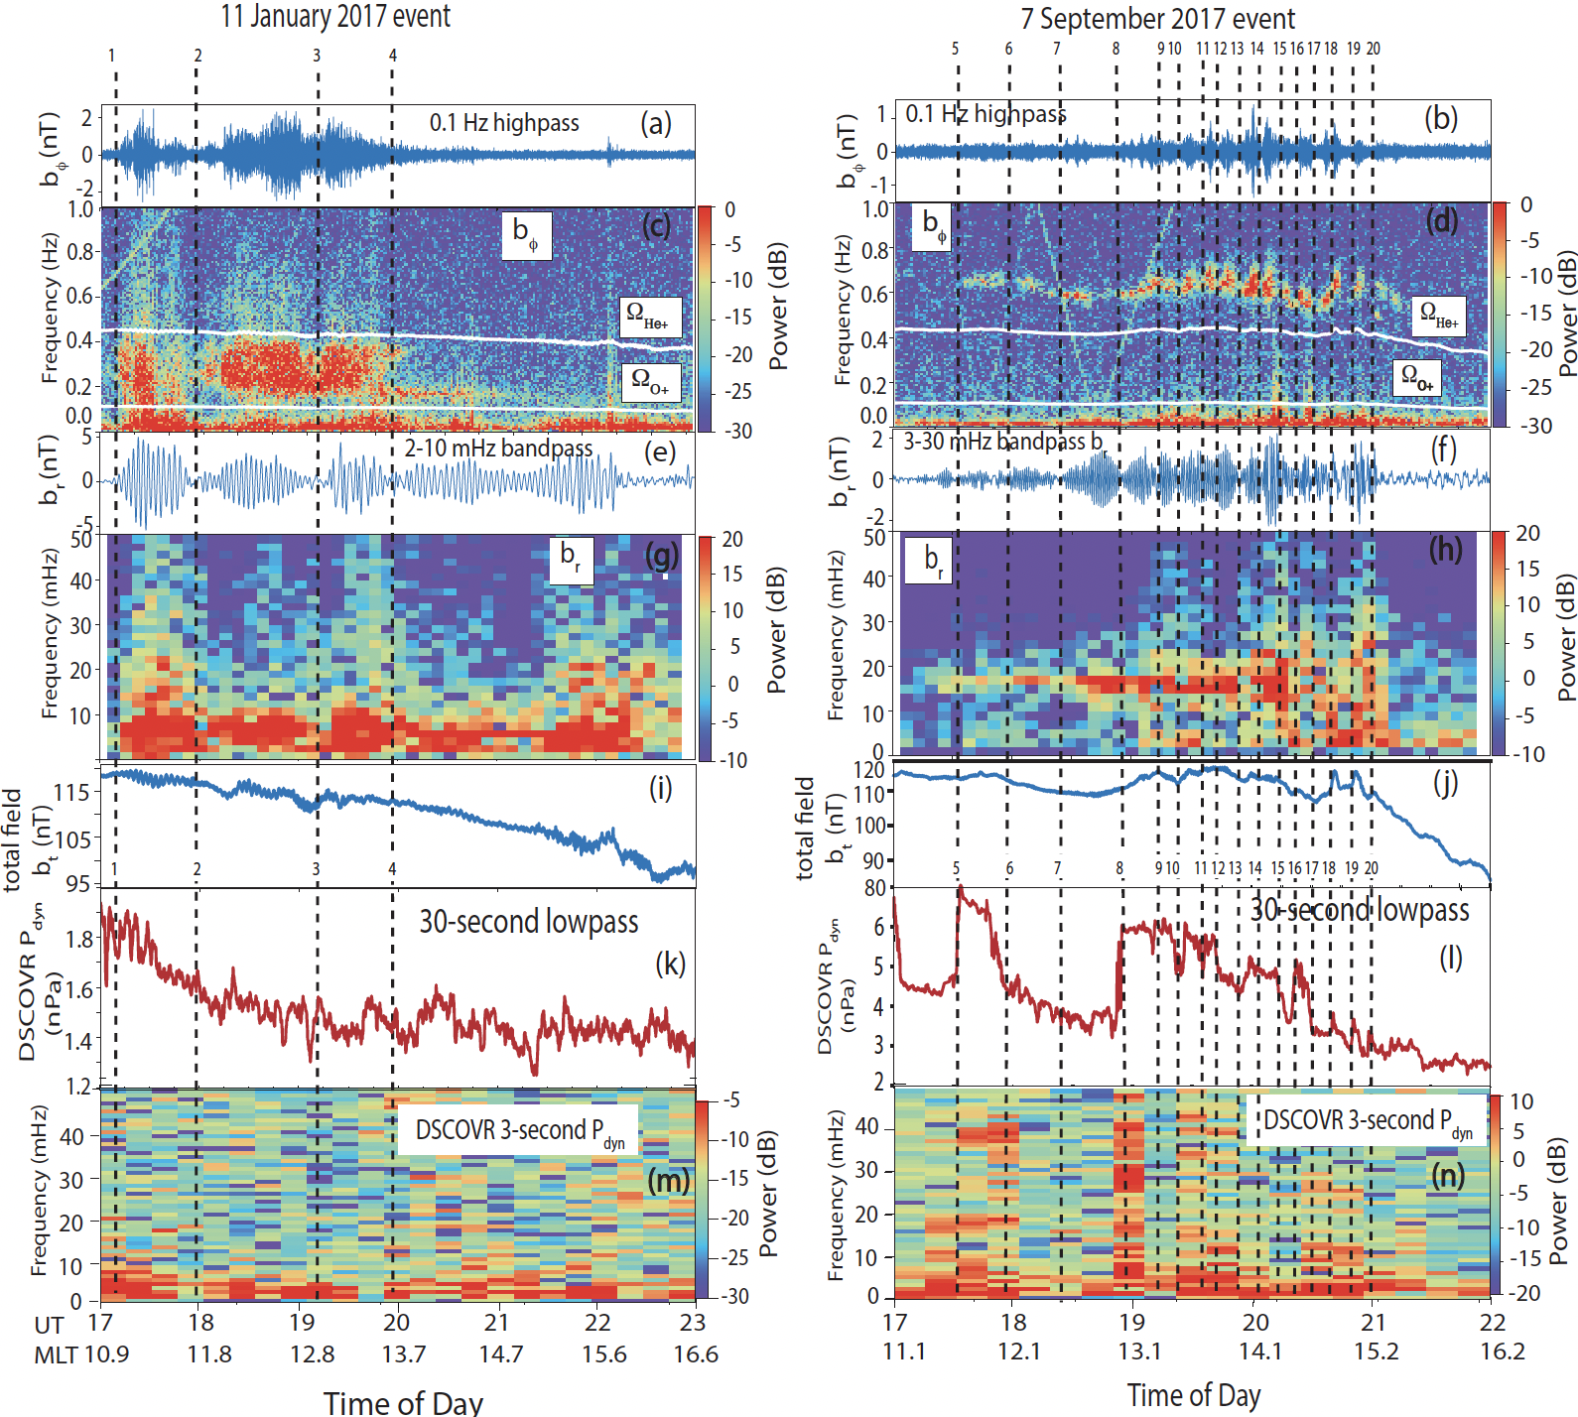
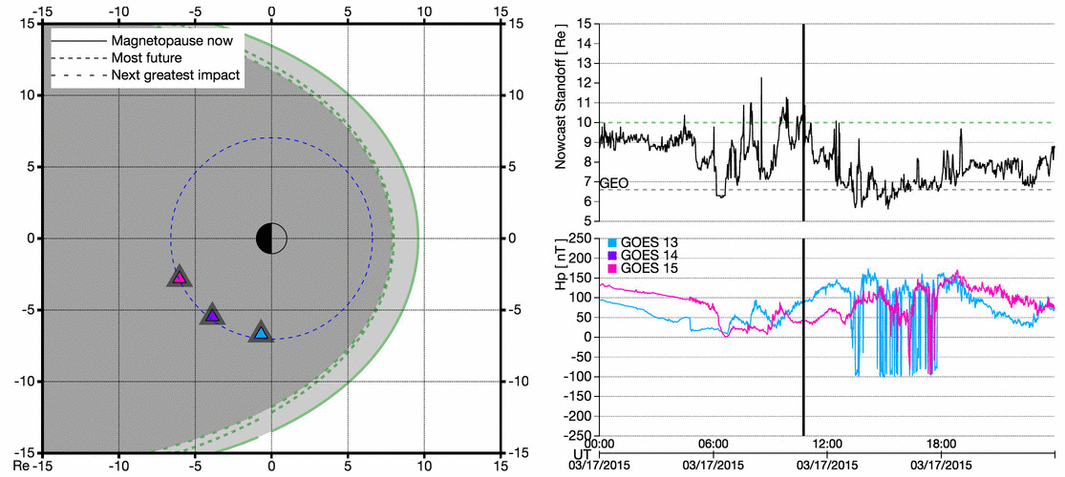
Data Usage
Operationally used by forecasters at SWPC
Real-time magnetometer dashboard on SWPC website
GOES-16
https://www.swpc.noaa.gov/products/goes-magnetometer
Scientific usage for research
Event identification
Figure 1, Loto’aniu et al. 2020, https://doi.org/10.1002/essoar.10503339.1
Continuing towards operational implementation of products such as magnetopause crossing identification

Slide 6
INSTRUMENT STATUS OVERVIEW
GOES-18 GMAG L1b Product Full PS-PVR

Slide 7
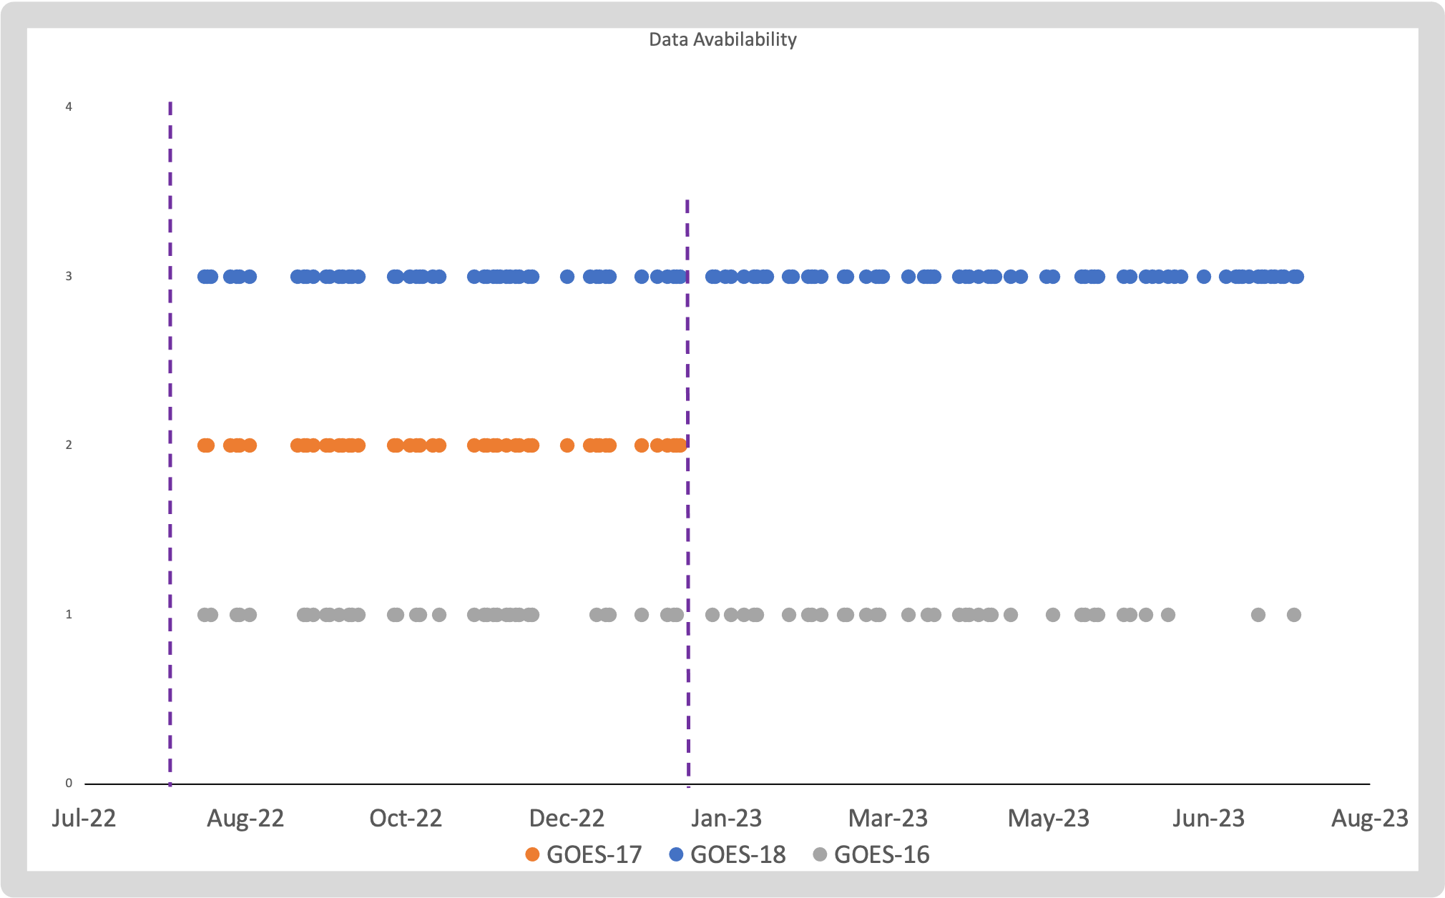
Data availability
GOES-17 yaw flip
Satellite | Days from launch to Full Maturity | Days available for use in GOES-18 PLPT’s
GOES-16 | 1535 | 78
GOES-17 | 1068 | 47
GOES-18 | 575 | 128
Considerations
GOES-18 PLT period was considerably condensed, thus there is less data collected at provisional + 1year
PLPT requirements limit the number of
days that are usable :
GOES-18 launched on March 1, 2022
quiet field conditions (Kp < 2)
days with no arcjet firings
GOES-18 Calibrations Applied to GPA
GOES-17 L1b products stop
GOES-18 zero-offset calibrations were applied to the GPA in August, 2022 (6 months after launch)
GOES-17 has limited data availability due to storage mode entry
GOES-16 arcjets went through periods of increased firing activity
G-18
G-17
G-16

Slide 8
Milestones Timeline
Event | Description | Start | End
1 | Magnetometer boom deployed | 3/23/22
2 | GMAG data flow | 3/23/22
3 | GOES-18 drift to 136.8 W | 5/16/22 | 6/6/22
4 | GOES-18 nudge to 137.0 W | 7/5/22 | 7/21/22
5 | GMAG Entrance Criteria met - Beta | 7/11/22
6 | GMAG updated LUTs Implemented in GPA | 8/8/22
7 | GMAG Entrance Criteria met - Provisional | 9/16/22
8 | GOES-18 declared operational | 1/4/23
11 | GOES-18 Full maturity PS-PVR | 9/27/23

Slide 9
PRODUCT QUALITY EVALUATION
GOES-18 GMAG L1b Product Full PS-PVR

Slide 10
GMAG Specific ADRs/WRs
ADR | WR | Short Description | Status | Expected Closure
1266 |  | G18 GMAG RevB LUT | closed | PR.09.08.33
1232 | 9135 | GMAG irregular timestamps | closed | PR.11.02.00
1213 |  | G18 GMAG LUT for PLT | closed | PR.09.08.13
1203 | 8970 | Mag L1b solar array current index label incorrect | closed | DO.12.00.00
1171 | 9326 | EXIS/MAG/SEISS ECEF_Z range | closed
1151 |  | Arcjet correction | on hold
1056 | 7663 | DO GS updates for GMAG on GOES-T/U | closed | DO.09.03.00/DO.10.01.01
1046 | 7453 | Erroneous MAG L1b quality flag set periods | closed
1045 |  | Remove IB shadow flag from good quality flag mask | closed | DO.09.03.00/DO.10.01.01
1010 | 7368 | MAG LUTs for DO 08.01.00 | closed | PR.08.03.03
1002 | 7292 | Move leap second comments for MAG EXIS and SEISS | closed | DO.09.03.00/DO.10.01.01
890 | 6880 | Updated MAG Arc Jet Correction | closed | DO.09.03.00/DO.10.01.01

Slide 11
GMAG Specific ADRs/WRs
ADR | WR | Short Description | Status | Expected Closure
 | 7346 | Ground MM updates required for GMAG on GOES-T/U | closed | MM.10.03.00
 | 7011 | DO needs a better way to configure MAG L0 data to receive on the L band in support of yaw flips | in work | TBD
 | 8520 | GMAG documentation incorrect in some cases | closed | MM.10.03.00
 | 8349 | update t4_status perform files to support GMAG for G18/19 | on hold | HOLD

Slide 12
Summary of Major Anomalies
ADR Number | WR Number | Short Description | Specific Issues | Impacts
1232 | 9135 | GMAG irregular timestamps | Mismatched timestamp cadence between L0b files and the expected timestamp cadence for L2 processing algorithms Fix was implemented in December of 2022 | L2 products
1151 |  | Arcjet correction | Arcjet correction matrices developed during PLT correct part of the arcjet signature, however, improvements are needed and they only apply to certain firing configurations and durations Ongoing work to determine a method that will correct for all of the arcjet signature in any firing configuration | L1b and L2 products

Slide 13
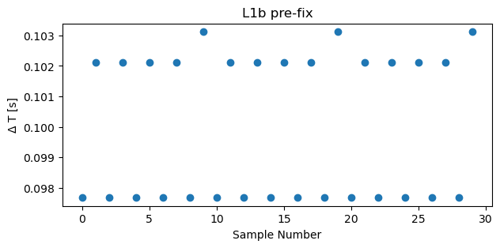
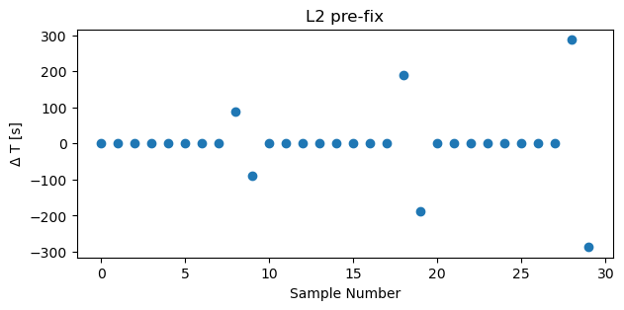
ADR 1232 Irregular Timestamps
G18 L1b pre-fix
• Initially post-launch, there was an irregular difference between consecutive GMAG timestamps (delta), i.e. timestamps did not repeat every 0.1 sec
•NOT due to a problem with the instrument; delta is within requirements, just not at regular intervals
•This created issues for L1b -> L2 NCEI and SWPC operational processing:
L2 algorithms assume regular timestamps at exactly 0.1 sec intervals
This is an issue because SWPC operationally uses L2 mag data
Irregular L1b timestamp
G18 L2 pre-fix
Results in large differences in L2 timestamps

Slide 14
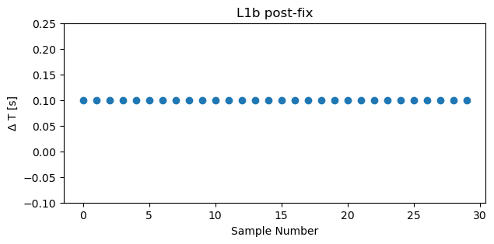
ADR 1232 Irregular Timestamps
G18 L1b post-fix
Resolution : round timestamps to make them regular
Fix was successfully included in publicly available L2 files starting December 7, 2022
G18 L2 post-fix
Regular ΔT
Between timestamps

Slide 15
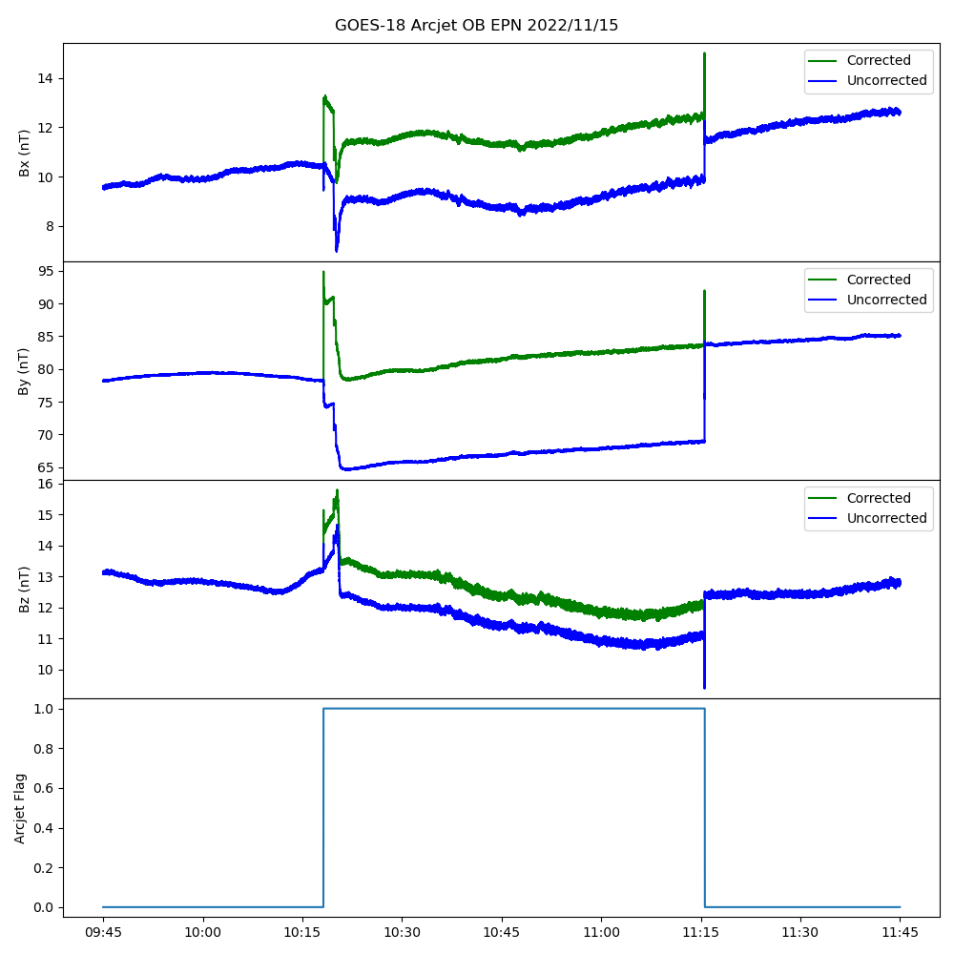
GOES-18 Arcjet Firings
GOES-18 OB L1b
During Arcjet Firing
Arcjet firings have interference effects on magnetometer data, similar to GOES-16 and 17
GOES – 18 firings generally occur for up to 90 minutes once every 4 days
GOES-18 correction matrices are applied and correct some of the effect, but the correction is not always valid
Firings are flagged
NCEI has ongoing work to develop a better correction method
E
Corrected
Uncorrected
P
N
Flag

Slide 16
Full Validation - PLPTs
Title | Activity | Data Needed | Success Criteria
A.3.1 Comparison to quiet field models [PLPT-MAG-001] | Validate Mag L1b product by comparing it to quiet field models. | 90 days, Kp < 2, no arcjet firings, only using 3 hours per day +/-2 hours from MLT noon | Data demonstrate that MAG measurements are close to magnetic field model values.
A.3.2 Cross Satellite intercalibration [PLPT-MAG-002] | Validate MAG L1b product by comparing it to other GOES in situ Magnetometer measurements. | 90 days of quiet field conditions, no arcjet firings (need not be contiguous) | Mag observations are consistent with other spacecraft observations
A.3.3 Noise Performance [PLPT-MAG-003] | Determine the noise level of the product, possible sources and possible corrections algorithms to meet 0.3nT MRD requirement | 90 days (need not be contiguous), no arcjet firings | Results determine a path forward to any correction algorithm needed
GOES-R 410-R-Beta, Provisional and Full validation-Readiness Implementation and Management Plan-0317 V2.0

Slide 17
RIMP v2 PLPT-MAG-001
Issues with magnetic field model input data
Models are essential for comparisons to satellites (PLPT 001) and allow for inter-satellite comparisons (PLPT 002) by correcting for longitudinal effects
TS04 Input Source | Issues | Effect
DSCOVR (TS04 solar wind input) | Reliability issues with plasma measurements | Large artificial spikes in model output
OMNI NASA Database (TS04 solar wind input) | Time periods where measurements from ACE, WIND and DSCOVR are not available (i.e. “bad”) | Periods of missing (nan) model output
OP77 ; quiet field with no solar wind input data, used to compare observations to quiet conditions
TS04 ; requires solar wind input data (OMNI NASA database or DSCOVR), better at estimating realistic conditions
Good quality, continuous solar wind input data is becoming less available as measurement quality for WIND and ACE degrade and DSCOVR faraday cup issues continue

Slide 18
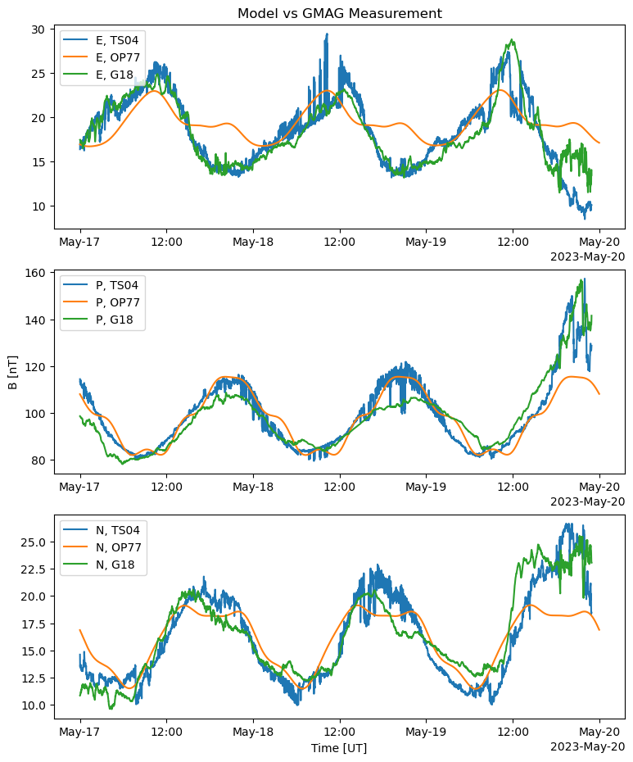
RIMP v2 PLPT-MAG-001
Comparison to quiet field models (TS04 and OP77)
Typical example
model outputs vs GMAG measurements
GOES-18 1minute average data was compared to the Tysganenko 2004 (TS04) and the Olson-Pfitser 1977 (OP77) models for quiet field conditions for 90 days
Mean difference of GMAG – Model is less than 5nT
Our implementation of TS04 model successfully incorporates solar wind parameters that are propagated from DSCOVR (L1) to the Earths bow-shock
NCEI has a quiet field L2 product using OP77. Including TS04 model is part of future work
Spikes due to DSCOVR issues

Slide 19
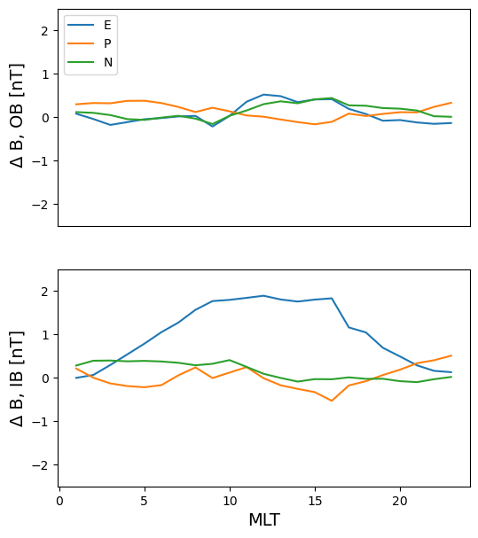
RIMP v2 PLPT-MAG-002
Cross-Satellite Comparisons (GOES-17)
Hourly Average
GOES-18 – GOES-17
Data used are from “co-location”, when the two spacecraft were located close together
Hourly average of the difference between GOES-18 and GOES-17 measurements
Some differences are expected due to thermal issues on GOES-17, especially with the IB sensor
GOES-17 MAG L1b products stopped being publicly produced on January 10th, 2023
Note: GOES-17 underwent a yaw flip on September 7^{th,} 2023, which requires correcting the data. Fred Rich provided correction values and methodology
OB
IB
Mean | E | P | N | Data length
G18 - G17 OB | 0.1 | 0.13 | 0.15 | 47 days
G18 - G17 IB | 1.1 | 0.05 | 0.14 | 47 days

Slide 20
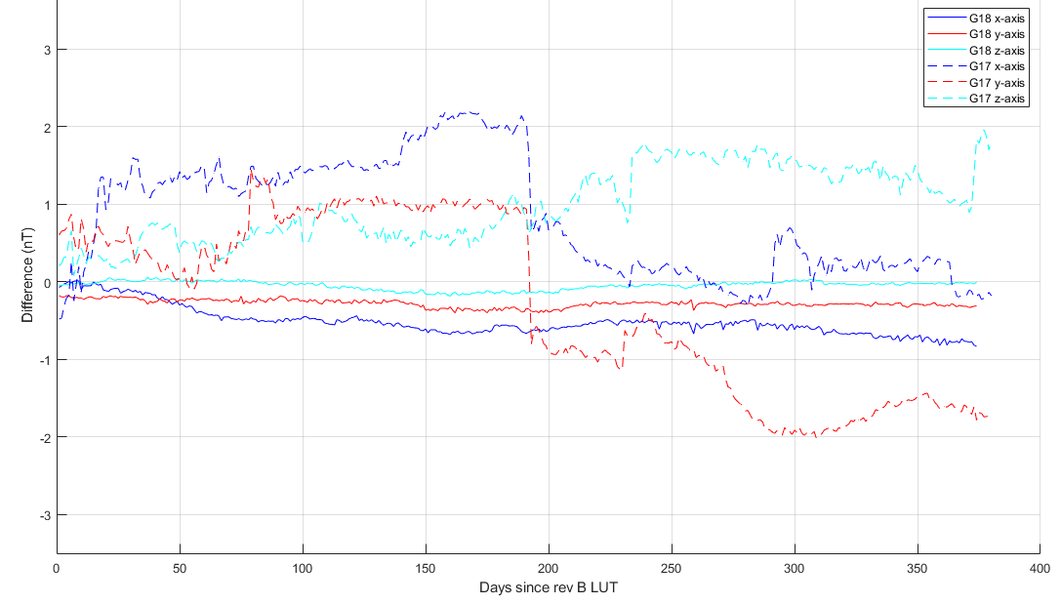
RIMP v2 PLPT-MAG-002
Cross-Satellite Comparisons (GOES-17)
Daily Mean
GOES-18 OB-IB vs
GOES-17 OB-IB
OB
GOES-17 OB heater setpoint change
The daily mean of GOES-18 OB-IB has much less drift over time than GOES-17 OB-IB
GOES-18 differences are much closer to zero than GOES-17
note: this plot includes days of all Kp conditions
Plot provided by NASA Flight

Slide 21
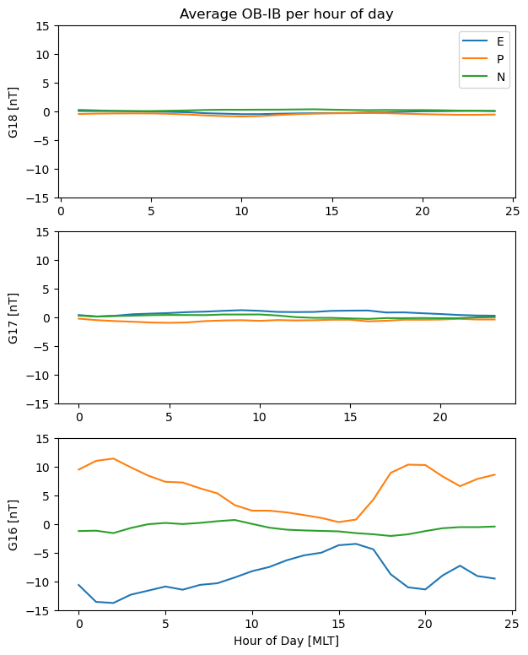
RIMP v2 PLPT-MAG-002
Cross-Satellite Comparisons (GOES-16, -17 and -18)
Hourly Average Diurnal Trend
by satellite
Hourly average OB – IB difference for each magnetometer suite, shows the average diurnal trend for the data length
Note : GOES-17 has significantly fewer days that meet the selection criteria, thus its average difference may be affected
The significant diurnal trend seen in GOES-16 is improved for GOES-17 and GOES-18
Inter-satellite OB-IB comparisons are a better indicator of performance than model comparisons, but are subject to issues in each satellite
These results confirm those from provisional, with a longer analysis period
G18 OB-IB
OB-IB [nT]
Data length: 78 days
G17 OB-IB
OB-IB [nT]
Data length: 47 days
G16 OB-IB
OB-IB [nT]
Data length: 78 days

Slide 22
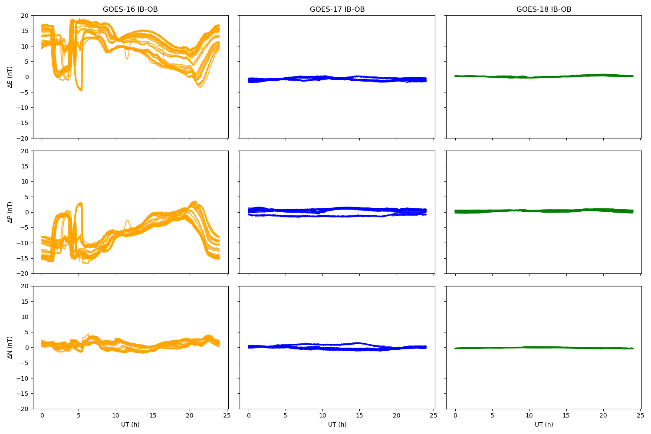
RIMP v2 PLPT-MAG-002
Cross-Satellite Comparisons (GOES-16,-17 and -18)
GOES-16
GOES-17
GOES-18
Daily IB – OB differences overlayed
Ideally, overlayed plots would show the same IB-OB difference every day, i.e. no spread
The spread of GOES-16 differences shows seasonal sensitivity, and profile shape shows diurnal trends
GOES-18 shows great improvement
IB-OB
E
IB-OB
P
IB-OB
N

Slide 23
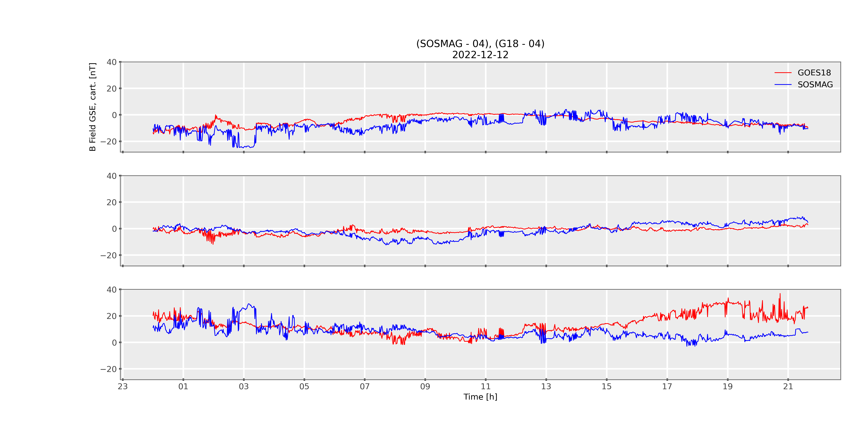
RIMP v2 PLPT-MAG-002
Cross-Satellite Comparisons (GK2A)
The Korean Meteorological Administration has a geostationary satellite, GEO-KOMPSAT-2A (GK2A) with magnetometers on board
NCEI is involved in a unique opportunity for cross-satellite inter-calibration
This is part of initial work for comparisons between the GOES-R satellites and the GK2A magnetometers
This is a typical example comparison, with longitudinal corrections done by subtracting the TS04 model
GOES-18 GMAG compared to
Korean GK2A SOSMAG
X_{GSE}
GMAG
SOSMAG
Y_{GSE}
Z_{GSE}

Slide 24
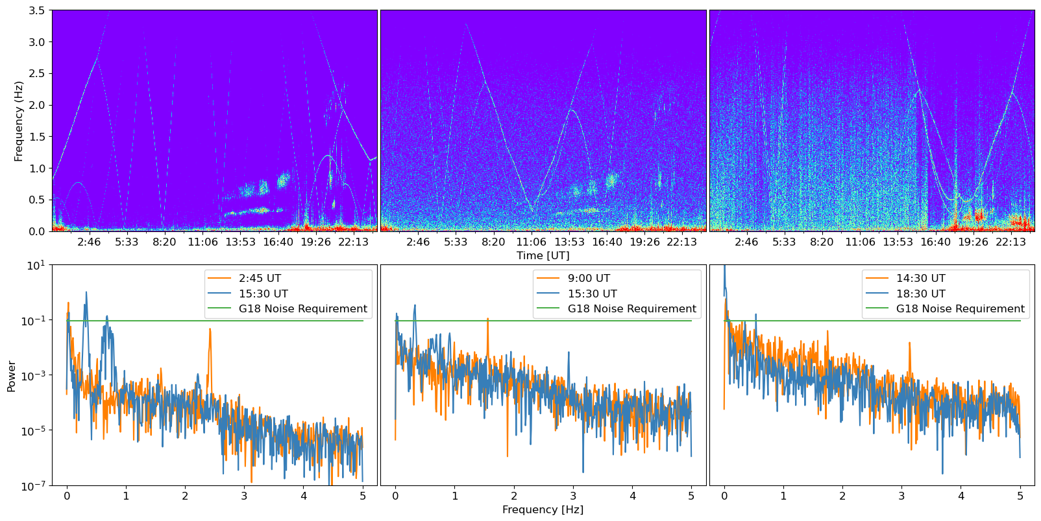
RIMP v2 PLPT-MAG-003
Noise Performance
GOES-18 GOES-17 GOES-16
Plasma waves
Wave activity?
Reaction
wheel
Reaction wheel?
Significant improvement in background noise levels throughout the GOES-R series
Higher background levels make it more difficult to identify events such as plasma waves
Easier to identify reaction wheels in GOES-18 dynamic and static spectrograms
The noise floor is within requirement for the sensors

Slide 25
RIMP v2 PLPT-MAG-003
Noise Performance
Noise Contributions:
Sensor : < 0.1nT
Reaction wheels : 0.1nT to 0.2nT
Heaters : < 0.02nT, ongoing analysis
Arcjets (not included in error analysis)
We believe MAG product noise is generally within 0.3 nT (excluding arcjet firings), but we have not fully studied noise characteristics and contributions for the new GMAG. Continued analysis for a longer period of time is necessary.

Slide 26
FULL MATURITY ASSESSMENT
GOES-18 GMAG L1b Product Full PS-PVR

Slide 27
Assessing GMAG Accuracy
GOES-18 GMAG accuracy assessment uses inter-satellite comparisons and GMAG OB-IB differences
We define accuracy as +/-(mean + 3σ)
Thermal instability on GOES-16 MAG makes comparisons less reliable
Although GOES-17 had improvements, there are still thermal instability issues and required a waiver for accuracy as it did not meet the 1nT requirement
Model comparisons (and thus longitudinal corrections) are less reliable, especially for days that have some level of geomagnetic activity
We believe the 3σ for GOES-18 – GOES-17 differences is mainly a result of GOES-17 issues
Overall, the GOES-18 OB-IB differences and 3σ are the best indicator of accuracy, which are 1nT or better
Satellite(s) | Sensor(s) | +/- (mean+ 3σ) E [nT] | +/- (mean + 3σ) P [nT] | +/- (mean + 3σ) N [nT]
G18 | OB-IB | +/-0.09 + 0.74 | +/-0.27 + 0.77 | +/-0.08 + 0.39
G18 - G17 | OB | +/-0.05 + 1.3 | +/-0.07 + 1.1 | +/-0.08 + 0.9
G18 - G17 | IB | +/-0.53+2.4 | +/-0.03 + 1.8 | +/-0.07 + 1.1

Slide 28
GOES-18 GMAG
Performance Baseline Status*
Assessment at Full validation
MRD ID | Description | MRD Requirement | Predicted Performance Baseline | Assessment at Full | Related PLPTs | Status
2019 | Product Measurement Accuracy | 1 nT (per axis) | (3σ_{x},3σ_{y},3σ_{z})=(0.74,0.77,0.39) nT one year after initial cal maneuver EOL predictions are under assessment | 1nT or less (per axis) (3σ_{x},3σ_{y},3σ_{z})=(0.74,0.77,0.39) | -001, -002 | PASS (excluding arcjet firings)
2022 | Product Measurement Precision | Fluctuations < 0.3 nT | Fluctuations < 0.3 nT | 0.3 nT or less | -002, -003 | PASS (consistent with provisional, excluding arcjet firings)
662 | MAG Product Noise | 0.3 nT at < 2.5Hz | 0.3 nT at < 2.5 Hz | 0.3 nT or less | -003 | PASS (excluding arcjet firings)
*These assessments exclude arcjet firings periods
GOES-R 410-R-RIMP-0317 V2.0

Slide 29
Full Validation Assessment
Preparation Activities | Assessment
Validation, QA, and anomaly resolution activities are ongoing. | Validation activities are ongoing. Results have been discussed with SWPC. L1b data available at NCEI website enabling research community participation.
Incremental product improvements may still be occurring. | Work on science quality data will continue at NCEI for arcjet and noise related issues, model data improvements and anomaly assessment. Some of these improvements will be done as updates to L2 products.
Users are engaged and user feedback is assessed. | Product improvements will result from steps to mitigate known and yet to be discovered anomalies.

Slide 30
Full Validation Assessment
End State | Assessment
Product performance for all products is defined and documented over a wide range of representative conditions via ongoing ground truth and validation efforts. | Performance tests included in provisional PLPT results GOES-18 MAG L1b has been compared to GOES-16 and GOES-17 GOES-18 MAG L1b has been compared to OP77 and TS04 magnetic field models The above were undertaken across different local times. Ongoing comparisons are still recommended for comparisons across a wider range of conditions
Products are operationally optimized, as necessary, considering mission parameters of cost and schedule, as compared to user expectations. | Yes, given resources and time.
All known product anomalies are documented, and shared with the user community. | Readme’s for L1b MAG products are appropriately updated. There are also documentation of recommendations in NASA, MIT-LL and NCEI presentations, including this one.
Product is operational. | L1b going to PDA & GRB. GOES-18 OB is being used operationally by SWPC.

Slide 31
SUMMARY & RECOMMENDATIONS
GOES-18 GMAG L1b Products Full PS-PVR

Slide 32
Summary and Recommendations
Recommendation that work continue to understand and correct for noise sources and improvements to the product. This work includes :
Long term trending for biases and OB-IB differences needs to continue. These are more stable for GOES-18 so far, but we have not had as long to monitor GMAG as MAG.
Ongoing analysis for noise performance.
Continued validation of flags.
Investigating the usability of the gradiometer.
Submission for publication currently in review, Loto’aniu et al. 2023, Initial On-Orbit Results from the GOES-18 Spacecraft Science Magnetometer
Need to improve truth datasets: The quality of solar wind model input data is degrading over time, which affects the model output quality. There is a need for analysis of the accuracy of models given decreasing solar wind input quality

Slide 33
Summary and Recommendations Continued
Arcjet firings : The effect of arcjet firings on magnetic field observations depends on the firing frequency, thruster parings and firing duration. The current correction does not work for all pairings, frequencies or durations that are used, or correct edge effects from power ramp up / down. NCEI has on going work to create a more robust correction.
NCEI is also investigating the effect of shorter, more frequent bursts as used on GOES-16 (due to power issues).
Analysis of performance during arcjet firings
NCEI is looking at the possibility of developing a machine learning magnetic field model that may help improve the quality of comparison data
Work towards GOES-U launch continues
Personnel resources for GOES-U have decreased recently, and resources are being moved towards SWFO
NCEI recommends the GOES-18 GMAG L1b product be transitioned to Full Validation status

