Slide 1
GOES-18 GLM Provisional Validation
Peer/Stakeholder Product Validation Review (PS-PVR)
Oct. 31, 2022
NWS Perspective: AWIPS Verification and Forecaster Feedback
John D. Evans and Lee Byerle
TOWR-S team, NWS Office of Observations

Slide 2
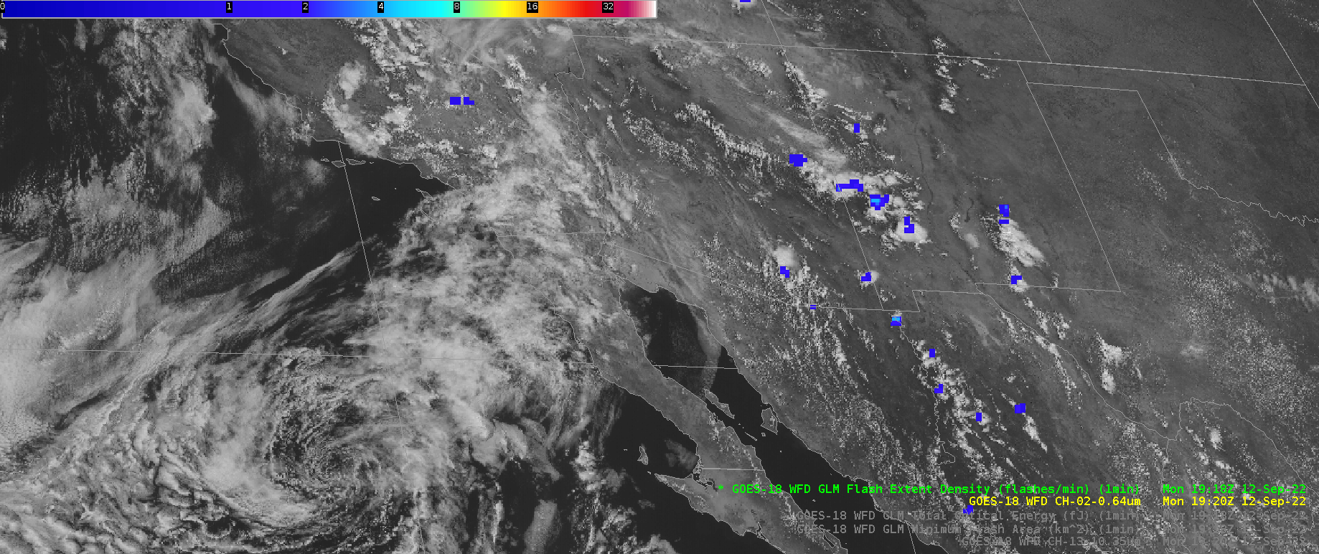
GOES-18 Gridded GLM Products in AWIPS: Flash Extent Density
GOES-18 Preliminary, Non-Operational Data

Slide 3
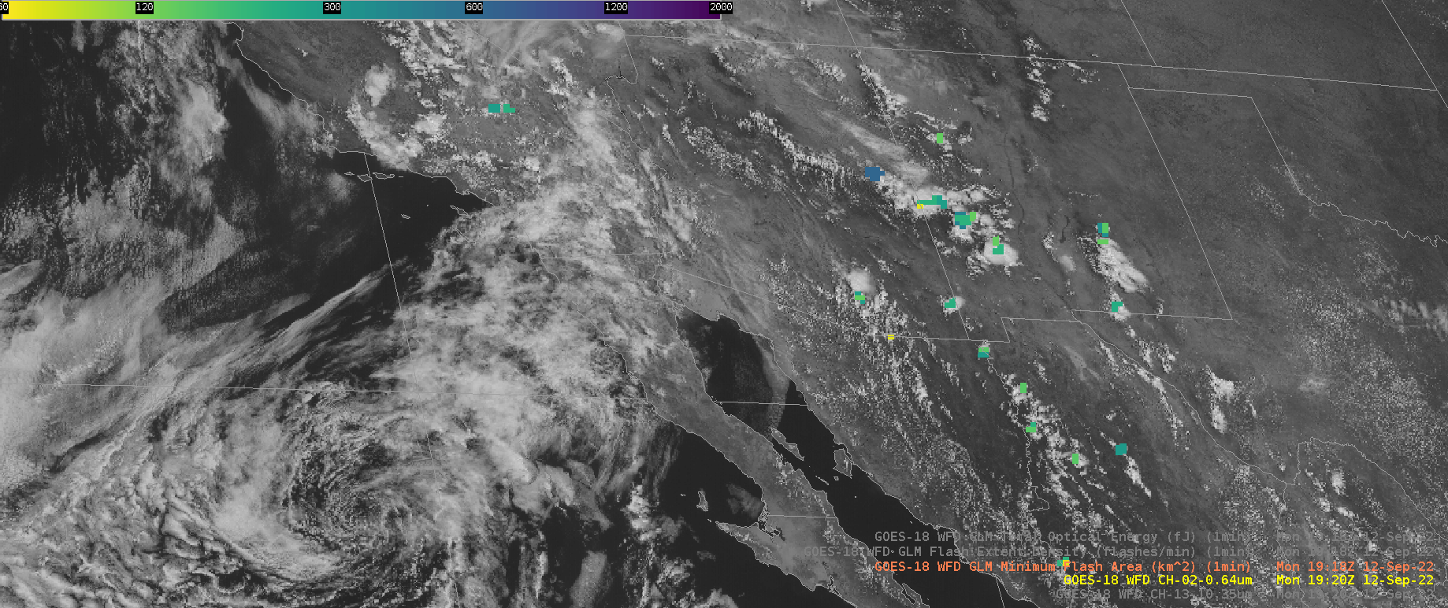
GOES-18 Gridded GLM Products in AWIPS: Minimum Flash Area
GOES-18 Preliminary, Non-Operational Data

Slide 4
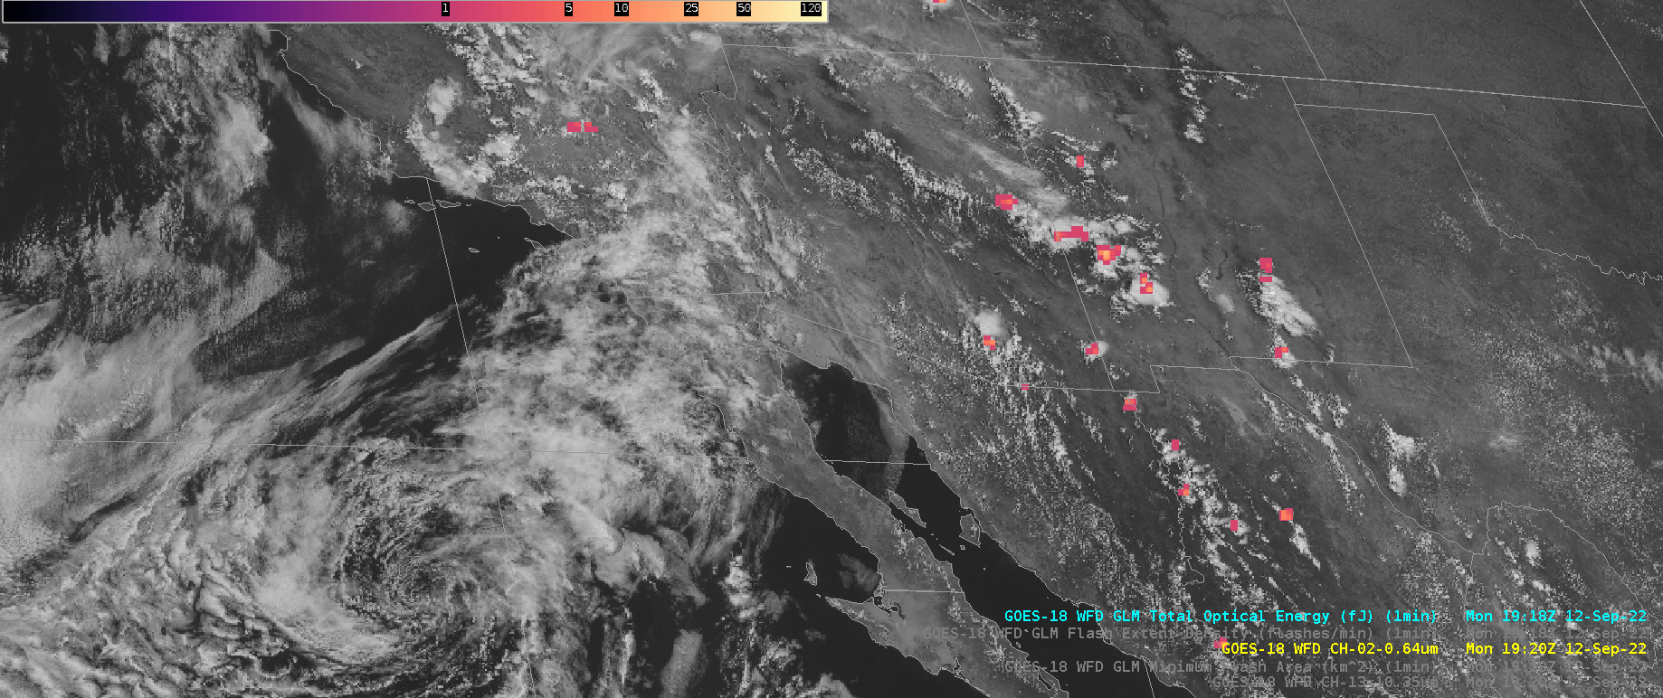
GOES-18 Gridded GLM Products in AWIPS: Total Optical Energy
GOES-18 Preliminary, Non-Operational Data

Slide 5
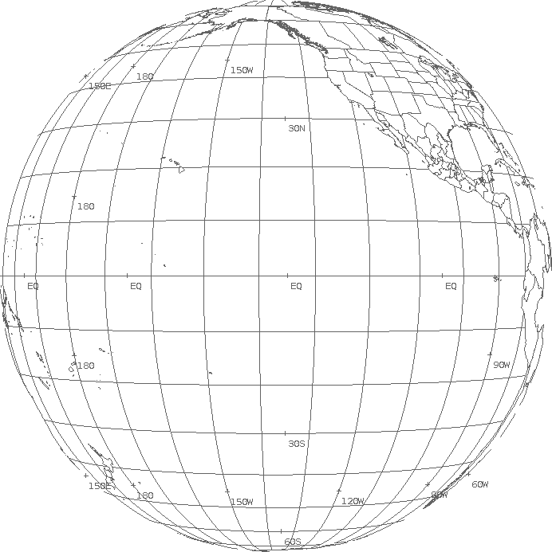
Notes on AWIPS integration of Gridded GLM Data Products
AWIPS integration should be straightforward, as sites have been receiving a nearly identical gridded GLM product since 2020 through non-operational systems (products generated at AWC and available via NWS Regional LDM)
AWIPS sites will need to be configured for a new filename pattern in the “dataset_name” global attribute
TOWR-S will bundle this configuration in an RPM file posted to all NWS AWIPS sites in ~Jan. 2023.
Recent DOE-T4 test (Oct. 26-28) confirmed that the AWIPS Network Control Facility (NCF) will
Distinguish East / West gridded GLM files and route them to SBN Channels GRE / GRW with correct WMO headers (TIRS00 KNES / TIRT00 KNES)
Based on “G16”, “G17”, or “G18” in incoming filenames (though “EGLMFD” / “WGLMFD” would be preferred)
Translate tile numbers (000, 001, … 061) to Bulletin Segment Headers (PAA, PAB, … PCJ)
 | 000 PAA | 001 PAB | 002 PAC | 003 PAD
004 PAE | 005 PAF | 006 PAG | 007 PAH | 008 PAI | 009 PAJ
010 PAK | 011 PAL | 012 PAM | 013 PAN | 014 PAO | 015 PAP
016 PAQ | 017 PAR | 018 PAS | 019 PAT | 020 PAU | 021 PAV
022 PAW | 023 PAX | 024 PAY | 025 PAZ | 026 PBA | 027 PBB
028 PBC | 029 PBD | 030 PBE | 031 PBF | 032 PBG | 033 PBH
034 PBI | 035 PBJ | 036 PBK | 037 PBL | 038 PBM | 039 PBN
040 PBO | 041 PBP | 042 PBQ | 043 PBR | 044 PBS | 045 PBT
046 PBU | 047 PBV | 048 PBW | 049 PBX | 050 PBY | 051 PBZ
052 PCA | 053 PCB | 054 PCC | 055 PCD | 056 PCE | 057 PCF
 | 058 PCG | 059 PCH | 060 PCI | 061 PCJ

Slide 6
Notes on AWIPS integration of Gridded GLM Data Products
Gridded GLM data products from GOES-16 and GOES-18 will go to AWIPS sites via the Satellite Broadcast Network as of March 2023.
Public Service Change Notice to be posted this month, detailing gridded GLM data content, tiling, size, cadence, WMO headers, and links to documentation.
Dataset Guide on VLab provides AWIPS details and links to Quick Guides, etc.

Slide 7
Forecaster Use of Gridded GLM data products
See NWS input to GOES-16 GLM PS-PVR (2018), “GOES-16 GLM Implementation in NWS”
Applications; User comments; Implementation phases
See K. Thiel, “GLM in the 2022 HWT Satellite Proving Ground Experiment”
Role in Decision support; Importance of FED, MFA; Uses of East+West GLM
Many NWS forecasters have had 2+ years of experience with gridded GLM data products
Frequent topic in weekly Satellite Book Club - for example:
Session 4 (What is better than one GL mapper?) Session 5 (May 7, 2020 severe outbreak) Session 9 (Florida Keys tracking updraft strength, special role for airport warnings) Session 16 (Great Lakes "marginally severe" events) Session 22 (understanding GLM) Session 26 (application of GLM during a severe weather outbreak in Oklahoma) | Session 40 (communicating TC Hazards) Session 41 (tornado detection Mid-Atlantic) Session 68 (LightningCast intro from CIMSS) Session 70 (Radar down, Severe Risk up) - "Lightning and sat trends are your friend" Session 110 (EF 2 tornado Midland WFO) Session 119 (GLM for tornado warnings during landfalling tropical cyclones)

