Slide 1
GOES-16/18 Fractional Snow Cover L2 Provisional Validation
Peer/Stakeholder Product Validation Review (PS-PVR)
Dec. 9, 2022 (slides revised Dec. 15, 2022)
AWIPS Verification / NWS Perspective
John D. Evans and Derek van Pelt
TOWR-S team, NWS Office of Observations

Slide 2
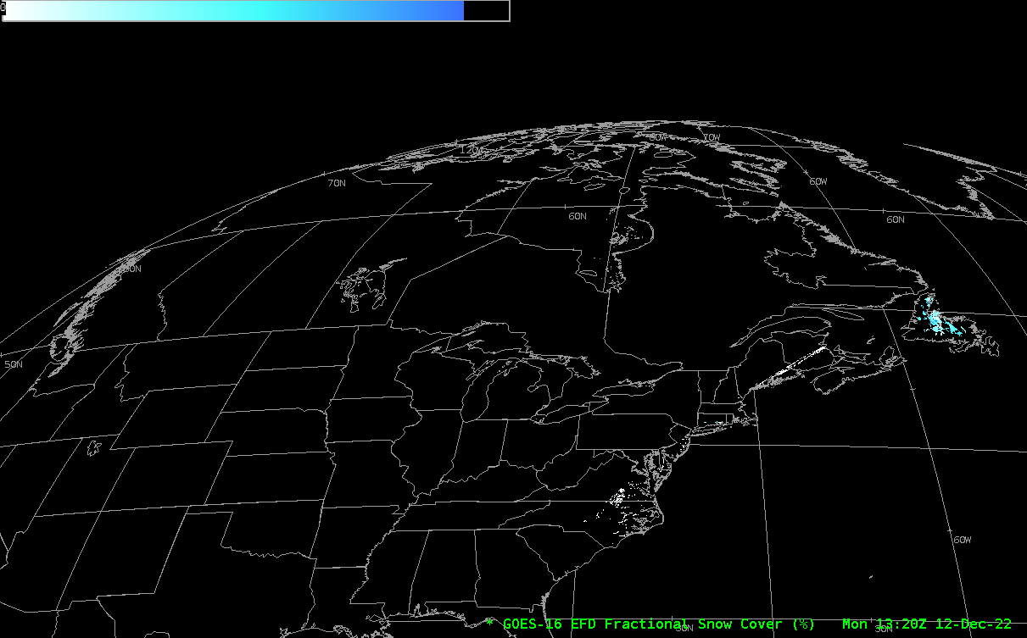
GOES-16 (GOES-East) Fractional Snow Cover in AWIPS
GOES-16 Full Disk Fractional Snow Cover Dec. 12, 2022 (13:20-18:30z)

Slide 3
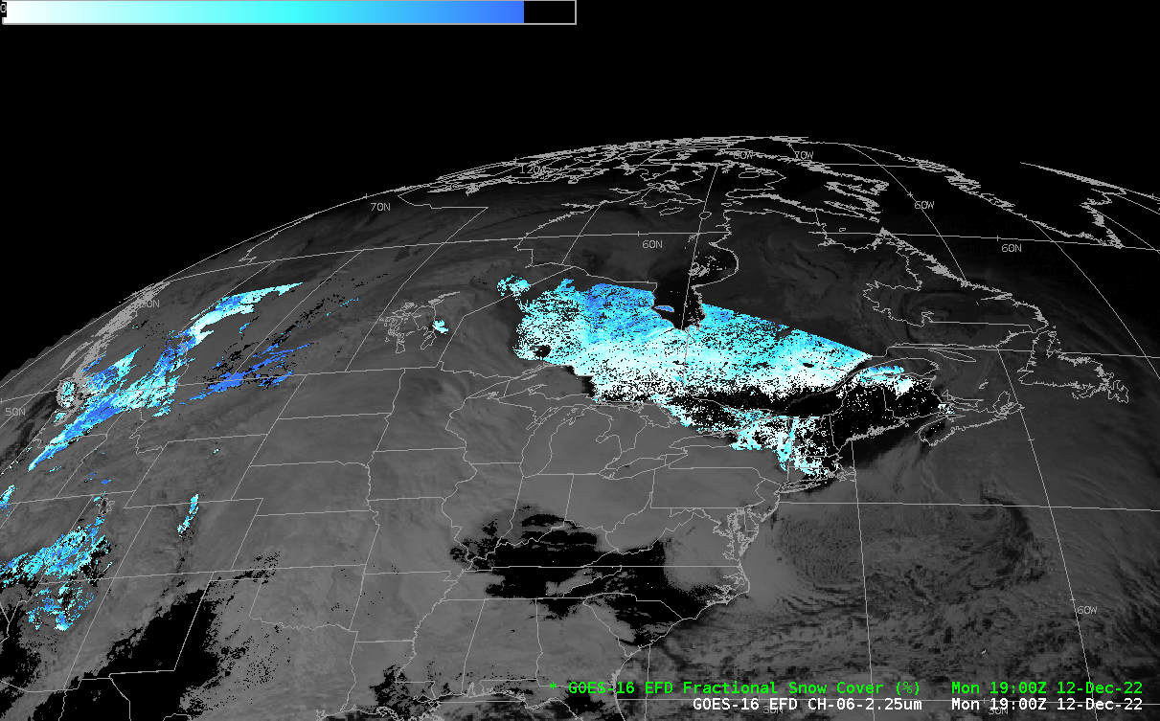
GOES-16 (GOES-East) Fractional Snow Cover in AWIPS
GOES-16 Full Disk Fractional Snow Cover Dec. 12, 2022 (19:00-21:10z)

Slide 4
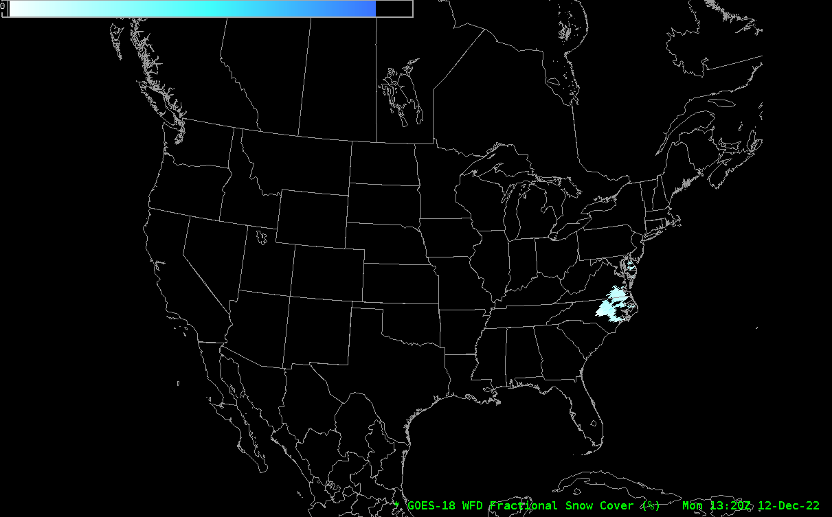
GOES-18 Fractional Snow Cover in AWIPS
GOES-18 Full Disk Fractional Snow Cover Dec. 12, 2022 (13:20-21:10z)

Slide 5
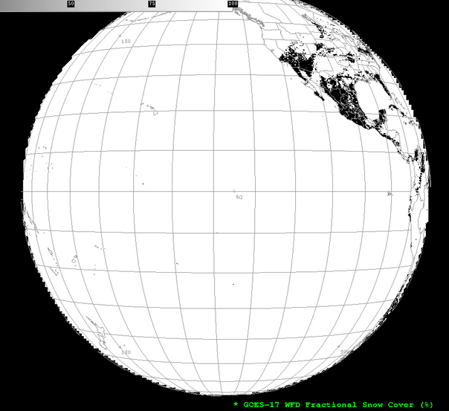
Notes on Fractional Snow Cover (FSC) & AWIPS
AWIPS can ingest the Enterprise FSC product… However the baseline configuration for legacy FSC doesn’t produce a useful display with Enterprise FSC 🠞
(Parameter “FSC” has been redefined; also “DQF”)
The configuration updates (new FSC units specification, DQF masking rule, and new color table) will be deployed through the TOWR-S RPM process.
No AWIPS code changes required
1-minute (Meso) and 5-minute (CONUS) revisits of FSC are probably overkill for most users; but they might be intermediate products used in building cloud-cleared composite views of FSC every 30 or 60 minutes.

