Slide 1
GOES-18 L2 (Group 4) Provisional Validation
Peer/Stakeholder Product Validation Review (PS-PVR)
Nov. 21, 2022
NWS Perspective / AWIPS Verification
John D. Evans and Derek van Pelt
TOWR-S team, NWS Office of Observations

Slide 2
Overview
Cloud Optical Depth
Cloud Particle Size
Sea Surface Temperature

Slide 3
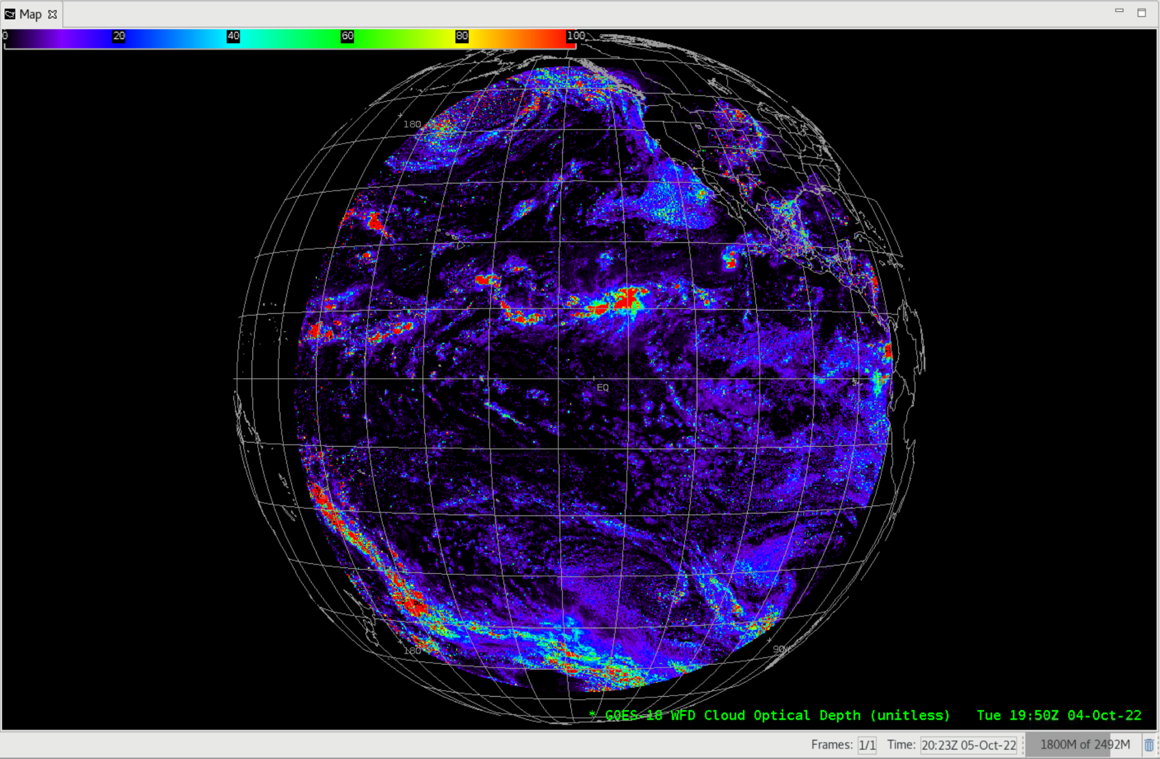
Cloud Optical Depth
GOES-18 Preliminary, Non-Operational Data

Slide 4
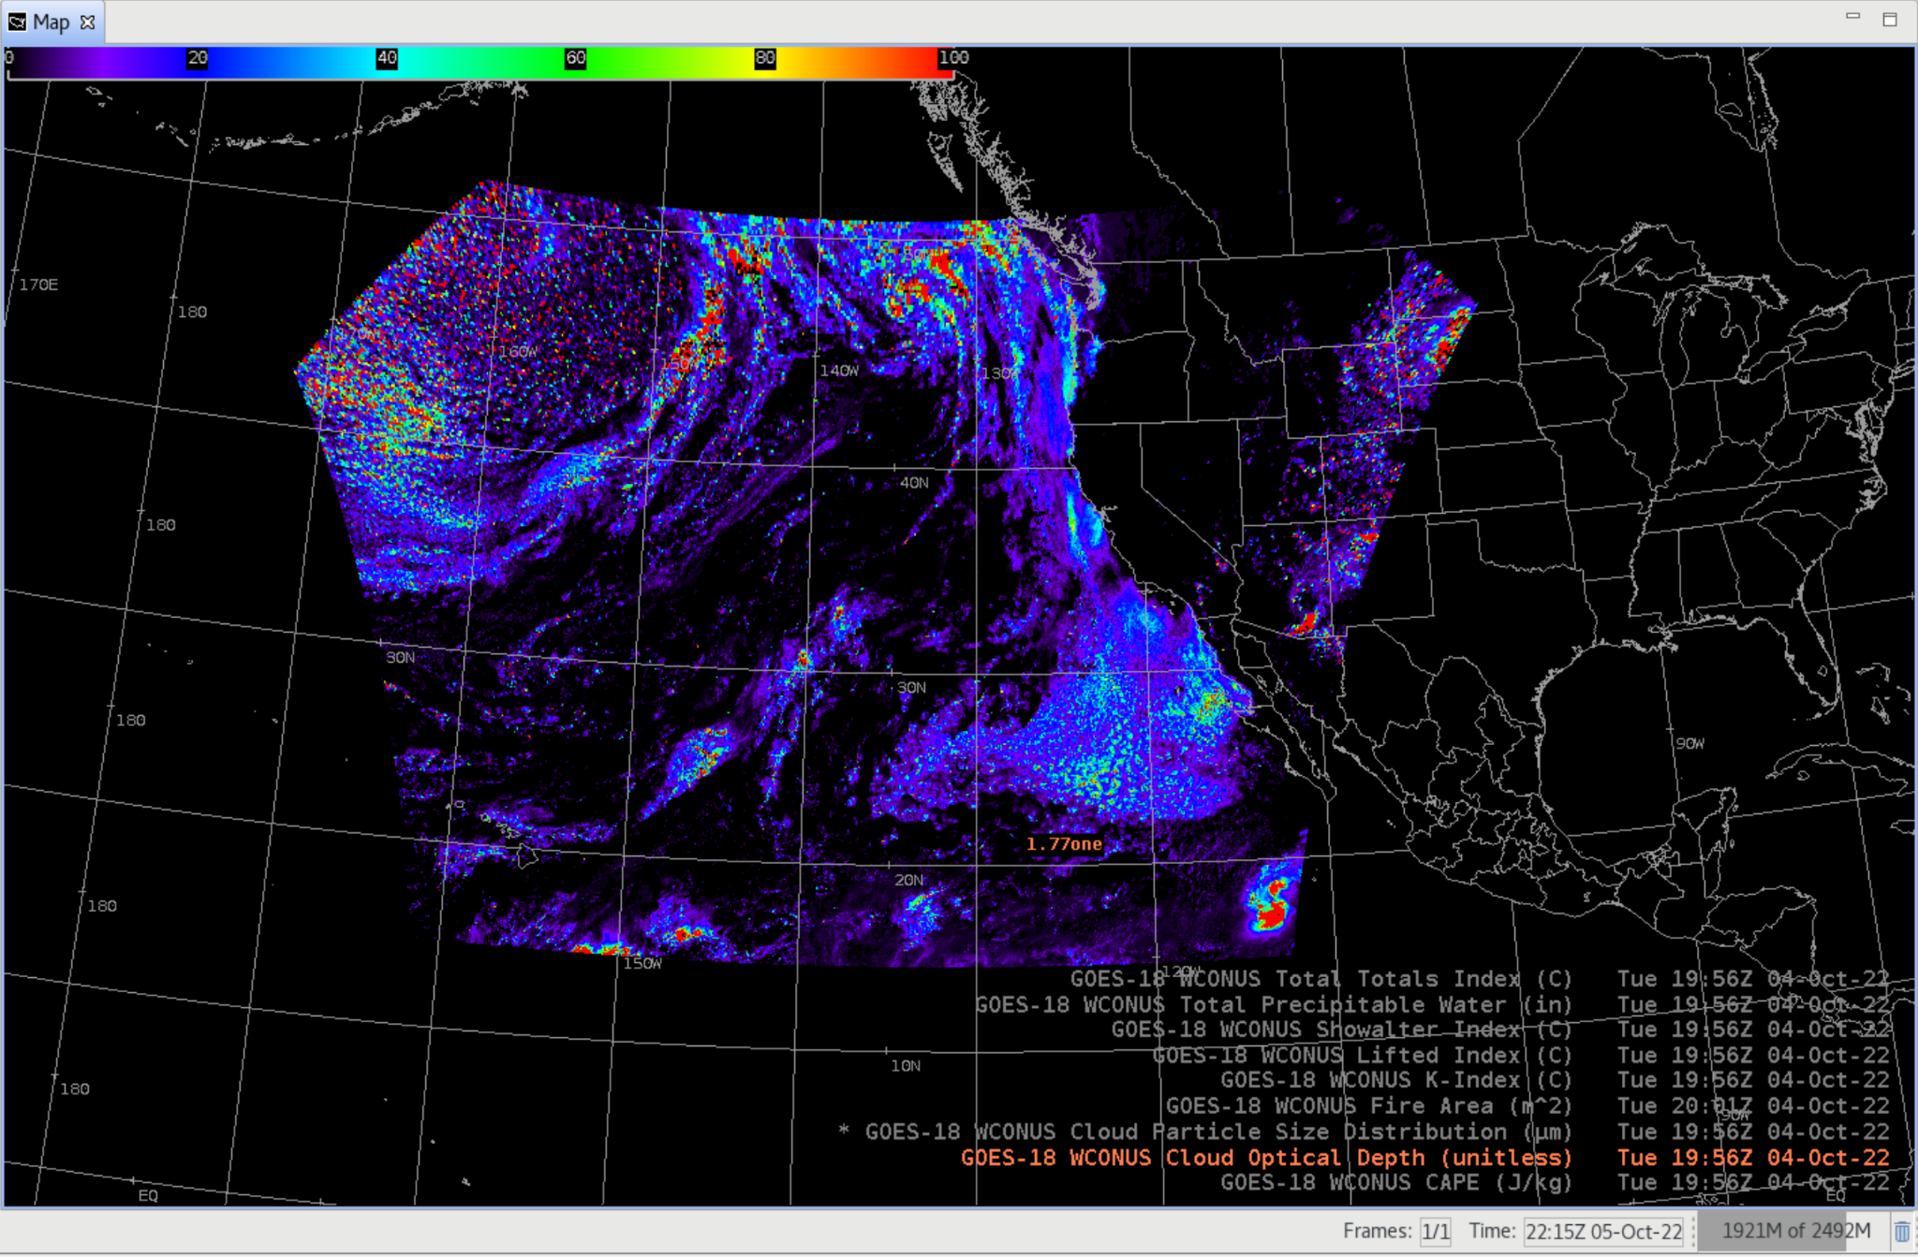
Cloud Optical Depth
GOES-18 Preliminary, Non-Operational Data

Slide 5
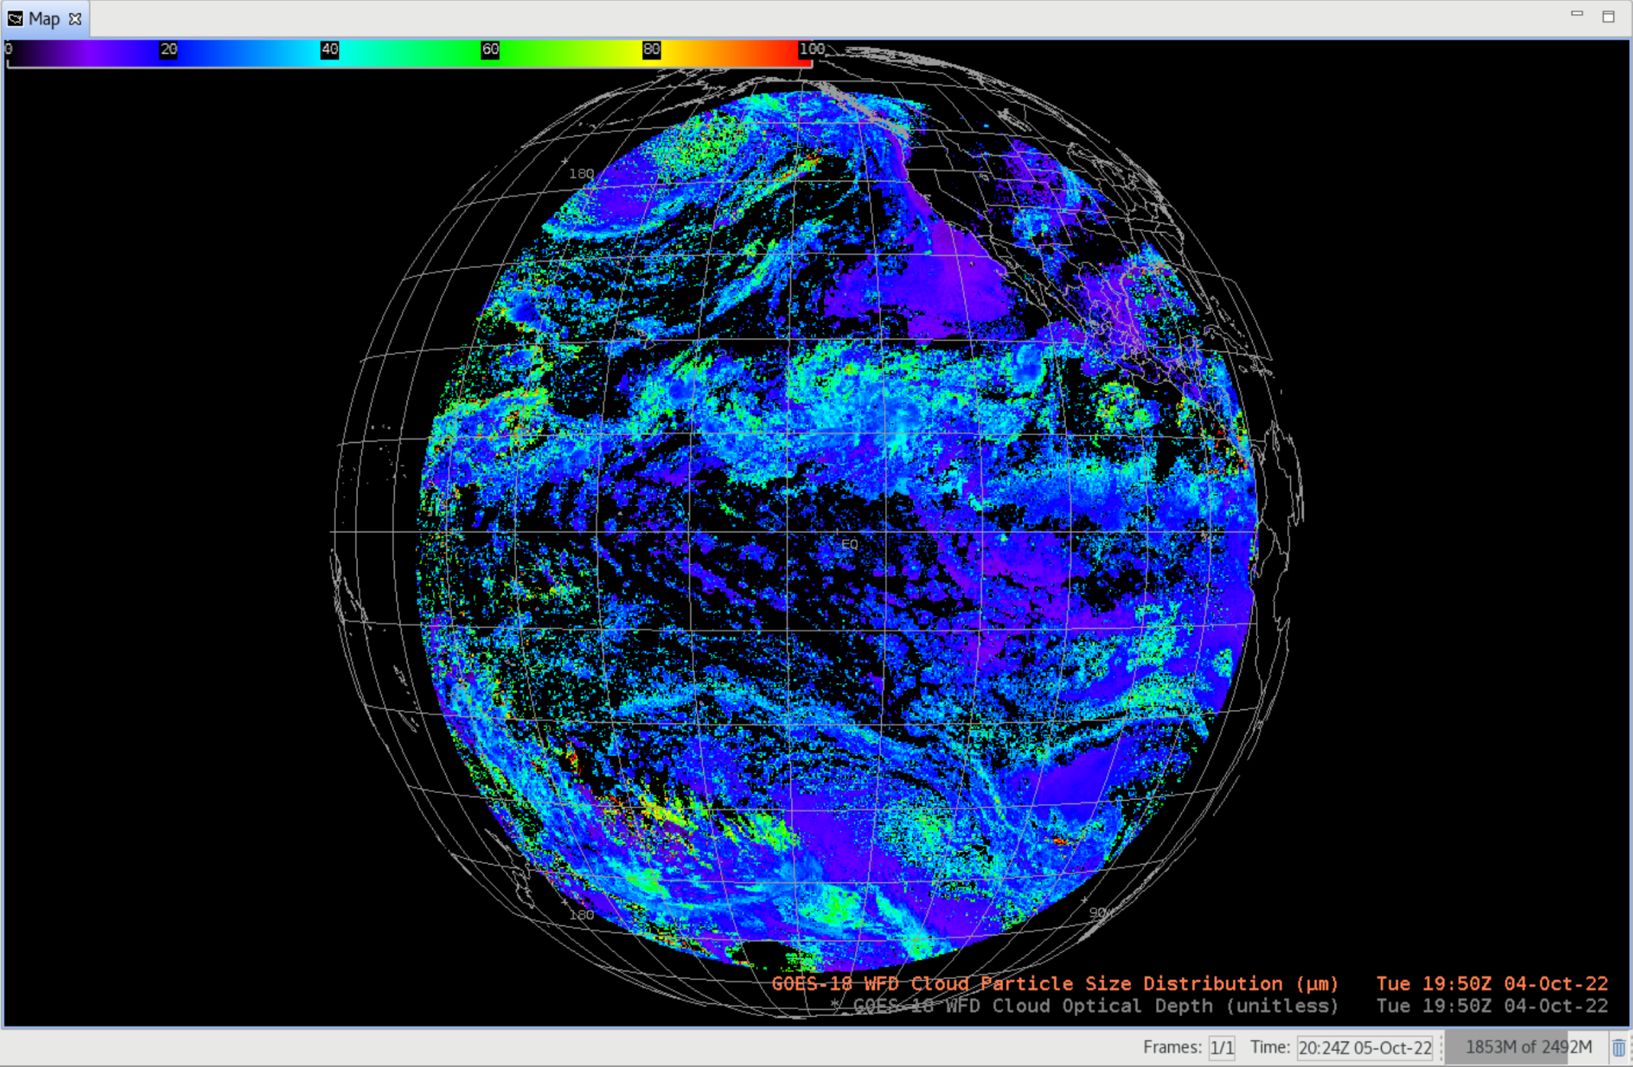
Cloud Particle Size
GOES-18 Preliminary, Non-Operational Data

Slide 6
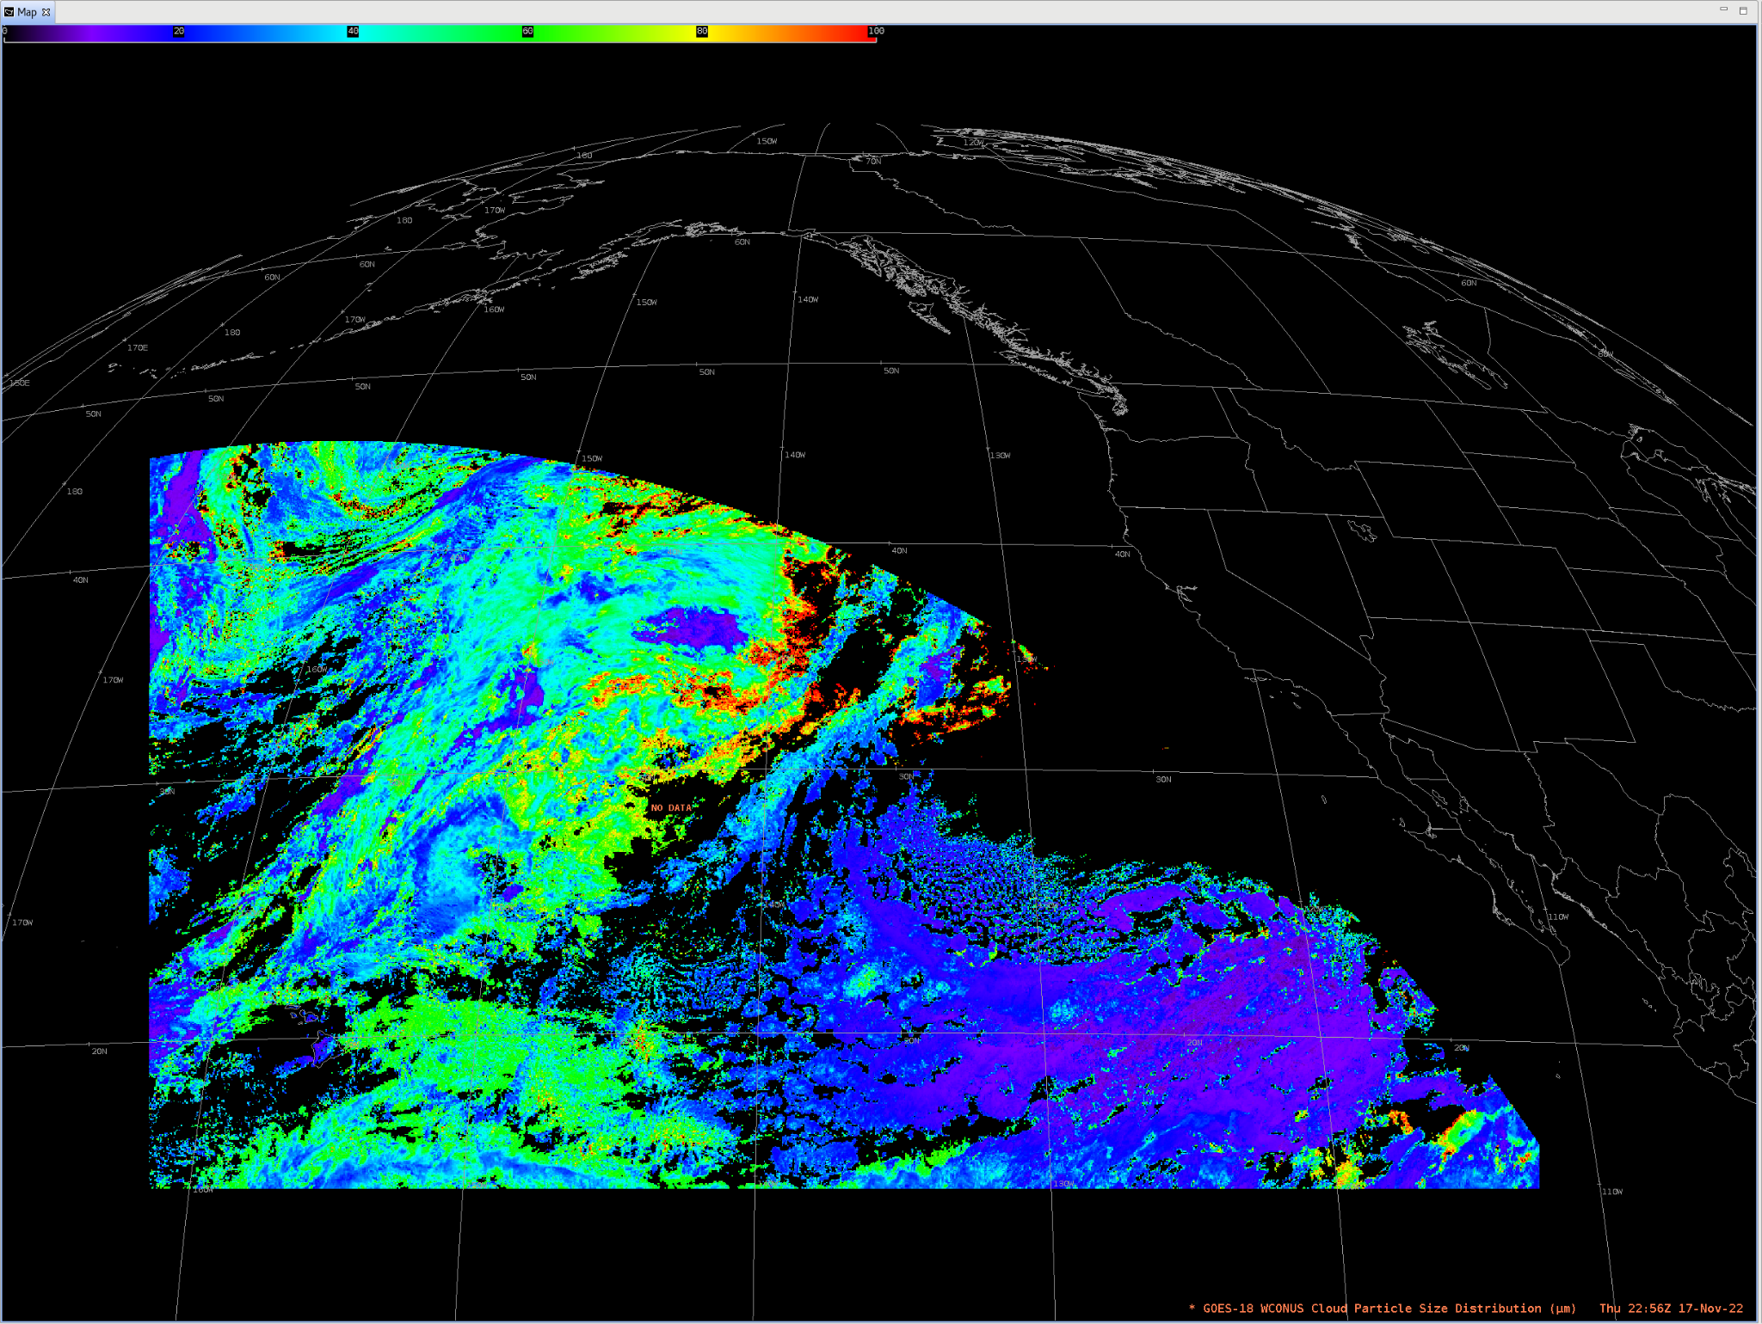
Cloud Particle Size
GOES-18 Preliminary, Non-Operational Data

Slide 7
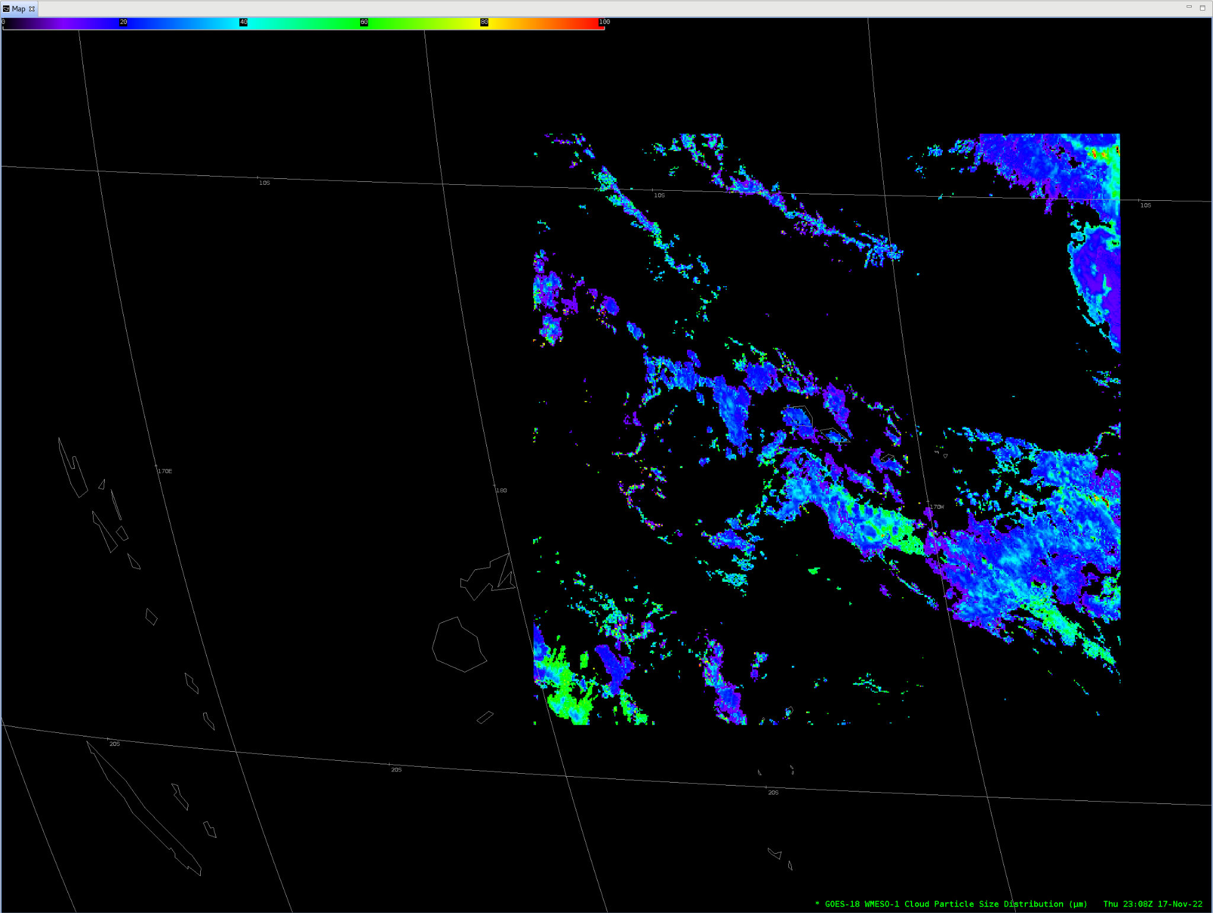
Cloud Particle Size
GOES-18 Preliminary, Non-Operational Data

Slide 8
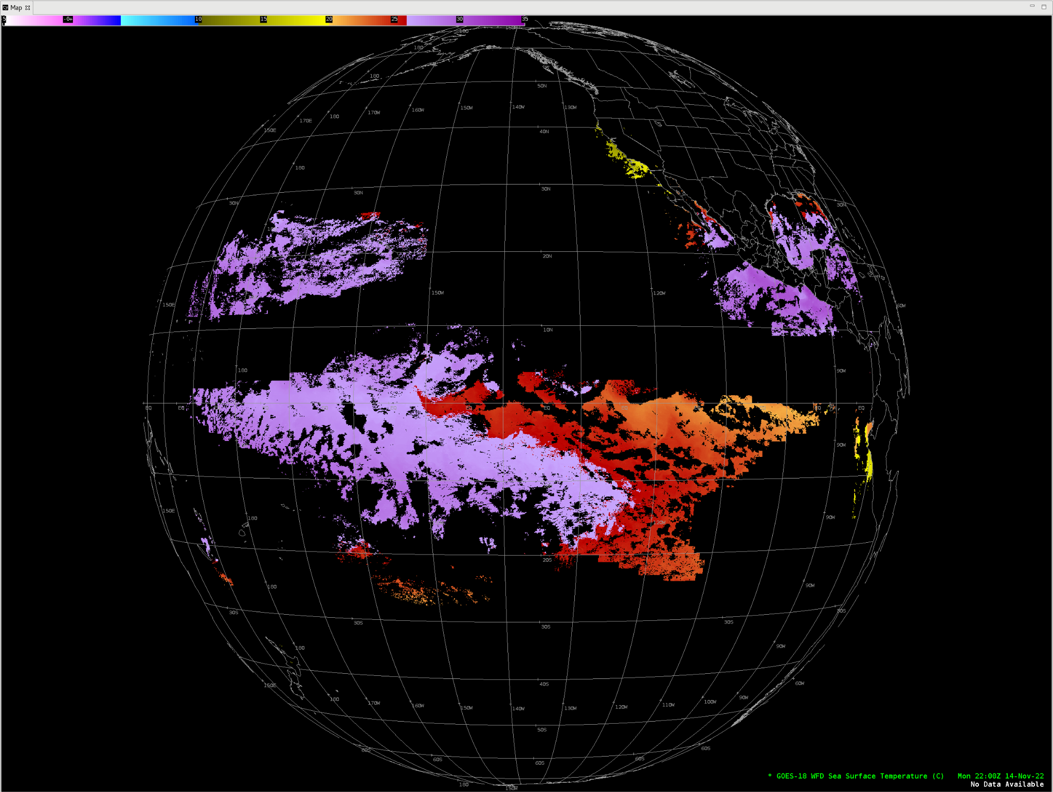
Sea Surface Temperature
GOES-18 Preliminary, Non-Operational Data

Slide 9
Notes
AWIPS ingests and displays all these products using baseline GOES-16/17 configurations.
No fielding issues are expected
G-18 products conform closely to G-16,17 conventions (GOES-R Product User Guide)
AWIPS’ existing configurations for G16 and G17 are extensible for G18+

