Slide 1
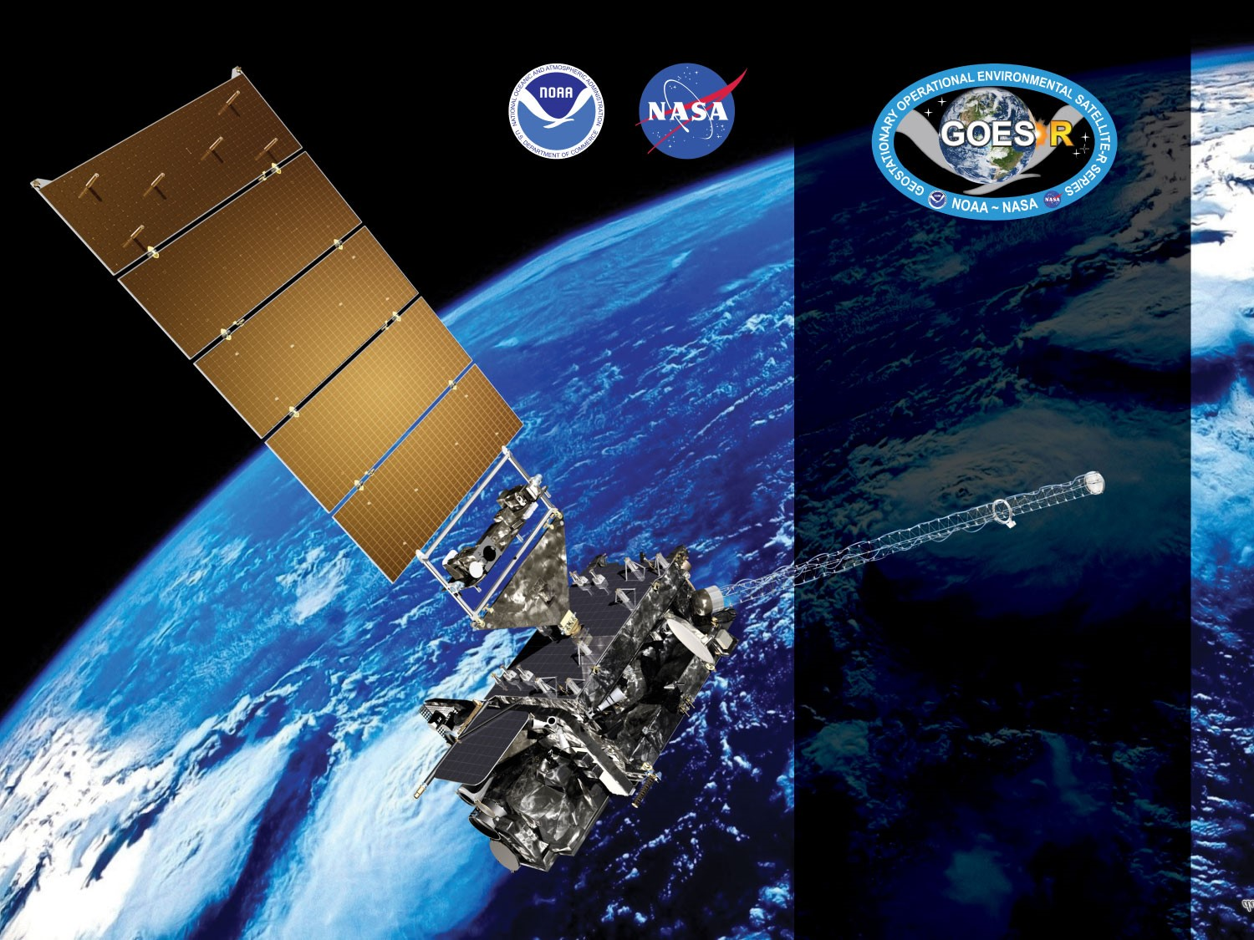
GOES-18 ABI L2+ LAP Products Provisional PS-PVR
October 12, 2022
Tim Schmit
GOES-R AWG
NOAA/NESDIS/STAR
GOES-R AWG LAP team: Zhenglong Li,
Jinlong Li
Richard Dworak,
UW-CIMSS
v1.4

Slide 2
Agenda
Provisional Validation Product Maturity Assessment
Data since June 22, 2022
Path to Full Maturity Review
Summary and Recommendations
The GOES-18 LAP achieved Beta on 5/11/2022

Slide 3
Products Overview
Same as GOES-16 and 17, the GOES-18 ABI L2 LAP algorithm includes regression and physical retrieval based on the infrared spectral bands as input. The algorithm is applied to 5x5 ABI pixels (~10 km) for generating LAP products over clear sky. The LAP products include LVT, LVM, TPW, and DSI.
Band Number | Wavelength (µm) | Purpose
8 | 6.19 | High-level atmospheric water vapor, winds, rainfall
9 | 6.93 | Mid-level atmospheric water vapor, winds, rainfall
10 | 7.34 | Lower-level atmospheric water vapor, winds, and SO₂
12 | 9.61* | Total ozone
13 | 10.33 | Surface and cloud
14 | 11.20 | Imagery, SST, clouds, rainfall
15 | 12.30 | Total water, ash, SST
16 | 13.30 | Air temperature, cloud heights and amounts
LAP products
Legacy Vertical Temperature profile (LVT)
Legacy Vertical Moisture profile (LVM)
Total Precipitable Water (TPW)
Derived Stability Indices (DSI)
Lifted Index (LI)
Convective Available Potential Energy (CAPE)
Showalter Index (SI)
K-Index (KI)
Total Totals (TT)
9.61* : used only in regression step
Notes:
* Only used in the regression step.

Slide 4
Review: Time-Line/Context
01 Mar 2022 GOES-T Launch
14 Mar 2022 GEO orbit attained (GOES-18 at 89.5W)
16 May - ~ 6 Jun 2022 Spacecraft drift to 136.8W from 89.5W
7 Jun 2022 Post Launch Product Test (PLPT) begins
5 Jul - ~ 21 Jul 2022 Spacecraft nudge to 137.0W
~3 Jan 2023 Transition to operations (West satellite)

Slide 5
PLPTs Under Review
PLPT ID | Descriptive Title | % Complete | Results | AWG POC
ABI-FD_TPW06 | Quantitative analysis of M6 FD TPW | 100 | Complete | AWG
ABI-CONUS_TPW07 | Quantitative analysis of M6 CONUS TPW | 100 | Complete | AWG
ABI-MESO_TPW08 | Quantitative analysis of M6 Meso TPW | 100 | Complete | AWG
See RIMP for ABI L2+ Total Precipitable Water
Notes:
PRO is responsible for 01 – 05.

Slide 6
PLPTs Under Review
PLPT ID | Descriptive Title | % Complete | Results | AWG POC
ABI-FD_LVT06 | Quantitative analysis of M6 FD LVT | 100 | Complete | AWG
ABI-CONUS_LVT07 | Quantitative analysis of M6 CONUS LVT | 100 | Complete | AWG
ABI-MESO_LVT08 | Quantitative analysis of M6 Meso LVT | 100 | Complete | AWG
See RIMP for ABI L2+ Legacy Vertical Temperature Profile
Notes:
PRO is responsible for 01 – 05.

Slide 7
PLPTs Under Review
PLPT ID | Descriptive Title | % Complete | Results | AWG POC
ABI-FD_LVM06 | Quantitative analysis of M6 FD LVM | 100 | Complete | AWG
ABI-CONUS_LVM07 | Quantitative analysis of M6 CONUS LVM | 100 | Complete | AWG
ABI-MESO_LVM08 | Quantitative analysis of M6 Meso LVM | 100 | Complete | AWG
See RIMP for ABI L2+ Legacy Vertical Moisture Profile
Notes:
PRO is responsible for 01 – 05.

Slide 8
PLPTs Under Review
PLPT ID | Descriptive Title | % Complete | Results | AWG POC
ABI-FD_DSI06 | Quantitative analysis of M6 FD DSI | 100 | Complete | AWG
ABI-CONUS_DSI07 | Quantitative analysis of M6 CONUS DSI | 100 | Complete | AWG
ABI-MESO_DSI08 | Quantitative analysis of M6 Meso DSI | 100 | Complete | AWG
See RIMP for ABI L2+ Derived Stability Indices
Notes:
PRO is responsible for 01 – 05.

Slide 9
PLPT Tests for each Domain
Our 3 PLPTs dealing with analysis are comprised of the same 2 methods.
Each contains the applications of these methods on the FD, CONUS and MESO domains.
The applications of each method to each domain is summarized below.
Some methods were redundant or not possible for some domains.
Same as what was done for GOES-16/17 LAP
Analysis Method | FD | CONUS | MESO
Visual Inspection
Comparison to reference data (RAOB, GPS, AMSR2)

Slide 10
Provisional Validation Product Maturity Assessment
GOES-18 ABI L2+ LAP Products Provisional PS-PVR

Slide 11
GOES-18 Data Used in this Review
July 2022 - September 2022:
All FD, CONUS, Meso1, and Meso2 LAP with RAOB, Suomi-Net GPS TPW, and AMSR2 TPW matchups within +/- 30 min, 20 km
September 1, 2022, 0000 UTC: Visual images of all domains for each variable;
September 15, 2022, 0000 UTC:
GOES-18 and GOES-16 intercomparison
October 5, 2022, 0000 UTC:
GOES-18 and GOES-17 intercomparison
September 25, 2022, 1700 UTC – 2100 UTC:
M4 mode test (5 min. full disk data);
August 14, 2022, 0100 UTC – 0650 UTC:
Sun migration effect on produtc
11

Slide 12
Definitions of Metrics
Passed: No visual artifacts and/or the comparison with the reference data near or above the specification.
Failed: Cause of performance degradation is unknown.
The comparisons with the reference data are computed over all data.
12

Slide 13
Examples of Visual Inspection of All Domains
13

Slide 14
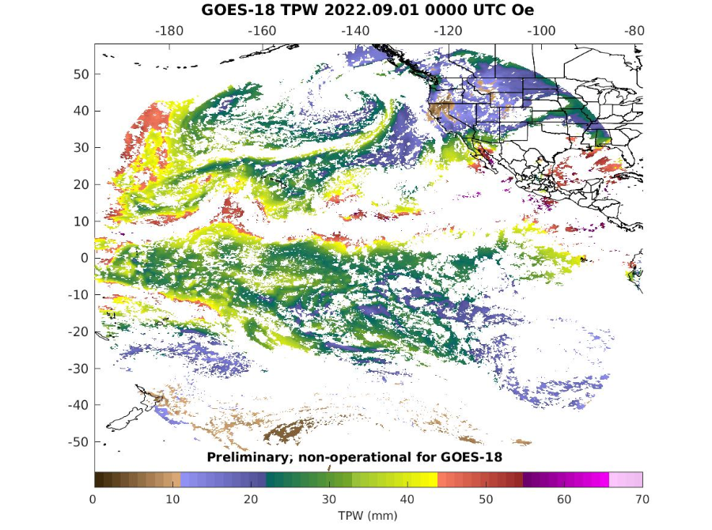
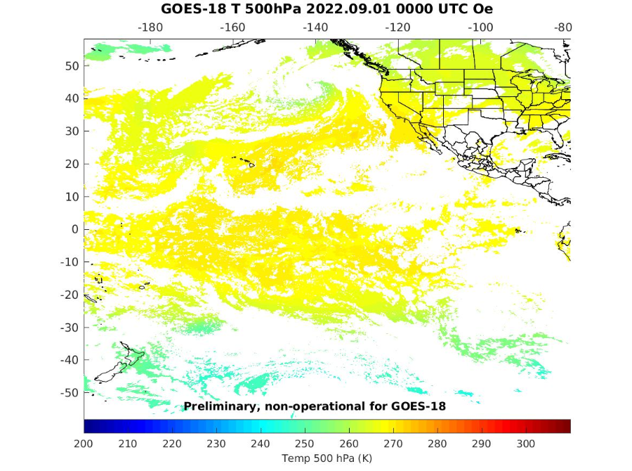
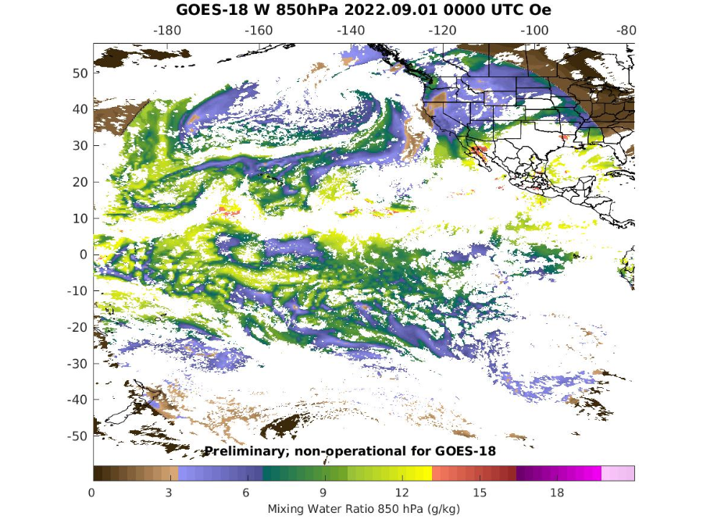
PLPT ABI-FD-TPW, LVT, LVM:
September 01 2022, 0000 UTC
TPW (mm)
Temp (K). 500 hPa
WV (g/kg) 850 hPa
TPW: Total Precipitable Water
LVT: Legacy Vertical Temperature profile
LVM: Legacy Vertical Moisture profile
14

Slide 15
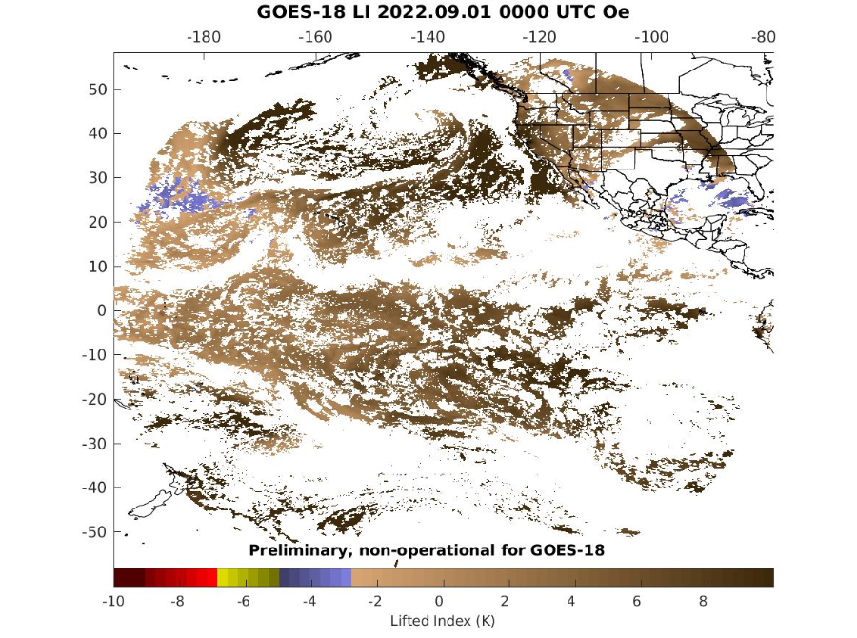
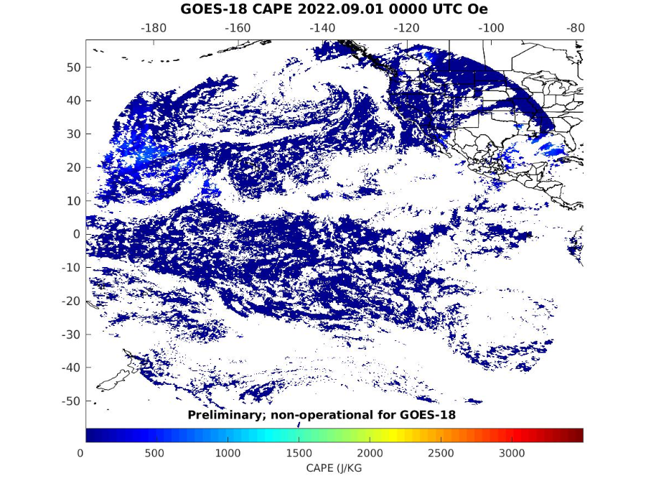
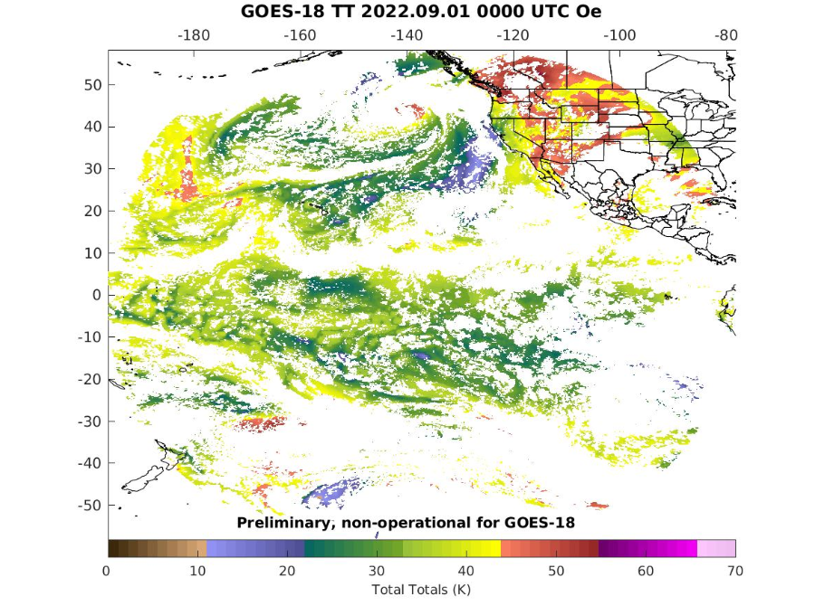
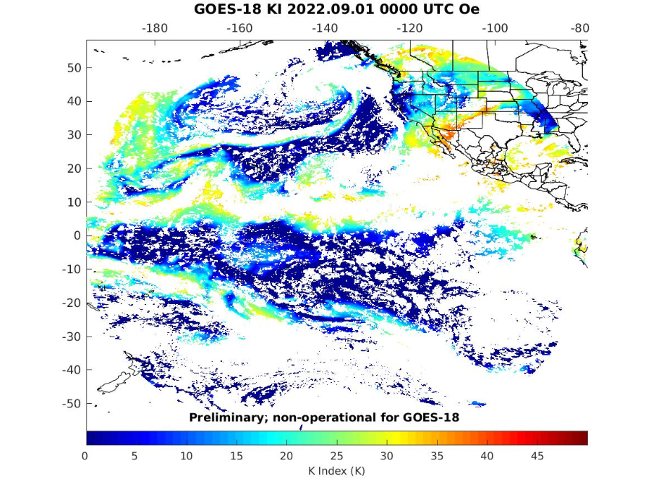
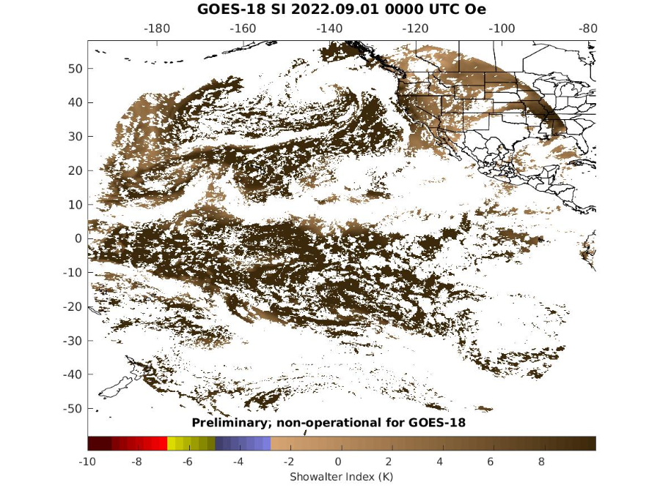
PLPT ABI-FD-DSI:
September 01 2022, 0000 UTC
LI
CAPE
TT
KI
SI
LI: Lifted Index
CAPE: Convective Available Potential Energy
TT: Total Totals
KI: K-Index
SI: Showalter Index
15

Slide 16
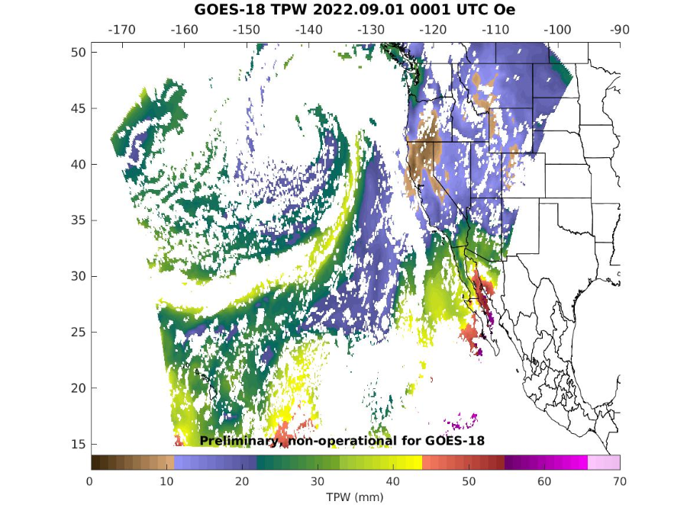
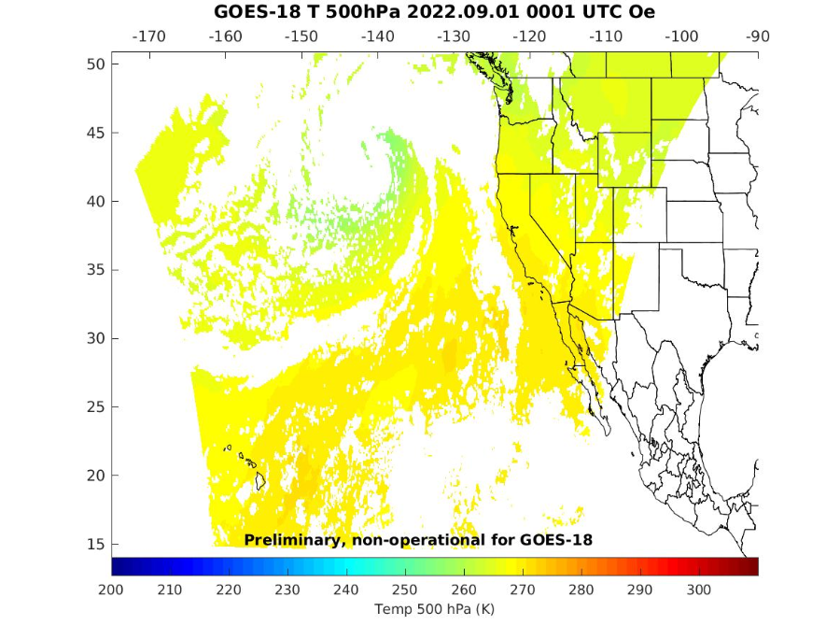
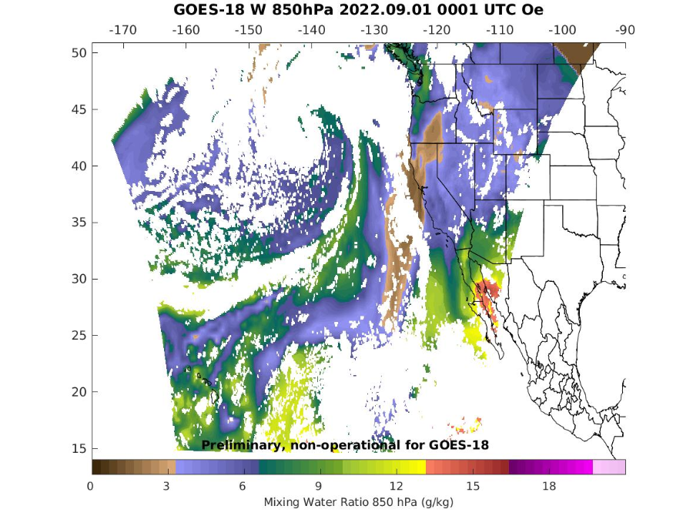
PLPT ABI-CONUS-TPW, LVT, LVM:
September 01 2022, 0000 UTC
TPW (mm)
Temp (K). 500 hPa
WV (g/kg) 850 hPa
TPW: Total Precipitable Water
LVT: Legacy Vertical Temperature profile
LVM: Legacy Vertical Moisture profile
16

Slide 17
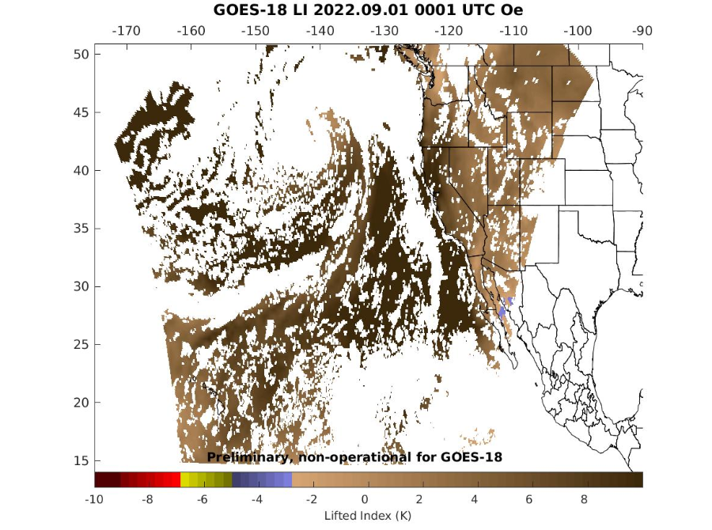
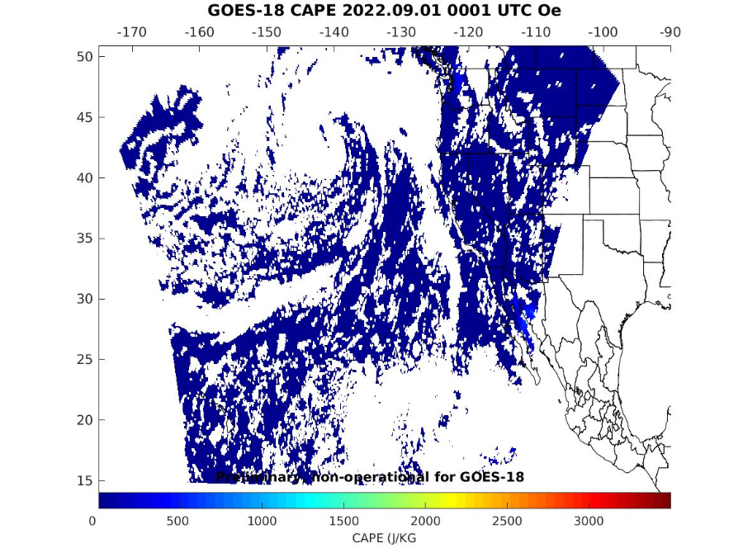
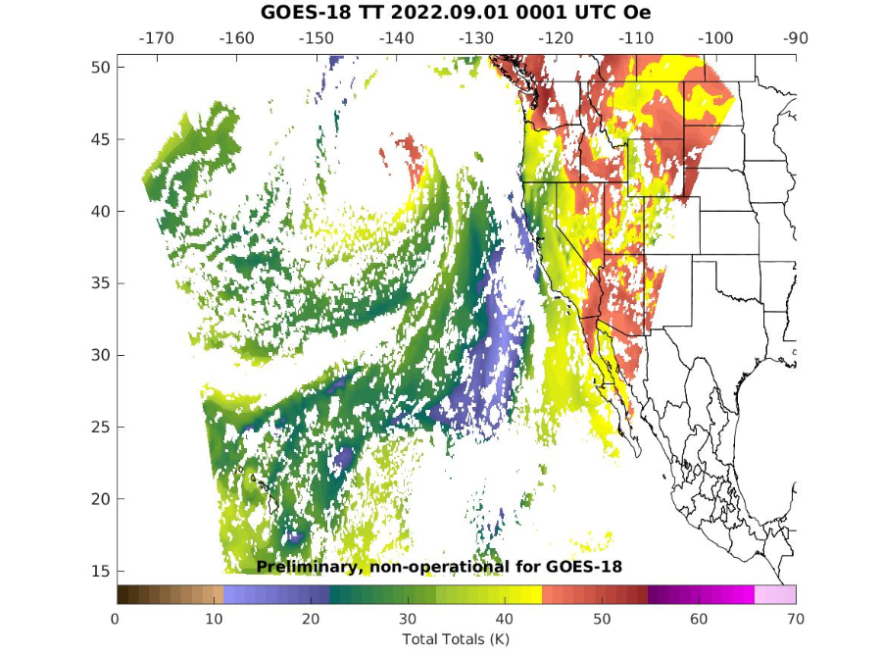
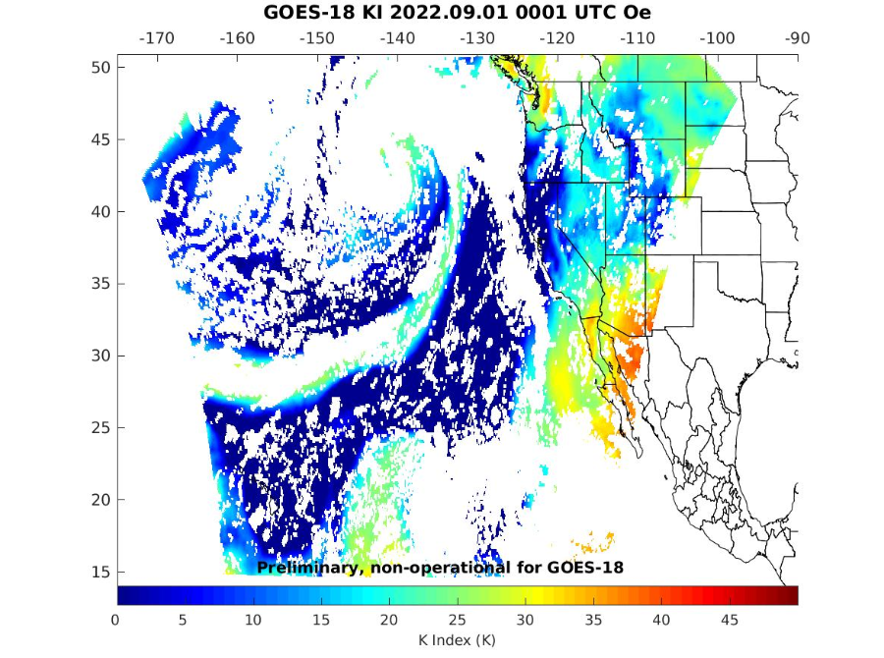
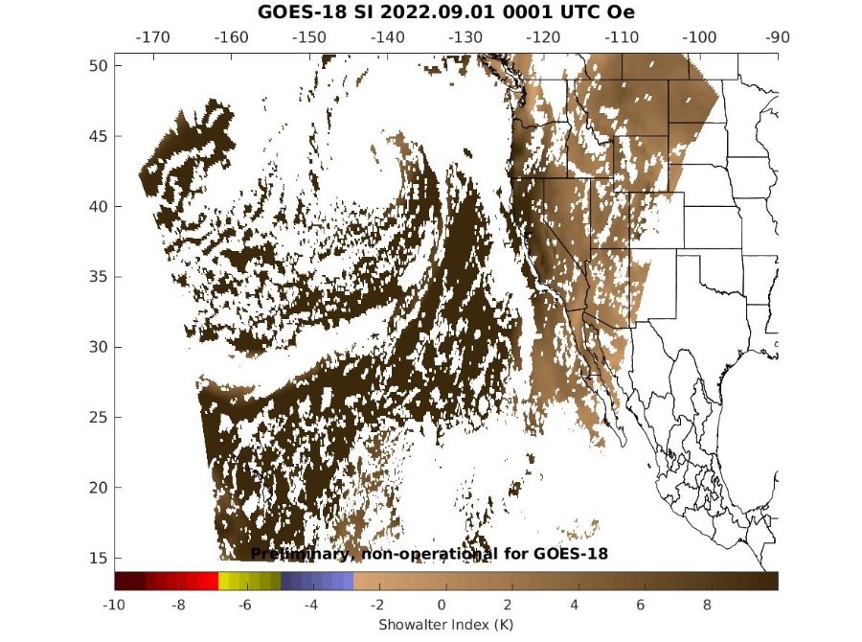
PLPT ABI-CONUS-DSI:
September 01 2022, 0000 UTC
LI
CAPE
TT
KI
SI
LI: Lifted Index
CAPE: Convective Available Potential Energy
TT: Total Totals
KI: K-Index
SI: Showalter Index
17

Slide 18
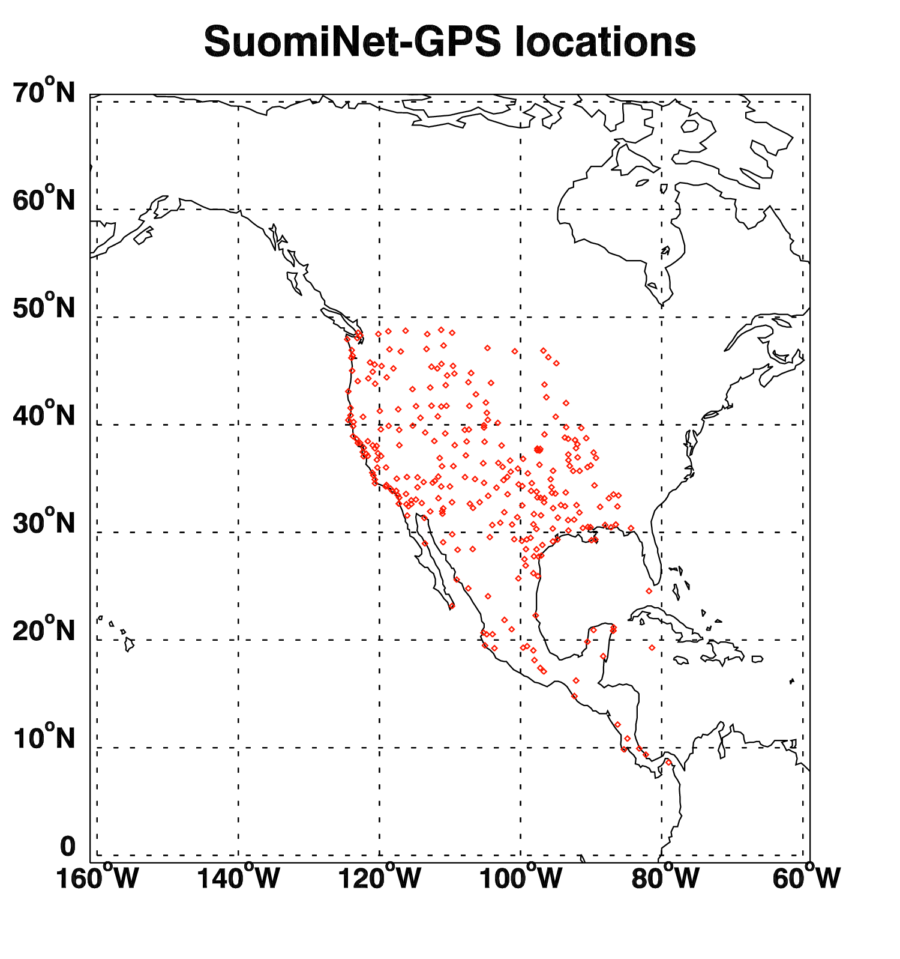
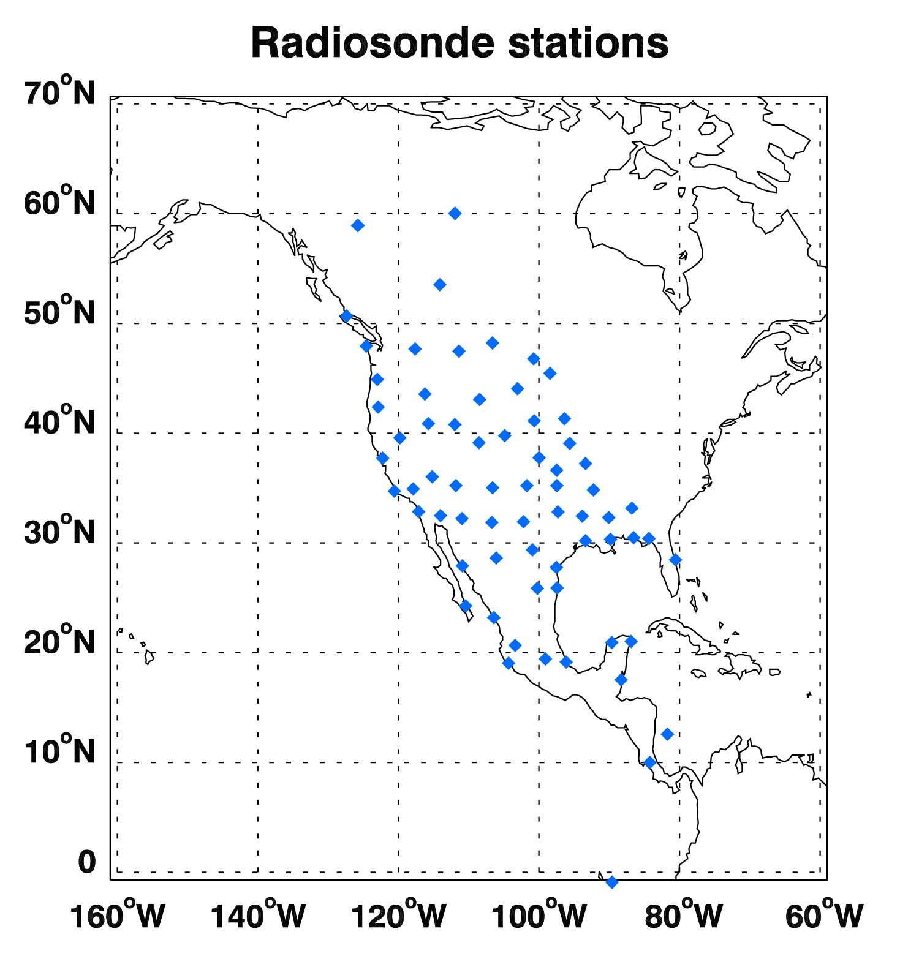
Locations of Suomi-Net GPS and RAOB
Suomi-Net GPS
RAOB
18
Notes:
On the left figure, all the red dots indicate SuomiNet-GPS locations and the blue dot in Dominican Republic (lat: 18.79, lon: -70.66) indicates the location
where most of the outliers in tpw figures are located.
On the right figure, all the red dots indicate RAOB locations and the blue dot near the Michigan Lake (lat: 43.75, lon: -87.71) indicates AERI observation.

Slide 19
Comparison TPW with the GPS, RAOB, AMSR2
19

Slide 20
Requirements for ABI LAP product: TPW
Product |  | Accuracy | Precision | Range
Temperature |  | 1 K below 400 hPa and above boundary layer | 2 K below 400 hPa and above boundary layer | 180 - 320 K
Moisture |  | Sfc - 300 hPa: 18% 300 - 100 hPa: 20% | Sfc - 300 hPa: 18% 300 - 100 hPa: 20% | 0 - 100%
TPW |  | 1 mm | 3 mm | 0 - 100 mm
DSI | LI | 2.0 K | 6.5 K | -10 ~ 40 K or above
 | CAPE | 1000 J/kg | 2500 J/kg | 0 - 5000 J/kg
 | SI | 2.0 K | 6.5 K | -10 ~ 4 K or above
 | TT | 1 K | 4 K | -43 ~ 56 K
 | KI | 2 K | 5 K | 0 - 40 K
20

Slide 21
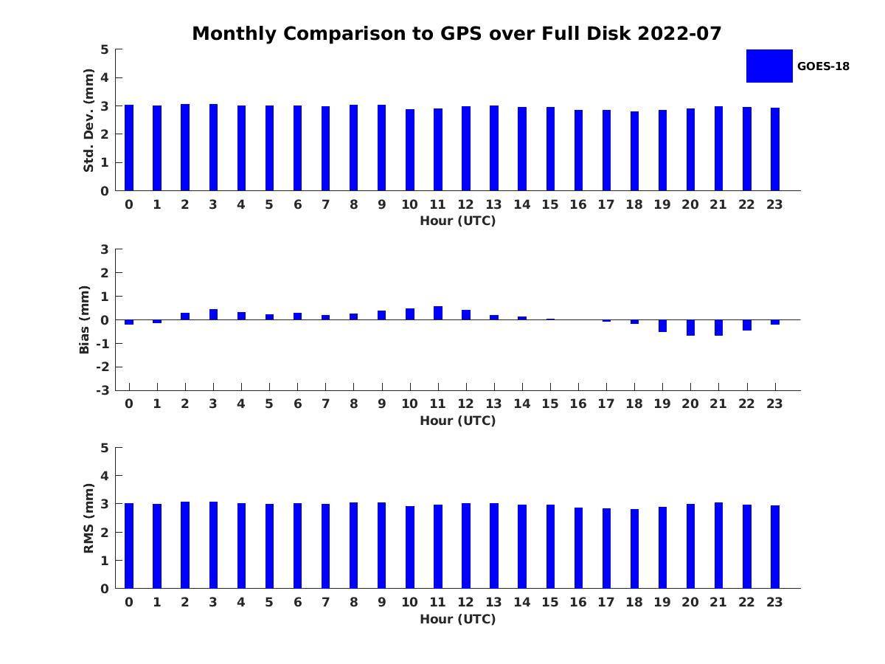
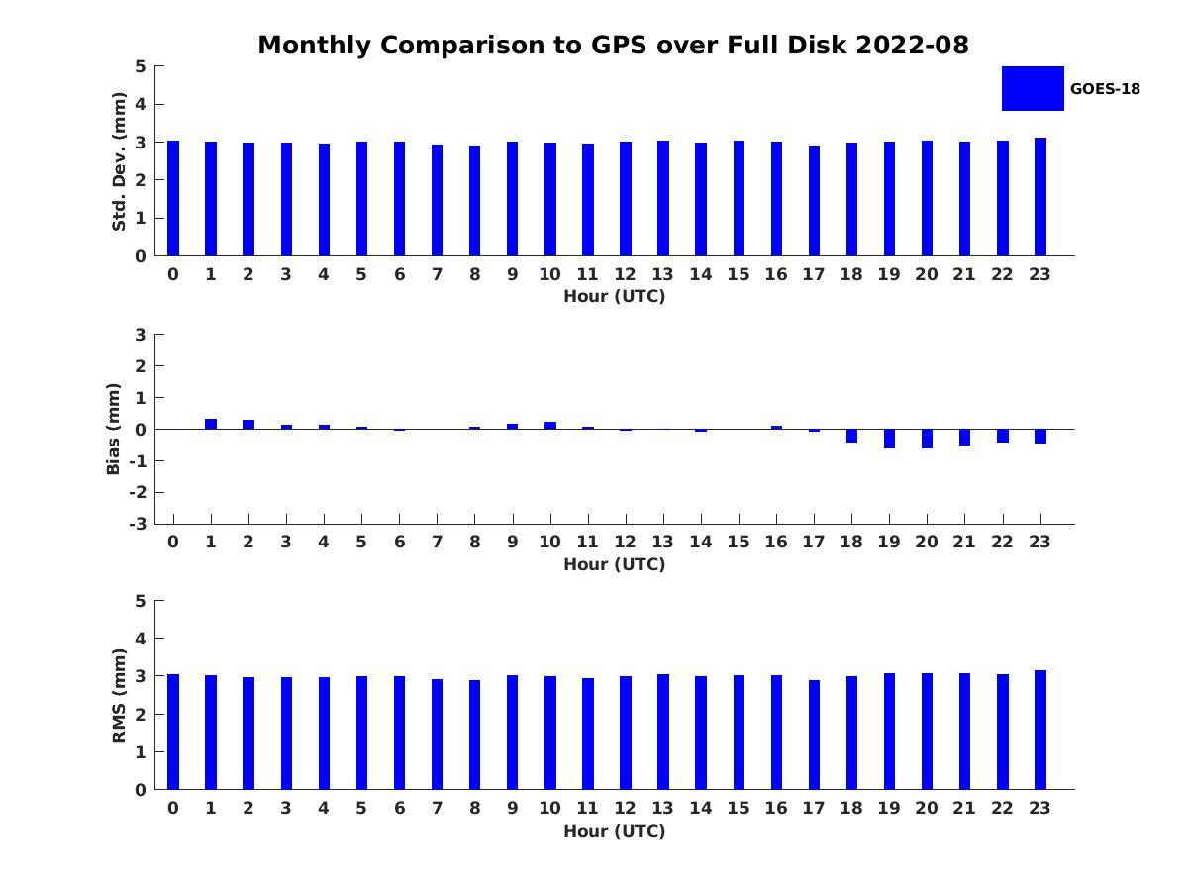
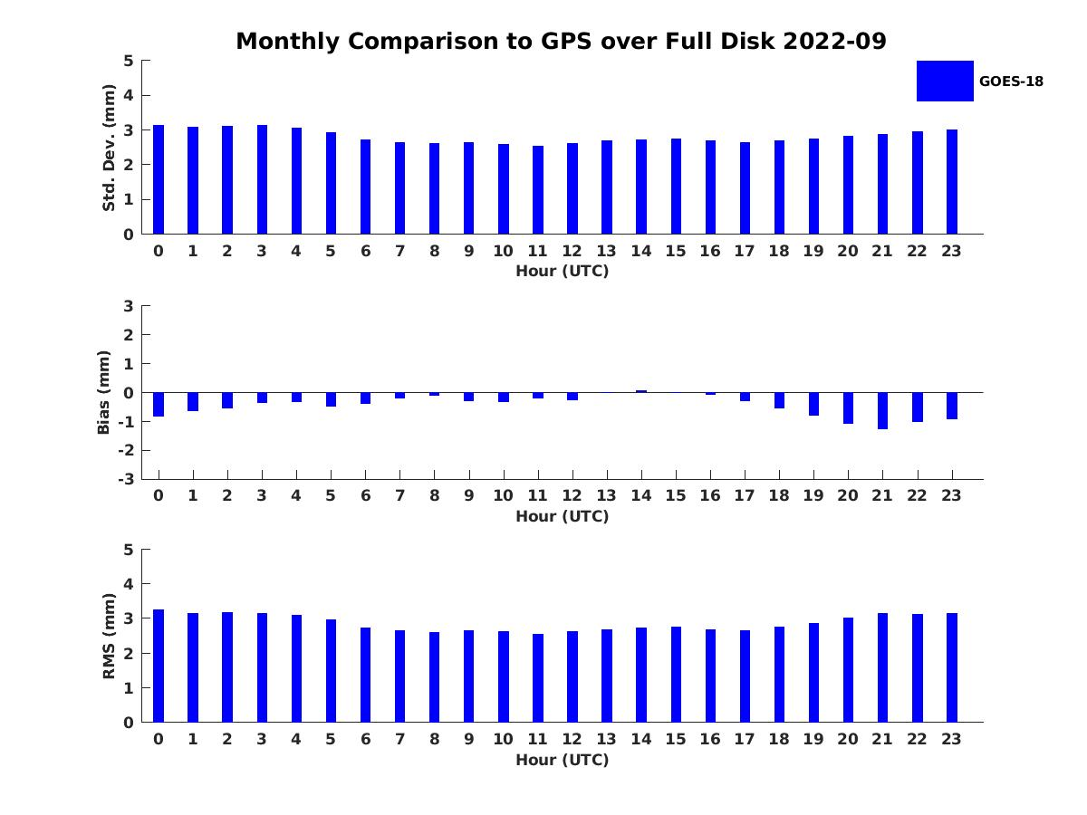
PLPT ABI-FD-TPW vs GPS:
2022.07-2022.09
Accuracy spec: 1 mm
Precision spec: 3 mm
STD
BIAS
RMSE
July August September
number: 454892
bias: 0.04 mm
std: 2.97 mm
rmse: 2.97
number: 484987
bias: -0.08 mm
std: 3.00 mm
rmse: 3.00
number: 290637
bias: -0.45 mm
std: 2.83 mm
rmse: 2.87
PASSED
21

Slide 22
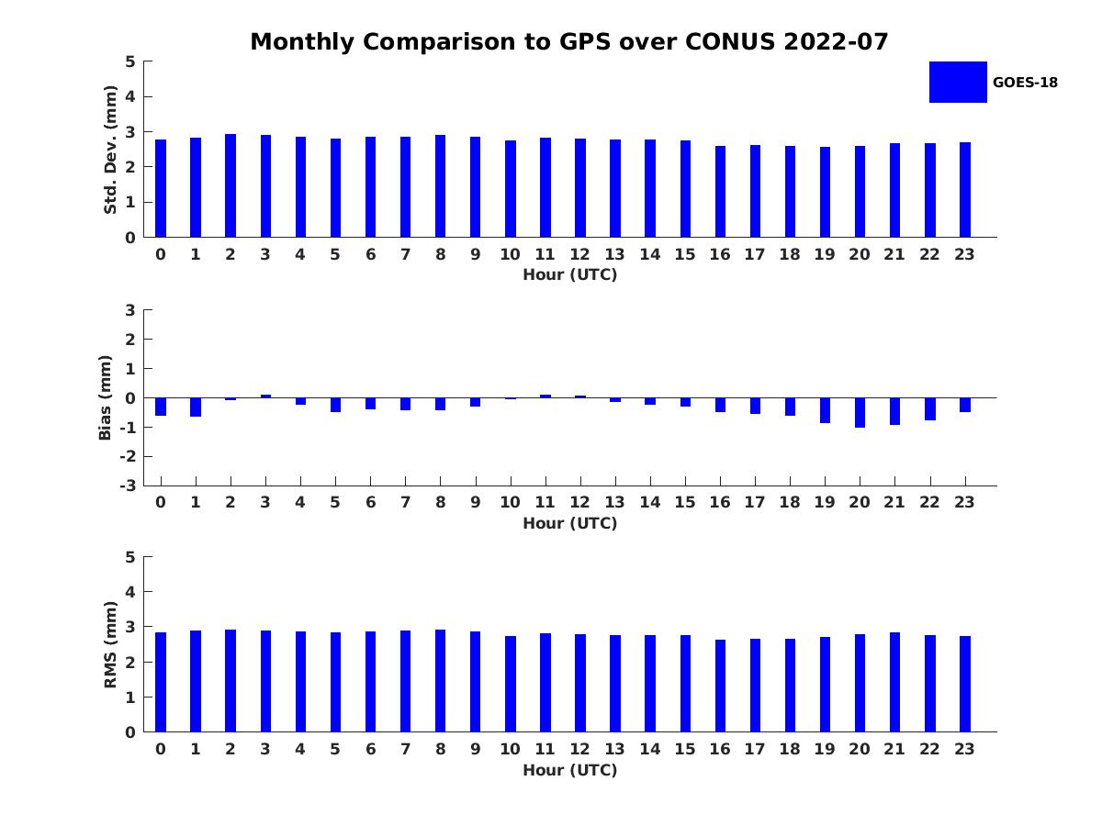
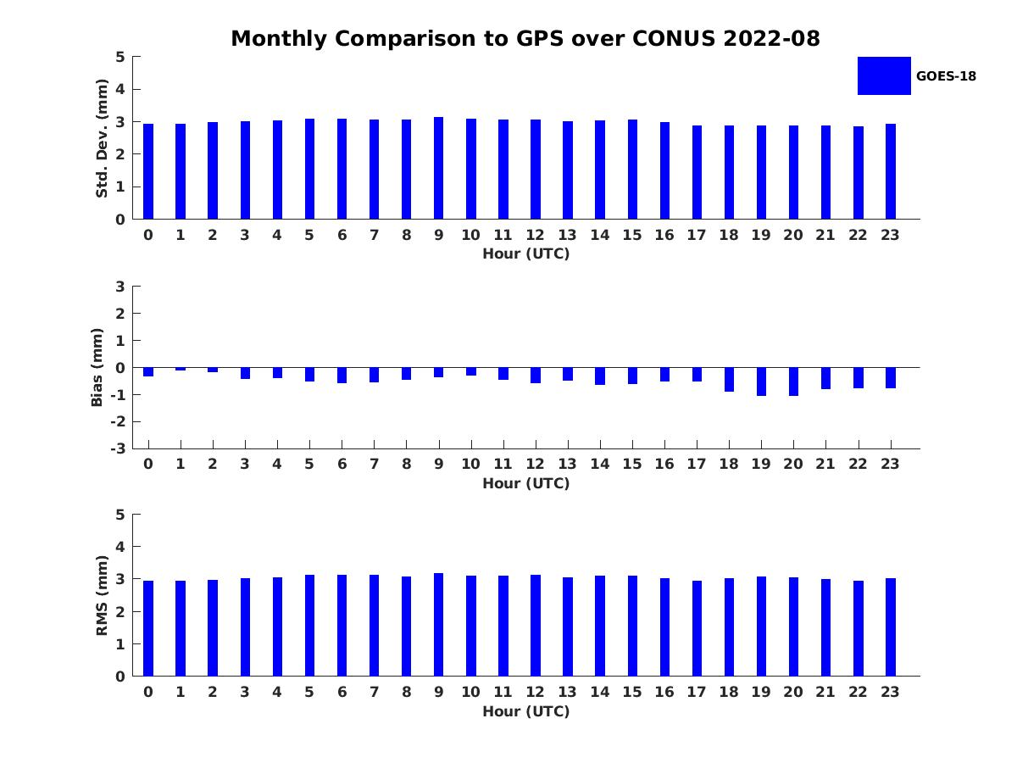
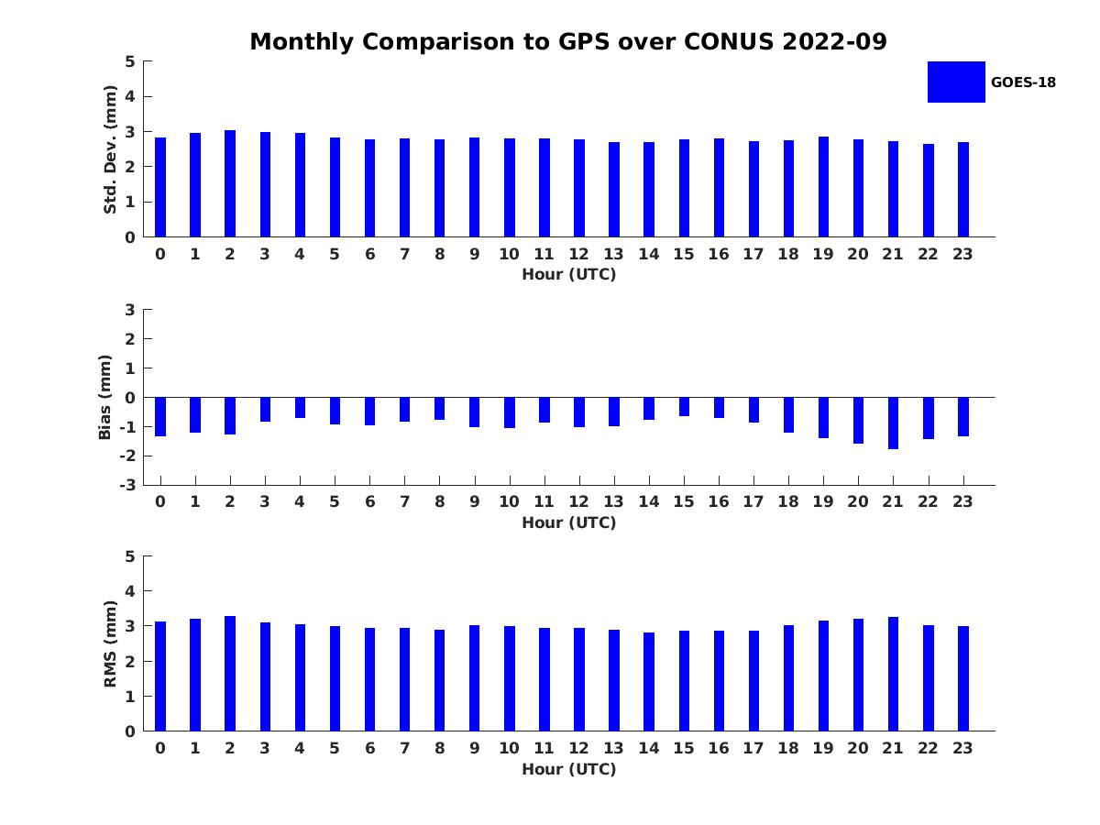
PLPT ABI-CONUS-TPW vs GPS:
2022.07-2022.09
Accuracy spec: 1 mm
Precision spec: 3 mm
STD
BIAS
RMSE
July August September
number: 243681
bias: -0.41 mm
std: 2.77 mm
rmse: 2.80
number: 269676
bias: -0.58 mm
std: 2.99 mm
rmse: 3.05
number: 102347
bias: -1.06 mm
std: 2.82 mm
rmse: 3.01
PASSED
22

Slide 23
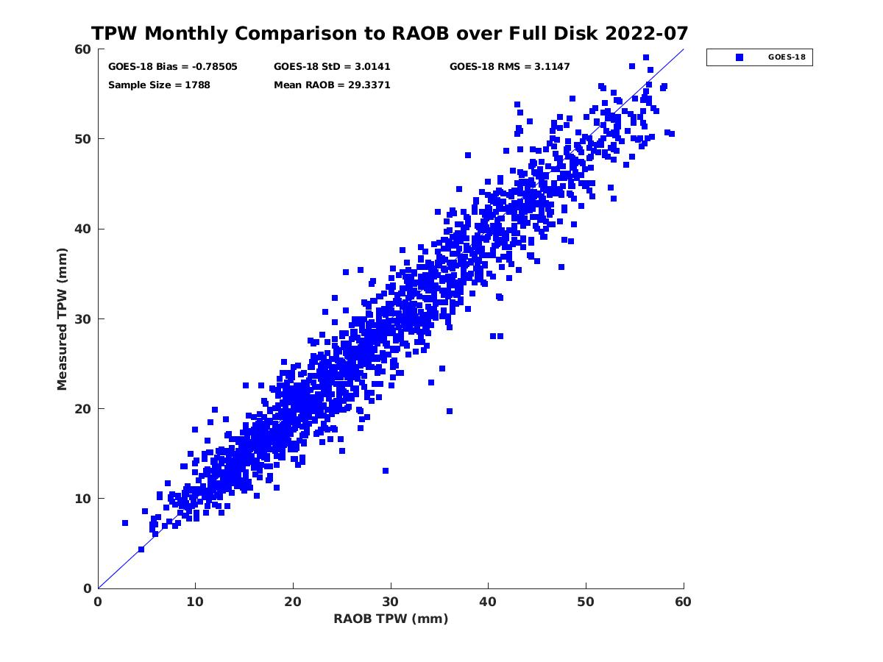
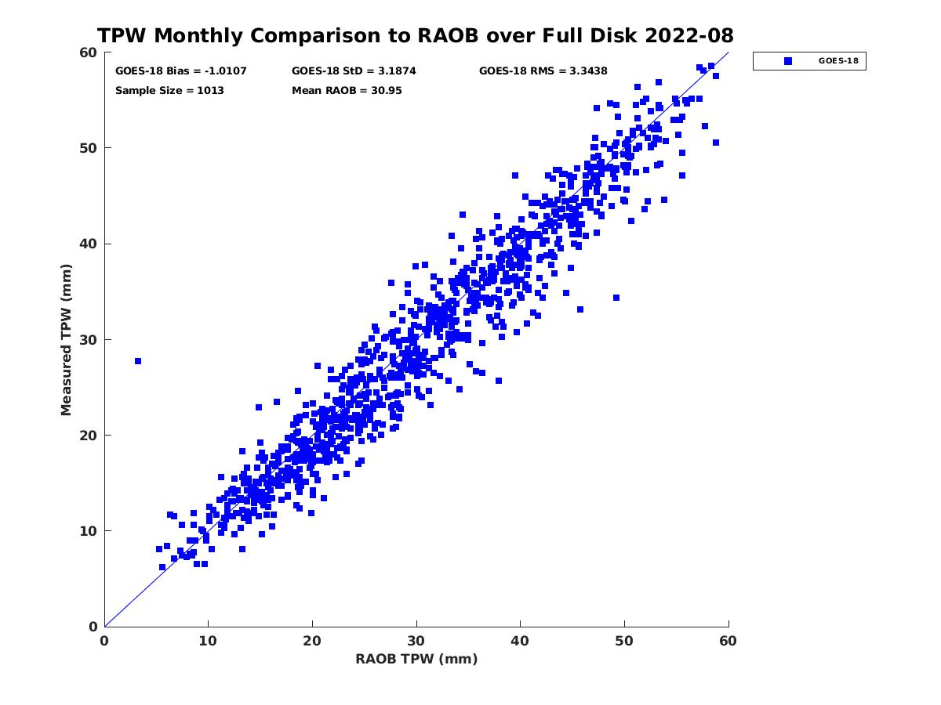
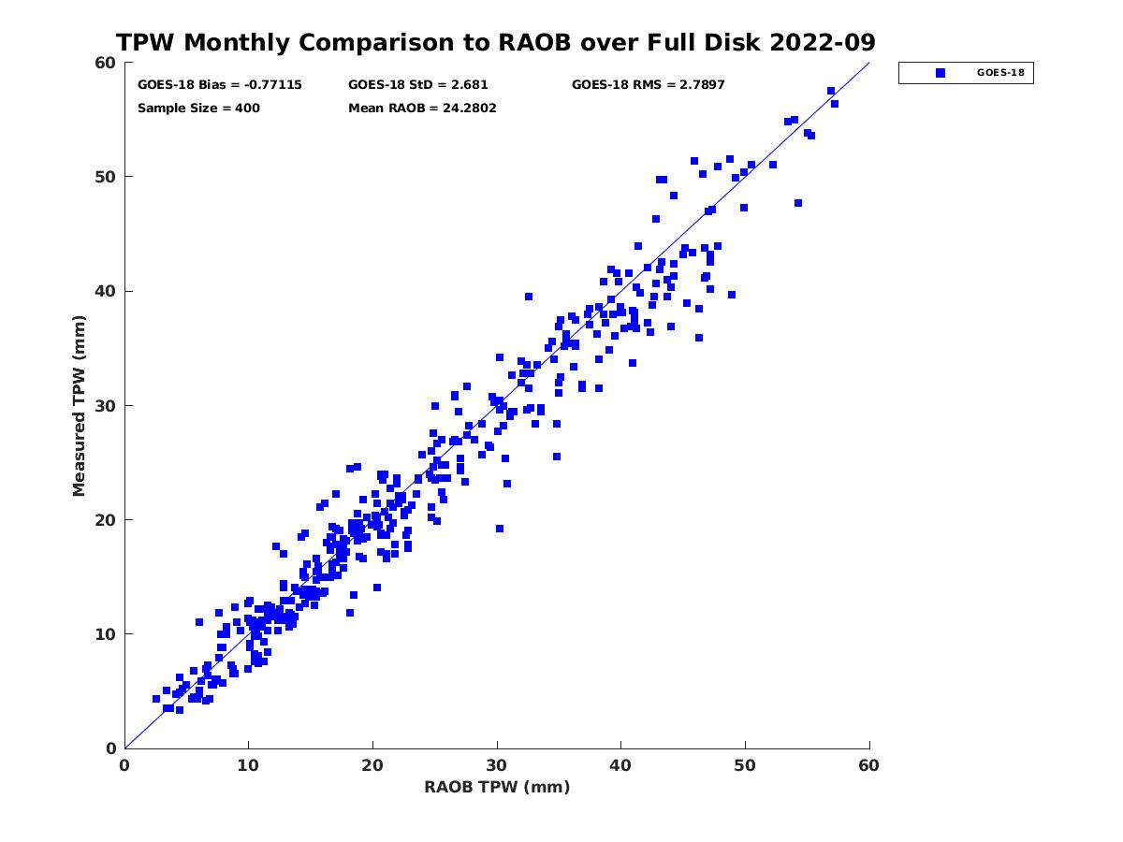
PLPT ABI-FD-TPW vs RAOB:
2022.07-2022.09
Accuracy spec: 1 mm
Precision spec: 3 mm
July August September
number: 1788
bias: -0.79 mm
std: 3.01 mm
number: 1013
bias: -1.01 mm
std: 3.19 mm
number: 400
bias: -0.77 mm
std: 2.68 mm
23

Slide 24
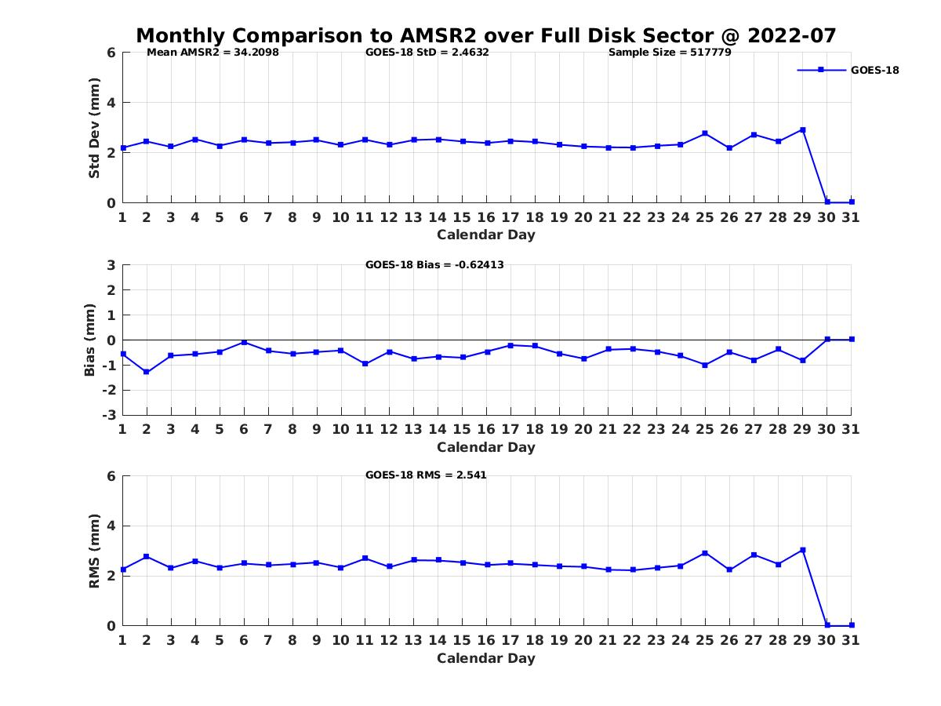
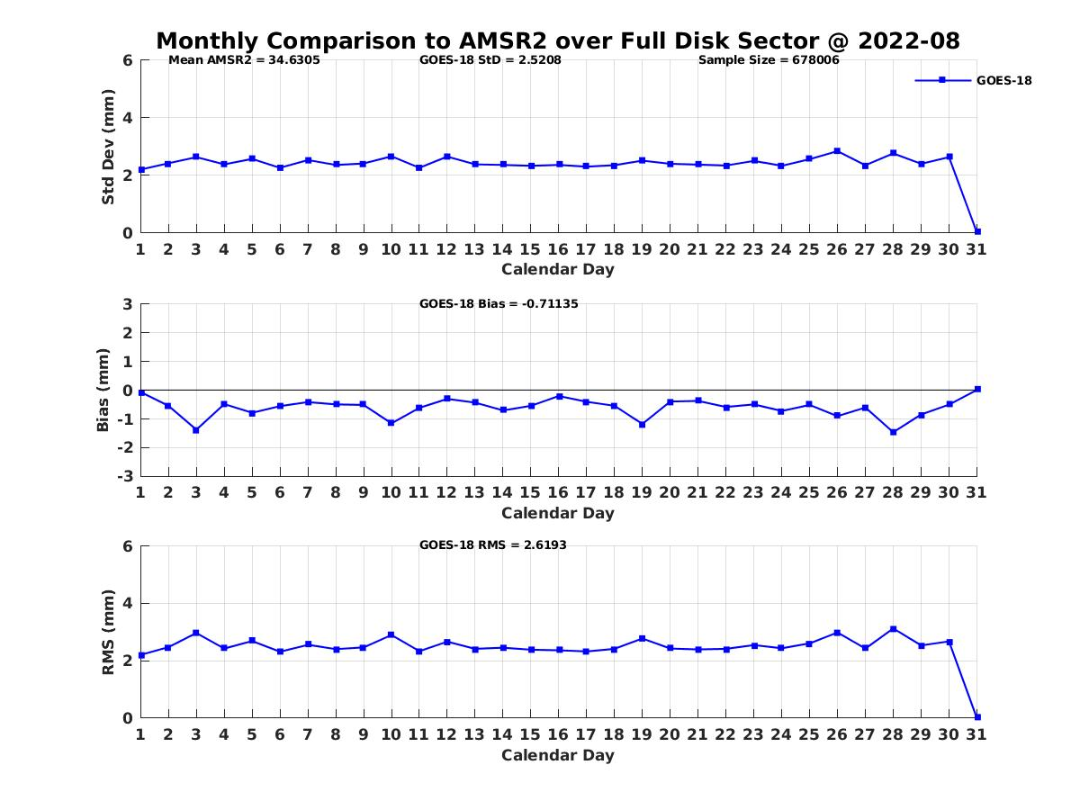
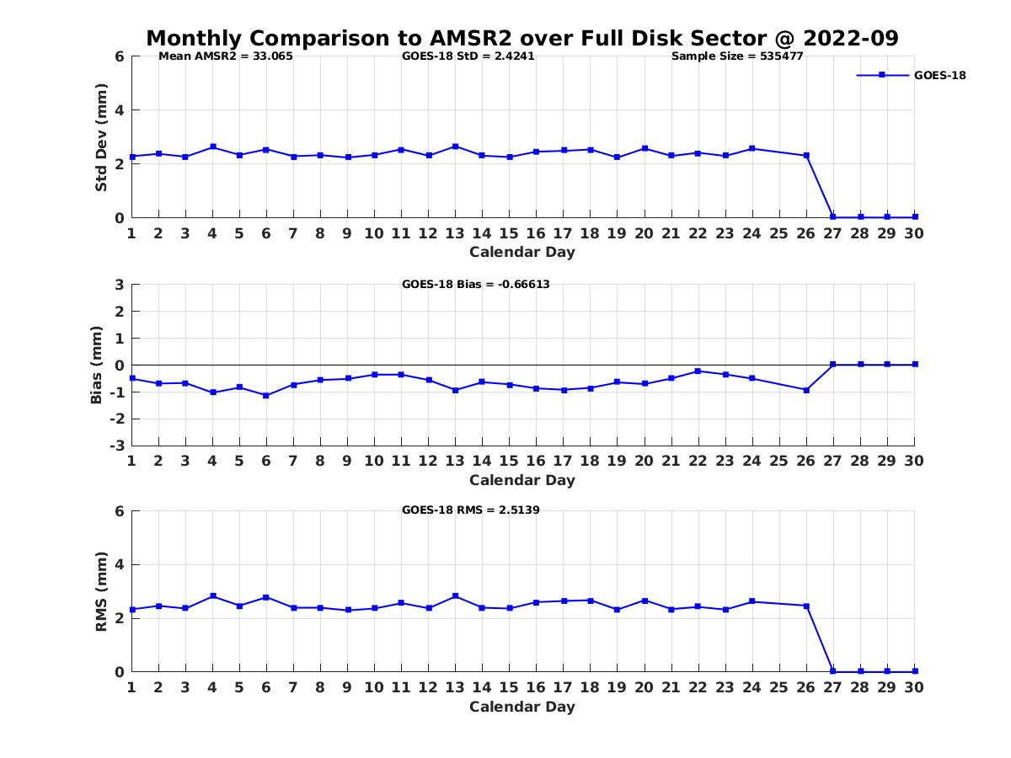
PLPT ABI-FD-TPW vs AMSR2:
2022.07-2022.09
Accuracy spec: 1 mm
Precision spec: 3 mm
STD
BIAS
RMSE
July August September
number: 517779
bias: -0.62mm
std: 2.46 mm
number: 678006
bias: -0.71 mm
std: 2.52 mm
number: 535477
bias: -0.67 mm
std: 2.427 mm
PASSED
24

Slide 25
TPW Performance Summary
TPW retrieval is working as expected on GOES-18 ABI data when combined with NWP short-rang forecasts (as first guess);
With a quantitative web-based tool (http://soundingval.ssec.wisc.edu) and the comparisons with RAOB, AMSR2, GPS, overall it does indicate performances meet spec. for all the coverages (FD, CONUS, Meso1, and Meso2), except in August the value compared with RAOB is a bit larger.

Slide 26
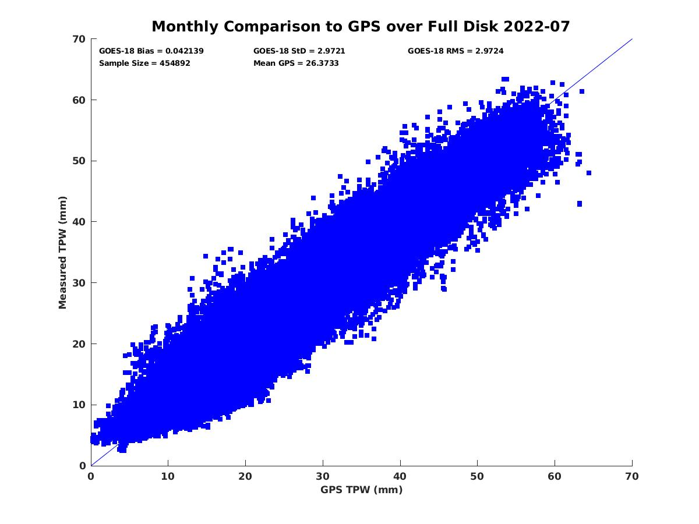
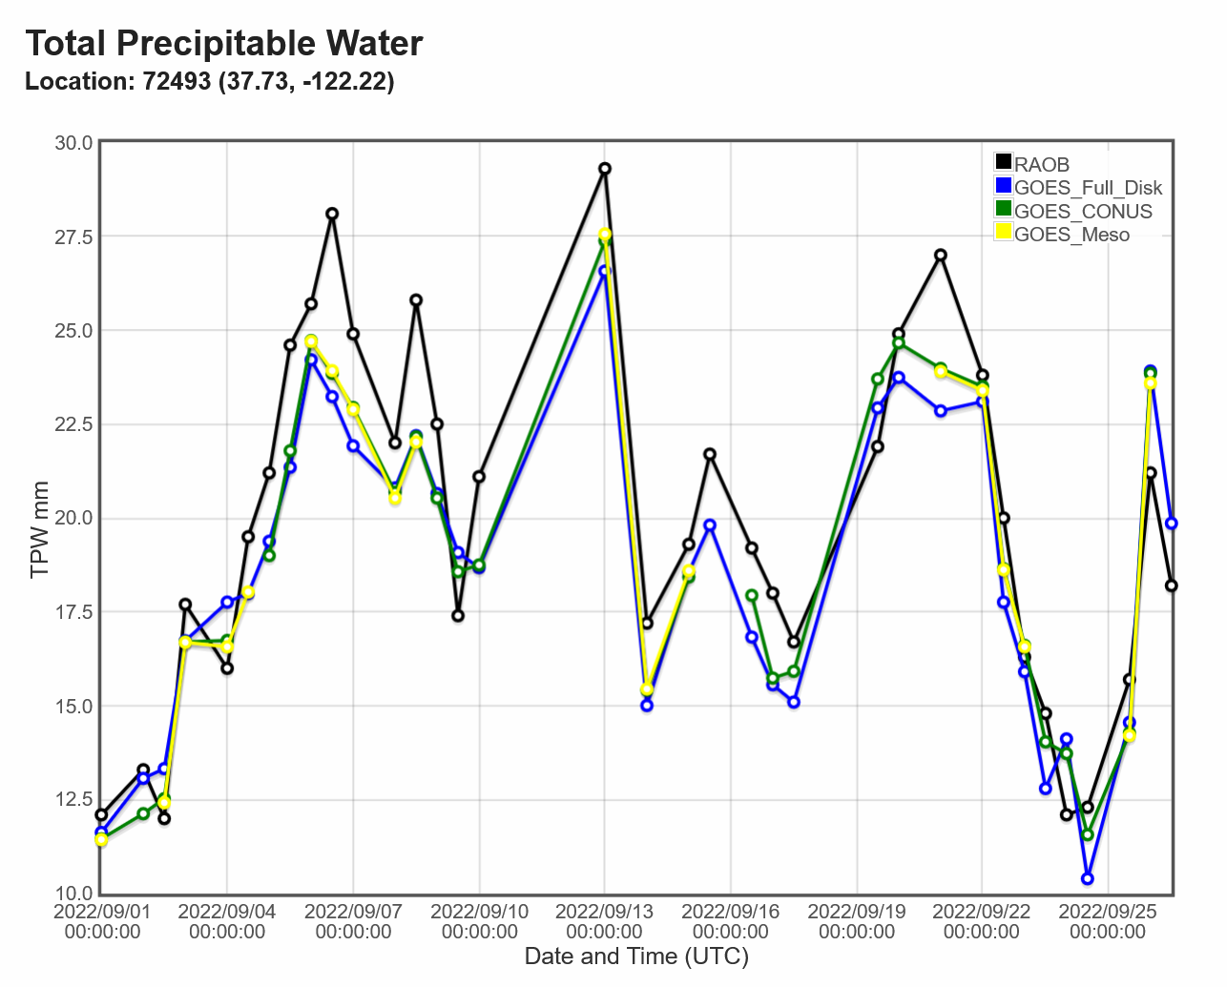
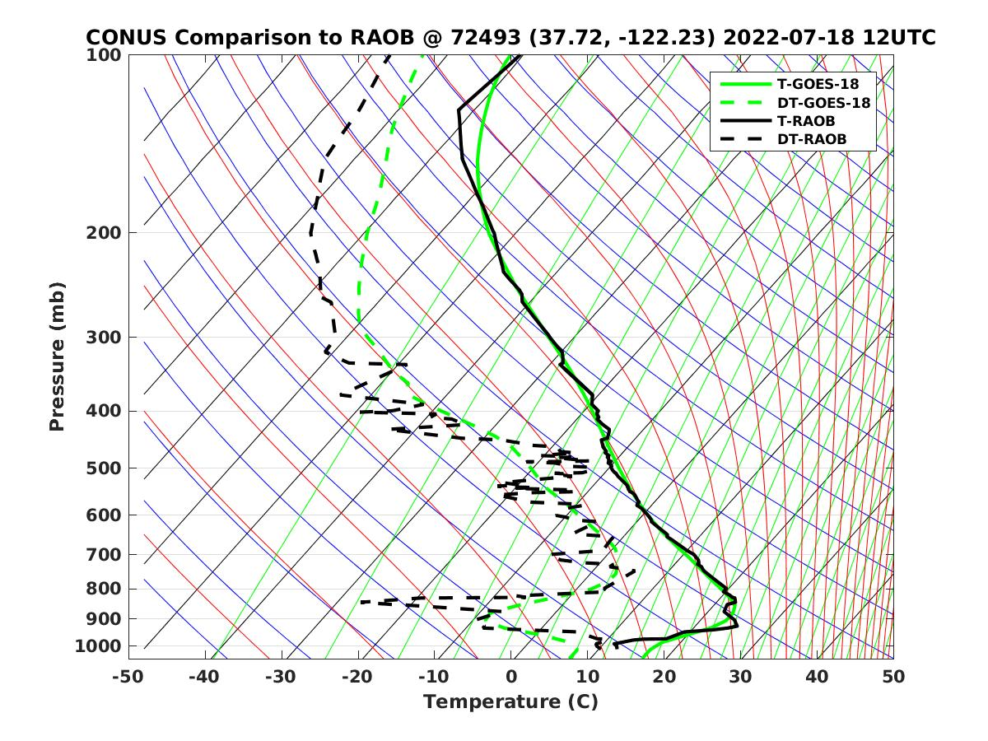
Real-time GOES-18 ABI LAP product validation webpage soundingval.ssec.wisc.edu
Imagery (Fulldisk TPW)
Regional Plots with GPS
Station TPW Plots

Slide 27
Comparison LVT & LVM with the RAOB
27

Slide 28
Requirements for ABI LAP products: LVT, LVM
Product |  | Accuracy | Precision | Range
Temperature (LVT) |  | 1 K below 400 hPa and above boundary layer | 2 K below 400 hPa and above boundary layer | 180 - 320 K
Moisture (LVM) |  | Sfc - 300 hPa: 18% 300 - 100 hPa: 20% | Sfc - 300 hPa: 18% 300 - 100 hPa: 20% | 0 - 100%
TPW |  | 1 mm | 3 mm | 0 - 100 mm
DSI | LI | 2.0 K | 6.5 K | -10 ~ 40 K or above
 | CAPE | 1000 J/kg | 2500 J/kg | 0 - 5000 J/kg
 | SI | 2.0 K | 6.5 K | -10 ~ 4 K or above
 | TT | 1 K | 4 K | -43 ~ 56 K
 | KI | 2 K | 5 K | 0 - 40 K
28

Slide 29
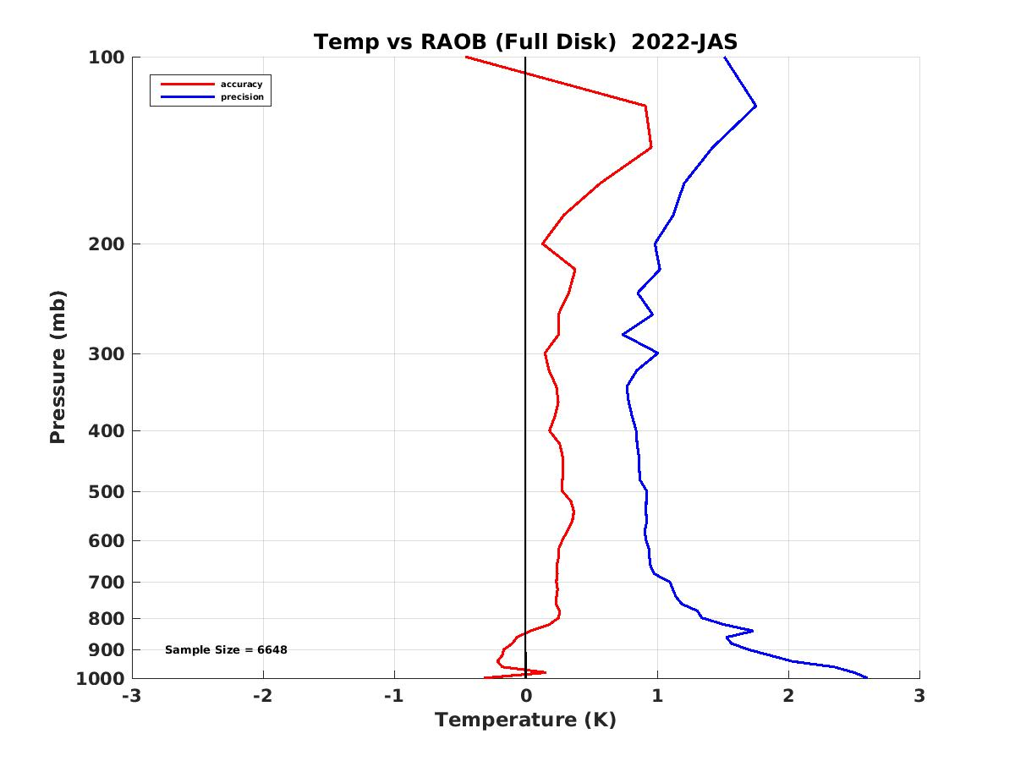
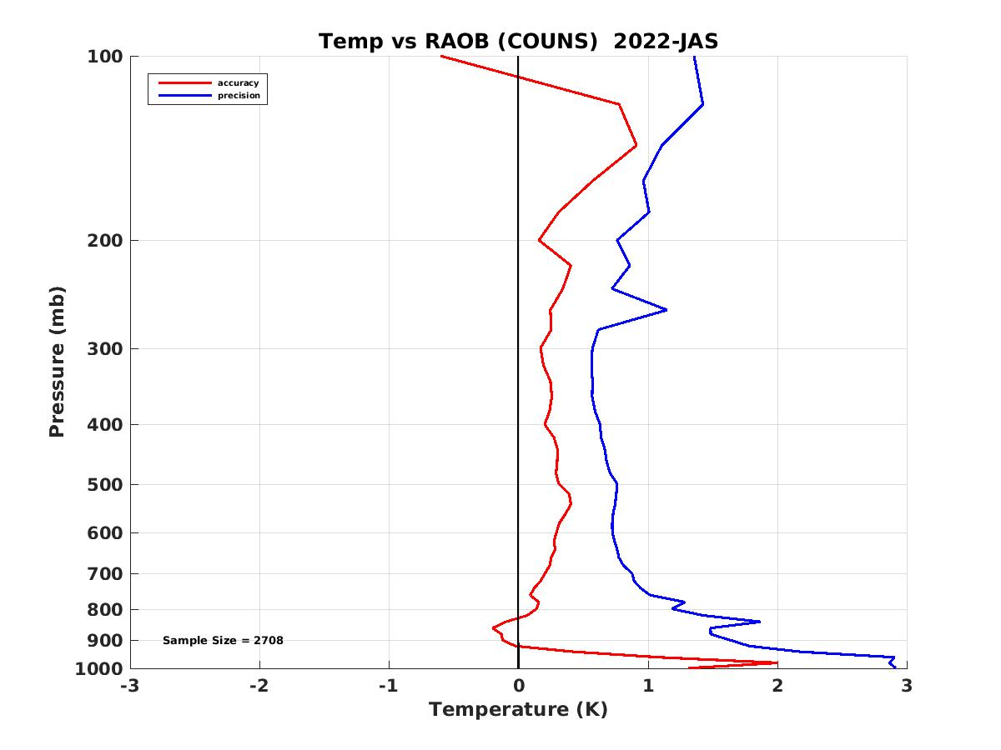
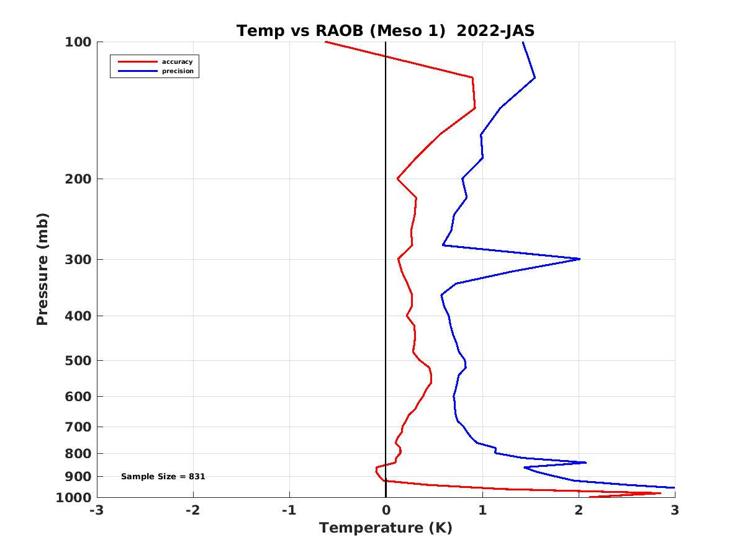
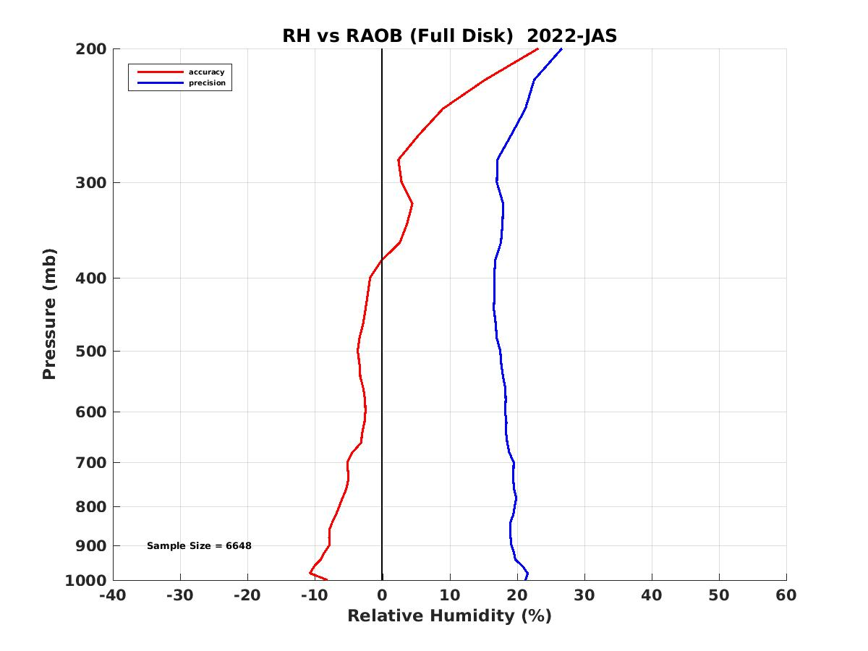
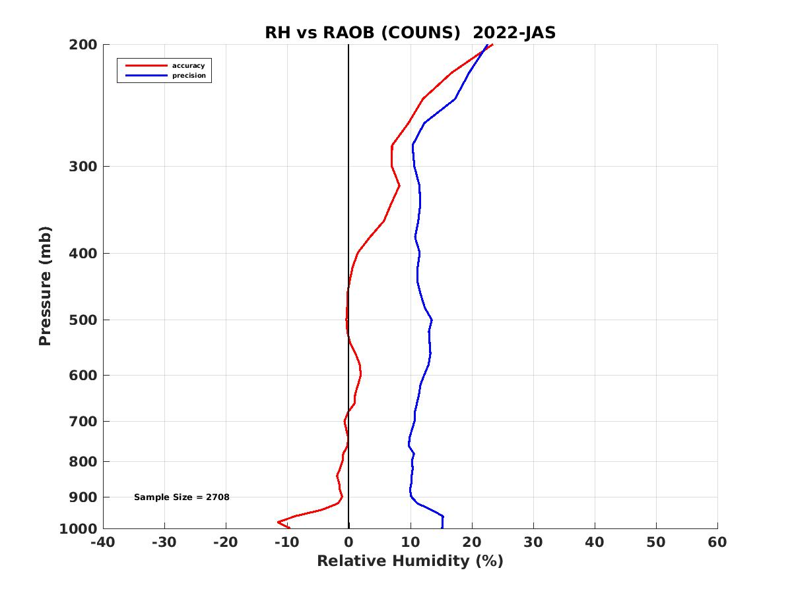
PLPT ABI-LVT, LVM (vs RAOB):
2022.07-2022.09
Full Disk
CONUS
Meso1
LVT (K)
Accuracy spec:
1 K (BL-400hPa)
Precision spec:
2 K (BL-400hPa)
LVM (%)
Accuracy & Precision spec:
18% (sfc-300hPa), 20% (300-100hPa)
29
Notes:
Full disk has large STD possibly due to lower RAOB quality from non-USA countries. MESO might not have enough samples for statistics.

Slide 30
LVT and LVM Performance Summary
LVT and LVM retrievals are working as expected on GOES-18 ABI data when combined with NWP short-range forecasts (as first guess);
Retrievals are sensitive to first guess;
With a highly quantitative web-based tool (http://soundingval.ssec.wisc.edu) and the comparisons with RAOB, the performances overall meet spec. for all the coverages (FD, CONUS, Meso1, Meso2), except for the near surface temperature, and also for the Relative Humidity at upper troposphere (100 - 300 hPa) when compared with RAOB, which is likely due to the known issue of dry bias of radiosonde observations.
30

Slide 31
Comparison DSI with the RAOB
31

Slide 32
Requirements for ABI LAP products: DSI
Product |  | Accuracy | Precision | Range
Temperature |  | 1 K below 400 hPa and above boundary layer | 2 K below 400 hPa and above boundary layer | 180 - 320 K
Moisture |  | Sfc - 300 hPa: 18% 300 - 100 hPa: 20% | Sfc - 300 hPa: 18% 300 - 100 hPa: 20% | 0 - 100%
TPW |  | 1 mm | 3 mm | 0 - 100 mm
DSI | LI | 2.0 K | 6.5 K | -10 ~ 40 K or above
 | CAPE | 1000 J/kg | 2500 J/kg | 0 - 5000 J/kg
 | SI | 2.0 K | 6.5 K | -10 ~ 4 K or above
 | TT | 1 K | 4 K | -43 ~ 56 K
 | KI | 2 K | 5 K | 0 - 40 K
32

Slide 33
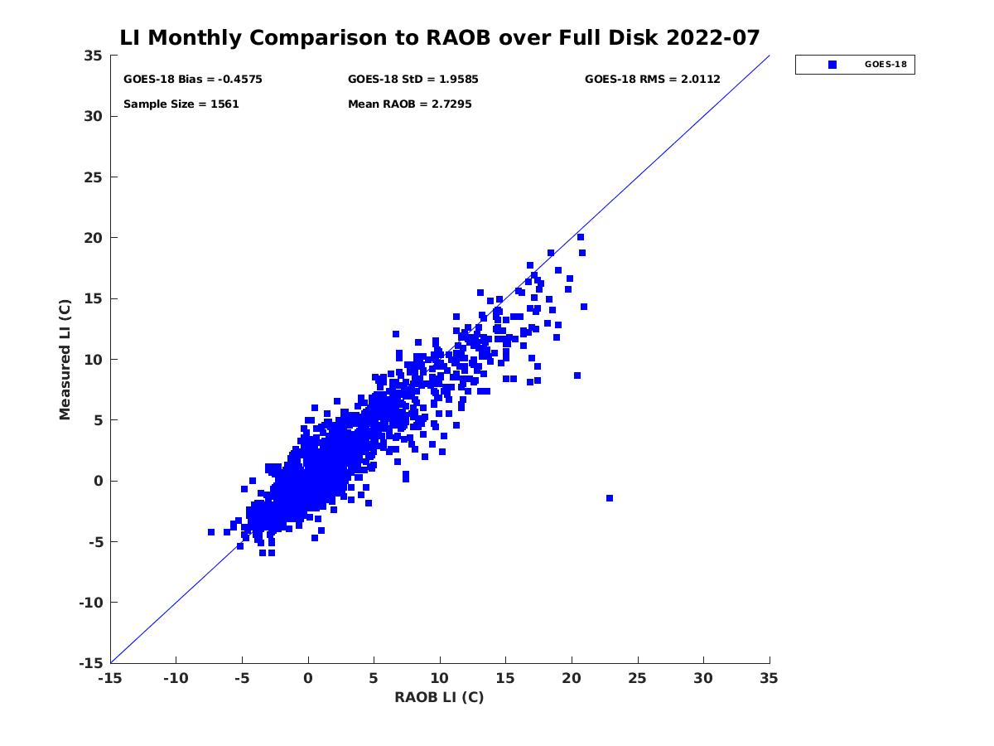
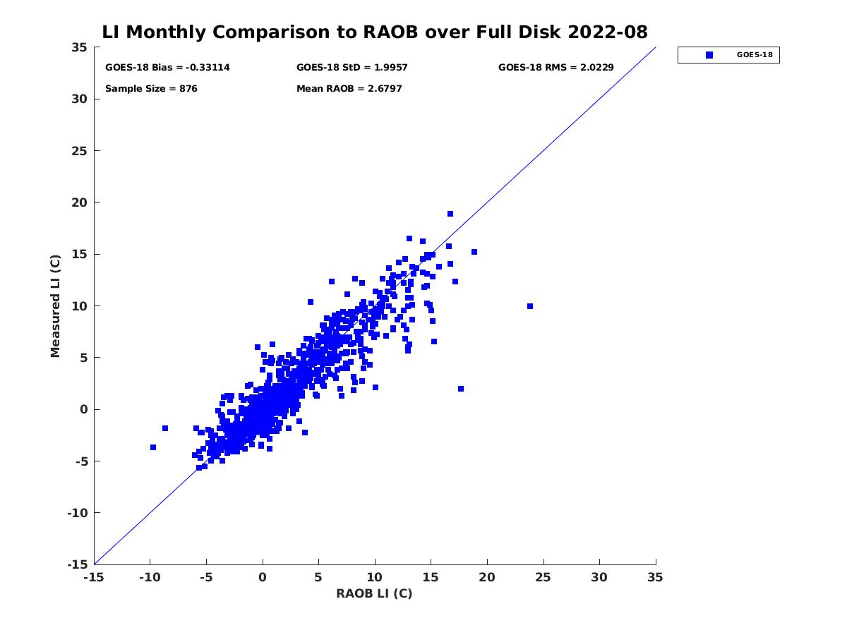
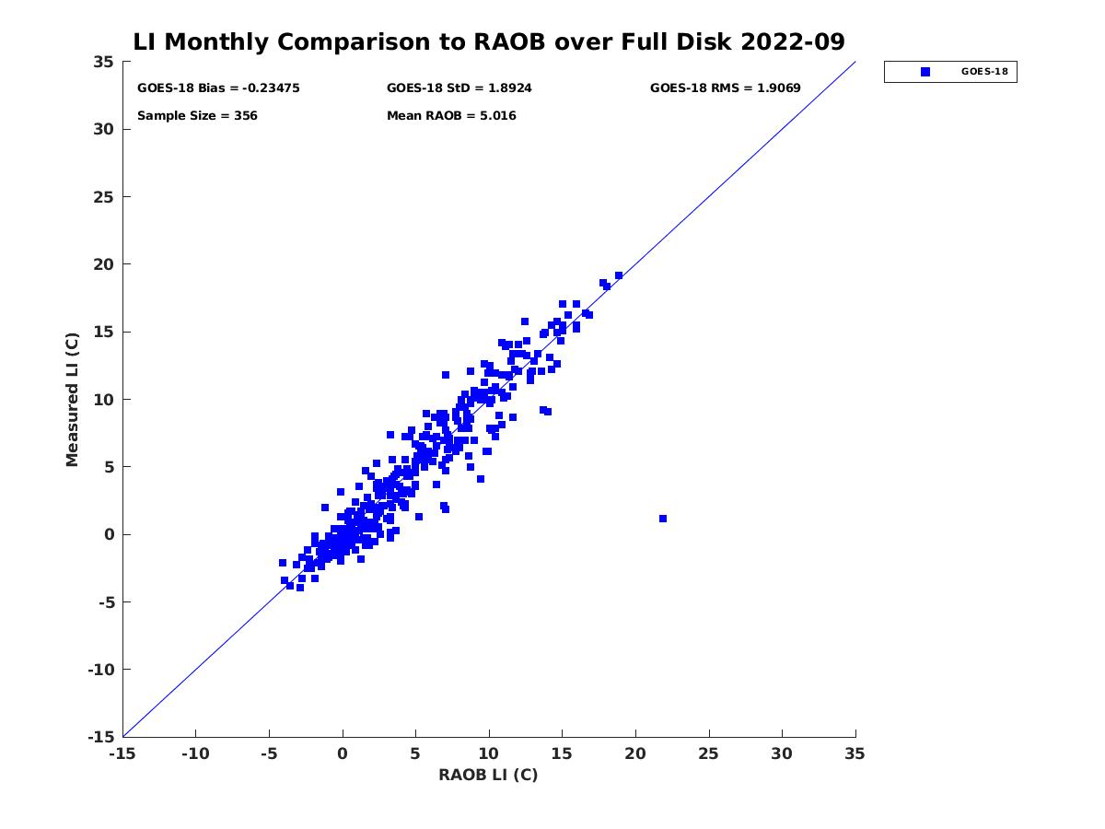
PLPT ABI-FD-DSI:
2022.07-2022.09
LI vs RAOB
Accuracy spec: 2 K
Precision spec: 6.5 K
July August September
number: 1561
bias: -0.46 K
std: 1.96 K
number: 876
bias: -0.33 K
std: 2.00 K
number: 356
bias: -0.23 K
std: 1.89 K
PASSED
33

Slide 34
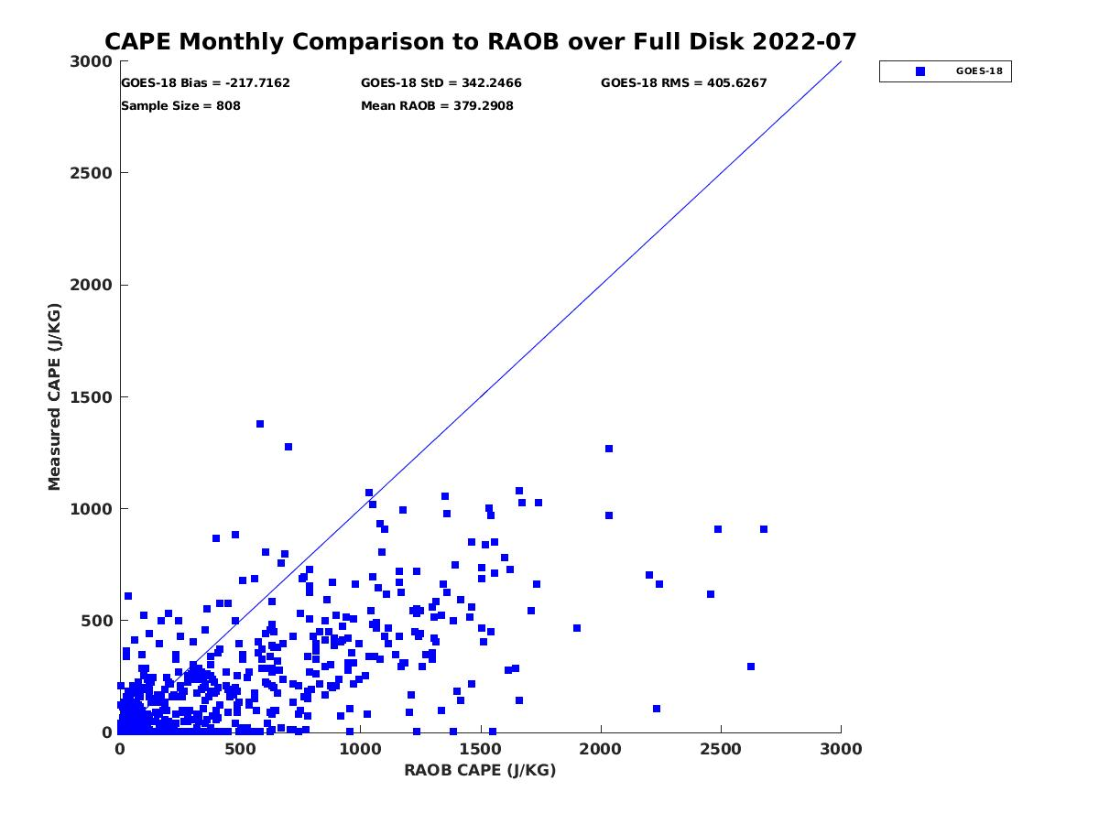
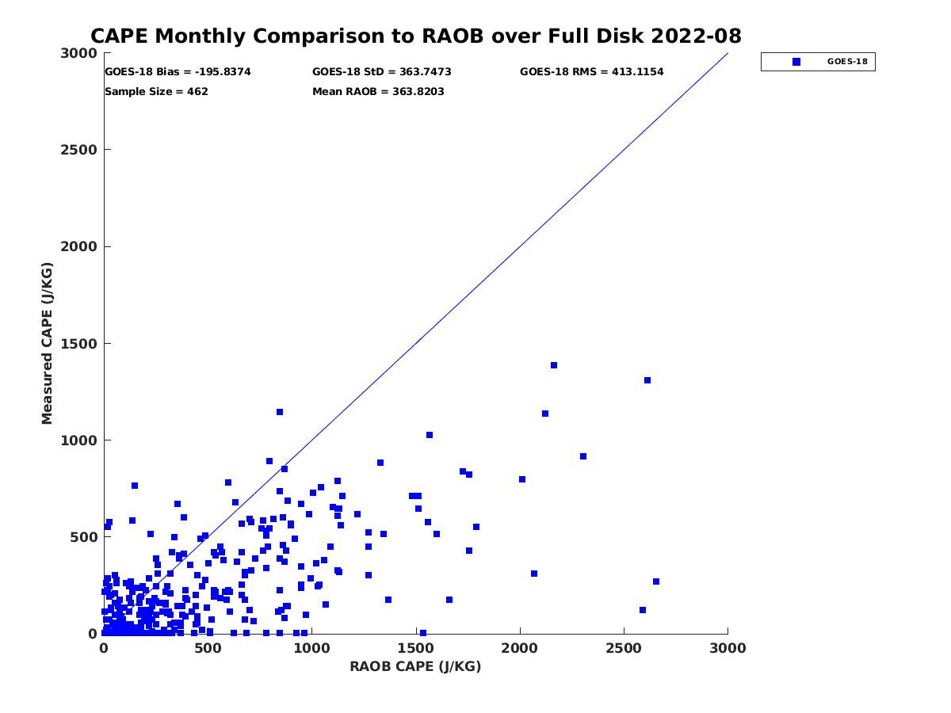
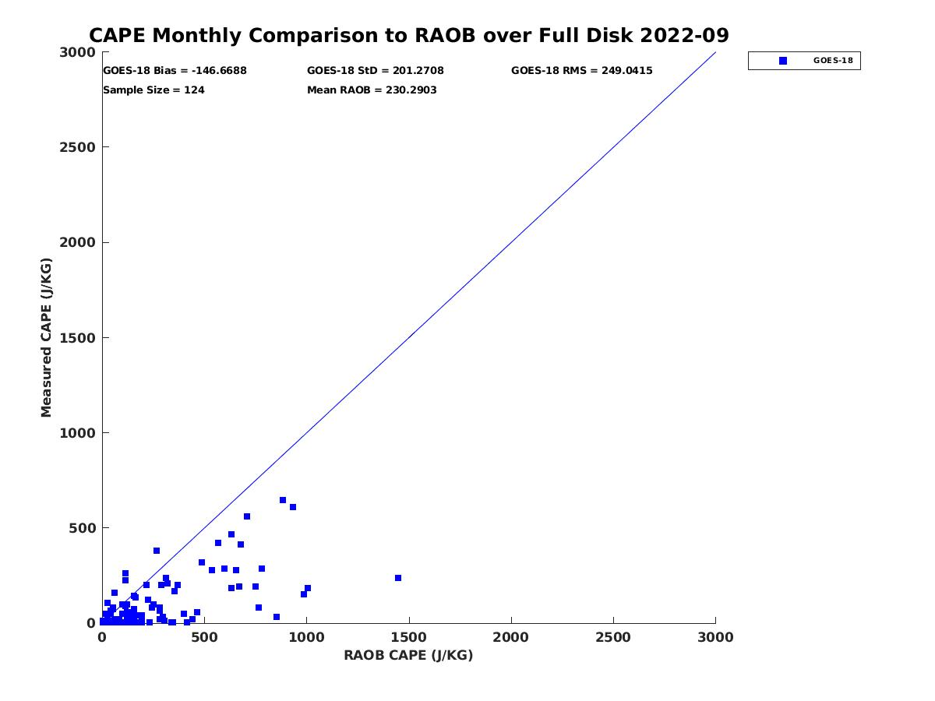
PLPT ABI-FD-DSI:
2022.07-2022.09
CAPE vs RAOB
Accuracy spec: 1000 J/kg
Precision spec: 2500 J/kg
July August September
number: 808
bias: -217.72 J/kg
std: 342.25 J/kg
number: 462
bias: -195.84 J/kg
std: 363.75 J/kg
number: 124
bias: -146.67 J/kg
std: 201.27 J/kg
PASSED
34

Slide 35
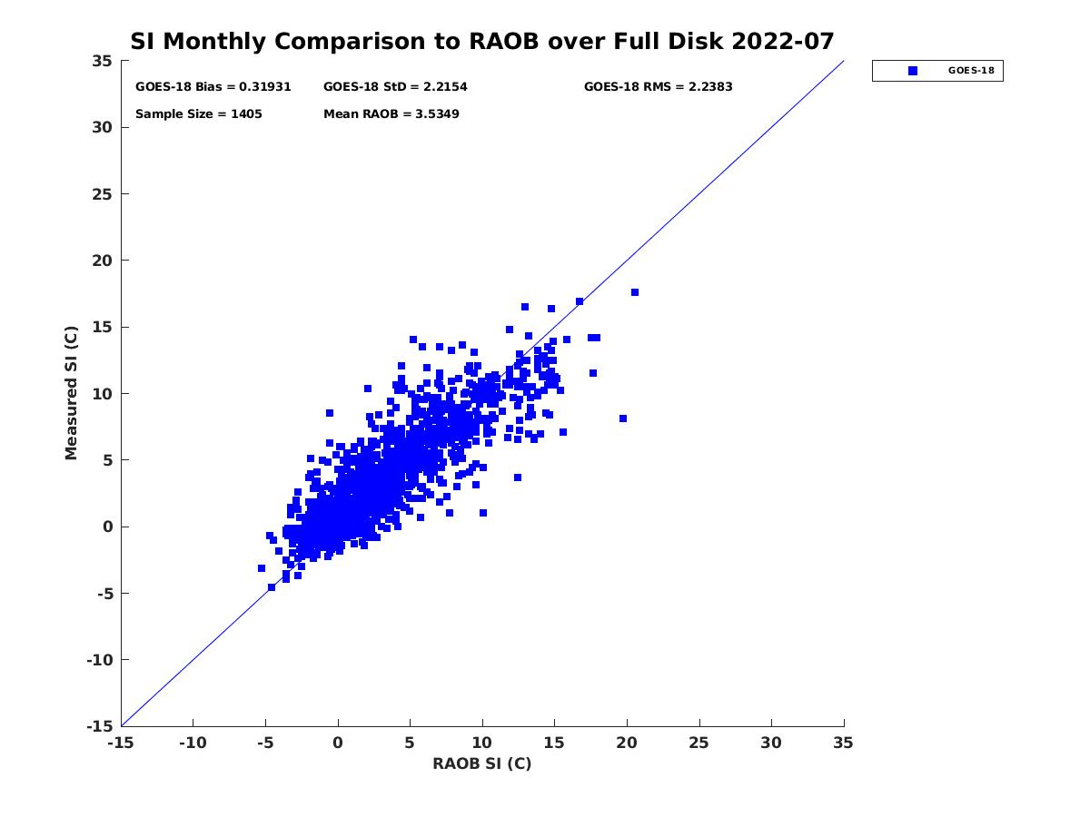
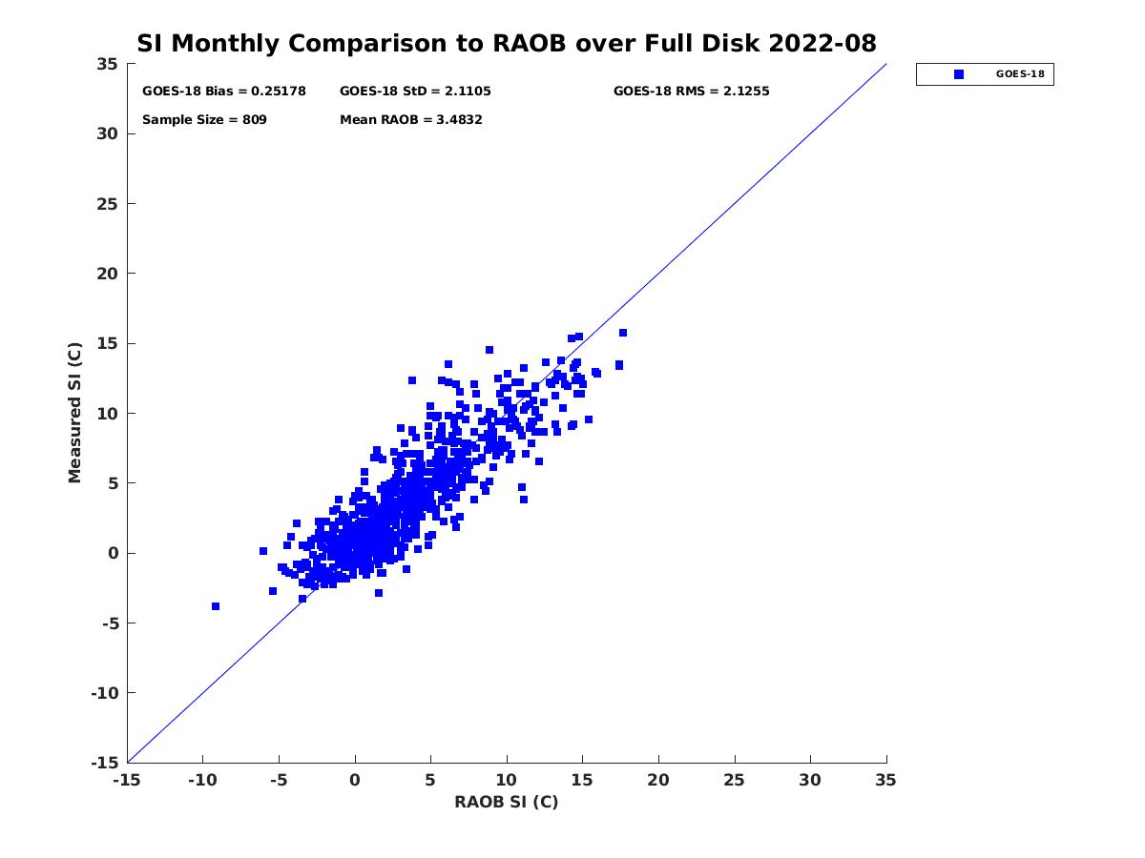
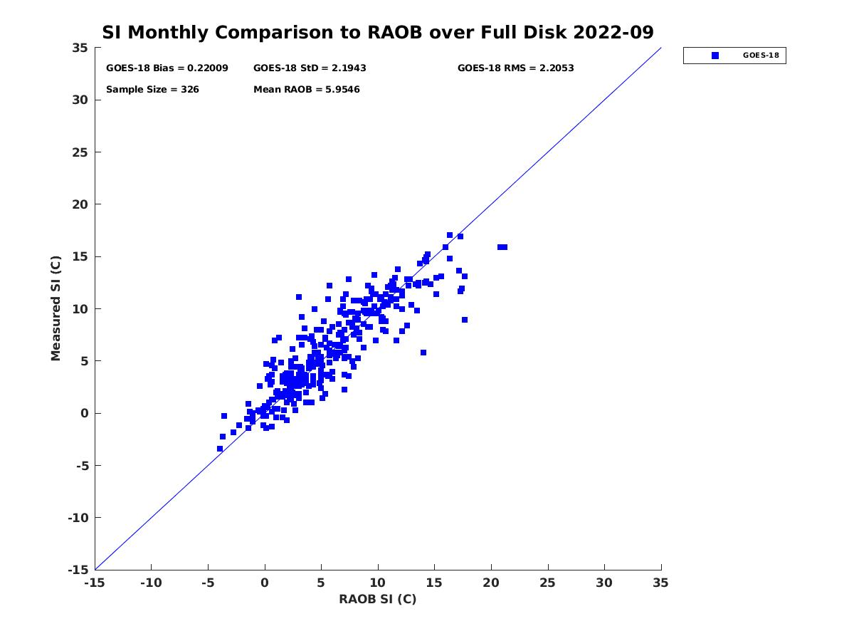
PLPT ABI-FD-DSI:
2022.07-2022.09
SI vs RAOB
Accuracy spec: 2 K
Precision spec: 6.5 K
July August September
number: 1405
bias: 0.32 K
std: 2.22 K
number: 809
bias: 0.25 K
std: 2.11 K
number: 326
bias: 0.22 K
std: 2.19 K
PASSED
35

Slide 36
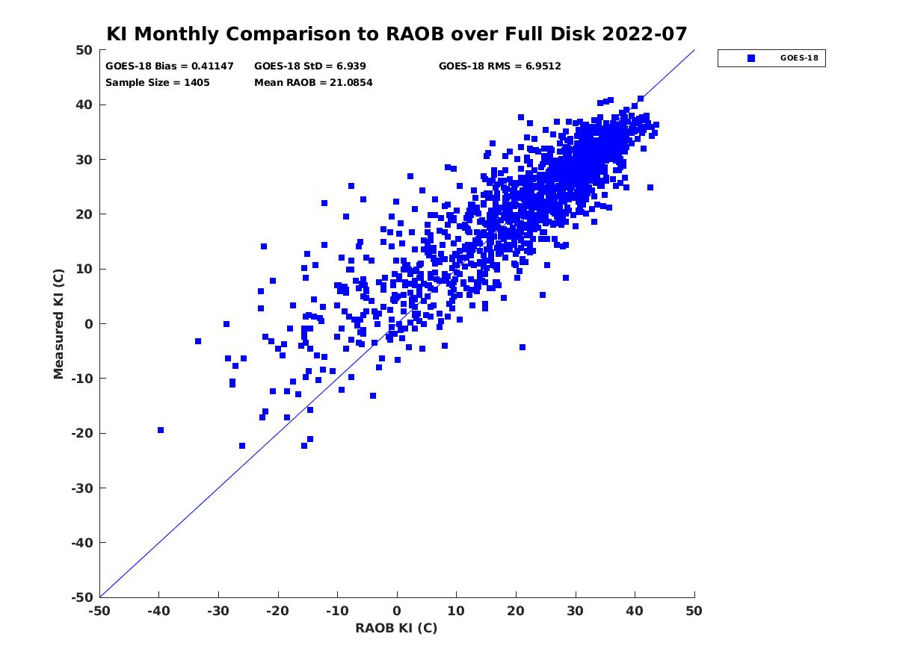
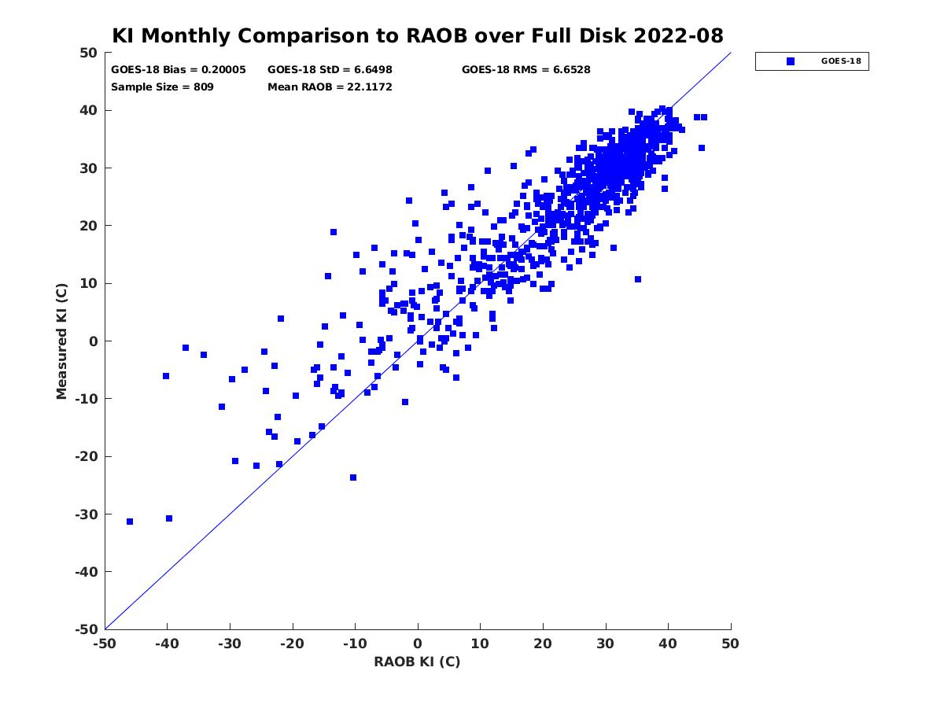
PLPT ABI-FD-DSI:
2022.07-2022.09
KI vs RAOB
Accuracy spec: 2 K
Precision spec: 5 K
July August September
number: 1405
bias: 0.41 K
std: 6.94 K
number: 809
bias: 0.20 K
std: 6.65 K
number: 326
bias: 1.24 K
std: 8.30 K
36

Slide 37
PLPT ABI-FD-DSI:
2022.07-2022.09
TT vs RAOB
Accuracy spec: 1 K
Precision spec: 4 K
July August September
number: 1405
bias: -0.72 K
std: 3.97 K
number: 809
bias: -0.87 K
std: 3.73 K
number: 326
bias: -0.44 K
std: 4.36 K
37

Slide 38
PLPT ABI-CONUS-DSI:
2022.07-2022.09
LI vs RAOB
Accuracy spec: 2 K
Precision spec: 6.5 K
July August September
number: 689
bias: -0.47 K
std: 1.97 K
number: 373
bias: -0.50 K
std: 2.09 K
number: 143
bias: -0.26 K
std: 1.58 K
PASSED
38

Slide 39
PLPT ABI-CONUS-DSI:
2022.07-2022.09
CAPE vs RAOB
Accuracy spec: 1000 J/kg
Precision spec: 2500 J/kg
July August September
number: 176
bias: -93.73 J/kg
std: 216.51 J/kg
number: 109
bias: -103.70 J/kg
std: 252.88 J/kg
number: 30
bias: -66.93 J/kg
std: 153.94 J/kg
PASSED
39

Slide 40
PLPT ABI-CONUS-DSI:
2022.07-2022.09
SI vs RAOB
Accuracy spec: 2 K
Precision spec: 6.5 K
July August September
number: 553
bias: -0.09 K
std: 2.30 K
number: 320
bias: 0.03 K
std: 2.22 K
number: 118
bias: -0.09 K
std: 2.04 K
PASSED
40

Slide 41
PLPT ABI-CONUS-DSI:
2022.07-2022.09
KI vs RAOB
Accuracy spec: 2 K
Precision spec: 5 K
July August September
number: 553
bias: 0.92 K
std: 7.55 K
number: 320
bias: 0.08 K
std: 7.08 K
number: 118
bias: 1.07 K
std: 8.09 K
41

Slide 42
PLPT ABI-CONUS-DSI:
2022.07-2022.09
TT vs RAOB
Accuracy spec: 1 K
Precision spec: 4 K
July August September
number: 553
bias: -0.53 K
std: 4.92 K
number: 320
bias: -0.84 K
std: 4.46 K
number: 118
bias: -0.76 K
std: 4.75 K
42

Slide 43
PLPT ABI-MESO1-DSI:
2022.07-2022.09
LI vs RAOB
Accuracy spec: 2 K
Precision spec: 6.5 K
July August September
number: 87
bias: -0.85 K
std: 2.34 K
number: 104
bias: -0.82 K
std: 2.33 K
number: 182
bias: -0.70 K
std: 1.69 K
PASSED
43

Slide 44
PLPT ABI-MESO1-DSI:
2022.07-2022.09
CAPE vs RAOB
Accuracy spec: 1000 J/kg
Precision spec: 2500 J/kg
July August September
number: 10
bias: -64.74 J/kg
std: 84.99 J/kg
number: 22
bias: -68.87 J/kg
std: 101.97 J/kg
number: 20
bias: -15.78 J/kg
std: 112.49 J/kg
44
PASSED

Slide 45
PLPT ABI-MESO1-DSI:
2022.07-2022.09
SI vs RAOB
Accuracy spec: 2 K
Precision spec: 6.5 K
July August September
number: 68
bias: -0.63 K
std: 2.41 K
number: 84
bias: 0.52 K
std: 2.11 K
number: 143
bias: -0.59 K
std: 1.77 K
PASSED
45

Slide 46
PLPT ABI-MESO1-DSI:
2022.07-2022.09
KI vs RAOB
Accuracy spec: 2 K
Precision spec: 5 K
July August September
number: 68
bias: 2.81 K
std: 8.39 K
number: 84
bias: 0.59 K
std: 7.50 K
number: 143
bias: 1.36 K
std: 6.29 K
46

Slide 47
PLPT ABI-MESO1-DSI:
2022.07-2022.09
TT vs RAOB
Accuracy spec: 1 K
Precision spec: 4 K
July August September
number: 68
bias: 0.44 K
std: 5.14 K
number: 84
bias: -0.06 K
std: 5.03 K
number: 143
bias: 0.14 K
std: 4.42 K
47

Slide 48
DSI Performance Summary
DSI retrieval is working as expected on GOES-18 ABI data when combined with NWP short-range forecasts (as first guess);
With a highly quantitative web-based tool (http://soundingval.ssec.wisc.edu) and the comparisons with RAOB, it indicates the performances from LI, CAPE and SI meet spec. for all the coverages, but the comparisons of TT and KI with RAOBs show the values are higher, particularly for the precision.
48

Slide 49
GOES-16 vs. GOES-18 ABI LAP Products comparisons
Temp at 850 mb
2022.09.15 00Z
GOES 16
GOES 18
Clear-sky, Overlapped coverage
GOES 18 – GOES 16

Slide 50
GOES-18 vs. GOES-16 comparisons
LVT and LVM
Bias and STD for the overlapped area (zenith angle ≤ 65)
2022.09.15 00Z
LVTT
LVMM
N = 133,237
N = 133,237

Slide 51
GOES-18 vs. GOES-16 comparisons
TPW and DSI
G18 – G16 statistics (zenith angle ≤ 65)
2022.09.15 00Z
LVMP
GOES 17
TPW
LI
CAPE
SI
KI
TT
N = 92710

Slide 52
GOES-17 vs. GOES-18 ABI LAP Products comparisons
RH at 850 mb
2022.10.05 00Z
GOES 17
GOES 18
Clear-sky, Overlapped coverage
GOES 18 – GOES 17

Slide 53
GOES-18 vs. GOES-17 comparisons
LVT and LVM
Bias and STD for the overlapped area (zenith angle ≤ 65)
2022.10.05 00Z
LVT
LVM
N = 133,237
N = 133,237

Slide 54
GOES-18 vs. GOES-17 comparisons
TPW and DSI
G18 – G17 statistics (zenith angle ≤ 65)
2022.10.05 00Z
GOES 17
TPW
LI
CAPE
SI
KI
TT
N = 375725

Slide 55
PLPT Outcomes: Summary
All PLPT activities needed to make LAP products provisional have been completed
Similar to GOES-16 performance
Minor issues revealed by PLPTs:
Missing values in random boxed areas
Slightly large discrepancy of some DSI products (KI and TT) compared with RAOB
These minor issues may not prevent the declaration of Provisional Maturity

Slide 56
Path to Full Maturity Review

Slide 57
Path to Full Maturity Review
We expect to apply the same PLPTs to be conducted for Full Maturity
Extend period for testing starting July 2022 and beyond.
Save L2 to enable further comparisons with the reference datasets.
Deep dive for those small samples that have large differences between LAP and references.
Currently minor issues may not prevent declaration of Full Maturity (3 issues identified through the PLPT work and will be mitigated during provisional stage)
Missing values are randomly discovered over some boxed areas.
LAP products are affected by the migration of the sun which might be caused by the cloud mask.
TT and KI values have slightly large discrepancy when compared with (“point-source”) RAOBs; previous experiences show that the results are closer to specification when considering only unstable atmospheric conditions.

Slide 58
Issue #1 – Missing data over randomly distributed boxed areas
Initial analysis showed missing data over randomly distributed boxed area
The missing data occur frequently and randomly in boxed shapes
Need to submit an ADR on this issue
This issue was raised for GOES-17, also happens for GOES-16, and it is not solved.
Notes:
PRO team may clarify more about this.

Slide 59
An example of the missing data in boxed area over Full disk
Data missing occur randomly, but often between 8:20 and 9:40 UTC

Slide 60
Missing data for M4 mode (5 minutes full disk)
At September 25, 2022, M4 scan mode was tested, in which the full disk scan is at every 5 minutes from 1700 UTC to 2100 UTC.
The complete 5 minutes L2 sounding data is only available from 1500 UTC to 1720 UTC
The missing data box is found at 1725 UTC
All data are missing from 1730 UTC to 21 UTC.
1720 UTC
1725 UTC
1730 UTC
Notes:
PRO team may clarify more about this.

Slide 61
Issue #2 – Weak effects of sun migration on products
Notes:
PRO team may clarify more about this.

Slide 62
Risks to Reaching Full
Risk Name | Description | Impact | Mitigation and Schedule
Missing values over randomly distributed areas | Infrequently, there are missing values over randomly distributed boxed areas, but just the full disk sector. | Minor | Suggest an ADR, similar to an earlier one which we thought was resolved.
The migration of the sun affecting the LAP products | The ABI LAP products are affected by sun-rise and sun-set. | Minor | Cloud mask may have influences on the ABI LAP products, as the scenes are illuminated, although appears to be a yield issue.
Wet bias of the relative humidity in upper troposphere (100 - 300 hPa) | The relative humidity in upper troposphere (100-300 hPa) shows large wetter bias than the spec. | Minor | Radiosonde has dry bias in observing the relative humidity in the upper troposphere. Does not pose risk for full maturity.
Slightly large discrepancy of several DSI | Several DSI show slightly larger discrepancy than the spec, compared to radiosondes. | Minor | If the atmospheric conditions are unstable, the statistics results are closer to the requirements. May need a high spectrally resolution sounder in geo to fully resolve.
Small Impact
Moderate Impact
Large Impact

Slide 63
Other concerns to Full Maturity
Layered PW (LPW) should be considered in the intermediate products based on the feedback from forecasters during Hazardous Weather Testbed (HWT) demonstration. LPW is available in IP from GOES-16.
Notes:
HWT – Hazardous Weather Testbed

Slide 64
SUMMARY AND RECOMMENDATIONS
GOES-18 ABI L2 LAP Product Provisional PS-PVR

Slide 65
Provisional Validation
Preparation Activities | Assessment
Validation activities are ongoing and the general research community is now encouraged to participate. | true
Severe algorithm anomalies are identified and under analysis. Solutions to anomalies are in development and testing. | no severe anomalies detected
Incremental product improvements may still be occurring. | true
L2+ only: Users are engaged in the Product Feedback Forums and user feedback is assessed. | ongoing
End State | Assessment
Product performance has been demonstrated through analysis of a small number of independent measurements obtained from select locations, periods, and associated ground truth or field campaign efforts. | true
Product analysis is sufficient to communicate product performance to users relative to expectations (Performance Baseline). | true
Documentation of product performance exists that includes recommended remediation strategies for all anomalies and weaknesses. Any algorithm changes associated with severe anomalies have been documented, implemented, tested, and shared with the user community. | ongoing
Testing has been fully documented. | ongoing
Product is ready for operational use and for use in comprehensive cal/val activities and product optimization. | true

Slide 66
Summary
A webpage has been developed for GOES-18 LAP product validation in near real-time
AWG LAP team has validated GOES-18 LAP products (TPW, LVT, LVM, DSI) from July 2022 to September 2022 with various reference data (RAOB, Suomi-Net GPS, AMSR2), the performance overall meet the requirements ;
AWG LAP team recommend that TPW, LVT, LVM, and DSI products be transitioned to Provisional status at this time;
AWG LAP team have found the following minor issues which should not prevent Provisional status
Missing values occur frequently and randomly over boxed areas.
The migration of the sun affects the LAP products via cloud mask.
Comparisons of TT and KI with RAOBs shows a little larger than spec.

Slide 67
Backup Material
GOES-18 ABI L2 LAP Product Provisional PS-PVR

