Slide 1
GOES-16 & 17 EXIS EUVS L1b Full Maturity PS-PVR
May 19, 2021
Presenter: Courtney Peck - NOAA NCEI and U. Colorado CIRES
Contributors:
U. of Colorado LASP: F. Eparvier, D. Woodraska, T. Eden, S. Mueller,
M. Snow, R. Meisner, A. Jones, T. Redick, ....
NCEI/CIRES: J. Machol, E. Zetterlund, J.M. Hughes, S. Codrescu, W. Rowland
Other: Rodney Viereck, Matt Garhart, ...

Slide 2
Outline
Overview of the GOES-16 and 17 EXIS/EUVS Instrument
Review of the EUVS Provisional Maturity Assessment
GOES-16 and 17 Evaluation of Level-1b Product Quality
GPA Issues
NCEI Status on EUVS Calibrations
Post Launch Product Tests (PLPTs)
Summary of Ongoing Investigations
Other Updates
Full Maturity Assessment

Slide 3
Quick Summary
GOES-16 and -17 EUVS declared operational in 09/2019
GPA: most ADRs resolved, a few remain. DO.09.05 to be implemented 06/17/2021.
Instrument
No surprises. GOES-16 and -17 behavior is similar.
Studies done with L1b, L2, and L0-processed data.
A few ongoing investigations remain.
PLPT inter-satellite comparison good for all instruments
On-orbit calibrations
LASP handed off L0 cal tools to NCEI
NCEI performs regular on-orbit calibrations
Data: operational and new science-quality GOES-16 available from NCEI.
Solar activity low since launch. SC 25 has begun.
ADR = Algorithm Discrepancy Report
LUT = Look Up Table

Slide 4
GOES-16 & 17 EUVS Full Maturity PS-PVR
The EXIS Instrument

Slide 5
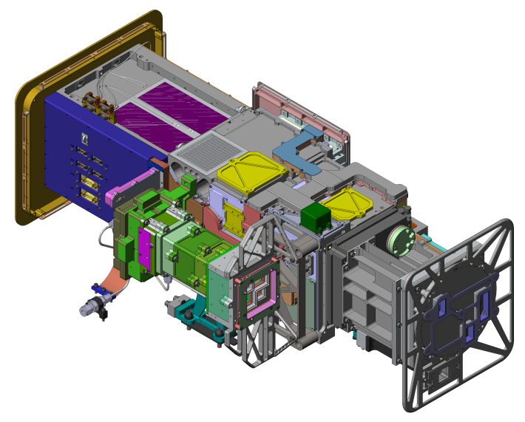
EUV and X-Ray Irradiance Sensors (EXIS)
X-Ray Sensor (XRS)
Monitor solar flares
Impacts communications and navigation
Warning for potential SEP events
Extreme Ultraviolet Sensor (EUVS)
Measures ultraviolet irradiance which impacts upper atmosphere
Sun Pointing Sensor (SPS)
Used for alignment (quad diode, 3.5° FOV)
EUVS
XRS
SPS
EXIS was designed, built and tested by the Laboratory for Atmospheric and Space Physics (LASP) at the University of Colorado.

Slide 6
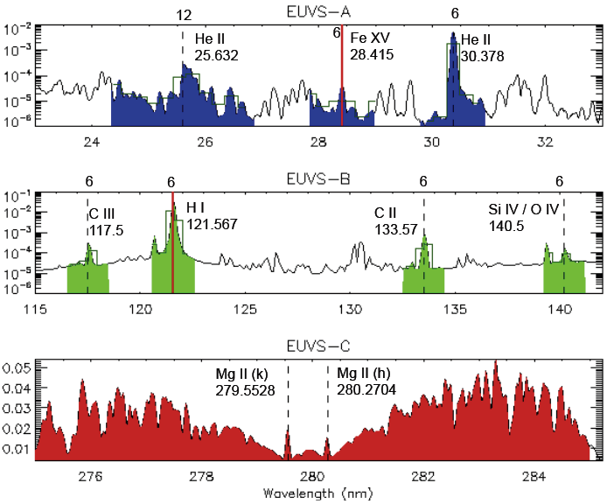
Extreme Ultraviolet Sensor (EUVS)
Requirements
≤30 s cadence
≤20% accuracy
Spectral model (5-127 nm)
3 Grating Spectrographs
EUVS-A: 24 diode array, filter wheel
EUVS-B: 24 diode array
EUVS-C: 512 diode array
L1b Products
7 solar lines
Mg II index
Spectral model (5-127 nm)
high res data
corona
transition
region
chromosphere
Notes:
Note that spectral model uses the 7 lines, mg index, and 2 xrs bandpasses to generate model
Model uses coefficients that weights the lines contribution to a band
Two components: fast flare and slow long components

Slide 7
GOES-16 & 17 EUVS Full Maturity PS-PVR
Review Of Previous Status:
Provisional Maturity Assessment
(25 September 2019)

Slide 8
Recap: Provisional status L1b GPA issues to resolved by Full Validation
G16
G17
DO.09.05 to go live on 06/17/2021
ADR | Issue | Delivery date at Provisional PS-PVR | Status as of May 2021
471 | EUVS-A, -B dark time dependence (Reopened as ADRs 1024 and 1030) | - | DO.09.05
523 | Reduce packet size for APID 255. | - | Closed
872 | Solar array currents incorrect in GOES-17 | Spring 2020 | Not Scheduled
894 | Lunar transit flag not set | Spring 2020 | DO.09.05
898 | EUVS dark current temperature correction | Spring 2020 | Closed
958 | Change EXIS LUT variables to double precision | Spring 2020 | DO.09.05
1002 | Move "...leap seconds" from units to long name. | - | Closed
G17
All but one ADR is either closed or will be closed with DO.09.05

Slide 9
G16
G17
Recap: Provisional status instrument issues to be resolved by Full Validation
# | Issue | Description | Status as of May 2021
1 | Create Mg II proxies for EUVS-B degradation | Need to create Mg II proxies for EUVS to use for degradation models | Completed
2 | ECI data | Need to determine GOES-17 ECI correction | Analysis not yet performed. EUVS data incorrect during ECI
3 | EUVS-A and -B temperature corrections | Implement ADR 898 | Completed
4 | EUVS-A filter degradation | LASP investigating degradation under Task Order 10. (see results in https://doi.org/10.1007/s11207-021-01806-4). | Completed
5 | Rocket calibration | June 2018 rocket spectrum should be used to calibrate EUVS-A data. | Completed
6 | EUVS-C spike removal | Determine if this should be added to L1b code. | Not completed
7 | EUVS model during flares | Small revisions needed to LUTs following implementation of various ADRs | Completed
8 | EUVS-C systematic behavior | Investigate subtle effect of Doppler effect on behavior of wings and lines | LUT was changed to expand diode mask due to Doppler effect. Further investigation needed for wing behavior.
G17
Most instrument issues since Provisional have been resolved. Remaining issues discussed in later slides [51-57] and data ReadMe caveats.
Notes:
We had these known instrument issues at provisional
LASP has published a paper on some of the findings for EUVS-A filter degradation
#3 was a huge improvement. Discussed in detail at provisional.

Slide 10
G16
G17
Recap: Other progress between Provisional and Full Validation
Objective | Details | Status as of May 2021
Analyze L1b, L2, and LASP-processed L0 data | Continuously perform comparisons for validation. Extra comparisons done with new science-quality data | Complete
Analyze daily, weekly, and quarterly calibrations | Summary in slide 24 | Complete
Provide updated calibration tables | Numerous NCEI-generated LUTs delivered to OE | Complete
LASP hand-over of calibration work | Most calibrations are now performed at NCEI. Majority of handover was completed by January 2020. | Complete
Create NCEI science reprocessed data for comparisons | Science-quality reprocessed EUVS L1b and L2 data complete and publicly available since April 2021 | Complete
Considerable progress has been made since Provisional
Notes:
At provisional we had plans to do these things, and we’ll talk about what we’ve done in future slides

Slide 11
GOES-16 & 17 EUVS Full Maturity PS-PVR
Evaluation of L1b Product
Quality

Slide 12
16 currently open EUVS GPA issues
- 10 of which will be delivered in DO.09.05 to be installed in OE on 06/17/2021
66 EUVS product fix ADRs closed
107 total closed EXIS ADRs (includes ~20 LUT updates)
G16
G17
Algorithm Discrepancy Reports (ADRs)
Notes:
Closed ADRs as of G16 launch

Slide 13
ADRs: 10 EUVS ADR fixes are validated and scheduled for 06/17/2021
G16
G17
ADR | Issue | Data Impact | Description / Impacts | New since Provisional | OE Delivery Date
894 | Lunar transit and other pointing issues | Moderate | 9 EXIS variables set incorrectly when there are pointing events |  | DO.09.05
958 | Make double precision LUT variables | Moderate | Improve accuracy of results |  | DO.09.05
1024 | *EUVS split diode error | Moderate | ~6% error in 121.6 nm line irradiance due to improper summation of split diode | x | DO.09.05
1030 | *Include low current data in line irradiance | Moderate | 7% error in all EUVS-A and B line irradiances | x | DO.09.05
1047 | *121.6 nm line irradiance error | Moderate | Software issue caused ~0.2% error in the 121.6 nm line irradiance | x | DO.09.05
1052 | *Exclude calibrations from spectral model | Moderate | Model calculation needs to exclude bad data. 17% error in some bins | x | DO.09.05
1053 | EUVS dark diode current error | Moderate | Dark diode currents improperly calculated with dark drift or temperature correction | x | DO.09.05
1054 | Exclude geocoronal data from EUVS model | Moderate | 121.6 nm line irradiance during geocoronal included in spectral model and causes error in spectral model | x | DO.09.05
1063 | sps_observation_times error | Minor | SPS timestamps incorrect results in incorrect elements in averages for angles (and EUVS). | x | DO.09.05
1087 | Pointing during eclipses | Moderate | Only one flag should be set at a time and pointing flag should not be set based on eclipse. Revise pointing flag names. | x | DO.09.05
Notes:
A lot of work in addressing all of these ADRs
As bigger issues were fixed, smaller but still impactful ones were uncovered.

Slide 14
Remaining ADR beyond DO.09.05: 6 unscheduled EUVS ADRs of mostly minor impact
G16
G17
ADR | Issue | Data Impact | Description / Impacts | New since Provisional | OE Delivery Date
822 | Remove time-stamped lines in LUTs | Minor | Remove time-stamped LUT variables |  | Not scheduled
872 | Solar array currents incorrect in GOES-17 | Minor | Solar array currents variables are incorrect |  | Not scheduled
1144 | *EUVS during lunar transit | Moderate | Spectral lines and Mg II set to fill values during eclipse and lunar transit | x | Not scheduled
1157 | EUVS metadata | Minor | Minor changes to metadata | x | Not scheduled
1158 | EUVS calibration flag change | Minor | Modify quality flags to clearly label calibrations | x | Not scheduled
1161 | *Penumbra only flag | Moderate | Add flag to indicate penumbra event without eclipse to SC_eclipse_flag | x | Not scheduled
Notes:
1157+ are new since May
1144 submitted at end of 2020 (was part of 1087, but required revisions)

Slide 15
ADR 1030: Include low current data in line irradiances and correct a mask index error
G16
G17
Discrepancy caused by:
Off-by-one diode mask index
Not including negative diode currents in irradiances
Causes ~7% offset error in line irradiances, which propagates into spectral model
Impacts all line irradiances
ADR fix to be installed in OE with DO.09.05 on 06/17/2021
Notes:
First talk about DO 0905 ADRs. Showing the validated data
Caused an ~7% error in the spectral model irradiances
These errors propagate into the spectral model. Cause large errors which can impact SWPC forecasting

Slide 16
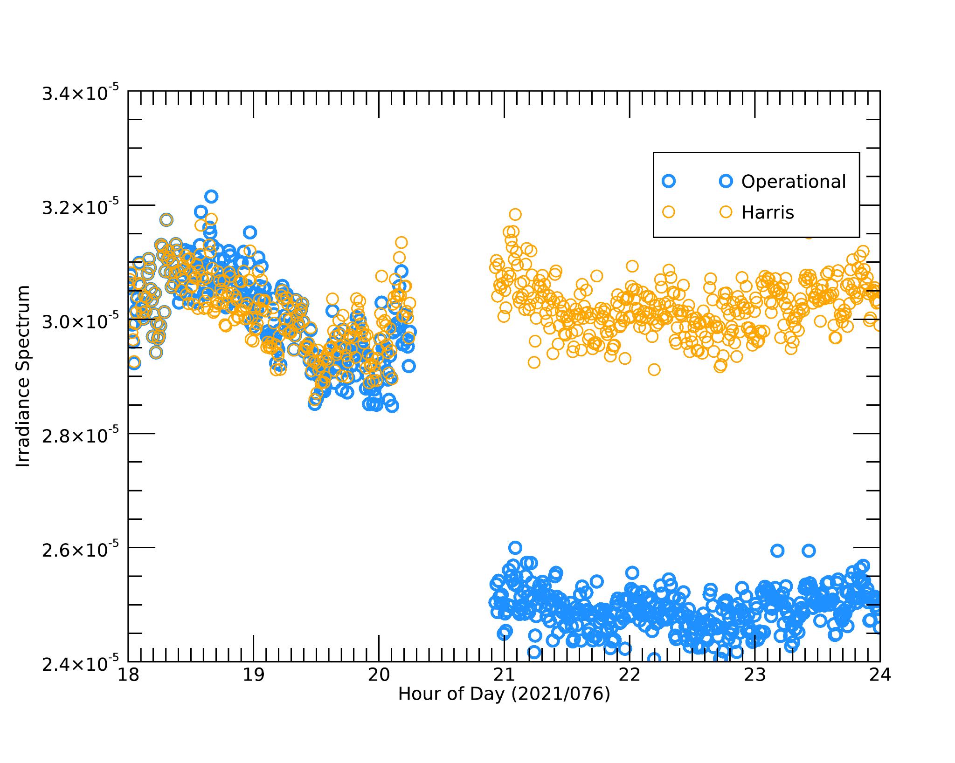
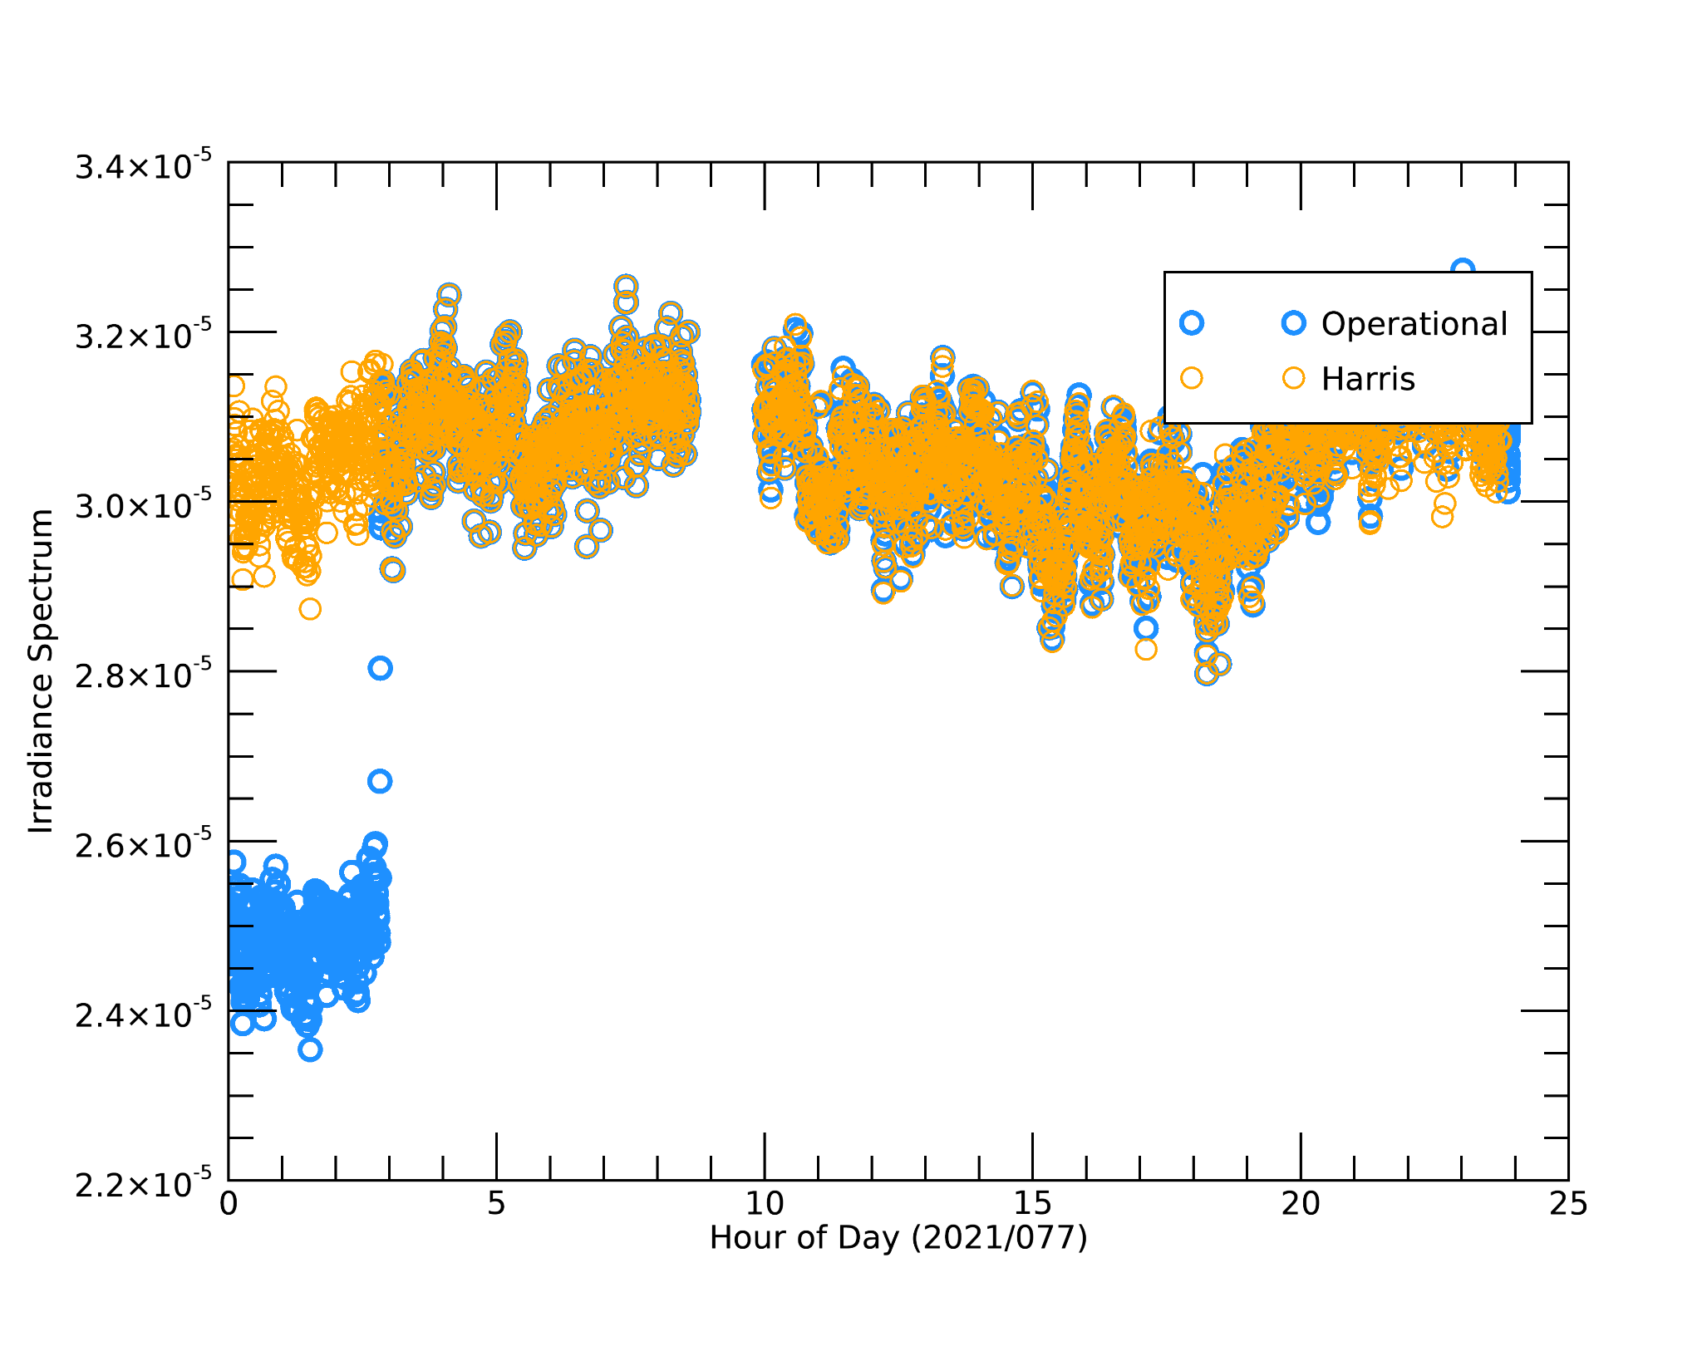
ADR 1052: Exclude calibrations from spectral model
G16
G17
5 - 10 nm Irradiance Spectrum
5 - 10 nm Irradiance Spectrum
Pre-ADR fix
Post-ADR fix
Pre-ADR fix
Post-ADR fix
~15% drop in spectrum irradiance due to inclusion of calibrations when calculating the long-term averages
Recovers back to nominal values after 6 hours
(duration of the long-term average window)
Note: Sudden jumps in data can erroneously signal an EUV event
ADR fix to be installed in OE with DO.09.05 on 06/17/2021
Notes:
Large sudden jumps in irradiance like this are especially problematic for forecasting since they can appear as though an event is starting

Slide 17
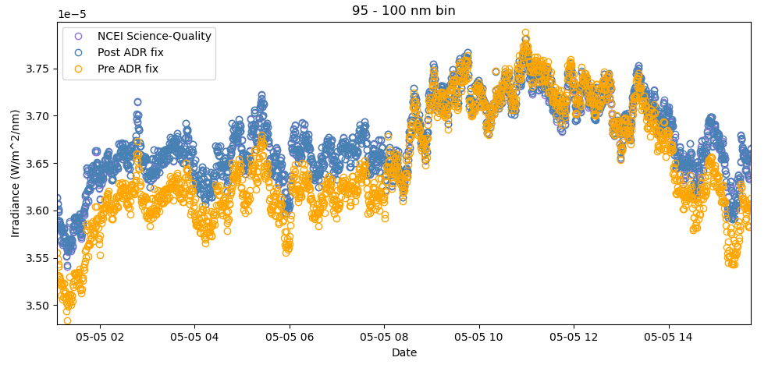
ADRs 1054: Exclude geocorona data from spectral model
G16
G17
Pre-ADR fix data included 121.6 nm geocoronal data, causing increase in spectral model irradiance after geocorona ends
Increase in irradiance can erroneously signal an EUV event
Geocorona event ends
Note: Pre ADR data is using different LUTs which slightly modifies pre and post ADR fix comparisons
ADR fix to be installed in OE with DO.09.05 on 06/17/2021
Notes:
Short term component of spectral model divides by the 9-hr average of the 121.6 line, which dominates and causes the spectral bin to artificially increase when that 9-hr average data is artificially too low
This jump in irradiance can appear as though an event is starting when it is only an algorithm artifact

Slide 18
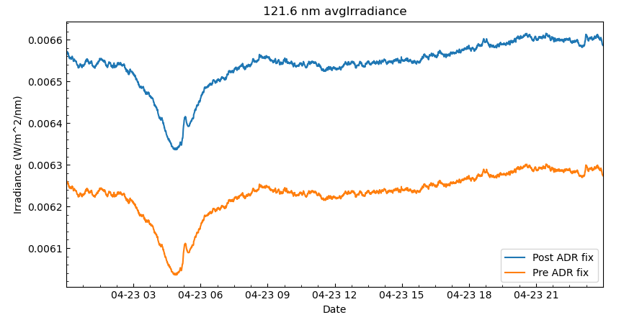
ADRs 1024 and 1047: Errors in calculation of 121.6 nm irradiance
G16
G17
A minor software bug in conversion from diode currents to irradiance caused an additional offset that impacted all irradiances
(ADR 1047)
Large offset of ~6% primarily due to summing split diode after computing the irradiance rather than before
(ADR 1024)
Irradiance errors propagate into spectral model
ADR fix to be installed in OE with DO.09.05 on 06/17/2021
Notes:
Jake Harburg at MIT found that it impacted more than just 121.6 nm lines
Large deviations (estimated around 6%) propagate into the spectral model which can impact forecasting

Slide 19
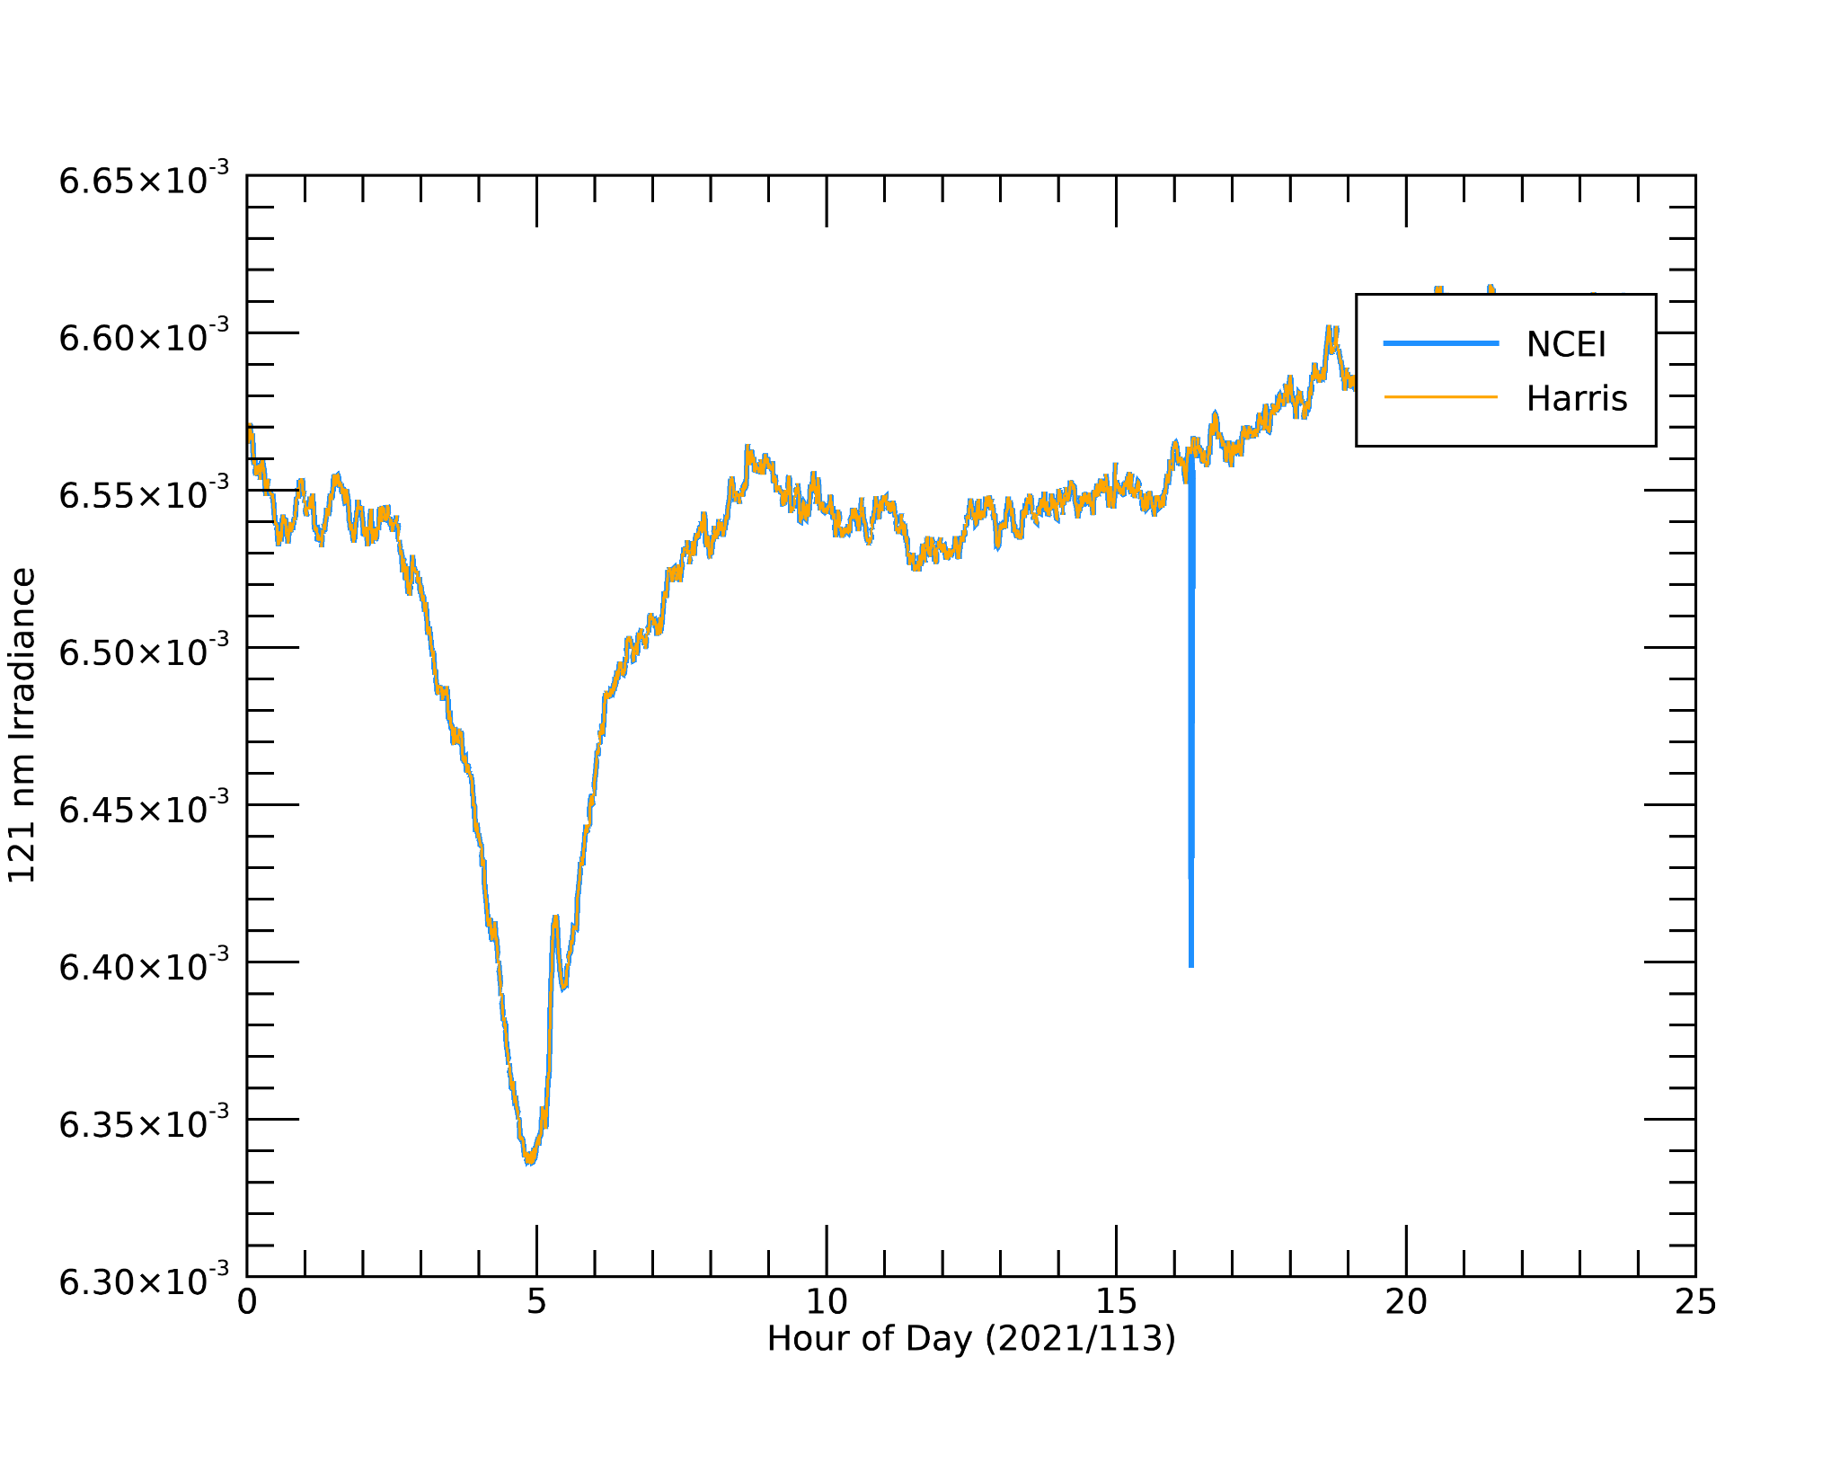
ADRs 1024 and 1047: 121.6 nm irradiance fixed after ADRs implemented
G16
G17
NCEI
Post-ADR fix
After correction, the ops data matches the NCEI data
ADR fix to be installed in OE with DO.09.05 on 06/17/2021

Slide 20
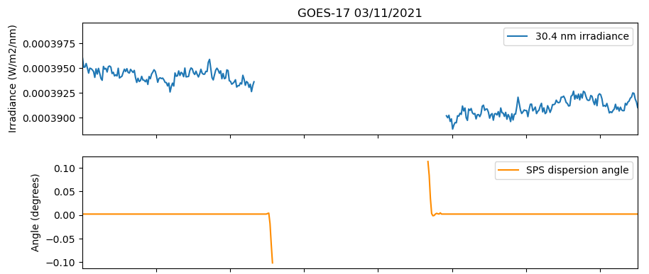
ADR 1144: Spectral lines and Mg II set to fill values during eclipse and lunar transit
G16
G17
Bad pointing
Eclipse flag on, but good pointing
Miss ~20 minutes of good data per day during eclipse season
Notes:
On to current open ADRs. Will talk about the two of moderate significance (note that these are less problematic than previous ADRs)
Miss about 20 minutes of good data during each eclipse

Slide 21
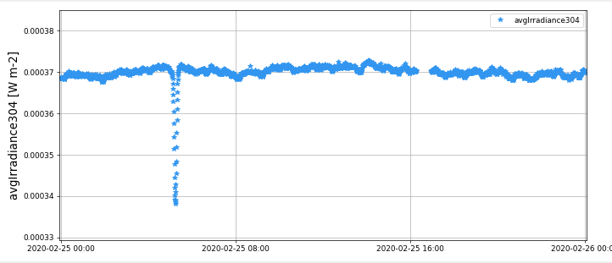
ADR 1161: Add flag to indicate penumbra event occurring without full eclipse to SC_eclipse_flag
G16
G17
Dip in data is due to penumbra-only eclipse
Effect seen in irradiance averages and spectral model
Notes:
Will impact irradiances at start and end of each eclipse season (4 x per year).
Without adding flag, it is not straightforward to flag the penumbral eclipse
Propagates into L2 products

Slide 22
10 ADR changes implemented in DO.09.05 on 06/17/2021 will significantly improve L1b product quality
Remaining ADRs are relatively minor and do not significantly impact data quality
G16
G17
ADRs summary
Notes:
Validation of DO.09.05 has verified the fixes

Slide 23
LASP handed over tools in January 2020
Implemented at NCEI with some upgrades
Multiple LUTs delivered and verified by LASP
G16
G17
EUVS calibrations

Slide 24
G16
G17
List of calibration routines
Name | Priority | Schedule / repeat | Instrument | Effects LUT? | NCEI Handover?
Bundle HDF5 files for delivery | N/A | As needed | All | Yes | Yes
EUVS-A filter degradation | High | 6 months | EUVS-A | Yes | Yes
EUVS-A/B dark drift | High | 6 months (consider checking every 3 months) | EUVS-A/B | Yes | Yes
FOV | Low | quarterly after each maneuver | All | No | Yes
*EUVS-B degradation | High | 6 months | EUVS-B | Yes | Yes
EUVS-C dark | High | 6 months | EUVS-C | Yes | Yes
Thermal dark correction | High | 6 months (after eclipse seasons) | EUVS-A/B | Yes | Yes
EUVS-C degradation | Low | 6 months | EUVS-C | No | No
EUVS-C readout noise | Low | quarterly | EUVS-C | No | Yes
EUVS-A flatfield | Low | annually | EUVS-A | Yes | Yes
EUVS-B flatfield | Low | annually | EUVS-B | Yes | Yes
EUVS-A gain | Low | 6 months (weekly cals) | EUVS-A | Yes | Yes
EUVS-B gain | Low | 6 months (weekly cals) | EUVS-B | Yes | Yes
XRS gain | Low | annually (quarterly cals) | XRS | Yes | Yes
SPS gain | Low | annually (quarterly cals) | SPS | Yes | Yes
SPS darks | Low | annually (eclipses) | SPS | Yes | Yes
Science packet telemetry trending | Low | Weekly | All | No | Yes
XRS darks | Medium | quarterly (off-point)/6 months for eclipse season. | XRS | Yes | No
XRS inter-satellite flare peak comparisons | Low | 6 months | XRS | No | Yes
EUVS-C particle filtering | Low | as needed | EUVS-C | No | Yes
Cruciform | Low | quarterly | All | No | No
Notes:
Want to give a sense of the types of calibrations that are done and those that are used in the LUTs.
the remaining items are undergoing revisions before their final handoff to NCEI
XRS darks still require a lot of manual work due to electron contamination
Every eclipse season, we run delta temperature (EUVS-A/B; darks as a function of temperature), dark drift (EUVS-A/B; darks as a function of time), and EUVS-A/B degradation.
Other calibrations: FOV, flatfield, gain, EUVS-C readout noise and darks. These are monitored, but haven't required updating since preflight or early mission.
Not yet handed over: EUVS-C degradation, XRS darks (cal tables recently updated by Tom), and cruciform

Slide 25
EUVS-B degradation trending routine was based on SORCE/SOLSTICE data
G16
G17
Original method:
Use SOLSTICE irradiances at EUVS-B wavelengths to correct degradation
Updated method:
Create proxies for SOLSTICE at EUVS-B wavelength based on EUVS Mg II
EUVS-B line irradiance
SOLSTICE “EUVS-B” proxy = f(Mg II)
Degradation
function
=
SOLSTICE “EUVS-B” irradiance
Degradation
function
EUVS-B line irradiance
=
Good SOLSTICE data ended in 04/2019
SOLSTICE “EUVS-B” proxy
Notes:
Want to talk briefly about EUVS-B degradation since we have done a lot of work modifying this trending routine and it provides some useful background for some upcoming slides on inter-satelilte comparisons
SOLSTICE corrected degradation, but data ended around 04/2019. No new degradation trends had been made, so we had to develop a method to create a proxy from SORCE data
Saw much larger range of irradiance variability as shown here (SORCE scaled to match EUVS Mg II)

Slide 26
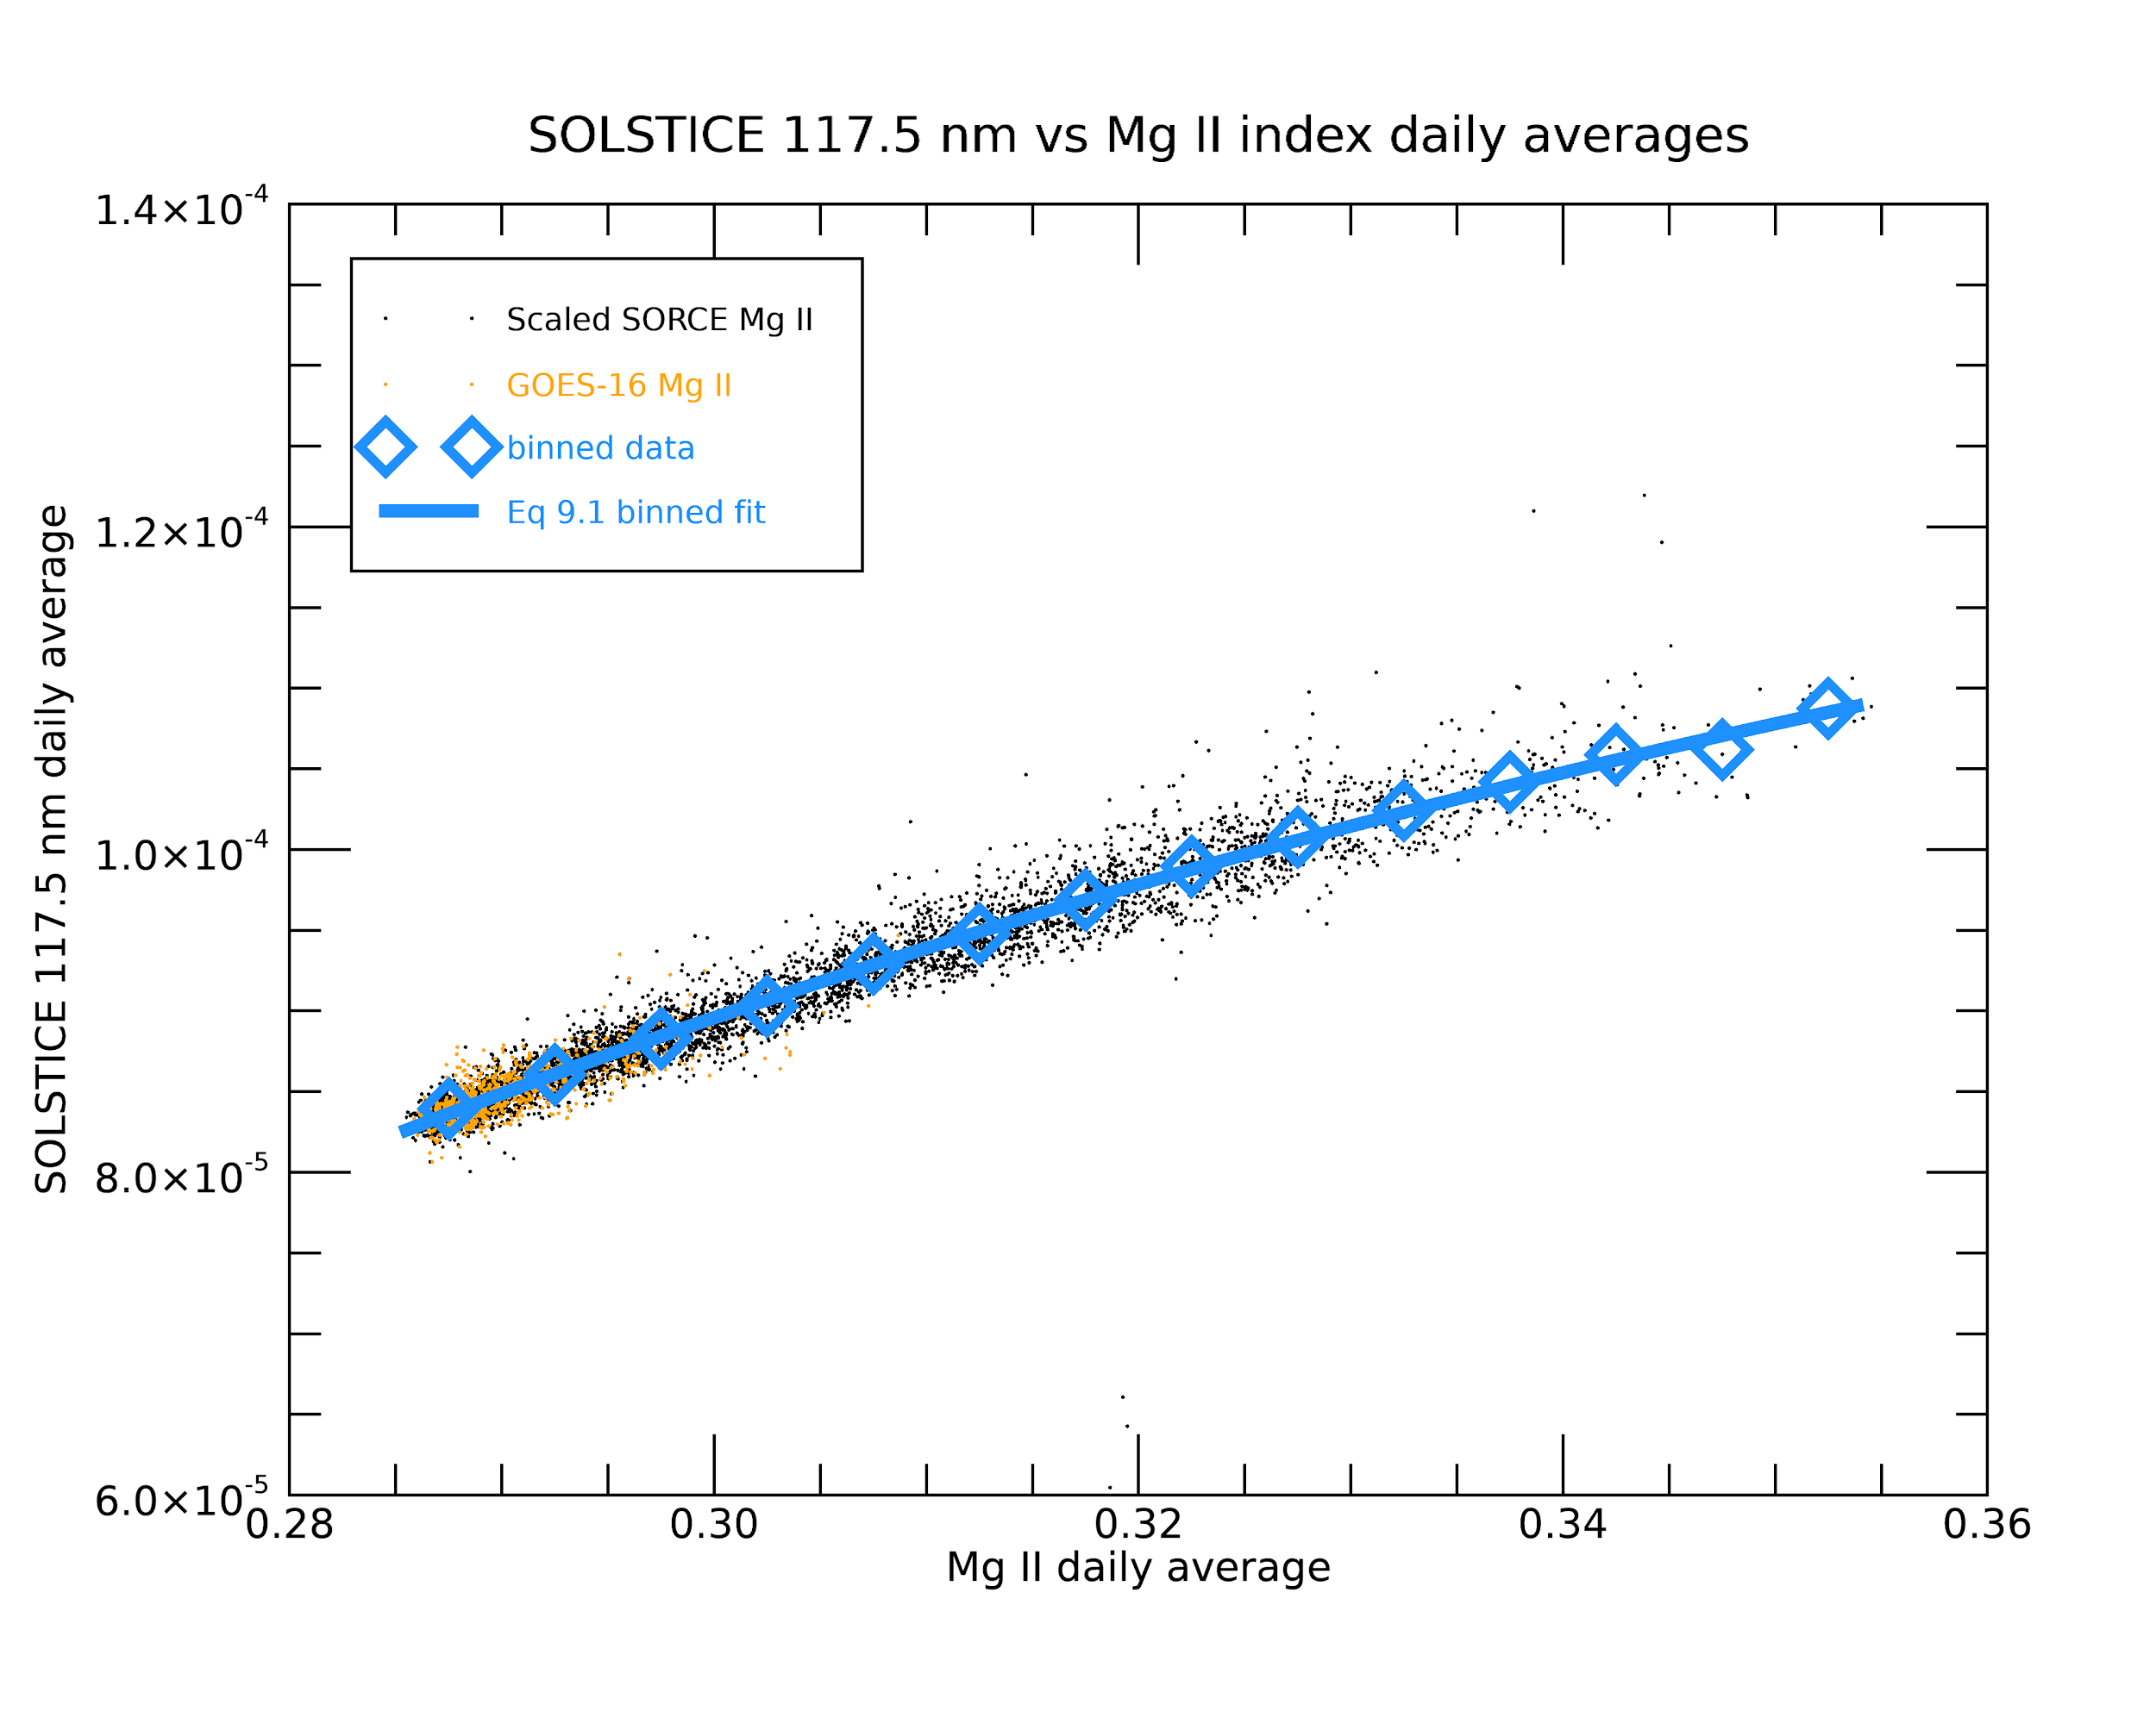
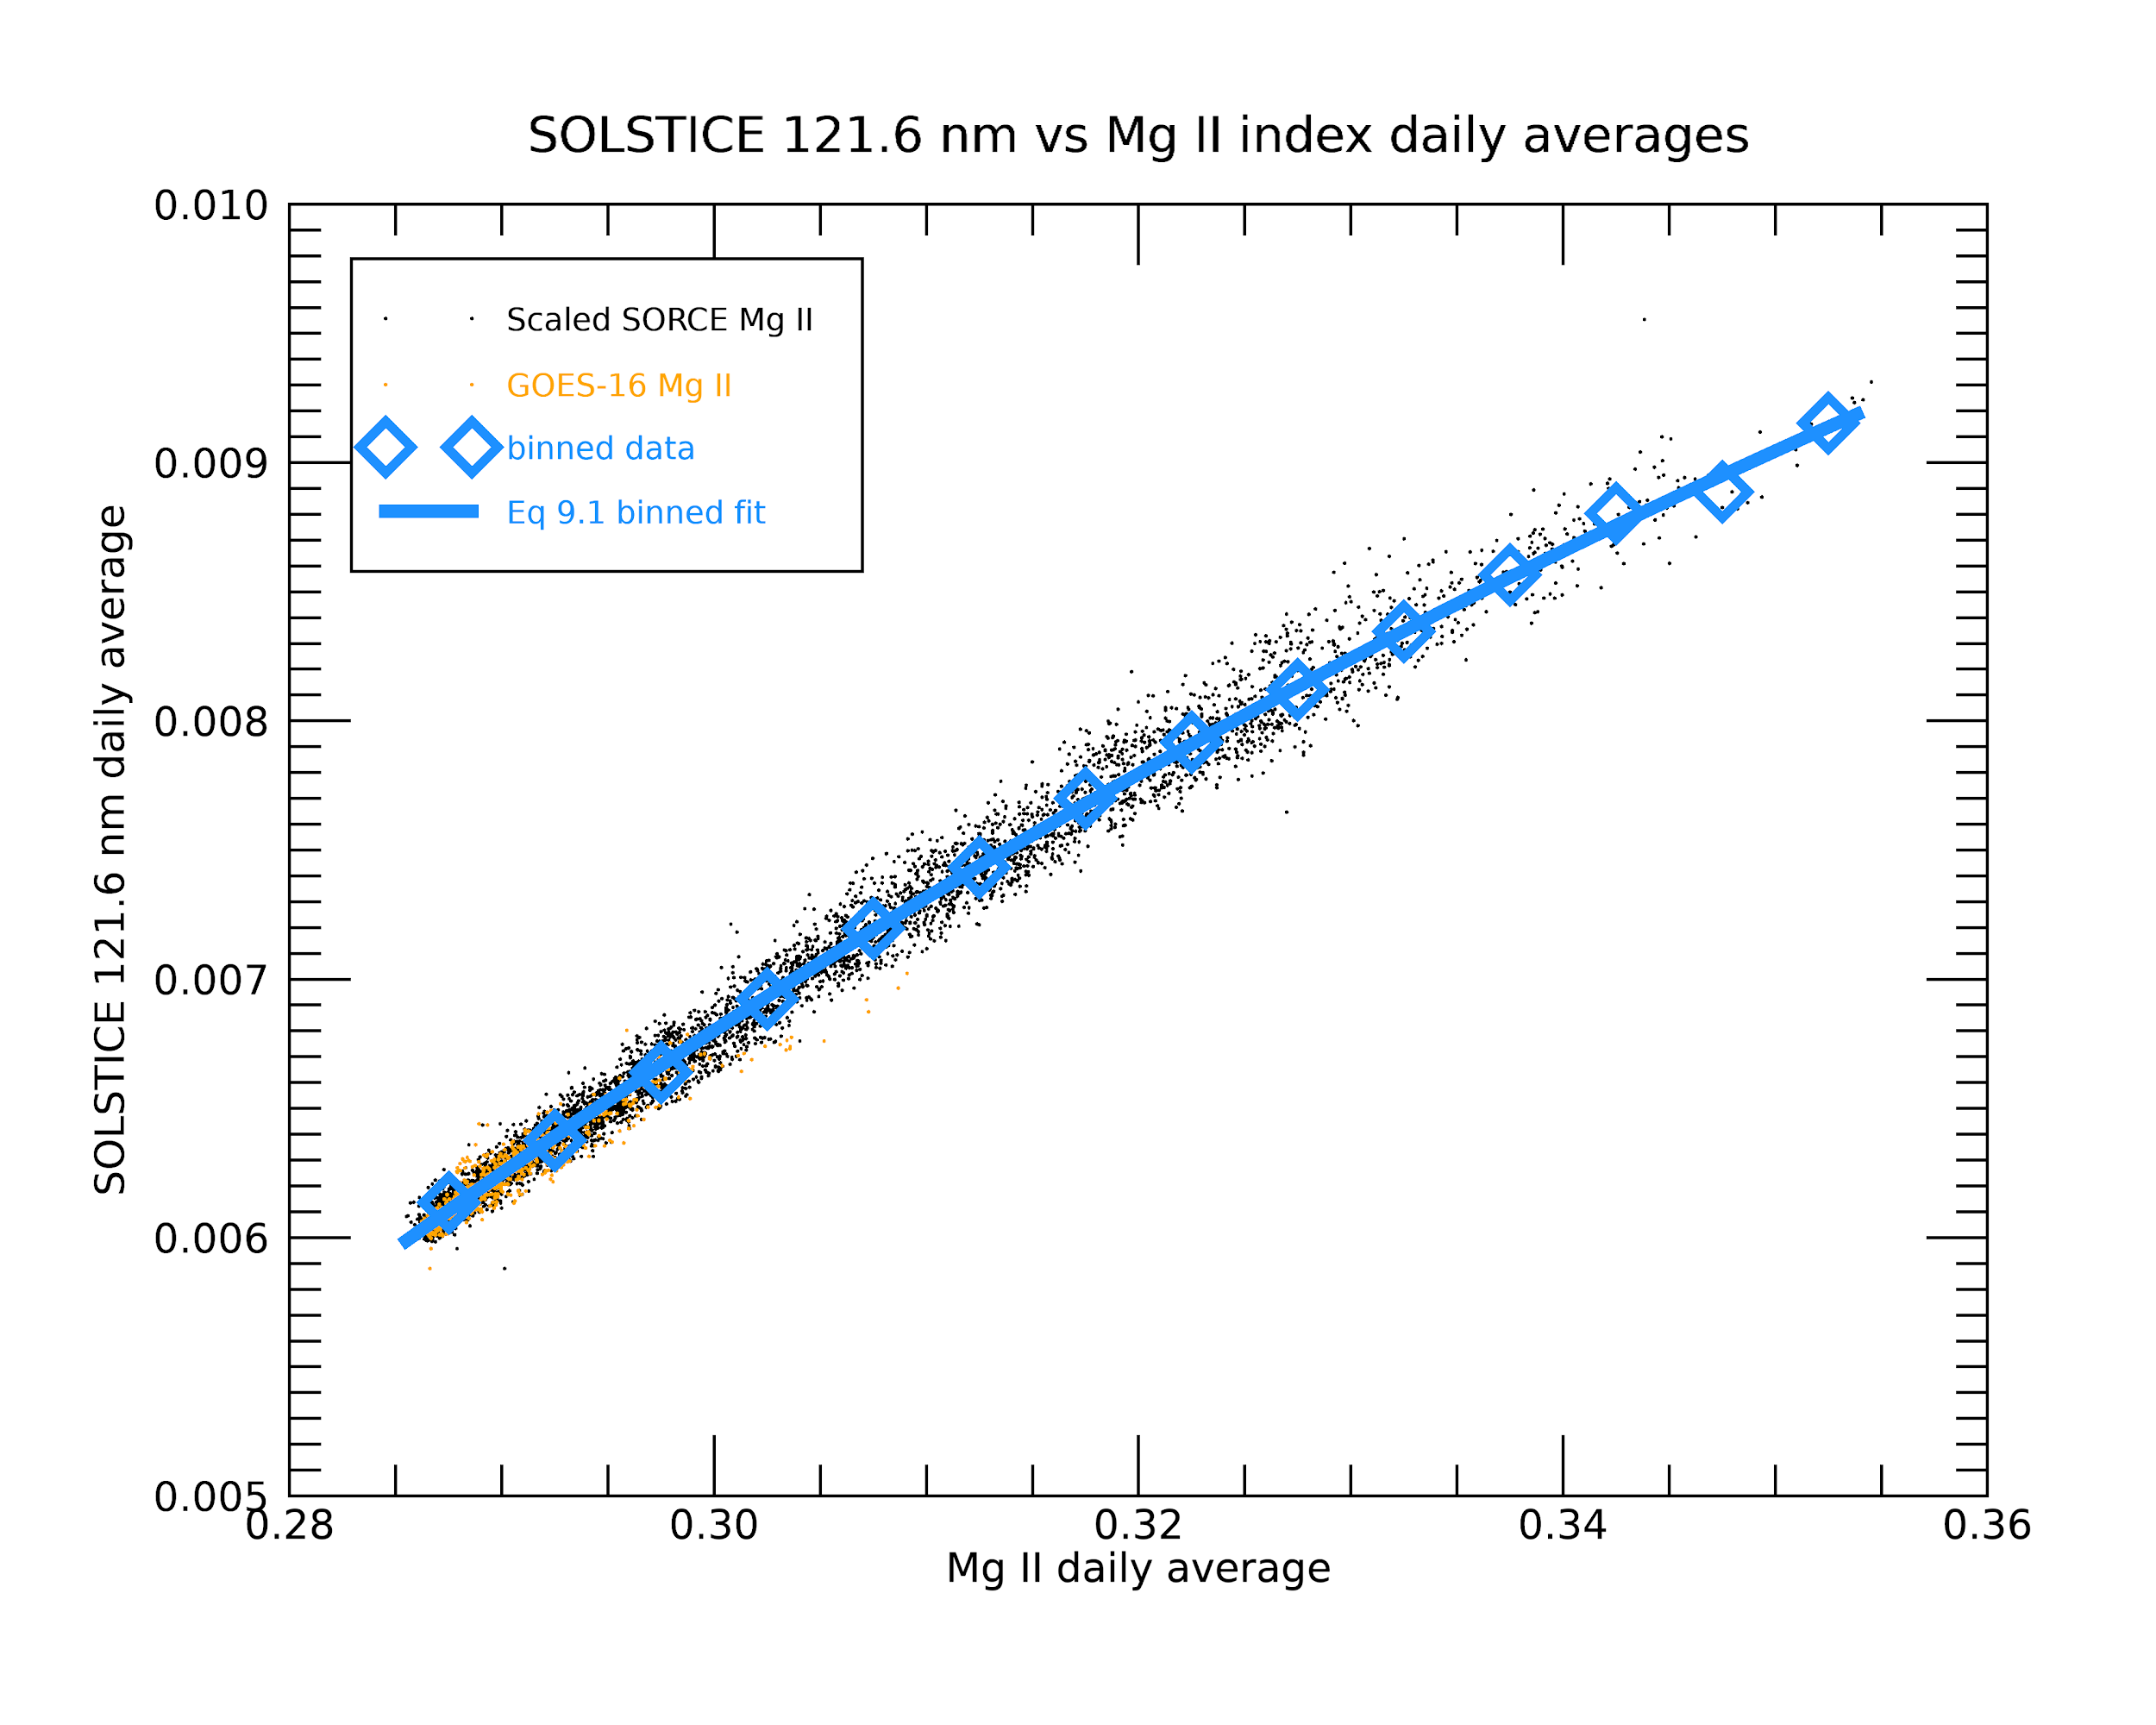
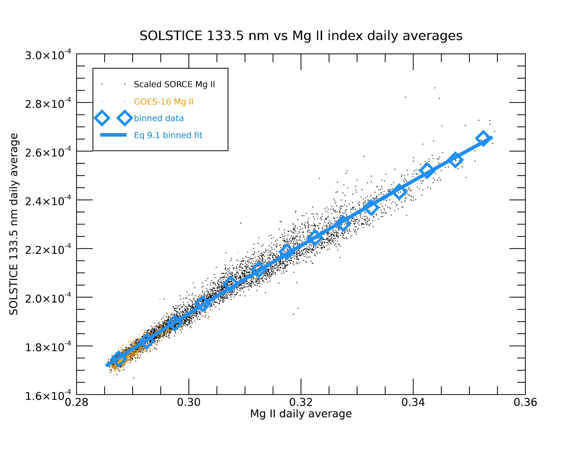
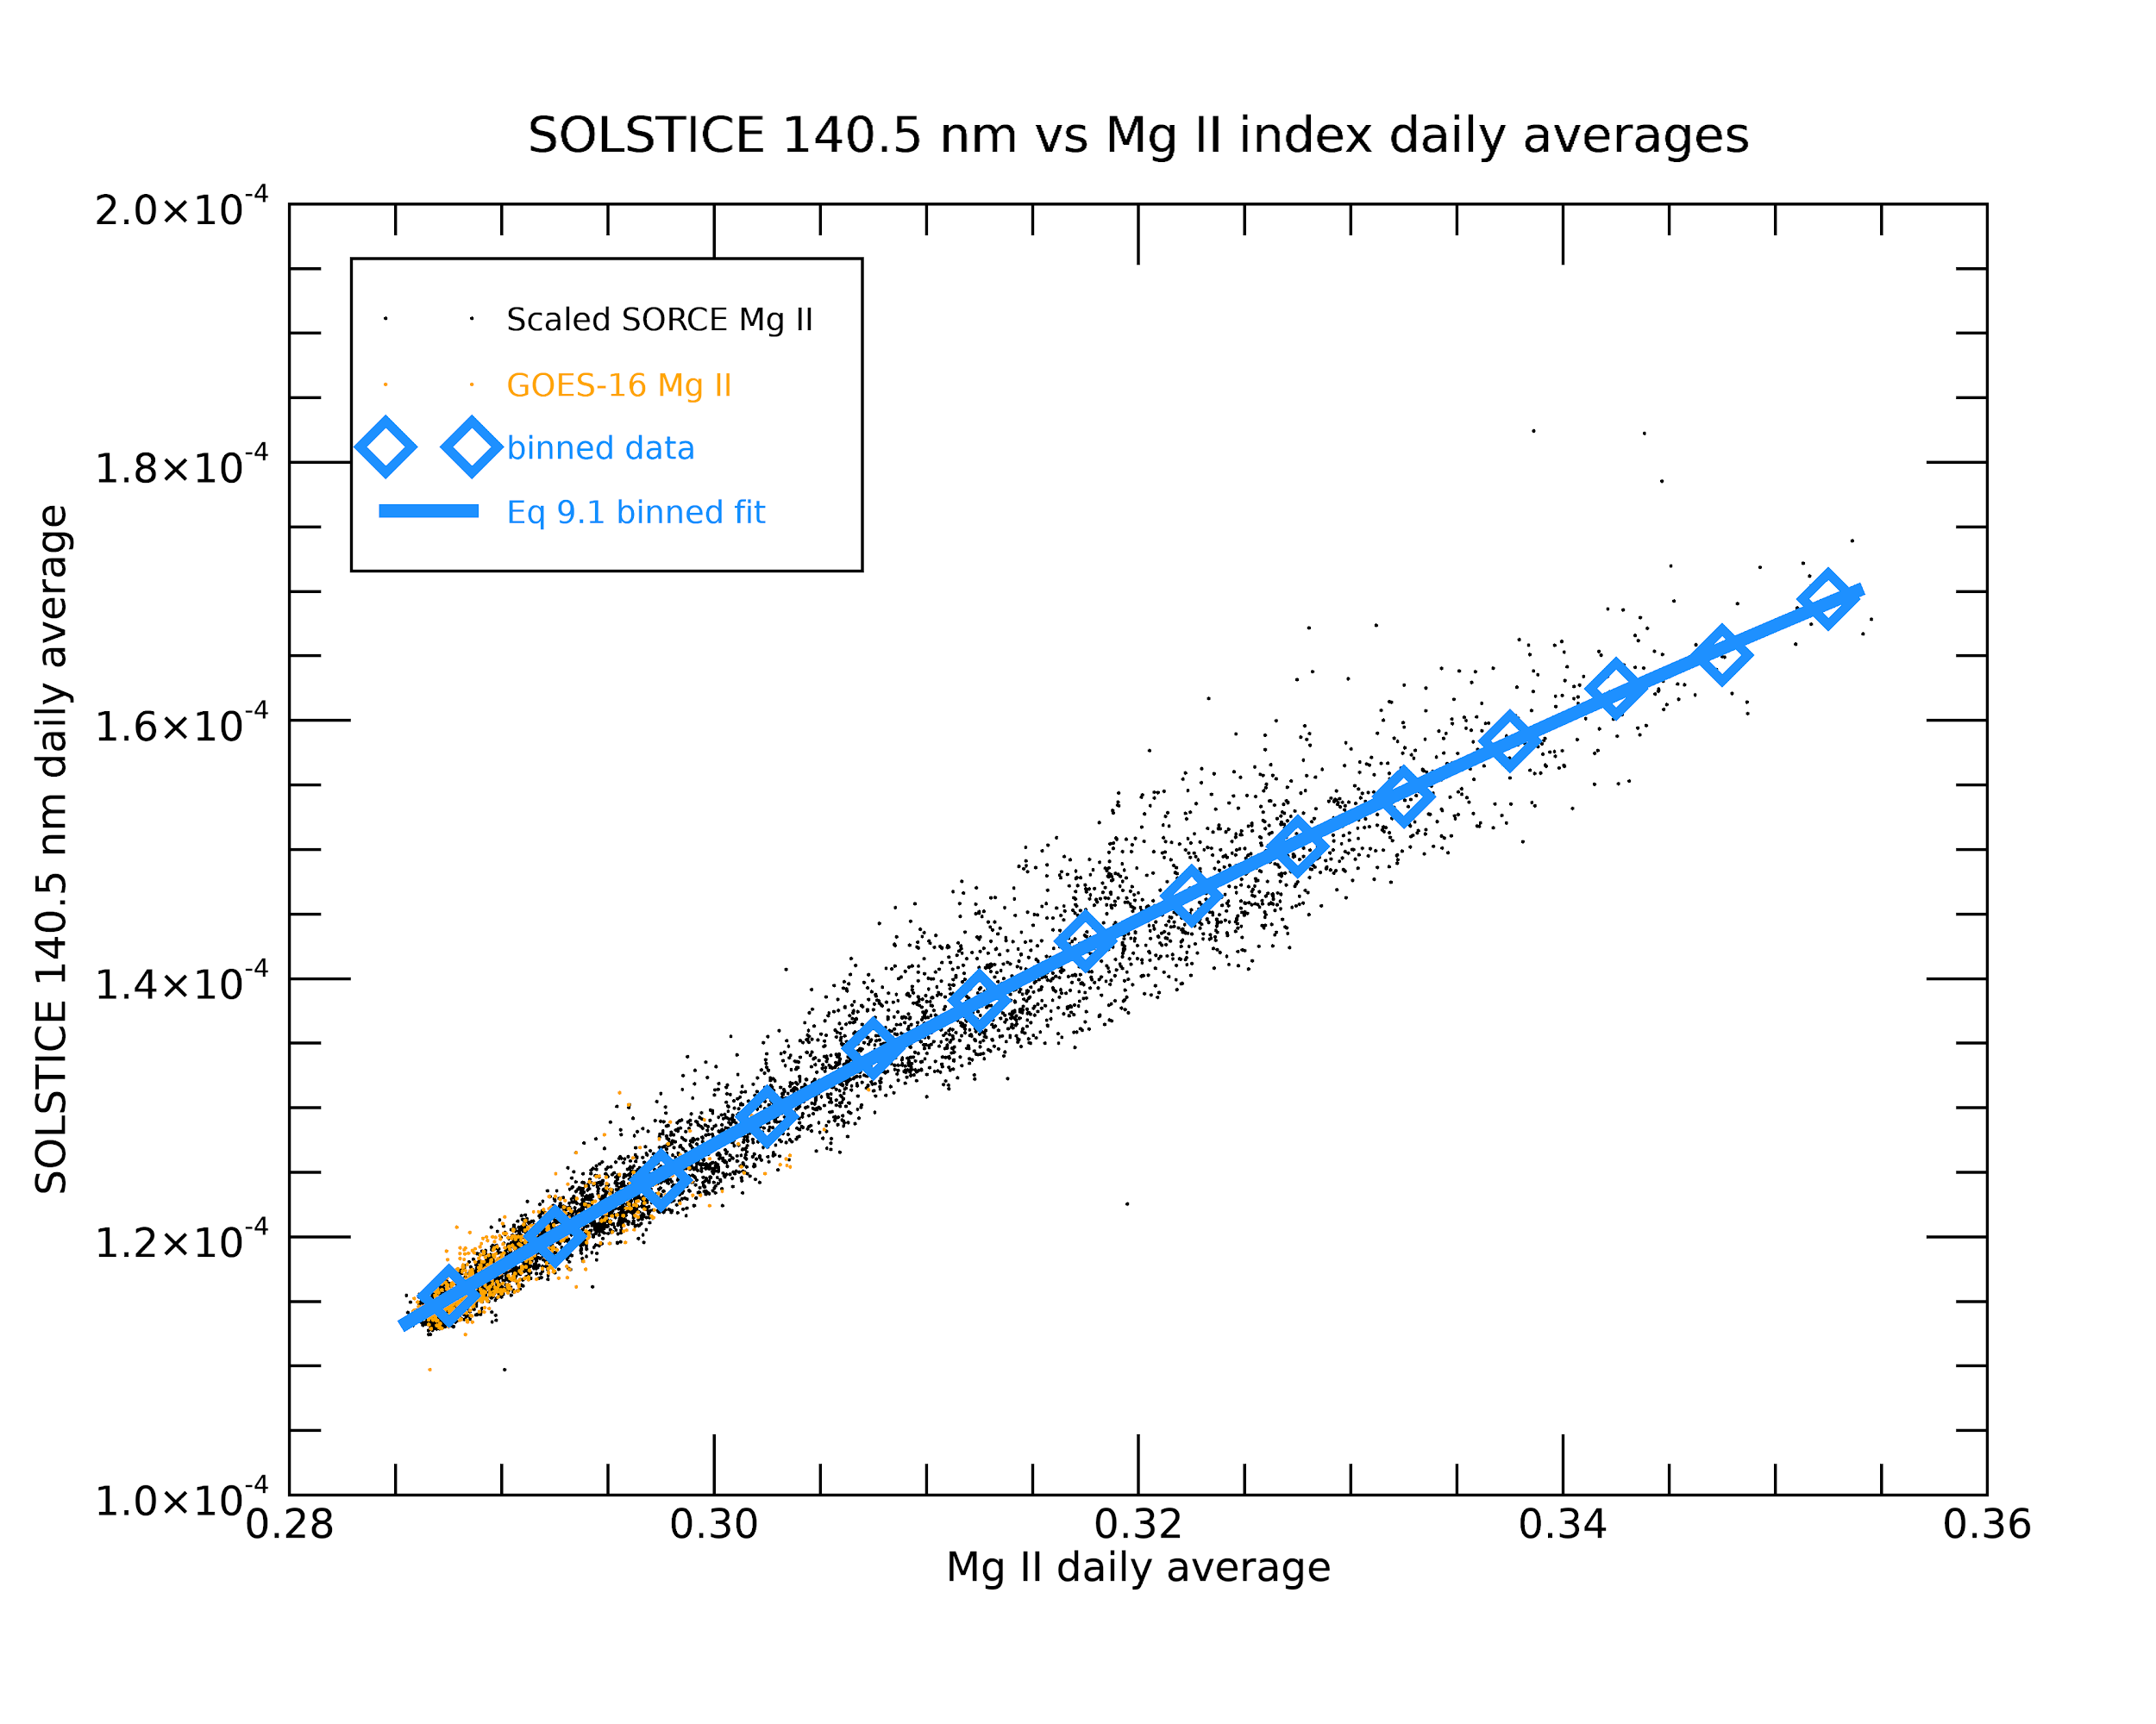
We create proxies of the SOLSTICE irradiances as a function of EUVS Mg II
G16
G17
The blue fits provide the function to create the proxy
Notes:
SOLSTICE corrected degradation, but data ended around 04/2019. No new degradation trends had been made, so we had to develop a method to create a proxy from SORCE data
Saw much larger range of irradiance variability as shown here (SORCE scaled to match EUVS Mg II)

Slide 27
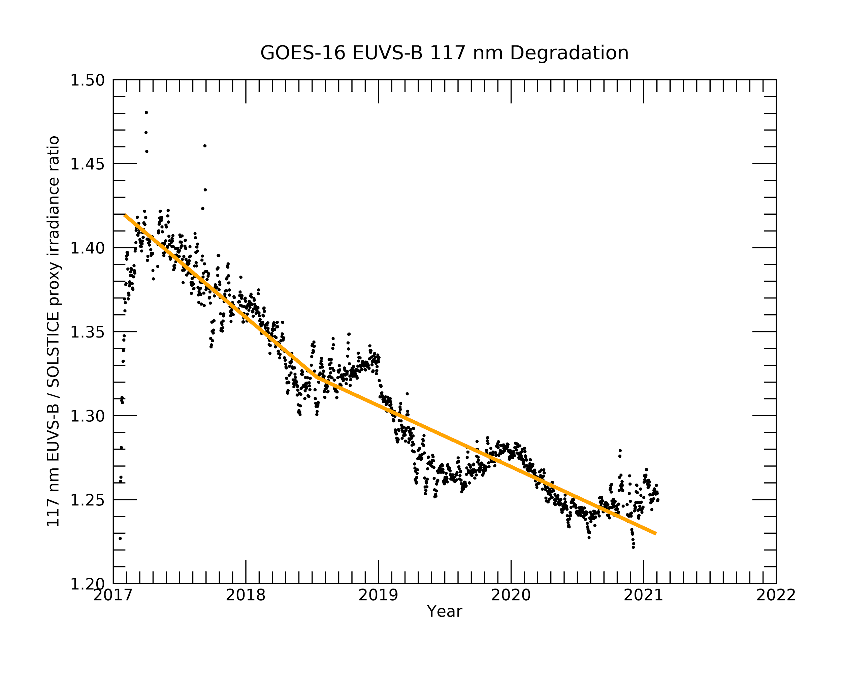
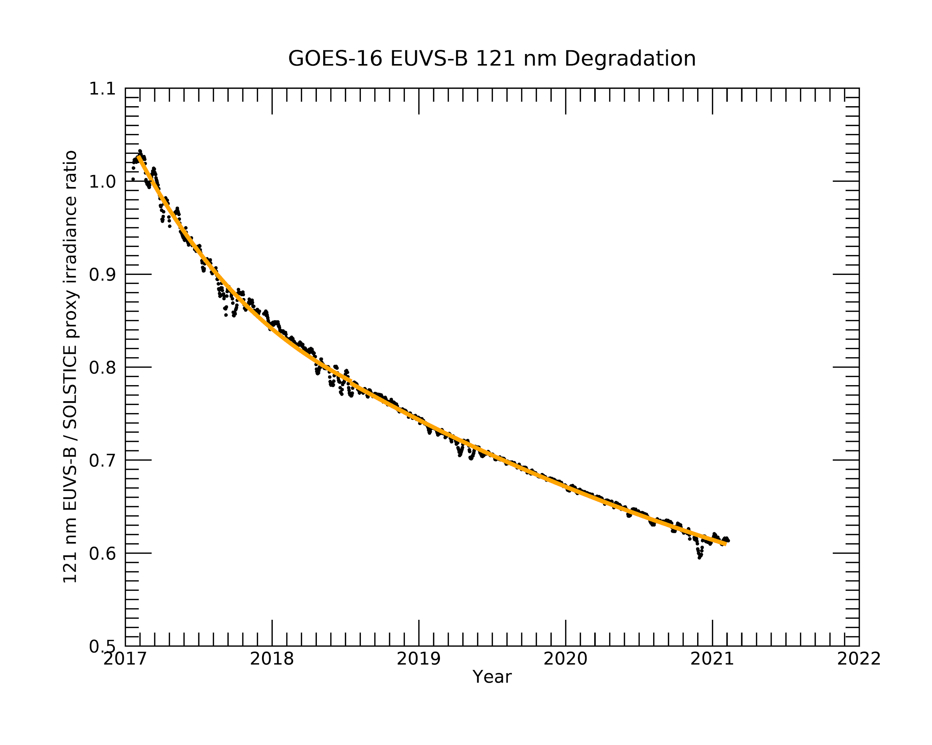
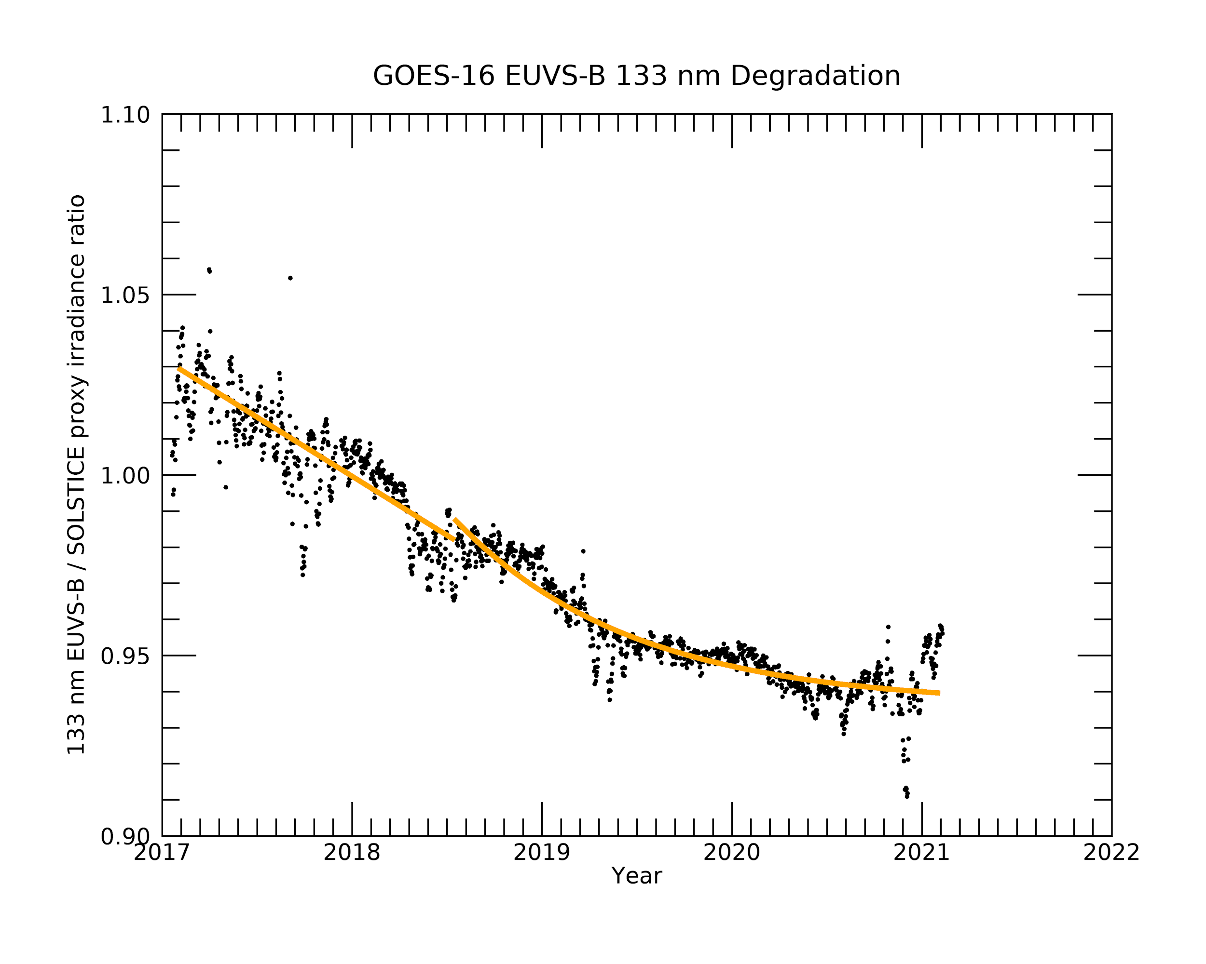
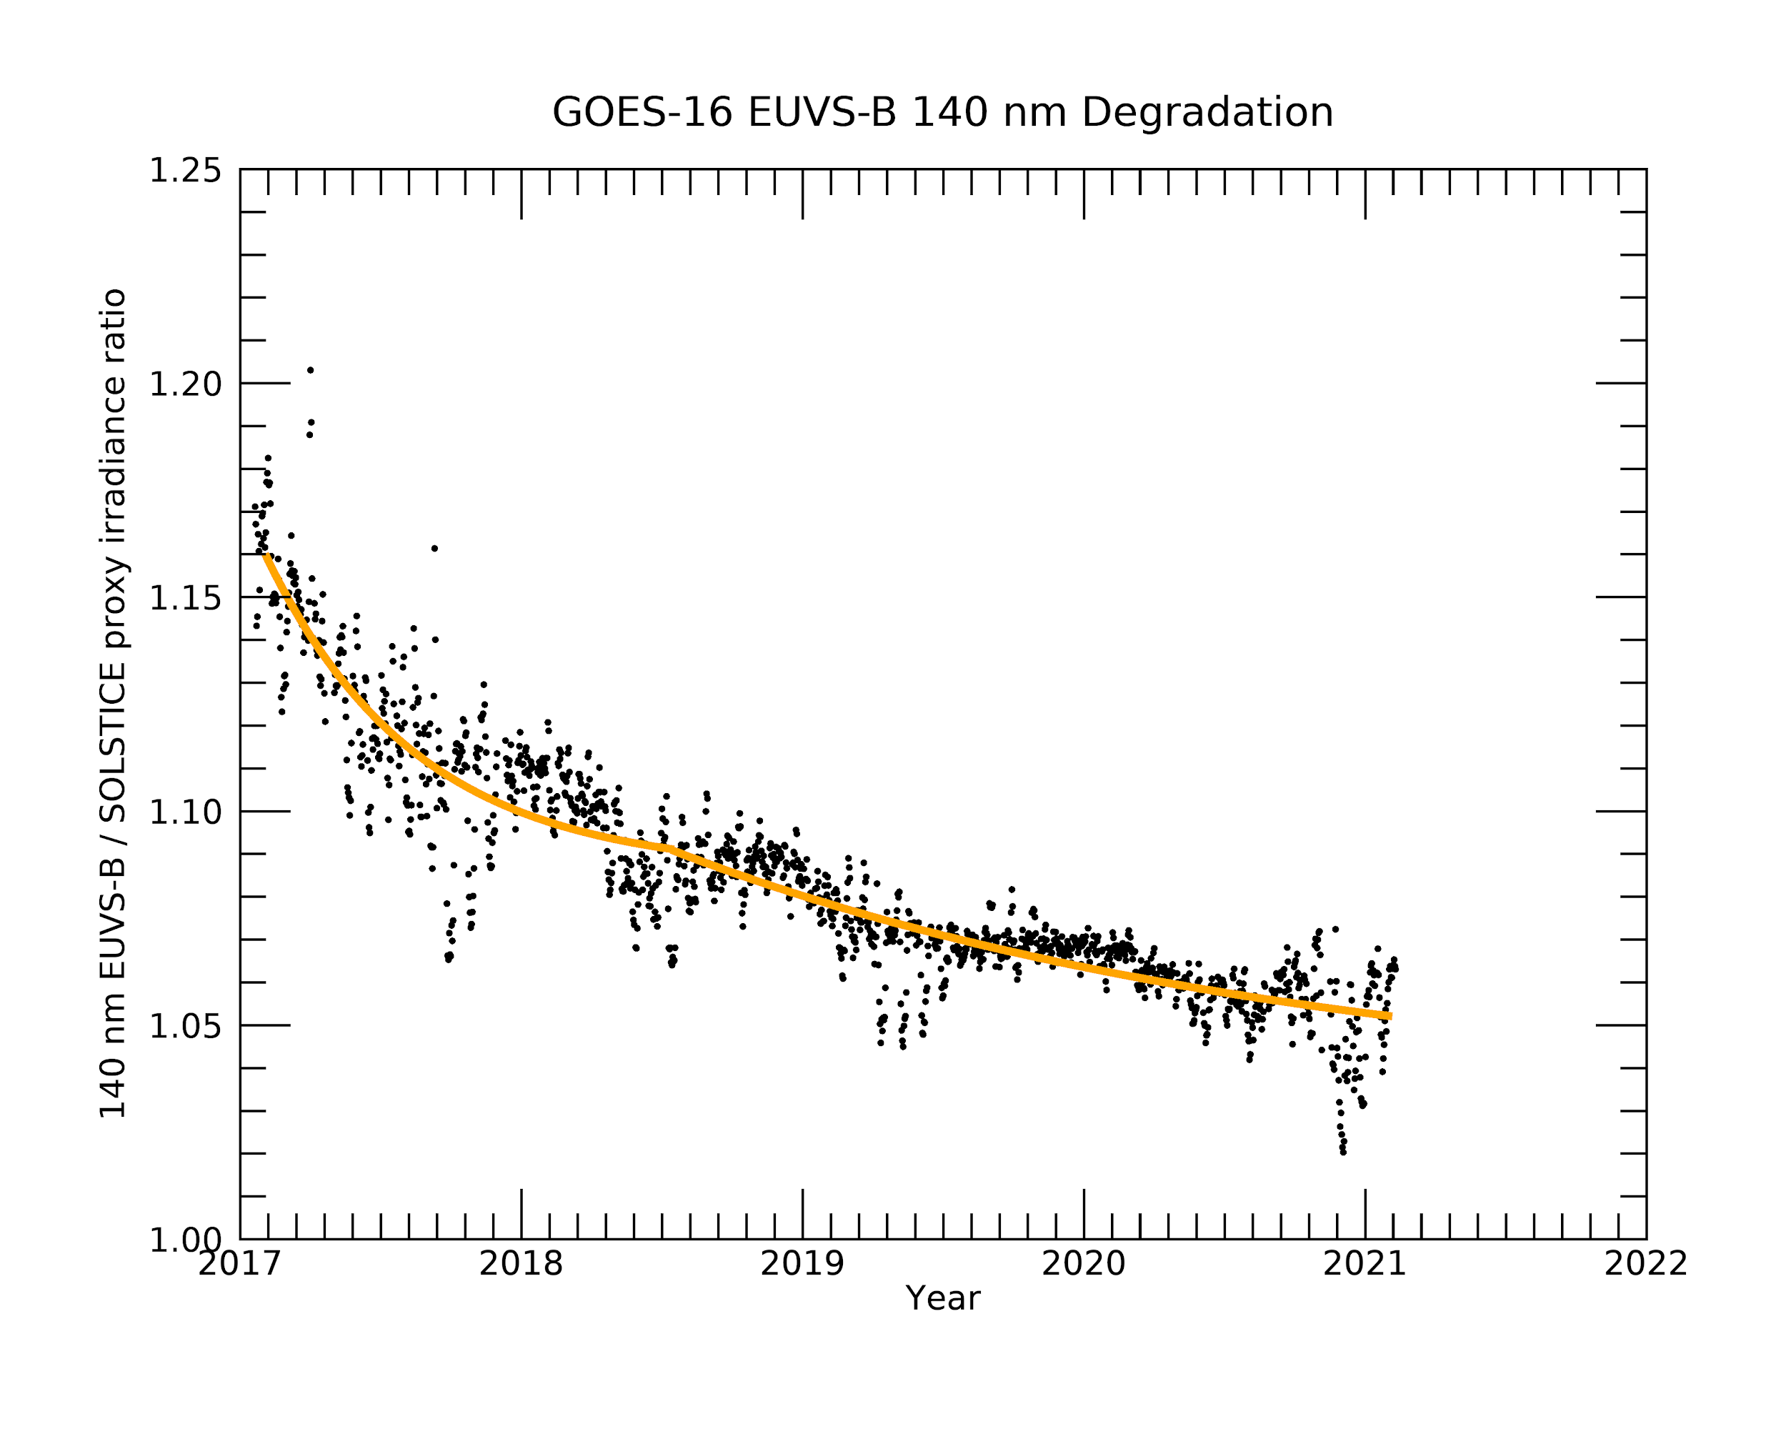
The proxy provides the SOLSTICE irradiance, which is used to derive the EUVS-B degradation factors
G16
G17
Provides degradation trends into future without SORCE/SOLSTICE measurements
Orange = degradation trend
Annual oscillation artifact addressed in “Ongoing investigations” [slide 57]
Notes:
Provides degradation trend into future without SORCE/SOLSTICE measurements
the last time EUVS-B degradation was updated was the end of 2019
Also need to note the oscillations which indicate an annual artifact in the data. Need to resolve this because (1) data has an artifact of several percent, and (2) the degradation correction is harder to fit.

Slide 28
Significant progress in analyzing calibrations and creating new LUTs
EUVS-B degradation trending underwent significant revisions to better correct degradation after good SORCE/SOLSTICE data ended in 04/2019
G16
G17
EUVS calibrations summary

Slide 29
G16
G17
Post-Launch Product Tests (PLPTs) for Full Validation
PLPT | Test Title | Operator | Status | Criteria
14 | XRS/EUVS/Mg II Inter-Satellite Comparisons (L1b) | LASP, NCEI | Pass | none
Full Validation Success Criteria from RIMP v1.1:
For this cross-comparison, there is no pass/fail on the result itself.
Data analysis performed with L1b and L2 data, from locally processed L0 data.

Slide 30
G16
G17
PLPT 14: EUVS-A inter-satellite comparisons for GOES-16 and 17
EUVS-A line | GOES-16 vs GOES-17 agreement* | GOES-16 vs GOES-17 offset
25.6 nm | 3.5% | 1.1%
28.4 nm | 15% | 1.2%
30.4 nm | 1% | 0.6%
*Based on 2 standard deviations (95%)

Slide 31
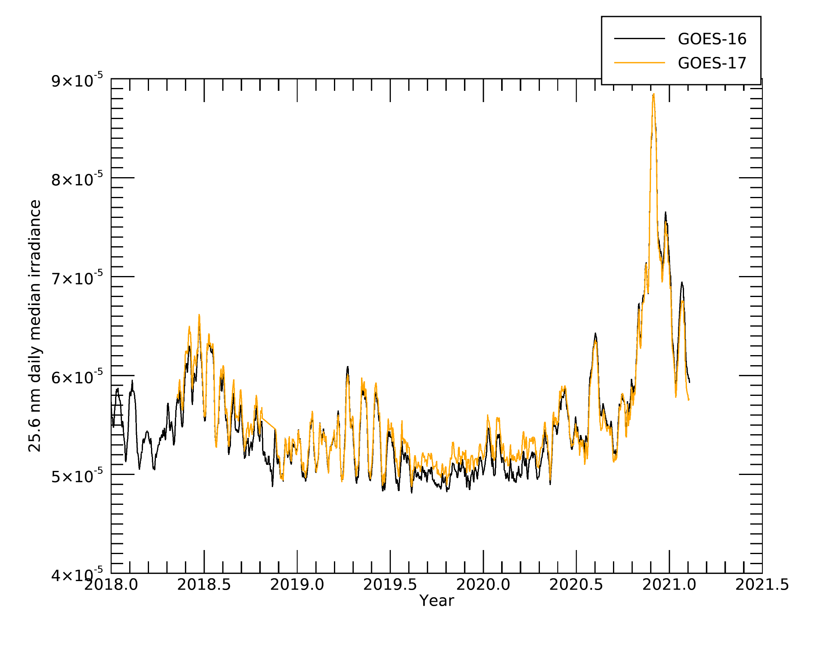
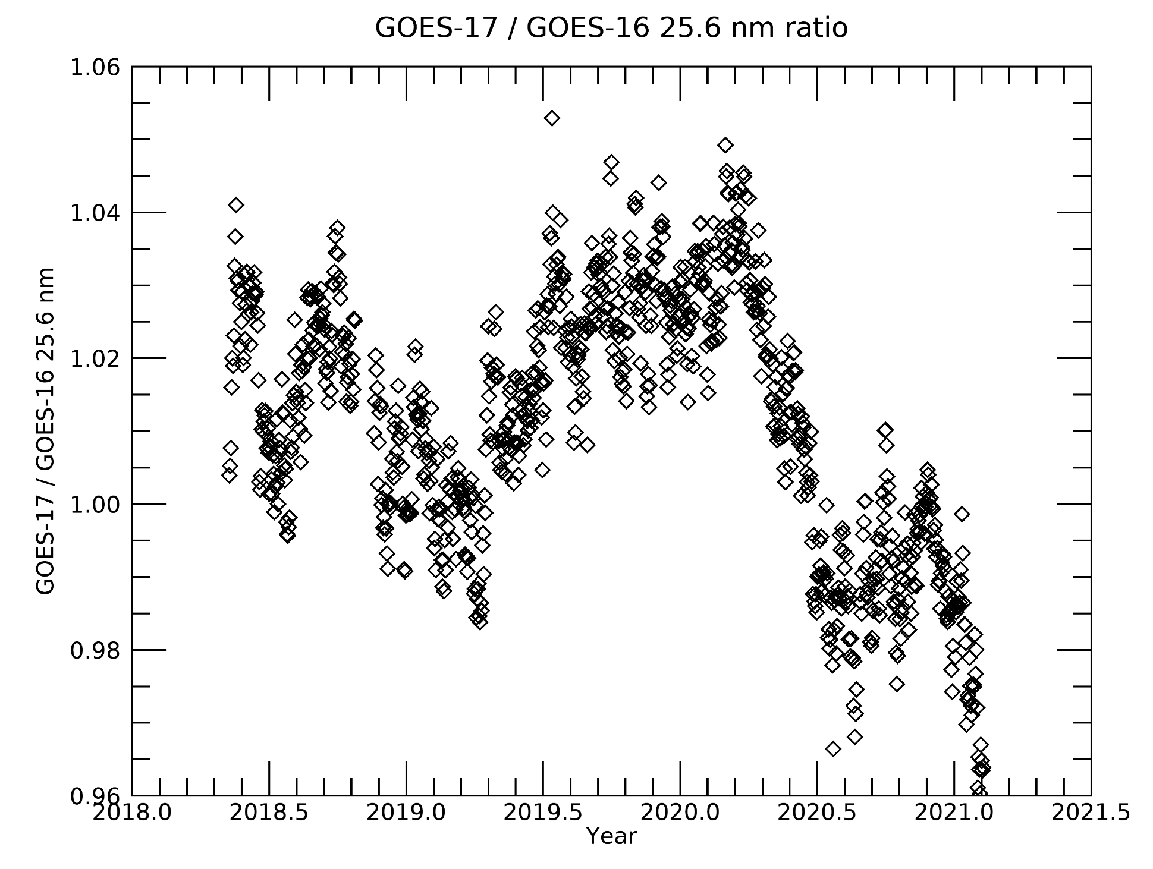
EUVS-A GOES-16 vs GOES-17 25.6 nm agree within 3.5%*
G16
G17
Mean: 1.011
St. Dev.: 0.0176
Plots made using NCEI data
ECI excluded
*2 standard deviations (95%)
Notes:
Different resistor installed on FM2, 3, 4 to suppress temperature dependence. Likely cause of the difference between the two instruments
ECI is excluded

Slide 32
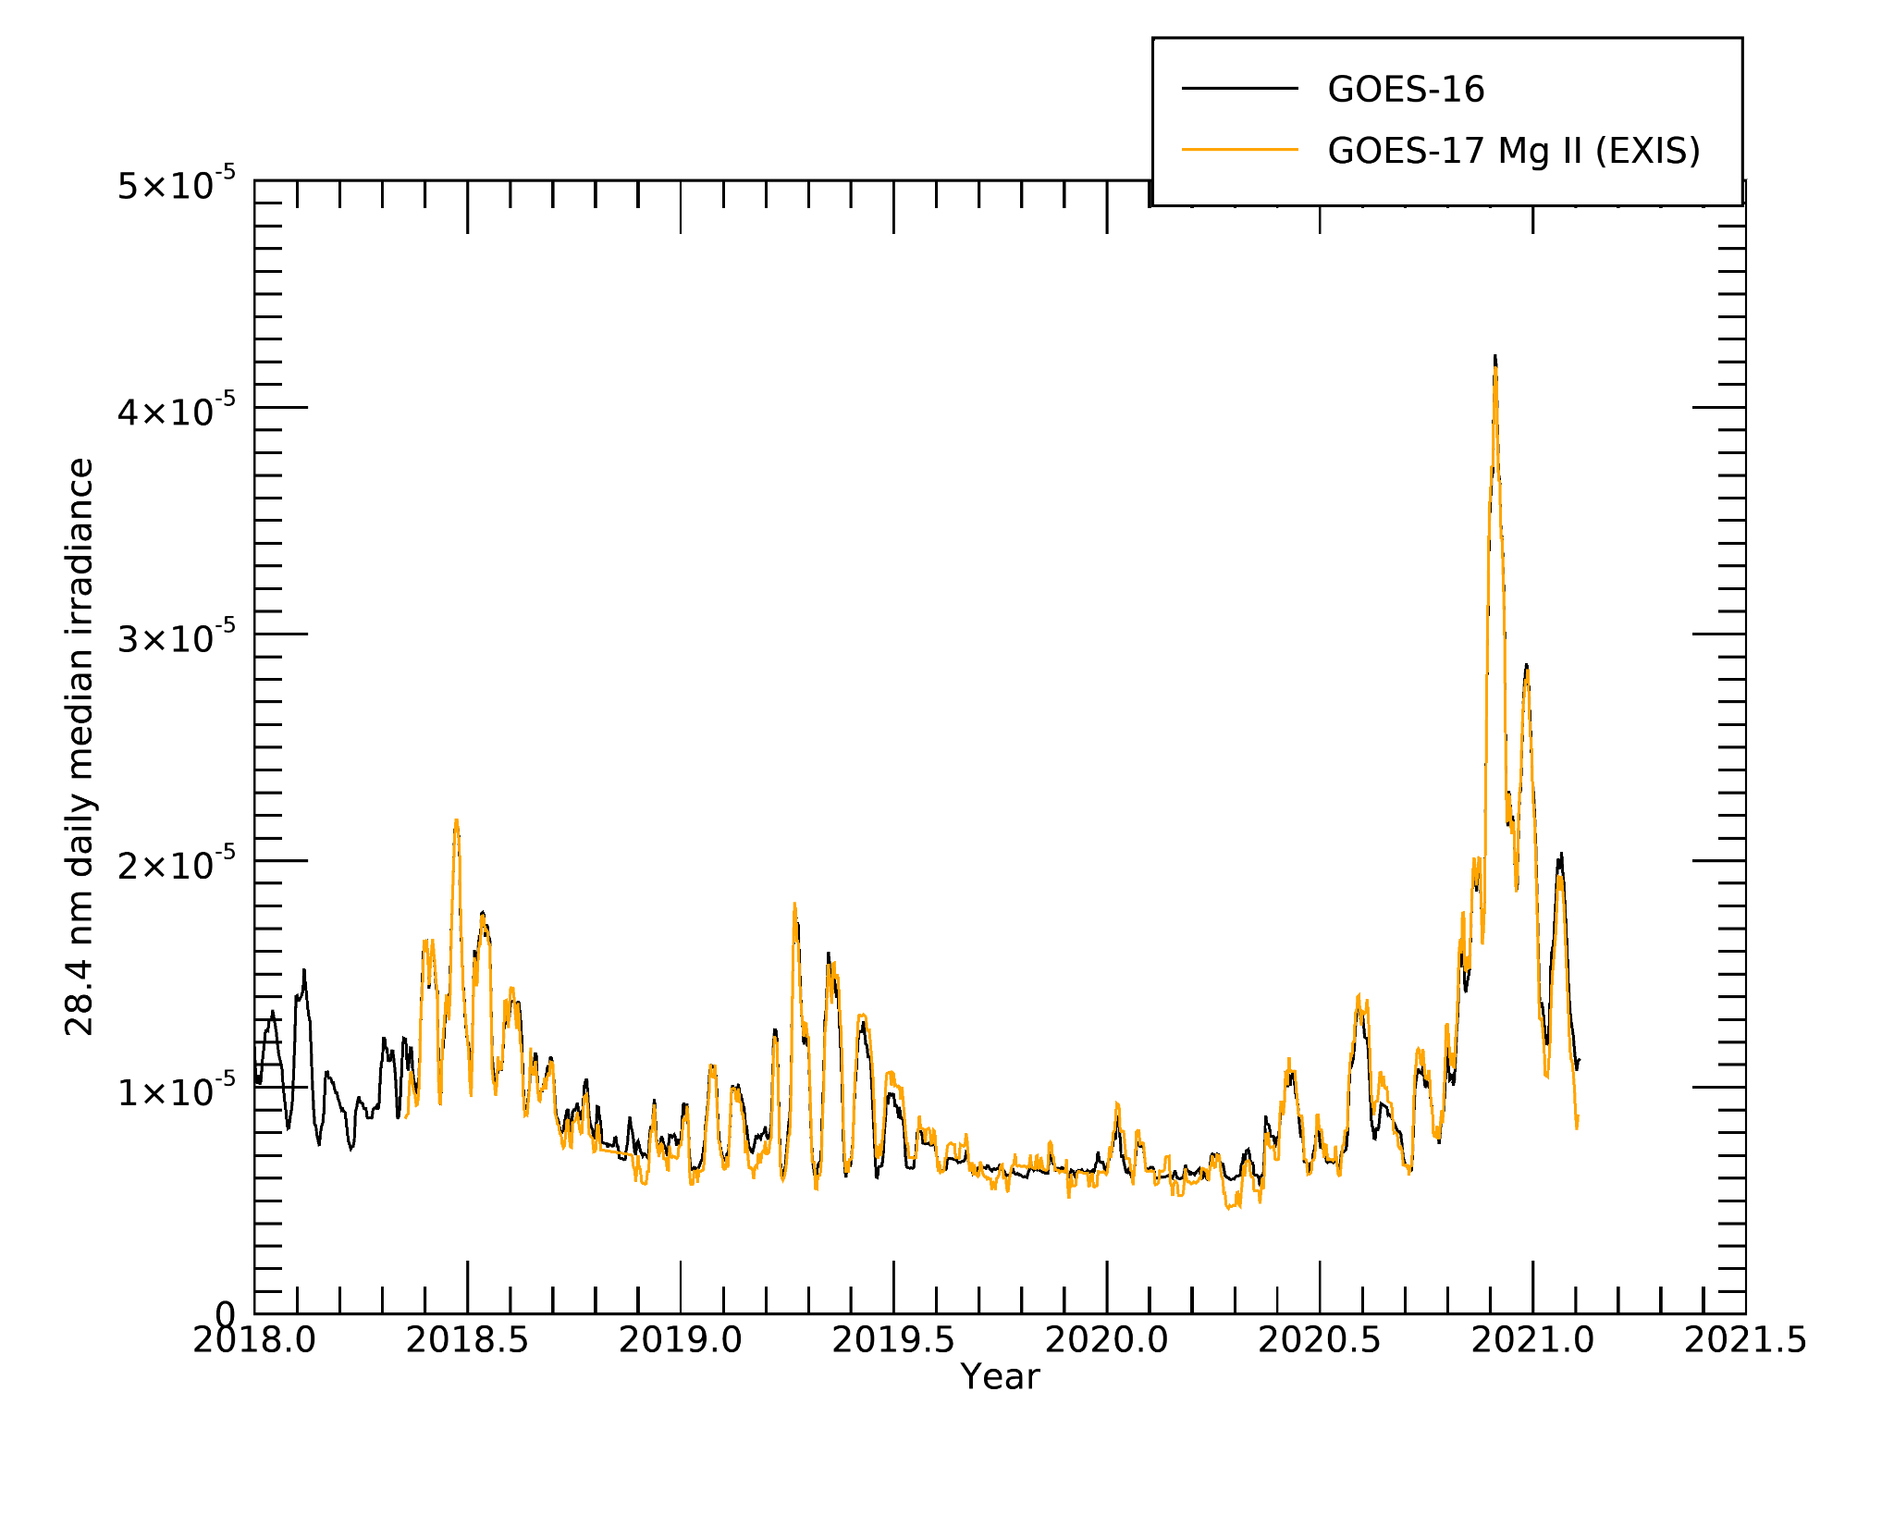
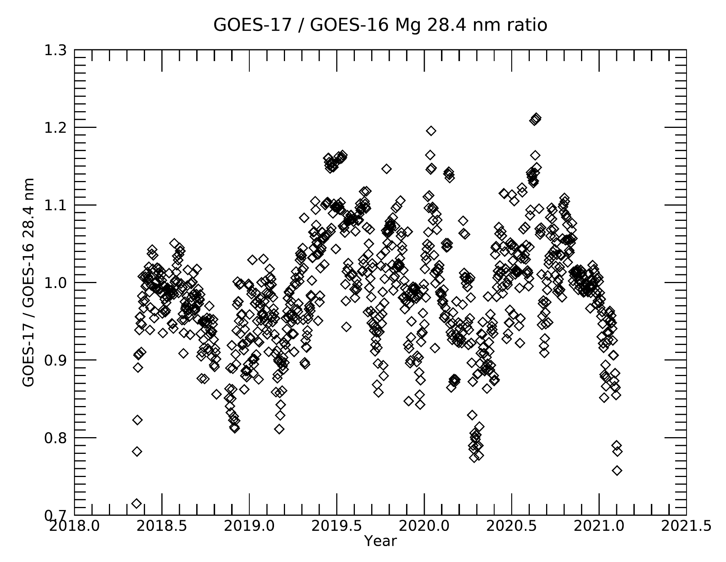
EUVS-A GOES-16 vs GOES-17 28.4 nm agree within 15%
G16
G17
Mean: 0.988
St. Dev.: 0.0746
Plots made using NCEI data
ECI excluded
*2 standard deviations (95%)
Notes:
Different resistor installed on FM2, 3, 4 to suppress temperature dependence. Likely cause of the difference between the two instruments

Slide 33
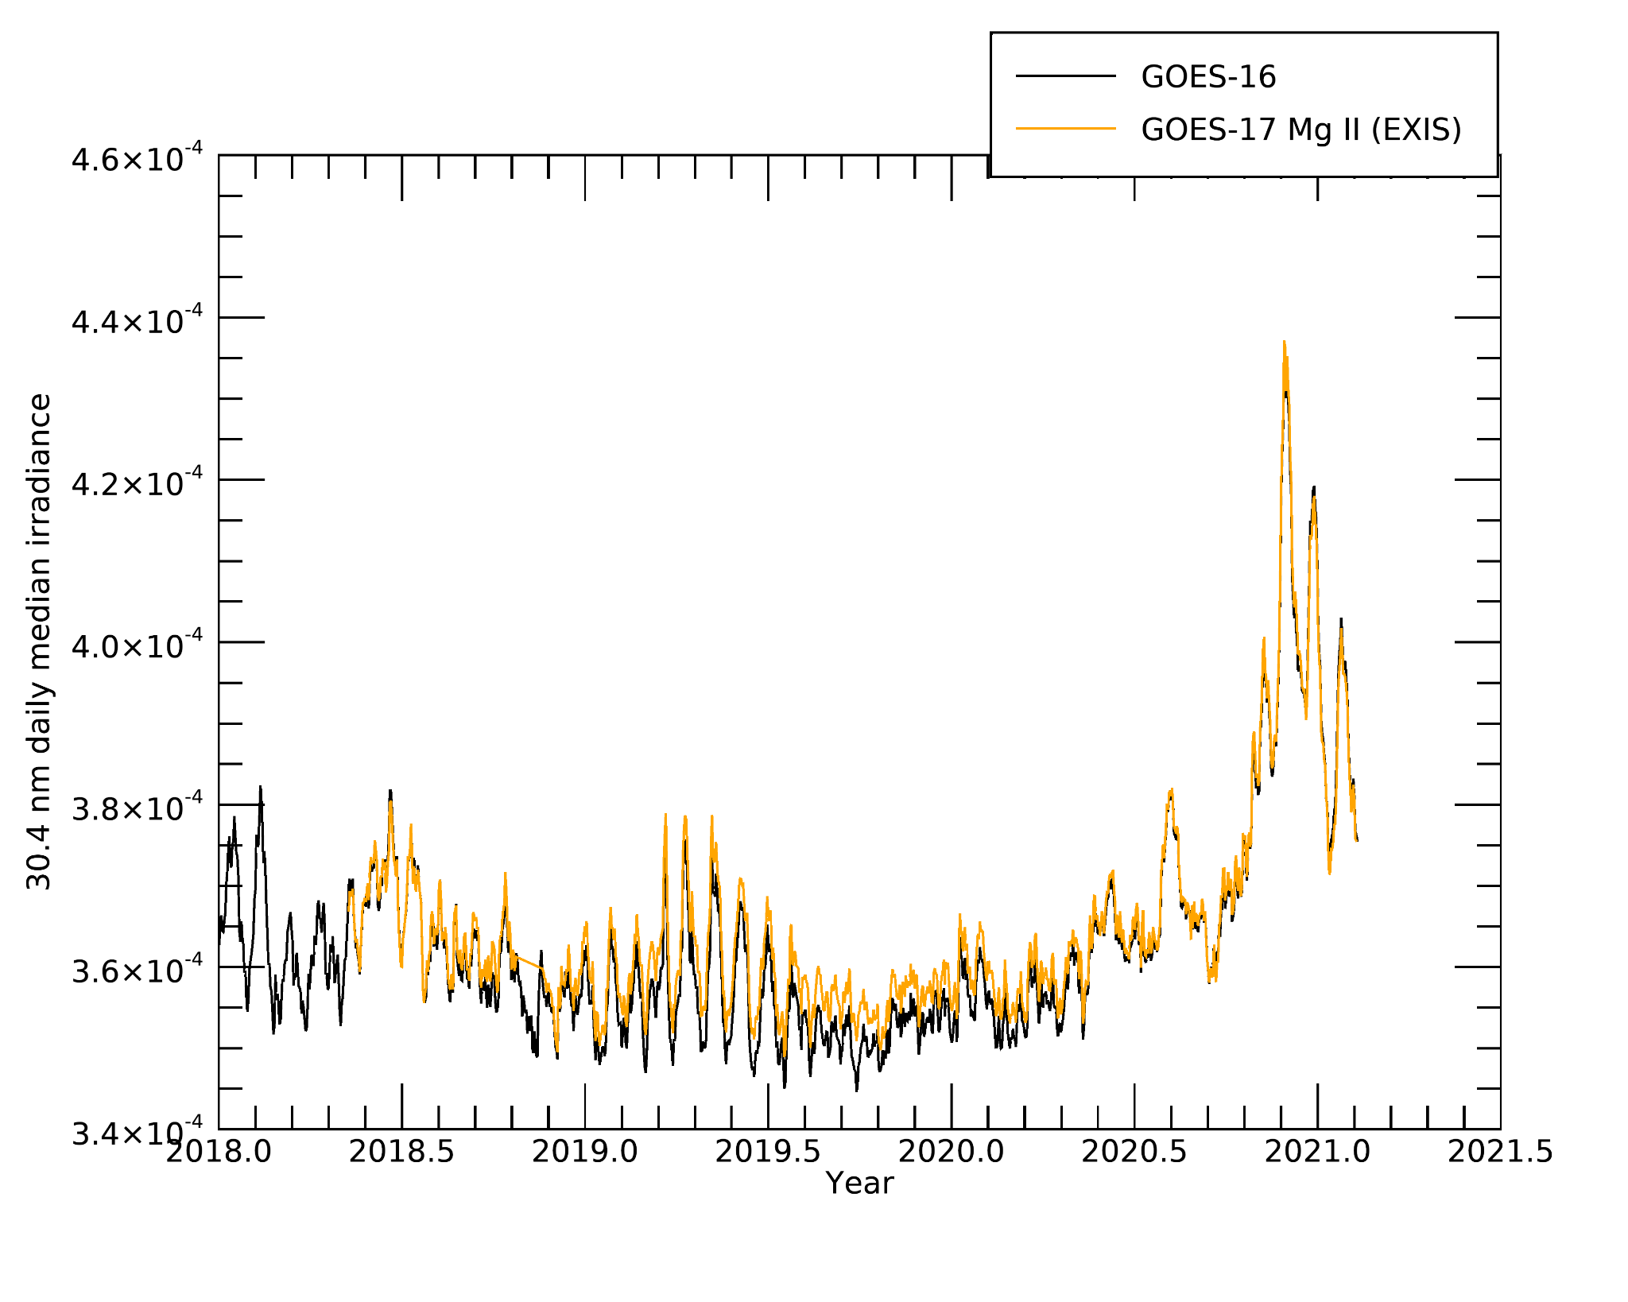
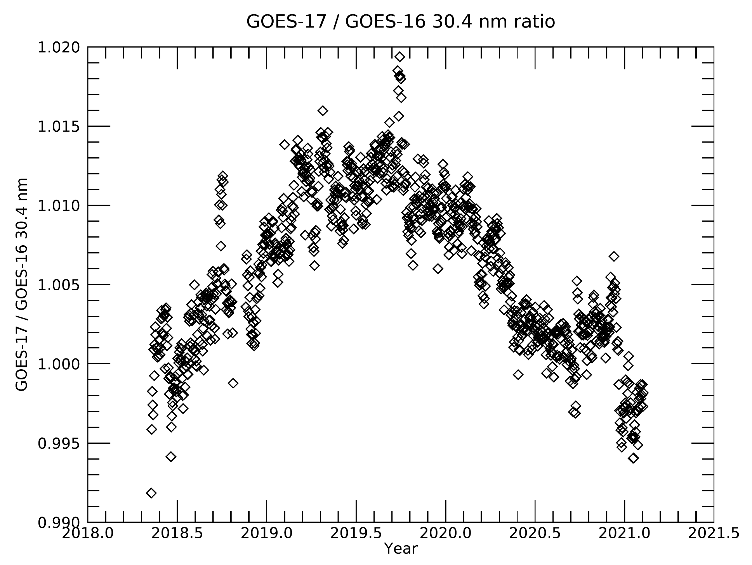
EUVS-A GOES-16 vs GOES-17 30.4 nm agree within 1%
G16
G17
Mean: 1.006
St. Dev.: 0.0050
Plots made using NCEI data
ECI excluded
*2 standard deviations (95%)

Slide 34
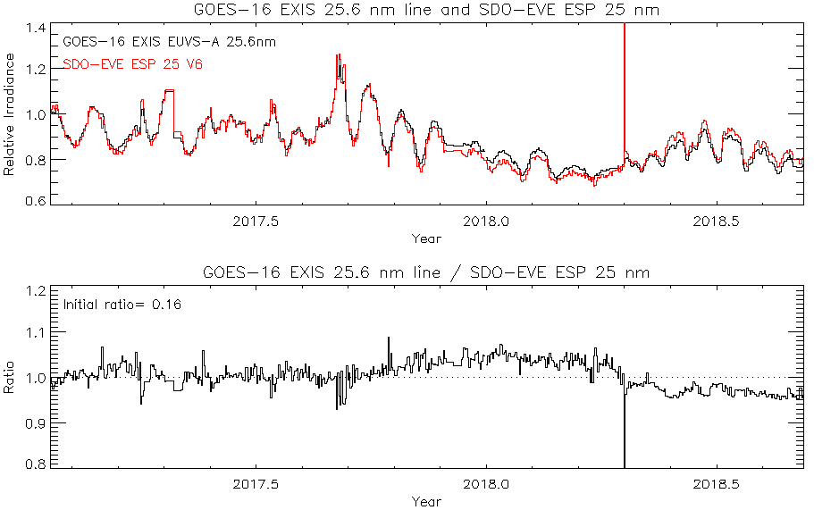
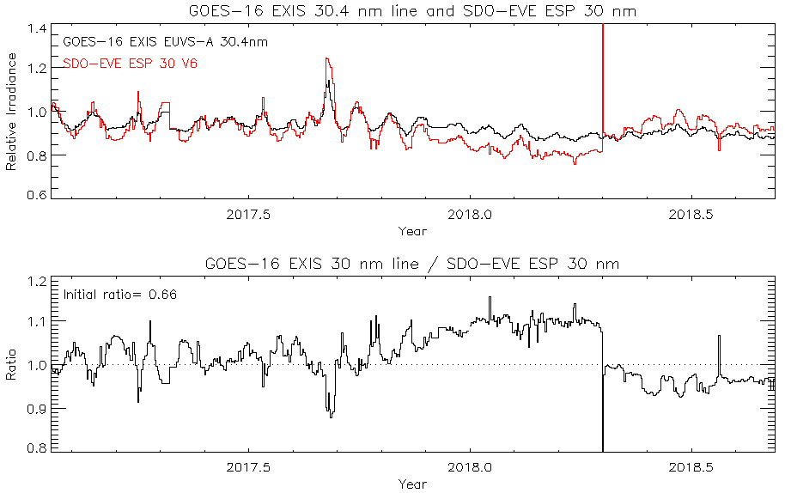
EUVS-A GOES-16 25.6 nm and 30.4 nm vs EVE ESP broadband diode
G16
EUVS-A filter degradation captured long-term degradation through 2018
Plots courtesy of LASP
Notes:
ESP windows centered on 18.9, 25.4, 29.8, and 36.1 nm with 4.4 nm window

Slide 35
G16
G17
PLPT 14: EUVS-B inter-satellite comparisons for GOES-16 and 17
EUVS-B line | GOES-16 vs GOES-17 agreement* | GOES-16 vs GOES-17 offset
117.5 nm | 5.5% | 0.02%
121.6 nm | 1.3% | 0.4%
133.5 nm | 1.3% | 0.1%
140.5 nm | 3.5% | 1.5%
*Based on 2 standard deviations (95%)
Notes:
4 wavelengths, 2 slides per wavelength
First vs SOLSTICE then vs each other

Slide 36
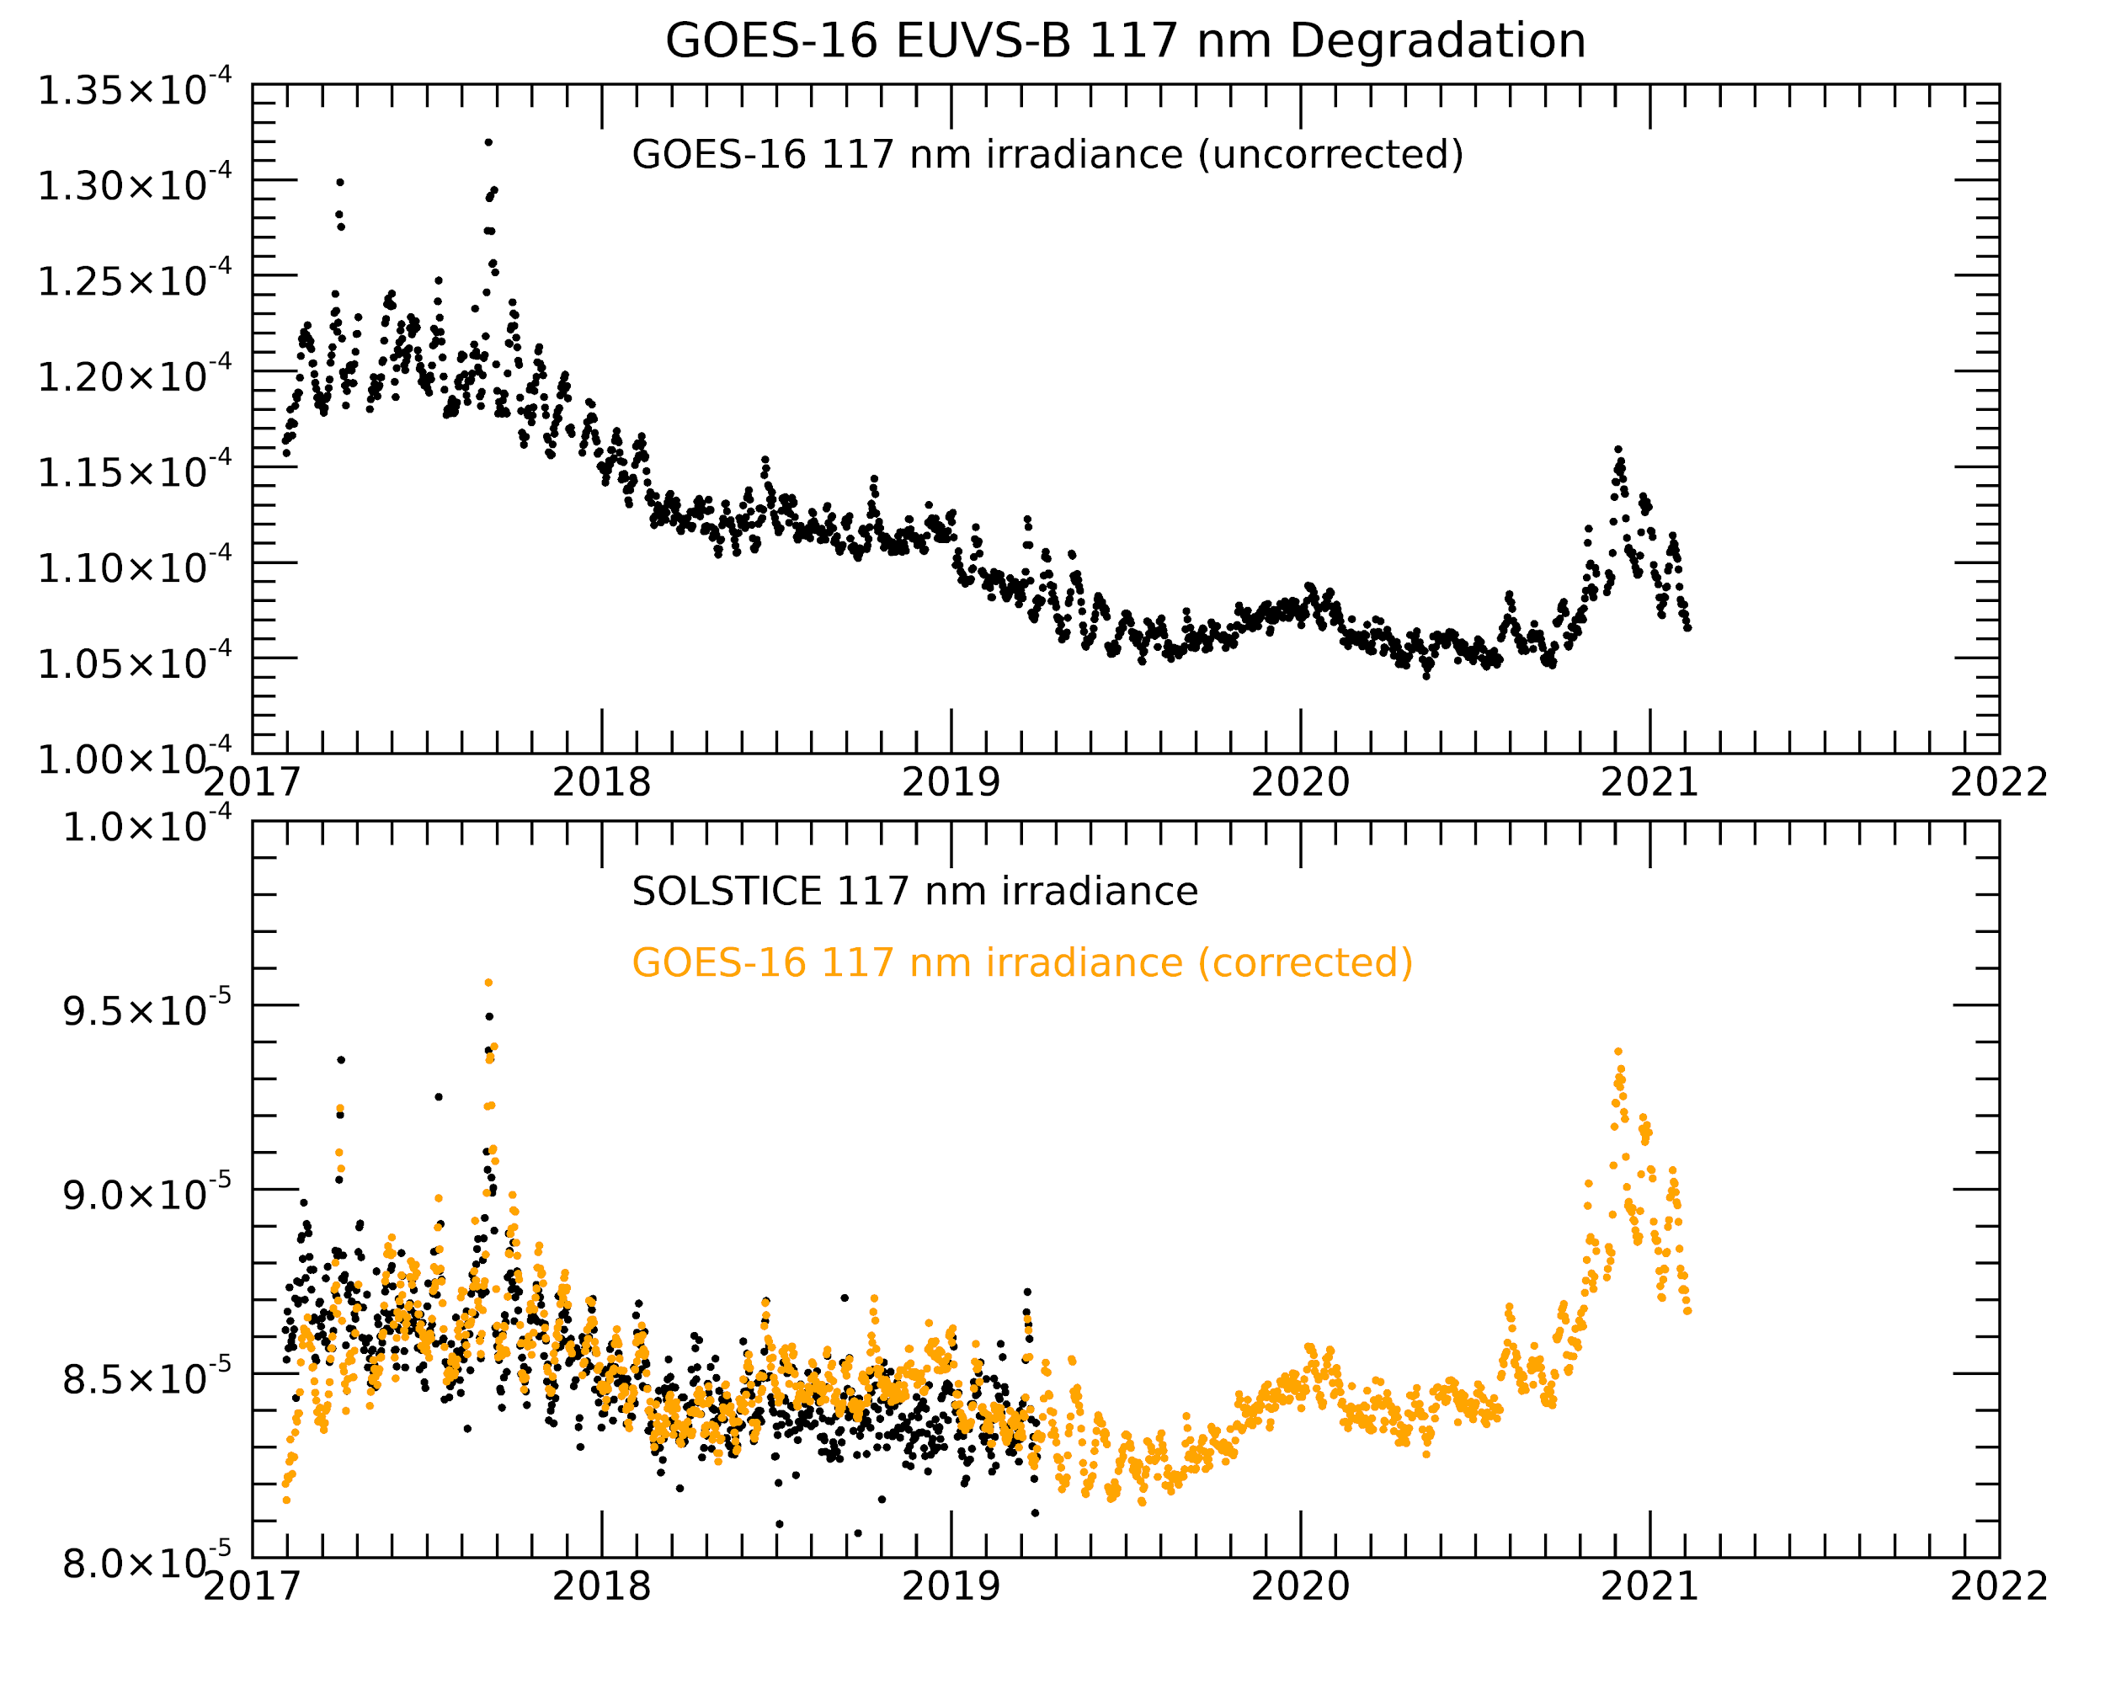
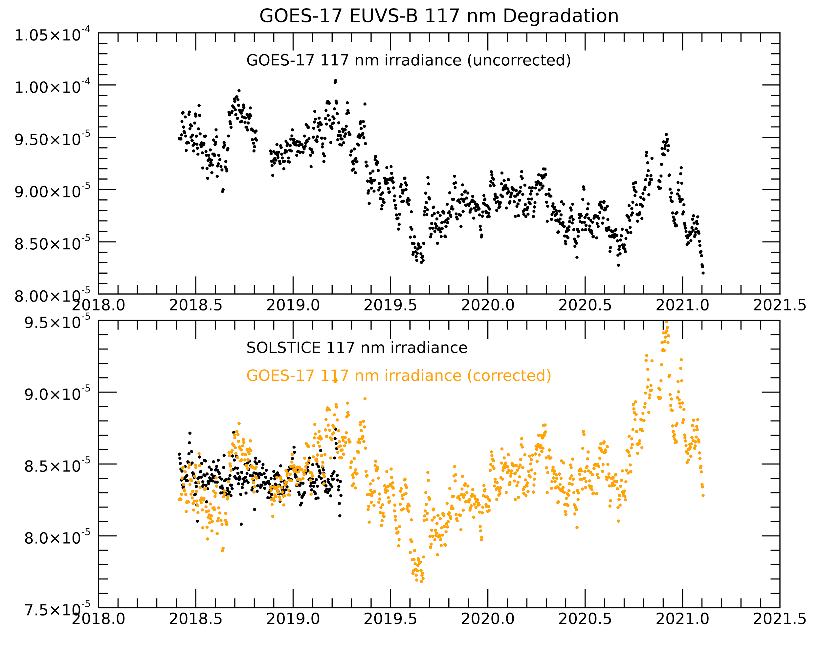
EUVS-B GOES-16 and 17 117.5 nm irradiance qualitatively agree with SOLSTICE after degradation correction
G16
G17
Irradiance (W/m2/nm)
Irradiance (W/m2/nm)
Irradiance (W/m2/nm)
Irradiance (W/m2/nm)
Plots made using NCEI data
ECI excluded
Notes:
All slides are daily values of the irradiances

Slide 37
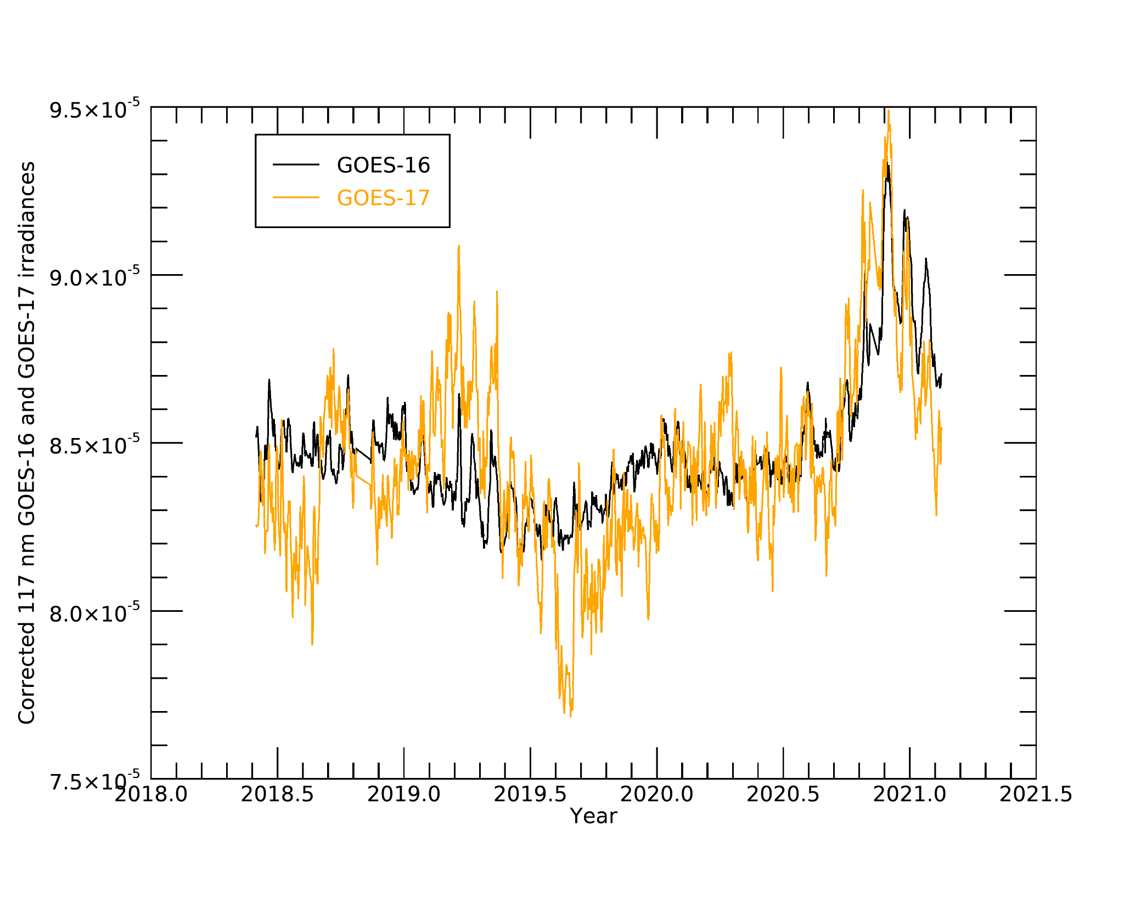
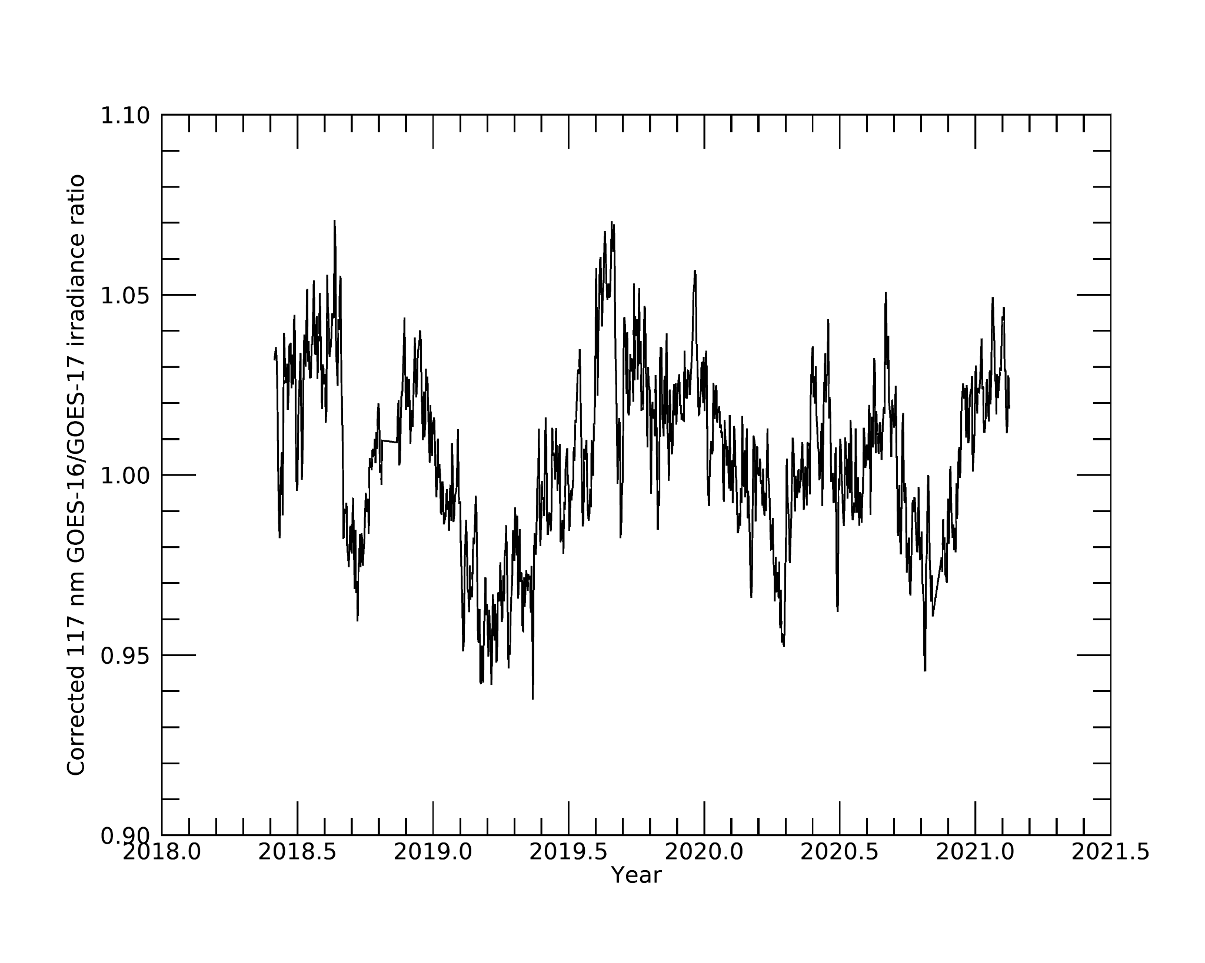
EUVS-B GOES-16 vs GOES-17 117.5 nm agree within 5.5%*
G16
G17
Mean: 1.0002
St. Dev.: 0.0276
Plots made using NCEI data
ECI excluded
*2 standard deviations (95%)

Slide 38
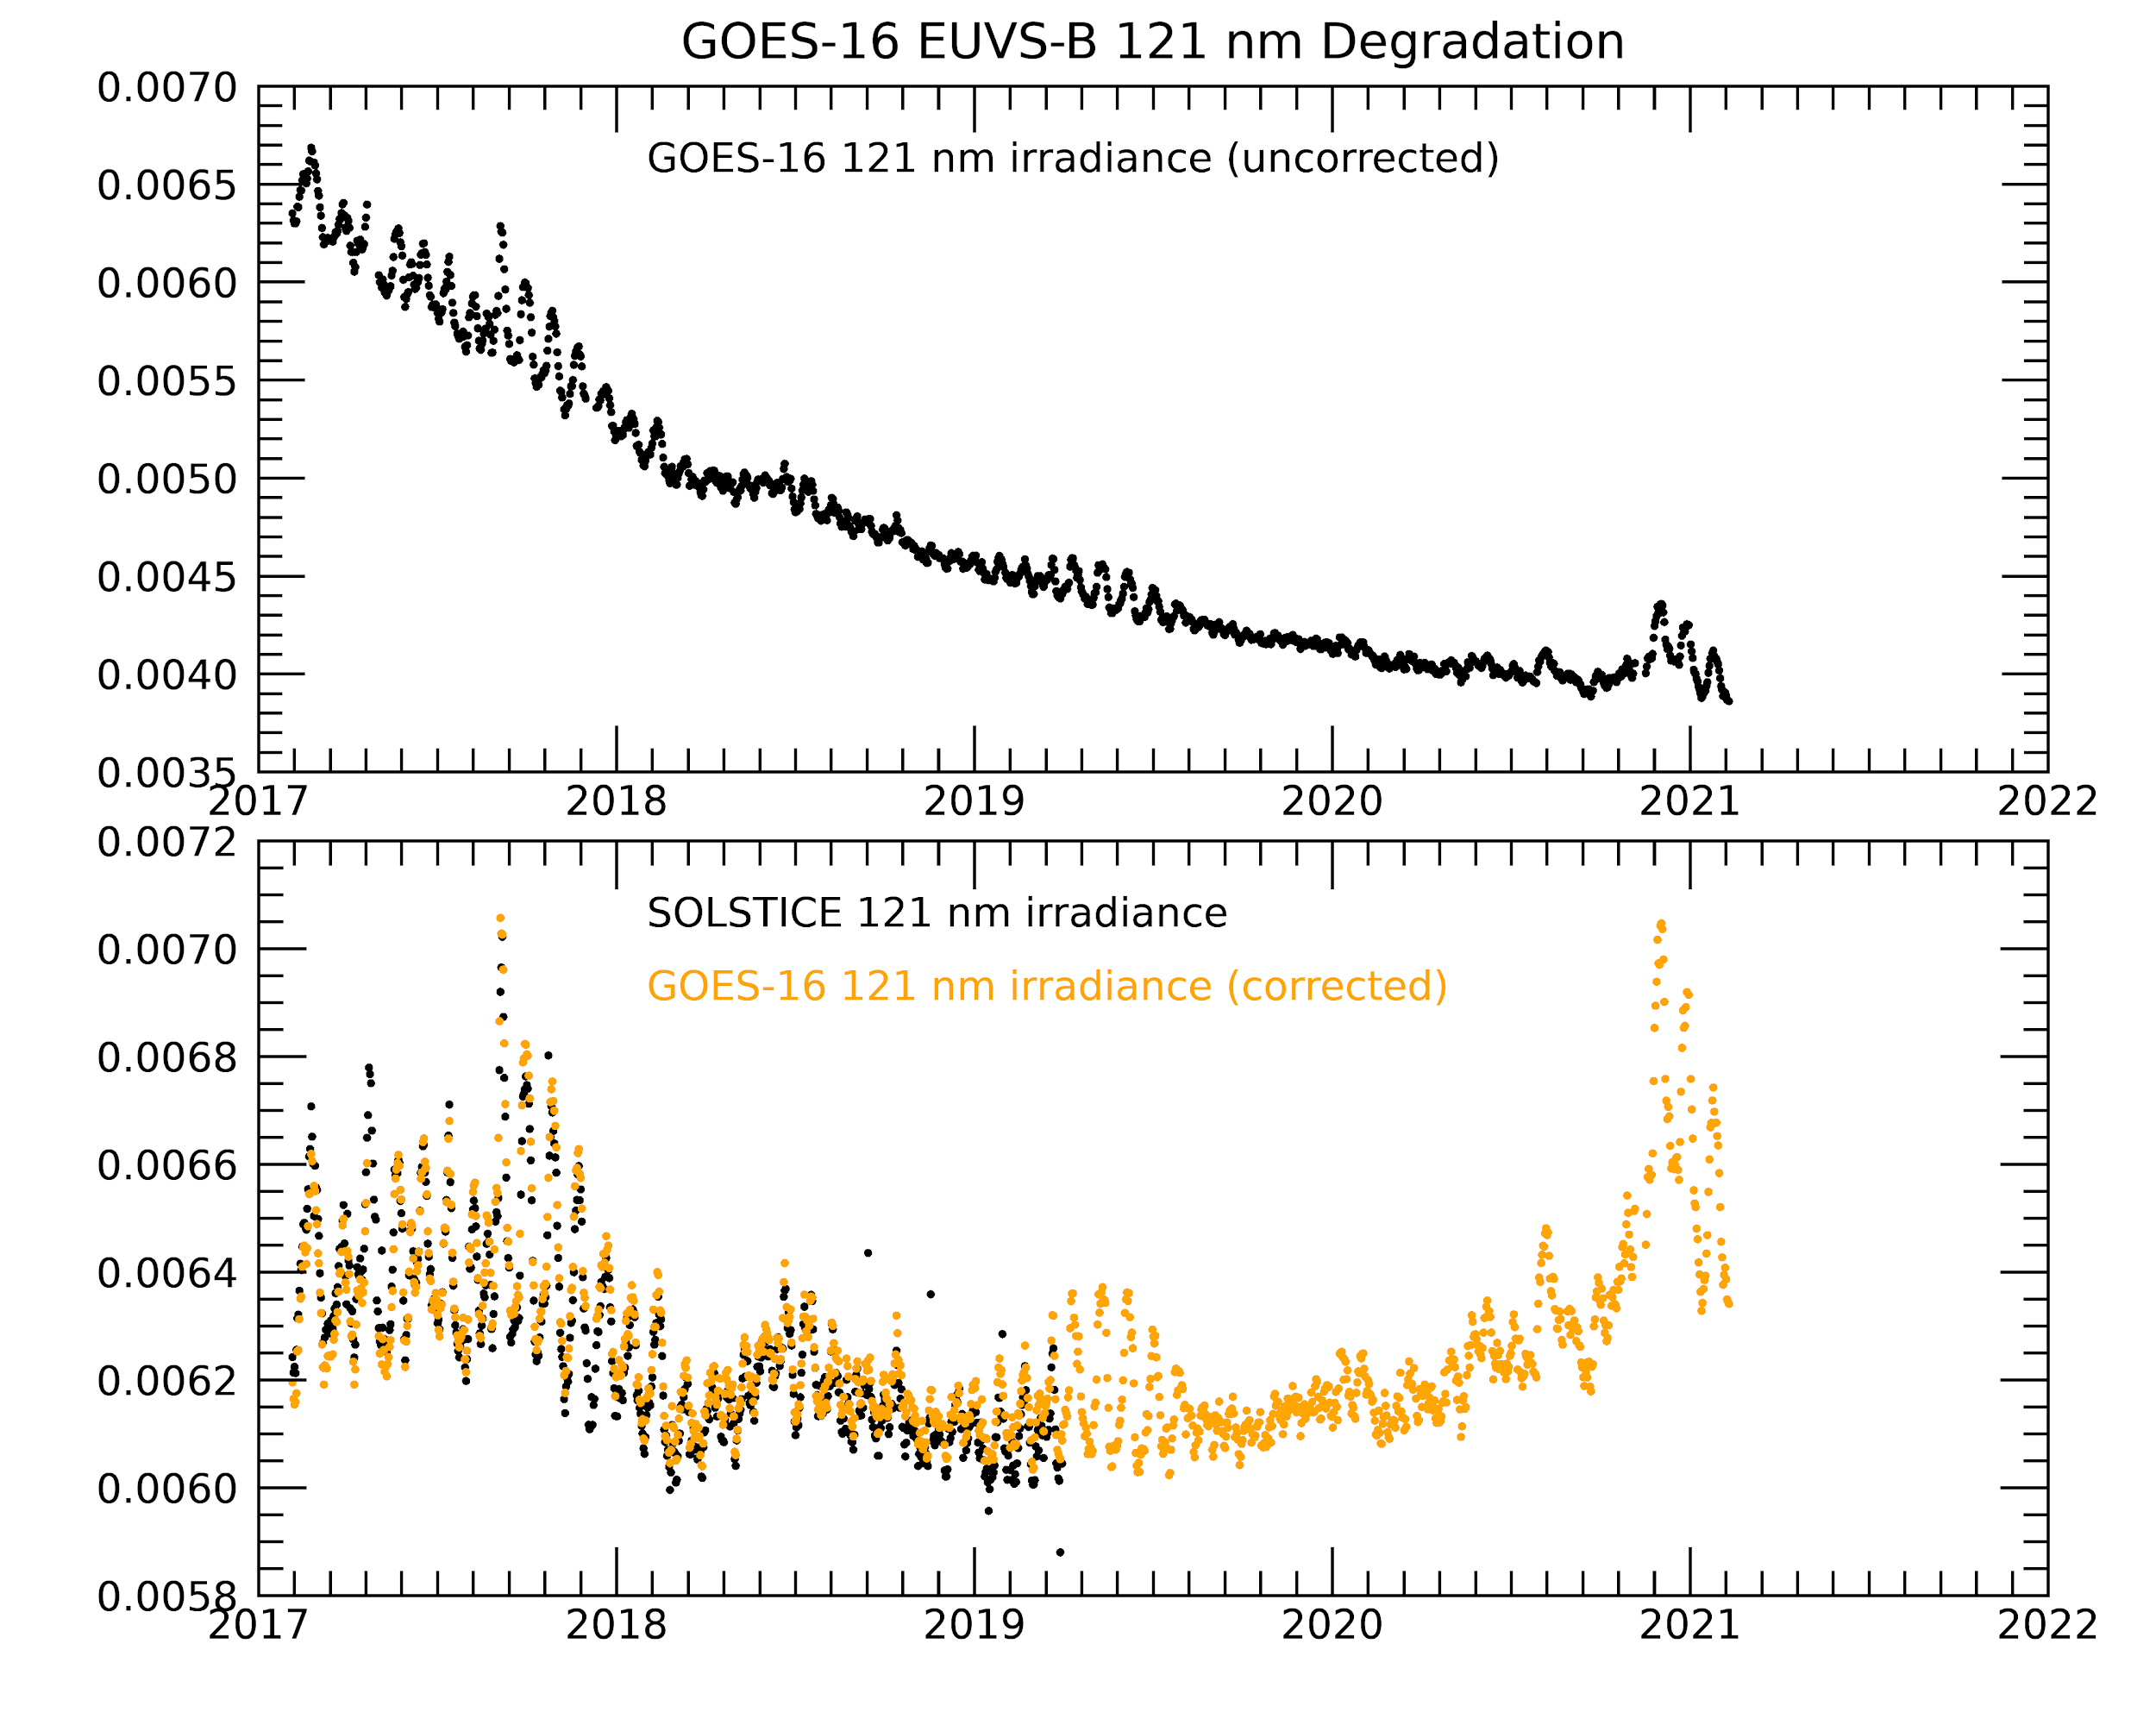
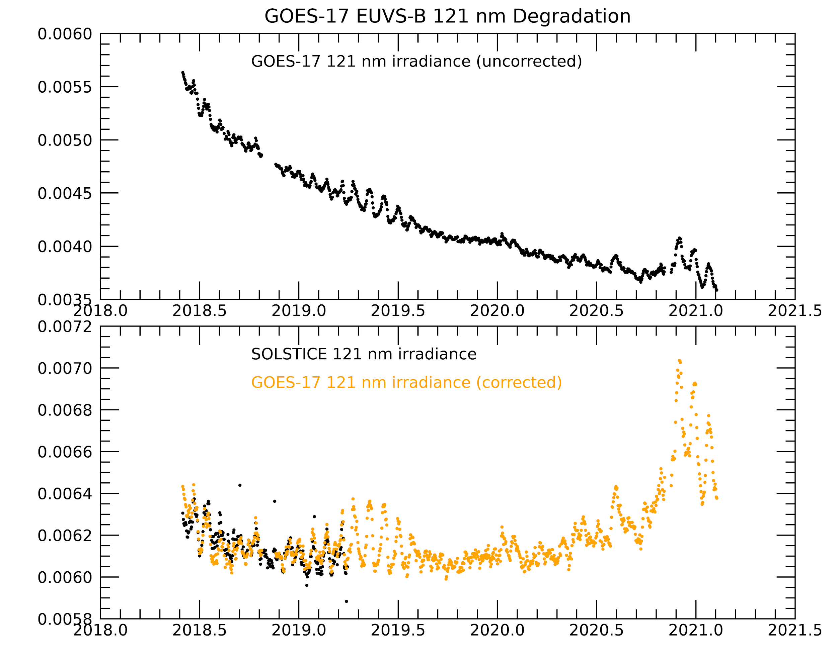
EUVS-B GOES-16 and 17 121.6 nm irradiance qualitatively agree with SOLSTICE after degradation correction
G16
G17
Irradiance (W/m2/nm)
Irradiance (W/m2/nm)
Irradiance (W/m2/nm)
Irradiance (W/m2/nm)
Plots made using NCEI data
ECI excluded

Slide 39
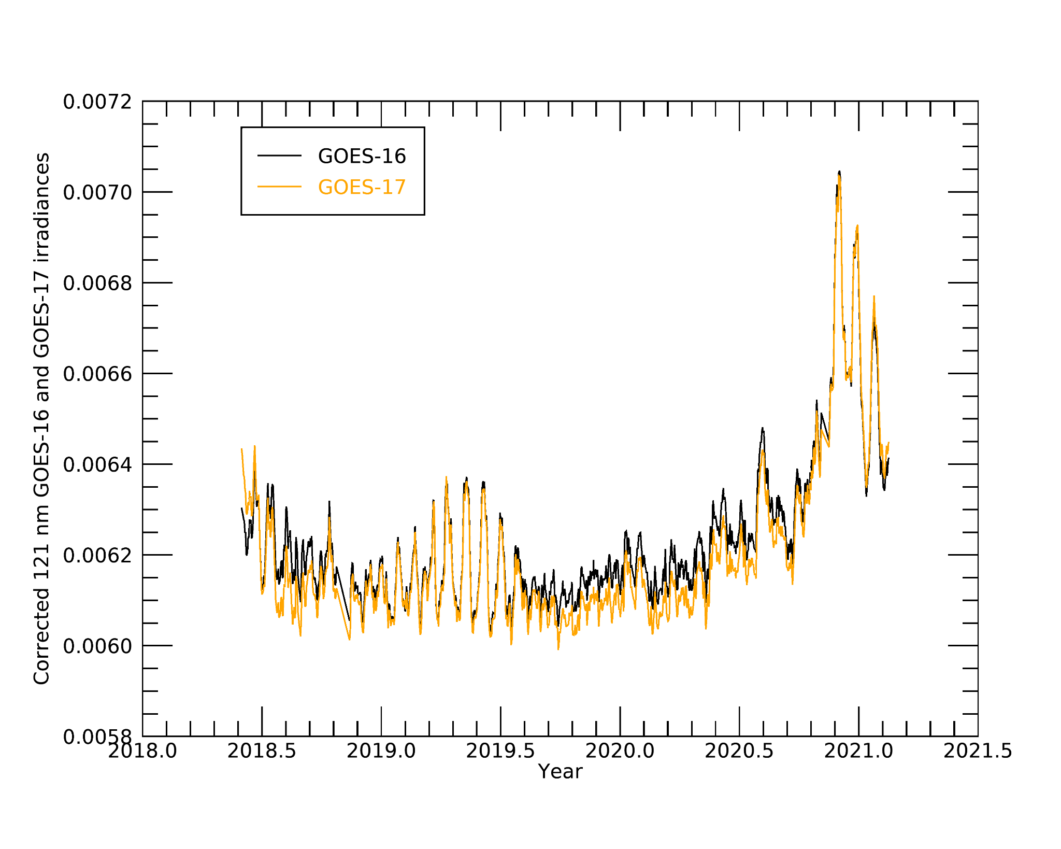
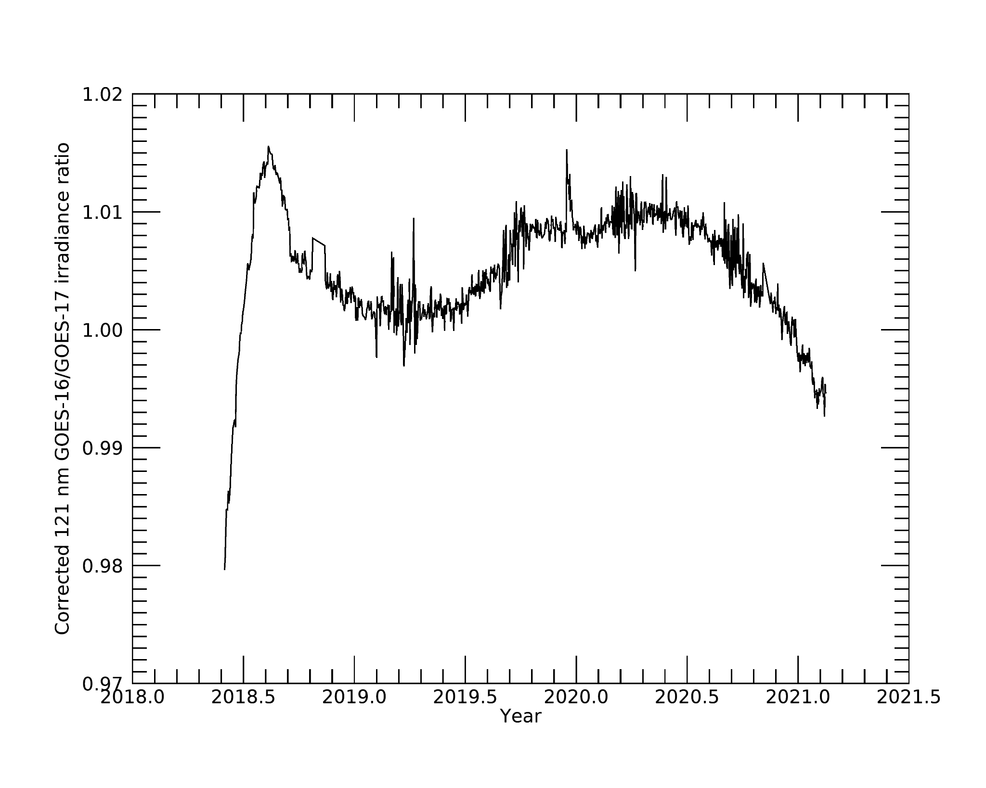
EUVS-B GOES-16 vs GOES-17 121.6 nm agree within 1.3%*
G16
G17
Shape likely showing the ratio of the implemented degradation functions
Mean: 1.004
St. Dev.: 0.0065
Plots made using NCEI data
ECI excluded
*2 standard deviations (95%)
Notes:
The shape is likely due to the ratio of the implemented degradation function

Slide 40
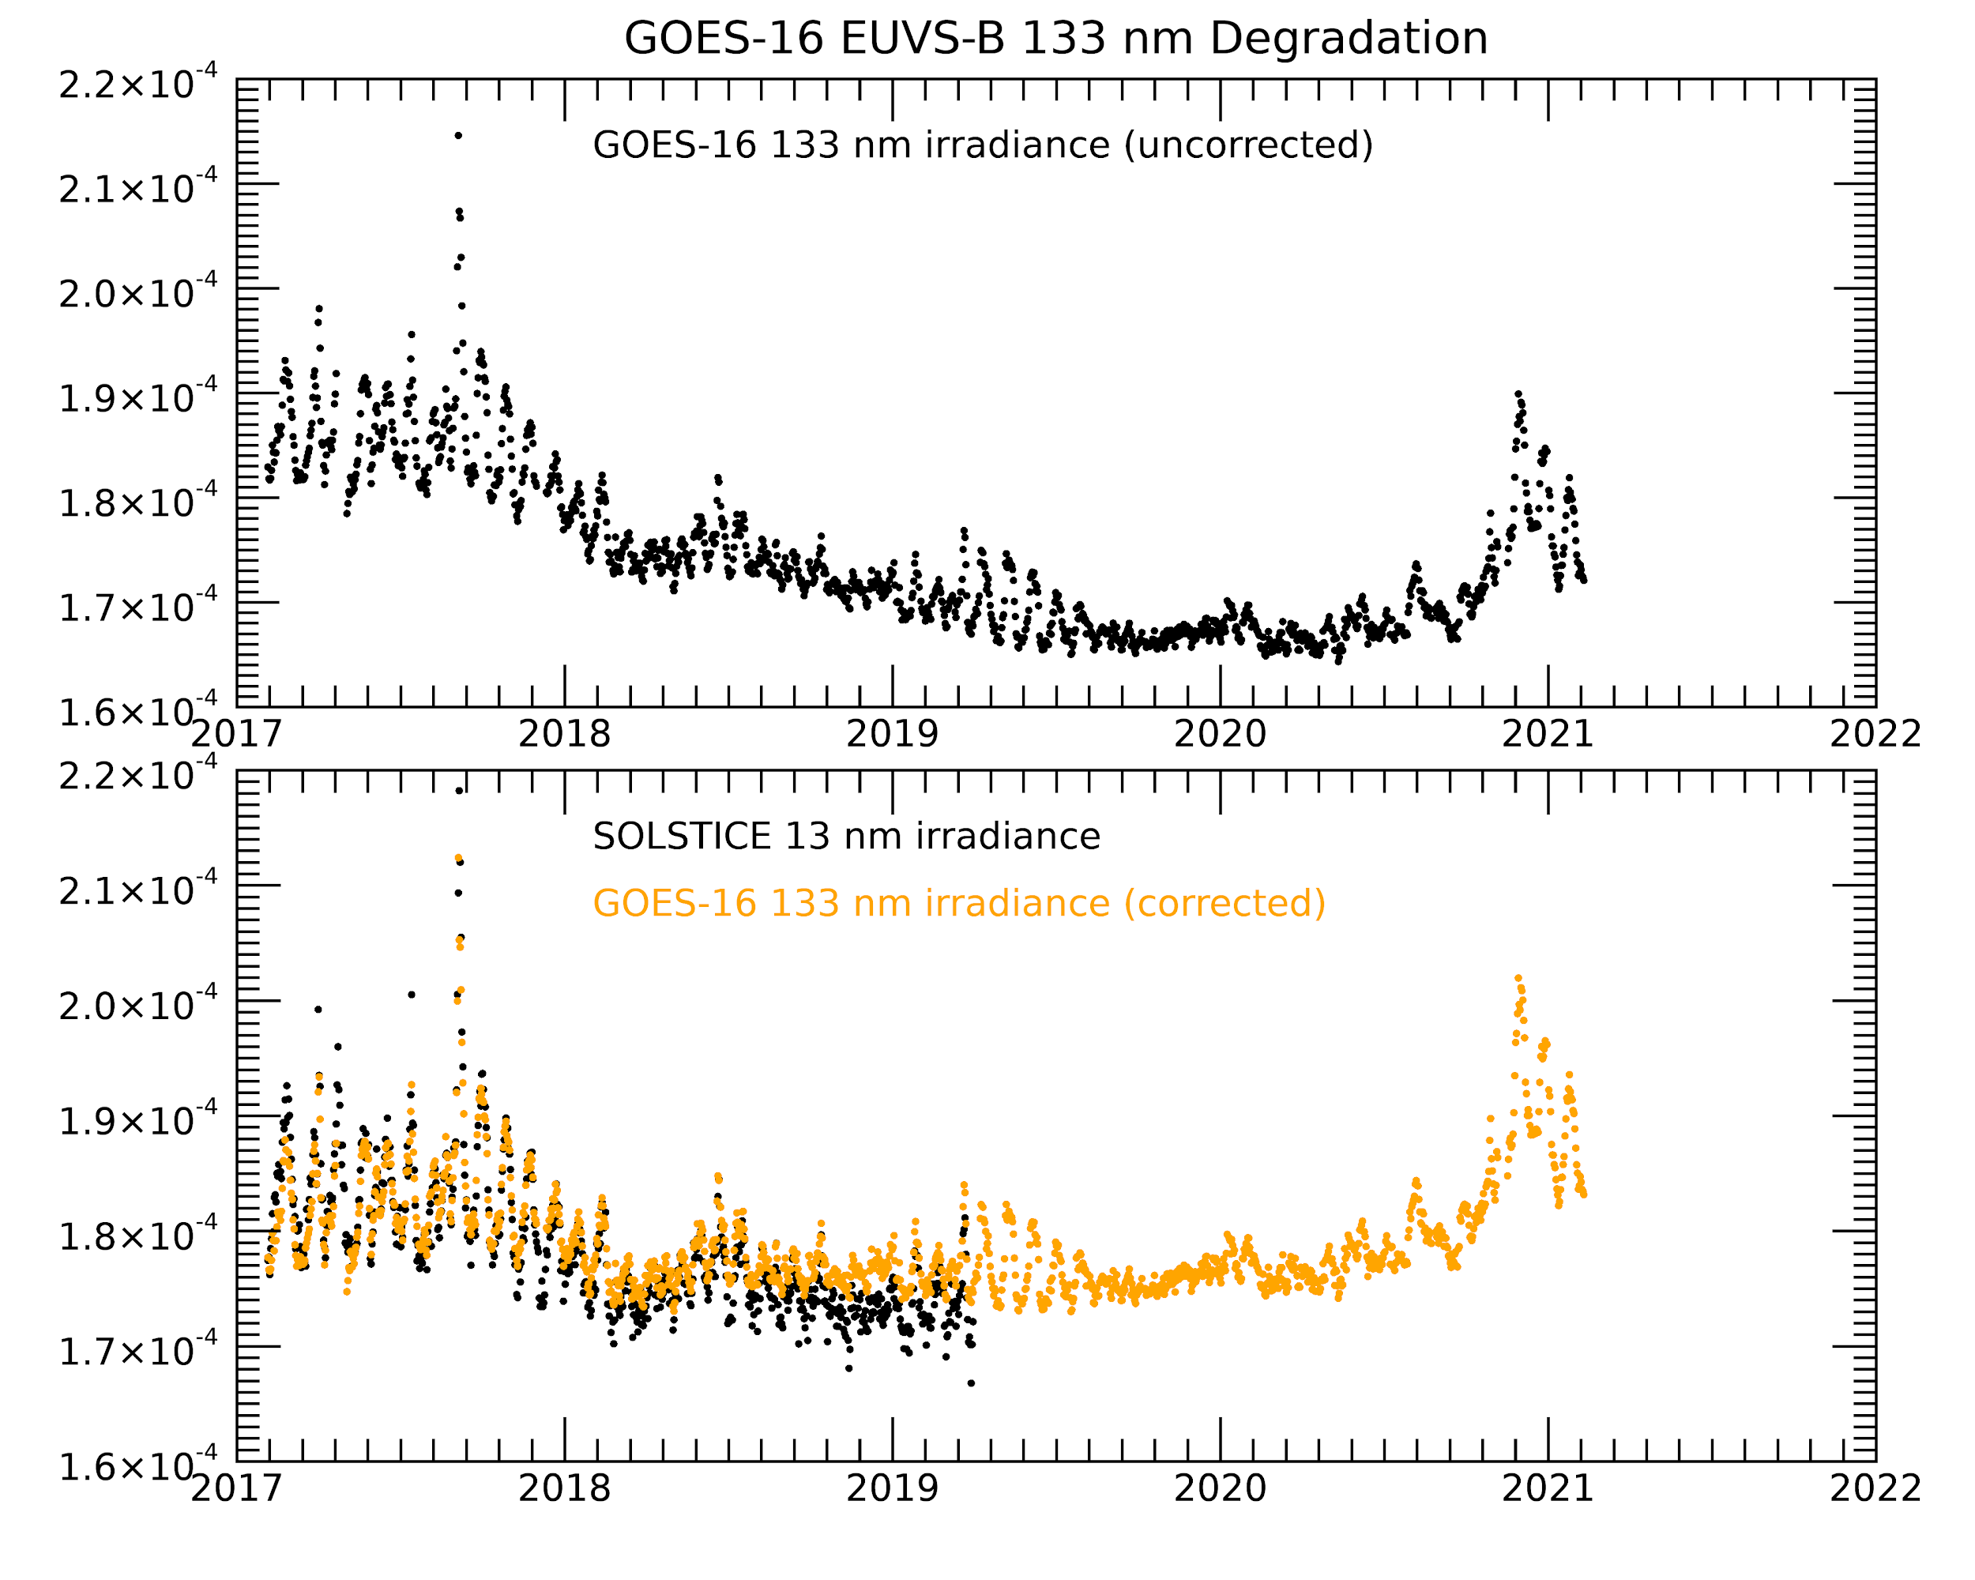
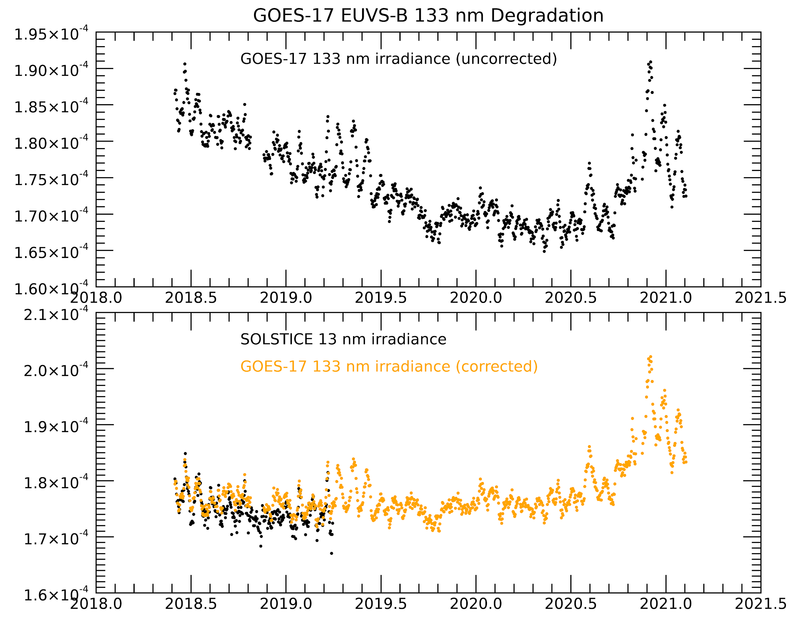
EUVS-B GOES-16 and 17 133.5 nm qualitatively agree with SOLSTICE after degradation correction
G16
G17
Irradiance (W/m2/nm)
Irradiance (W/m2/nm)
Irradiance (W/m2/nm)
Irradiance (W/m2/nm)
Plots made using NCEI data
ECI excluded

Slide 41
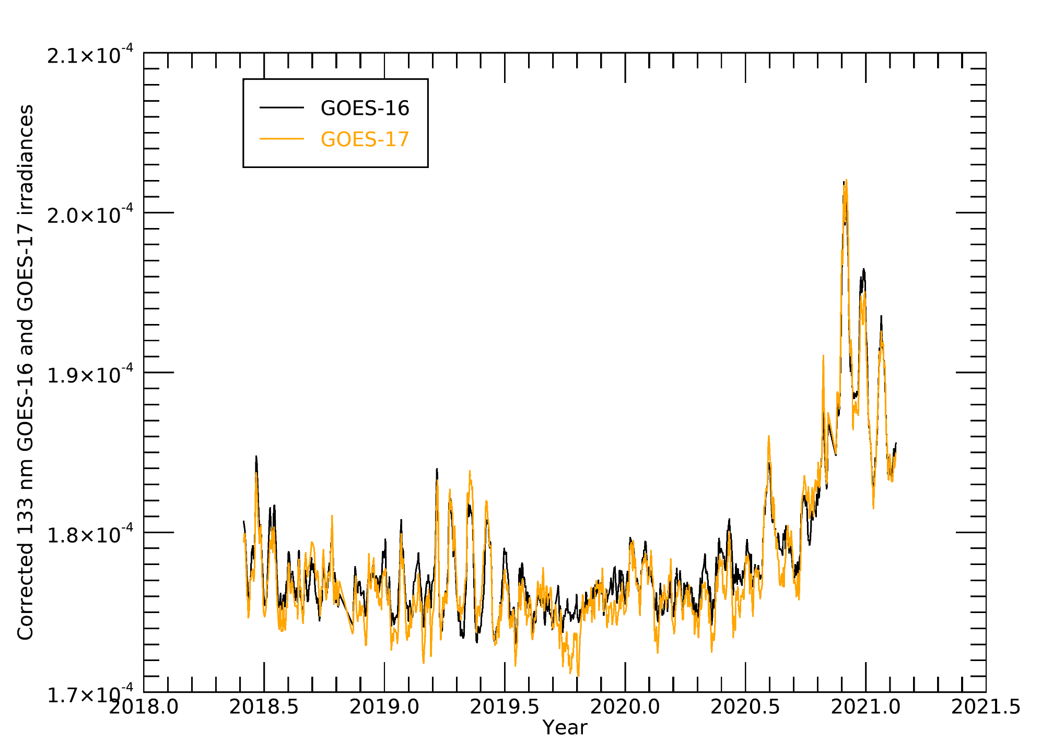
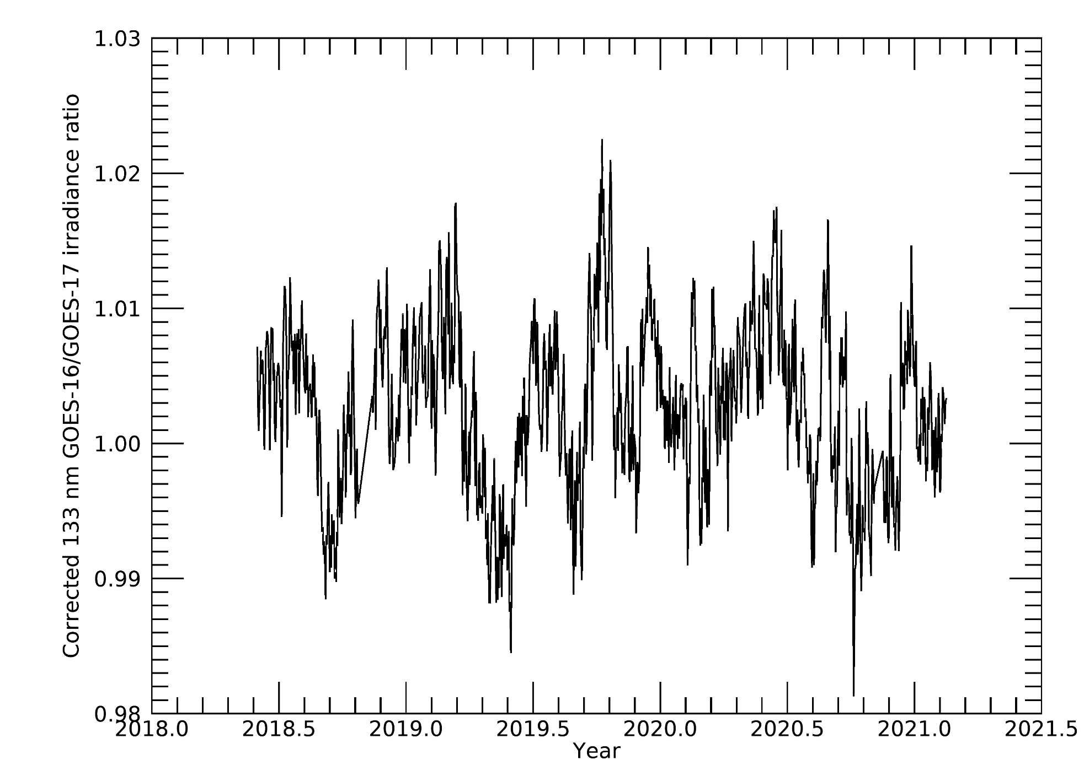
EUVS-B GOES-16 vs GOES-17 133.5 nm agree within 1.3%*
G16
G17
Mean: 1.001
St. Dev.: 0.0066
Plots made using NCEI data
ECI excluded
*2 standard deviations (95%)

Slide 42
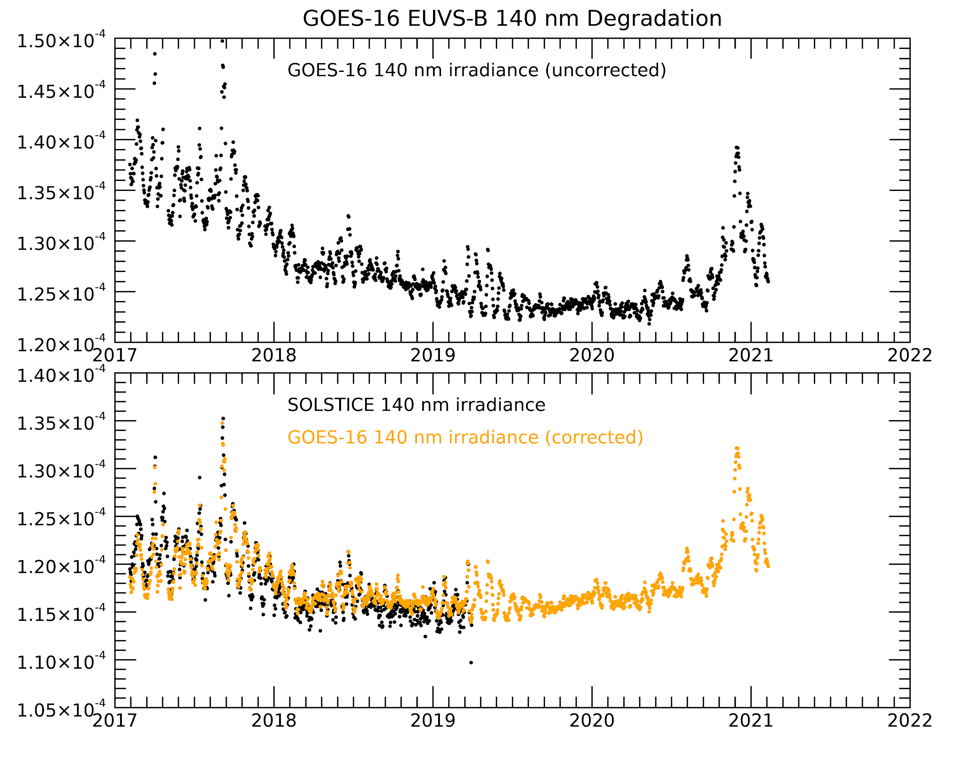
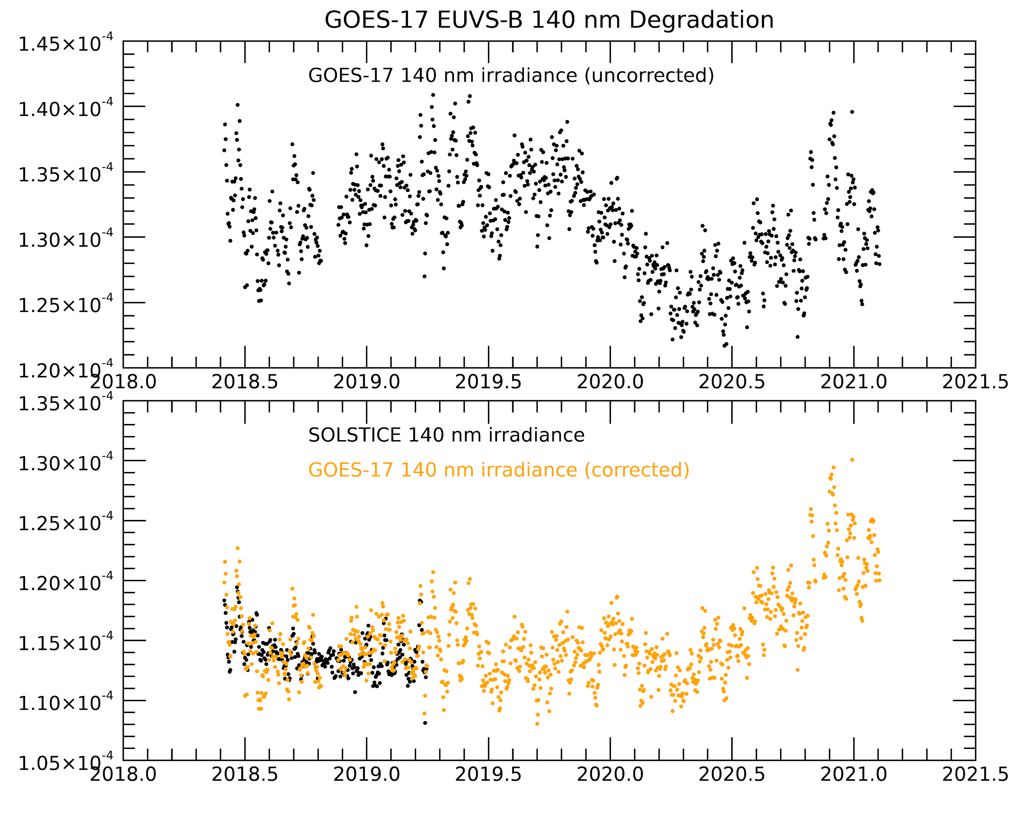
EUVS-B GOES-16 and 17 140.5 nm qualitatively agree with SOLSTICE after degradation correction
G16
G17
Irradiance (W/m2/nm)
Irradiance (W/m2/nm)
Irradiance (W/m2/nm)
Irradiance (W/m2/nm)
Plots made using NCEI data
ECI excluded

Slide 43
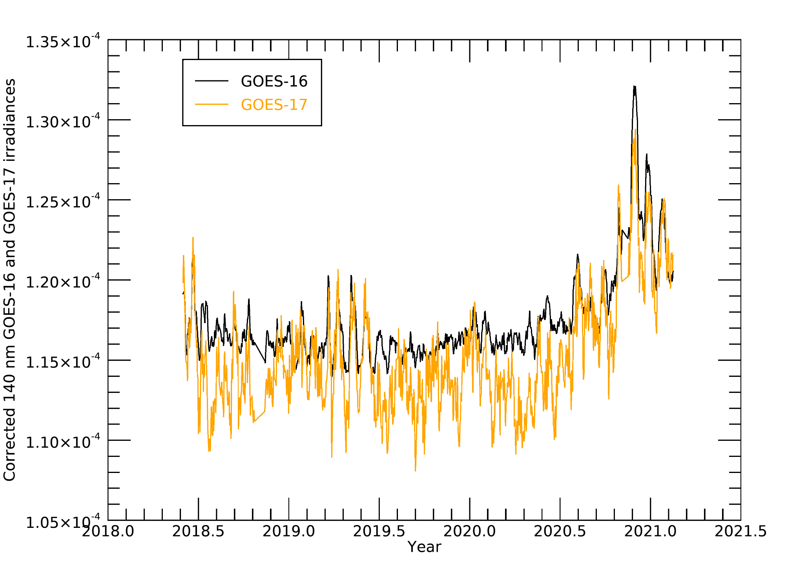
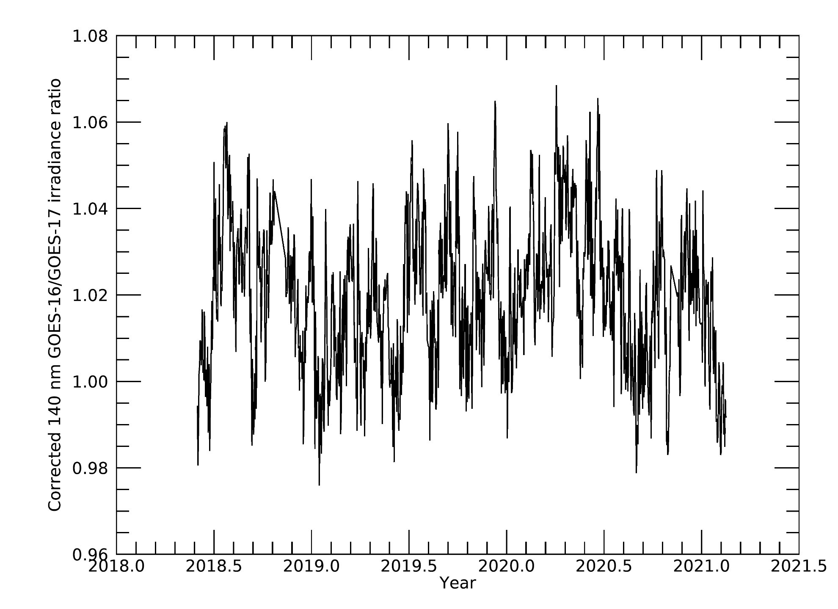
EUVS-B GOES-16 vs GOES-17 140.5 nm agree within 3.5%*
G16
G17
Mean: 1.015
St. Dev.: 0.0175
Plots made using NCEI data
ECI excluded
*2 standard deviations (95%)

Slide 44
G16
G17
PLPT 14: EUVS-C inter-satellite comparisons for GOES-16 and 17
EUVS-C line | GOES-16 vs GOES-17 agreement* | GOES-16 vs GOES-17 offset
Mg II | 0.2% | 2.9%

Slide 45
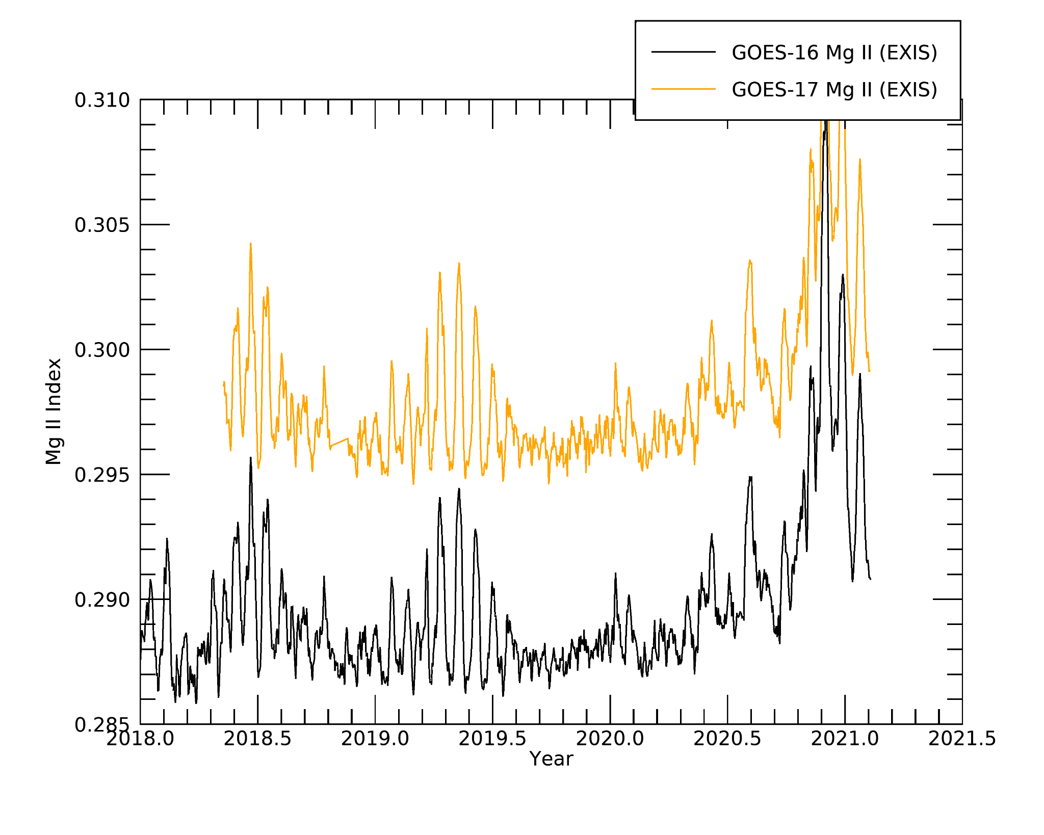
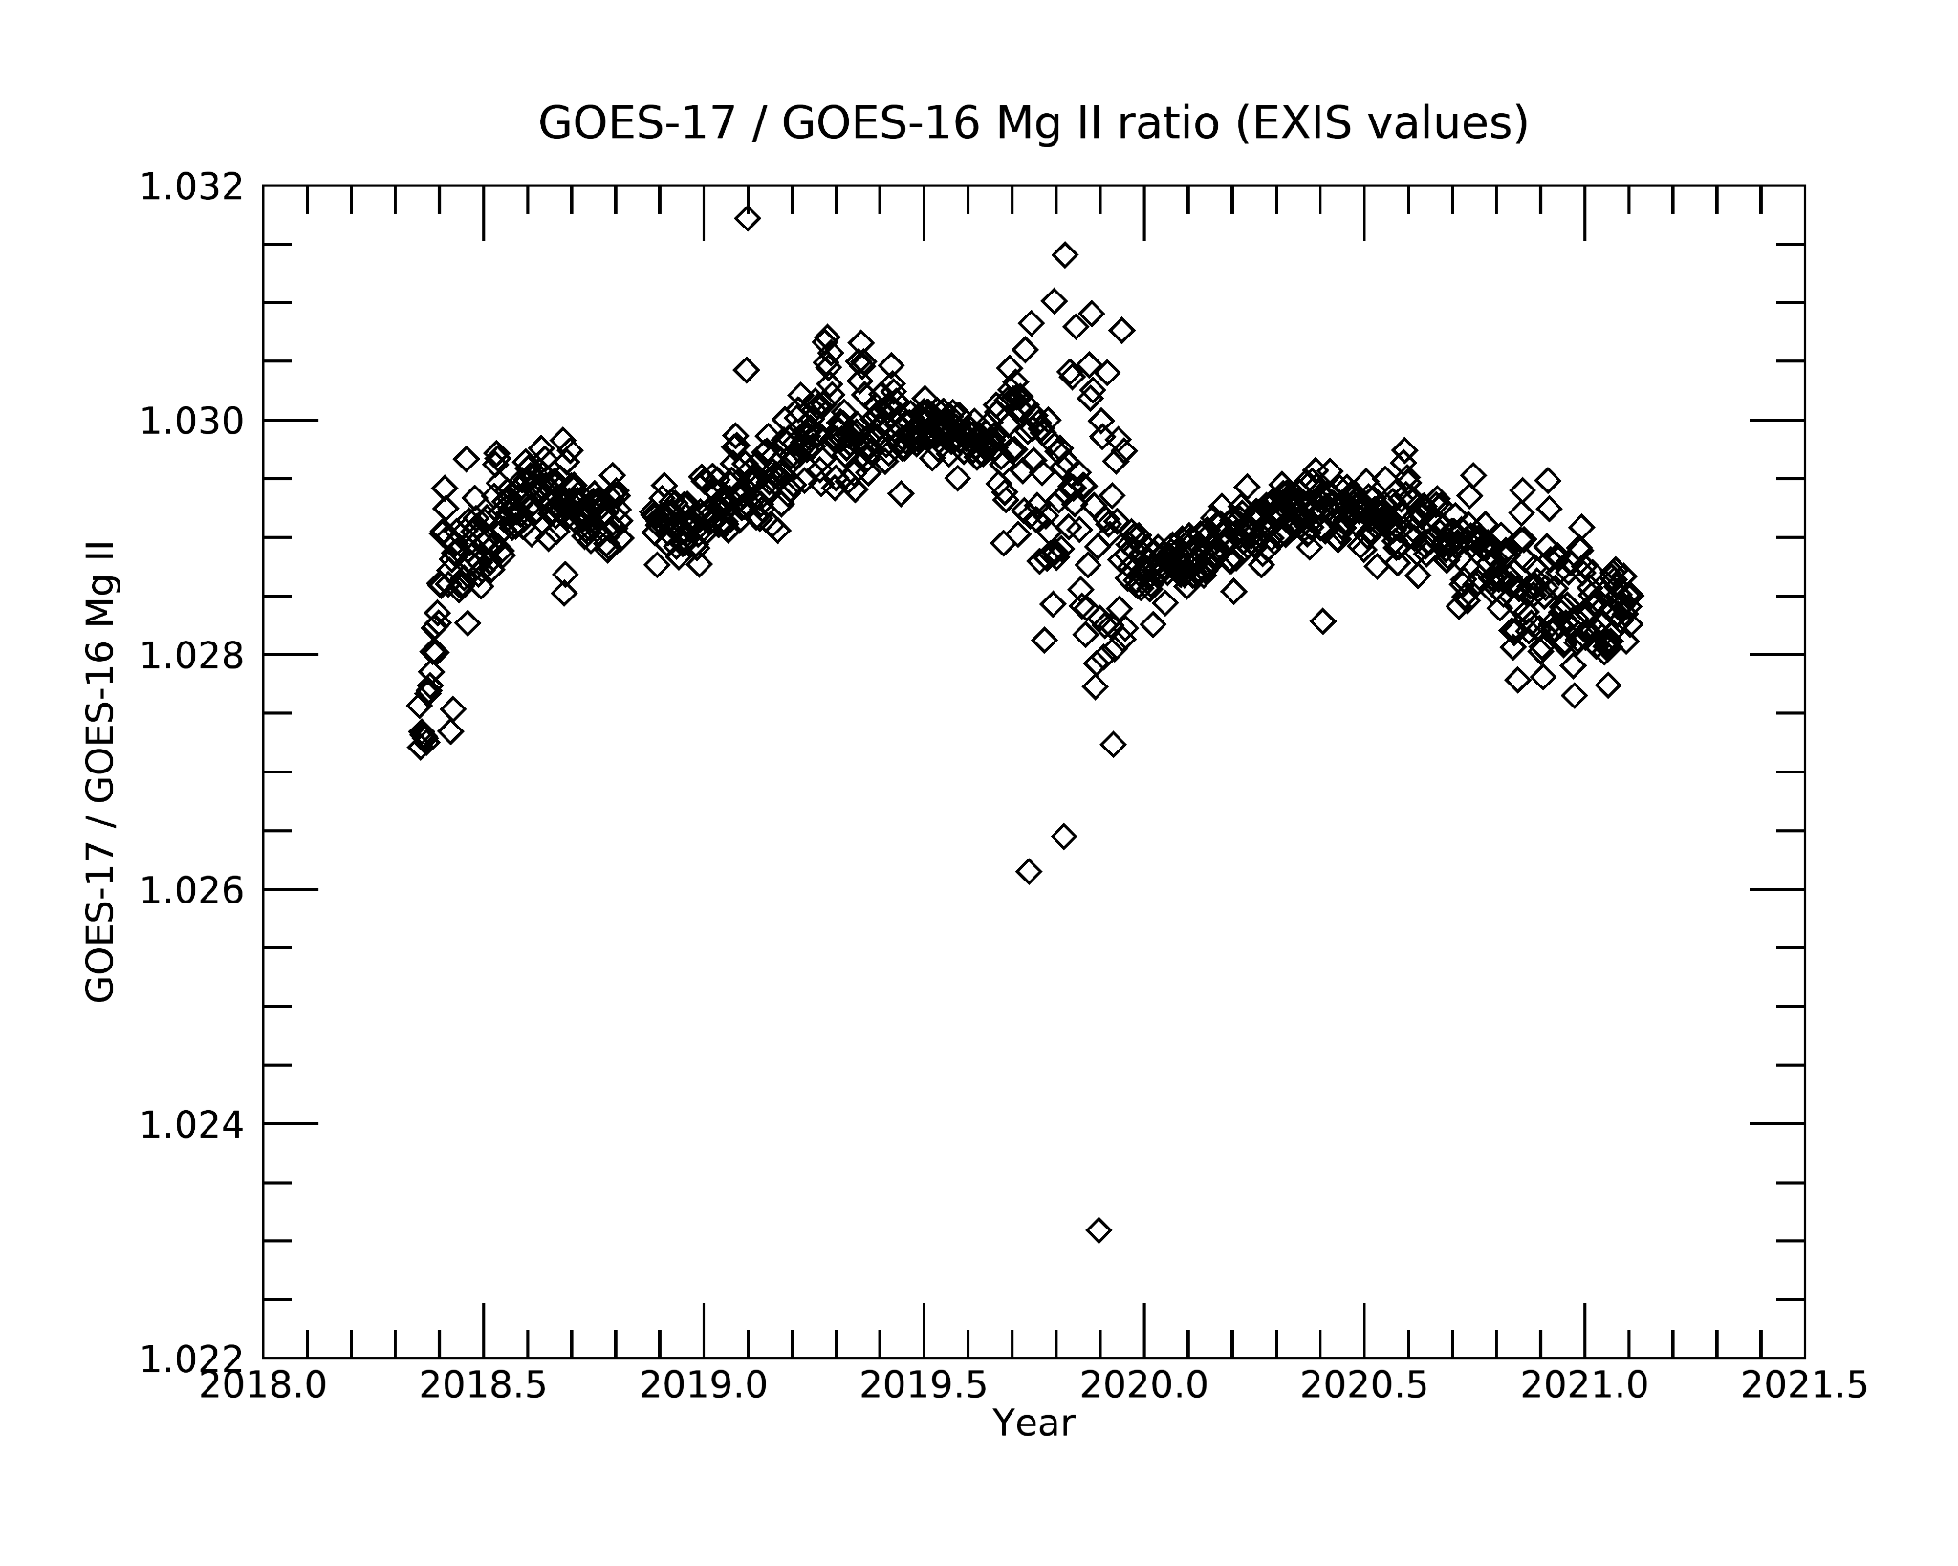
EUVS-C GOES-16 vs GOES-17 Mg II index agree within 0.2%*
G16
G17
Mean: 1.029
St. Dev.: 0.00064
Plots made using NCEI data
ECI excluded
*2 standard deviations (95%)
Notes:
Offset doesn’t matter. Perfect mg II measurements are scaled linearly to each other (depends on exact wavelengths seen by diodes, and are slightly different between G16 and 17)

Slide 46
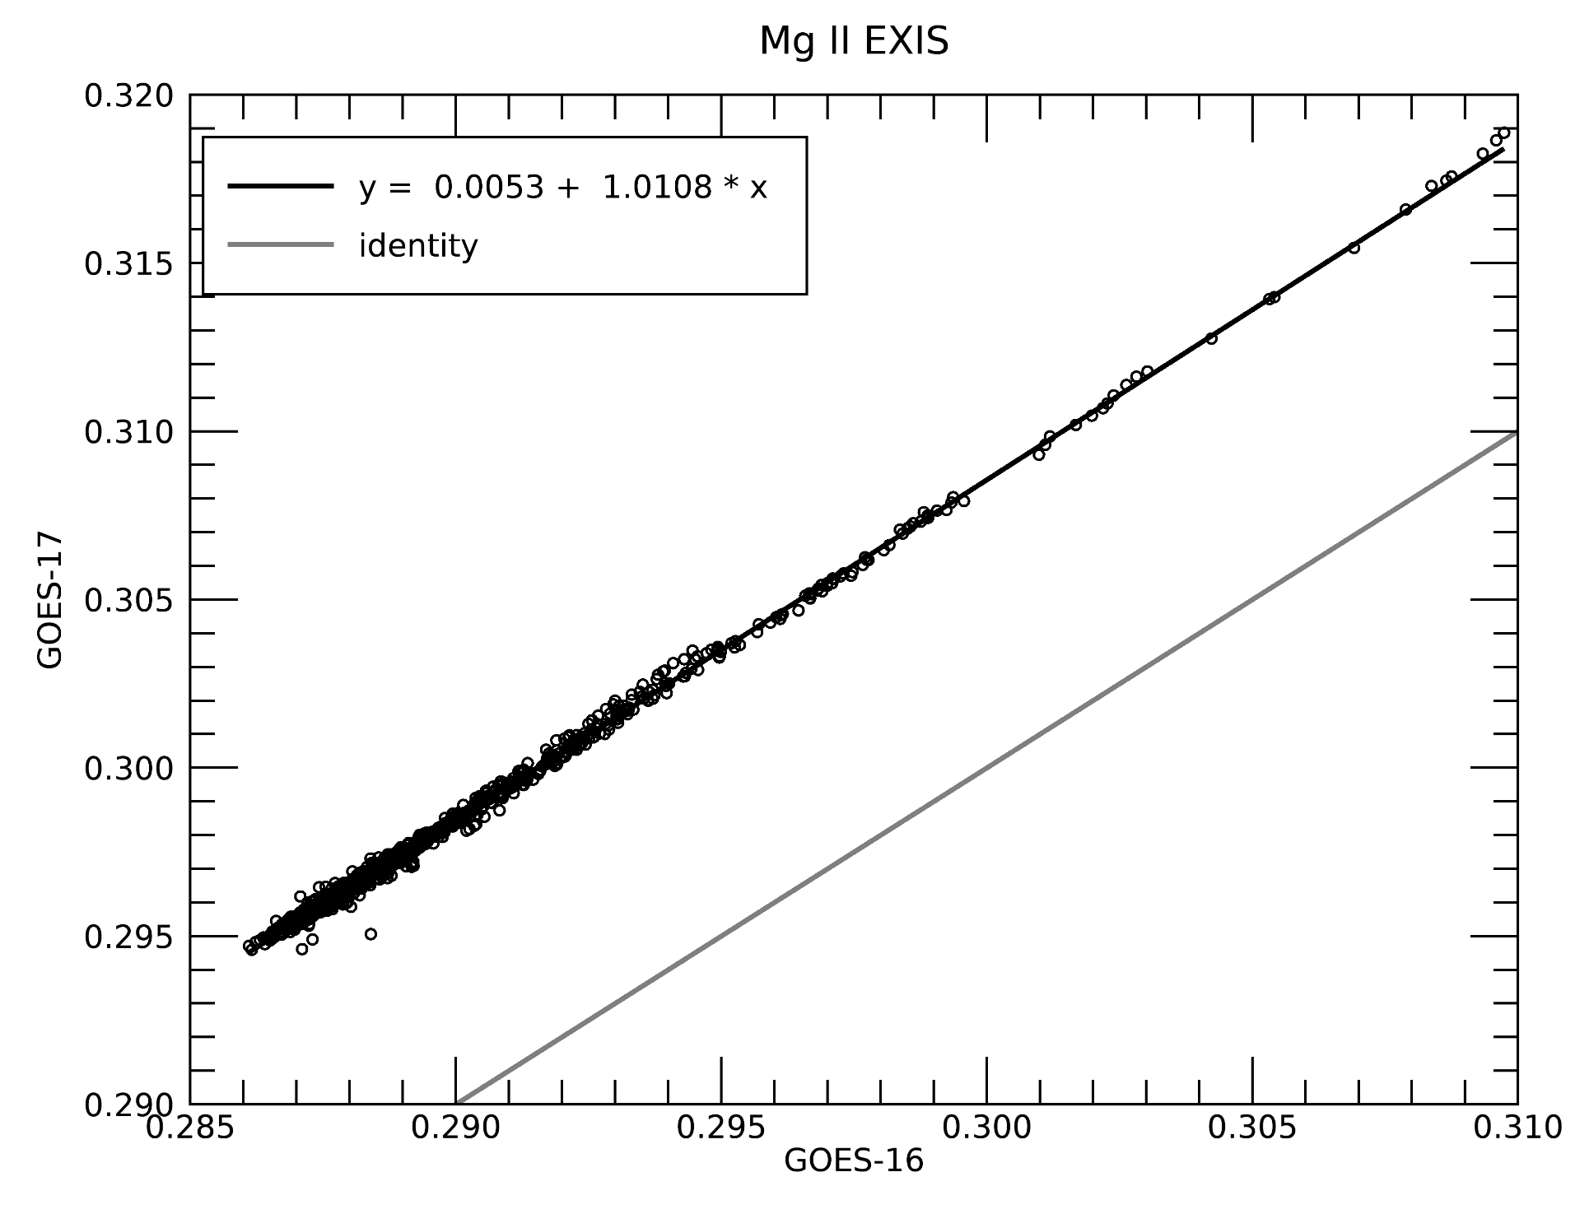
EUVS-C GOES-16 vs GOES-17 Mg II index scale linearly demonstrating good agreement between satellites
G16
G17
Plots made using NCEI data
ECI excluded
Notes:
Look they can be linearly scaled!

Slide 47
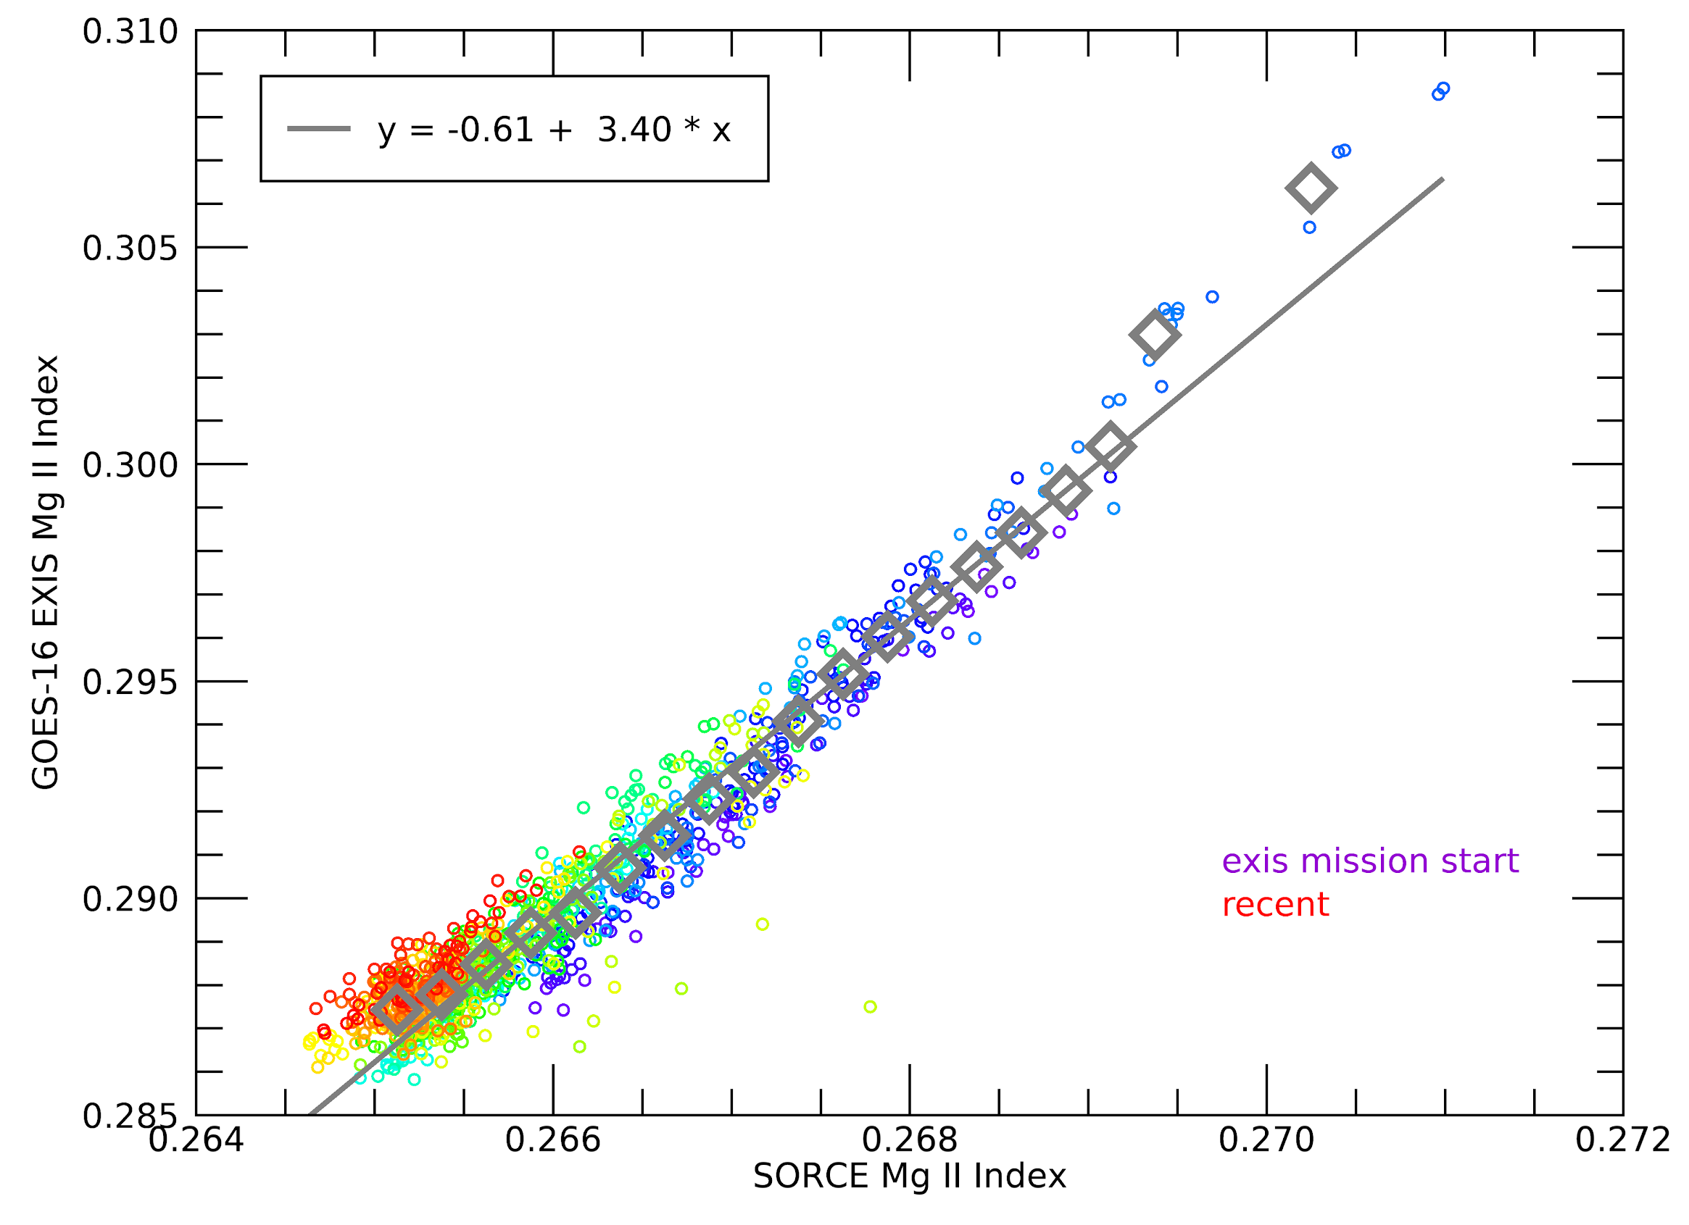
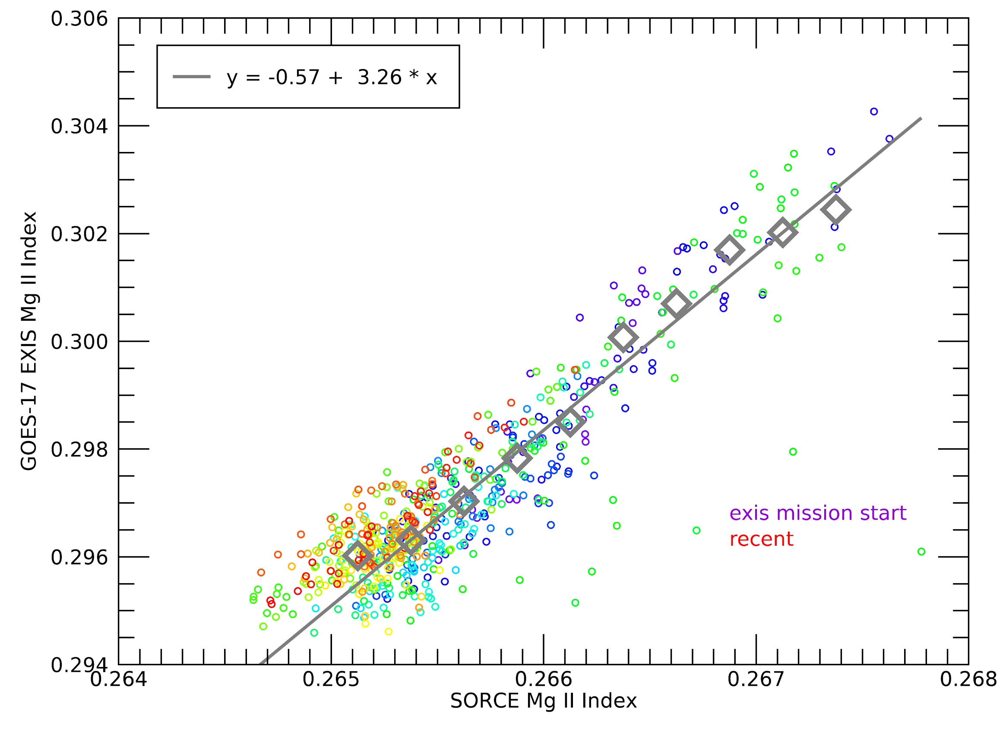
EUVS-C GOES-16 and 17 vs SORCE Mg II index scale linearly demonstrating good agreement between satellites
G16
G17
Plots made using NCEI data
Notes:
Recent data is mainly around 04/2019
Only looking at small part of variability that Mg II normally has since GOES has not seen high Mg II signals yet

Slide 48
G16
G17
Comparison to Performance Baseline

Slide 49
GOES-16 Performance Baseline
G16
MRD ID | Quantity | MRD Requirement | MIT/LL Predicted Performance | NCEI Values* | Related PLPTs | Status
577 | EUVS Long-term stability (life of mission) | < ±5% or ability to track | Track Changes | Track Changes | 04, 05, 06, 07 | PASS
2027 | EUVS Product Measurement Range | EUVS-A: 0.5X to 10X solar max 1.4x10⁻⁵ to 5.3x10⁻² W/m² EUVS-B: 0.5X to 10X solar max 1.4x10⁻⁵ to 5.3x10⁻² W/m² | EUVS-A: 9.5x10⁻⁶ to 5.0x10⁻³ W/m² EUVS-B: 2.6x10⁻³ to 1.0x10⁻¹ W/m² | EUVS-A: 4.7e-7 to 0.93 W/m² EUVS-B: 1.8e-6 to 1.64 W/m² |  | PASS
2028 | EUVS Product Measurement Accuracy | < 20% | EUVS-A at 14.27% EUVS-B at 11.62% EUVS-C at 0.10% | EUVS-A: ≤2.7% EUVS-B: ≤7.7% |  | PASS
2031 | EUVS Product Measurement Precision | < 20% at min flux | EUVS-A: 4.6% EUVS-B: <0.05% | EUVS-A: ≤2.9% EUVS-B: ≤9.4% |  | PASS
2032 | EUVS Long-term stability | < ±5% or ability to track | Track Changes | Track Changes | 04, 05, 06, 07 | PASS
*Statistical values which are unchanged since Provisional. Values measured at 30-s cadence.
Notes:
No changes since Provisional

Slide 50
GOES-17 Performance Baseline
G17
MRD ID | Quantity | MRD Requirement | MIT/LL Predicted Performance | NCEI Values* | Related PLPTs | Status
577 | EUVS Long-term stability (life of mission) | < ±5% or ability to track | Track Changes | Track Changes | 04, 05, 06, 07 | PASS
2027 | EUVS Product Measurement Range | EUVS-A: 0.5X to 10X solar max 1.4x10⁻⁵ to 5.3x10⁻² W/m² EUVS-B: 0.5X to 10X solar max 1.4x10⁻⁵ to 5.3x10⁻² W/m² | 2.4x10⁻⁷ to 5.3x10⁻² W/m² | EUVS-A: 6.3x10⁻⁷ to 1.03 W/m² EUVS-B: 1.4x10⁻⁶ to 1.19 W/m² |  | PASS
2028 | EUVS Product Measurement Accuracy | < 20% | EUVS-A at 18.42% EUVS-B at 18.41% EUVS-C at 16% | EUVS-A: ≤4.0% EUVS-B: ≤5.9% |  | PASS
2031 | EUVS Product Measurement Precision | < 20% at min flux | EUVS-A: 7.3% EUVS-B: 1.8% | EUVS-A: ≤3.3% EUVS-B: ≤5.9% |  | PASS
2032 | EUVS Long-term stability | < ±5% or ability to track | Track Changes | Track Changes | 04, 05, 06, 07 | PASS
*Statistical values which are unchanged since Provisional. Values measured at 30-s cadence.

Slide 51
The EUVS inter-satellite comparisons demonstrate good agreement between GOES-16 and -17, as well as with other instruments.
This demonstrates reliability of the calibrations, trending, and instrument performance over time.
G16
G17
PLPT summary

Slide 52
Ongoing Investigations
G16
G17
# | Issue | Description | Comments to Users
1 | *ECI data | GOES-17 ECI data needs correction | Data invalid during ECI period until reprocessed.
2 | *EUVS-C spike removal | Determine if this should be added to L1b code. | Spikes can add noise to data.
3 | *EUVS-C systematic behavior | Further detailed investigation of behavior of wings and lines. | Examine impacts of Doppler and seasonal effects and degradation.
4 | Jumps in spectral model | Jumps in spectral model that use 121.6 nm irradiance due to changing Case number from geocorona | New LUT will be generated
5 | Oscillation artifact | Annual cycle oscillation in EUVS-B line irradiances | Under investigation
6 | Uncorrected temperature effects | Artifacts in line irradiances after eclipses due to uncorrected temperature effects | Under investigation
G17
*Investigations ongoing from Provisional
Notes:
Not ADRs, but things we are looking into. Included in data caveats in Readmes

Slide 53
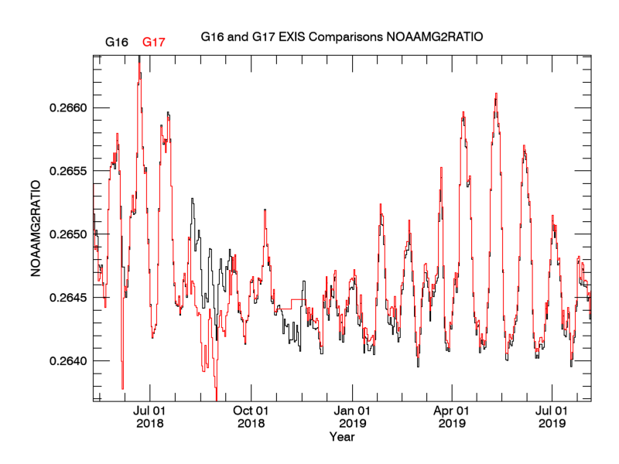
GOES-17 data will be analyzed to correct ECI-induced errors
G17
Currents pointing limits are +- 7 arcmin, but should be changed and likely made time-dependent
ECI 8/6/2018-9/13/2018
Plot courtesy of LASP
Notes:
G17 data drops a lot during ECI even though data during ECI off points are flagged as bad (and not included)
Incorrect pointing thresholds are causing much/all of the error. A secondary effect is ECI-induced, which is that furthermore, the pointing thresholds are probably changing with time.
There is also a spike removal issue in EUVS-C which ECI will cause trouble with.
G16: 2/12/2018
G16: 2/13/2018
G17: 4/30/2018
G17: 6/4/2018-6/7/2018
G17: 8/6/2018-9/13/2018
G17: 8/28/2019-12/16/2019

Slide 54
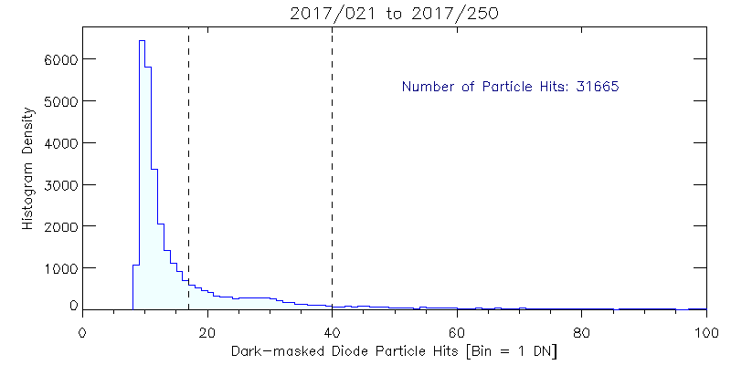
EUVS-C spike removal will be evaluated in future work
G16
G17
The current single threshold technique for removing particle spikes in all EUVS-C diodes can be improved to reduce noise
Each diode may need its own threshold
Previous threshold
New threshold
Analysis and plots courtesy of Tom Eden (LASP)
Notes:
Spike removal removes points above a certain threshold

Slide 55
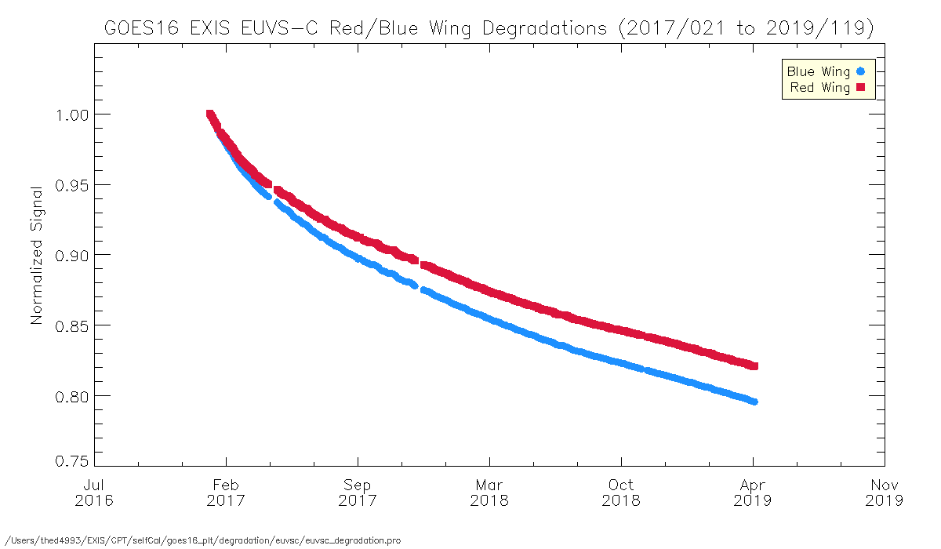
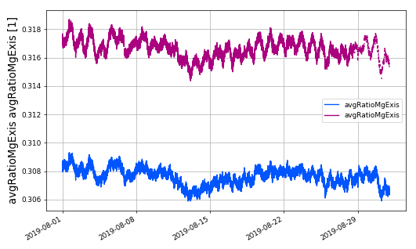
EUVS-C shows systematic behavior including daily variation and difference in degradation rates in red and blue wings
G16
G17
Pronounced daily variation in GOES-17
Degradation rate different between red and blue wings
GOES-17
Mg II index
GOES-16

Slide 56
Jumps in 121.6 nm dependent spectral model bins due to geocorona event
G16
G17
Spectral model coefficients in LUTs will be revised to reduce model bins dependency on 121.6 nm irradiance
Large jumps in irradiance can erroneously signal an EUV event

Slide 57
Annual oscillation artifact
G16
G17
Similar oscillations in GOES-17
G16 wavelength | Cycle artifact
117 nm | +/- 1.5%
121 nm | +/- 1.3%
133 nm | +/- 1.0%
140 nm | +/- 0.9%
Possibly due to temperature corrections

Slide 58
Residual temperature artifact after ADR 898 correction in 25.6, 117.5, 140.5 nm lines
G16
G17
ADR 898 largely resolved temperature artifact, but some residual effect remains in some lines
117.5 and 140.5 nm see errors as large as the daily variability of the lines
Irradiance (W/m2/nm)
Irradiance (W/m2/nm)
Irradiance (W/m2/nm)
Notes:
Artifact in 117 and 140 are not a surprise since the ADR 898 correction was not predicted to fully correct these lines
25.6 (not shown) the artifact is smaller than before the fix but is still there.

Slide 59
G16
G17
GOES-16 & 17 EUVS Full Maturity PS-PVR
Other Updates

Slide 60
G16
G17
GOES-16 EUVS Operational and Science-Quality L1b and L2 data released at NCEI!
GOES-16 only
Science-quality data
Reprocessed daily files from L0
Uses latest LUTs and fixes back to start of mission
Lags operational by several days – fills data gaps
Data available from 02/2017
GOES-17 to be released after ECI analysis
The public debut of the GOES-R September 2017 flare data in EUV

Slide 61
G16
G17
EUVS Data at NCEI-CO Portal
https://www.ngdc.noaa.gov/stp/satellite/goes-r.html
NCEI GOES-R Web Portal
Operational and science-quality L1b and L2 data
Documents
Plots
Data releases announced in solar newsletters and to mailing list of ~100 people
SWPC provides JSON files of L2 data with <2-min latency
Notes:
"They do not release netcdf which would match NCEI"

Slide 62
GOES-16 & 17 EUVS Full Maturity PS-PVR
Full Maturity Assessment

Slide 63
Full Validation: Definition and Prior Activities
Preparation Activities | Assessment
Validation, quality assessment, and anomaly resolution activities are ongoing. | Validation activities are ongoing. Results have been discussed with SWPC. Release of data by NCEI has enabled research community participation.
Incremental product improvements may still be occurring. | Product improvements will result from the resolution to issues given on the slides titled "Remaining ADRs" and "Ongoing Investigations"
Users are engaged and user feedback is assessed. | Discussions with SWPC and the science community are ongoing.

Slide 64
Full Validation Assessment: Status after Full Validation
End State | Assessment
Product performance for all products is defined and documented over a wide range of representative conditions via ongoing ground truth and validation efforts. | EUVS irradiance measurements from GOES-16 and -17 have been inter-compared with each other and with the SOLSTICE instrument. Instrument was calibrated at NIST. Products are documented in Readmes and User Guides.
Products are operationally optimized, as necessary, considering mission parameters of cost, schedule, and technical competence as compared to user expectations. | After DO.09.05 is implemented ono 06/17/2021 and except as described on the slide titled "Ongoing Investigations”, the products are operationally optimized. Regular monitoring, on-orbit calibrations and LUT updates will maintain this optimization.
All known product anomalies are documented and shared with the user community. | Anomalies are listed in the caveats section in the L1b Readmes at the NCEI GOES-R web site.
Product is operational. | L1b available for real-time operations as of 09/2019. Operational useability of the data after DO.09.05 install (06/17/2021) will be significantly improved. GOES-16 EUVS L2 products: 1-minute averages and daily averages (line irradiances, Mg II index, and proxy spectrum) NCEI: Products currently available SWPC: Require evaluation and testing before operational implementation L2 products in development: Flare summary, high temporal/spectral resolution measurement GOES-17 EUVS L2 products: Available operationally at SWPC later this year

Slide 65
Next Steps for EUVS
Continue analysis of instrument issues
Resolve remaining GOES-16 and 17 ongoing investigations [slide 52]
Evaluate ECI-related degradation and pointing in GOES-17 [slide 53, 54]
Calibrations
Complete handover of 3 remaining calibration routines [slide 24]
Continue analyzing daily, weekly and quarterly calibrations.
Continue providing updated calibration tables.
Develop regular monitoring of data.
Verify remaining ADR fixes
Current ADRs [slide 14]
1144: Irradiances during eclipse/transits
1161: Flag penumbra-only events

Slide 66
Summary and Recommendations
Analysis of GOES-16 and -17 L1b products demonstrate that the performance of both instruments is understood and operating as expected
GOES-17 requires additional investigation of degradation and long-term stability due to ECI effects
Following the install of DO.09.05 ADR fixes, all known Ground System and instrumental issues prohibitive to Full Validation Maturity have been resolved for GOES-16 and -17
Fixes for remaining ADRs need to be implemented to provide good data at all times
Continued data monitoring and twice yearly updates to on-orbit LUTs by NCEI are required

Slide 67
GOES-16 & 17 EUVS Full Maturity PS-PVR
Reference and Backup Slides

Slide 68
EUVS Accuracy Requirements
1.2
1. PORD ±20% allowed systematic error
true irradiance
measured
1.0
2. Measured error which maintains true solar variability.
0.8
0.6
3. Same measurement with extra systematic error due to improper temperature correction appears as false solar variability.
Relative Irradiance
0.4
0.2
Time
Bias or Systematic Errors: Offset errors that remains with repeated measurements. Systematic errors can be reduced through calibration.
Random, Stochastic or Precision Errors: Random-like values about the mean value. (not shown in cartoon)

Slide 69
Rescaling SORCE Mg II data after SORCE outage
G16
G17
Orange = before 2014 SORCE data gap
Blue = after 2014 SORCE data gap
Needed to scale SORCE Mg II data to Bremen Mg II to correct for instrument changes during outage
SORCE was off from 2013/197 to 2014/054
Notes:
EUVS-B degradation required revisions

Slide 70
Determined linear scaling factor between SORCE Mg II and Bremen Mg II to correct the data after the outage
G16
G17
Orange = before 2014 SORCE data gap
Blue = after 2014 SORCE data gap
The corrected SORCE Mg II data is then used to correct the SORCE “EUVS-B” line irradiances
Notes:
EUVS-B degradation required revisions

Slide 71
Derive scaling between Mg II and SORCE SOLSTICE “EUVS-B” line irradiances
G16
G17
Orange = before 2014 SORCE data gap
Blue = after 2014 SORCE data gap
Orange = before 2014 SORCE data (corrected) g ap
Blue = after 2014 SORCE data gap
This provides a proxy for how the EUVS-B line irradiances scale with Mg II index
Notes:
EUVS-B degradation required revisions

Slide 72
Scale corrected SORCE Mg II to the EUVS Mg II index
G16
G17
Notes:
Recent data is mainly around 04/2019
Only looking at small part of variability that Mg II has since GOES has not seen high Mg II signals yet

Slide 73
Method provides a degradation trend into the future without SORCE/SOLSTICE measurements
G16
G17
Orange = degradation trend
Green = previous degradation trend
Offset in trends due to change in SOLSTICE version
Notes:
Note that green lines were using an older version of the SORCE data
the last time EUVS-B degradation was updated was the end of 2019
Also need to note the oscillations which indicate an annual artifact in the data. Need to resolve this because (1) data has an artifact of several percent, and (2) the degradation correction is harder to fit.

Slide 74
Same method applied to GOES-17, which has less overlap with SOLSTICE
G16
G17
Orange = degradation trend
Green = previous degradation trend
Offset in trends due to change in SOLSTICE version
Notes:
Note that green lines were using an older version of the SORCE data

Slide 75
EUVS-A GOES-16 and -17 vs EVE rocket spectrum
G16
G17
GOES-16 EUVS-A line | EVE rocket scaling factor
25.6 nm | 0.89175
28.4 nm | 0.81565
30.4 nm | 0.98474
GOES-17 EUVS-A line | EVE rocket scaling factor
25.6 nm | 0.92071
28.4 nm | 0.84704
30.4 nm | 1.02008
GOES-16 and -17 EUVS-A degradation trends are pinned to the EVE rocket data

Slide 76
ADR 898 remaining temperature artifact (green) vs pre-ADR fix (blue)
wavel. [nm] | daily solar variability | March 2020/2021: post-eclipse error/total irradiance | post-eclipse error/ daily variability | post-eclipse error/total irradiance | post-eclipse error/ daily variability | effectiveness of ADR 898 correction | used for HASDM
25.6 | 2% | 0.8%? | 0.4 | 2% | 1 | very good
28.4 | 5% | ? | ? | 4% | 0.8 | very good | yes
30.4 | 1% | ? | ? | 2% | 2 | very good | yes
117.5 | 2% | 3.65% | 1.83 | 5% | 2.5 | half of error remains
121.6 | 0.5% | ? | ? | 0.5%? | 1? | uncertain | yes
133.5 | 1% | 0.5 | 0.5 | 7% | 7 | good
140.5 | 1.5% | 1.4 | 1 | 1% | 0.7 | small improvement
Conclusion: New green column is relatively consistent with blue columns from Provisional PS-PVR.

Slide 77
Small line irradiance discrepancy between operational and NCEI data, possibly machine precision
G16
G17
GOES-16
GOES-17
Currently under investigation
Notes:
EUVS time constants? Maybe too subtle
Verify flags during offpoints
Mg II shows au factor shifted by 4 hours. Super subtle

