Slide 1
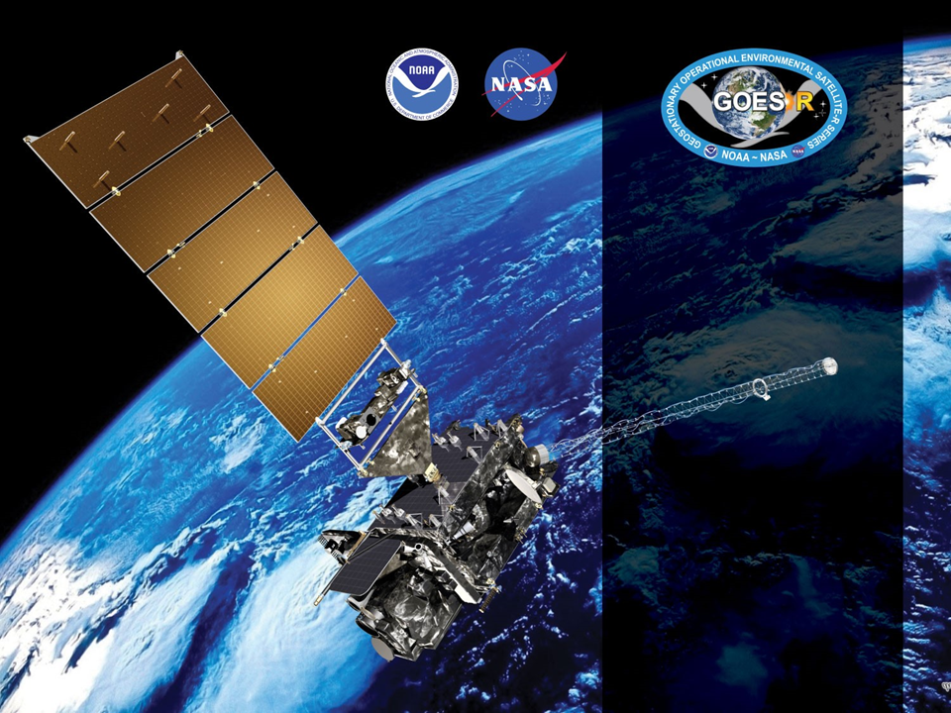
GOES-17 ABI L2+ SW Radiation Budget (SRB)
Provisional PS-PVR
Status and Plan for Assessing Warm Periods
June 27, 2019
GOES-R AWG
Istvan Laszlo¹, Hye-Yun Kim², Hongqing Liu², Rachel Pinker³, Kathy Lantz⁴ and the PRO Team
¹NOAA/NESDIS/STAR, ²IMSG, ³University of Maryland, ⁴NOAA/OAR/ESRL

Slide 2
Outline
Product Overview
Review of ADRs
Provisional Maturity Assessment
  Comparison with SURFRAD, CERES, GOES-15, GOES-16
Plan for Assessing Warm Periods
  GOES-17 LHP Anomaly Impact and Mitigation
Path to Full Validated Maturity
Summary and Recommendations
Supplement
  Various supporting material and notes

Slide 3
Contents of Supplement
Impacts of G17 LWIR FPM temperature anomaly on SRB products (75-80)
Empirical narrow-to-broadband (NTB) coefficients (81-88)
Notes on spatial and temporal resolution (89-91)
ABI TPW in SRB Algorithm (92-96)
The SRB algorithm (97-100)
Note on direct path retrieval (101-102)
Impact G17 ABI Band 2 gain change (103-110)

Slide 4
Product Overview: RSR
Reflected Shortwave Radiation: Top-Of-Atmosphere
  instantaneous SW (0.2-4.0 µm) flux emerging at the Earth’s TOA,
  produced on a global latitude/longitude grid at
    0.25 degree (25 km) resolution for Full Disk and
    0.25 degree (25 km) resolution for CONUS.
  produced once per hour.
Table 5.25.1 in Product Definition and User’s Guide (PUG) Vol 5: Level 2+ Products, Revision 1.2 (4/11/2018)
 | Measurement |  |  |  | Mapping
Region | Range | Accuracy | Precision | Performance Conditions | Accuracy
Full Disk & CONUS | 0 to 1300 W/m² | 85 W/m² at high end of range (1000 W/m²) 65 W/m² at middle of range (350 W/m²) 110 W/m² at low end of range (<200 W/m²)^{[2]} | 100 W/m² for high end of range (1000 W/m²) 130 W/m² for middle of range (350 W/m²) 100 W/m² for low end of range (<200 W/m2^{)[2]} | LZA ≤ 70 degrees, daytime ^{[1]} | Full Disk: 4 km CONUS: 2 km
[1] Conditions for good quality prescribed by the algorithm are for SZA ≤ 70 degrees.
[2] NOTE: Low end specs are missing from PUG!

Slide 5
Product Overview: DSR
Downward Shortwave Radiation: Surface
  instantaneous total SW (0.2-4.0 µm) flux received at the Earth’s surface,
  produced on a global latitude/longitude grid at
    0.50 degree (50 km) resolution for Full Disk,
    0.25 degree (25 km) resolution for CONUS, and
    0.05 degree (05 km) resolution for Mesoscale,
  produced once per hour.
Table 5.24.1 in Product Definition and User’s Guide (PUG) Vol 5: Level 2+ Products, Revision 1.2 (4/11/2018)
 | Measurement |  |  |  | Mapping
Region | Range | Accuracy | Precision | Performance Conditions | Accuracy
Full Disk, CONUS, & Mesoscale | 0 to 1500 W/m² | 85 W/m² at high end of range (1000 W/m²) 65 W/m² at middle of range (350 W/m²) 110 W/m² at low end of range (100 W/m²) | 100 W/m² for high end of range (1000 W/m²) 130 W/m² for middle of range (350 W/m²) 100 W/m² for low end of range (100 W/m²) | LZA ≤ 70 degrees, daytime, solar elevation angle > 25 degrees ^{[1]} | Full Disk: 4 km CONUS: 2 km Mesoscale: 1 km
[1] Conditions for good quality prescribed by the algorithm are for SZA ≤ 70 degrees.

Slide 6
GOES-R DSR/RSR Product
Precedence Chain
Cloud phase, optical depth, droplet size, top height
ABI
Climatology
4-level Cloud Mask
Cloud & Moisture Imagery
DSR
RSR
Snow Mask
ABI FSC product
IMS/SSMI snow ice mask
TPW
ABI product
GFS product
Climatology
Valid for INDIRECT PATH

Slide 7
Pre-Provisional Time-Line
01 Mar 2018 GOES-S Launch
27 Aug 2018 GOES-17 SRB is at Beta Maturity
24 Oct–13 Nov 2018 Spacecraft drift to West slot
12 Feb 2019 Declared as GOES-WEST; began data collection and analysis for Provisional
02 APR 2019 Switch to Mode 6
27 APR 2019 Band 2 gain correction (radiance reduced by ~ 6.9%)
06 May 2019 Clear-sky mask reached Provisional for cool period
27 June 2019 GOES-17 SRB PS-PVR Provisional

Slide 8
ADRs IN PROGRESS PRIOR TO GOES-17 SRB PROVISIONAL REVIEW
GOES-17 Shortwave Radiation Budget L2 Product Provisional PS-PVR

Slide 9
ADRs in Progress
Title | Description (date submitted) | Impact | Mitigation | Status
ADR875 | ABI TPW unit is not converted correctly in SRB algorithm (12/7/18). | Moderate. | Tested in DE, but not in OE | Not Installed
ADR617 | ClearCompAlb is incorrect in MESO product. Time series has only a single value (2/28/18). | Incorrect ClearCompAlb value causes incorrect retrievals in indirect path. | N/A On hold until removing reprojection issue is decided | Not Installed
ADR864 | G17 MESO are located incorrectly (11/13/18). | Hinders validation. |  | Not Installed
ADR914 | MESO DSR is filled with _FillValue during local daytime (1/5/18). | Hinders validation. |  | Not Installed
ADR933 | DSRM2 is filled with _FillValue all day (4/8/19). | Hinders validation. |  | Not Installed
ADR408/393 | At beta PSPVR, reprojection was reported to be detrimental to the usability of the product by the community by AWG lead and PSPVR chair supported the change (7/31/17) | Reprojection is detrimental to the usability of the product by the community. | N/A | Not Installed
ADR743 | Missing flag_meanings attribute for PQI3 (4/16/18). | Hinders usage and getting information from it. | N/A | Not installed
 | PQIs are not initialized with _FillValue (4/16/18). | One may assume that provided values are valid. | N/A | Not installed
MESO DOMAIN ISSUE
Except for ADRs for MESO domain and for TPW, ADRs have little impact on product quality.
Little Impact
Moderate Impact
Big Impact
Notes:
IL: 914 is for G16 and G17 (HYK), 933 is for G17 (AA)

Slide 10
Other Issues – no ADR
Risk Name | Description | Impact | Mitigation and Schedule
Incorrect statistics in CONUS metadata | DSR and RSR statistics (mean, max, min, standard deviation) in metadata are likely incorrect in CONUS product. | Little | Issue is now only present in M4 CONUS.
  Mean, max, min and standard deviation in GS M4 CONUS file cannot be reproduced from DSR data in file.
  Example: M4 CONUS DSR statistics for 2019092_1505 UTC
Source | Min. (W m⁻²) | Max. (W m⁻²) | Mean (W m⁻²) | StdDev (W m⁻²)
GS | 7.22 | 901.12* | 401.24 | 171.69
AWG (All DQF) | 0.11 | 665.97 | 227.99 | 178.01
AWG (Good DQF) | 8.47 | 665.97 | 364.93 | 134.86
*Value is not found in the DSR data.
Notes:
IL: Is there no ADR for this? NO

Slide 11
Product Quality Evaluation
GOES-17 Shortwave Radiation Budget L2 Product Provisional PS-PVR

Slide 12
Provisional PLPTs
Test ID | Test Title
ABI-FD_DSR09 ABI-FD_RSR09 | Assess precision and accuracy of FD product for an extended period that includes some but not all seasonal variability
ABI-CONUS_DSR10 ABI-CONUS_RSR10 | Assess precision and accuracy of CONUS product for an extended period that includes some but not all seasonal variability
ABI-MESO_DSR11^{[1]} | Assess precision and accuracy of MESO product for an extended period that includes some but not all seasonal variability
[1]: Assessment of MESO product has been attempted, but no matchup was found because data are located outside of area “seen” by GOES-17; ADR 864 is on-hold until SRB reprojection issue (ADR 408) is decided on.

Slide 13
Application of PLPT Analysis
Tests to Domains
Analysis Method |  | FD | CONUS | MESO
Visual | Comparison with GSIP
 | Comparison with G16 (new)
Quantitative | Comparison of G17 RSR with CERES RSR
 | Comparison of G17 DSR with ground measurements (SURFRAD and SOLRAD)
 | Comparison with GOES-16 (new)
Evaluation of MESO product was not possible due to incorrect mapping.
Added G17 vs. G16 comparison. (Using G16 as precedent.)
CERES: Clouds and the Earth Radiant Energy System
GSIP: Geostationary Surface and Insolation Product
SURFRAD: Surface Radiation Budget Network (US)
SOLRAD: Solar radiation network (US)

Slide 14
GOES-17 Data Used in this Review
G17 DSR and RSR in CONUS, FD, and DSR in MESO.
Time period: 02/12 – 5/31, 2019; Days: 043 – 151.
  Intermediate Products (IP) available only until 5/11/19
    Some analysis is done only for the time when IP is available.
Matchups (set of quasi coincident and collocated G17 and reference data):
  RSR in CONUS and FD with CERES observations.
  DSR in CONUS and FD with SURFRAD and SOLRAD measurements.
    G17 data are spatially averaged within an area of 25-km radius centered on ground site.
    Reference data are temporally averaged within ±30-min centered on G17 retrieval time.
  No matchups for MESO DSR due to incorrect mapping (ADR 864).
Notes:
IL: Start date is when GOES-17 was declared GOES West

Slide 15
GOES-17 Data Used in this Review
Only “cool period” is used; hours with high focal plane temperature are excluded.
  All daytime retrievals are used except the ones indicated in the ABI channel saturation predictions table from the GOES-R homepage (summarized below).
    https://www.goes-r.gov/users/GOES-17-ABI-Performance.html#summaryOfCooling
  SRB products between 9 – 17 UTC for Jan – May 26, 2019 have been excluded from analysis.
2019 Date Range | Appx. Time of Day | 2019 Date Range | Appx. Time of Day
Jan 01 – Feb 26 | 0830 – 1730 UTC | Jul 20 – Aug 30 | 0900 – 1700 UTC
Feb 26 – Mar 20 | 0900 – 1700 UTC | Aug 30 – Sep 23 | 0930 – 1630 UTC
Mar 20 – Apr 13 | 0900 – 1700 UTC | Sep 23 – Oct 16 | 0900 – 1700 UTC
Apr 13 – May 26 | 0900 – 1700 UTC | Oct 16 – Dec 12 | 0900 – 1700 UTC
May 26 – Jul 20 | No saturation

Slide 16
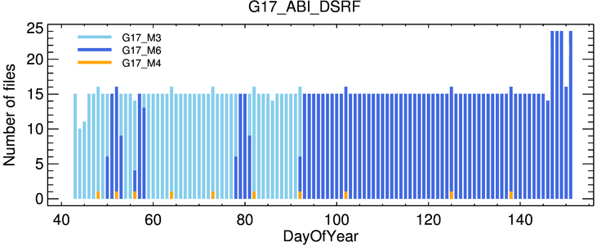
GOES-17 Data Used in this Review: Data Availability
Example of data availability of FD DSR:
  15 files per day between 2/12 – 5/26, 2019 when hours affected by LHP issue (9 – 17 UTC) are excluded
  24 files per day since 5/27, 2019; no hours are excluded.
  No missing file for 3/27 – 5/25, 2019.
Only daytime hours are used in analysis.
G17 transits to M6

Slide 17
Visual and Quantitative Comparisons
GOES-17 Shortwave Radiation Budget L2 Product Provisional PS-PVR

Slide 18
Comparison with GSIP (G15)
GOES-17 Shortwave Radiation Budget L2 Product Provisional PS-PVR

Slide 19
Geostationary Surface and Insolation Product (GSIP)
Independent RSR and DSR from GSIP (GOES-15)
  Uses an algorithm similar to the ABI indirect path algorithm.
  Nominal spatial resolution: 4 km
  Not used as reference data due to lack of maintenance of good calibration of G15 Imager in GSIP
GSIP (G15) full disk (GWDISK) and extended northern hemisphere (GWNHEM) RSR and DSR plots are centered on GOES West position for visual comparison with G17 RSR and DSR.

Slide 20
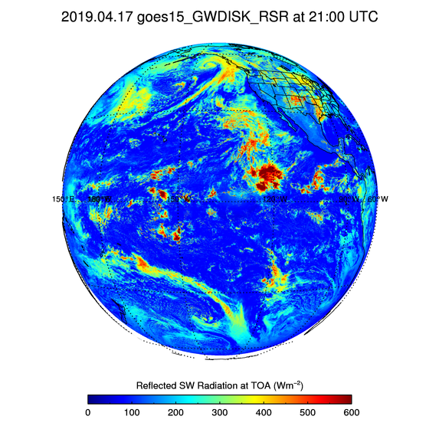
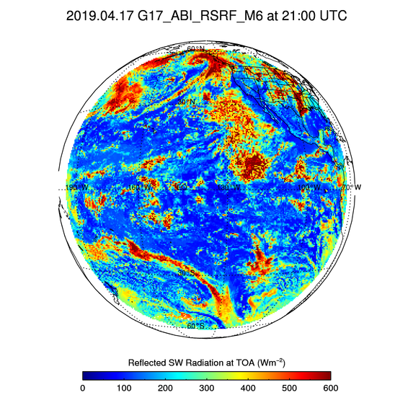
GSIP (GWDISK) vs. G17 RSRF
G15/GSIP (L) and G17 FD (R) RSR on Apr 17, 2019 at 21 UTC.
Difference in spatial resolution of GSIP and G17 RSR is obvious.
In spite of difference in resolution fidelity of RSR fields is good.
G17 clouds reflect more solar radiation.

Slide 21
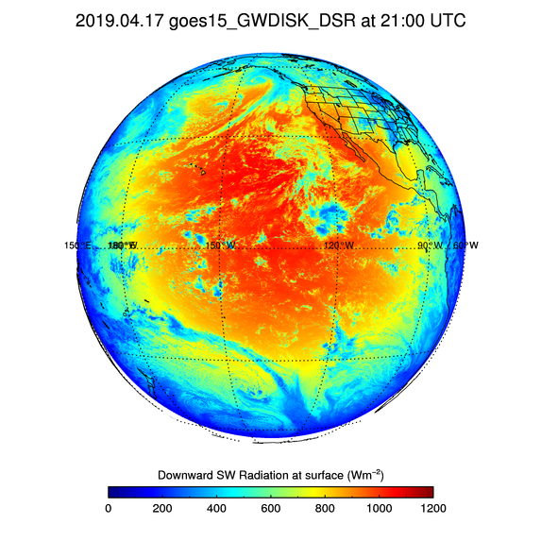
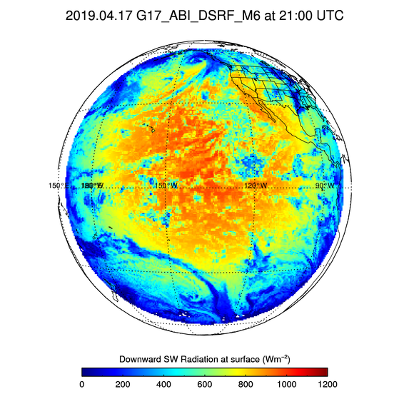
GSIP (GWDISK) vs. G17 DSRF
G15/GSIP (L) and G17 FD (R) DSR on Apr 17, 2019 at 21 UTC.
Difference in spatial resolution of GSIP and G17 DSR is obvious.
In spite of difference in resolution fidelity of DSR fields is good.
G17 DSR is smaller than GSIP DSR.

Slide 22
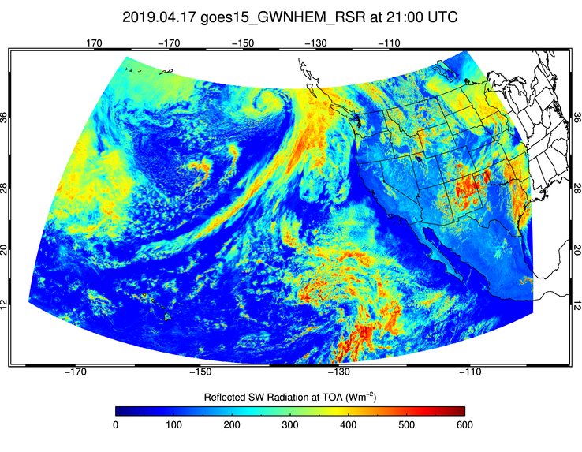
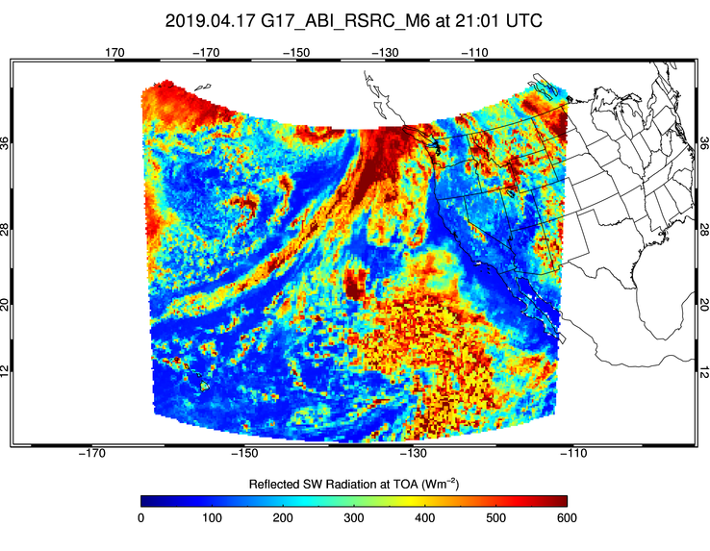
GSIP (GWNHEM) vs. G17 RSRC
G15/GSIP (L) and G17 FD (R) RSR on Apr 17, 2019 at 21 UTC.
  Observation time difference: 1 minute.
Difference in spatial resolution of GSIP and G17 RSR is obvious.
In spite of difference in resolution fidelity of RSR fields is good.
G17 clouds reflect more solar radiation.

Slide 23
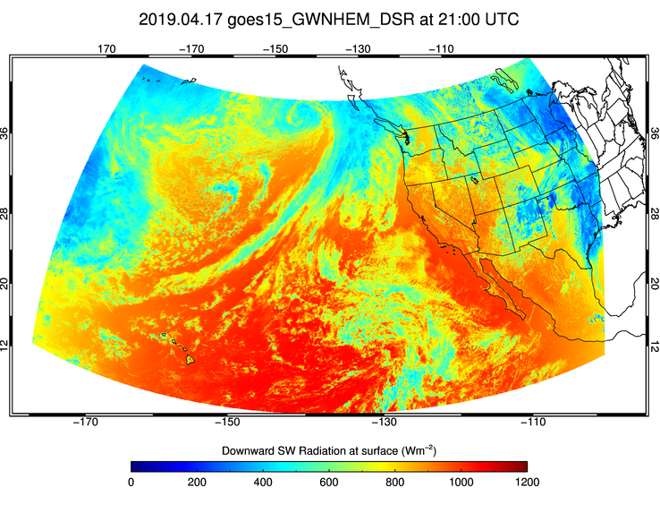
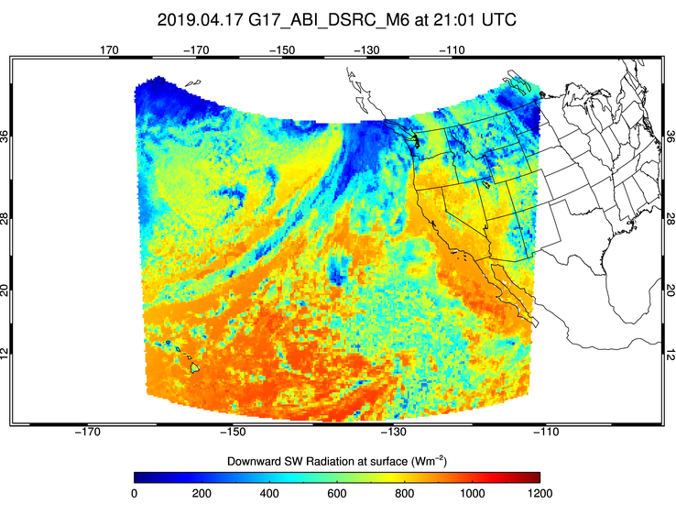
GSIP (GWNHEM) vs. G17 DSRC
G15/GSIP (L) and G17 FD (R) DSR on Apr 17, 2019 at 21 UTC.
  Observation time difference: 1 minute.
Difference in spatial resolution of GSIP and G17 DSR is obvious.
In spite of difference in resolution fidelity of DSR fields is good.
G17 DSR is smaller than GSIP DSR.

Slide 24
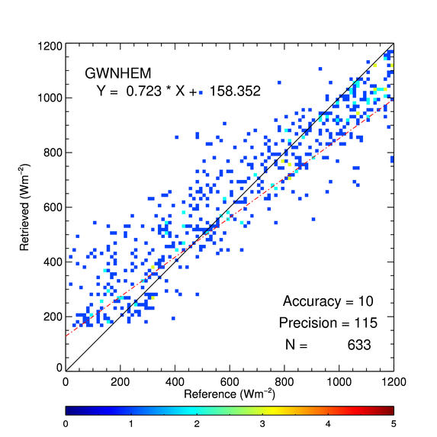
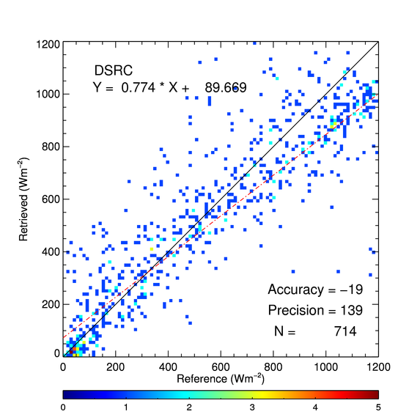
GSIP/G15 and G17 DSR vs. SURFRAD DSR
G15 GWNHEM (left) and G17 DSRC (right) over 3 SURFRAD sites (DRA, FPK, and TBL) for 4/1 – 4/30, 2019.
Overall, GSIP/G15 A and P values are better, but G17 retrievals significantly reduce overestimation at low end seen in GSIP/G15.
Notes:
hours of 09 – 17 UTC are excluded.

Slide 25
Comparison with GOES-16
GOES-17 Shortwave Radiation Budget L2 Product Provisional PS-PVR

Slide 26
Data used
RSR and DSR FD products in G17-G16 overlap area on May 10, 2019.
Comparison with reference data over same stations for period Feb 12 – May 31, 2019;
  09 – 17 UTC products are excluded when necessary.
Notes:
IL: Show map of common (overlap) area

Slide 27
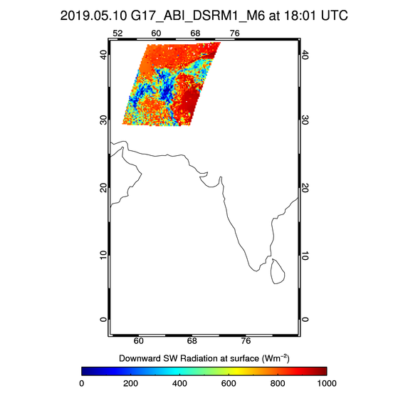
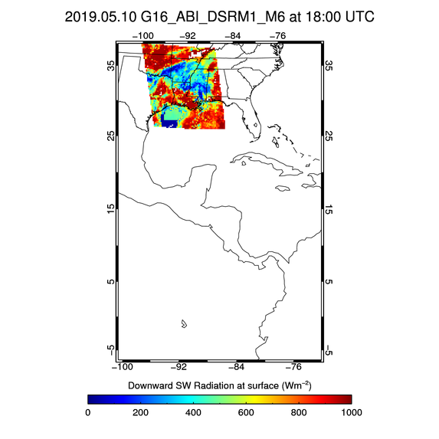
G16/G17 MESO Flux Comparison: 18 UTC on 5/10/19
G17 DSRM1 (L) and G16 DSRM1 (R)
G17 DSRM1 (left) is incorrectly located. .

Slide 28
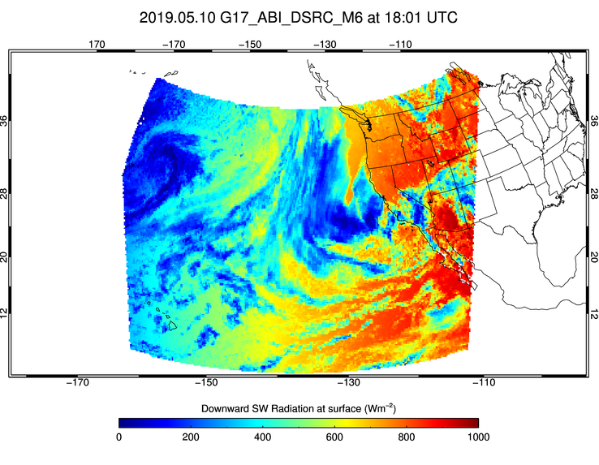
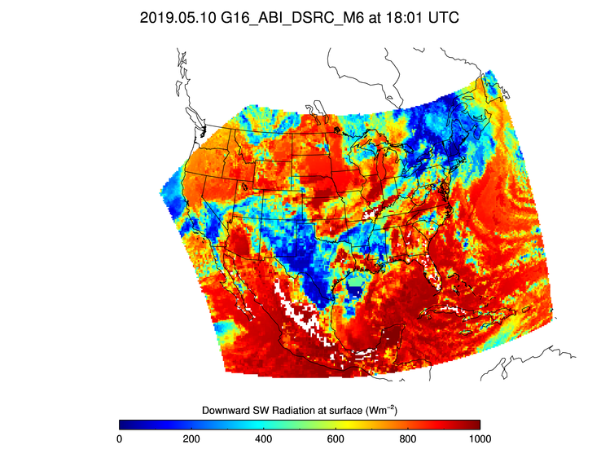
G16/G17 CONUS Flux Comparison: 18 UTC on 5/10/19
G17 DSRC (L) and G16 DSRC (R)
G17 and G16 CONUS domains cover mostly different areas.
.

Slide 29
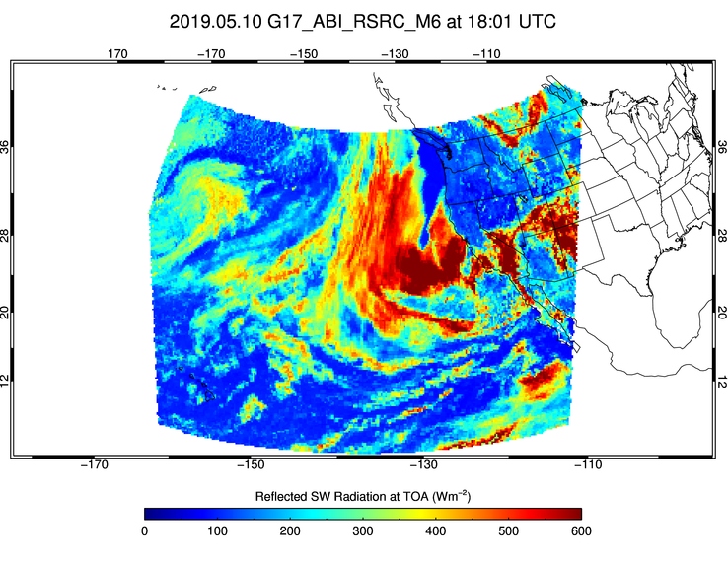
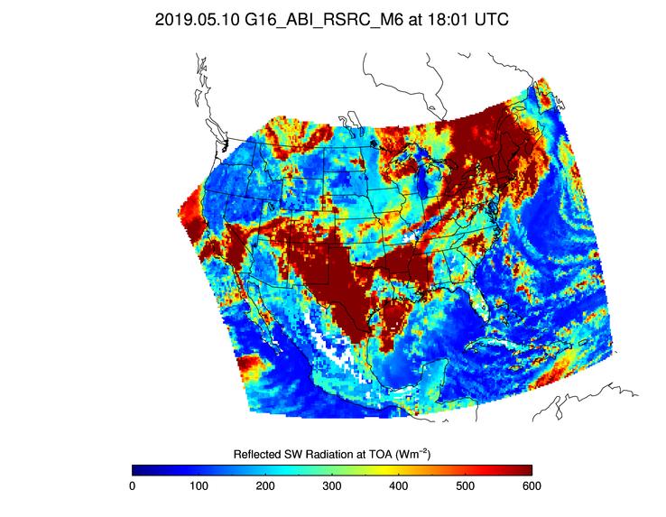
G16/G17 CONUS Flux Comparison: 18 UTC on 5/10/19
G17 RSRC (L) and G16 RSRC (R)
G17 and G16 CONUS domains cover mostly different areas.

Slide 30
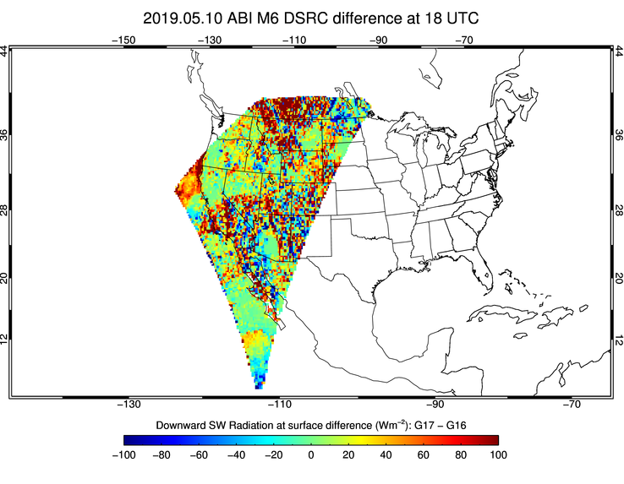
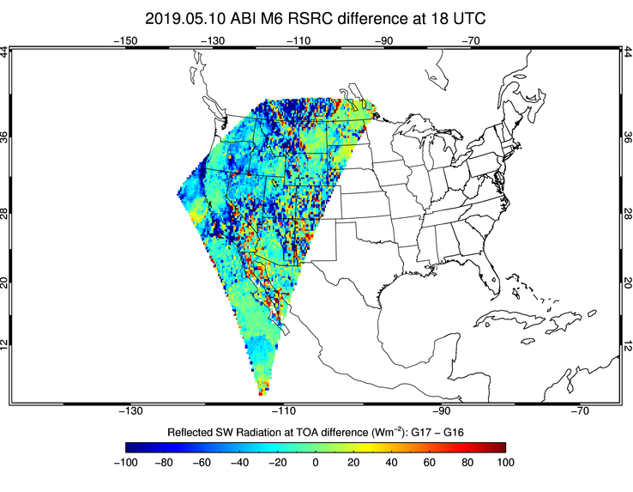
Flux difference in the overlap area at 18 UTC on 5/10/19
Flux difference (G17 – G16) of DSRC (L) and RSRC (R).
Large differences in both DSR and RSR at this time..

Slide 31
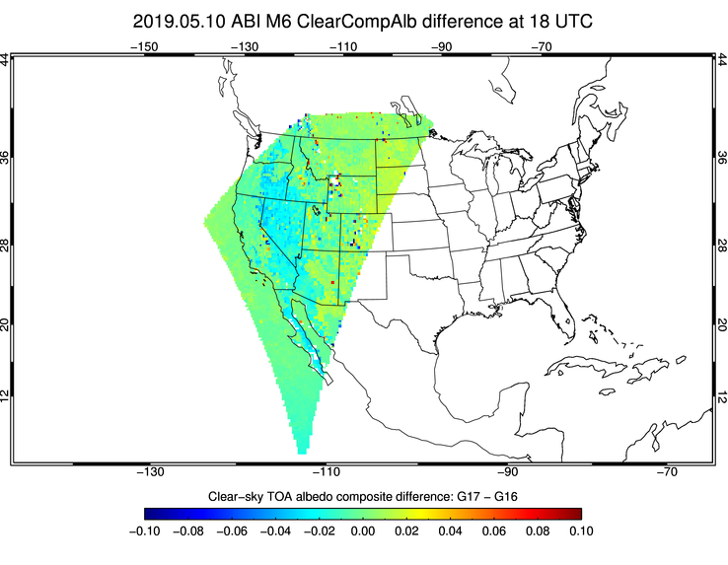
ClearCompAlb difference in the overlap area at 18 UTC on 5/10/19
Large part of the DSR/RSR difference is due to difference in the clear-sky composite TOA albedo difference (G17 – G16) .

Slide 32
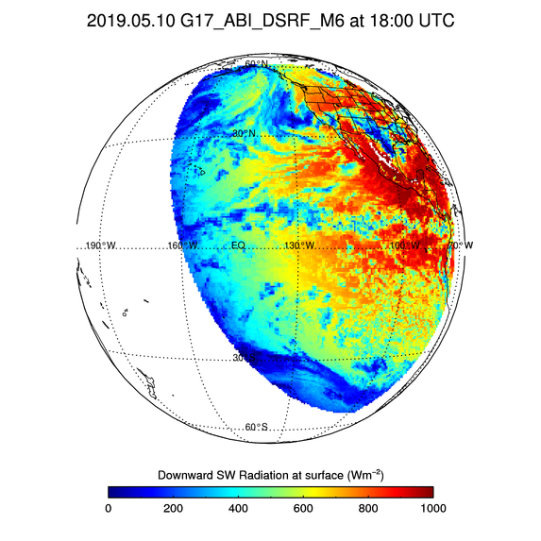
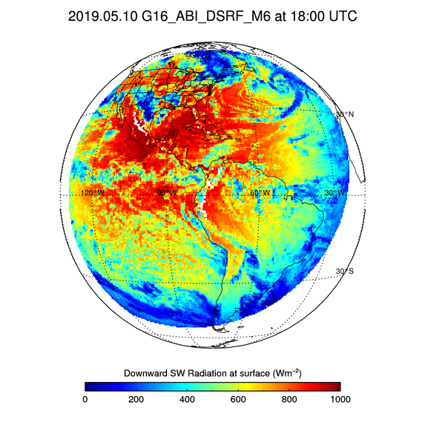
G16/G17 FD Flux Comparison: 18 UTC on 5/10/19
G17 DSRF (L) and G16 DSRF (R)

Slide 33
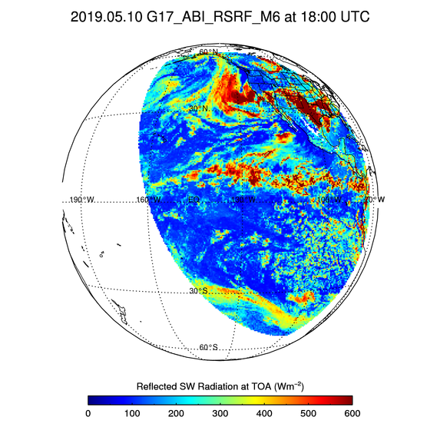
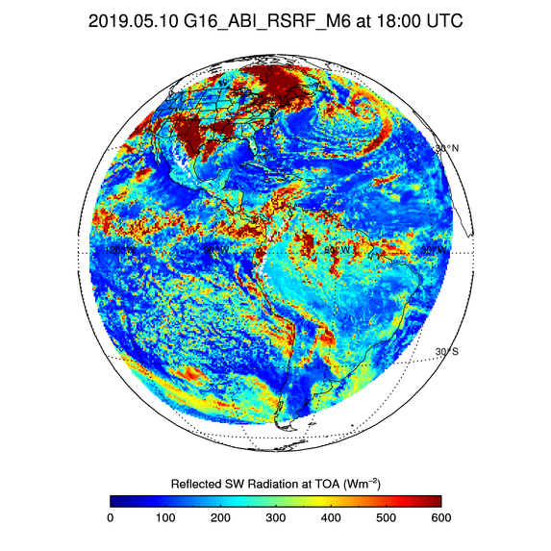
G16/G17 FD Flux Comparison: 18 UTC on 5/10/19
G17 RSRF (L) and G16 RSRF (R)

Slide 34
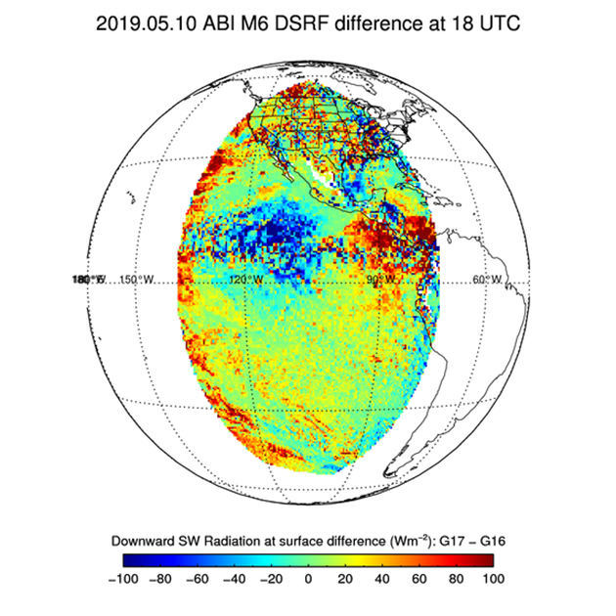
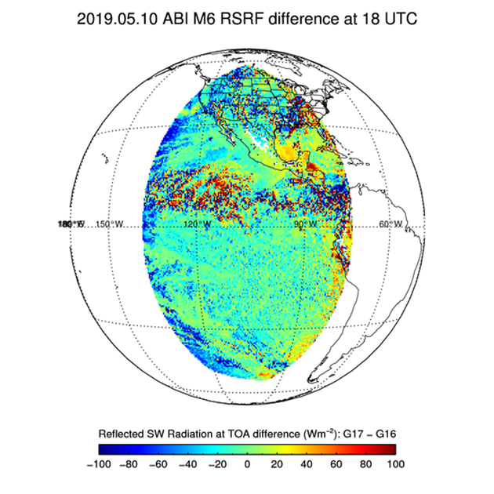
Flux difference in overlap area at 18 UTC on 5/10/2019
G17-G16 DSR
G17-G16 RSR
Time of maximum flux difference (18 UTC) is shown. G17 and G16 view angle differences combined with uncertainties in angular distribution models lead to flux differences.
Notes:
IL: All quality or just good retrievals? YES, GOOD

Slide 35
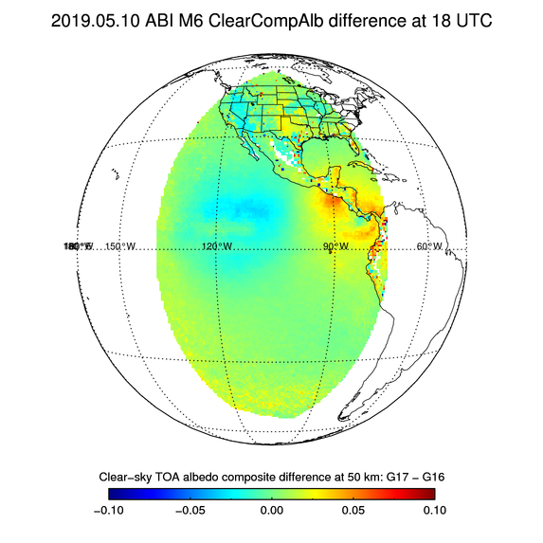
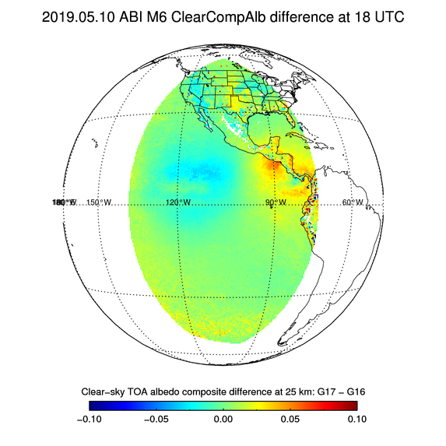
ClearCompAlb difference in the overlap area at 18 UTC on 5/10/19
G17-G16 Clear-sky composite TOA albedo
for DSR (50 km)
G17-G16 Clear-sky composite TOA albedo
for RSR (25 km)
Large part of the DSR/RSR difference is due to difference in the clear-sky composite TOA albedo difference (G17 – G16) .

Slide 36
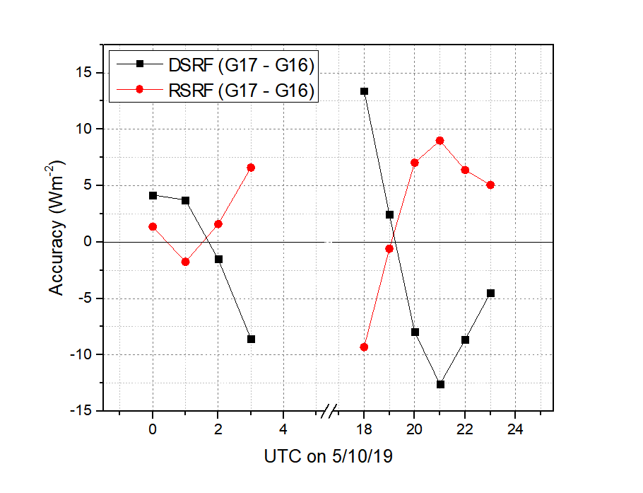
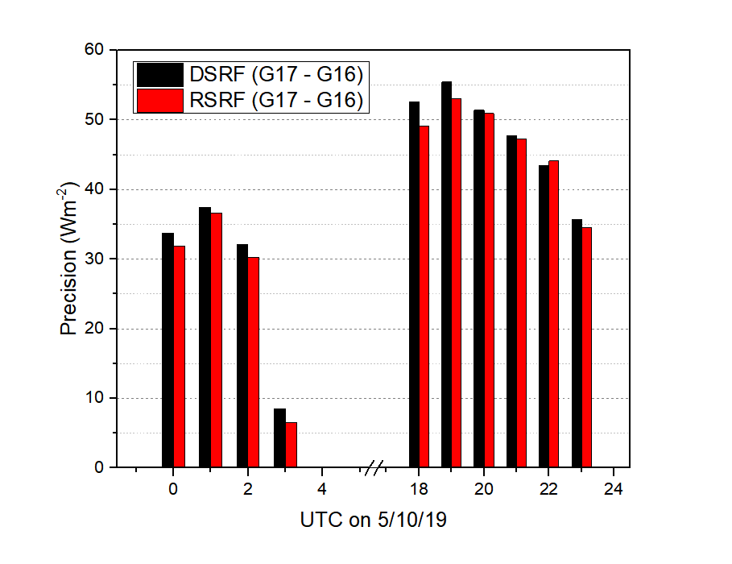
Flux difference vs. UTC in overlap area on 5/10/2019
G17-G16 flux difference of DSRF (black) and RSRF (red).
  Mean flux difference (left) and standard deviation (std) of differences (right).
Overall flux differences are -2 and +2.5 Wm⁻² for DSR and RSR.

Slide 37
Probability Plots (1)
Using probability plots to compare GOES-17 and GOES-16 DSR and RSR.
Data: good-quality DSR and RSR over SURFRAD sites: 02/12/2019 – 05/15/2019.
Normal distribution is assumed.
Reference lines and fit parameters, mean (µ) and standard deviation (σ), are compared.
Test for measuring whether GOES-17 and GOES-16 DSR/RSR are statistically same or different:
  Akaike Information Criteria (AIC),
  F-test.

Slide 38
Probability Plots (2)
DSR
RSR
Probability plots suggest GOES-17 and GOES-16 DSR/RSR empirical CDFs are similar.
AIC and F-test indicate GOES-17 and GOES-16 DSR/RSR products are statistically not different.
Statistical similarity of GOES-17 and GOES-16 products does not necessarily mean they agree with the reference data.

Slide 39
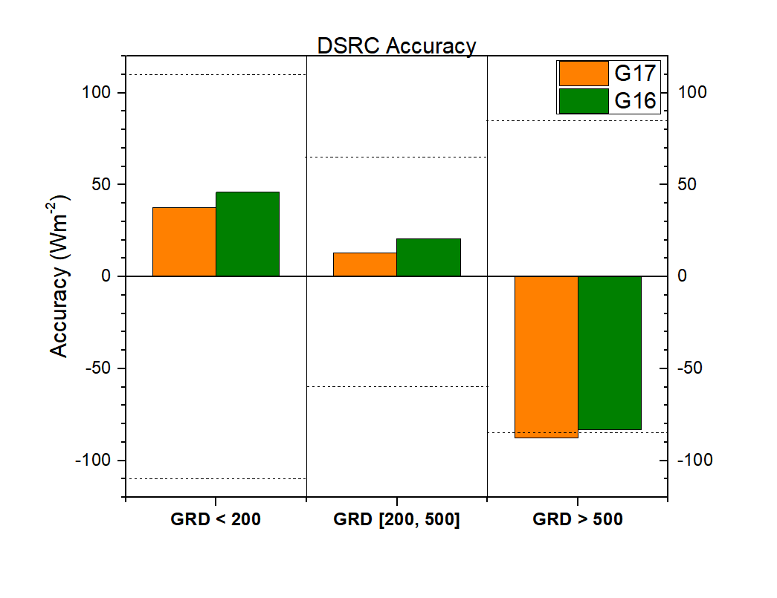
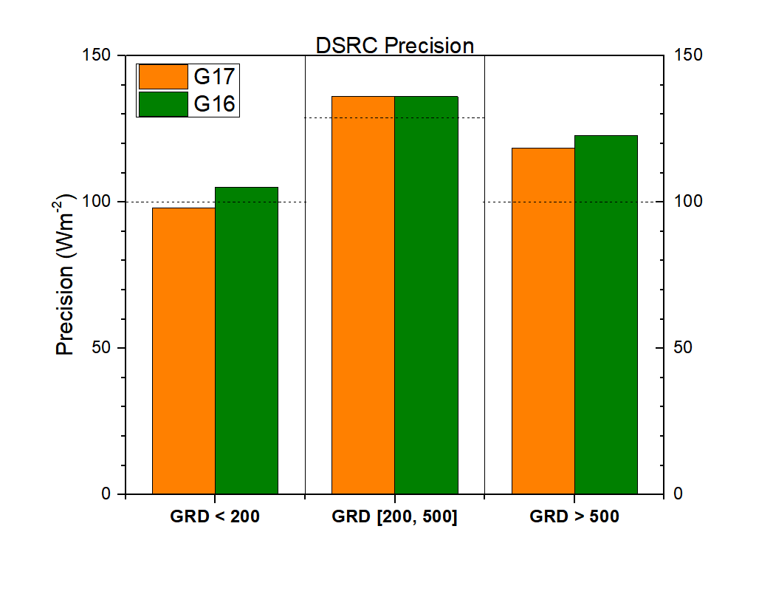
CONUS DSR comparison over same stations
DSRC from G17 and G16 for 2/12 – 5/31, 2019 compared with ground measurements.
  G17 A and P are comparable to (or slightly better than) G16 A and P.
Notes:
precedent

Slide 40
Comparison with Reference data
GOES-17 Shortwave Radiation Budget L2 Product Provisional PS-PVR

Slide 41
Definitions of Metrics for Quantitative Comparisons
Passed: Accuracy and Precision meet or slightly exceed requirements. Potential contributors for deviations are identified.
Partial-Passed: Accuracy/Precision deviates significantly from requirements, but potential contributors for deviations are identified.
Failed: Accuracy/Precision deviates significantly from requirements and source of poor performance is unknown, or source known and correction requires new algorithm.

Slide 42
Comparison of GOES-17 RSR with CERES RSR
GOES-17 Shortwave Radiation Budget L2 Product Provisional PS-PVR

Slide 43
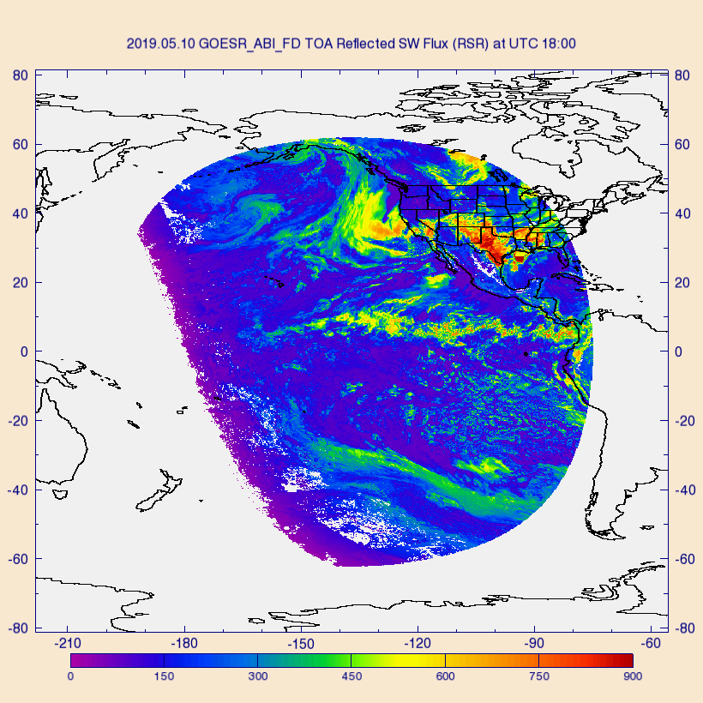
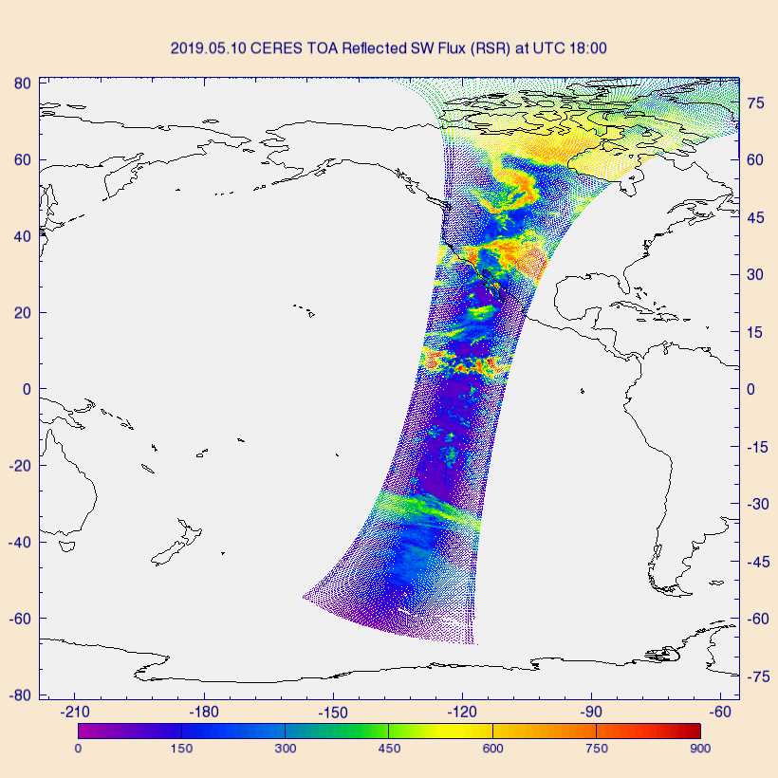
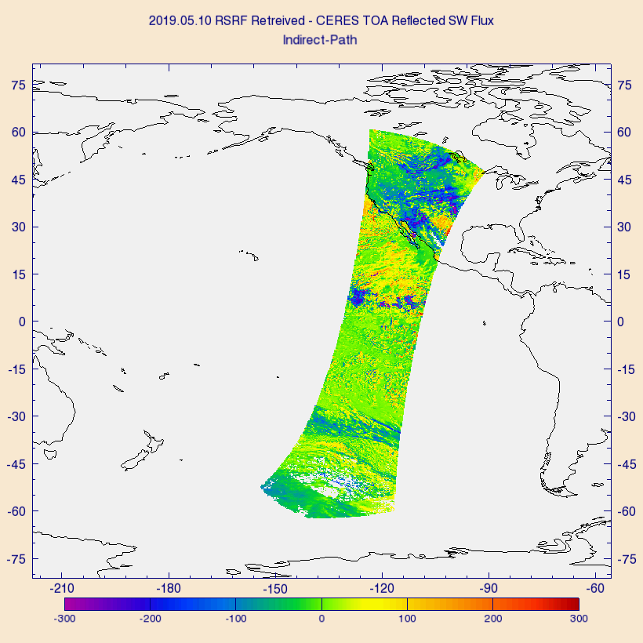
PLPT Task ABI-FD_RSR09
Comparison of G17 RSR with CERES/Terra TOA reflected flux on 5/10/2019 at 18-23 UTC over full disk:
  G17 (left), CERES (middle), and G17 – CERES difference (right).
  Largest differences (± 300 Wm⁻²) are over clouds.
Notes:
ALL quality.

Slide 44
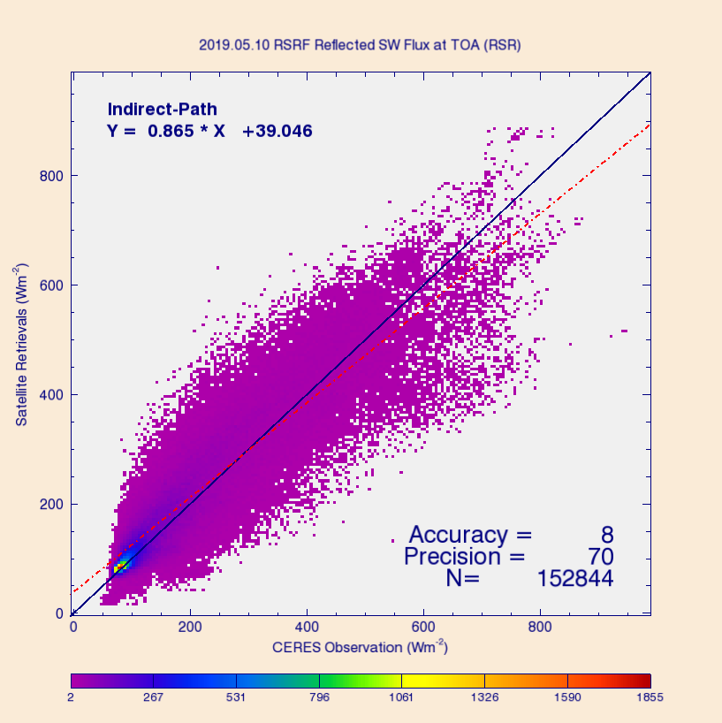
PLPT Task ABI-FD_RSR09
Comparison of G17 FD RSR product with CERES/Terra TOA fluxes for 5/10/2019 over full disk (over 152K points).
Range | A | P | N
CERES < 200 | 15 (110) | 40 (100) | 87,772
[200, 500] | 16 (65) | 80 (130) | 53,305
CERES > 500 | -78 (85) | 122 (100) | 11,767
Requirements are in parenthesis. Units: W m⁻².
Only one day!
Accuracy (A) and precision (P) are within specs except for high range P (cloudy sky).
Accuracy (A): mean bias (satellite – reference)
Precision (P): standard deviation of biases
Notes:
All quality.

Slide 45
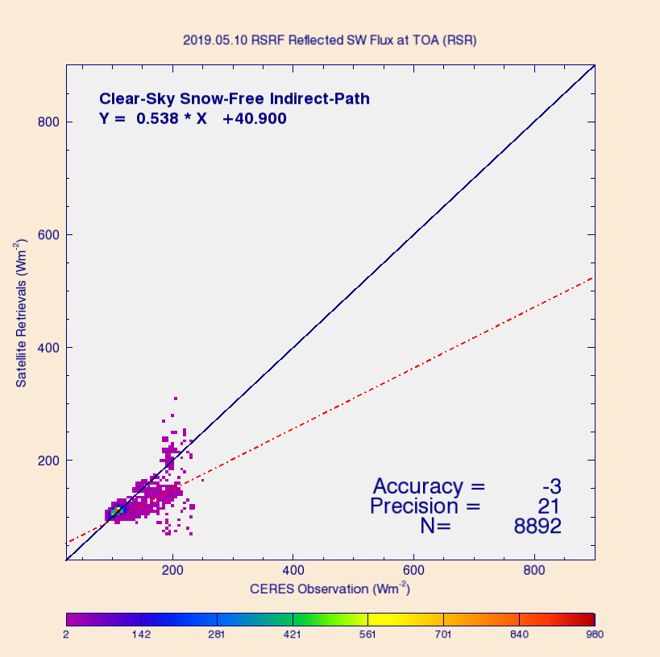
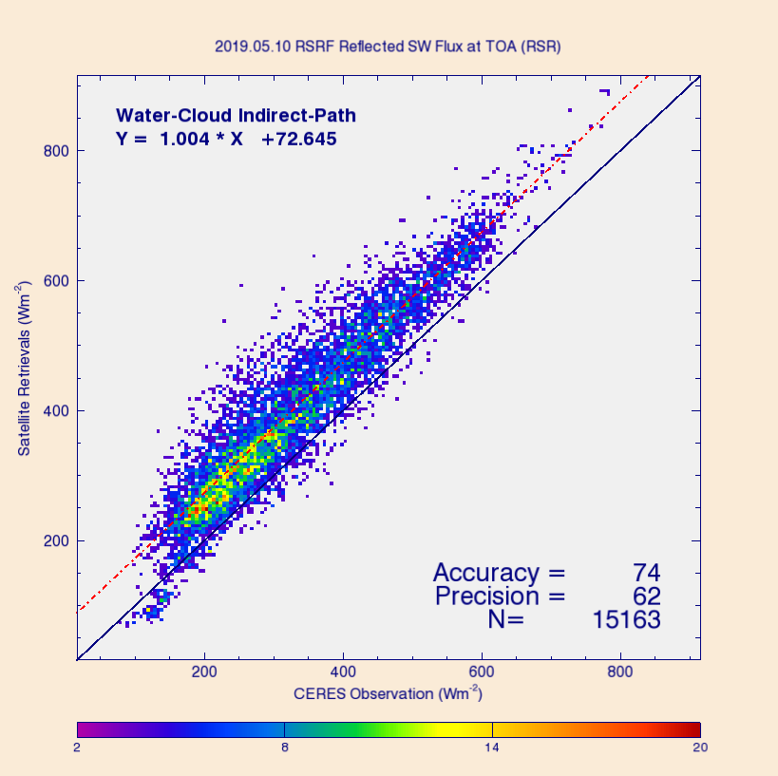
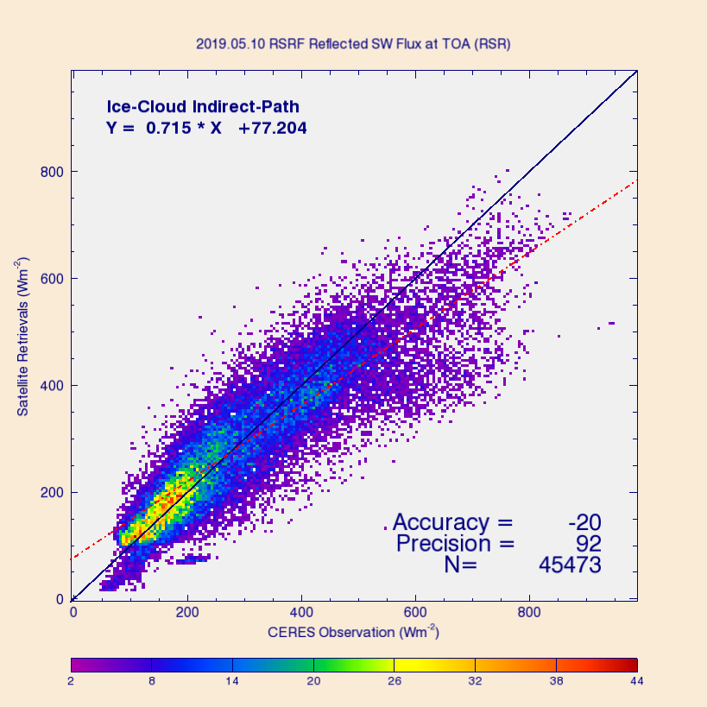
PLPT Task ABI-FD_RSR09
Comparison of G17 FD RSR with CERES/Terra TOA reflected flux for 3 scene types on 5/10/2019:
  Clear sky (left), water cloud (middle), and ice cloud (right).
  Largest biases are for water and ice clouds.
Accuracy: mean bias (satellite – reference)
Precision: standard deviation of biases
Notes:
IL: We know that the narrow-to-broadband (NTB) conversion has larger errors for cloudy scenes; empirical NTB conversion will help.

Slide 46
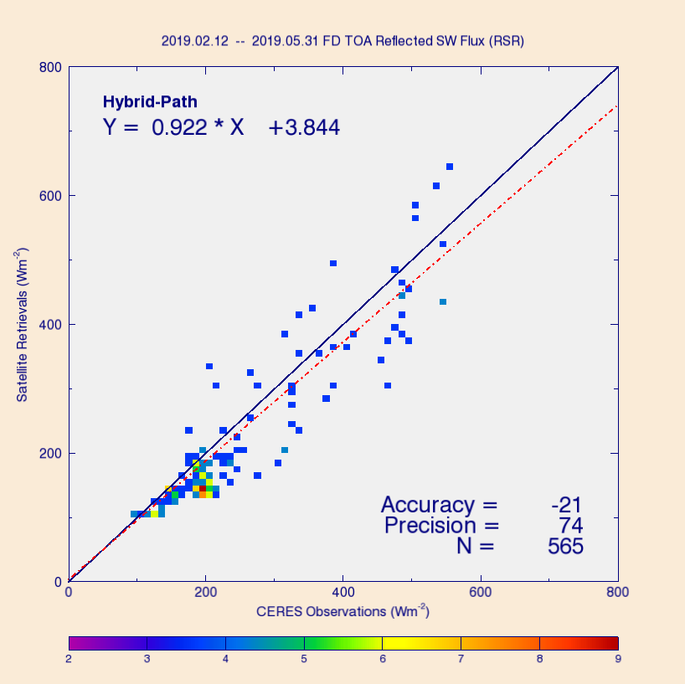
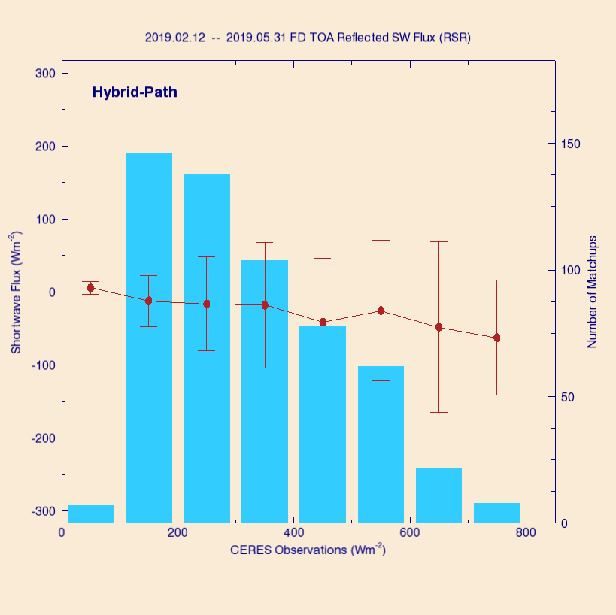
PLPT Task ABI-FD_RSR09
Comparison of G17 FD RSR product with CERES/Terra TOA fluxes for 2/12 – 5/31, 2019, but over selected sites only.
Underestimation on average; largest bias is at high RSR (cloud).
Sites: SURFRAD and SOLRAD (see later).

Slide 47
PLPT Task ABI-FD_RSR09
Comparison of G17 FD RSR product with CERES/Terra TOA fluxes for the time period 2/12 – 5/10, 2019 over full disk.
Accuracy (A) and precision (P) are within specs except for high range P (cloudy sky).
Range | A | P | N
CERES < 200 | 23 (110) | 44 (100) | 6,770,700
[200, 500] | 25 (65) | 77 (130) | 5,670,890
CERES > 500 | -78 (85) | 112 (100) | 1,002,720
All | 16 | 72 | 13,444,321
Requirements are in parenthesis. Units: W m⁻².
Accuracy (A): mean bias (satellite – reference)
Precision (P): standard deviation of biases

Slide 48
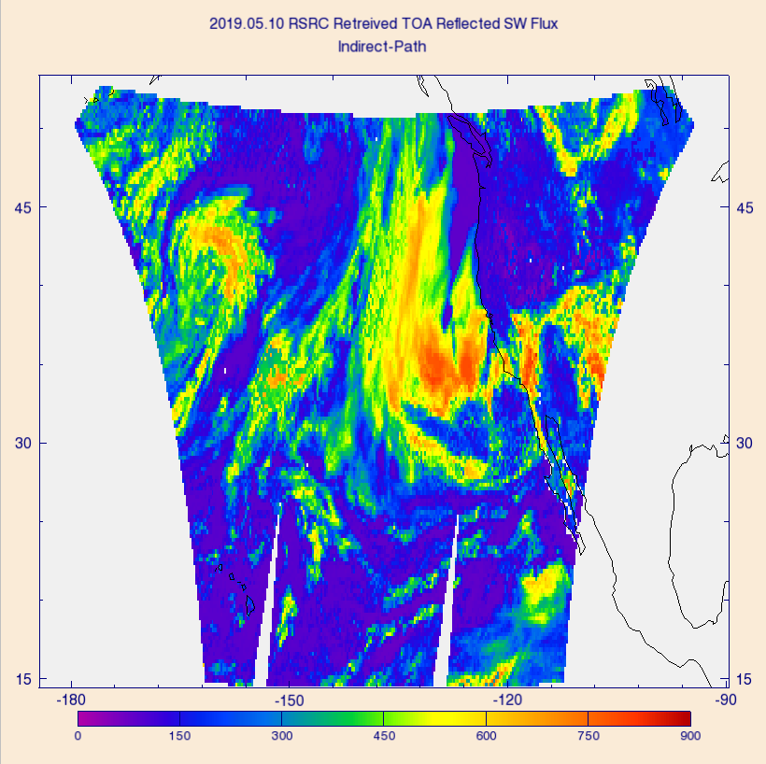
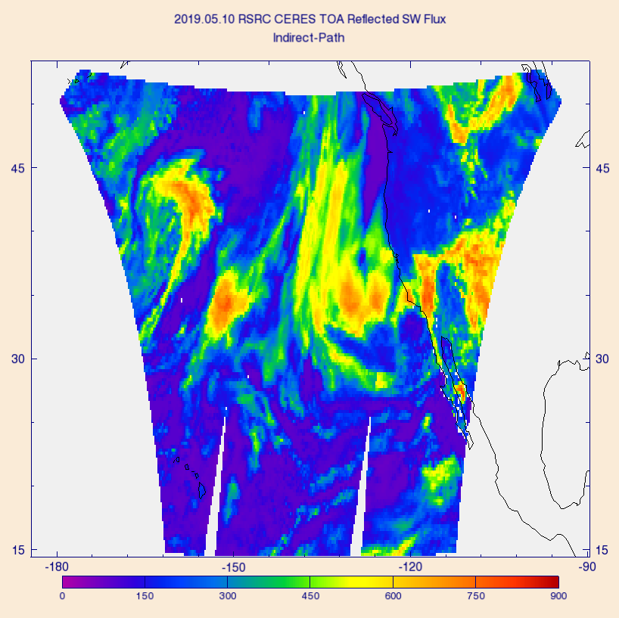
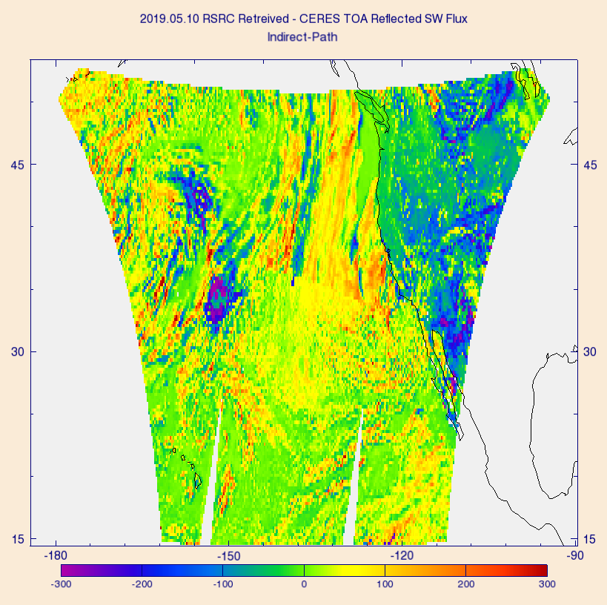
PLPT Task ABI-CONUS_RSR10
Comparison of G17 RSR with CERES/Terra TOA reflected flux on 5/10/2019 over CONUS:
  G17 (left), CERES (middle), and G17 – CERES difference (right).
  Largest differences (± 300 Wm⁻²) are over clouds.

Slide 49
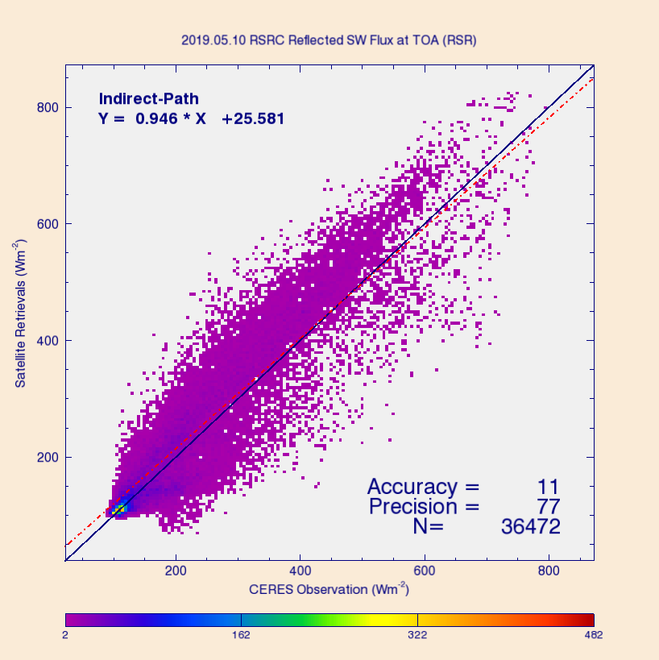
PLPT Task ABI-CONUS_RSR10
Comparison of G17 RSR product with CERES/Terra TOA fluxes for 5/10/2019 over CONUS (over 36K points).
Range | A | P | N
CERES < 200 | 11 (110) | 48 (100) | 16,617
[200, 500] | 21 (65) | 88 (130) | 16,053
CERES > 500 | -31 (85) | 111 (100) | 3,802
Requirements are in parenthesis. Units: W m⁻².
Accuracy (A) and precision (P) are within specs except for high range P (cloudy sky).
Accuracy (A): mean bias (satellite – reference)
Precision (P): standard deviation of biases

Slide 50
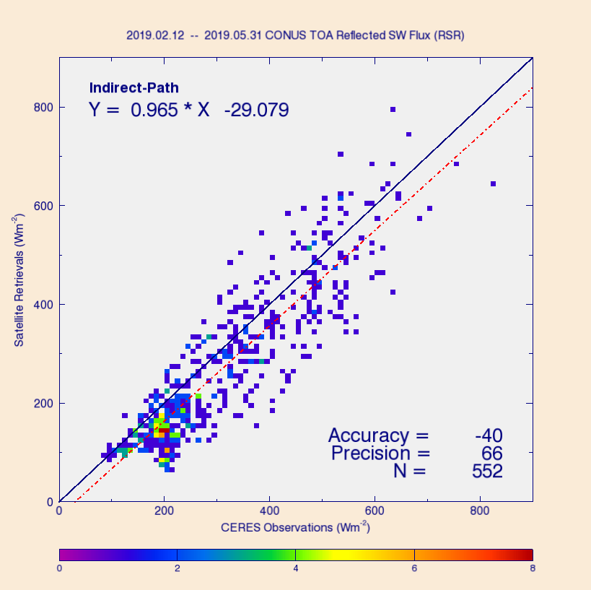
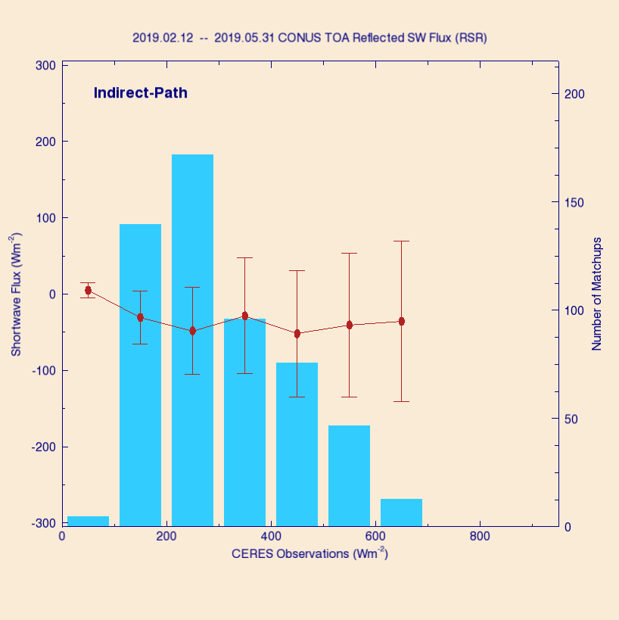
PLPT Task ABI-CONUS_RSR10
Comparison of G17 CONUS RSR product with CERES/Terra TOA fluxes for 2/12 – 5/31, 2019, but over selected sites only.
Underestimation on average; largest bias is again at high RSR (cloud).
Sites: SURFRAD and SOLRAD (see later).

Slide 51
PLPT Task ABI-CONUS_RSR10
Comparison of G17 RSR product with CERES/Terra TOA fluxes for the time period 2/12 – 5/10, 2019 over CONUS.
Accuracy (A) and precision (P) are within specs in all ranges.
Range | A | P | N
CERES < 200 | 19 (110) | 47 (100) | 1,244,120
[200, 500] | 15 (65) | 79 (130) | 1,589,140
CERES > 500 | -52 (85) | 94 (100) | 323,727
All | 10 | 73 | 3,156,994
Requirements are in parenthesis. Units: W m⁻².
Accuracy (A): mean bias (satellite – reference)
Precision (P): standard deviation of biases

Slide 52
Comparison of GOES-17 DSR with SURFRAD and SOLRAD DSR
GOES-17 Shortwave Radiation Budget L2 Product Provisional PS-PVR

Slide 53
Reference Data for
Quantitative Evaluation of DSR
Surface Radiation Network (SURFRAD)
  Accurate, long-term, continuous measurements.
  7 permanent sites in climatologically diverse regions in the US.
Integrated Surface Irradiance Study (SOLRAD)
  Monitors surface radiation in the US, in collaboration with SURFRAD.
  Currently 7 stations are available.
Number of stations used depends on the domain
  CONUS: 8 stations,
  FD: 12 stations,
  2 stations (Penn State and Sterling) are not seen by GOES 17.

Slide 54
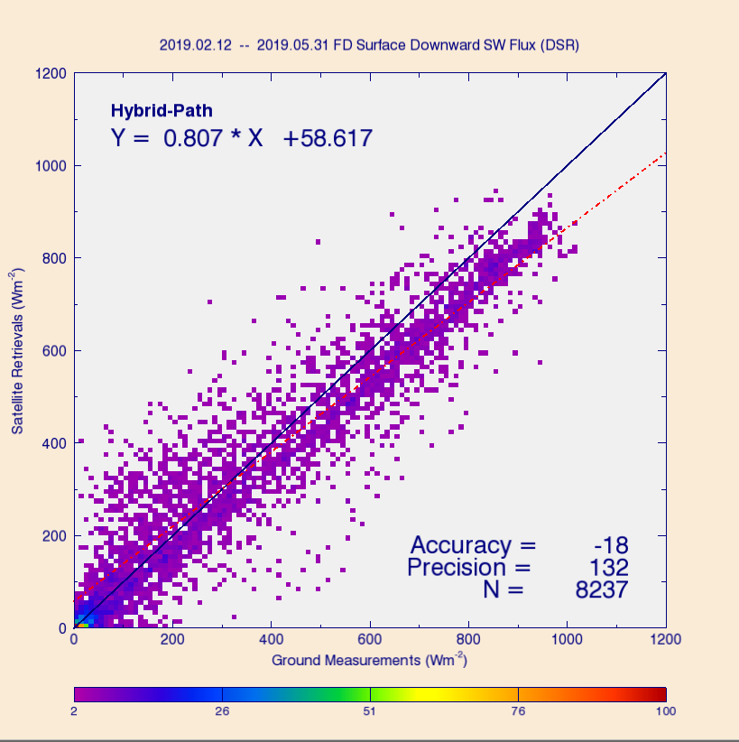
PLPT Task ABI-FD_DSR09
Comparison of FD DSR product (50 km) with SURFRAD and SOLRAD for 2/12 – 5/31, 2019.
Range | A | P | N
Ground < 200 | 41 (110) | 104 (100) | 2,678
[200, 500] | -5 (65) | 134 (130) | 2,460
Ground > 500 | -81 (85) | 124 (100) | 3,099
Requirements are in parenthesis. Units: W m⁻².
Accuracy (A) requirements are met in all ranges, but Precision (P) values slightly exceed requirements in low and mid ranges. Exceeding P requirement in high range is larger.
Accuracy (A): mean bias (satellite – reference)
Precision (P): standard deviation of biases
Notes:
IL: Spring season; larger scatter is expected due to rapidly changing surface conditions. (GOES-16 provisional met requirements; time period was late summer-early fall; less scatter.)

Slide 55
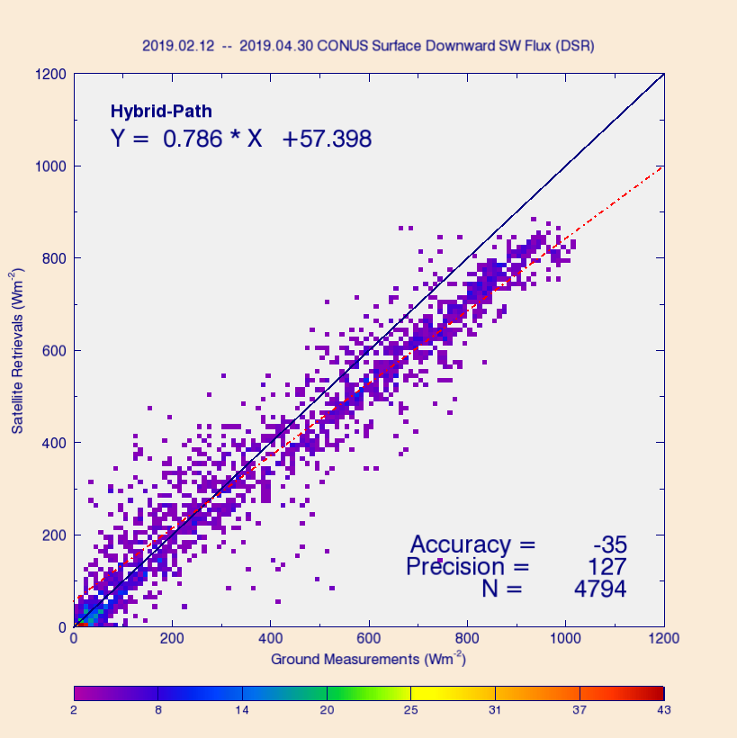
PLPT Task ABI-CONUS_DSR10
Comparison of CONUS DSR product (25 km) with SURFRAD and SOLRAD for 2/12 – 5/31, 2019.
Range | A | P | N
Ground < 200 | 37 (110) | 95 (100) | 1,990
[200, 500] | 9 (65) | 131 (130) | 1,963
Ground > 500 | -85 (85) | 117 (100) | 3,037
Requirements are in parenthesis. Units: W m⁻².
Accuracy (A) values meet requirements in all ranges, but Precision (P) values slightly exceed requirements in mid and high ranges.
Accuracy (A): mean bias (satellite – reference)
Precision (P): standard deviation of biases

Slide 56


Diurnal Cycle of DSRC - Clear
Clear-sky examples: the “good” and the “bad”.
Under predominantly clear skies G17 DSR follows the diurnal change in ground-measured DSR, but degree of agreement can vary with location.

Slide 57


Diurnal Cycle of DSRC - Cloudy
Cloudy-sky examples: the “good” and the “bad”.
G17 DSR follows the diurnal change in ground-measured DSR even under cloudy or partly cloudy skies (“very difficult” scene), but degree of agreement varies with location.

Slide 58

Diurnal Cycle of Hourly DSR
Hourly average DSR from data combined from all 8 sites for period 2/12 – 5/31, 2019.
G17 average diurnal cycle tends to underestimate, but closely follows, the average diurnal cycle from ground.
Notes:
IL: Is this from CONUS DSR? YES

Slide 59
Summary of G17 vs. Reference RSR and DSR Comparison
G17 RSR is evaluated with CERES RSR (Passed).
  FD: within specs except for high range P (cloudy sky).
    Empirical NTB (when implemented) will improve P.
  CONUS: within specs in 4-month data.
G17 DSR is evaluated with SURFRAD and SOLRAD ground data (Passed).
  FD: within specs, except P values slightly exceed requirements in low and mid ranges. Excess in high range is larger.
  CONUS: within specs, except P values slightly exceed requirements in mid and high ranges.
  Empirical NTB is expected to improve precision.
  Quality of G17 DSR is very similar to quality of G16 DSR.
MESO: G17 MESO DSR is incorrectly mapped (Failed).
  Currently, no known users of MESO products.
LINK

Slide 60
Provisional Maturity Assessment
GOES-17 Shortwave Radiation Budget L2 Product Provisional PS-PVR

Slide 61
Provisional Validation
Preparation Activities | Assessment
Validation activities are ongoing and the general research community is now encouraged to participate. | Validation activities are ongoing. The general research community has been participating and providing feedback.
Severe algorithm anomalies are identified and under analysis. Solutions to anomalies are in development and testing. | Operational and algorithm anomalies have been identified. Four MESO ADRs (incorrect clear composite albedo, not in G17 file of view, _FillValue during daytime) remain on-hold; two ADRs are open (incorrect ABI TPW unit; bad initialization of PQIs and missing IP flag_meaning in PQI3); only one (ABI TPW unit) impacts accuracy/precision.
Incremental product improvements may still be occurring. | Incremental product improvements are expected.

Slide 62
Provisional Validation
End State | Assessment
Product performance has been demonstrated through analysis of a small number of independent measurements obtained from select locations, periods, and associated ground truth or field campaign efforts. | This has been demonstrated using CERES, SURFRAD and SOLRAD as truth and independent statellite retrivals from GSIP and GOES-16.
Product analysis is sufficient to communicate product performance to users relative to expectations (Performance Baseline). | This has been communicated in PS-PVR.
Documentation of product performance exists that includes recommended remediation strategies for all anomalies and weaknesses. Any algorithm changes associated with severe anomalies have been documented, implemented, tested, and shared with the user community. | These are documented in this PS-PVR presentation and will be documented in a separate ReadMe file.
Product is ready for operational use and for use in comprehensive cal/val activities and product optimization. | We concur.

Slide 63
Plans for Assessment of warm period

Slide 64
Impact of GOES-17 LHP anomaly on SRB Products
Direct impact: NO.
  ABI VIS & NIR channels (Bands 1 – 6) are used as inputs in SRB retrieval – These bands are not impacted by LWIR temp. anomaly.
Indirect impact: YES, but likely minimal.
  SRB algorithm uses upstream ABI products (Clear-sky Mask and Cloud products) that are impacted by LWIR focal plane temperature (FPM) anomaly.
  SRB products are daytime products; impact of excessive LWIR FPM temperatures are somewhat minimized by times of daylight and solar zenith angle limit for good-quality DSR and RSR.
PCAL extends the time of usable retrievals by about an hour.
Material supporting the statements above is in the Supplement - Impacts of G17 LWIR FPM temperature .

Slide 65
Plan for Assessing Warm Period and Mitigation
Plan:
  Use GOES-17 RSR and DSR from warm period with predictive calibration (PCAL) turned on.
  Compare with corresponding GOES-16 RSR and DSR for GOES-17/GOES-16 overlap area, and with surface data.
  Evaluate high LWIR FPM temperature flag in ABI L1B data if its use in SRB algorithm further helps with avoiding times of high FPM temperatures.
Mitigation:
  No changes in SRB algorithm are planned (bands used are not impacted)
  But, if needed, implement screening pixels for high LWIR FPM temperature based on flag in ABI L1B and set quality to bad or discard retrieval. It is unlikely that this will be needed since Clear-sky Mask should already account for the impact.

Slide 66
Path to full Validation Maturity
GOES-17 Shortwave Radiation Budget L2 Product Provisional PS-PVR

Slide 67
Issues and Status
ADRs Potentially Needing Resolution for Full VAL
ADR | Title | Status | Build
617 | ClearCompAlb is incorrect in MESO product. Time series has only a single value (one day). | On hold | --
864 | G17 MESO1/2 is located incorrectly
914 | MESO DSR is filled with _FillValue during local daytime
933 | G17 DSRM2 if filled with _FillValue
875 | ABI TPW unit is not scaled correctly in GS SRB algorithm | Submitted | --
743 | Missing flag_meanings attribute for PQI3. | Submitted | --
 | PQIs are not initialized with _FillValue. | Submitted | --
408 393 | Remove unnecessary lat/lon re-projection from Radiation | On hold | --
N/A | Incorrect statistics in CONUS metadata | On hold | --
ADR in red is needed for Full Val (ADR875, TPW unit).
ADRs in green are for MESO; they needed for Full Val if MESO product is kept. (Enterprise algorithm will not solve all of these issues).

Slide 68
Issues and Status
Other Actions Needed for Full VAL
Action | Title | Desired Implementation Date into OE
New ADR(s) needed | L2 SRB algorithm - further update of the narrow-to-broadband (NTB) albedo conversion | ≧6 month prior to PS-PVR FULL
New ADR(s) needed | Update, add more levels to quality flags using information currently only in IP. | ≧6 month prior to PS-PVR FULL

Slide 69
Path to Full Validation - PLPTs
PLPT ID | Descriptive Title
ABI-FD_DSR12 ABI-FD_RSR12 | Assess precision and accuracy of FD product for an extended period that includes seasonally representative number of independent measurements
ABI-CONUS_DSR13 ABI-CONUS_RSR13 | Assess precision and accuracy of FD product for an extended period that includes seasonally representative number of independent measurements
ABI-MESO_DSR14 | Assess precision and accuracy of FD product for an extended period that includes seasonally representative number of independent measurements
AWG SRB Team will conduct these tests to further evaluate the L2 SRB product quality.
Full test plans and procedures are given in the ABI L2+ DSR and RSR Readiness, Implementation, and Management Plan (RIMP v1.0; 416-R-RIMP-0327)

Slide 70
Path to Full Validation – Risks
Risk Name | Description | Impact | Mitigation and Schedule
Update NTB coefficients | as discussed; Priority 1 | Moderate | New WR/ADR needed
Update, expand quality flags | as discussed; Priority 2 | Little | New WR/ADR needed
Correct ABI TPW unit in SRB algorithm | ABI TPW unit is not scaled correctly in SRB algorithm | Moderate | ADR875 submitted and running in DE
Little Impact
Moderate Impact
Big Impact

Slide 71
Summary & Recommendations
GOES-17 Shortwave Radiation Budget L2 Product Provisional PS-PVR

Slide 72
Summary
Overall, the FD and CONUS DSR and RSR products are ready for operational and scientific use
  FD and CONUS RSR and DSR products from GOES West location are useable starting 03/24/2019 (ClearInstAlb reset on 2/25/19, need 28 days to build time-series).
  MESO products were not evaluated due to incorrect mapping or having no retrievals.
  In general, good quality retrievals are recommended for quantitative applications due to their better overall performance.
Measured RSR and DSR performance against reference data
  Accuracy specs are met in all domains and ranges of RSR and DSR.
  RSR precision specs are met except in high range.
  DSR precision specs are only met in low range over CONUS.
  Updates will be needed for the narrow-to-broadband (NTB) transformation to further improve performance. (The empirical NTB is promising, but requires collection of more ABI and CERES data.)

Slide 73
Recommendation
AWG SRB Team believes that the GOES-17 L2 RSR and DSR Full Disk and CONUS products have reached Provisional Maturity, as defined by the GOES-R Program.
MESO DSR products should stay at Beta maturity until (at least) they are correctly mapped and evaluated.

Slide 74
Supplement
GOES-17 Shortwave Radiation Budget L2 Product Provisional PS-PVR

Slide 75
Impacts of G17 LWIR FPM temperature anomaly on SRB products
GOES-17 Shortwave Radiation Budget L2 Product Provisional PS-PVR

Slide 76
Data Set and Strategy
Run the SRB algorithm offline to retrieve DSR and RSR for 2/26/2019.
  G17 SRB:
    Use G17 ABI L1B reflectances and G17 ABI cloud products (G17),
    Use 5-min G17 ABI PCAL L1B reflectances and G17 CLAVR-x cloud products generated from G17 PCAL L1B (G17PC)
  G16 SRB:
    Use G16 ABI L1B and G16 cloud products (G16).
Extract RSR and DSR for common (overlap) G17 and G16 data area.
Calculate averages over overlap area.
Compare time series of area-averages.

Slide 77

G17 FPM temperatures on 8/29/18
FPM temperatures at times of CLAVR-x cloud mask availability.
LWIR peak at 10:30 UTC
Limited valid SRB retrievals for comparison in G17 + G16 overlap area due to:
  difference in satellite position,
  temporal resolution difference
    G16 FD every 15 min,
    G17 FD every 10 min,
  G17 clear-sky mask availability.

Slide 78


G17 and G16 Fluxes as Function of Time of Day
DSR
RSR
Difference between G16 and G17 at LWIR peak temperature at 13:30 UTC is not larger than at other (cooler) times.
G17PC fluxes are closer to G16 than G17.

Slide 79


FPM temp. increase impacts on SRB: Number of retrievals and cloudiness
G17PC allows retrievals to be made at earlier times and has more retrievals at all times than G17.
G17PC cloud cover fraction is closer to G16 than it is from G17.

Slide 80
FPM temperature impacts on SRB: Summary
Difference between G16 and G17 at LWIR peak temperature at 13:30 UTC is not much larger than at other (cooler) times.
Fluxes derived from PCAL L1B and clear-sky mask are closer to G16 than G17 without PCAL.
G17PC cloud cover fraction is closer to G16 than it is from G17.
G17PC has more number of valid retrievals than G17 at all hours.
G17PC allows retrievals to be made at an earlier time of the day.
(BACK)

Slide 81
Empirical narrow-to-broadband (NTB) coefficients
GOES-17 Shortwave Radiation Budget L2 Product Provisional PS-PVR

Slide 82
Empirical NTB coefficients from CERES/ABI matchup
Challenges:
  CERES/ABI being on a polar/geostationary platform, severely limits angularly and temporally matched ABI and CERES data pairs.
  Coincident CERES broadband and ABI narrowband bidirectional reflectances are usually observed at different satellite angles.
Our solution:
  Use CERES broadband albedos and the CERES Angular Distribution Model (ADM) to estimate broadband bidirectional reflectances that would be observed by CERES at ABI view angles,
  generate pairs of these estimated CERES broadband reflectances and ABI narrowband reflectances, and establish relationships between them (NTB coefficients from linear regression).
Test runs:
  Empirical NTB coefficients derived using G16 matchups are used in G17!
  Built time series of clear-sky TOA albedos every 30 minutes at 2-km, ABI pixel resolution, from data for Mar 2-30, 2019.
  Ran offline SRB algorithm for Mar 31, 2019.

Slide 83


Empirical NTB coefficient test:
RSR and DSR with Current NTB
RSR and DSR retrievals for Mar 31, 2019.
Retrievals used current (GS) NTB coefficients.

Slide 84


Empirical NTB coefficient test:
RSR and DSR with Empirical NTB
RSR and DSR retrievals for Mar 31, 2019.
Retrievals used empirical NTB coefficients.

Slide 85


Empirical NTB coefficient test:
Empirical - Current Difference
Using empirical NTB coefficients significantly changes both RSR and DSR.
Change is most noticeable for clouds.

Slide 86


Empirical NTB coefficient test:
G17 RSR vs. CERES RSR
Current NTB
Empirical NTB
Using empirical NTB improves G17 RSR accuracy and precision.
Brings high (cloudy-sky) G17 RSR closer to CERES RSR.

Slide 87


Empirical NTB coefficient test:
G17 DSR vs. Ground DSR
Current NTB
Empirical NTB
Using empirical NTB improved G17 DSR precision, but increased the bias for this single day.

Slide 88
Summary of Empirical NTB Coefficients Test for 3/31/2019
Applying Empirical NTB:
  improves accuracy and precision of G17 RSR,
    brings high G17 RSR closer to CERES RSR at high end,
  decreases DSR standard deviation, but increases bias somewhat.
    CAVEAT: retrievals are only from a single day!
  results in slightly more valid retrievals.
BACK
Accuracy (A) and precision (P) of G17 RSR derived with current and empirical NTB vs. CERES RSR
RSR error | Current NTB |  |  | Empirical NTB
 | A | P | N | A | P | N
CERES < 200 | 13 | 70 | 24,178,140 | 10 | 58 | 24,223,722
[200, 500] | 12 | 122 | 14,087,145 | -8 | 103 | 14,123,367
CERES > 500 | -112 | 139 | 2,639,522 | -20 | 105 | 2,639,546
All | 4 | 101 | 40,904,807 | 2 | 80 | 40,986,635
Units: W m⁻².

Slide 89
NoteS on spatial and temporal resolution

Slide 90
Comments on spatial and temporal
GOES-R DSR and RSR resolutions
Spatial resolution of GOES-R FD/CONUS DSR: 50/25 km. These represent a step back from the 4-km spatial resolution in current GSIP.
Many users need higher resolution radiation products:
  Needed in GOES Evapotranspiration and Drought (GET-D) product, “which is extremely valuable for validating and improving EMC land surface models” (Jack Kain, Chief of the Model Physics Group at EMC).
  North American Land Data Assimilation System (NLDAS): 0.125º (~12.5 km) (Mitchell et al., 2004; Xia et al., 2012),
  Coral reef health modeling: 5 km (SPSRB request #0905-0004, “Upgrades in GOES Solar Radiation Product Suite for Coral Reef Watch Products”),
  Solar energy applications: 1-10 km.
Temporal resolution of GOES-R DSR and RSR product is 1 hour. Some applications (coral reef health modeling) use daily total values; more accurate values can be obtained using 10-min data.
Going to 2 km in GOES-R DSR and RSR would:
  eliminate the need for complex gridding/mapping done now,
  allow generation of more accurate clear-composite TOA albedo for MESO.

Slide 91


Gridded vs. pixel-level DSR
AWG Radiation Team Results
50 km FD DSR (GS)
2 km FD DSR (AWG)
Retrieval every hour
Retrieval every 30 minutes

Slide 92
ABI TPW in SRB Algorithm
GOES-17 Shortwave Radiation Budget L2 Product Provisional PS-PVR

Slide 93
ADR 875: ABI TPW unit in GS SRB algorithm
SRB algorithm requires TPW in cm.
NWP and ABI TPW are in mm; NWP TWP is converted to cm while ABI TPW is not.
ADR 875 is to fix this issue; it was tested in DE
  SRB at 18 – 20 UTC on 5/1/19 from DE were compared with OE data.
    Not all differences seen are due to TPW difference:
      Difference in observation time: DE at top of the hour while OE at 10-min past the hour,
      Some inputs in DE and OE (e.g., clear-sky composite TOA albedo) are different.
ADR 875 is not yet implemented in OE.

Slide 94


ADR 875 continued: source of TWP in SRB OE IP (PQI1)
DSRF (left) at 50 km and RSRF (right) at 25 km
  ABI TPW in red, NWP TPW in yellow, both in blue
  More blue color (both sources) in DSRF
  Ss
  ss

Slide 95


ADR 875 continued: SRB FD from DE, 18 UTC on 5/1/19
ABI TPW is correctly used in SRB algorithm
DSRF (left) and RSRF (right)

Slide 96


ADR 875 continued: SRB FD from OE, 18 UTC on 5/1/19
ABI TPW is incorrectly used in SRB algorithm
DSRF (left) and RSRF (right)

Slide 97
The SRB algorithm
A brief overview of the concept and critical elements

Slide 98
SRB Algorithm Overview
RSR = (Broadband TOA albedo, A) x (TOA Solar Irradiance)
DSR = (Broadband Transmittance, T) x (TOA Solar Irradiance)
A/T = f ( optical depth of cloud/aerosol/molecular, TPW, O₃, surface albedo, etc. )
SRB algorithm uses either of two paths to determine A and T:
  Direct path: calculates A and T from inputs needed in f using RT model,
  Indirect path: estimates A from narrowband ABI reflectances, and determines T from A and TPW, O₃, pressure.
Current GS algorithms do not provide surface albedo product; DSR and RSR are retrieved using Indirect path.

Slide 99
Determining A in Indirect Path
Narrow-to-Broadband Conversion
In Indirect Path A is determined by
  Estimating broadband bidirectional (BD) reflectance a_{bb} from narrowband ABI reflectances a_{i} by applying narrowband-to-broadband (NTB) conversion.
  Applying angular distributional models to convert broadband bidirectional reflectances to broadband albedo A.
Illustration of NTB conversion

Slide 100

Clear-Sky Composite TOA Albedo
In Indirect Path surface albedo is determined from a clear-sky composite TOA albedo calculated as the median of clear-sky TOA broadband albedos over 28 days.

Slide 101
Note on direct path retrieval

Slide 102
Note Regarding Direct Path Retrieval
It is expected the (previously day-2) surface albedo product will become available in the GS.
This is expected to have an impact on the radiation product, since the radiation algorithm will use the direct path whenever other products necessary to run it are also available.
RSR and DSR from the direct path may be viewed as a "mostly new" product that did not go through the beta/provisional reviews.
Recommend preventing GS/OE to run the direct path by inputting only missing surface albedo values until AWG has a chance to evaluate the product generated with the direct path in the GS/DE or in the AWG Framework.

Slide 103
Impact G17 ABI Band 2 gain change
GOES-17 Shortwave Radiation Budget L2 Product Provisional PS-PVR

Slide 104
Data used in the test
DE data with reduced (by 6.2%) band 2 were available for Dec 2, 2018.
CAVEATS:
  Inputs used in OR and DE may not exactly be the same:
    Gridded inputs to the SRB algorithm were not available.
    DE IP were not available, but ClearCompAlb difference was noticed when they were available.

Slide 105


G17 CHN02 test:
G17_DE_20181202_2000

Slide 106


G17 CHN02 test: G17_OR_20181202_2000

Slide 107


G17 CHN02 test: DE - OR

Slide 108


G17 CHN02 test:
SRB FD comparison
Flux difference
  DE fluxes over(under) estimates DSR(RSR) of G17 OR
N_valid_retr difference
  DE retrieved more in mid-day; DSRF at 50 km, RSRF at 25 km

Slide 109


G17 CHN02 test:
DSRC comparison
DE DSRC over SURFRAD
  DE DSRC has better accuracy by 9 Wm-2
OE DSRC over SURFRAD
  OR DSRC has better precision by 5 Wm-2

Slide 110


G17 CHN02 test:
RSRF comparison with CERES
DE RSRF shows slightly better agreements.
RANGE | DE |  |  | OE
 | A | P | N | A | P | N
CERES < 200 | 19 | 43 | 105397 | 21 | 44 | 105574
[200, 500] | 31 | 80 | 73157 | 38 | 81 | 73271
CERES > 500 | -63 | 117 | 13899 | -47 | 118 | 13900
All | 17 | 70 | 192453 | 23 | 71 | 192745
DE
OE

