Slide 1
GOES-16 and -17 FHS, SST in AWIPS
NWS/OBS update to GOES-17 Provisional PS-PVR
July 25, 2019

Slide 2
Overview of GOES-17 Fire Hot Spot and SST in AWIPS
GOES-17
FHS and SST about to begin an evaluation at limited set of NWS test and field/evaluation sites via the AWIPS Data Delivery (DD) access method (i.e., tailorable end-user subscription to PDA delivers product directly to requesting NWS field office)
Preparing for operational test and evaluation with AWIPS DD access/distribution
Products not yet available in AWIPS on a continuous operational basis via SBN (though SBN transmission of FHS may commence in late Aug ’19)
All required AWIPS software for NWS distribution/exploitation is already in place

Slide 3
GOES-17 Fire/Hotspot CONUS
Temperature colorbar range 400K-1200K
Fire pixels circled

Slide 4
GOES-17 Fire/Hotspot Full Disk (NW Terr. and AK)
Temperature colorbar range 400K-1200K
Fire pixels circled

Slide 5
GOES-17 Sea Surface Temperature
Temperature colorbar 23-95 degF (-5 to 35 C)
Display degF or
degC. Can use cursor
to sample both units
Notes:
-5 to 35 C
23 to 95 F

Slide 6
Overview of GOES-16 FHS and SST in AWIPS
GOES-16
Fielded AWIPS baseline handles ingest and display
Applies mask to display good quality Fire Power/Area/Temp, SST pixels
NWS transmission of via the SBN (ABI sectors* and start dates):
GOES-16 Fire/Hotspot (F, C), May 31 2017
GOES-16 Sea Surface Temperature (F), January 17, 2018
* ABI Sectors: F = Full Disk, C = CONUS
Examples are in the following slides (AWIPS2/CAVE screenshots)

Slide 7
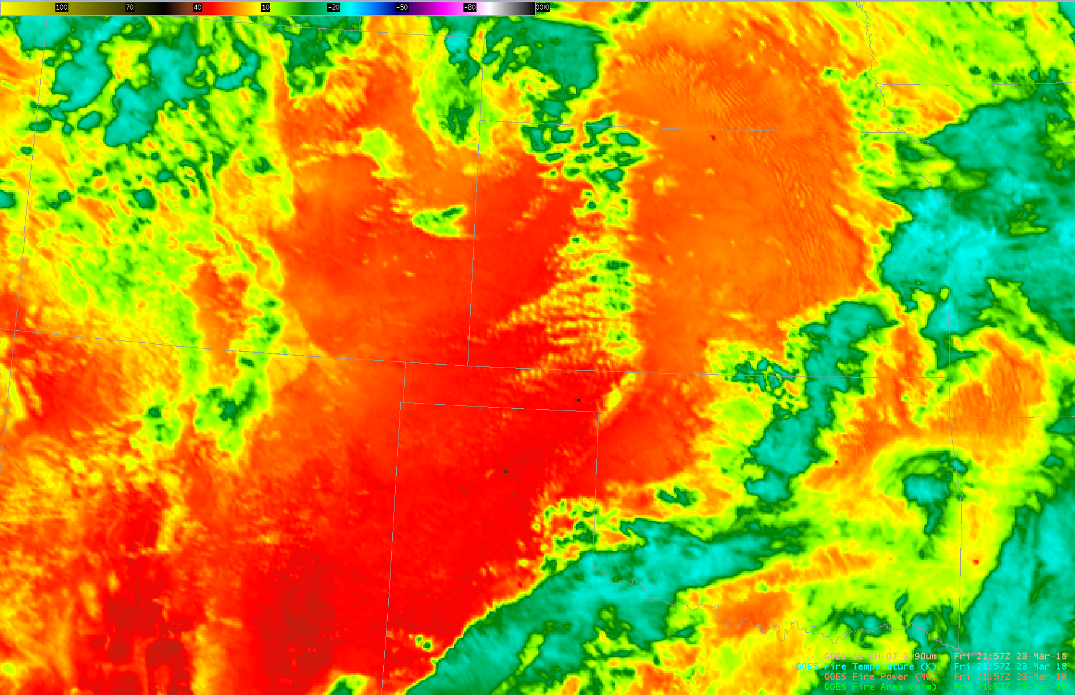
GOES-16 3.9um Imagery and Fire/Hotspot w/ SPC Outlook
Temp: 700K
Power: 178 MW
Area: 13878 m2
7

Slide 8
GOES-16 SST and 0.64um Imagery
14:22 Z 13 Feb 2018
8

Slide 9
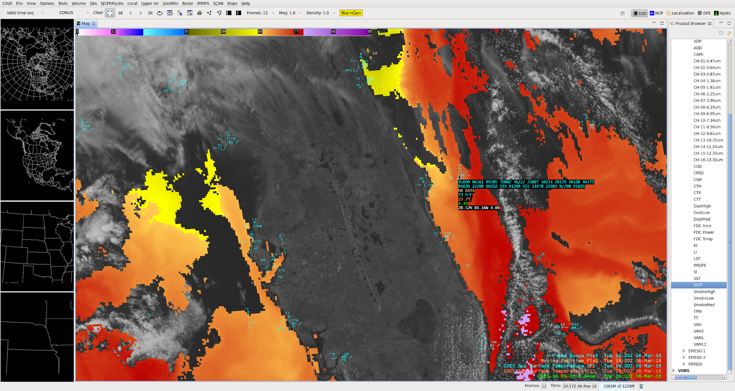
GOES-16 SST Zoom-in (Florida)
Cursor readout shown:
Buoy: 74F
ABI SST: 73.9F (23.3C)
9

Slide 10
Questions/Discussion

