Slide 1
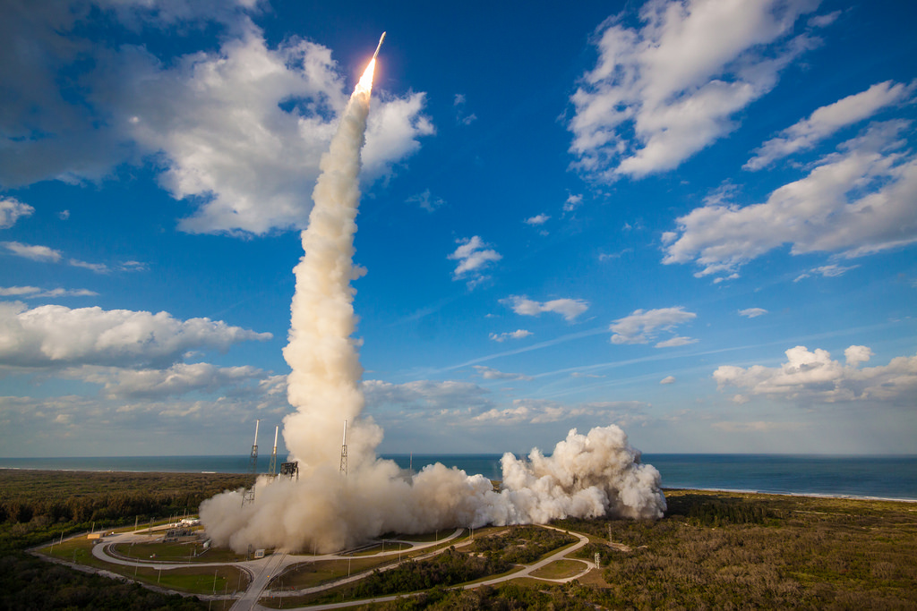
Welcome to GOES-17 OTRR
Peer Stakeholder-Product Validation Review (PS-PVR) for the
Provisional Maturity of GOES-17 ABI L1b Products
GOES-R Calibration Working Group, 28 November 2018

Slide 2
Acknowledgements
Current CWG Members: F. Yu, V. Kondratovich, H. Yoo, H. Qian, Z. Wang, and S. Guo.
Former CWG Members: C. Cao, F. Padula, A. Pearlman, D. Pogorzala, R. Datla, X. Shao, M. Grotenhuis, M. Chu, B. Efremova, R. Iacovazzi, L. Zhu, J. Choi, and R. Mirza-Saliq.
External Members: T. Schmit, M. Gunshor, D. Lindsey, Steve Miller, M. Coakley, K. Mitchell.
Instrument and Ground Vendors: W. Harting, J. Van Naarden, D. Gall, L. Roop, M. Wilson.
GOES-R Program for technical, administrative, and financial support: C. Rollins, A. Reth, Z. Li, M. Weinreb, J. Fulbright, E. Kline, W. Lebair, J. Kronenwetter, M. Seybold, E. Grigsby, S. Goodman, C. Keeler, A. Krimchansky.
STAR Colleagues for feedback, web, administrative, contract, financial support: J. Daniels, AWG leads, L. Brown, S. Kalluri, etc.
And many more.
Notes:
All: missed anyone?

Slide 3
Presentation Outline
Introduction
Post-Launch Product Tests (PLPT) – what we did.
ABI L1b Product Performance – what we learned.
Assessment of Maturity – looking back.
Path to Full Validation – looking ahead.
Summary and Recommendations

Slide 4
Presentation Outline
Introduction
Post-Launch Product Tests (PLPT)
ABI L1b Product Performance
Assessment of Maturity
Path to Full Validation
Summary and Recommendations

Slide 5
GOES-17 Post Launch Major Events
Event | Date
Launch | 2018-03-01
Orbit Insertion (became GOES-17) | 2018-03-12
PLT Started | 2018-03-26
Door Opened | 2018-04-13
First VNIR Image | 2018-04-13
LHP Anomaly Discovered | 2018-04-28
First IR Image | 2018-07-27
PLT Resumed | 2018-07-30
Beta PS-PVR | 2018-08-27
PLT Ended | 2018-10-20
Drift Started | 2018-10-24
Drift Ended | 2018-11-13
Provisional PS-PVR | 2018-11-28

Slide 6
Context
Review of whether GOES-17 ABI L1b products have reached the Provisional Maturity as defined by the GOES-R Program.
  Review of maturity, instead of verification of requirement, although requirements are often used as reference.
  Focus on L1b products, instead of the ABI instrument, although the two are often closely related.
  Based in part on previously completed Beta review and PLTs, although different methods can and have been used to characterize the L1b products.
Significantly affected by the Loop Heat Pipe Anomaly.

Slide 7
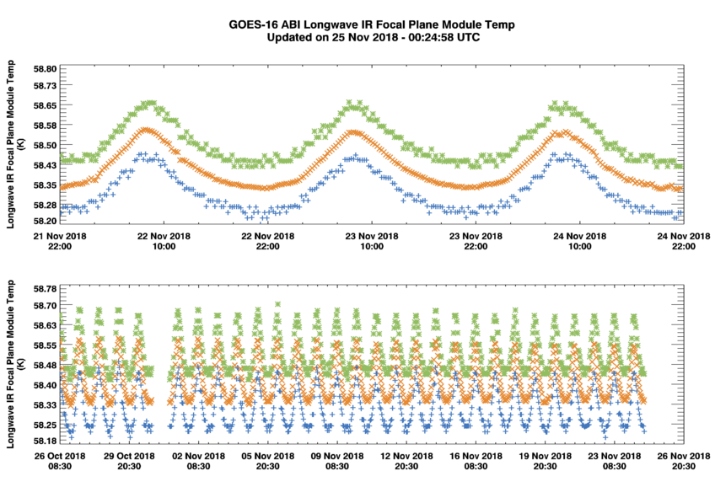
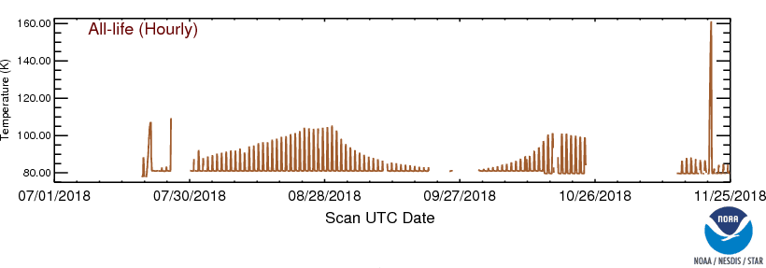
LHP Anomaly & FPM Temperature
GOES-16
58.3K – 58.5K
GOES-17
81K – 105K

Slide 8
Scope
Mode 3 when ABI is stable during PLPT.
  Extend to unstable period, M4 & M6, and post-drift performance when possible.
Performance:
  Geometric (INR)
  Radiometric – Solar (VNIR)
  Radiometric – Emissive (IR)
Metrics:
  Accuracy – difference from reference or “truth”
  Precision – confidence of evaluation
  Stability – variation in time, space, mode, etc.
Technical details such as linearity and dynamic range etc. are addressed only if inquired.
  Covered by PLT.
  Will complete by Full Validation.

Slide 9
PLPT for GOES-16 ABI
Test ID | Short Title
ABI-L1b-PLPT-001 | IR Validation IASI CrIS
ABI-L1b-PLPT-002 | IR Validation CRTM
ABI-L1b-PLPT-003 | ZRDQ Performance
ABI-L1b-PLPT-004 | VNIR Validation VIIRS
ABI-L1b-PLPT-005 | VNIR Validation Sonora
ABI-L1b-PLPT-006 | VNIR Validation RVS
ABI-L1b-PLPT-007 | Monitoring
ABI-L1b-PLPT-008 | AD Converter
ABI-L1b-PLPT-009 | Low Light SNR
ABI-L1b-PLPT-010 | Image Navigation
ABI-L1b-PLPT-011 | Image Registration
ABI-L1b-PLPT-012 | Image Stitching
ABI-L1b-PLPT-013 | VNIR Validation DCC
ABI-L1b-PLPT-014 | Detector Uniformity Stability NSS
ABI-L1b-PLPT-015 | Validation SNO NSS
ABI-L1b-PLPT-016 | L2 Validation Support NSS
ABI-L1b-PLPT-017 | Lunar NSS
ABI-L1b-PLPT-018 | Detector Uniformity
ABI-L1b-PLPT-019 | Initial Solar Calibration
ABI-L1b-PLPT-020 | IR Spatial Uniformity
Test ID | Short Title
ABI-L1b-PLPT-021 | SRF Verification
ABI-L1b-PLPT-022 | OOB Response
ABI-L1b-PLPT-023 | Polarization
ABI-L1b-PLPT-024 | Cal-to-Cal Repeatability
ABI-L1b-PLPT-025 | Linearity
ABI-L1b-PLPT-026 | Ghosting
ABI-L1b-PLPT-027 | Field Campaign – Aircraft
ABI-L1b-PLPT-028 | Field Campaign – Surface
ABI-L1b-PLPT-029 | VNIR Verification – Rayleigh
ABI-L1b-PLPT-030 | VNIR Verification – Uyuni
ABI-L1b-PLPT-031 | BDS
ABI-L1b-PLPT-032 | VNIR SNR & Dynamic Range
ABI-L1b-PLPT-033 | IR Cal Stability
ABI-L1b-PLPT-034 | MTF
ABI-L1b-PLPT-035 | Coherent Noise
ABI-L1b-PLPT-036 | IR SNR & Dynamic Range
Critical tests are in bold.
Experimental tests are in italic.

Slide 10
Revised PLPT for GOES-17 ABI
Test ID | Short Title
ABI-L1b-PLPT-001 | IR Validation
ABI-L1b-PLPT-002 | IR Validation CRTM
ABI-L1b-PLPT-003 | ZRDQ Performance
ABI-L1b-PLPT-004 | VNIR Validation
ABI-L1b-PLPT-005 | VNIR Validation Desert Sonora
ABI-L1b-PLPT-006 | VNIR Spatial Uniformity
ABI-L1b-PLPT-007 | Monitoring
ABI-L1b-PLPT-008 | AD Converter
ABI-L1b-PLPT-009 | Low Light SNR
ABI-L1b-PLPT-010 | Image Navigation
ABI-L1b-PLPT-011 | Image Registration
ABI-L1b-PLPT-012 | Image Swath Registration
ABI-L1b-PLPT-013 | VNIR Validation DCC
ABI-L1b-PLPT-014 | Detector Uniformity Stability NSS
ABI-L1b-PLPT-015 | Validation SNO NSS
ABI-L1b-PLPT-016 | L2 Validation Support NSS
ABI-L1b-PLPT-017 | Lunar NSS
ABI-L1b-PLPT-018 | Detector Uniformity
ABI-L1b-PLPT-019 | Initial Solar Calibration
ABI-L1b-PLPT-020 | IR Spatial Uniformity
Test ID | Short Title
ABI-L1b-PLPT-021 | SRF Verification
ABI-L1b-PLPT-022 | OOB Response
ABI-L1b-PLPT-023 | Polarization
ABI-L1b-PLPT-024 | Cal-to-Cal Repeatability
ABI-L1b-PLPT-025 | Linearity
ABI-L1b-PLPT-026 | Ghosting
ABI-L1b-PLPT-027 | Field Campaign – Aircraft
ABI-L1b-PLPT-028 | Field Campaign – Surface
ABI-L1b-PLPT-029 | VNIR Verification – Rayleigh
ABI-L1b-PLPT-030 | VNIR Verification Desert
ABI-L1b-PLPT-031 | BDS
ABI-L1b-PLPT-032 | VNIR SNR & Dynamic Range
ABI-L1b-PLPT-033 | IR Cal Stability
ABI-L1b-PLPT-034 | MTF
ABI-L1b-PLPT-035 | Coherent Noise
ABI-L1b-PLPT-036 | IR SNR & Dynamic Range
ABI-L1b-PLPT-037 | Stray Light During Solar Calibration
ABI-L1b-PLPT-038 | Lunar Calibration
Critical tests are in bold.
Experimental tests are in italic.

Slide 11
Presentation Outline
Introduction
Post-Launch Product Tests (PLPT)
ABI L1b Product Performance
Assessment of Maturity
Path to Full Validation
Summary and Recommendations

Slide 12
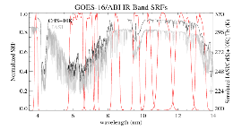
ABI-L1b-PLPT-001
IR Validation
Objective
Validate thermal emissive band radiances by comparison with coincident LEO IR hyperspectral measurements
Related Requirements
MRD 737, 1493, 1503, 1513, 2130
Method
Inter-calibration based on spatial, temporal, and spectral collocated homogeneous scenes, per Global Space based Inter-Calibration (GSICS) algorithm.
Time difference: <7.5 minutes for Mode3 FD data and <2.5 minutes for Mode4 FD data
Viewing geometry difference: cosine VZN diff. <1%
Geo-location difference: < ABI pixel footprint size
Spectral match: LEO spectra convolved as “pseudo-pixel”
Same target: CoVs of “pseudo-pixel” radiance < 3%
Results
Conclusion
G17 ABI IR radiance bias is small and stable during “cold” FPM period (except for B16).
No strong scene radiance Tb bias for all the IR bands
No apparent diurnal variation during the cold FPM period
Latitude/Longitude dependent Tb bias can be observed
Large Tb bias during the hot PFM period
On Schedule

Slide 13
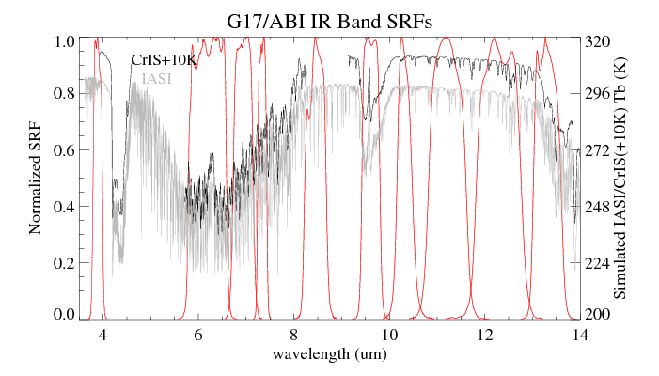
IR Bias under “Best” Condition
CrIS not completely cover ABI B08 SRF
LEO | B07 | B08 | B09 | B10 | B11 | B12 | B13 | B14 | B15 | B16
NPPCrIS vs. G17 | - | 0.475 (0.177) | 0.049 (0.169) | -0.035 (0.162) | - | -0.083 (0.203) | -0.124 (0.211) | -0.152 (0.218) | 0.015 (0.236) | 0.449 (0.305)
N20CrIS vs. G17 | - | 0.477 (0.188) | 0.089 (0.174) | 0.002 (0.168) | - | -0.064 (0.210) | -0.057 (0.204) | -0.099 (0.225) | 0.061 (0.252) | 0.469 (0.316)
IASI –B vs. G17 | -0.023 (0.169) | -0.102 (0.205) | 0.054 (0.192) | -0.029 (0.188) | -0.02 (0.218) | -0.118 (0.249) | -0.070 (0.280) | -0.081 (0.311) | 0.046 (0.323) | 0.413 (0.350)
IASI-A vs. G17 | -0.078 (0.168) | -0.189 (0.235) | 0.020 (0.233) | -0.064 (0.228) | -0.002 (0.327) | -0.111 (0.298) | -0.042 (0.349) | -0.068 (0.378) | 0.052 (0.392) | 0.449 (0.388)
Overall very accurate. Comparable with G16, except for B16

Slide 14
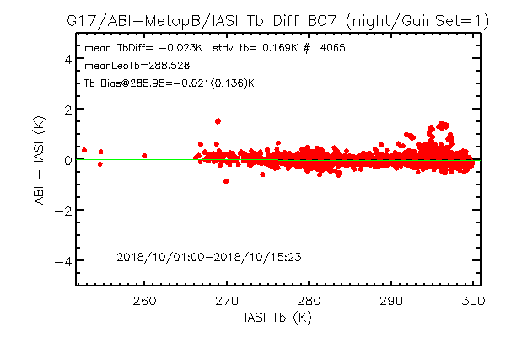
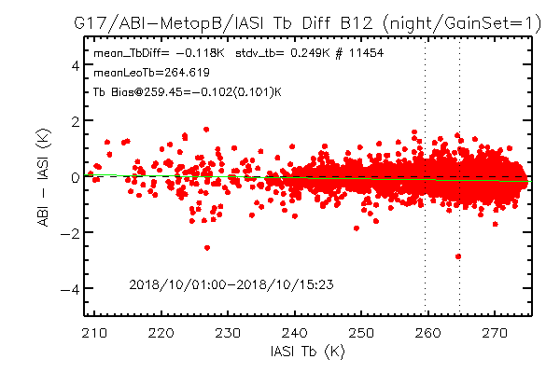
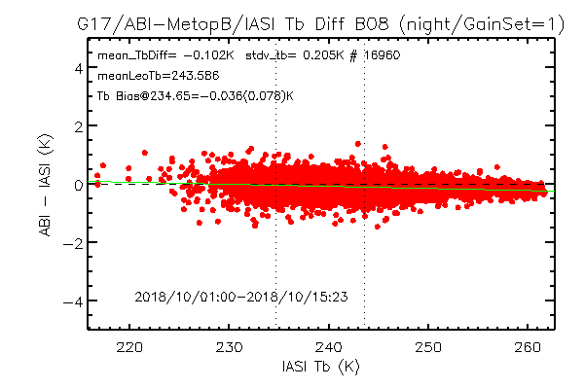
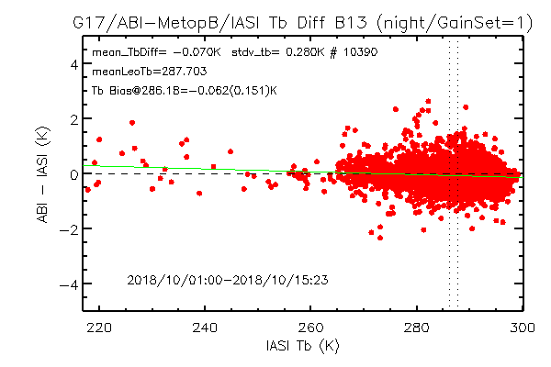
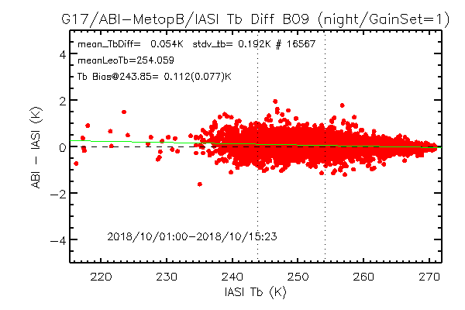
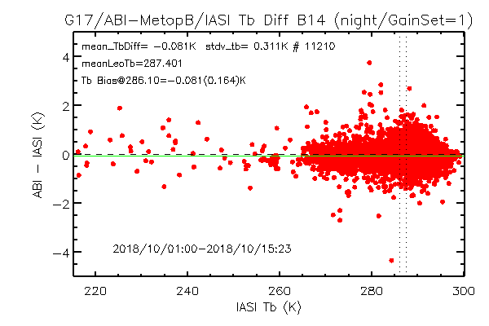
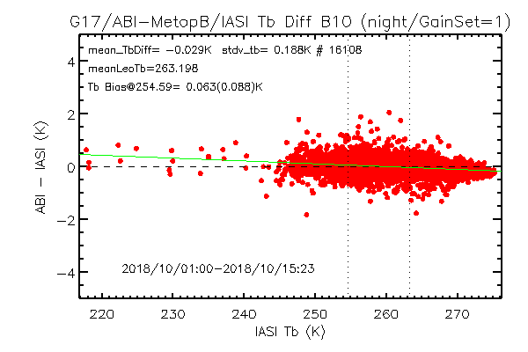
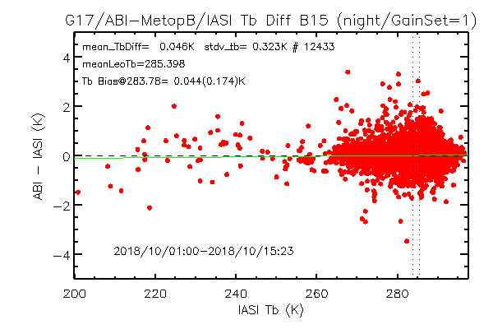
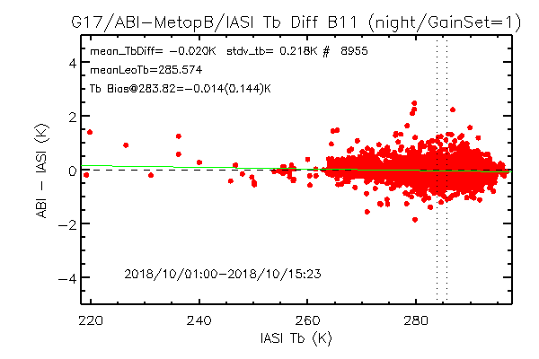
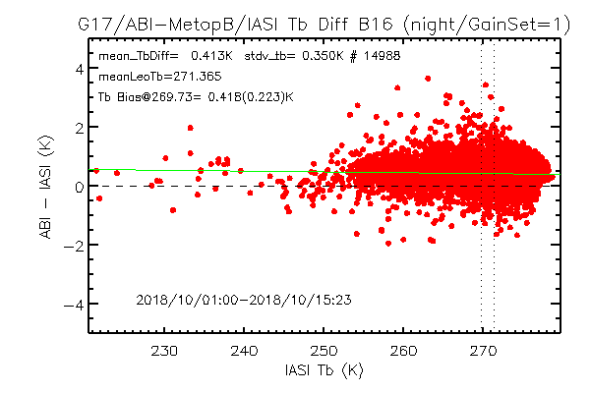
Scatterplot of Tb vs. Tb Bias
G17 ABI Gain Set =1,
Collocated with night-time Metop-B/IASI
Radiance bias does not seem to depend on scene T_{b}.

Slide 15
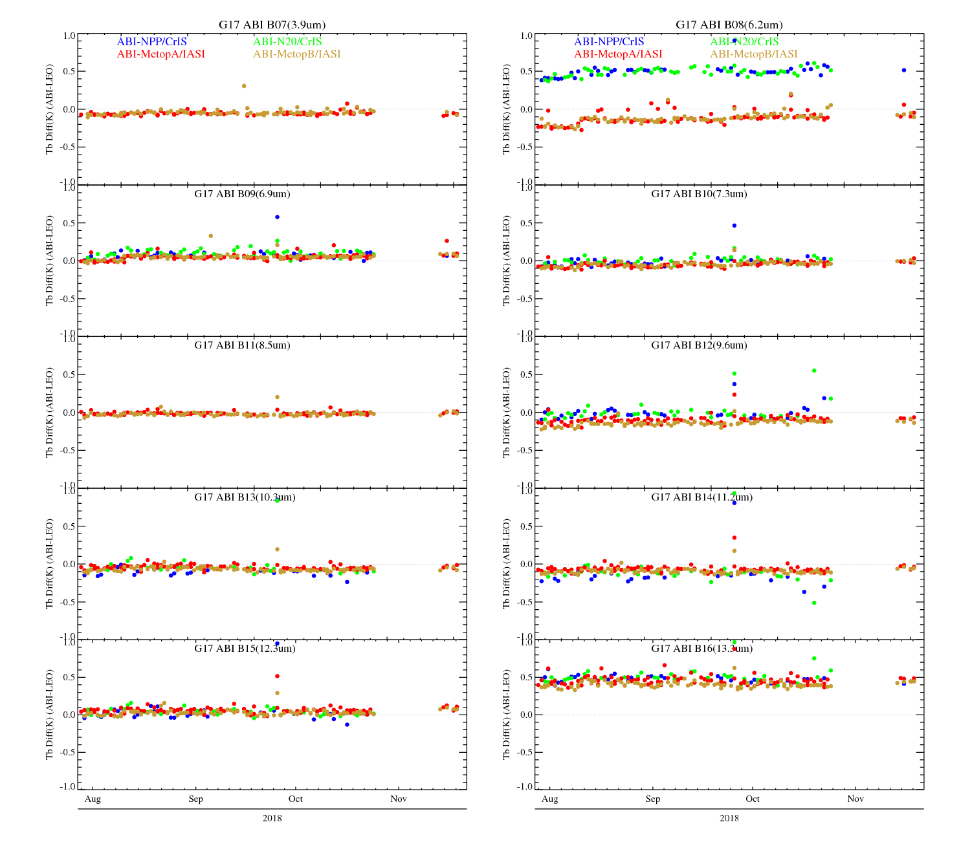
Time-Series of GEO-LEO IR Inter-Calibration
(best condition: Gain Set=1, Night-time Collocations)
Long-term stable

Slide 16
T_{b} Bias at Gain Set=3 (10/16/2018-10/18/2018)
Large Tb Bias and Variation over the Hot period

Slide 17
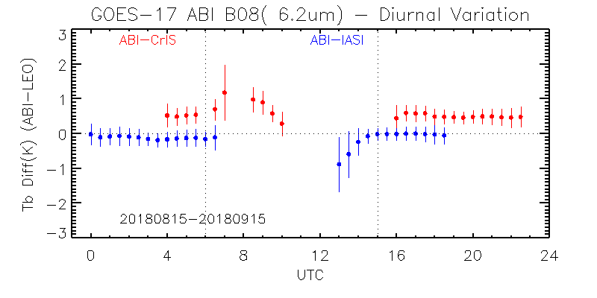
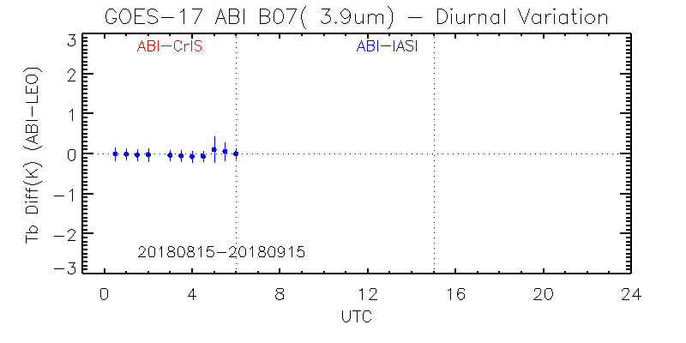
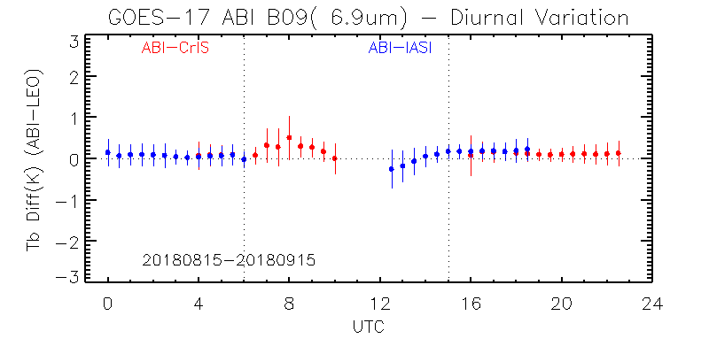
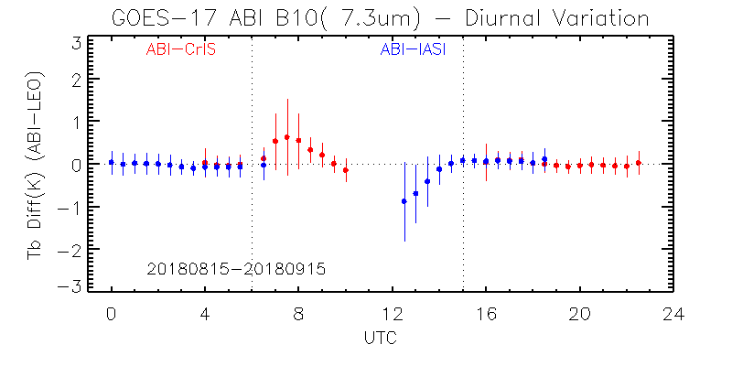
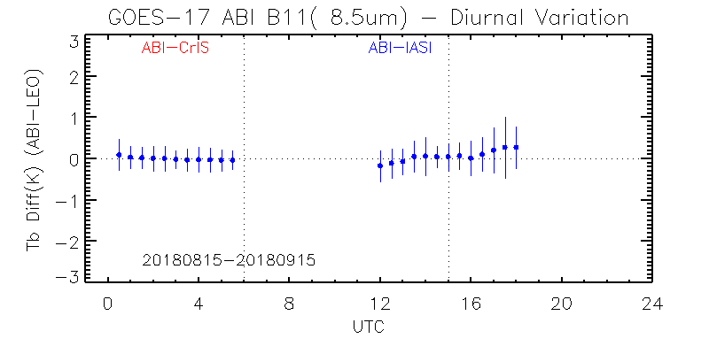
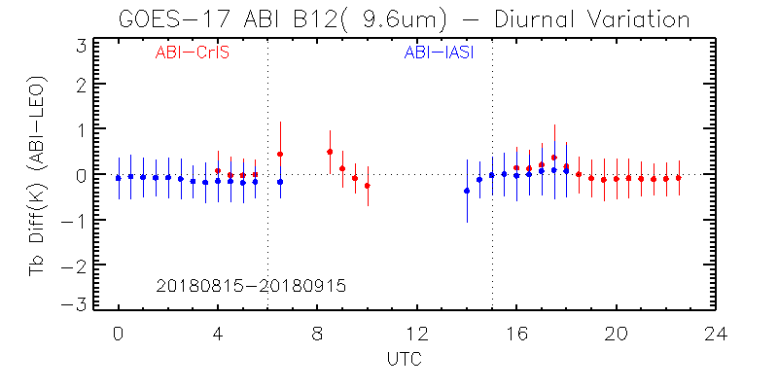
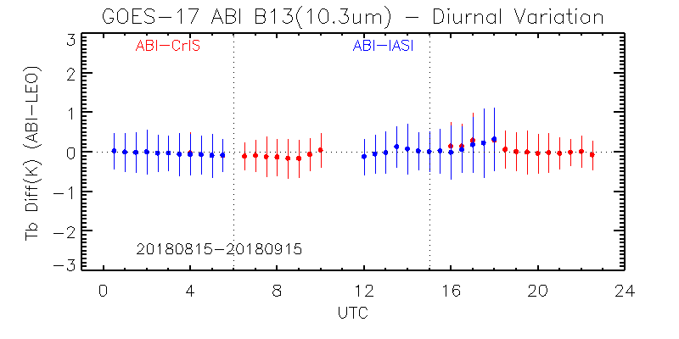
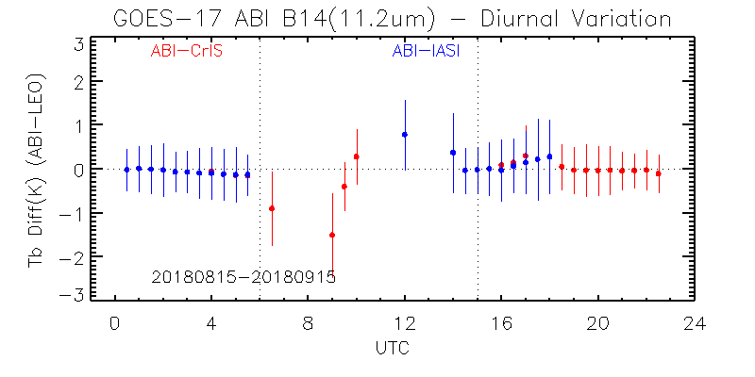
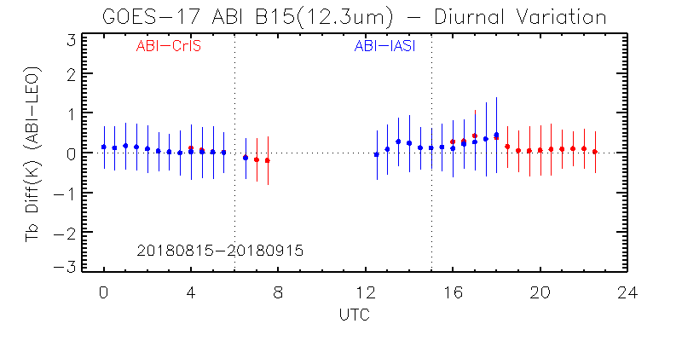
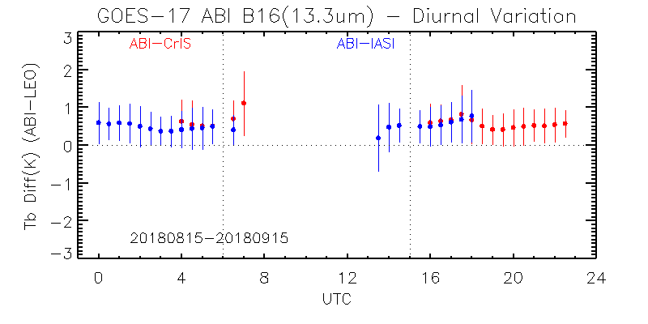
Diurnal Variation
Stable over the good time. Relatively large variation or no data over the warm period.

Slide 18
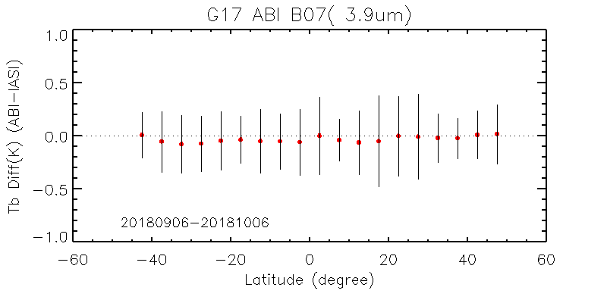
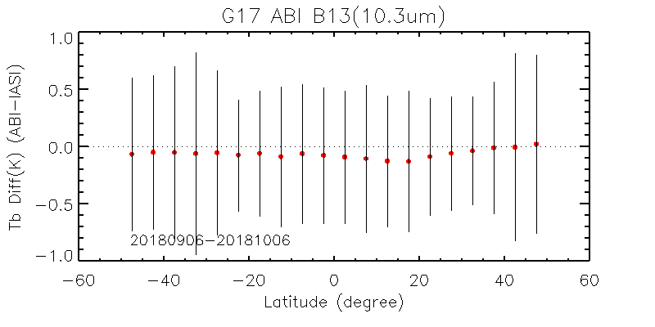
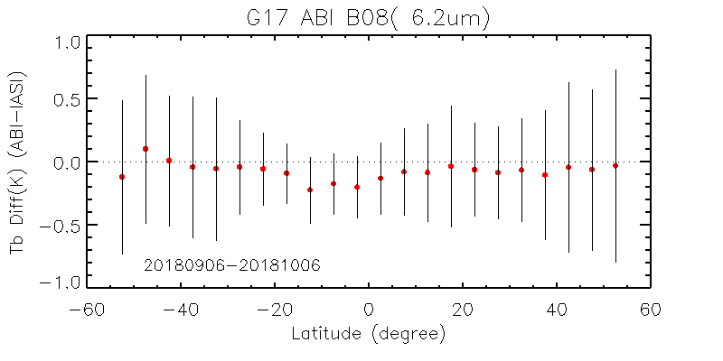
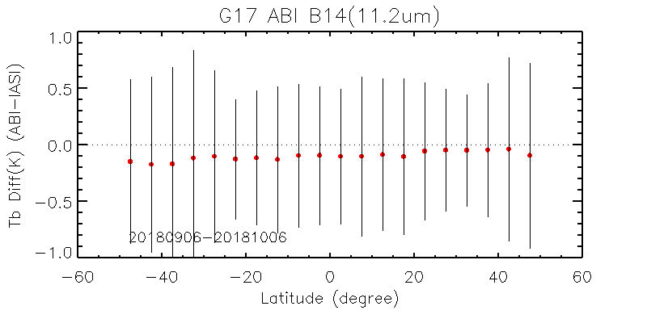
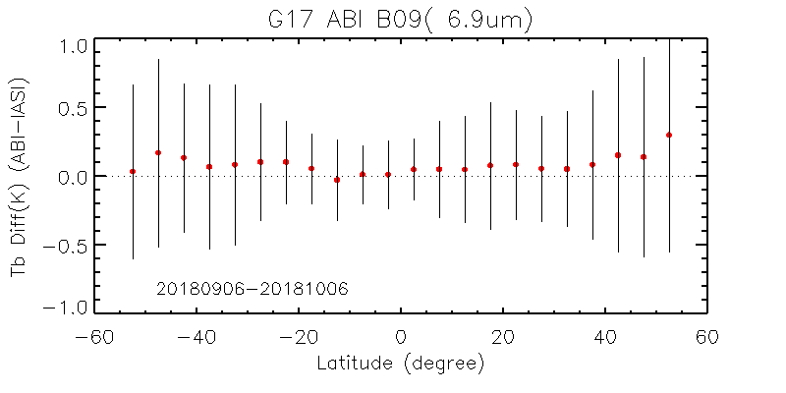
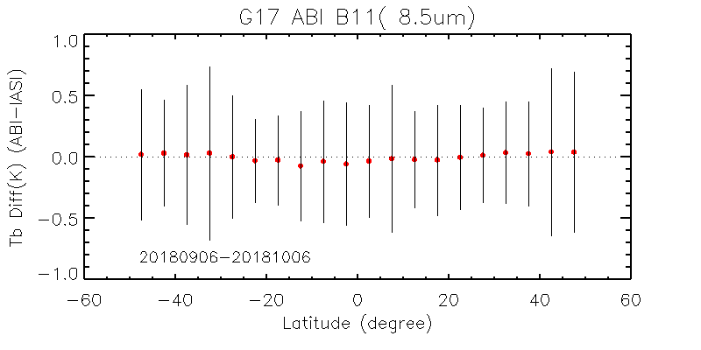
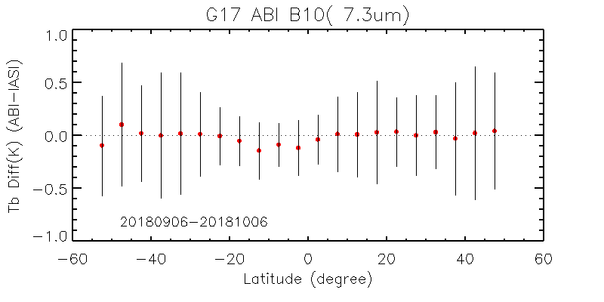
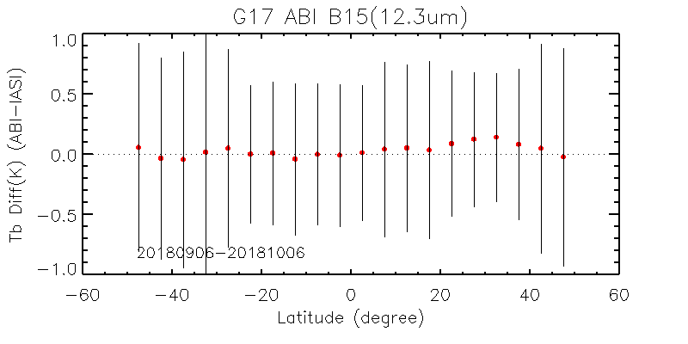
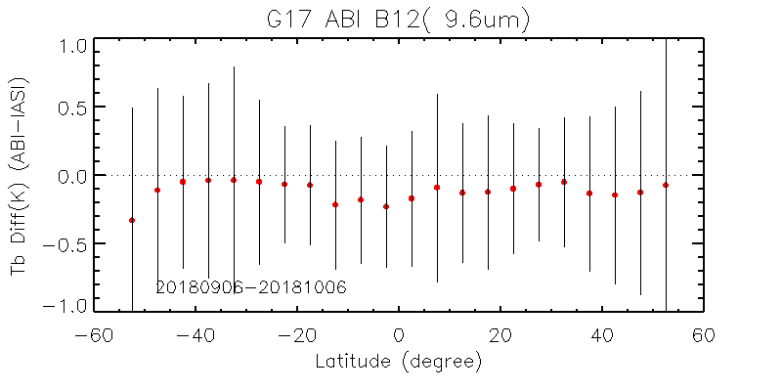
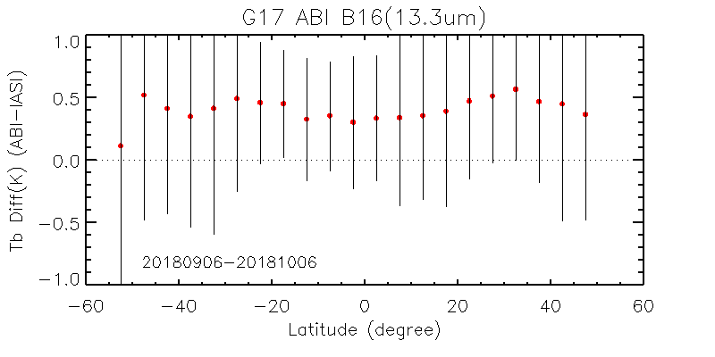
NS Direction, best condition
Latitude dependent Tb bias at some IR bans

Slide 19
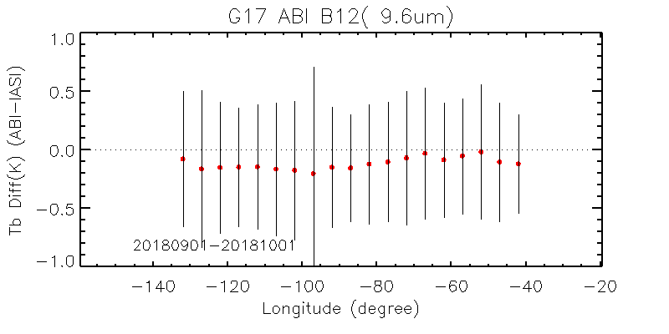
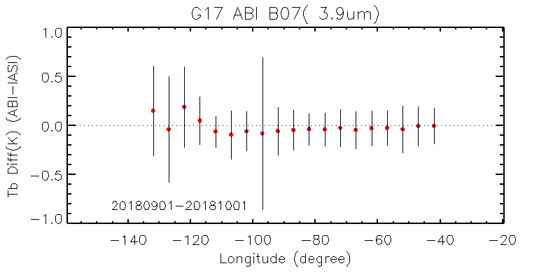
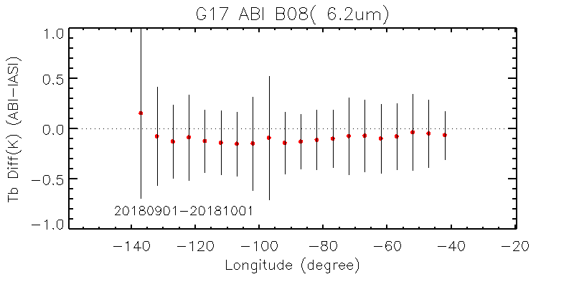
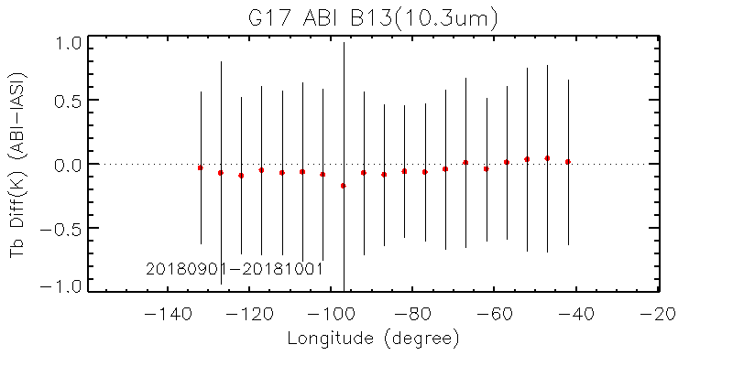
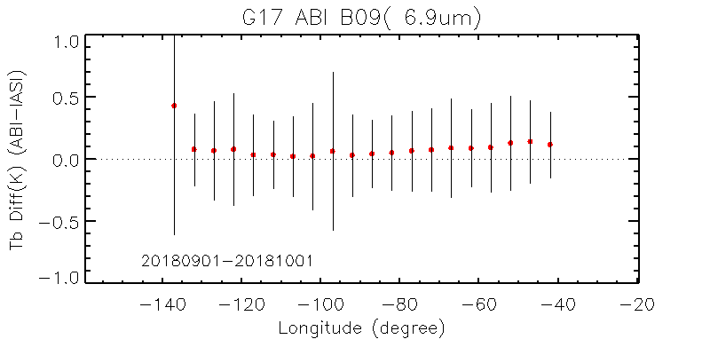
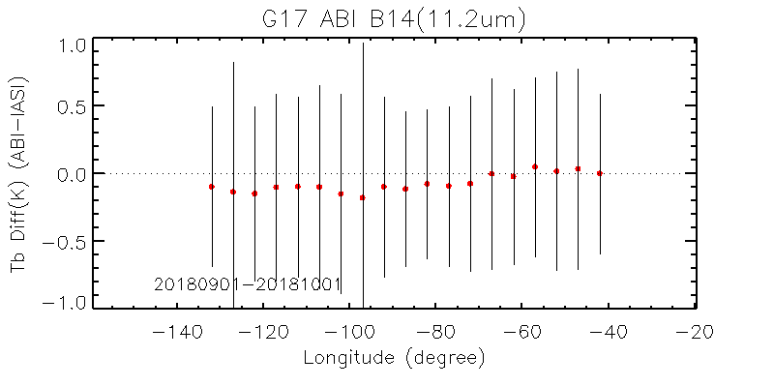
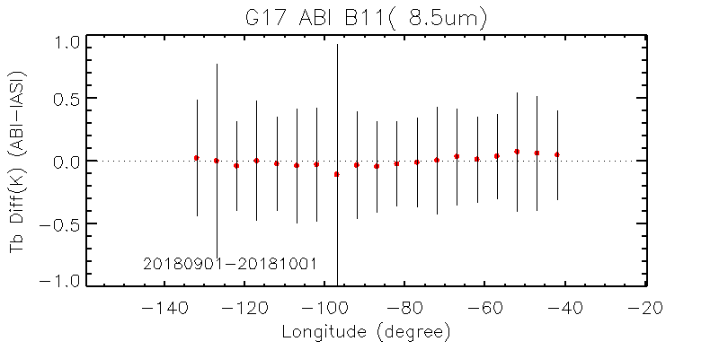
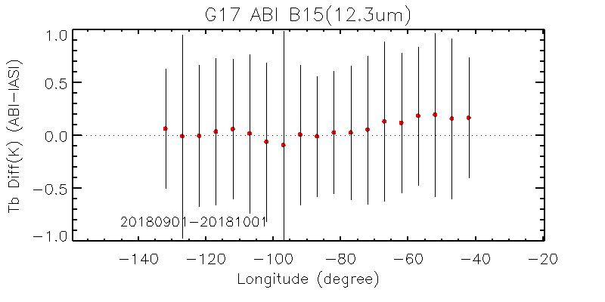
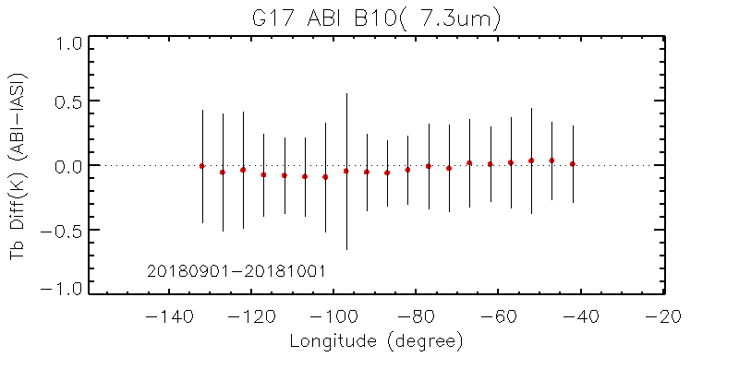
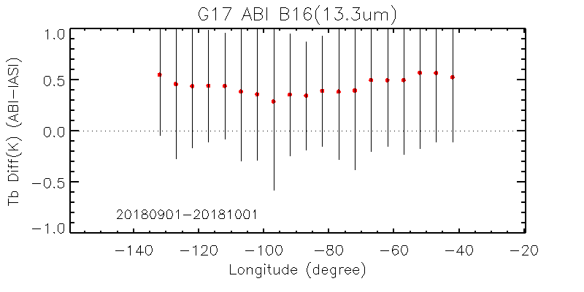
EW Direction, best condition
Slight longitude dependent Tb bias at some IR bans

Slide 20
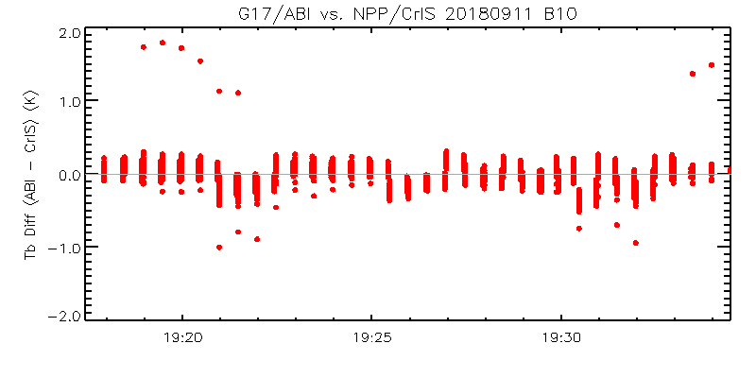
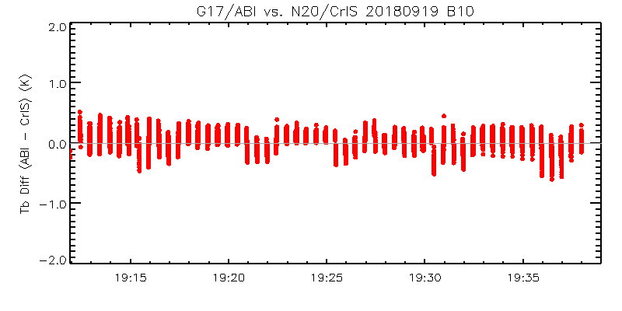
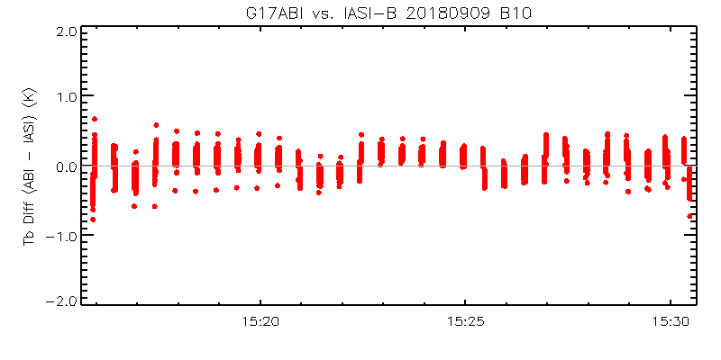
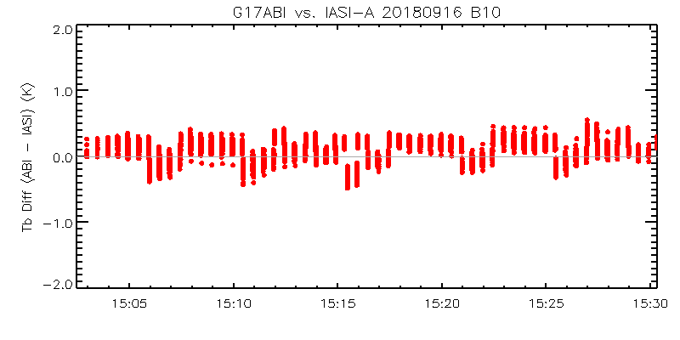
Special Data Collections: MESO SNO
SNPP
NOAA-20
Metop-B
Metop-A
Swath-to-Swath and MESO-to-MESO scan Tb difference can be observed

Slide 21



ABI-L1b-PLPT-003
Zone of Reduced Data Quality
Objective
Quantify measurement errors that may occur in the visible and IR channels when the sun is near and within 3º - 7.5 º for ABI VINIR and 5 º - 7.5 º from the ABI line of sight for ABI B07 3.9 um channel.
Related Requirements
MRD (2120): Radiometric accuracy for ABI IR band
<2K @300K inside restricted zone
<1K @300K outside restricted zone (> 7.5º)
Methodology
Steps: Difference-Radiance-Image; Coordinate Transformation; Exponential Fitting and Estimation of Maximum Stray Light
Results
Summary
Long term monitoring shows that G17 ABI CH07 stray light inside and outside ZRDQ are both within the specification and weaker than G16 ABI CH07
Long term monitoring of ABI VNIR channel stray light has been carried out. No requirements are violated for stray light at night side for ABI VNIR channel.
Inside ZRDQ for ABI CH07
Spec @300K
Outside ZRDQ for ABI CH07
Spec @300K
Long Term Monitoring of Maximum Stray Light for G17 ABI CH07
On Schedule

Slide 22
ABI-L1b-PLPT-003: ZRDQ Performance
Test ID: ABI-L1b-PLPT-003
Test Name: ZRDQ Performance
Description: Quantify measurement errors that may occur in the visible and IR channels when the sun is near and within 3 ⁰ - 7.5⁰ for VINIR and 5⁰ - 7.5⁰ for 3.9 um channel from the ABI LOS.
Due to the nature of the test, PLPT-03 is limited to within +/- 40 days of an equinox. Due to limited seasonal opportunities, this test will be continued through full validation and operations as required depending on the severity and reproducibility of stray-light effects on L1b products.
Success Criterion:. At the Provisional PS-PVR, quantify the radiance error near and within the zone of reduced data quality (ZRDQ).

Slide 23
G17 ABI PLPT 03 Test Results-CWG
Overall stray light magnitude of G17 ABI B07 weaker than G16 ABI B07
Spike stray light (partially inside the restricted zone) becomes the dominant source of stray light for B07
G17 ABI
Other Issues: significant stray light in ABI VNIR Channel (ABI1-6) around mid- night has been observed. Since it occurs around midnight , no requirements are violated for ABI VNIR bands. But, do raise some concerns.
Stray light in other IR channels is not observable.
B07 (3.9um) | Requirement (mW/m²-sr-cm⁻¹) | Actual Max (mW/m²-sr-cm⁻¹)
Inside R.Z. (5º-7.5º) | < 0.077 (2K@300k) | ~0.047 ±0.0046 (1.24±0.12K@300k) (Sept. 21,2018)
Outside R.Z. (>7.5º) | < 0.038 (1K@300k) | ~0.0145 ±0.0046、(0.38±0.12K@300k) (Oct. 15, 2018)

Slide 24


Comparison of GOES-16 and GOES-17 ABI CH07 Stray Light
GOES-16
GOES-17

Slide 25



GOES-16 and GOES-17 ABI CH07 Stray Light Comparison
Spec @300K inside ZRDQ
GOES-16 Daily Maximum Stray Light
GOES-17 Daily Maximum Stray Light
Inside ZRDQ
Inside ZRDQ
Outside ZRDQ
Spec @300K outside ZRDQ
Outside ZRDQ
GOES-17 CH07 stray light is weaker than GOES-16 CH07
Both are within specs

Slide 26


ABI CH01 on Aug. 12, 2018
GOES-16
GOES-17
nadir at -75.2 Deg.
nadir at -89.5 Deg.

Slide 27










GOES-16 and GOES-17 ABI VNIR Stray Light on Aug. 12, 2018
CH01
CH02
CH03
CH04
CH05
GOES-17
GOES-16
GOES-17 VNIR channel stray light is weaker, but of larger spread.

Slide 28










Additional Leaking Path for GOES-17 ABI?
CH01
CH02
CH03
CH04
CH05
GOES-17
GOES-16

Slide 29



G17 ABI VNIR Channel Stray Light Monitoring (Inside and Outside ZRDQ)

Slide 30


G17 ABI VNIR Channel Stray Light Monitoring (Inside and Outside ZRDQ)

Slide 31
ABI-L1b-PLPT-004
VNIR Validation
Objective
Validate radiance accuracy of the VNIR bands using temporally and spatially coincident SNPP VIIRS VNIR data collected at the same viewing geometry
Related Requirements
MRD 737, 2120, and 2130
Method
GSICS Ray-matching method
Time difference: <5 minutes for M3 data
Cosine of viewing zenith angle difference < 1%
Time: 17:00UTC-19:00UTC
Geolocation range: 1ºS < latitude < 1ºN
Azimuth angle difference: < 30°
SRF adjustment
Results
Conclusion
G17 VNIR radiance bias is small except for B02.
B02 is ~9% brighter than expected, similar to GOES-16.
B01/B02/B03/B05 biases show small but significant dependence on scene radiance.
  All negative slope
B05 has relatively larger uncertainty (~6%) at low albedo scenes (<30%). Uncertainty reduces as scene radiance/albedo increases
On Schedule

Slide 32






Scatterplot of Scene Dependent Refl. Ratio
F-test significant at B01/B02/B03/B05

Slide 33

Time-series of G17 vs. NPP/VIIRS Refl. Ratio
Under investigation
Long-term Stable, except for B06 (B05?).

Slide 34





ABI-L1b-PLPT-006
VNIR Spatial Uniformity
Objective
Determine and validate scan mirror angle-dependent reflectivity corrections for the VNIR bands.
Related Requirements
MRD 2120
Methodology
Use of GIRO model to compensate for lunar irradiance variation for the lunar images collected as it transited across the ABI field of regard
Results
Summary
Lunar chasing events were successfully conducted on 07/30/2018 and 10/20/2018.
VNIR spatial uniformity is within 1% for 5 bands.
B01 has several issues:
  Structural variation within each 15 minutes of timeline on 07/30/2018 and 10/20/2018.
  “Humps” on 10/2018
  Ongoing effort to investigate root cause to the B01 irradiance variations
07/30/2018
10/20/2018
B01
B02
B01
B02
B03
B04
B03
B04
B05
B06
B05
B06
On Schedule
6/1/2018

Slide 35

ABI-L1b-PLPT-007
Instrument Performance Monitoring
Objective
Perform automated monitoring of G17 ABI instrument performance in all 16 bands and Engineering Telemetry in near-real time at the STAR designated GOES Calibration web site.
Related Requirements
MRD737 (Long-term radiance drift); MRD2120 (Solar calibration absolute accuracy); MRD-2121 and MRD-2158 (Calibration-to-calibration radiance precision); and MRD-2130 (Product monitoring).
Methodology
Flow chart of ABI IPM processing
Results
CWG GOES-17 ABI IPM results can be found at the following links:
Instrument Calibration Data https://www.star.nesdis.noaa.gov/GOESCal/G17_IPM_Ops-BothCalStats_daily.php
Engineering Data https://www.star.nesdis.noaa.gov/GOESCal/G17_IPM_EngTelemStats_daily.php
Solar Calibration Data https://www.star.nesdis.noaa.gov/GOESCal/G16_ABI_Solar_Cal_static.php
Summary
CWG provides automated monitoring of G17 ABI instrument performance in all 16 bands and Engineering Telemetry in near-real time.
This IPM provides valuable and timely supports for the calibration work in CWG group, helping in resolving the issues in the algorithm/LUTs update, major anomaly events, missing dataset etc.
Monitored data represents at least 95% of INST-CAL data available for processing.
On Schedule

Slide 36
GOES-17 ABI IPM Architecture
STAR User
Local Interface
STAR Processing Servers
STAR Web Servers
Public User Facility
Public Viewport
All Users
STAR IPM Web Pages
Read from GRIDS
Read Web-ready ICVS Output Artifacts
STAR Computing Storage
GOES-R Instr. Cal Data Products (NSOF ESPDS-PDA)
Import to SCDR or Local Storage
Imported Data and Products
Web-ready GOES-R ICVS Plots, Images, and Analysis
GOES-R ICVS Dataset Storage (GRIDS)
Read in Imported Data and Products
Update GRIDS
Read
from GRIDS
Write Web-ready ICVS Output Artifacts
STAR Processing Servers
Perform Analyses to Update Instrument Performance Time Series
Perform Instrument Near- and Long-Term Time-Series Analysis and Generate Output Artifacts
GOES-17 ABI IPM Architecture

Slide 37

GOES-17 ABI IPM Data Flow
GOES-17 ABI IPM Data Flow

Slide 38
GOES-17 ABI IPM Components
Visible Near-Infrared (VNIR) and Infrared Channel Statistics
https://www.star.nesdis.noaa.gov/GOESCal/G17_IPM_Ops-IRCalStats_daily.php
Solar Calibration Statistics
https://www.star.nesdis.noaa.gov/GOESCal/G17_ABI_Solar_Cal_static.php
Engineering Telemetry Statistics
https://www.star.nesdis.noaa.gov/GOESCal/G17_IPM_EngTelemStats_daily.php

Slide 39


G17 IPM
Instrument Monitoring Engineering
Example: ABI LWIR FPM temperatures trending
Left: corrected FPM by CWG with the original one from INST-CAL file (right), which experienced with wrong count-to-temperature coefficients before DO.07 implemented in OE on Oct 15,2018
Smaller diurnal variation after post-drift.

Slide 40


G17 IPM
Instrument Monitoring Engineering
Example: FPM temperatures trending performs well. Lower VNIR FPM(left)
Some temperatures show lower values, but in line with life-mission range and a small diurnal variation. Other temperatures keep the same patterns as before.

Slide 41


G17 IPM
Instrument Monitoring Engineering
Internal version plotting with multiple number of ICT and Optical Bench temperatures
Generally agree well the previous stage, with few variables showing lower temperatures, but in line with the life-mission period

Slide 42


G17 IPM
VNIR bands
Gain
Space look
VNIR section performs normal after post-drift.
The trending shows the consistent pattern before G17 drift
Few smaller gaps occurred. Checked that INST-CAL file was there, will double check this later
Will discuss the period with arrows in the late slides

Slide 43

G17 IPM
VNIR bands Mean Gain
Internal version with 6 bands
On 11.14.2018, several bands experienced two gain shifting. The first one is due to solar cal at 02:54UTC, but an unknown reason for the later around 15:00-16:00UTC

Slide 44


G17 IPM
VNIR bands
Band04
Band06
On 11.14.2018, several bands experienced two gain shifting. The first one is due to solar cal at 02:54UTC, but an unknown reason for the later around 15:00-16:00UTC

Slide 45


G17 IPM
IR bands
Space look
Gain
IR section performs normal after post-drift. Example of Band08
IR sections performs normal after post-drift.

Slide 46


G17 IPM
IR bands
IR section monitoring and trending function performs normal after post-drift
Left: Internal version with 10 IR bands panel
Right: Example of Band13 gain trending in different timescale. Smaller variation of gain set2?

Slide 47


G17 IPM
IR bands
Detector level IR section monitoring and trending function performs normal after post-drift
Left: Band10 gain after post-drift (1-day and 5-day, we have a 30-day plotting)
Right: Band10 NEdT after post-drift

Slide 48

G17 IPM
Solar Calibration

Slide 49




ABI-L1b-PLPT-009
Low Light SNR
Objective
Method
Use ABI L1b band 2 MESO data from a Mode-3 timeline with collocated MESO-1 and MESO-2 centers.
For each of the 30 MESO scenes, compute a measure of spatial variability for each pixel
For low-light pixels with low spatial variability – i.e., mainly clear-sky homogenous ocean regions - find the temporal difference between consecutive MESO scenes
Compile results from all MESO images and determine SNR statistics for 0.2% interval over the low-light for 4%-6% albedo range.
Characterize G17 band 2 SNR at low light 5% albedo level, validate the low light SNR for Band 2
Related Requirements for Provisional Maturity
MRD2156 - The GOES-R Space Segment shall produce Radiance product observations in low light (5% albedo) conditions in the 0.64 micron band at a 50:1 SNR
Results
Conclusion
Attempted to seek the clear-sky homogenous region with criteria of the at least 1 hour stable M3 MESO2 L1B image at the day time.
Within the region selected with mainly clear-sky homogenous condition, the low-light SNR is calculated.
CWG characterized that the mean SNR at 5% albedo for G17 in this target is 40.7.
On Schedule

Slide 50

ABI-L1b-PLPT-010
Image Navigation
Objective
Quantify the navigation residuals of ABI window channels. Check navigation stability. Trend performance during PLPT period and support other PLPTs as needed.
Related Requirements
MRD522 (Navigation errors not during eclipse); MRD523 (Navigation errors during eclipse); MRD538 and MRD539 (Frame-to-frame registration (FFR)).
Method
Landmark use for the nav. error determination
Results
The CWG GOES-R ABI Image Navigation results can be found at the following links:
SLT Noon Navigation Residuals: https://www.star.nesdis.noaa.gov/GOESCal/G17_ABI_INR_daily.php
SLT Noon FFR:
https://www.star.nesdis.noaa.gov/GOESCal/G17_ABI_INR_daily.php
Daily Monitor Residuals:
https://www.star.nesdis.noaa.gov/GOESCal/G17_ABI_INR_daily.php
Daily Monitor FFR:
https://www.star.nesdis.noaa.gov/GOESCal/G17_ABI_INR_daily.php
Daily-Averaged Residuals for 2 Weeks:
https://www.star.nesdis.noaa.gov/GOESCal/G17_ABI_INR_daily.php
Daily-Averaged FFR for 2 Weeks:
https://www.star.nesdis.noaa.gov/GOESCal/G17_ABI_INR_daily.php
Conclusion
ABI in-frame navigation residuals meet requirements but are larger than expected performance.
ABI frame-to-frame navigation residuals meet requirements and expected performance.
Navigation residuals during eclipse meet requirements.
Navigation residuals for Modes 3, 4, and 6 have comparable values
On Schedule

Slide 51

ABI-L1b-PLPT-011
Image Registration
Objective
Quantify the channel-to-channel registration (CCR) of the ABI window channels. Check CCR stability. Trend performance during PLPT period and support other PLPTs as needed.
Related Requirements
MRD529 – 533 (channel-to-channel registration). No expected performance baseline results for MRD531 and MRD533.
Method
Method 1: compare the navigation residuals of a channel pair.
Method 2: navigate one channel with respect to another.
Results
The CWG GOES-R ABI Channel-to-Channel Registration results can be found at the following links:
SLT Noon CCR:
https://www.star.nesdis.noaa.gov/GOESCal/G17_ABI_INR_daily.php
Daily Monitor CCR:
https://www.star.nesdis.noaa.gov/GOESCal/G17_ABI_INR_daily.php
Daily-Averaged CCR for 2 Weeks:
https://www.star.nesdis.noaa.gov/GOESCal/G17_ABI_INR_daily.php
Conclusion
ABI in-FPA CCR residuals meet requirements but exceed the expected performance errors.
ABI VNIR-MWIR CCR residuals are larger than required.
ABI MWIR-LWIR CCR residuals are considerably larger than the baseline.
Recommendation: Further Kalman filter tuning, more star observations, check RDP updates, especially for the channel 7.
On Schedule

Slide 52

ABI-L1b-PLPT-012
Image Swath Registration
Objective
Assess the swath-to-swath registration (SSR) and within-frame registration (WIFR) errors of the ABI window channels. Trend performance during PLPT period and support other PLPTs as needed.
Related Requirements
MRD535 (pixel-to-pixel registration error within frame (WIFR-I) – separate two navigated radiance sample); MRD536 (pixel-to-pixel registration error within frame (WIFR-II) – register two adjacent lines/swaths)
Method
WIFR I error: STD of landmark residuals.
WIFR II error: Average absolute SSR.
Swath residual: Average of landmark residuals within a swath.
Results
The CWG GOES-R ABI Swath-to-Swath Registration and WIFR results can be found at the following links:
SLT Noon Swath Residuals:
https://www.star.nesdis.noaa.gov/GOESCal/G17_ABI_INR_daily.php
Daily Monitor STD (East-West and North-South):
https://www.star.nesdis.noaa.gov/GOESCal/G17_ABI_INR_daily.php
Daily-Averaged STD for 2 weeks (East-West and North-South):
https://www.star.nesdis.noaa.gov/GOESCal/G17_ABI_INR_daily.php
Conclusion
ABI WIFR-I errors of visible channels are below the baseline and expected performance. Other channel - above the baseline but decrease with RDP updates. Constant half-pixel shift between the MESO and other frames – fix is scheduled in DO08.
ABI SSR VNIR residuals meet requirements.
ABI SSR MWIR and LWIR residuals exceed requirements, especially channel 7.
Recommendation: Further Kalman filter tuning, more star observations, check RDP updates for channel 7.
On Schedule

Slide 53


ABI-L1b-PLPT-013
VNIR Validation DCC
Objective
To provide useful information of the G17ABI radiometric calibration stability by monitoring DCC reflectance trending.
To validate the radiance accuracy of G17ABI six visible and near infrared bands using the NPP-VIIRS data as references.
This PLPT supports MRD-737 (Long-term radiance drift), MRD-2120 (Solar calibration absolute accuracy), MRD-2130 (Product monitoring).
Methodology
The DCC pixels are described as followings:
20°S < latitude < 20°N and 120°W< longitude < 60°W
Brightness temperature at Band 14 (11µm) < 205 K
Standard deviation at Band 14 (11µm) < 1 K
Solar zenith angle < 40° and viewing zenith angle < 40 °
Reflectance standard deviation at Band 2 (0.64µm) < 0.03
Avoid sun glint area & data quality flag ≤ 1 for ABI data
Apply for Spectral Band Adjustment Factor (SBAF) derived from SCIAMACHY between ABI and VIIRS, Angular Distribution Model (ADM) adjustment
Select VIIRS DCC pixel within 1 km distance from ABI DCC pixel
Results
Summary
DCCs reflectance from both G17ABI and NPP-VIIRS are in a good agreement in terms of pattern and shape.
G17ABI DCC reflectance of Bands 1, 2, 3, 4 and 5 is brighter than NPP-VIIRS for 0.95 %, 12.1 %, 1.8 %, 1 %, and 2.7 %, respectively but the G17ABI Band 6 is slightly darker than NPP-VIIRS about 0.7 %. The G17ABI Band 2 is much brighter than NPP-VIIRS I band.
On Schedule
Left: Time series of DCC reflectance from G17 ABI and NPP-VIIRS
for six VNIR bands; right: DCC reflectance ratio for six VNIR bands.
11/28/2018

Slide 54
ABI-L1b-PLPT-015
NSS During SNO
Objective
- Confirm the detector-to-detector variability quantified in other NSS-related tests such as PLT-018 and PLPT-018 for the VNIR bands
- Validate the calibration of each detector of the six ABI VNIR bands using VIIRS as reference
Methodology
On the date and time of SNO, perform NSS at nadir
Results
Summary
Six SNO NSS events were requested, according to PLPT_North_South_Scan_SNO_V3.1_GOES-S.docx
The last four events were reported as “conducted” in the SOE and PLT morning briefing slides.
Three of the SNO NSS events were actually executed.
  L0 data were downloaded from LZSS and ingested with GRATDAT
  Only data conducted on 09/27 and 10/03 were ingested as NSS data. Data collocated on 10/13 were Mode 3 data
Only one SNO NSS data collocated with S-NPP will be used for further analysis
LEO Satellite | Data | Requested Time (UTC) ¹ | Event Time (UTC) reported in SOE/PLT morning briefing slides | Actually executed Events²
Metop-B | 09/04/2018 | 15:26 | None | -
NOAA-20 | 09/17/2018 | 07:22 | None | -
S-NPP | 09/27/2018 | 19:24 | 19:22 - 19:27 | M5(NSS data)
Metop-B | 10/03/2018 | 15:26 | 07:19 - 07:24 | M5 (NSS data)
NOAA-20 | 10/03/2018 | 07:21 | 15:24 – 15:29 | M5 (NSS data)
S-NPP | 10/13/2018 | 19:24 | 19:22 – 19:27 | M3 (Not NSS data)
1: Requested by F. Padula and M. Cook
2: Successfully ingested by GRATDAT as Mode25 NSS data
On Schedule

Slide 55






ABI-L1b-PLPT-017
NSS Lunar
Objective
Characterize ABI instrument performance using the north-south scan (NSS) of the Moon.
Related Requirements
MRD519: detector-to-detector radiance with relative accuracy in each band within1-sigma noise
Methodology
ABI scans across the moon with north-south scan mode
Results
Summary
Lunar NSS was successfully conducted on 08/30/2018 and 09/25/2018.
Each ABI detector successfully scanned across the Moon
  Although some detectors had moon-contamination space looks on 09/25/2018, valid lunar NSS for each detector was collected for each detectors from the two lunar NSS events.
Ongoing effort using the lunar NSS data for MTF, blooming, OOF, and detector-to-detector uniformity assessments.
 | 08/30/2018 | 09/25/2017
Lunar phase angle | 49º - 51º | 7º-10º
NSS over the Moon? | Yes | Yes
Issue | - | Some space calibration data were contaminated with the Moon.
On Schedule

Slide 56
ABI-L1b-PLPT-018
Detector Uniformity
Objective
Investigate the root cause of detector-to-detector variability for selected ABI bands.
Related Requirements
MRD519: detector-to-detector radiance with relative accuracy in each band within1-sigma noise
Methodology
Collect NSS data over Deep Convective Clouds. This establish detector SRF effects on ICT calibration.
Collect NSS data over a variety of scenes.
Collect nearly overlapped MESO data over South America that include high and low humidity, high and low altitude, high and low reflectance, ocean and forest.
Analyze the above data to evaluate the effect of surface reflectance and atmospheric absorption on detector variability.
Results
Nearly overlapped data were partially collected.
Summary
Adequate NSS and some overlapped MESO data have been collected.
Reduced urgency and priority for this test, based on GOES16 experience and GOES17 issues related to LHP anomaly.
This test will continue later.
Delayed

Slide 57

ABI-L1b-PLPT-019
Initial Solar Calibration
Objective
Method
Establish the baseline of calibration based on Solar Calibration Target (SCT, also known as Solar Diffuser SD) for ABI visible and near infrared (VNIR) bands.
Related Requirements for Provisional Maturity
Derived calibration coefficients for ABI VNIR bands at the beginning of life (BOL).
Estimate the uncertainty of the derivation.
Compare with similar measurements and derivation pre-launch.
Reconcile discrepancies and provide the supports
Equation to calculate VNIR band detector gain
Where m is the VNIR band gain for each detector. $f_{int,ch},$as Solar calibration Integration factor is 9, $L_{SCT}^{eff}$ as effective VNIR channel average spectral radiance, and Q is quadratic coefficient for each detector in bands. $\overline{X}$ is the average of scene count for solar calibration and space look view, reprehensively.
Results
Conclusion
G17 ABI VNIR Bands Solar Calibration trending:
https://www.star.nesdis.noaa.gov/GOESCal/G17_ABI_Solar_Cal_static.php
CWG characterized G17 ABI VNIR bands gain in the overall mean and detector level in mission-life, including before and after the initial three solar cal events on Jul 31,2018
The first three solar cal gain pattern and magnitude generally agree each other with difference <0.5%.
Band02 detector gains has a pop-up-down pattern due to Q term from the column, especially in the prelaunch gain.
Band03-06 detector gain variation is large in GS, while CWG gain performs well in the variation.
GS band04-06 detector gain variation experienced major four-stage features since first three solar cal.
GOES-17 ABI VNIR bands mean gains from GS and CWG
On Schedule

Slide 58
Introduction to PLPT-019
Total 34 Solar Calibrations events (ends Nov 14, 2018) have been performed for G17 VNIR bands since the three initial solar calibration on Jul 31,2018.
Currently, G17 ABI VNIR bands solar calibration was executed normally at 02:54UTC on Nov 14, 2018 after G17 drifted to the operational west position(-137.2W).
CWG conducted a preliminary assessment of G17 ABI VNIR bands solar calibration with CWG in-house solar cal processing package and evaluated the results with comparison to the processing of GS.
We focused on the variation of band mean, detector-level gain, SNR and counts, especially explored the features at different stages of G17 (e.g. first three solar calibration, yaw flip, before and post-drift).

Slide 59
D PLT ABI VNIR Solar Calibration
Test | Date | File Type | Channels | Start Times (on band 3) | Notes | Elev. [deg]
Yaw flip | 20180521 | INST-CAL | 1-6 | 17:56:31Z | No data | 0.37
Yaw flip | 20180530 | INST-CAL | 1-6 | 17:57:29Z | Processed | 0.38
Yaw flip | 20180611 | INST-CAL | 1-6 | 17:59:37Z | Processed | 0.37
Yaw flip | 20180613 | INST-CAL | 1-6 | 18:00:03Z | Processed | 0.37
Yaw flip | 20180616 | INST-CAL | 1-6 | 18:00:41Z | Processed | 0.38
 | 20180627 | INST-CAL | 1-6 | 06:03:06Z | Processed | -0.35
BDS col Test (7 solar cals) | 20180724* | INST-CAL | 1-6 | 06:06:33Z | Processed | -1.3
PLT008 P1-1 | 20180731 | INST-CAL | 1-6 | 06:06:25Z | Processed | -0.35
PLT008 P1-1 | 20180731 | INST-CAL | 1-6 | 06:09:25Z | Processed | *
PLT008 P1-1 | 20180731 | INST-CAL | 1-6 | 06:12:25Z | Processed | *
PLT008 P2 | 20180802 | INST-CAL | 1-6 | 06:06:17Z | Processed | -0.34
PLT008 P3 | 20180804 | INST-CAL | 1-6 | 06:06:07Z | Processed | -0.35
PLT008 P4 | 20180806 | INST-CAL | 1-6 | 06:05:55Z | Processed | -0.35
PLT008 P5 | 20180808 | INST-CAL | 1-6 | 06:05:40Z | Processed | -0.34
PLT008 P6 | 20180810 | INST-CAL | 1-6 | 06:05:23Z | Processed | -0.34
PLT008 P7 | 20180812 | INST-CAL | 1-6 | 06:05:04Z | Processed | -0.34
PLT008 P8 | 20180814 | INST-CAL | 1-6 | 06:04:43Z | Processed | -0.33
PLT008 P9 | 20180816 | INST-CAL | 1-6 | 06:04:19Z | Processed | -0.33
  PLT ABI VNIR Radiometric Calibration test began on 07/31/2018
  BDS column ABI VNIR Radiometric Calibration test began on 06/24/2018
  Yaw flip began 05.16 and ended on 06/20.
  Time and angles are based on band 3 scanning.
Notes:
59
59

Slide 60

Mean Gain Ratio of CWG/GS to Prelaunch
The difference between CWG and GS improved, compared to previous two events with DO.07 in OE since 10.15.2018 with details below
CWG vs GS | band 1 | band 2 | band 3 | band 4 | band 5 | band 6
Diff before 10.18 | 1.50% | <0.5% | <0.5% | 1% | 1% | 1%
DO.07 (10.15-10.24) | 1.50% | <0.5% | 0.60% | 5% | <0.2% | 3%
DO.07 Post-drift | 1.5% | <0.5% | 0.6% | 2% | <0.4% | 1%

Slide 61
Results at the early stage
12 Solar Calibrations events have been performed 07/31/2018 to 08/18/2018 (on-going) with the solar cal before the PLT beginning date.
  Confirm that G17 solar cal timing is correct, following the way of G16.
The linear coefficients trend stability is band-dependent
  band 2 detector gain shows a pop-up-down pattern. Mean band 2 gain is 7.5% higher compared to prelaunch for both CWG and GS.
  band 4 gain id lower Prelaunch for GS (17%) and CWG band 4 (11%). band 4 mean GS gain is decreasing, compared to CWG (ADR754).
  band 6 has a similar decreasing pattern as band 4.
  band 1 GS gain is 1.5% than CWG after 06.11.(ADR753)
  ADR752: GS band 3/04/05/06 detector variation is much larger than the ones of CWG and Prelaunch.
We expect some GS processing issues. The GS anomalies need to be understood and resolved.
 | Ch1 |  | Ch2 |  | Ch3 |  | Ch4 |  | Ch5 |  | Ch6
Date | CWG | GS | CWG | GS | CWG | GS | CWG | GS | CWG | GS | CWG | GS
2018.08.16 | -0.4% | 1.2% | 7.2% | 7.3% | -4.6% | -5.2% | -11.2% | -17.1% | 4.0% | 4.2% | 5.3% | 1.7%
Percentage is the one compared to prelaunch for CWG and GS

Slide 62


Solar Cal Timing
Local time
UTC time
Local time
Consistent with the best time CWG predicted, similar as previous events

Slide 63


Solar Cal Timing and Angles
Local time
Elevation Angle
Beta Angle
Comparison of GS actual observation (black) and CWG (red) simulated the best timing, with the difference in brown line (bottom) .
G17 solar cal timing varied ~02.54UTC in yaw flip after post-drift, following the way of G16. Timing is stable, with comparison to optimum timing CWG simulated
G17 elevation/beta angles are stable, accordingly.

Slide 64

Detector Gain of Initial Three Solar Cal
On 07.31.2018

Slide 65

Detector Gain of Initial Three Solar Cal
On 07.31.2018
VNIR bands cal detector gain variation among first three solar cal events is within 0.5%, with a slope along the detectors.

Slide 66



Detector Gain of CWG/GS/Prelaunch
band 04-06 at different stages
10.14
10.22
DO.07
11.14
DO.07
Post-drift

Slide 67

Similar Detector Gain Variation on 07.31.2018
  The features of detector gain in band 04-06 after post-drift on 11.14. 2018 is similar to the stage of first three solar cal on 07.31.2018
  band 04-06 detector gain experienced four-stage features since first three solar cal.

Slide 68
band 2 Detector Gain Variation
10.14.2018
10.22.2018
DO.07
11.14.2018
DO.07 Post-drift
  band 2 Detector Gain Variation did not show major pattern change since the last stages for both CWG and GS
  Similar performance between CWG and GS on 11.14.2018, compared to before-drift
  Slight difference between CWG and GS 10.14 vs 10.22

Slide 69
Solar Cal SCT Count

Slide 70

Solar Cal Space look Count

Slide 71

Solar Cal Delta Count

Slide 72


G17 VNIR Bands Mean SNR trend
GS
CWG
Features of mean SNR from CWG/GS:
Overall, mean GS/CWG SNR during the last solar cal events are larger than specification, slightly band-dependent on worst condition.
Solar cal mean SNR on 11.14.2018 keeps consistent as before for both CWG and GS
band 1-03 CWG/GS general agree well
GS/CWG SNR mean band 4-06 began to be in line.

Slide 73


G17 VNIR Bands Detector SNR trend
band 4
band 1
Features of detector SNR from CWG/GS:
band 4(left): do see difference since 10.18.2018, including the post-drift on 11.14.2018.
band 1(right): generally agree well

Slide 74
Summary of PLPT-019
CWG conducted in-house solar calibration for all GOES-17 solar cal events and provide a preliminary assessment of GOES-17 ABI VNIR Bands Solar Cal. Compared to prelaunch, the mean gain of GS/CWG after initial solar cal (with 20 days) is summarized as below
VNIR bands detector gain variation among first solar cal events is within 0.5%.
After G17 drift, it shows an improvement of GS GOES-17 ABI VNIR mean gain between CWG and GS, especially in bands 4-6, compared to the before-drift with DO.07.
  Both CWG and GS band 2 mea gain increased to 8% higher compared to prelaunch
  Improved, but still large band 3-06 detector variation is large in GS (e.g. old ADR752)
  GS band 4-06 detector gain variation experienced major four-stage features since first three solar cal on 07.31.2018.
  GS/CWG band 1 diffs 1.5% after 06.11 (current ADR753)
  Agreement between CWG and GS in SNR both in visible band 1-03 and NIR band 4-06 with recent changes in GS.
 | Ch1 |  | Ch2 |  | Ch3 |  | Ch4 |  | Ch5 |  | Ch6
Date | CWG | GS | CWG | GS | CWG | GS | CWG | GS | CWG | GS | CWG | GS
2018.08.16 | -0.4% | 1.2% | 7.2% | 7.3% | -4.6% | -5.2% | -11.2% | -17.1% | 4.0% | 4.2% | 5.3% | 1.7%
Percentage is the one compared to prelaunch for CWG and GS

Slide 75


ABI-L1b-PLPT-020
IR Spatial uniformity
Objective
Verify spatial uniformity for the ABI IR bands
Related Requirements
MRD 737, 1493, 1503, 1513
Methodology
Time-series of space MESO images conducted above or below the Earth Poles to investigate root cause to PICA and verify the spatial uniformity after the scan mirror emissivity LUT updates.
GEO-LEO IR inter-calibration at diurnal and geolocation variations to validate spatial uniformity of the Earth scenes
Results
Summary
Full-disk swaths of space scans were collected via the roll maneuver right before the PLT/PLPT started.
A series of space chasing events were conducted before and after the updates of scan-mirror emissivity look-up tables.
Evidences of uniformity residual exist.
On going effort to investigate and correct the inadequacy.
Space radiance for the space chasing swaths
Calibrated space radiance for a FD swath in the roll-maneuver position
On Schedule
6/1/2018

Slide 76



ABI-L1b-PLPT-021
Spectral Response Function (SRF)
Objective
Evaluate ABI SRF for IR bands
Related Requirements
MRD506, 1493, 1503, 1513, 2120, 2130
Methodology
References
- X. Wu and F. Yu, 2013, TGRS, 51(3), 1215-1223.
- Yu, F. and X. Wu, 2013, TGRS, 51(3). 1200-1214.
Results
Summary
All the IR bands have negative bias to CrIS/IASI within less than 0.3K.
These slight cold biases may be mainly due to the erroneous blackbody PRT temperature
GOES16 ABI IR SRF are generally well characterized on-ground.
Further analysis of sounding channel SRFs may be conducted after the PRT temperature correction.
On Schedule
Mean Tb bias to CrIS (in red) and IASI (in blue)

Slide 77




ABI-L1b-PLPT-022
Out-Of-Band Response
Objective
Assess ABI out-of-band (OOB) response for IR bands
Related Requirements
MRD 1493, 1503, 1513, 2120, 2130
Methodology
- Examine the differences of spatially integrated ABI measurements and spectrally integrated IASI measurements as a function of selected wavelength as obtained from concurrent IASI measurements. The two should not be correlated in the absence of OOB.
- Examine the lunar NSS data. OOB, if exists, cab be validated with extra radiance when it scans space.
Results
Summary
For a given IR band, no significant relationship can be found between its Tb bias to IASI and any other IR bands
Several bands show relatively larger correlations with the neighbor band in the FPM.
These slight OOB energy can be observed with the lunar NSS data
Correlation between B16 and IASI Tb difference versus all the other IR bands

Slide 78


ABI-L1b-PLPT-024
Cal-to-Cal Repeatability
Objective
Assess the calibration-to-calibration repeatability for ABI.
Related Requirements
MRD519 (relative accuracy of radiance product).
Methodology
Track the gain change between consecutive ICT calibration and concerts it into temperature variation
gain variation and cal-to-cal repeatability
Results
Summary
The cal-to-cal repeatability is significantly less than the relative accuracy requirement of the product.
The long-term drift of the cal-to-cal repeatability is negligibly small, as well as its diurnal and seasonal variation.
The assessment only covers normal repeatability, not gain jump due to various reasons (level-shift, detector saturation, etc.)
Calibration-to-Calibration Stability

Slide 79


ABI-L1b-PLPT-025
Linearity
Objective
Validate the system linearity for selected channels of ABI.
Method
Reanalyze the PLT ECAL data: nonlinearity is assessed by the maximum deviation from linear fitting between detector response of SCT/ICT and integration time.
colors: detectors
Results
Conclusion
The system requirement of linearity is met for most detectors and bands.
The results overall agree with vendor’s evaluation.
Later detector BDS update should improve the linearity of a few outlier detectors.
There are still detectors with significantly large out-of-family non-linearity.
The characterized non-linearity for IR detectors
On Schedule

Slide 80







ABI-L1b-PLPT-026
Ghosting
Objective
Analysis of lunar NSS for the out-of-field and blooming effect.
Related Requirements
None MRD, but characterization necessary for full characterization of L1B products
Methodology
Band 1
Band 6
Results
Summary
Characterized the out-of-field and blooming effect for each detector of the bands
The OOF and blooming effects are very small for all the detectors.
For the VNIR bands, B1/2/3 have less samples impacted with OOF and blooming than B4/5/6
Some B6 detectors was affected with low straylight away from the Moon. This straylight can be shown with normal lunar scan image
Band 6
Band 1

Slide 81


ABI-L1b-PLPT-029
Rayleigh Scattering Calibration
Objective
Using the Rayleigh scattering calibration method, find relative and absolute calibration and trending of ABI Band 1; and relative and absolute calibration and trending of ABI Band 2.
Related Requirements
MRD-737, MRD-2120 and MRD-2130
Methodology
Applied the Vermote (1992) method to ABI
Calibration targets are determined from a climatology developed by Fougnie (2002) - targets include portions of Scene-0 South East Pacific Ocean, Scene-3 North Atlantic Ocean, and Scene-8 Costa Rica Dome.
Scene solar and satellite geometry filter settings adopted from Fougnie and Henri (2009).
The NASA 6SV 1.0 Beta version is used to simulate and compare to ABI Band 1 and 2 top-of-atmosphere radiances.
Results
Summary
Success Criteria | Status
Relative and absolute calibration and trending of ABI Band 1; and relative and absolute calibration and trending of ABI Band 2. | Not Conclusive - Uncertainty of climatological mean aerosol optical depth (AOD) can lead to uncertainties and/or biases of up to 12% and 34% for Ch 1 and Ch 2 results, respectively. Method needs more accurate AOD inputs to determine relative and absolute calibration and trending.
ABI Ch 1 Obs/Sim Albedo versus Date for Pacific SE
ABI Ch 2 Obs/Sim Albedo versus Date for Pacific SE
Full Report:
GOES-R_ABI-L1b-PLPT-029_Report_FullValMat_24FEB2018.pptx

Slide 82


ABI-L1b-PLPT-030
VNIR Validation: Deserts
Objective
To monitor any changes in the solar calibration
with the day-by-day cloud-free desert reflectance.
To validate the accuracy of ABI Channels 1, 2, 3,
5, and 6 over the Uyuni Desert using VIIRS
measurements as reference.
This PLPT supports MRD-737 (Long-term radiance
drift), MRD-2120 (Solar calibration absolute accuracy),
MRD-2130 (Product monitoring).
Methodology
Reflectance from two geophysical targets of the uniform
areas is monitored for radiometric and temporal stability.
All the G17 ABI data used for inter-comparison with NPP-
VIIRS are corrected with Spectral Band Adjustment Factor
(SBAF) coefficients as follows:
R_{VIIRS, ABI} = (R_{ABI} – SBAF_Offset) / SBAF_Slope
where R_{ABI} is the ABI reflectance and R_{VIIRS,ABI} is the ABI
reflectance corrected with NPP-VIIRS spectral response
function. The SBAF_Slope and SBAF_Offset are the slope and
offset of the SCIAMACHY-based linear regression coefficients.
Results
Summary
Uyuni desert is a stable target during August –
October but reflectance is getting low during early
wintertime due to precipitation.
Desert reflectance observed from the G17 ABI five VNIR
bands is reasonably accurate compared with the NPP-
VIIRS results.
Less uncertainty in the bidirectional reflectance
distribution function effect is seen.
On Schedule
11/28/2018
Time series of reflectance variations over the Target 1 (left) and the Target 2 (right) from the G17ABI and NPP-VIIRS for five VNIR channels.

Slide 83
ABI-L1b-PLPT-032
VNIR SNR and Dynamic Range
Objective
Method
Determine the ABI visible and near infrared (VNIR) channels’ signal-to-noise ratio (SNR) and Dynamic Range at the beginning-of-life (BOL).
Related Requirements
MRD737 (Long-term radiance drift);
MRD1493/MRD1503 MRD1513(Product Measurement Accuracy);
MRD2120(solar reflective channels to within an absolute accuracy of 5%)
Equations to calculate SNR and DNR
(1)
$$DNR=\left(2^{bits}− \overline{dnspc}\right)∗M$$
(2)
Where SNR is the VNIR band signal-noise-ratio, dn is the dynamic range for the detector dn is digital count; subscript SCT and SPC denote Solar Calibration Target (a solar diffuser) and space, respectively; the overhead bar denotes average; σ² is variance; DNR is the dynamic range for the detector, M the band gain.
Results
Conclusion
G17 SNR monitoring and trending:
https://www.star.nesdis.noaa.gov/GOESCal/G17_ABI_Solar_Cal_static.php
CWG characterized the features of GOES-17 ABI VNIR bands SNR in the overall mean and detector level.
VNIR bands mean SNR exceeded the specification recently. Bands 1-3 show stable while bands 4-6 show an improvement from the early stage.
Band-dependent at worst condition, especially bands 4-6.
G17 VNIR bands dynamic ranges all meet the requirements
GOES-17 ABI VNIR SNR mean, stdv, max, min from GS
On Schedule

Slide 84



ABI-L1b-PLPT-033
IR CALIBRATION STABILITY
Objective
Evaluate the detector-to-detector, swath-to-swath, channel-to-channel radiometric calibration stability for ABI IR channels.
Related Requirements
MRD519 (relative accuracy of radiance product).
Methodology
Reanalyze the special scan data executed for PLT and validate the PLT results.
Results
Summary
Detector-to-detector repeatability meets the specification of requirement.
Swath-to-swatch repeatability meets the specification of requirement.
Channel-to-channel repeatability meets the specification of requirement.
There is no indication of serious on-orbit degradation of the repeatability.
PLT Repeatability Reanalysis Results

Slide 85




ABI-L1b-PLPT-034
Spatial Resolution (MTF) Evaluation of ABI
Methodology
E/W Rising MTF of ABI CH01
Objective
Evaluate the ABI spatial resolution in terms of Modulation Transfer Function (MTF). Report post-launch E/W and N/S rising/falling MTF and comparison with MRD requirements and pre-launch MTF values
Related Requirements
MRD527: Spatial resolution (MTF)
Lunar NSS Data on Sept. 25, 2018
E/W Rising MTF of ABI CH13
E/W rising/falling MTF calculated with ABI MESO scan of Moon
N/S rising/falling MTF calculated with ABI NSS of Moon
Results
Summary
EW Rising MTF for G17 ABI
Successful evaluation of ABI spatial resolution with lunar MTF
All of E/W rising MTFs and majority of N/S rising and falling MTFs meet the requirement
E/W falling MTFs of ABI need lunar observation with sharp E/W falling edge
ABI CH06 and CH11-CH13 N/S rising MTFs and ABI CH11-CH13 falling MTFs performance degrade due to transition slope in space from NSS data.
On Schedule

Slide 86



ABI-L1b-PLPT-034
Spatial Resolution (MTF) Evaluation of ABI
N/S Rising MTF
N/S Falling MTF
E/W Rising MTF
E/W Falling MTF (N/A)
(Need other lunar observation to evaluate)

Slide 87


ABI-L1b-PLPT-035
COHERENT NOISE
Objective
Evaluate the coherent noise for ABI.
Related Requirements
MRD 506 (radiometric sensitivity and dynamic range).
Methodology
Perform Fourier transform to cropped l1b images of 2017 & 2018. Compare the Fourier series coefficients with spec. to check exceedance and on-orbit change.
FFT
Cropped Band 4 Night Time Image and Its Fourier Spectrum
Results
Summary
The coherent noise magnitude is within the system specification of requirement.
The coherent noise level has been basically stable. There is no noticeable temporal variation.
The source of the coherent noise is better understood.
For bands 2 and 5, their coherent noise is detectable from l1b image.
*: units - W/m²/sr/μm
Band No. | FFT Max* (2017) | FFT Max (2018) | FFT Max. in SI (2017) | FFT Max. in SI (2018)
1 | 0.0005 | 0.0045 | 0.0006 | 0.0056
2 | 0.2047 | 0.2712 | 1.2907 | 1.7098
3 | 0.0154 | 0.0143 | 0.0407 | 0.0379
4 | 0.0033 | 0.0038 | 0.0461 | 0.0534
5 | 0.0103 | 0.0094 | 0.1078 | 0.0982
6 | 0.0002 | 0.0004 | 0.0082 | 0.0139
Coherent Noise Characterization Results

Slide 88





ABI-L1b-PLPT-036
IR SNR and Dynamic Range
Objective
Determine the SNR (NEdT) and dynamic range of ABI IR channels at the beginning-of-life (BOL)
Method
Evaluate the noise of IR detectors based on the NEdT saved in INST-CAL with proper adjustment.
Calculate the saturation radiance/temperature by
$$L_{max}=M\left(2^{12}−1−x_{spacelook,max}\right)$$
$$T_{max}=planck\left(L_{max}\right)$$
Typical daily trending of NEdT and saturation temperature
Results
Conclusion
The NEdT and dynamic range of IR detectors are consistent with the vendor’s evaluation.
The NEdT of IR detectors are worse than G-16 but overall meet the system requirements except for bands 12 & 16.
There are still detectors with significantly large out-of-family NEdT.
The dynamic range of IR detectors meet the system requirements and are better than G-16.
On Schedule

Slide 89


ABI-L1b-PLPT-037
Stray Light During Solar Calibration
Objective
Characterize possible straylight impacts during solar calibration target (SCT) looks in the operational solar calibration configuration.
Related Requirements
MRD 737, 2120, and 2130
Method
solar calibration events beyond the nominal solar cal time.
Event (HH:MM UTC) | Solar Cal Cover (SCC)
06:05 | Open SCC
09:05 | Open SCC
12:05 | Closed SCC
12:06 | Open SCC, nominal Solar Cal.
15:05 | Open SCC
18:05 | Open SCC
Results
Conclusion
A series of solar calibration events were conducted on 08/28/2018.
Straylight from the main optical port and the open SCC can not be detected for the events conducted on 12:05Z, 15:05Z and 18:05Z.
  ~0.16% at B06 with closed SCC at 12:05Z
Elevated SCT offset count can be observed at 09:05Z with SCC open (~4-5% of nominal solar cal data). No concern with it as SCC is normally in nearly “closed” position.
TIM meeting was held on 10/02/2018. Consensus was reached that there should be no concern for the straylight and SCC “NOTCLOSED” impacts.
Delta Count (SCT-SPL) on 09:05Z
Completed
On Schedule

Slide 90
Presentation Outline
Introduction
Post-Launch Product Tests (PLPT)
ABI L1b Product Performance
Assessment of Maturity
Path to Full Validation
Summary and Recommendations

Slide 91
VNIR Noise
Evaluation metrics
G16/17 @Provisional
Performance vs. requirement / baseline

Slide 92
VNIR Noise
Band 1-3 are comparable to G16.
B04 failed MRD. B05 & B06 failed PB.
Mean are comparable to G16, suggesting BDS issue.
PB bars are high, even for G16.

Slide 93

VNIR Noise Stability
Post-Drift

Slide 94
IR Noise
All worse than G16.
All failed PB.
6 of the 10 bands failed MRD

Slide 95
IR Noise
Except for 9.61 and 13.3 channels, mean is within MRD and comparable to G16 ➔ Negative impacts on user experience may be somehow limited.

Slide 96

IR Noise Stability
GOES-16:
Diurnal: 27.8±0.8mK
Long Term: Stable.

Slide 97

IR Noise Stability
GOES-17:
Diurnal: 34.5±1.5mK
Long Term: Too early but no major concerns so far.

Slide 98

Noise with Unstable FPM Temp
Warm (2018-10-23)
detector gain switch

Slide 99

Noise with Unstable FPM Temp
Cool (2018-11-14)
detector gain switch

Slide 100
VNIR Accuracy

Slide 101

VNIR Accuracy Stability
Post-Drift
Gain Variation
Good Instrument.
Unstable Ground.

Slide 102
IR Accuracy
Dependence of SRF on FPM temperature?

Slide 103
IR Stability
Post-Drift

Slide 104
T_{b} Bias at Gain Set=3 (10/16/2018-10/18/2018)
Large and unstable – to be characterized and improved.

Slide 105
Navigation Accuracy
Met MRD. Worse than G16 @ Full Validation (but better than G16 @ Provisional – not shown).
0.64 & 0.86 Channels: Better than Performance Baseline. M3, M4, & M6 are similar.
Other Channels: Worse than Performance Baseline. M3 is slightly worse than M4 & M6.

Slide 106
Navigation Accuracy
Met MRD. Better than G16 @ Full Validation.
  Major improvement
Still worse than Performance Baseline.
M3, M4, & M6 are similar.

Slide 107
CCR Accuracy
Much better than G16 @ Provisional.
Met MRD for pairs on the same FPM (0.86-1.61 and 9.61-13.3).
Not quite for pairs on VNIR & MWIR.
Long way to go for MWIR & LWIR.
No significant difference among modes.
PB remains challenging for most pairs

Slide 108
FFR Accuracy
Met the MRD and the Performance Baseline.
Mode 3 seems a bit better than M4 & M6 (Mode 3 is more stable).

Slide 109
Average (Daily and Image) SSR Accuracy
Swath residual: the average of landmark residuals within a swath.
SSR: Absolute difference of the swath residuals averaged over all swaths of the FD image.
VNIR: Met the MRD and largely the Performance Baseline.
MWIR and LWIR: Exceed the MRD, especially for the 3.9 Channel. But better than G16 @ Provisional.

Slide 110
INR Stability
Performance history, Sept 14 to Oct. 23, 2018.
  Residual, r-CCR, FFR, WIFR, and SSR.
  Mean and standard deviation for each.
  VNIR star comparison, PM vs. CENRAIS.
Major navigation event
  X-RDP update 9/20.
  Y-RDP update 9/21.
  Yaw flip 9/24, followed by GNC-only navigation period and Kalman filter reset.
  Mode 6 started, 9/25.
  Mode 4 started, 9/30.
  Mode 6 started, 10/1.
  RDP update, 10/3.
  Mode 3 started, 10/5.
  Diagonal Scan for VIS stars implemented, 10/15.

Slide 111


Daily Residuals, 9/14 – 10/23
← -160 urad before 09/13
1
2
3
4
5
6
7
8
9
1
2
3
4
5
6
7
8
9
Legend: ABI daily-average residuals are plotted. Time is UTC. No VNIR residuals during nighttime. Uninterrupted data stream is joined by lines. Empty spaces are data gaps.
Discussion: Large LOS and FPM offsets (about 600 urad) were observed in the first light image. EW (x) and NS (y) navigation errors are reduced by the order of magnitude by the static LOS correction, allowing the star observations and routine navigation. Residual NS offset by about 150 urad was eliminated on September 13. The plots show the navigation error evolution since September 14. Dense timeline of testing and RDP updates has contributed to an uneven pattern. However, even at the beginning of the period the navigation residuals are comfortably low, a marked improvement with respect to ABI on GOES-16.

Slide 112


Daily Residuals STD, 9/14 – 10/23
Legend: ABI daily-average Standard Deviations (STDs) are plotted. Time is UTC. No VNIR residuals during nighttime. Uninterrupted data stream is joined by lines. Empty spaces are data gaps.
Discussion: Large LOS and FPM offsets (about 600 urad) were observed in the first light image. EW (x) and NS (y) navigation errors are reduced by the order of magnitude by the static LOS correction, allowing the star observations and routine navigation. Residual NS offset by about 150 urad was eliminated on September 13. The plots show the navigation STD evolution since September 14. Dense timeline of testing and RDP updates has contributed to an uneven pattern. However, even at the beginning of the period the navigation STDs are comfortably low and show a tendency to decreasing, a marked improvement with respect to ABI on GOES-16.

Slide 113



Daily r-CCR, 9/14 – 10/23
In-FPA CCR
MWIR - VNIR & LWIR CCR
VNIR - LWIR CCR
Legend: ABI daily-averaged vector Channel-to-Channel Registration (CCR) errors are plotted. Time is UTC. No VNIR residuals during nighttime. Uninterrupted data stream is joined by lines. Empty spaces are data gaps.
LEFT plot shows CCR for within-FPA channel pairs, Red color for the channel pairs from LWIR, green for MWIR, and blue for VNIR. They alternate with black in order to distinguish neighboring plots.
MIDDLE plot shows the same for the channel pairs including MWIR window channels 7 and 11. Red color for the channel pairs from LWIR, and blue for VNIR. They alternate with black in order to distinguish neighboring plots.
RIGHT plot shows the same for VNIR-LWIR pairs of channels. Red color alternates with black in order to distinguish neighboring plots.
Discussion: CCR vector error shows less navigation problems for within-FPA pairs of channels (left plot) in comparison with the channel pairs from different FPAs (middle and right plots). That shows the Kalman filter being one of the focus points of the navigation. With respect to that, co-registration of channels 2 and 7 is the key parameter.

Slide 114



Daily r-CCR STD, 9/14 – 10/23
In-FPA CCR STD
MWIR - VNIR & LWIR CCR STD
VNIR - LWIR CCR STD
Legend: ABI daily-averaged vector Channel-to-Channel Registration (CCR) STDs are plotted. Time is UTC. No VNIR residuals during nighttime. Uninterrupted data stream is joined by lines. Empty spaces are data gaps.
LEFT plot shows CCR STD for within-FPA channel pairs, Red color for the channel pairs from LWIR, green for MWIR, and blue for VNIR. They alternate with black in order to distinguish neighboring plots.
MIDDLE plot shows the same for the channel pairs including MWIR window channels 7 and 11. Red color for the channel pairs from LWIR, and blue for VNIR. They alternate with black in order to distinguish neighboring plots.
RIGHT plot shows the same for VNIR-LWIR pairs of channels. Red color alternates with black in order to distinguish neighboring plots.
Discussion: CCR vector STD shows less navigation problems for within-FPA pairs of channels (left plot) in comparison with the channel pairs from different FPAs (middle and right plots). That shows the Kalman filter being one of the focus points of the navigation. With respect to that, co-registration of channels 2 and 7 is the key parameter.

Slide 115


Daily FFR, 9/14 – 10/23
Legend: ABI daily-averaged Frame-to-Frame Registration (FFR) errors are plotted (squares). Daily-averaged absolute FFR values are plotted as diamonds. Time is UTC. No VNIR residuals during nighttime. Uninterrupted data stream is joined by lines. Empty spaces are data gaps.
Discussion: Daily FFRs are very close to zero, as expected. Daily absolute FFRs show increasingly-stable navigation during the period. CENRAIS was unable to process Mode 6 data for FFR except for one day, that is why plots show total zero for these days.

Slide 116


Daily FFR STD, 9/14 – 10/23
Legend: ABI daily-averaged Frame-to-Frame Registration (FFR) STDs are plotted (squares). Daily-averaged absolute FFR values are plotted as diamonds. Time is UTC. No VNIR residuals during nighttime. Uninterrupted data stream is joined by lines. Empty spaces are data gaps.
Discussion: Daily FFR STDs react more dynamically on the changing modes and RDP LUTs, showing the same tendency to decrease by the end of the period. CENRAIS was unable to process Mode 6 data for FFR except for one day, that is why plots show total zero for these days.

Slide 117


Daily WIFR, 9/14 – 10/23
Legend: ABI daily-averaged Within Frame Registration (WIFR) errors are plotted. Time is UTC. No VNIR residuals during nighttime. Uninterrupted data stream is joined by lines. Empty spaces are data gaps.
Discussion: WIFR is very sensitive to the image quality and shows an overall tendency to better image quality (lower WIFR), except for the last day, when a RDP LUT deployment error was made. Some small spikes correlate with the days when other deployment mistakes were made.

Slide 118


Daily WIFR STD, 9/14 – 10/23
Legend: ABI daily-averaged Within Frame Registration (WIFR) STDs are plotted. Time is UTC. No VNIR residuals during nighttime. Uninterrupted data stream is joined by lines. Empty spaces are data gaps.
Discussion: WIFR STD is very large when the image quality is low (lower-quality images have enhanced diurnal dependence). STD also shows an overall tendency to better image quality (lower WIFR STD), except for the last day, when a RDP LUT deployment error was made.

Slide 119


Daily SSR, 9/14 – 10/23
Legend: ABI daily-averaged Swath-to-Swath Registration (SSR) errors are plotted (squares). Daily-averaged absolute SSR values are plotted as diamonds. Time is UTC. No VNIR residuals during nighttime. Uninterrupted data stream is joined by lines. Empty spaces are data gaps.
Discussion: Daily SSRs are very close to zero, as expected (image shape and size are stable). Decrease in the absolute SSR values is desirable and remains an issue.

Slide 120


Daily SSR STD, 9/14 – 10/23
Legend: ABI daily-averaged Swath-to-Swath Registration (SSR) STDs are plotted (squares). Daily-averaged absolute SSR STD values are plotted as diamonds. Time is UTC. No VNIR residuals during nighttime. Uninterrupted data stream is joined by lines. Empty spaces are data gaps.
Discussion: Daily SSR STDs are very close to zero, as expected (image shape and size are stable). Decrease in the absolute SSR STD values is desirable and remains an issue.

Slide 121

VNIR Stars Comparison (PM – CENRAIS, 7/10)
-0.07
-0.55
Legend: CENRAIS-measured VNIR daily-averaged navigation residuals (EW and NS) are plotted in red over the GRITT plot of the VNIR star residuals. Also plotted are mean (solid) and 3-σ (dashed) of the differences.
Discussion: Good agreement is observed.

Slide 122
Presentation Outline
Introduction
Post-Launch Product Tests (PLPT)
ABI L1b Product Performance
Assessment of Maturity
Path to Full Validation
Summary and Recommendations

Slide 123
Provisional Validation
Preparation Activities | Assessment
Validation activities are ongoing and the general research community is now encouraged to participate. | Product quality has been bench marked. Comprehensive validation activities are ongoing. The general research community has been actively participating and providing feedback.
Severe algorithm anomalies are identified and under analysis. Solutions to anomalies are in development and testing. | Operational and algorithm anomalies have been identified and prioritized based on their criticality, root cause investigation and maturity of solution, implementation schedule, etc.
Incremental product improvements may still be occurring. | Incremental product improvements are expected.

Slide 124
Provisional Validation
End State | Assessment
Product performance has been demonstrated through analysis of a small number of independent measurements obtained from select locations, periods, and associated ground truth or field campaign efforts. | This has been demonstrated.
Product analysis is sufficient to communicate product performance to users relative to expectations (Performance Baseline). | This has been communicated during PS-PVR.
Documentation of product performance exists that includes recommended remediation strategies for all anomalies and weaknesses. Any algorithm changes associated with severe anomalies have been documented, implemented, tested, and shared with the user community. | These have been documented, for example in test report and ReadMe file.
Testing has been fully documented. | Testing has been fully documented in PLPT Report.
Product is ready for operational use and for use in comprehensive cal/val activities and product optimization. | We concur.

Slide 125
Presentation Outline
Introduction
Post-Launch Product Tests (PLPT)
ABI L1b Product Performance
Assessment of Maturity
Path to Full Validation
  Progress since Beta
  Overall assessment of current status
  Steps to reach the goal
Summary and Recommendations

Slide 126
Progress Since Beta
Reviewed PLT final reports:
  Completed.
Performed PLPTs:
  Started and on-going.
Assisted anomaly resolution:
  Discover/Confirm; Characterize; Investigate; Correct; Implement; Verify; and Document.
Prepared preliminary assessment of findings for maturity promotion:
  Completed.
Managed risks:

Slide 127
Risks to Reaching Provisional
Risk Name | Description | Impact | Status
Mission Data | IF the lack of accurate instrument engineering and calibration data continues; | THEN the efficiency or even the effectiveness of CWG work will be compromised. | Mostly resolved with DO.07. Very important and appreciated.
Contract | IF the problematic transition to ProTech contract continues; | THEN CWG may not be able to complete all tasks on time. | Many setbacks and complications indeed. Resolved now.
Funding | IF the FY19 fund cannot be …; | THEN CWG may not be able to complete all tasks on time. | Did not recover/resolve. Remains a risk.
Notes:
Following are things important to CWG but I’m not sure I should bring it to the review:
Communication with Ground. We often do not know what happened there.
Documentation about Ground algorithm.
FY19 funds be available by June 1 (July to August in the past) to smooth out several unexpected changes associated with contract changes.

Slide 128
Status at Provisional – GOES-17
 | Past Performance | Current Status | Future Outlook
IR Calibration | Accurate and stable when FPM temp is stable. Large but tolerable noise for most channels. Less known and may be unacceptable performance when FPM unstable. | Resolve and monitor anomalies. Extend to performance when FPM temperature is unstable. Characterize. Seek opportunity to improve. | Incremental to moderate improvement for performance when FPM temperature is stable. Need to define the performance when FPM temperature is unstable, and chart a path forward.
VNIR Calibration | High accuracy. Except for B02 bias. Low noise. Instrument is stable. Except for B03 BRDF Ground seems improving. | Resolve and monitor anomalies. | Incremental improvements. Will reach Performance Baseline.
INR | Decent performance After the correction of 160 µrad error. Frequent RDP update without adverse effects. The INR team (Flight, Ground, IPATS, CWG) are more skillful and confident in operating Kalman filter for ABI. | RDP LUT verification; Additional tuning of the Kalman filter for better temporal stability of navigation; Include more star observation in the Mode 3 and 6 timelines to increase the image quality. | Incremental improvements. Will reach Performance Baseline.

Slide 129
Status at Provisional – GOES-16
 | Past Performance | Current Status | Future Outlook
IR Calibration | Accurate and stable. Acceptable noise, dynamic range, bias, and diurnal stability from beginning. Critical issues: None. | Performance has been good and stable without critical issues. Major remaining issues: PICA Midnight (space look shift?) | Good start Lack of hands-on experience, due to lack of INST-ENG data.
VNIR Calibration | Accurate, but unstable Critical issues: Initial bias Banding and striping 10% bias | Critical issues have been resolved. Overall performance acceptable. B02 bias well known. Major remaining issues: B02 differs from prelaunch ~7% B02 jumped ~4% Striping (nonlinearity?) Decouple solar cal and update | Team expertise. Good understanding of major issues. Good instrument. Need to work on some hard core problems that may require algorithm change
INR | Often inaccurate and unstable. Good first light navigation – good foundation without Kalman filter. Kalman filter works under favorable conditions. Critical issues: Ingest of star data, esp. IR Continuity of coregistration files Gyro spike RDP | Critical issues have been resolved. Recent performance becomes acceptable. Major remaining issues: Stability Large NS navigation accuracy (update RDP). CCR (Channel-to-Channel Registration) | Team expertise. Concept of KF-based INR strategy has been demonstrated. Good understanding of major issues. Corrections are in various stages of implementation in GS. This has been expected as the difficult problem.

Slide 130
Path to Full Validation
Complete PLPTs.
Resolve current issues.
Monitor for new anomalies.
IR calibration when FPM temperature is not steady.
  Characterize performance and impact on L1b products.
  Seek for improvements.
Prepare comprehensive assessment of instrument performance and L1b product quality for maturity promotion.
Identify and manage risks.

Slide 131
Risks to Full Validation
Risk Name | Description | Impact | Mitigation and Schedule
Communication with GS | IF CWG does not know what happens at GS; | THEN it becomes difficult for CWG to plan its actions. | Raise awareness. Stress the importance and urgency.
Documentation | IF CWG does not have the documents it needs; | THEN it becomes difficult for CWG to work efficiently and effectively. | Raise awareness. Stress the importance and urgency.
Funding | IF the FY19 fund cannot be dispensed by June 1, 2019 (1-2 months earlier than before); | THEN CWG work may be interrupted. | Raise awareness.
Contract / Grant | IF UMD grant renewal encounters unexpected difficulties; | THEN CWG work may be interrupted. | Watch closely and plan accordingly.

Slide 132
Major Issues
ADR 792: B02 bias (~10% brighter). #100.
ADR 814: B03 gain oscillation, which may or may not be due to K-coeff. #101, #82, #33.
ADR ###: B16 bias, which may or may not be due to SRF dependence on FPM temperature. #102, #14.
ADR 825: B05 striping (not shown).
ADR ###: B01 variation (#34).
ADR ###: Temporal variation of IR space count (not shown).
ADR ###: Scene dependence of VNIR bias (#32).
ADR ###: Residual PICA (not shown).
ADR ###: IR space count difference in two MESO swaths (not shown).

Slide 133
ADR Monitored by CWG
ADR # | Description | PoC | Module* | Status
254 | Positive Radiance Bias (9%) in ABI B02 | FY | G-16 | Active
292 | ABI INST-CAL Offset Field Irregularities | ZW | - | Active
300 | Large Navigation Error in ABI Meso Scan | VK | - | Active
304 | DO.04.04 ABI INST-CAL-ENG Data Show Irregularities | ZW | - | Active
352 | Bad ABI M4 Space Look Means | HQ | G-16 | Active
486 | ABI CH2 INST-CAL Data Record Number Inconsistency | HQ | G-16 | Active
500 | ABI update to CDRL 80 Volume 3 Rev F | - | G-16 | Completed
503 | ABI cold pixels near bright scenes | ZW | - | Active
583 | Missing ABI INST-CAL .XML files in LZSS | FY | - | Active
594 | ABI Lunar Intrusion Level Latch up: Longer Term Fix | ZW | G-16 | Active
616 | ABI Meso Navigation Bias relative to Full Disk/CONUS | VK | G-16 | Active
642 | Two ABI M2 files per channel for every SCT event | HQ | G-16 | Hold
704 | ABI CDRL42 Updates for GS PG L1b Processing | ZW | G-16 | Active
729 | ABI Saturated Internal Cal Target Counts | FY | G-16 | Active
732 | G16 ABI Band3 Striping | HQ | G-16 | Hold
*: If not indicated, it means the ADR is applied to all on-orbit modules

Slide 134
ADR Monitored by CWG
ADR # | Description | PoC | Module | Status
741 | ABI update to CDRL 80 Volume 3 Rev G | HQ | G-16 | Active
753 | G17 Band01 gain raised 1.5% since 06.11.2018 | HQ | G-17 | Active
769 | same time coverage timing at G16/G17 lunar L1alpha | FY | G-17 | Active
770 | Striping in G-17 ABI IR images | ZW | G-17 | Active
771 | G-17 ABI IR detectors with large NEdT | ZW | G-17 | Active
775 | ABI/G16 Anomalous Kalman Filter Response | VK | G-18 | Hold
790 | G17 ABI B01 RVS issue | FY | G-17 | Active
791 | G16 ABI B04/B06 lunar data mis-processed | FY | G-16 | Active
792 | G17 Band02 Post-launch Gain 6.2% over Pre-launch | HQ | G-17 | Active
800 | empty data field in INST-CAL | ZW | - | Active
803 | G-17 lunar intrusion rejection algorithm revision | ZW | G-17 | Active
808 | temporal change of GOES-17 space look count | ZW | G-17 | Active
809 | G17 Periodic Infrared Calibration Anomaly Residue | FY | G-17 | Active
811 | G-17 space look spatial uniformity | ZW | G-17 | Active
814 | G17 Band03 gain variation | HQ | G-17 | Active

Slide 135
ADR Monitored by CWG
ADR # | Description | PoC | Module | Status
815 | G17 band02 prelaunch gain variation with BDS col=2 | HQ | G-17 | Active
817 | fill-in space look statistics in INST-CAL | ZW | - | Active
825 | G-17 Band 5 Striping | HQ | G-17 | Active
826 | G-17 ICT PRT Coeff. LUT Update | ZW | G-17 | Active
831 | output gain setting info | ZW | G-17 | Active
838 | G17 VNIR bands striping since 10.15.2018 | HQ | G-17 | Active
839 | G17 Solar cal gain change since 10.18.2018 | HQ | G-17 | Active
853 | Missing GOES-17 ABI Lunar L1alpha data from LZSS | FY | G-17 | Active
856 | G16/17 Band 2 INST-CAL subset file missing | HQ | - | Submitted
TBD | GPA’s handling of saturated detectors |  | G-17 | Proposed

Slide 136
ADR Monitored by CWG
ADR # | Description | PoC | Module | Status
574 | Corrections to ABI Image Navigation Ground Alg | VK | G-17 | Active
759 | ABI Temperature difference compared to CASSIE | ZW | - | Active
777 | Controlling deployment of ABI SCT-derived gains | HQ | - | Active
807 | ABI FD scan does not update ICT gains mid-scene | ZW | G-17 | Active
823 | G17 ABI ch11 detector 203 is bad | ZW | G-17 | Active
827 | ABI L1b temperature data quality flag (TDQF) | ZW | G-17 | Active
832 | GOES-16 X-axis Bias Anomaly | SG | G-16 | Active
858 | ABI FM1 Kalman LUT QBoost Update | ? | G-16 | Submitted
859 | ABI CDRL 79 FM2 Rev M Q tables | ? | G-17 | Submitted

Slide 137
Presentation Outline
Introduction
Post-Launch Product Tests (PLPT)
ABI L1b Product Performance
Assessment of Maturity
Path to Full Validation
Summary and Recommendations

Slide 138
Summary and Recommendations
Introduced the context in which this review is conducted.
  PLTs; LHP Anomaly; Revised PLPTs; Scope.
Reviewed the Post-Launch Product Tests (PLPT) activities.
Highlighted key performances of ABI L1b product.
  INR; VNIR; IR.
  Accuracy is on par with GOES-16 in general.
  Elevated radiometric noise for IR, as expected because of LHP anomaly, but the noise with stable FPM temp is largely within MRD.
  Too soon for credible assessment of stability, but no major concerns yet.
Assessed the Provisional Maturity per GOES-R Program
Outlined the path to Full Validation maturity.
Recommendation: the GOES-17 ABI L1b products be designated the Provisional Maturity per GOES-R Program.

