Slide 1
NWS Update
GOES-17 ABI L1b & CMI Full Validation PS-PVR
NOAA/NWS Office of Observations
February 19, 2020

Slide 2
Topics
Bottom Line Up Front
GOES-17 CMI and SCMI in AWIPS and N-AWIPS
AWIPS Visualization and Exploitation of CMI/SCMI
AWIPS Menus and Screen Captures
MDS/MMM for ABI Meso Requests
Timeline and Noteworthy Items
GOES-17 LHP Impacts and Mitigation
Summary Assessment
NWS Brief to GOES-17 ABI L1b & CMI Full PS-PVR

Slide 3
Bottom Line Up Front
GOES-17 CMI acceptable for NWS operations during cool season
LHP-affected ABI bands are variously marginal or unacceptable for NWS operations during periods of elevated focal plane module temperature during the warm season. The main affected NWS mission areas* are:
aviation (turbulence, especially during Feb heating period)
tropical (especially during Aug heating period)
potentially volcanic
* although not the subject of today’s review, note that ABI-based GOES West Atmospheric Motion Vectors (AMVs) will be lost during periods of LHP-related AMV degradations. The global NWP impact is expected to be relatively small due to the intermittency of the losses and overall resiliency of the global observing system.

Slide 4
From NWS Brief to NOSC (January 2020):
Geostationary satellite imagery is a fundamental observation that greatly supports the weather analysis and forecasting capabilities of the National Weather Service.
Findings presented here are based on the performance of the GOES-17 imager to date, with degraded imagery and imagery band outages up to 8 hours depending on the day of the year, and during a certain time of the day.
Changes to the timing, length, and severity of imagery degradation periods would require a renewed evaluation of their impact on NWS operations.

Slide 5
GOES-17 Cloud and Moisture Imagery in AWIPS and N-AWIPS
Fielded AWIPS baseline handles ingest/decode/store/display/purge of ABI Imagery
All ABI channels, all sectors (AWIPS-derived RGBs and channel differences)
WFOs/RFCs/RHQs receive SCMI for AWIPS via SBN (after drift to 137.2 degW, since November 15, 2018)
Examples are shown in the following slides (AWIPS/N-AWIPS screenshots)
Fielded N-AWIPS baseline handles ingest and display of ABI Imagery
All channels, all sectors
Projected McIDAS Area files
NCEP Centers receive CMI (for AWIPS and N-AWIPS) via GRB, with SBN/SCMI as backup (since November 15, 2018)

Slide 6
AWIPS Visualization and Exploitation
GOES-16 ABI processing and rendering in NWS for 36+ months; that processing/functionality was extended for GOES-17 ABI
Satellite Enhancement Team (SET) review and approval process (now dormant)
Collaborative activity among NWS regional/field reps, cooperative institutes, NWS HQ (OBS/TOWR-S Team) and GOES-R Program Office
Defined menu structures, enhancement tables, RGB and difference definitions
Orderly deployment of RPM updates to regional and national forecast offices
OBS/TOWR-S team coordinates and executes agile RPM process which accelerates changes into AWIPS (with baseline incorporation once functionality stabilizes)
AWIPS/N-AWIPS refinements and training continue
N-AWIPS phase-out continuing through at least FY21 (transition to AWIPS)

Slide 7
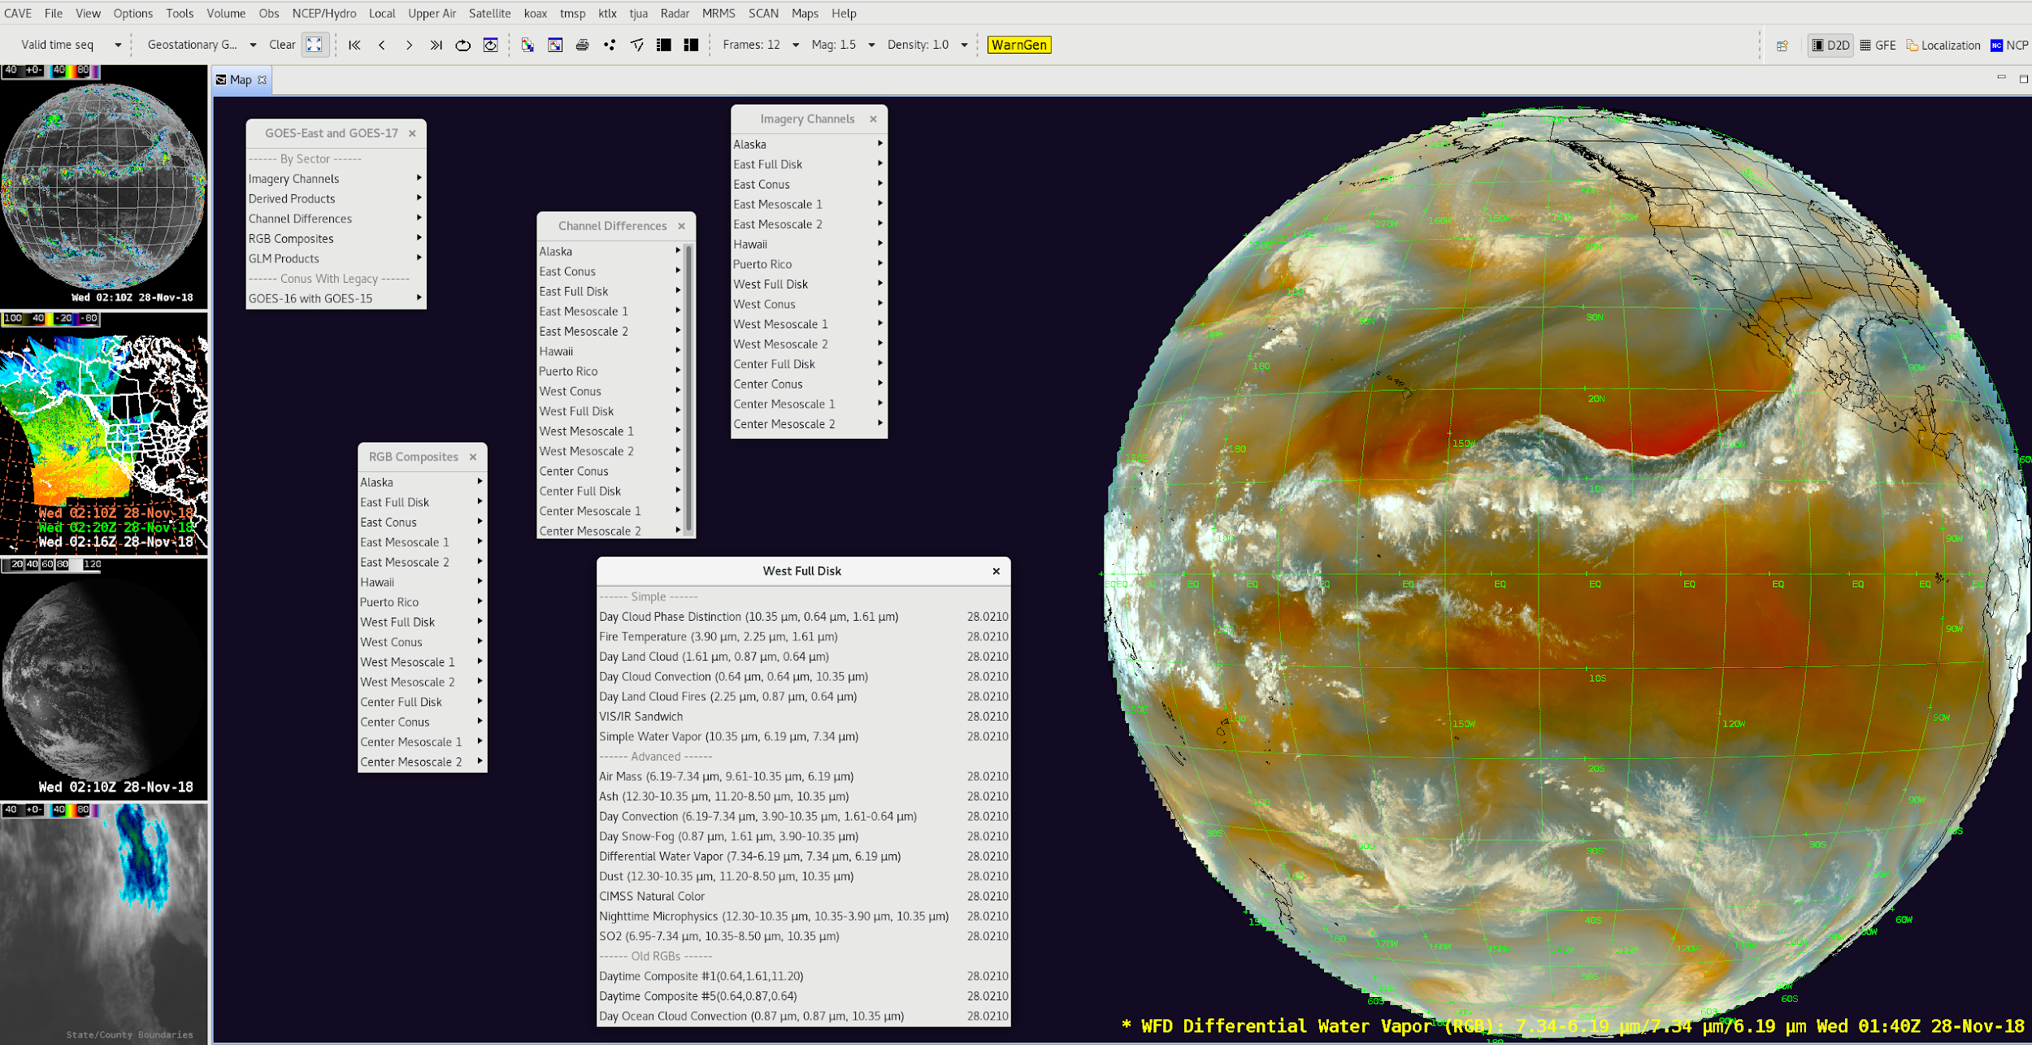
AWIPS/CAVE/D2D Menus for GOES-17

Slide 8
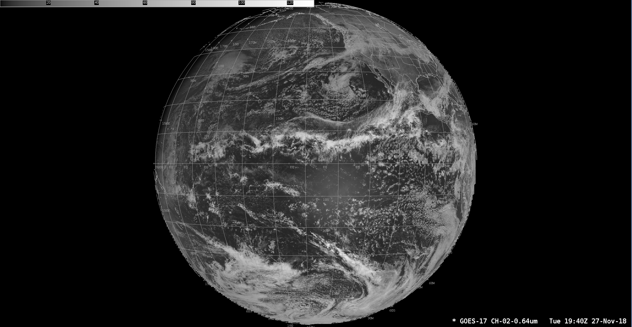
AWIPS/CAVE/D2D Example: GOES-17 ABI 0.64µm West Full Disk

Slide 9
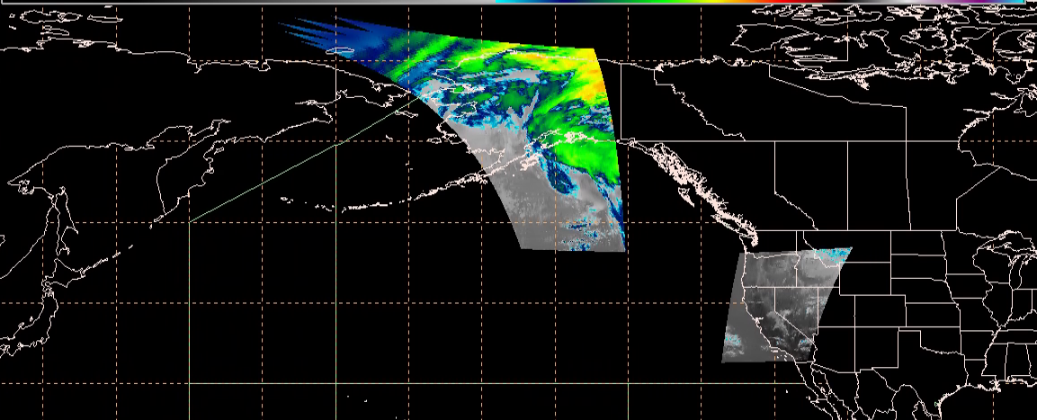
AWIPS Example: GOES-17 ABI 10.3µm Mesoscale Sectors (Default Locations)
WMESO-1 and WMESO-2 23:06Z / 18 Feb 2020
Notes:
Update with new Mesos in default location

Slide 10
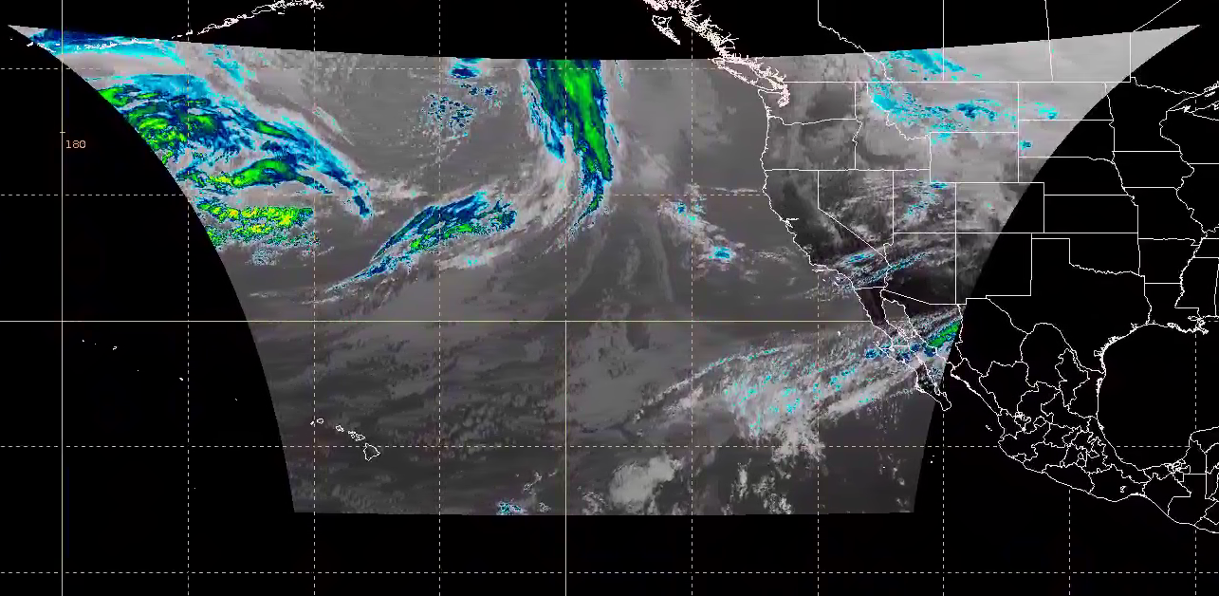
AWIPS example: PACUS Sector
WCONUS CH-13 10.3µm 19:41Z / 18 Feb 2020

Slide 11
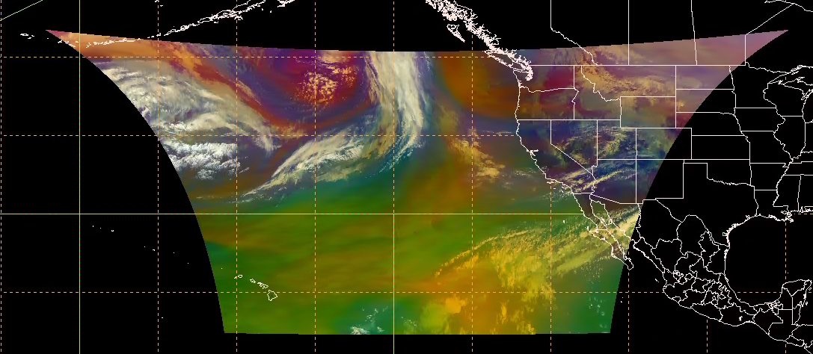
AWIPS example: Air Mass RGB
Air Mass RGB 19:41Z / 18 Feb 2020

Slide 12
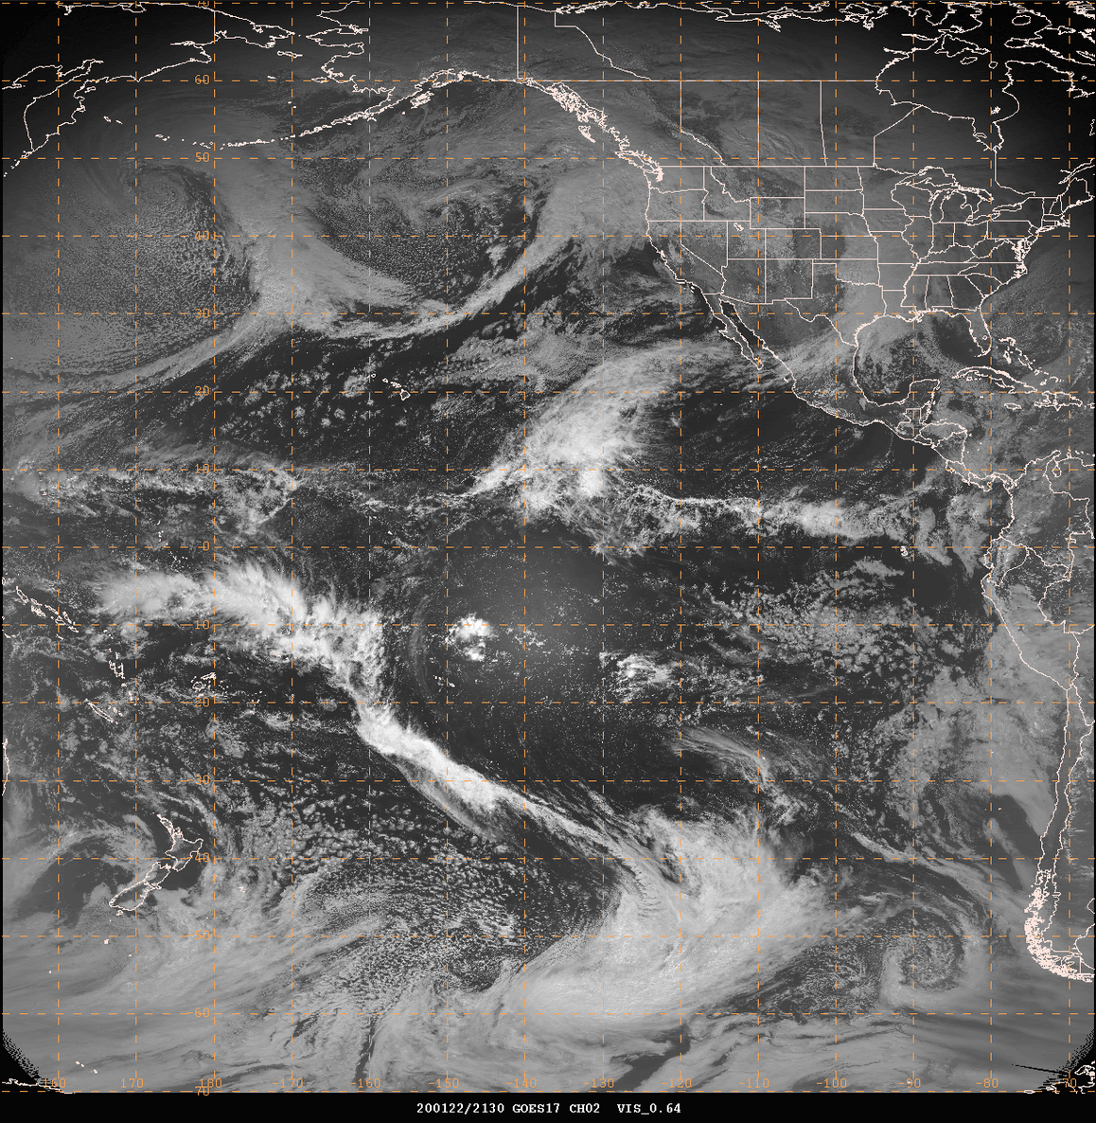
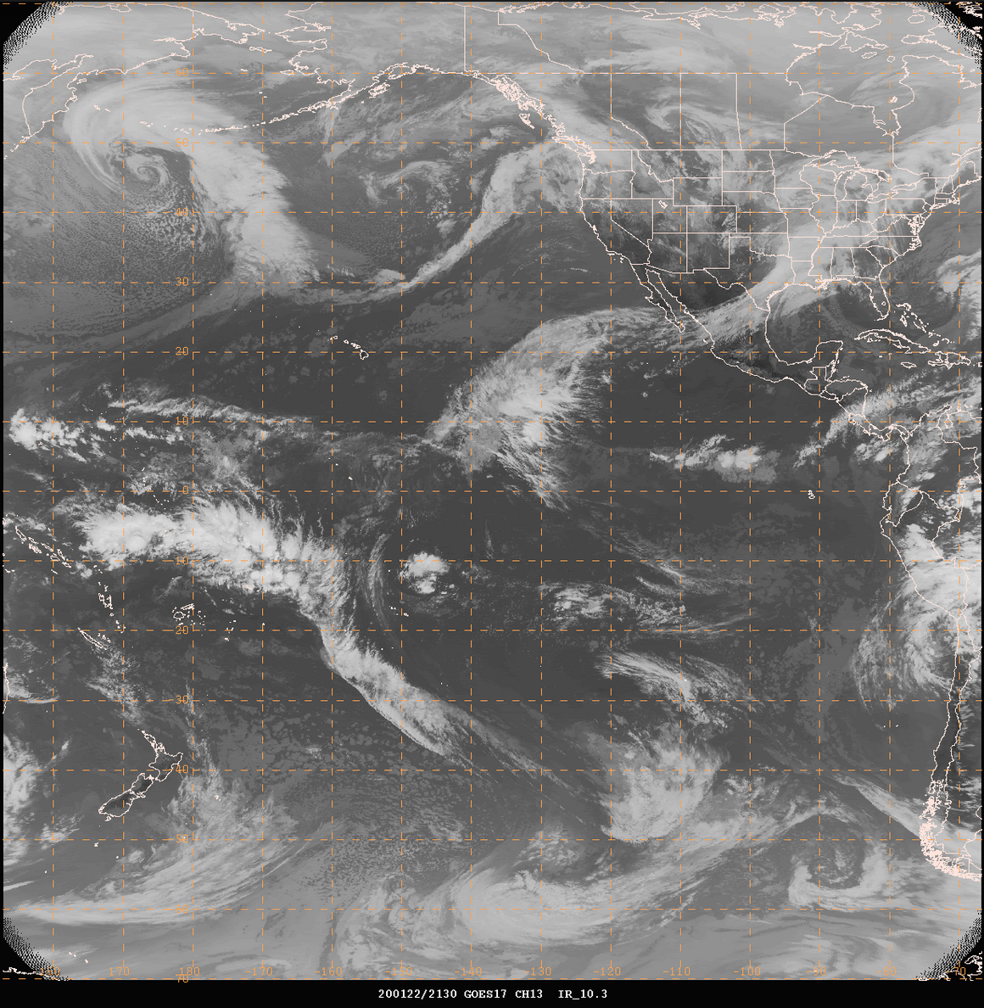
NAWIPS GOES-17 Full Disk Imagery (Jan 22, 2020, 2130Z)
CH-02 0.64um
CH-13 10.3um

Slide 13
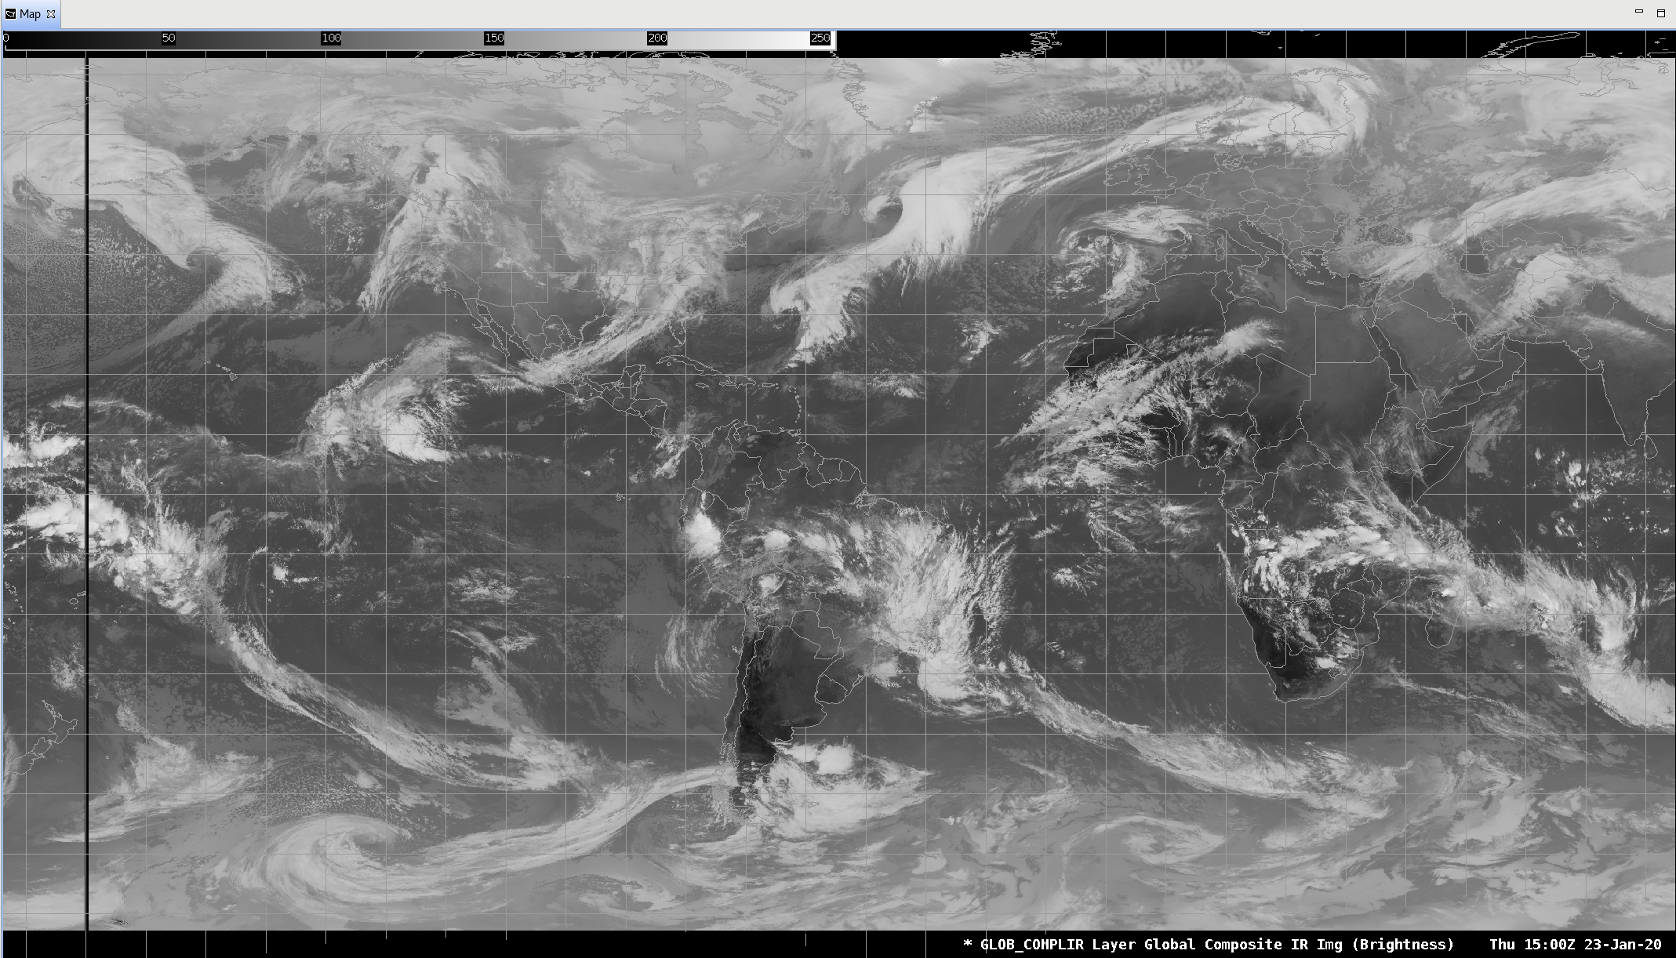
AWIPS 5-Sat Composite - Global Window IR
The image to the right is a multi-satellite global composite of window IR imagery. It draws from GOES-16 (GOES-East), GOES-17 (GOES-West), Meteosat-8, Meteosat-11, and Himawari-8.

Slide 14
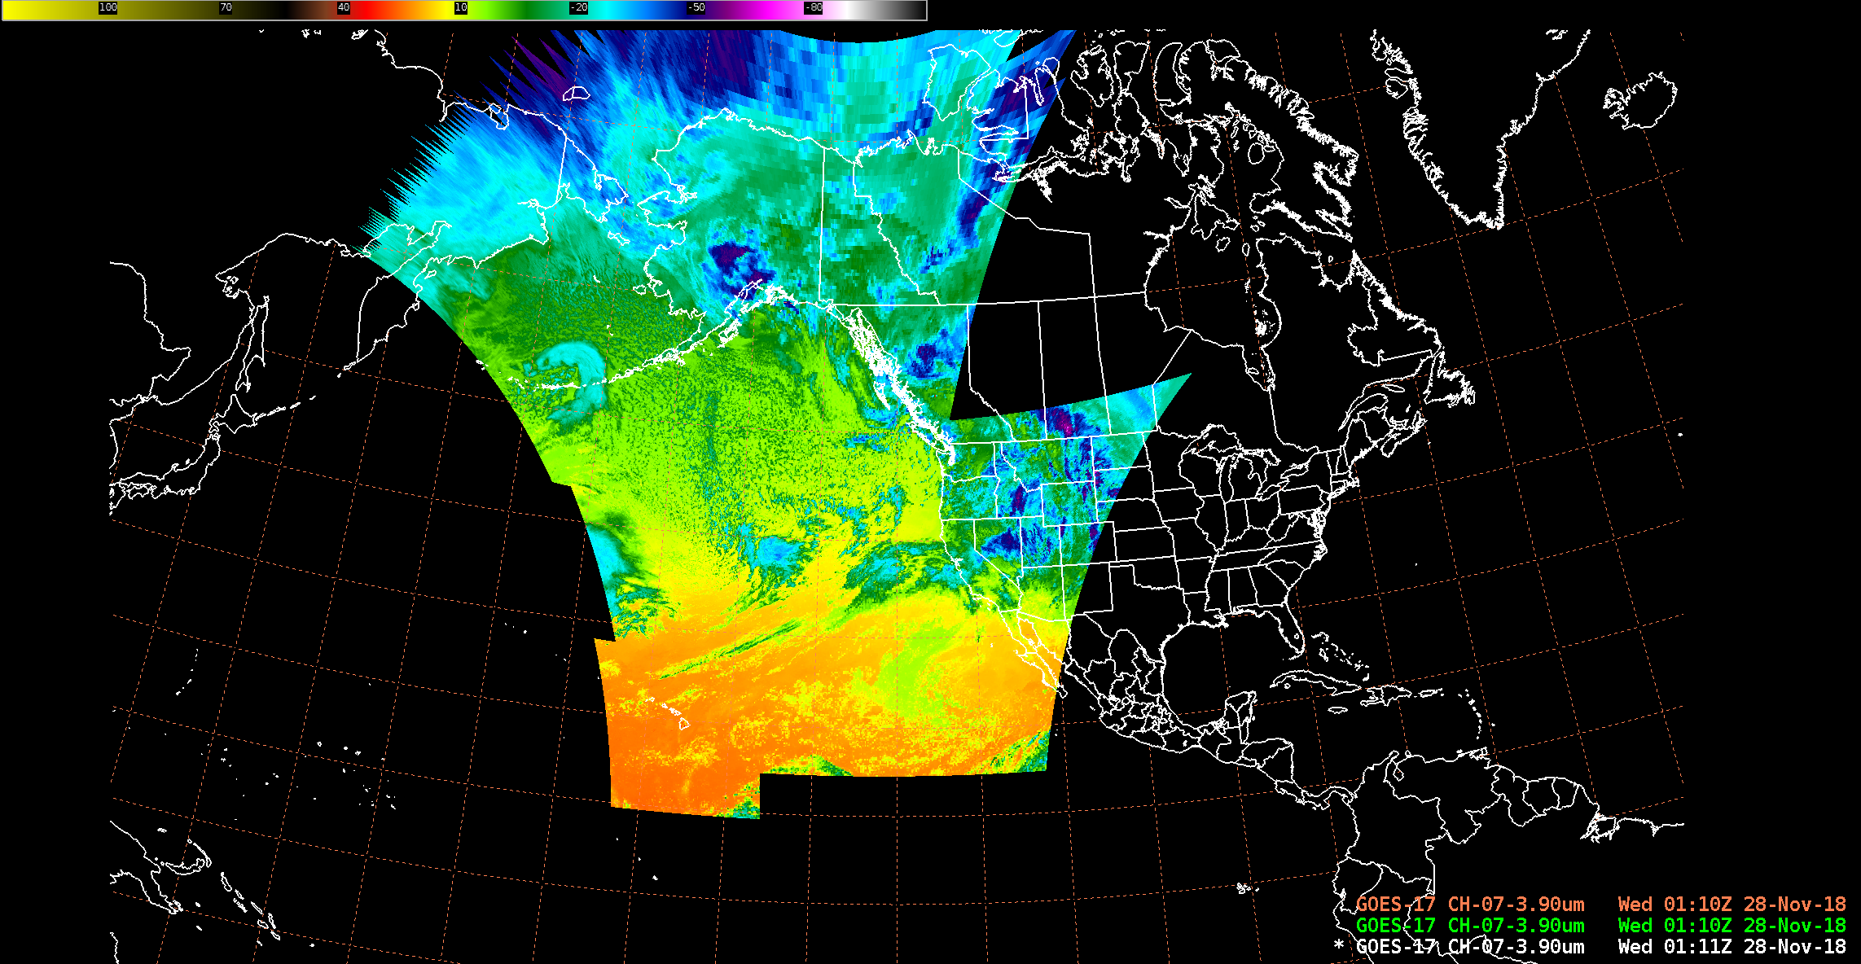
GOES-17 ABI SCMI Sectors in AWIPS*
Alaska
WCONUS
Hawaii
* excludes full disk and mesos

Slide 15
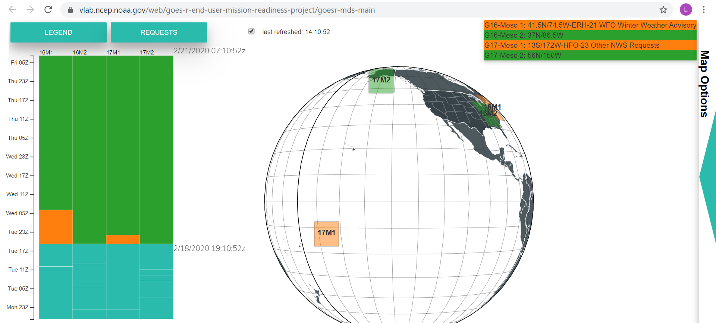
Exploitation of GOES-17 ABI Mesoscale Imagery at NWS
Mesoscale Mission Manager (MMM) Tool on NOAA Virtual Lab facilitates and encourages collaboration and utilization for mesoscale sector placement (tool sometimes called Meso Domain Scheduler (MDS))
Standard Operating Procedure documents mission priorities and the NESDIS/NWS meso request process
NWS Governance of ABI/Meso process managed by NWS Operations Division, MDS/MMM tool and process supported by OBS/TOWR-S team

Slide 16
Timeline and Noteworthy Items
GOES-17 SCMI (the GS/NCF/SBN delivered imagery) was activated into NWS on the fixed grid in late Aug 2018 (GOES-17 at checkout location)
Data flowing continuously since prior to transition to operations in Feb 2019 (post-drift activation was in Nov 2018)
NWS participated in GOES-17 Mode 6 tests and subsequent transition
NWS participated in GOES-16/17 dual Mode 4 tests
Pcal implemented into NESDIS operations in July 2019
Periods of degraded imagery noted and documented in various NWS Operational Test and Evaluation (OT&E) evaluations
OT&Es for all four CY2019 LHP events
non-LHP (e.g. striping, especially in water vapor bands but also in other IR channels)

Slide 17
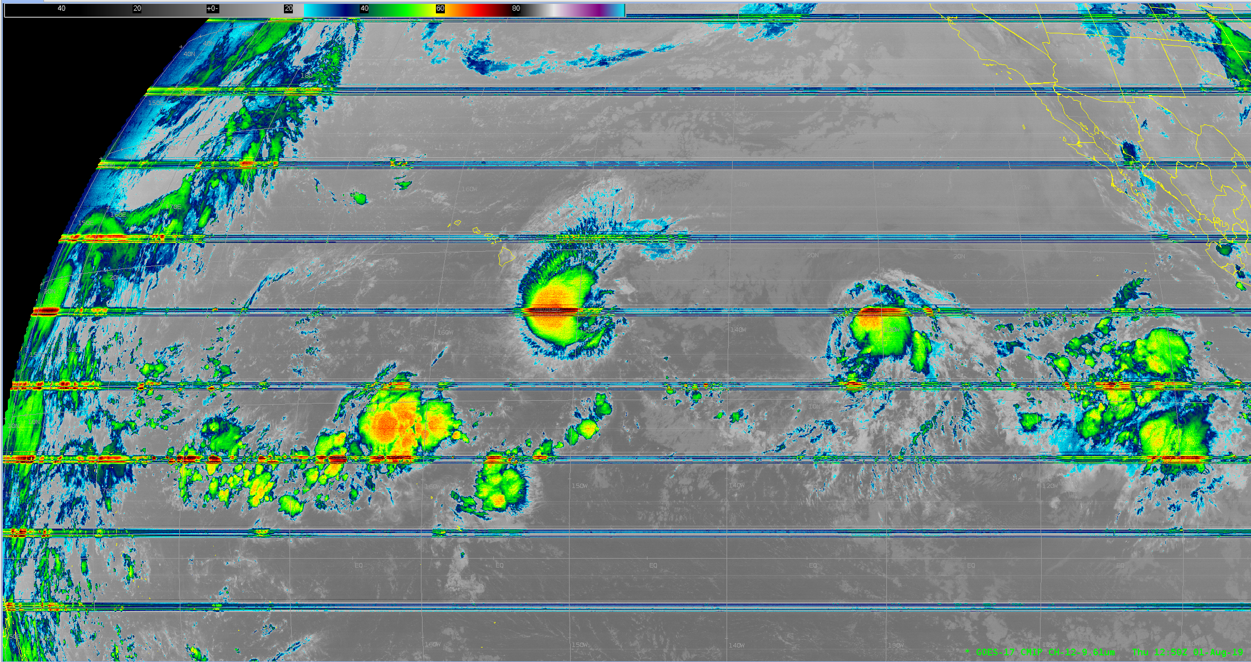
August 1st 2019 Band 12 (9.61um) at 12:50Z
Erick
Flossie

Slide 18
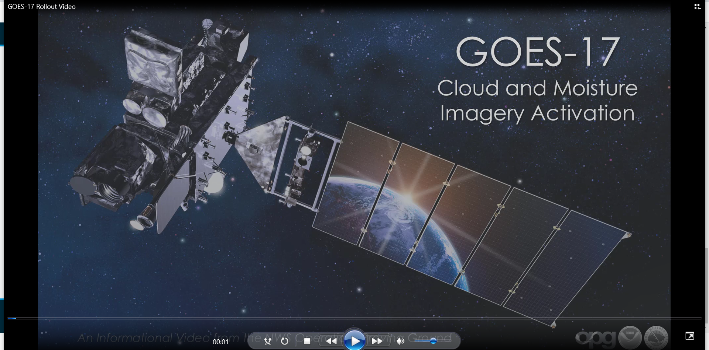
GOES-17 Loop Heat Pipe from NWS Perspective
NWS Operations Proving Ground disseminated training for all
WFOs/RFCs/NCEP Centers regarding the LHP data issues and
what to expect during specific times of the year
TOWR-S team has set up and regularly uses a
satellite-specific NWS/AWIPS chatroom to relay data issues to
forecasters and also to receive reports of data issues
TOWR-S developed an automated process to monitor the degradation present in the ABI IR channels due to the LHP, as well as subjective tracking-by-hour

Slide 19
GOES-17 ABI LHP Impacts to NWS Mission
Aviation (Turbulence and Volcanic Ash)
Tropical
The NWS mission impacts were gathered from the OPPSD Operational Test and Evaluation* (OT&E) draft report and an Office of Observations field assessment of Honolulu Operations. Both reports cover aspects of the Fall 2019 LHP period(s).
Draft OT&E Report*
Honolulu Field
Office Assessment
* OT&E report includes feedback from staff at several NWS OT&E Sites: Weather Forecast Office Honolulu (WFO HFO), Central Pacific Hurricane Center (CPHC), National Hurricane Center (NHC), Alaska Volcanic Ash Advisory Center (VAAC), Aviation Weather Center (AWC) and Ocean Prediction Center (OPC). See backup slide on summary of NWS impacts/findings, from OT&E.

Slide 20
Mitigation Considerations
ABI Imagery De-striping Algorithm
Maintains gradients between lines and adjusts the mean radiances prior to conversion to brightness temperature
Handles convective clouds separately due to greater susceptibility of cold pixels to striping
Does not smooth image outside of stripes (no bulk operator)
Evaluated in NWS/Lab and will be under evaluation at NWS Pacific Region
NWS evaluated mitigations (e.g., pcal, fusion, alt./cooling time lines) and is open to evaluating other potential LHP mitigations

Slide 21
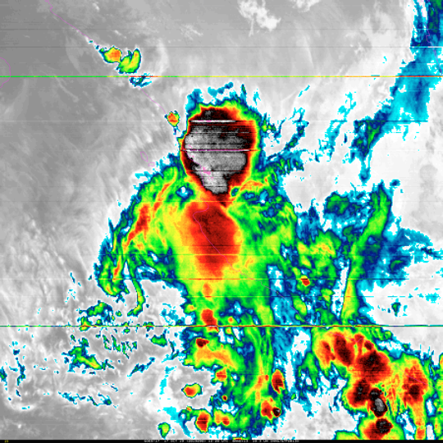
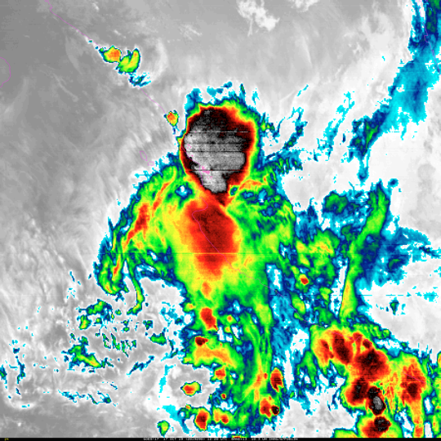

Slide 22
Summary Assessment
GOES-17 ABI imagery is being widely used across in NWS as the primary source for GOES-West imagery
NWS requests continued NESDIS attention on:
Alt/cooling tests and implementation
Calibration improvements in the IR Window bands, during cool periods
Destriping
Inclusion of GOES-17 ABI data in NESDIS’s new Multi-satellite composite product
Hardening of Himawari processing/distribution
Add FPM Temperature and DQF metadata to SCMI
AI for turbulence detection

Slide 23
Thanks!
Questions?

Slide 24
Back-Up Slide

Slide 25
LHP Impacts: OT&E Team Report Summary (Highlights)
IR (esp WV) and RGB products unusable during worst degradation
Fusion evaluated in 2019 was not useful at this time for operational forecasting, but it may be useful in the future if NESDIS makes some changes to the fusion imagery to make if more usable for forecasters during LHP degradation
The OCONUS Sites (Alaska, Hawaii) and NHC are most impacted by the LHP issue. Survey results indicate that the LHP issue has a significant impact on these sites and for OPC’s ability to make accurate forecasts during the LHP season that may impact mission
Degraded or unusable GOES-17 IR imagery and RGB’s could prove highly problematic for operational aviation, tropical cyclone, and volcanic ash services.
Initial GOES-17 ABI Alternate/Cooling Scan, tested in Oct 2019, provided mixed results (some imagery improvement, but too much imagery sacrificed). Newer version under evaluation during Feb 2020.
The OT&E Survey results conclude that the loss and degradation of GOES-17 imagery during the LHP Degradation (especially at and around the critical 12Z forecast time) significantly impacts the NWS mission in Tropical, Aviation, and Volcanic forecast operations
Notes:
Lee move to backup

