Slide 1
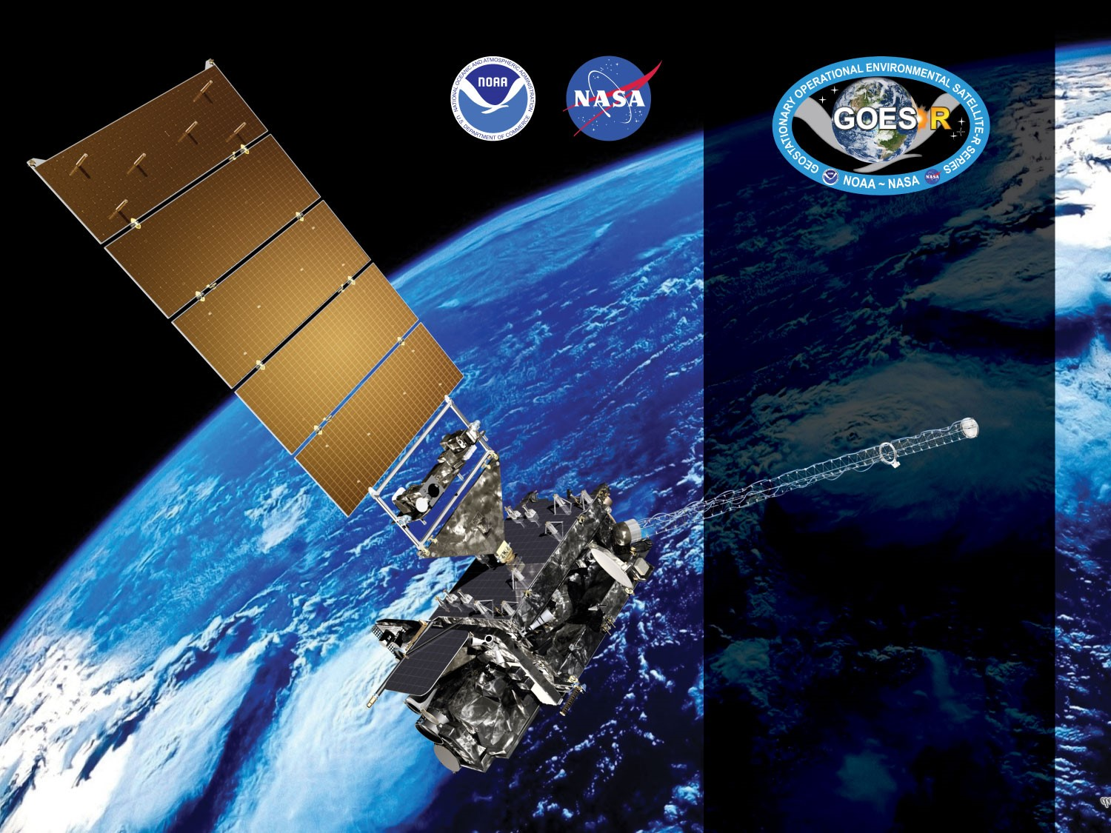
GOES-17 ABI L2+ LAP Products Provisional* PS-PVR
May 16, 2019
Tim Schmit
GOES-R AWG
NOAA/NESDIS/STAR
GOES-R AWG LAP team: Jun Li,
Richard Dworak, Zhenglong Li
UW-CIMSS
v1.4

Slide 2
Agenda
Provisional* Validation Product Maturity Assessment
GOES-17 Focal Plane Temperatures during stable times
Data between 0900 UTC and 1800 UTC were ignored in this analysis
Path to Delta Review (LHP mitigation)
Summary and Recommendations
The GOES-17 LAP (Legacy Atmospheric Profiles) shown here are only beta-stage maturity

Slide 3
Products Overview
Same as GOES-16, the GOES-17 ABI L2 LAP algorithm includes regression and physical retrieval based on the infrared spectral bands as input. The algorithm is applied to 5x5 ABI pixels (~10 km) for generating LAP products over clear sky. The LAP products include LVT, LVM, TPW, and DSI.
Band Number | Wavelength (µm) | Purpose
8 | 6.19 | High-level atmospheric water vapor, winds, rainfall
9 | 6.93 | Mid-level atmospheric water vapor, winds, rainfall
10 | 7.34 | Lower-level atmospheric water vapor, winds, and SO₂
12 | 9.61* | Total ozone
13 | 10.33 | Surface and cloud
14 | 11.20 | Imagery, SST, clouds, rainfall
15 | 12.30 | Total water, ash, SST
16 | 13.30 | Air temperature, cloud heights and amounts
LAP products
Legacy Vertical Temperature profile (LVT)
Legacy Vertical Moisture profile (LVM)
Total Precipitable Water (TPW)
Derived Stability Indices (DSI)
Lifted Index (LI)
Convective Available Potential Energy (CAPE)
Showalter Index (SI)
K-Index (KI)
Total Totals (TT)
9.61* : used only in regression
Notes:
* Only used in the regression step.

Slide 4
Review: Time-Line/Context
01 Mar 2018 GOES-S Launch
12 Mar 2018 GEO orbit attained (became GOES-17)
24 Oct ~ 13 Nov 2018 Spacecraft drift to 137.2W from 89.5W
15 Nov 2018 Radiance data distribution resumes
12 Feb 2019 Transitioned to operations as NOAA’s GOES West satellite

Slide 5
PLPTs Under Review
PLPT ID | Descriptive Title | % Complete | Results | AWG POC
ABI-FD_TPW09 | Quantitative analysis of M6 FD TPW | 100 | Complete | AWG
ABI-CONUS_TPW10 | Quantitative analysis of M6 CONUS TPW | 100 | Complete | AWG
ABI-MESO_TPW11 | Quantitative analysis of M6 Meso TPW | 100 | Complete | AWG
Notes:
PRO is responsible for 01 – 05.

Slide 6
PLPTs Under Review
PLPT ID | Descriptive Title | % Complete | Results | AWG POC
ABI-FD_LVT09 | Quantitative analysis of M6 FD LVT | 100 | Complete | AWG
ABI-CONUS_LVT10 | Quantitative analysis of M6 CONUS LVT | 100 | Complete | AWG
ABI-MESO_LVT11 | Quantitative analysis of M6 Meso LVT | 100 | Complete | AWG
Notes:
PRO is responsible for 01 – 05.

Slide 7
PLPTs Under Review
PLPT ID | Descriptive Title | % Complete | Results | AWG POC
ABI-FD_LVM09 | Quantitative analysis of M6 FD LVM | 100 | Complete | AWG
ABI-CONUS_LVM10 | Quantitative analysis of M6 CONUS LVM | 100 | Complete | AWG
ABI-MESO_LVM11 | Quantitative analysis of M6 Meso LVM | 100 | Complete | AWG
Notes:
PRO is responsible for 01 – 05.

Slide 8
PLPTs Under Review
PLPT ID | Descriptive Title | % Complete | Results | AWG POC
ABI-FD_DSI09 | Quantitative analysis of M6 FD DSI | 100 | Complete | AWG
ABI-CONUS_DSI10 | Quantitative analysis of M6 CONUS DSI | 100 | Complete | AWG
ABI-MESO_DSI11 | Quantitative analysis of M6 Meso DSI | 100 | Complete | AWG
Notes:
PRO is responsible for 01 – 05.

Slide 9
PLPT Tests for each Domain
Our 3 PLPTs dealing with analysis are comprised of the same 2 methods.
Each contains the applications of these methods on the FD, CONUS and MESO domains.
The applications of each method to each domain is summarized below.
Some methods were redundant or not possible for some domains.
Same as what was done for GOES-16 LAP
Analysis Method | FD | CONUS | MESO
Visual Inspection
Comparison to reference data (RAOB, GPS, AMSR2)

Slide 10
Provisional Validation Product Maturity Assessment
GOES-17 ABI L2+ LAP Products Provisional* PS-PVR

Slide 11
GOES-17 Data Used in this Review
November 2018 - April 2019 (excluded period of LHP issue):
All FD, CONUS, Meso1, and Meso2 LAP with RAOB, Suomi-Net GPS TPW, and AMSR2 TPW matchups within +/- 30 min, 20 km
FD and CONUS LAP with ECMWF and GDAS matchups within 0.125 °
January - April 2019:
Meso1 and Meso2 LAP with ECMWF and GDAS matchups within 0.125 °;
Day 60 (March 1, 2019), 0000 UTC: Visual images of all domains for each variable;
11

Slide 12
Definitions of Metrics
Passed: No visual artifacts and/or the comparison with the reference data near or above the specification.
Failed: Cause of performance degradation is unknown.
The comparisons with the reference data are computed over all data.
12

Slide 13
Examples of Visual Inspection of All Domains
13

Slide 14
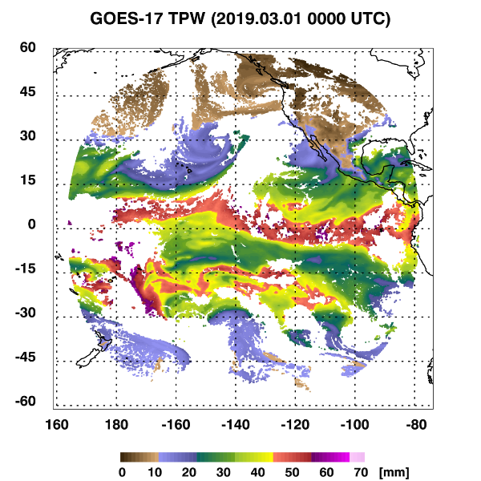
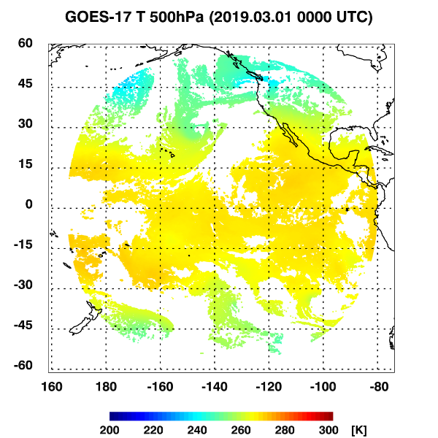
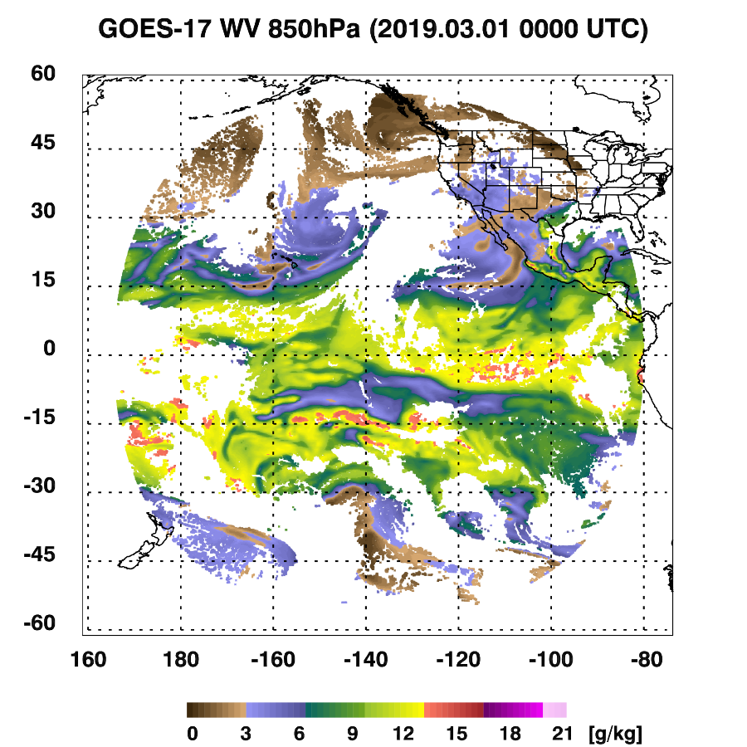
PLPT ABI-FD-TPW, LVT, LVM:
March 01 2019, 0000 UTC
TPW (mm)
Temp (K). 500 hPa
WV (g/kg) 850 hPa
TPW: Total Precipitable Water
LVT: Legacy Vertical Temperature profile
LVM: Legacy Vertical Moisture profile
14

Slide 15
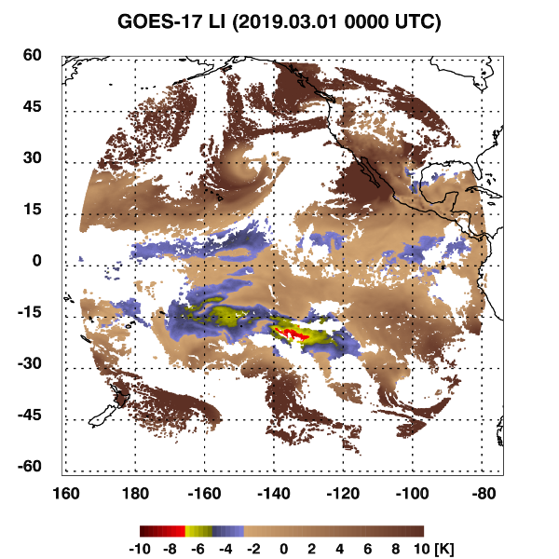
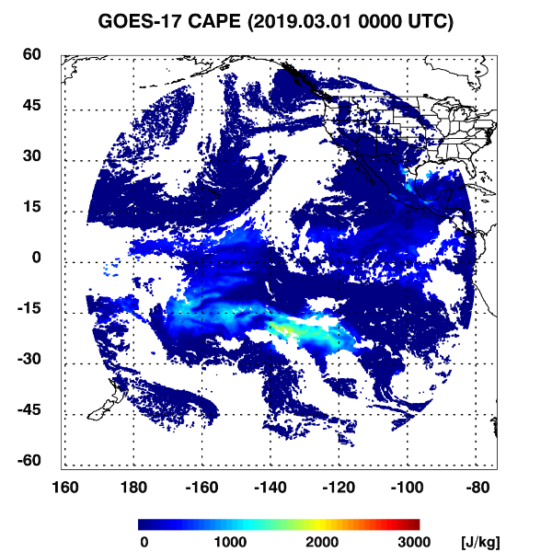
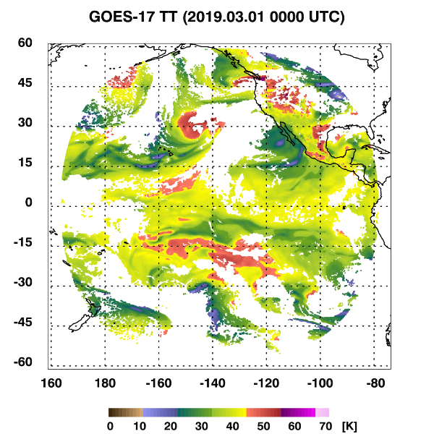
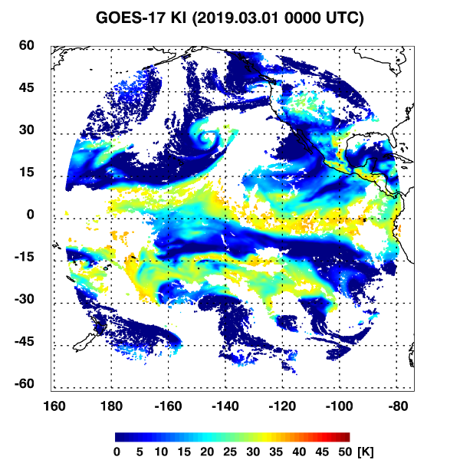
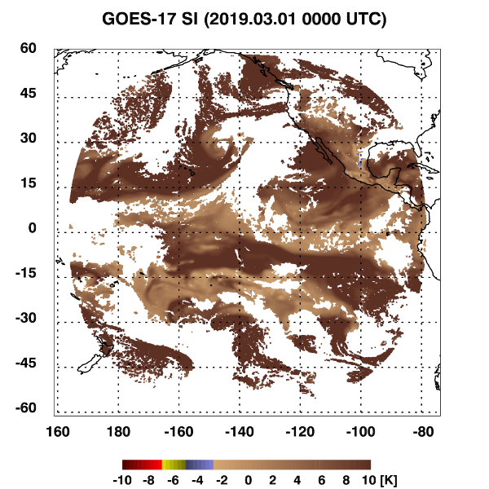
PLPT ABI-FD-DSI:
March 01 2019, 0000 UTC
LI
CAPE
TT
KI
SI
LI: Lifted Index
CAPE: Convective Available Potential Energy
TT: Total Totals
KI: K-Index
SI: Showalter Index
15

Slide 16
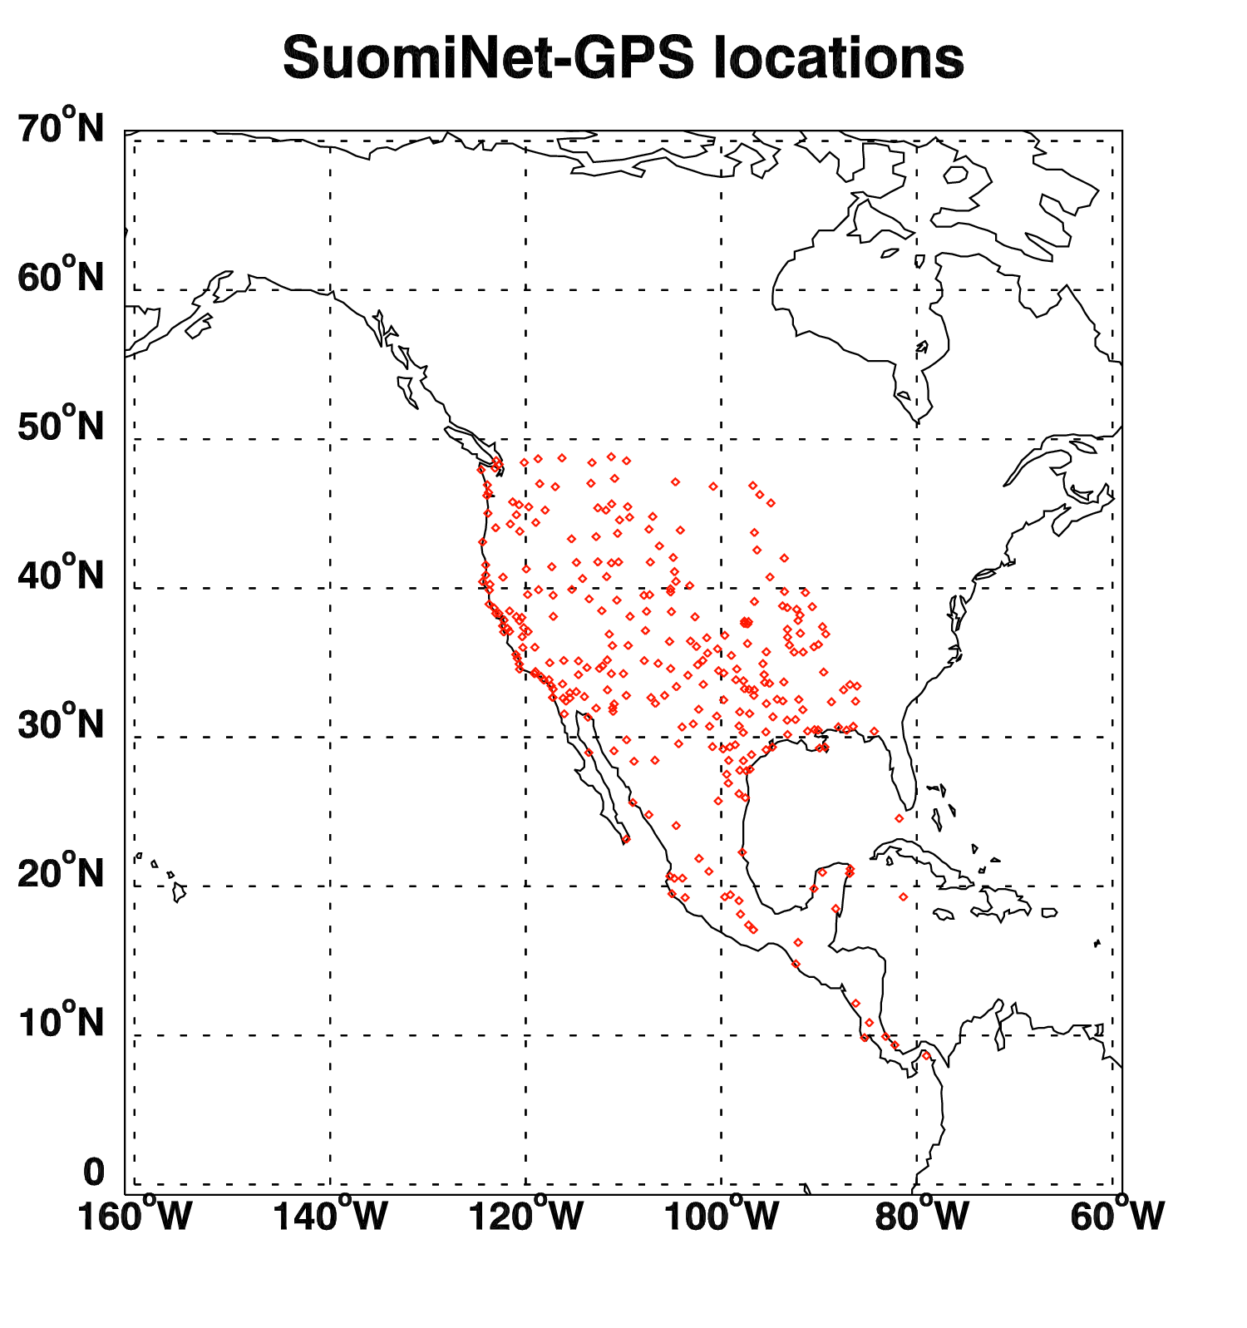
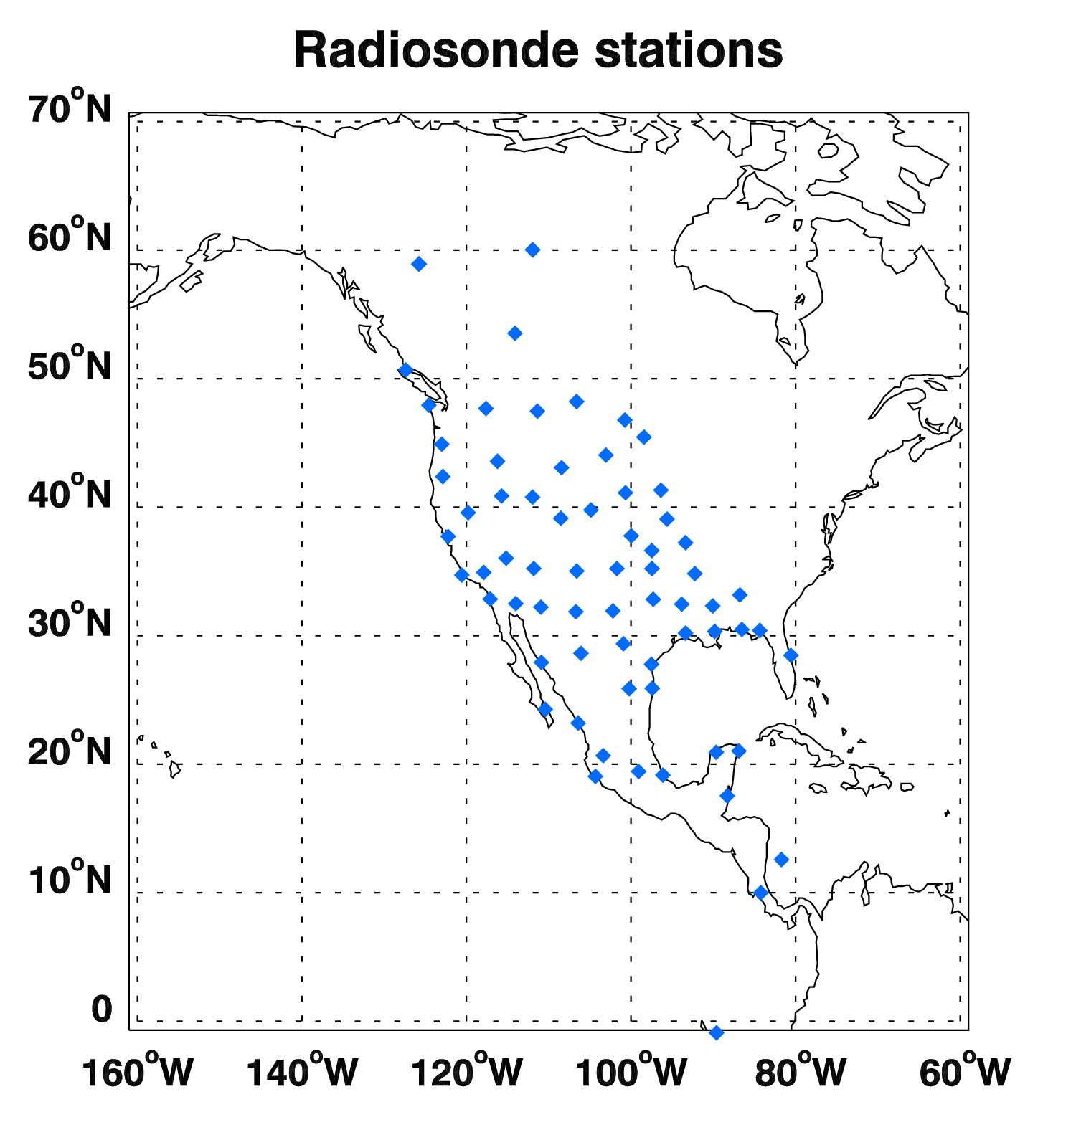
Locations of Suomi-Net GPS and RAOB
Suomi-Net GPS
RAOB
16
Notes:
On the left figure, all the red dots indicate SuomiNet-GPS locations and the blue dot in Dominican Republic (lat: 18.79, lon: -70.66) indicates the location
where most of the outliers in tpw figures are located.
On the right figure, all the red dots indicate RAOB locations and the blue dot near the Michigan Lake (lat: 43.75, lon: -87.71) indicates AERI observation.

Slide 17
Comparison TPW with the GPS, RAOB, AMSR2, ECMWF, and GDAS
17

Slide 18
Requirements for ABI LAP product: TPW
Product |  | Accuracy | Precision | Range
Temperature |  | 1 K below 400 hPa and above boundary layer | 2 K below 400 hPa and above boundary layer | 180 - 320 K
Moisture |  | Sfc - 300 hPa: 18% 300 - 100 hPa: 20% | Sfc - 300 hPa: 18% 300 - 100 hPa: 20% | 0 - 100%
TPW |  | 1 mm | 3 mm | 0 - 100 mm
DSI | LI | 2.0 K | 6.5 K | -10 ~ 40 K or above
 | CAPE | 1000 J/kg | 2500 J/kg | 0 - 5000 J/kg
 | SI | 2.0 K | 6.5 K | -10 ~ 4 K or above
 | TT | 1 K | 4 K | -43 ~ 56 K
 | KI | 2 K | 5 K | 0 - 40 K
18

Slide 19
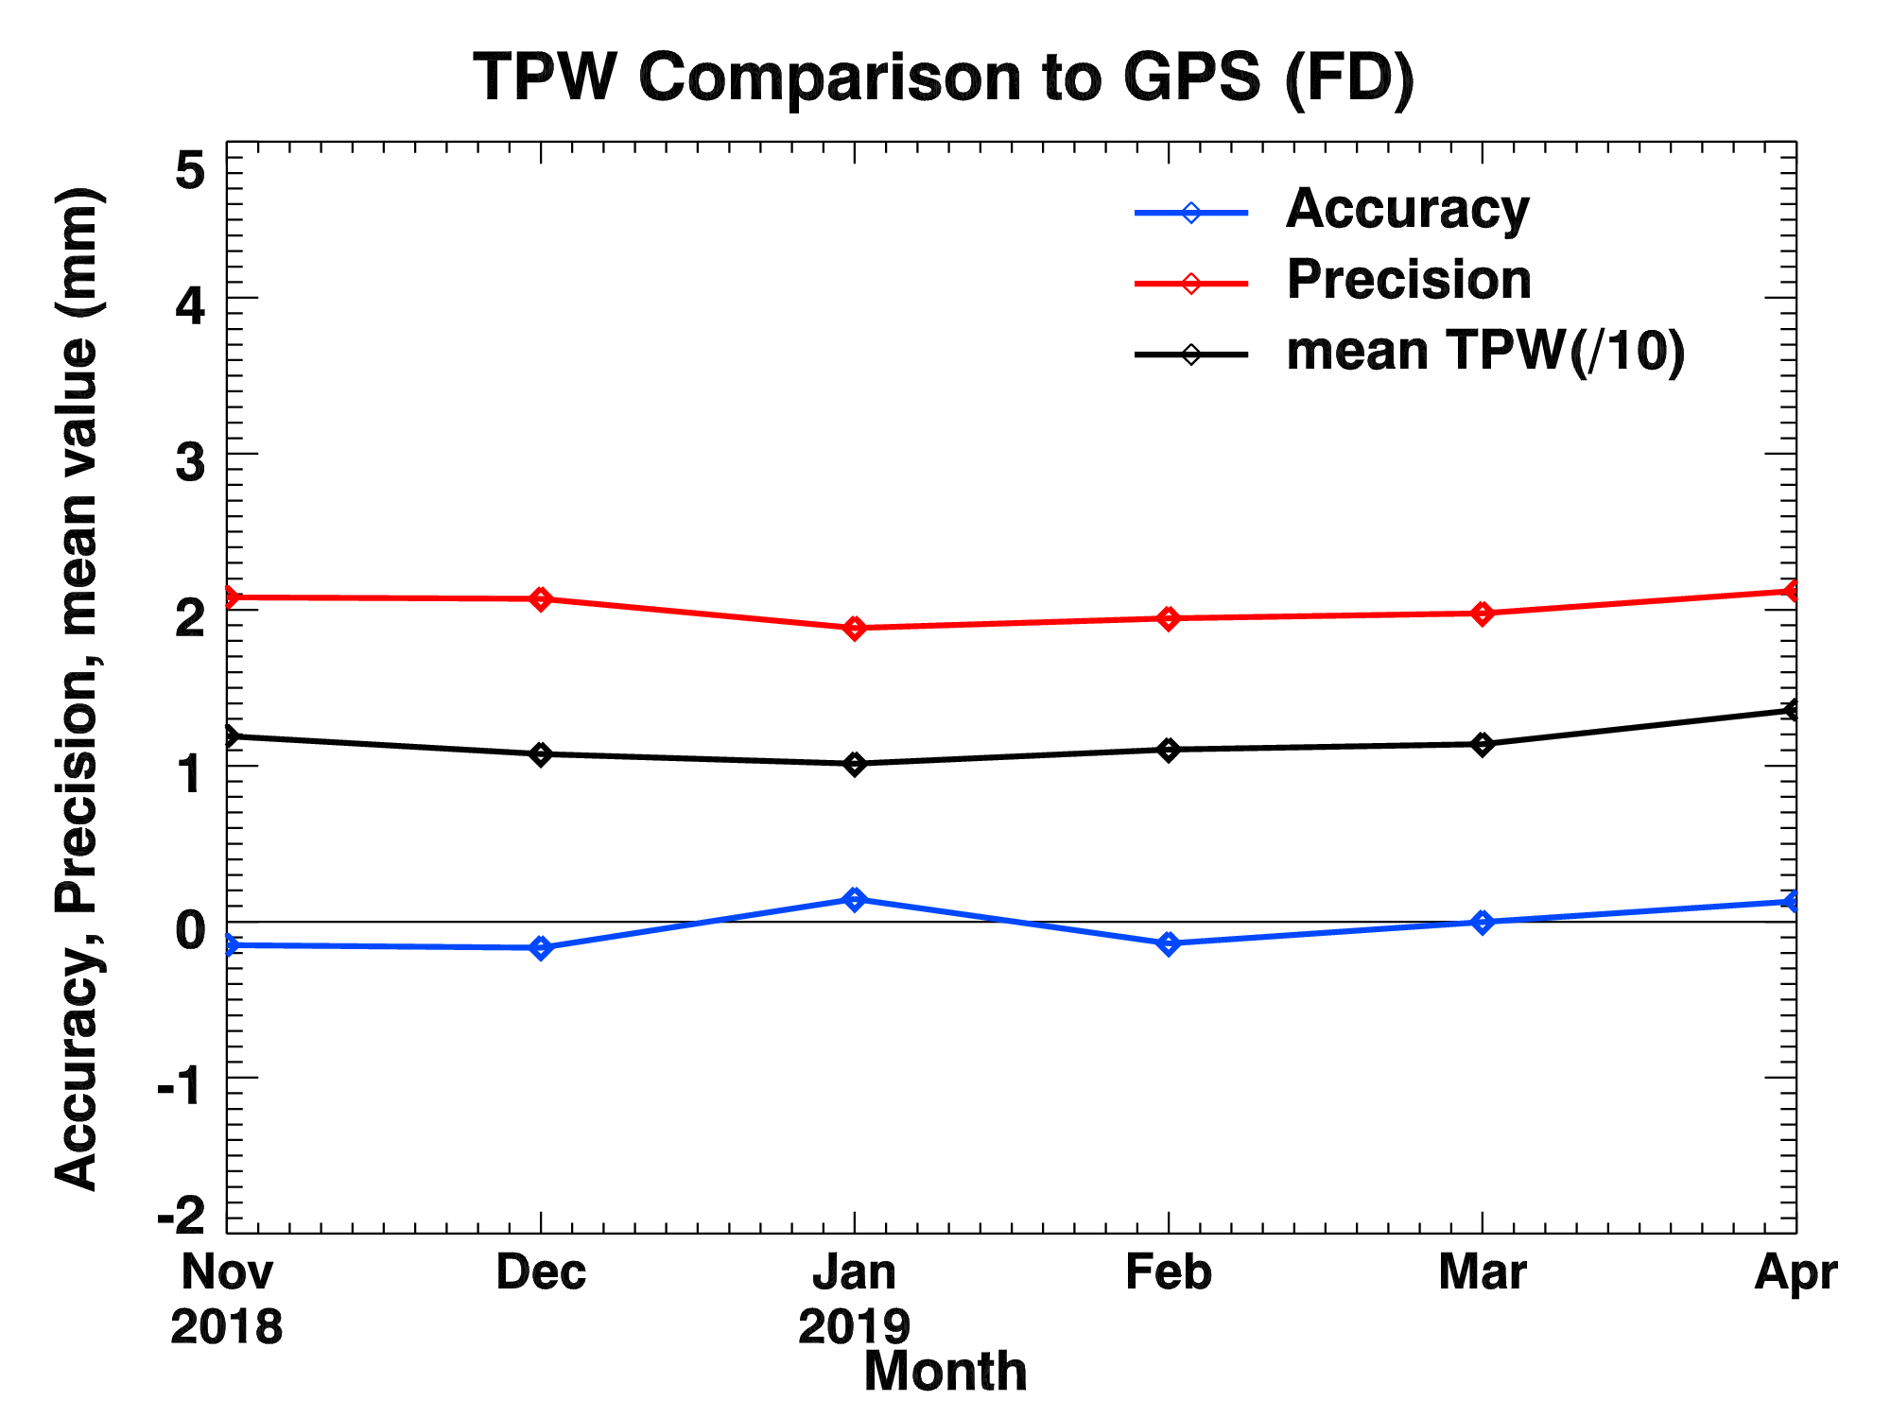
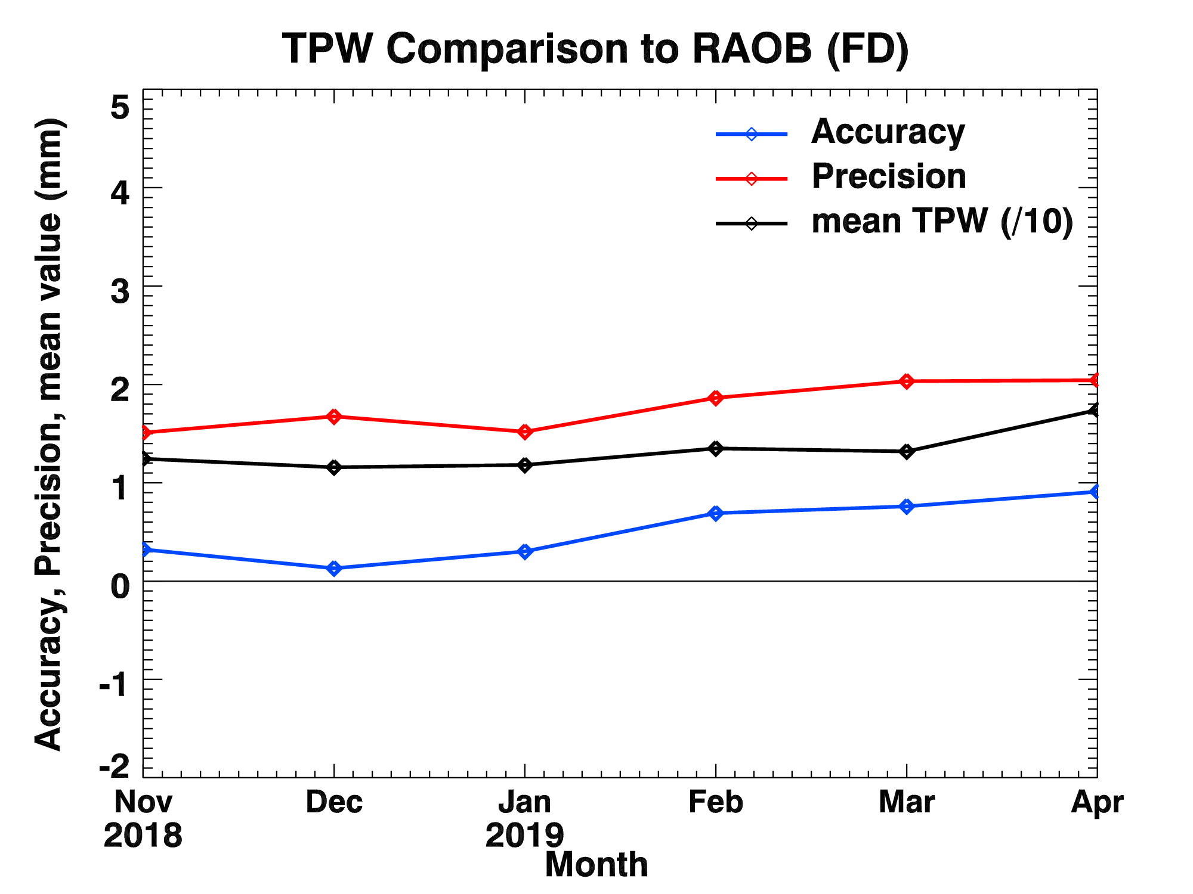
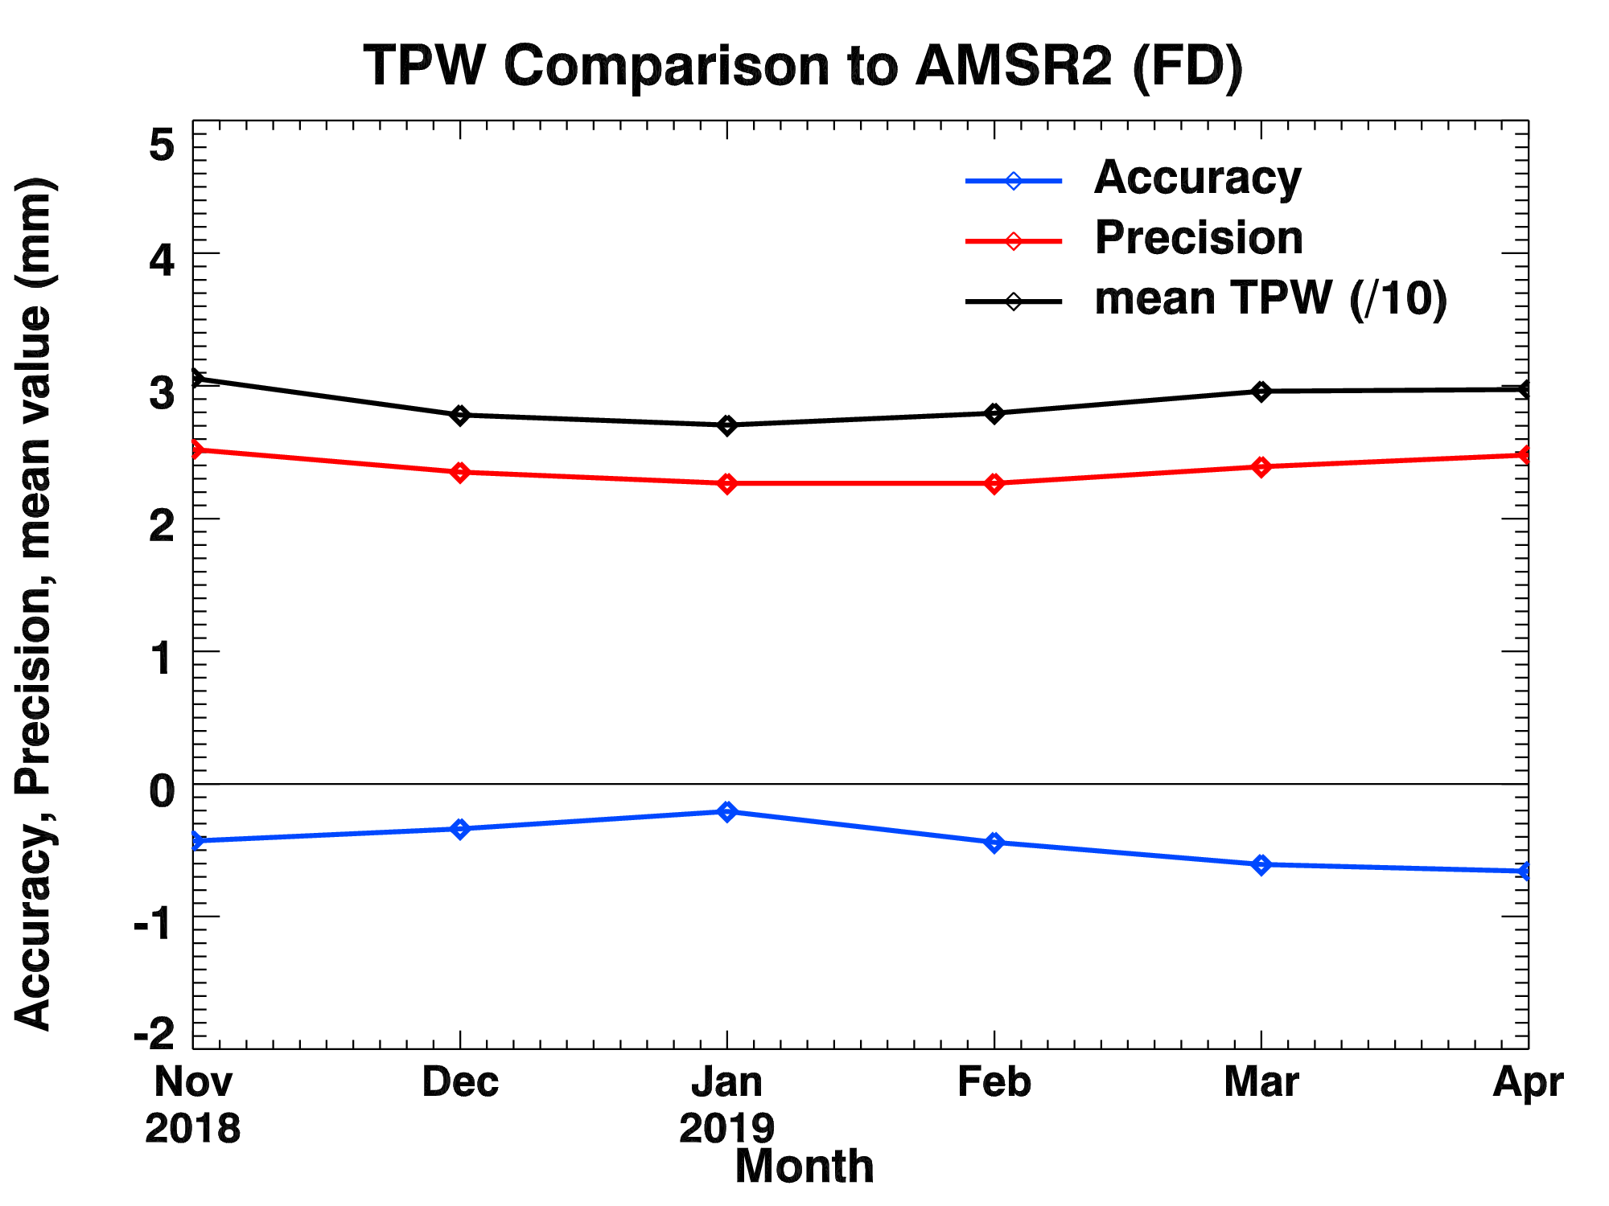
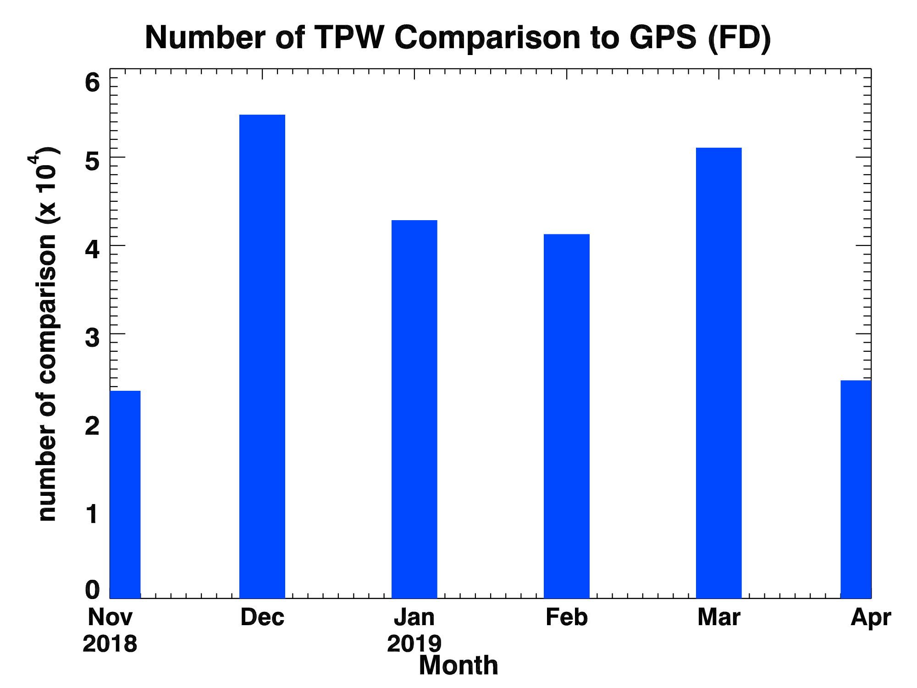
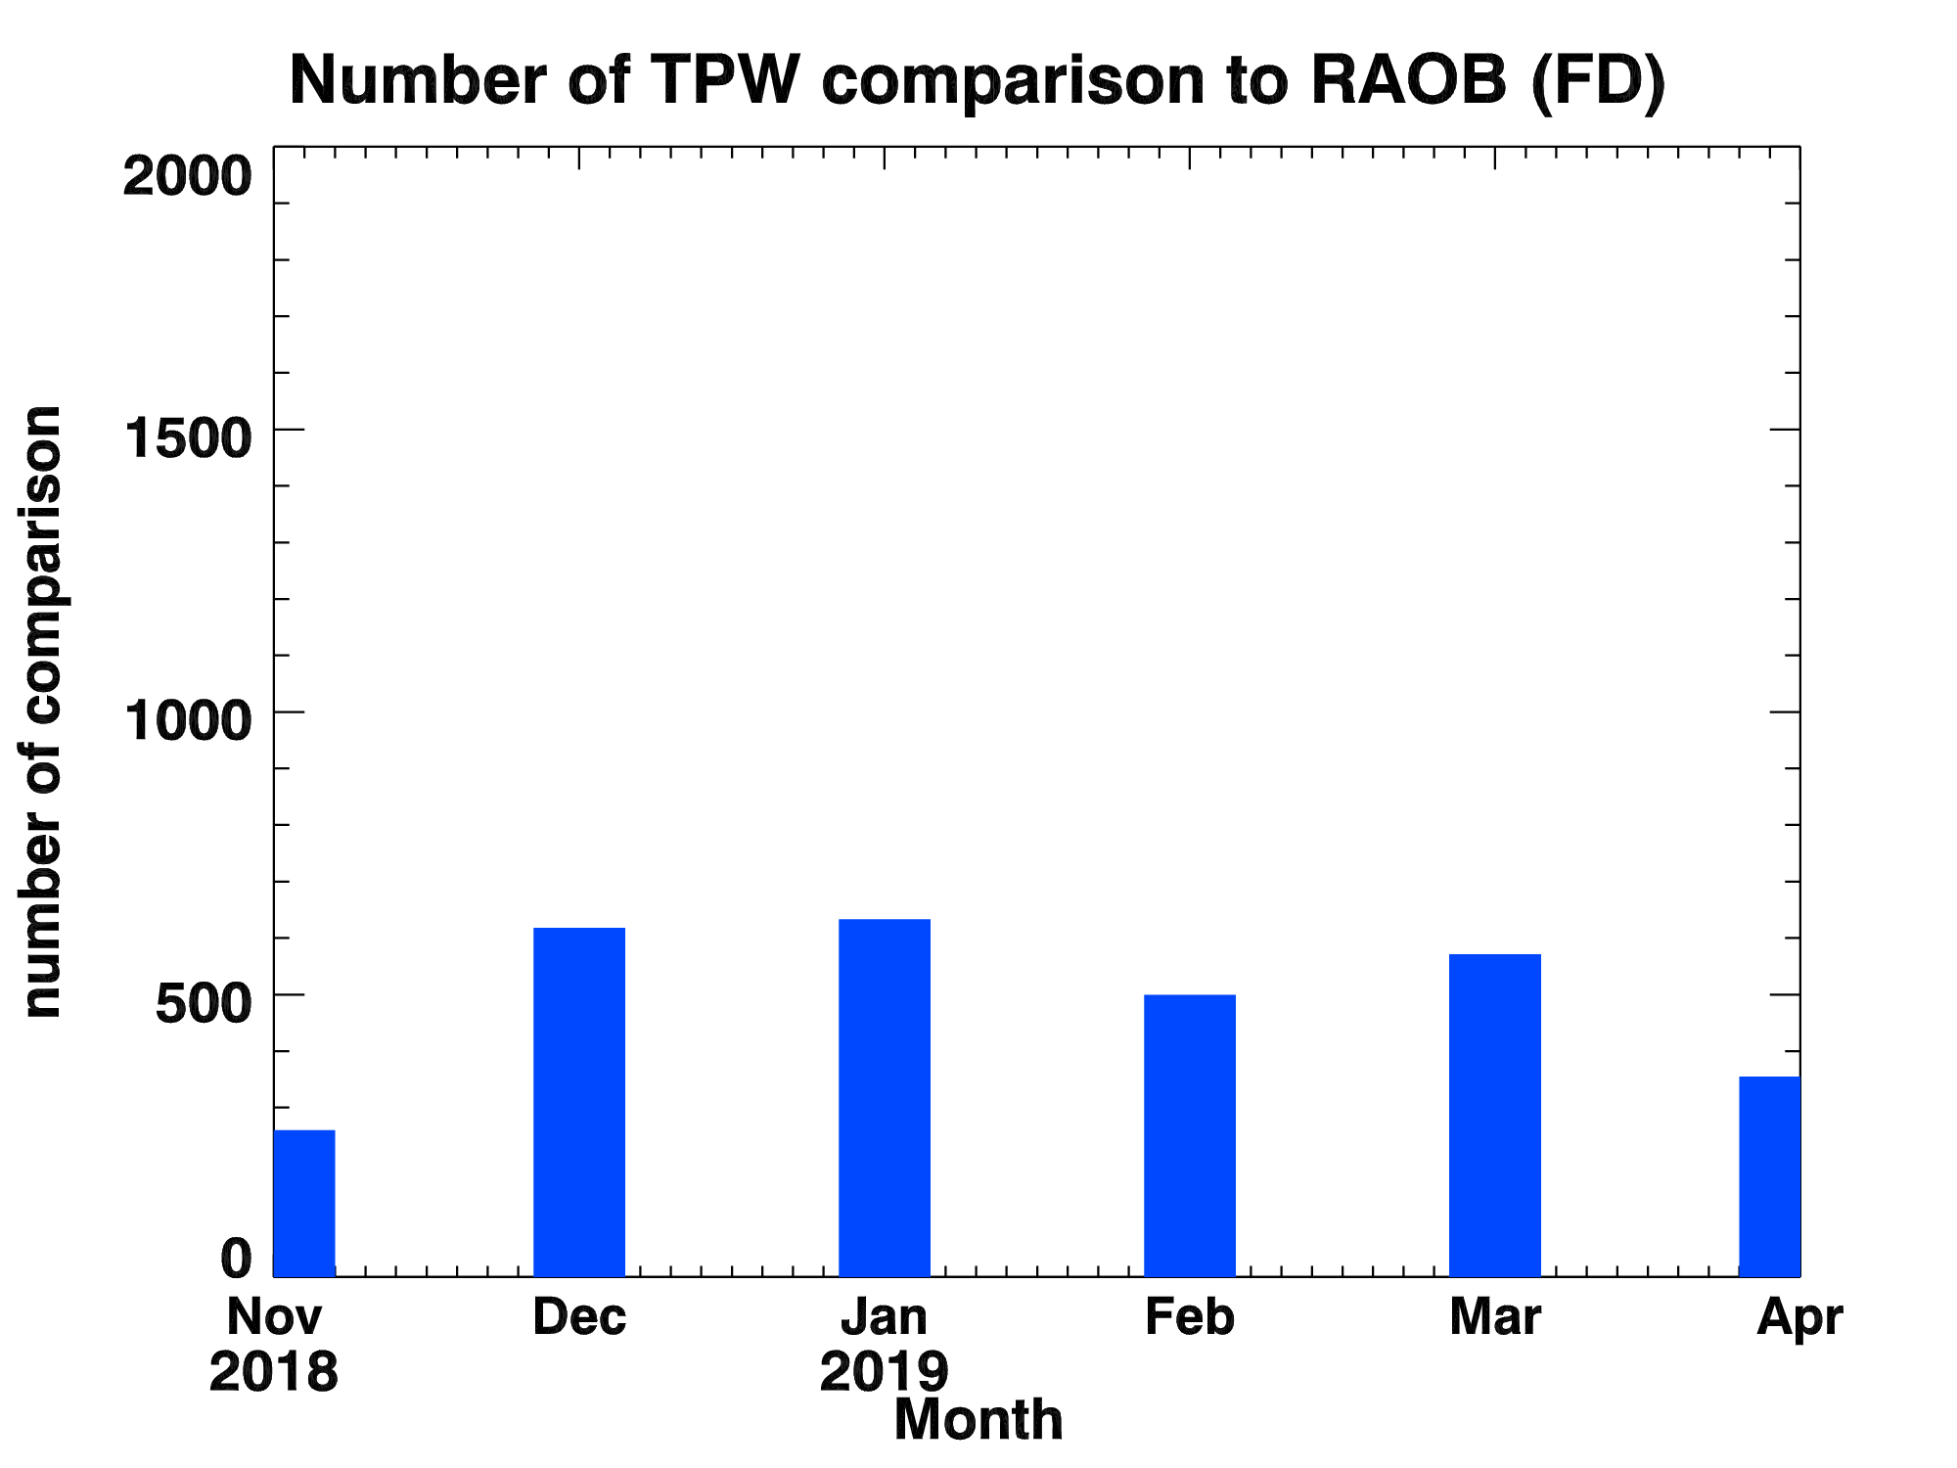
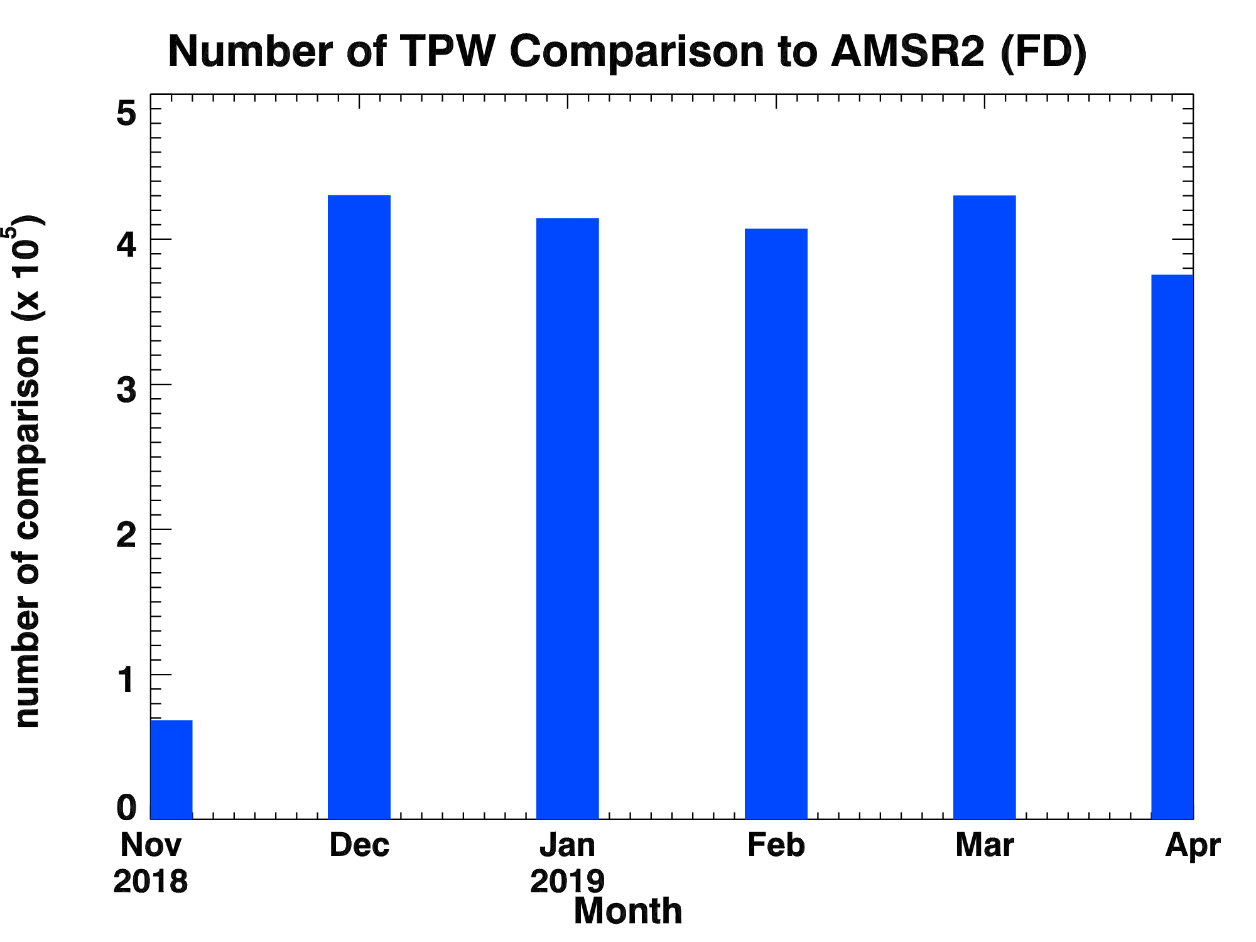
PLPT ABI-FD-TPW:
2018.11-2019.04
Accuracy spec: 1 mm
Precision spec: 3 mm
GPS
RAOB
AMSR2
PASSED
Use data b/w 18Z~09Z
Use 00Z data
19
Use data b/w 18Z~09Z

Slide 20
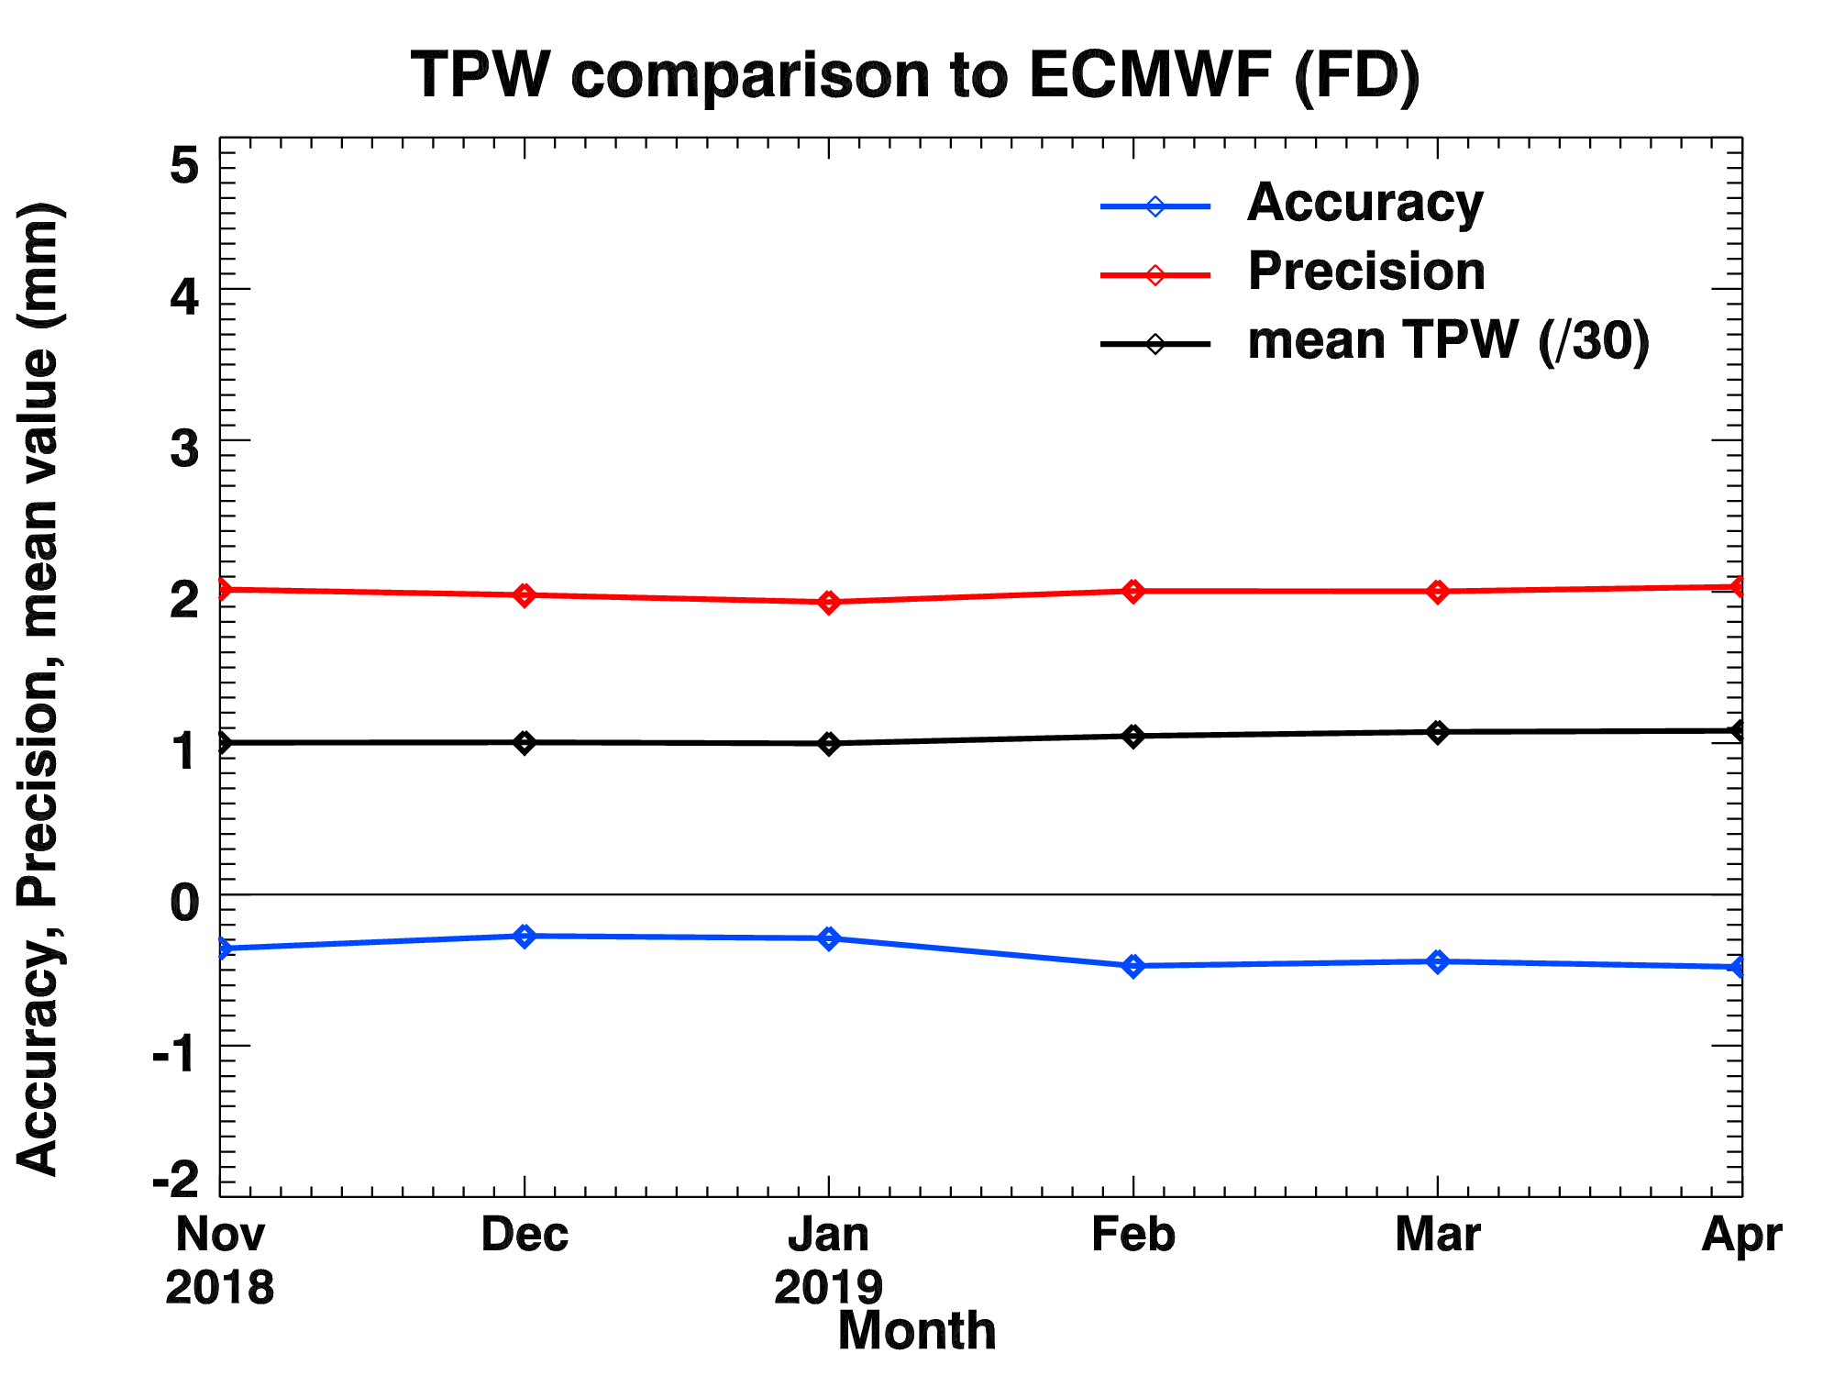
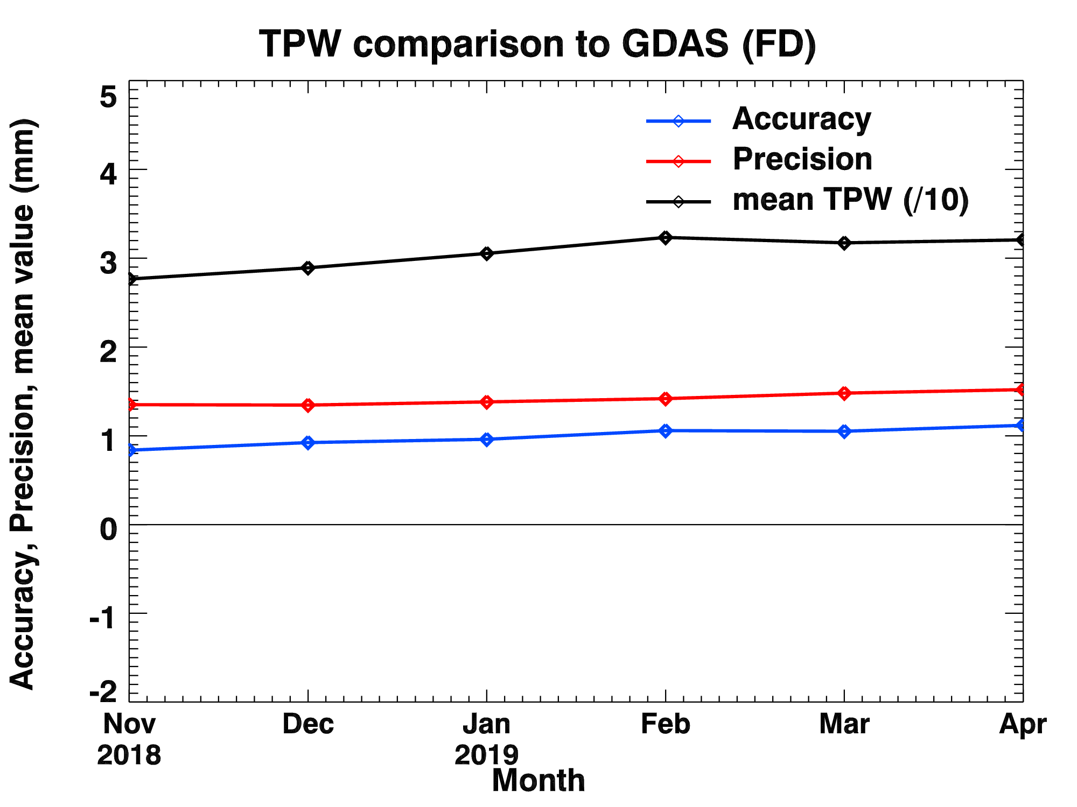
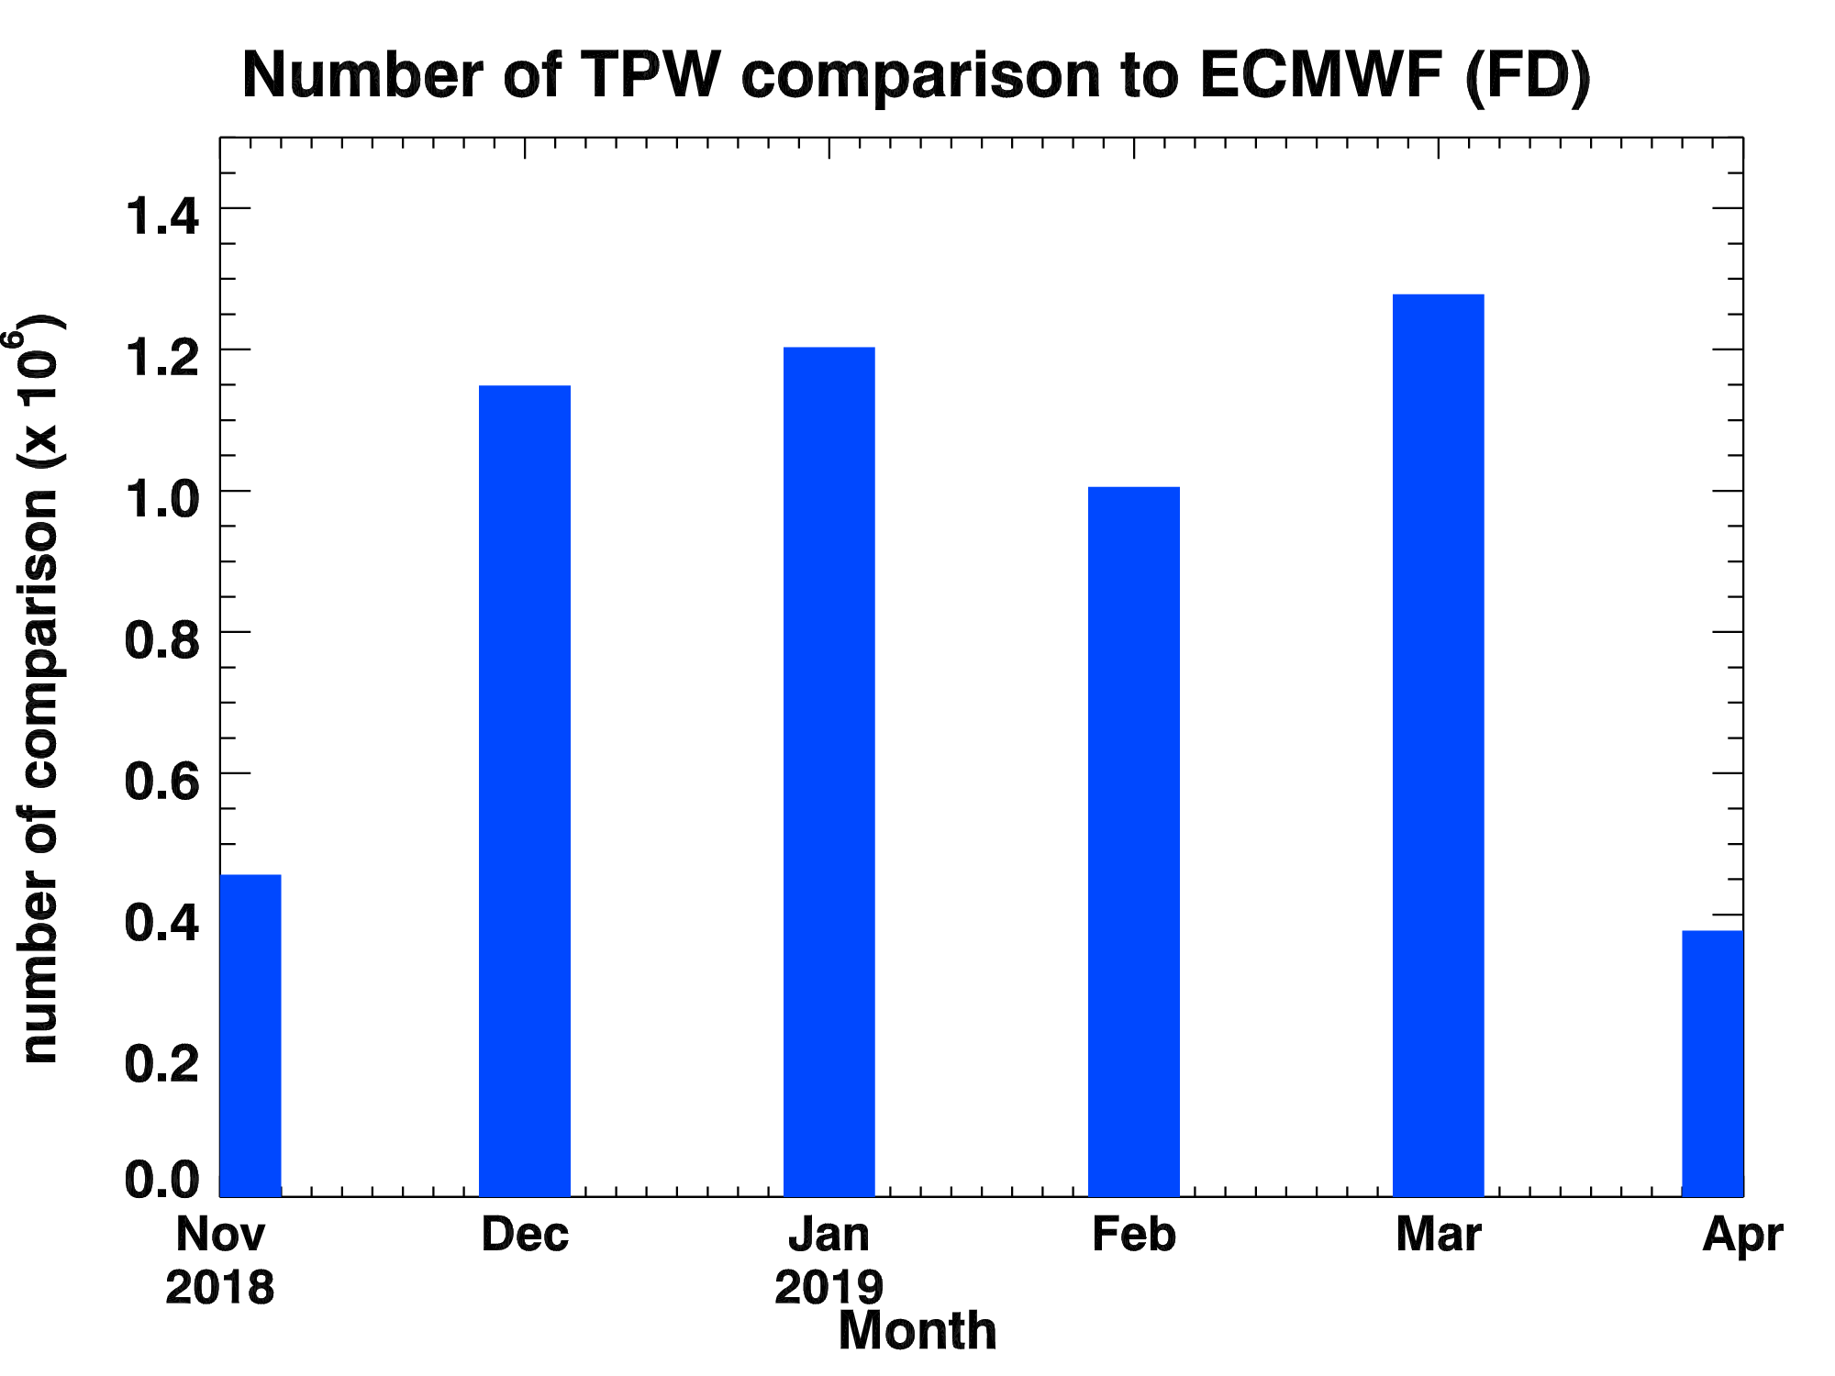
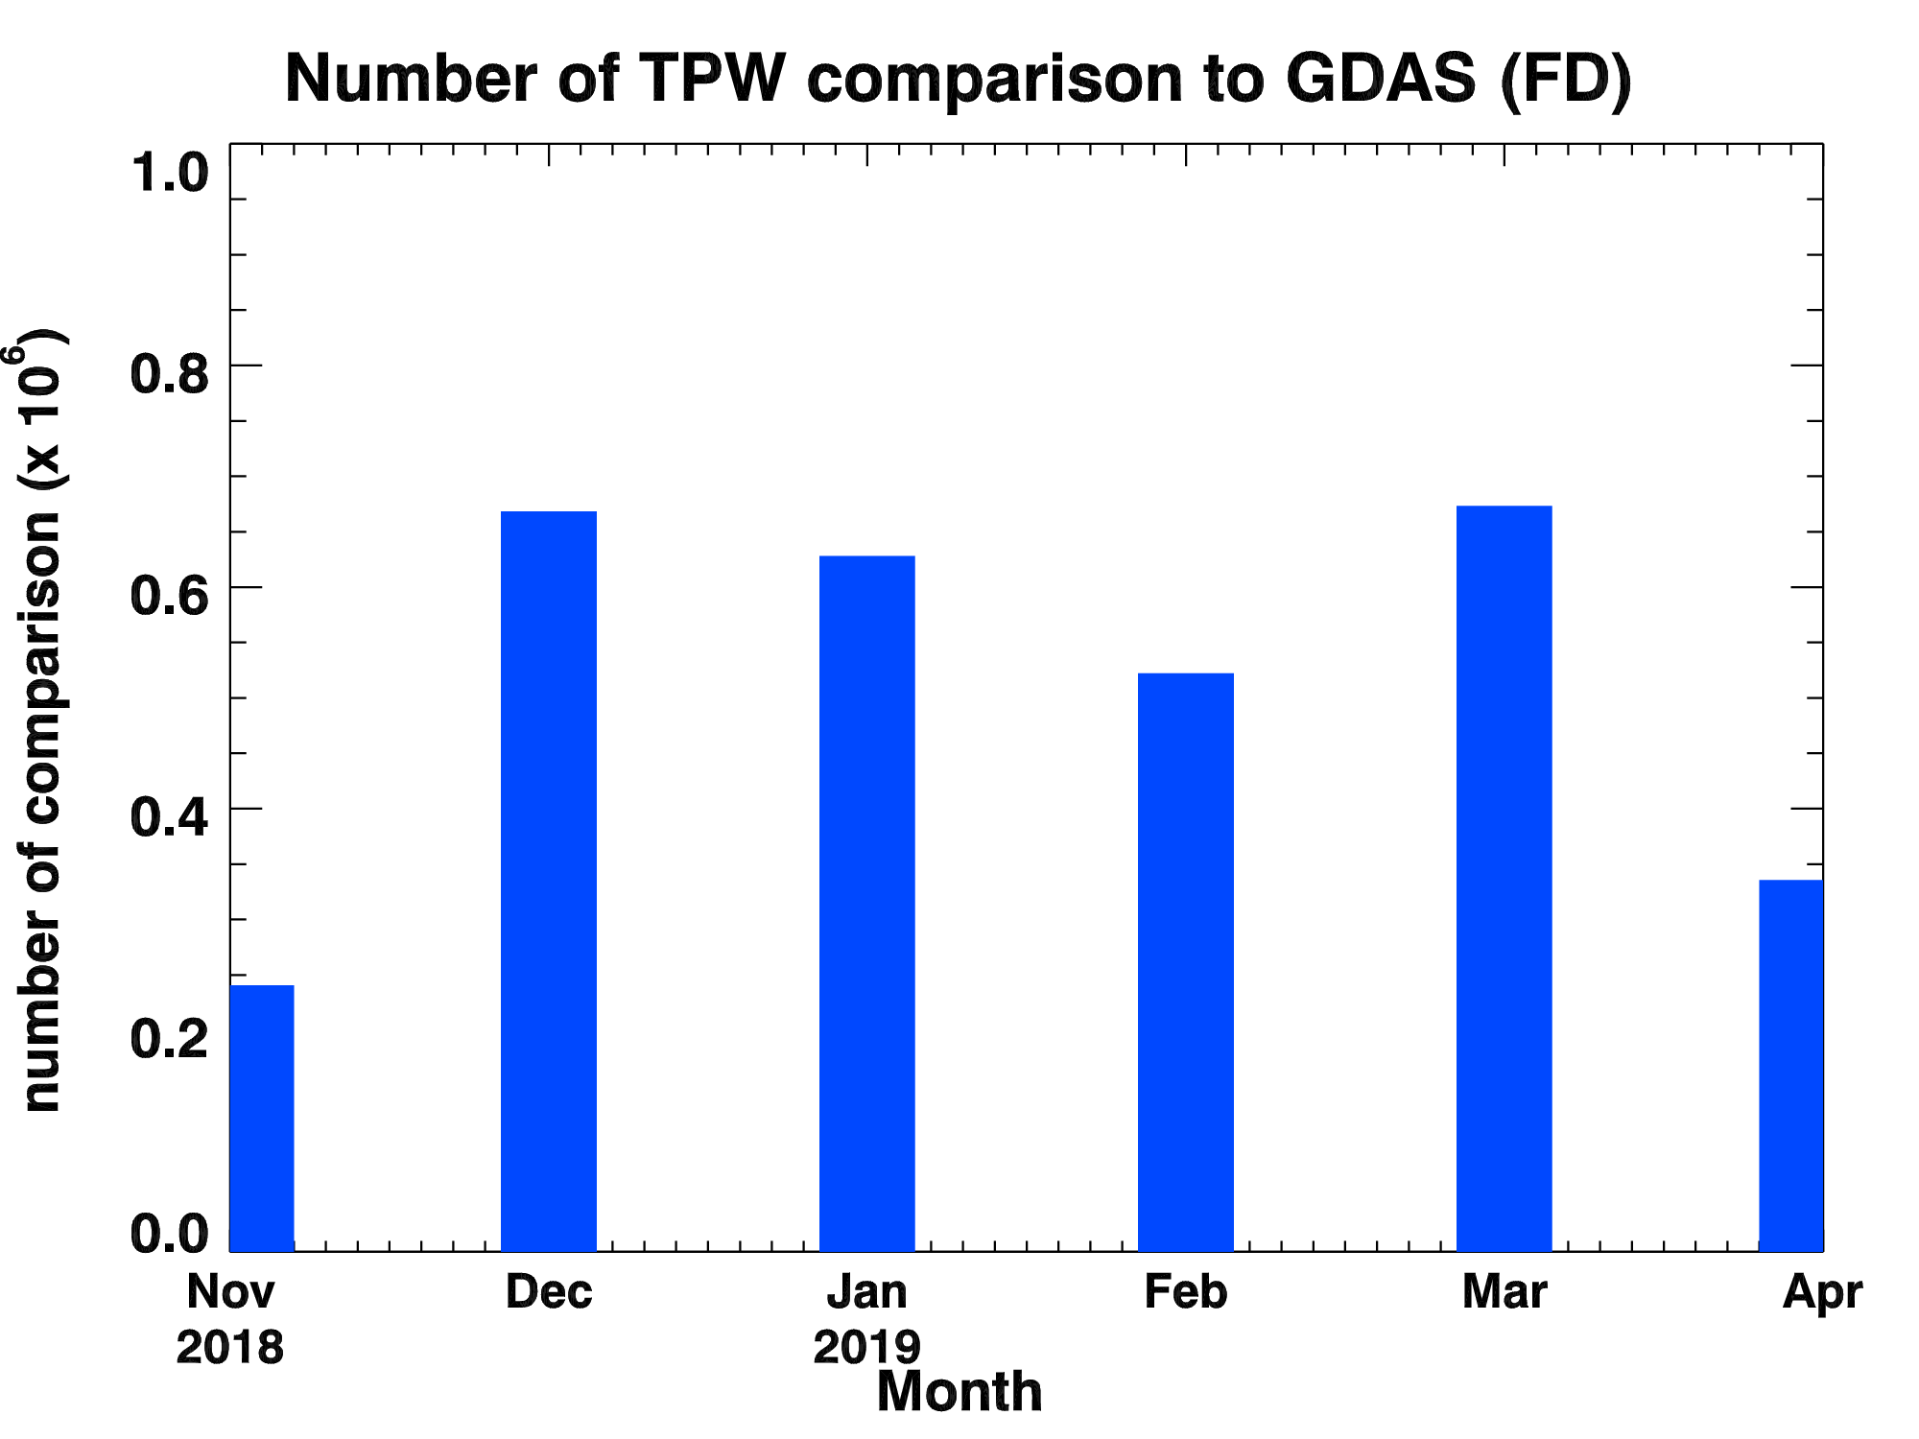
PLPT ABI-FD-TPW:
2018.11-2019.04
Accuracy spec: 1 mm
Precision spec: 3 mm
ECMWF
GDAS
PASSED
20
Use 00/06/18Z data
Use 00/06/18Z data

Slide 21
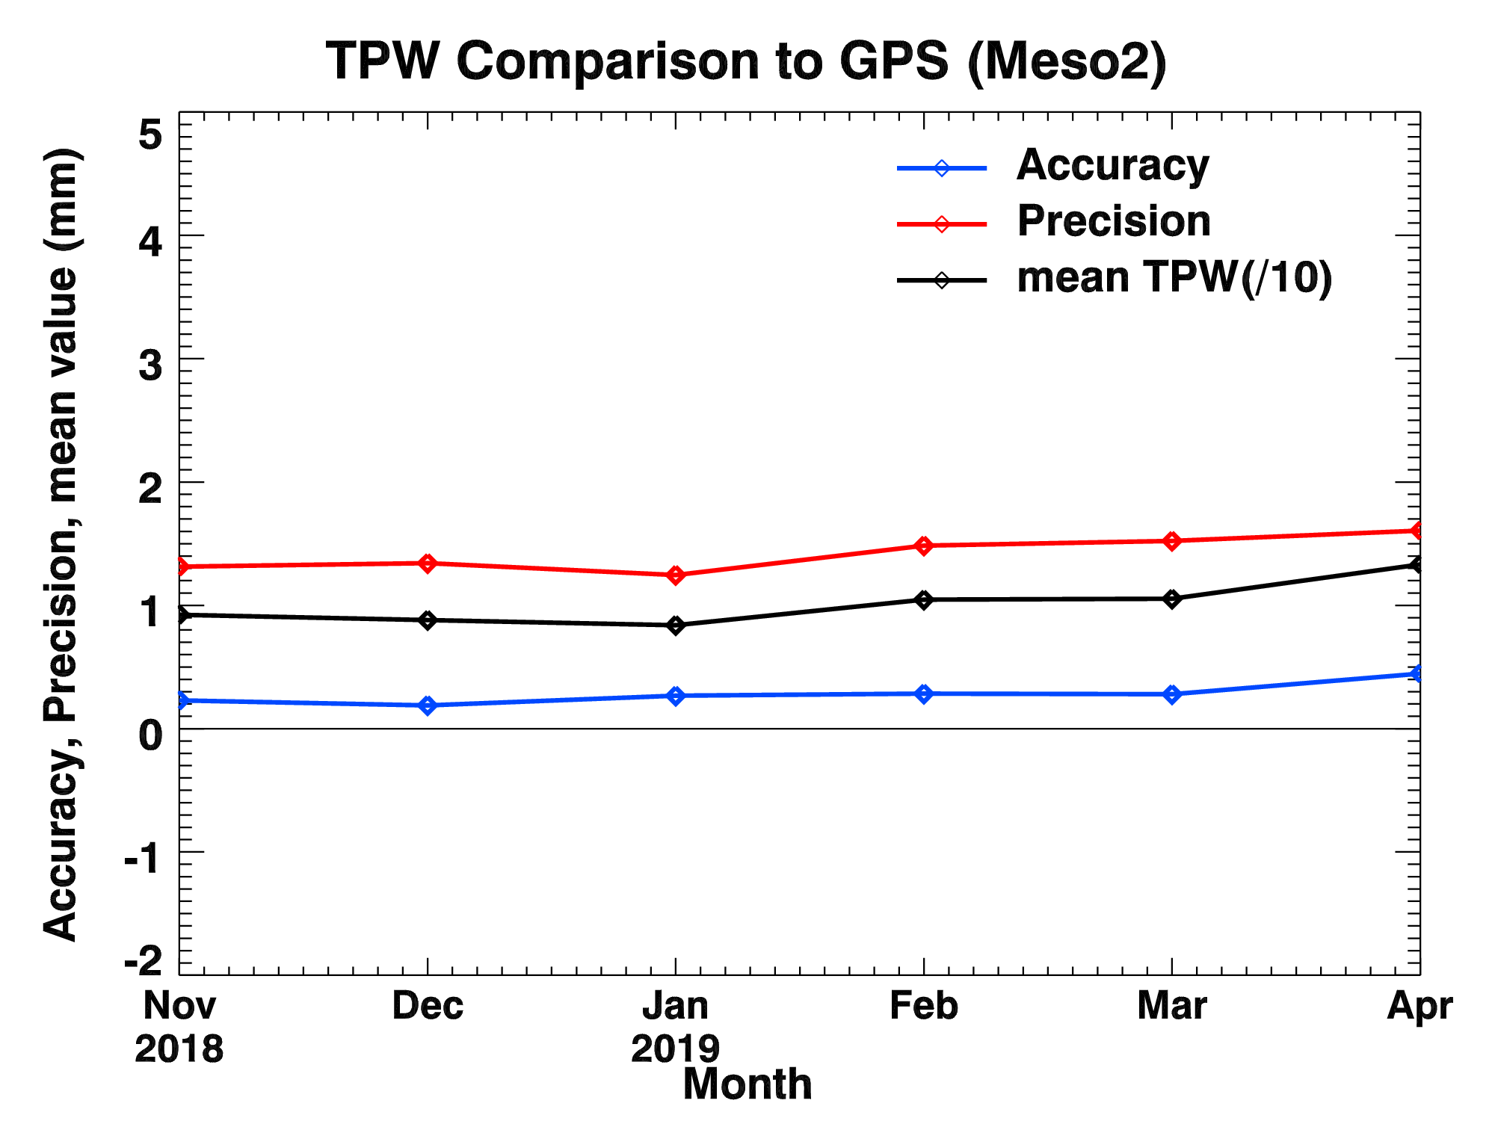
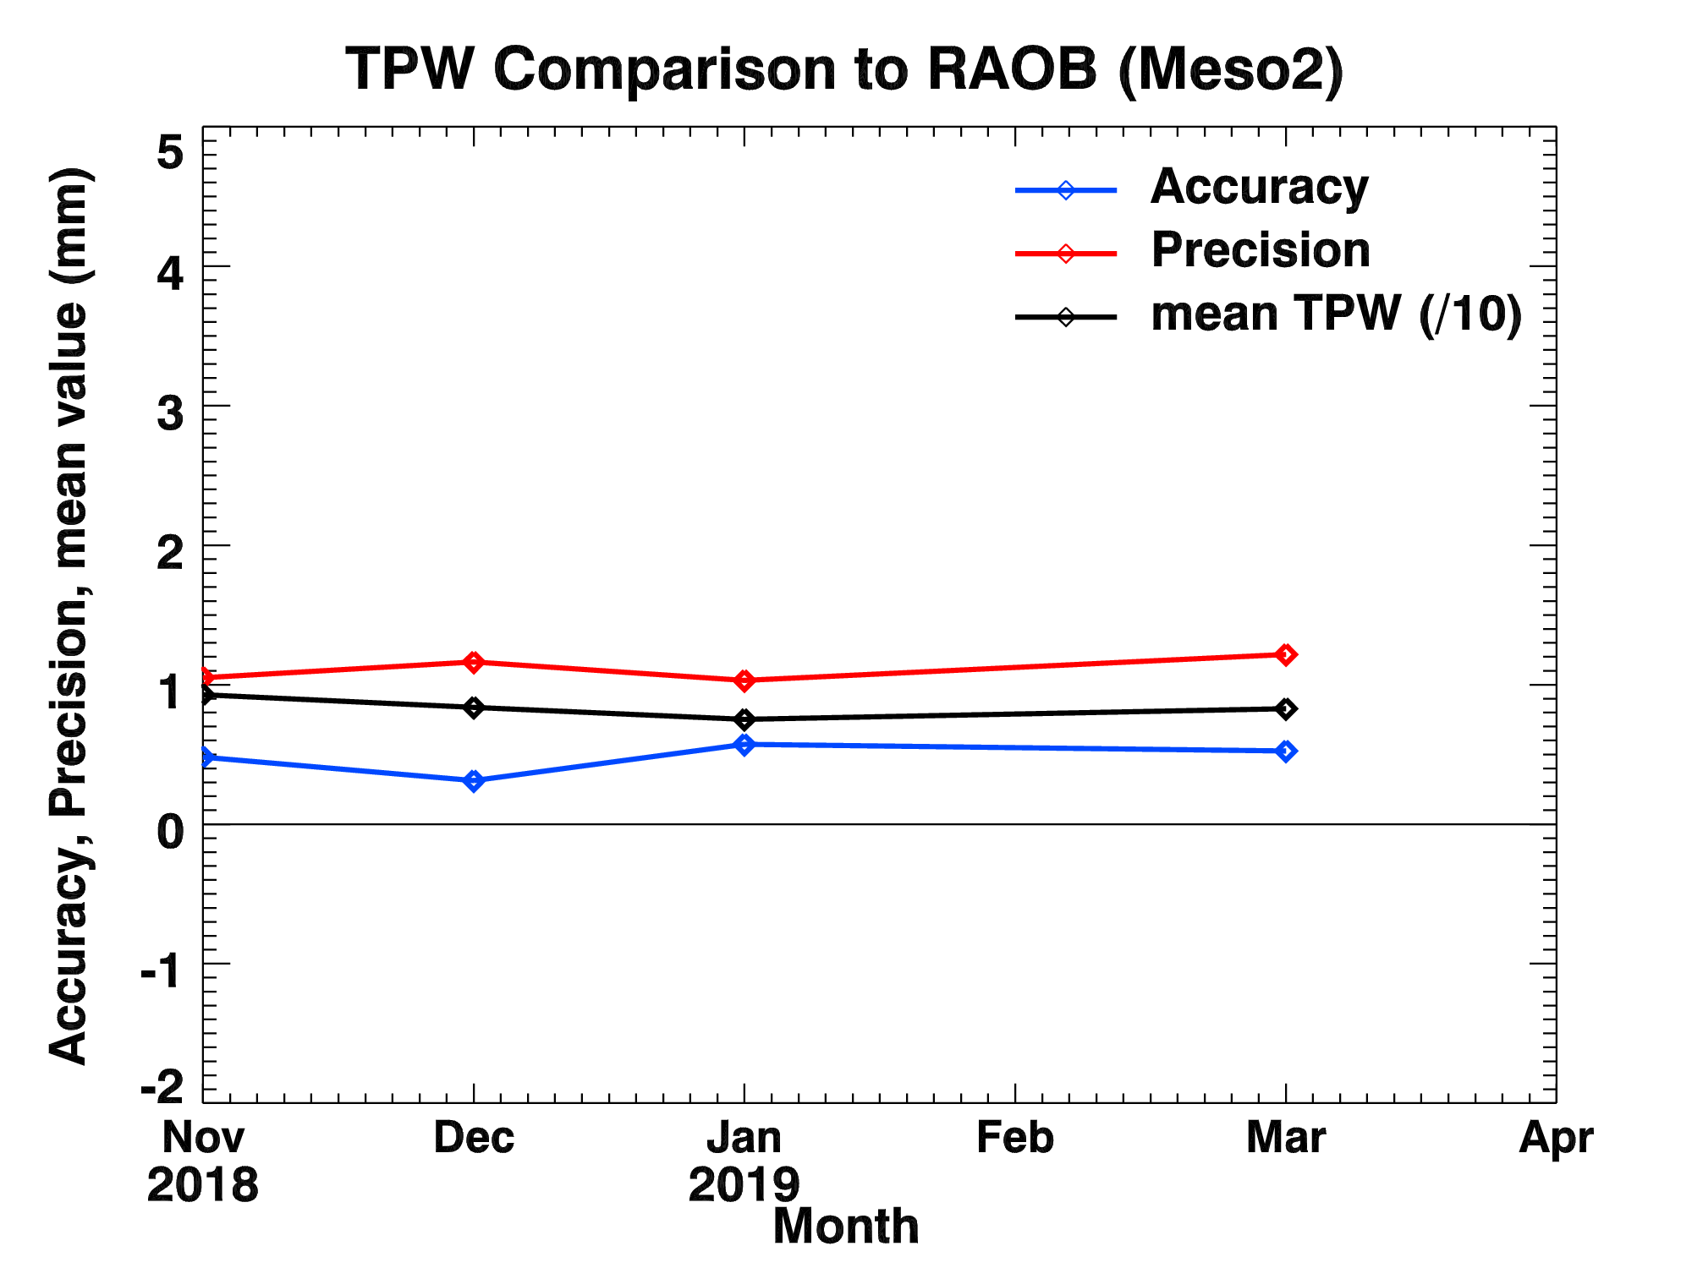
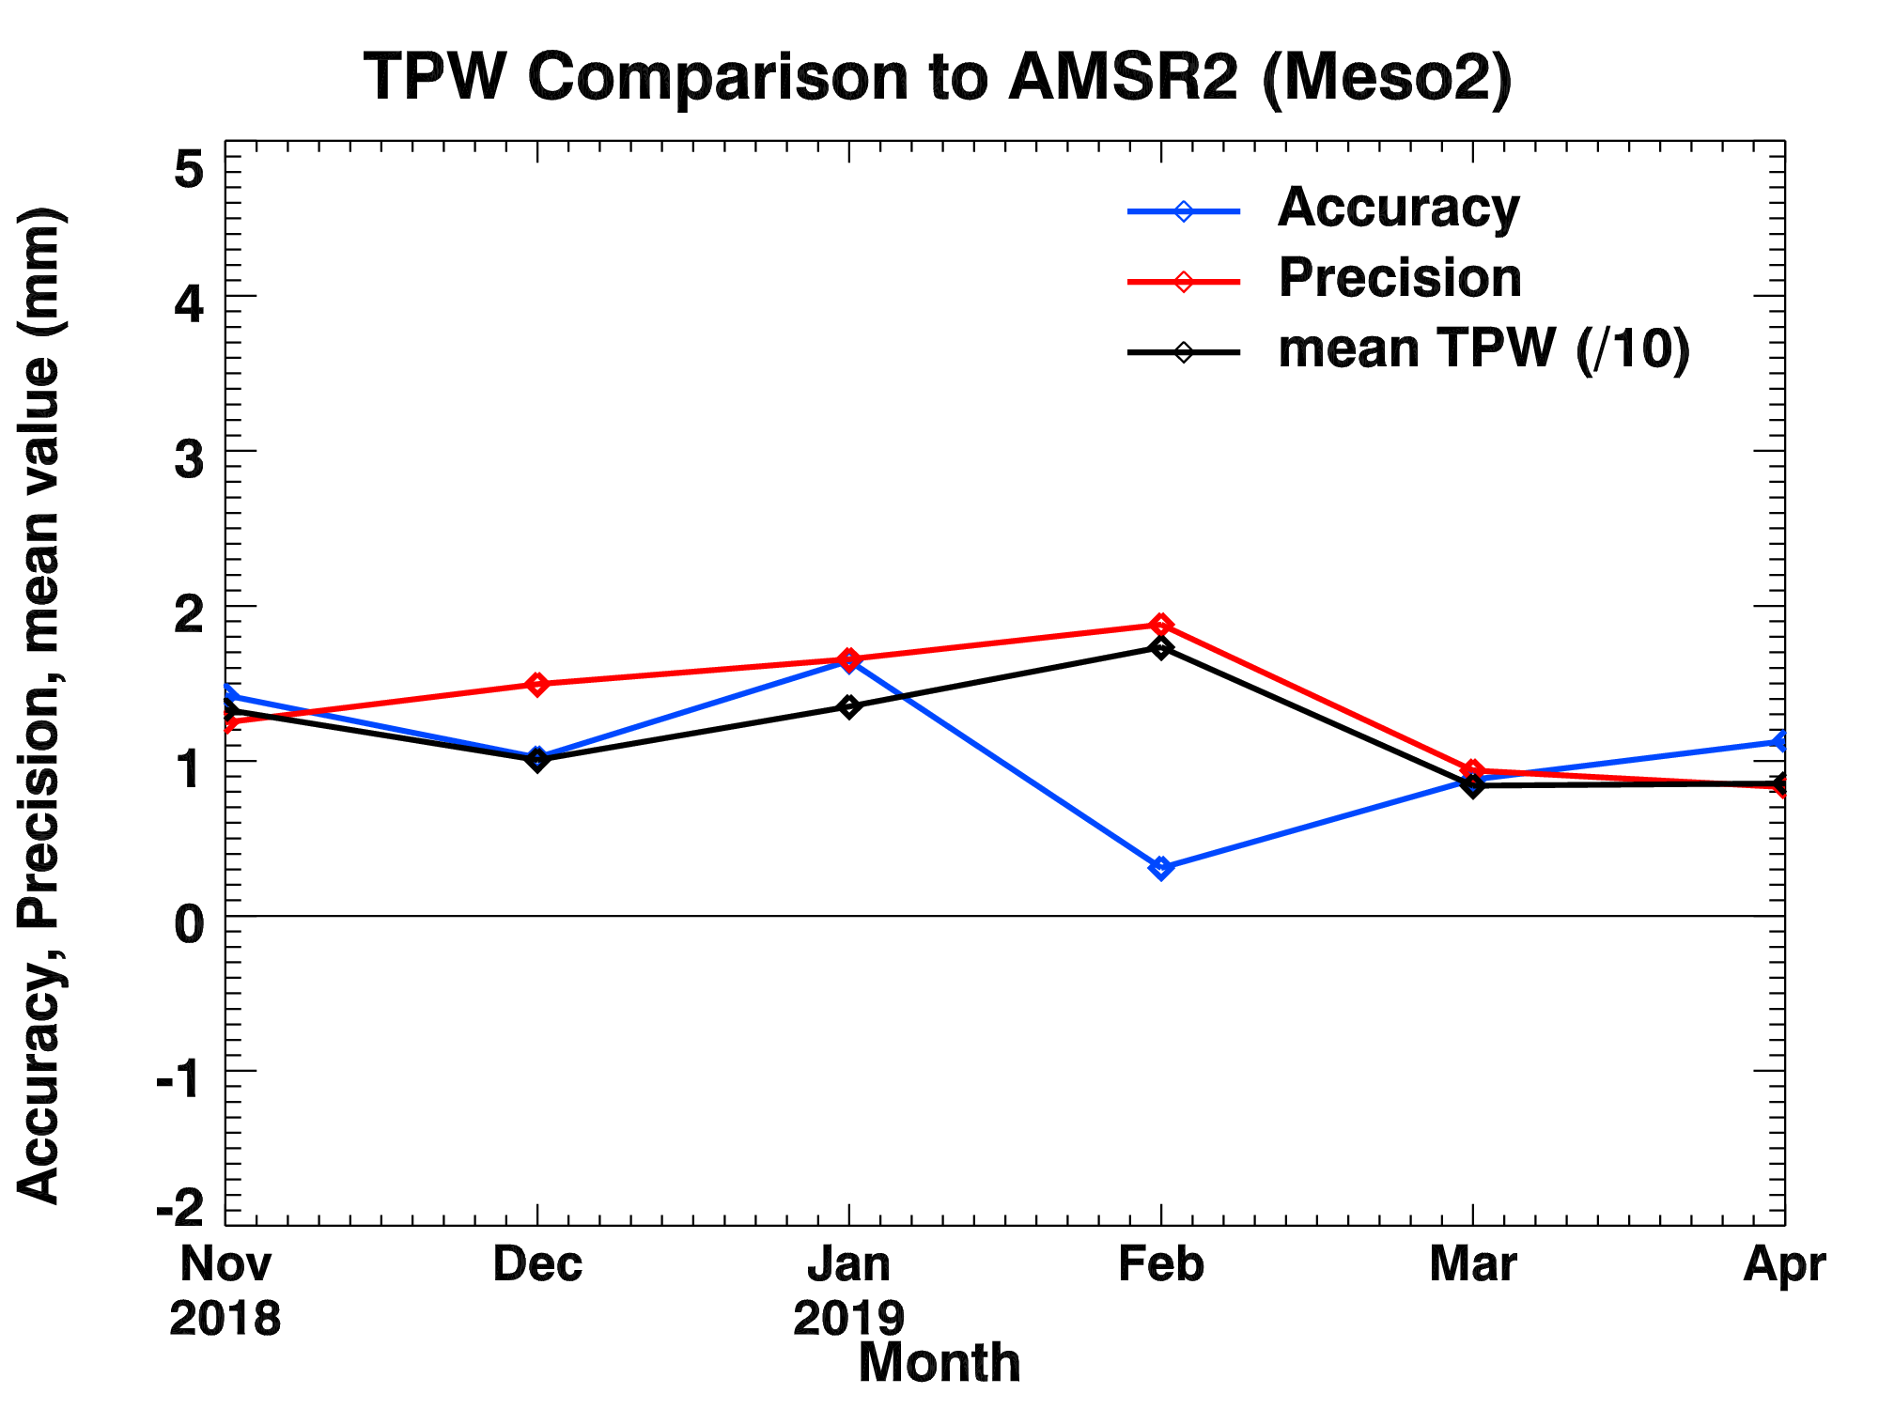
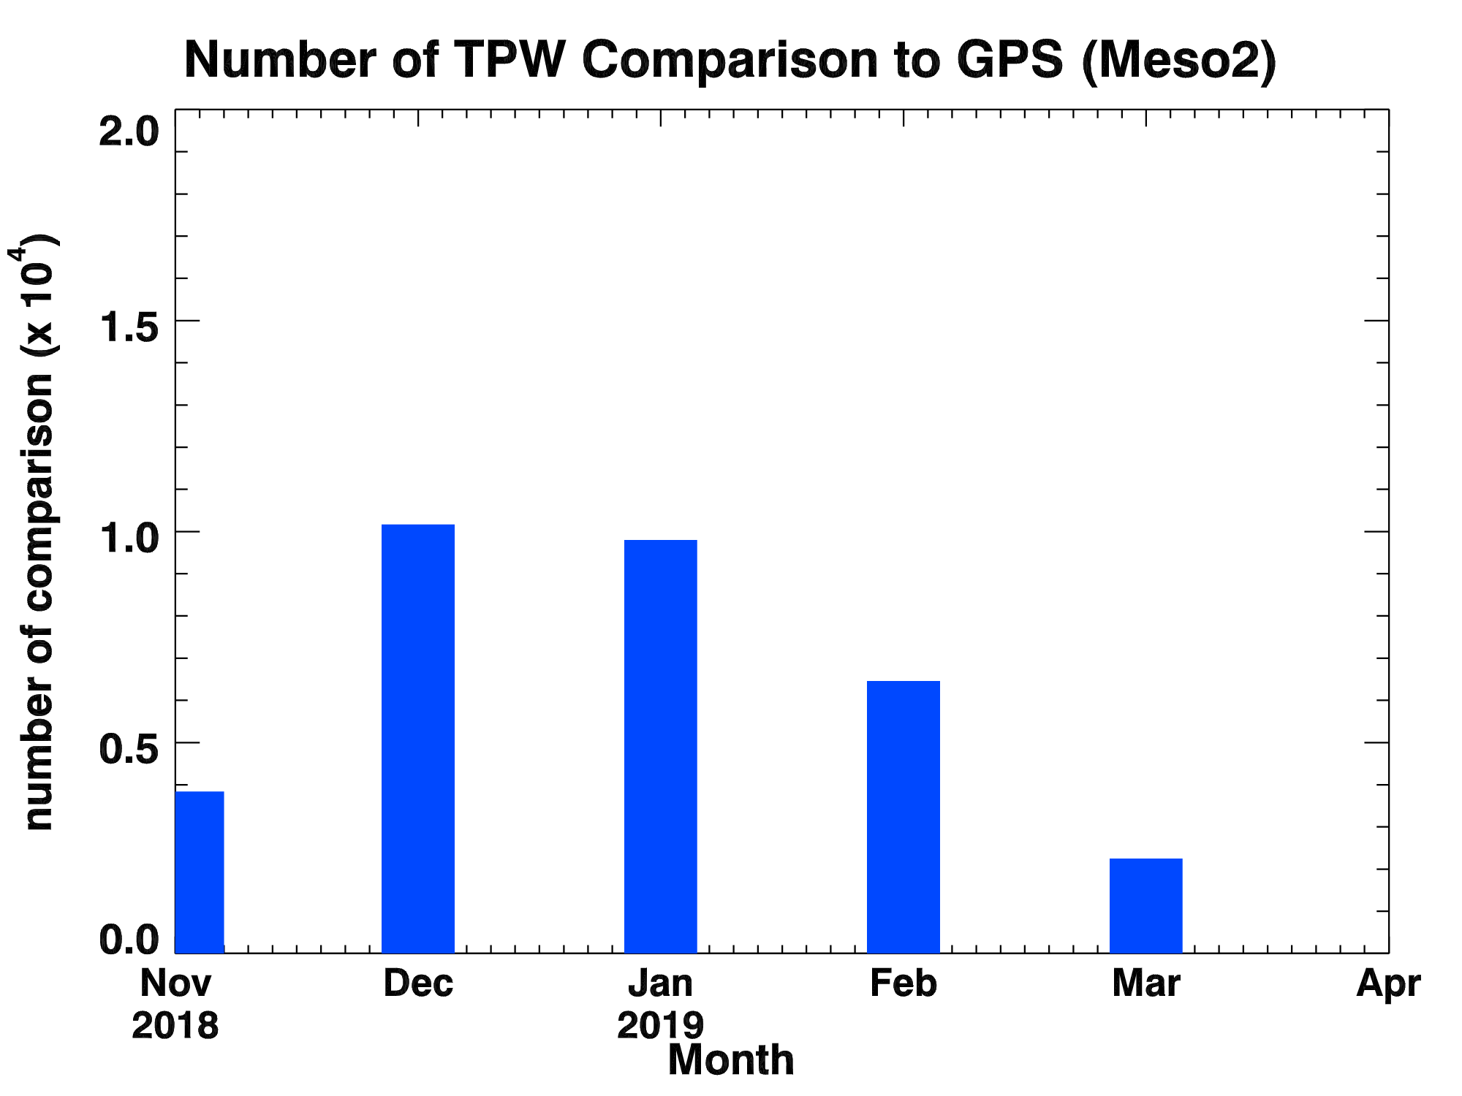
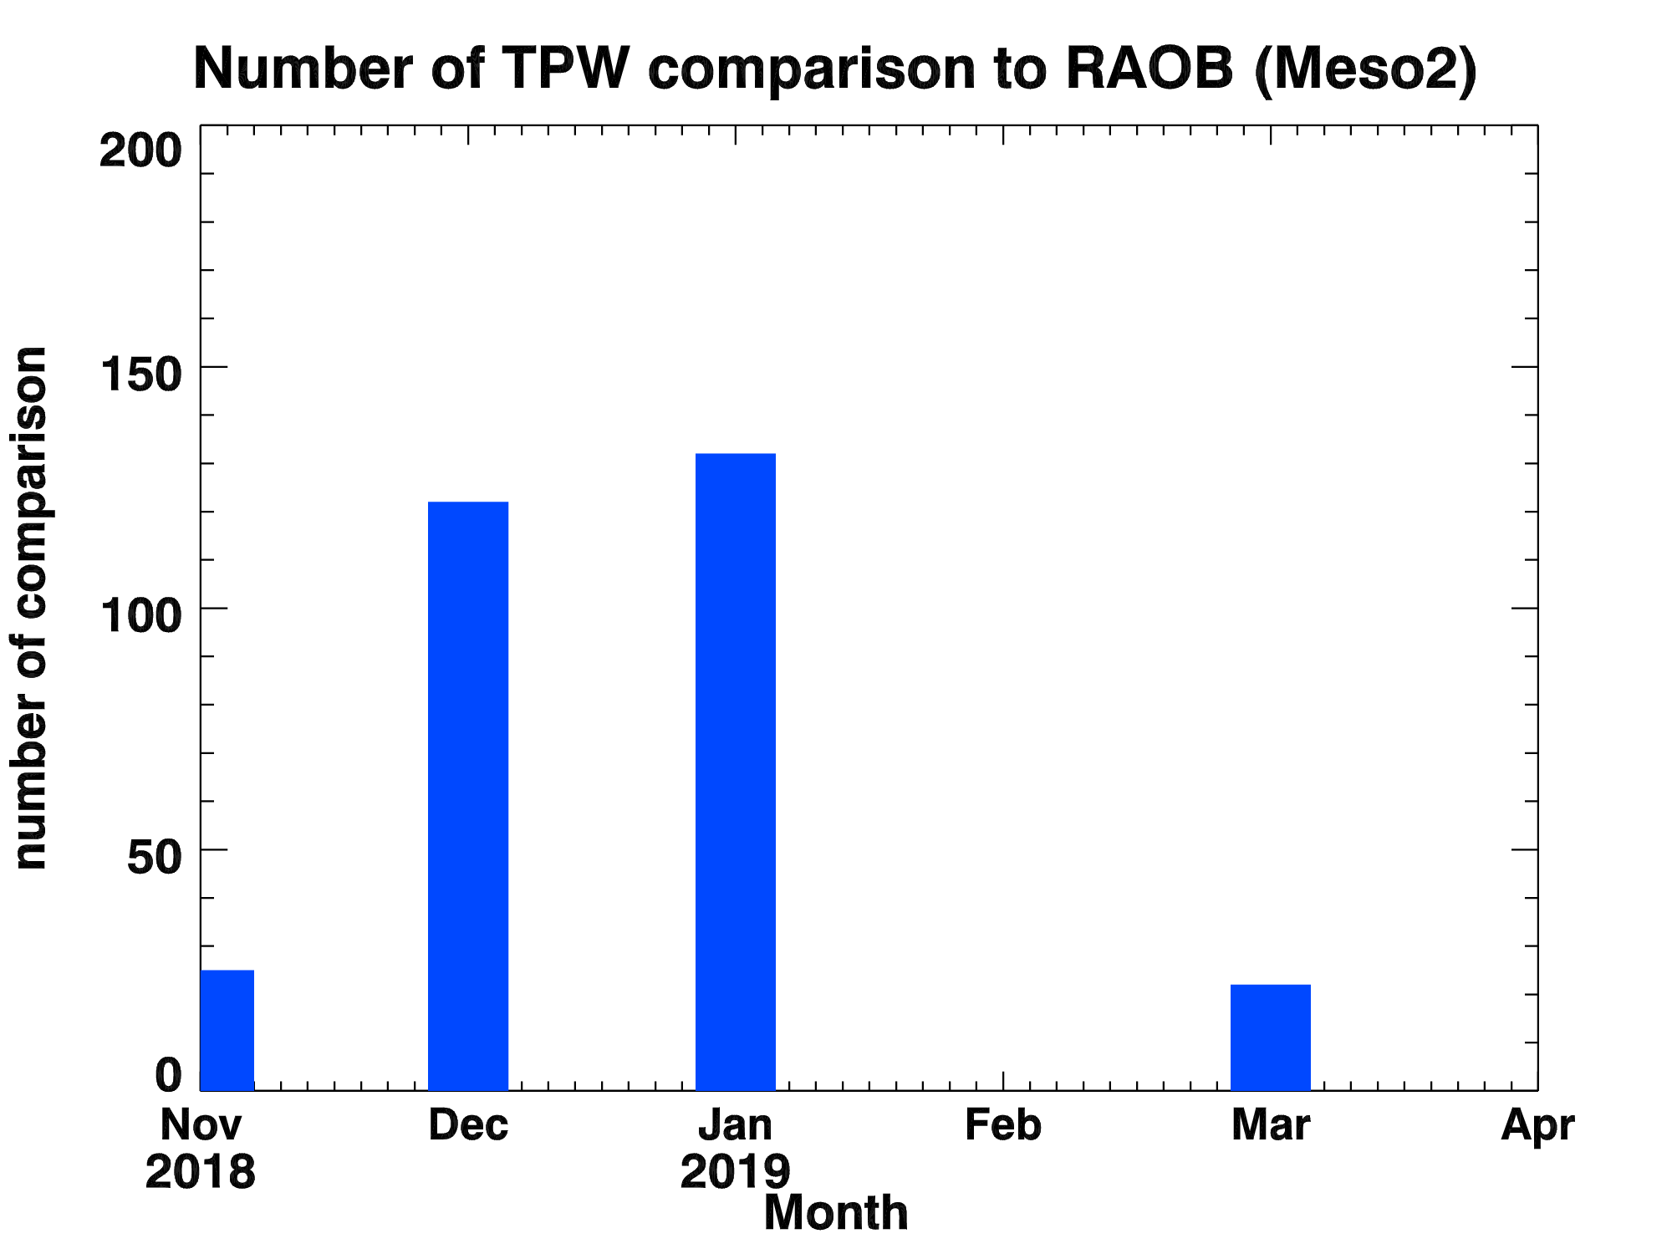
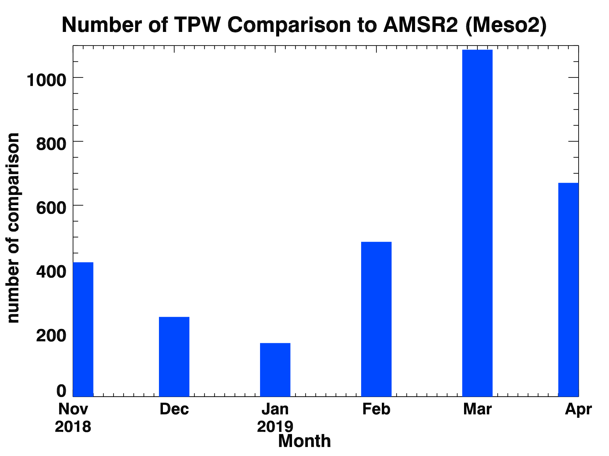
PLPT ABI-MESO2-TPW:
2018.11-2019.04
Accuracy spec: 1 mm
Precision spec: 3 mm
GPS
RAOB
AMSR2
21

Slide 22
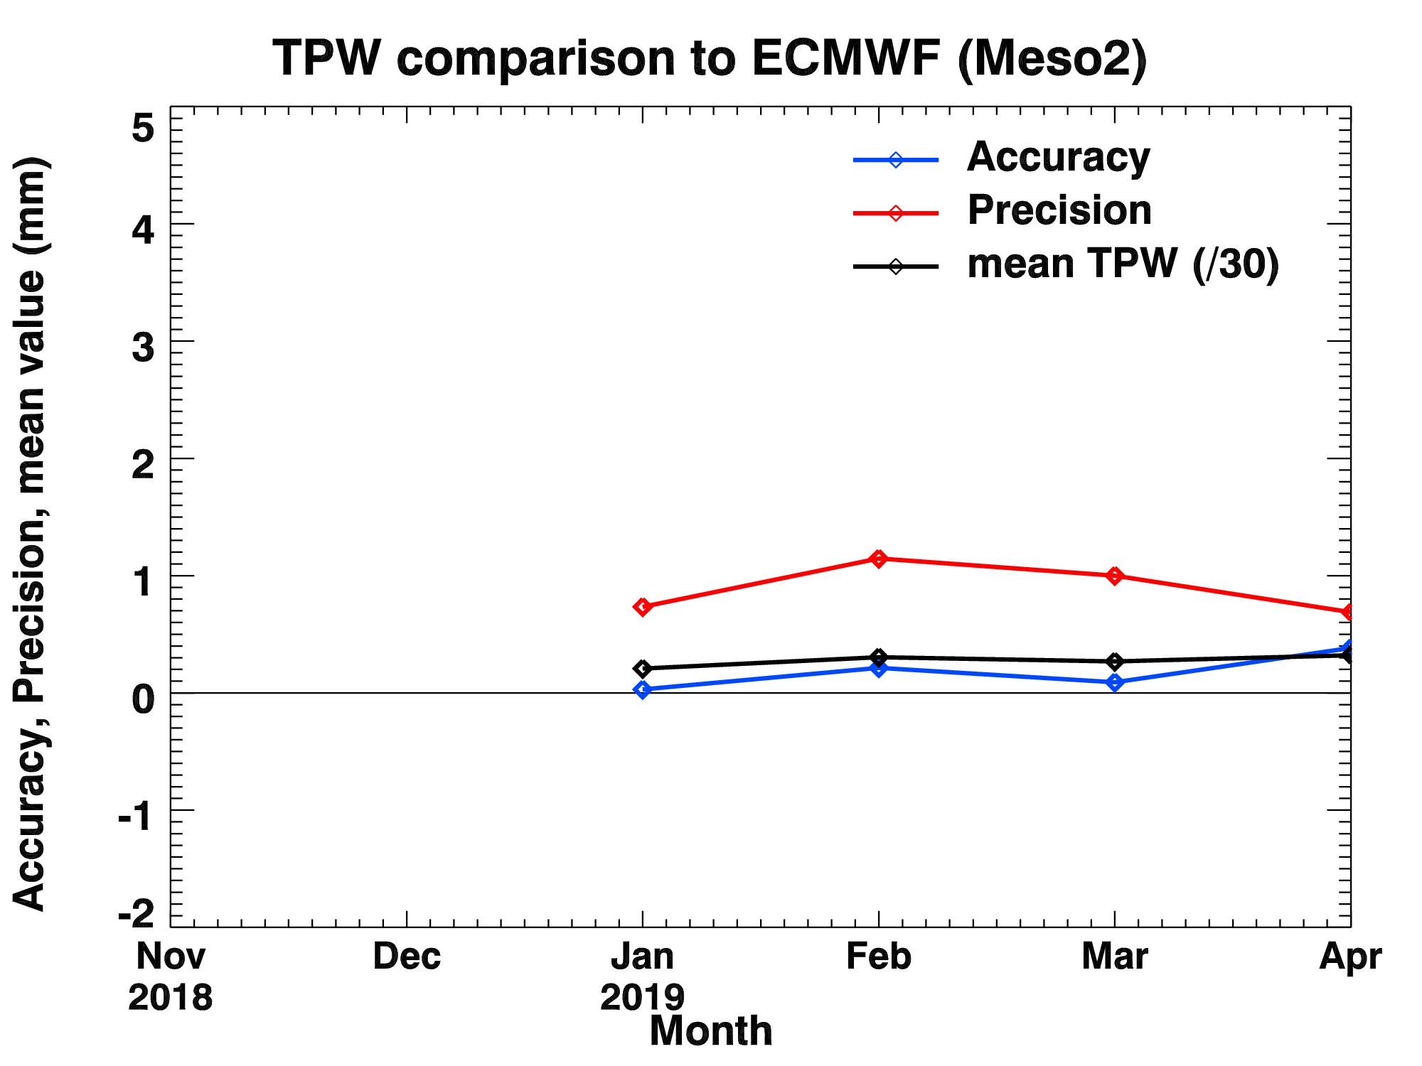
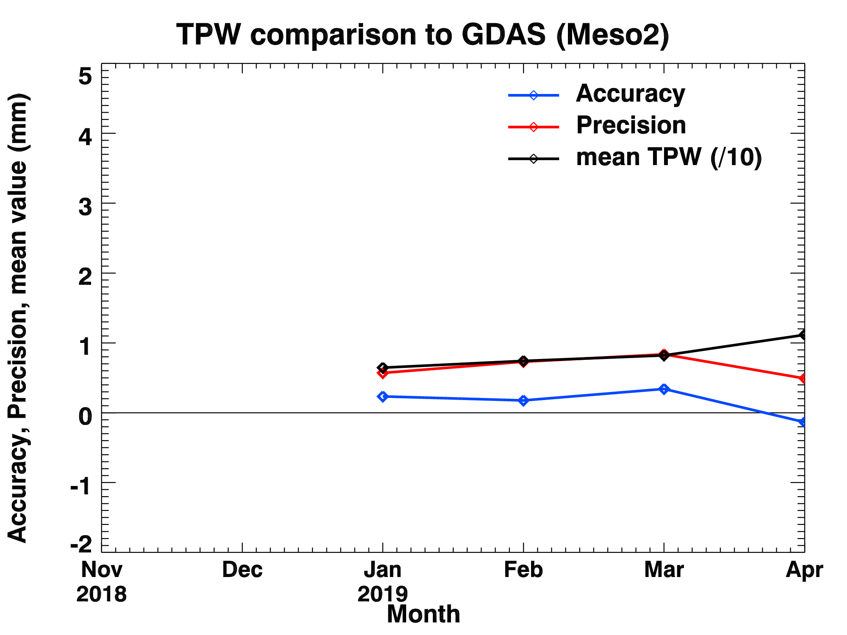
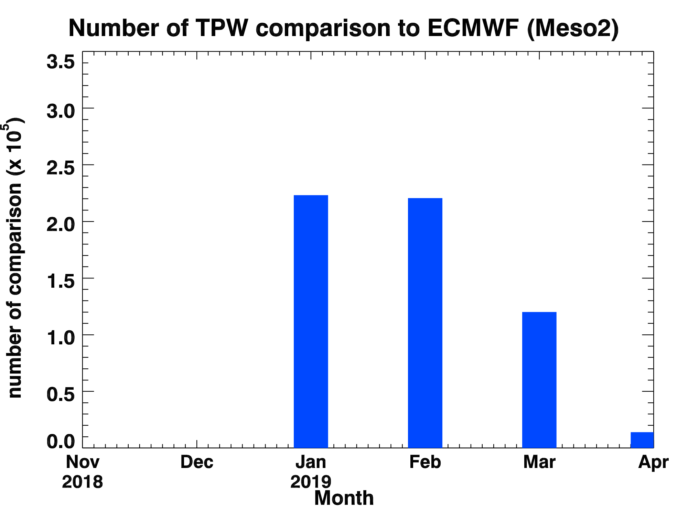
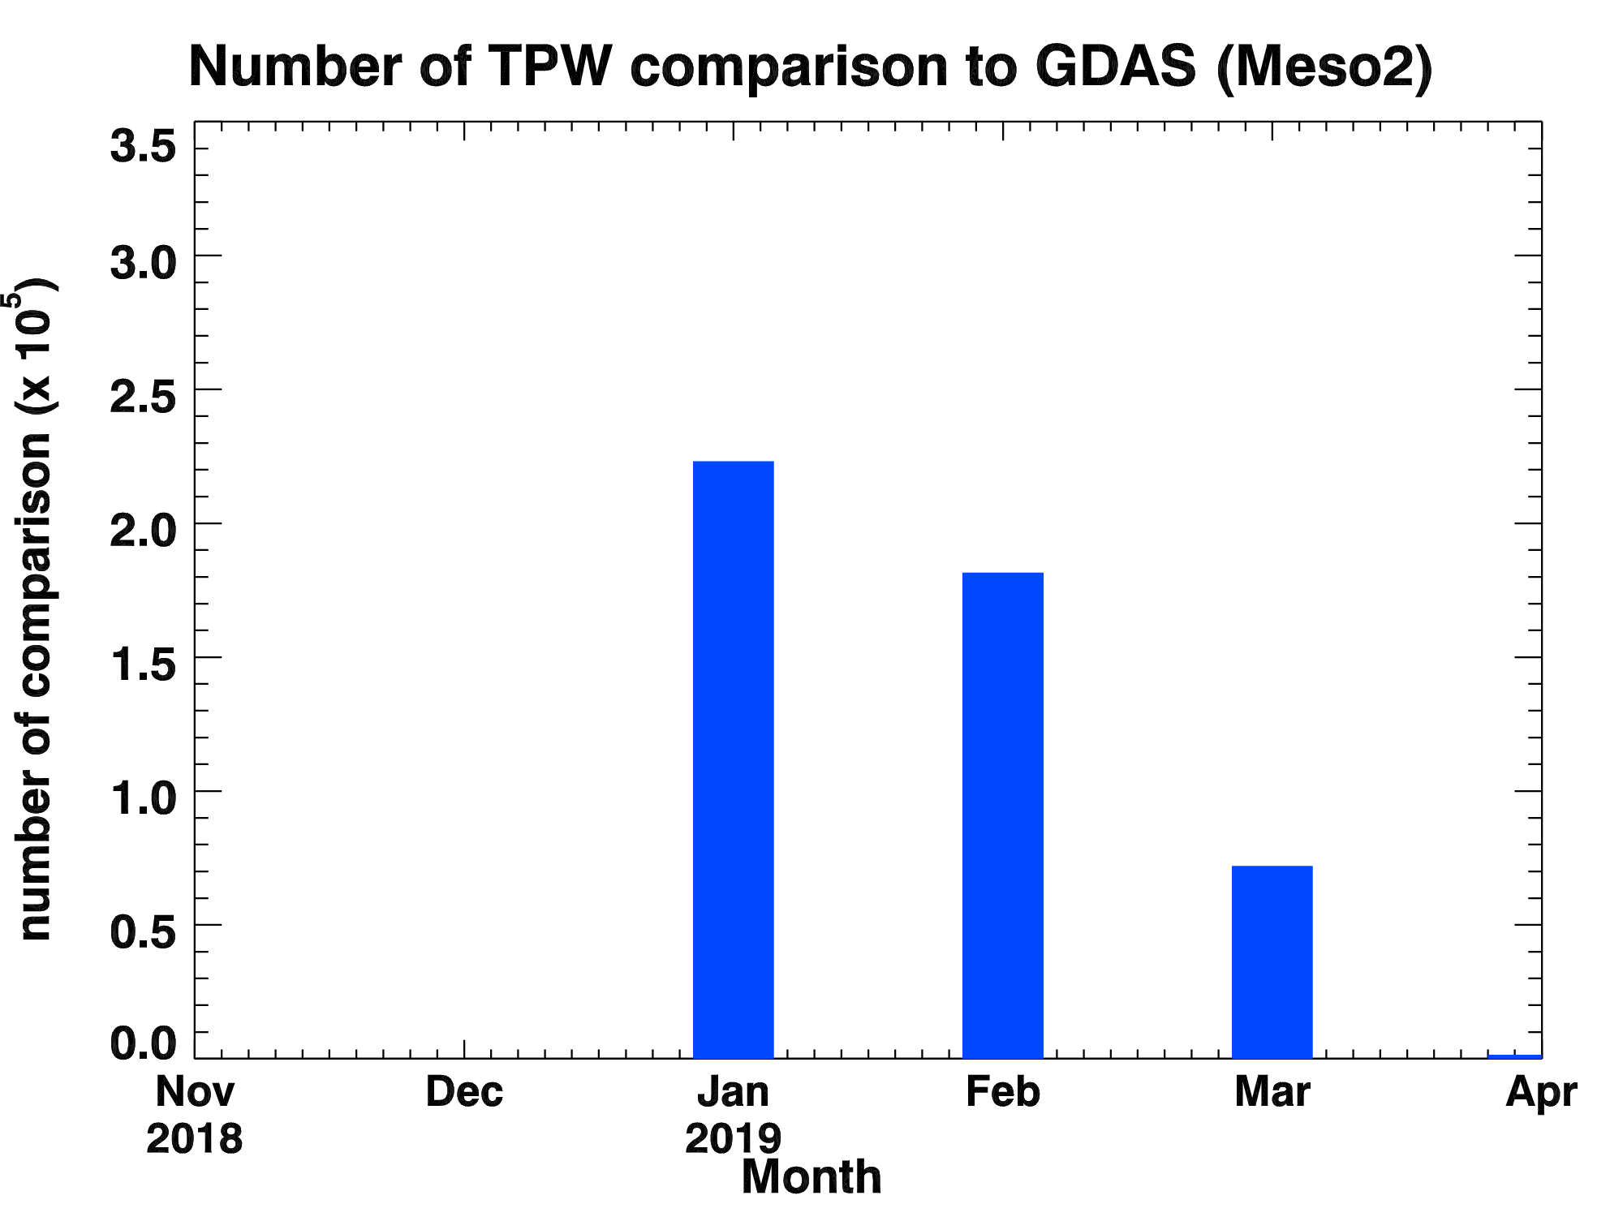
PLPT ABI-MESO2-TPW:
2018.11-2019.04
Accuracy spec: 1 mm
Precision spec: 3 mm
ECMWF
GDAS
22

Slide 23
TPW Performance Summary
TPW retrieval is working as expected on GOES-17 ABI data when combined with NWP short-rang forecasts (as first guess);
With a quantitative web-based tool (http://soundingval.ssec.wisc.edu) and the comparisons with RAOB, AMSR2, GPS, ECMWF and GDAS, it does indicate performances meet spec. for all the coverages (FD, CONUS, Meso1, and Meso2), except several Meso1 and Meso2 cases which do not have enough number of samples or where mean TPW is comparatively large.
23

Slide 24
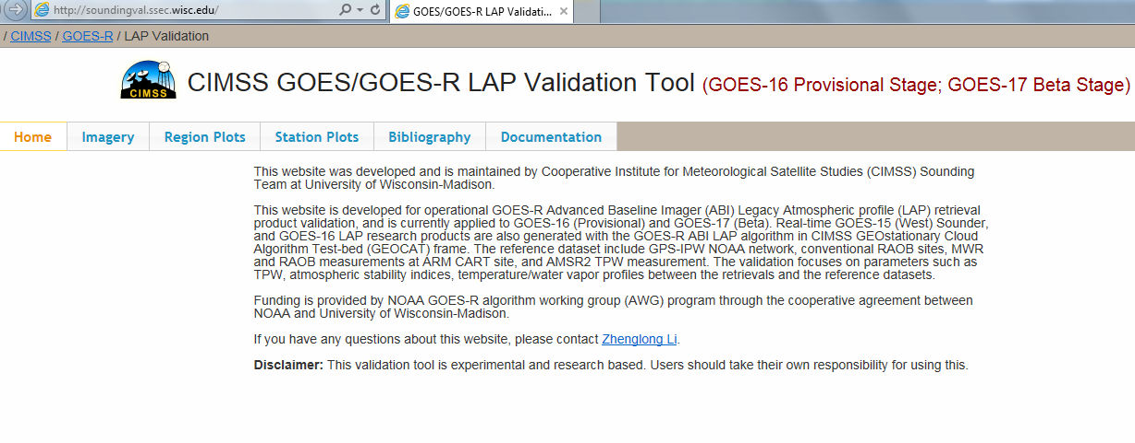
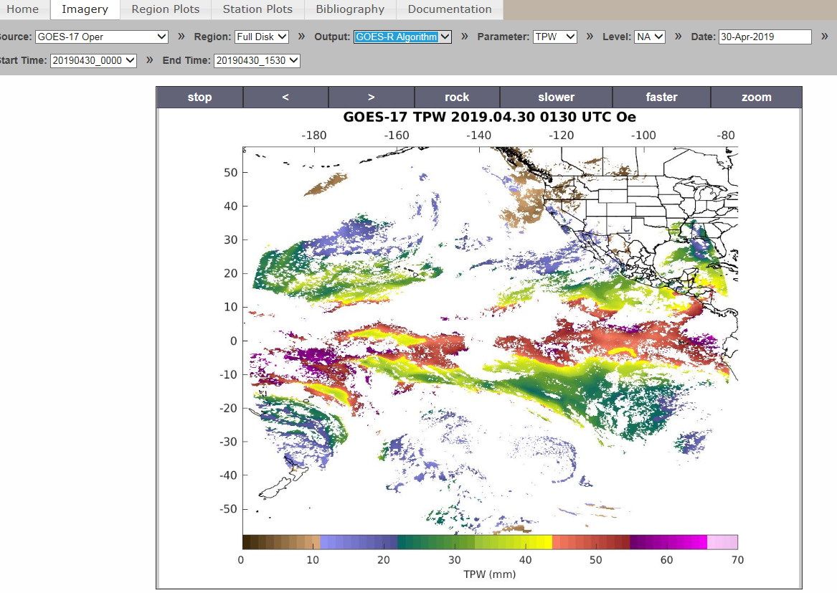
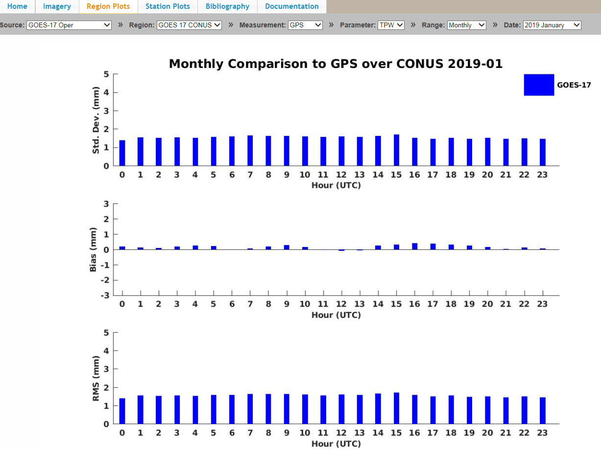
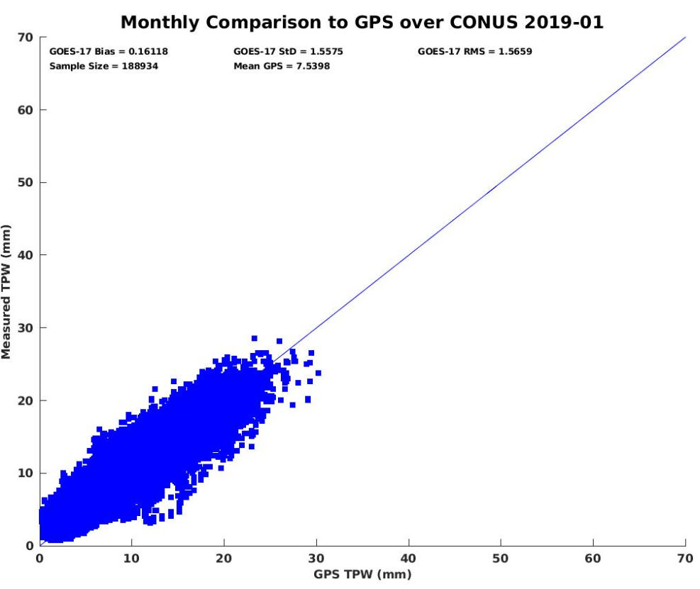
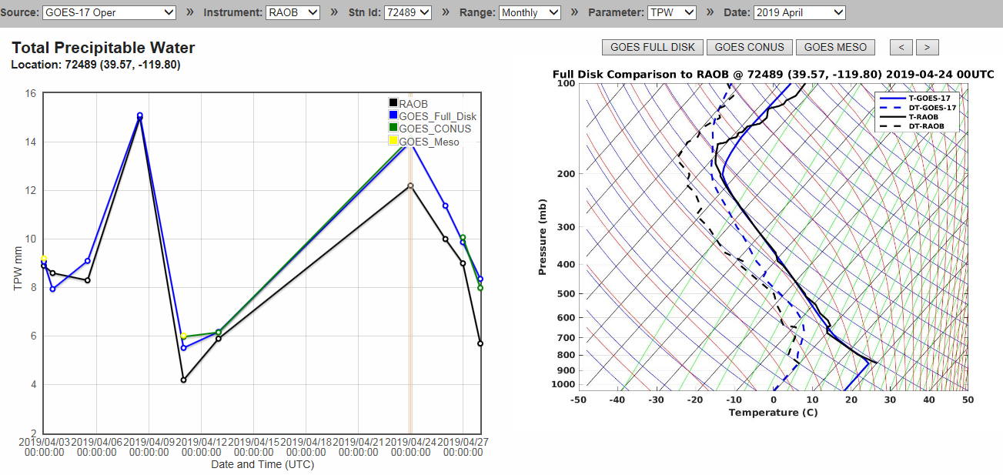
Real-time GOES-17 ABI LAP product validation webpage soundingval.ssec.wisc.edu
Imagery (Fulldisk TPW)
Station TPW Plots
Regional Plots with GPS

Slide 25
Comparison LVT & LVM with the RAOB, ECMWF, and GDAS
25

Slide 26
Requirements for ABI LAP products: LVT, LVM
Product |  | Accuracy | Precision | Range
Temperature (LVT) |  | 1 K below 400 hPa and above boundary layer | 2 K below 400 hPa and above boundary layer | 180 - 320 K
Moisture (LVM) |  | Sfc - 300 hPa: 18% 300 - 100 hPa: 20% | Sfc - 300 hPa: 18% 300 - 100 hPa: 20% | 0 - 100%
TPW |  | 1 mm | 3 mm | 0 - 100 mm
DSI | LI | 2.0 K | 6.5 K | -10 ~ 40 K or above
 | CAPE | 1000 J/kg | 2500 J/kg | 0 - 5000 J/kg
 | SI | 2.0 K | 6.5 K | -10 ~ 4 K or above
 | TT | 1 K | 4 K | -43 ~ 56 K
 | KI | 2 K | 5 K | 0 - 40 K
26

Slide 27
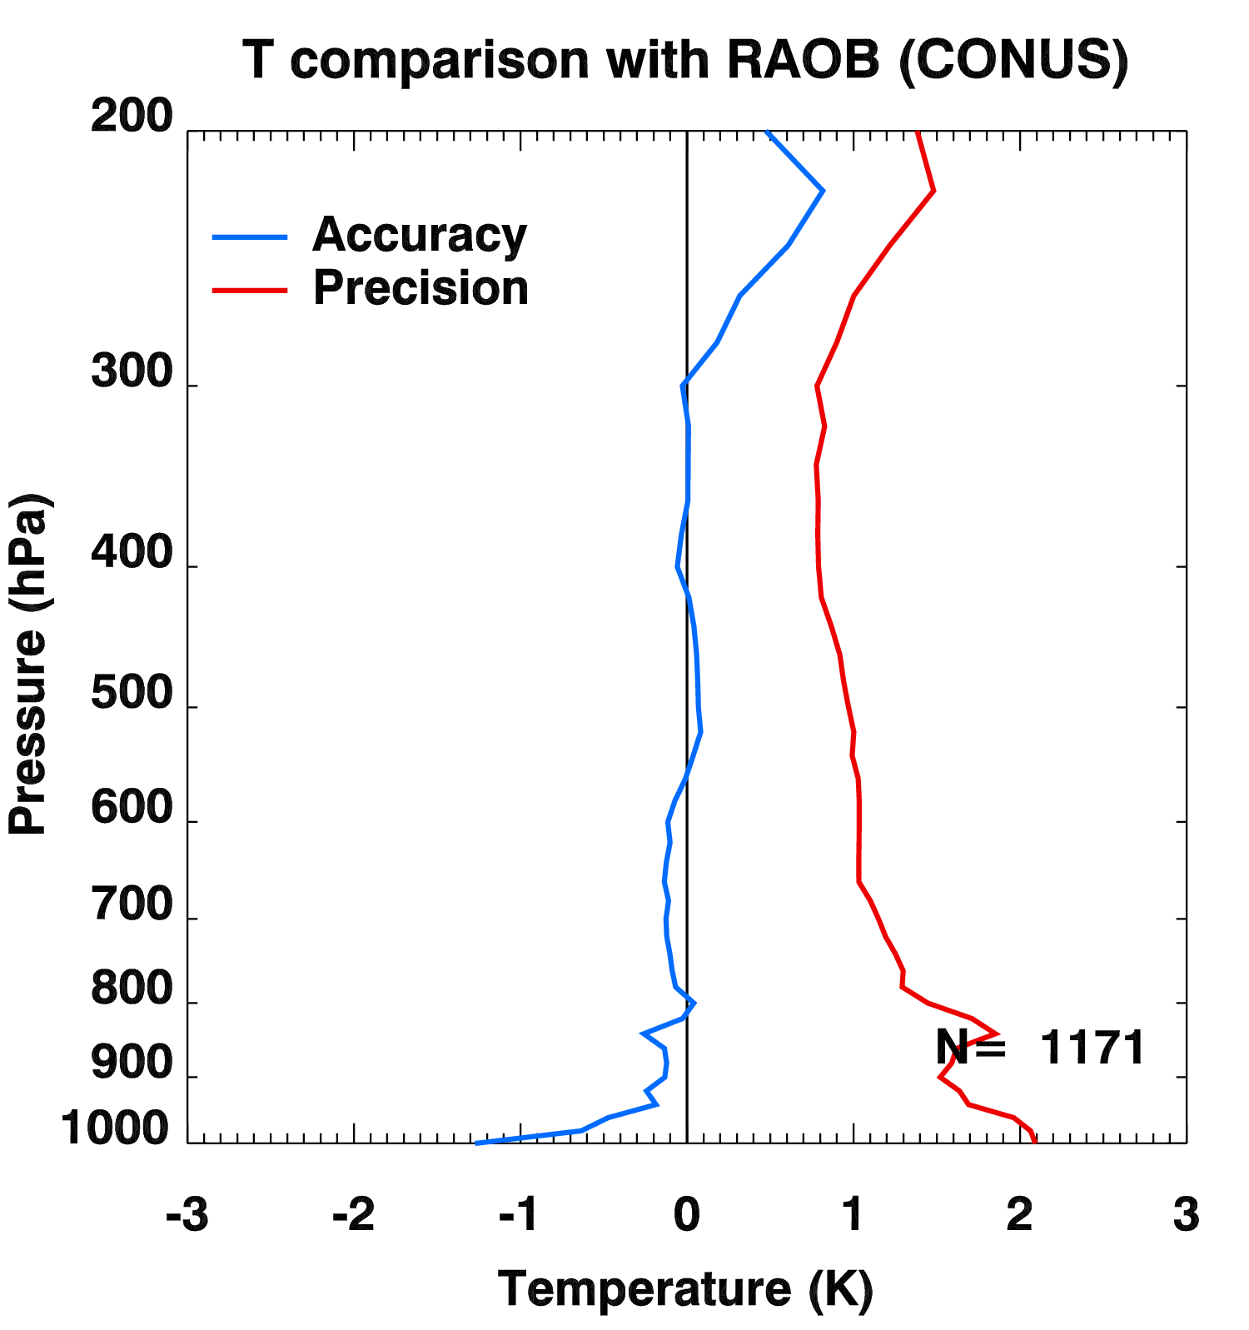
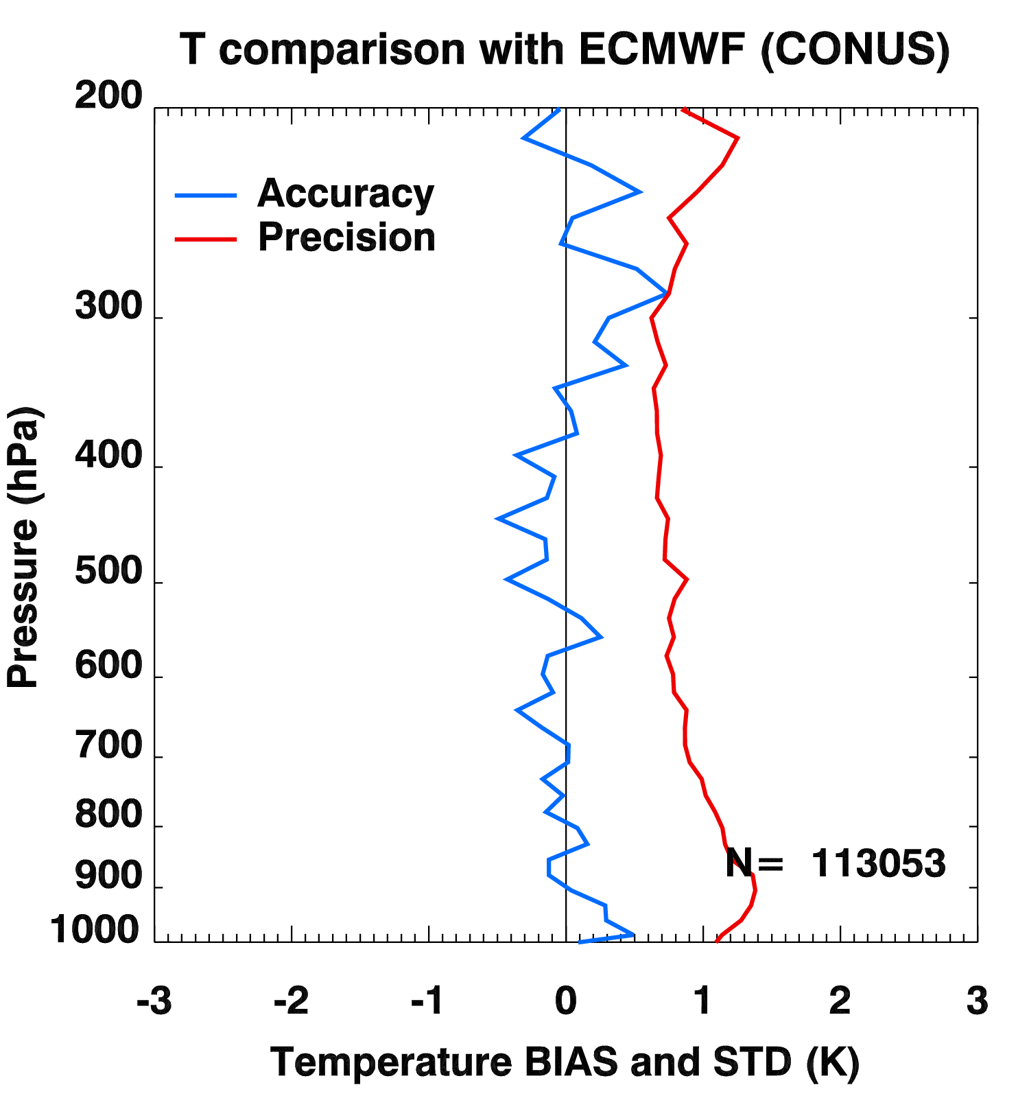
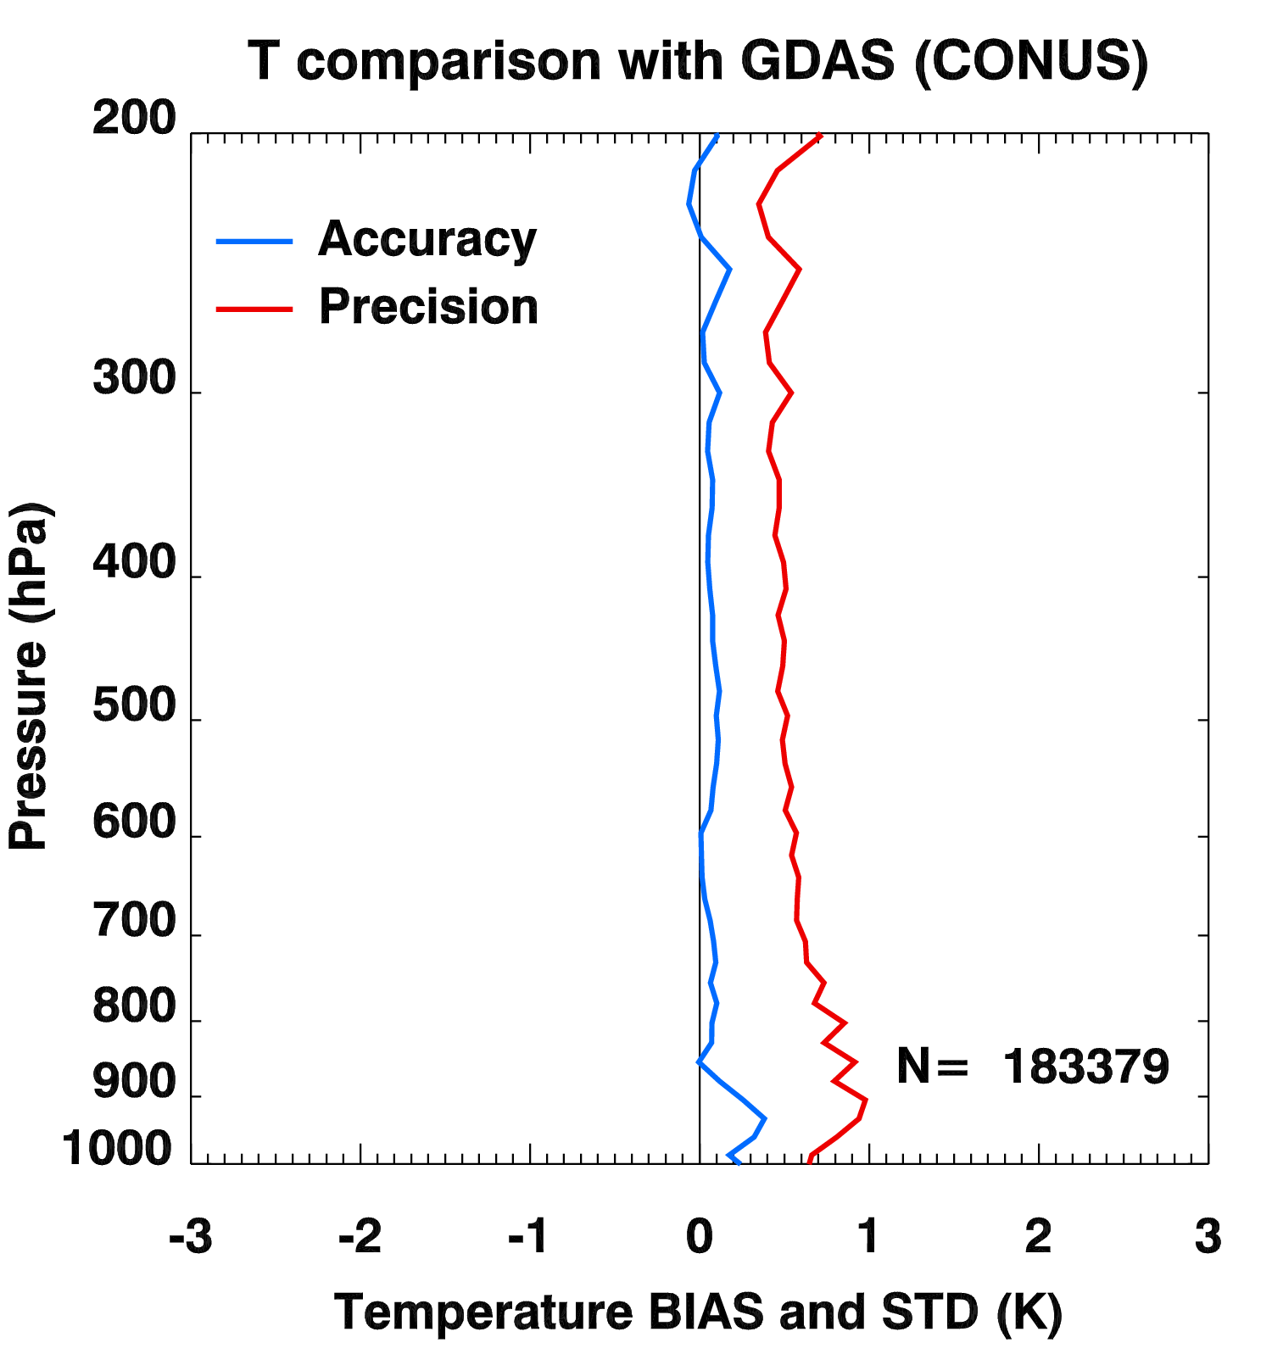
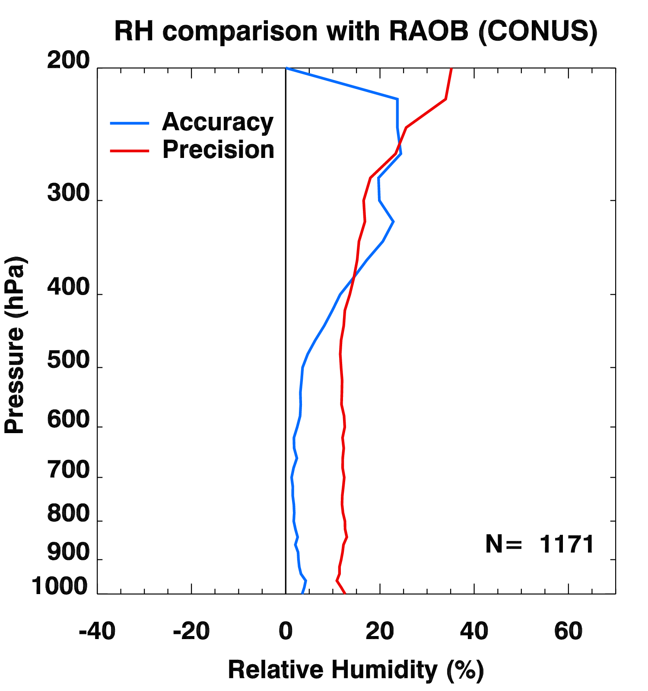
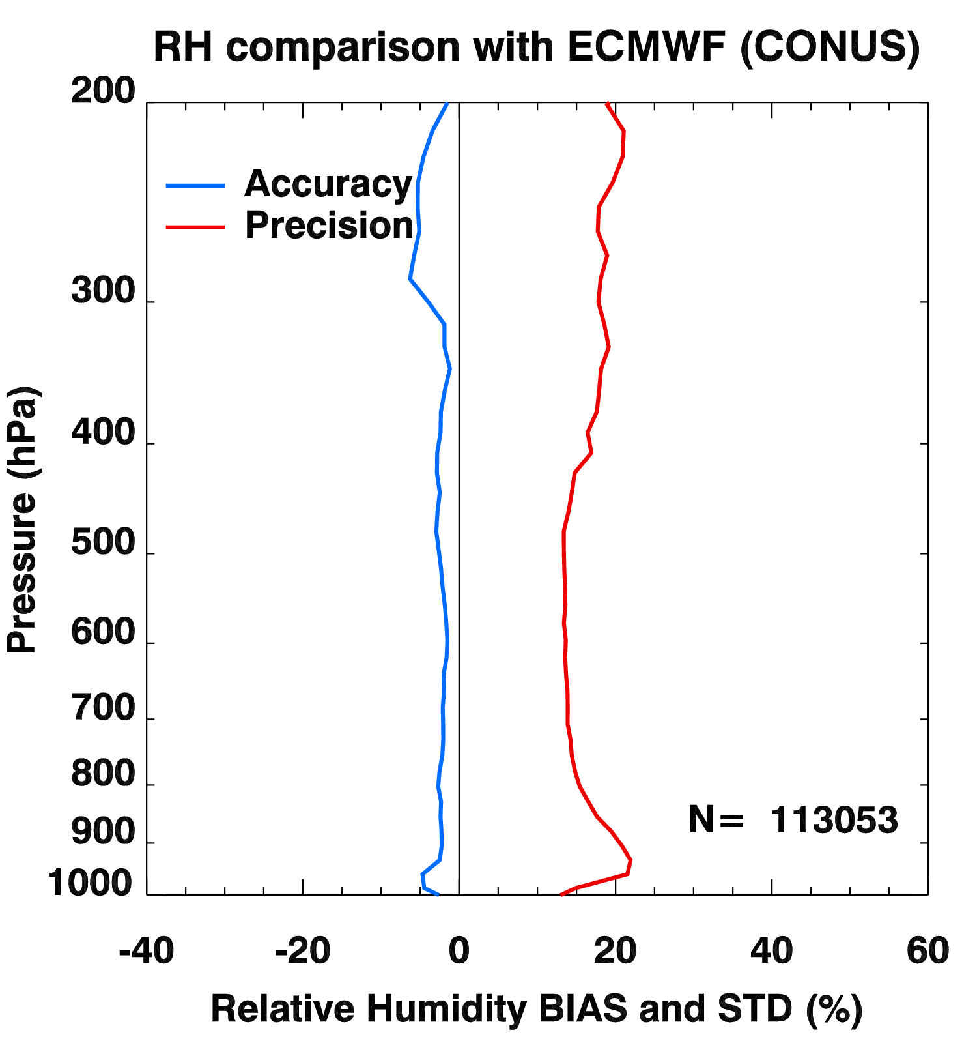
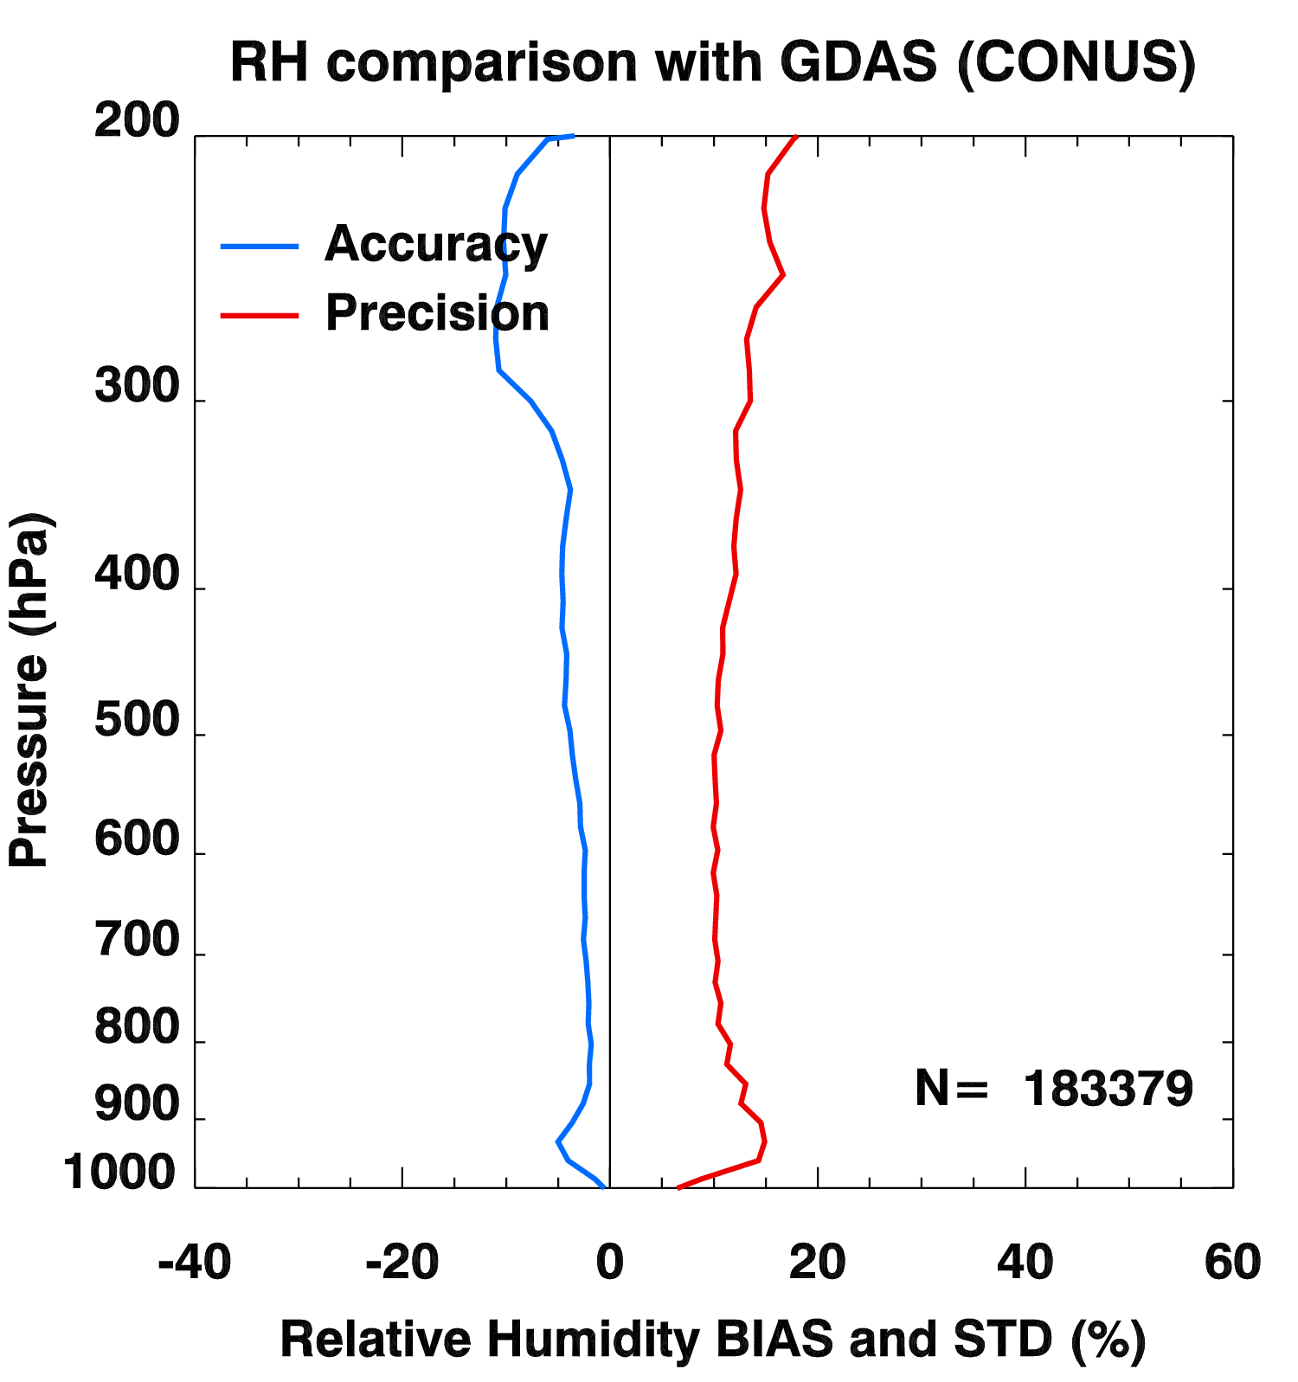
PLPT ABI-CONUS-LVT, LVM:
2018.11-2019.04
RAOB
ECMWF
GDAS
LVT (K)
Accuracy spec:
1 K (BL-400hPa)
Precision spec:
2 K (BL-400hPa)
LVM (%)
Accuracy & Precision spec:
18% (sfc-300hPa), 20% (300-100hPa)
27
Notes:
Sample size is “maximum”, eg, if one level has a match.

Slide 28
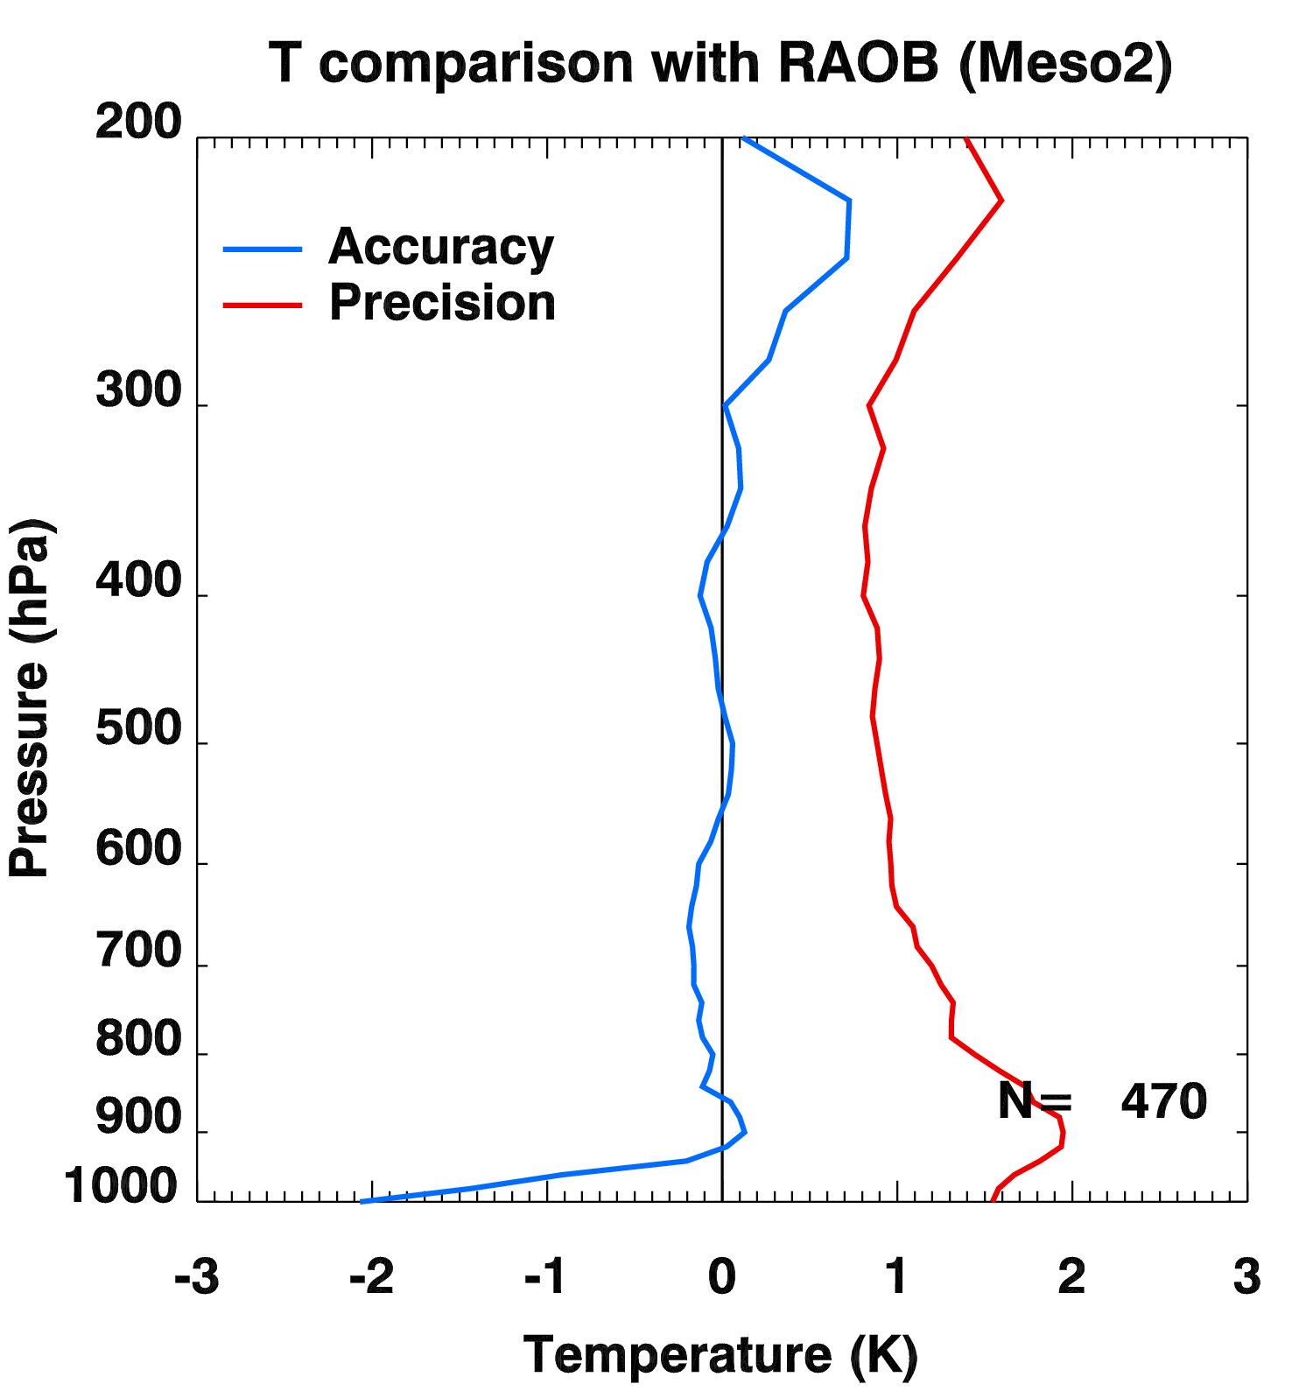
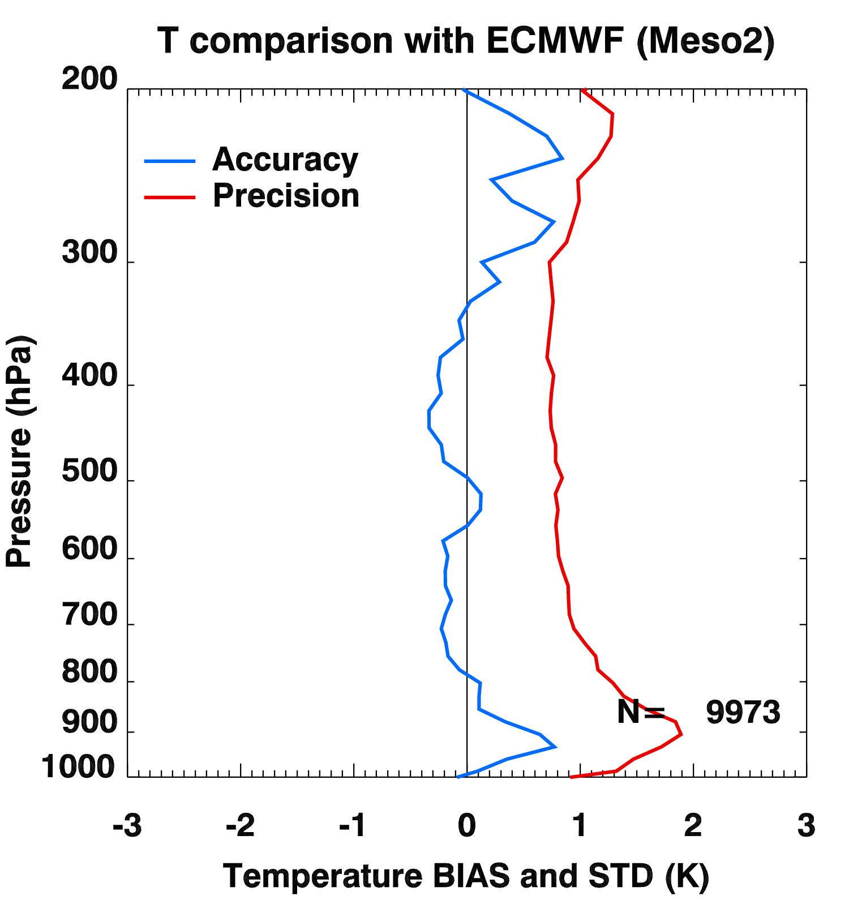
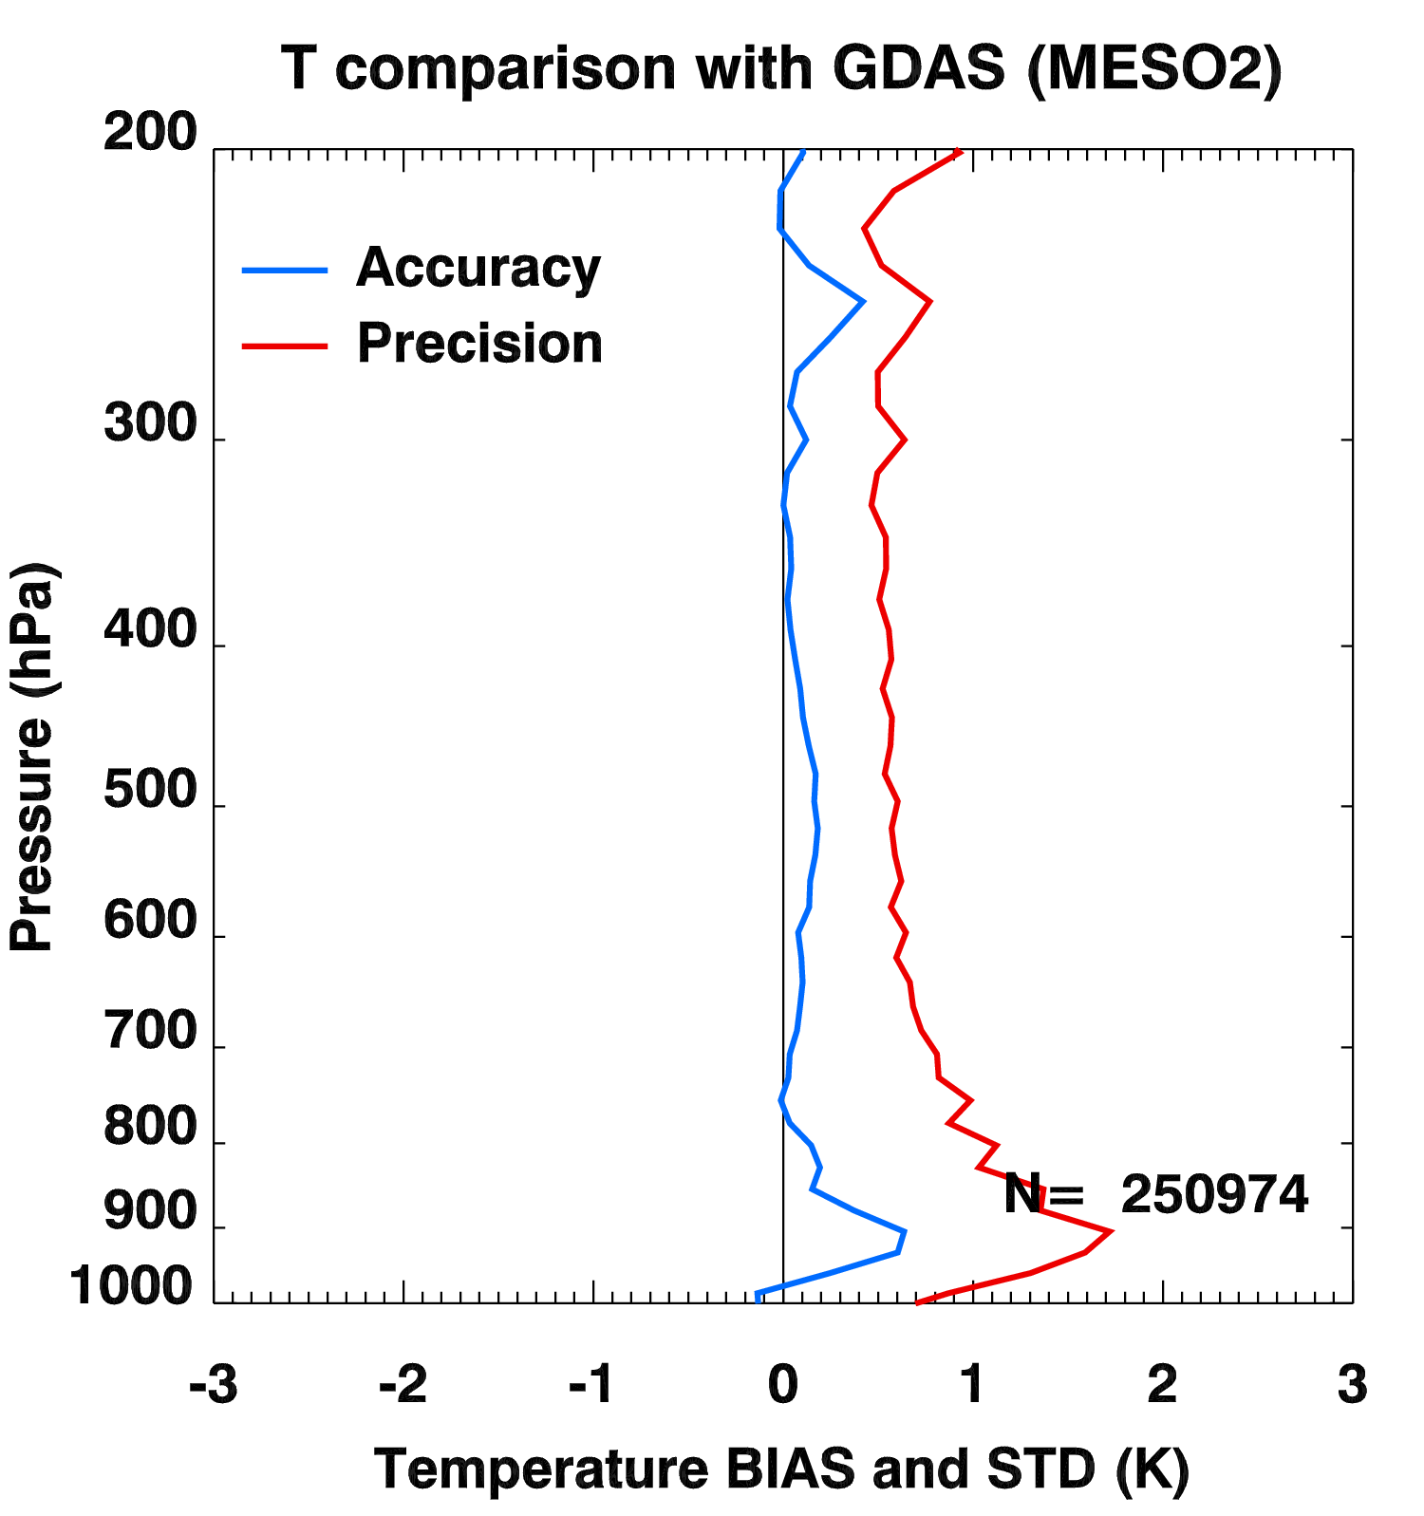
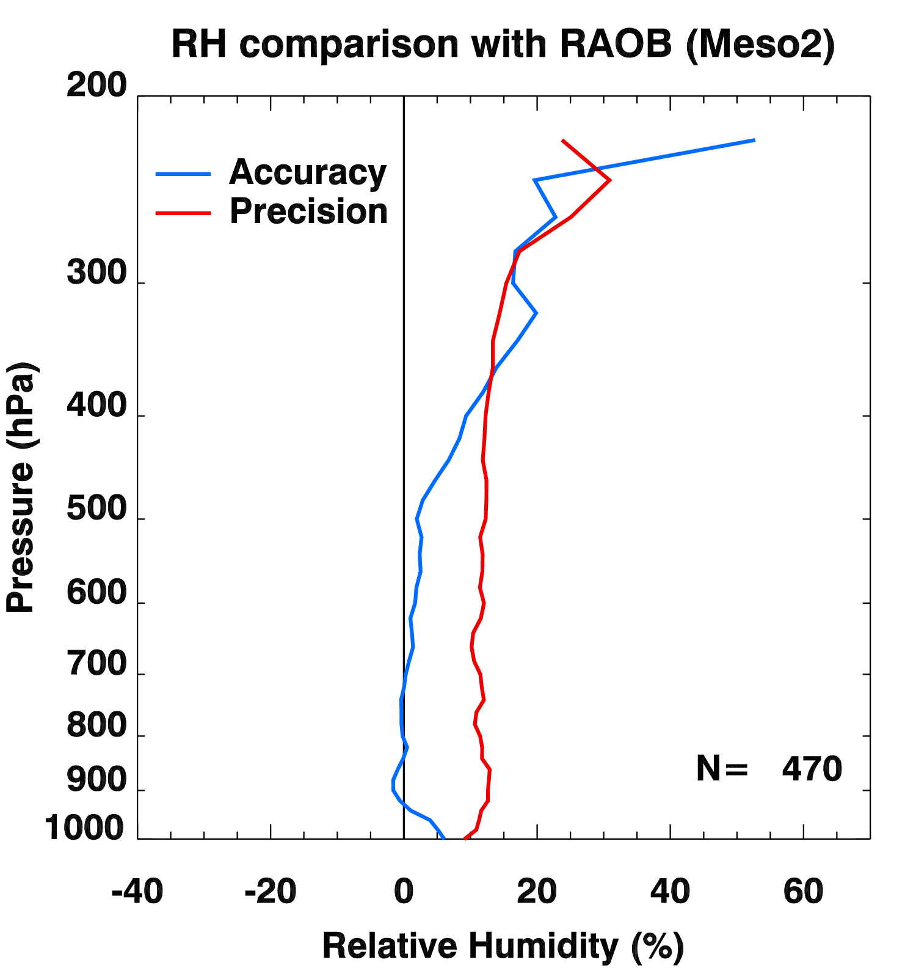
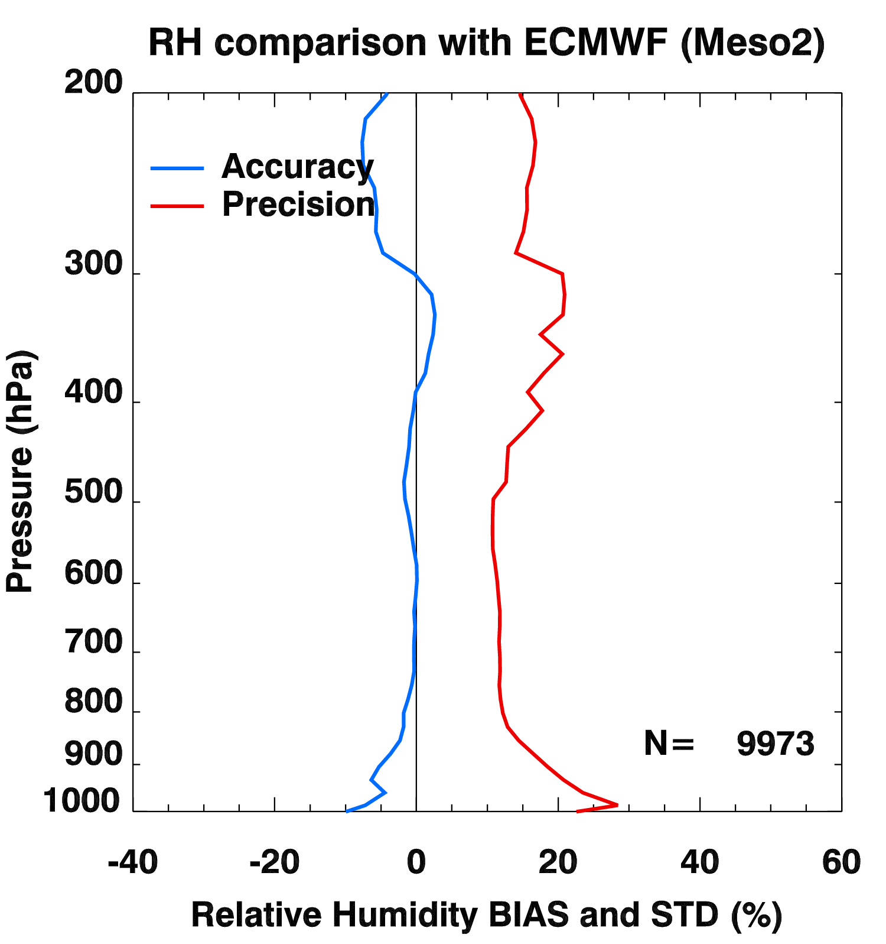
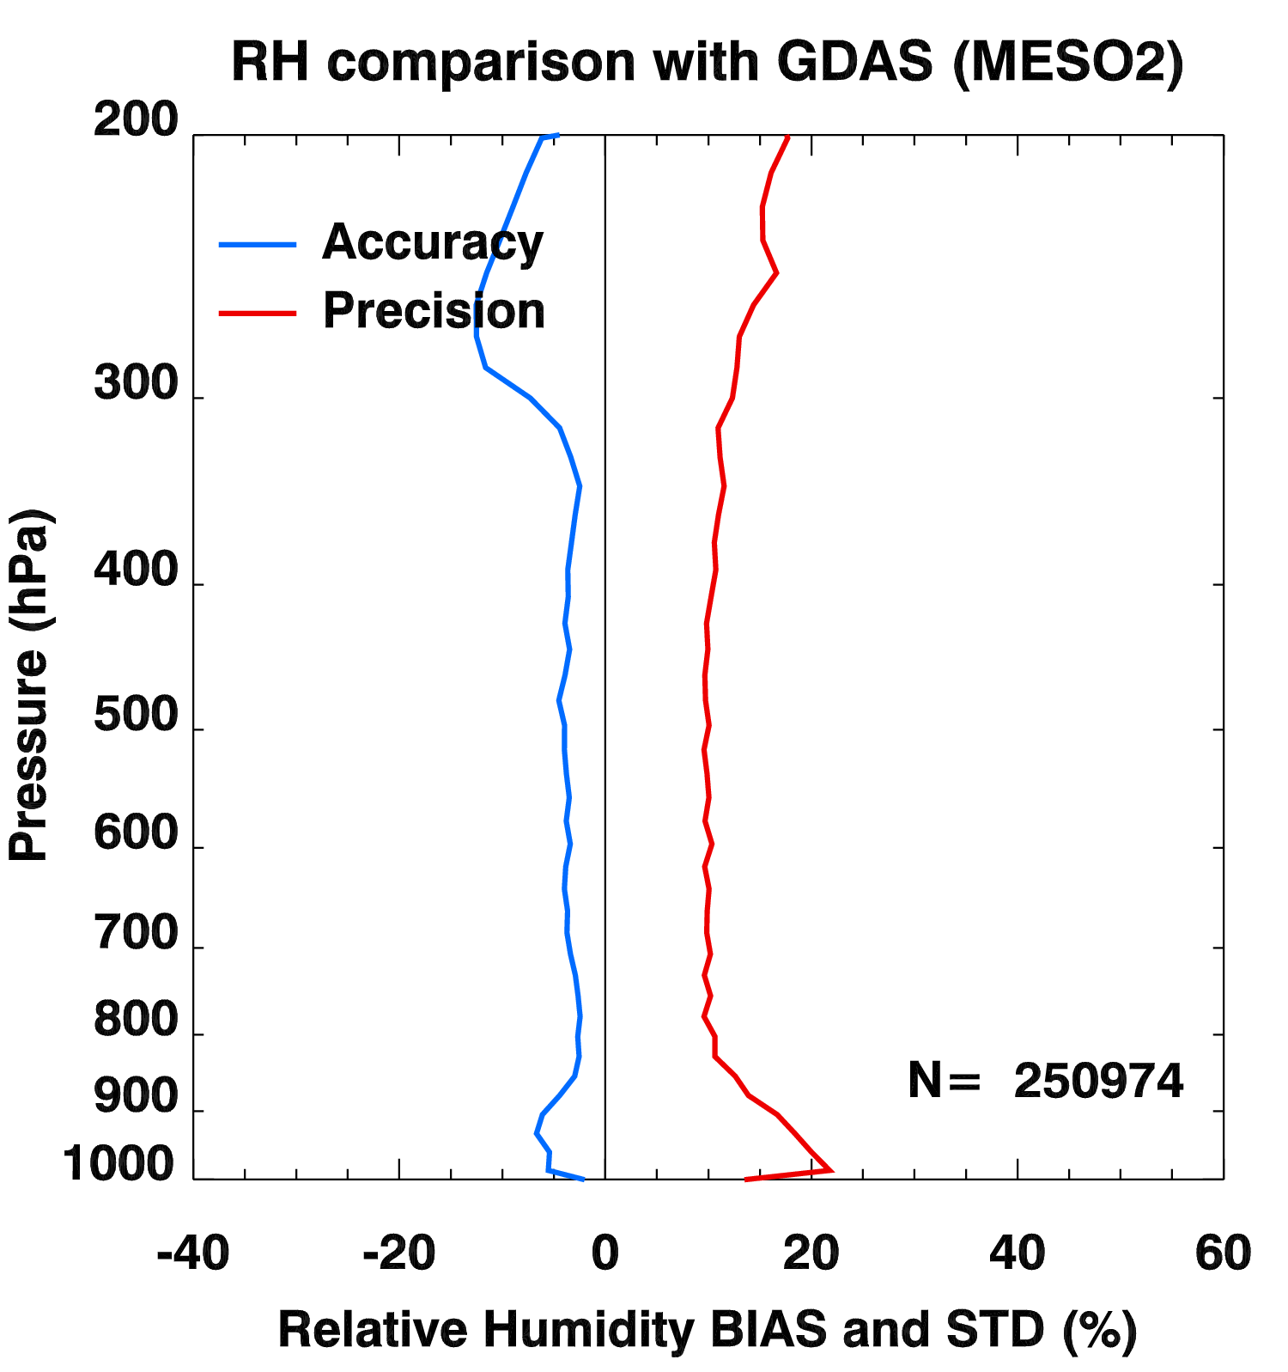
PLPT ABI-Meso2-LVT, LVM:
2018.11-2019.04
2019.01-2019.04
RAOB
ECMWF
GDAS
LVT (K)
Accuracy spec:
1 K (BL-400hPa)
Precision spec:
2 K (BL-400hPa)
LVM (%)
Accuracy & Precision spec:
18% (sfc-300hPa), 20% (300-100hPa)
28

Slide 29
LVT and LVM Performance Summary
LVT and LVM retrievals are working as expected on GOES-17 ABI data when combined with NWP short-range forecasts (as first guess);
Retrievals are sensitive to first guess;
With a highly quantitative web-based tool (http://soundingval.ssec.wisc.edu) and the comparisons with RAOB, ECMWF, and GDAS, the performances overall meet spec. for all the coverages (FD, CONUS, Meso1, Meso2), except where sample size is small (Meso1 and Meso2) and also for the Relative Humidity at upper troposphere (100 - 300 hPa) when compared with RAOB, which is likely due to the known issue of dry bias of radiosonde observations.
29

Slide 30
Comparison DSI with the RAOB, ECMWF, and GDAS
30

Slide 31
Requirements for ABI LAP products: DSI
Product |  | Accuracy | Precision | Range
Temperature |  | 1 K below 400 hPa and above boundary layer | 2 K below 400 hPa and above boundary layer | 180 - 320 K
Moisture |  | Sfc - 300 hPa: 18% 300 - 100 hPa: 20% | Sfc - 300 hPa: 18% 300 - 100 hPa: 20% | 0 - 100%
TPW |  | 1 mm | 3 mm | 0 - 100 mm
DSI | LI | 2.0 K | 6.5 K | -10 ~ 40 K or above
 | CAPE | 1000 J/kg | 2500 J/kg | 0 - 5000 J/kg
 | SI | 2.0 K | 6.5 K | -10 ~ 4 K or above
 | TT | 1 K | 4 K | -43 ~ 56 K
 | KI | 2 K | 5 K | 0 - 40 K
31

Slide 32
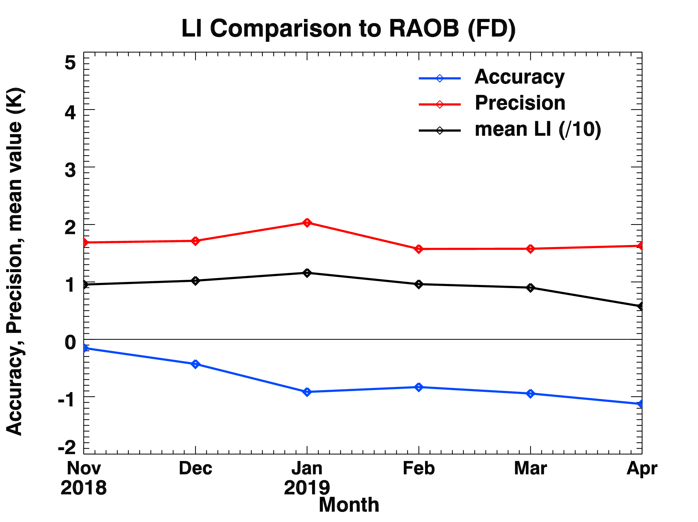
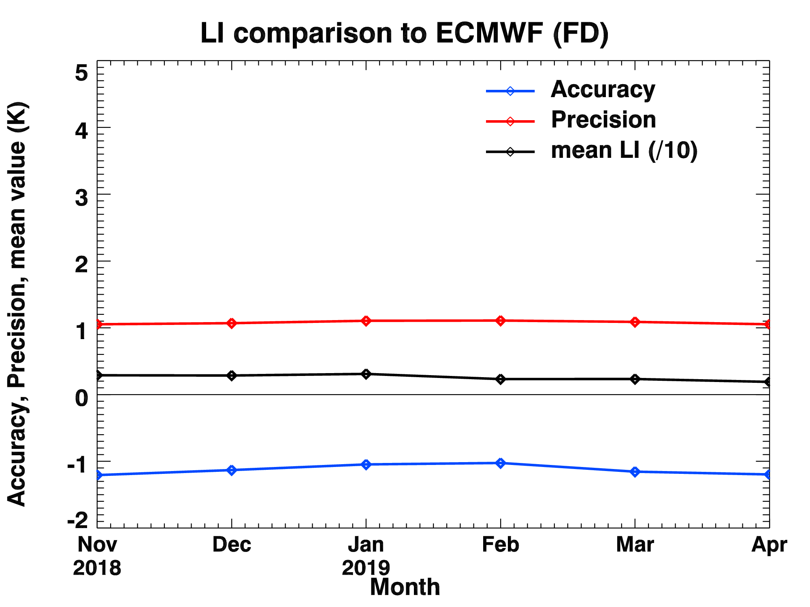
PLPT ABI-FD-DSI:
2018.11-2019.04 LI
Accuracy spec: 2 K
Precision spec: 6.5 K
RAOB
ECMWF
GDAS
32

Slide 33
PLPT ABI-FD-DSI:
2018.11-2019.04 CAPE
Accuracy spec: 1000 J/kg
Precision spec: 2500 J/kg
RAOB
ECMWF
GDAS
33

Slide 34
PLPT ABI-FD-DSI:
2018.11-2019.04 SI
Accuracy spec: 2 K
Precision spec: 6.5 K
RAOB
ECMWF
GDAS
34

Slide 35
PLPT ABI-FD-DSI:
2018.11-2019.04 KI
Accuracy spec: 2 K
Precision spec: 5 K
RAOB*
ECMWF
GDAS
*KI results are slightly larger than spec when compared with RAOBs.
35

Slide 36
PLPT ABI-FD-DSI:
2018.11-2019.04 TT
Accuracy spec: 1 K
Precision spec: 4 K
RAOB*
ECMWF
GDAS
*TT results are slightly larger than spec when compared with RAOBs. See next slide for more analysis
36

Slide 37
PLPT ABI-FD-DSI:
2018.11-2019.04
including “only unstable cases”
KI (>26 for unstable cases)
TT (>44 for unstable cases)
Accuracy spec: 2 K
Precision spec: 5 K
Accuracy spec: 1 K
Precision spec: 4 K
Comparisons with RAOB
37
Notes:
Considering only unstable cases, most of the accuracy and precision of TT and KI are reduced in magnitude.

Slide 38
PLPT ABI-MESO2-DSI:
2018.11-2019.04 LI
Accuracy spec: 2 K
Precision spec: 6.5 K
RAOB
ECMWF
GDAS
38

Slide 39
PLPT ABI-MESO2-DSI:
2018.11-2019.04 CAPE
Accuracy spec: 1000 J/kg
Precision spec: 2500 J/kg
RAOB
ECMWF
GDAS
39

Slide 40
PLPT ABI-MESO2-DSI:
2018.11-2019.04 SI
Accuracy spec: 2 K
Precision spec: 6.5 K
RAOB
ECMWF
GDAS
40

Slide 41
PLPT ABI-MESO2-DSI:
2018.11-2019.04 KI
Accuracy spec: 2 K
Precision spec: 5 K
RAOB*
ECMWF
GDAS
*KI results are slightly larger than spec when compared with RAOBs.
41

Slide 42
PLPT ABI-MESO2-DSI:
2018.11-2019.04 TT
Accuracy spec: 1 K
Precision spec: 4 K
RAOB*
ECMWF
GDAS
*TT results are slightly larger than spec when compared with RAOBs.
42

Slide 43
DSI Performance Summary
DSI retrieval is working as expected on GOES-17 ABI data when combined with NWP short-range forecasts (as first guess);
With a highly quantitative web-based tool (http://soundingval.ssec.wisc.edu) and the comparisons with RAOB, ECMWF and GDAS, it does indicate performances mostly meet spec. for all the coverages, except small sample size cases and the comparisons of TT and KI with RAOBs. The TT and KI results are much closer to the requirements if the atmosphere is in the unstable conditions.
43

Slide 44
GOES-16 vs. GOES-17 ABI LAP Products comparisons
GOES 17
GOES 16
Clear-sky, Overlapped coverage
GOES 17 – GOES 16

Slide 45
GOES-17 vs. GOES-16 comparisons
LVT and LVM
Bias and STD for the overlapped area (zenith angle ≤ 65)
2019.03.01 00Z
LVT
LVM
N = 133,237
N = 133,237

Slide 46
GOES-17 vs. GOES-16 comparisons
TPW and DSI
G17 – G16 statistics (zenith angle ≤ 65)
2019.03.01 00Z
LVMP
GOES 17
TPW
LI
CAPE
SI
KI
TT
N = 147,894

Slide 47
PLPT Outcomes: Summary
All PLPT activities needed to make LAP products provisional have been completed.
Minor issues revealed by PLPTs:
Missing values in random boxed areas
The migration of the sun affects the LAP products
The Loop Heat Pipe affects the LAP products
Slightly large discrepancy of some DSI products (KI and TT) compared with RAOB
These minor issues may not prevent the declaration of Provisional Maturity

Slide 48
Path to Delta Review

Slide 49
Path to Delta Review
We expect to apply the same PLPTs to be conducted for Full Maturity
Extend period for testing throughout May 2019 to November 2019.
Save L2 to enable further comparisons with the reference datasets.
Deep dive for those small samples that have large differences between LAP and references.
Evaluate added value (spatial, temporal, precision, accuracy) over NWP background.
Currently minor issues may not prevent declaration of Full Maturity (3 issues identified through the PLPT work and will be mitigated during provisional stage)
Missing values are randomly discovered over some boxed areas.
LAP products are affected by the migration of the sun which might be caused by the cloud mask.
The retrieval rate decrease during the Loop Heat Pipe problem time-period
TT and KI values have slightly large discrepancy when compared with (“point-source”) RAOBs; when considering only unstable atmospheric conditions, the results are closer to specification.

Slide 50
Issue #1 – Missing data over randomly distributed boxed areas
Initial analysis showed missing data over randomly distributed boxed area
The missing data occur frequently and randomly in boxed shapes
Need to submit an ADR on this issue
Thought this issue was eliminated, but it’s not.
Harder to track down since it’s very intermittent.
Notes:
PRO team may clarify more about this.

Slide 51
An example of the missing data in boxed area over Full disk
Sometimes due to missing radiance data…due to solar avoidance

Slide 52
An example of the missing data in boxed area over Full disk
But sometimes the radiance data is there and hence an ADR is needed.

Slide 53
An example of the missing data in boxed area over Full disk
But sometimes the radiance data is there

Slide 54
Issue #2 – The migration of the sun affecting the LAP products
Initial analysis showed that the migration of the sun affects the LAP products.
Some retrievals appear abnormal in sun-set and sun-rise regions.
This might just because during the day, more spectral bands are used in the cloud mask.
Notes:
PRO team may clarify more about this.

Slide 55
An example of the migration of the sun affecting LAP products over Full Disk (might via cloud mask)
animation
Notes:
Regions of sun-rise and sun-set are prone to this issue.

Slide 56
Issue #3 – GOES-17 Loop Heat Pipe (LHP) problems affect the retrievals of LAP products
Initial analysis showed that the GOES-17 LHP affects the LAP products.
Some or most of the data are missing during nighttime hours (around 10 UTC ~ 17 UTC in March), and the retrieval rate decreases during this time period.

Slide 57
GOES-17 LHP issue
GOES-17 LWIR Focal Plane Modul (FPM) on Apr. 1, 2019
Without solar forcing, the FPM temperature (black lines) is around 80 K
At night, when sunlight hits ABI, FPM temperatures increase
CH8
CH9
CH10
CH11
CH12
CH13
CH14
CH15
CH16
→ excluded period of LHP issue for the ABI LAP evaluation

Slide 58
An example of the GOES-17 LHP effects
1100 UTC
1300 UTC
Starting from around 1000 UTC until 1700 UTC, the retrieval rate of LAP products dramatically decreases.
1500 UTC
1700 UTC

Slide 59
GOES-17 LAP mitigation studies
(Sensitivity studies with GOES-16 ABI)

Slide 60
Mitigation questions to be addressed
What is the impact of removing 13.4 μm band in the GOES-R series LAP algorithm?
How to handle the increased observation noise during LHP period in LAP algorithm and what is the impact on LAP product quality?
What is the recommended mitigation strategies and approaches for operational GOES-17 LAP product during LHP period?

Slide 61
GOES-17 LAP mitigation strategies during LHP period
The overall considerations on G-17 LAP mitigation are based on two facts:
during LHP period, some IR bands such as 13.4 μm band might not be available, while some bands such as WV absorption bands might have higher observation noise than those of GOES-16;
GOES-R series LAP algorithm has two components: regression followed by 1Dvar based physical retrieval.
Overall strategies on G-17 mitigation during LHP period:
remove regression step, using NWP as input directly instead of using regression results as input;
Remove channels not available during LHP period;
Increase observation errors for those bands with increased noise during LHP period.
Related Questions to be addressed in this study with GOES-16 ABI data:
What is the impact of removing 13.4 μm band on LAP?
What is the impact of removing regression step on LAP?

Slide 62
Experiments with GOES-16 ABI data
CIMSS ABI near real-time (NRT) LAP retrieval algorithm (prototype algorithm for baseline LAP product)
Use Regressions to generate the first guess, followed by
Physical retrieval
ABI IR bands used in physical retrieval:
Ch8 (6.2μm) | on | Ch13 (10.3μm) | on
Ch9 (6.9μm) | on | Ch14 (11.2μm) | on
Ch10 (7.3μm) | on | Ch15 (12.3μm) | on
Ch11 (8.4μm) | off | Ch16 (13.4μm) | on
Ch12 (9.6μm) | off
Experiments
Without regression step
Drop off Ch15 (with regression)
Drop off Ch16 (with regression)
Drop off Ch15 and Ch16 (with regression)
Comparisons and impact analysis
compare the results with the ABI near real-time TPW for 2018-06-22 01 UTC – 23 UTC (1 hour interval)

Slide 63
Experiment 1. No regression
(using NWP as first guess instead)
Comparison with the ABI NRT TPW (individual scene)
2018.06.22 01Z
Discontinuity line appears
220° 240° 260° 280° 300° 320° 340°
Without regression step, the retrieval rate slightly decreases: 96.7%
Visible negative biases are shown mainly in the northern hemisphere
Note the discontinuity line in the bias map

Slide 64
Experiment 2. Drop off Ch15
Comparison with the ABI NRT TPW (individual scene)
2018.06.22 01Z
220° 240° 260° 280° 300° 320° 340°
Retrieval rate slightly decreases: 98.1%
Moderate negative biases (smaller than the Exp.1) in the northern hemisphere

Slide 65
Experiment 3. Drop off Ch16
Comparison with the ABI NRT TPW (individual scene)
2018.06.22 01Z
220° 240° 260° 280° 300° 320° 340°
Retrieval rate decreases: 95.5%
The retrieved TPW shows very little change without Channel 16.

Slide 66
Experiment 4. Drop off Ch15, Ch16
Comparison with the ABI NRT TPW (individual scene)
2018.06.22 01Z
220° 240° 260° 280° 300° 320° 340°
Retrieval rate decreases: 94.6%

Slide 67
Experiments 1~4
Mean TPW Difference
Exp.1 No Regressions Exp.2 Drop off Ch15
Exp.3 Drop off Ch16 Exp.4 Drop off Ch15 and Ch16
(averaged between 01 UTC ~ 23 UTC)
Exp.1
Exp.2
Exp.3
Exp.4

Slide 68
Summary from G16 sensitivity studies
Regression step has substantial impact on LAP results;
Removing band 16 has little impact on LAP;
Removing band 15 has slight impact on LAP;
Removing band (s) might slightly reduce successful retrievals.

Slide 69
GOES-17 Mitigation Plans
Plans
use a day of maximum Focal Plane Module heating (February and/or April 2019) with Predicative Cal processed GOES-17 ABI data and generate retrievals with the modified algorithm
compare to operational retrievals
use as the basis for the prototype science codes

Slide 70
Risks to Reaching Full
Risk Name | Description | Impact | Mitigation and Schedule
Missing values over randomly distributed areas | In frequently, there are missing values over randomly distributed boxed areas, but just the full disk sector. | Minor | Suggest an ADR, similar to an earlier one which we thought resolved.
The migration of the sun affecting the LAP products | The ABI LAP products are affected by sun-rise and sun-set. | Minor | Cloud mask may have influences on the ABI LAP products, as the scenes are illuminated, although appears to be a yield issue.
Wet bias of the relative humidity in upper troposphere (100 - 300 hPa) | The relative humidity in upper troposphere (100-300 hPa) shows large wetter bias than the spec. | Minor | Radiosonde has dry bias in observing the relative humidity in the upper troposphere. So the comparison with ECMWF analysis data will be included for further tests.
Slightly large discrepancy of several DSI | Several DSI show slightly larger discrepancy than the spec, compared to radiosondes. | Minor | If the atmospheric conditions are unstable, the statistics results are closer to the requirements. May need a high spectrally resolution sounder in geo to fully resolve.
Small Impact
Moderate Impact
Large Impact

Slide 71
Other concerns to Delta
CAPE method in GOES-17 LAP is based on MLCAPE (mixed layer) which might be different from other CAPE products forecasters compare to.
Need to output the surface pressure.
Layered PW (LPW) should be considered in the enhanced products based on the feedback from forecasters during HWT demonstration.
Same as GOES-16
Notes:
HWT – Hazardous Weather Testbed

Slide 72
SBCAPE vs. MLCAPE
SPC mesoscale analysis & ABI
SBCAPE: red contours
SPC
MLCAPE: red contours
SPC
ABI CAPE
Usually, MLCAPE is much lower than SBCAPE due to the averaging
SBCAPE: surface-based CAPE
MLCAPE: mean-layer CAPE (lowest 100 hPa layer)
Currently, the ABI baseline CAPE is based on MLCAPE.

Slide 73
SUMMARY AND RECOMMENDATIONS
GOES-17 ABI L2 LAP Product Provisional PS-PVR

Slide 74
Summary
AWG LAP team has validated GOES-17 LAP products (TPW, LVT, LVM, DSI) from November 2018 to April 2019 with various reference data (RAOB, Suomi-Net GPS, ECMWF analysis, GDAS, AMSR2) in near real-time, the performance meet the requirements (for the “stable” times of the day/year);
AWG LAP team recommend that TPW, LVT, LVM, and DSI products be transitioned to Provisional status at this time;
AWG LAP team have found the following minor issues which should not prevent Provisional status
Missing values occur frequently and randomly over boxed areas.
The migration of the sun affects the LAP products via cloud mask.
Decrease in the retrieval rate due to the LHP effects
Comparisons of TT and KI with RAOBs shows a little larger than spec. The TT and KI results are much closer to the requirements when compared with RAOBs if the atmosphere is in the unstable conditions.

Slide 75
Backup Material
GOES-17 ABI L2 LAP Product Provisional PS-PVR

Slide 76
PLPT ABI-CONUS-TPW, LVT, LVM:
March 01 2019, 0000 UTC
TPW (mm)
Temp (K). 500 hPa hPa
WV (g/kg) 850 hPa
TPW: Total Precipitable Water
LVT: Legacy Vertical Temperature profile
LVM: Legacy Vertical Moisture profile
76

Slide 77
PLPT ABI-CONUS-DSI:
March 01 2019, 0000 UTC
LI
CAPE
TT
KI
SI
LI: Lifted Index
CAPE: Convective Available Potential Energy
TT: Total Totals
KI: K-Index
SI: Showalter Index
77

Slide 78
PLPT ABI-MESO1-TPW, LVT, LVM:
March 01 2019, 0000 UTC
TPW (mm)
Temp (K). 500 hPa hPa
WV (g/kg) 850 hPa
TPW: Total Precipitable Water
LVT: Legacy Vertical Temperature profile
LVM: Legacy Vertical Moisture profile
78

Slide 79
PLPT ABI-MESO1-DSI:
March 01 2019, 0000 UTC
LI
CAPE
TT
KI
SI
LI: Lifted Index
CAPE: Convective Available Potential Energy
TT: Total Totals
KI: K-Index
SI: Showalter Index
79

Slide 80
PLPT ABI-MESO2-TPW, LVT, LVM:
March 01, 2019, 0000 UTC
TPW (mm)
Temp (K). 500 hPa hPa
WV (g/kg) 850 hPa
TPW: Total Precipitable Water
LVT: Legacy Vertical Temperature profile
LVM: Legacy Vertical Moisture profile
80

Slide 81
PLPT ABI-MESO2-DSI:
March 01, 2019, 0000 UTC
LI
CAPE
TT
KI
SI
LI: Lifted Index
CAPE: Convective Available Potential Energy
TT: Total Totals
KI: K-Index
SI: Showalter Index
81

Slide 82
PLPT ABI-CONUS-TPW:
2018.11-2019.04
Accuracy spec: 1 mm
Precision spec: 3 mm
GPS
RAOB
AMSR2
PASSED
82

Slide 83
PLPT ABI-CONUS-TPW:
2018.11-2019.04
Accuracy spec: 1 mm
Precision spec: 3 mm
ECMWF
GDAS
PASSED
83

Slide 84
PLPT ABI-MESO1-TPW:
2018.11-2019.04
Accuracy spec: 1 mm
Precision spec: 3 mm
GPS
RAOB
AMSR2
84

Slide 85
PLPT ABI-MESO1-TPW:
2018.11-2019.04
Accuracy spec: 1 mm
Precision spec: 3 mm
ECMWF
GDAS
85

Slide 86
PLPT ABI-FD-LVT, LVM:
2018.11-2019.04
RAOB
ECMWF
GDAS
LVT (K)
Accuracy spec:
1 K (BL-400hPa)
Precision spec:
2 K (BL-400hPa)
LVM (%)
Accuracy & Precision spec:
18% (sfc-300hPa), 20% (300-100hPa)
86
Notes:
Sample size is “maximum”, eg, if one level has a match.

Slide 87
PLPT ABI-Meso1-LVT, LVM:
2018.11-2019.04
2019.01-2019.04
RAOB
ECMWF
GDAS
LVT (K)
Accuracy spec:
1 K (BL-400hPa)
Precision spec:
2 K (BL-400hPa)
LVM (%)
Accuracy & Precision spec:
18% (sfc-300hPa), 20% (300-100hPa)
87

Slide 88
PLPT ABI-CONUS-DSI:
2018.11-2019.04 LI
Accuracy spec: 2 K
Precision spec: 6.5 K
RAOB
ECMWF
GDAS
88

Slide 89
PLPT ABI-CONUS-DSI:
2018.11-2019.04 CAPE
Accuracy spec: 1000 J/kg
Precision spec: 2500 J/kg
RAOB
ECMWF
GDAS
89

Slide 90
PLPT ABI-CONUS-DSI:
2018.11-2019.04 SI
Accuracy spec: 2 K
Precision spec: 6.5 K
RAOB
ECMWF
GDAS
90

Slide 91
PLPT ABI-CONUS-DSI:
2018.11-2019.04 KI
Accuracy spec: 2 K
Precision spec: 5 K
RAOB*
ECMWF
GDAS
*KI results are slightly larger than spec when compared with RAOBs.
91

Slide 92
PLPT ABI-CONUS-DSI:
2018.11-2019.04 TT
Accuracy spec: 1 K
Precision spec: 4 K
RAOB*
ECMWF
GDAS
*TT results are slightly larger than spec when compared with RAOBs.
92

Slide 93
PLPT ABI-MESO1-DSI:
2018.11-2019.04 LI
Accuracy spec: 2 K
Precision spec: 6.5 K
RAOB
ECMWF
GDAS
93

Slide 94
PLPT ABI-MESO1-DSI:
2018.11-2019.04 CAPE
Accuracy spec: 1000 J/kg
Precision spec: 2500 J/kg
RAOB
ECMWF
GDAS
94

Slide 95
PLPT ABI-MESO1-DSI:
2018.11-2019.04 SI
Accuracy spec: 2 K
Precision spec: 6.5 K
RAOB
ECMWF
GDAS
95

Slide 96
PLPT ABI-MESO1-DSI:
2018.11-2019.04 KI
Accuracy spec: 2 K
Precision spec: 5 K
RAOB*
ECMWF
GDAS
*KI results are slightly larger than spec when compared with RAOBs.
96

Slide 97
PLPT ABI-MESO1-DSI:
2018.11-2019.04 TT
Accuracy spec: 1 K
Precision spec: 4 K
RAOB*
ECMWF
GDAS
*TT results are slightly larger than spec when compared with RAOBs.
97

Slide 98
An example of the missing data in boxed area over Full disk
But sometimes the radiance data is mostly there, but some bands missing

Slide 99
An example of the missing data in boxed area over Full disk
But sometimes the radiance data is (mostly) there

Slide 100
An example of the missing data in boxed area over Full disk
But sometimes the radiance data is there

Slide 101
An example of the missing data in boxed area over Full disk
But sometimes the radiance data is there, but not all the bands (eg, water vapor)

Slide 102
An example of the missing data in boxed area over Full disk
But sometimes the radiance data is not there

Slide 103
An example of the missing data in boxed area over Full disk
But sometimes the radiance data seems to be there

Slide 104
An example of the missing data in boxed area over Full disk
But sometimes the radiance data seems to be there

