Slide 1
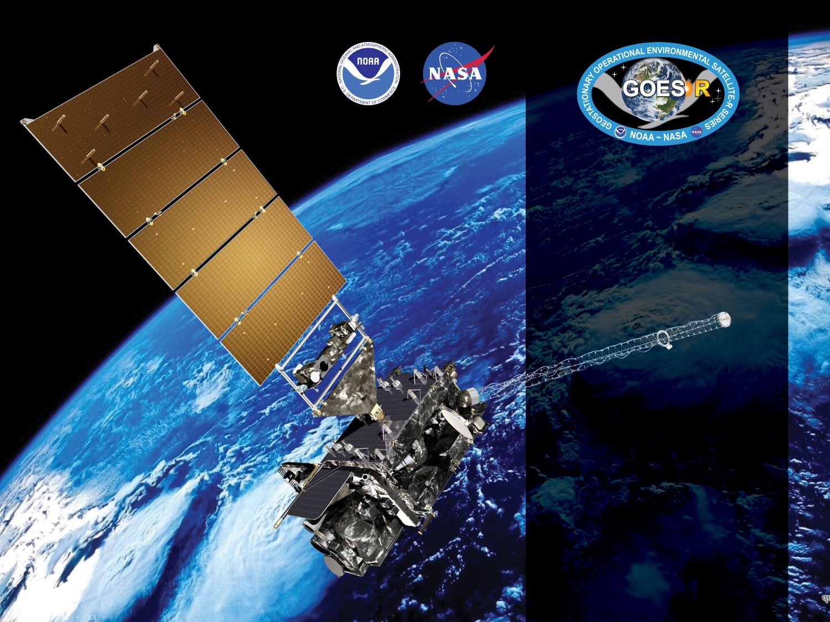
GOES-16 & -17 ABI L2+
Ice Concentration & Extent
Ice Thickness & Age
Ice Motion
Provisional PS-PVR
January 21, 2021
GOES-R AWG
Jeff Key¹,
Yinghui Liu¹,
Xuanji Wang²,
Aaron Letterly²
¹NOAA/NESDIS/STAR
²CIMSS/UW-Madison
Notes:
PS-PVR - Peer-Stakeholder Product Validation Review

Slide 2
Outline
For each product - Ice Concentration, Ice Thickness and Age, and Ice Motion:
Product Overview
Product Quality Evaluation
Product Validation
Provisional Maturity Assessment
Summary
Then:
Users
Overall summary and recommendations

Slide 3
GOES-16 & -17 ABI L2+
Provisional PS-PVR
Ice Concentration
Yinghui Liu
NOAA/NESDIS/STAR
January 21, 2021
GOES-R AWG

Slide 4
PRODUCT OVERVIEW
GOES-16 & GOES-17 NOAT Cryosphere Products Provisional PS-PVR

Slide 5
Ice Concentration Background
Sea and lake ice concentration reports the fraction (in tenths) of the sea or lake surface covered by ice. Total concentration includes all stages of development that are present.
GOES-16 and GOES-17 ice concentration EDR consists of two products: Full Disk (FD) and CONUS.
User needs:
  National Ice Center’s request for generating the ice chart
  Alaska Ice Program’s request to monitor ice conditions
  General users for long-term global sea and lake monitoring, commercial transport, inputs for numerical weather forecasting.
Notes:
Current algorithm does not use the term of the emissivity difference between band 14 and 15. Our efforts have been focused on the enterprise algorithm.
Application examples
Downscaling of GOES-16 LST over urban or non-urban areas and its application in weather prediction models.
Air surface temperature, heat index.
Application in drought, downscaling soil moisture product.

Slide 6
Mission Requirements
Products | Sea and Lake Ice Concentration: CONUS | Sea and Lake Ice Concentration: Full Disk
Geographic Coverage | CONUS | Full Disk
Horizontal Resolution | 3 km | 10 km
Mapping Accuracy | ≤ 1.5 km | ≤ 5 km
Measurement Range¹ | 0/10 – 10/10 | 0/10 – 10/10
Measurement Accuracy (%) | 10.0 | 10.0
Measurement Precision (%) | 30 | 30.0
Refresh Rate | 180 minutes | 6 hr
Mission Product Data latency | 60 minutes | 180 minutes
Temporal Coverage Qualifier² | Solar Zenith Angle < 67 | Local Zenith Angle < 67
Product Extent Qualifier³ | Local Zenith Angle < 67 | Local Zenith Angle < 67
Cloud Cover Conditions Qualifier | Clear | Clear
¹ The product generates ice concentration in percentage, 0-100%. ² The product generates ice concentration in both daytime and nighttime. ³ The product is Quantitative out to at least 67 degrees LZA and qualitative at larger LZA.

Slide 7
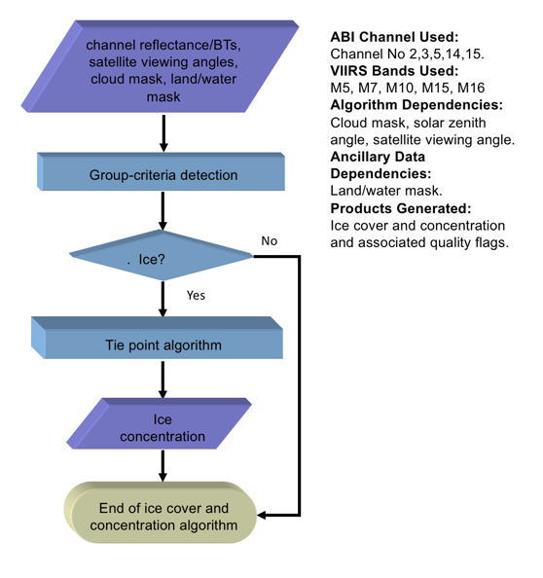
Ice concentration flow chart
High level flowchart of the ice cover and concentration algorithm illustrate the main processing sections.

Slide 8
Algorithm Overview
Read in the sensor data, ancillary data (land/sea mask), and
derived product (cloud mask);
Calculate the surface temperature using split-window approach
T_{s} = a + bT₁₁ + cT₁₂ + d [(T₁₁ − T₁₂)(secθ − 1)]
T_{s} is the estimated surface skin temperature (K),
T₁₁ and T₁₂ are the brightness temperatures (K) at 11 μm and 12 μm bands,
θ is the sensor scan angle, and a, b, c, and d are retrieval coefficients.
Apply threshold tests to detect ice covered pixels based on NDSI (Normalized Difference Snow Index), reflectance at 0.86 𝝁m, and surface temperature in daytime and surface temperature at nighttime;
Derive the ice concentration using a tie point algorithm.
C_{p} = (B_{p} − B_{water})/(B_{ice} − B_{water})
where B_{water} is the reflectance or temperature of pure water pixels,
B_{ice} is the reflectance or temperature of pure ice pixels (tie point reflectance or temperature),
and B_{p} is the observed reflectance or temperature of the pixel.

Slide 9
Product quality evaluation
GOES-16 & GOES-17 NOAT Cryosphere Products Provisional PS-PVR

Slide 10
Top Level Summary of
Product Quality
The analysis was based on the product during the “cool” period with relatively low and stable focal plane module (FPM) temperature
The sea and lake ice concentration product quality is satisfactory
  Overall performance compared to products from other sensors
The sea and lake ice concentration product at low and stable focal plane module (FPM) temperature period is ready for operational use and for use in comprehensive cal/val activities and product optimization.

Slide 11
PLPTs Under Review: Provisional
There has not been a Period of Post-Launch Product Testing (PLPT) for ice products. The table below lists the types of test performed, details of which are on the subsequent slides.
Test ID | Test Title
IceConcQuickLook | Qualitative inspection of ice concentration product.
IceMaskQuickLook | Qualitative inspection of ice mask.
IceConcentration | Full disk ice concentration product accuracy and precision assessment using in-house tools for matchup and statistical analysis comparing ABI ice concentration to AMSR2 ice concentration. Ice products generated by the Ground System on PDA and by ASSISTT are used in the analyses.
IceMask | Same as above

Slide 12
Closed ADRs
Title | Description | Status | Mitigation
none
Notes:
Items 2 and 3 combined in the same ADR 340
Item 5 was added to ADR 644 in the last minute.

Slide 13
Open/Pending ADRs
Title | Description | Status | Mitigation
ADR 1132 | Enterprise ICE added to the Ground System
ADR 1143 | Cryosphere products DQF improvements |  | Science team is evaluating current quality flags and assessing the need for new ones
Notes:
Unsigned-integer data type leads to much confusion among different software packages, it is proposed to change the data type to signed integer and only use the positive half for LST. Advantages: 1. Consistent to its current implementation, 2. No confusion. Disadvantage: scaling error doubles, negligible impact on product performance.

Slide 14
GOES-16 and GOES-17 Data
Used in this Review
GOES-16/17 GS/PDA Data
  Goes-16 Full Disk data every 3-6 hours January 10-18, 2021
  Goes-17 Full Disk data every 3-6 hours January 11-18, 2021
GOES-16/17 Framework Data from ASSISTT
  GOES-16 Feb 3,4,5, 12-25, March 1-10 2020 hourly FD data
  GOES-17 Feb 3,4,5, 12-25, March 1-10 2020 hourly FD data

Slide 15
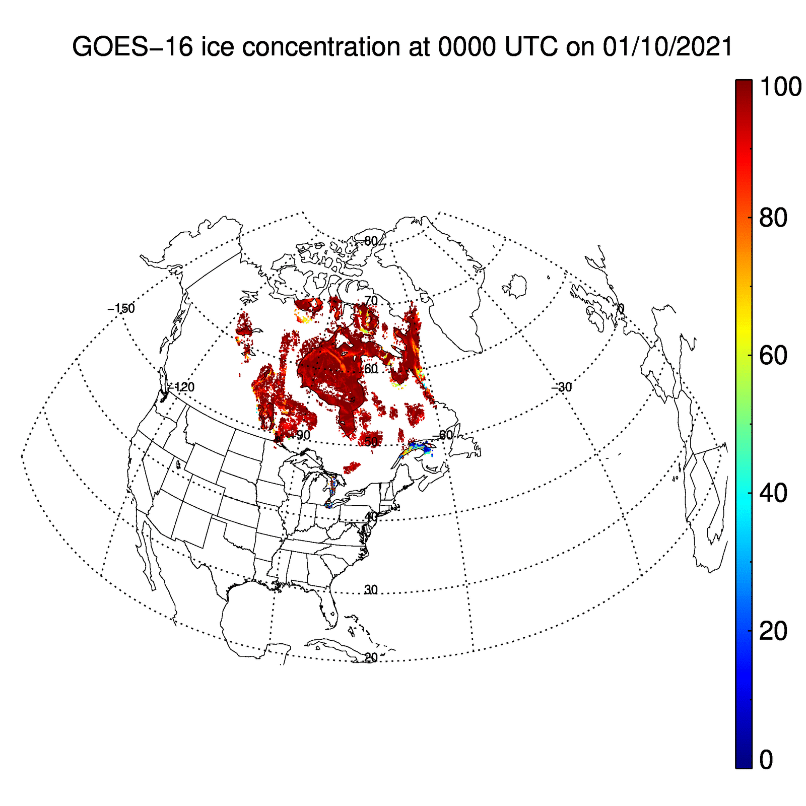
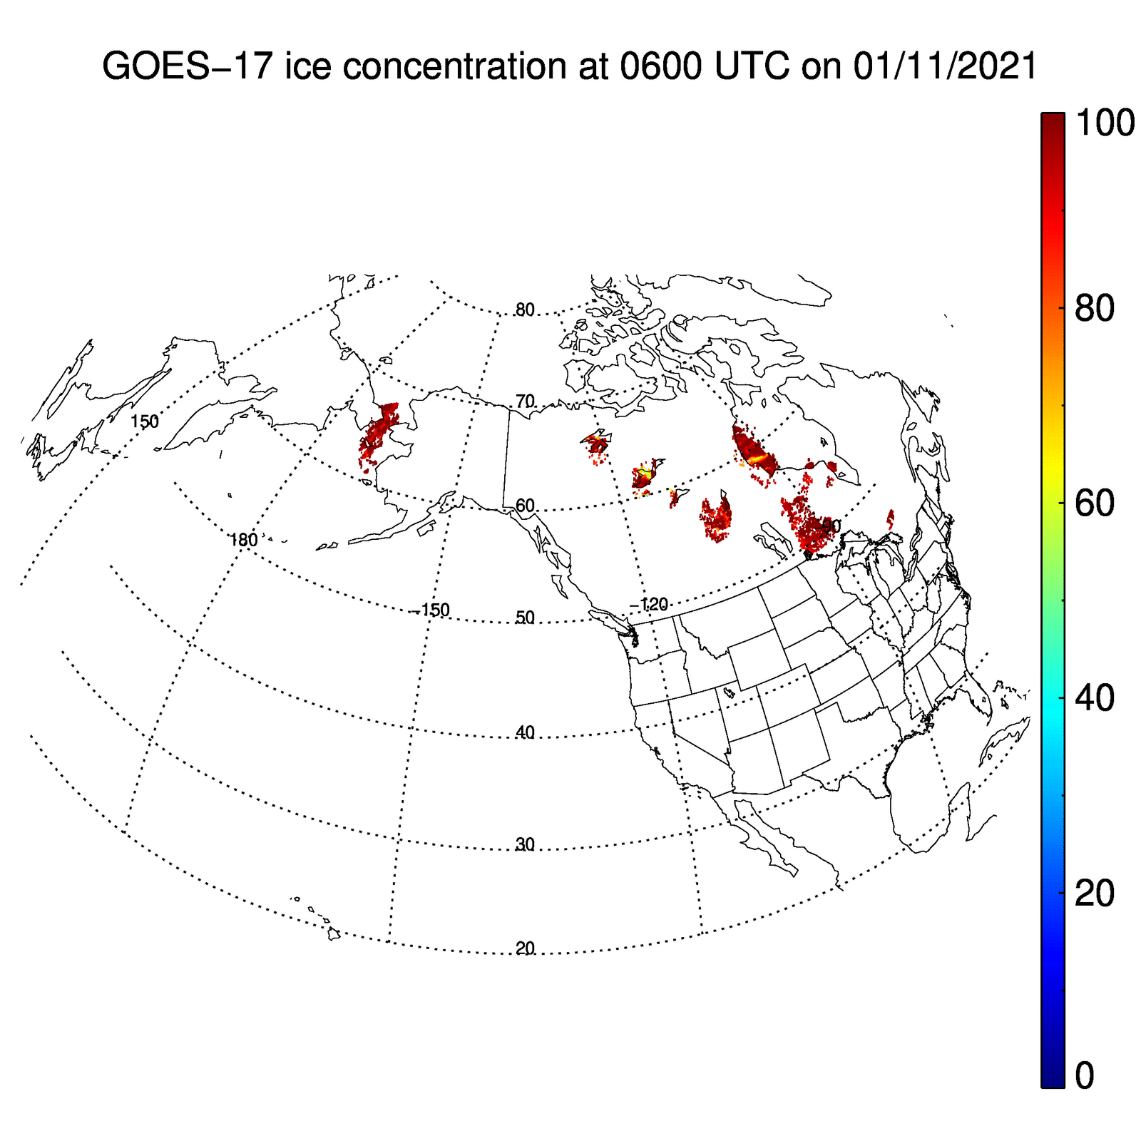
Visual Inspection
GOES-16 FD ice concentration from Jan 10-18 2021
GOES-17 FD ice concentration from Jan 11-18 2021

Slide 16
Product Inspection
Data Quality Flag
Bit | Meaning
 | 01 | 02 | 03 | 04
1 | ✓ | ✓ | ✓ | ✓
2 | ✓ | ✓ | ✓ | ✓
✓
x
✗
Passed
Correction in process
Not passed
Notes:
CONUS LST during March 2019 is used for this inspection.
FD LST involves aggregation, which is not available to LST AWG. So we focus on the testing of CONUS LST for this purpose.
CONUS M4 metadata is based on blocks, some of which might consists of areas out of CONUS. This leads to the inconsistency between the metadata calculated locally and those included in the official product.

Slide 17
PRODUCT VALIDATION
GOES-16 & GOES-17 NOAT Cryosphere Products Provisional PS-PVR

Slide 18
Reference Data
Reference data sets: The AMSR2 (Advanced Microwave Scanning Radiometer 2 ) instrument onboard the GCOM-W1 (Global Change Observation Mission 1st – Water) satellite is a twelve-channel, six-frequency, passive-microwave radiometer system. The AMSR2 NOAA enterprise sea ice product includes sea ice concentration using NASA team 2 algorithm mapped to a Equal-Area Scalable Earth Grid (EASE-Grid) version 2 at 10.0 km spatial resolution. The reference data sets covers daily AMSR2 ice concentration from January 10 to 18 2021, and from Feb 1 to March 10 2020.
Notes:
Enterprise algorithm will replace the baseline algorithm.
The implementation in GS is scheduled at June 2020.
The enterprise algorithm for JPSS has been implemented in NDE system and replaced the existing IDPS algorithm.

Slide 19
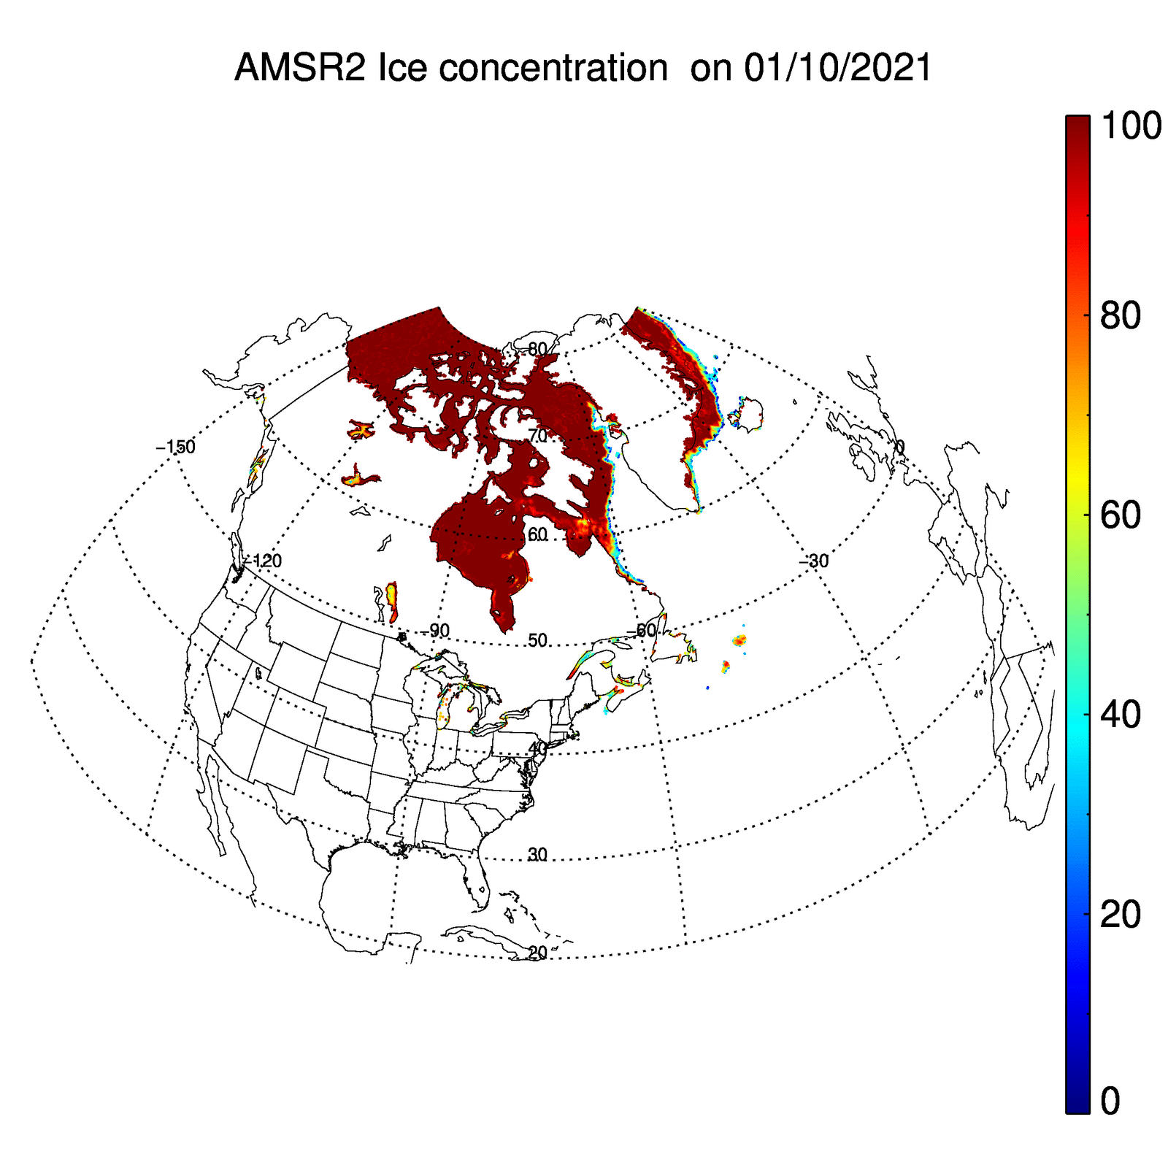
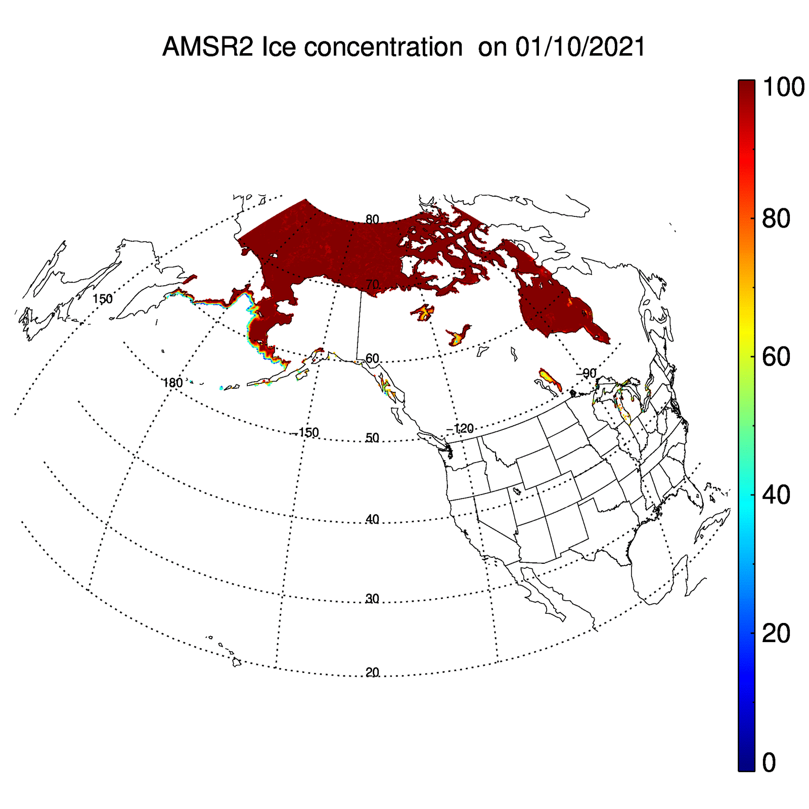
AMSR2 ice concentration
AMSR2 ice concentration from Jan 10-18 2021
AMSR2 ice concentration from Jan 10-18 2021
Notes:
19
High-quality in-situ validation site for LST is very limited, especially after GOES-17 becomes GOES-West.
More sites are needed.
19

Slide 20
Calibration/Validation Results

Slide 21
Validation Procedures
Matchups (set of quasi-coincident and collocated GOES-16/GOES-17 and reference data):
  Passive microwave ice concentration from AMSR2 (The Advanced Microwave Scanning Radiometer 2), which has been validated and is an operational NOAA product.
  GOES-16 and GOES-17 ice concentration and ice mask, and AMSR2 ice concentration are remapped to 2 km EASE 2 (Equal-Area Scalable Earth version 2) Grid.
Hourly GOES-16 and 17 data are compared to daily AMSR2 data due to the relatively low temporal frequency of sea and lake ice.

Slide 22
Ice Cover Validation
Performance: Ice cover (2 km remap) GOES-16 from Ground System
Case number Total pairs | Sea/Lake ice cover, AMSR2 | Water, AMSR2
Sea/Lake ice cover, ABI | 1.266e+07 | 2.000e+06
Water, ABI | 1.310e+05 | 3.838e+08
Correct detection = 99.47% (total correct for two categories divided by total of all categories)
  The correct detection rate is higher than the 80% correct detection requirement.
PASSED

Slide 23
Ice Cover Validation
Performance: Ice cover (2 km remap) GOES-17 from Ground System
Case number Total pairs | Sea/Lake ice cover, AMSR2 | Water, AMSR2
Sea/Lake ice cover, ABI | 5.605e+06 | 1.141e+06
Water, ABI | 3.904e+04 | 3.840e+08
Correct detection = 99.70% (total correct for two categories divided by total of all categories)
  The correct detection rate is higher than the 80% correct detection requirement.
PASSED

Slide 24
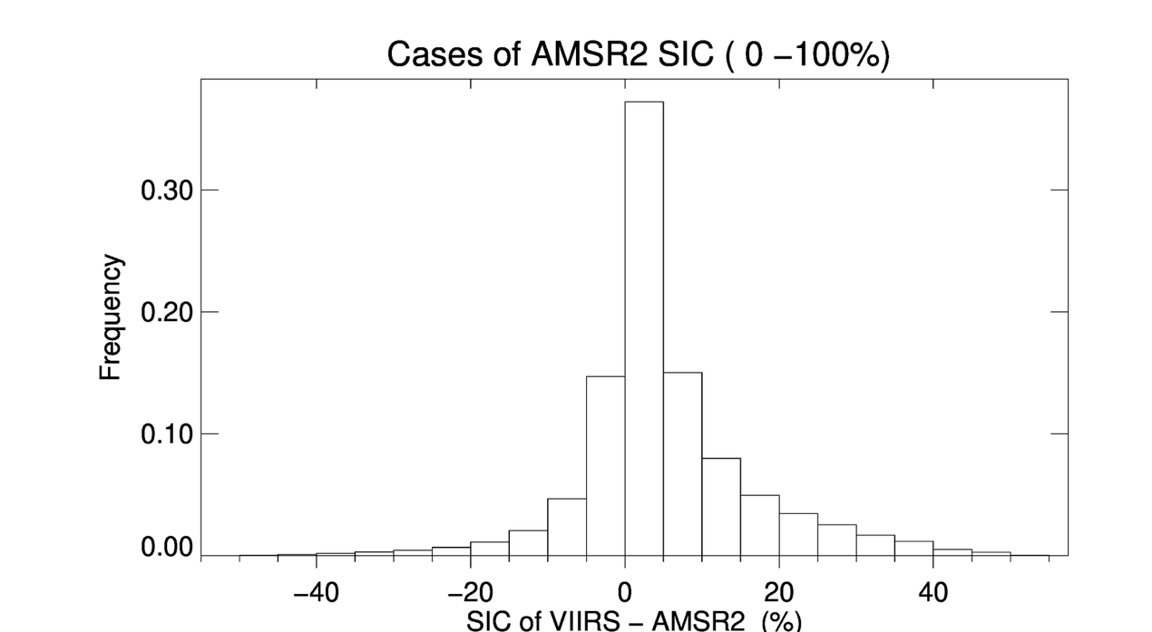
GOES-16 Ice Concentration Validation
Ice concentration (2 km remap) GOES-16 from Ground System
All cases: 1.27 e+07
Accuracy: 1.96%
Precision: 8.58%
SIC of ABI – AMSR2 (%)
  The product accuracy and precision meet the requirement of 10% accuracy and 30% precision.

Slide 25
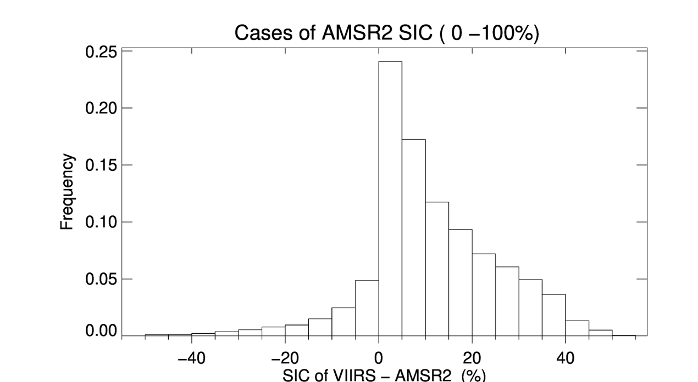
GOES-16 Ice Concentration Validation
Ice concentration (2 km remap) GOES-16 from Ground System
Daytime cases: 2.25 e+05
Accuracy: 2.41%
Precision: 14.86%
SIC of ABI – AMSR2 (%)
  The product accuracy and precision meet the requirement of 10% accuracy and 30% precision.

Slide 26

GOES-16 Ice Concentration Validation
Ice concentration (2 km remap) GOES-16 from Ground System
Nighttime cases: 1.24 e+07
Accuracy: 2.03%
Precision: 8.40%
  The product accuracy and precision meet the requirement of 10% accuracy and 30% precision.

Slide 27
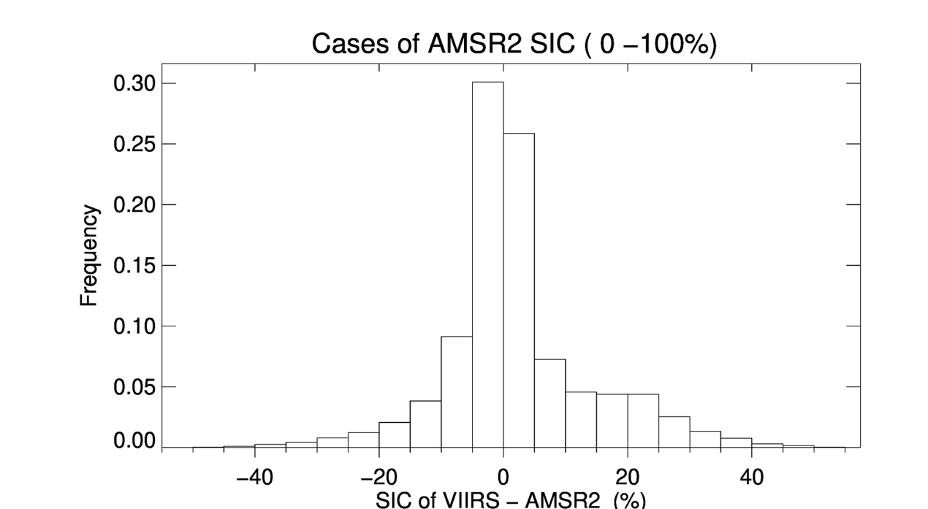
GOES-17 Ice Concentration Validation
Ice concentration (2 km remap) GOES-17 from Ground System
All cases: 5.61 e+06
Accuracy: 1.60%
Precision: 8.96%
  The product accuracy and precision meet the requirement of 10% accuracy and 30% precision.

Slide 28
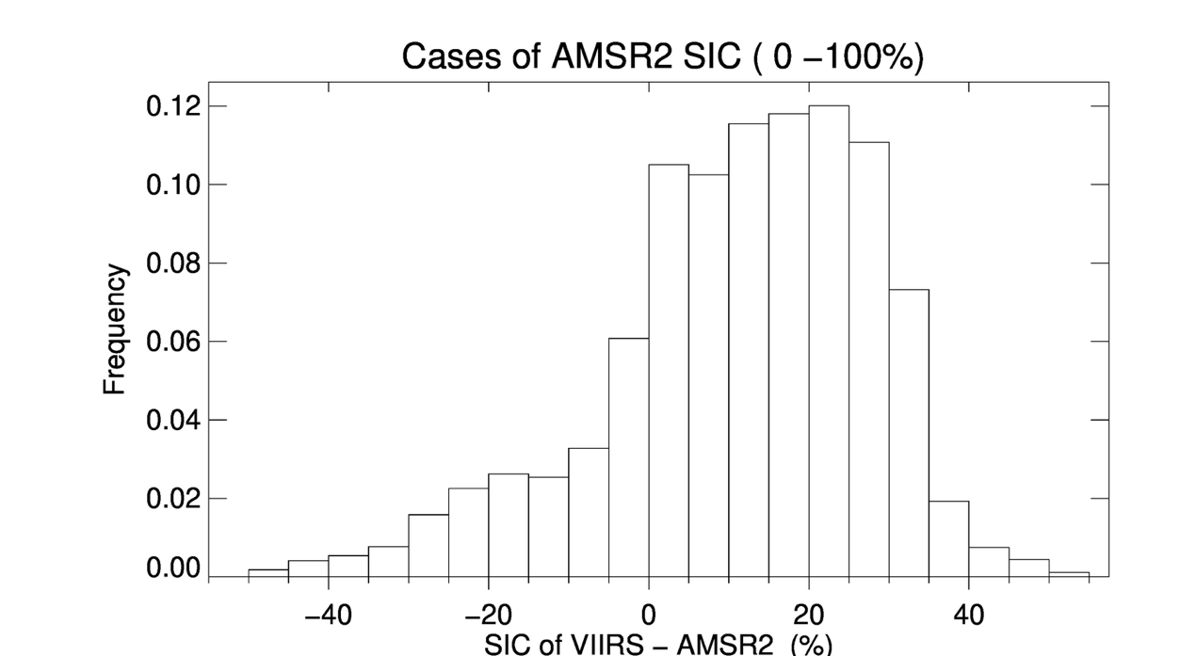
GOES-17 Ice Concentration Validation
Ice concentration (2 km remap) GOES-17 from Ground System
Daytime cases: 5.08 e+04
Accuracy: 4.72%
Precision: 18.10%
  The product accuracy and precision meet the requirement of 10% accuracy and 30% precision.

Slide 29
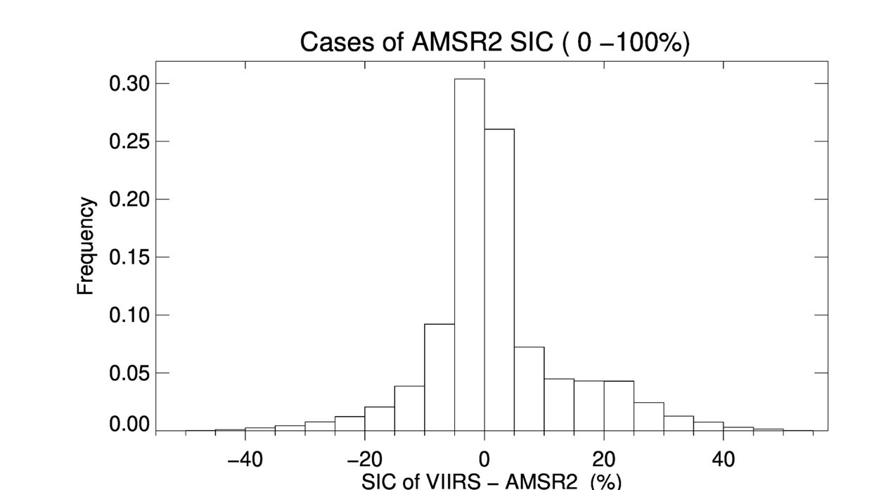
GOES-17 Ice Concentration Validation
Ice concentration (2 km remap) GOES-17 from Ground System
Nighttime cases: 5.55 e+06
Accuracy: 1.66%
Precision: 8.81%
  The product accuracy and precision meet the requirement of 10% accuracy and 30% precision.

Slide 30
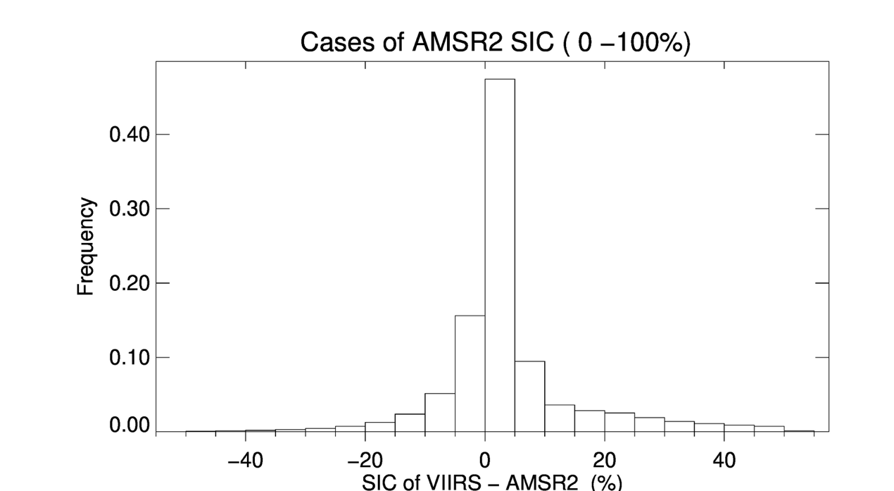
Validation of ASSISTT products
Ice concentration (2 km remap) GOES-16 from ASSISTT
All cases: 1.51 e+08
Accuracy: 1.69%
Precision: 8.76%
  The product accuracy and precision meet the requirement of 10% accuracy and 30% precision.

Slide 31
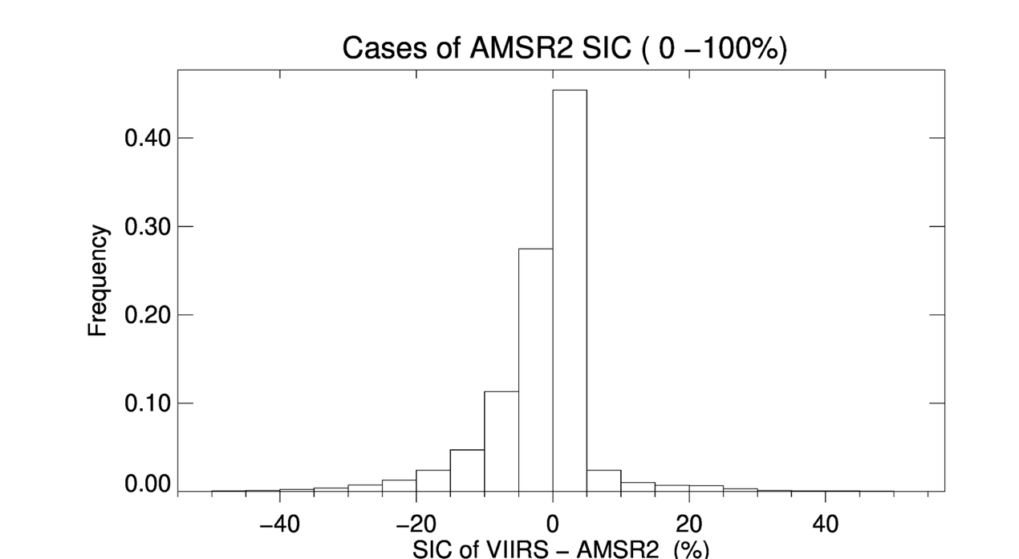
Validation of ASSISTT products
Ice concentration (2 km remap) GOES-17 from ASSISTT
All cases: 4.86 e+07
Accuracy: 2.44%
Precision: 8.31%
  The product accuracy and precision meet the requirement of 10% accuracy and 30% precision.

Slide 32
Validation Summary
GOES-16 and 17 ABI sea and lake ice concentration products from the Ground System from January 10-18, 2021, and from the Framework in February and March 2020 have been produced.
The ABI ice concentration and ice cover products are evaluated using AMSR2 daily ice concentration products, with both products remapped to 2 km EASE-Grid v2.
Results show correction detection rate of ABI ice cover is over 99%, which meets the requirement of 80%.
Results also show the ABI ice concentration has an measurement accuracy of 1.96% (2.41%, 2.03%) and precision of 8.58% (14.86%, 8.40) for GOES-16 (daytime and nighttime), and accuracy of 1.60% (4.72%, 1.66%) and precision of 8.96% (18.10%, 8.81) for GOES-17 (daytime and nighttime) with a 2 km remapped comparison, which meets the requirement of accuracy at 10% and precision at 30%.
The validation has also been carried out with all products remapped to 4 km EASE 2 Grid, and same validation results are derived. Validation results are not dependent on the spatial resolution of the remapping common grids.
Notes:
Performance of enterprise algorithm is better than baseline.

Slide 33
Provisional Maturity Assessment
GOES-16 & GOES-17 NOAT Cryosphere Products Provisional PS-PVR

Slide 34
Provisional Validation
Preparation Activities | Assessment
Validation activities are ongoing and the general research community is now encouraged to participate. | True
Severe algorithm anomalies are identified and under analysis. Solutions to anomalies are in development and testing. | There are no severe, or even mild, algorithm anomalies.
Incremental product improvements may still be occurring. | The results of this review are not dependent upon any planned improvements.
Notes:
This needs update from the management?

Slide 35
Provisional Validation
End State | Assessment
Product performance has been demonstrated through analysis of a small number of independent measurements obtained from select locations, periods, and associated ground truth or field campaign efforts. | A limited, but not small, set of product examples have been evaluated.
Product analysis is sufficient to communicate product performance to users relative to expectations (Performance Baseline). | True
Documentation of product performance exists that includes recommended remediation strategies for all anomalies and weaknesses. Any algorithm changes associated with severe anomalies have been documented, implemented, tested, and shared with the user community. | There are no anomalies or significant weaknesses.
Testing has been fully documented. | This slide set is the documentation for test results.
Product is ready for operational use and for use in comprehensive cal/val activities and product optimization. | True

Slide 36
Path to Delta Review
GOES-16 & GOES-17 NOAT Cryosphere Products Provisional PS-PVR

Slide 37
Issues
The Delta Provisional PS-PVR is for enterprise algorithms with GOES-17 loop heat pipe (LHP) mitigation, including the “warm” period. It is currently scheduled for 7 January 2022.
Major issues:
  FPM overheating degrades product quality
  An accurate cloud mask is key to the performance of sea and lake ice products
Others:
  There are differences in performance between products during daytime and nighttime
  Quality flag and product indicator index needs further examination
Notes:
From E. Kline: The delta Provisional PS-PVR is for GOES-17 only. For cryo products it is currently scheduled for January 7, 2022. This will be a review of the enterprise algorithm with mitigations for the LHP anomaly incorporated. In the current review we are "ignoring" warm periods of GOES-17 performance, instead focusing on cool periods for GOES-17, and all times for GOES-16.

Slide 38
Path to Delta Maturity
Impact of LHP overheating on ice products and our LHP mitigation needs further testing and evaluation.
We expect to carry out the same activities for future maturity review
  The collection of Ground System ice products will continue. The current time series is not long enough to yield statistically significant conclusions.
  Case studies will be carried out.
  Validation employing data from polar-orbiting satellites, aircraft, and in situ measurements will continue.
Install, testing, and GEAR review of the Enterprise algorithms.

Slide 39
Full Validation PLPTs
There are currently no Full Validation PLPTs for ice products. The table below lists the types of tests to be performed.
PLPT ID | Descriptive Title
IceConcQuickLook | Qualitative inspection of ice concentration product.
IceMaskQuickLook | Qualitative inspection of ice mask.
IceConcentration | Full disk ice concentration product accuracy and precision assessment using in-house tools for matchup and statistical analysis comparing ABI ice concentration to AMSR2 ice concentration. Ice products generated by the Ground System will be used in the analyses.
IceMask | Same as above

Slide 40
Path to Delta Validation – Risks
Risk Name | Description | Impact | Mitigation and Schedule
N/A

Slide 41
Summary & Recommendations
GOES-16 & GOES-17 NOAT Cryosphere Products Provisional PS-PVR

Slide 42
Summary
The analysis is based on the data with relatively low and stable FPM temperature (the “cool” period for GOES-17).
Due to the limited availability of Ground System ice products, additional ice products generated by ASSISTT for last winter were also used in the analyses.
Overall, the ice concentration and extent product meets the mission requirement of accuracy and precision.

Slide 43
Recommendation
The AWG Cryosphere Team believes that the GOES-16 and GOES-17 ice concentration and extent product has reached Provisional Maturity.

Slide 44
GOES-16 & -17 ABI L2+
Provisional PS-PVR
Ice Thickness & Age
Xuanji Wang
CIMSS/UW-Madison
January 21, 2021
GOES-R AWG

Slide 45
PRODUCT OVERVIEW
GOES-16 & GOES-17 NOAT Cryosphere Products Provisional PS-PVR

Slide 46
Ice Age/thickness Products Background
Ice age is the time period of ice existence. The mission requirement is for ice age categories, not age per se. The three categories are ice free, first year ice, and older ice.
The algorithm determines the age category based on ice thickness, which it estimates.
Ice thickness is retrieved by the One-dimensional Thermodynamic Ice Model (OTIM), based on ice surface energy budget theory.
GOES-16/17 ice age/thickness EDR is a Full Disk (FD) product.
Users needs:
  One of the Essential Climate Variables (ECVs) in the Third version of the ECV Inventory by the Global Climate Observing System (GCOS) of the WMO
  General users for long-term global ice monitoring, hydrological monitoring, numerical model prediction, ecosystem monitoring, and climate studies, etc.
Notes:
Current algorithm does not use the term of the emissivity difference between band 14 and 15. Our efforts have been focused on the enterprise algorithm.
Application examples
Downscaling of GOES-16 LST over urban or non-urban areas and its application in weather prediction models.
Air surface temperature, heat index.
Application in drought, downscaling soil moisture product.

Slide 47
Mission Requirements
GOES-16/17 Sea/Lake Ice Thickness/ Age Mission Requirements
Satellite Source | GOES-16/17 ABI
Accuracy | 80% correct classification
Measurement Range | 0 - 3.0 m for Ice Thickness Ice free, first year, and older ice classification for Ice Age
Latency | 3236 seconds
Timeliness | 3236 seconds
Refresh | 3 hours
Coverage | FD
Horizontal Resolution | FD – 2 km
Cloud Cover Conditions Qualifier | Clear Conditions associated with threshold accuracy
Temporal Qualifier | Ice Covered waters; Day and Night Day with sun at less than 67 degree solar zenith angle
Product Extent Qualifier | Quantitative out to at least 67 degrees LZA and qualitative at larger LZA (Note: AITA is processed out to LZA = 80 degrees)

Slide 48
Ice age/thickness processing flow
Top-Level Processing
OTIM and Ice age classification begin
ABI Channel Used: Retrieved products, e.g., cloud, IST.
Algorithm Dependencies: See separate slide.
Ancillary Data Dependencies: NWP/NCEP/ECMWF, et al.
Products Generated: Ice thickness and age and associated quality flags.
Surface air temperature, pressure, wind, and moisture (optional)
Cloud mask, ice physical properties, snow cover, sea/lake mask
Ice type
end
For each pixel
Surface albedo
Surface temperature
Surface radiative fluxes
Surface heat fluxes
One-dimensional Thermodynamic Ice Model - OTIM
All-sky sea/lake ice thickness
For each pixel
Sea/lake ice age classification
end
All-sky sea/lake ice age
OTIM and Ice age Classification end

Slide 49
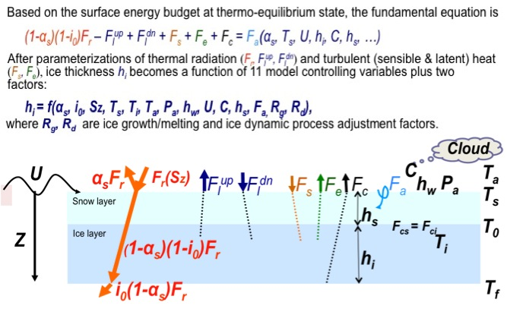
Ice Age/Thickness Algorithm Overview
One-Dimensional Thermodynamic Ice Model (OTIM)
One-dimensional Thermodynamic Ice Model (OTIM)

Slide 50
GOES-16/17 Ice Age/Thickness Product
Algorithm Dependencies
OTIM Algorithm Dependencies
Cloud products
Radiation products
Sounding products
Cloud mask
Solar radiation
Air temperature
Cloud fraction
Thermal radiation
Air moisture
Cloud opt. prop.
Surface albedo
Air pressure
Cryosphere ice thickness/age algorithm
Snow cover
Ice identification
Surface skin temp.
Surface wind
Snow depth
Ice concentration

Slide 51
Product quality evaluation
GOES-16 & GOES-17 NOAT Cryosphere Products Provisional PS-PVR

Slide 52
Top Level Summary of Product Quality
The analysis was based on the available GOES-16/17 data from the ASSISTT for some days in February and March in 2020, and from the GS/PDA for some days in January 2021.
The GOES-16/17 hourly data were used to make a daily composite ice products for the best chance to have maximum ice cover available and compare to other daily ice products from US NIC, CryoSat-2, SMOS, NOAA-19, NOAA-20, IceBridge. Some are indirect comparisons.
Since ice age is based on ice thickness, we want to go beyond about the validation by checking the ice thickness accuracy in comparison with the data from other sources as well.
Overall, the GOES ice age/thickness products meet the requirements. It appears that cloud contamination is still an issue. Statistics for ice thickness/age from ASSISTT are somewhat better than from GS/PDA, though both have limited days of data.

Slide 53
PLPTs Under Review: Provisional
There has not been a Period of Post-Launch Product Testing (PLPT) for ice products. The table below lists the types of test performed, details of which are on the subsequent slides.
Test ID | Test Title
IceThicknessQuickLook | Qualitative inspection of ice thickness product.
IceAgeQuickLook | Qualitative inspection of ice age product.
IceThickness | Full disk ice thickness product accuracy and precision assessment using in-house tools for matchup and statistical analysis comparing ABI ice thickness to ice charts and ice thickness from VIIRS and CryoSat2. Ice products generated by the Ground System on PDA and by ASSISTT are used in the analyses.
IceAge | Same as above

Slide 54
Closed ADRs
Title | Description | Status | Mitigation
none
Notes:
Items 2 and 3 combined in the same ADR 340
Item 5 was added to ADR 644 in the last minute.

Slide 55
Open/Pending ADRs
Title | Description | Status | Mitigation
ADR 1133 | Enterprise ITA added to the Ground System
ADR 1143 | Cryosphere products DQF improvements |  | Science team is evaluating current quality flags and assessing the need for new ones
Notes:
Unsigned-integer data type leads to much confusion among different software packages, it is proposed to change the data type to signed integer and only use the positive half for LST. Advantages: 1. Consistent to its current implementation, 2. No confusion. Disadvantage: scaling error doubles, negligible impact on product performance.

Slide 56
GOES-16/17 Data Used in this Review
GOES-16 Framework Data
– February 1-28, and April 17-30, 2018
GOES-16/17 ASSISTT Data
– February 4-25, 2020
GOES-16/17 GS/PDA Data
– January 10-12, 2021

Slide 57
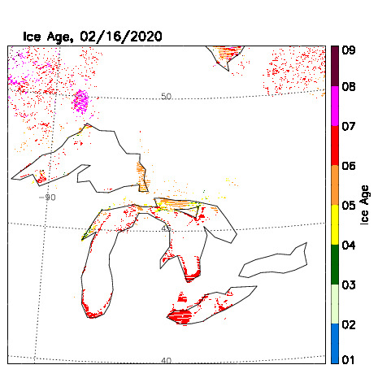
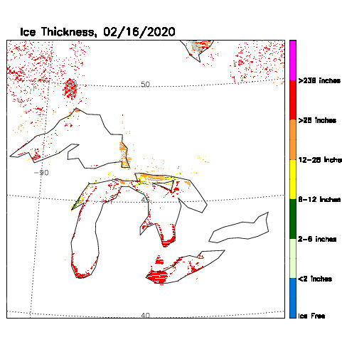
Visual Inspection
GOES-16, 2020-02-16, Ice Age
GOES-16, 2020-02-16, Ice Thickness
GOES-16/17 Ice age and ice thickness data from the ASSISTT.
Notes:
Left: FD and CONUS LSTs at GOES-Test. An example impacted by high FPM temperature (Middle: maximum at around 103 K).
Anomaly, saturation (missing data), striping can be observed between Hours 9 and 15.
Right: FD and CONUS LSTs at GOES-West. Relatively low FPM temperature period, minimally impacted by the FPM temp.

Slide 58
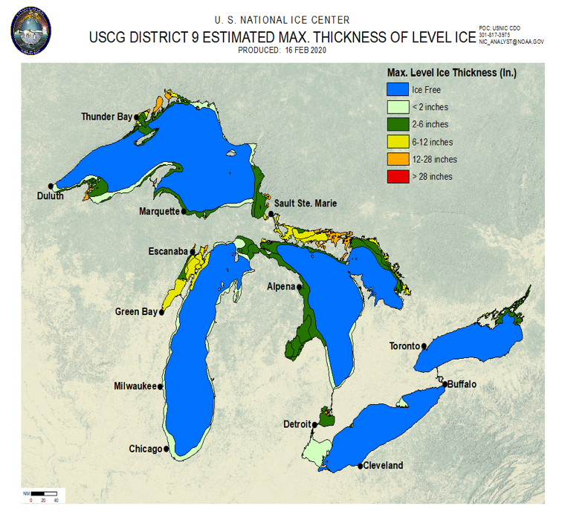
Visual Inspection
GOES-16, 2020-02-16, Ice Thickness
US NIC, 2020-02-16, Ice Thickness
GOES-16/17 data from the ASSISTT
Notes:
Left: FD and CONUS LSTs at GOES-Test. An example impacted by high FPM temperature (Middle: maximum at around 103 K).
Anomaly, saturation (missing data), striping can be observed between Hours 9 and 15.
Right: FD and CONUS LSTs at GOES-West. Relatively low FPM temperature period, minimally impacted by the FPM temp.

Slide 59
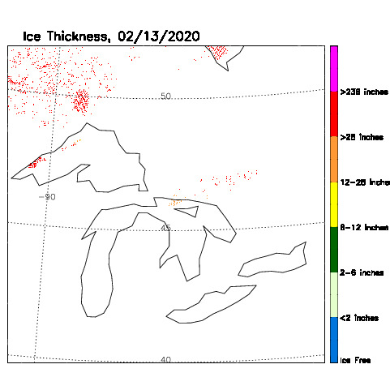
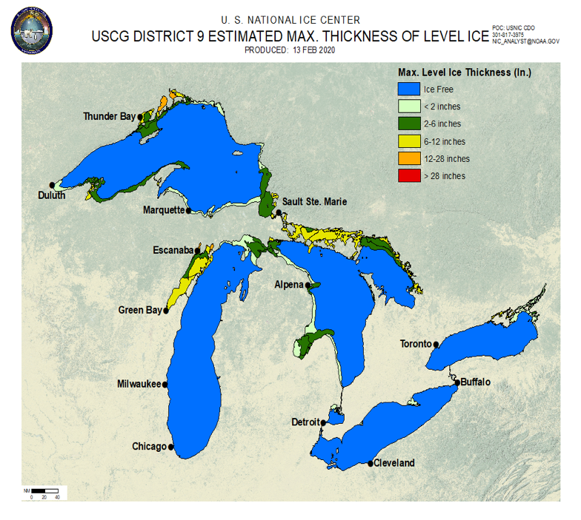
Visual Inspection
GOES-17, 2020-02-13, Ice Thickness
US NIC, 2020-02-13, Ice Thickness
GOES-16/17 data from the ASSISTT
Notes:
Left: FD and CONUS LSTs at GOES-Test. An example impacted by high FPM temperature (Middle: maximum at around 103 K).
Anomaly, saturation (missing data), striping can be observed between Hours 9 and 15.
Right: FD and CONUS LSTs at GOES-West. Relatively low FPM temperature period, minimally impacted by the FPM temp.

Slide 60
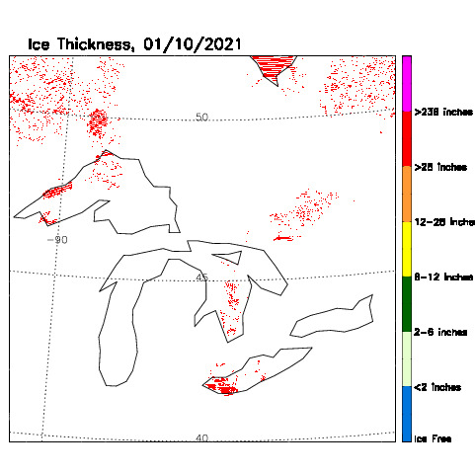
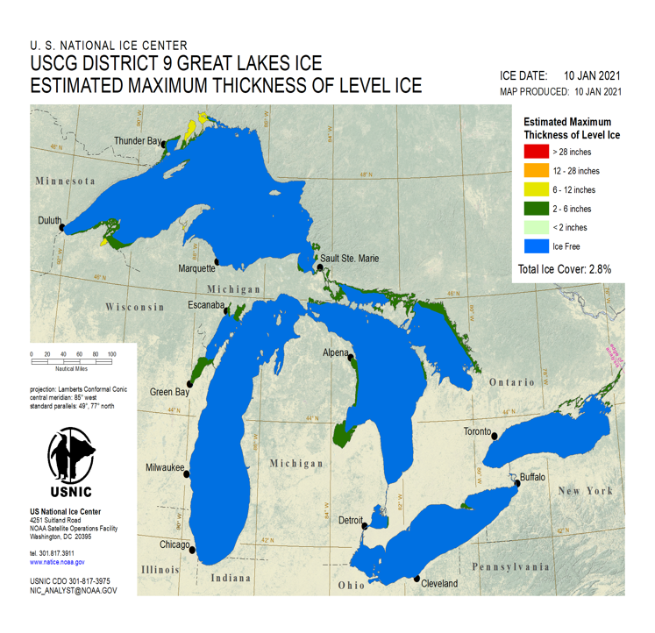
Visual Inspection
GOES-16, 2021-01-10, Ice Thickness
US NIC, 2021-01-10, Ice Thickness
GOES-16/17 data from the GS/PDA
Notes:
Left: FD and CONUS LSTs at GOES-Test. An example impacted by high FPM temperature (Middle: maximum at around 103 K).
Anomaly, saturation (missing data), striping can be observed between Hours 9 and 15.
Right: FD and CONUS LSTs at GOES-West. Relatively low FPM temperature period, minimally impacted by the FPM temp.

Slide 61
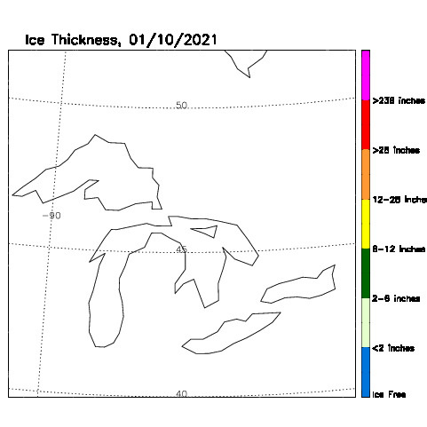

Visual Inspection
GOES-17, 2021-01-10, Ice Thickness
US NIC, 2020-02-13, Ice Thickness
GOES-16/17 data from the GS/PDA
Notes:
Left: FD and CONUS LSTs at GOES-Test. An example impacted by high FPM temperature (Middle: maximum at around 103 K).
Anomaly, saturation (missing data), striping can be observed between Hours 9 and 15.
Right: FD and CONUS LSTs at GOES-West. Relatively low FPM temperature period, minimally impacted by the FPM temp.

Slide 62
PRODUCT VALIDATION
GOES-16 & GOES-17 NOAT Cryosphere Products Provisional PS-PVR

Slide 63
Reference Data
NOAA-19 Data
- February 1-28, April 1-30, 2018, and January 10-12, 2021
NOAA-20 Data
- November, December, 2018, January 2019, February 16, 2020, and January 10-12, 2021
CryoSat-2 and SMOS
- Monthly means of February, April, November, December 2018, and January 2019

Slide 64
Validation Procedures
There are no in-situ measurements of ice thickness in the Great Lakes or Hudson Bay, which are the primary areas for ABI ice products.
Therefore, ABI ice thickness is compared to National Ice Center ice charts (qualitatively), and the thickness data from other satellites (quantitatively).
Note that the requirement is for correct classification in three categories: ice free, first-year ice, and older ice. In the Great Lakes and Hudson Bay, all ice is first-year ice! Meeting that requirement is relatively easy, so we have chosen to validate many more age categories as well as ice thickness.

Slide 65
Sea and Lake Ice Thickness Product Validation: NOAA-19 vs GOES-16 ABI
Comparison of NOAA-19 with GOES-16 ABI Framework (Feb 1-28, 2018)
NOAA-19 GOES-16 ABI NOAA-19 minus GOES-16 ABI Difference histogram
Ice thickness (m) | NOAA-19 | GOES-16 ABI | Difference : ABS(GOES-16 minus NOAA-19)
Mean | 1.42 | 1.43 | 0.02 (1.41%) in terms of APP-x mean
|Mean| | 1.42 | 1.43 | 0.02 (1.41%) in terms of APP-x mean
STD | 0.65 | 0.65 | 0.06 (4.23%) in terms of APP-x mean
RMS | 1.56 | 1.57 | 0.06 (4.23%) in terms of APP-x mean
RMSE | 0.65 | 0.65 | 0.06 (4.23%) in terms of APP-x mean

Slide 66
Sea and Lake Ice Age Product Validation: NOAA-19 vs GOES-16 ABI
Ice age category: Ice free (<=0.001m), New ice (0.001~0.10m), Grey ice (0.10~0.15m),
Grey-white ice (0.15~0.30m), Thin first-year (FY) ice (0.30~0.70m),
Median first-year (FY) ice (0.70~1.20m), Thick first-year (FY) ice (1.20~1.80m),
Older ice (>=1.80m).
Mission requirement: Ice free, First-year ice, older ice.
Comparison of NOAA-19 with GOES-16 ABI Framework (Feb 1-28, 2018)
 | Total ice | Ice free | New Ice | Grey ice |  | Grey-white ice | Thin FY ice | Median FY ice |  | Thick FY ice | Older ice
 | Number of total Pixels
NOAA-19 | 27512 | 0 | 2148 | 255 |  | 350 | 2402 | 743 |  | 13697 | 7917
GOES-16 | 27512 | 0 | 2148 | 255 |  | 350 | 2402 | 743 |  | 13480 | 8134
Difference |  | 0 (0%) | 0 (0%) | 0 (0%) |  | 0 (0%) | 0 (0%) | 0 (0%) |  | 217 (1.58%) | 217 (2.74%)
Requirement Accuracy (>80%) |  | Ice free |  |  | First-year ice |  |  |  | Older ice
 |  |  |  |  | 98.89% (1.11% error) |  |  |  | 97.26% (2.74% error)
PASSED

Slide 67
Sea and Lake Ice Age Product Validation: NOAA-19 vs GOES-16 ABI
Comparison of NOAA-19 with GOES-16 ABI Framework (Feb 10, 2018)
 | Total ice | Ice free |  | New Ice | Grey ice | Grey-white ice |  | Thin FY ice | Median FY ice |  | Thick FY ice | Older ice
 | Number of total Pixels
NOAA-19 | 16480 | 0 |  | 0 | 1 | 0 |  | 44 | 221 |  | 13646 | 2717
GOES-16 | 16480 | 0 |  | 0 | 1 | 0 |  | 44 | 221 |  | 13330 | 3030
Difference |  | 0 (0%) |  | 0 (0%) | 0 (0%) | 0 (0%) |  | 0 (0%) | 0 (0%) |  | 316 (2.32%) | 313 (11.52%)
Requirement |  |  | Ice Free |  |  |  | First-year ice |  |  | Older ice
Accuracy (> 80%) |  |  |  |  |  |  | 97.71% (2.29% error) |  |  | 88.48% (11.52%)
PASSED

Slide 68
Sea and Lake Ice Age Product Validation: NOAA-19 vs GOES-16 ABI
Comparison of NOAA-19 with GOES-16 ABI Framework (April 30, 2018)
 | Total ice | Ice free |  | New Ice | Grey ice | Grey-white ice |  | Thin FY ice | Median FY ice |  | Thick FY ice | Older ice
 | Number of total Pixels
NOAA-19 | 21016 | 0 |  | 0 | 0 | 0 |  | 20 | 41 |  | 3748 | 17302
GOES-16 | 21016 | 0 |  | 0 | 0 | 0 |  | 20 | 41 |  | 3852 | 17195
Difference |  | 0 (0%) |  | 0 (0%) | 0 (0%) | 0 (0%) |  | 0 (0%) | 0 (0%) |  | 104 (2.77%) | 107 (0.62%)
Requirement |  |  | Ice free |  |  |  | First-year ice |  |  | Older ice
Accuracy (>80%) |  |  |  |  |  |  | 97.20% (2.80% error) |  |  | 99.38% (0.62% error)
PASSED
68

Slide 69
Sea and Lake Ice Thickness Product Validation: CryoSat-2 vs GOES-16 ABI
Comparison of CryoSat-2 with GOES-16 ABI Framework (Feb 1-28, 2018)
CryoSat-2 GOES-16 ABI CryoSat-2 minus GOES-16 ABI Difference histogram
Ice thickness (m) | CryoSat-2 | GOES-16 ABI | Difference : ABS(GOES-16 minus CryoSat-2)
Mean | 1.76 | 1.76 | 0.005 (0.28%) in terms of CryoSat-2 mean
|Mean| | 1.76 | 1.76 | 0.025 (1.42%) in terms of CryoSat-2 mean
STD | 0.76 | 0.74 | 0.13 (7.39%) in terms of CryoSat-2 mean
RMS | 1.91 | 1.91 | 0.13 (7.39%) in terms of CryoSat-2 mean
RMSE | 0.76 | 0.74 | 0.13 (7.39%) in terms of CryoSat-2 mean
69
Notes:
The CryoSat-2 sea ice thickness data is from http://data.meereisportal.de/gallery/index_new.php?lang=en_US&ice-type=extent&active-tab1=measurement&active-tab2=thickness.
meereisportal.de/seaiceportel.de is an initiative of the Helmholtz Climate Initiative (REKLIM), the Alfred Wegener Institut, Helmholtz Centre for polar and marine research, in cooperation with the University of Bremen (Institute for environmental physics). Its aim is to gather all important and up-to-date information connected to the subject of sea ice. The portal is offering comprehensive background information, processed data and direct access to the data base.
meereisportal.de/seaiceportal.de was laid out as an open portal and shall serve scientific groups performing research on sea ice as a platform for communicating the results of their research.

Slide 70
Sea and Lake Ice Thickness Product Validation: CryoSat-2 vs GOES-16 ABI
Comparison of CryoSat-2 with GOES-16 ABI Framework (April, 2018)
CryoSat-2 (April 1-30) GOES-16 ABI (April 17-30) CryoSat-2 minus GOES-16 ABI Difference histogram
Ice thickness (m) | CryoSat-2 | GOES-16 ABI | Difference: ABS (GOES-16 minus CryoSat-2)
Mean | 1.93 | 1.95 | 0.018 (0.93%) in terms of CryoSat-2 mean
|Mean| | 1.93 | 1.95 | 0.019 (0.98%) in terms of CryoSat-2 mean
STD | 0.75 | 0.73 | 0.15 (7.77%) in terms of CryoSat-2 mean
RMS | 2.08 | 2.08 | 0.15 (7.77%) in terms of CryoSat-2 mean
RMSE | 0.75 | 0.73 | 0.15 (7.77%) in terms of CryoSat-2 mean
70

Slide 71
Sea and Lake Ice Age Product Validation: CryoSat-2 vs GOES-16 ABI
Comparison of CryoSat-2 with GOES-16 ABI Framework (Feb 1-28, 2018)
 | Total ice | Ice free |  | New Ice | Grey ice | Grey-white ice |  | Thin FY ice | Median FY ice |  | Thick FY ice | Older ice
 | Number of total Pixels
CryoSat-2 | 15152 | 0 |  | 16 | 22 | 67 |  | 473 | 2693 |  | 6166 | 5715
GOES-16 | 15152 | 0 |  | 14 | 19 | 65 |  | 450 | 2519 |  | 6495 | 5590
Difference |  | 0 (0%) |  | 2 (12.50%) | 3 (13.64%) | 2 (2.99%) |  | 23 (4.86%) | 174 (6.46%) |  | 329 (5.34%) | 313 (5.48%)
Requirement |  |  | Ice free |  |  |  | First-year ice |  |  | Older ice
Accuracy (>80%) |  |  |  |  |  |  | 94.35% (5.65% error) |  |  | 97.80% (2.20% error)
PASSED

Slide 72
Sea and Lake Ice Age Product Validation: CryoSat-2 vs GOES-16 ABI
Comparison of CryoSat-2 with GOES-16 ABI Framework (April, 2018)
 | Total ice | Ice free |  | New Ice | Grey ice | Grey-white ice |  | Thin FY ice | Median FY ice |  | Thick FY ice | Older ice
 | Number of total Pixels
CryoSat-2 | 14456 | 0 |  | 18 | 11 | 62 |  | 379 | 1730 |  | 4503 | 7753
GOES-16 | 14456 | 0 |  | 8 | 9 | 31 |  | 290 | 1614 |  | 4744 | 7760
Difference |  | 0 (0%) |  | 10 (55.56%) | 2 (22.22%) | 31 (50.00%) |  | 89 (23.48%) | 116 (6.71%) |  | 104 (5.35%) | 107 (1.38%)
Requirement |  |  | Ice free |  |  |  | First-year ice |  |  | Older ice
Accuracy (>80%) |  |  |  |  |  |  | 94.75% (5.25% error) |  |  | 98.62% (1.38% error)
PASSED

Slide 73
Additional Algorithm Verification: NOAA-20 vs CryoSat-2/SMOS
NOAA-20 CryoSat-2/SMOS
Because of the small GOES-16/17 sample sizes, we demonstrate the validity of the ice thickness/age algorithm using VIIRS data compared to ice thickness from a satellite radar altimeter and passive microwave blended product (this slide), and an altimeter system on an aircraft (next slide).
Period composite of ice thickness over January 3 - 28, 2019 from NOAA-20.
Monthly mean of ice thickness for January 2019 from CryoSat-2 and SMOS combined.
No. of Pixels | Water | New/Young Ice (< 0.30 m) | Other ice (>= 0.30 m)
CTP | 19228 | 273 | 17156
TMP | 39962
PCT | 92%
CTP: Correctly Typed Pixels
TMP: Total Matched Pixels
PCT: Probability of Correct Typing
Notes:
Performance of enterprise algorithm is better than baseline.

Slide 74
Additional Algorithm Verification: NOAA-20 vs CryoSat-2/SMOS
November 2018
No. of Pixels | Water | New/Young Ice (< 0.30 m) | Other ice (>= 0.30 m)
CTP | 22133 | 468 | 11603
TMP | 40274
PCT | 85%
December 2018
No. of Pixels | Water | New/Young Ice (< 0.30 m) | Other ice (>= 0.30 m)
CTP | 20636 | 413 | 14852
TMP | 40059
PCT | 90%
January 2019
No. of Pixels | Water | New/Young Ice (< 0.30 m) | Other ice (>= 0.30 m)
CTP | 19228 | 273 | 17156
TMP | 39962
PCT | 92%
CTP: Correctly Typed Pixels
TMP: Total Matched Pixels
PCT: Probability of Correct Typing
Notes:
Performance of enterprise algorithm is better than baseline.

Slide 75
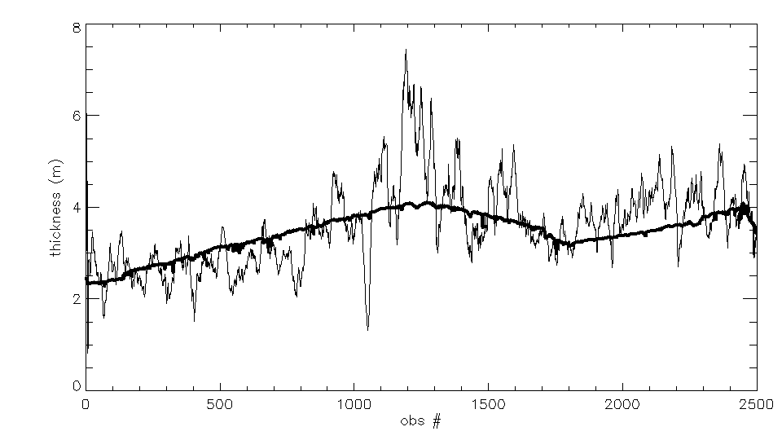
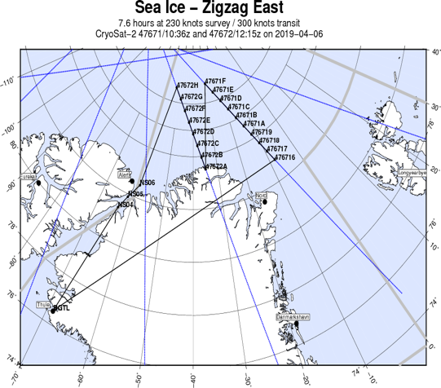
Additional Algorithm Verification: NOAA-20 vs IceBridge
Figure 2. NOAA-20 ice thickness product (dark, smoother line) vs. IceBridge ice thickness measurements (jumpy line) along the flight track, for approximately 2500 observations. IceBridge observations were smoothed with a running 20-point filter. The same algorithm is used for both GOES , NOAA-20 and NPP ice thickness products. From Mark A. Tschudi.
Thickness product Mean (m) St. Dev. (m)
IceBridge 2.80 2.32
NOAA-20 2.68 1.48
Accuracy of NPP-VIIRS in terms of IceBridge : 95%, for all Older ice

Slide 76
GOES-17 Ice Products (From ASSISTT) Validation (GOES daily composite ice products vs NOAA-20, both remapped to same EASE grid for the Arctic area)
GOES-17 from ASSISTT
NOAA-20
GOES-17 minus NOAA-20
02/16/2020
GOES-17 NOAA-20
Mean 1.071 1.066
Median 0.722 0.861
STD 0.825 0.737
Older ice has small sample size and more likely cloud contamination influence.
Requirement | Ice free | First-year ice | Older ice
Pixel number | GOES-17 vs NOAA-20 | 1041 vs 1122 | 316 vs 235
Accuracy (>80%) |  | 92.22% (7.78% error) | 74.37% (25.63% error)
PASSED
Notes:
US NIC ice thickness is estimated based on Canadian NAIS ice chart, without quantitative data available, just chart. So only qualitative/visual comparison can be done. There are some Ice existence differences between the two, especially Lake Erie and southern part of Lake Michigan. There are ice in southern part of Lake Michigan, Lake Huron, and Lake Erie as seen in both images.

Slide 77
GOES-17 Ice Products (From GS/PDA) Validation (GOES daily composite ice products vs NOAA-20, both remapped to same EASE grid for the Arctic area)
GOES-17 from GS/PDA
NOAA-20
GOES-17 minus NOAA-20
01/11/2021
Requirement | Ice free | First-year ice | Older ice
Pixel number | GOES-17 vs NOAA-20 | 953 vs 953 | 8 vs 8
Accuracy (>80%) |  | 100% (0% error) | 100% (0% error)
Older ice has small sample size and more likely cloud contamination influence for the lower latitude part of the Arctic.
PASSED
Notes:
US NIC ice thickness is estimated based on Canadian NAIS ice chart, without quantitative data available, just chart. So only qualitative/visual comparison can be done. There are some Ice existence differences between the two, especially Lake Erie and southern part of Lake Michigan. There are ice in southern part of Lake Michigan, Lake Huron, and Lake Erie as seen in both images.

Slide 78
GOES-16 Ice Products (From GS/PDA) Validation (GOES daily composite ice products vs NOAA-20, both remapped to same EASE grid for the Arctic area)
GOES-16 from GS/PDA
NOAA-20
GOES-16 minus NOAA-20
01/10/2021
Requirement | Ice free | First-year ice | Older ice
Pixel number | GOES-16 vs NOAA-20 | 2488 vs 2433 | 55 vs 70
Accuracy (>80%) |  | 97.79% (2.21% error) | 72.73% (27.27% error)
Older ice has small sample size and more likely cloud contamination influence for the lower latitude part of the Arctic.
PASSED
Notes:
US NIC ice thickness is estimated based on Canadian NAIS ice chart, without quantitative data available, just chart. So only qualitative/visual comparison can be done. There are some Ice existence differences between the two, especially Lake Erie and southern part of Lake Michigan. There are ice in southern part of Lake Michigan, Lake Huron, and Lake Erie as seen in both images.

Slide 79
GOES-16 Ice Products (From GS/PDA) Validation (GOES daily composite ice products vs NOAA-19, both remapped to same EASE grid for the Arctic area)
GOES-16 from GS/PDA
NOAA-19
GOES-16 minus NOAA-19
01/11/2021
Requirement | Ice free | First-year ice | Older ice
Pixel number | GOES-16 vs NOAA-19 | 1159 vs 1161 | 2 vs 0
Accuracy (>80%) |  | ~100% (~0% error) | Too less samples
Older ice has small sample size and more likely cloud contamination influence for the lower latitude part of the Arctic.
PASSED
Notes:
US NIC ice thickness is estimated based on Canadian NAIS ice chart, without quantitative data available, just chart. So only qualitative/visual comparison can be done. There are some Ice existence differences between the two, especially Lake Erie and southern part of Lake Michigan. There are ice in southern part of Lake Michigan, Lake Huron, and Lake Erie as seen in both images.

Slide 80
GOES-17 Ice Products (From GS/PDA) Validation (GOES daily composite ice products vs NOAA-19, both remapped to same EASE grid for the Arctic area)
GOES-17 from GS/PDA
NOAA-19
GOES-17 minus NOAA-19
01/11/2021
Requirement | Ice free | First-year ice | Older ice
Pixel number | GOES-17 vs NOAA-19 | 965 vs 972 | 7 vs 0
Accuracy (>80%) |  | 99.93% (0.07% error) | Too less samples
Older ice has small sample size and more likely cloud contamination influence for the lower latitude part of the Arctic.
PASSED
Notes:
US NIC ice thickness is estimated based on Canadian NAIS ice chart, without quantitative data available, just chart. So only qualitative/visual comparison can be done. There are some Ice existence differences between the two, especially Lake Erie and southern part of Lake Michigan. There are ice in southern part of Lake Michigan, Lake Huron, and Lake Erie as seen in both images.

Slide 81
Provisional Maturity Assessment
GOES-16 & GOES-17 NOAT Cryosphere Products Provisional PS-PVR

Slide 82
Provisional Validation
Preparation Activities | Assessment
Validation activities are ongoing and the general research community is now encouraged to participate. | True
Some algorithm anomalies are identified and under analysis. Solutions to anomalies are in development and testing. | There are no anomalies that need to be addressed.
Incremental product improvements may still be occurring. | The results of this review are not dependent upon any planned improvements.
Notes:
This needs update from the management?

Slide 83
Provisional Validation
End State | Assessment
Product performance has been demonstrated through analysis of a number of independent measurements obtained from data sources, periods, and associated field campaign efforts. | A limited, but not small, set of product examples have been evaluated.
Product analysis is sufficient to communicate product performance to users relative to expectations (Performance Baseline). | True
Documentation of product performance exists that includes recommended remediation strategies for all anomalies and weaknesses. Any algorithm changes associated with severe anomalies have been documented, implemented, tested, and shared with the user community. | There are no anomalies or significant weaknesses.
Testing has been fully documented. | This slide set is the documentation for test results.
Product is ready for operational use and for use in comprehensive cal/val activities and product optimization. | True

Slide 84
Path to Delta Review
GOES-16 & GOES-17 NOAT Cryosphere Products Provisional PS-PVR

Slide 85
Issues
The Delta Provisional PS-PVR is for enterprise algorithms with GOES-17 loop heat pipe (LHP) mitigation, including the “warm” period. It is currently scheduled for 7 January 2022.
Major issues:
  FPM overheating degrades product quality
  An accurate cloud mask is key to the performance of sea and lake ice products
Others:
  There are differences in performance between products during daytime and nighttime
  Quality flag and product indicator index needs further examination
Notes:
From E. Kline: The delta Provisional PS-PVR is for GOES-17 only. For cryo products it is currently scheduled for January 7, 2022. This will be a review of the enterprise algorithm with mitigations for the LHP anomaly incorporated. In the current review we are "ignoring" warm periods of GOES-17 performance, instead focusing on cool periods for GOES-17, and all times for GOES-16.

Slide 86
Path to Delta Maturity
Impact of LHP overheating on ice products and our LHP mitigation needs further testing and evaluation.
We expect to carry out the same activities for future maturity review
  The collection of Ground System ice products will continue. The current time series is not long enough to yield statistically significant conclusions.
  Case studies will be carried out.
  Validation employing data from polar-orbiting satellites, aircraft, and in situ measurements will continue.
Install, testing, and GEAR review of the Enterprise algorithms.

Slide 87
Full Validation PLPTs
There are currently no Full Validation PLPTs for ice products. The table below lists the types of tests to be performed.
PLPT ID | Descriptive Title
IceThicknessQuickLook | Qualitative inspection of ice thickness product.
IceAgeQuickLook | Qualitative inspection of ice age product.
IceThickness | Full disk ice thickness product accuracy and precision assessment using in-house tools for matchup and statistical analysis comparing ABI ice thickness to ice charts and ice thickness from VIIRS and CryoSat2. Ice products generated by the Ground System will be used in the analyses.
IceAge | Same as above

Slide 88
Path to Delta Validation – Risks
Risk Name | Description | Impact | Mitigation and Schedule
N/A

Slide 89
Summary & Recommendations
GOES-16 & GOES-17 NOAT Cryosphere Products Provisional PS-PVR

Slide 90
Summary
With regard to the mission requirements, validating ice age categories (first-year and older ice) is simply a validation of the ice mask in the Great Lakes and Hudson Bay. Ice concentration validation showed that the ice mask has an accuracy well over 80%. That conclusion was confirmed here in all tests.
Given that ice age is here defined in terms of ice thickness, we have gone beyond the basic requirement by validating ice thickness itself and additional age categories through comparisons to products from CryoSat-2, SMOS, IceBridge, NOAA-19, and NOAA-20.
Overall, the GOES-16/17 ice age/thickness product meets the requirement. However, it appears that cloud contamination is still an issue.
Notes:
Performance of enterprise algorithm is better than baseline.

Slide 91
Recommendation
The Cryosphere Team recommends the GOES-16/-17 ice thickness and age product for Provisional Maturity.
Notes:
Performance of enterprise algorithm is better than baseline.

Slide 92
GOES-16 & -17 ABI L2+
Provisional PS-PVR
Ice Motion
Aaron Letterly
CIMSS/UW-Madison
January 21, 2021
GOES-R AWG

Slide 93
PRODUCT OVERVIEW
GOES-16 & GOES-17 NOAT Cryosphere Products Provisional PS-PVR

Slide 94
Ice Motion Background
The ABI Automated Ice Motion (AIM) algorithm outputs a vector displacement between two ice-covered sea or lake pixels in a pair of images 24 hours apart.
Ice motion is primarily caused by:
  wind
  water currents
  internal stresses on the ice pack
The product provides a tool for ice analysts to better predict short-term ice conditions. It can also be used to verify modeled ice motion.
Notes:
Current algorithm does not use the term of the emissivity difference between band 14 and 15. Our efforts have been focused on the enterprise algorithm.
Application examples
Downscaling of GOES-16 LST over urban or non-urban areas and its application in weather prediction models.
Air surface temperature, heat index.
Application in drought, downscaling soil moisture product.

Slide 95
Mission Requirements
Products | Sea and Lake Ice Motion: CONUS | Sea and Lake Ice Motion: Hemispheric
Geographic Coverage | CONUS | Full Disk
Horizontal Resolution | 5km | 15km
Mapping Accuracy | ≤ 2.5 km | ≤ 7.5 km
Measurement Range (°) | 0 - 360° | 0 - 360°
Measurement Range (km/day) | 0 – 51.84 km/day | 0 – 51.84 km/day
Measurement Accuracy (°) | 22.5° | 22.5°
Measurement Accuracy (km/day) | 3 km/day | 3 km/day
Measurement Precision (°) | 30.0° | 30.0°
Measurement Precision (km/day) | 3 km/day | 3 km/day
Refresh Rate | 3 hr | 3 hr
Temporal Coverage Qualifier | Solar Zenith Angle < 67 | Solar Zenith Angle < 67
Extent Qualifier | Local Zenith Angle <67 | Local Zenith Angle < 67
Notes:
The Full Disk LST resolution is 10 km. This has a few drawbacks:
10 km resolution limits its application (e.g., drought)
LST has large variability in space, such a coarse resolution is not enough for many studies;
This requires extra processing step of aggregation;
Aggregation algorithm is not available to AWG LST team, we can not reproduce the Full Disk product locally and therefore some issues can not be easily verified;
10 km is much larger than the footprint of in-situ stations (~ a few tens meters), leading to a large validation uncertainty.
All three products are hourly, which can not reflect the quick change of LST and fails to take advantage of the rapid scan by ABI, e.g., 10 (15) min for FD, 5 min for CONUS, and 1 min for two MESOs for mode 3 (6).

Slide 96
AIM processing flow
Ice motion algorithm begin
ABI Band Used:
Band No 2
Band No 14
Algorithm Dependencies:
Cloud mask
Ice mask
Ancillary Data Dependencies:
Land/water mask.
Products Generated:
Ice motion vector and associated quality flags.
Ice Motion is retrieved if
  Pixel availability
        input data not bad data
        input data not missing
  Not over land
  Cloud Mask
    Clear at current time
    Clear at 24-hours previous
  Ice mask
    Ice-covered pixel at current time
    Ice-covered pixel 24 hours previous
Current and 24-hour previous ABI band BTs and cloud mask, land/water mask
begin
Calculate Maximum cross-correlation
Run vector filtering
Determine ice motion vector based on ice mask
Ice motion
Ice motion algorithm end

Slide 97
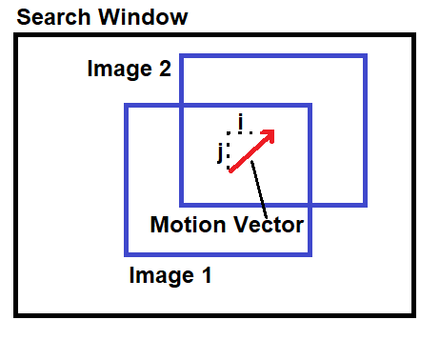
AIM Algorithm Overview
Ice motion algorithm utilizes a cross correlation between sets of pixels in image pairs to determine motion
Current ice motion algorithms apply:
  spatial coherence filter
  displacement filter
  threshold of the correlation coefficient
  to distinguish realistic ice motion vectors

Slide 98
GOES-R AIM Product
Precedence Chain
Cloud Mask Day 1
Ice Mask Day 1
Ice Motion Product
Imagery
Cloud Mask Day 2
Ice Mask Day 2

Slide 99
Product quality evaluation
GOES-16 & GOES-17 NOAT Cryosphere Products Provisional PS-PVR

Slide 100
Top Level Summary of
Product Quality (AIM)
The analysis was based on the product during early January over the Hudson Bay (G16, G17) and Bering Sea (G17) regions
  Supplemental data from ASSIST from February-March 2020 was used
The AIM product quality is not satisfactory
  Overall performance compared to modeled observations shows differences, especially from G17
  Significant reductions in 2021 product data availability due to cloud cover in G16/G17 footprint
The AIM product is not ready for operational use at current capabilities, but could be improved by including additional post-processing steps to increase precision of ice motion speed and direction.

Slide 101
PLPTs Under Review: Provisional
There has not been a Period of Post-Launch Product Testing (PLPT) for ice products. The table below lists the types of test performed, details of which are on the subsequent slides.
Test ID | Test Title
IceMotionQuickLook | Qualitative inspection of ice motion product.
IceMotion | Full disk ice motion product accuracy and precision assessment using in-house tools for matchup and statistical analysis comparing ABI ice motion to similar products based on microwave data. Ice products generated by the Ground System on PDA and by ASSISTT are used in the analyses.

Slide 102
Closed ADRs
Title | Description | Status | Mitigation
none
Notes:
Items 2 and 3 combined in the same ADR 340
Item 5 was added to ADR 644 in the last minute.

Slide 103
Open/Pending ADRs
Title | Description | Status | Mitigation
ADR 1134 | Enterprise IM added to the Ground System
ADR 1143 | Cryosphere products DQF improvements |  | Science team is evaluating current quality flags and assessing the need for new ones
(To be added) | Add clustering procedure to ice motion algorithm. |  | The clustering procedure used by the science team needs to be rewritten from IDL to Fortran or C, delivered to ASSISTT, then implemented in the Ground System. The code conversion can be done in the next 3-6 months.
Notes:
Unsigned-integer data type leads to much confusion among different software packages, it is proposed to change the data type to signed integer and only use the positive half for LST. Advantages: 1. Consistent to its current implementation, 2. No confusion. Disadvantage: scaling error doubles, negligible impact on product performance.

Slide 104
GOES-16/17 Data
Used in this Review
Time period: 01/10 – 01/13, 2021; Days: 10 – 13.
  Files from Ground System made available locally for G16 and G17 on 01/10/2020
  Used all files (21) containing ice motion data in review
  Full Disk domain
Time period: 02/04 – 03/10,2020; Days: 35 – 69.
  Files for G16 and G17 from ASSIST for preliminary data testing
  Used 22 files containing ice motion data in analysis

Slide 105
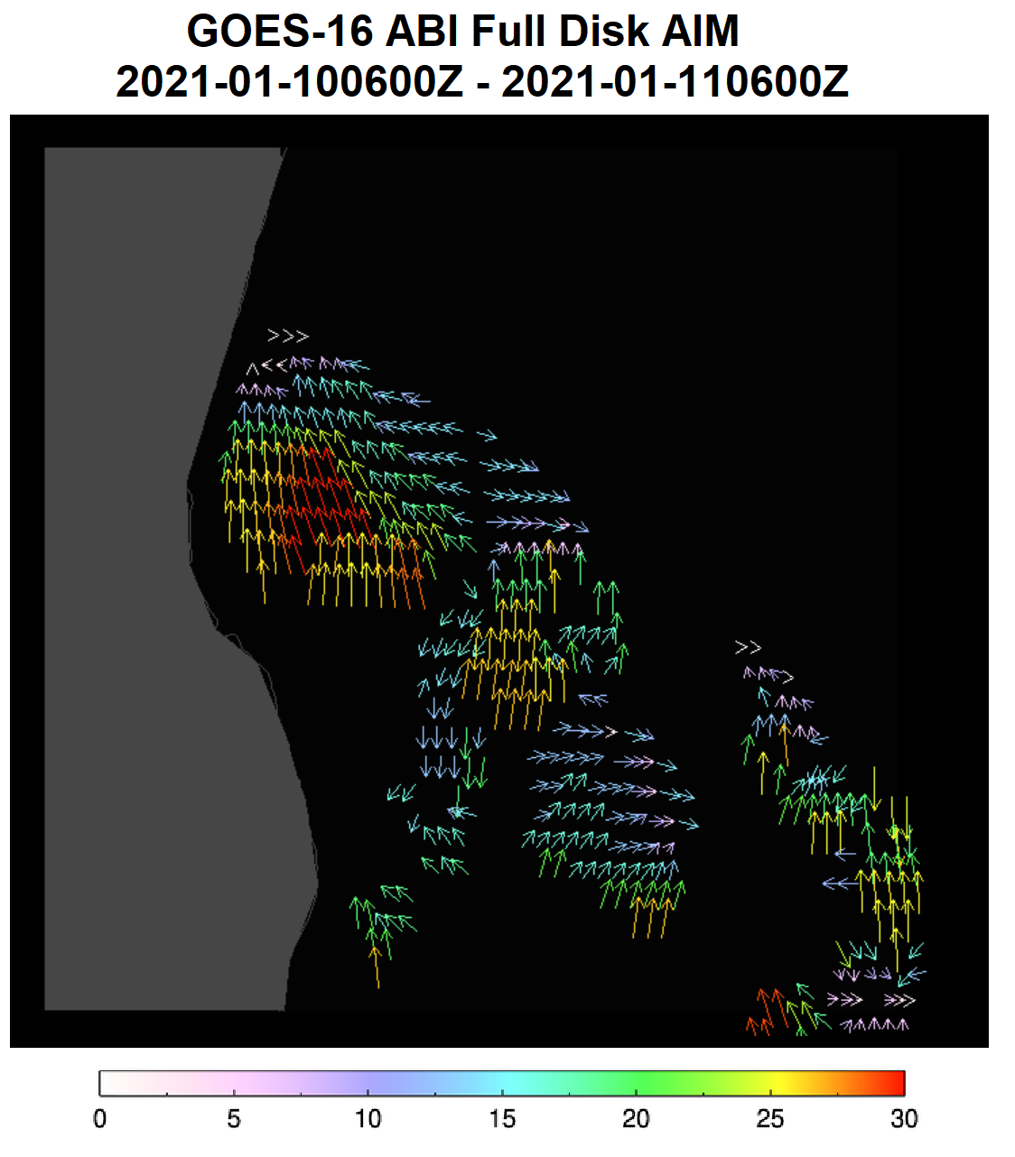
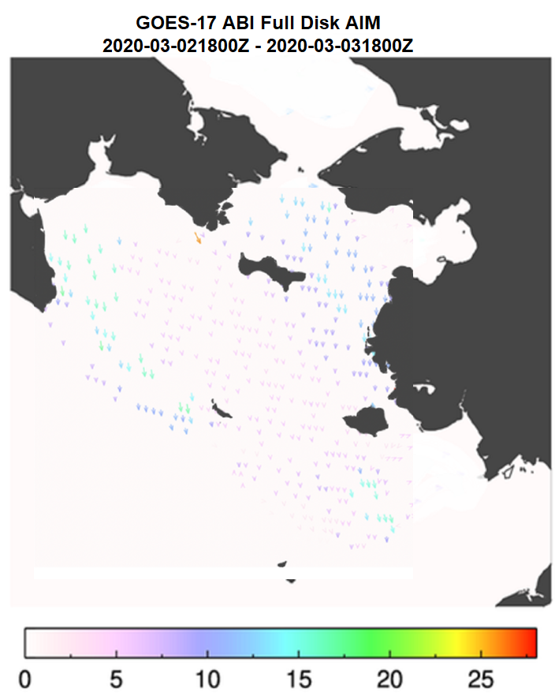
Visual Inspection
GOES-EAST 2021-01-10
GOES-WEST
2020-03-03
Notes:
Left: Some areas of G16 ice motion, under cloud-free conditions, show realistic ice motion patterns. Area-wide ice motion is not as coherent as shown examples
GOES-17 data from ASSIST shown plotted here, showing extent of ice motion footprint in the Bering Sea
Right: FD and CONUS LSTs at GOES-West. Relatively low FPM temperature period, minimally impacted by the FPM temp.

Slide 106
PRODUCT VALIDATION
GOES-16 & GOES-17 NOAT Cryosphere Products Provisional PS-PVR

Slide 107
Reference Data
Reference data: Low-resolution ice drift product from the EUMETSAT Oceans and Sea Ice Satellite Application Facility (OSI-SAF). This is a 48-hour product, whereas the GOES-R ice motion product is for motion over 24 hours.
Matchups (set of quasi coincident and collocated G16/17 and reference data). GOES-R ice motion data are averaged spatially to nearest ice drift vector within 75 km.

Slide 108
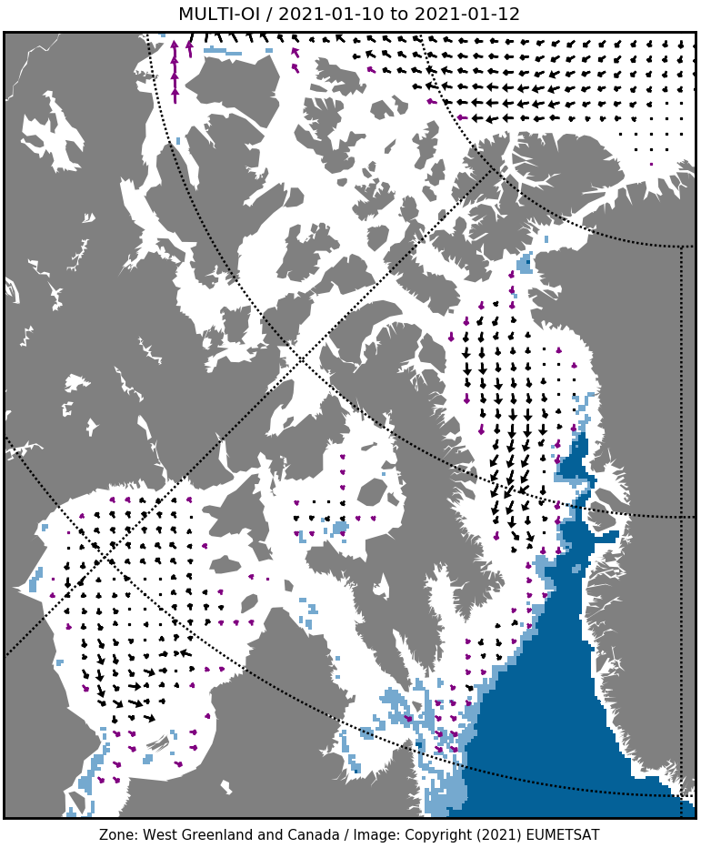
Ice Drift Validation Data
OSI-SAF Motion
  Oceans and Sea Ice Satellite Application Facility (OSI-SAF)
    Low-resolution passive and active microwave data (SSMIS,AMSR-E, ASCAT)
    Well-maintained and continuously assessed for accuracy
    Available with 3-day lag, computed using same MCC method
  Ice motion data at “high” spatial/temporal resolution are not readily available from established datasets
Notes:
108
High-quality validation sets for ice motion is very limited, especially for GOES 17 footprint, which only partially covers the Hudson Bay
More sites are needed, but were not available due to extensive cloud cover
108

Slide 109
Comparison of AIM with OSI-SAF Data

Slide 110
Validation Procedures
Retrieve G16/G17 ABI AIM data and OSI-SAF data for target area (Hudson Bay)
Determine total number of AIM vectors in target area
  If heavy cloud cover across region OR no ABI vectors within 75 km of OSI-SAF data, skip the file for validation
  G16 (2 files unused) / G17 (8 files unused) affected by areal cloud cover during analysis period
Average AIM vectors within 75 km of OSI-SAF measurement
  Determine local bias at each location for speed/direction
Report bias/precision over target area using all local biases

Slide 111
Full Disk AIM Validation
Platform | Speed Accuracy (km/day) | Speed Precision (km/day) | Direction Accuracy (degrees) | Direction Precision (degrees) | Number (Avg)
G16 | 3.46 | 6.83 | 39.03 | 62.48 | 7490
G17 | 6.20 | 8.26 | 66.58 | 65.76 | 577
Requirement | 3.0 | 3.0 | 30.0 | 30.0
Non-uniformity of ABI ice motion field compared to truth data resulted in large precision errors.
G17 PDA sample size was very small (pairs of clear scenes 24 hrs apart are needed), often compared to only 4-5 OSI-SAF measurement locations. The sample size may be insufficient to draw conclusions on accuracy and precision.
Failed
Notes:
A study with more G17 cases is necessary. On average, G17 has only 7.5% of G16 vector amounts.
Large errors in precision (both) and accuracy (direction) explained in following slides

Slide 112
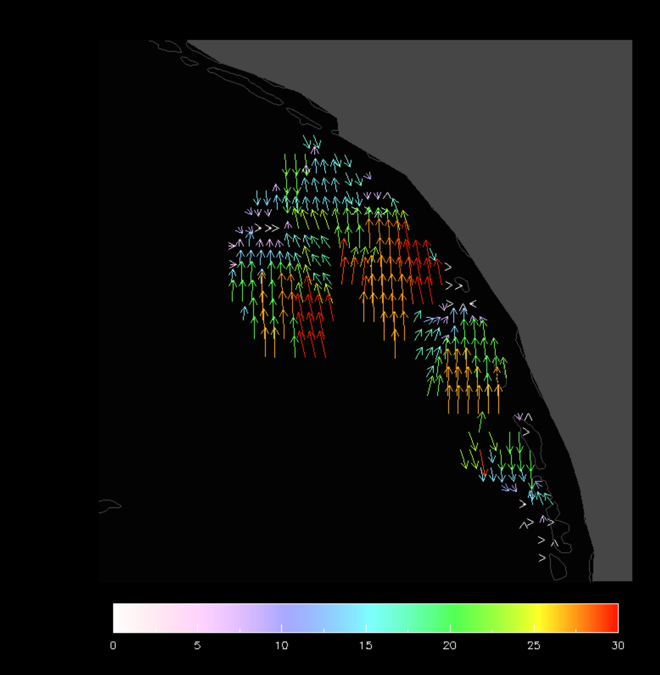
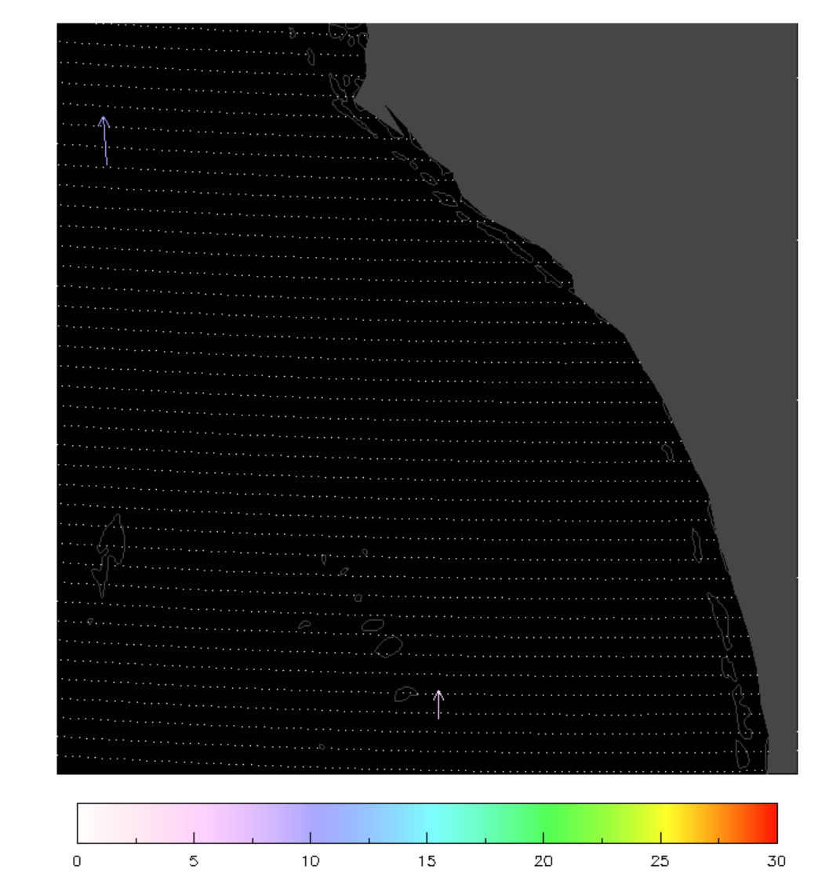
Full Disk AIM Validation
January 12 0600Z (G16) ice motion vs. January 11-13 OSI-SAF motion
Notes:
Coherent, reasonable ice motion field in NW Hudson Bay. Compared to only two nearby OSI-SAF ice motion vectors, large standard deviation in direction and motion, even if bias were small.

Slide 113
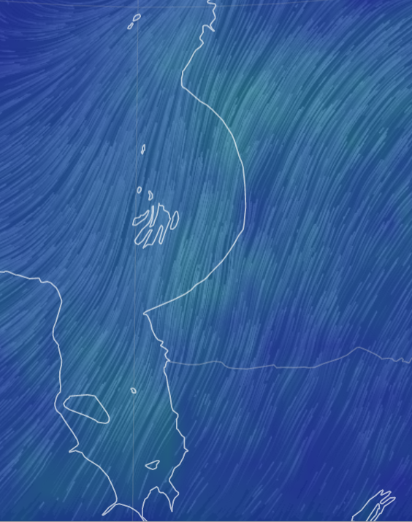
Full Disk AIM Validation
January 12 0600Z ice motion vs January 11 1800Z GFS Surface Wind Field (visualization from earth.nullschool.net)
Notes:
Possible validation opportunity using ~2% of GFS surface wind speed collocated with motion. Technically difficult with time constraints (req’d downloading GFS data, gridding, etc…)

Slide 114
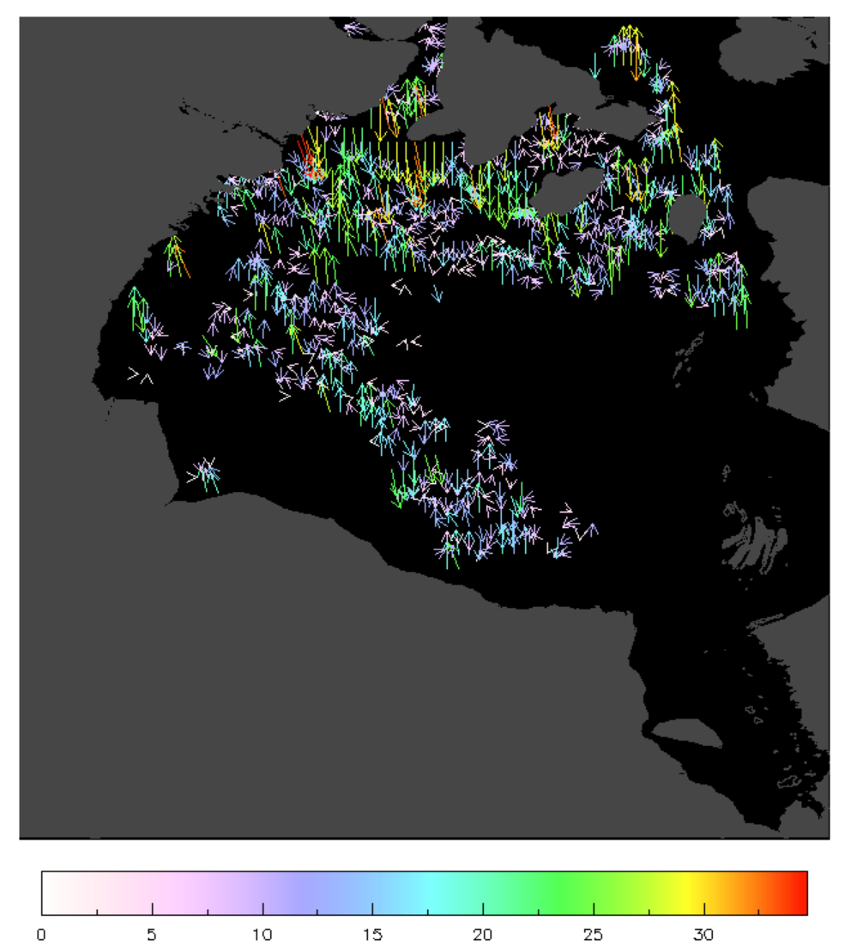
Full Disk AIM Validation
January 11 1500Z ice motion field showing spatially averaged (0.25°) vectors
Variation in direction of slower (0-10km per day) ice motion increases precision error
Notes:
Even when averaged to the nearest 0.25 degree lat/lon, currently output ice motion field is incoherent. Most deviation comes from vectors below 10 km/day speeds. Motion vectors at edge of clear/cloudy may also be tracking cloud

Slide 115
Full Disk AIM Validation with Clustering
ASSIST data from February and March 2020 over Hudson Bay and Bering Sea were used
Post-processing routine employed to reduce motion vector “noise”
  Density-based clustering algorithm applied to u- and v- motion from ASSIST output file
Clustering routine applied over small spatial areas
  Reduces total number of output vectors
  Results in smooth distribution of ice motion distance and direction
Notes:
ASSIST data used as supplementary dataset. Similar output files that were gridded and then clustered for analysis and statistics.

Slide 116
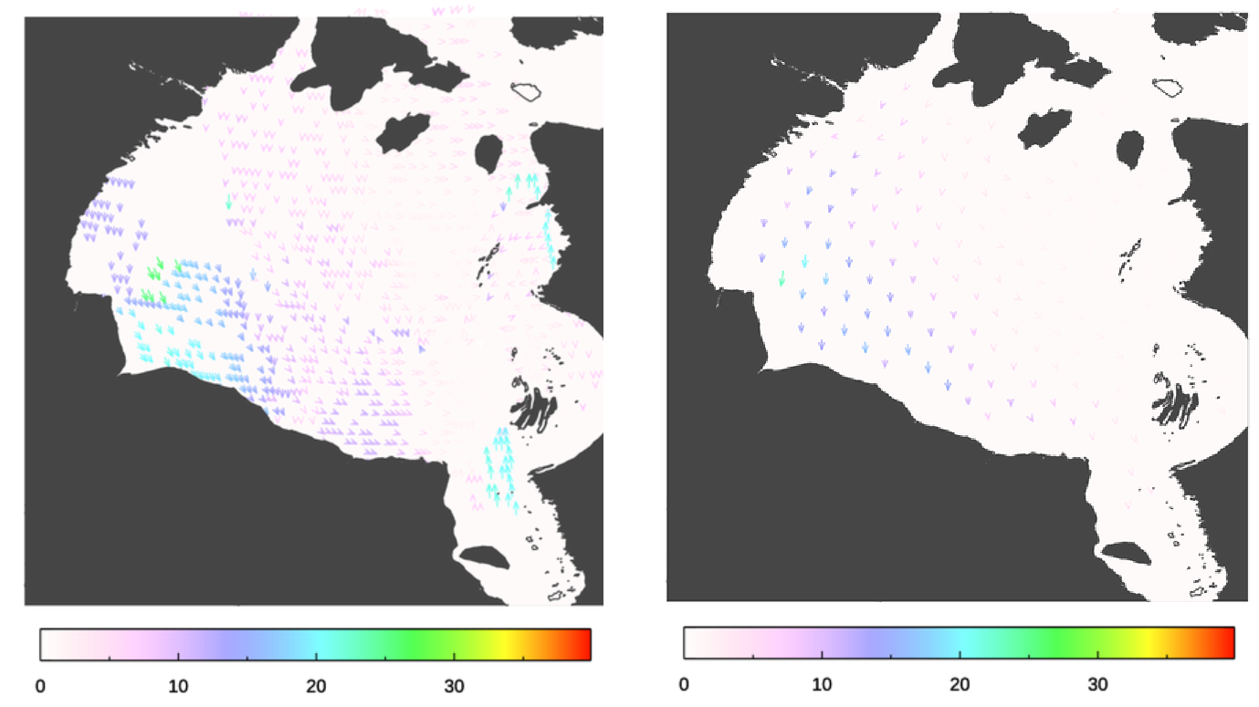
Full Disk AIM Validation
with Clustering
“Clustered” ice motion from G16 ABI (Feb 19, 0300Z) vs. OSI-SAF ice motion (Feb 17-19, 2020)
Notes:
Clustering shows a more logical distribution of motion and direction. Compares well (in many cases to 48-hour motion)

Slide 117
Full Disk AIM Validation with Clustering
Statistics using ASSIST data from February and March 2020 over Hudson Bay, after applying clustering routine
Platform | Speed Accuracy (km/day) | Speed Precision (km/day) | Direction Accuracy (degrees) | Direction Precision (degrees) | Number (Avg)
G16 | 1.91 | 2.17 | 12.34 | 28.71 | 2000
G17 | 2.45 | 3.96 | 16.48 | 18.44 | 850
Requirement | 3.0 | 3.0 | 30.0 | 30.0
PASSED
Notes:
Performance of clustered ice motion output is an improvement over Ground System output statistics shown earlier.

Slide 118
Validation Summary
Performance of current ice motion algorithm does not meet requirements when compared with validation data.
Much of the target area was cloud-covered during the analysis (Jan 10 – Jan 13)
  Partial cloud cover causes difficulties with motion tracking algorithm
ASSISTT data (Feb 4 – Mar 10) passed 7/8 speed and direction requirements when clustered output was used
Notes:
Statistical errors and qualitative errors are too high to recommend for operational status at this time. ASSIST analysis shows that clustering current output could improve error statistics.

Slide 119
Provisional Maturity Assessment
GOES-16 & GOES-17 NOAT Cryosphere Products Provisional PS-PVR

Slide 120
Provisional Validation
Preparation Activities | Assessment
Validation activities are ongoing and the general research community is now encouraged to participate. | The research community can participate with the understanding that an algorithm improvement is being recommended
Severe algorithm anomalies are identified and under analysis. Solutions to anomalies are in development and testing. | Anomalies have been identified, as has a solution
Incremental product improvements may still be occurring. | True
Notes:
This needs update from the management?

Slide 121
Provisional Validation
End State | Assessment
Product performance has been demonstrated through analysis of a small number of independent measurements obtained from select locations, periods, and associated ground truth or field campaign efforts. | More locations are needed, too much cloud cover over Bering Sea in available data
Product analysis is sufficient to communicate product performance to users relative to expectations (Performance Baseline). | Performance can be communicated as long as it is clear that the product is beta
Documentation of product performance exists that includes recommended remediation strategies for all anomalies and weaknesses. Any algorithm changes associated with severe anomalies have been documented, implemented, tested, and shared with the user community. | This slide set constitutes the documentation of current performance
Testing has been fully documented. | Only in this slide set
Product is ready for operational use and for use in comprehensive cal/val activities and product optimization. | False

Slide 122
Path to Delta Review
GOES-16 & GOES-17 NOAT Cryosphere Products Provisional PS-PVR

Slide 123
Issues
The Delta Provisional PS-PVR is for enterprise algorithms with GOES-17 loop heat pipe (LHP) mitigation, including the “warm” period. It is currently scheduled for 7 January 2022.
Major issues:
  FPM overheating degrades product quality
  An accurate cloud mask is key to the performance of sea and lake ice products
Others:
  There are differences in performance between products during daytime and nighttime
  Quality flag and product indicator index needs further examination
Notes:
From E. Kline: The delta Provisional PS-PVR is for GOES-17 only. For cryo products it is currently scheduled for January 7, 2022. This will be a review of the enterprise algorithm with mitigations for the LHP anomaly incorporated. In the current review we are "ignoring" warm periods of GOES-17 performance, instead focusing on cool periods for GOES-17, and all times for GOES-16.

Slide 124
Path to Delta Maturity
Impact of LHP overheating on ice products and our LHP mitigation needs further testing and evaluation.
We expect to carry out the same activities for future maturity review
  The collection of Ground System ice products will continue. The current time series is not long enough to yield statistically significant conclusions.
  Case studies will be carried out.
  Validation employing data from polar-orbiting satellites, aircraft, and in situ measurements will continue.
Install, testing, and GEAR review of the Enterprise algorithms.

Slide 125
Full Validation PLPTs
There are currently no Full Validation PLPTs for ice products. The table below lists the types of tests to be performed.
PLPT ID | Descriptive Title
IceMotionQuickLook | Qualitative inspection of ice motion product.
IceMotion | Full disk ice motion product accuracy and precision assessment using in-house tools for matchup and statistical analysis comparing ABI ice motion to similar products based on microwave data. Ice products generated by the Ground System will be used in the analyses.

Slide 126
Path to Delta Validation – Risks
Risk Name | Description | Impact | Mitigation and Schedule
(To be added) | Add clustering procedure to ice motion algorithm. | Improve ice motion accuracy and precision. | The clustering procedure used by the science team needs to be rewritten from IDL to Fortran or C, delivered to ASSISTT, then implemented in the Ground System. The code conversion can be done in the next 3-6 months.

Slide 127
Summary & Recommendations
GOES-16 & GOES-17 NOAT Cryosphere Products Provisional PS-PVR

Slide 128
Summary
The analysis is based on the data over the Hudson Bay under cloud-free conditions during early January 2021.
Overall, all the ice motion product does not meet the mission requirements for accuracy and precision.
  Validation results show high precision error in direction due to deviation in ice motion vector field compared to truth data.
  Mission requirement are met for some validation tests.
  It is possible that additional data, particularly more clear scenes, would improve the results.
The product performance would be improved if a density-based clustering algorithm is applied to the currently output data.
  Using ASSIST data and the clustering routine, qualitative and statistical improvements are shown.

Slide 129
Recommendation
The GOES-16 and GOES-17 Automated Ice Motion product has not yet met the Provisional Maturity as defined by the GOES-R Program.
It is recommended that a clustering routine (similarly employed in ABI and VIIRS wind products) be added to the Ground System AIM algorithm in order to reduce accuracy and precision errors. Testing by the science team indicates that the product would meet requirements with the additional procedure.
Notes:
Similar clustering routines exist and improve other operational GOES-series products.

Slide 130
Summary & Recommendations for all products
GOES-16 & GOES-17 NOAT Cryosphere Products Provisional PS-PVR

Slide 131
Users – All Products
Stakeholders:
STAR, OSPO, NCEI, other users listed below
Users:
Ice analysts and forecasters: National Ice Center (NIC), NWS Alaska Sea Ice Program (ASIP), Great Lakes region WFOs (e.g., Duluth, Marquette, Cleveland)
NWP: NCEP/EMC
Benefits:
NIC (part of OPC), ASIP, and NWS WFOs will be provided enhanced ice information for navigation and safety, such as marine operations and lake shore flooding.
NCEP/EMC will initially use products for verification of their ice model fields, and possibly future assimilation.
Long-term global sea and lake monitoring.

Slide 132
Overall Summary and
Recommendations
GOES-16 and -17 ice products generated by the Ground System have been evaluated for a limited period in January 2021. In order to provide a broader dataset, ice products generated by ASSISTT for February-March 2020 were also evaluated. Recommendations are as follows:
Ice Concentration: The ice concentration product meets accuracy and precision requirements for GOES-16 and cool-period GOES-17 under all conditions. We recommend it for Provisional Maturity status.
Ice Thickness and Age: The ice thickness and age product meets accuracy and precision requirements for GOES-16 and cool-period GOES-17 under all conditions. We recommend it for Provisional Maturity status.
Ice Motion: The ice motion product does not meet accuracy and precision requirements for GOES-16 and cool-period GOES-17 under all conditions. We do not recommend it for Provisional Maturity status. We recommend that an additional procedure be added, which has been demonstrated to improve accuracy and precision to the point of meeting requirements.

Slide 133
Backup Slides
GOES-16 & GOES-17 NOAT Cryosphere Products Provisional PS-PVR

Slide 134
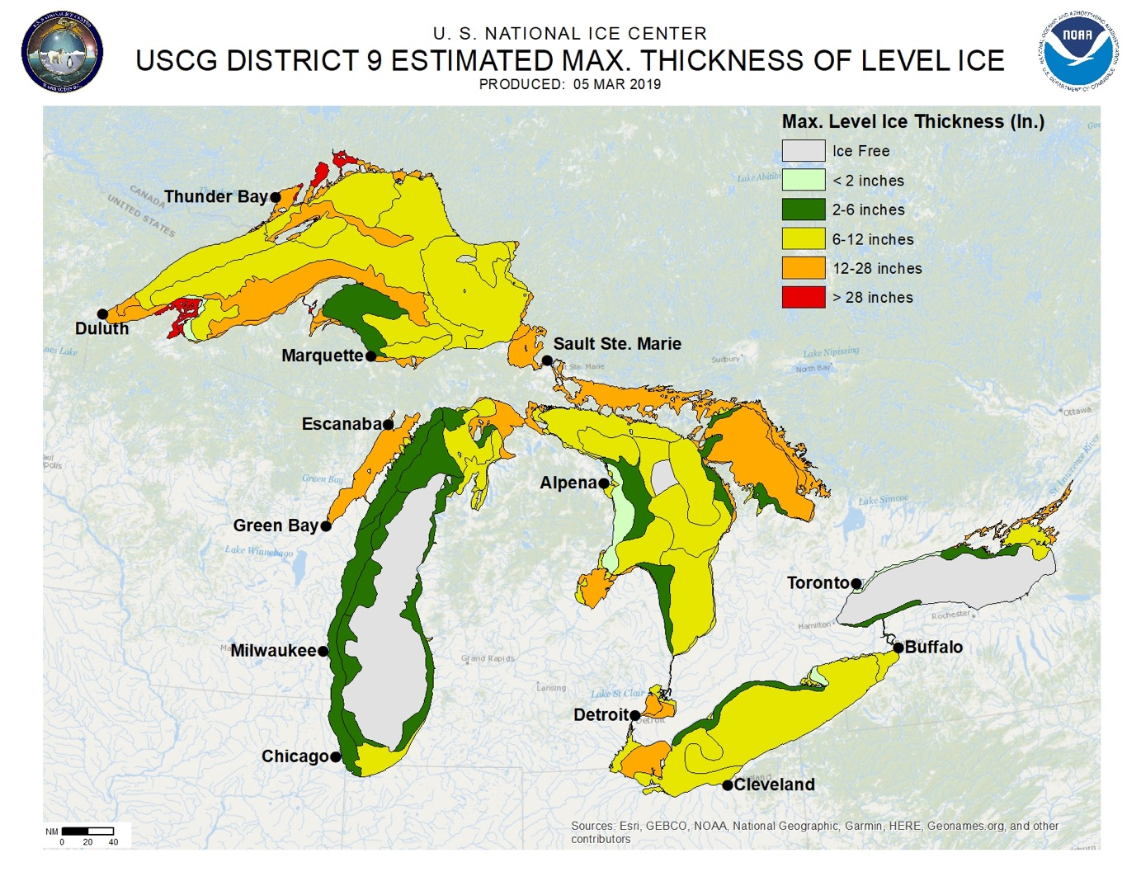

Slide 135
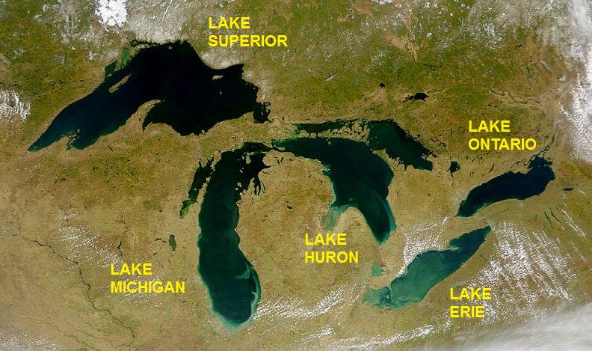

Slide 136
Definitions of Metrics for Quantitative Comparisons
Passed: Accuracy and Precision meet or slightly exceed requirements. Potential contributors for deviations are identified.
Partial-Passed: Accuracy/Precision deviates significantly from requirements, but potential contributors for deviations are identified.
Failed: Accuracy/Precision deviates significantly from requirements and source of poor performance is unknown, or source known and correction requires new algorithm.

Slide 137
Risks to Reaching Provisional
Risk | Description | Impact | Mitigation | Current Status
Focal Plan Module (FPM) overheating | Due to FPM overheating issue, degradation of L1b data and the upstreaming EDR data as LST algorithm input was expected. This leads to the degradation of LST product especially during the nighttime. The impact is more significant between hours 06 and 15 UTC. | Major | LST team evaluates the product with relatively low impact from the issue, by removing high and unstable FPM temperature periods. The team is also working on a mitigation algorithm towards the Delta maturity. | The periods with high and unstable FPM temperature were removed for evaluation of the product performance. A mitigation algorithm is being worked on.
Navigation / Registration | Errors in sensor navigation/registration might degrade the LST data performance, though the band to band co-registration issue has been greatly reduced since L1b data beta maturity. | Unknown | LST team is actively monitoring the issue. | The issue was reported to be fixed on Sept. 13, 2018. No obvious navigation issues have been found.
outdated Emissivity used | Seebor emissivity monthly average at year 2005 used in LST retrieval might not be tuned to ABI sensor and can not reflect the real-time variation of the land surface. | Intermediate | LST AWG has developed the split-window channel emissivity for ABI sensor. | LST AWG developed the emissivity product for ABI sensor. Implementation in operational LST retrieval is not scheduled yet.
FD LST aggregation impact | Pixel size of FD LST is 10 km and has large mismatch with the SURFRAD in-situ (~ a few tens meters) | Unknown | TBD | Validation results with in-situ observations is acceptable. Site characterization is being studied.
Notes:
TPW is an important variable to determine which coefficient set is being used for specific pixel. The ground system incorrectly used TPW in mm instead of cm, which leads to significant bias in the LST product. The LST AWG team reported the issue on 6/23/2017 and it got fixed in OE since 1/25/2018 16:00 (UTC).
Emissivity used in LST retrieval is Seebor emissivity (monthly from year 2005), which is not tuned up for real-time operational LST retrieval and can not reflect the real-time variation of the land surface. The LST AWG team has developed its own daily emissivity product specific for ABI sensor.

Slide 138
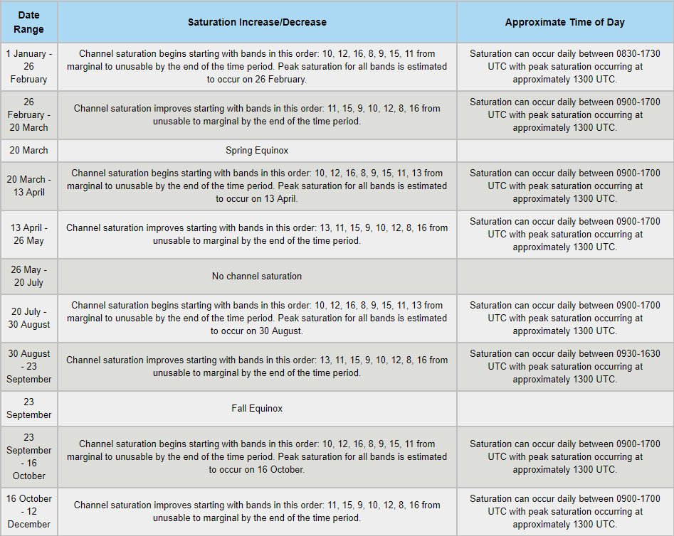
High FPM Temperature Period
https://www.goes-r.gov/users/GOES-17-ABI-Performance.html
Notes:
The predicted “hot” periods in year 2019 listed in the table are removed for provisional activities.
We extended the table to when the satellite is on Test position by decreasing the start and end time of each period with 3 hours.

