Slide 1
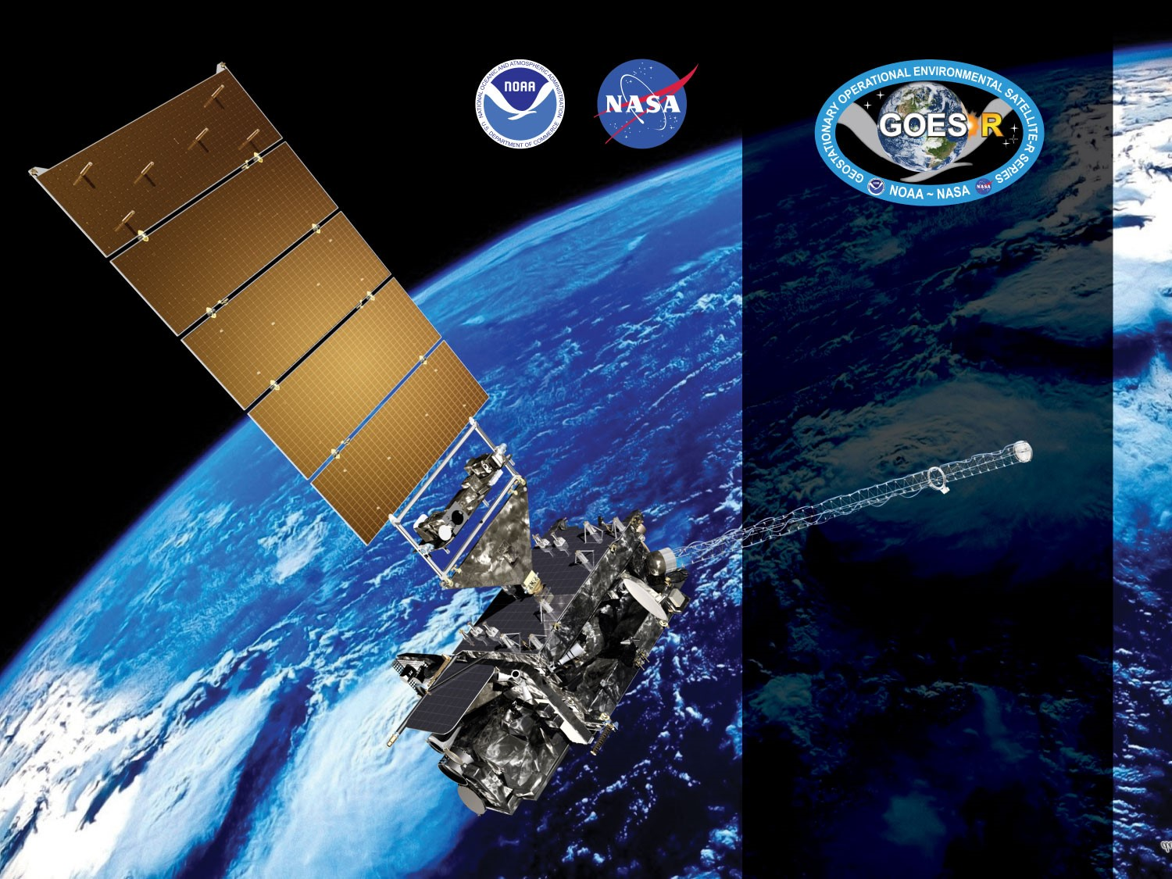
GOES-17 ABI L2+ Cloud Top Phase (CPH) Provisional PS-PVR
May 6, 2019
Michael Pavolonis*, Corey Calvert, Jason Brunner
GOES-R AWG
NOAA/NESDIS/STAR*
CIMSS

Slide 2
Agenda
Provisional Validation Product Maturity Assessment
Path to Delta Review (LHP mitigation)
Summary and Recommendations

Slide 3
Provisional Validation Product Maturity Assessment
GOES-17 Cloud Top Phase L2 Product Provisional PS-PVR

Slide 4
Requirements for FULL Validation
CPH: 80% accuracy for clouds with an optical depth > 1.0. (Same requirement for all ABI sectors)

Slide 5
PLPTs Under Review
PROVISIONAL
PLPT ID | Descriptive Title | % Complete | Results | AWG POC
ABI-FD_CPHp04 | Quantitative analysis of M3 FD CPH | 100 | Complete | AWG
ABI-CONUS_CPHp04 | Quantitative analysis of M3 CONUS CPH | 100 | Complete | AWG
ABI-MESO_CPHp03 | Quantitative analysis of M3 Meso CPH | 100 | Complete | AWG

Slide 6
Requirements
PROVISIONAL
Assess the accuracy and precision requirements for CPH.
Document impacts with upstream dependencies (Cloud Top Parameters, Cloud Optical Properties and Derived Motion Winds).
All ABI modes must meet horizontal, mapping, and range requirements.
If accuracy and precision are not met, document reasons why as an ADR.
Remediation strategies in place.
Product ready for potential operational use.

Slide 7
Application of PLPT Quantitative Analysis Tests to each Domain
Our 3 PLPTs dealing with analysis are comprised of the same 3 methods.
Each contains the applications of these methods on the FD, CONUS and MESO domains.
The applications of each method to each domain is summarized below.
Some methods were redundant or not possible for some domains.
Analysis Method | FD | CONUS | MESO
Visual Inspection
Comparison to other Clouds (e.g. GOES-16)
CALIPSO Lidar Comparison
7
Notes:
MESO images that are in-sync with CALIPSO are rare.
MESO domains over ocean were not found.
No reason to repeat CALIPSO FD analysis on CONUS.

Slide 8
Qualitative Evaluation of Cloud Top Phase Product

Slide 9
Qualitative Success Definitions
PASSED
Specifications are met for product cadence and creation.
PARTIAL-PASSED
Specifications are close to being met for product cadence and creation. Example: Products created with missing blocks.
FAILED
Specifications are far from being met for product cadence and creation.

Slide 10
PLPT ABI-FD_CPH01:
CPH Full Disk Mode 3: January 2, 2019
PASSED
Notes:
Mode 3 = 15 minutes

Slide 11
PLPT ABI-FD_CPH01:
CPH Full Disk Mode 6: February 20, 2019
*** Elevated focal plane temperature due to loop heat pipe issue occurred during part of this time period, which significantly degrades the CPH product.

Slide 12
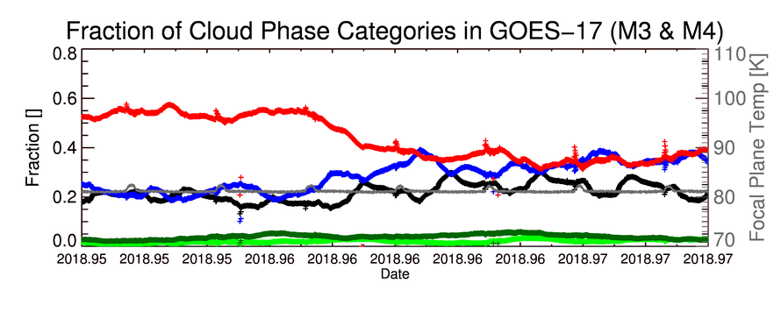
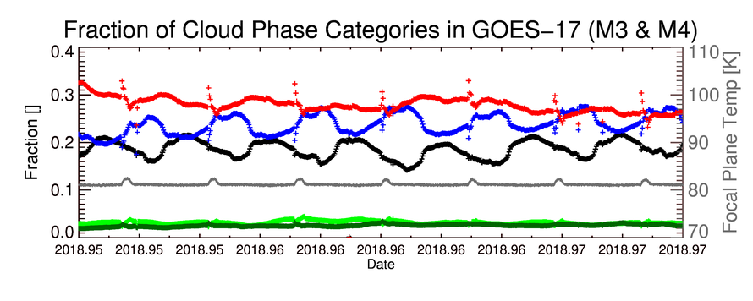
Time Series of Cloud Phase Fractions
Cloud Phase Legend
Clear Sky
Liquid Phase
Supercooled Phase
Mixed Phase
Ice Phase
Time period is Dec. 13 – Dec. 19, 2018
Time series of the cloud phase fraction in GOES-17 (M3 & M4) for CONUS (top) and Full Disk (bottom)
Expected diurnal cycle is seen. Deviations from expected behavior are minimal and understood
CONUS
FD
Cloud phase product is minimally impacted by the loop heat pipe issue when the FPT is at or near the “nominal” value
PASSED
Notes:
Shows the fraction of GOES-17 pixels for each cloud phase. Pretty stable performance as expected.

Slide 13
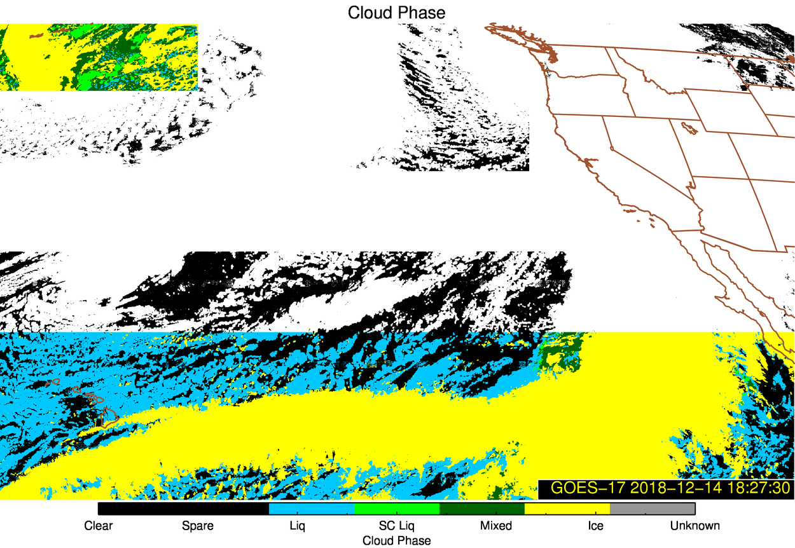
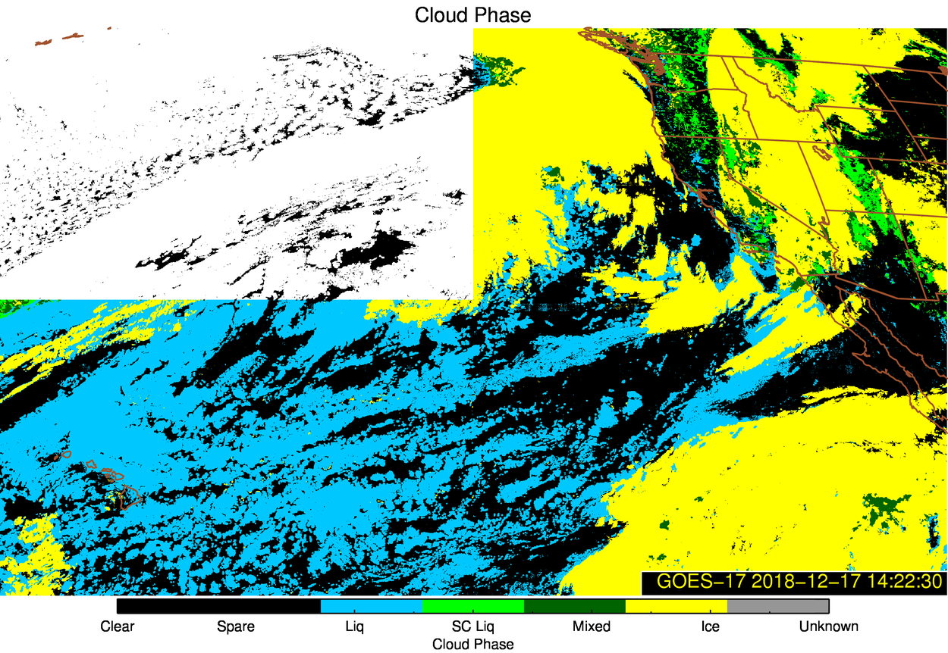
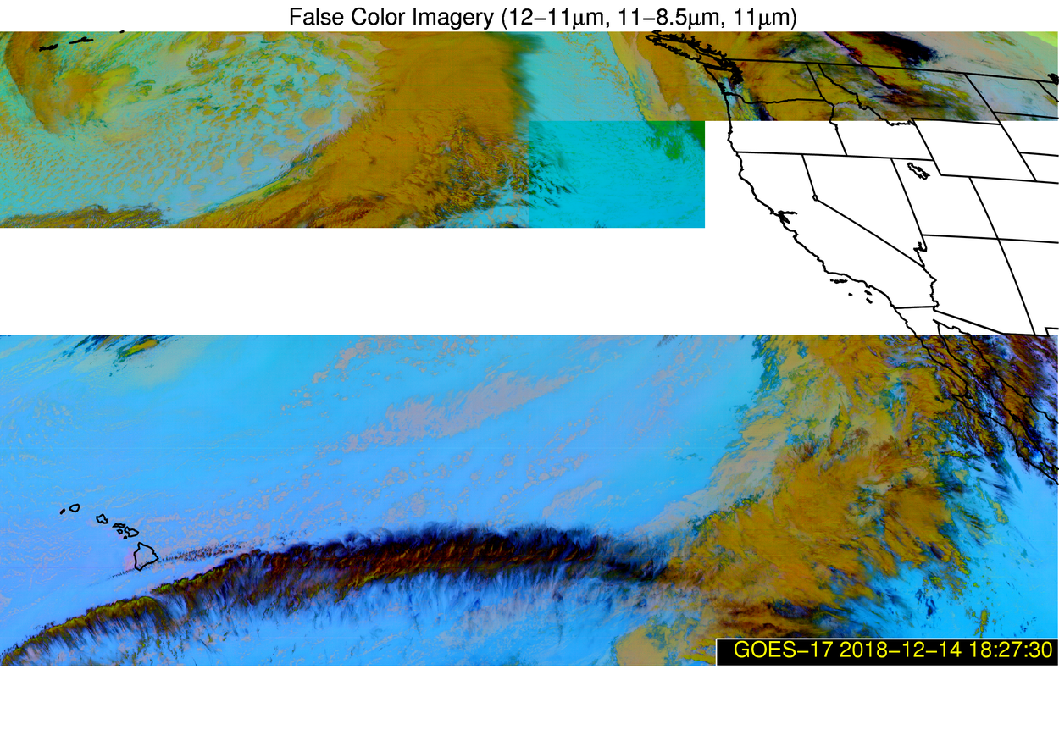
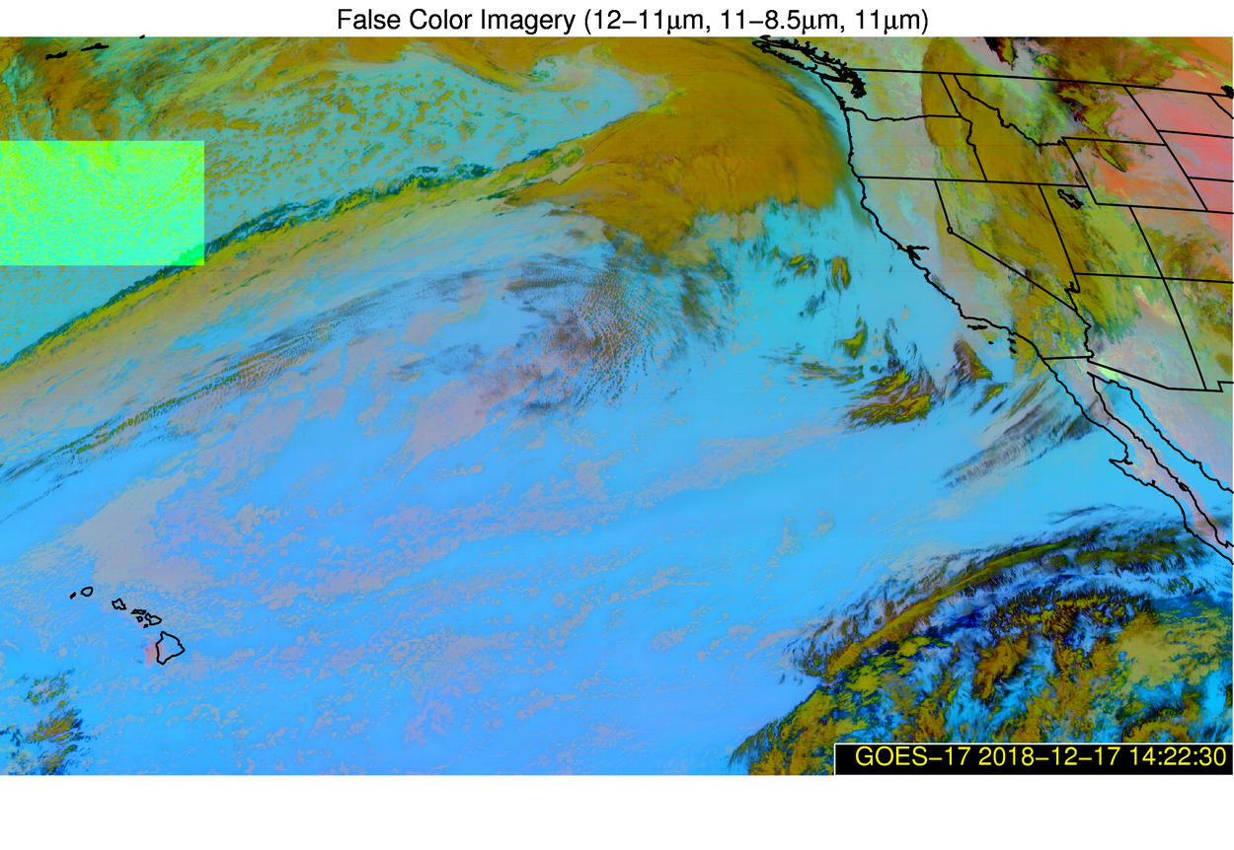
Time Series Cloud Phase Outliers
December 14, 2018 @ 18:27 UTC
December 17, 2018 @ 14:22 UTC
Major outliers in time series are caused by missing or bad L1b data
Notes:
Missing or bad L1 data from channels not used to make these RGBs impacts the phase product

Slide 14
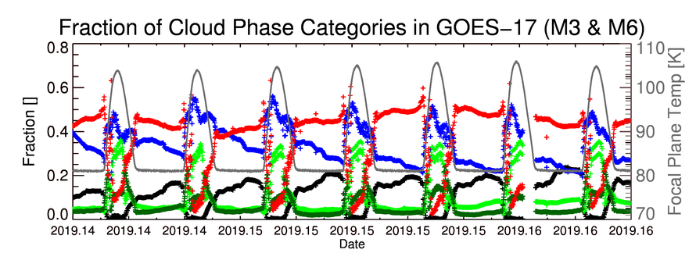
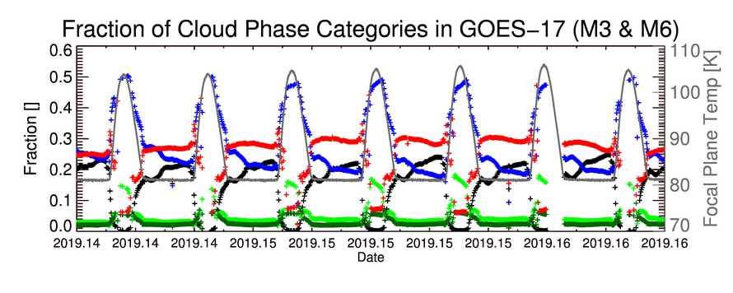
Time Series of Cloud Phase Fractions
Cloud Phase Legend
Clear Sky
Liquid Phase
Supercooled Phase
Mixed Phase
Ice Phase
Time period is Feb. 20 – Feb. 26, 2019
Time series of the cloud phase fraction in GOES-17 (M3, M4 & M6) for CONUS (top) and Full Disk (bottom)
Small data outages are present due to issues with the PDA
CONUS
FD
Cloud Phase product is severely impacted when the FPT is severely elevated

Slide 15
Quantitative Evaluation of Cloud Top Phase Product

Slide 16
Quantitative Success Definitions
PASSED
Specifications are met for clouds with COD > 1.0 and where the cloud mask matches that of the “truth” data.
PARTIAL-PASSED
Specifications are close to being met for clouds with COD > 1 and where the cloud mask matches that of the “truth” data.
FAILED
Specifications are far from being met for clouds with COD > 1 and where the cloud mask matches that of the “truth” data.

Slide 17
Comparison to NASA CALIPSO/CALIOP Cloud Phase

Slide 18
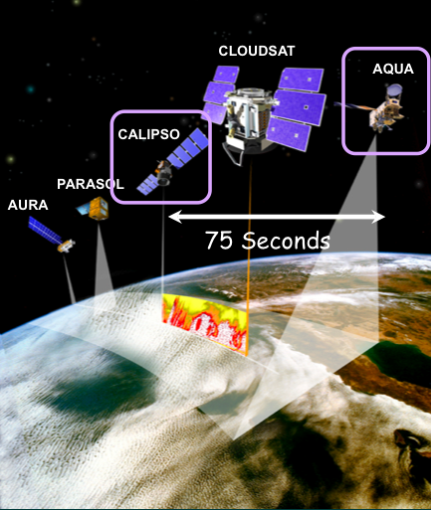
CALIOP vs ABI Comparison Description
CALIOP is a lidar, with depolarization, on board the CALIPSO satellite in the NASA A-Train.
The CALIOP 1 and 5 km vertical feature mask products are merged to derive the cloud phase of the highest cloud layer with CALIOP 532 nm optical depth > 0.01
19 days (Dec 9, 2018 – Jan 4, 2019) of CALIOP and ABI matchup data are used
Filters applied to GOES-17:
Scan time difference ± 7.5 minutes,
Sensor Zenith Angle < 70.0
ABI and CALIOP agree that a cloud is present
Validation analysis is a function of the CALIOP 532 nm cloud optical depth

Slide 19
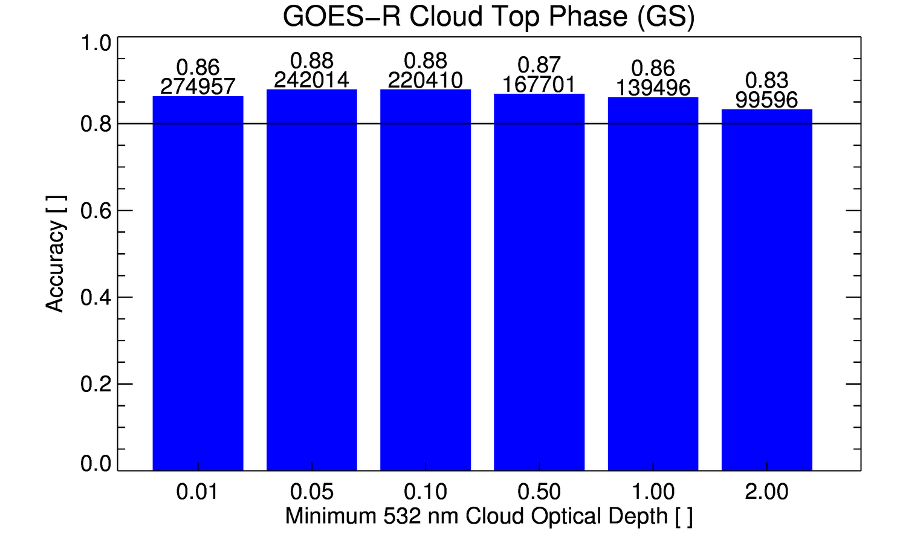
Overall Validation Against 80% Accuracy Requirement – GOES-17
The ABI cloud top phase product comfortably meets the accuracy specification without invoking the optical depth qualifier.
GOES-17
Requirement
PASSED

Slide 20
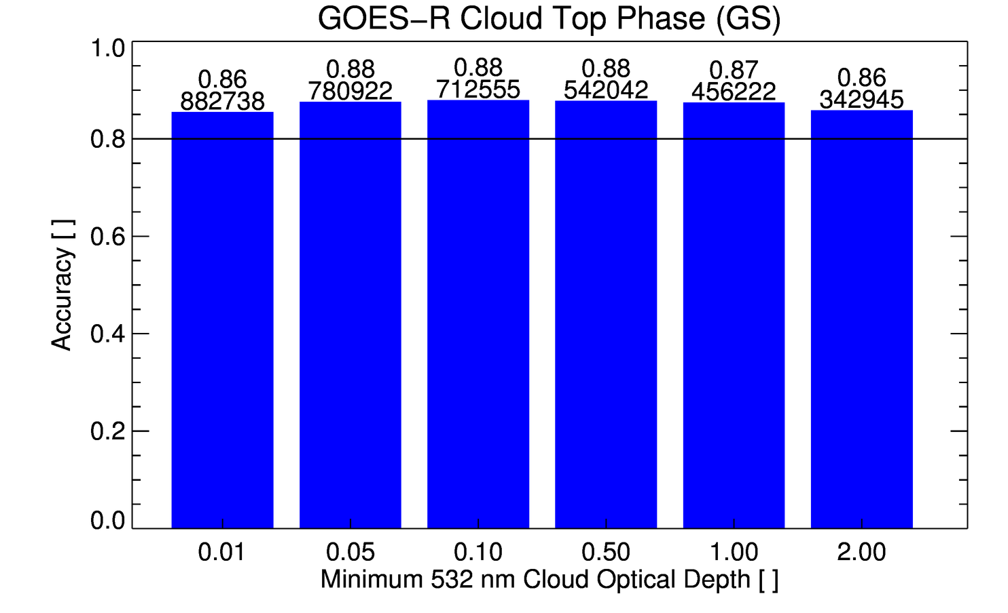
Overall Validation Against 80% Accuracy Requirement – GOES-16
The ABI cloud top phase product comfortably meets the accuracy specification without invoking the optical depth qualifier.
GOES-16
Requirement

Slide 21
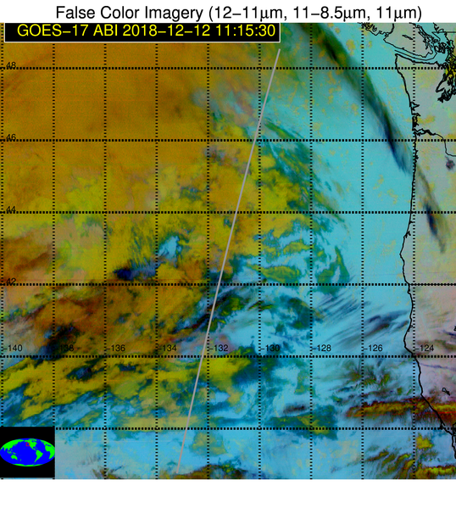
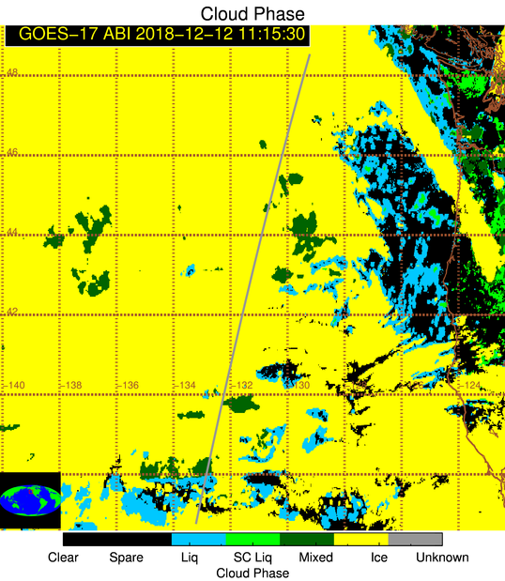
“Deep Dive” Example
Deep dive enables deeper understanding of issues and clearly demonstrates challenges
Differentiating between liquid, mixed, and ice is challenging, especially if L1b is biased
Supercooled and mixed misclassified as ice
Supercooled and mixed misclassified as ice

Slide 22
CALIPSO Conclusions
At times when the GOES-17 ABI focal plane temperature is at or near the nominal value, the ABI cloud top phase product meets the accuracy specification without invoking the cloud optical depth qualifier.
The GOES-17/CALIOP results are consistent with the GOES-16/CALIOP results
Targeted improvements: thin cirrus detection, broken cloud systems, and potentially mixed phase clouds (more on this coming up)

Slide 23
Comparison to GOES-16 Cloud Phase

Slide 24
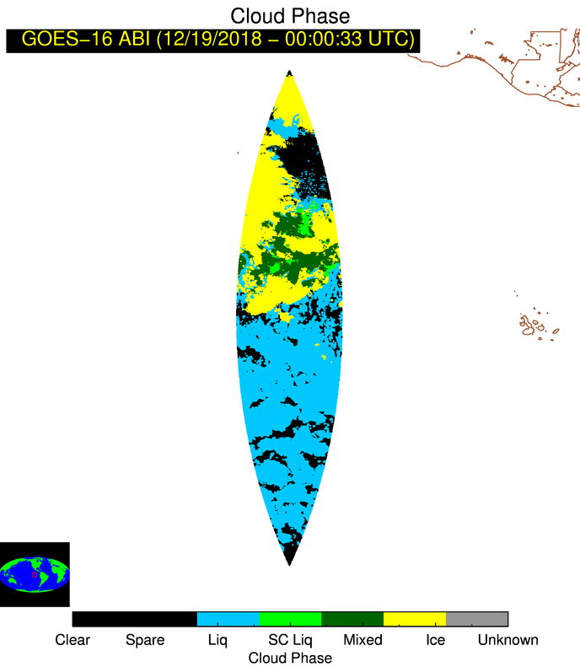
GOES-17 vs. GOES-16 Comparison Description
The GOES-16 cloud phase products are very well characterized
Differences between the GOES-16 and GOES-17 cloud phase products are quantified as a function of time of day
1 day of hourly, co-located, GOES-16/GOES-17 data are used for the analysis (~6 million pixels)
Filters applied:
GOES-16 & GOES-17 sensor zenith angle < 40.0 deg.
The GOES-16 AND GOES-17 cloud mask indicate cloud
GOES-16
GOES-17

Slide 25
GOES-17 vs. GOES-16 Cloud Phase Comparison
GOES-17
GOES-16

Slide 26
GOES-17 vs. GOES-16 Cloud Phase Comparison
Number of GOES-16 pixels per phase category:
Liquid | Supercooled | Mixed | Ice
3,579,860 (60.71%) | 65,310 (1.11%) | 563,270 (9.55%) | 1,688,055 (28.63%)
Total # of co-located pts:
5,896,495
GOES-16 vs. GOES-17
GOES-17 Ice | 164,604 (4.60%) | 11,129 (17.04%) | 242,736 (43.09%) | 1,553,715 (92.04%)
GOES-17 Mixed | 22,050 (0.62%) | 39,227 (60.06%) | 296,688 (52.67%) | 45,576 (2.70%)
GOES-17 supercooled | 4,171 (0.12%) | 8,386 (12.84%) | 3,282 (0.58%) | 1,914 (0.11%)
GOES-17 Liquid | 3,389,035 (94.67%) | 6,568 (10.06%) | 20,564 (3.65%) | 86,850 (5.14%)
 | GOES-16 Liquid | GOES-16 SC | GOES-16 Mixed | GOES-16 Ice
For the entire 24-hr period, 89% of the co-located GOES-16 and GOES-17 cloud phase results were identical
PASSED

Slide 27
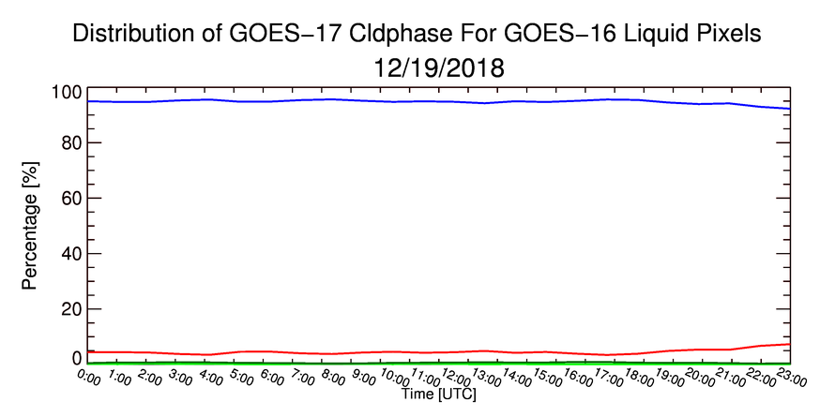
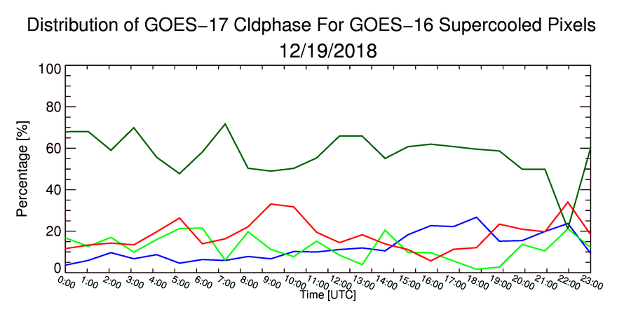
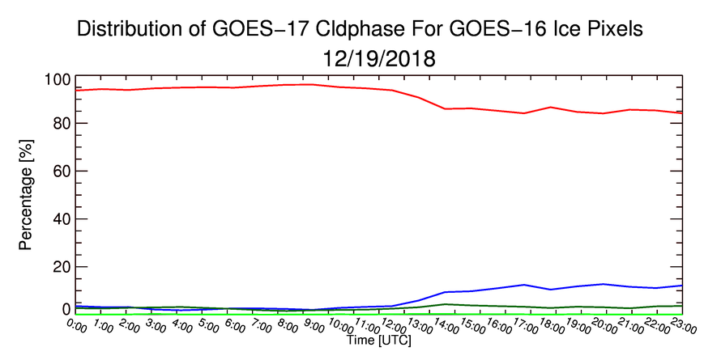
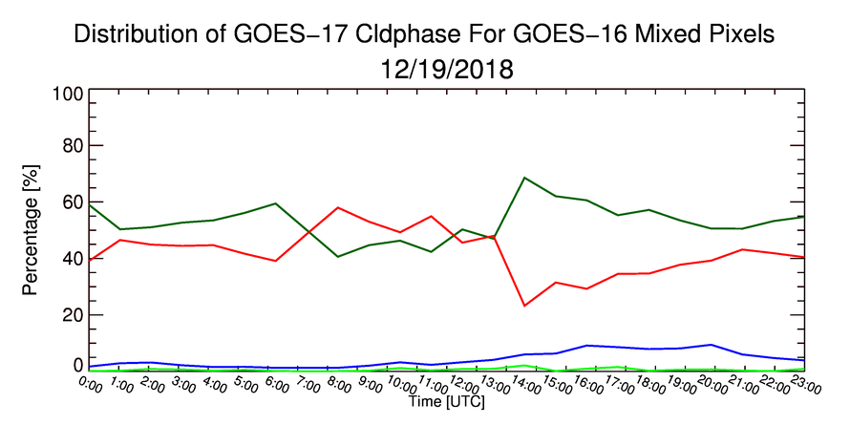
GOES-17 vs. GOES-16 Comparison
Time series of the GOES-17 cloud phase category frequency for each GOES-16 cloud phase category is shown
GOES-17 Phase Legend: - Liquid - Supercooled - Mixed - Ice
GOES-16 = Supercooled
GOES-16 = Liquid
GOES-16 = Mixed
GOES-16 = Ice

Slide 28
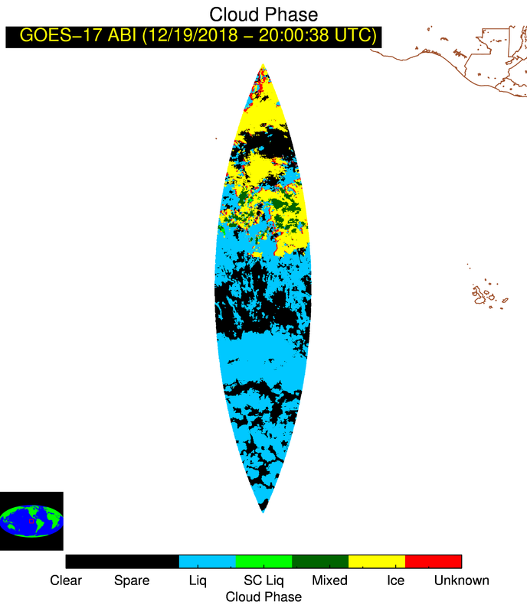
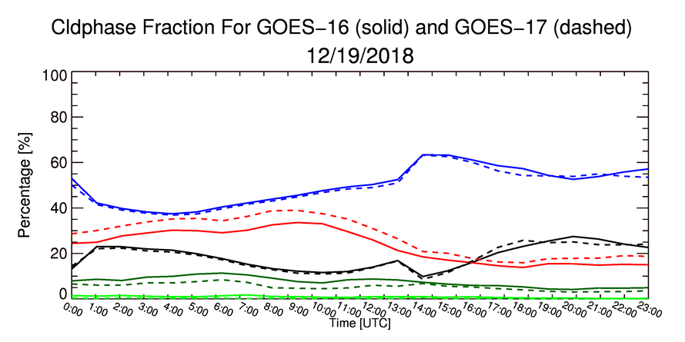
GOES-17 vs. GOES-16 Comparison
Differences between G16 and G17 are most common near cloud edges when more than 1 cloud layer is present (competing parallax effects are primarily to blame)
Liquid
Supercooled
Mixed
Ice
Red pixels: GOES-17 = liquid
GOES-16 = ice
Night-to-day transition
Clear
Liquid
Supercooled
Mixed
Ice
Night-to-day transition
Note the increase in the fraction of liquid pixels at the night-to-day transition
This is due to increased daytime cloudy pixels identified by the cloud mask

Slide 29
GOES-16 vs. GOES-17 Conclusions
89% of the co-located GOES-16 and GOES-17 cloud phase results were identical
Differing parallax effects were not taken into account
Supercooled liquid water is less common in the GOES-17 version of the products and mixed phase is more common. Differences in L1b are the likely cause (further improvements in GOES-17 ABI L1b are expected).

Slide 30
Situational Performance Assessment: Downstream Algorithms and Applications

Slide 31
Feedback from Downstream Algorithms
Cloud Phase Algorithm works well.
However, when the cloud phase is wrong, it has a large impact on the cloud height retrieval.
We notice two potential phase team may want to track
Ice cloud phase on the edges of water cloud
Determination of ice phase when NIR imagery would indicate otherwise.
These issues may contribute to the over-estimation of height discussed in the AMV presentation.
Examples Follow

Slide 32
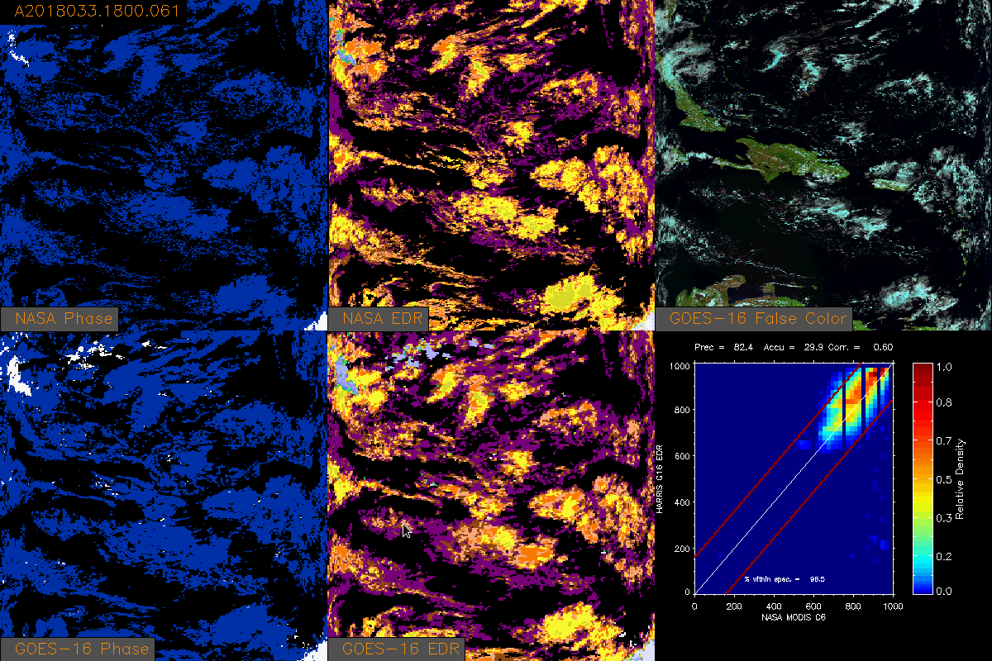
Mislabeling of Liquid Water Clouds at Edges
GOES-R CPH sometimes mislabels liquid water cloud edges as ice, leading to a significant underestimation of cloud top pressure along with profound impacts on optical properties and AMV’s

Slide 33
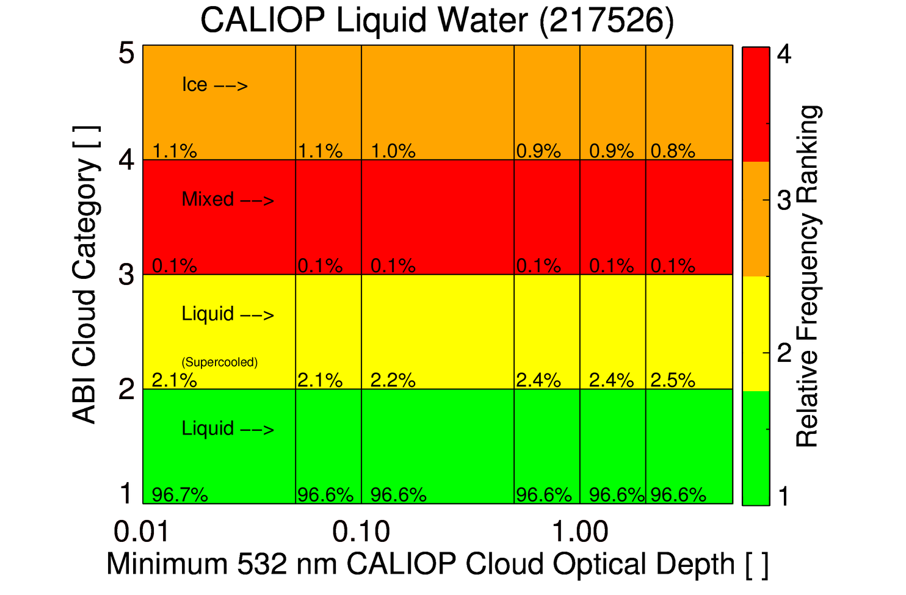
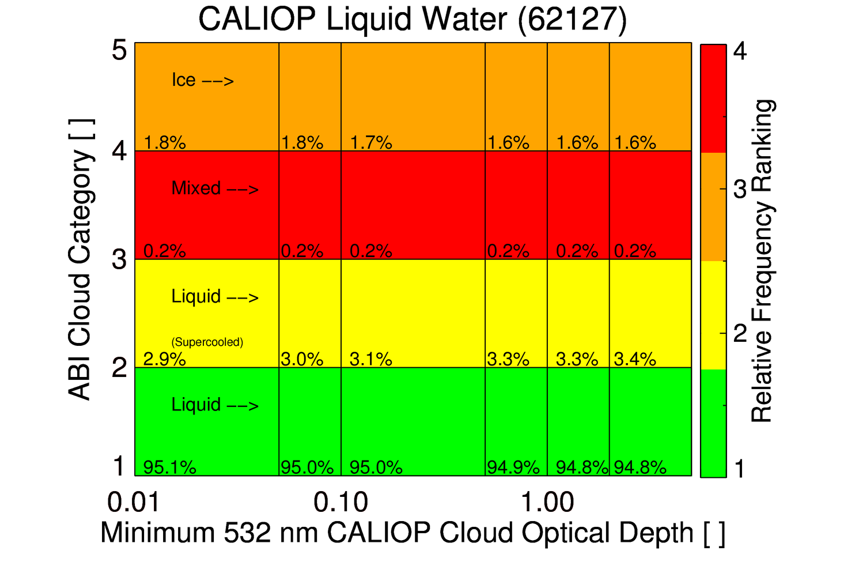
When CALIOP indicates liquid water, the GOES-16 and GOES-17 cloud phase generally agree.
GOES-16
About 1.1% of GOES-16 and 1.8% of GOES-17 cloud phase results will be misclassified as ice, which has significant impacts on the downstream algorithms.
GOES-17

Slide 34
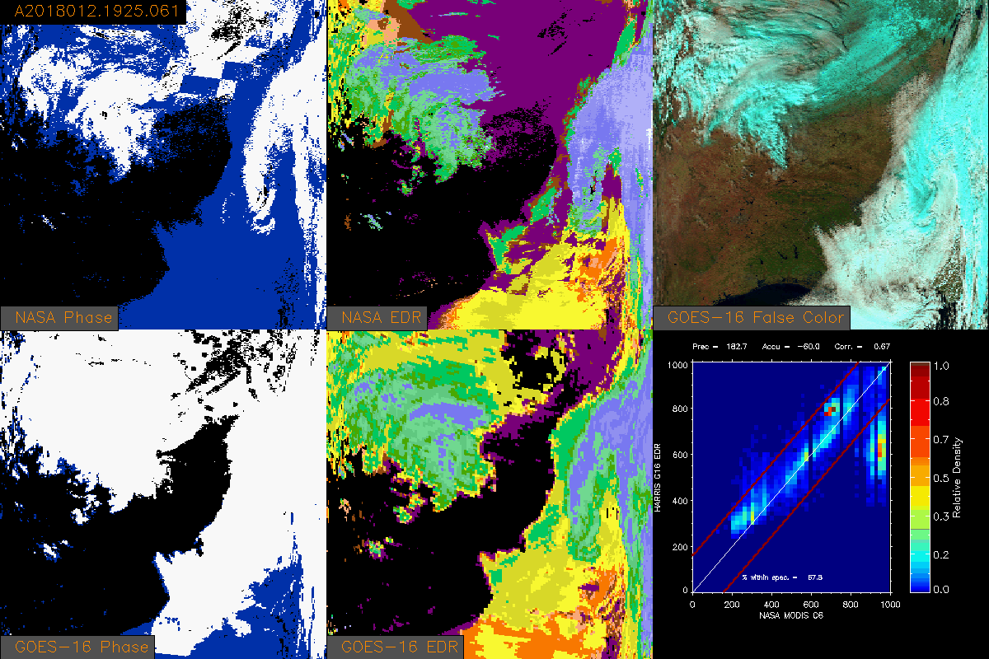
Ice Phase Detection Inconsistency with Near-Infrared
GOES-R CPH sometimes over detects ice relative to independent near-infrared measurements. Such misclassifications can lead to cloud height/pressure/temperature/optical depth/effective radius errors.

Slide 35
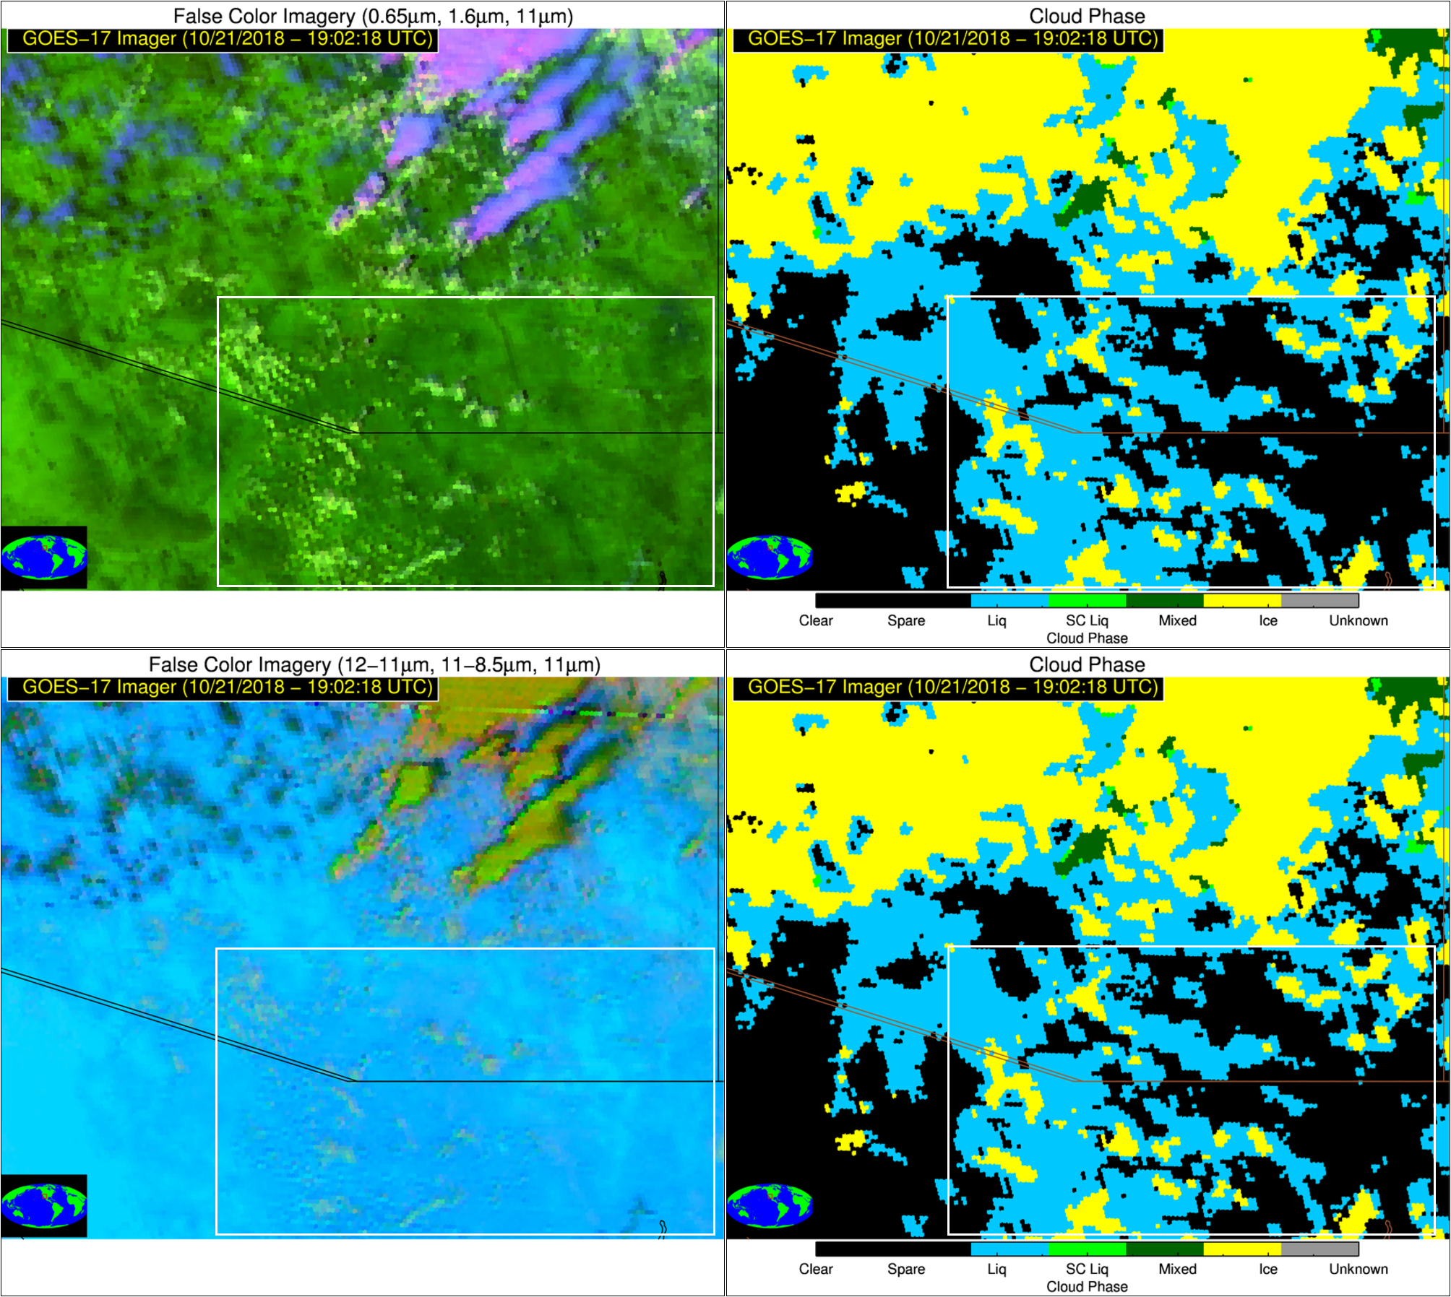
ABI CPH Vs. 1.6 μm Reflectance
October 21, 2018 – Developing convection over Arizona/Northern Mexico (19:02:18 UTC)
Sub-pixel variability, associated with developing cumulus clouds, can cause non-glaciated clouds to be incorrectly classified as ice.
The incorrect classification can be inferred through comparisons with near infrared reflectance
This issue impacts the downstream products and will negatively impact applications that rely on cloud phase product (e.g. ProbSevere)

Slide 36
ABI CPH Vs. 1.6 μm Reflectance
October 21, 2018 – Developing convection over Arizona/Northern Mexico

Slide 37
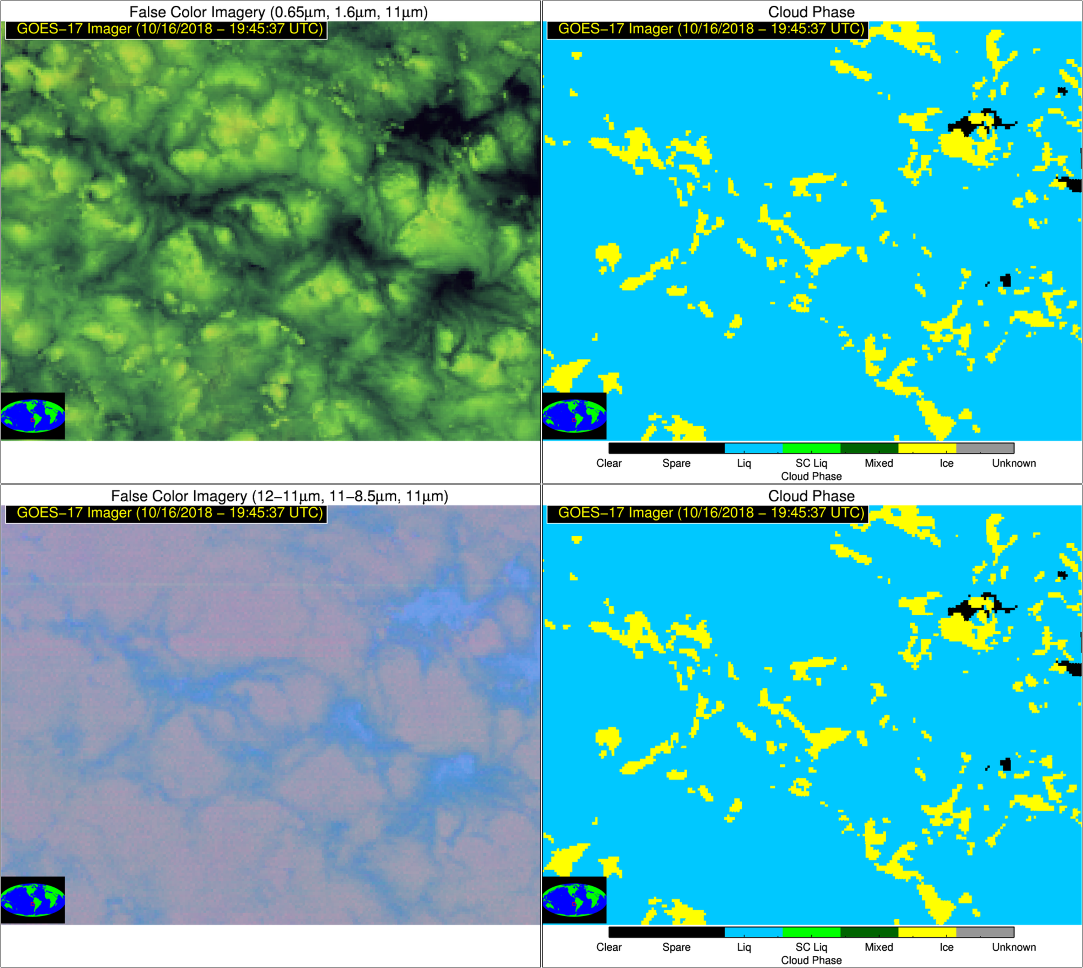
ABI CPH Vs. 1.6 μm Reflectance
October 16, 2018 – Stratocumulus clouds over Eastern Pacific Ocean off west coast of South America (19:45:37 UTC)
Breaks/edges of stratocumulus clouds can cause non-glaciated clouds to be incorrectly classified as ice.
The incorrect classification can be inferred through comparisons with near infrared reflectance
This issue impacts the downstream products and will negatively impact applications that rely on cloud phase product (e.g. fog/low stratus)

Slide 38
ABI CPH Vs. 1.6 μm Reflectance
October 16, 2018 – Stratocumulus clouds over Eastern Pacific Ocean off west coast of South America

Slide 39
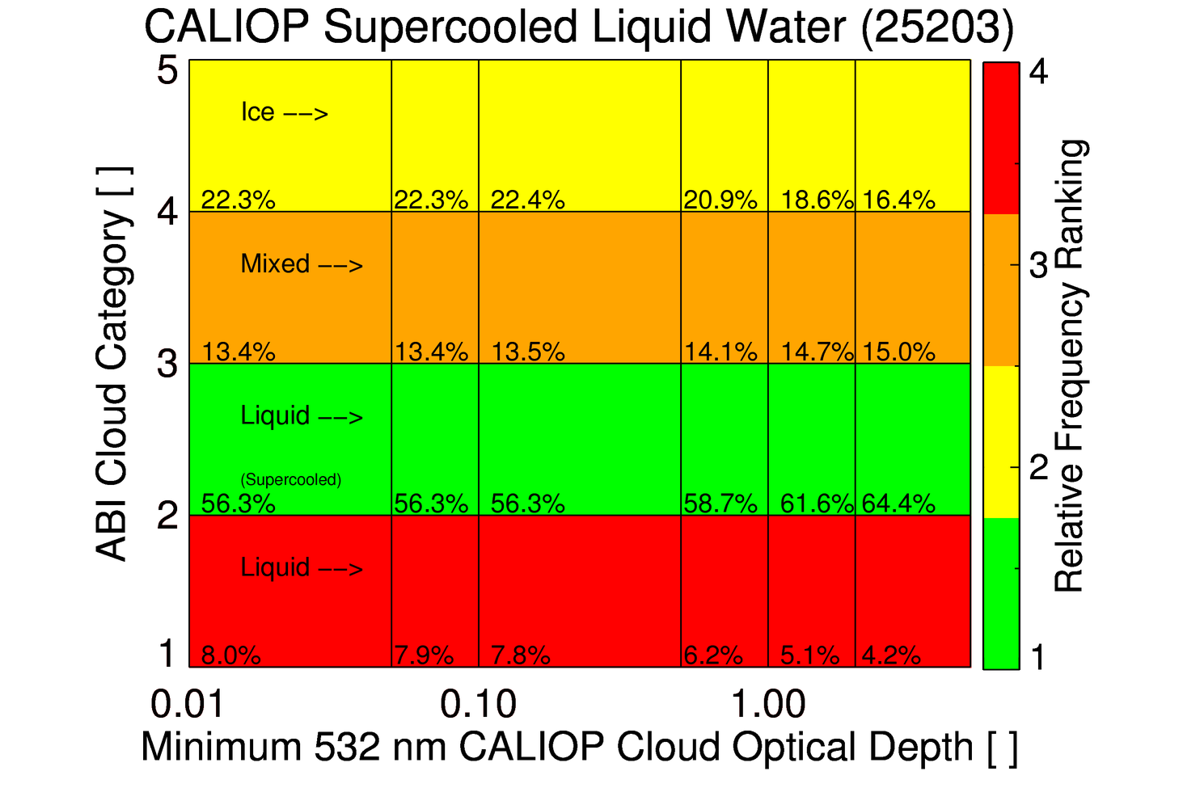
Assessment for Aircraft Icing Applications
~60% (~70% for GOES-16) of optically thick supercooled liquid water clouds are correctly classified
Only about 5% of clouds that may have supercooled liquid are missed

Slide 40
Summary: Dependencies and Applications
Cloud phase misclassifications, near cloud edges and in heterogeneous cumulus cloud fields, were identified in the GOES-16 version of the baseline cloud phase products. These same issues are also present in the GOES-17 version.
Algorithms enhancements, including the utilization of additional spectral bands (0.64, 1.37, 1.6, and 3.9 μm), are being developed to address these issues.
In the presence of supercooled liquid or mixed phase clouds, the accuracy of the GOES-16 phase product exceeds the GOES-17 product. The exact cause (likely related to L1b data quality) is still being investigated. This may adversely impact downstream applications such as aircraft icing and fog/low stratus detection.

Slide 41
Provisional Maturity Assessment
GOES-17 Cloud Top Phase L2 Product Provisional PS-PVR

Slide 42
Issues and Status ADRs Addressed
No ADRs for CPH
Notes:
No impact on the product.

Slide 43
Provisional Validation
Preparation Activities | Assessment
Validation activities are ongoing and the general research community is now encouraged to participate. | Validation activities are ongoing. The general research and user community has been participating and providing feedback.
Severe algorithm anomalies are identified and under analysis. Solutions to anomalies are in development and testing. | While no severe algorithm anomalies have been identified (aside from LHP related issues), we are working with the rest of the cloud team and the DMV team on sporadic anomalies.
Incremental product improvements may still be occurring. | Incremental product improvements are expected.

Slide 44
Provisional Validation
End State | Assessment
Product performance has been demonstrated through analysis of a small number of independent measurements obtained from select locations, periods, and associated ground truth or field campaign efforts. | This has been demonstrated.
Product analysis is sufficient to communicate product performance to users relative to expectations (Performance Baseline). | This has been communicated in PS-PVR.
Documentation of product performance exists that includes recommended remediation strategies for all anomalies and weaknesses. Any algorithm changes associated with severe anomalies have been documented, implemented, tested, and shared with the user community. | These are documented in this slide deck and will be documented in a separate report and ReadMe file.
Testing has been fully documented. | Testing will be documented in a PLPT Report.
Product is ready for operational use and for use in comprehensive cal/val activities and product optimization (only applies to times when the focal plane temperature is at or near the nominal value). | We concur.

Slide 45
Recommendation
AWG Cloud Team believes that the GOES-17 Cloud Top Phase L2 product has reached the Provisional Maturity as defined by the GOES-R Program.

Slide 46
Path to Delta Review

Slide 47
GOES-17 Loop Heat Pipe (LHP) Mitigation Strategy
Graceful degradation
Identify when each channel (7.3, 8.4, 11.2, 12.3 μm) used in the CPH algorithm saturates due to the LHP issue
Turn off any cloud phase tests or methodology that requires those channels
Channel substitution and additional spectral bands
Once disabling tests degrades the phase product beyond a critical threshold, channel substitutions are required
The CPH algorithm becomes critically impacted when either the 8.4 (band 11) or 12.3 (band 15) μm channels saturate
We are developing a version of the algorithm that utilizes the 3.9, 10.3, and 11.2 μm channels, none of which completely saturates
An updated version of the CPH algorithm is planned for August 2019
Notes:
No impact on the product.

Slide 48
GOES-17 Loop Heat Pipe (LHP) Mitigation Strategy
Identify when channels saturate due to the LHP issue
Bias analyses were created for GOES-17 and GOES-16 from Feb 26, 2019 to determine when channels saturate and can no longer be trusted
An example bias analysis between the GOES-16 and GOES-17 8.4 – 11.2 μm brightness temperature difference (BTD) is shown
Red bars are the GOES-16-GOES-17 (NO predictive calibration) bias
Blue bars are the GOES-16-GOES-17 (WITH predictive calibration) bias
The BTD(8.4-11.2 μm) can not be trusted between 12-16:30 UTC
Notes:
No impact on the product.

Slide 49
GOES-17 Loop Heat Pipe (LHP) Mitigation Strategy
Identify when channels saturate or become too noisy due to the LHP issue
The Feb 26, 2019 GOES-16/GOES-17 bias analysis was used to determine when saturation/noise becomes an issue
Loss of channels for cloud phase (slightly less than worse case focal plane heating):
Channel 7: never saturates (not currently used)
Channel 10: 11:00 – 17:00 UTC
Channel 11: 12:00 – 16:30 UTC
Channel 13: never saturates (not currently used)
Channel 14: never saturates
Channel 15: 11:00 – 16:30 UTC
Notes:
No impact on the product.

Slide 50
GOES-17 Loop Heat Pipe (LHP) Mitigation Strategy
Channel substitution
Each IR channel is impacted differently by the LHP issue
This false color image animation was creating using channels 11, 13 and 15
With Predictive Calibration
Without Predictive Calibration
Notes:
No impact on the product.

Slide 51
GOES-17 Loop Heat Pipe (LHP) Mitigation Strategy
Substituting channels less-impacted by the LHP issue can help
Substituted channels may decrease accuracy of cloud phase discrimination
This false color image animation was creating using channels 7, 13 and 14
With Predictive Calibration
Without Predictive Calibration
Notes:
No impact on the product.

Slide 52
Summary: Path to Delta Review
Effective GOES-17 ABI LHP issue mitigation is possible for cloud phase through the use of different, but less sensitive, spectral channel combinations (similar to an approach applied to AVHRR at night).
Predictive calibration is an essential part of the mitigation process.
Predictive calibration is not scheduled to be implemented until June, which makes the development and validation of algorithm mitigation measures more challenging. Test data sets help, but there is no substitute for a constant flow of data.

Slide 53
Summary & Recommendations
GOES-17 Cloud Top Phase L2 Product Provisional PS-PVR

Slide 54
Summary
The AWG Cloud Team recommends that GOES-17 Baseline Cloud Top Phase product be transitioned to Provisional status at this time
A rigorous assessment showed that the algorithm comfortably meets the accuracy specification and is consistent with the GOES-16 products when the focal plane temperature is at or near the nominal value
Like with GOES-16, the Cloud Team has found some situational performance issues that impact downstream products and may impact downstream user applications
Liquid water cloud edges are sometimes misclassified as ice clouds.
Developing cumulus clouds and mid level clouds are too often classified as ice.
An algorithm enhancement and GOES-17 LHP issue mitigation plan has been developed. The algorithm enhancements will be integrated into the enterprise phase algorithm and later delivered to the GOES-R Program for integration into the GS.

Slide 55
Backup Material
GOES-17 Cloud Top Phase L2 Product Provisional PS-PVR

Slide 56
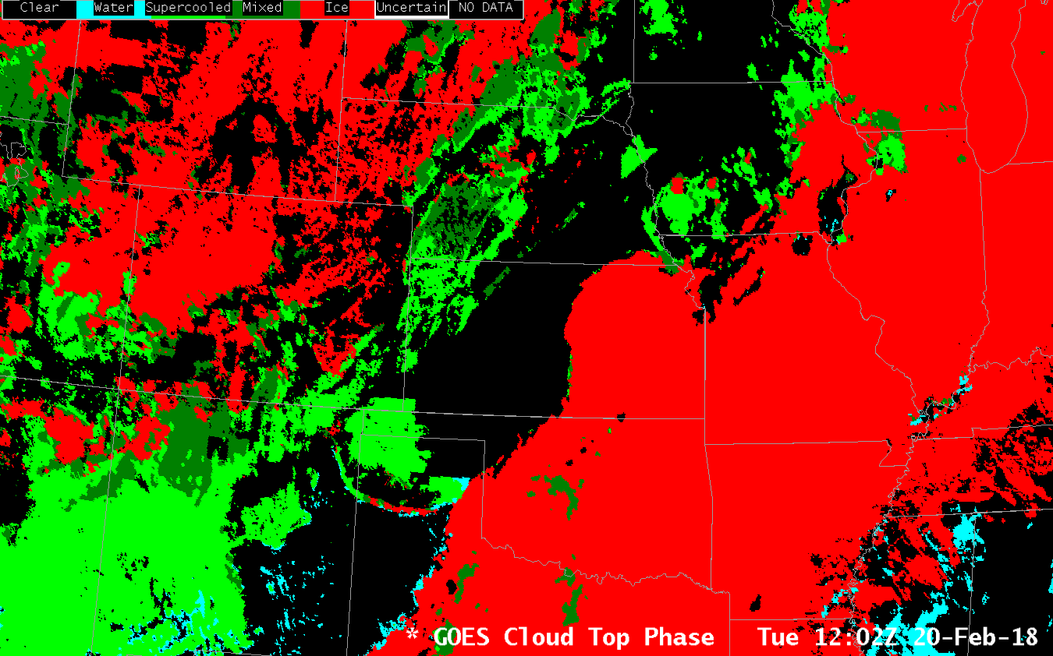
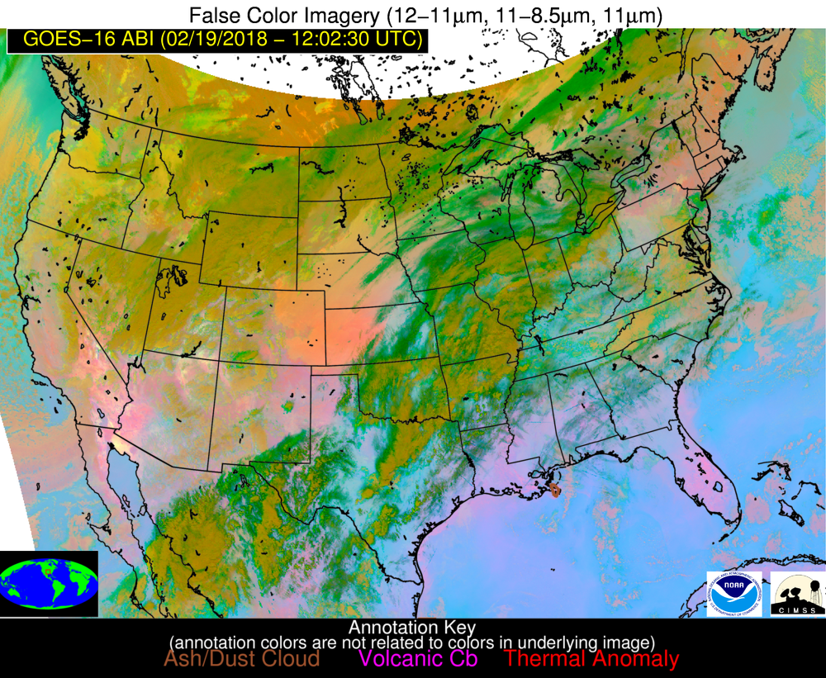
Cloud Mask Impacts
Some NWS users have asked why phase is sometimes “black” in AWIPS when clouds can be seen in imagery
Low clouds missed by cloud mask
Low clouds are often difficult to detect, so specialized algorithms used to identify hazardous low clouds

