Slide 1
Peer Stakeholder-Product Validation Review (PS-PVR)
For the Provisional Maturity of GOES-16 SEISS
MPS-LO L1b Product
March 29, 2019
GOES-R Calibration Working Group (CWG)
Presenter: Brian Kress
Contributors: Athanasios Boudouridis, Juan Rodriguez
NOAA NCEI / CIRES
This review incorporates results from Assurance Technology Corporation PLTs.
These GOES-16 data are preliminary, non-operational data and are undergoing testing. Users bear all responsibility for inspecting the data prior to use and for the manner in which the data are utilized.

Slide 2
Outline
MPS-LO Overview
Review of Beta Maturity
Product Quality Evaluation
  Instrument and GPA Anomalies and Resolution
  Analysis and PLPTs Supporting Assessment for Provisional Status
Provisional Maturity Assessment
Path to Full Validation Maturity
Summary and Recommendations
These GOES-16 data are preliminary, non-operational data and are undergoing testing. Users bear all responsibility for inspecting the data prior to use and for the manner in which the data are utilized.

Slide 3
MPS-LO OVERVIEW
GOES-16 MPS-LO L1b Product Provisional PS-PVR
These GOES-16 data are preliminary, non-operational data and are undergoing testing. Users bear all responsibility for inspecting the data prior to use and for the manner in which the data are utilized.

Slide 4
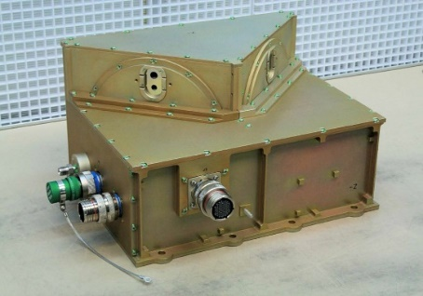
Space Environment In-Situ Suite (SEISS)
Magnetospheric Particle Sensor –
Low Energy (MPS-LO)
Magnetospheric Particle Sensor – Low Energy (MPS-LO):
    Electrostatic analyzers (2 per species)
    14 angular zones (12 unique), 2 background zones
    30 eV-30 keV electrons: 15 energies
    30 eV-30 keV ions: 15 energies
    L1b product: Magnetospheric Electrons and Protons: Low Energy
    SWx applications: Spacecraft frame charging
Magnetic field vector from GOES tri-axial fluxgate magnetometer is essential for calculating pitch angle for each telescope / angular zone
GOES-16 SEISS sensors turned on 08 Jan 2017
SEISS MPS-LO designed, built, tested and calibrated by Assurance Technology Corporation (ATC)
These GOES-16 data are preliminary, non-operational data and are undergoing testing. Users bear all responsibility for inspecting the data prior to use and for the manner in which the data are utilized.

Slide 5
MPS-LO Ion and Electron Counts in
14 Zones and 15 Energy-Channels
Flux = counts (in L0 data) / instrument geometric factor
2 x 14 x 15 = 420 flux time-series in MPS-LO L1b data
Energy Channels:
E1: 30,000 eV
E1: 18,300 eV
E3: 11,200 eV
E4: 6,280 eV
E5: 4,820 eV
E6: 2,550 eV
E7: 1,550 eV
E8: 950 eV
E9: 580 eV
E10: 350 eV
E11: 220 eV
E12: 130 eV
E13: 81 eV
E14: 49 eV
E15: 30 eV
Right Sensor
Head (RSH)
Left Sensor
Head (LSH)
Northward
Z6R (Z7R) and Z6L (Z7L) fluxes are expected to be the same due to overlapping fields of view.
30° Overlap in Coverage
-Z Anti-Earthward
These GOES-16 data are preliminary, non-operational data and are undergoing testing. Users bear all responsibility for inspecting the data prior to use and for the manner in which the data are utilized.

Slide 6
A Few Comments About MPS-LO
NOAA’s first plasma instrument on GOES!
Measures thermal population (~1keV at geosynchronous)
Measuring the low energy component of a plasma is notoriously difficult – Plasma instruments are known to require special care.
Surface charging on spacecraft is associated with <50 keV electrons [NASA, “Mitigating in-space charging effects – a guideline,” NASA Technical Handbook NASA- HDBK-4002A, March 3, 2011].
Electrostatic discharge (ESD) due to spacecraft charging causes most of the environmentally related anomalies on spacecraft, and surface charging has caused the most serious anomalies, i.e., those that have resulted in the loss of the mission [Koons et al., 1999].
In addition to its operational use at SWPC, we are looking forward to making this data available to the science community.
These GOES-16 data are preliminary, non-operational data and are undergoing testing. Users bear all responsibility for inspecting the data prior to use and for the manner in which the data are utilized.

Slide 7
MPS-LO Primary Operational Use
Data stream for NOAA-NWS SWPC
MPS-LO Density and Temperature Moments and Level of Spacecraft Charging
MAG L1b 1m averages
Level 1b
Level 2
SEISS MPS-LO L2 1m averages and the Density and Temperature Moments and Level of Spacecraft Charging algorithm are phase 2 algorithms. MPS-LO 5m averages is phase 3.
L2 densities and temperatures are also used in the L2 Magnetometer Magnetopause Crossing Detection algorithm as an indicator of magnetopause crossings at geosynchronous.
The L2 Moments algorithm identifies ion line signatures of SC charging and uses the ion line to determine the spacecraft potential:
When an ion line is not present, the L2 Moments routine uses an empirical relation between densities, temperatures, and level of charging to monitor SC charging.
1 sec.
Ion line
Backgrounds from heightened radiation belt fluxes
MPS-LO spectrogram of count rates from zone 4, with ion line signatures of spacecraft charging. The first ion line enhancement appears near 1 keV at ~5:30-6:30 UT during an eclipse period.
UT Hours
On 22 March 2017
These GOES-16 data are preliminary, non-operational data and are undergoing testing. Users bear all responsibility for inspecting the data prior to use and for the manner in which the data are utilized.

Slide 8
REVIEW OF BETA MATURITY
(G16 SEISS Beta PS-PVR, February 10, 2017)
GOES-16 MPS-LO L1b Product Provisional PS-PVR
These GOES-16 data are preliminary, non-operational data and are undergoing testing. Users bear all responsibility for inspecting the data prior to use and for the manner in which the data are utilized.

Slide 9
G16 MPS-LO Beta PS-PVR Overview
Two MPS-LO Vendor PLTs completed
  PLT-SEI-004 MPS-LO Initial IFCs (HV OFF & ON)
    8 and 11 January 2017
    ATC report: SEISS-TR-Y121-9_MPS-LO_IFC.pdf
  PLT-SEI-005 MPS-LO HV Optimization (ATC Recommends this test be done every 6 months.)
    Initial HV Optimization was done on 2017-01-09.
    Re-done on 2017-03-01, due to inconclusive results of the first test.
    ATC report: SEISS-TR-Y121-1-13_MPSLO_HV_Optimization_Final.pdf
Two MPS-LO PLPTs supporting beta maturity:
  PLPT-SEI-003 MPS-Lo Zone Cross-Comparison – PAD sanity check and compare overlapping zones.
  PLPT-SEI-006 Backgrounds Trending – Comparisons with MPS-HI channels performed.
One ADR/WR Impacting MPS-LO L1b presented during beta review:
ADR | WR | Short Description | Status | Expected Closure
NA | 3907 | Excessively high MPS-LO backgrounds | Open | 1. Allow MCPs to outgas 2. Re-run HV adjustment PLT with modified procedure. Goal: set HV at least one step lower on ion and electron MCPs.
These GOES-16 data are preliminary, non-operational data and are undergoing testing. Users bear all responsibility for inspecting the data prior to use and for the manner in which the data are utilized.

Slide 10
MPS-LO HV Optimization Results
(Post Beta PS-PVR)
Optimize setting of high voltage (HV) bias across micro-channel plate (MCP) detector (type of electron multiplier).
Goal is to set HV low enough so as not to introduce excessive noise and crosstalk but high enough so that we operate in/near saturation (uniformity of charge exiting MCPs with individual particle hit).
G16/FM1 MPS-LO HV optimization performed on 2017-03-01.
ATC Report: SEISS-TR-Y121-1-13_MPSLO_HV_Optimization_Final.pdf (Report date: 5 Nov. 2018)
ATC Recommends that the G16 MPS-LO Electron (EMCP) HV is raised from step 25 to step 26.
ATC Recommends that the G16 MPS-LO Ion (IMCP) remains at step 26.
These GOES-16 data are preliminary, non-operational data and are undergoing testing. Users bear all responsibility for inspecting the data prior to use and for the manner in which the data are utilized.

Slide 11
PRODUCT QUALITY EVALUATION
GOES-16 MPS-LO L1b Product Provisional PS-PVR
These GOES-16 data are preliminary, non-operational data and are undergoing testing. Users bear all responsibility for inspecting the data prior to use and for the manner in which the data are utilized.

Slide 12
Summary of MPS-LO Anomalies
High Backgrounds / Negative Fluxes
  Resolution strategy: ADRs 326, 763, and empirical derivation of background removal coefficients
  Source of backgrounds not fully understood.
Interzonal Crosstalk
  Cross talk at a level of 30% was observed in FM1 SH-R electrons with MCPs operated on voltage step 26 (SEISS-D-ML079-1_RevC.pdf). Crosstalk correction coefficients were not measured in FM1 ground/beam calibrations. Crosstalk is apparent in energy-dependent count rates in background zones in on-orbit data. Impact of crosstalk on currently reported fluxes is unknown.
Evidence for significant error in absolute values of reported fluxes (e.g., PLPT-SEI-003: MPS-LO Zone Cross-Comparison). Possible sources of error in reported fluxes:
  Gradual decrease in in-band and background zone response with time (seen on slide 25)
  MCP HV setting different from calibration
  No crosstalk correction scaling of geometric factors for G16, since crosstalk was not measured for this unit, but is evident in BGs
  Significant differences between left and right sensor head fluxes (seen in Zone Cross-Comparison)
  May be insufficient or too much background removal
  To reduce crosstalk and noise, instrument not operated in full saturation
Degraded performance of lower energy ion channels due to persistent high backgrounds
Effect of arc jet firing
These GOES-16 data are preliminary, non-operational data and are undergoing testing. Users bear all responsibility for inspecting the data prior to use and for the manner in which the data are utilized.

Slide 13
  High Backgrounds / Negative Fluxes – ADRs 326, 763, and 764 (G17) and Empirical Derivation of Background Removal Coefficients at NCEI
GOES-16 MPS-LO L1b Product Provisional PS-PVR
These GOES-16 data are preliminary, non-operational data and are undergoing testing. Users bear all responsibility for inspecting the data prior to use and for the manner in which the data are utilized.

Slide 14
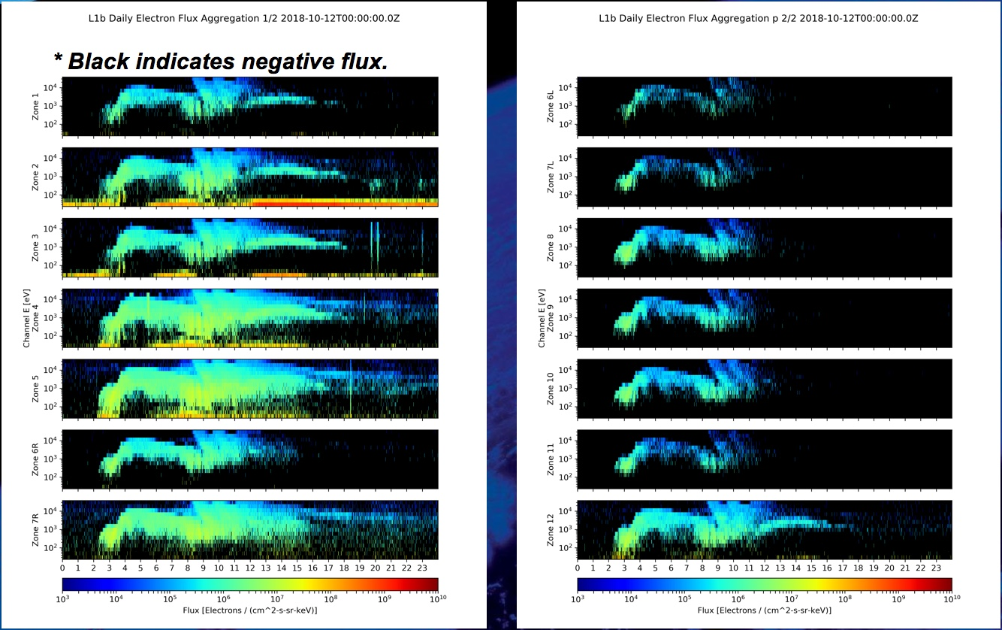
L1b Electrons on 12 Oct. 2018
(Prior to implementation of ADR 326, MPS-LO GPA Changes)
Black indicates negative values.
G16 MPS-LO L1b data from right and left electron sensor heads on 10/12/18.
Negative flux (black pixels) due to high backgrounds: Corrected counts = total counts – background counts
Addressed by ADR326/WR5860 MPS-Lo GPA Changes, in build DO.07.01.00, and ADR763 (LUT update).
These GOES-16 data are preliminary, non-operational data and are undergoing testing. Users bear all responsibility for inspecting the data prior to use and for the manner in which the data are utilized.

Slide 15
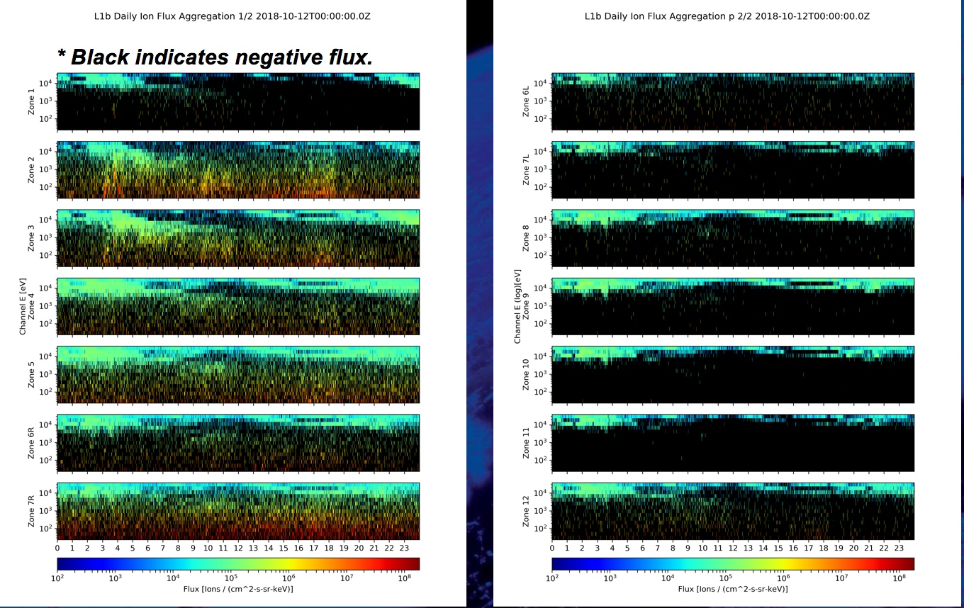
L1b Ions on 12 Oct. 2018
(Prior to implementation of ADR 326, MPS-LO GPA Changes)
G16 MPS-LO L1b data from right and left ion sensor heads on 10/12/18.
Negative flux (black pixels) due to high backgrounds: Corrected counts = total counts – background counts
Addressed by ADR326/WR5860 MPS-Lo GPA Changes, in build DO.07.01.00, and ADR763 (LUT update).
These GOES-16 data are preliminary, non-operational data and are undergoing testing. Users bear all responsibility for inspecting the data prior to use and for the manner in which the data are utilized.

Slide 16
MPS-LO Background Removal
In-band
(electrons or ions)
Penetrating radiation / Backgrounds
~
Sweep voltage
(selects 15 energies)
BG
In-band
Illuminated zone accumulates
both in-band and BG counts
Unilluminated
Background
Zone
14 zones
(viewing directions)
Simplified background (BG) removal expression :
Corrected Counts = Total counts – BG Removal Coefficient x BG Counts
Pre- ADR326 CDRL80 expression has 4 BG removal coefficients, one for each species and sensor head, all were set to one in the launch version of the MPS-LO LUT. Analysis shows need for energy and zone dependent BG removal coefficients with values <1 for most energy-zone pairs. Need to characterize in-band vs. BG response for 14 zones x 15 energies for electrons and ions.
These GOES-16 data are preliminary, non-operational data and are undergoing testing. Users bear all responsibility for inspecting the data prior to use and for the manner in which the data are utilized.

Slide 17

Three Actions Addressing MPS-LO
High Backgrounds / Negative Fluxes
ADR326: Implement energy dependent background subtraction, previously energy-sweep averaged (Also involves non-trivial modification to error term – Complete description in ADR_326_Addendum_Revised_10-2-18.pdf.)
  $Currently: M_{m,k,i,j}=N_{m,k,i,j}^{tot.}−C_{m,k}{Avg_N}_{m,k}^{BG}$
  $Modify to: M_{m,k,i,j}=N_{m,k,i,j}^{tot.}−C_{m,k}N_{m,k,j}^{BG}$
ADR326: Generalization of background (BG) removal coefficient to include zone and energy dependence
  $C_{m,k}$ (2✕2) → $C_{m,k,i,j}$ (2✕2✕7✕15)
NCEI: Empirical derivation of BG removal coefficients (by demanding positive fluxes, averaged over some interval, using many months of data) and L1b processing G16 and G17 LUT updates (ADRs 763 and 764 ).
m = 1,2 for electrons and ions respectively.
k = 1,2 for right and left sensor heads.
r = 1-4 is species & sensor head group index,
for ions-R, ions-L, electrons-R, electrons-L.
i = 1-7 is zone index for 7 zones in each SH.
j = 1-15 is energy channel index.
These GOES-16 data are preliminary, non-operational data and are undergoing testing. Users bear all responsibility for inspecting the data prior to use and for the manner in which the data are utilized.

Slide 18

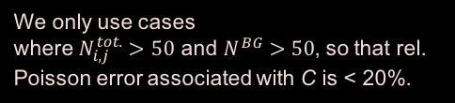
Empirical Determination of Background Removal Coefficients
The corrected counts M in a given zone and energy channel are the total counts N^{tot.} minus the counts from penetrating radiation
$M_{i,j}=N_{i,j}^{tot.}−C_{i,j}N^{BG}$,
where i and j are the is the zone and energy indices, respectively, and the counts in zone i due to penetrating radiation is assumed to be proportional to the counts in the associated (same species and sensor head) background zone N^{BG}.
If we demand that the flux averaged over some time-interval is non-negative, this places an upper bound on the background removal coefficient.
$${\overline{M}}_{i,j}={\overline{N}}_{i,j}^{tot.}−C_{i,j}{\overline{N}}^{BG}≥0 → C_{i,j}≤\frac{{\overline{N}}_{i,j}^{tot.}}{{\overline{N}}^{BG}}$$
where the overbar denotes an average over some time interval (e.g., 5 min. averages from 1s data). An upper bound for $C_{i,j}$ can be determined empirically by taking the minimum value of ${\overline{N}}_{i,j}^{tot.}/{\overline{N}}^{BG}$ attained over months of data
Set $C_{i,j}=Min\left[{\left(\frac{{\overline{N}}_{i,j}^{tot.}}{{\overline{N}}^{BG}}\right)}_{k}\right]$,
where k is index for the averaging interval, and we take minimum from many such intervals. An upper bound of 1 is also placed on the C coefficients.
We only use cases
where $N_{i,j}^{tot.}>50$ and $N^{BG}>50$, so that rel. Poisson error associated with C is < 20%.
These GOES-16 data are preliminary, non-operational data and are undergoing testing. Users bear all responsibility for inspecting the data prior to use and for the manner in which the data are utilized.

Slide 19
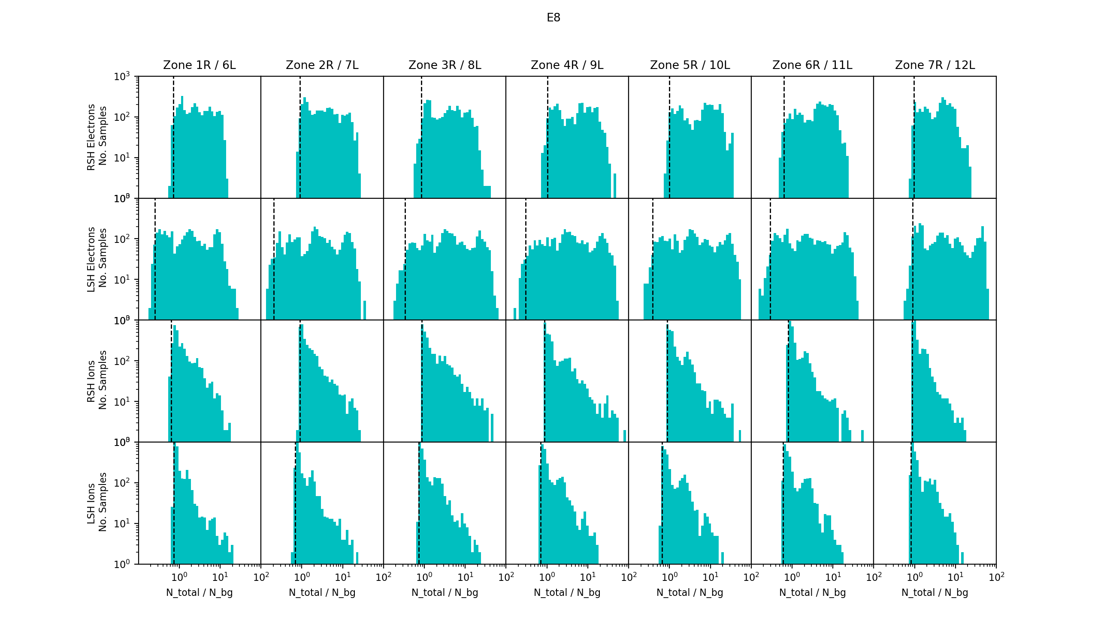
Remove Outliers by Accepting 1% Negative Fluxes (on avg.)
Example showing N_{tot.}/N_{BG} distributions from all ion and electron zones in E8 energy channel
Here using 11 non-consecutive days (3168 5m intervals) with varying levels
of geomagnetic activity.
To remove outliers that significantly reduce the background removal, the first percentile of N^{tot.}/N^{BG} values, indicated by the black vertical dashed lines (instead of minima), are used for the BG removal coefficients, so we expect 1% negative values in our 5m averages.
These GOES-16 data are preliminary, non-operational data and are undergoing testing. Users bear all responsibility for inspecting the data prior to use and for the manner in which the data are utilized.

Slide 20
Empirical Background Removal Coefficients
These tables are included in the current G16 MPS-LO LUT:
SeissMpsLoCalInrParameters(FM1A_CDRL79RevC_DO_07_01_00)-600840846.0.h5
Ion Background Removal Coefficients
Electron Background Removal Coefficients
ADR326 MPS-LO GPA Changes included a LUT configuration change to accommodate the new table shown (2x2 table modified to 2x2x7x15). The updated LUT was provided by NCEI under ADR763.
These GOES-16 data are preliminary, non-operational data and are undergoing testing. Users bear all responsibility for inspecting the data prior to use and for the manner in which the data are utilized.

Slide 21
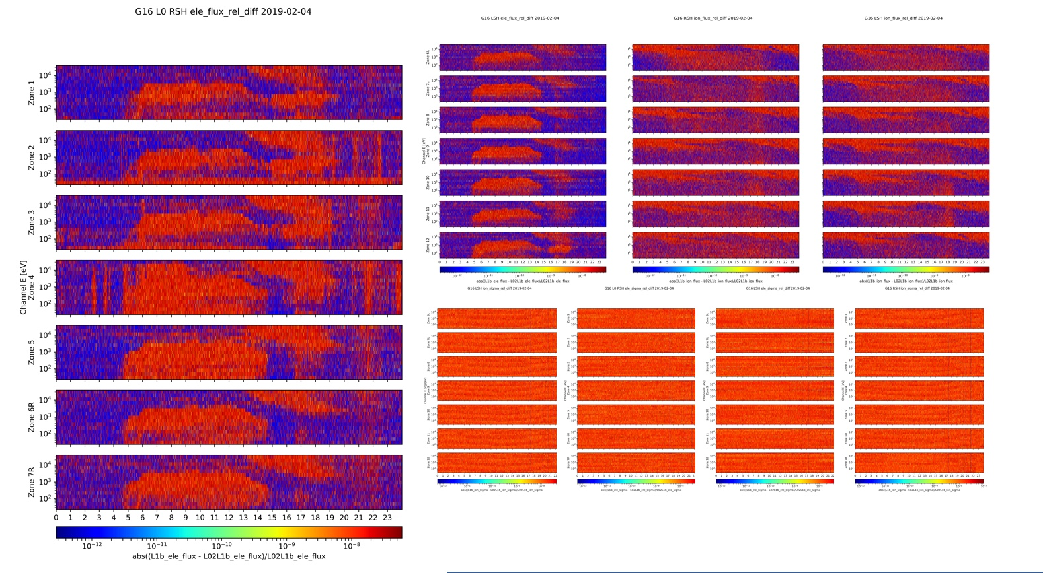
Verification of ADRs 326 and 763
(L1b – NCEI_in-house_L0_to_L1b) / NCEI_in-house_L0_to_L1b
Right sensor head electrons
Left sensor head electrons
RIght sensor head ions
Left sensor head ions
Verification of fluxes
Flux error term for R & L SH electrons and ions
Verification of flux error term
24 Hours
< 1.E-7 rel. difference in all cases.
Verification of ADR 326, MPS-LO GPA Changes and ADR 763, G16 MPS-LO LUT Update. L1b flux and error in agreement with NCEI’s in-house L0 to L1b result to within 1.E-7 (using single precision floats).
L1b fluxes and errors were similarly verified for ADR 764 G17 MPS-LO LUT Update.
These GOES-16 data are preliminary, non-operational data and are undergoing testing. Users bear all responsibility for inspecting the data prior to use and for the manner in which the data are utilized.

Slide 22
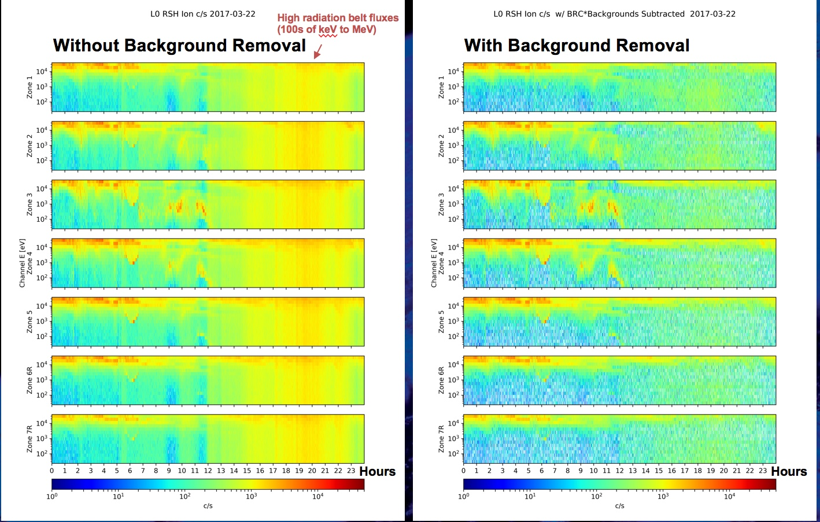
First, the Good News
Example of MPS-LO background removal with empirically determined BG removal coefficients showing ion counts/sec., using 11 days of varying geomagnetic activity for determining BG removal coefficients.
Hours
These GOES-16 data are preliminary, non-operational data and are undergoing testing. Users bear all responsibility for inspecting the data prior to use and for the manner in which the data are utilized.

Slide 23
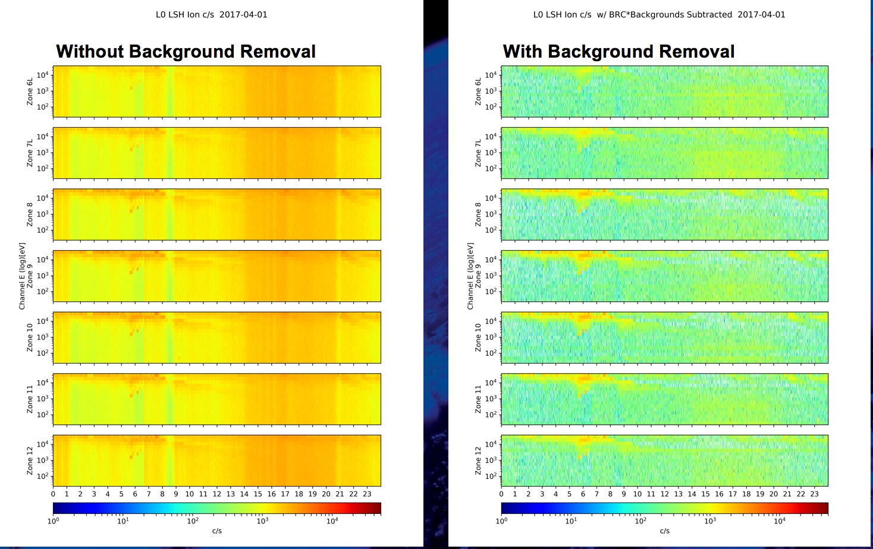
4/1/17 LSH Ions
Example of MPS-LO background removal with empirically determined BG removal coefficients showing ion counts/sec., using 11 days of varying geomagnetic activity for determining BG removal coefficients.
These GOES-16 data are preliminary, non-operational data and are undergoing testing. Users bear all responsibility for inspecting the data prior to use and for the manner in which the data are utilized.

Slide 24
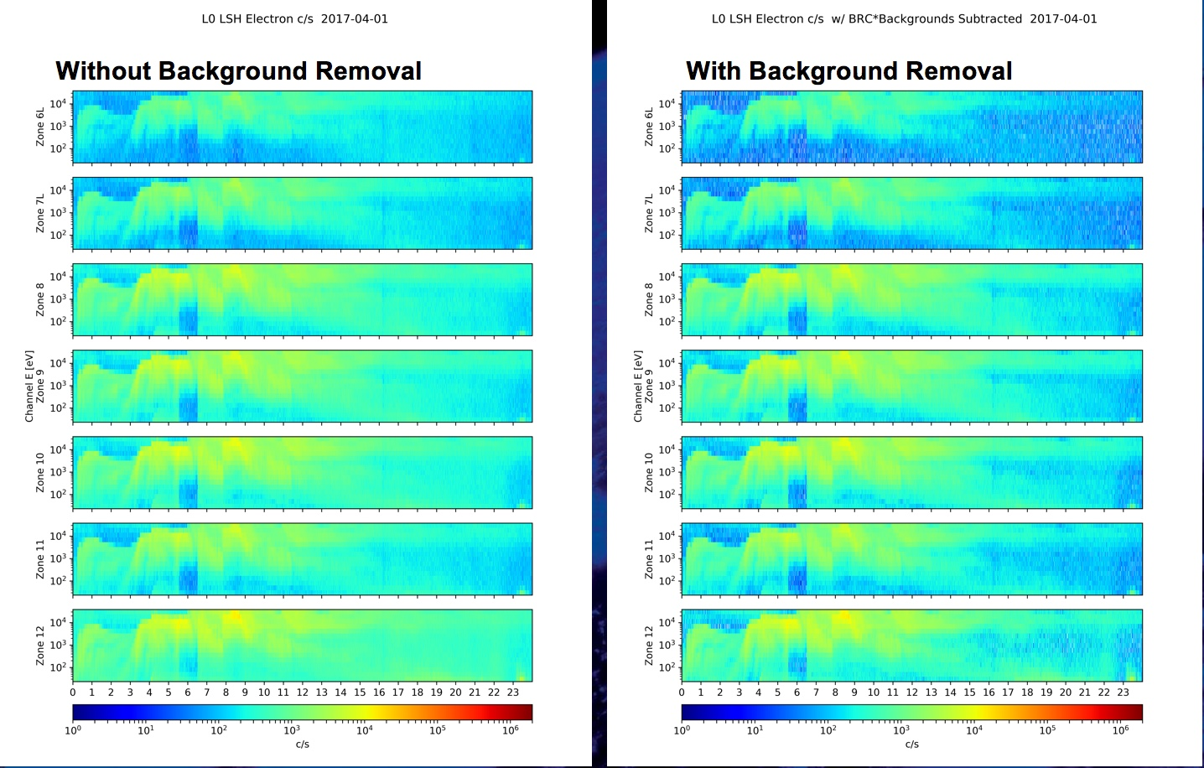
4/1/17 LSH Electrons
Example of MPS-LO background removal with empirically determined BG removal coefficients showing electron counts/sec., using 11 days of varying geomagnetic activity for determining BG removal coefficients.
These GOES-16 data are preliminary, non-operational data and are undergoing testing. Users bear all responsibility for inspecting the data prior to use and for the manner in which the data are utilized.

Slide 25
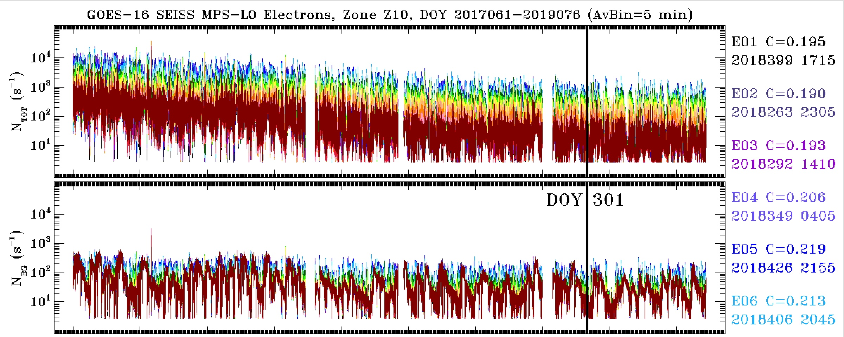
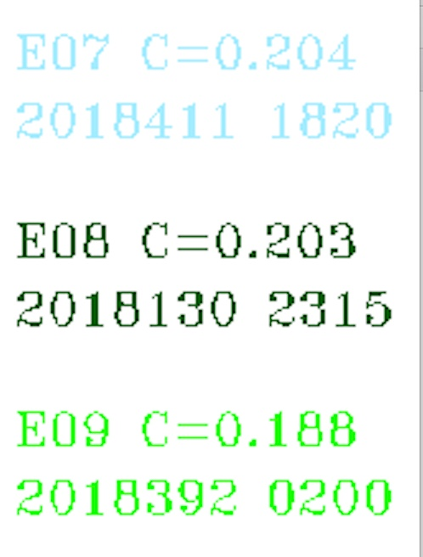
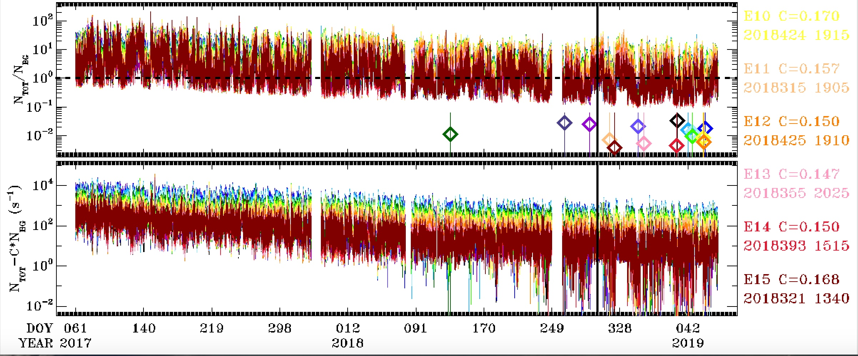
Problem: Secular Change in Background Removal Coefficients
Analysis period used for BG removal
coefficients currently in LUT
On average, N_{Tot.}/N_{BG} has gradually decreased almost an order of magnitude since March 2017. There is much less significant decrease in N_{Tot.}/N_{BG} from the ion zones. Background coefficients will need to be periodically checked and updated.
Colored diamonds to the left indicate minimum values of N_{Total}/N_{BG} found, within entire period shown.
BG removal coe. = 1 percentile value of N_{Total}/N_{BG}
These GOES-16 data are preliminary, non-operational data and are undergoing testing. Users bear all responsibility for inspecting the data prior to use and for the manner in which the data are utilized.

Slide 26
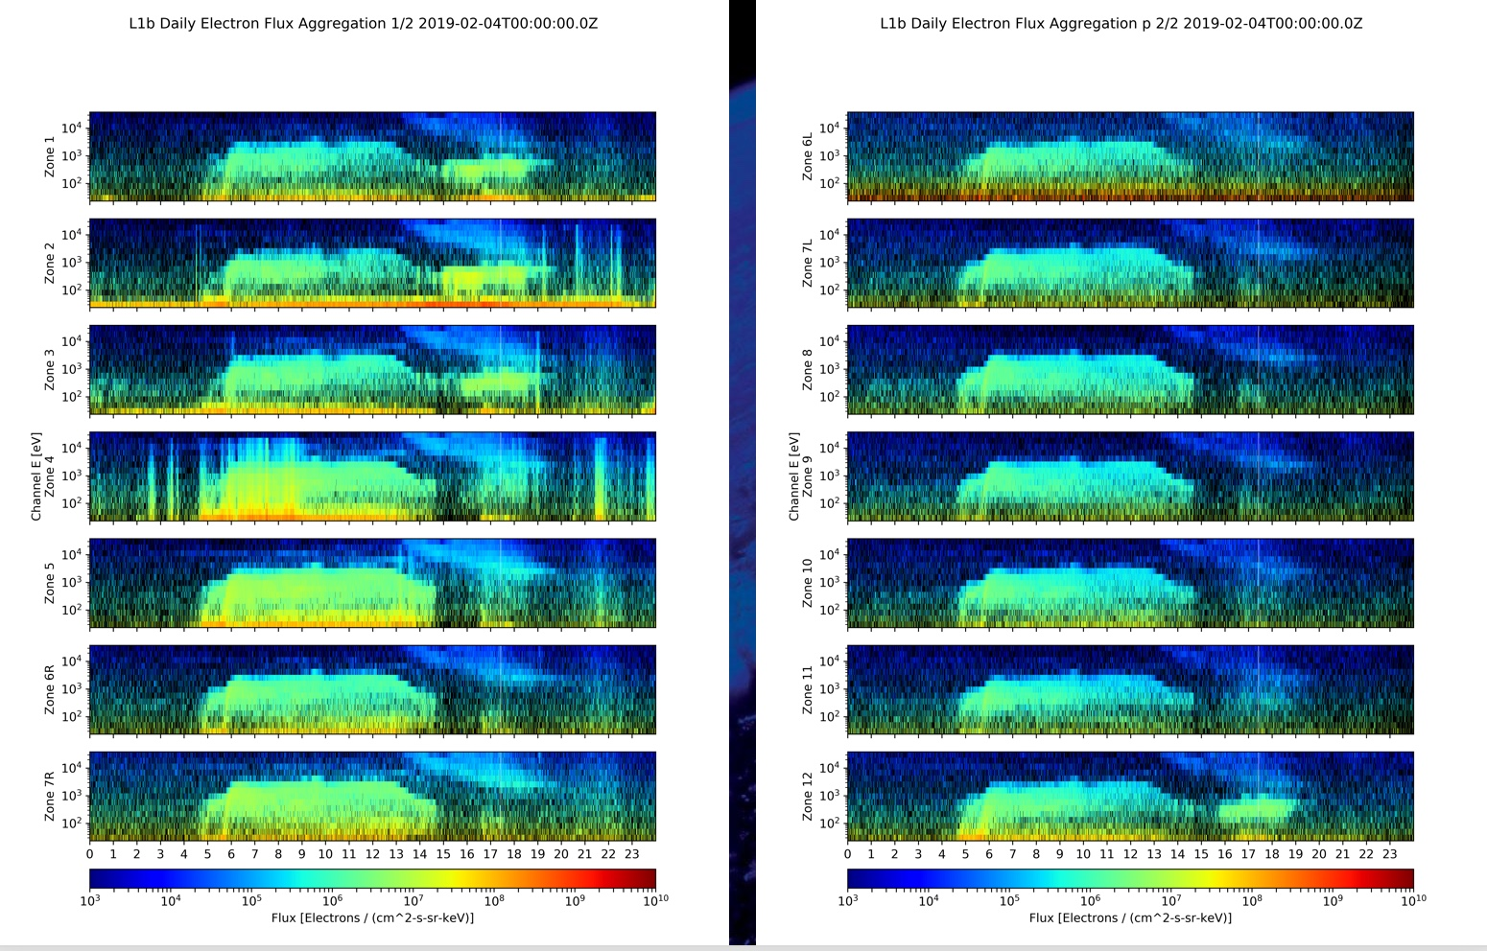
Current L1b Electrons
(with implementation of ADR 326, MPS-LO GPA Changes)
The current L1b electron spectrograms do not look very impressive with regard to fixing the problem with negative values. There are 3 reasons for this:
Radiation belt fluxes (source of backgrounds) are very high on the day shown here (2019-02-04).
The secular decrease in N_{tot.}/N_{BG} since the end of the period used to determine BG removal coefficients currently in the L1b LUT means that the coefficients are now too high.
This is 1s data, whereas the coefficients are set so that we have 1% neg. values in 5m averages – We expect speckled black pixels in the 1s data due to Poisson statistics.
These GOES-16 data are preliminary, non-operational data and are undergoing testing. Users bear all responsibility for inspecting the data prior to use and for the manner in which the data are utilized.

Slide 27
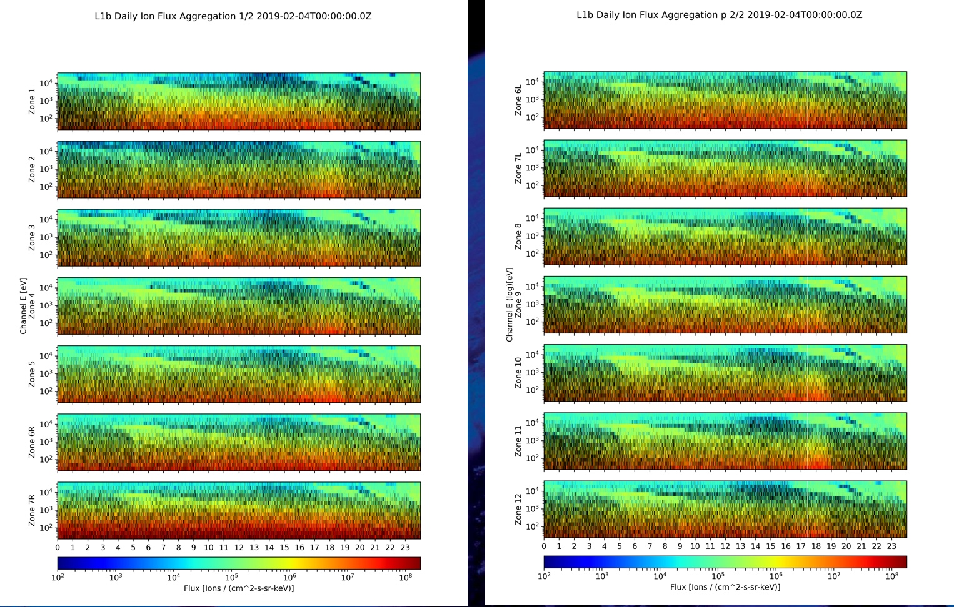
Current L1b Ions
(with implementation of ADR 326, MPS-LO GPA Changes)
…Similarly for the ions.
These GOES-16 data are preliminary, non-operational data and are undergoing testing. Users bear all responsibility for inspecting the data prior to use and for the manner in which the data are utilized.

Slide 28
Additional MPS-LO Anomalies
Interzonal Crosstalk
Effect of Arc Jet Firing
MPS-LO L1b IFC leakage
Effect of High Backgrounds on Low Energy Ions Measurement
These GOES-16 data are preliminary, non-operational data and are undergoing testing. Users bear all responsibility for inspecting the data prior to use and for the manner in which the data are utilized.

Slide 29
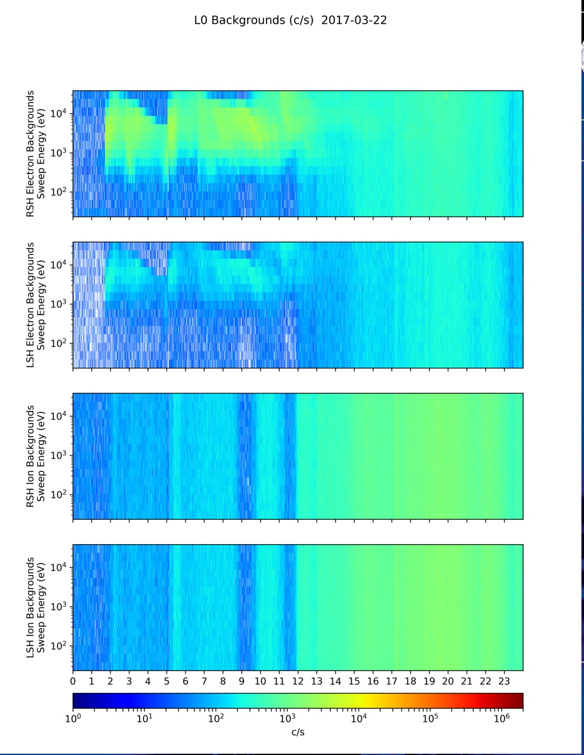
Crosstalk Between Zones Seen in Background Zones
Crosstalk from illuminated zones
Energy independent Backgrounds
Right sensor head
electron background zone
Left sensor head
electron background zone
Right sensor head
ion background zone
Left sensor head
ion background zone
Crosstalk is apparent in energy-dependent count rates in electron background zones in on-orbit data. (Since background zones are not illuminated by energy sweep voltage, we do not expect energy dependent count rates in background zones.)
These GOES-16 data are preliminary, non-operational data and are undergoing testing. Users bear all responsibility for inspecting the data prior to use and for the manner in which the data are utilized.

Slide 30

Crosstalk Correction
There is crosstalk between zones, including crosstalk into background zones.
Background-corrected count rate
$M_{i}=N_{i}^{tot.}−N^{BG}$
With assumption that crosstalk from one zone is distributed uniformly to other zones, by subtracting backgrounds (also containing crosstalk), we remove the crosstalk from the signal M (desirable).
However, some signal from the i^{th} zone (in background via crosstalk) is also subtracted from N^{tot.} (not desirable). The background-corrected flux is scaled up to compensate for this using the crosstalk correction factor 1 / (1 - k_{i}).
Crosstalk-corrected Flux: $F_{i}=\frac{M_{i}}{\left(1−k_{i}\right)G_{i}}$
The total counts include crosstalk from 6 other zones.
The BG counts include crosstalk from all 7 illuminated zones.
Full derivation of CT correction in Cross-Talk_and_Penetratating_Flux_Correction_Algorithm-Jan_2018_v1, ATC, 1/15/18
These GOES-16 data are preliminary, non-operational data and are undergoing testing. Users bear all responsibility for inspecting the data prior to use and for the manner in which the data are utilized.

Slide 31
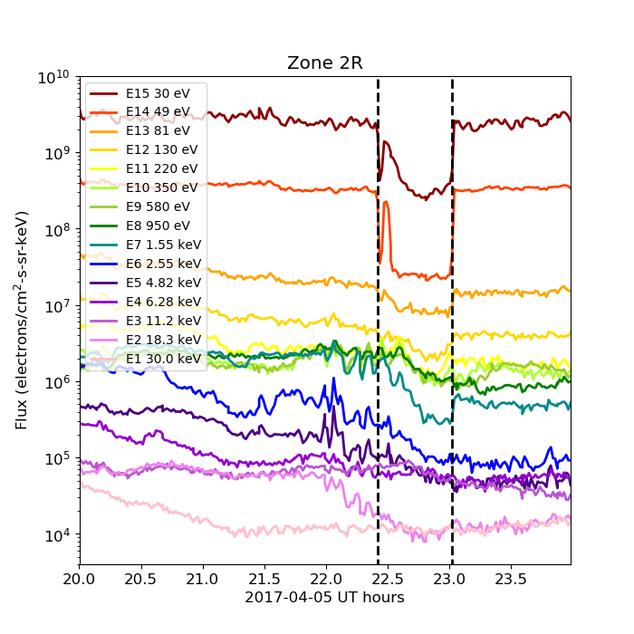
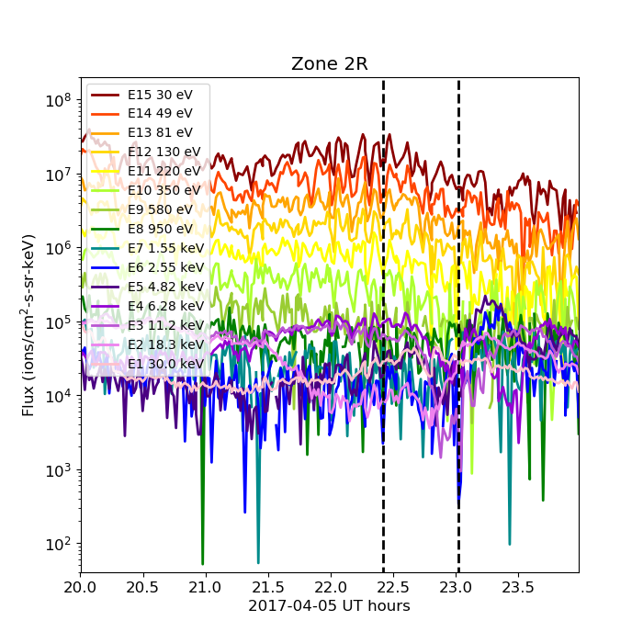
Effect of Arc Jet Firing
MPS-LO Electron and Ion time-series on 2017-04-05 showing the effect of arc jet firing (occurring between the vertical dashed lines). There is a drop in flux in the lowest electron energy channels. There is no discernable effect on the ion fluxes during the same period. In both cases fluxes from Zone 2R are shown. The Zone 2R viewing direction usually corresponds to pitch angles from near zero to ~20 deg.
Low energy electrons measured by MPS-LO are mainly photoelectrons emitted by the spacecraft. Since the [secondary] photoelectrons are removed in the L2 Moments code, this effect is benign. A request has been submitted to make the arc jet flag (created for MAG) available in MPS-LO L1b (ADR596/WR5800).
These GOES-16 data are preliminary, non-operational data and are undergoing testing. Users bear all responsibility for inspecting the data prior to use and for the manner in which the data are utilized.

Slide 32
G16 and G17 MPS-HI and MPS-LO L1b IFC leakage (ADR780)
MPS-LO problem description: IFC pulses are leaking into L1b fluxes in over half the channels (electron and ion)
  Occurs at end of periods when MODE flag set to 4, used to mask IFCs
  Violates accuracy requirement
IFC mode status changes are out of sync with IFC pulser status:
  Sensors report that they are in IFC mode 1-second before the IFC starts
  Sensors report that they are back in Normal mode 1-second before IFC is completed
MPS-LO IFC tables cannot be changed
The agreed-to path forward is a ground software modification
  ATC recommends that, in the GPA software, the IFC mask should be extended for 2 seconds beyond the MODE = 4 (IFC mode) status.
  This will prevent IFC leakage without compromising the functionality of the IFC tables.
  Applies to MPS-LO, MPS-HI and SGPS
Thanks to Elizabeth Dawson (ATC) for her contributions to this information, including tech memo dated 07 November 2018
These GOES-16 data are preliminary, non-operational data and are undergoing testing. Users bear all responsibility for inspecting the data prior to use and for the manner in which the data are utilized.

Slide 33
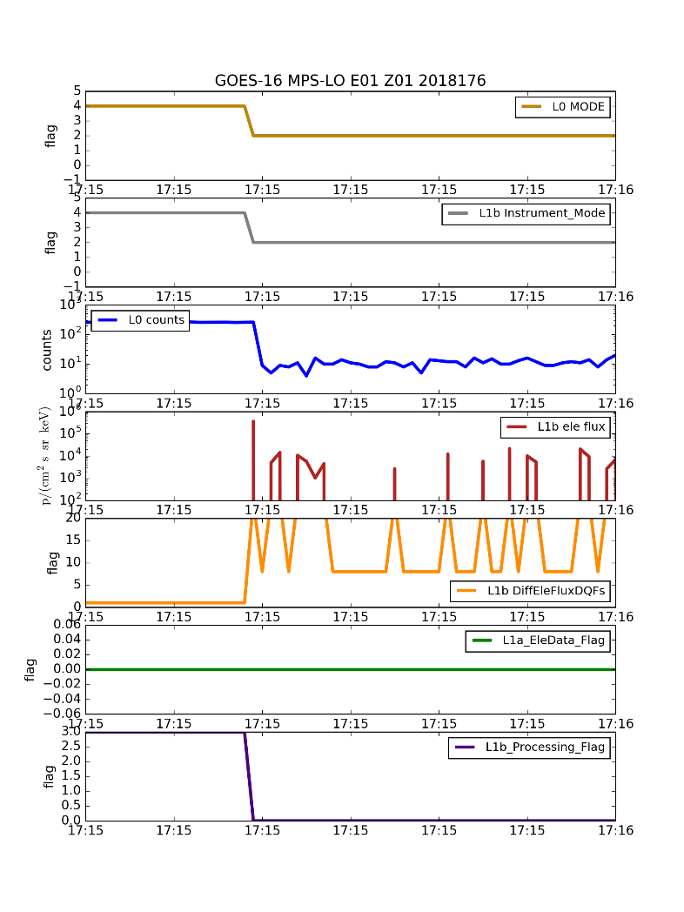
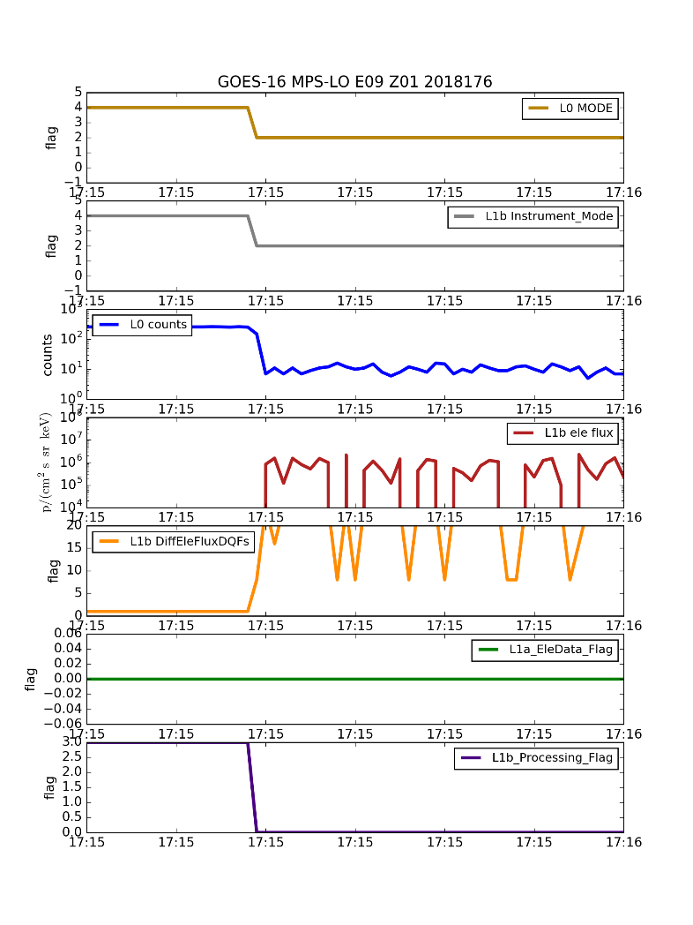
More than half of the MPS-LO electron and ion channels have IFC leaks
All angular zones are affected
Ion channels I1-I8 are affected
Electron channels E1-E8 are affected
Based on these plots, it is not clear why channels 9-15 are not affected since the pulse continues beyond the flag
IFC
IFC
?
These GOES-16 data are preliminary, non-operational data and are undergoing testing. Users bear all responsibility for inspecting the data prior to use and for the manner in which the data are utilized.

Slide 34
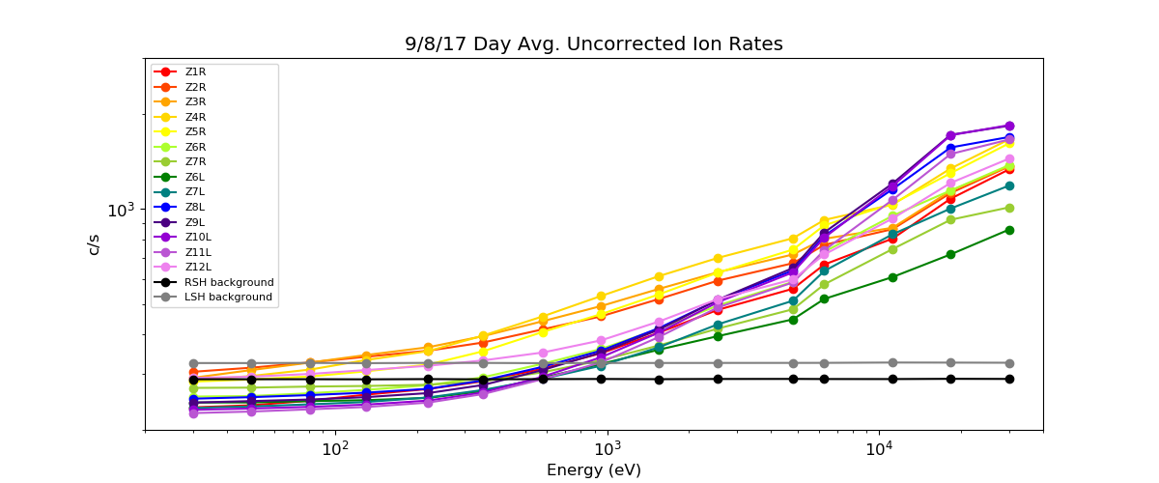
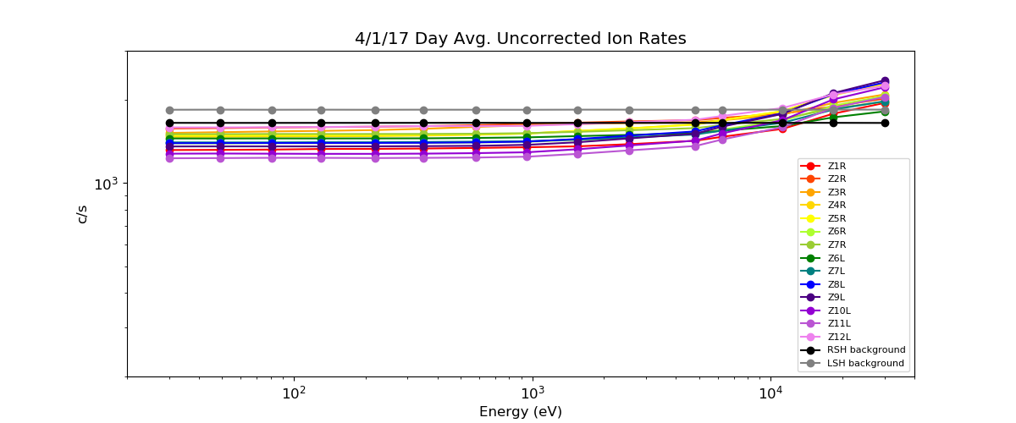
Effect of High Backgrounds on Low Energy Ions Measurement
Geomagnetic storm day
(elevated ions)
count rate
2x10²
Signal to background ratio low on days when backgrounds are high.
No measurement here below ~1 keV.
count rate
High radiation belts day
(high backgrounds)
2x10²
These GOES-16 data are preliminary, non-operational data and are undergoing testing. Users bear all responsibility for inspecting the data prior to use and for the manner in which the data are utilized.

Slide 35
  MPS-LO Provisional Post Launch Product Tests (PLPTs)
GOES-16 MPS-LO L1b Product Provisional PS-PVR
These GOES-16 data are preliminary, non-operational data and are undergoing testing. Users bear all responsibility for inspecting the data prior to use and for the manner in which the data are utilized.

Slide 36
MPS-LO PLPTs Supporting Provisional Maturity
PLPT-SEI-003 MPS-Lo Zone Cross-Comparison
PLPT-SEI-005 Cross satellite Comparison of Trapped Particles
PLPT-SEI-006 Backgrounds Trending
These GOES-16 data are preliminary, non-operational data and are undergoing testing. Users bear all responsibility for inspecting the data prior to use and for the manner in which the data are utilized.

Slide 37
PLPT-SEI-003: MPS-LO Zone Cross-Comparison – Method (1/4)
Compares fluxes measured by pairs of MPS-LO angular zones when central pitch angle is the same
Under such conditions, zones should observe the same flux at the same energy
Steps:
  Input 1-min MPS-LO fluxes and pitch angles calculated from MAG BRF
  Identify whenever a pair of zones has pitch angles within 1 degree and pitch angles varying more slowly than 30 deg/minute
  Use supplementary angles of pitch angles > 90 degrees to have sufficient matches (assumes up-going and down-going trapped fluxes are the same on a 1-minute timescale)
  Report observed fluxes for each pitch angle match
  Estimate scaling factors optimally based on set of all matches
Ref: Rowland, W., and R. S. Weigel (2012), Intra-calibration of particle detectors on a three-axis stabilized geostationary platform, Space Weather, 10, S11002, doi:10.1029/2012SW000816.
These GOES-16 data are preliminary, non-operational data and are undergoing testing. Users bear all responsibility for inspecting the data prior to use and for the manner in which the data are utilized.

Slide 38
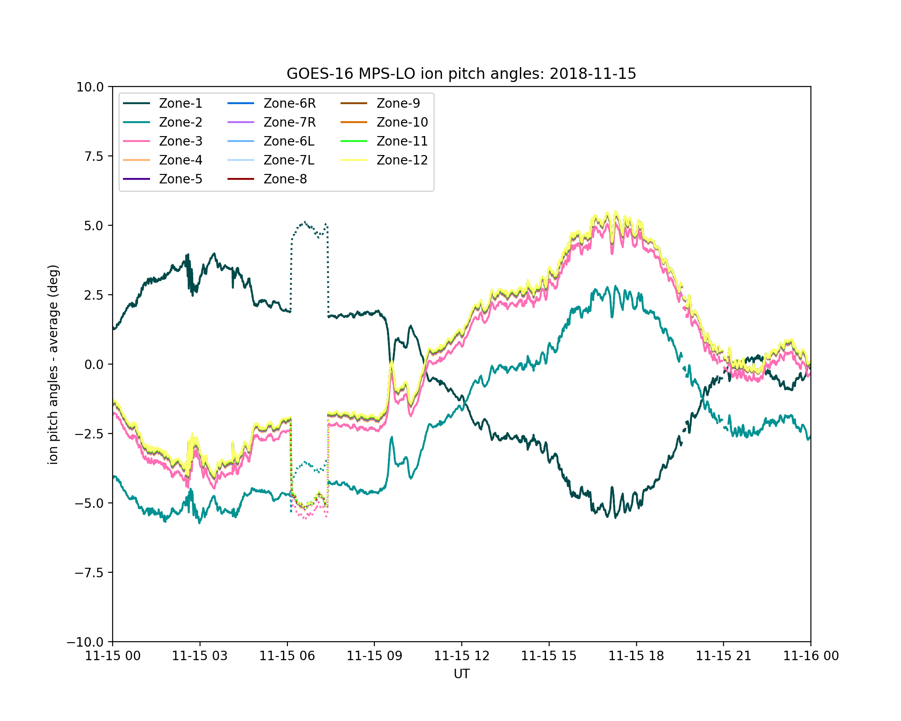
PLPT-SEI-003: MPS-LO Zone Cross-Comparison – Method (2/4)
Example of pitch angles from masked MAG data due to arcjet
Pitch angles calculated from 1-min averages of G16 MAG L1b body-reference-frame (BRF) data (provisional)
Zonal look directions derived from beta angles in ATC 'SEISS-TR-ML074-2 Rev. C [2016-08-24]’ (alpha angles set to zero)
Distinct for ions and electrons
Effect of arcjet on pitch angles (removed)
These GOES-16 data are preliminary, non-operational data and are undergoing testing. Users bear all responsibility for inspecting the data prior to use and for the manner in which the data are utilized.

Slide 39
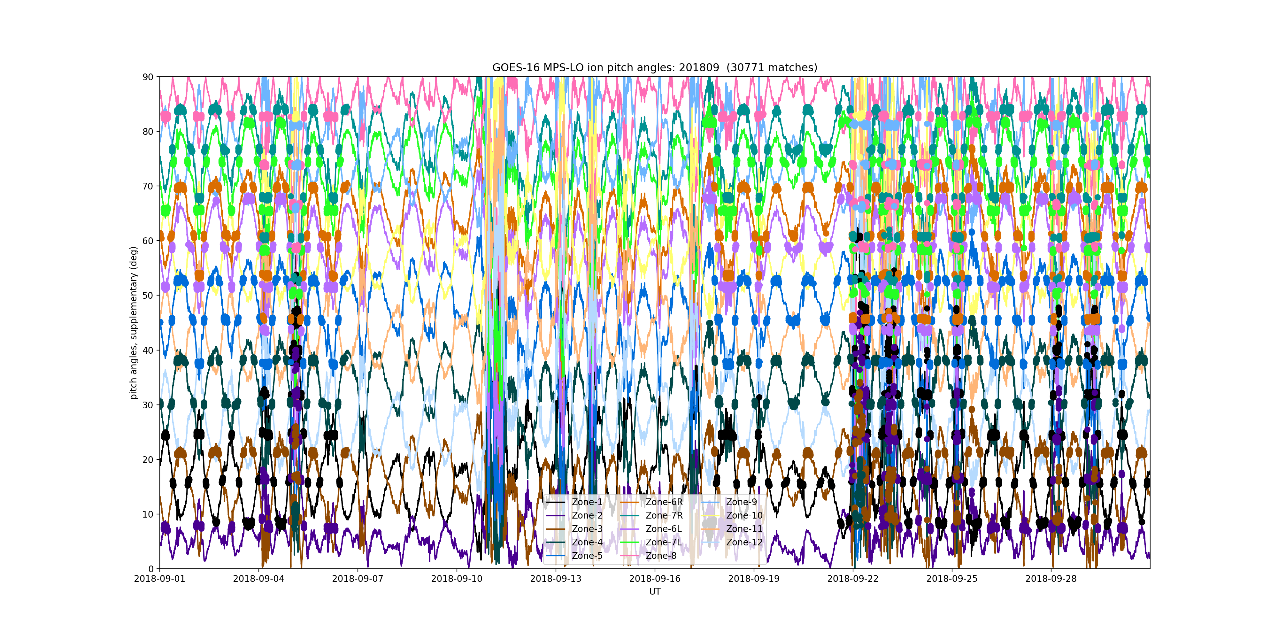
PLPT-SEI-003: MPS-LO Zone Cross-Comparison – Method (3/4)
Example: Ion Pitch Angles, September 2018 (supplementary angles of p.a. > 90 deg)
90°
60°
30°
0°
Dots indicate pitch angle matches (absent 9/6-17 due to sweep voltage OFF)
100-10,000 matches per month, depending on energy and zone
These GOES-16 data are preliminary, non-operational data and are undergoing testing. Users bear all responsibility for inspecting the data prior to use and for the manner in which the data are utilized.

Slide 40

PLPT-SEI-003: MPS-LO Zone Cross-Comparison – Method (4/4)
Use Nelder-Mead method to minimize the following objective function: sum of squares of the following difference term (~30k terms [matches] in the sum per energy)
To reduce effect of statistical noise, use only matches where both fluxes correspond to at least 1000 counts/minute
A non-linear problem: need a good initial guess for the scale factors in order for the solution to converge
  1000-6000 iterations needed, depending on the energy and species
  2.5 (2.8) hours needed for three months, 14 zones, 15 energies of ions (electrons) on macOS 2.5 GHz Intel Core i7
Because they are only valid in a relative sense, scale factors must be normalized – here, normalized to those of Zone 1 (arbitrary choice)
$$R\left(m\right)=\frac{{SF}_{i}\left(m\right)J_{i}\left(m\right)−{SF}_{j}\left(m\right)J_{j}\left(m\right)}{{SF}_{i}\left(m\right)J_{i}\left(m\right)+{SF}_{j}\left(m\right)J_{j}\left(m\right)}$$
Ref: Rowland, W., and R. S. Weigel (2012), Intra-calibration of particle detectors on a three-axis stabilized geostationary platform, Space Weather, 10, S11002, doi:10.1029/2012SW000816.
These GOES-16 data are preliminary, non-operational data and are undergoing testing. Users bear all responsibility for inspecting the data prior to use and for the manner in which the data are utilized.

Slide 41
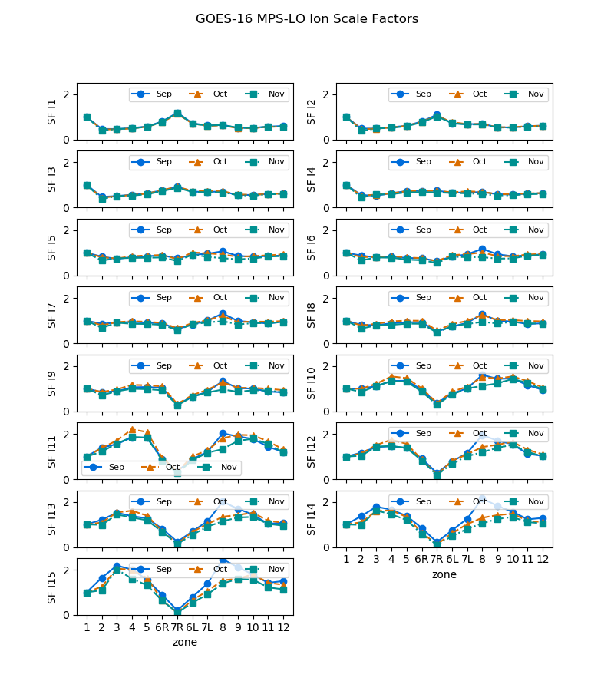
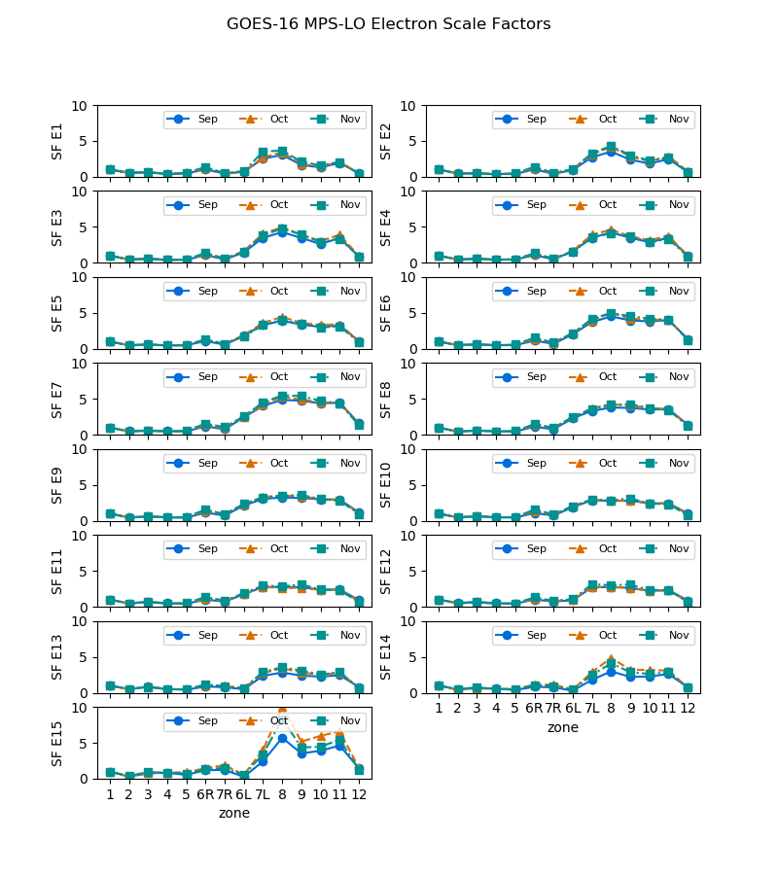
PLPT-SEI-003: MPS-LO Zone Cross-Comparison – Scale Factor Results (1/2)
Ions, Sept-Nov 2018
Electrons, Sept-Nov 2018
R L
R L
Multiplicative scale factors plotted vs. zone for each energy
OK consistency month-to-month – indicates need to do this on a monthly basis
Electron zones show strong R-L asymmetry, as expected
These GOES-16 data are preliminary, non-operational data and are undergoing testing. Users bear all responsibility for inspecting the data prior to use and for the manner in which the data are utilized.

Slide 42
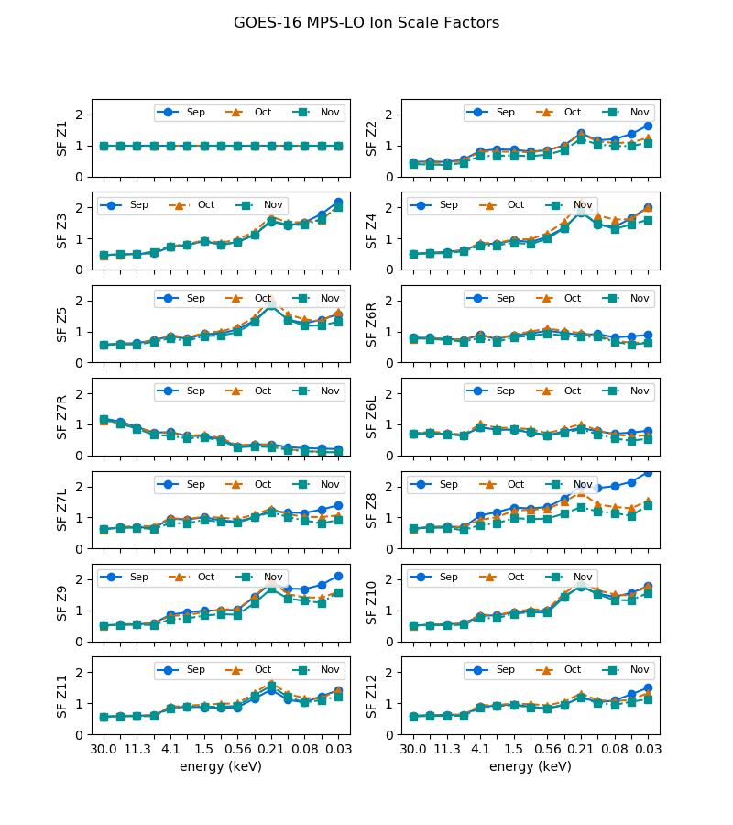
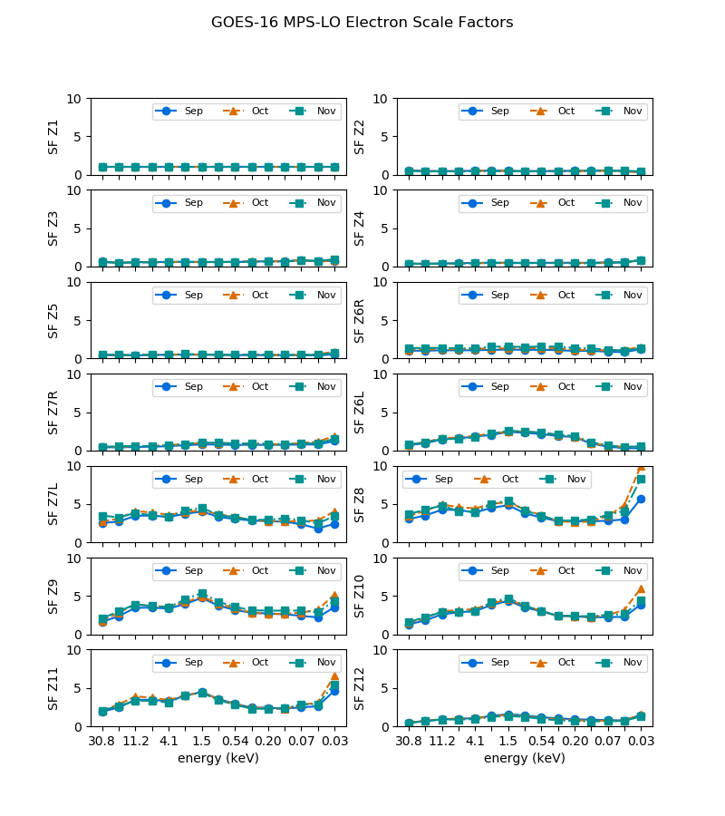
PLPT-SEI-003: MPS-LO Zone Cross-Comparison – Scale Factor Results (2/2)
Ions, Sept-Nov 2018
Electrons, Sept-Nov 2018
Multiplicative scale factors plotted vs. energy step for each zone (highest energy is lowest energy step) OK consistency month-to-month – indicates need to do this on a monthly basis
Scaling of up to an order of magnitude needed for some zone-energy channels.
These GOES-16 data are preliminary, non-operational data and are undergoing testing. Users bear all responsibility for inspecting the data prior to use and for the manner in which the data are utilized.

Slide 43
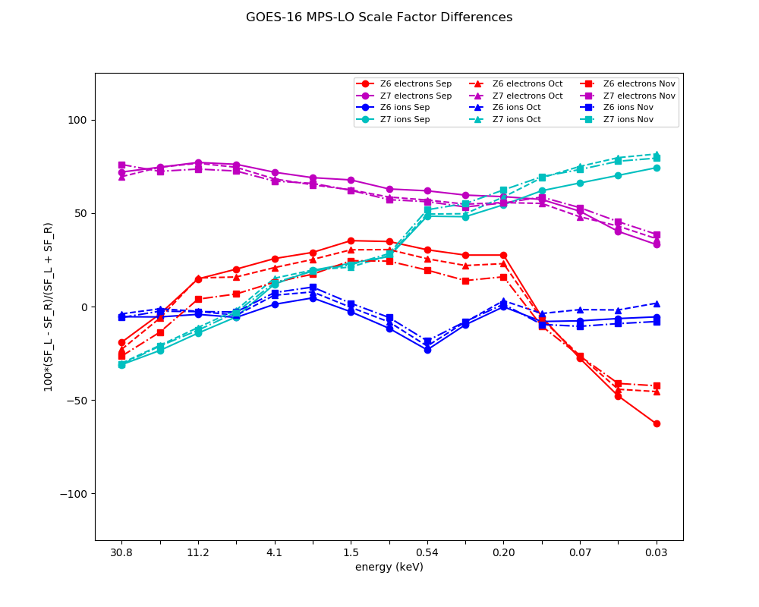
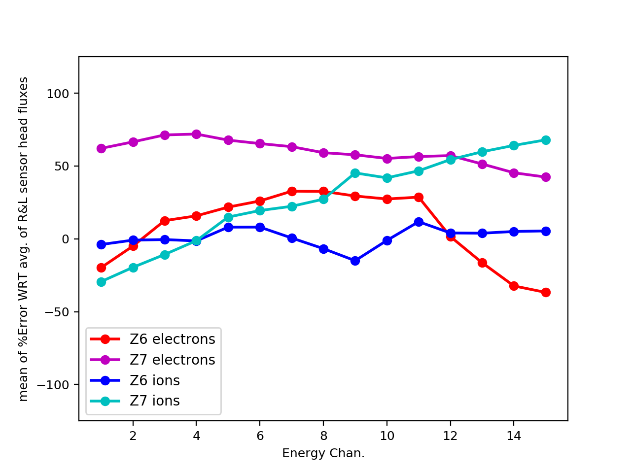
PLPT-SEI-003: MPS-LO Zone Cross-Comparison – Comparison of Overlapping Zones
(Z6R with Z6L and Z7R with Z7L)
3-month mean of error of each overlapping zone with respect to average of overlapping pair
Error computed from Z6 and Z7 scale factors
determined with method described on previous slides
Using 3 months of 1 min. averaged fluxes, the percent error with respect to the avg. of the overlapping pair is calculated for each 1m sample (i.e., we split the difference, thus errors associated with the 2 overlapping zones are the same). Then, the mean value of errors from 3 months of 1 min. averages is calculated.
The error computed by comparing fluxes from overlapping zones (left figure) is in close agreement with error computed from the scale factors obtained by minimizing error associated with cross comparisons of all zones described on previous slides (right figure), showing verification of results by an independent method.
These GOES-16 data are preliminary, non-operational data and are undergoing testing. Users bear all responsibility for inspecting the data prior to use and for the manner in which the data are utilized.
Partial pass

Slide 44
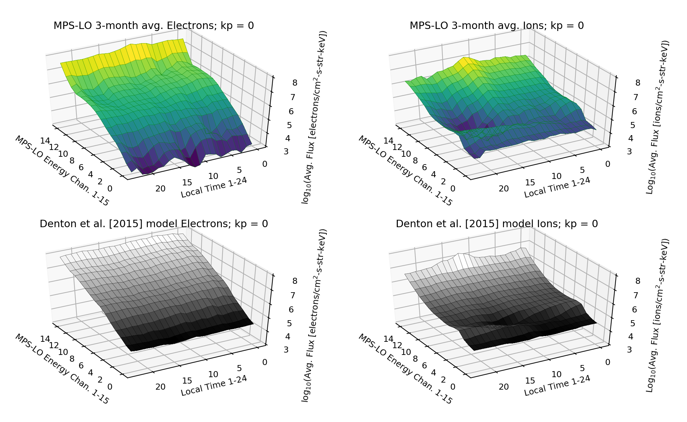
PLPT-SEI-005 Cross satellite Comparison of Trapped Particles
Comparison of G16 MPS-LO Sep-Nov 2018 data with Denton et al. [2015; 2016] model, based on 1990-2007 observations from the Magnetospheric Plasma Analyzer (MPA) instruments on seven Los Alamos National Laboratory (LANL) satellites at GEO. MPS-LO fluxes are binned in local-time and Kp geomagnetic activity index, and then 3-month averaged, for comparison with Denton model.
These GOES-16 data are preliminary, non-operational data and are undergoing testing. Users bear all responsibility for inspecting the data prior to use and for the manner in which the data are utilized.

Slide 45
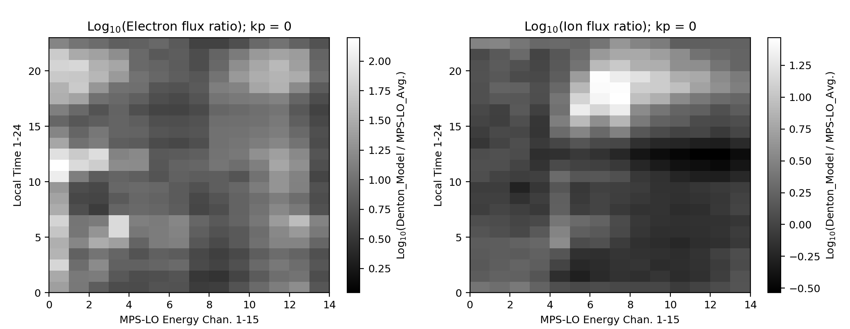
PLPT-SEI-005 Cross satellite Comparison of Trapped Particles
Denton model electron fluxes up to factor of 100 higher at highest energies.
Denton model ion fluxes up to factor of 30 higher.
The Denton et al. [2015; 2016] model electron fluxes are up to 2 orders of magnitude higher than the LT-Kp binned MPS-LO electron fluxes.
The Denton model ion fluxes are up to a factor of 30 higher than the MPS-LO ion fluxes.
Not apples to apples comparison (3-months of MPS-LO data during solar min. vs. 1990-2007 MPA)
General trends in data are similar – Verification that MPS-LO is measuring environmental fluxes.
These GOES-16 data are preliminary, non-operational data and are undergoing testing. Users bear all responsibility for inspecting the data prior to use and for the manner in which the data are utilized.

Slide 46
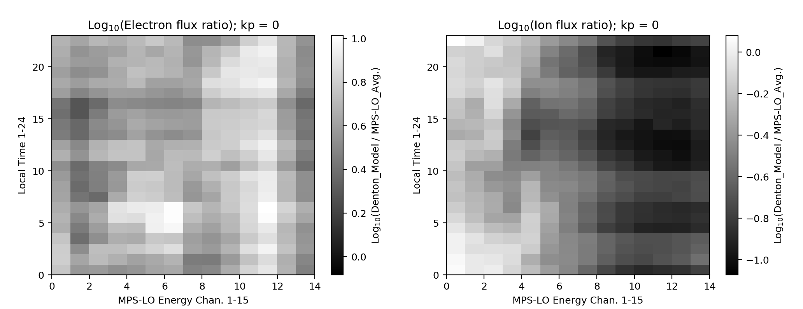
PLPT-SEI-005 Cross satellite Comparison of Trapped Particles
Denton model electron fluxes up to factor of 10 higher at highest energies.
MPS-LO ion fluxes up to factor of 10 higher.
Comparison without MPS-LO background removal.
In this case, the Denton model electron fluxes are up one order of magnitude higher than MPS-LO.
The MPS-LO ion fluxes are up to an order of magnitude higher than the Denton model Ion fluxes.
These results show that lower MPS-LO electron fluxes are not due to background subtraction alone. The lower MPS-LO ion fluxes, however, may be due to too much background subtraction.
These GOES-16 data are preliminary, non-operational data and are undergoing testing. Users bear all responsibility for inspecting the data prior to use and for the manner in which the data are utilized.
Partial pass

Slide 47
PLPT-SEI-006
Backgrounds Trending
Extensive analysis of backgrounds were performed for empirical determination of BG removal coefficients.
Ratio of in-band to Background response characterized with determination of background removal coefficients.
Source of backgrounds is not fully understood (mainly radiation belt electrons, but at lower energies than expected).
  Simulations show that penetration of MPS-LO box by electrons should be limited >=MeV energies.
  There is good correlation between MPS-LO backgrounds and 100s of keV electrons (400-800 keV).
In general, in-band and background zone responses have been gradually decreasing since launch (e.g., slide 25).
These GOES-16 data are preliminary, non-operational data and are undergoing testing. Users bear all responsibility for inspecting the data prior to use and for the manner in which the data are utilized.

Slide 48
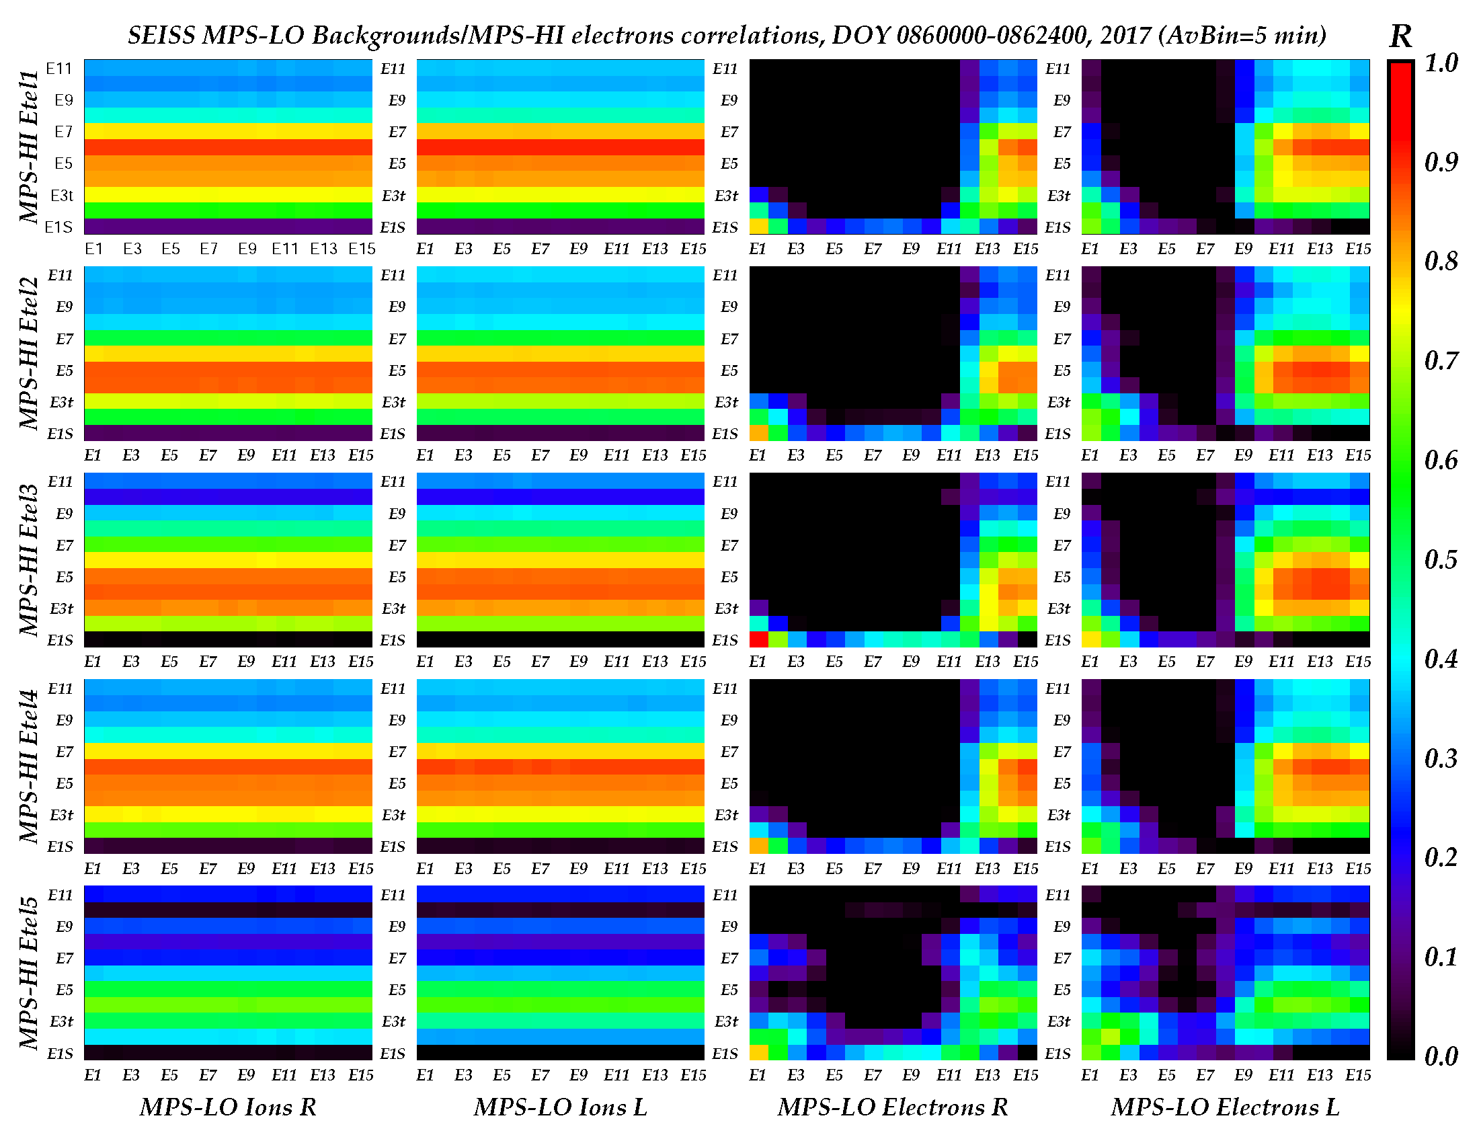
Correlations Between MPS-LO Backgrounds and MPS-HI Channels
MPS-HI Channels
At lower electron energies and all ion energies, MPS-LO backgrounds are well correlated with MPS-HI 600-800 keV electrons.
MPS-LO backgrounds
These GOES-16 data are preliminary, non-operational data and are undergoing testing. Users bear all responsibility for inspecting the data prior to use and for the manner in which the data are utilized.
Partial pass

Slide 49
PROVISIONAL MATURITY ASSESSMENT
GOES-16 MPS-LO L1b Product Provisional PS-PVR
These GOES-16 data are preliminary, non-operational data and are undergoing testing. Users bear all responsibility for inspecting the data prior to use and for the manner in which the data are utilized.

Slide 50
Summary of G16 MPS-LO Instrument/GPA Issues Identified and Resolution Status
High Backgrounds / Negative Fluxes
    Resolution: ADRs 326 MPS-LO GPA Changes, ADR 763 G16 MPS-LO LUT Update (ADR 764 for G17 MPS-LO), and empirical derivation of background removal coefficients by NCEI.
    First bullet done, but BG removal coefficients will need additional updates.
Interzonal crosstalk
    Not observed/measured in FM1 ground/beam calibrations but apparent in energy-dependent count rates in background zones in on-orbit data – No path forward yet for G16.
Effect of arc jet firing – ADR596 Make Arc Jet Flag available for SEISS MPS-LO
Evidence for significant error in absolute values of reported fluxes (e.g., PLPT-SEI-003: MPS-LO Zone Cross-Comparison) – Geometric factors may need adjustment.
ADRs/WRs Impacting Validation of G16 MPS-LO L1b
ADR# | WR# | Short Description | Status | Expected Closure
326 | 5424 | MPS-LO GPA Changes | Closed | w/ build DO.07.01.00
763 | 6978 | G16 MPS-LO LUT Update (ADR764 for similar G17) | Closed | w/ LUT change
596 | 5800 | Make Arc Jet Flag available for SEISS MPS-LO | In work | DO.09.00.00
780 | 6845 | GPA update for SEISS MPS-HI and MPS-LO L1b IFC leakage | Approved / In-Analysis | TBD?
TBD | TBD | G16 MPS-LO Crosstalk Correction LUT update | TBD | TBD
Full validation items
These GOES-16 data are preliminary, non-operational data and are undergoing testing. Users bear all responsibility for inspecting the data prior to use and for the manner in which the data are utilized.

Slide 51
Provisional Validation
Preparation Activities | Assessment
Validation activities are ongoing and the general research community is now encouraged to participate. | Validation activities are ongoing. Results have been discussed with SWPC. Release of data by NCEI will enable research community participation.
Severe algorithm anomalies are identified and under analysis. Solutions to anomalies are in development and testing. | ADR326 MPS-LO GPA Changes implemented in DO.07.01 (was needed for provisional). ADR780 GPA update for MPS-LO L1b IFC leakage in-Analysis, needed for full.
Incremental product improvements may still be occurring. | Product improvements will result from steps to mitigate known (on previous chart) and any yet to be discovered anomalies.
These GOES-16 data are preliminary, non-operational data and are undergoing testing. Users bear all responsibility for inspecting the data prior to use and for the manner in which the data are utilized.

Slide 52
Provisional Validation
End State | Assessment
Product performance has been demonstrated through analysis of independent measurements obtained from select locations, periods, and associated ground truth or field campaign efforts. | G16/FM1/SN101 MPS-LO ground/beam calibrated. Performance tests included in provisional PLPT results
Product analysis is sufficient to communicate product performance to users relative to expectations (Performance Baseline). | Yes, to the limited extent that absolute accuracy can verified on-orbit.
Documentation of product performance exists that includes recommended remediation strategies for all anomalies and weaknesses. Any algorithm changes associated with severe anomalies have been documented, implemented, tested, and shared with the user community. | PUG and/or CDRL80 will need to be updated to reflect changes, e.g., ADR326 MPS-LO GPA Changes. A complete description of known anomalies will be included in readme file with release of data to public.
Testing has been fully documented. | In this presentation and supplemental materials.
Product is ready for operational use and for use in comprehensive cal/val activities and product optimization. | Readiness for operational use TBD at provisional PS-PVR review.
These GOES-16 data are preliminary, non-operational data and are undergoing testing. Users bear all responsibility for inspecting the data prior to use and for the manner in which the data are utilized.

Slide 53
PATH TO FULL VALIDATION MATURITY
GOES-16 MPS-LO L1b Product Provisional PS-PVR
These GOES-16 data are preliminary, non-operational data and are undergoing testing. Users bear all responsibility for inspecting the data prior to use and for the manner in which the data are utilized.

Slide 54
Path to Full Validation
ADRs/WRs to be resolved prior to Full Validation.
PLPTs to be conducted prior to Full Validation.
Performance Baseline Status.
Risks to getting to Full, both from L1b product definition and user (SWPC) feedback
These GOES-16 data are preliminary, non-operational data and are undergoing testing. Users bear all responsibility for inspecting the data prior to use and for the manner in which the data are utilized.

Slide 55
ADRs/WRs Impacting Full Validation of G16 MPS-LO L1b
ADR# | WR# | Short Description | Status | Expected Closure
596 | 5800 | Make Arc Jet Flag available for SEISS MPS-LO | In work | DO.09.00.00
780 | 6845 | GPA update for SEISS MPS-HI and MPS-LO L1b IFC leakage | Approved / In-Analysis | TBD?
TBD | TBD | G16 MPS-LO Crosstalk Correction LUT update | TBD | TBD
These GOES-16 data are preliminary, non-operational data and are undergoing testing. Users bear all responsibility for inspecting the data prior to use and for the manner in which the data are utilized.

Slide 56
Path to Full Validation - PLPTs
Title | Activity | Data Needed | Success Criteria
A.3.2 MPS-Lo Zone Cross-Comparison [PLPT-SEI-003] | Perform a sanity check of PADs, determine the relative sensitivity/response among MPS-LO zones and determine relative inter-calibration factors for zone Z6L vs. Z6R and Z7L vs. Z7R, for each of 15 energies and for both electrons and ions. | Three months of continuous data. | Fully characterize differences in response among MPS-LO zones.
A.3.4 Cross Satellite Comparison of Trapped Particles [PLPT-SEI-005] | Inter-calibrate MPS-LO with similar measurements on other missions. | Magnetospheric Plasma Analyzer (MPA) data from Los Alamos National Laboratory satellites. | [Full] Differences quantified on data taken through validation phase.
A.3.5 Backgrounds Trending [PLPT-SEI-006] | (1) Trend daily/weekly minima from MPS-LO ion and electron background zones (ZGR and ZGL). (2) Correlate orbital variations in MPS-LO backgrounds with MPS-HI and SGPS measurements. | Four months of continuous data. | [Full] Perform analysis during validation phase.
From RIMP v1.0 (02 June 2016).
Full PLPTs are ongoing continuations of Provisional PLPTs.
These GOES-16 data are preliminary, non-operational data and are undergoing testing. Users bear all responsibility for inspecting the data prior to use and for the manner in which the data are utilized.

Slide 57
GOES-16 MPS-LO
Performance Baseline Status
Assessment at Provisional
MRD ID | Description | MRD Requirement | MIT/LL Predicted Performance Baseline | NCEI Assessment at Provisional | Related PLPTs | Status
1987 | MPS-LO Orthogonality/ Coverage | 5 directions | 14 directions (zones) | 14 directions (zones) | -03 | PASS
1991 | MPS-LO Measurement Range | 30 eV – 30 keV (protons and electrons) | 30 eV – 30 keV | 0.025-30.8 keV (electrons) 0.030-30.0 keV/q (ions) [values from CDRL79] | -05 | PASS
1992 | MPS-LO Measurement Accuracy | 45% @min flux, 25% @10X min flux | 420 separate accuracies (2 species x 14 angles x 15 energies); Worst case for 10x min flux: Electrons: 23%; Ions: 20% Worst case for min flux: Electrons: 40%; Ions: 38% | Absolute accuracy cannot be verified on-orbit. Results of PLPT-03 indicate that 25% relative accuracy not currently achieved on-orbit. | -03, -05, -06 | Results of PLPT-03, 05 and 06 will need to be applied
These GOES-16 data are preliminary, non-operational data and are undergoing testing. Users bear all responsibility for inspecting the data prior to use and for the manner in which the data are utilized.

Slide 58
Path to Full Validation – Risks
Risk Name | Description | Impact | Mitigation and Schedule
High Backgrounds / Negative Fluxes | Higher than expected backgrounds results negative (background subtracted) fluxes in L1b. | Degrades accuracy of reported fluxes. | Addressed by ADR326 MPS-LO GPA Changes, ADR763 G16 MPS-LO LUT Update, and empirical derivation of background removal coefficients (done). Background removal coefficients will need to be periodically updated.
G16/FM1 Crosstalk | Interzonal crosstalk, – Not measured in FM1 ground calibrations but apparent in background count rates on-orbit. | Full impact not known. Additional analysis needed. May introduce up to 30% error in fluxes (severity dependent on HV setting). | A crosstalk correction scheme has been developed. Crosstalk correction coefficients (not measured for FM1) need to be obtained through empirical analysis of on-orbit data and/or estimated from crosstalk correction coefficients measured in ground calibrations of later flight models. This is needed for full validation.
Significant error in absolute values of reported fluxes. | Evidence for significant error in absolute values of reported fluxes from Provisional PLPT results. | Reported fluxes up to an order of magnitude in error - Severely degrades operational and science quality of data. | Full validation PLPTs: PLPT-SEI-003 MPS-LO Zone Cross-Comparison and PLPT-SEI-005 Cross satellite Comparison of Trapped Particles will provide necessary scaling of geometric factors.
These GOES-16 data are preliminary, non-operational data and are undergoing testing. Users bear all responsibility for inspecting the data prior to use and for the manner in which the data are utilized.

Slide 59
SUMMARY & RECOMMENDATIONS
GOES-16 MPS-LO L1b Products Provisional PS-PVR
These GOES-16 data are preliminary, non-operational data and are undergoing testing. Users bear all responsibility for inspecting the data prior to use and for the manner in which the data are utilized.

Slide 60
Summary
The G16/FM1 MPS-LO anomalies identified that negatively impact performance are
  High Backgrounds / Negative Fluxes – Addressed by ADR326 MPS-LO GPA Changes, ADR763 G16 MPS-LO LUT Update, and empirical derivation of background removal coefficients by NCEI. BG removal coefficients will need additional updates.
  Interzonal Crosstalk – Not measured in FM1 ground calibrations but apparent in energy-dependent background count rates on-orbit. No path forward yet for G16.
  Evidence for significant error in absolute values of reported fluxes (e.g., PLPT-SEI-003: MPS-LO Zone Cross-Comparison) – Geometric factors will need periodic adjustment.
MPS-LO uses the ion-line to identify SC charging and quantify the level of charging. If an ion line is not present, MPS-LO L2 processing uses an empirical relation between densities, temperatures, and level of charging to monitor SC charging.
Densities and temperatures from L2 processing will be affected by error in absolute values of reported fluxes, but the empirical relation used to determine level of charging from density and temperature (yet to be determined for MPS-LO) will compensate for errors in absolute value of reported fluxes.
G16/FM1 MPS-LO is currently performing as needed to fulfill an intended operational use, i.e., identifying SC charging and level of charging.
A path to achieving accurate fluxes and moments has been identified (on following slide).
These GOES-16 data are preliminary, non-operational data and are undergoing testing. Users bear all responsibility for inspecting the data prior to use and for the manner in which the data are utilized.

Slide 61
Recommendations
NCEI recommends G16 MPS-LO L1b data for transition to provisional status.
The G16 MPS-LO Electron (EMCP) HV should be raised from step 25 to step 26 (Recommended by ATC; Done yesterday?).
Continue performing HV optimization procedure every 6 months (as planned).
Monitor effect of changes in HV setting on observed count rates.
Background removal coefficients will need to be updated regularly. We recommend performing empirical determination of background removal coefficients and MPS-LO LUT update following each HV optimization.
More to come…
These GOES-16 data are preliminary, non-operational data and are undergoing testing. Users bear all responsibility for inspecting the data prior to use and for the manner in which the data are utilized.

Slide 62
Recommendations Cont.
Scale geometric factors using results from [Full] PLPT-SEI-003 MPS-LO Zone Cross-Comparison. This will bring MPS-LO into agreement with itself. The Zone Cross-Comparison procedure should be repeated periodically to check for self-consistent agreement among MPS-LO zones and scale geometric factors as needed.
Perform careful comparisons with current data from other missions (e.g., LANL MPA), to insure quality of data for science community and support space weather modeling and prediction at SWPC. This activity is included in [Full] PLPT-SEI-005. This will provide scaling of geometric factors needed to correct error in absolute values of reported fluxes.
Empirically determined parameters used in the SEISS Level 2 Density and Temperature Moments and Level of Spacecraft Charging algorithm need to be tailored to MPS-LO.
This is NOAA’s first plasma instrument on GOES – We need to take special care!

Slide 63
BACKUP SLIDES
GOES-16 MPS-LO L1b Product Provisional PS-PVR
These GOES-16 data are preliminary, non-operational data and are undergoing testing. Users bear all responsibility for inspecting the data prior to use and for the manner in which the data are utilized.

Slide 64
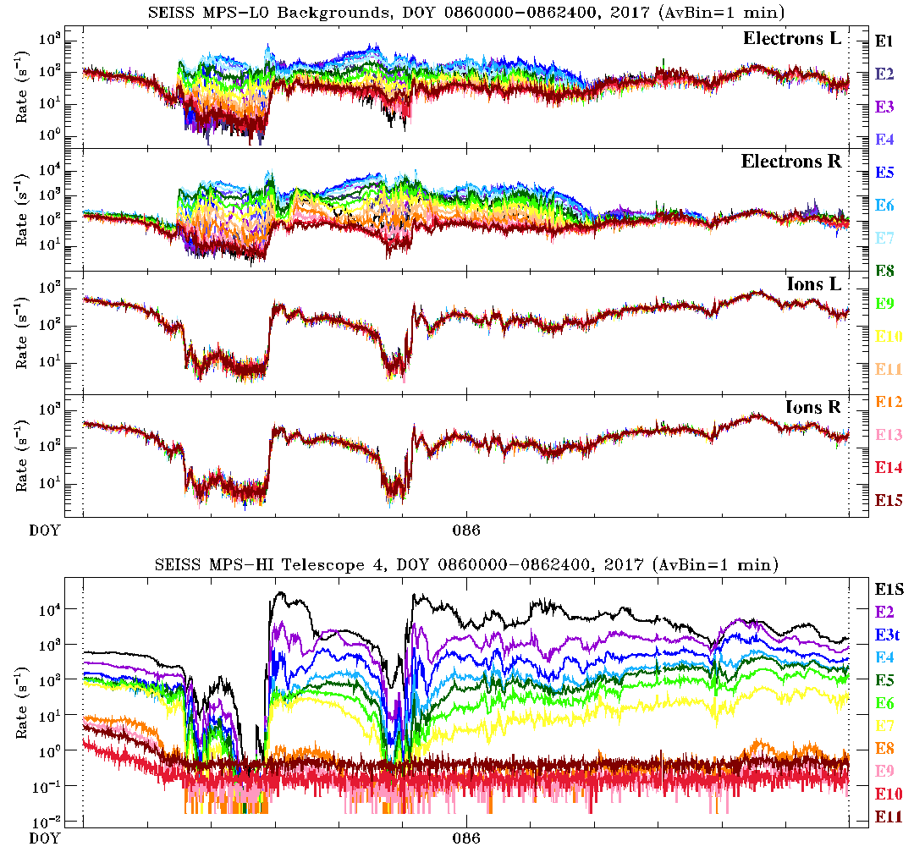
SEISS MPS-LO backgrounds
4 background zones: Electrons L, Electrons R, Ions L, Ions R
15 energy channels: E1 at 30 keV, E15 at 30 eV
Plotted for day 086 of 2017, 0000-2400 UT
Plotted along all the MPS-HI electron channels (E1S-E11)
Similar daily correlation between MPS-LO backgrounds and MPS-HI, at least for the ion and low- energy electron MPS-LO backgrounds
These GOES-16 data are preliminary, non-operational data and are undergoing testing. Users bear all responsibility for inspecting the data prior to use and for the manner in which the data are utilized.

Slide 65
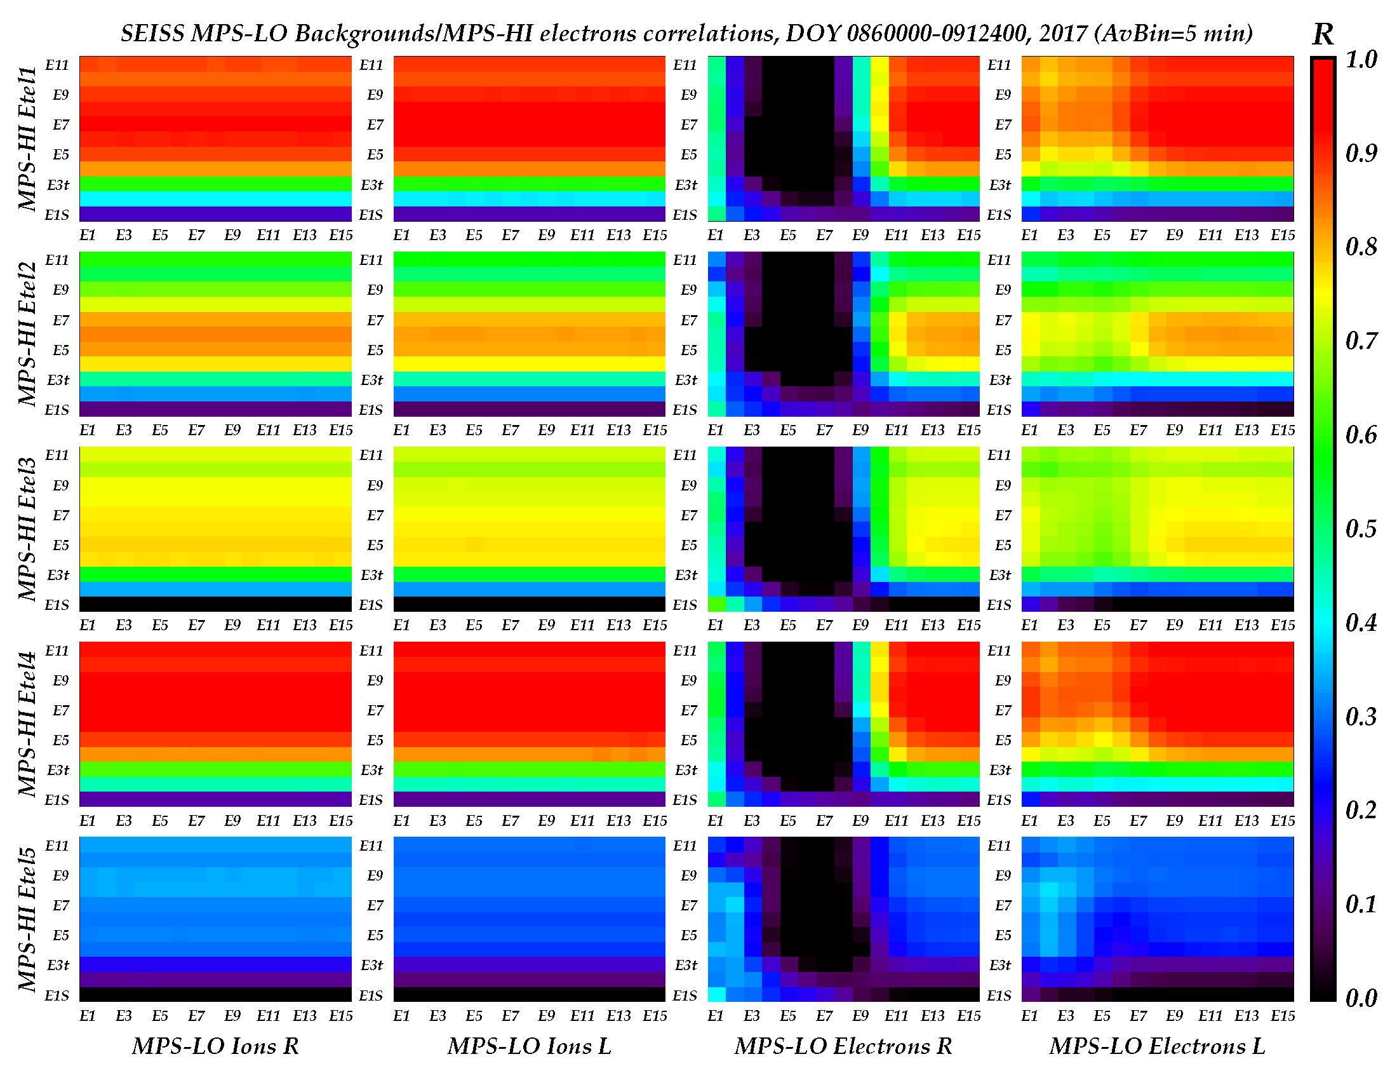
SEISS MPS-LO backgrounds
These GOES-16 data are preliminary, non-operational data and are undergoing testing. Users bear all responsibility for inspecting the data prior to use and for the manner in which the data are utilized.

Slide 66
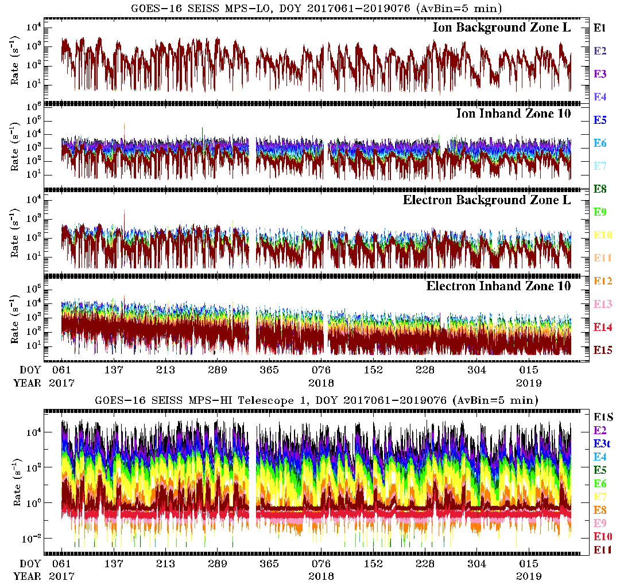
~2 Yrs. Of MPS-LO Backgrounds and MPS-HI Telescope 1
These GOES-16 data are preliminary, non-operational data and are undergoing testing. Users bear all responsibility for inspecting the data prior to use and for the manner in which the data are utilized.

Slide 67
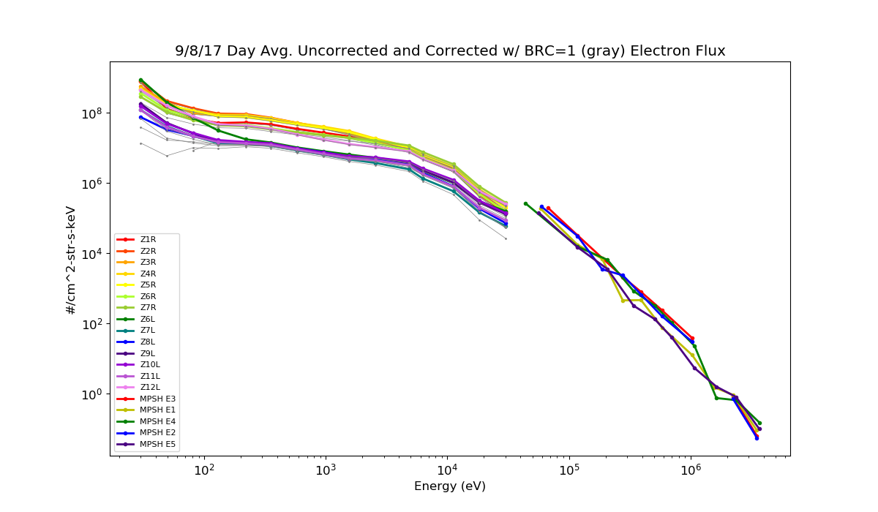
MPS-LO and MPS-HI 1-Day Averaged Electron Spectra
MPS-LO
MPS-HI
Colors are uncorrected fluxes.
Corrected fluxes (in gray) are with energy-dependent backgrounds subtracted.
Dropouts/missing points indicate negative background subtracted fluxes.
These GOES-16 data are preliminary, non-operational data and are undergoing testing. Users bear all responsibility for inspecting the data prior to use and for the manner in which the data are utilized.

Slide 68
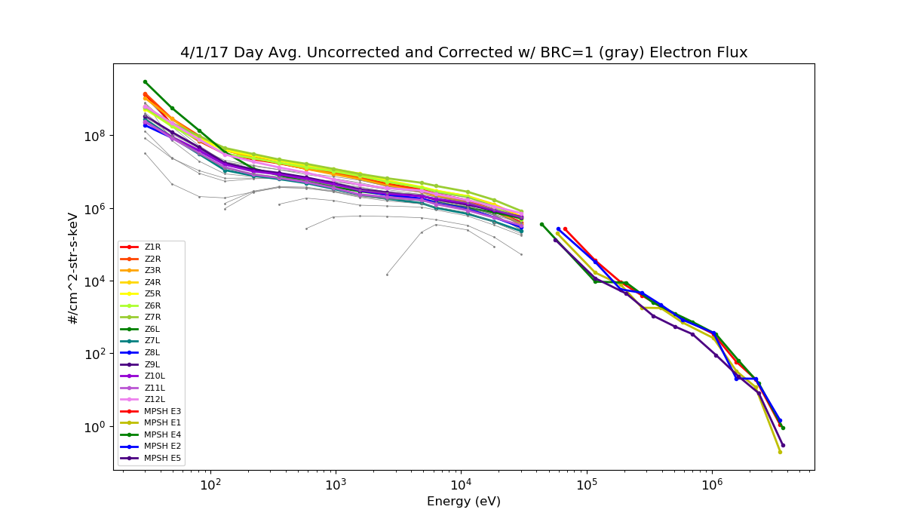
MPS-LO and MPS-HI 1-Day Averaged Electron Spectra
MPS-LO
MPS-HI
Colors are uncorrected fluxes.
Corrected fluxes (in gray) are with energy-dependent backgrounds subtracted.
Dropouts/missing points indicate negative background subtracted fluxes.
These GOES-16 data are preliminary, non-operational data and are undergoing testing. Users bear all responsibility for inspecting the data prior to use and for the manner in which the data are utilized.

Slide 69
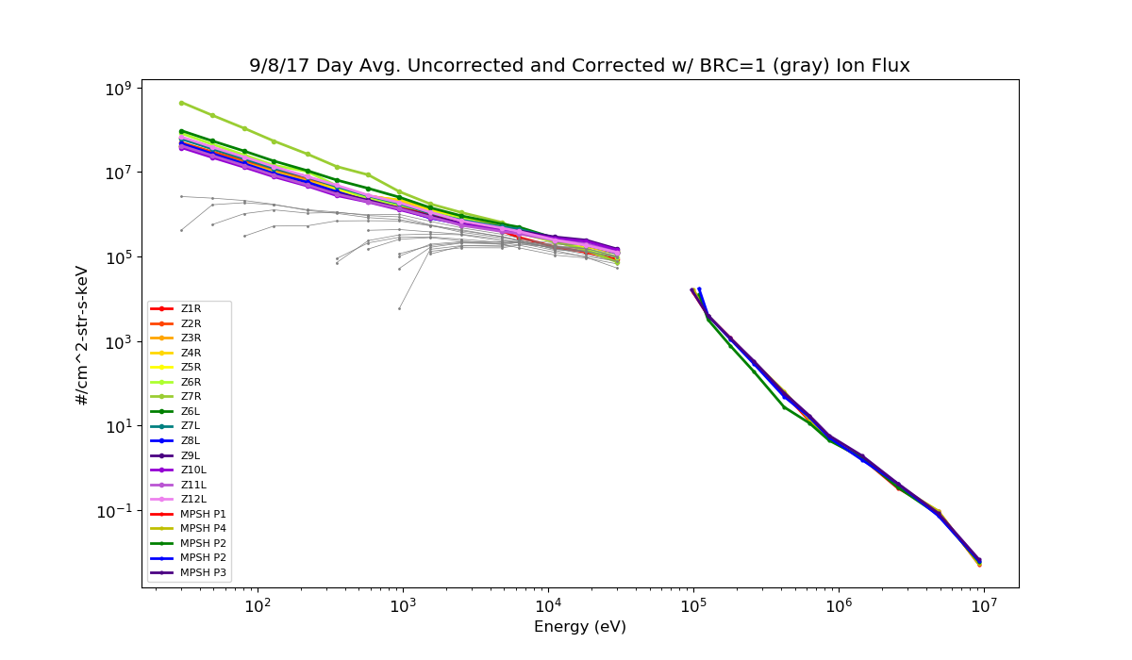
MPS-LO and MPS-HI 1-Day Averaged Ion Spectra
MPS-LO
MPS-HI
Colors are uncorrected fluxes.
Corrected fluxes (in gray) are with energy-dependent backgrounds subtracted.
Dropouts/missing points indicate negative background subtracted fluxes.
These GOES-16 data are preliminary, non-operational data and are undergoing testing. Users bear all responsibility for inspecting the data prior to use and for the manner in which the data are utilized.

Slide 70
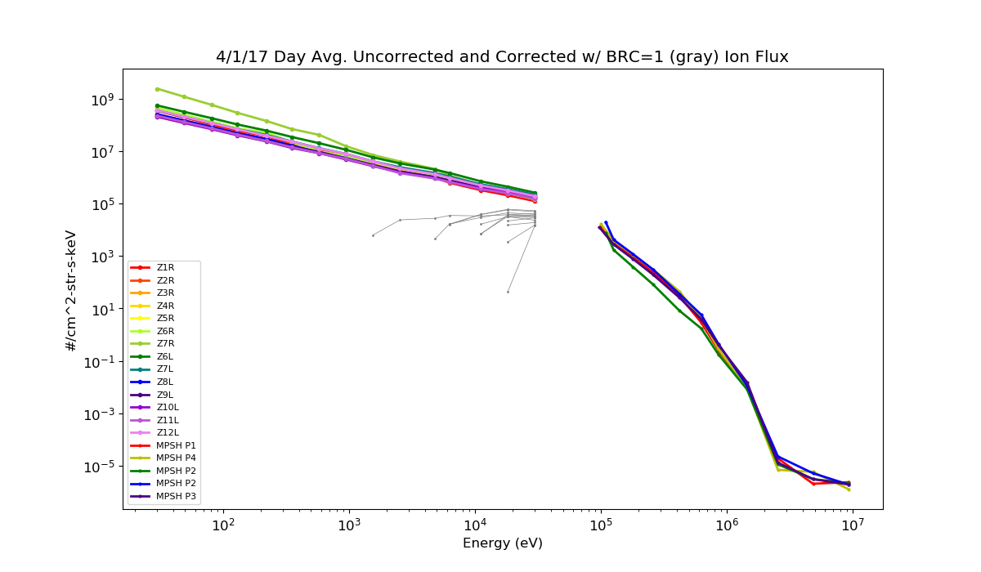
MPS-LO and MPS-HI 1-Day Averaged Ion Spectra
MPS-LO
MPS-HI
Colors are uncorrected fluxes.
Corrected fluxes (in gray) are with energy-dependent backgrounds subtracted.
Dropouts/missing points indicate negative background subtracted fluxes.
These GOES-16 data are preliminary, non-operational data and are undergoing testing. Users bear all responsibility for inspecting the data prior to use and for the manner in which the data are utilized.

