Slide 1
G16/17 MPS-Lo Full Validation PS-PVR SWPC Overview
MPS-Lo brings an important new capability that will characterize the surface-charging environment and address an important satellite industry need
MPS-Lo is a complicated instrument that requires significant effort
The NCEI team has done an excellent job characterizing the instrument and implementing many of the corrective measures
Software corrections have been identified that can address most issues and will enable useful flux measurements
Issues remain, such as out-of-band contamination and sensitivity degradation, that will require ongoing effort
SWPC is highly appreciative of the excellent work and diligence provided by NCEI, as well as the support provided by ATC and the entire GOES project
SWPC concurs with NCEI’s recommendation for MPS-Lo to transition to Full Validation status, and we recommend continued effort to maintain and improve the data quality

Slide 2
GOES-R Requirements Gathering Process

Slide 3
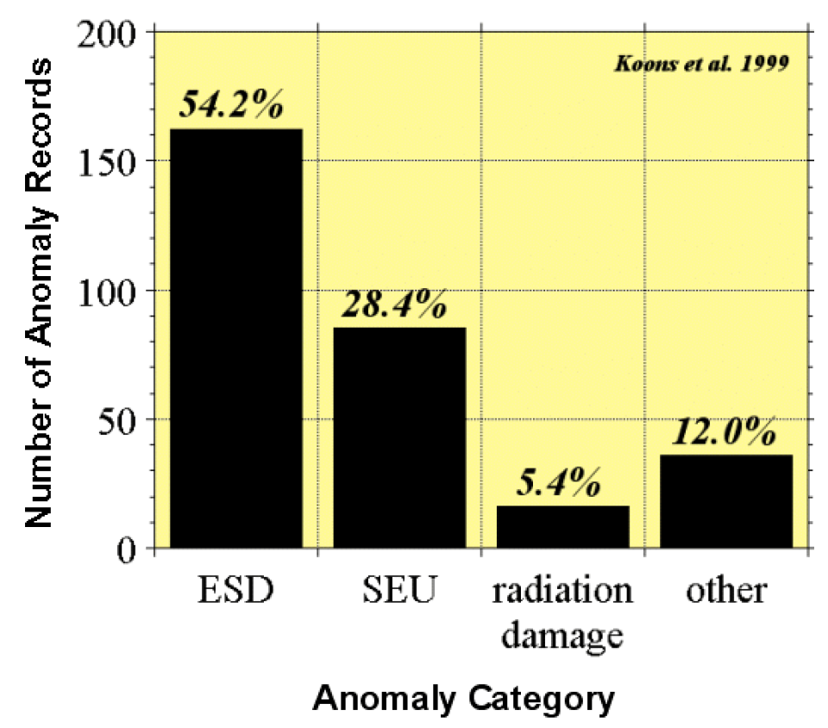
GOES-R+ Workshop Recommendations
Compilation of databases of spacecraft anomalies attributed to the space environment
Study sponsored by the National Security Space Architect
Workshop recommended low energy electron and proton measurements to support spacecraft anomaly resolution related to surface charging (electostatic discharge (ESD)) and to monitor radiation dose to surfaces and surface damage.

Slide 4
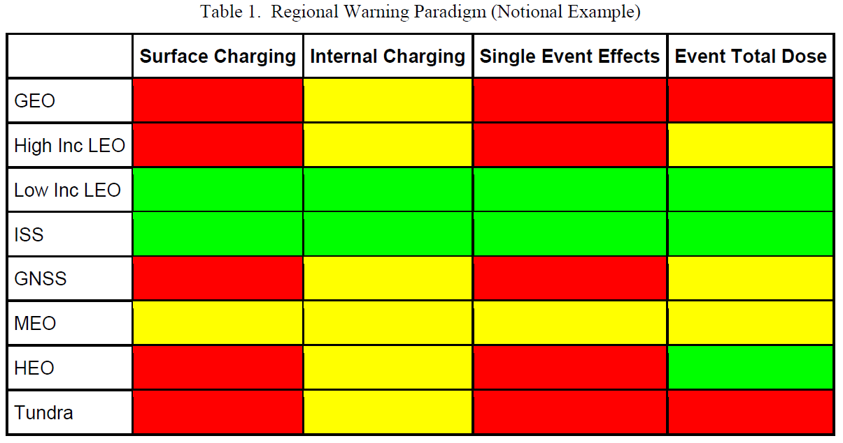
Space Environment Engineering and Science Applications Workshop
Aerospace Report No. ATR-2019-00431, 2019
“The highest priority hazard is solar energetic particles and their access to the magnetosphere, followed closely by the electron plasma of the ring current, which causes surface charging.”

Slide 5
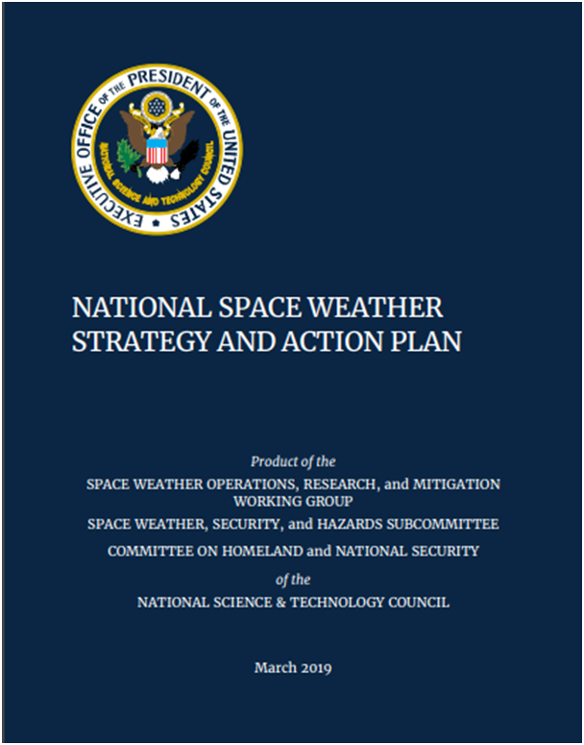
National Space Weather Action
Action 2.11.6: DOC, in coordination with NASA and DoD, develop a plan for a robust real-time assimilative environmental specification model such that it supports 1) Nowcasting of the space environment, and 2) Analysis and attribution of spacecraft anomalies due to routine and extreme space weather
MPS-Lo will be an important data source for this data assimilative environmental model

Slide 6
G16/17 MPS-LO Full Validation PS-PVR SWPC Overview
MPS-Lo brings an important new capability that will characterize the surface-charging environment and address an important satellite industry need
The NCEI team has done an excellent job characterizing the instrument and implementing many of the corrective measures
Software corrections have been identified that can address most issues and will enable useful flux measurements
Issues remain, such as out-of-band contamination and sensitivity degradation, that will require ongoing effort
SWPC is highly appreciative of the excellent work and diligence provided by NCEI, as well as the support provided by ATC and the entire GOES project
SWPC concurs with NCEI’s recommendation for MPS-Lo to transition to Full Validation status, and we recommend continued effort to maintain and improve the data quality

