Slide 1
Peer Stakeholder-Product Validation Review (PS-PVR) For the Full Maturity of GOES-16 SEISS EHIS L1b Product Follow-up
January 19, 2022
GOES-R Calibration Working Group (CWG)
Brian Kress and Juan Rodriguez
NOAA-NCEI / CIRES
We thank the University of New Hampshire for their guidance in the analysis of the pulse-height data.

Slide 2
Outline
EHIS Overview / Introductory Material
Brief Review of PS-PVR For the Full Maturity of GOES-16 SEISS EHIS L1b Product, Presented on May 13, 2020
ADR/WR Status
Review of Product Quality Evaluation
Hydrogen
Alpha particles (i.e., Helium-4)
Heavy Ions
Overview of May 13, 2020 G16 EHIS PS-PVR Recommendations/Conclusions
Assessment of SGPS Helium Product Now Included in L1b Processing (Under ADR1025)
Summary and Recommendations

Slide 3
Energetic Heavy Ion Sensor (EHIS)
MRD 3.3.6.1.1 Energetic Heavy Ions
Primary purpose: measure fluxes of solar energetic particles (SEPs) responsible for Single Event Effects (SEE) in electronics
Single solid-state telescope using angle-detecting inclined sensor (ADIS) system to discriminate heavy ions by atomic number (Z)
L1b cadence is 5 minutes
FM1 (SN101) CDRL79 release: SEISS-D-EH079-1, Rev D (3 May 2016) – Contains constants used in L1b LUT and in flight tables
Current EHIS FM1 LUT: "SeissEhisCalInrParameters(FM1A_CDRL79RevD_DO_07_00_00)-582860861.0.h5"
inclined detectors
scintillator
Credit: SEISS-D-SY079_EHIS_CALTIM_Update-1-6-14

Slide 4
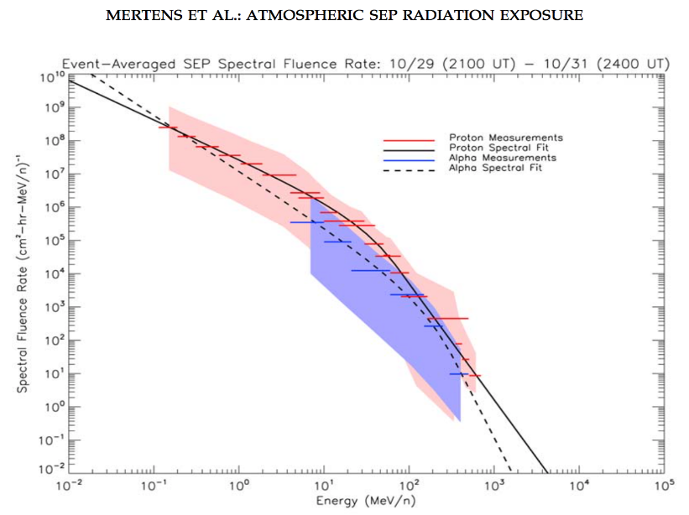
Operational Use of Heavy Ions
EHIS Level-2 Linear Energy Transfer (LET) Product
Expresses heavy ion fluxes in units of LET (source of single-event effects) in silicon for the spacecraft design and testing communities
Provides a 1-D real-time estimate of LET in silicon for situational awareness, under shielding characteristic of robotic spacecraft (50, 100, 500 mil Al)
Helium measurements are needed for current SWPC capabilities
Current FAA aviation-radiation model can benefit from GOES He measurements. Model is being transitioned to SWPC operations.
He flux measurement is critical for Level-2 Linear Energy Transfer Product.
GOES helium measurements used in atmospheric radiation models
e.g., Nowcast of Atmospheric Ionizing Radiation for Aviation Safety (NAIRAS) model currently running at the NASA Langley Research Center uses real-time GOES proton and alpha fluxes. https://sol.spacenvironment.net/nairas/
Mertens, C. J., B. T. Kress, M. Wiltberger, S. R. Blattnig, T. S. Slaba, S. C. Solomon, and M. Engel (2010), Geomagnetic influence on aircraft radiation exposure during a solar energetic particle event in October 2003, Space Weather, 8, S03006, doi:10.1029/2009SW000487.
Fits to GOES real-time proton and alpha fluxes used as input to NAIRAS model.

Slide 5
Review of PS-PVR For the Full Maturity of GOES-16 SEISS EHIS L1b Product, Presented on May 13, 2020
GOES-16 EHIS L1b Product Full Validation PS-PVR

Slide 6
EHIS ADRs/WRs to-date, all closed except 1025 and 1064, associated w/ too-low He measurement
ADR# | WR# | Short Description | Status | G16 | G17 | Expected Closure
267 | 5370 | LUT Filenames not Traceable to Metadata | Closed | √ | √ | DO.07.00.00
342 |  | Inaccurate SWx Instrument ID Fields (FM2, should be FM1) | Closed | √ |  | DO.06.03
414 | 4920 | Start and End Time Stamps for SEIS-L1b-EHIS | Closed | √ | √ | DO.07.00.00
428 |  | Ground LUT in OE to bring L1b in line with FSW table changes | Closed | √ |  | 26 Jan 2018
510 | 5413, 5483 | SWx L1b generation slowdown / stoppage | Closed | √ | √ | DO.07.00.00
517 | 4431, 3802 | Small but routine L1b gaps, mostly for SEISS (EHIS, MPS-LO, MPS-HI) | Closed | √ | √ | resolved by WR4431 in DO.06.03
582 | 5762 | EHIS Flags read incorrectly: HFR_Flag, IFC_Flag, SCC_Flag | Closed | √ | √ | DO.06.03
703 | 6146 | Replace Be and B fluxes with fill values | Closed | √ | √ | PR.07.02.00
727 | 6113 | GOES-16 EHIS unexpected low fluxes from lowest energy helium channel (HE1) | Closed |  |  | Flight WR
804 | 6661 | SEISS EHIS L1b ‘StatErrorsBounds’ variables issue [incorrect dimension name: ‘energy bounds’ instead of ‘error bounds’] | confirmed in DE for G16 | √ | √ | PR.07.02.00 DO.08.00.00
1025 | 7579 | Add Helium to the SGPS Product | In operations Fix-fail in-work | √ | √ | DO.11.00.00 (Oct. 2022)
1064 | 8745 | SEISS EHIS He conversion from SGPS | Post-analysis Awaiting work | √ | √ | DO.12.00.00
Updated since May 2020
Updated since May 2020

Slide 7
Summary of PLPT-SEI-004 SEP Event Cross-comparisons
Hydrogen
EHIS H1-H3 hydrogen energy channel fluxes are lower than SGPS, GOES-13 and -15 hydrogen ion fluxes by a factor of 3-5.
EHIS H5 is 2-3 times higher than SGPS, GOES-13 and -15.
Operational Hydrogen fluxes will be obtained from SGPS.
Helium
EHIS HE1 (Helium/alpha particle lowest energy channel) Sept. 2017 SEP event fluence is low by a factor of $≈$7 in comparison with SGPS, GOES-13, -15, and ACE measurements, which are approximately in agreement.
The source of the too-low HE1 measurement is not understood and thought to be an instrument problem, likely to also be an issue with GOES-17, -T, and -U.
EHIS HE2 flux is lower than G13 and G15 helium flux by a factor of ~3.
Heavy Ions
EHIS fluxes are systematically a factor of 2-4 lower than SIS fluxes, but it is not obvious which instrument is more accurate.
Figures showing these results included in May 13, 2020 G16 EHIS Full Validation PS-PVR.

Slide 8
Overview of Status at May 13, 2020 G16 EHIS Full Validation PS-PVR
EHIS measures heavy ion (Z>2) fluxes during Solar Particle Events as designed.
The EHIS HE1 measurement was low by a factor of ≈7 during the Sept. 2017 SPE. Reason is not understood and thought to be an instrument problem, likely to also be an issue for GOES-17, -T, and -U.
Helium measurements are needed for current SWPC capabilities, other heavy ions are a new capability. GOES real-time Helium measurements have been provided since 1970s.
EHIS ADRs all closed except 1025 and 1064
ADR 1025: implement processing of SGPS He measurements (counts in 12 channels in SGPS L0 data) and report fluxes the SGPS L1b data.
ADR 1064: interpolate the SGPS He measurements from 12 SGPS energy channels into 5 EHIS channels and put the results in the EHIS L1b data.
On May 13, 2020, EHIS L1b data did not meet the criteria for transition to Full Validation status – Transition to full validation postponed until after implementation of SGPS He processing in L1b.

Slide 9
Assessment of SGPS Helium Product, Now included in L1b Processing (Under ADR1025)
GOES-16 EHIS L1b Product Full Validation PS-PVR

Slide 10
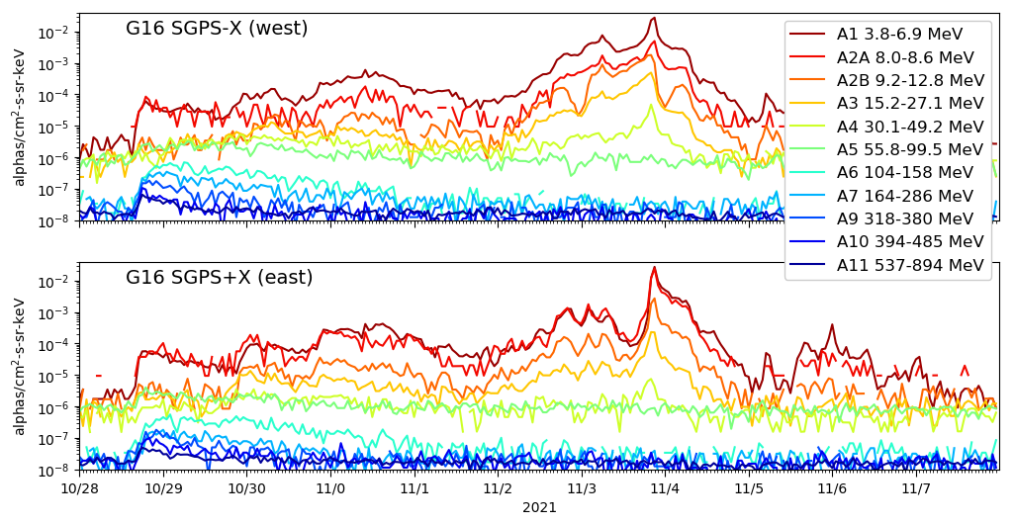
ADR1025 Summary
ADR1025: Include SGPS alpha fluxes in L1b product
Similar to proton processing but with some differences in configuration of channels, background removal, etc.
SGPS L1b ground LUTs (HDF5 files) and output/product files (NetCDF files) modified to include alpha parameters, fluxes, uncertainties, DQFs, etc.
Alpha fluxes in 11 channels ~4-800 MeV in L1b (best specification of solar alpha particle flux spectrum available!)
Went live in operations at 17:52:00 UT on 8 Aug. 2021.
Verified against NCEI in-house L0->L1b processing.
GOES-16 SGPS Oct-Nov. 2021 1-hour avg. L1b
alpha fluxes

Slide 11
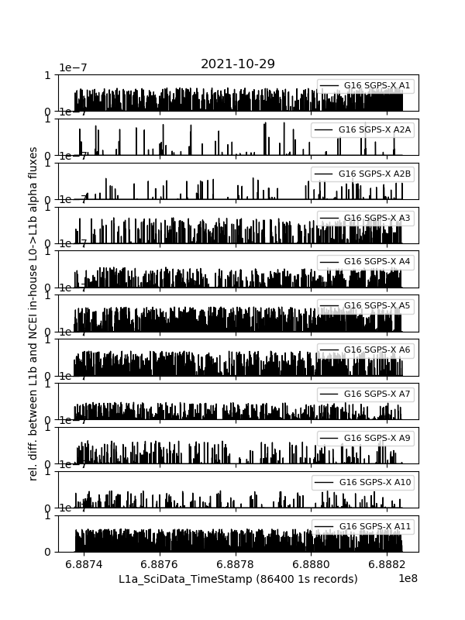
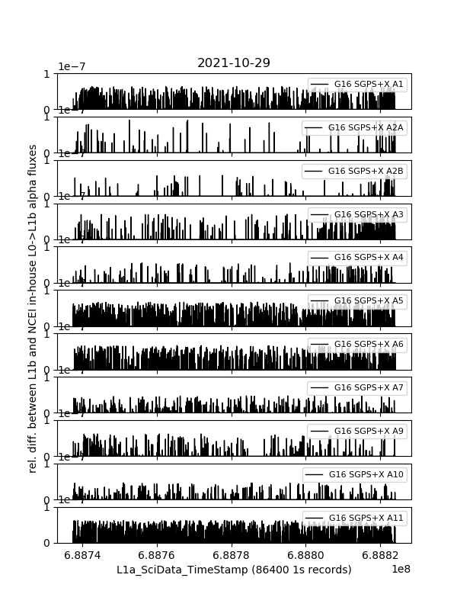
ADR1025 Verification with NCEI in-house L0->L1b processing
G16 SGPS-X
G16 SGPS+X
Relative difference between Ground L1b and NCEI in-house L0->L1b alpha processing verified < 1.e-7 (computer float round-off error) in 86400 samples in all channels.
Similarly verified for flux uncertainties and in GOES-17 alpha processing.

Slide 12
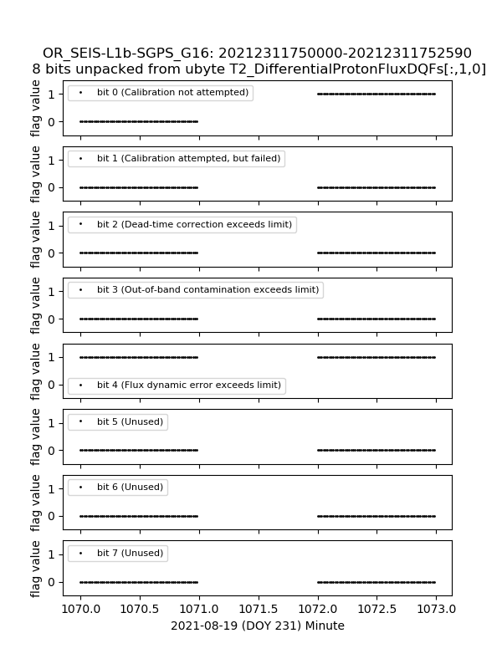
ADR1025 Fix-Fail
ADR1025 beautifully implemented in L1b except, G16 and G17 SGPS+X P6, P7, A6 and A7 (all T2) DQFs bit 0 flipped 0->1 indicating bad data, thus we have fill values in L2.
P6, P7, A6 and A7 have been missing from L2 data since ADR1025 went live in operations at 17:52:00 UT on 8 Aug. 2021.
Flipped DQF bit 0->1
G16 & G17 SGPS+X P6, P7, A6, and A7 not reported in L2

Slide 13
SGPS Helium-4/Alpha Measurement Validation
General approach to SGPS alpha measurement validation
Verify NCEI in-house L0->L1b with Ground L1b (shown on slide 11)
Use NCEI L0->L1b to process G16 SGPS Sept. 2017 SEP event alpha fluxes from L0 data
Quantify differences between Sept. 2017 SEP event GOES-13 & -15 and GOES-16 SGPS alpha fluxes
Sept. 2017 events have significantly higher count rates than the Oct. 2021 event, providing a much better measurement (less noise & more accuracy).
More importantly, in Sept. 2017 we have GOES-13 and -15 EPS measurements and can compare the new SGPS alpha measurements with the legacy EPS alpha measurements
Quantify differences between Oct. 2021 GOES-16 and -17 alpha fluxes

Slide 14
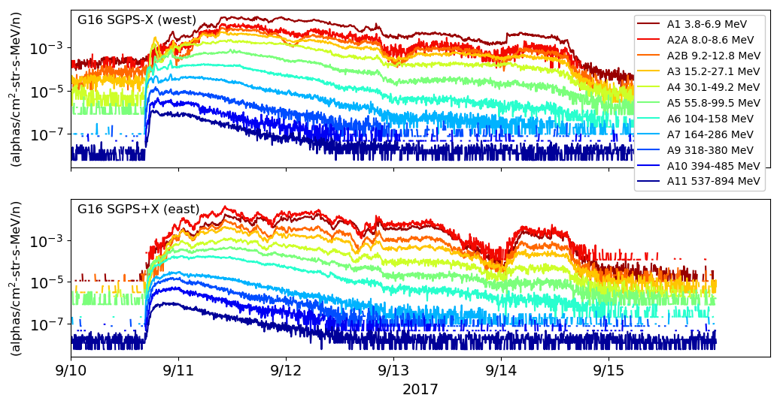
G16 SGPS Sept. 2017 SEP Event Alpha Fluxes Processed From L0
Expected diurnal temperature dependence in G16 SGPS-X. Correction developed and implemented for proton channels. Need to empirically derive coefficients for alpha channels.
Probable mischaracterization of A2A energy band (A2A flux should not be > A1).
A8 energy band redundantly overlaps with A7 and A9. A8 not included in L1b.

Slide 15
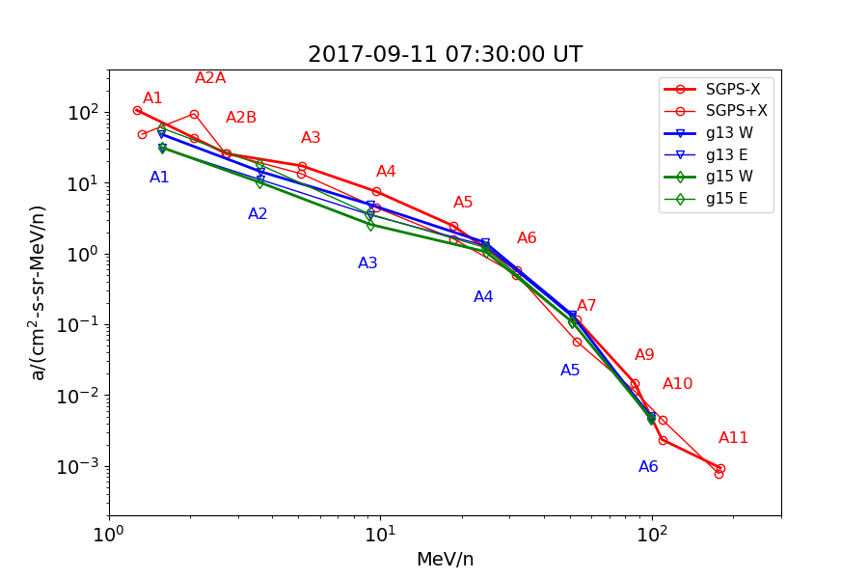
Comparison of SGPS Alpha Spectra with GOES-13 and -15 EPS
Probable mischaracterization of A2A. geometric factor or energy bounds. This channel needs work.
Good agreement not necessarily expected at lower energies since this is a geomagnetically quiet period and due to magnetospheric Helium.
SGPS-X A10 low due to temperature dependent fluctuations. Correction implemented in L2 processing (currently used for protons). Need to empirically derive correction coefficients for alpha measurements.

Slide 16
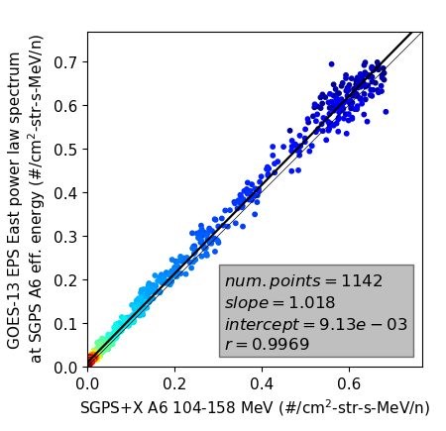
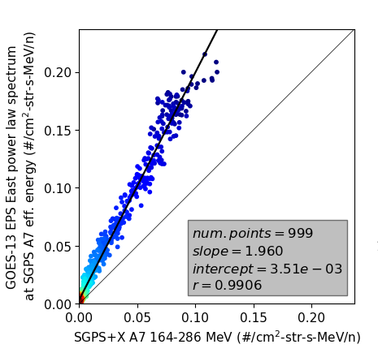
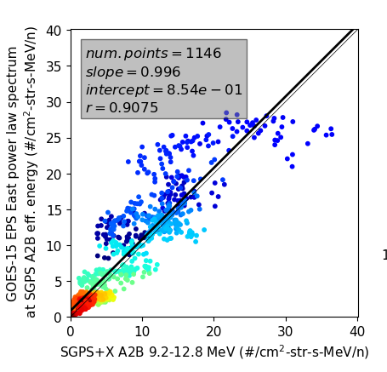
Examples of Cross Calibrations with GOES-13 and -15 EPS
(the good)
(the bad)
(the ugly)
In general, the SGPS alpha fluxes are within a factor of 2 of the legacy GOES-13 and -15 EPS alpha measurements.
Complete tables of linear fit results are included in backup slides.

Slide 17
Full Validation Assessment
Preparation Activities | Assessment
Validation, QA, and anomaly resolution activities are ongoing. | Validation activities are ongoing. Results have been discussed with SWPC. Research community participation is ongoing.
Incremental product improvements may still be occurring. | Previous (May 13, 2020): Substantial product improvements are in-work. Current: Incremental product improvements will include Analysis and adjustment of A2A channel energy bounds and/or geo. factor Empirically derive G16 SGPS-X alpha channel temp. correction coefficients ADR1025 still in-work (fix broken SGPS+X T2 DQFs)
Users are engaged and user feedback is assessed. | Discussions with SWPC are ongoing.
GOES-R product maturity level preparation activities from RIMP v2.0, Responsible Organization: GOES-R Program/Code 410

Slide 18
Full Validation Assessment
End State | Assessment
Product performance for all products is defined and documented over a wide range of representative conditions via ongoing ground truth and validation efforts. | EHIS fluxes compared with observations from SGPS, GOES-13, and -15. EHIS FM1 and FM2 units ground/beam calibrated.
Products are operationally optimized, as necessary, considering mission parameters of cost, schedule, and technical competence as compared to user expectations. | Previous: Products are not operationally optimized. Current: Products are operationally optimized, as necessary, considering…
All known product anomalies are documented, and shared with the user community. | Yes, in L1b README and PS-PVR presentations.
Product is operational. | Previous: Alpha particle measurements do not meet accuracy requirement. Current: SGPS alpha measurements in L1b.
GOES-R product maturity level preparation activities from RIMP v2.0, Responsible Organization: GOES-R Program/Code 410

Slide 19
Summary and Recommendations
EHIS measures heavy ion (Z>2) fluxes during Solar Particle Events as designed.
Operational H and He measurements are provided by SGPS.
Quality alpha measurements now in operational L1b, however, additional work to be done
A2 channel mischaracterization issue (noted on slides 14 and 15).
GOES-R Ground: ADR1025 fix-fail (G16 and G17 SGPS+X T2 DQFs broken, as noted on slide 12)
NCEI: Empirically derive coefficients for correction for temperature dependence in some G16 SGPS-X alpha channels
NCEI recommends GOES-16 EHIS L1b for transition to Full Validation status.

Slide 20
Backup charts
GOES-16 EHIS L1b Product Full Validation PS-PVR

Slide 21
GOES-13, -15, and -16 Alpha Measurement Cross-Calibration Results
Corresponding scatter plots are available on request and will be archived and made publically available from NCEI (e.g., complete GOES-13, -15 and -16 proton cross calibration results are available here: https://www.ngdc.noaa.gov/stp/space-weather/satellite-data/satellite-systems/goesr/solar_proton_events/sgps_sep2017_event_data/eps_sgps_comparison_plots/).

