Slide 1
G16/17 Magnetometer L1b Full Maturity SWPC Overview
Peer Stakeholder-
Product Validation Review (PS-PVR)
February 25, 2021
GOES-R Calibration Working Group (CWG)
Presenter: Howard Singer/Space Weather Prediction Center

Slide 2
Magnetometer Measured Impacts at Earth-Some Examples
Solar Wind Shocks and Sudden Impulses
When these impact Earth, large disturbances in Earth’s magnetic field can cause geomagnetically induced currents (GICs) in power grids
Forecasters use DSCOVR to give warnings, but GOES magnetometer shows impact at Earth and contributes to alerts
Magnetopause Crossings
Satellite operators have utilized GOES magnetometer data to understand when their satellite, normally in Earth’s magnetosphere, is located in an extremely different plasma and field environment (e.g. affects on torquer coils); but also important for understanding major losses of radiation belt particles
Storms and Substorms
Forecasters use changes in the orientation of the geosynchronous observed magnetic field as an indication of the potential for the release of built up energy and subsequent injections of energetic particles that can cause spacecraft charging and particle precipitation into the auroral zone affecting HF radio wave propagation
Satellite Anomalies
GOES-11 magnetometer data were key to understanding the environmental conditions related to the 8-month outage of Galaxy 15

Slide 3
Magnetometer: Operational Use Summary
Providing forecasters and the public with situational awareness of the level of geomagnetic disturbances
Contributing to energetic particle products that use the orientation of the magnetic field for specifying the radiation belts and using in radiation belt models supporting satellite users
Utilizing for real-time, operational validation of the Geospace model that supports power grid operations
Detecting magnetopause crossings and alerts for the detection of solar wind shocks and sudden impulses at Earth
Supporting sounding rocket launch decisions
Conducting research for understanding the space environment and producing future products
Developing techniques for new operational applications (e.g. wave-particle interactions needed by radiation belt models)
Providing data to NESDIS NCEI archives and one of the most used data sets by the scientific community (through NCEI and NASA)

Slide 4
Customer Testimonials
“As you may know I run 2 large consortium projects on space weather just now, one on forecasting the radiation belts for satellites and one on radiation belt science that feeds into better forecast models (Sat-Risk and Rad-Sat). So, we use the GOES magnetometer data for operational space weather forecasting, and for research that will improve the forecasts.”-- Professor Richard B. Horne, Head, Space Weather and Atmosphere, British Antarctic Survey
“The GOES series represents a long continuous record of high-quality magnetic field measurements from a key region of the space environment, the geostationary orbit. …Accurate knowledge of the magnitude of that field is critical for magnetospheric dynamics research. ” --Professor Tuija Pulkkinen, Chair, Department of Climate and Space Sciences and Engineering, University of Michigan
“In our opinion, GOES magnetometer data are of outstanding interest and value, due to the unique properties of the geostationary orbit.” Dr. Nikolai Tsyganenko (GOES-R program uses Tsyganenko models for MAG validation)
The GOES magnetic field observations are quite unique sources of geomagnetic field data in the magnetosphere.– Dr. Tsutomu Nagatsuma, Director of Planning and Collaboration Promotion Office Social Innovation Unit, Sendai, Japan

Slide 5
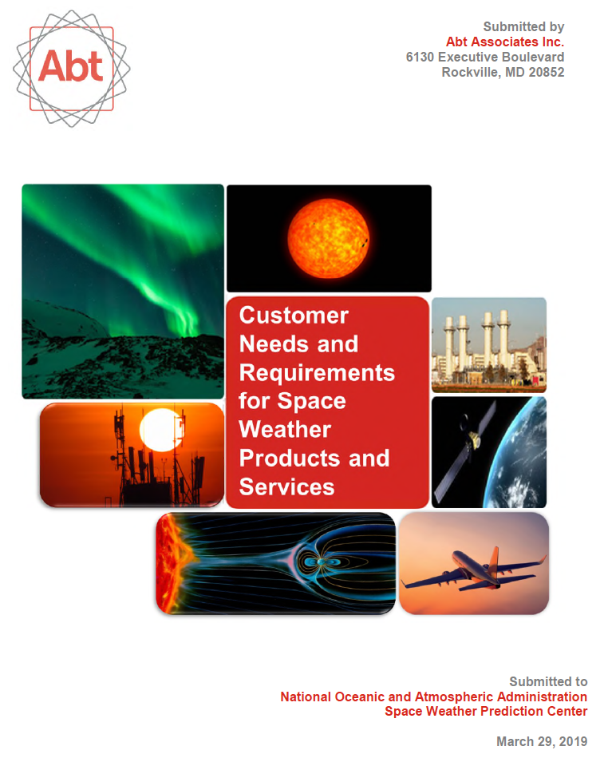
Customer Needs and Requirements
“The magnetopause location is known to be important for radiation belt losses and for specifying the level of space weather disturbance in the magnetosphere and ionosphere, both of which are important for operational considerations.”

Slide 6
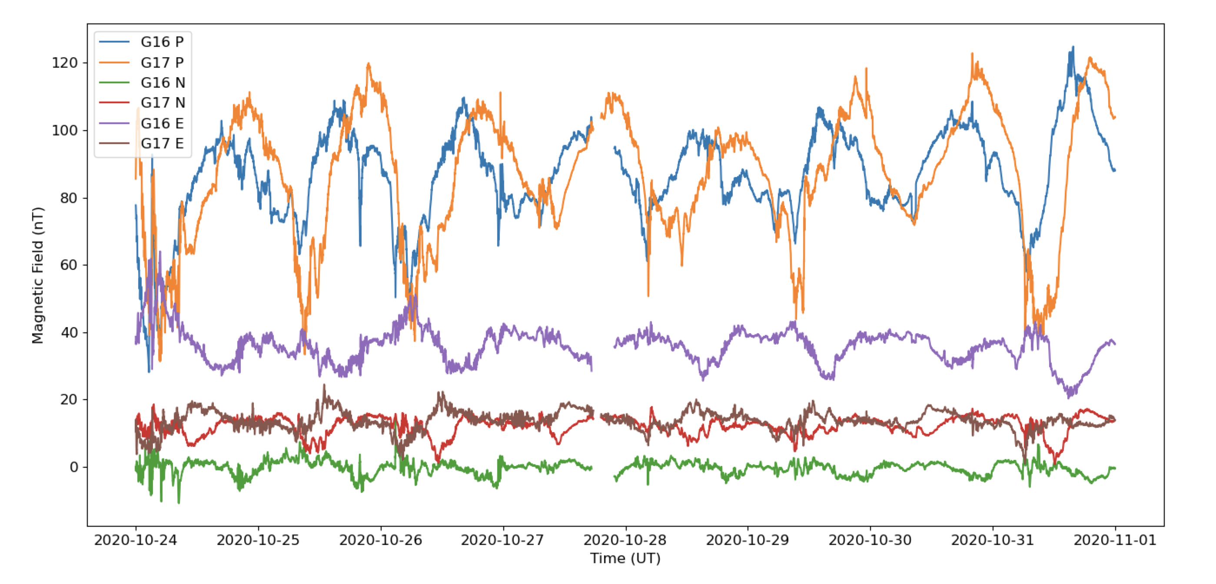
GOES 16/17 Magnetometer Data
Illustrating Variations at
Different Geosynchronous Locations
For Example: P (solar wind pressure, tail stretching, substorm energy release)
E (tail stretching and energy release)
N (Current systems)

Slide 7
Arcjet Firing Contaminates Operational Observations
Arcjet use on GOES-16 is becoming more frequent than planned
Requires customer application attention
Correction algorithms require maintenance and modification

Slide 8
G16/17 MAG Full Validation PS-PVR SWPC Overview
MAG serves an important capability that characterizes the geospace environment including the level of disturbance and controls the trajectory of radiation belt particles
The NCEI team (in collaboration with the GOES project) has done an excellent job characterizing the instrument performance leading to future improvements and implementing many of the corrective measures to deal with both instrument and accommodation issues
Tasks remain, such as: improvements to arcjet correction; thermal corrections (including use of machine learning techniques); reduction and characterization of noise; long-term trending for bias stability; and efforts to utilize the new GOES-T/U GMAG including cal/val and any on-orbit performance issues
SWPC is highly appreciative of the excellent work and diligence provided by NCEI, as well as the support provided by the entire GOES project
SWPC concurs with NCEI’s recommendation for MAG to transition to Full Validation status, and we recommend continued effort to maintain and improve the data quality for space weather users

